Slide 1


SEXUAL EXPLOITATION
EDUCATION
DEMO
FOR PARENTS, STAFF MEMBERS, & OLDER YOUTH
Myths
&REALITY
LESSON #1
Notes:
NOTE
Log in to WalkingWise.com and refer to the Walking Wise Education Guide to implement classroom teaching tips.
Most importantly:
• DEFINE SCHOOL POLICY
Establish a sexual exploitation reporting protocol with a trauma-informed response. The Walking Wise Implementation Guide provides a sample protocol.
• AGE & AUDIENCE
This presentation can be edited by following the procedures on page 3 to align with your school policies, specific age groups, and the involvement of at-risk audiences.
• SUPPORT PROCEDURE
Provide your audience with guidance on accessing immediate help or arranging a private meeting with a social worker, counselor, nurse, school resource officer, or another trustworthy staff member to report concerns for themselves or a peer.
• SECOND SAFE ADULT
Ensure a second trustworthy adult, such as a teacher, is present in the learning setting to observe audience reactions and identify those who may benefit from a follow-up meeting. This person should remain focused and free from other duties during the presentation.
• IMPLEMENT SLIDO.com
Please log in to WalkingWise.com for instructions on incorporating Slido into the PowerPoint presentation to engage your audience using digital polling.

Slide 2

HELLO!
This Myths & Reality presentation was created for parents, staff members, and young adults. It may be appropriate to share with some older high school students, such as juniors or seniors.
We provide this classroom-style lesson on the Myths & Reality of sexual exploitation, modeled after the lessons used with students. This provides adults with a firsthand look at our education, helping them understand how key topics are presented in middle and high school settings.
Walking Wise also equips adults to talk about sexual exploitation with clarity and confidence. To begin the learning journey, we offer a comprehensive 12-topic online course specifically designed for adults called WalkingWise: Sexual Exploitation Education.
Myths
&REALITY
©2025 Walking Wise
2

Slide 3
DEMO
NOTE TO PRESENTERS
You may delete slides if they do not align with your organization's or school's policies, are not age-appropriate, or exceed the available class time. Speaker notes appear when using the “slide show” setting in PowerPoint and can be modified to suit your speaking style.
Walking Wise slides are copyright-protected and may not be modified without prior written permission.
If you would like to add your own content, you may do so as follows:
  Insert a new PowerPoint slide.
  Remove the Walking Wise logo and copyright "©2025 Walking Wise" from the new slide.
  Always add your organization's name or logo to each new slide you create.
Walking Wise provides an interactive digital tool to enhance audience engagement. Subscribers can log in to WalkingWise.com for instructions to set up the online polling tool.
Please delete this instruction page before presenting to audiences.
©2025 Walking Wise
3
Notes:
NOTE
The presenter is welcome to customize this Walking Wise presentation according to the instructions provided on this page.
For revision requests, please send an email to hello@WalkingWise.com.

Slide 4

CONFRONTING SEXUAL EXPLOITATION
DEMO
WALKING WISE
KNOWLEDGE serves as a
powerful defense against
sexual predators.
©2025 Walking Wise
4

Slide 5
CONFRONTING SEXUAL EXPLOITATION
DEMO
WALKING WISE
SEXUAL EXPLOITATION includes grooming, sextortion, pornography
& sex trafficking.
©2025 Walking Wise
5

Slide 6
SENSITIVE DISCUSSION AHEAD
DEMO
CONTENT ALERT
This presentation addresses serious topics related to sexual exploitation.
Some content may be emotionally challenging to view.
If you feel uncomfortable at any point, please pause or stop the presentation as needed. Your well-being comes first.
©2025 Walking Wise
6
Notes:
NOTE TO PRESENTER
Please tailor this message to align with your organization's policies and protocols.
Please provide a confidential avenue for students to report concerns and seek help for themselves or their peers if they suspect sexual abuse, grooming, sextortion, pornography-related exploitation, or human trafficking. This may include a designated address or text line.
Consider displaying posters in your school or facility that outline various ways students can access immediate support or request a private meeting with a school safety team member or another trusted adult.

Slide 7
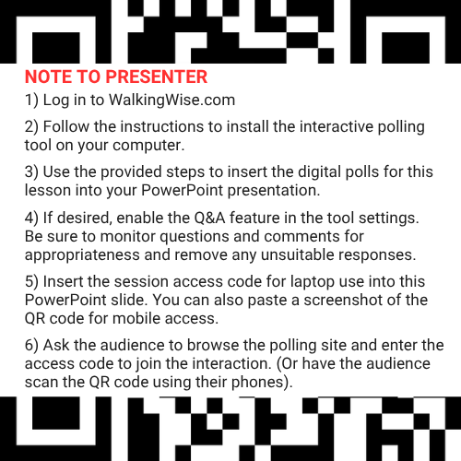
DIGITAL PARTICIPATION
DEMO
Join in by using
access code:
#XXXX
©2025 Walking Wise
7
Notes:
NOTE
For digital interaction with audiences:
Log in to WalkingWise.com to follow instructions on setting up Slido questions/answers for this presentation. Then, replace the QR code and #code in this slide with your custom QR/#code.
Please verify whether the Q&A feature has been activated before presenting to audiences. An adult should monitor questions and comments to ensure appropriateness. Slido has a feature that allows you to delete unwanted questions and comments.

Slide 8


STATISTICS
DEMO
Statistics are Only Estimates
  Study results may be unreliable because most sexual crimes go unreported.
Myths
&REALITY
©2025 Walking Wise
8
Notes:
In this presentation, we'll discuss statistics, but it's important to note that while statistics provide valuable insights into an issue, they cannot be entirely relied upon.
Here are a few reasons:
• UNREPORTED
Victims may stay silent due to fear, shame, or manipulation.
• INCONSISTENT COLLECTION
Geographical areas have different legal definitions for sexual crimes, making data hard to compare.
• FOCUS GROUPS
Small or specific focus groups participating in a study or survey may not accurately reflect the diversity or experiences of the broader population.

Slide 9
STATISTICS
DEMO
Statistics are Only Estimates
  Study results may be unreliable because most sexual crimes go unreported.
  The methods used to collect information can vary widely between studies, leading to inconsistency.
Myths
&REALITY
©2025 Walking Wise
9
Notes:
In this presentation, we'll discuss statistics, but it's important to note that while statistics provide valuable insights into an issue, they cannot be entirely relied upon.
Here are a few reasons:
• UNREPORTED
Victims may stay silent due to fear, shame, or manipulation.
• INCONSISTENT COLLECTION
Geographical areas have different legal definitions for sexual crimes, making data hard to compare.
• FOCUS GROUPS
Small or specific focus groups participating in a study or survey may not accurately reflect the diversity or experiences of the broader population.

Slide 10
STATISTICS
DEMO
Statistics are Only Estimates
  Study results may be unreliable because most sexual crimes go unreported.
  The methods used to collect information can vary widely between studies, leading to inconsistency.
  Focus groups in studies may not accurately represent the larger population.
Myths
&REALITY
©2025 Walking Wise
10
Notes:
In this presentation, we'll discuss statistics, but it's important to note that while statistics provide valuable insights into an issue, they cannot be entirely relied upon.
Here are a few reasons:
• UNREPORTED
Victims may stay silent due to fear, shame, or manipulation.
• INCONSISTENT COLLECTION
Geographical areas have different legal definitions for sexual crimes, making data hard to compare.
• FOCUS GROUPS
Small or specific focus groups participating in a study or survey may not accurately reflect the diversity or experiences of the broader population.

Slide 11

EDUCATON GUIDE
VOCABULARY
VOCABULARY
  Child Exploitation
  Commercial Sex
  Child Sex Trafficking
  Myth
  Sex Trafficking
  Coercion
  Labor Trafficking
  Safe Harbor
  Manipulation
  Intimidation
Myths
&REALITY
©2025 Walking Wise
11
3
Notes:
NOTE
Understanding vocabulary terms related to the behaviors of sexual predators can empower young people to recognize warning signs of harmful situations.
Knowing terminology helps them identify manipulative tactics predators use to build trust and exploit vulnerabilities.
With this knowledge, young people are better equipped to spot red flags, understand that these behaviors are abusive, and feel more confident reporting predators to trusted adults or authorities, potentially preventing further harm.

Slide 12
EDUCATON GUIDE
DEMO
VOCABULARY
CHILD EXPLOITATION
The use of a child for someone else’s benefit, often in an abusive, unfair, or harmful manner.
Includes: Sexual exploitation (grooming & sex trafficking), sextortion,
labor trafficking, and criminal activity (i.e., drug dealing and theft).
Myths
&REALITY
©2025 Walking Wise
Section 7102. 22 USC Ch. 78: Trafficking Victims Protection, From Title 22—Foreign Relations and Intercourse.
12
3
Notes:
Assisting Source
OpenAI. (2024). ChatGPT [Large language model]. https://chatgpt.com
FOR LEGAL DEFINITION:
Section 7102. 22 USC Ch. 78: Trafficking Victims Protection, From Title 22—Foreign Relations and Intercourse. Retrieved January 3, 2025, from https://uscode.house.gov/view.xhtml?hl=false&edition=prelim&path=%2Fprelim%40title22%2Fchapter78&req=granuleid%3AUSC-prelim-title22-chapter78&num=0&saved=L3ByZWxpbUB0aXRsZTIyL2NoYXB0ZXI3OA%3D%3D%7CZ3JhbnVsZWlkOlVTQy1wcmVsaW0tdGl0bGUyMi1jaGFwdGVyNzg%3D%7C%7C%7C0%7Cfalse%7Cprelim
Criminal Division, U.S. Department of Justice. Citizen's Guide To U.S. Federal Law On Child Sex Trafficking. Retrieved January 3, 2025, from https://www.justice.gov/criminal/criminal-ceos/citizens-guide-us-federal-law-child-sex-trafficking

Slide 13
EDUCATON GUIDE
DEMO
VOCABULARY
COMMERCIAL SEX
Any sex act on account of which anything of value is given to or received by any person.
Myths
&REALITY
©2025 Walking Wise
Section 7102. 22 USC Ch. 78: Trafficking Victims Protection, From Title 22—Foreign Relations and Intercourse.
13
3
Notes:
Assisting Source
OpenAI. (2024). ChatGPT [Large language model]. https://chatgpt.com
FOR LEGAL DEFINITION:
Section 7102. 22 USC Ch. 78: Trafficking Victims Protection, From Title 22—Foreign Relations and Intercourse. Retrieved January 3, 2025, from https://uscode.house.gov/view.xhtml?hl=false&edition=prelim&path=%2Fprelim%40title22%2Fchapter78&req=granuleid%3AUSC-prelim-title22-chapter78&num=0&saved=L3ByZWxpbUB0aXRsZTIyL2NoYXB0ZXI3OA%3D%3D%7CZ3JhbnVsZWlkOlVTQy1wcmVsaW0tdGl0bGUyMi1jaGFwdGVyNzg%3D%7C%7C%7C0%7Cfalse%7Cprelim
Criminal Division, U.S. Department of Justice. Citizen's Guide To U.S. Federal Law On Child Sex Trafficking. Retrieved January 3, 2025, from https://www.justice.gov/criminal/criminal-ceos/citizens-guide-us-federal-law-child-sex-trafficking

Slide 14
EDUCATON GUIDE
DEMO
VOCABULARY
MYTH
A false belief commonly held by a group.
Myths
&REALITY
©2025 Walking Wise
14
3
Notes:
Assisting Source
OpenAI. (2024). ChatGPT [Large language model]. https://chatgpt.com

Slide 15
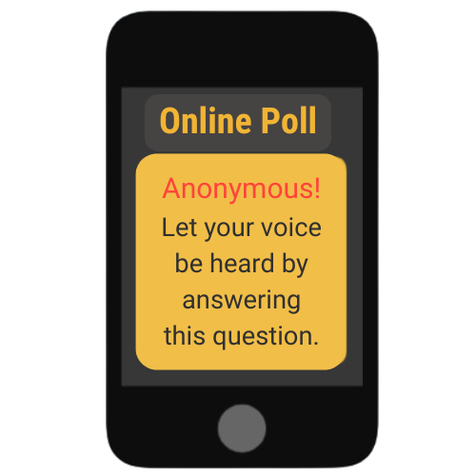
LESSON PLANS
MYTH OR REALITY?
Myth or Reality? All commercial sex is considered human trafficking.
Myths
&REALITY
©2025 Walking Wise
Polaris Project (2025) Myths, Facts, and Statistics. PolarisProject.org.
15
3
Notes:
Online Polling Interaction
All commercial sex is considered human trafficking.
A) Myth
B) Reality
ANSWER
A) Myth - Not all commercial sex is human trafficking, as some adults willfully choose to participate in what is described as 'sex work.'
Commercial sex involving a minor is always legally considered human trafficking.
Commercial sex involving an adult is human trafficking if the person providing commercial sex is doing so against his or her will as a result of force, fraud, or coercion.
Source
Polaris Project (2025) Myths, Facts, and Statistics. PolarisProject.org., Retrieved January 6, 2025, from https://polarisproject.org/myths-facts-and-statistics/?gad_source=1&gclid=CjwKCAiAm-67BhBlEiwAEVftNpjEBS3aD54aH9qHzJjL01wnVgSL4rc8WgP7CHE_PvAjOR1wN9AchBoCgk8QAvD_BwE

Slide 16
LESSON PLANS
MYTH OR REALITY?
DEMO
ANSWER: MYTH
Not all commercial sex is human trafficking, as some adults willfully choose to participate in what is described as 'sex work.'
Myths
&REALITY
©2025 Walking Wise
Polaris Project (2025) Myths, Facts, and Statistics. PolarisProject.org.
16
3
Notes:
ANSWER
A) Myth - Not all commercial sex is human trafficking, as some adults willfully choose to participate in what is described as 'sex work.'
Commercial sex involving a minor is always legally considered human trafficking.
Commercial sex involving an adult is human trafficking if the person providing commercial sex is doing so against his or her will as a result of force, fraud, or coercion.
Source
Polaris Project (2025) Myths, Facts, and Statistics. PolarisProject.org., Retrieved January 6, 2025, from https://polarisproject.org/myths-facts-and-statistics/?gad_source=1&gclid=CjwKCAiAm-67BhBlEiwAEVftNpjEBS3aD54aH9qHzJjL01wnVgSL4rc8WgP7CHE_PvAjOR1wN9AchBoCgk8QAvD_BwE

Slide 17
EDUCATON GUIDE
DEMO
VOCABULARY
SEX TRAFFICKING
A commercial sex act that involves an adult through the use of FORCE, FRAUD, COERCION, OR a CHILD under age 18.
Myths
&REALITY
©2025 Walking Wise
Section 7102. 22 USC Ch. 78: Trafficking Victims Protection, From Title 22—Foreign Relations and Intercourse.
17
3
Notes:
Assisting Source
OpenAI. (2024). ChatGPT [Large language model]. https://chatgpt.com
FOR LEGAL DEFINITION:
Section 7102. 22 USC Ch. 78: Trafficking Victims Protection, From Title 22—Foreign Relations and Intercourse. Retrieved January 3, 2025, from https://uscode.house.gov/view.xhtml?hl=false&edition=prelim&path=%2Fprelim%40title22%2Fchapter78&req=granuleid%3AUSC-prelim-title22-chapter78&num=0&saved=L3ByZWxpbUB0aXRsZTIyL2NoYXB0ZXI3OA%3D%3D%7CZ3JhbnVsZWlkOlVTQy1wcmVsaW0tdGl0bGUyMi1jaGFwdGVyNzg%3D%7C%7C%7C0%7Cfalse%7Cprelim

Slide 18
EDUCATON GUIDE
DEMO
VOCABULARY
CHILD SEX TRAFFICKING
It is illegal to knowingly recruit, entice, transport, harbor, or maintain a minor, knowing or disregarding the fact that they are underage, for the purpose of engaging them in a sex act in exchange for anything of value.
Myths
&REALITY
©2025 Walking Wise
Criminal Division, U.S. Department of Justice (2025). Citizen's Guide To U.S. Federal Law On Child Sex Trafficking.
18
3
Notes:
Assisting Source
OpenAI. (2024). ChatGPT [Large language model]. https://chatgpt.com
Criminal Division, U.S. Department of Justice. Citizen's Guide To U.S. Federal Law On Child Sex Trafficking. Retrieved January 3, 2025, from https://www.justice.gov/criminal/criminal-ceos/citizens-guide-us-federal-law-child-sex-trafficking
For Legal Definition:
18 USC 1591: Sex trafficking of children or by force, fraud, or coercion. (n.d.). Title 18- Crimes and Criminal Procedure, Part 1 - Crimes Chapter 77 - Peonage and Slavery. Retrieved January 3, 2025, from https://uscode.house.gov/view.xhtml?req=granuleid%3AUSC-2000-title18-section1591&num=0&edition=2000#sourcecredit

Slide 19
COMMERCIAL SEX INDUSTRY
DEMO
Prostitution
  Involves adults (18+) willfully engaging, agreeing, or offering to engage in sexual conduct with another person in return for a fee.[1]
©2025 Walking Wise
Cornell Law School (n.d.). Legal Information Institute: Prostitution. Law.Cornell.edu.
19
Notes:
Source
Cornell Law School (n.d.). Legal Information Institute: Prostitution. Law.Cornell.edu. Retrieved January 13, 2025, from Cornell Law School (n.d.). Legal Information Institute: Prostitution. Law.Cornell.edu.

Slide 20
COMMERCIAL SEX INDUSTRY
DEMO
Prostitution
  Involves adults (18+) willfully engaging, agreeing, or offering to engage in sexual conduct with another person in return for a fee.[1]
  Prostitution is illegal throughout the U.S. except in certain rural counties in Nevada.
©2025 Walking Wise
  Cornell Law School (n.d.). Legal Information Institute: Prostitution. Law.Cornell.edu.
20
Notes:
Source
Cornell Law School (n.d.). Legal Information Institute: Prostitution. Law.Cornell.edu. Retrieved January 13, 2025, from Cornell Law School (n.d.). Legal Information Institute: Prostitution. Law.Cornell.edu.

Slide 21
COMMERCIAL SEX INDUSTRY
DEMO
Prostitution
  Involves adults (18+) willfully engaging, agreeing, or offering to engage in sexual conduct with another person in return for a fee.[1]
  Prostitution is illegal throughout the U.S. except in certain rural counties in Nevada.[1]
  Those held accountable for involvement include traffickers (pimps), sex buyers, and volunteered adult 'sex workers.'
©2025 Walking Wise
  Cornell Law School (n.d.). Legal Information Institute: Prostitution. Law.Cornell.edu.
21
Notes:
Source
Cornell Law School (n.d.). Legal Information Institute: Prostitution. Law.Cornell.edu. Retrieved January 13, 2025, from Cornell Law School (n.d.). Legal Information Institute: Prostitution. Law.Cornell.edu.

Slide 22
LESSON PLANS
TRAFFICKING INDUSTRIES
DEMO
Myth or Reality? Human trafficking only happens in illegal or underground industries in the U.S.
Myths
&REALITY
©2025 Walking Wise
Polaris Project (2025) Myths, Facts, and Statistics. PolarisProject.org.
22
3
Notes:
Online Polling Interaction
Human trafficking happens in illegal or underground industries in the U.S.
A) Myth
B) Reality
ANSWER:
A) Myth - Human trafficking occurs in both legal and illegal businesses and industries.
Source
Polaris Project (2025) Myths, Facts, and Statistics. PolarisProject.org., Retrieved January 6, 2025, from https://polarisproject.org/myths-facts-and-statistics/?gad_source=1&gclid=CjwKCAiAm-67BhBlEiwAEVftNpjEBS3aD54aH9qHzJjL01wnVgSL4rc8WgP7CHE_PvAjOR1wN9AchBoCgk8QAvD_BwE

Slide 23
LESSON PLANS
MYTH OR REALITY?
DEMO
ANSWER: MYTH
Human trafficking occurs in both legal and illegal businesses and industries.
Myths
&REALITY
©2025 Walking Wise
Polaris Project (2025) Myths, Facts, and Statistics. PolarisProject.org.
23
3
Notes:
ANSWER:
A) Myth - Human trafficking occurs in both legal and illegal businesses and industries.
Source
Polaris Project (2025) Myths, Facts, and Statistics. PolarisProject.org., Retrieved January 6, 2025, from https://polarisproject.org/myths-facts-and-statistics/?gad_source=1&gclid=CjwKCAiAm-67BhBlEiwAEVftNpjEBS3aD54aH9qHzJjL01wnVgSL4rc8WgP7CHE_PvAjOR1wN9AchBoCgk8QAvD_BwE

Slide 24
EDUCATON GUIDE
DEMO
VOCABULARY
LABOR TRAFFICKING
The recruitment, harboring, transportation, provision, or obtaining of a person for labor or services through the use of force, fraud, or coercion.
Includes: involuntary servitude, peonage, debt bondage, or slavery.
Myths
&REALITY
©2025 Walking Wise
Section 7102. 22 USC Ch. 78: Trafficking Victims Protection, From Title 22—Foreign Relations and Intercourse.
24
3
Notes:
• HARBORING
An act of providing shelter or concealment for someone to engage in illegal activities, such as human trafficking.
• INVOLUNTARY SERVITUDE
A condition where individuals are forced to work against their will through threats, coercion, or abuse and are unable to leave freely.
• DEBT BONDAGE
A form of exploitation where individuals are forced to work to repay a debt, often under unfair conditions that make it impossible to fully pay off, trapping them in a cycle of servitude.
• PEONAGE
A system of forced labor where individuals are compelled to work to pay off a debt, often under exploitative and coercive conditions.
• SLAVERY
The practice of owning and controlling individuals as property, depriving them of freedom and forcing them to work without consent or fair compensation.
Source
OpenAI. (2024). ChatGPT [Large language model]. https://chatgpt.com
FOR LEGAL DEFINITION:
Section 7102. 22 USC Ch. 78: Trafficking Victims Protection, From Title 22—Foreign Relations and Intercourse. Retrieved January 3, 2025, from https://uscode.house.gov/view.xhtml?hl=false&edition=prelim&path=%2Fprelim%40title22%2Fchapter78&req=granuleid%3AUSC-prelim-title22-chapter78&num=0&saved=L3ByZWxpbUB0aXRsZTIyL2NoYXB0ZXI3OA%3D%3D%7CZ3JhbnVsZWlkOlVTQy1wcmVsaW0tdGl0bGUyMi1jaGFwdGVyNzg%3D%7C%7C%7C0%7Cfalse%7Cprelim

Slide 25
DEMO
BUSINESSES & INDUSTRIES
Illicit Industries in Sex Trafficking
  Social Media Platforms
  Illicit Massage Parlors
  Entertainment Industry: Strip Clubs & Casinos
  Hospitality Industry: Hotels & Motels
  Sex Tourism
Myths
&REALITY
©2025 Walking Wise
25

Slide 26
DEMO
BUSINESSES & INDUSTRIES
Illicit Industries in Labor Trafficking
  Hotel Housekeeping
  Restaurants & Tourism
  Agriculture: Crops, Livestock, Fisheries
  Logging & Mining
  Construction & Factories
  Carnivals
Myths
&REALITY
©2025 Walking Wise
26

Slide 27
LESSON PLANS
MY COMMUNITY
DEMO
Myth or Reality? Sex trafficking involves violence against victims.
Myths
&REALITY
©2025 Walking Wise
Polaris Project (2025) Myths, Facts, and Statistics. PolarisProject.org.
27
3
Notes:
Online Polling Interaction
Sex trafficking involves violence against victims.
A) Myth
B) Reality
ANSWER
A) Myth. Sometimes violence is involved; however, traffickers often use manipulation, intimidation, and threats to control their victims.
Source
Polaris Project (2025) Myths, Facts, and Statistics. PolarisProject.org., Retrieved January 6, 2025, from https://polarisproject.org/myths-facts-and-statistics/?gad_source=1&gclid=CjwKCAiAm-67BhBlEiwAEVftNpjEBS3aD54aH9qHzJjL01wnVgSL4rc8WgP7CHE_PvAjOR1wN9AchBoCgk8QAvD_BwE

Slide 28
LESSON PLANS
MYTH OR REALITY?
DEMO
ANSWER: MYTH
Sometimes violence is involved; however, traffickers often use manipulation, intimidation, and threats to control their victims.
Myths
&REALITY
©2025 Walking Wise
Polaris Project (2025) Myths, Facts, and Statistics. PolarisProject.org.
28
3
Notes:
ANSWER
A) Myth. Sometimes violence is involved; however, traffickers often use manipulation, intimidation, and threats to control their victims.
Source
Polaris Project (2025) Myths, Facts, and Statistics. PolarisProject.org., Retrieved January 6, 2025, from https://polarisproject.org/myths-facts-and-statistics/?gad_source=1&gclid=CjwKCAiAm-67BhBlEiwAEVftNpjEBS3aD54aH9qHzJjL01wnVgSL4rc8WgP7CHE_PvAjOR1wN9AchBoCgk8QAvD_BwE

Slide 29
EDUCATON GUIDE
DEMO
VOCABULARY
COERCE
To manipulate, threaten, or intimidate someone to act against their will.
Myths
&REALITY
©2025 Walking Wise
Section 7102. 22 USC Ch. 78: Trafficking Victims Protection, From Title 22—Foreign Relations and Intercourse.
29
3
Notes:
Assisting Source
OpenAI. (2024). ChatGPT [Large language model]. https://chatgpt.com
FOR LEGAL DEFINITION:
18 USC 1591: Sex trafficking of children or by force, fraud, or coercion. (n.d.). Title 18- Crimes and Criminal Procedure, Part 1 - Crimes Chapter 77 - Peonage and Slavery. Retrieved January 3, 2025, from https://uscode.house.gov/view.xhtml?req=granuleid%3AUSC-2000-title18-section1591&num=0&edition=2000#sourcecredit

Slide 30
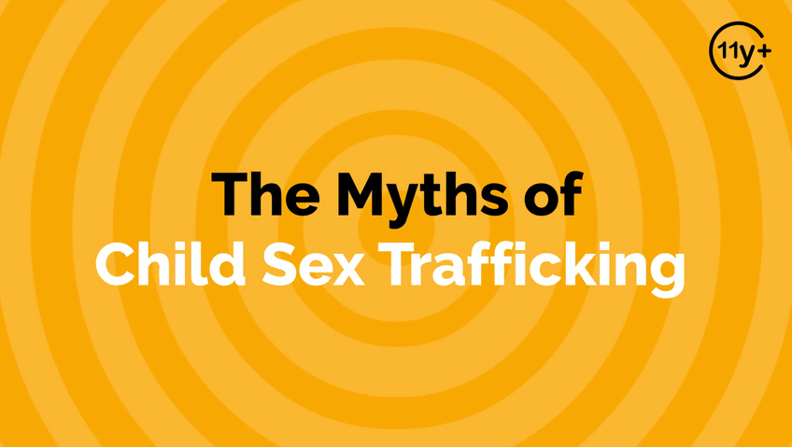
Visit WalkingWise.com DEMO for free access to this animated video.
©2025 Walking Wise
30
Notes:
Message Especially for Teens:
Businesses worldwide use explainer-style animation as a training tool for their employees.
So, this 3-minute Walking Wise animated video series is appropriate for both teens (ages 11+) and adults to learn how sexual predators use manipulation, intimidation, and coercion to exploit young and vulnerable people.
NOTE
Log in to Walking Wise.com to watch the three-minute animated video with your audience.

Slide 31
EDUCATON GUIDE
DEMO
PROTECTING CHILDREN
SAFE HARBOR ACT
State safe harbor laws recognize trafficked minors and disabled adults as victims, NOT criminals, and ensure their access to protection and care.
Myths
&REALITY
©2025 Walking Wise
Section 7102. 22 USC Ch. 78: Trafficking Victims Protection, From Title 22—Foreign Relations and Intercourse.
Shared Hope International Institute for Justice & Advocacy (n.d.). Report Cards on Child & Youth Sex Trafficking 2023 Toolkit, p. 33.
31
3
Notes:
Source
Shared Hope International Institute for Justice & Advocacy (n.d.). Report Cards on Child & Youth Sex Trafficking 2023 Toolkit, p. 33. Sharedhope.org. Retrieved January 5, 2025, from https://reportcards.sharedhope.org/wp-content/uploads/2023/11/2023_Toolkit.pdf
FOR LEGAL DEFINITION:
Section 7102. 22 USC Ch. 78: Trafficking Victims Protection, From Title 22—Foreign Relations and Intercourse. Retrieved January 3, 2025, from https://uscode.house.gov/view.xhtml?hl=false&edition=prelim&path=%2Fprelim%40title22%2Fchapter78&req=granuleid%3AUSC-prelim-title22-chapter78&num=0&saved=L3ByZWxpbUB0aXRsZTIyL2NoYXB0ZXI3OA%3D%3D%7CZ3JhbnVsZWlkOlVTQy1wcmVsaW0tdGl0bGUyMi1jaGFwdGVyNzg%3D%7C%7C%7C0%7Cfalse%7Cprelim

Slide 32
SAFE HARBOR
DEMO
Abolishing the Prosecution of Children
  Without Safe Harbor Laws, child victims are arrested and prosecuted for prostitution crimes.
  Mullen, K., Lloyd, R. (n.d.) The Passage of the Safe Harbor Act and the Voice of Sexually Exploited Youth.
  Clayton E., Krugman, R., Simon, P. (2013). Confronting Commercial Sexual Exploitation and Sex Trafficking of Minors in the United States. Institute of Medicine and National Research Council of The National Academies.
  Shared Hope International Institute for Justice & Advocacy (n.d.). Report Cards on Child & Youth Sex Trafficking 2023 Toolkit, p. 33.
©2025 Walking Wise
32
Notes:
• NEW YORK
The first safe harbor law in the United States was enacted in New York in 2008. This legislation, known as the Safe Harbor Act, was signed into law by Governor David Paterson on September 25, 2008. It marked New York as the first state to recognize that minors subjected to sexual trafficking required protection rather than detention.[1]
• 2013 STUDY
Confronting Commercial Sexual Exploitation and Sex Trafficking of Minors in the United States[2]
Source
Mullen, K., Lloyd, R. (n.d.) The Passage of the Safe Harbor Act and the Voice of Sexually Exploited Youth. Retrieved January 6, 2025, from https://ww2.nycourts.gov/sites/default/files/document/files/2018-07/MULLEN%20_HUMAN%20TRAFFICKING_1_d_0.pdf
2. Clayton E., Krugman, R., Simon, P. (2013). Confronting Commercial Sexual Exploitation and Sex Trafficking of Minors in the United States. Institute of Medicine and National Research Council of The National Academies. Retrieved January 6, 2025, from https://ojjdp.ojp.gov/sites/g/files/xyckuh176/files/pubs/243838.pdf

Slide 33
SAFE HARBOR
DEMO
Abolishing the Prosecution of Children
  Without Safe Harbor laws, child victims are arrested and prosecuted for prostitution crimes.
  The Safe Harbor Act was FIRST signed into law by the State of New York in 2008.[1]
  Mullen, K., Lloyd, R. (n.d.) The Passage of the Safe Harbor Act and the Voice of Sexually Exploited Youth.
  Clayton E., Krugman, R., Simon, P. (2013). Confronting Commercial Sexual Exploitation and Sex Trafficking of Minors in the United States. Institute of Medicine and National Research Council of The National Academies.
  Shared Hope International Institute for Justice & Advocacy (n.d.). Report Cards on Child & Youth Sex Trafficking 2023 Toolkit, p. 33.
©2025 Walking Wise
33
Notes:
• NEW YORK
The first safe harbor law in the United States was enacted in New York in 2008. This legislation, known as the Safe Harbor Act, was signed into law by Governor David Paterson on September 25, 2008. It marked New York as the first state to recognize that minors subjected to sexual trafficking required protection rather than detention.[1]
• 2013 STUDY
Confronting Commercial Sexual Exploitation and Sex Trafficking of Minors in the United States[2]
Source
Mullen, K., Lloyd, R. (n.d.) The Passage of the Safe Harbor Act and the Voice of Sexually Exploited Youth. Retrieved January 6, 2025, from https://ww2.nycourts.gov/sites/default/files/document/files/2018-07/MULLEN%20_HUMAN%20TRAFFICKING_1_d_0.pdf
2. Clayton E., Krugman, R., Simon, P. (2013). Confronting Commercial Sexual Exploitation and Sex Trafficking of Minors in the United States. Institute of Medicine and National Research Council of The National Academies. Retrieved January 6, 2025, from https://ojjdp.ojp.gov/sites/g/files/xyckuh176/files/pubs/243838.pdf

Slide 34
SAFE HARBOR
DEMO
Abolishing the Prosecution of Children
  Without Safe Harbor laws, child victims are arrested and prosecuted for prostitution crimes.
  The Safe Harbor Act was FIRST signed into law by the State of New York in 2008.[1]
  A 2013 study on the trafficking of minors raised awareness, which led to other states passing Safe Harbor legislation.[2]
  Mullen, K., Lloyd, R. (n.d.) The Passage of the Safe Harbor Act and the Voice of Sexually Exploited Youth.
  Clayton E., Krugman, R., Simon, P. (2013). Confronting Commercial Sexual Exploitation and Sex Trafficking of Minors in the United States. Institute of Medicine and National Research Council of The National Academies.
  Shared Hope International Institute for Justice & Advocacy (n.d.). Report Cards on Child & Youth Sex Trafficking 2023 Toolkit, p. 33.
©2025 Walking Wise
34
Notes:
• NEW YORK
The first safe harbor law in the United States was enacted in New York in 2008. This legislation, known as the Safe Harbor Act, was signed into law by Governor David Paterson on September 25, 2008. It marked New York as the first state to recognize that minors subjected to sexual trafficking required protection rather than detention.[1]
• 2013 STUDY
Confronting Commercial Sexual Exploitation and Sex Trafficking of Minors in the United States[2]
Source
Mullen, K., Lloyd, R. (n.d.) The Passage of the Safe Harbor Act and the Voice of Sexually Exploited Youth. Retrieved January 6, 2025, from https://ww2.nycourts.gov/sites/default/files/document/files/2018-07/MULLEN%20_HUMAN%20TRAFFICKING_1_d_0.pdf
2. Clayton E., Krugman, R., Simon, P. (2013). Confronting Commercial Sexual Exploitation and Sex Trafficking of Minors in the United States. Institute of Medicine and National Research Council of The National Academies. Retrieved January 6, 2025, from https://ojjdp.ojp.gov/sites/g/files/xyckuh176/files/pubs/243838.pdf

Slide 35
SAFE HARBOR
DEMO
Federal Law Calls for State Enforcement
  Treat a child (under 18) as a victim rather than a criminal.
©2025 Walking Wise
22 USC 7101: Purposes and findings. Title 22-Foreign Relations and Intercourse. Chapter 78 - Trafficking Victims Protection.
35
Notes:
NOTE
The U.S. government provides legal guidance for states to enact State Harbor laws, as indicated in this slide.
Source
United States Code (n.d.). Title 22, Chapter 78 – Trafficking Victims Protection, §7101. Purposes and findings.USC.house.gov. Retrieved January 5, 2025, from https://uscode.house.gov/view.xhtml?hl=false&edition=prelim&path=%2Fprelim%40title22%2Fchapter78&req=granuleid%3AUSC-prelim-title22-section7101&num=0&saved=L3ByZWxpbUB0aXRsZTIyL2NoYXB0ZXI3OA%3D%3D%7CZ3JhbnVsZWlkOlVTQy1wcmVsaW0tdGl0bGUyMi1jaGFwdGVyNzg%3D%7C%7C%7C0%7Cfalse%7Cprelim

Slide 36
SAFE HARBOR
DEMO
Federal Law Calls for State Enforcement
  Treat a child (under 18) as a victim rather than a criminal.
  Prohibit prosecuting children for prostitution offenses.
©2025 Walking Wise
22 USC 7101: Purposes and findings. Title 22-Foreign Relations and Intercourse. Chapter 78 - Trafficking Victims Protection.
36
Notes:
NOTE
The U.S. government provides legal guidance for states to enact State Harbor laws, as indicated in this slide.
Source
United States Code (n.d.). Title 22, Chapter 78 – Trafficking Victims Protection, §7101. Purposes and findings.USC.house.gov. Retrieved January 5, 2025, from https://uscode.house.gov/view.xhtml?hl=false&edition=prelim&path=%2Fprelim%40title22%2Fchapter78&req=granuleid%3AUSC-prelim-title22-section7101&num=0&saved=L3ByZWxpbUB0aXRsZTIyL2NoYXB0ZXI3OA%3D%3D%7CZ3JhbnVsZWlkOlVTQy1wcmVsaW0tdGl0bGUyMi1jaGFwdGVyNzg%3D%7C%7C%7C0%7Cfalse%7Cprelim

Slide 37
SAFE HARBOR
DEMO
Federal Law Calls for State Enforcement
  Treat a child (under 18) as a victim rather than a criminal.
  Prohibit prosecuting children for prostitution offenses.
  Ensure that children are referred to appropriate service providers for necessary care and support.
©2025 Walking Wise
22 USC 7101: Purposes and findings. Title 22-Foreign Relations and Intercourse. Chapter 78 - Trafficking Victims Protection.
37
Notes:
NOTE
The U.S. government provides legal guidance for states to enact State Harbor laws, as indicated in this slide.
Source
United States Code (n.d.). Title 22, Chapter 78 – Trafficking Victims Protection, §7101. Purposes and findings.USC.house.gov. Retrieved January 5, 2025, from https://uscode.house.gov/view.xhtml?hl=false&edition=prelim&path=%2Fprelim%40title22%2Fchapter78&req=granuleid%3AUSC-prelim-title22-section7101&num=0&saved=L3ByZWxpbUB0aXRsZTIyL2NoYXB0ZXI3OA%3D%3D%7CZ3JhbnVsZWlkOlVTQy1wcmVsaW0tdGl0bGUyMi1jaGFwdGVyNzg%3D%7C%7C%7C0%7Cfalse%7Cprelim

Slide 38
SAFE HARBOR
DEMO
Federal Law Calls for State Enforcement
  Treat children (under 18) as victims rather than criminals.
  Prohibit prosecuting children for prostitution offenses.
  Ensure children are referred to appropriate service providers for necessary care and support.
  Ensure the children are NOT required to prove they have been victimized by force, fraud, or coercion in order to receive protection and care.
©2025 Walking Wise
22 USC 7101: Purposes and findings. Title 22-Foreign Relations and Intercourse. Chapter 78 - Trafficking Victims Protection.
38
Notes:
NOTE
The U.S. government provides legal guidance for states to enact State Harbor laws, as indicated in this slide.
Source
United States Code (n.d.). Title 22, Chapter 78 – Trafficking Victims Protection, §7101. Purposes and findings.USC.house.gov. Retrieved January 5, 2025, from https://uscode.house.gov/view.xhtml?hl=false&edition=prelim&path=%2Fprelim%40title22%2Fchapter78&req=granuleid%3AUSC-prelim-title22-section7101&num=0&saved=L3ByZWxpbUB0aXRsZTIyL2NoYXB0ZXI3OA%3D%3D%7CZ3JhbnVsZWlkOlVTQy1wcmVsaW0tdGl0bGUyMi1jaGFwdGVyNzg%3D%7C%7C%7C0%7Cfalse%7Cprelim

Slide 39
LESSON PLANS
MYTH OR REALITY?
DEMO
Myth or Reality? Sex trafficking requires victims to be transported across state or international borders.
Myths
&REALITY
©2025 Walking Wise
National Human Trafficking Hotline (n.d.). Fact Sheet: Human Trafficking. The Administration for Children and Families.
39
3
Notes:
Online Polling Interaction
Sex trafficking requires victims to be transported across state or international borders.
A) Myth
B) Reality
ANSWER
A) Myth. Human trafficking crimes often occur within victims' own communities, and sometimes involve moving victims out-of-state and beyond borders.
The Trafficking Victims Protection Act (TVPA) prohibits the transportation of victims across state and national borders.
Source
National Human Trafficking Hotline (n.d.). Fact Sheet: Human Trafficking. The Administration for Children and Families. Retrieved May 1, 2024, from https://www.acf.hhs.gov/otip/fact-sheet/resource/fshumantrafficking

Slide 40
LESSON PLANS
MYTH OR REALITY?
DEMO
ANSWER: MYTH
Human trafficking crimes often occur within a victim's own community in the U.S.
Myths
&REALITY
©2025 Walking Wise
National Human Trafficking Hotline (n.d.). Fact Sheet: Human Trafficking. The Administration for Children and Families.
40
3
Notes:
ANSWER
A) Myth. Human trafficking crimes often occur within victims' own communities, and sometimes involve moving victims out-of-state and beyond borders.
The Trafficking Victims Protection Act (TVPA) prohibits the transportation of victims across state and national borders.
Source
National Human Trafficking Hotline (n.d.). Fact Sheet: Human Trafficking. The Administration for Children and Families. Retrieved May 1, 2024, from https://www.acf.hhs.gov/otip/fact-sheet/resource/fshumantrafficking

Slide 41
TRANSPORTATION
DEMO
Local vs. Long Distance
  Victims can be trafficked near their homes, in their homes, and long distances from their communities.
©2025 Walking Wise
  National Human Trafficking Hotline (n.d.). Fact Sheet: Human Trafficking. The Administration for Children and Families.
  One Hundred Sixth Congress of the United States of America at the Second Session (2000, January 24). Victims of Trafficking and Violence Protection Act of 2000
41
Notes:
Source
1. National Human Trafficking Hotline (n.d.). Fact Sheet: Human Trafficking. The Administration for Children and Families. Retrieved January 25, 2025, from https://www.acf.hhs.gov/otip/fact-sheet/resource/fshumantrafficking
2. One Hundred Sixth Congress of the United States of America at the Second Session (2000, January 24). Victims of Trafficking and Violence Protection Act of 2000. GovInfo.gov. Retrieved January 6, 2025, from https://www.govinfo.gov/content/pkg/BILLS-106hr3244enr/pdf/BILLS-106hr3244enr.pdf

Slide 42
TRANSPORTATION
DEMO
Local vs. Long Distance
  Victims can be trafficked near their homes, in their homes, and long distances from their communities.
  Traffickers often relocate victims across state lines to serve new buyers.[1]
©2025 Walking Wise
  National Human Trafficking Hotline (n.d.). Fact Sheet: Human Trafficking. The Administration for Children and Families.
  One Hundred Sixth Congress of the United States of America at the Second Session (2000, January 24). Victims of Trafficking and Violence Protection Act of 2000
42
Notes:
Source
1. National Human Trafficking Hotline (n.d.). Fact Sheet: Human Trafficking. The Administration for Children and Families. Retrieved January 25, 2025, from https://www.acf.hhs.gov/otip/fact-sheet/resource/fshumantrafficking
2. One Hundred Sixth Congress of the United States of America at the Second Session (2000, January 24). Victims of Trafficking and Violence Protection Act of 2000. GovInfo.gov. Retrieved January 6, 2025, from https://www.govinfo.gov/content/pkg/BILLS-106hr3244enr/pdf/BILLS-106hr3244enr.pdf

Slide 43
TRANSPORTATION
DEMO
Local vs. Long Distance
  Victims can be trafficked near their homes, in their homes, and long distances from their communities.
  Traffickers often relocate victims across state lines to serve new buyers.[1]
  Trafficking Victims Protection Act (TVPA) makes it illegal to move or arrange the travel of victims.[2]
©2025 Walking Wise
  National Human Trafficking Hotline (n.d.). Fact Sheet: Human Trafficking. The Administration for Children and Families.
  One Hundred Sixth Congress of the United States of America at the Second Session (2000, January 24). Victims of Trafficking and Violence Protection Act of 2000
43
Notes:
Source
1. National Human Trafficking Hotline (n.d.). Fact Sheet: Human Trafficking. The Administration for Children and Families. Retrieved January 25, 2025, from https://www.acf.hhs.gov/otip/fact-sheet/resource/fshumantrafficking
2. One Hundred Sixth Congress of the United States of America at the Second Session (2000, January 24). Victims of Trafficking and Violence Protection Act of 2000. GovInfo.gov. Retrieved January 6, 2025, from https://www.govinfo.gov/content/pkg/BILLS-106hr3244enr/pdf/BILLS-106hr3244enr.pdf

Slide 44
LESSON PLANS
DEMO
TRAFFICKING MYTH
MYTH: Sex traffickers only target females.
Myths
&REALITY
©2025 Walking Wise
44
3
Notes:
MYTH: It is a myth that sex traffickers only target females.

Slide 45
LESSON PLANS
MALE VICTIMS
DEMO
What percent of males are trafficked in the U.S. commercial sex trade?
Myths
&REALITY
©2025 Walking Wise
Swaner, R., Labriola, M., Rempel, M., Walker, A., & Spadafore, J. (2016, March). Youth Involvement in the Sex Trade: A National Study, p. 40.
45
3
Notes:
Online Polling Interaction
What percent of males are trafficked in the U.S. commercial sex trade?
A) 6%
B) 16%
C) 26%
D) 36%
ANSWER
D) 36% of males are believed to be victims of sex trafficking.
Source
Swaner, R., Labriola, M., Rempel, M., Walker, A., & Spadafore, J. (2016, March). Youth Involvement in the Sex Trade: A National Study, p. 40. Courtinnovation.org. Retrieved February 25, 2024, from https://www.ojp.gov/pdffiles1/ojjdp/grants/249952.pdf

Slide 46
LESSON PLANS
MALE VICTIMS
DEMO
ANSWER:
It is estimated that 36% of males are believed to be victims of sex trafficking.
Myths
&REALITY
©2025 Walking Wise
Swaner, R., Labriola, M., Rempel, M., Walker, A., & Spadafore, J. (2016, March). Youth Involvement in the Sex Trade: A National Study, p. 40.
46
3
Notes:
ANSWER
D) 36% of males are believed to be victims of sex trafficking.
Source
Swaner, R., Labriola, M., Rempel, M., Walker, A., & Spadafore, J. (2016, March). Youth Involvement in the Sex Trade: A National Study, p. 40. Courtinnovation.org. Retrieved February 25, 2024, from https://www.ojp.gov/pdffiles1/ojjdp/grants/249952.pdf

Slide 47
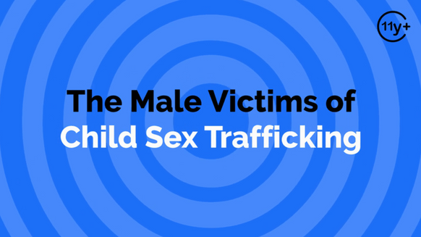
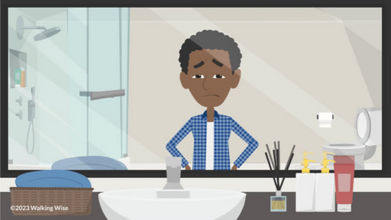
DEMO
REALITY
Males are Victims Too
  90% to 95% of sexual violations against males are not reported.[1]
  Thomas, J. C., & Kopel, J. (2023). Male Victims of Sexual Assault: A Review of the Literature. Behavioral Sciences (Basel, Switzerland), 13(4), 304
  Dube, S. R., Anda, R. F., Whitfield, C. L., Brown, D. W., Felitti, V. J., Dong, M., & Giles, W. H. (2005). Long-term consequences of childhood sexual abuse by gender of victim. American Journal of Preventive Medicine, 28(5), 430–438.
©2025 Walking Wise
47
Notes:
Source
1. Thomas, J. C., & Kopel, J. (2023). Male Victims of Sexual Assault: A Review of the Literature. Behavioral sciences (Basel, Switzerland), 13(4), 304. https://doi.org/10.3390/bs13040304. Retrieved April 21, 2024, from https://www.ncbi.nlm.nih.gov/pmc/articles/PMC10135558/
2. Dube, S. R., Anda, R. F., Whitfield, C. L., Brown, D. W., Felitti, V. J., Dong, M., & Giles, W. H. (2005). Long-term consequences of childhood sexual abuse by gender of victim. American Journal of Preventive Medicine, 28(5), 430–438. Retrieved April 23, 2024, from https://pubmed.ncbi.nlm.nih.gov/15894146/

Slide 48
DEMO
REALITY
Males are Victims Too
  90% to 95% of sexual violations against males are not reported.[1]
  Female predators commit 40% of sexual abuse against males.[2]
  Thomas, J. C., & Kopel, J. (2023). Male Victims of Sexual Assault: A Review of the Literature. Behavioral Sciences (Basel, Switzerland), 13(4), 304
  Dube, S. R., Anda, R. F., Whitfield, C. L., Brown, D. W., Felitti, V. J., Dong, M., & Giles, W. H. (2005). Long-term consequences of childhood sexual abuse by gender of victim. American Journal of Preventive Medicine, 28(5), 430–438.
©2025 Walking Wise
48
Notes:
Source
1. Thomas, J. C., & Kopel, J. (2023). Male Victims of Sexual Assault: A Review of the Literature. Behavioral sciences (Basel, Switzerland), 13(4), 304. https://doi.org/10.3390/bs13040304. Retrieved April 21, 2024, from https://www.ncbi.nlm.nih.gov/pmc/articles/PMC10135558/
2. Dube, S. R., Anda, R. F., Whitfield, C. L., Brown, D. W., Felitti, V. J., Dong, M., & Giles, W. H. (2005). Long-term consequences of childhood sexual abuse by gender of victim. American Journal of Preventive Medicine, 28(5), 430–438. Retrieved April 23, 2024, from https://pubmed.ncbi.nlm.nih.gov/15894146/

Slide 49
DEMO
REALITY
Males are Victims Too
  90% to 95% of sexual violations against males are not reported.[1]
  Female predators commit 40% of sexual abuse against males.[2]
  Most males don’t disclose due to fear of social stigma and shame.
  Thomas, J. C., & Kopel, J. (2023). Male Victims of Sexual Assault: A Review of the Literature. Behavioral Sciences (Basel, Switzerland), 13(4), 304
  Dube, S. R., Anda, R. F., Whitfield, C. L., Brown, D. W., Felitti, V. J., Dong, M., & Giles, W. H. (2005). Long-term consequences of childhood sexual abuse by gender of victim. American Journal of Preventive Medicine, 28(5), 430–438.
©2025 Walking Wise
49
Notes:
Source
1. Thomas, J. C., & Kopel, J. (2023). Male Victims of Sexual Assault: A Review of the Literature. Behavioral sciences (Basel, Switzerland), 13(4), 304. https://doi.org/10.3390/bs13040304. Retrieved April 21, 2024, from https://www.ncbi.nlm.nih.gov/pmc/articles/PMC10135558/
2. Dube, S. R., Anda, R. F., Whitfield, C. L., Brown, D. W., Felitti, V. J., Dong, M., & Giles, W. H. (2005). Long-term consequences of childhood sexual abuse by gender of victim. American Journal of Preventive Medicine, 28(5), 430–438. Retrieved April 23, 2024, from https://pubmed.ncbi.nlm.nih.gov/15894146/

Slide 50
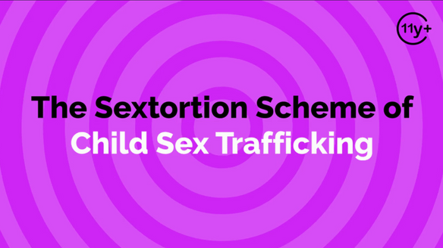
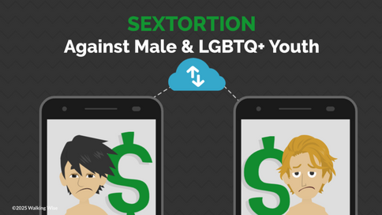
DEMO
REALITY
Males Are Targets of Sextortion
  36.2 million reports of online child exploitation in 2023.[1]
  National Center for Missing & Exploited Children (2023). 2023 CyberTipline Report, p. 3.
  Thorn and National Center for Missing and Exploited Children (NCMEC). (2024). Trends in Financial Sextortion: An investigation of sextortion reports in NCMEC CyberTipline data, pp. 9, 13.
  Thorn (2023). LGBTQ+ Youth Perspectives: How LGBTQ+ Youth are Navigating Exploration and Risks of Sexual Exploitation Online, p. 10, 14.
©2025 Walking Wise
50
Notes:
Source
1. National Center for Missing & Exploited Children (2023). 2023 CyberTipline Report, p. 3. Missingkids.org. Retrieved May 9, 2024, from https://www.missingkids.org/content/dam/missingkids/pdfs/2023-CyberTipline-Report.pdf
2. Thorn and National Center for Missing and Exploited Children (NCMEC). (2024). Trends in Financial Sextortion: An investigation of sextortion reports in NCMEC CyberTipline data, pp. 9, 13. Retrieved October 19, 2024, from https://info.thorn.org/hubfs/Research/Thorn_TrendsInFinancialSextortion_June2024.pdf
3. Thorn (2023). LGBTQ+ Youth Perspectives: How LGBTQ+ Youth are Navigating Exploration and Risks of Sexual Exploitation Online, p. 10, 14.
https://info.thorn.org/hubfs/Research/Thorn_LGBTQ+YouthPerspectives_June2023_FNL.pdf

Slide 51
DEMO
REALITY
Males Are Targets of Sextortion
  36.2 million reports of online child exploitation in 2023.[1]
  Males, ages 14 to 17, are especially targeted by Sextortionists.[2]
  National Center for Missing & Exploited Children (2023). 2023 CyberTipline Report, p. 3.
  Thorn and National Center for Missing and Exploited Children (NCMEC). (2024). Trends in Financial Sextortion: An investigation of sextortion reports in NCMEC CyberTipline data, pp. 9, 13.
  Thorn (2023). LGBTQ+ Youth Perspectives: How LGBTQ+ Youth are Navigating Exploration and Risks of Sexual Exploitation Online, p. 10, 14.
©2025 Walking Wise
51
Notes:
Source
1. National Center for Missing & Exploited Children (2023). 2023 CyberTipline Report, p. 3. Missingkids.org. Retrieved May 9, 2024, from https://www.missingkids.org/content/dam/missingkids/pdfs/2023-CyberTipline-Report.pdf
2. Thorn and National Center for Missing and Exploited Children (NCMEC). (2024). Trends in Financial Sextortion: An investigation of sextortion reports in NCMEC CyberTipline data, pp. 9, 13. Retrieved October 19, 2024, from https://info.thorn.org/hubfs/Research/Thorn_TrendsInFinancialSextortion_June2024.pdf
3. Thorn (2023). LGBTQ+ Youth Perspectives: How LGBTQ+ Youth are Navigating Exploration and Risks of Sexual Exploitation Online, p. 10, 14.
https://info.thorn.org/hubfs/Research/Thorn_LGBTQ+YouthPerspectives_June2023_FNL.pdf

Slide 52
DEMO
REALITY
Males Are Targets of Sextortion
  36.2 million reports of online child exploitation in 2023.[1]
  Males, ages 14 to 17, are especially targeted by Sextortionists.[2]
  90% of male victims are ‘sextorted’ for money, while females are often ‘sextorted’ for sexual content or sex acts.[2]
  National Center for Missing & Exploited Children (2023). 2023 CyberTipline Report, p. 3.
  Thorn and National Center for Missing and Exploited Children (NCMEC). (2024). Trends in Financial Sextortion: An investigation of sextortion reports in NCMEC CyberTipline data, pp. 9, 13.
  Thorn (2023). LGBTQ+ Youth Perspectives: How LGBTQ+ Youth are Navigating Exploration and Risks of Sexual Exploitation Online, p. 10, 14.
©2025 Walking Wise
52
Notes:
Source
1. National Center for Missing & Exploited Children (2023). 2023 CyberTipline Report, p. 3. Missingkids.org. Retrieved May 9, 2024, from https://www.missingkids.org/content/dam/missingkids/pdfs/2023-CyberTipline-Report.pdf
2. Thorn and National Center for Missing and Exploited Children (NCMEC). (2024). Trends in Financial Sextortion: An investigation of sextortion reports in NCMEC CyberTipline data, pp. 9, 13. Retrieved October 19, 2024, from https://info.thorn.org/hubfs/Research/Thorn_TrendsInFinancialSextortion_June2024.pdf
3. Thorn (2023). LGBTQ+ Youth Perspectives: How LGBTQ+ Youth are Navigating Exploration and Risks of Sexual Exploitation Online, p. 10, 14.
https://info.thorn.org/hubfs/Research/Thorn_LGBTQ+YouthPerspectives_June2023_FNL.pdf

Slide 53
DEMO
REALITY
Males Are Targets of Sextortion
  36.2 million reports of online child exploitation in 2023.[1]
  Males, ages 14 to 17, are especially targeted by Sextortionists.[2]
  90% of male victims are ‘sextorted’ for money, while females are often ‘sextorted’ for sexual content or sex acts.[2]
  Most LGBTQ+ youth rely heavily on online social circles, significantly increasing their exposure to predators.[3]
  National Center for Missing & Exploited Children (2023). 2023 CyberTipline Report, p. 3.
  Thorn and National Center for Missing and Exploited Children (NCMEC). (2024). Trends in Financial Sextortion: An investigation of sextortion reports in NCMEC CyberTipline data, pp. 9, 13.
  Thorn (2023). LGBTQ+ Youth Perspectives: How LGBTQ+ Youth are Navigating Exploration and Risks of Sexual Exploitation Online, p. 10, 14.
©2025 Walking Wise
53
Notes:
Source
1. National Center for Missing & Exploited Children (2023). 2023 CyberTipline Report, p. 3. Missingkids.org. Retrieved May 9, 2024, from https://www.missingkids.org/content/dam/missingkids/pdfs/2023-CyberTipline-Report.pdf
2. Thorn and National Center for Missing and Exploited Children (NCMEC). (2024). Trends in Financial Sextortion: An investigation of sextortion reports in NCMEC CyberTipline data, pp. 9, 13. Retrieved October 19, 2024, from https://info.thorn.org/hubfs/Research/Thorn_TrendsInFinancialSextortion_June2024.pdf
3. Thorn (2023). LGBTQ+ Youth Perspectives: How LGBTQ+ Youth are Navigating Exploration and Risks of Sexual Exploitation Online, p. 10, 14.
https://info.thorn.org/hubfs/Research/Thorn_LGBTQ+YouthPerspectives_June2023_FNL.pdf

Slide 54
LESSON PLANS
DEMO
LEARN MORE
OTHER TOPICS
  The "Myths & Reality" presentation also discusses:
    Sexting acronyms parents should know
    Missing U.S. children
    Running away and homelessness
    Female and peer recruiters
    Trustworthy versus unsafe adults
    Grooming and the pornography link
Myths
&REALITY
©2025 Walking Wise
54
3

Slide 55
LESSON PLANS
DEMO
WHY SUBSCRIBE
Walking Wise
  The "Myths & Reality" presentation offers an engaging learning experience for staff members and parents.
Myths
&REALITY
©2025 Walking Wise
55
3

Slide 56
LESSON PLANS
DEMO
WHY SUBSCRIBE
Walking Wise
  The "Myths & Reality" presentation offers an engaging learning experience for staff members and parents.
  It provides insight, reinforcing the need to teach students using our 12-lesson youth curriculum.
Myths
&REALITY
©2025 Walking Wise
56
3

Slide 57
LESSON PLANS
DEMO
WHY SUBSCRIBE
Subscribe to WalkingWise.com to unlock the complete “Myths & Reality” presentation for adults.
Myths
&REALITY
©2025 Walking Wise
57
3

Slide 58
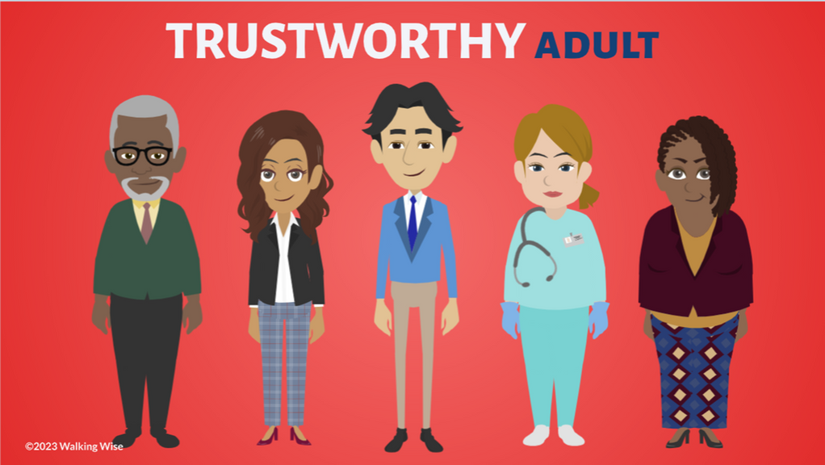


WALKING WISE
DEMO
WalkingWise.com
Learn more about trustworthy adults, groomers, and sexual predators by taking the Walking Wise online course for adults.
Online Course for Adults Accredited by:
Postgraduate Institue for Medicine
Academy of Forensic Nursing
©2025 Walking Wise
58

Slide 59

DEMO
Thank you!
WalkingWise.com
©2025 Walking Wise
59
Notes:
NOTE
To access additional resources about the myths, please refer to the last page of Lesson Plan #1 in the Walking Wise Education Guide.
We welcome your feedback at hello@WalkingWise.com.
Thank you!
Karla Highman
Founder, WalkingWise.com

