Slide 1
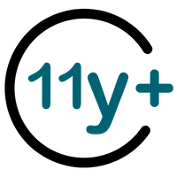
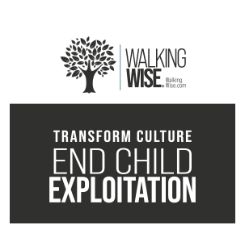
SEXUAL EXPLOITATION
EDUCATION
family
SECRET
LESSON #11
Notes:
NOTE
Log in to WalkingWise.com and refer to the Walking Wise Education Guide to implement classroom teaching tips.
Most importantly:
• DEFINE SCHOOL POLICY
Establish an anti-trafficking reporting protocol with a trauma-informed response. The Walking Wise Implementation Guide provides a sample protocol.
• AGE & AUDIENCE
This presentation can be edited by following the procedures on page 3 to align with your school policies, specific age groups, and the involvement of at-risk audiences.
• SUPPORT PROCEDURE
Provide your audience with guidance on accessing immediate help or arranging a private meeting with a social worker, counselor, nurse, school resource officer, or another trustworthy staff member to report concerns for themselves or a peer.
• SECOND SAFE ADULT
Ensure a second trustworthy adult, such as a teacher, is present in the learning setting to observe audience reactions and identify those who may benefit from a follow-up meeting. This person should remain focused and free from other duties during the presentation.
• IMPLEMENT SLIDO.com
Join Walking Wise in using Slido.com to create an anonymous user experience.
Contact us at support@WalkingWise.com for more information.

Slide 2
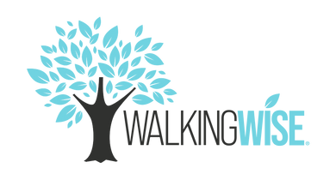
NOTE TO PRESENTER
This presentation is exclusively for Walking Wise® subscribers and not for redistribution.
Walking Wise encourages the use of Slido.com, an interactive digital tool, to enhance audience engagement. For more information, contact us at support@WalkingWise.com. Once configured, integrate Slido polling and add a post-evaluation to the PowerPoint presentation.
Presenters are encouraged to edit speaker notes to match their speaking style (viewable in presentation mode). You can also delete slides from this Walking Wise presentation to make sure the content aligns with your school policies, is age-appropriate, and fits within available class time. However, the existing slides are copyright-protected and may not be modified without prior written permission from Walking Wise.
We encourage you to add your own content by following these instructions:
Insert new PowerPoint slides.
Remove the Walking Wise logo and copyright "©2025 Walking Wise" from the new slides.
Always add your organization's name or logo to each new slide.
Please delete this instruction page before presenting to audiences.
©2024-2026 Walking Wise
2
Notes:
NOTE
The presenter is welcome to customize this Walking Wise presentation according to the instructions provided on this page.
For revision requests, please email us at:
support@WalkingWise.com.

Slide 3

CONFRONTING SEXUAL EXPLOITATION
WALKING WISE
KNOWLEDGE serves as a
powerful defense against
sexual predators.
©2024-2026 Walking Wise
3

Slide 4
CONFRONTING SEXUAL EXPLOITATION
WALKING WISE
SEXUAL EXPLOITATION includes grooming, sextortion, pornography
& sex trafficking.
©2024-2026 Walking Wise
4

Slide 5
SENSITIVE DISCUSSION AHEAD
CONTENT ALERT
We’ll be discussing serious issues about sexual exploitation.
Some parts may be difficult to hear.
If you ever feel uncomfortable, you can step out and speak with a trustworthy adult for support.
You’re not alone—we’re here to help you.
©2024-2026 Walking Wise
5
Notes:
NOTE TO PRESENTER
Please tailor this message to align with your organization's policies and protocols.
Please provide a confidential avenue for students to report concerns and seek help for themselves or their peers if they suspect sexual abuse, grooming, sextortion, pornography-related exploitation, or human trafficking. This may include a designated address or text line.
Consider displaying posters in your school or facility that outline various ways students can access immediate support or request a private meeting with a school safety team member or another trusted adult.

Slide 6
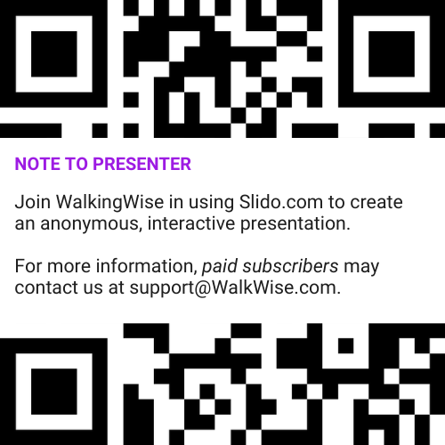
DIGITAL PARTICIPATION
©2024-2026 Walking Wise
6
Notes:
NOTE
For Online Interactive Polling with audiences:
Join Walking Wise in using Slido.com to create an anonymous user experience.
Contact us at support@WalkingWise.com for more information.
Upon Activating Slido.com:
Please verify that the Q&A feature is enabled before presenting to audiences. An adult should monitor questions and comments to ensure they are appropriate. Slido has a feature that allows you to delete unwanted questions and comments.

Slide 7



STATISTICS
Statistics are Only Estimates
🔍 Many sexual crimes are never reported, so study results may not fully reflect what is really happening.
©2024-2026 Walking Wise
7
Notes:
In this presentation, we'll discuss statistics, but it's important to note that while statistics provide valuable insights into an issue, they cannot be relied upon entirely.
Here are a few reasons:
• UNREPORTED
Victims may stay silent due to fear, shame, or manipulation.
• INCONSISTENT COLLECTION
Geographical areas have different legal definitions for sexual crimes, making data hard to compare.
• FOCUS GROUPS
Small or specific focus groups participating in a study or survey may not accurately reflect the diversity or experiences of the broader population.

Slide 8
STATISTICS
Statistics are Only Estimates
📊 Studies collect information in different ways, which can lead to different results.
©2024-2026 Walking Wise
8
Notes:
In this presentation, we'll discuss statistics, but it's important to note that while statistics provide valuable insights into an issue, they cannot be relied upon entirely.
Here are a few reasons:
• UNREPORTED
Victims may stay silent due to fear, shame, or manipulation.
• INCONSISTENT COLLECTION
Geographical areas have different legal definitions for sexual crimes, making data hard to compare.
• FOCUS GROUPS
Small or specific focus groups participating in a study or survey may not accurately reflect the diversity or experiences of the broader population.

Slide 9
STATISTICS
Statistics are Only Estimates
👥 Some studies use small groups of people, and those groups may not represent everyone.
©2024-2026 Walking Wise
9
Notes:
In this presentation, we'll discuss statistics, but it's important to note that while statistics provide valuable insights into an issue, they cannot be relied upon entirely.
Here are a few reasons:
• UNREPORTED
Victims may stay silent due to fear, shame, or manipulation.
• INCONSISTENT COLLECTION
Geographical areas have different legal definitions for sexual crimes, making data hard to compare.
• FOCUS GROUPS
Small or specific focus groups participating in a study or survey may not accurately reflect the diversity or experiences of the broader population.

Slide 10
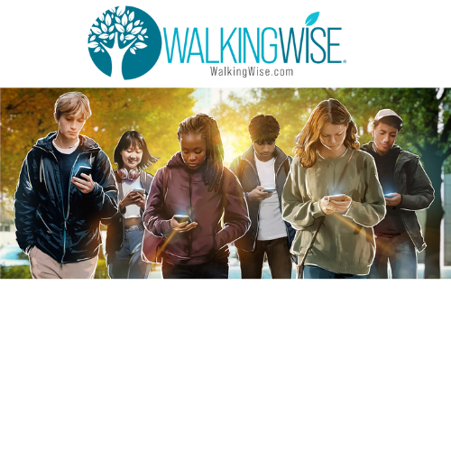
EDUCATON GUIDE
VOCABULARY
VOCABULARY
Predator
Family Trafficker
Child Abuse
Child Exploitation
Child Sexual Exploitation
Mind Control
Generational
Influence
©2024-2026 Walking Wise
10
3
Notes:
NOTE
Understanding vocabulary terms related to the behaviors of sexual predators can empower young people to recognize warning signs of harmful situations.
Knowing terminology helps them identify manipulative tactics predators use to build trust and exploit vulnerabilities.
With this knowledge, young people are better equipped to spot red flags, understand that these behaviors are abusive, and feel more confident reporting predators to trusted adults or authorities, potentially preventing further harm.

Slide 11
EDUCATON GUIDE
VOCABULARY
PREDATOR
A person who injures, abuses, or takes advantage of others for personal gain or profit.
©2024-2026 Walking Wise
11
3
Notes:
Assisting Source
OpenAI. (2024). ChatGPT [Large language model]. https://chatgpt.com

Slide 12
EDUCATON GUIDE
VOCABULARY
FAMILY TRAFFICKER
A family member who manipulates, tricks, or pressures the family’s child into sexual exploitation or labor in exchange for money, housing, drugs, or favors.
©2024-2026 Walking Wise
12
3
Notes:
Assisting Source
OpenAI. (2024). ChatGPT [Large language model]. https://chatgpt.com

Slide 13
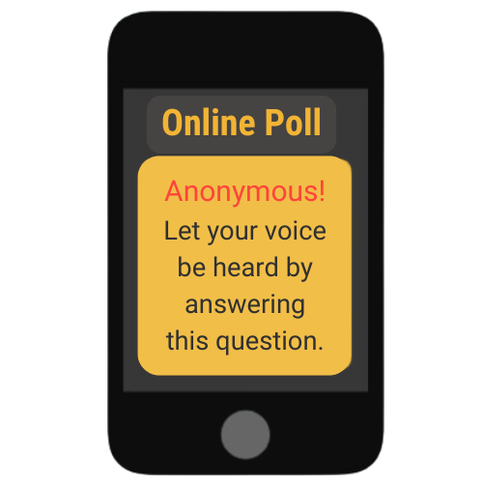
LESSON PLANS
VICTIM OF ABUSE
At what age are children most commonly trafficked by a family member?
Allert, J. (2022). Domestic Minor Familial Sex Trafficking: A National Study of Prevalence, Characteristics, and Challenges across the Justice Process, p. 18. Institute for Shelter Care.
13
©2024-2026 Walking Wise
3
Notes:
Online Interactive Polling
SLIDO.com: Multiple Choice
At what age are children most commonly trafficked by a family member?
A) 10 to 13 years old
B) 14 to 17 years old
C) 16 to 21 years old
D) 18 to 21 years old
ANSWERS:
B) 14 to 17 years old is the age at which most children are trafficked by a family member.
A large 2021 study identified 917 children who were trafficked by a family member between 2018 and 2021, 72% were between the ages of 14 and 17.
-20% of the children were between 10 and 13 years old.
-6% were between the ages of 6 and 9 years old, and 1.4% were between the ages of 1 and 5, with less than 1% were infants.
Source
Allert, J. (2022). Domestic Minor Familial Sex Trafficking: A National Study of Prevalence, Characteristics, and Challenges across the Justice Process, p. 18. Institute for Shelter Care. Retrieved March 15, 2024, from https://instituteforsheltercare.org/familial/

Slide 14
ANSWER
Between the ages of 14 and 17 years is the most common age of children trafficked by a family member.
©2024-2026 Walking Wise
Allert, J. (2022). Domestic Minor Familial Sex Trafficking: A National Study of Prevalence, Characteristics, and Challenges across the Justice Process, p. 17.
14
Notes:
Online Interactive Polling
SLIDO.com: Multiple Choice
At what age are children most commonly trafficked by a family member?
A) 10 to 13 years old
B) 14 to 17 years old
C) 16 to 21 years old
D) 18 to 21 years old
ANSWERS:
B) 14 to 17 years old is the age at which most children are trafficked by a family member.
A large 2021 study identified 917 children who were trafficked by a family member between 2018 and 2021, 72% were between the ages of 14 and 17.
-20% of the children were between 10 and 13 years old.
-6% were between the ages of 6 and 9 years old, and 1.4% were between the ages of 1 and 5, with less than 1% were infants.
Source
Allert, J. (2022). Domestic Minor Familial Sex Trafficking: A National Study of Prevalence, Characteristics, and Challenges across the Justice Process, p. 18. Institute for Shelter Care. Retrieved March 15, 2024, from https://instituteforsheltercare.org/familial/

Slide 15
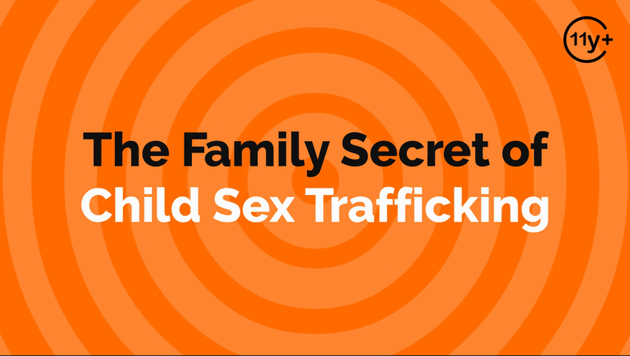
Log in to WalkingWise.com to access this animated video.
©2024-2026 Walking Wise
15
Notes:
Message Especially for Teens:
Businesses worldwide use explainer-style animation as a training tool for their employees. So, this 3-minute Walking Wise animated video series is appropriate for both teens (ages 11+) and adults to learn how sexual predators use manipulation, intimidation, and coercion to exploit young people.
NOTE
Log in to Walking Wise.com to watch the three-minute animated video with audiences.

Slide 16
LESSON PLANS
FAMILY VICTIMS
What percent of trafficked victims in the U.S. were exploited by a family member?
©2024-2026 Walking Wise
16
3
Notes:
Online Interactive Polling
SLIDO.com: Multiple Choice
What percent of victims are trafficked by a family member?
A) ~22% of Victims
B) ~32% of Victims
C) ~42% of Victims
D) ~52% of Victims
ANSWER
C) ~42% if victims were found to be trafficked by a family member.
In its 2020 report on human trafficking trends, the Polaris Project disclosed that family members were responsible for 2,448 cases, recruiting 42% of victims.
Source
Polaris Project (n.d.). Human Trafficking Trends in 2020, p. 2. PolarisProject.org. Retrieved January 24, 2026, from https://polarisproject.org/wp-content/uploads/2022/01/Human-Trafficking-Trends-in-2020-by-Polaris.pdf

Slide 17
ANSWER
~42% of victims were trafficked by a family member, according to a study.
©2024-2026 Walking Wise
Polaris Project (n.d.). Human Trafficking Trends in 2020, p. 2. PolarisProject.org.
17
Notes:
Online Interactive Polling
SLIDO.com: Multiple Choice
What percent of victims are trafficked by a family member?
A) ~22% of Victims
B) ~32% of Victims
C) ~42% of Victims
D) ~52% of Victims
ANSWER
C) ~42% if victims were found to be trafficked by a family member.
In its 2020 report on human trafficking trends, the Polaris Project disclosed that family members were responsible for 2,448 cases, recruiting 42% of victims.
Source
Polaris Project (n.d.). Human Trafficking Trends in 2020, p. 2. PolarisProject.org. Retrieved January 24, 2026, from https://polarisproject.org/wp-content/uploads/2022/01/Human-Trafficking-Trends-in-2020-by-Polaris.pdf

Slide 18
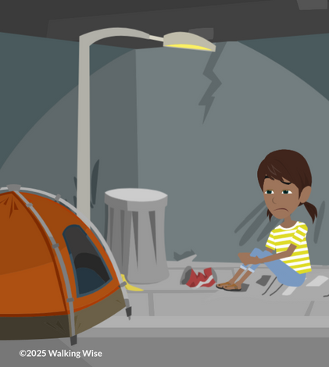
RISK FACTORS
What are examples of ‘harsh circumstances’ that increase the risk of family trafficking?
©2024-2026 Walking Wise
18

Slide 19
RISK FACTORS
Childhood Risk Factors
Housing Instability: Not knowing where you will live next, running away, or moving between homes often.
Joan A. Reid, Juliana Huard & Rachael A. Haskell (2015) Family-facilitated juvenile sex trafficking, Journal of Crime and Justice, 38:3, 361-376.
Allert, J. (2022). Domestic Minor Familial Sex Trafficking: A National Study of Prevalence, Characteristics, and Challenges across the Justice Process, p. 18. Institute for Shelter Care.
©2024-2026 Walking Wise
19
Notes:
RISK FACTORS
Harsh circumstances can increase a child’s vulnerability to exploitation by creating unmet emotional, physical, or social needs.
Involvement in systems such as foster care or juvenile justice can reflect instability, disrupted attachments, or limited adult protection.
Running away is often a survival response to unsafe environments, rather than a choice. This may include abuse, neglect, or the misuse of drugs and alcohol in the home. Involvement in the justice system can further isolate youth from support.
Youth who experience emotional distress, disabilities, or academic challenges may be more easily manipulated by family members or caregivers who misuse power or control.
These risk factors do not cause trafficking, but they can increase susceptibility when protective supports are lacking.
Source
Joan A. Reid, Juliana Huard & Rachael A. Haskell (2015) Family-facilitated juvenile sex trafficking, Journal of Crime and Justice, 38:3, 361-376, DOI: 10.1080/0735648X.2014.967965 https://www.tandfonline.com/eprint/ZBS7nZCXxC3VqqUaHZ3k/full
Allert, J. (2022). Domestic Minor Familial Sex Trafficking: A National Study of Prevalence, Characteristics, and Challenges across the Justice Process, p. 18. Institute for Shelter Care. Retrieved March 15, 2024, from https://instituteforsheltercare.org/familial/

Slide 20
RISK FACTORS
Childhood Risk Factors
Outside Care: Has been supported by foster care or the child welfare system.
Joan A. Reid, Juliana Huard & Rachael A. Haskell (2015) Family-facilitated juvenile sex trafficking, Journal of Crime and Justice, 38:3, 361-376.
Allert, J. (2022). Domestic Minor Familial Sex Trafficking: A National Study of Prevalence, Characteristics, and Challenges across the Justice Process, p. 18. Institute for Shelter Care.
©2024-2026 Walking Wise
20
Notes:
RISK FACTORS
Harsh circumstances can increase a child’s vulnerability to exploitation by creating unmet emotional, physical, or social needs.
Involvement in systems such as foster care or juvenile justice can reflect instability, disrupted attachments, or limited adult protection.
Running away is often a survival response to unsafe environments, rather than a choice. This may include abuse, neglect, or the misuse of drugs and alcohol in the home. Involvement in the justice system can further isolate youth from support.
Youth who experience emotional distress, disabilities, or academic challenges may be more easily manipulated by family members or caregivers who misuse power or control.
These risk factors do not cause trafficking, but they can increase susceptibility when protective supports are lacking.
Source
Joan A. Reid, Juliana Huard & Rachael A. Haskell (2015) Family-facilitated juvenile sex trafficking, Journal of Crime and Justice, 38:3, 361-376, DOI: 10.1080/0735648X.2014.967965 https://www.tandfonline.com/eprint/ZBS7nZCXxC3VqqUaHZ3k/full
Allert, J. (2022). Domestic Minor Familial Sex Trafficking: A National Study of Prevalence, Characteristics, and Challenges across the Justice Process, p. 18. Institute for Shelter Care. Retrieved March 15, 2024, from https://instituteforsheltercare.org/familial/

Slide 21
RISK FACTORS
Childhood Risk Factors
Substance Use: Family member misuses drugs or alcohol.
Joan A. Reid, Juliana Huard & Rachael A. Haskell (2015) Family-facilitated juvenile sex trafficking, Journal of Crime and Justice, 38:3, 361-376.
Allert, J. (2022). Domestic Minor Familial Sex Trafficking: A National Study of Prevalence, Characteristics, and Challenges across the Justice Process, p. 18. Institute for Shelter Care.
©2024-2026 Walking Wise
21
Notes:
RISK FACTORS
Harsh circumstances can increase a child’s vulnerability to exploitation by creating unmet emotional, physical, or social needs.
Involvement in systems such as foster care or juvenile justice can reflect instability, disrupted attachments, or limited adult protection.
Running away is often a survival response to unsafe environments, rather than a choice. This may include abuse, neglect, or the misuse of drugs and alcohol in the home. Involvement in the justice system can further isolate youth from support.
Youth who experience emotional distress, disabilities, or academic challenges may be more easily manipulated by family members or caregivers who misuse power or control.
These risk factors do not cause trafficking, but they can increase susceptibility when protective supports are lacking.
Source
Joan A. Reid, Juliana Huard & Rachael A. Haskell (2015) Family-facilitated juvenile sex trafficking, Journal of Crime and Justice, 38:3, 361-376, DOI: 10.1080/0735648X.2014.967965 https://www.tandfonline.com/eprint/ZBS7nZCXxC3VqqUaHZ3k/full
Allert, J. (2022). Domestic Minor Familial Sex Trafficking: A National Study of Prevalence, Characteristics, and Challenges across the Justice Process, p. 21. Institute for Shelter Care. Retrieved March 15, 2024, from https://instituteforsheltercare.org/familial/

Slide 22
RISK FACTORS
Childhood Risk Factors
Legal System: Having been arrested or involved in the juvenile justice system.
Joan A. Reid, Juliana Huard & Rachael A. Haskell (2015) Family-facilitated juvenile sex trafficking, Journal of Crime and Justice, 38:3, 361-376.
Allert, J. (2022). Domestic Minor Familial Sex Trafficking: A National Study of Prevalence, Characteristics, and Challenges across the Justice Process, p. 18. Institute for Shelter Care.
©2024-2026 Walking Wise
22
Notes:
RISK FACTORS
Harsh circumstances can increase a child’s vulnerability to exploitation by creating unmet emotional, physical, or social needs.
Involvement in systems such as foster care or juvenile justice can reflect instability, disrupted attachments, or limited adult protection.
Running away is often a survival response to unsafe environments, rather than a choice. This may include abuse, neglect, or the misuse of drugs and alcohol in the home. Involvement in the justice system can further isolate youth from support.
Youth who experience emotional distress, disabilities, or academic challenges may be more easily manipulated by family members or caregivers who misuse power or control.
These risk factors do not cause trafficking, but they can increase susceptibility when protective supports are lacking.
Source
Joan A. Reid, Juliana Huard & Rachael A. Haskell (2015) Family-facilitated juvenile sex trafficking, Journal of Crime and Justice, 38:3, 361-376, DOI: 10.1080/0735648X.2014.967965 https://www.tandfonline.com/eprint/ZBS7nZCXxC3VqqUaHZ3k/full
Allert, J. (2022). Domestic Minor Familial Sex Trafficking: A National Study of Prevalence, Characteristics, and Challenges across the Justice Process, p. 21. Institute for Shelter Care. Retrieved March 15, 2024, from https://instituteforsheltercare.org/familial/

Slide 23
RISK FACTORS
Childhood Risk Factors
Incarceration: Having a close family member in prison or who is involved in criminal activity.
Joan A. Reid, Juliana Huard & Rachael A. Haskell (2015) Family-facilitated juvenile sex trafficking, Journal of Crime and Justice, 38:3, 361-376.
Allert, J. (2022). Domestic Minor Familial Sex Trafficking: A National Study of Prevalence, Characteristics, and Challenges across the Justice Process, p. 18. Institute for Shelter Care.
©2024-2026 Walking Wise
23
Notes:
RISK FACTORS
Harsh circumstances can increase a child’s vulnerability to exploitation by creating unmet emotional, physical, or social needs.
Involvement in systems such as foster care or juvenile justice can reflect instability, disrupted attachments, or limited adult protection.
Running away is often a survival response to unsafe environments, rather than a choice. This may include abuse, neglect, or the misuse of drugs and alcohol in the home. Involvement in the justice system can further isolate youth from support.
Youth who experience emotional distress, disabilities, or academic challenges may be more easily manipulated by family members or caregivers who misuse power or control.
These risk factors do not cause trafficking, but they can increase susceptibility when protective supports are lacking.
Source
Joan A. Reid, Juliana Huard & Rachael A. Haskell (2015) Family-facilitated juvenile sex trafficking, Journal of Crime and Justice, 38:3, 361-376, DOI: 10.1080/0735648X.2014.967965 https://www.tandfonline.com/eprint/ZBS7nZCXxC3VqqUaHZ3k/full
Allert, J. (2022). Domestic Minor Familial Sex Trafficking: A National Study of Prevalence, Characteristics, and Challenges across the Justice Process, p. 21. Institute for Shelter Care. Retrieved March 15, 2024, from https://instituteforsheltercare.org/familial/

Slide 24
RISK FACTORS
Childhood Risk Factors
Endures Abuse: Has experienced past physical or emotional mistreatment or neglect.
Joan A. Reid, Juliana Huard & Rachael A. Haskell (2015) Family-facilitated juvenile sex trafficking, Journal of Crime and Justice, 38:3, 361-376.
Allert, J. (2022). Domestic Minor Familial Sex Trafficking: A National Study of Prevalence, Characteristics, and Challenges across the Justice Process, p. 18. Institute for Shelter Care.
©2024-2026 Walking Wise
24
Notes:
RISK FACTORS
Harsh circumstances can increase a child’s vulnerability to exploitation by creating unmet emotional, physical, or social needs.
Involvement in systems such as foster care or juvenile justice can reflect instability, disrupted attachments, or limited adult protection.
Running away is often a survival response to unsafe environments, rather than a choice. This may include abuse, neglect, or the misuse of drugs and alcohol in the home. Involvement in the justice system can further isolate youth from support.
Youth who experience emotional distress, disabilities, or academic challenges may be more easily manipulated by family members or caregivers who misuse power or control.
These risk factors do not cause trafficking, but they can increase susceptibility when protective supports are lacking.
Source
Joan A. Reid, Juliana Huard & Rachael A. Haskell (2015) Family-facilitated juvenile sex trafficking, Journal of Crime and Justice, 38:3, 361-376, DOI: 10.1080/0735648X.2014.967965 https://www.tandfonline.com/eprint/ZBS7nZCXxC3VqqUaHZ3k/full
Allert, J. (2022). Domestic Minor Familial Sex Trafficking: A National Study of Prevalence, Characteristics, and Challenges across the Justice Process, p. 21. Institute for Shelter Care. Retrieved March 15, 2024, from https://instituteforsheltercare.org/familial/

Slide 25
RISK FACTORS
Childhood Risk Factors
Pornography Exposure: Exposed to pornography in the home.
Joan A. Reid, Juliana Huard & Rachael A. Haskell (2015) Family-facilitated juvenile sex trafficking, Journal of Crime and Justice, 38:3, 361-376.
Allert, J. (2022). Domestic Minor Familial Sex Trafficking: A National Study of Prevalence, Characteristics, and Challenges across the Justice Process, p. 18. Institute for Shelter Care.
©2024-2026 Walking Wise
25
Notes:
RISK FACTORS
Harsh circumstances can increase a child’s vulnerability to exploitation by creating unmet emotional, physical, or social needs.
Involvement in systems such as foster care or juvenile justice can reflect instability, disrupted attachments, or limited adult protection.
Running away is often a survival response to unsafe environments, rather than a choice. This may include abuse, neglect, or the misuse of drugs and alcohol in the home. Involvement in the justice system can further isolate youth from support.
Youth who experience emotional distress, disabilities, or academic challenges may be more easily manipulated by family members or caregivers who misuse power or control.
These risk factors do not cause trafficking, but they can increase susceptibility when protective supports are lacking.
Source
Joan A. Reid, Juliana Huard & Rachael A. Haskell (2015) Family-facilitated juvenile sex trafficking, Journal of Crime and Justice, 38:3, 361-376, DOI: 10.1080/0735648X.2014.967965 https://www.tandfonline.com/eprint/ZBS7nZCXxC3VqqUaHZ3k/full
Allert, J. (2022). Domestic Minor Familial Sex Trafficking: A National Study of Prevalence, Characteristics, and Challenges across the Justice Process, p. 21. Institute for Shelter Care. Retrieved March 15, 2024, from https://instituteforsheltercare.org/familial/

Slide 26
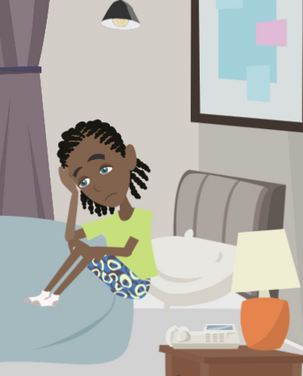
LESSON PLANS
ABUSE VS. TRAFFICKING
How is sexual abuse by a family member different from being sex trafficked by the family?
©2024-2026 Walking Wise
26
3

Slide 27
VOCABULARY
CHILD ABUSE
Any act (or failure to act) that results in harm, potential harm, or risk of harm to a child (under 18).
©2024-2026 Walking Wise
27
Notes:
Assisting Source
OpenAI. (2024). ChatGPT [Large language model]. https://chatgpt.com

Slide 28
ABUSE VS. EXPLOITATION
Forms of Child Abuse
Sexual Abuse: Sexual harm for someone’s control or gratification.
©2024-2026 Walking Wise
Joan A. Reid, Juliana Huard, & Rachael A. Haskell (2015). Family-facilitated juvenile sex trafficking, Journal of Crime and Justice.
28
Notes:
CHILD ABUSE
Child abuse refers to actions or failures to act that cause harm or risk of harm to a child. Abuse can be physical, emotional, sexual, or take the form of neglect, and it often occurs within relationships where a child depends on an adult for care or protection.
Sexual abuse involves inappropriate sexual behavior toward a child and is driven by power and control, not consent.
These forms of abuse may occur on their own or together and can happen in any type of family or community. Abuse is never the child’s fault, and many children do not disclose abuse right away due to fear, confusion, or loyalty to the abuser.
Source
Joan A. Reid, Juliana Huard & Rachael A. Haskell (2015). Family-facilitated juvenile sex trafficking, Journal of Crime and Justice, 38:3, 361-376, DOI: 10.1080/0735648X.2014.967965 https://www.tandfonline.com/eprint/ZBS7nZCXxC3VqqUaHZ3k/full

Slide 29
ABUSE VS. EXPLOITATION
Forms of Child Abuse
Sexual Abuse: Sexual harm for someone’s control or gratification.
Physical Abuse: Intentional physical harm or injury.
©2024-2026 Walking Wise
Joan A. Reid, Juliana Huard, & Rachael A. Haskell (2015). Family-facilitated juvenile sex trafficking, Journal of Crime and Justice.
29
Notes:
CHILD ABUSE
Child abuse refers to actions or failures to act that cause harm or risk of harm to a child. Abuse can be physical, emotional, sexual, or take the form of neglect, and it often occurs within relationships where a child depends on an adult for care or protection.
Sexual abuse involves inappropriate sexual behavior toward a child and is driven by power and control, not consent.
These forms of abuse may occur on their own or together and can happen in any type of family or community. Abuse is never the child’s fault, and many children do not disclose abuse right away due to fear, confusion, or loyalty to the abuser.
Source
Joan A. Reid, Juliana Huard & Rachael A. Haskell (2015). Family-facilitated juvenile sex trafficking, Journal of Crime and Justice, 38:3, 361-376, DOI: 10.1080/0735648X.2014.967965 https://www.tandfonline.com/eprint/ZBS7nZCXxC3VqqUaHZ3k/full

Slide 30
ABUSE VS. EXPLOITATION
Forms of Child Abuse
Sexual Abuse: Sexual harm for someone’s control or gratification.
Physical Abuse: Intentional physical harm or injury.
Emotional Abuse: Harming a child’s sense of safety or self-worth.
©2024-2026 Walking Wise
Joan A. Reid, Juliana Huard, & Rachael A. Haskell (2015). Family-facilitated juvenile sex trafficking, Journal of Crime and Justice.
30
Notes:
CHILD ABUSE
Child abuse refers to actions or failures to act that cause harm or risk of harm to a child. Abuse can be physical, emotional, sexual, or take the form of neglect, and it often occurs within relationships where a child depends on an adult for care or protection.
Sexual abuse involves inappropriate sexual behavior toward a child and is driven by power and control, not consent.
These forms of abuse may occur on their own or together and can happen in any type of family or community. Abuse is never the child’s fault, and many children do not disclose abuse right away due to fear, confusion, or loyalty to the abuser.
Source
Joan A. Reid, Juliana Huard & Rachael A. Haskell (2015). Family-facilitated juvenile sex trafficking, Journal of Crime and Justice, 38:3, 361-376, DOI: 10.1080/0735648X.2014.967965 https://www.tandfonline.com/eprint/ZBS7nZCXxC3VqqUaHZ3k/full

Slide 31
ABUSE VS. EXPLOITATION
Forms of Child Abuse
Sexual Abuse: Sexual harm for someone’s control or gratification.
Physical Abuse: Intentional physical harm or injury.
Emotional Abuse: Harming a child’s sense of safety or self-worth.
Neglect: An adult’s failure to provide basic needs, supervision, or protection.
©2024-2026 Walking Wise
Joan A. Reid, Juliana Huard, & Rachael A. Haskell (2015). Family-facilitated juvenile sex trafficking, Journal of Crime and Justice.
31
Notes:
CHILD ABUSE
Child abuse refers to actions or failures to act that cause harm or risk of harm to a child. Abuse can be physical, emotional, sexual, or take the form of neglect, and it often occurs within relationships where a child depends on an adult for care or protection.
Sexual abuse involves inappropriate sexual behavior toward a child and is driven by power and control, not consent.
These forms of abuse may occur on their own or together and can happen in any type of family or community. Abuse is never the child’s fault, and many children do not disclose abuse right away due to fear, confusion, or loyalty to the abuser.
Source
Joan A. Reid, Juliana Huard & Rachael A. Haskell (2015). Family-facilitated juvenile sex trafficking, Journal of Crime and Justice, 38:3, 361-376, DOI: 10.1080/0735648X.2014.967965 https://www.tandfonline.com/eprint/ZBS7nZCXxC3VqqUaHZ3k/full

Slide 32
ABUSE VS. EXPLOITATION
Forms of Child Abuse
Sexual Exploitation: Trafficking is also a form of child abuse.
©2024-2026 Walking Wise
Joan A. Reid, Juliana Huard, & Rachael A. Haskell (2015). Family-facilitated juvenile sex trafficking, Journal of Crime and Justice.
32
Notes:
CHILD ABUSE
Child abuse refers to actions or failures to act that cause harm or risk of harm to a child. Abuse can be physical, emotional, sexual, or take the form of neglect, and it often occurs within relationships where a child depends on an adult for care or protection.
Sexual abuse involves inappropriate sexual behavior toward a child and is driven by power and control, not consent.
These forms of abuse may occur on their own or together and can happen in any type of family or community. Abuse is never the child’s fault, and many children do not disclose abuse right away due to fear, confusion, or loyalty to the abuser.
Source
Joan A. Reid, Juliana Huard & Rachael A. Haskell (2015). Family-facilitated juvenile sex trafficking, Journal of Crime and Justice, 38:3, 361-376, DOI: 10.1080/0735648X.2014.967965 https://www.tandfonline.com/eprint/ZBS7nZCXxC3VqqUaHZ3k/full

Slide 33
VOCABULARY
CHILD EXPLOITATION
Involves taking advantage of a child (under 18) for personal or financial gain.
©2024-2026 Walking Wise
33
Notes:
Assisting Source
OpenAI. (2024). ChatGPT [Large language model]. https://chatgpt.com

Slide 34
VOCABULARY
CHILD SEXUAL EXPLOITATION
The use of a child for sexual acts in exchange for something of value, such as money, drugs, food, shelter, gifts, or protection.
©2024-2026 Walking Wise
34
Notes:
Assisting Source
OpenAI. (2024). ChatGPT [Large language model]. https://chatgpt.com

Slide 35
ABUSE VS. EXPLOITATION
Forms of Child Exploitation
Sex Trafficking: A child is made to engage in sexual acts in exchange for something of value.
©2024-2026 Walking Wise
35
Notes:
CHILD EXPLOITATION
Child exploitation occurs when a child is used for someone else’s benefit, profit, or advantage.
Sexual exploitation, including sex trafficking, involves exchanging a child’s sexual abuse for something of value, such as money, drugs, shelter, or protection.
Other forms of exploitation, like grooming and sextortion, rely on manipulation, threats, or coercion rather than physical force.
Exploitation often involves someone the child knows and trusts. While all exploitation is a form of abuse, exploitation involves an added element of gain for the exploiter.

Slide 36
ABUSE VS. EXPLOITATION
Forms of Child Exploitation
Grooming: An adult builds trust to manipulate or prepare a child for abuse or exploitation.
©2024-2026 Walking Wise
36
Notes:
CHILD EXPLOITATION
Child exploitation occurs when a child is used for someone else’s benefit, profit, or advantage.
Sexual exploitation, including sex trafficking, involves exchanging a child’s sexual abuse for something of value, such as money, drugs, shelter, or protection.
Other forms of exploitation, like grooming and sextortion, rely on manipulation, threats, or coercion rather than physical force.
Exploitation often involves someone the child knows and trusts. While all exploitation is a form of abuse, exploitation involves an added element of gain for the exploiter.

Slide 37
ABUSE VS. EXPLOITATION
Forms of Child Exploitation
Sextortion: Threatening or blackmailing a child to obtain sexual images, videos, or acts.
©2024-2026 Walking Wise
37
Notes:
CHILD EXPLOITATION
Child exploitation occurs when a child is used for someone else’s benefit, profit, or advantage.
Sexual exploitation, including sex trafficking, involves exchanging a child’s sexual abuse for something of value, such as money, drugs, shelter, or protection.
Other forms of exploitation, like grooming and sextortion, rely on manipulation, threats, or coercion rather than physical force.
Exploitation often involves someone the child knows and trusts. While all exploitation is a form of abuse, exploitation involves an added element of gain for the exploiter.

Slide 38
ABUSE VS. EXPLOITATION
Forms of Child Exploitation
Child Sexual Abuse Material (CSAM): Sexual images or videos of children, sometimes called child pornography.
©2024-2026 Walking Wise
38
Notes:
CHILD EXPLOITATION
Child exploitation occurs when a child is used for someone else’s benefit, profit, or advantage.
Sexual exploitation, including sex trafficking, involves exchanging a child’s sexual abuse for something of value, such as money, drugs, shelter, or protection.
Other forms of exploitation, like grooming and sextortion, rely on manipulation, threats, or coercion rather than physical force.
Exploitation often involves someone the child knows and trusts. While all exploitation is a form of abuse, exploitation involves an added element of gain for the exploiter.

Slide 39
ABUSE VS. EXPLOITATION
Forms of Child Exploitation
Child Labor: Forcing or manipulating a child to work in harmful, illegal, or unsafe conditions.
©2024-2026 Walking Wise
39
Notes:
CHILD EXPLOITATION
Child exploitation occurs when a child is used for someone else’s benefit, profit, or advantage.
Sexual exploitation, including sex trafficking, involves exchanging a child’s sexual abuse for something of value, such as money, drugs, shelter, or protection.
Other forms of exploitation, like grooming and sextortion, rely on manipulation, threats, or coercion rather than physical force.
Exploitation often involves someone the child knows and trusts. While all exploitation is a form of abuse, exploitation involves an added element of gain for the exploiter.

Slide 40
EDUCATON GUIDE
VOCABULARY
INFLUENCE
The ability to impact the actions, behavior, or opinions of others without using force or direct control.
©2024-2026 Walking Wise
40
3
Notes:
Assisting Source
OpenAI. (2024). ChatGPT [Large language model]. https://chatgpt.com

Slide 41
VOCABULARY
MIND CONTROL
When someone influences a person’s thoughts, feelings, and beliefs to control their actions.
©2024-2026 Walking Wise
41
Notes:
Assisting Source
OpenAI. (2024). ChatGPT [Large language model]. https://chatgpt.com

Slide 42
LESSON PLANS
FAMILY TRAFFICKERS
Which family member is most often involved in trafficking children within their family?
©2024-2026 Walking Wise
42
3
Notes:
Online Interactive Polling
SLIDO.com: Multiple Choice
Which family member is most often involved in trafficking children within their family?
A) Uncles
B) Fathers
C) Mothers
D) Grandparents
ANSWER
C) Mothers - Studies show that mothers are most often the family member trafficking the children.
Mothers are the most common perpetrators of familial trafficking by a wide margin (60.29%), based on 917 cases between 2018 and 2021.
Source
Allert, J. (2022). Domestic Minor Familial Sex Trafficking: A National Study of Prevalence, Characteristics, and Challenges across the Justice Process, p. 21. Institute for Shelter Care. Retrieved March 15, 2024, from https://instituteforsheltercare.org/familial/

Slide 43
ANSWER
Mothers are most often the person responsible for trafficking children within the family.
©2024-2026 Walking Wise
Allert, J. (2022). Domestic Minor Familial Sex Trafficking: A National Study of Prevalence, Characteristics, and Challenges across the Justice Process, p. 21. Institute for Shelter Care.
43
Notes:
Online Interactive Polling
SLIDO.com: Multiple Choice
Which family member is most often involved in trafficking children within their family?
A) Uncles
B) Fathers
C) Mothers
D) Grandparents
ANSWER
C) Mothers - Studies show that mothers are most often the family member trafficking the children.
Mothers are the most common perpetrators of familial trafficking by a wide margin (60.29%), based on 917 cases between 2018 and 2021.
Source
Allert, J. (2022). Domestic Minor Familial Sex Trafficking: A National Study of Prevalence, Characteristics, and Challenges across the Justice Process, p. 21. Institute for Shelter Care. Retrieved March 15, 2024, from https://instituteforsheltercare.org/familial/

Slide 44
FAMILY TRAFFICKERS
Different Family Members
No Single Profile: Children can be trafficked by many types of family members.
©2024-2026 Walking Wise
Allert, J. (2022). Domestic Minor Familial Sex Trafficking: A National Study of Prevalence, Characteristics, and Challenges across the Justice Process, p. 21. Institute for Shelter Care.
44
Notes:
FAMILY PREDATORS
Children can be trafficked by any family member, including parents, guardians, or extended relatives.
Traffickers often exploit the trust, authority, or dependence inherent in family relationships to control or manipulate a child.
Understanding that trafficking can happen within families helps clarify that exploitation is about the abuser’s actions, not the child’s family structure, and reinforces that the child is never at fault.
Source
Allert, J. (2022). Domestic Minor Familial Sex Trafficking: A National Study of Prevalence, Characteristics, and Challenges across the Justice Process, p. 15. Institute for Shelter Care. Retrieved March 15, 2024, from https://instituteforsheltercare.org/familial/

Slide 45
FAMILY TRAFFICKERS
Different Family Members
Immediate Family Members: Mothers, fathers, and siblings.
©2024-2026 Walking Wise
Allert, J. (2022). Domestic Minor Familial Sex Trafficking: A National Study of Prevalence, Characteristics, and Challenges across the Justice Process, p. 21. Institute for Shelter Care.
45
Notes:
FAMILY PREDATORS
Children can be trafficked by any family member, including parents, guardians, or extended relatives.
Traffickers often exploit the trust, authority, or dependence inherent in family relationships to control or manipulate a child.
Understanding that trafficking can happen within families helps clarify that exploitation is about the abuser’s actions, not the child’s family structure, and reinforces that the child is never at fault.
Source
Allert, J. (2022). Domestic Minor Familial Sex Trafficking: A National Study of Prevalence, Characteristics, and Challenges across the Justice Process, p. 15. Institute for Shelter Care. Retrieved March 15, 2024, from https://instituteforsheltercare.org/familial/

Slide 46
FAMILY TRAFFICKERS
Different Family Members
Caregivers & Guardians: Stepparents, adoptive parents, or foster parents.
©2024-2026 Walking Wise
Allert, J. (2022). Domestic Minor Familial Sex Trafficking: A National Study of Prevalence, Characteristics, and Challenges across the Justice Process, p. 21. Institute for Shelter Care.
46
Notes:
FAMILY PREDATORS
Children can be trafficked by any family member, including parents, guardians, or extended relatives.
Traffickers often exploit the trust, authority, or dependence inherent in family relationships to control or manipulate a child.
Understanding that trafficking can happen within families helps clarify that exploitation is about the abuser’s actions, not the child’s family structure, and reinforces that the child is never at fault.
Source
Allert, J. (2022). Domestic Minor Familial Sex Trafficking: A National Study of Prevalence, Characteristics, and Challenges across the Justice Process, p. 15. Institute for Shelter Care. Retrieved March 15, 2024, from https://instituteforsheltercare.org/familial/

Slide 47
FAMILY TRAFFICKERS
Different Family Members
Extended Family: Uncles, aunts, grandparents, stepfamily, cousins, or other relatives.
©2024-2026 Walking Wise
Allert, J. (2022). Domestic Minor Familial Sex Trafficking: A National Study of Prevalence, Characteristics, and Challenges across the Justice Process, p. 21. Institute for Shelter Care.
47
Notes:
FAMILY PREDATORS
Children can be trafficked by any family member, including parents, guardians, or extended relatives.
Traffickers often exploit the trust, authority, or dependence inherent in family relationships to control or manipulate a child.
Understanding that trafficking can happen within families helps clarify that exploitation is about the abuser’s actions, not the child’s family structure, and reinforces that the child is never at fault.
Source
Allert, J. (2022). Domestic Minor Familial Sex Trafficking: A National Study of Prevalence, Characteristics, and Challenges across the Justice Process, p. 15. Institute for Shelter Care. Retrieved March 15, 2024, from https://instituteforsheltercare.org/familial/

Slide 48
EDUCATON GUIDE
VOCABULARY
GENERATIONAL
A repeated cycle of behaviors, beliefs, or traditions passed down from parents to their children, grandchildren, and so on.
©2024-2026 Walking Wise
48
3
Notes:
Assisting Source
OpenAI. (2024). ChatGPT [Large language model]. https://chatgpt.com

Slide 49
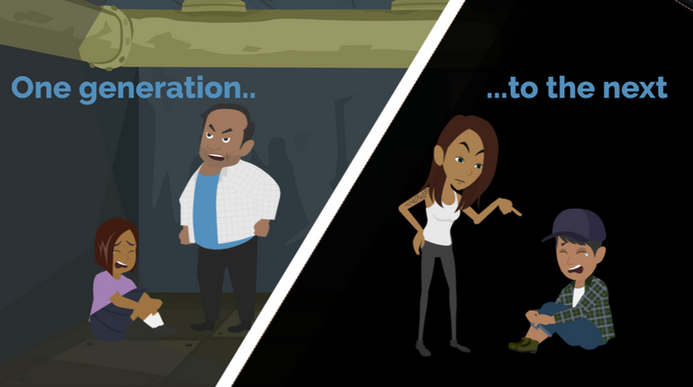
LESSON PLANS
GENERATIONAL
How does sexual exploitation continue from one generation to the next?
©2024-2026 Walking Wise
49
3

Slide 50
GENERATIONAL
Family Behavior
Family Influence: Family beliefs, attitudes, and behaviors shape what children learn to see as normal or acceptable.
©2024-2026 Walking Wise
50
Notes:
GENERATIONAL
Patterns of sexual exploitation can persist across generations when children grow up in environments where harmful behaviors are normalized or unchallenged.
Family attitudes, exposure to sexualized materials, and early experiences can influence how children understand boundaries, consent, and healthy relationships.
Recognizing these patterns helps highlight the importance of protective factors, education, and supportive adults in breaking the cycle.

Slide 51
GENERATIONAL
Family Behavior
Early Exposure: Viewing pornography or sexual activity in the home can reduce sensitivity to abusive behavior.
©2024-2026 Walking Wise
51
Notes:
GENERATIONAL
Patterns of sexual exploitation can persist across generations when children grow up in environments where harmful behaviors are normalized or unchallenged.
Family attitudes, exposure to sexualized materials, and early experiences can influence how children understand boundaries, consent, and healthy relationships.
Recognizing these patterns helps highlight the importance of protective factors, education, and supportive adults in breaking the cycle.

Slide 52
GENERATIONAL
Normalized Abuse
Early Grooming: Sexual abuse often starts when children are very young.
©2024-2026 Walking Wise
Henderson, M. F. (2022, September). Human Trafficking by Families. University of North Carolina
School of Government, Public Management Bulletin, No.24, Sog.unc.edu, pp. 4,5.
52
Notes:
GENERATIONAL
Abusers often use grooming and manipulation to make children doubt their understanding of right and wrong.
By normalizing abuse, presenting it as special treatment, or framing it as a family obligation, traffickers create confusion and fear, which can make it difficult for young people to recognize that what is happening is illegal and harmful.
This highlights the importance of teaching children about consent, healthy boundaries, and that they are never responsible for an adult’s abusive behavior.
Source
Henderson, M. F. (2022, September). Human Trafficking by Families. University of North Carolina
School of Government, Public Management Bulletin, No.24, Sog.unc.edu, pp. 4,5. Retrieved January 25, 2026, from https://www.sog.unc.edu/sites/default/files/reports/PMB%2024_Henderson.pdf

Slide 53
GENERATIONAL
Normalized Abuse
Manipulation: Some children are made to believe that these experiences are common for all young people.
©2024-2026 Walking Wise
Henderson, M. F. (2022, September). Human Trafficking by Families. University of North Carolina
School of Government, Public Management Bulletin, No.24, Sog.unc.edu, pp. 4,5.
53
Notes:
GENERATIONAL
Abusers often use grooming and manipulation to make children doubt their understanding of right and wrong.
By normalizing abuse, presenting it as special treatment, or framing it as a family obligation, traffickers create confusion and fear, which can make it difficult for young people to recognize that what is happening is illegal and harmful.
This highlights the importance of teaching children about consent, healthy boundaries, and that they are never responsible for an adult’s abusive behavior.
Source
Henderson, M. F. (2022, September). Human Trafficking by Families. University of North Carolina
School of Government, Public Management Bulletin, No.24, Sog.unc.edu, pp. 4,5. Retrieved January 25, 2026, from https://www.sog.unc.edu/sites/default/files/reports/PMB%2024_Henderson.pdf

Slide 54
GENERATIONAL
Normalized Abuse
False Privilege: They may be told they are "special" or "chosen," making the abuse seem like an honor.
©2024-2026 Walking Wise
Henderson, M. F. (2022, September). Human Trafficking by Families. University of North Carolina
School of Government, Public Management Bulletin, No.24, Sog.unc.edu, pp. 4,5.
54
Notes:
GENERATIONAL
Abusers often use grooming and manipulation to make children doubt their understanding of right and wrong.
By normalizing abuse, presenting it as special treatment, or framing it as a family obligation, traffickers create confusion and fear, which can make it difficult for young people to recognize that what is happening is illegal and harmful.
This highlights the importance of teaching children about consent, healthy boundaries, and that they are never responsible for an adult’s abusive behavior.
Source
Henderson, M. F. (2022, September). Human Trafficking by Families. University of North Carolina
School of Government, Public Management Bulletin, No.24, Sog.unc.edu, pp. 4,5. Retrieved January 25, 2026, from https://www.sog.unc.edu/sites/default/files/reports/PMB%2024_Henderson.pdf

Slide 55
GENERATIONAL
Normalized Abuse
Family Obligation: Some are led to believe it's their duty or “chore” to help support their family financially.
©2024-2026 Walking Wise
Henderson, M. F. (2022, September). Human Trafficking by Families. University of North Carolina
School of Government, Public Management Bulletin, No.24, Sog.unc.edu, pp. 4,5.
55
Notes:
GENERATIONAL
Abusers often use grooming and manipulation to make children doubt their understanding of right and wrong.
By normalizing abuse, presenting it as special treatment, or framing it as a family obligation, traffickers create confusion and fear, which can make it difficult for young people to recognize that what is happening is illegal and harmful.
This highlights the importance of teaching children about consent, healthy boundaries, and that they are never responsible for an adult’s abusive behavior.
Source
Henderson, M. F. (2022, September). Human Trafficking by Families. University of North Carolina
School of Government, Public Management Bulletin, No.24, Sog.unc.edu, pp. 4,5. Retrieved January 25, 2026, from https://www.sog.unc.edu/sites/default/files/reports/PMB%2024_Henderson.pdf

Slide 56
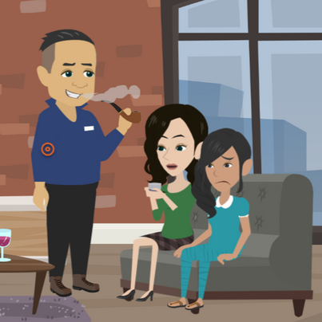
LESSON PLANS
MIND CONTROL
What tactics might family members use to make a child cooperate with their demands?
©2024-2026 Walking Wise
56
3

Slide 57
MIND CONTROL
Misused Authority
Authority Figure: Children are taught to trust and obey parents and caregivers, even when the treatment feels wrong or unsafe.
Henderson, M. F. (2022). Human trafficking by families (Public Management Bulletin No. 24). School of Government, University of North Carolina at Chapel Hill.
Allert, J. (2022). Domestic Minor Familial Sex Trafficking: A National Study of Prevalence, Characteristics, and Challenges across the Justice Process, p. 21. Institute for Shelter Care
57
©2024-2026 Walking Wise
Notes:
FAMILY AUTHORITY
Children have a natural tendency to trust, obey, and remain loyal to their parents and caregivers, even when those adults cause harm.
Many trafficked children fear punishment, rejection, or being removed from the family if they do not comply with demands.
Loyalty to family members, combined with dependence on them for food, shelter, and emotional support, can make it difficult for children to recognize exploitation or seek help.
In some cases, children may also believe that other family members will protect or defend the trafficker, increasing feelings of isolation and fear. These dynamics help explain why abuse and trafficking within families often remain hidden.
Source
Henderson, M. F. (2022). Human trafficking by families (Public Management Bulletin No. 24). School of Government, University of North Carolina at Chapel Hill. Retrieved January 25, 2026, from https://www.sog.unc.edu/sites/default/files/reports/PMB%2024_Henderson.pdf
Allert, J. (2022). Domestic Minor Familial Sex Trafficking: A National Study of Prevalence, Characteristics, and Challenges across the Justice Process, p. 21. Institute for Shelter Care. Retrieved March 15, 2024, from https://instituteforsheltercare.org/familial/

Slide 58
MIND CONTROL
Misused Authority
Threats & Fear: Family members may use threats and punishment to enforce obedience.
Henderson, M. F. (2022). Human trafficking by families (Public Management Bulletin No. 24). School of Government, University of North Carolina at Chapel Hill.
Allert, J. (2022). Domestic Minor Familial Sex Trafficking: A National Study of Prevalence, Characteristics, and Challenges across the Justice Process, p. 21. Institute for Shelter Care
58
©2024-2026 Walking Wise
Notes:
FAMILY AUTHORITY
Children have a natural tendency to trust, obey, and remain loyal to their parents and caregivers, even when those adults cause harm.
Many trafficked children fear punishment, rejection, or being removed from the family if they do not comply with demands.
Loyalty to family members, combined with dependence on them for food, shelter, and emotional support, can make it difficult for children to recognize exploitation or seek help.
In some cases, children may also believe that other family members will protect or defend the trafficker, increasing feelings of isolation and fear. These dynamics help explain why abuse and trafficking within families often remain hidden.
Source
Henderson, M. F. (2022). Human trafficking by families (Public Management Bulletin No. 24). School of Government, University of North Carolina at Chapel Hill. Retrieved January 25, 2026, from https://www.sog.unc.edu/sites/default/files/reports/PMB%2024_Henderson.pdf
Allert, J. (2022). Domestic Minor Familial Sex Trafficking: A National Study of Prevalence, Characteristics, and Challenges across the Justice Process, p. 21. Institute for Shelter Care. Retrieved March 15, 2024, from https://instituteforsheltercare.org/familial/

Slide 59
MIND CONTROL
Misused Authority
Loss of Family: Children may fear rejection by other family members or being kicked out of their home.
Henderson, M. F. (2022). Human trafficking by families (Public Management Bulletin No. 24). School of Government, University of North Carolina at Chapel Hill.
Allert, J. (2022). Domestic Minor Familial Sex Trafficking: A National Study of Prevalence, Characteristics, and Challenges across the Justice Process, p. 21. Institute for Shelter Care
59
©2024-2026 Walking Wise
Notes:
FAMILY AUTHORITY
Children have a natural tendency to trust, obey, and remain loyal to their parents and caregivers, even when those adults cause harm.
Many trafficked children fear punishment, rejection, or being removed from the family if they do not comply with demands.
Loyalty to family members, combined with dependence on them for food, shelter, and emotional support, can make it difficult for children to recognize exploitation or seek help.
In some cases, children may also believe that other family members will protect or defend the trafficker, increasing feelings of isolation and fear. These dynamics help explain why abuse and trafficking within families often remain hidden.
Source
Henderson, M. F. (2022). Human trafficking by families (Public Management Bulletin No. 24). School of Government, University of North Carolina at Chapel Hill. Retrieved January 25, 2026, from https://www.sog.unc.edu/sites/default/files/reports/PMB%2024_Henderson.pdf
Allert, J. (2022). Domestic Minor Familial Sex Trafficking: A National Study of Prevalence, Characteristics, and Challenges across the Justice Process, p. 21. Institute for Shelter Care. Retrieved March 15, 2024, from https://instituteforsheltercare.org/familial/

Slide 60
MIND CONTROL
Use of Substances
Forced Use: Family traffickers may give drugs or alcohol to children without their knowledge or force substance use.
Henderson, M. F. (2022). Human trafficking by families (Public Management Bulletin No. 24). School of Government, University of North Carolina at Chapel Hill.
Allert, J. (2022). Domestic Minor Familial Sex Trafficking: A National Study of Prevalence, Characteristics, and Challenges across the Justice Process, p. 21. Institute for Shelter Care
60
©2024-2026 Walking Wise
Notes:
SUBSTANCE USE
Substances are often used as a tool of control in sexual exploitation.
Family traffickers may expose children to drugs or alcohol to create dependence, reduce resistance, or impair judgment. Over time, addiction can deepen control, especially when access to substances is tied to obedience or cooperation.
This manipulation increases fear and dependence and makes it harder for victims to recognize abuse or seek help. Substance use in these situations is a result of exploitation, not a choice by the child.
Source
Henderson, M. F. (2022). Human trafficking by families (Public Management Bulletin No. 24). School of Government, University of North Carolina at Chapel Hill. Retrieved January 25, 2026, from https://www.sog.unc.edu/sites/default/files/reports/PMB%2024_Henderson.pdf
Allert, J. (2022). Domestic Minor Familial Sex Trafficking: A National Study of Prevalence, Characteristics, and Challenges across the Justice Process, p. 21. Institute for Shelter Care. Retrieved March 15, 2024, from https://instituteforsheltercare.org/familial/

Slide 61
MIND CONTROL
Use of Substances
Lowered Awareness: Substances can make a child feel relaxed, numb, confused, or less able to remember what happened.
Henderson, M. F. (2022). Human trafficking by families (Public Management Bulletin No. 24). School of Government, University of North Carolina at Chapel Hill.
Allert, J. (2022). Domestic Minor Familial Sex Trafficking: A National Study of Prevalence, Characteristics, and Challenges across the Justice Process, p. 21. Institute for Shelter Care
61
©2024-2026 Walking Wise
Notes:
SUBSTANCE USE
Substances are often used as a tool of control in sexual exploitation.
Family traffickers may expose children to drugs or alcohol to create dependence, reduce resistance, or impair judgment. Over time, addiction can deepen control, especially when access to substances is tied to obedience or cooperation.
This manipulation increases fear and dependence and makes it harder for victims to recognize abuse or seek help. Substance use in these situations is a result of exploitation, not a choice by the child.
Source
Henderson, M. F. (2022). Human trafficking by families (Public Management Bulletin No. 24). School of Government, University of North Carolina at Chapel Hill. Retrieved January 25, 2026, from https://www.sog.unc.edu/sites/default/files/reports/PMB%2024_Henderson.pdf
Allert, J. (2022). Domestic Minor Familial Sex Trafficking: A National Study of Prevalence, Characteristics, and Challenges across the Justice Process, p. 21. Institute for Shelter Care. Retrieved March 15, 2024, from https://instituteforsheltercare.org/familial/

Slide 62
MIND CONTROL
Use of Substances
Withdrawal: Substances may be withheld to cause painful withdrawal symptoms and then given as reward for cooperating.
Henderson, M. F. (2022). Human trafficking by families (Public Management Bulletin No. 24). School of Government, University of North Carolina at Chapel Hill.
Allert, J. (2022). Domestic Minor Familial Sex Trafficking: A National Study of Prevalence, Characteristics, and Challenges across the Justice Process, p. 21. Institute for Shelter Care
62
©2024-2026 Walking Wise
Notes:
SUBSTANCE USE
Substances are often used as a tool of control in sexual exploitation.
Family traffickers may expose children to drugs or alcohol to create dependence, reduce resistance, or impair judgment. Over time, addiction can deepen control, especially when access to substances is tied to obedience or cooperation.
This manipulation increases fear and dependence and makes it harder for victims to recognize abuse or seek help. Substance use in these situations is a result of exploitation, not a choice by the child.
Source
Henderson, M. F. (2022). Human trafficking by families (Public Management Bulletin No. 24). School of Government, University of North Carolina at Chapel Hill. Retrieved January 25, 2026, from https://www.sog.unc.edu/sites/default/files/reports/PMB%2024_Henderson.pdf
Allert, J. (2022). Domestic Minor Familial Sex Trafficking: A National Study of Prevalence, Characteristics, and Challenges across the Justice Process, p. 21. Institute for Shelter Care. Retrieved March 15, 2024, from https://instituteforsheltercare.org/familial/

Slide 63
UNREPORTED CRIME
What are the ways family traffickers or abusers get away with their crimes against children?
©2024-2026 Walking Wise
63
Notes:
Online Interactive Polling
SLIDO.com: Open Text
What are the ways family traffickers or abusers get away with their crimes against children?
POSSIBLE ANSWERS
• Parent or Caregiver Authority
• Threatens Harm
• Seems Normal
• Isolates Victim
• Conrol using Drugs & Alcohol

Slide 64
ANSWER
Reasons for Unreported Crime
• Parent or Caregiver Authority
• Threatens Harm
• Seems Normal
• Isolates Victim
• Control using Drugs & Alcohol
Henderson, M. F. (2022). Human trafficking by families (Public Management Bulletin No. 24). School of Government, University of North Carolina at Chapel Hill.
Allert, J. (2022). Domestic Minor Familial Sex Trafficking: A National Study of Prevalence, Characteristics, and Challenges across the Justice Process, p. 21. Institute for Shelter Care
64
©2024-2026 Walking Wise
Notes:
Online Interactive Polling
SLIDO.com: Open Text
What are the ways family traffickers or abusers get away with their crimes against children?
POSSIBLE ANSWERS
• Parent or Caregiver Authority
• Threatens Harm
• Seems Normal
• Isolates Victim
• Control using Drugs & Alcohol

Slide 65
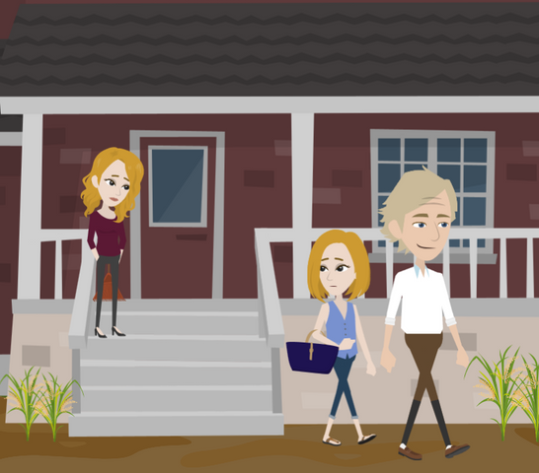
LESSON PLANS
PRESSURING PARENTS
Why might a parent feel pressured into exploiting their children?
©2024-2026 Walking Wise
65
3

Slide 66
PRESSURING PARENTS
High-Risk Situations
Financial Harship: Experiencing deep poverty or a sudden financial crisis, making a caregiver feel desperate.
©2024-2026 Walking Wise
Kinnish, K., Barba, A., Blacker, D., Dierkhising, C., Garrett, R., Grady, J.B., Greenbaum, V.J., Griffin, D., Rubiales, R., Spring, G., Wozniak, J., and Child Sex Trafficking Collaborative Group. (2021). Child sex trafficking: Who is vulnerable to being trafficked? Los Angeles, CA, and Durham, NC: National Center for Child Traumatic Stress.
66
Notes:
HIGH RISK SITUATIONS
Research shows that poverty, lack of stable housing, and financial desperation are key risk factors that traffickers target to gain control and influence harmful behaviors, including exploitation of children.
Families under extreme financial pressure or facing housing instability may feel desperate, and debt pressure or coercion by drug traffickers can further reduce a caregiver’s ability to make safe choices for their children.
Source
Kinnish, K., Barba, A., Blacker, D., Dierkhising, C., Garrett, R., Grady, J.B., Greenbaum, V.J., Griffin, D., Rubiales, R., Spring, G., Wozniak, J., and Child Sex Trafficking Collaborative Group. (2021). Child sex trafficking: Who is vulnerable to being trafficked? Los Angeles, CA, and Durham, NC: National Center for Child Traumatic Stress. Retrieved January 25, 2026, from https://www.nctsn.org/sites/default/files/resources/fact-sheet/child_sex_trafficking_who_is_vulnerable_to_being_trafficked.pdf?utm_source=chatgpt.com

Slide 67
PRESSURING PARENTS
High-Risk Situations
Housing Instability: Facing eviction, homelessness, or inability to pay rent increases vulnerability.
©2024-2026 Walking Wise
Kinnish, K., Barba, A., Blacker, D., Dierkhising, C., Garrett, R., Grady, J.B., Greenbaum, V.J., Griffin, D., Rubiales, R., Spring, G., Wozniak, J., and Child Sex Trafficking Collaborative Group. (2021). Child sex trafficking: Who is vulnerable to being trafficked? Los Angeles, CA, and Durham, NC: National Center for Child Traumatic Stress.
67
Notes:
HIGH RISK SITUATIONS
Research shows that poverty, lack of stable housing, and financial desperation are key risk factors that traffickers target to gain control and influence harmful behaviors, including exploitation of children.
Families under extreme financial pressure or facing housing instability may feel desperate, and debt pressure or coercion by drug traffickers can further reduce a caregiver’s ability to make safe choices for their children.
Source
Kinnish, K., Barba, A., Blacker, D., Dierkhising, C., Garrett, R., Grady, J.B., Greenbaum, V.J., Griffin, D., Rubiales, R., Spring, G., Wozniak, J., and Child Sex Trafficking Collaborative Group. (2021). Child sex trafficking: Who is vulnerable to being trafficked? Los Angeles, CA, and Durham, NC: National Center for Child Traumatic Stress. Retrieved January 25, 2026, from https://www.nctsn.org/sites/default/files/resources/fact-sheet/child_sex_trafficking_who_is_vulnerable_to_being_trafficked.pdf?utm_source=chatgpt.com

Slide 68
PRESSURING PARENTS
High-Risk Situations
Inadequate Supervision: Leaving children unsupervised or vulnerable to those likely to sexually exploit them.
©2024-2026 Walking Wise
Kinnish, K., Barba, A., Blacker, D., Dierkhising, C., Garrett, R., Grady, J.B., Greenbaum, V.J., Griffin, D., Rubiales, R., Spring, G., Wozniak, J., and Child Sex Trafficking Collaborative Group. (2021). Child sex trafficking: Who is vulnerable to being trafficked? Los Angeles, CA, and Durham, NC: National Center for Child Traumatic Stress.
68
Notes:
HIGH RISK SITUATIONS
Research shows that poverty, lack of stable housing, and financial desperation are key risk factors that traffickers target to gain control and influence harmful behaviors, including exploitation of children.
Families under extreme financial pressure or facing housing instability may feel desperate, and debt pressure or coercion by drug traffickers can further reduce a caregiver’s ability to make safe choices for their children.
Source
Kinnish, K., Barba, A., Blacker, D., Dierkhising, C., Garrett, R., Grady, J.B., Greenbaum, V.J., Griffin, D., Rubiales, R., Spring, G., Wozniak, J., and Child Sex Trafficking Collaborative Group. (2021). Child sex trafficking: Who is vulnerable to being trafficked? Los Angeles, CA, and Durham, NC: National Center for Child Traumatic Stress. Retrieved January 25, 2026, from https://www.nctsn.org/sites/default/files/resources/fact-sheet/child_sex_trafficking_who_is_vulnerable_to_being_trafficked.pdf?utm_source=chatgpt.com

Slide 69
PRESSURING PARENTS
High-Risk Situations
Coerced: Parents controlled by a trafficker or gang members may be forced to involve their children.
©2024-2026 Walking Wise
Kinnish, K., Barba, A., Blacker, D., Dierkhising, C., Garrett, R., Grady, J.B., Greenbaum, V.J., Griffin, D., Rubiales, R., Spring, G., Wozniak, J., and Child Sex Trafficking Collaborative Group. (2021). Child sex trafficking: Who is vulnerable to being trafficked? Los Angeles, CA, and Durham, NC: National Center for Child Traumatic Stress.
69
Notes:
HIGH RISK SITUATIONS
Research shows that poverty, lack of stable housing, and financial desperation are key risk factors that traffickers target to gain control and influence harmful behaviors, including exploitation of children.
Families under extreme financial pressure or facing housing instability may feel desperate, and debt pressure or coercion by drug traffickers can further reduce a caregiver’s ability to make safe choices for their children.
Source
Kinnish, K., Barba, A., Blacker, D., Dierkhising, C., Garrett, R., Grady, J.B., Greenbaum, V.J., Griffin, D., Rubiales, R., Spring, G., Wozniak, J., and Child Sex Trafficking Collaborative Group. (2021). Child sex trafficking: Who is vulnerable to being trafficked? Los Angeles, CA, and Durham, NC: National Center for Child Traumatic Stress. Retrieved January 25, 2026, from https://www.nctsn.org/sites/default/files/resources/fact-sheet/child_sex_trafficking_who_is_vulnerable_to_being_trafficked.pdf?utm_source=chatgpt.com

Slide 70
LESSON PLANS
REPORTING CRIME
Who is most likely to report suspected sex trafficking of a child to police?
©2024-2026 Walking Wise
70
3
Notes:
Online Interactive Polling
Slido.com: Multiple Choice
Who is most likely to report suspected sex trafficking of a child to police?
A) Community Members
B) Family Members
C) School Staff Members
D) Medical Staff Members
ANSWER
A) Community Members
"[Familial trafficking] cases are more likely to be reported by anonymous community members rather than by professionals who work with vulnerable populations (such as teachers, health care providers, social workers, law enforcement officers)."
Source
Henderson, M. F. (2022, September). Human Trafficking by Families. University of North Carolina School of Government, Public Management Bulletin, No.24, Sog.unc.edu, p. 12. Retrieved March 3, 2024, from https://www.sog.unc.edu/sites/default/files/reports/PMB%2024_Henderson.pdf

Slide 71
ANSWER
Community members are most likely to report suspicions of child sex trafficking to police.
©2024-2026 Walking Wise
Emily E. Edwards, Jennifer S. Middleton, & Jennifer Cole, “Family-Controlled Trafficking in the United States: Victim Characteristics, System Response, and Case Outcomes,” Journal of Human Trafficking, p. 12.
71
Notes:
Online Interactive Polling
Slido.com: Multiple Choice
Who is most likely to report suspected sex trafficking of a child to police?
A) Community Members
B) Family Members
C) School Staff Members
D) Medical Staff Members
ANSWER
A) Community Members
"[Familial trafficking] cases are more likely to be reported by anonymous community members rather than by professionals who work with vulnerable populations (such as teachers, health care providers, social workers, law enforcement officers)."[1]
Source
1. Henderson, M. F. (2022, September). Human Trafficking by Families. University of North Carolina School of Government, Public Management Bulletin, No.24, Sog.unc.edu, p. 12. Retrieved March 3, 2024, from https://www.sog.unc.edu/sites/default/files/reports/PMB%2024_Henderson.pdf
Emily E. Edwards, Jennifer S. Middleton, & Jennifer Cole, “Family-Controlled Trafficking in the United States: Victim Characteristics, System Response, and Case Outcomes,” Journal of Human Trafficking, p. 12. Retrieved January 25, 2026, from https://doi.org/10.1080/23322705.2022.2039866

Slide 72
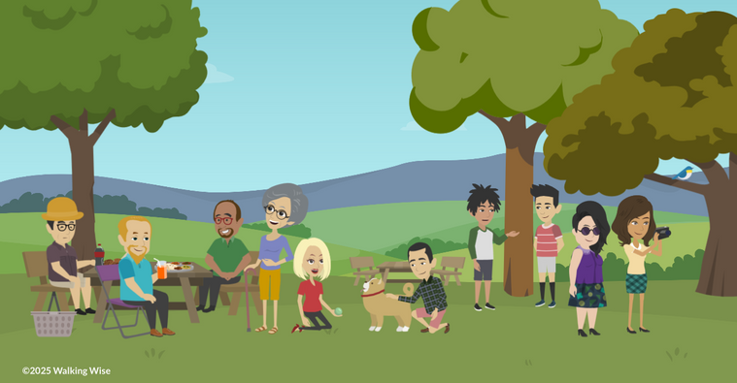
PROTECTIVE FACTORS
What are examples of living in a healthy family environment that helps protect children from predators?
©2024-2026 Walking Wise
72

Slide 73
PROTECTIVE FACTORS
What Helps Keep Children Safe
Reliable Adults: Surrounded by trustworthy, supportive adults.
©2024-2026 Walking Wise
73
Notes:
PROTECTIVE FACTORS
Protective factors are positive conditions in individuals, families, and communities that reduce risk and build resilience against adverse experiences like trafficking.
While protective factors can lower risk, their absence does not mean harm will occur, and their presence does not guarantee safety—exploitation can happen in any family structure.
• TRUSTWORTHY ADULTS
Sexual predators are less likely to prey upon youth who have a trusted adult to guide them.
• STRONG RELATIONSHIPS
Building strong relationships with trustworthy family members, friends, and community members can offer children a sense of belonging and support.
• ECONOMIC STABILITY
Financial stability can allow individuals to achieve their goals and provide for themselves, reducing their vulnerability to groomers and traffickers.

Slide 74
PROTECTIVE FACTORS
What Helps Keep Children Safe
Relationships: Building strong, healthy relationships with protective family and peers.
©2024-2026 Walking Wise
74
Notes:
PROTECTIVE FACTORS
Protective factors are positive conditions in individuals, families, and communities that reduce risk and build resilience against adverse experiences like trafficking.
While protective factors can lower risk, their absence does not mean harm will occur, and their presence does not guarantee safety—exploitation can happen in any family structure.
• TRUSTWORTHY ADULTS
Sexual predators are less likely to prey upon youth who have a trusted adult to guide them.
• STRONG RELATIONSHIPS
Building strong relationships with trustworthy family members, friends, and community members can offer children a sense of belonging and support.
• ECONOMIC STABILITY
Financial stability can allow individuals to achieve their goals and provide for themselves, reducing their vulnerability to groomers and traffickers.

Slide 75
PROTECTIVE FACTORS
What Helps Keep Children Safe
Household: Living in a home with stable routines and basic financial security.
©2024-2026 Walking Wise
75
Notes:
PROTECTIVE FACTORS
Protective factors are positive conditions in individuals, families, and communities that reduce risk and build resilience against adverse experiences like trafficking.
While protective factors can lower risk, their absence does not mean harm will occur, and their presence does not guarantee safety—exploitation can happen in any family structure.
• TRUSTWORTHY ADULTS
Sexual predators are less likely to prey upon youth who have a trusted adult to guide them.
• STRONG RELATIONSHIPS
Building strong relationships with trustworthy family members, friends, and community members can offer children a sense of belonging and support.
• ECONOMIC STABILITY
Financial stability can allow individuals to achieve their goals and provide for themselves, reducing their vulnerability to groomers and traffickers.

Slide 76
PROTECTIVE FACTORS
What Helps Keep Children Safe
Good Health: Experiences physical and emotional well-being.
©2024-2026 Walking Wise
76
Notes:
PROTECTIVE FACTORS
Protective factors are positive conditions in individuals, families, and communities that reduce risk and build resilience against adverse experiences like trafficking.
While protective factors can lower risk, their absence does not mean harm will occur, and their presence does not guarantee safety—exploitation can happen in any family structure.
• WELL-BEING
Access to healthcare and mental health services can help individuals receive the support they need to lead a more secure life.
• EDUCATION
Access to education provides youth with the learning tools they need to develop a social and emotional skill set that can undermine traffickers' manipulative efforts.
• AWARENESS
Knowledge is often a powerful defense against sexual predators because awareness helps young people understand the warning signs of potentially dangerous situations.

Slide 77
PROTECTIVE FACTORS
What Helps Keep Children Safe
School: Encouraged to learn, grow, and succeed academically.
©2024-2026 Walking Wise
77
Notes:
PROTECTIVE FACTORS
Protective factors are positive conditions in individuals, families, and communities that reduce risk and build resilience against adverse experiences like trafficking.
While protective factors can lower risk, their absence does not mean harm will occur, and their presence does not guarantee safety—exploitation can happen in any family structure.
• WELL-BEING
Access to healthcare and mental health services can help individuals receive the support they need to lead a more secure life.
• EDUCATION
Access to education provides youth with the learning tools they need to develop a social and emotional skill set that can undermine traffickers' manipulative efforts.
• AWARENESS
Knowledge is often a powerful defense against sexual predators because awareness helps young people understand the warning signs of potentially dangerous situations.

Slide 78
PROTECTIVE FACTORS
What Helps Keep Children Safe
Safety: Aware of the signs of unsafe or manipulative situations.
©2024-2026 Walking Wise
78
Notes:
PROTECTIVE FACTORS
Protective factors are positive conditions in individuals, families, and communities that reduce risk and build resilience against adverse experiences like trafficking.
While protective factors can lower risk, their absence does not mean harm will occur, and their presence does not guarantee safety—exploitation can happen in any family structure.
• WELL-BEING
Access to healthcare and mental health services can help individuals receive the support they need to lead a more secure life.
• EDUCATION
Access to education provides youth with the learning tools they need to develop a social and emotional skill set that can undermine traffickers' manipulative efforts.
• AWARENESS
Knowledge is often a powerful defense against sexual predators because awareness helps young people understand the warning signs of potentially dangerous situations.

Slide 79
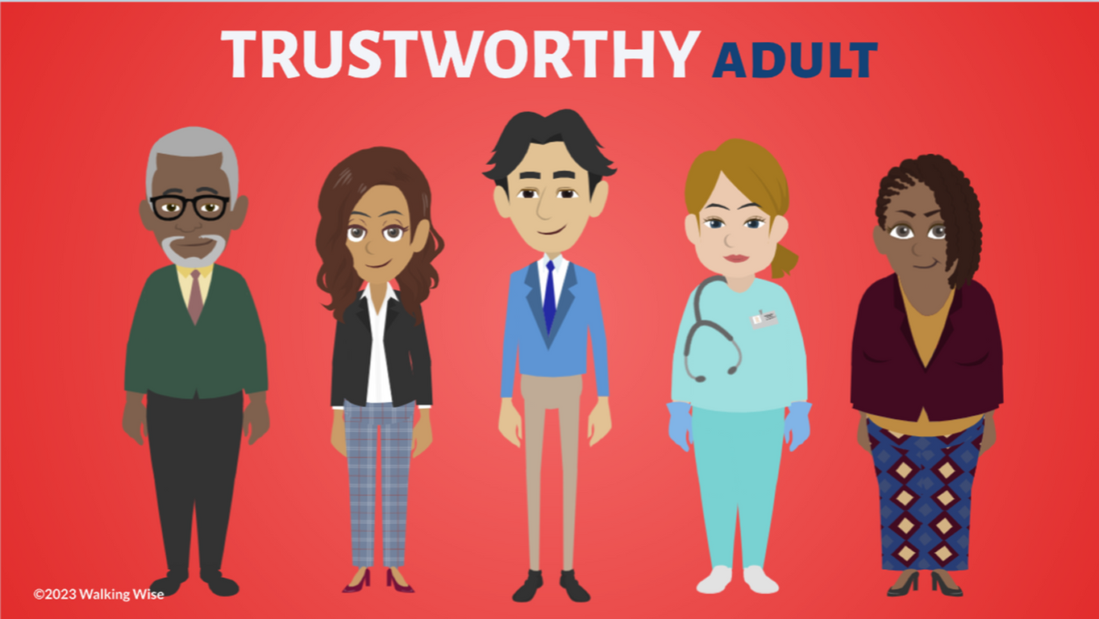
ASK FOR HELP
©2024-2026 Walking Wise
79

Slide 80

ASK FOR HELP
What are ways young people can ask for help?
©2024-2026 Walking Wise
80

Slide 81
ASK FOR HELP
How to Ask for Help
If you are in immediate danger, dial 911.
©2024-2026 Walking Wise
81

Slide 82
ASK FOR HELP
How to Ask for Help
If you are in immediate danger, dial 911.
If the sexual predator IS a family member, consider telling a trustworthy adult.
©2024-2026 Walking Wise
82

Slide 83
ASK FOR HELP
How to Ask for Help
If you are in immediate danger, dial 911.
If the sexual predator IS a family member, consider telling a trustworthy adult.
If the sexual predator is NOT family, consider telling a parent.
©2024-2026 Walking Wise
83

Slide 84
ASK FOR HELP
How to Ask for Help
If you are in immediate danger, dial 911.
If the sexual predator IS a family member, consider telling a trustworthy adult.
If the sexual predator is NOT family, consider telling a parent.
If you are a student in school, consider telling a trustworthy teacher, coach, school nurse, social worker, counselor, resource officer, or principal.
©2024-2026 Walking Wise
84

Slide 85
ASK FOR HELP
How to Ask for Help
If you are in immediate danger, dial 911.
If the sexual predator IS a family member, consider telling a trustworthy adult.
If the sexual predator is NOT family, consider telling a parent.
If you are a student in school, consider telling a trustworthy teacher, coach, school nurse, social worker, counselor, resource officer, or principal.
To gain internet access for help, consider using a computer at your school or a public library.
©2024-2026 Walking Wise
85

Slide 86
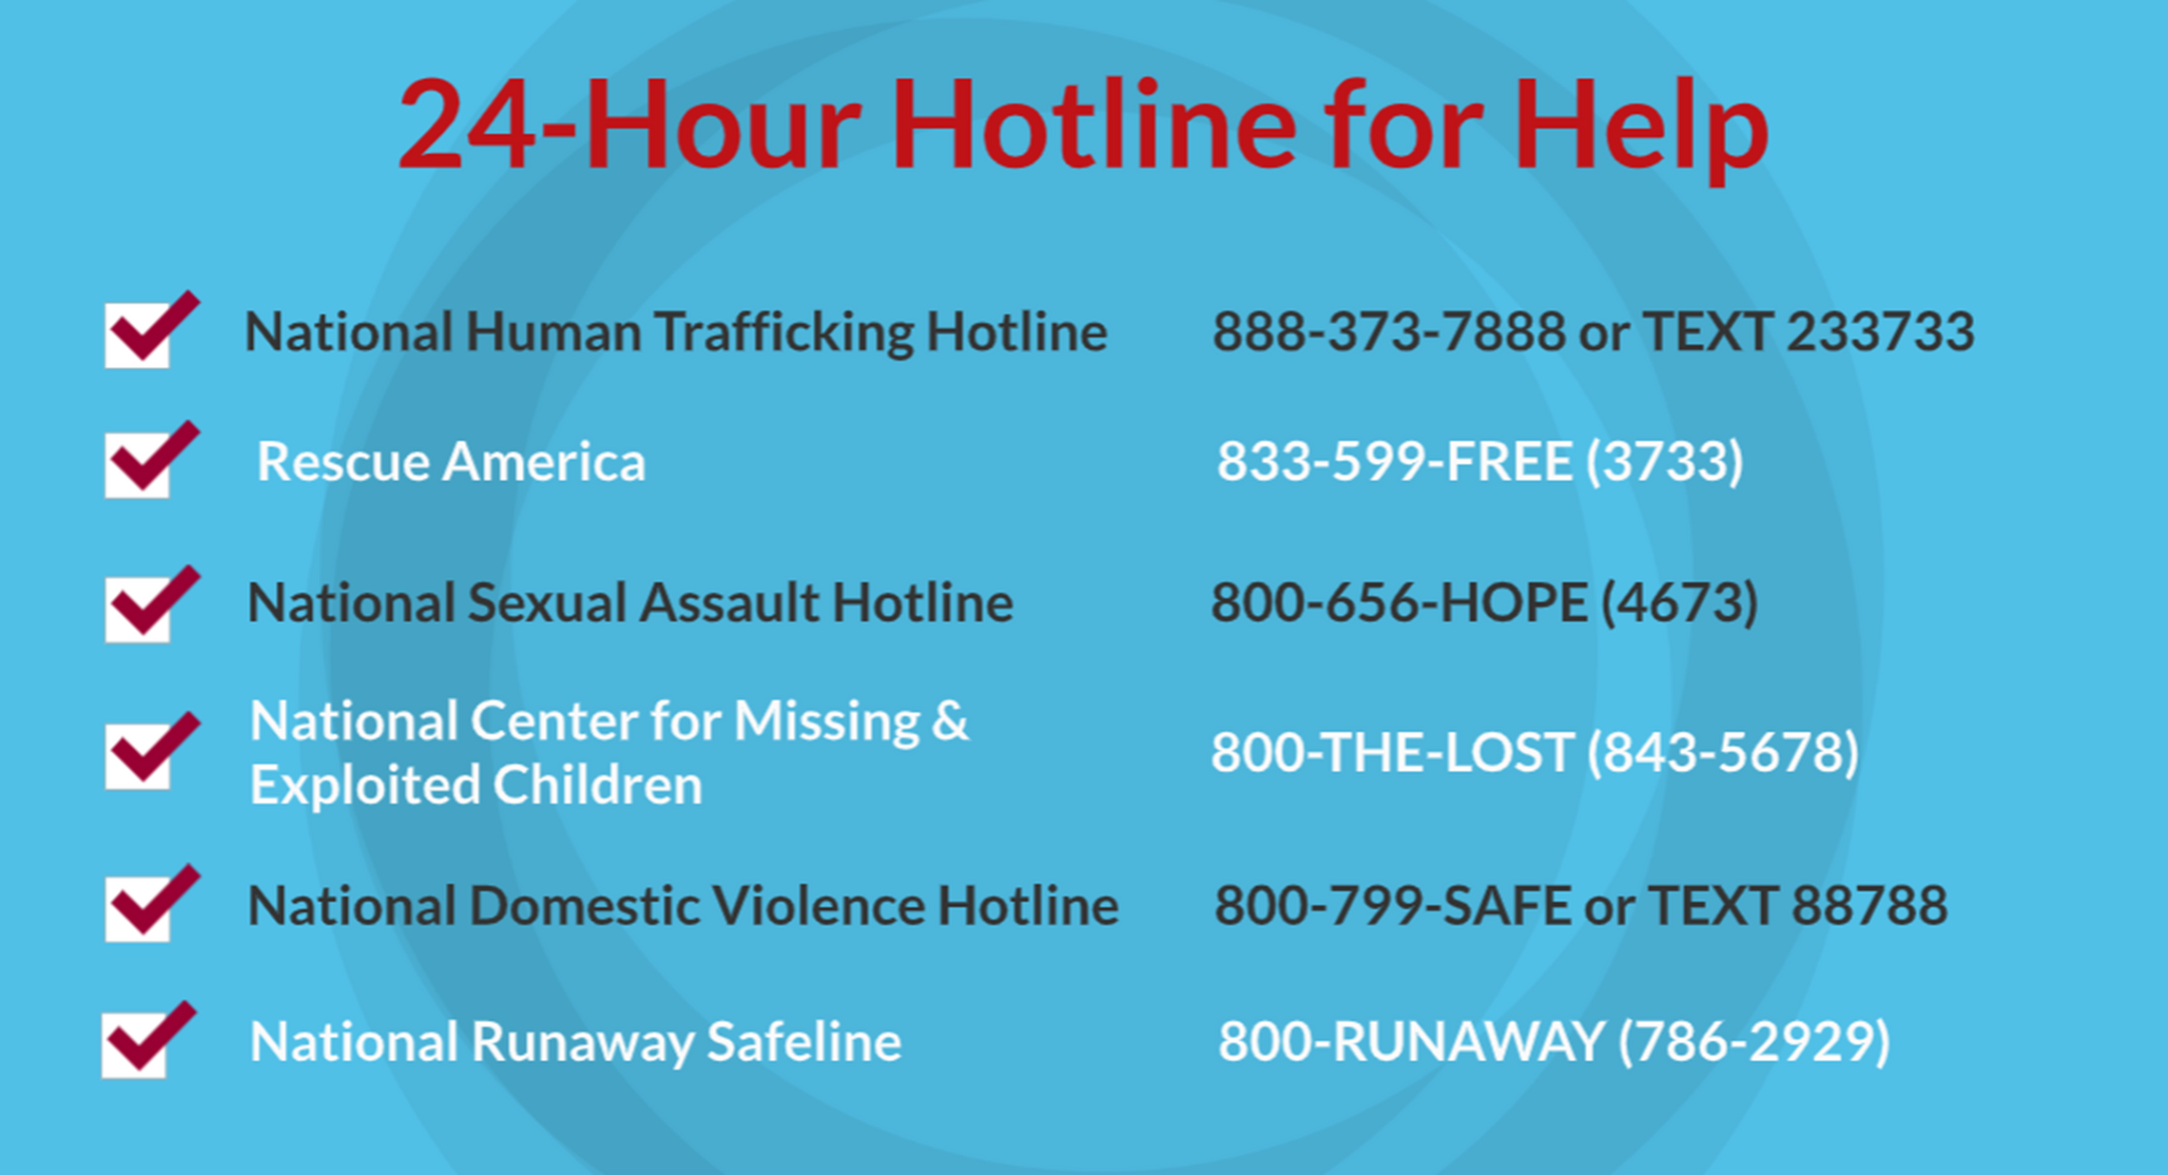
©2024-2026 Walking Wise
86
Notes:
NOTE
Presenters may ask their audience to consider adding a few "hotline for help" phone numbers in their cell phone contacts or take a photo of this slide.

Slide 87
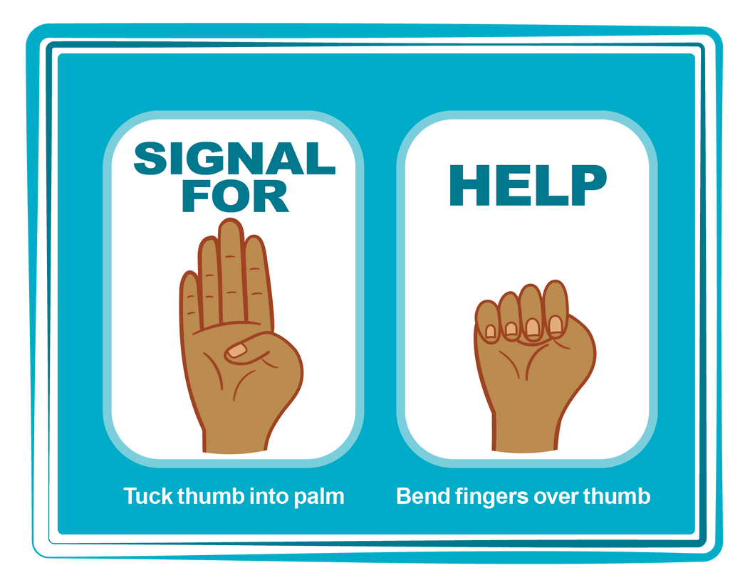
HAND SIGNAL FOR HELP
©2024-2026 Walking Wise
Source: Canadian Women’s Foundation, April 2020
87
Notes:
Although the hand signal for help has not yet achieved universal recognition, it may discreetly get someone's attention in urgent situations.
• SILENT
It can be used silently.
• UNTRACKABLE
It leaves no digital footprint.
• CONCEALED
It can be done secretly when a perpetrator is in the vicinity.
• SIGNALS DISTRESS
Combining the hand signal with distressed facial expressions might help attract the attention of an individual who is unfamiliar with the signal's meaning.
Source
Canadian Women's Foundation, April 2020

Slide 88
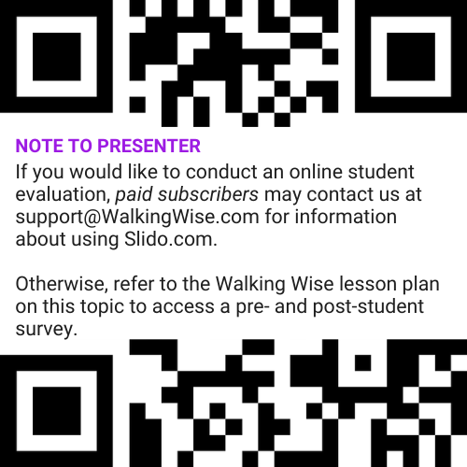
EVALUATION
©2024-2026 Walking Wise
88
Notes:
Two ways to conduct a pre-/post-student evaluation:
1) Use the pre/post survey in the Walking Wise lesson plan for this topic.
2) Activate Slido.com to conduct an online survey.

Slide 89

SHARE YOUR THOUGHTS
1. How would you rate this lesson?
2. What was the one thing you liked?
3. What one thing should we improve?
If using Slido: Replace “#XXXX” with your organization’s custom Slido code.
©2024-2026 Walking Wise
89
Notes:
Online Interactive Polling
SLIDO.com: 3-Question Survey
IF SLIDO IS ACTIVATED:
Follow the instructions provided on WalkingWise.com to access your school or organization's custom Slido QR code and #code, which the audience will use to complete the 3-question evaluation.
Please encourage your audience to scan your organization's custom QR code to share what they enjoyed and what could be improved about the lesson.
Please send any feedback you want to share to Walking Wise at support@WalkingWise.com.

Slide 90


Thank you!
WalkingWise.com
Online Course for Adults Accredited by:
Postgraduate Institue for Medicine
Academy of Forensic Nursing
©2024-2026 Walking Wise
90
Notes:
NOTE
To access additional resources about familial trafficking, please refer to the last page of Lesson Plan #11 in the Walking Wise Education Guide.
We welcome your feedback at support@WalkingWise.com.
Thank you!
Karla Highman
Founder, WalkingWise.com

