Slide 1
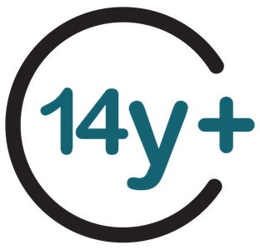
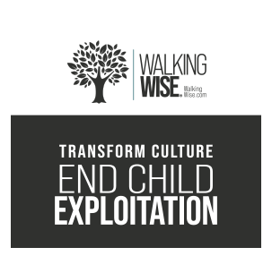
SEXUAL EXPLOITATION
EDUCATION
family
SECRET
BY WALKING WISE
Presentation Updated: May 8, 2026
Notes:
NOTE TO PRESENTER
Log in to WalkingWise.com and refer to the Implementation Toolkit for classroom teaching tips.
Most importantly:
DEFINE SCHOOL POLICY
Establish a sexual exploitation reporting protocol with a trauma-informed response. The Walking Wise Implementation Toolkit provides a sample protocol.
AGE & AUDIENCE
This presentation can be edited by following the procedures on page 3 to align with your school policies, specific age groups, and the involvement of at-risk audiences.
SUPPORT PROCEDURE
Provide your students with guidance on how to access immediate help or arrange a private meeting with a social worker, counselor, nurse, school resource officer, or another trustworthy staff member to report concerns about themselves or a peer.
SECOND SAFE ADULT
Ensure a second trustworthy adult, such as a teacher, is present in the learning setting to observe student reactions and identify those who may benefit from a follow-up meeting. This person should remain focused and free from other duties during the presentation.

Slide 2

5-Year Track
NOTE TO PRESENTER
Meaningful learning takes time. By introducing topics gradually over several years, educators can create steady growth in awareness and understanding.
Our recommended teaching plan offers a long-term path for middle and high school students to build knowledge and confidence.
PARENTS & STAFF
#1 Myths & Reality
6th GRADE
#2 Trustworthy vs. Unsafe Adult
#3 Grooming Process
7th GRADE
#4 Pornography Link
#5 Sextortion Scheme
8th GRADE
#6 Male Victims
#7 Runaways as Targets
#8 Rural Risks
9th GRADE
#9 Human Traffickers
#10 Female & Peer Recruiters
10th GRADE
#11 Family Secret
$12 Hidden Buyers
©2024-2026 Walking Wise
2

Slide 3
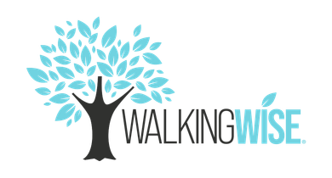
NOTE TO PRESENTER
This presentation is exclusively for Walking Wise® subscribers and not for redistribution.
Presenters are encouraged to edit speaker notes to match their speaking style (viewable in presentation mode). You can also delete slides and content from this Walking Wise presentation to ensure the information aligns with your school policies, is age-appropriate, and fits within available class time. However, the slides are copyright-protected and may not be reworded without prior written permission from Walking Wise.
We encourage you to add your own content by following these instructions:
  Insert new PowerPoint slides.
  Remove the Walking Wise logo and copyright "©2026 Walking Wise" from the new slides.
  Always add your organization's name or logo to each new slide.
Please delete this instruction page before presenting to audiences.
©2024-2026 Walking Wise
3
Notes:
NOTE TO PRESENTER
The presenter is welcome to customize this Walking Wise presentation according to the instructions provided on this page.
For revision requests, please email us at: support@WalkingWise.com.

Slide 4
SENSITIVE TOPICS WILL BE DISCUSSED
CONTENT NOTICE
We’ll be discussing serious safety issues today.
Some topics may be difficult to hear.
If you ever feel uncomfortable, you can step out and speak with a trustworthy adult for support.
You’re not alone—help is available.
©2024-2026 Walking Wise
4
Notes:
NOTE TO PRESENTER
Trauma-Informed Delivery Guidelines
To support a safe and effective learning environment, please follow these guidelines:
• Present the information in a calm, matter-of-fact way and avoid sensational or alarming language.
• Avoid graphic details. Focus on helping students understand behaviors, risk, and ways to stay safe.
• Never blame victims. Responsibility always belongs to the person who caused harm.
• Maintain a steady, composed tone. Students often mirror the presenter's emotional cues.
• Do not ask students to share personal experiences or disclosures.
• If students laugh or react awkwardly, respond neutrally and gently redirect the focus.
• Pair all risk information with needed resources, practical solutions, and support options.
• Reinforce that students are not alone and that trustworthy adults are available to help.

Slide 5
STATISTICS
Why Study Results Can Vary
  Some crimes are never reported, making it hard to reveal the entire issue.
  Studies collect information in different ways, leading to different results.
  Small studies may not represent everyone.
©2024-2026 Walking Wise
5
Notes:
In this presentation, we'll discuss statistics, but it's important to note that while statistics provide valuable insights into an issue, they cannot be relied upon entirely.
Here are a few reasons:
UNREPORTED
Victims often do not report the crimes committed against them due to fear, shame, retaliation, or manipulation. Also, many don’t realize that what is happening to them is a crime.
INCONSISTENT COLLECTION
Areas may define sexual crimes in various ways or use different methods to collect data, making it hard to compare information.
FOCUS GROUPS
Small or specific focus groups participating in a study or survey may not accurately reflect the diversity or experiences of the broader population.

Slide 6

WHY LEARN ABOUT THIS
KNOWLEDGE serves as a
powerful defense against
sexual predators.
©2024-2026 Walking Wise
6
Notes:
Education is one of the strongest tools for preventing exploitation.
When young people understand how predators operate, they are better able to recognize manipulation and avoid dangerous situations.
Reinforce that awareness increases safety.

Slide 7
PREVENTION EDUCATION
SEXUAL EXPLOITATION includes grooming, sextortion, pornography
& sex trafficking.
©2024-2026 Walking Wise
7
Notes:
SEXUAL EXPLOITATION
Taking advantage of another person for their own benefit, especially in a sexual way, often using pressure, tricks, or control.
Below are different forms of exploitation:
GROOMING
Building trust, dependency, or an emotional connection to manipulate someone.
SEXTORTION
Threatening to share embarrassing or sexual images, videos, or information to pressure someone into following demands.
PORNOGRAPHY
Involving someone in creating sexual images who is under 18, or someone who is pressured, or unable/unwilling to give consent.
SEX TRAFFICKING
Manipulating or forcing someone into sexual activity in exchange for money or something of value.
Trafficking and Violence Protection Act (TVPA) of 2000 (Legal Definition):
SEX TRAFFICKING is the recruitment, harboring, transportation, provision, obtaining, patronizing, or soliciting of a person under the age of 18 for the purpose of a commercial sex act.
TVPA link: Retrieved April 14, 2026, from https://www.govinfo.gov/content/pkg/BILLS-106hr3244enr/pdf/BILLS-106hr3244enr.pdf

Slide 8
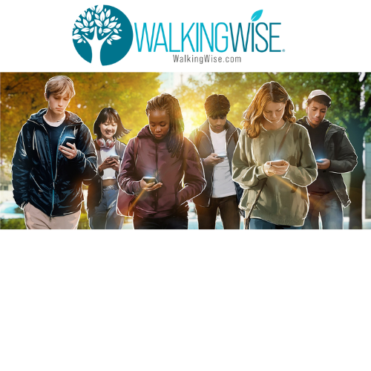



EDUCATON GUIDE
VOCABULARY
Words to Understand
  Family Secret
  Mind Control
  Generational
  Influence
  Predator
  Family Trafficker
  Child Abuse
  Child Exploitation
©2024-2026 Walking Wise
8
3
Notes:
Understanding vocabulary terms related to the behaviors of sexual predators can empower young people to recognize warning signs of harmful situations.
Knowing these terms helps them identify manipulative tactics that unsafe people (predators/traffickers) use to build trust and exploit vulnerabilities.
With this knowledge, young people are better equipped to spot red flags, understand that these behaviors are abusive, and feel more confident reporting predators to trusted adults or authorities, potentially preventing further harm.

Slide 9
EDUCATON GUIDE
VOCABULARY
FAMILY SECRET
When family members are told to keep information hidden from others.
This can include situations involving harm, unsafe behavior, or illegal activity.
©2024-2026 Walking Wise
9
3

Slide 10
EDUCATON GUIDE
VOCABULARY
PREDATOR
A person who abuses, manipulates, or takes advantage of others for personal gain or control.
©2024-2026 Walking Wise
10
3

Slide 11
VOCABULARY
SEX TRAFFICKING
To force (violence), fraud (trick/lies), or coerce (pressure) someone into sexual activity in exchange for money or something of value;
or to give someone sexual access to a child (under 18) for something of value.
©2024-2026 Walking Wise
11

Slide 12
EDUCATON GUIDE
VOCABULARY
FAMILY TRAFFICKER
When a family member or caregiver allows or arranges for others to have sexual access to the family’s child/teen in exchange for something of value, such as money, drugs, or housing.
Referred to as a familial trafficker
©2024-2026 Walking Wise
12
3

Slide 13
LESSON PLANS
WHAT DO YOU THINK?
What family member can be involved in trafficking a child within their family?
©2024-2026 Walking Wise
13
3

Slide 14
WHAT DO YOU THINK?
What family member can be involved in trafficking a child within their family?
A) Uncles
B) Fathers
C) Mothers
D) Grandparents
©2024-2026 Walking Wise
14

Slide 15
ANSWER
Many different types of family members can be involved in trafficking children in their family.
©2024-2026 Walking Wise
Allert, J. (2022). Domestic Minor Familial Sex Trafficking: A National Study of Prevalence, Characteristics, and Challenges across the Justice Process, p. 21. Institute for Shelter Care.
15
Notes:
Most family members are safe and caring.
However, in cases where trafficking does occur within a family, there is no single type of person responsible.
The key takeaway is that unsafe situations are not limited to one type of family member.
Source
Allert, J. (2022). Domestic Minor Familial Sex Trafficking: A National Study of Prevalence, Characteristics, and Challenges across the Justice Process, p. 21. Institute for Shelter Care. Retrieved March 15, 2024, from https://instituteforsheltercare.org/familial/

Slide 16
FAMILY TRAFFICKERS
Traffickers can be Any Family Member
  Immediate Family Members: Mothers, fathers, and siblings
©2024-2026 Walking Wise
Allert, J. (2022). Domestic Minor Familial Sex Trafficking: A National Study of Prevalence, Characteristics, and Challenges across the Justice Process, p. 21. Institute for Shelter Care.
16
Notes:
FAMILY TRAFFICKERS
Research shows that trafficking within families can involve a wide range of individuals, including parents or guardians, siblings, and extended family members.
In these situations, traffickers often take advantage of the trust, authority, or dependence that naturally exists in family relationships to control or manipulate a child.
Understanding this helps clarify that exploitation is based on the actions of the offender, not the child’s family structure, and reinforces that the child is never at fault.
Source
Allert, J. (2022). Domestic Minor Familial Sex Trafficking: A National Study of Prevalence, Characteristics, and Challenges across the Justice Process, p. 15. Institute for Shelter Care. Retrieved March 15, 2024, from https://instituteforsheltercare.org/familial/

Slide 17
FAMILY TRAFFICKERS
Traffickers can be Any Family Member
  Immediate Family Members: Mothers, fathers, and siblings
  Caregivers & Guardians: Stepparents, adoptive parents, or foster parents
©2024-2026 Walking Wise
Allert, J. (2022). Domestic Minor Familial Sex Trafficking: A National Study of Prevalence, Characteristics, and Challenges across the Justice Process, p. 21. Institute for Shelter Care.
17
Notes:
FAMILY TRAFFICKERS
Research shows that trafficking within families can involve a wide range of individuals, including parents or guardians, siblings, and extended family members.
In these situations, traffickers often take advantage of the trust, authority, or dependence that naturally exists in family relationships to control or manipulate a child.
Understanding this helps clarify that exploitation is based on the actions of the offender, not the child’s family structure, and reinforces that the child is never at fault.
Source
Allert, J. (2022). Domestic Minor Familial Sex Trafficking: A National Study of Prevalence, Characteristics, and Challenges across the Justice Process, p. 15. Institute for Shelter Care. Retrieved March 15, 2024, from https://instituteforsheltercare.org/familial/

Slide 18
FAMILY TRAFFICKERS
Traffickers can be Any Family Member
  Immediate Family Members: Mothers, fathers, and siblings
  Caregivers & Guardians: Stepparents, adoptive parents, or foster parents
  Extended Family: Uncles, aunts, grandparents, stepfamily, cousins, or other relatives
©2024-2026 Walking Wise
Allert, J. (2022). Domestic Minor Familial Sex Trafficking: A National Study of Prevalence, Characteristics, and Challenges across the Justice Process, p. 21. Institute for Shelter Care.
18
Notes:
FAMILY TRAFFICKERS
Research shows that trafficking within families can involve a wide range of individuals, including parents or guardians, siblings, and extended family members.
In these situations, traffickers often take advantage of the trust, authority, or dependence that naturally exists in family relationships to control or manipulate a child.
Understanding this helps clarify that exploitation is based on the actions of the offender, not the child’s family structure, and reinforces that the child is never at fault.
Source
Allert, J. (2022). Domestic Minor Familial Sex Trafficking: A National Study of Prevalence, Characteristics, and Challenges across the Justice Process, p. 15. Institute for Shelter Care. Retrieved March 15, 2024, from https://instituteforsheltercare.org/familial/

Slide 19

family secret
by walking wise
Log in to WalkingWise.com to access this animated video.
©2024-2026 Walking Wise
19
Notes:
This 3-minute Walking Wise animated video series teaches how sexual predators use manipulation, intimidation, and coercion to exploit young people.
NOTE
Log in to Walking Wise.com to watch the three-minute animated video with audiences.
Is animation appropriate for teens?
Yes, even businesses worldwide use explainer-style animation as a training tool for their employees.

Slide 20
LESSON PLANS
WHAT DO YOU THINK?
About what percentage of victims are recruited or trafficked by a family member?
©2024-2026 Walking Wise
20
3

Slide 21
ANSWER
About one-third (33%) of victims are recruited or trafficked by a member of their own family.
n=10,500
©2024-2026 Walking Wise
Polaris. (2022). 2021 U.S. national human trafficking hotline statistics. Polaris Project.
21
Notes:
Human trafficking is often underreported because it is hidden, and trafficking within families can be even more difficult to identify.
Data from the National Human Trafficking Hotline shows that in cases where the recruiter was known, about one-third, or 33%, involved a family member.
This helps us understand that while not all cases involve family, a significant number do.
Source
Polaris. (2022). 2021 U.S. National Human Trafficking Hotline statistics. Polaris Project. Retrieved April 30, 2026, from https://polarisproject.org/2021-us-national-human-trafficking-hotline-statistics/

Slide 22
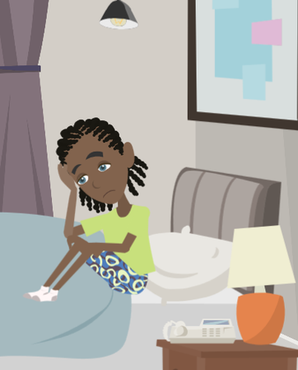
LESSON PLANS
ABUSE VS. EXPLOITATION
How is child abuse different from child exploitation?
©2024-2026 Walking Wise
22
3

Slide 23
VOCABULARY
CHILD ABUSE
Any act (or failure to act) that causes harm, potential harm, or risk of harm to a child under 18, including physical, emotional, or sexual abuse or neglect.
©2024-2026 Walking Wise
23

Slide 24
VOCABULARY
CHILD EXPLOITATION
Taking advantage of a child (under 18) in an unfair or harmful way for personal gain, often by using power, trust, or a child’s vulnerability.
©2024-2026 Walking Wise
24

Slide 25
ABUSE VS. EXPLOITATION
Forms of Child Abuse
  Sexual Abuse: Inappropriate sexual behavior toward a child
©2024-2026 Walking Wise
Joan A. Reid, Juliana Huard, & Rachael A. Haskell (2015). Family-facilitated juvenile sex trafficking, Journal of Crime and Justice.
25
Notes:
CHILD ABUSE
Child abuse includes actions—or a failure to act—that cause harm or risk of harm to a child. This can include physical, emotional, or sexual abuse, as well as neglect.
Abuse can be carried out by an adult or, in some cases, by another young person, such as a peer or an acquaintance.
Sexual abuse involves inappropriate sexual behavior toward a child and is based on power and control. A child cannot give legal or informed consent to sexual activity, which is why any sexual behavior involving a child is considered abuse.
Exploitation, including labor or sex trafficking, is also a form of child abuse because it involves taking advantage of a child for personal gain.
These forms of abuse can happen in any type of family or community, and a child is never responsible for the harm done to them.
Source
Joan A. Reid, Juliana Huard & Rachael A. Haskell (2015). Family-facilitated juvenile sex trafficking, Journal of Crime and Justice, 38:3, 361-376, DOI: 10.1080/0735648X.2014.967965 https://www.tandfonline.com/eprint/ZBS7nZCXxC3VqqUaHZ3k/full

Slide 26
ABUSE VS. EXPLOITATION
Forms of Child Abuse
  Sexual Abuse: Inappropriate sexual behavior toward a child
  Physical Abuse: Intentional physical harm or injury
©2024-2026 Walking Wise
Joan A. Reid, Juliana Huard, & Rachael A. Haskell (2015). Family-facilitated juvenile sex trafficking, Journal of Crime and Justice.
26
Notes:
CHILD ABUSE
Child abuse includes actions—or a failure to act—that cause harm or risk of harm to a child. This can include physical, emotional, or sexual abuse, as well as neglect.
Abuse can be carried out by an adult or, in some cases, by another young person, such as a peer or an acquaintance.
Sexual abuse involves inappropriate sexual behavior toward a child and is based on power and control. A child cannot give legal or informed consent to sexual activity, which is why any sexual behavior involving a child is considered abuse.
Exploitation, including labor or sex trafficking, is also a form of child abuse because it involves taking advantage of a child for personal gain.
These forms of abuse can happen in any type of family or community, and a child is never responsible for the harm done to them.
Source
Joan A. Reid, Juliana Huard & Rachael A. Haskell (2015). Family-facilitated juvenile sex trafficking, Journal of Crime and Justice, 38:3, 361-376, DOI: 10.1080/0735648X.2014.967965 https://www.tandfonline.com/eprint/ZBS7nZCXxC3VqqUaHZ3k/full

Slide 27
ABUSE VS. EXPLOITATION
Forms of Child Abuse
  Sexual Abuse: Inappropriate sexual behavior toward a child
  Physical Abuse: Intentional physical harm or injury
  Emotional Abuse: Harming a child’s sense of safety or self-worth
©2024-2026 Walking Wise
Joan A. Reid, Juliana Huard, & Rachael A. Haskell (2015). Family-facilitated juvenile sex trafficking, Journal of Crime and Justice.
27
Notes:
CHILD ABUSE
Child abuse includes actions—or a failure to act—that cause harm or risk of harm to a child. This can include physical, emotional, or sexual abuse, as well as neglect.
Abuse can be carried out by an adult or, in some cases, by another young person, such as a peer or an acquaintance.
Sexual abuse involves inappropriate sexual behavior toward a child and is based on power and control. A child cannot give legal or informed consent to sexual activity, which is why any sexual behavior involving a child is considered abuse.
Exploitation, including labor or sex trafficking, is also a form of child abuse because it involves taking advantage of a child for personal gain.
These forms of abuse can happen in any type of family or community, and a child is never responsible for the harm done to them.
Source
Joan A. Reid, Juliana Huard & Rachael A. Haskell (2015). Family-facilitated juvenile sex trafficking, Journal of Crime and Justice, 38:3, 361-376, DOI: 10.1080/0735648X.2014.967965 https://www.tandfonline.com/eprint/ZBS7nZCXxC3VqqUaHZ3k/full

Slide 28
ABUSE VS. EXPLOITATION
Forms of Child Abuse
  Sexual Abuse: Inappropriate sexual behavior toward a child
  Physical Abuse: Intentional physical harm or injury
  Emotional Abuse: Harming a child’s sense of safety or self-worth
  Neglect: Failure to provide basic needs, supervision, or protection
©2024-2026 Walking Wise
Joan A. Reid, Juliana Huard, & Rachael A. Haskell (2015). Family-facilitated juvenile sex trafficking, Journal of Crime and Justice.
28
Notes:
CHILD ABUSE
Child abuse includes actions—or a failure to act—that cause harm or risk of harm to a child. This can include physical, emotional, or sexual abuse, as well as neglect.
Abuse can be carried out by an adult or, in some cases, by another young person, such as a peer or an acquaintance.
Sexual abuse involves inappropriate sexual behavior toward a child and is based on power and control. A child cannot give legal or informed consent to sexual activity, which is why any sexual behavior involving a child is considered abuse.
Exploitation, including labor or sex trafficking, is also a form of child abuse because it involves taking advantage of a child for personal gain.
These forms of abuse can happen in any type of family or community, and a child is never responsible for the harm done to them.
Source
Joan A. Reid, Juliana Huard & Rachael A. Haskell (2015). Family-facilitated juvenile sex trafficking, Journal of Crime and Justice, 38:3, 361-376, DOI: 10.1080/0735648X.2014.967965 https://www.tandfonline.com/eprint/ZBS7nZCXxC3VqqUaHZ3k/full

Slide 29
ABUSE VS. EXPLOITATION
Forms of Child Abuse
  Sexual Abuse: Inappropriate sexual behavior toward a child
  Physical Abuse: Intentional physical harm or injury
  Emotional Abuse: Harming a child’s sense of safety or self-worth
  Neglect: Failure to provide basic needs, supervision, or protection
  Exploitation: Taking advantage of a child for gain or profit
©2024-2026 Walking Wise
Joan A. Reid, Juliana Huard, & Rachael A. Haskell (2015). Family-facilitated juvenile sex trafficking, Journal of Crime and Justice.
29
Notes:
CHILD ABUSE
Child abuse includes actions—or a failure to act—that cause harm or risk of harm to a child. This can include physical, emotional, or sexual abuse, as well as neglect.
Abuse can be carried out by an adult or, in some cases, by another young person, such as a peer or an acquaintance.
Sexual abuse involves inappropriate sexual behavior toward a child and is based on power and control. A child cannot give legal or informed consent to sexual activity, which is why any sexual behavior involving a child is considered abuse.
Exploitation, including labor or sex trafficking, is also a form of child abuse because it involves taking advantage of a child for personal gain.
These forms of abuse can happen in any type of family or community, and a child is never responsible for the harm done to them.
Source
Joan A. Reid, Juliana Huard & Rachael A. Haskell (2015). Family-facilitated juvenile sex trafficking, Journal of Crime and Justice, 38:3, 361-376, DOI: 10.1080/0735648X.2014.967965 https://www.tandfonline.com/eprint/ZBS7nZCXxC3VqqUaHZ3k/full

Slide 30
ABUSE VS. EXPLOITATION
Forms of Child Exploitation
Grooming: An adult or peer builds trust to manipulate or prepare a child for sexual abuse or trafficking.
©2024-2026 Walking Wise
National Center for Missing & Exploited Children. (n.d.). Child sexual exploitation and prevention resources.
30
Notes:
CHILD EXPLOITATION
Child exploitation occurs when a child is used for someone else’s benefit, profit, or advantage. This includes sexual exploitation, where abuse is exchanged for something of value, such as money, drugs, housing, or protection.
Exploitation often involves manipulation rather than physical force. For example, grooming involves building trust to prepare a child for harm, and sextortion involves threats or blackmail to gain sexual images or control.
Child sexual abuse material, or CSAM—also known as child pornography—refers to sexual images or videos of a child. CSAM is considered exploitation because the child is being used for someone else’s benefit, whether that is financial gain, control, or the sharing of images with others.
Exploitation often involves someone the child knows and trusts, and it is important to remember that all exploitation is abuse, but exploitation also includes an added element of gain for the offender.
Source
National Center for Missing & Exploited Children. (n.d.). Child sexual exploitation and prevention resources. Retrieved May 2, 2026, from https://www.missingkids.org/theissues

Slide 31
ABUSE VS. EXPLOITATION
Forms of Child Exploitation
Sextortion: Threatening or blackmailing a child to obtain sexual images, videos, or sexual activity.
©2024-2026 Walking Wise
National Center for Missing & Exploited Children. (n.d.). Child sexual exploitation and prevention resources.
31
Notes:
CHILD EXPLOITATION
Child exploitation occurs when a child is used for someone else’s benefit, profit, or advantage. This includes sexual exploitation, where abuse is exchanged for something of value, such as money, drugs, housing, or protection.
Exploitation often involves manipulation rather than physical force. For example, grooming involves building trust to prepare a child for harm, and sextortion involves threats or blackmail to gain sexual images or control.
Child sexual abuse material, or CSAM—also known as child pornography—refers to sexual images or videos of a child. CSAM is considered exploitation because the child is being used for someone else’s benefit, whether that is financial gain, control, or the sharing of images with others.
Exploitation often involves someone the child knows and trusts, and it is important to remember that all exploitation is abuse, but exploitation also includes an added element of gain for the offender.
Source
National Center for Missing & Exploited Children. (n.d.). Child sexual exploitation and prevention resources. Retrieved May 2, 2026, from https://www.missingkids.org/theissues

Slide 32
ABUSE VS. EXPLOITATION
Forms of Child Exploitation
Child Sexual Abuse Material (CSAM): Creating or sharing sexual images or videos of a child (aka: child pornography).
©2024-2026 Walking Wise
National Center for Missing & Exploited Children. (n.d.). Child sexual exploitation and prevention resources.
32
Notes:
CHILD EXPLOITATION
Child exploitation occurs when a child is used for someone else’s benefit, profit, or advantage. This includes sexual exploitation, where abuse is exchanged for something of value, such as money, drugs, housing, or protection.
Exploitation often involves manipulation rather than physical force. For example, grooming involves building trust to prepare a child for harm, and sextortion involves threats or blackmail to gain sexual images or control.
Child sexual abuse material, or CSAM—also known as child pornography—refers to sexual images or videos of a child. CSAM is considered exploitation because the child is being used for someone else’s benefit, whether that is financial gain, control, or the sharing of images with others.
Exploitation often involves someone the child knows and trusts, and it is important to remember that all exploitation is abuse, but exploitation also includes an added element of gain for the offender.
Source
National Center for Missing & Exploited Children. (n.d.). Child sexual exploitation and prevention resources. Retrieved May 2, 2026, from https://www.missingkids.org/theissues

Slide 33
ABUSE VS. EXPLOITATION
Forms of Child Exploitation
Sex Trafficking: Involving a child in sexual activity in exchange for something of value.
©2024-2026 Walking Wise
National Center for Missing & Exploited Children. (n.d.). Child sexual exploitation and prevention resources.
33
Notes:
CHILD EXPLOITATION
Child exploitation occurs when a child is used for someone else’s benefit, profit, or advantage. This includes sexual exploitation, where abuse is exchanged for something of value, such as money, drugs, housing, or protection.
Exploitation often involves manipulation rather than physical force. For example, grooming involves building trust to prepare a child for harm, and sextortion involves threats or blackmail to gain sexual images or control.
Child sexual abuse material, or CSAM—also known as child pornography—refers to sexual images or videos of a child. CSAM is considered exploitation because the child is being used for someone else’s benefit, whether that is financial gain, control, or the sharing of images with others.
Exploitation often involves someone the child knows and trusts, and it is important to remember that all exploitation is abuse, but exploitation also includes an added element of gain for the offender.
Source
National Center for Missing & Exploited Children. (n.d.). Child sexual exploitation and prevention resources. Retrieved May 2, 2026, from https://www.missingkids.org/theissues

Slide 34
ABUSE VS. EXPLOITATION
Forms of Child Exploitation
Child Labor: Forcing or manipulating a child to work in harmful or unsafe conditions.
©2024-2026 Walking Wise
National Center for Missing & Exploited Children. (n.d.). Child sexual exploitation and prevention resources.
34
Notes:
CHILD EXPLOITATION
Child exploitation occurs when a child is used for someone else’s benefit, profit, or advantage. This includes sexual exploitation, where abuse is exchanged for something of value, such as money, drugs, housing, or protection.
Exploitation often involves manipulation rather than physical force. For example, grooming involves building trust to prepare a child for harm, and sextortion involves threats or blackmail to gain sexual images or control.
Child sexual abuse material, or CSAM—also known as child pornography—refers to sexual images or videos of a child. CSAM is considered exploitation because the child is being used for someone else’s benefit, whether that is financial gain, control, or the sharing of images with others.
Exploitation often involves someone the child knows and trusts, and it is important to remember that all exploitation is abuse, but exploitation also includes an added element of gain for the offender.
Source
National Center for Missing & Exploited Children. (n.d.). Child sexual exploitation and prevention resources. Retrieved May 2, 2026, from https://www.missingkids.org/theissues

Slide 35
EDUCATON GUIDE
VOCABULARY
INFLUENCE
The ability to affect someone’s thoughts, decisions, or actions without using force or direct control.
©2024-2026 Walking Wise
35
3

Slide 36

LESSON PLANS
EXTERNAL PRESSURE
Who might pressure or influence some family members to exploit their child?
©2024-2026 Walking Wise
36
3

Slide 37
EXTERNAL PRESSURE
Who Can Influence Harmful Decisions
Traffickers: Family members under the control of a trafficker may be pressured to involve their child in harmful situations.
  Kinnish, K., Barba, A., Blacker, D., Dierkhising, C., Garrett, R., Grady, J.B., Greenbaum, V.J., Griffin, D., Rubiales, R., Spring, G., Wozniak, J., and Child Sex Trafficking Collaborative Group. (2021). Child sex trafficking: Who is vulnerable to being trafficked? Los Angeles, CA, and Durham, NC: National Center for Child Traumatic Stress.
  Henderson, M. F. (2022). Human trafficking by families (Public Management Bulletin No. 24). University of North Carolina School of Government.
©2024-2026 Walking Wise
37
Notes:
HIGH RISK SITUATIONS
In some cases, parents or caregivers may experience pressure or influence from others, including individuals involved in criminal activity.
Research shows that factors such as financial stress, housing instability, and substance misuse can increase vulnerability and make it easier for others to influence harmful decisions. This pressure may involve manipulation, threats, or debt.
While these circumstances can increase risk, there is never a valid reason to exploit a child, and responsibility always remains with the person causing harm.
Source
Kinnish, K., Barba, A., Blacker, D., Dierkhising, C., Garrett, R., Grady, J.B., Greenbaum, V.J., Griffin, D., Rubiales, R., Spring, G., Wozniak, J., and Child Sex Trafficking Collaborative Group. (2021). Child sex trafficking: Who is vulnerable to being trafficked? Los Angeles, CA, and Durham, NC: National Center for Child Traumatic Stress. Retrieved January 25, 2026, from https://www.nctsn.org/sites/default/files/resources/fact-sheet/child_sex_trafficking_who_is_vulnerable_to_being_trafficked.pdf?utm_source=chatgpt.com
Henderson, M. F. (2022). Human trafficking by families (Public Management Bulletin No. 24). University of North Carolina School of Government. Retrieved May 4, 2026, from https://www.sog.unc.edu/sites/default/files/reports/PMB%2024_Henderson.pdf

Slide 38
EXTERNAL PRESSURE
Who Can Influence Harmful Decisions
Gangs: Involvement in gangs may create pressure through threats or expectations to engage children in illegal activity.
  Kinnish, K., Barba, A., Blacker, D., Dierkhising, C., Garrett, R., Grady, J.B., Greenbaum, V.J., Griffin, D., Rubiales, R., Spring, G., Wozniak, J., and Child Sex Trafficking Collaborative Group. (2021). Child sex trafficking: Who is vulnerable to being trafficked? Los Angeles, CA, and Durham, NC: National Center for Child Traumatic Stress.
  Henderson, M. F. (2022). Human trafficking by families (Public Management Bulletin No. 24). University of North Carolina School of Government.
©2024-2026 Walking Wise
38
Notes:
HIGH RISK SITUATIONS
In some cases, parents or caregivers may experience pressure or influence from others, including individuals involved in criminal activity.
Research shows that factors such as financial stress, housing instability, and substance misuse can increase vulnerability and make it easier for others to influence harmful decisions. This pressure may involve manipulation, threats, or debt.
While these circumstances can increase risk, there is never a valid reason to exploit a child, and responsibility always remains with the person causing harm.
Source
Kinnish, K., Barba, A., Blacker, D., Dierkhising, C., Garrett, R., Grady, J.B., Greenbaum, V.J., Griffin, D., Rubiales, R., Spring, G., Wozniak, J., and Child Sex Trafficking Collaborative Group. (2021). Child sex trafficking: Who is vulnerable to being trafficked? Los Angeles, CA, and Durham, NC: National Center for Child Traumatic Stress. Retrieved January 25, 2026, from https://www.nctsn.org/sites/default/files/resources/fact-sheet/child_sex_trafficking_who_is_vulnerable_to_being_trafficked.pdf?utm_source=chatgpt.com
Henderson, M. F. (2022). Human trafficking by families (Public Management Bulletin No. 24). University of North Carolina School of Government. Retrieved May 4, 2026, from https://www.sog.unc.edu/sites/default/files/reports/PMB%2024_Henderson.pdf

Slide 39
EXTERNAL PRESSURE
Who Can Influence Harmful Decisions
Drug Dealers: Debt or dependence on drugs may be used to pressure a family member into making harmful decisions.
  Kinnish, K., Barba, A., Blacker, D., Dierkhising, C., Garrett, R., Grady, J.B., Greenbaum, V.J., Griffin, D., Rubiales, R., Spring, G., Wozniak, J., and Child Sex Trafficking Collaborative Group. (2021). Child sex trafficking: Who is vulnerable to being trafficked? Los Angeles, CA, and Durham, NC: National Center for Child Traumatic Stress.
  Henderson, M. F. (2022). Human trafficking by families (Public Management Bulletin No. 24). University of North Carolina School of Government.
©2024-2026 Walking Wise
39
Notes:
HIGH RISK SITUATIONS
In some cases, parents or caregivers may experience pressure or influence from others, including individuals involved in criminal activity.
Research shows that factors such as financial stress, housing instability, and substance misuse can increase vulnerability and make it easier for others to influence harmful decisions. This pressure may involve manipulation, threats, or debt.
While these circumstances can increase risk, there is never a valid reason to exploit a child, and responsibility always remains with the person causing harm.
Source
Kinnish, K., Barba, A., Blacker, D., Dierkhising, C., Garrett, R., Grady, J.B., Greenbaum, V.J., Griffin, D., Rubiales, R., Spring, G., Wozniak, J., and Child Sex Trafficking Collaborative Group. (2021). Child sex trafficking: Who is vulnerable to being trafficked? Los Angeles, CA, and Durham, NC: National Center for Child Traumatic Stress. Retrieved January 25, 2026, from https://www.nctsn.org/sites/default/files/resources/fact-sheet/child_sex_trafficking_who_is_vulnerable_to_being_trafficked.pdf?utm_source=chatgpt.com
Henderson, M. F. (2022). Human trafficking by families (Public Management Bulletin No. 24). University of North Carolina School of Government. Retrieved May 4, 2026, from https://www.sog.unc.edu/sites/default/files/reports/PMB%2024_Henderson.pdf

Slide 40
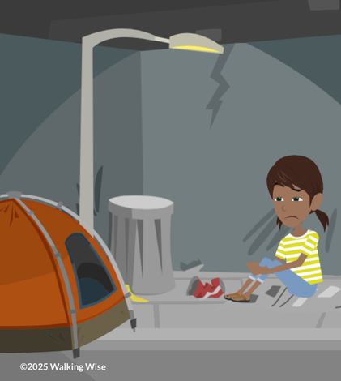
RISK FACTORS
What are examples of ‘harsh circumstances’ that increase the risk of family trafficking?
©2024-2026 Walking Wise
40

Slide 41
RISK FACTORS
Family Trafficking Risk Factors
  Substance Misuse: Family members misuse drugs or alcohol
  Joan A. Reid, Juliana Huard & Rachael A. Haskell (2015) Family-facilitated juvenile sex trafficking, Journal of Crime and Justice, 38:3, 361-376.
  Allert, J. (2022). Domestic Minor Familial Sex Trafficking: A National Study of Prevalence, Characteristics, and Challenges across the Justice Process, p. 18. Institute for Shelter Care.
©2024-2026 Walking Wise
41
Notes:
RISK FACTORS
Harsh circumstances can increase a young person’s vulnerability to exploitation by creating unmet needs or limiting access to support.
Situations such as substance misuse, financial hardship, unstable housing, or exposure to criminal activity can make it easier for someone to misuse power or control within the family.
It is important to understand that these are risk factors, not causes. Having one or more of these experiences does not mean exploitation will occur, but it can increase risk when protective support systems are limited.
Source
Joan A. Reid, Juliana Huard & Rachael A. Haskell (2015) Family-facilitated juvenile sex trafficking, Journal of Crime and Justice, 38:3, 361-376, DOI: 10.1080/0735648X.2014.967965 https://www.tandfonline.com/eprint/ZBS7nZCXxC3VqqUaHZ3k/full
Allert, J. (2022). Domestic Minor Familial Sex Trafficking: A National Study of Prevalence, Characteristics, and Challenges across the Justice Process, p. 18. Institute for Shelter Care. Retrieved March 15, 2024, from https://instituteforsheltercare.org/familial/

Slide 42
RISK FACTORS
Family Trafficking Risk Factors
  Substance Misuse: Family members misuse drugs or alcohol
  Financial Hardship: Family experiencing extreme poverty
  Joan A. Reid, Juliana Huard & Rachael A. Haskell (2015) Family-facilitated juvenile sex trafficking, Journal of Crime and Justice, 38:3, 361-376.
  Allert, J. (2022). Domestic Minor Familial Sex Trafficking: A National Study of Prevalence, Characteristics, and Challenges across the Justice Process, p. 18. Institute for Shelter Care.
©2024-2026 Walking Wise
42
Notes:
RISK FACTORS
Harsh circumstances can increase a young person’s vulnerability to exploitation by creating unmet needs or limiting access to support.
Situations such as substance misuse, financial hardship, unstable housing, or exposure to criminal activity can make it easier for someone to misuse power or control within the family.
It is important to understand that these are risk factors, not causes. Having one or more of these experiences does not mean exploitation will occur, but it can increase risk when protective support systems are limited.
Source
Joan A. Reid, Juliana Huard & Rachael A. Haskell (2015) Family-facilitated juvenile sex trafficking, Journal of Crime and Justice, 38:3, 361-376, DOI: 10.1080/0735648X.2014.967965 https://www.tandfonline.com/eprint/ZBS7nZCXxC3VqqUaHZ3k/full
Allert, J. (2022). Domestic Minor Familial Sex Trafficking: A National Study of Prevalence, Characteristics, and Challenges across the Justice Process, p. 18. Institute for Shelter Care. Retrieved March 15, 2024, from https://instituteforsheltercare.org/familial/

Slide 43
RISK FACTORS
Family Trafficking Risk Factors
  Substance Misuse: Family members misuse drugs or alcohol
  Financial Hardship: Family experiencing extreme poverty
  Unstable Housing: Difficulty paying rent or frequent moves
  Joan A. Reid, Juliana Huard & Rachael A. Haskell (2015) Family-facilitated juvenile sex trafficking, Journal of Crime and Justice, 38:3, 361-376.
  Allert, J. (2022). Domestic Minor Familial Sex Trafficking: A National Study of Prevalence, Characteristics, and Challenges across the Justice Process, p. 18. Institute for Shelter Care.
©2024-2026 Walking Wise
43
Notes:
RISK FACTORS
Harsh circumstances can increase a young person’s vulnerability to exploitation by creating unmet needs or limiting access to support.
Situations such as substance misuse, financial hardship, unstable housing, or exposure to criminal activity can make it easier for someone to misuse power or control within the family.
It is important to understand that these are risk factors, not causes. Having one or more of these experiences does not mean exploitation will occur, but it can increase risk when protective support systems are limited.
Source
Joan A. Reid, Juliana Huard & Rachael A. Haskell (2015) Family-facilitated juvenile sex trafficking, Journal of Crime and Justice, 38:3, 361-376, DOI: 10.1080/0735648X.2014.967965 https://www.tandfonline.com/eprint/ZBS7nZCXxC3VqqUaHZ3k/full
Allert, J. (2022). Domestic Minor Familial Sex Trafficking: A National Study of Prevalence, Characteristics, and Challenges across the Justice Process, p. 18. Institute for Shelter Care. Retrieved March 15, 2024, from https://instituteforsheltercare.org/familial/

Slide 44
RISK FACTORS
Family Trafficking Risk Factors
  Substance Misuse: Family members misuse drugs or alcohol
  Financial Hardship: Family experiencing extreme poverty
  Unstable Housing: Difficulty paying rent or frequent moves
  Crime: Caregiver involved in gangs or illegal activity
  Joan A. Reid, Juliana Huard & Rachael A. Haskell (2015) Family-facilitated juvenile sex trafficking, Journal of Crime and Justice, 38:3, 361-376.
  Allert, J. (2022). Domestic Minor Familial Sex Trafficking: A National Study of Prevalence, Characteristics, and Challenges across the Justice Process, p. 18. Institute for Shelter Care.
©2024-2026 Walking Wise
44
Notes:
RISK FACTORS
Harsh circumstances can increase a young person’s vulnerability to exploitation by creating unmet needs or limiting access to support.
Situations such as substance misuse, financial hardship, unstable housing, or exposure to criminal activity can make it easier for someone to misuse power or control within the family.
It is important to understand that these are risk factors, not causes. Having one or more of these experiences does not mean exploitation will occur, but it can increase risk when protective support systems are limited.
Source
Joan A. Reid, Juliana Huard & Rachael A. Haskell (2015) Family-facilitated juvenile sex trafficking, Journal of Crime and Justice, 38:3, 361-376, DOI: 10.1080/0735648X.2014.967965 https://www.tandfonline.com/eprint/ZBS7nZCXxC3VqqUaHZ3k/full
Allert, J. (2022). Domestic Minor Familial Sex Trafficking: A National Study of Prevalence, Characteristics, and Challenges across the Justice Process, p. 18. Institute for Shelter Care. Retrieved March 15, 2024, from https://instituteforsheltercare.org/familial/

Slide 45
RISK FACTORS
Youth Risk Factors
  Mistreatment: Experiencing abuse, neglect, or violence
  Joan A. Reid, Juliana Huard & Rachael A. Haskell (2015) Family-facilitated juvenile sex trafficking, Journal of Crime and Justice, 38:3, 361-376.
  Allert, J. (2022). Domestic Minor Familial Sex Trafficking: A National Study of Prevalence, Characteristics, and Challenges across the Justice Process, p. 18. Institute for Shelter Care.
©2024-2026 Walking Wise
45
Notes:
YOUTH RISK FACTORS
Some young people may face personal challenges that increase their vulnerability to exploitation. Experiences such as abuse, neglect, or violence can affect a young person’s sense of safety and support.
Running away is often a response to unsafe conditions, not simply a choice, and can increase risk when basic needs are unmet.
Involvement in systems like foster care or the juvenile justice system can also reflect instability or limited access to consistent protection.
It is important to remember that these are risk factors, not causes, and having these experiences does not mean exploitation will occur.
Source
Joan A. Reid, Juliana Huard & Rachael A. Haskell (2015) Family-facilitated juvenile sex trafficking, Journal of Crime and Justice, 38:3, 361-376, DOI: 10.1080/0735648X.2014.967965 https://www.tandfonline.com/eprint/ZBS7nZCXxC3VqqUaHZ3k/full
Allert, J. (2022). Domestic Minor Familial Sex Trafficking: A National Study of Prevalence, Characteristics, and Challenges across the Justice Process, p. 18. Institute for Shelter Care. Retrieved March 15, 2024, from https://instituteforsheltercare.org/familial/

Slide 46
RISK FACTORS
Youth Risk Factors
  Mistreatment: Experiencing abuse, neglect, or violence
  Isolation: Limited social or emotional connection with others
  Joan A. Reid, Juliana Huard & Rachael A. Haskell (2015) Family-facilitated juvenile sex trafficking, Journal of Crime and Justice, 38:3, 361-376.
  Allert, J. (2022). Domestic Minor Familial Sex Trafficking: A National Study of Prevalence, Characteristics, and Challenges across the Justice Process, p. 18. Institute for Shelter Care.
©2024-2026 Walking Wise
46
Notes:
YOUTH RISK FACTORS
Some young people may face personal challenges that increase their vulnerability to exploitation. Experiences such as abuse, neglect, or violence can affect a young person’s sense of safety and support.
Running away is often a response to unsafe conditions, not simply a choice, and can increase risk when basic needs are unmet.
Involvement in systems like foster care or the juvenile justice system can also reflect instability or limited access to consistent protection.
It is important to remember that these are risk factors, not causes, and having these experiences does not mean exploitation will occur.
Source
Joan A. Reid, Juliana Huard & Rachael A. Haskell (2015) Family-facilitated juvenile sex trafficking, Journal of Crime and Justice, 38:3, 361-376, DOI: 10.1080/0735648X.2014.967965 https://www.tandfonline.com/eprint/ZBS7nZCXxC3VqqUaHZ3k/full
Allert, J. (2022). Domestic Minor Familial Sex Trafficking: A National Study of Prevalence, Characteristics, and Challenges across the Justice Process, p. 18. Institute for Shelter Care. Retrieved March 15, 2024, from https://instituteforsheltercare.org/familial/

Slide 47
RISK FACTORS
Youth Risk Factors
  Mistreatment: Experiencing abuse, neglect, or violence
  Isolation: Limited social or emotional connection with others
  Running Away: Leaving home or lacking a safe place to stay
  Joan A. Reid, Juliana Huard & Rachael A. Haskell (2015) Family-facilitated juvenile sex trafficking, Journal of Crime and Justice, 38:3, 361-376.
  Allert, J. (2022). Domestic Minor Familial Sex Trafficking: A National Study of Prevalence, Characteristics, and Challenges across the Justice Process, p. 18. Institute for Shelter Care.
©2024-2026 Walking Wise
47
Notes:
YOUTH RISK FACTORS
Some young people may face personal challenges that increase their vulnerability to exploitation. Experiences such as abuse, neglect, or violence can affect a young person’s sense of safety and support.
Running away is often a response to unsafe conditions, not simply a choice, and can increase risk when basic needs are unmet.
Involvement in systems like foster care or the juvenile justice system can also reflect instability or limited access to consistent protection.
It is important to remember that these are risk factors, not causes, and having these experiences does not mean exploitation will occur.
Source
Joan A. Reid, Juliana Huard & Rachael A. Haskell (2015) Family-facilitated juvenile sex trafficking, Journal of Crime and Justice, 38:3, 361-376, DOI: 10.1080/0735648X.2014.967965 https://www.tandfonline.com/eprint/ZBS7nZCXxC3VqqUaHZ3k/full
Allert, J. (2022). Domestic Minor Familial Sex Trafficking: A National Study of Prevalence, Characteristics, and Challenges across the Justice Process, p. 18. Institute for Shelter Care. Retrieved March 15, 2024, from https://instituteforsheltercare.org/familial/

Slide 48
RISK FACTORS
Youth Risk Factors
  Mistreatment: Experiencing abuse, neglect, or violence
  Isolation: Limited social or emotional connection with others
  Running Away: Leaving home or lacking a safe place to stay
  Child Welfare: Receiving care outside the home (foster care)
  Joan A. Reid, Juliana Huard & Rachael A. Haskell (2015) Family-facilitated juvenile sex trafficking, Journal of Crime and Justice, 38:3, 361-376.
  Allert, J. (2022). Domestic Minor Familial Sex Trafficking: A National Study of Prevalence, Characteristics, and Challenges across the Justice Process, p. 18. Institute for Shelter Care.
©2024-2026 Walking Wise
48
Notes:
YOUTH RISK FACTORS
Some young people may face personal challenges that increase their vulnerability to exploitation. Experiences such as abuse, neglect, or violence can affect a young person’s sense of safety and support.
Running away is often a response to unsafe conditions, not simply a choice, and can increase risk when basic needs are unmet.
Involvement in systems like foster care or the juvenile justice system can also reflect instability or limited access to consistent protection.
It is important to remember that these are risk factors, not causes, and having these experiences does not mean exploitation will occur.
Source
Joan A. Reid, Juliana Huard & Rachael A. Haskell (2015) Family-facilitated juvenile sex trafficking, Journal of Crime and Justice, 38:3, 361-376, DOI: 10.1080/0735648X.2014.967965 https://www.tandfonline.com/eprint/ZBS7nZCXxC3VqqUaHZ3k/full
Allert, J. (2022). Domestic Minor Familial Sex Trafficking: A National Study of Prevalence, Characteristics, and Challenges across the Justice Process, p. 18. Institute for Shelter Care. Retrieved March 15, 2024, from https://instituteforsheltercare.org/familial/

Slide 49
RISK FACTORS
Youth Risk Factors
  Mistreatment: Experiencing abuse, neglect, or violence
  Isolation: Limited social or emotional connection with others
  Running Away: Leaving home or lacking a safe place to stay
  Child Welfare: Receiving care outside the home (foster care)
  Justice System: Involved in the juvenile justice system
  Joan A. Reid, Juliana Huard & Rachael A. Haskell (2015) Family-facilitated juvenile sex trafficking, Journal of Crime and Justice, 38:3, 361-376.
  Allert, J. (2022). Domestic Minor Familial Sex Trafficking: A National Study of Prevalence, Characteristics, and Challenges across the Justice Process, p. 18. Institute for Shelter Care.
©2024-2026 Walking Wise
49
Notes:
YOUTH RISK FACTORS
Some young people may face personal challenges that increase their vulnerability to exploitation. Experiences such as abuse, neglect, or violence can affect a young person’s sense of safety and support.
Running away is often a response to unsafe conditions, not simply a choice, and can increase risk when basic needs are unmet.
Involvement in systems like foster care or the juvenile justice system can also reflect instability or limited access to consistent protection.
It is important to remember that these are risk factors, not causes, and having these experiences does not mean exploitation will occur.
Source
Joan A. Reid, Juliana Huard & Rachael A. Haskell (2015) Family-facilitated juvenile sex trafficking, Journal of Crime and Justice, 38:3, 361-376, DOI: 10.1080/0735648X.2014.967965 https://www.tandfonline.com/eprint/ZBS7nZCXxC3VqqUaHZ3k/full
Allert, J. (2022). Domestic Minor Familial Sex Trafficking: A National Study of Prevalence, Characteristics, and Challenges across the Justice Process, p. 18. Institute for Shelter Care. Retrieved March 15, 2024, from https://instituteforsheltercare.org/familial/

Slide 50
VOCABULARY
MIND CONTROL
The use of manipulation to influence a person’s thoughts, feelings, and beliefs to control their behavior or actions, often without them realizing it.
©2024-2026 Walking Wise
50

Slide 51
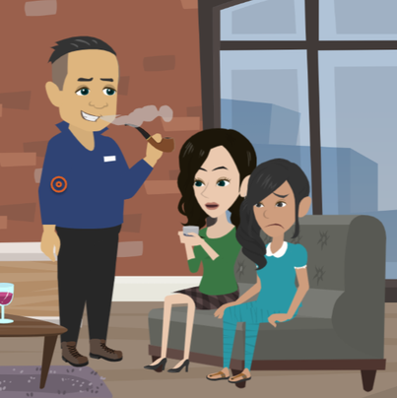
LESSON PLANS
MIND CONTROL
How do family traffickers control young people to keep the abuse hidden?
©2024-2026 Walking Wise
51
3

Slide 52
MIND CONTROL
Authority & Fear
Parental Authority: Children are taught to trust and obey adults, making it harder to question unsafe behavior.
Henderson, M. F. (2022). Human trafficking by families (Public Management Bulletin No. 24). School of Government, University of North Carolina at Chapel Hill.
Allert, J. (2022). Domestic Minor Familial Sex Trafficking: A National Study of Prevalence, Characteristics, and Challenges across the Justice Process, p. 21. Institute for Shelter Care
52
©2024-2026 Walking Wise
Notes:
FAMILY AUTHORITY
Family traffickers often take advantage of the natural trust and authority that exists between children and caregivers.
Young people are often taught to trust and obey adults in their family, which can make it harder to question unsafe behavior.
Traffickers may also use threats, punishment, or fear to enforce control and keep the abuse hidden.
In some cases, young people may fear being rejected, losing their home, or not being supported by other family members.
These pressures can make it difficult to speak up or seek help, even when something feels wrong.
Source
Henderson, M. F. (2022). Human trafficking by families (Public Management Bulletin No. 24). School of Government, University of North Carolina at Chapel Hill. Retrieved January 25, 2026, from https://www.sog.unc.edu/sites/default/files/reports/PMB%2024_Henderson.pdf
Allert, J. (2022). Domestic Minor Familial Sex Trafficking: A National Study of Prevalence, Characteristics, and Challenges across the Justice Process, p. 21. Institute for Shelter Care. Retrieved March 15, 2024, from https://instituteforsheltercare.org/familial/

Slide 53
MIND CONTROL
Authority & Fear
Threats & Fear: Threats and punishment to control behavior and to keep abuse hidden.
Henderson, M. F. (2022). Human trafficking by families (Public Management Bulletin No. 24). School of Government, University of North Carolina at Chapel Hill.
Allert, J. (2022). Domestic Minor Familial Sex Trafficking: A National Study of Prevalence, Characteristics, and Challenges across the Justice Process, p. 21. Institute for Shelter Care
53
©2024-2026 Walking Wise
Notes:
FAMILY AUTHORITY
Family traffickers often take advantage of the natural trust and authority that exists between children and caregivers.
Young people are often taught to trust and obey adults in their family, which can make it harder to question unsafe behavior.
Traffickers may also use threats, punishment, or fear to enforce control and keep the abuse hidden.
In some cases, young people may fear being rejected, losing their home, or not being supported by other family members.
These pressures can make it difficult to speak up or seek help, even when something feels wrong.
Source
Henderson, M. F. (2022). Human trafficking by families (Public Management Bulletin No. 24). School of Government, University of North Carolina at Chapel Hill. Retrieved January 25, 2026, from https://www.sog.unc.edu/sites/default/files/reports/PMB%2024_Henderson.pdf
Allert, J. (2022). Domestic Minor Familial Sex Trafficking: A National Study of Prevalence, Characteristics, and Challenges across the Justice Process, p. 21. Institute for Shelter Care. Retrieved March 15, 2024, from https://instituteforsheltercare.org/familial/

Slide 54
MIND CONTROL
Authority & Fear
Loss of Family: Children may fear being rejected, losing their home, or losing the support of their family
Henderson, M. F. (2022). Human trafficking by families (Public Management Bulletin No. 24). School of Government, University of North Carolina at Chapel Hill.
Allert, J. (2022). Domestic Minor Familial Sex Trafficking: A National Study of Prevalence, Characteristics, and Challenges across the Justice Process, p. 21. Institute for Shelter Care
54
©2024-2026 Walking Wise
Notes:
FAMILY AUTHORITY
Family traffickers often take advantage of the natural trust and authority that exists between children and caregivers.
Young people are often taught to trust and obey adults in their family, which can make it harder to question unsafe behavior.
Traffickers may also use threats, punishment, or fear to enforce control and keep the abuse hidden.
In some cases, young people may fear being rejected, losing their home, or not being supported by other family members.
These pressures can make it difficult to speak up or seek help, even when something feels wrong.
Source
Henderson, M. F. (2022). Human trafficking by families (Public Management Bulletin No. 24). School of Government, University of North Carolina at Chapel Hill. Retrieved January 25, 2026, from https://www.sog.unc.edu/sites/default/files/reports/PMB%2024_Henderson.pdf
Allert, J. (2022). Domestic Minor Familial Sex Trafficking: A National Study of Prevalence, Characteristics, and Challenges across the Justice Process, p. 21. Institute for Shelter Care. Retrieved March 15, 2024, from https://instituteforsheltercare.org/familial/

Slide 55
MIND CONTROL
Pressure & Substance Use
Financial Pressure: A child may be told they must help provide money for basic needs such as housing and food.
Henderson, M. F. (2022). Human trafficking by families (Public Management Bulletin No. 24). School of Government, University of North Carolina at Chapel Hill.
Allert, J. (2022). Domestic Minor Familial Sex Trafficking: A National Study of Prevalence, Characteristics, and Challenges across the Justice Process, p. 21. Institute for Shelter Care
55
©2024-2026 Walking Wise
Notes:
SUBSTANCE USE
Family traffickers may also use financial pressure and substances as ways to control young people.
A child may be told they must help meet the family’s basic needs, such as paying for housing or food, which can create a sense of responsibility or fear if they do not comply.
In some cases, drugs or alcohol may be introduced to lower resistance, create confusion, or build dependence. Over time, this can increase control and make it harder for a young person to recognize the abuse or seek help.
It is important to understand that substance use in these situations is part of the exploitation and not the child’s fault.
Source
Henderson, M. F. (2022). Human trafficking by families (Public Management Bulletin No. 24). School of Government, University of North Carolina at Chapel Hill. Retrieved January 25, 2026, from https://www.sog.unc.edu/sites/default/files/reports/PMB%2024_Henderson.pdf
Allert, J. (2022). Domestic Minor Familial Sex Trafficking: A National Study of Prevalence, Characteristics, and Challenges across the Justice Process, p. 21. Institute for Shelter Care. Retrieved March 15, 2024, from https://instituteforsheltercare.org/familial/

Slide 56
MIND CONTROL
Pressure & Substance Use
Substance Use: Drugs and alcohol may be used to lower resistance, create confusion, or build dependence.
Henderson, M. F. (2022). Human trafficking by families (Public Management Bulletin No. 24). School of Government, University of North Carolina at Chapel Hill.
Allert, J. (2022). Domestic Minor Familial Sex Trafficking: A National Study of Prevalence, Characteristics, and Challenges across the Justice Process, p. 21. Institute for Shelter Care
56
©2024-2026 Walking Wise
Notes:
SUBSTANCE USE
Family traffickers may also use financial pressure and substances as ways to control young people.
A child may be told they must help meet the family’s basic needs, such as paying for housing or food, which can create a sense of responsibility or fear if they do not comply.
In some cases, drugs or alcohol may be introduced to lower resistance, create confusion, or build dependence. Over time, this can increase control and make it harder for a young person to recognize the abuse or seek help.
It is important to understand that substance use in these situations is part of the exploitation and not the child’s fault.
Source
Henderson, M. F. (2022). Human trafficking by families (Public Management Bulletin No. 24). School of Government, University of North Carolina at Chapel Hill. Retrieved January 25, 2026, from https://www.sog.unc.edu/sites/default/files/reports/PMB%2024_Henderson.pdf
Allert, J. (2022). Domestic Minor Familial Sex Trafficking: A National Study of Prevalence, Characteristics, and Challenges across the Justice Process, p. 21. Institute for Shelter Care. Retrieved March 15, 2024, from https://instituteforsheltercare.org/familial/

Slide 57
EDUCATON GUIDE
VOCABULARY
GENERATIONAL
Patterns of behavior, beliefs, or experiences that are repeated and passed down within the family over time—from parents to their children, to grandchildren, etc.
©2024-2026 Walking Wise
57
3

Slide 58
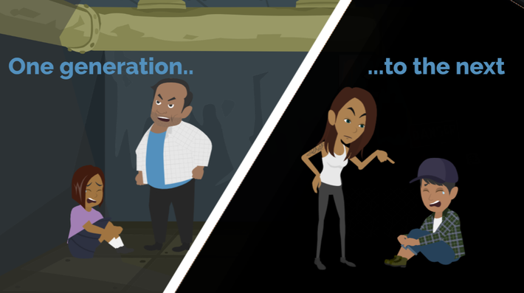
LESSON PLANS
GENERATIONAL
How does sexual exploitation continue from one generation to the next?
©2024-2026 Walking Wise
58
3

Slide 59
GENERATIONAL
How Family Influences Behavior
Learned Behavior: Young people learn what they believe is “normal” based on what they see or experience at home.
©2024-2026 Walking Wise
Henderson, M. F. (2022, September). Human Trafficking by Families. University of North Carolina
School of Government, Public Management Bulletin, No.24, Sog.unc.edu, pp. 4,5.
59
Notes:
GENERATIONAL
Sexual exploitation can continue across generations when harmful behaviors are seen as normal or are not addressed.
Young people often learn from what they see and experience at home, which can shape their understanding of relationships and boundaries.
When unsafe behavior continues in an environment, it can increase the risk that similar patterns are repeated. However, these patterns can be broken through awareness, education, and support from safe and trusted adults.
Source
Henderson, M. F. (2022, September). Human Trafficking by Families. University of North Carolina
School of Government, Public Management Bulletin, No.24, Sog.unc.edu, pp. 4,5. Retrieved January 25, 2026, from https://www.sog.unc.edu/sites/default/files/reports/PMB%2024_Henderson.pdf

Slide 60
GENERATIONAL
How Family Influences Behavior
Exposure to Risk: When harmful behavior continues, it can increase the likelihood that the child will repeat it.
©2024-2026 Walking Wise
Henderson, M. F. (2022, September). Human Trafficking by Families. University of North Carolina
School of Government, Public Management Bulletin, No.24, Sog.unc.edu, pp. 4,5.
60
Notes:
GENERATIONAL
Sexual exploitation can continue across generations when harmful behaviors are seen as normal or are not addressed.
Young people often learn from what they see and experience at home, which can shape their understanding of relationships and boundaries.
When unsafe behavior continues in an environment, it can increase the risk that similar patterns are repeated. However, these patterns can be broken through awareness, education, and support from safe and trusted adults.
Source
Henderson, M. F. (2022, September). Human Trafficking by Families. University of North Carolina
School of Government, Public Management Bulletin, No.24, Sog.unc.edu, pp. 4,5. Retrieved January 25, 2026, from https://www.sog.unc.edu/sites/default/files/reports/PMB%2024_Henderson.pdf

Slide 61
LESSON PLANS
WHAT DO YOU THINK?
Who is most likely to report suspected sex trafficking of a child to police?
©2024-2026 Walking Wise
61
3

Slide 62
WHAT DO YOU THINK?
Who is most likely to report suspected sex trafficking of a child to police?
A) Community Members
B) Family Members
C) School Staff Members
D) Medical Staff Members
©2024-2026 Walking Wise
62

Slide 63
ANSWER
Community members are more often the ones who report suspicions of child trafficking to police.
©2024-2026 Walking Wise
Emily E. Edwards, Jennifer S. Middleton, & Jennifer Cole, “Family-Controlled Trafficking in the United States: Victim Characteristics, System Response, and Case Outcomes,” Journal of Human Trafficking, p. 12.
63
Notes:
Research shows that suspected cases of familial trafficking are often reported by community members rather than professionals.
This may be because the abuse is hidden within the family and can be difficult for systems or agencies to detect.
Neighbors, friends, or others in the community may notice warning signs, making them more likely to choose to report concerns.
This highlights the importance of awareness, as anyone who recognizes unsafe situations can help protect a child.
Source
Henderson, M. F. (2022, September). Human Trafficking by Families. University of North Carolina School of Government, Public Management Bulletin, No.24, Sog.unc.edu, p. 12. Retrieved March 3, 2024, from https://www.sog.unc.edu/sites/default/files/reports/PMB%2024_Henderson.pdf

Slide 64
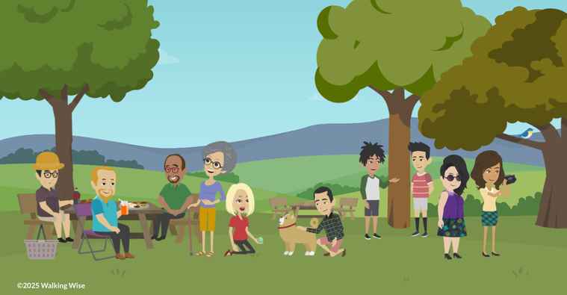
PROTECTIVE FACTORS
What are examples of living in a healthy family environment that helps protect children?
©2024-2026 Walking Wise
64

Slide 65
PROTECTIVE FACTORS
Safe Living Environments (Charmed Life)
Reliable Adults: Trustworthy, supportive adults who provide guidance and protection
©2024-2026 Walking Wise
65
Notes:
PROTECTIVE FACTORS
Protective factors are positive conditions that help reduce risk and support a young person’s safety and well-being.
Having reliable, trustworthy adults can provide guidance, support, and protection.
A stable home environment, including consistent routines and basic financial security, can also help reduce vulnerability.
Strong, healthy relationships with family, peers, and other supportive individuals can create a sense of connection and belonging.
While these factors can lower risk, it is important to remember that exploitation can happen in any environment, and a young person is never at fault.

Slide 66
PROTECTIVE FACTORS
Safe Living Environments (Charmed Life)
Basic Needs: Confident that food, clean clothing, and housing will be provided every day
©2024-2026 Walking Wise
66
Notes:
PROTECTIVE FACTORS
Protective factors are positive conditions that help reduce risk and support a young person’s safety and well-being.
Having reliable, trustworthy adults can provide guidance, support, and protection.
A stable home environment, including consistent routines and basic financial security, can also help reduce vulnerability.
Strong, healthy relationships with family, peers, and other supportive individuals can create a sense of connection and belonging.
While these factors can lower risk, it is important to remember that exploitation can happen in any environment, and a young person is never at fault.

Slide 67
PROTECTIVE FACTORS
Safe Living Environments (Charmed Life)
Relationships: Strong connections and positive relationships with parents, siblings, and friends
©2024-2026 Walking Wise
67
Notes:
PROTECTIVE FACTORS
Protective factors are positive conditions that help reduce risk and support a young person’s safety and well-being.
Having reliable, trustworthy adults can provide guidance, support, and protection.
A stable home environment, including consistent routines and basic financial security, can also help reduce vulnerability.
Strong, healthy relationships with family, peers, and other supportive individuals can create a sense of connection and belonging.
While these factors can lower risk, it is important to remember that exploitation can happen in any environment, and a young person is never at fault.

Slide 68
PROTECTIVE FACTORS
What Helps Keep Children Safe
  Well-being: Maintains strong physical and emotional health
©2024-2026 Walking Wise
68
Notes:
PROTECTIVE FACTORS
Good physical and emotional health can help young people feel more confident and better able to recognize when something is not right.
A supportive school environment encourages learning, growth, and connection with trusted adults.
Awareness of unsafe or manipulative situations also plays an important role in protection, helping young people recognize warning signs and seek help when needed.

Slide 69
PROTECTIVE FACTORS
What Helps Keep Children Safe
  Well-being: Maintains strong physical and emotional health
  School Support: Encouraged to learn, grow, and succeed
©2024-2026 Walking Wise
69
Notes:
PROTECTIVE FACTORS
Good physical and emotional health can help young people feel more confident and better able to recognize when something is not right.
A supportive school environment encourages learning, growth, and connection with trusted adults.
Awareness of unsafe or manipulative situations also plays an important role in protection, helping young people recognize warning signs and seek help when needed.

Slide 70
PROTECTIVE FACTORS
What Helps Keep Children Safe
  Well-being: Maintains strong physical and emotional health
  School Support: Encouraged to learn, grow, and succeed
  Awareness: Able to recognize unsafe or manipulative situations
©2024-2026 Walking Wise
70
Notes:
PROTECTIVE FACTORS
Good physical and emotional health can help young people feel more confident and better able to recognize when something is not right.
A supportive school environment encourages learning, growth, and connection with trusted adults.
Awareness of unsafe or manipulative situations also plays an important role in protection, helping young people recognize warning signs and seek help when needed.

Slide 71
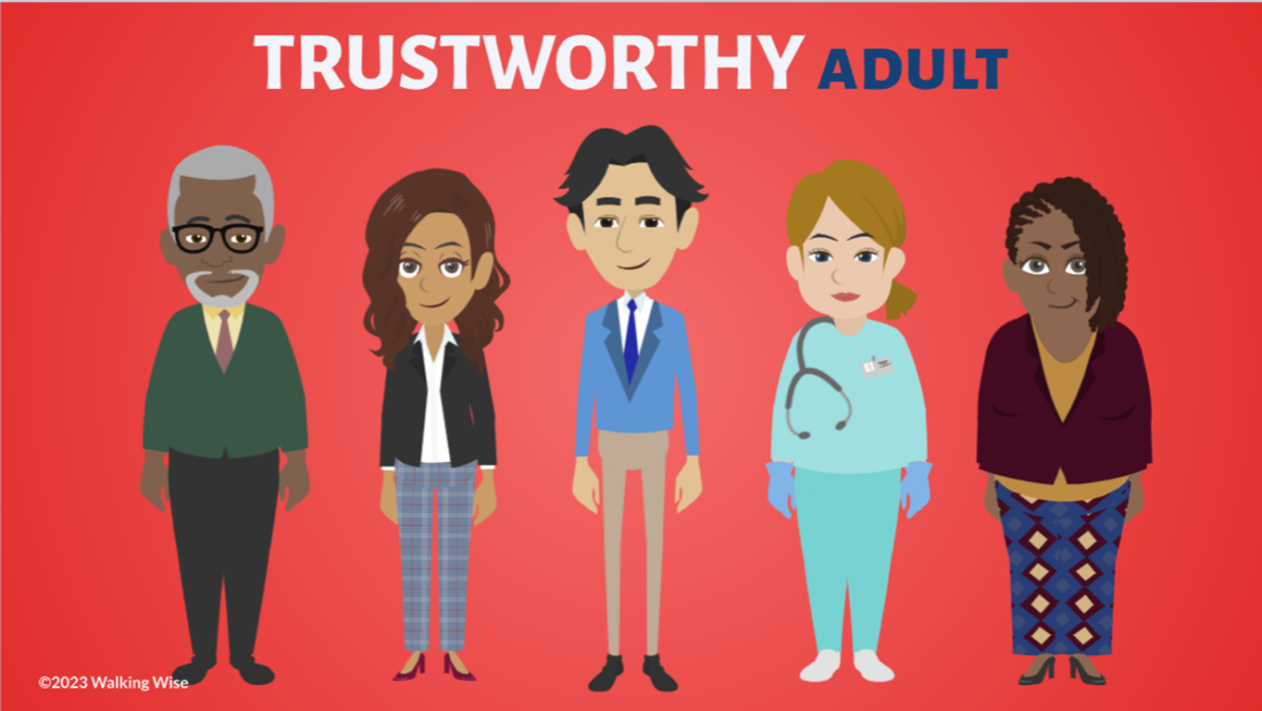
ASK FOR HELP
©2024-2026 Walking Wise
71
Notes:
Walking Wise asked a focus group of survivors:
What do you think young people should know about sex trafficking?
ANSWER
The survivors agreed that the most vital information teens should know is how to ask for help.
At the top of their list:
Tell a TRUSTWORTHY adult.

Slide 72

ASK FOR HELP
What are ways young people can ask for help?
©2024-2026 Walking Wise
72

Slide 73
ASK FOR HELP
How to Ask for Help
  If you are in immediate danger, dial 911.
©2024-2026 Walking Wise
73

Slide 74
ASK FOR HELP
How to Ask for Help
  If you are in immediate danger, dial 911.
  If the sexual predator IS a family member, tell a trustworthy adult.
©2024-2026 Walking Wise
74

Slide 75
ASK FOR HELP
How to Ask for Help
  If you are in immediate danger, dial 911.
  If the sexual predator IS a family member, tell a trustworthy adult.
  If the sexual predator is NOT family, tell a parent or guardian
©2024-2026 Walking Wise
75

Slide 76
ASK FOR HELP
How to Ask for Help
  If you are in immediate danger, dial 911.
  If the sexual predator IS a family member, tell a trustworthy adult.
  If the sexual predator is NOT family, tell a parent or guardian
  If you are a student, tell a trustworthy teacher, coach, school nurse, social worker, counselor, resource officer, or principal.
©2024-2026 Walking Wise
76

Slide 77
ASK FOR HELP
How to Ask for Help
  If you are in immediate danger, dial 911.
  If the sexual predator IS a family member, tell a trustworthy adult.
  If the sexual predator is NOT family, tell a parent or guardian
  If you are a student, tell a trustworthy teacher, coach, school nurse, social worker, counselor, resource officer, or principal.
  To gain internet access for help, use a computer at school or a public library.
©2024-2026 Walking Wise
77

Slide 78
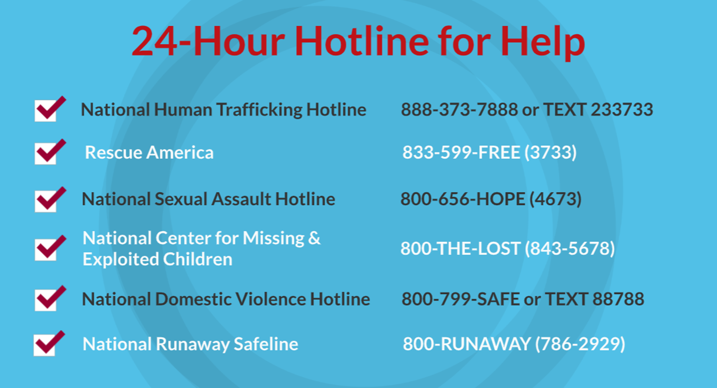
©2024-2026 Walking Wise
78
Notes:
NOTE TO PRESENTER
Presenters may ask their audience to consider adding a few "hotline for help" phone numbers to their cell phone contacts or take a photo of this slide.

Slide 79
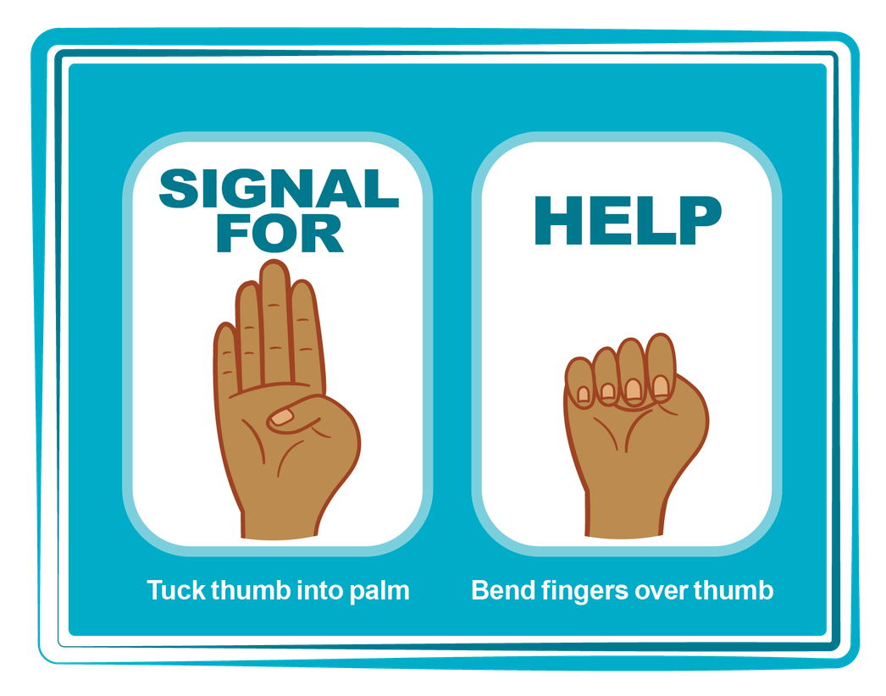
HAND SIGNAL FOR HELP
©2024-2026 Walking Wise
Source: Canadian Women’s Foundation, April 2020
79
Notes:
Although the hand signal for help has not yet achieved universal recognition, it may quietly get someone's attention in urgent situations.
SILENT
It can be used silently.
UNTRACKABLE
It leaves no digital footprint.
CONCEALED
It can be done secretly when a perpetrator is in the vicinity.
SIGNALS DISTRESS
A distressed facial expression can help others recognize that help is needed if the hand signal is not understood—but it is important not to alert the predator/trafficker, causing harm.
Source
Canadian Women's Foundation, April 2020

Slide 80


Thank you!
WalkingWise.com
Online Course for Adults Accredited by:
Postgraduate Institute for Medicine
Academy of Forensic Nursing
©2024-2026 Walking Wise
80
Notes:
NOTE TO PRESENTER
To access additional resources about familial trafficking, please refer to the last page of Lesson Plan #11 on the Walking Wise EducLearning Platform.
We welcome your feedback at support@WalkingWise.com.

