Slide 1


SEXUAL EXPLOITATION
EDUCATION
family
SECRET
LESSON #11
Notes:
NOTE
Log in to WalkingWise.com and refer to the Walking Wise Education Guide to implement classroom teaching tips.
Most importantly:
• DEFINE SCHOOL POLICY
Establish an anti-trafficking reporting protocol with a trauma-informed response. The Walking Wise Implementation Guide provides a sample protocol.
• AGE & AUDIENCE
This presentation can be edited by following the procedures on page 3 to align with your school policies, specific age groups, and the involvement of at-risk audiences.
• SUPPORT PROCEDURE
Provide your audience with guidance on accessing immediate help or arranging a private meeting with a social worker, counselor, nurse, school resource officer, or another trustworthy staff member to report concerns for themselves or a peer.
• SECOND SAFE ADULT
Ensure a second trustworthy adult, such as a teacher, is present in the learning setting to observe audience reactions and identify those who may benefit from a follow-up meeting. This person should remain focused and free from other duties during the presentation.
• IMPLEMENT SLIDO.com
Please log in to WalkingWise.com for instructions on incorporating Slido into this PowerPoint presentation to engage your audience using digital polling.

Slide 2

NOTE TO PRESENTER
This presentation is exclusively for Walking Wise® subscribers and not for redistribution.
Walking Wise provides an interactive digital tool, Slido.com, to enhance audience engagement. To implement Slido for your organization, you can log in to WalkingWise.com for setup instructions. Once configured, integrate Slido polling and add a post-evaluation into the PowerPoint presentation.
Presenters are encouraged to edit speaker notes to match their speaking style (viewable in presentation mode). You can also delete slides from this Walking Wise presentation to make sure the content aligns with your school policies, is age-appropriate, and fits within available class time. However, the existing slides are copyright-protected and may not be modified without prior written permission from Walking Wise.
If you would like to add your own content, you may do so under the following conditions:
Insert new PowerPoint slides.
Remove the Walking Wise logo and copyright "©2025 Walking Wise" from the new slides.
Always add your organization's name or logo to each new slide.
Please delete this instruction page before presenting to audiences.
©2025 Walking Wise
2
Notes:
NOTE
The presenter is welcome to customize this Walking Wise presentation according to the instructions provided on this page.
For revision requests, please send an email to support@WalkingWise.com.

Slide 3

CONFRONTING SEXUAL EXPLOITATION
WALKING WISE
KNOWLEDGE serves as a
powerful defense against
sexual predators.
©2025 Walking Wise
3

Slide 4
CONFRONTING SEXUAL EXPLOITATION
WALKING WISE
SEXUAL EXPLOITATION includes grooming, sextortion, pornography
& sex trafficking.
©2025 Walking Wise
4

Slide 5
SENSITIVE DISCUSSION AHEAD
CONTENT ALERT
We’ll be discussing serious issues about sexual exploitation.
Some parts may be difficult to hear.
If you ever feel uncomfortable, you can step out and speak with a trustworthy adult for support.
You’re not alone—we’re here to help you.
©2025 Walking Wise
5
Notes:
NOTE TO PRESENTER
Please tailor this message to align with your organization's policies and protocols.
Please provide a confidential avenue for students to report concerns and seek help for themselves or their peers if they suspect sexual abuse, grooming, sextortion, pornography-related exploitation, or human trafficking. This may include a designated address or text line.
Consider displaying posters in your school or facility that outline various ways students can access immediate support or request a private meeting with a school safety team member or another trusted adult.

Slide 6


DIGITAL PARTICIPATION
©2025 Walking Wise
6
Notes:
NOTE
For digital interaction with audiences:
Log in to WalkingWise.com to follow instructions on setting up Slido questions/answers for this presentation. Then, replace the QR code and #code in this slide with your custom QR/#code.
Please verify whether the Q&A feature has been activated before presenting to audiences. An adult should monitor questions and comments to ensure appropriateness. Slido has a feature that allows you to delete unwanted questions and comments.

Slide 7



STATISTICS
Statistics are Only Estimates
Study results may be unreliable because most sexual crimes go unreported.
©2025 Walking Wise
7
Notes:
In this presentation, we'll discuss statistics, but it's important to note that while statistics provide valuable insights into an issue, they cannot be entirely relied upon.
Here are a few reasons:
• UNREPORTED
Victims may stay silent due to fear, shame, or manipulation.
• INCONSISTENT COLLECTION
Geographical areas have different legal definitions for sexual crimes, making data hard to compare.
• FOCUS GROUPS
Small or specific focus groups participating in a study or survey may not accurately reflect the diversity or experiences of the broader population.

Slide 8
STATISTICS
Statistics are Only Estimates
Study results may be unreliable because most sexual crimes go unreported.
The methods used to collect information can vary widely between studies, leading to inconsistency.
©2025 Walking Wise
8
Notes:
In this presentation, we'll discuss statistics, but it's important to note that while statistics provide valuable insights into an issue, they cannot be entirely relied upon.
Here are a few reasons:
• UNREPORTED
Victims may stay silent due to fear, shame, or manipulation.
• INCONSISTENT COLLECTION
Geographical areas have different legal definitions for sexual crimes, making data hard to compare.
• FOCUS GROUPS
Small or specific focus groups participating in a study or survey may not accurately reflect the diversity or experiences of the broader population.

Slide 9
STATISTICS
Statistics are Only Estimates
Study results may be unreliable because most sexual crimes go unreported.
The methods used to collect information can vary widely between studies, leading to inconsistency.
Focus groups in studies may not accurately represent the larger population.
©2025 Walking Wise
9
Notes:
In this presentation, we'll discuss statistics, but it's important to note that while statistics provide valuable insights into an issue, they cannot be entirely relied upon.
Here are a few reasons:
• UNREPORTED
Victims may stay silent due to fear, shame, or manipulation.
• INCONSISTENT COLLECTION
Geographical areas have different legal definitions for sexual crimes, making data hard to compare.
• FOCUS GROUPS
Small or specific focus groups participating in a study or survey may not accurately reflect the diversity or experiences of the broader population.

Slide 10

EDUCATON GUIDE
VOCABULARY
VOCABULARY
Predator
Family Trafficking
Child Abuse
Child Exploitation
Mind Control
Generational
Influence
©2025 Walking Wise
10
3
Notes:
NOTE
Understanding vocabulary terms related to the behaviors of sexual predators can empower young people to recognize warning signs of harmful situations.
Knowing terminology helps them identify manipulative tactics predators use to build trust and exploit vulnerabilities.
With this knowledge, young people are better equipped to spot red flags, understand that these behaviors are abusive, and feel more confident reporting predators to trusted adults or authorities, potentially preventing further harm.

Slide 11
EDUCATON GUIDE
VOCABULARY
PREDATOR
A person who injures, abuses, or takes advantage of others for personal gain or profit.
©2025 Walking Wise
11
3
Notes:
Assisting Source
OpenAI. (2024). ChatGPT [Large language model]. https://chatgpt.com

Slide 12
EDUCATON GUIDE
VOCABULARY
FAMILY TRAFFICKING
Family trafficking involves a family member who manipulates, tricks, or pressures the family’s child into sexual exploitation or labor in exchange for money, drugs, or favors.
©2025 Walking Wise
12
3
Notes:
Assisting Source
OpenAI. (2024). ChatGPT [Large language model]. https://chatgpt.com

Slide 13

LESSON PLANS
VICTIM OF ABUSE
At what age are children most commonly trafficked by a family member?
Allert, J. (2022). Domestic Minor Familial Sex Trafficking: A National Study of Prevalence, Characteristics, and Challenges across the Justice Process, p. 18. Institute for Shelter Care.
13
©2025 Walking Wise
3
Notes:
SLIDO.com: Multiple Choice
At what age are children most commonly trafficked by a family member?
A) 10 to 13 years old
B) 14 to 17 years old
C) 15 to 21 years old
D) 18 to 21 years old
ANSWERS:
B) 14 to 17 years old
• Of 917 children whom a family member trafficked between 2018 and 2021, 72% were between the ages of 14 and 17.
Source
Allert, J. (2022). Domestic Minor Familial Sex Trafficking: A National Study of Prevalence, Characteristics, and Challenges across the Justice Process, p. 18. Institute for Shelter Care. Retrieved March 15, 2024, from https://instituteforsheltercare.org/familial/

Slide 14
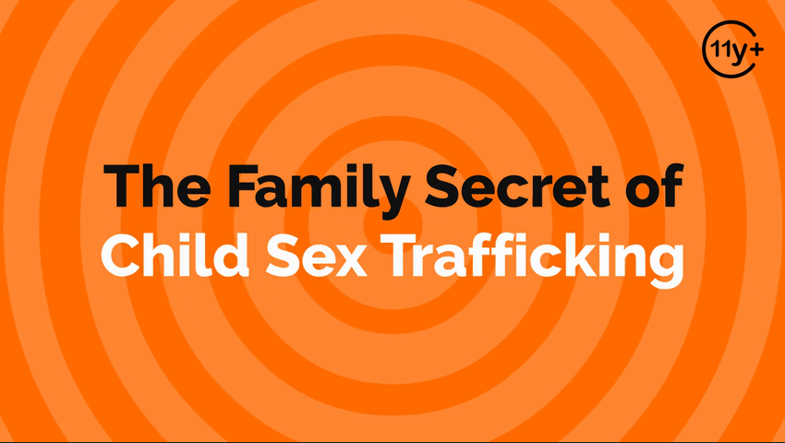
Log in to WalkingWise.com to access this animated video.
©2025 Walking Wise
14
Notes:
Message Especially for Teens:
Businesses worldwide use explainer-style animation as a training tool for their employees. So, this 3-minute Walking Wise animated video series is appropriate for both teens (ages 11+) and adults to learn how sexual predators use manipulation, intimidation, and coercion to exploit young people.
NOTE
Log in to Walking Wise.com to watch the three-minute animated video with audiences.

Slide 15
LESSON PLANS
FAMILY VICTIM
About what percent of victims are trafficked by a family member?
©2025 Walking Wise
Polaris Project (n.d.), Human Trafficking Trends in 2020, National Human Trafficking Hotline.
15
3
Notes:
SLIDO.com: Multiple Choice
About what percent of victims are trafficked by a family member?
A) 12%
B) 22%
C) 32%
D) 42%
ANSWER
D) About 42% of victims are trafficked by a family member.
• In its 2020 report on human trafficking trends, the Polaris Project disclosed that family members were responsible for 2,448 cases, recruiting 42% of victims.
Source
Polaris Project (n.d.). Human Trafficking Trends in 2020, p. 2. PolarisProject.org. Retrieved February 27, 2024, from https://polarisproject.org/wp-content/uploads/2022/01/Human-Trafficking-Trends-in-2020-by-Polaris.pdf

Slide 16
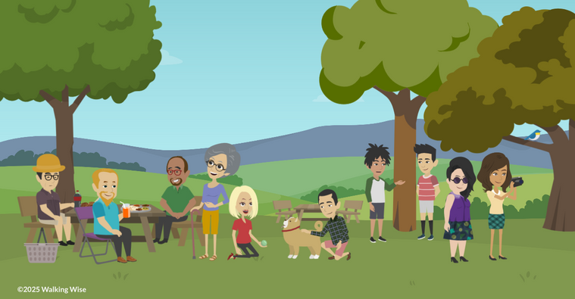
PROTECTIVE FACTORS
What are examples of living in a healthy family environment that protects children from predators?
©2025 Walking Wise
16

Slide 17
PROTECTIVE FACTORS
Safe Childhood Upbringing
Surrounded by trustworthy and supportive adults.
©2025 Walking Wise
17
Notes:
• TRUSTWORTHY ADULTS
Sexual predators are less likely to prey upon youth who have a trusted adult to guide them.
• STRONG RELATIONSHIPS
Working to build strong relationships with
trustworthy family members, friends, and community members can offer children a sense of belonging and support.
• ECONOMIC STABILITY
Financial stability can allow individuals to achieve their goals and provide for themselves, reducing their vulnerability to groomers and traffickers.
• WELL-BEING
Access to healthcare and mental health services can help individuals receive the support they need to lead a more secure life.
• EDUCATION
Access to education provides youth with the learning tools they need to develop a social and emotional skill set that can undermine traffickers' manipulative efforts.
• AWARENESS
Knowledge is often a powerful defense against sexual predators because awareness helps young people understand the warning signs of potentially dangerous situations.

Slide 18
PROTECTIVE FACTORS
Safe Childhood Upbringing
Surrounded by trustworthy and supportive adults.
Have strong, positive relationships with family and friends.
©2025 Walking Wise
18
Notes:
• TRUSTWORTHY ADULTS
Sexual predators are less likely to prey upon youth who have a trusted adult to guide them.
• STRONG RELATIONSHIPS
Working to build strong relationships with
trustworthy family members, friends, and community members can offer children a sense of belonging and support.
• ECONOMIC STABILITY
Financial stability can allow individuals to achieve their goals and provide for themselves, reducing their vulnerability to groomers and traffickers.
• WELL-BEING
Access to healthcare and mental health services can help individuals receive the support they need to lead a more secure life.
• EDUCATION
Access to education provides youth with the learning tools they need to develop a social and emotional skill set that can undermine traffickers' manipulative efforts.
• AWARENESS
Knowledge is often a powerful defense against sexual predators because awareness helps young people understand the warning signs of potentially dangerous situations.

Slide 19
PROTECTIVE FACTORS
Safe Childhood Upbringing
Surrounded by trustworthy and supportive adults.
Have strong, positive relationships with family and friends.
Live in a household with stable family finances.
©2025 Walking Wise
19
Notes:
• TRUSTWORTHY ADULTS
Sexual predators are less likely to prey upon youth who have a trusted adult to guide them.
• STRONG RELATIONSHIPS
Working to build strong relationships with
trustworthy family members, friends, and community members can offer children a sense of belonging and support.
• ECONOMIC STABILITY
Financial stability can allow individuals to achieve their goals and provide for themselves, reducing their vulnerability to groomers and traffickers.
• WELL-BEING
Access to healthcare and mental health services can help individuals receive the support they need to lead a more secure life.
• EDUCATION
Access to education provides youth with the learning tools they need to develop a social and emotional skill set that can undermine traffickers' manipulative efforts.
• AWARENESS
Knowledge is often a powerful defense against sexual predators because awareness helps young people understand the warning signs of potentially dangerous situations.

Slide 20
PROTECTIVE FACTORS
Safe Childhood Upbringing
Surrounded by trustworthy and supportive adults.
Have strong, positive relationships with family and friends.
Live in a household with stable family finances.
Experience healthy physical and mental well-being.
©2025 Walking Wise
20
Notes:
• TRUSTWORTHY ADULTS
Sexual predators are less likely to prey upon youth who have a trusted adult to guide them.
• STRONG RELATIONSHIPS
Working to build strong relationships with
trustworthy family members, friends, and community members can offer children a sense of belonging and support.
• ECONOMIC STABILITY
Financial stability can allow individuals to achieve their goals and provide for themselves, reducing their vulnerability to groomers and traffickers.
• WELL-BEING
Access to healthcare and mental health services can help individuals receive the support they need to lead a more secure life.
• EDUCATION
Access to education provides youth with the learning tools they need to develop a social and emotional skill set that can undermine traffickers' manipulative efforts.
• AWARENESS
Knowledge is often a powerful defense against sexual predators because awareness helps young people understand the warning signs of potentially dangerous situations.

Slide 21
PROTECTIVE FACTORS
Safe Childhood Upbringing
Surrounded by trustworthy and supportive adults.
Have strong, positive relationships with family and friends.
Live in a household with stable family finances.
Experience healthy physical and mental well-being.
Encouraged to learn and grow academically.
©2025 Walking Wise
21
Notes:
• TRUSTWORTHY ADULTS
Sexual predators are less likely to prey upon youth who have a trusted adult to guide them.
• STRONG RELATIONSHIPS
Working to build strong relationships with
trustworthy family members, friends, and community members can offer children a sense of belonging and support.
• ECONOMIC STABILITY
Financial stability can allow individuals to achieve their goals and provide for themselves, reducing their vulnerability to groomers and traffickers.
• WELL-BEING
Access to healthcare and mental health services can help individuals receive the support they need to lead a more secure life.
• EDUCATION
Access to education provides youth with the learning tools they need to develop a social and emotional skill set that can undermine traffickers' manipulative efforts.
• AWARENESS
Knowledge is often a powerful defense against sexual predators because awareness helps young people understand the warning signs of potentially dangerous situations.

Slide 22
PROTECTIVE FACTORS
Safe Childhood Upbringing
Surrounded by trustworthy and supportive adults.
Have strong, positive relationships with family and friends.
Live in a household with stable family finances.
Experience healthy physical and mental well-being.
Encouraged to learn and grow academically.
Aware of warning signs of potentially dangerous situations.
©2025 Walking Wise
22
Notes:
• TRUSTWORTHY ADULTS
Sexual predators are less likely to prey upon youth who have a trusted adult to guide them.
• STRONG RELATIONSHIPS
Working to build strong relationships with
trustworthy family members, friends, and community members can offer children a sense of belonging and support.
• ECONOMIC STABILITY
Financial stability can allow individuals to achieve their goals and provide for themselves, reducing their vulnerability to groomers and traffickers.
• WELL-BEING
Access to healthcare and mental health services can help individuals receive the support they need to lead a more secure life.
• EDUCATION
Access to education provides youth with the learning tools they need to develop a social and emotional skill set that can undermine traffickers' manipulative efforts.
• AWARENESS
Knowledge is often a powerful defense against sexual predators because awareness helps young people understand the warning signs of potentially dangerous situations.

Slide 23
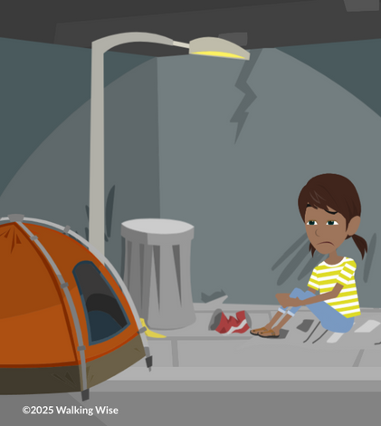
RISK FACTORS
What are examples of ‘harsh circumstances’ that increase the risk of family trafficking?
©2025 Walking Wise
23

Slide 24
HARSH CIRCUMSTANCES
Childhood Risk Factors
Struggles with emotional challenges, like loneliness or anxiety.
©2025 Walking Wise
24

Slide 25
HARSH CIRCUMSTANCES
Childhood Risk Factors
Struggles with emotional challenges, like loneliness or anxiety.
Experience learning difficulties or physical challenges.
©2025 Walking Wise
25

Slide 26
HARSH CIRCUMSTANCES
Childhood Risk Factors
Struggles with emotional challenges, like loneliness or anxiety.
Experience learning difficulties or physical challenges.
Involved in the child welfare system.
©2025 Walking Wise
26

Slide 27
HARSH CIRCUMSTANCES
Childhood Risk Factors
Struggles with emotional challenges, like loneliness or anxiety.
Experience learning difficulties or physical challenges.
Involved in the child welfare system.
History of running away from home.
©2025 Walking Wise
27

Slide 28
HARSH CIRCUMSTANCES
Childhood Risk Factors
Struggles with emotional challenges, like loneliness or anxiety.
Experience learning difficulties or physical challenges.
Involved in the child welfare system.
History of running away from home.
History of arrests for juvenile offenses.
©2025 Walking Wise
28

Slide 29
HARSH CIRCUMSTANCES
Childhood Risk Factors
Faces financial hardship, like lack of food, shelter & clothing.
©2025 Walking Wise
29

Slide 30
HARSH CIRCUMSTANCES
Childhood Risk Factors
Faces financial hardship, like lack of food, shelter & clothing.
Lives in a single-parent household or the father is absent.
©2025 Walking Wise
30

Slide 31
HARSH CIRCUMSTANCES
Childhood Risk Factors
Faces financial hardship, like lack of food, shelter & clothing.
Lives in a single-parent household or the father is absent.
Endures mistreatment, including violence and sexual abuse.
©2025 Walking Wise
31

Slide 32
HARSH CIRCUMSTANCES
Childhood Risk Factors
Faces financial hardship, like lack of food, shelter & clothing.
Lives in a single-parent household or the father is absent.
Endures mistreatment, including violence and sexual abuse.
Experiences emotional abuse, neglect, or abandonment.
©2025 Walking Wise
32

Slide 33
HARSH CIRCUMSTANCES
Childhood Risk Factors
Faces financial hardship, like lack of food, shelter & clothing.
Lives in a single-parent household or the father is absent.
Endures mistreatment, including violence and sexual abuse.
Experiences emotional abuse, neglect, or abandonment.
Exposed to pornography in the home.
©2025 Walking Wise
33

Slide 34
HARSH CIRCUMSTANCES
Childhood Risk Factors
Adults of authority engage in unsafe or harmful behavior.
©2025 Walking Wise
34

Slide 35
HARSH CIRCUMSTANCES
Childhood Risk Factors
Adults of authority engage in unsafe or harmful behavior.
Family members misuse drugs or alcohol.
©2025 Walking Wise
35

Slide 36
HARSH CIRCUMSTANCES
Childhood Risk Factors
Adults of authority engage in unsafe or harmful behavior.
Family members misuse drugs or alcohol.
A family member is in jail or prison (incarcerated).
©2025 Walking Wise
36

Slide 37
HARSH CIRCUMSTANCES
Childhood Risk Factors
Adults of authority engage in unsafe or harmful behavior.
Family members misuse drugs or alcohol.
A family member is in jail or prison (incarcerated).
Criminal activity occurs in the home or community.
©2025 Walking Wise
37

Slide 38
HARSH CIRCUMSTANCES
Childhood Risk Factors
Adults of authority engage in unsafe or harmful behavior.
Family members misuse drugs or alcohol.
A family member is in jail or prison (incarcerated).
Criminal activity occurs in the home or community.
Family member participates in prostitution.
©2025 Walking Wise
38

Slide 39
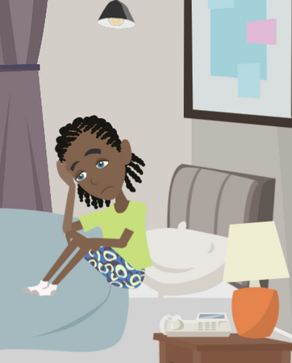
LESSON PLANS
ABUSE VS. TRAFFICKING
How is sexual abuse by a family member different from being sex trafficked by the family?
©2025 Walking Wise
39
3

Slide 40
VOCABULARY
CHILD ABUSE
Any act (or failure to act) that results in harm, potential harm, or risk of harm to a child under 18.
©2025 Walking Wise
40
Notes:
Assisting Source
OpenAI. (2024). ChatGPT [Large language model]. https://chatgpt.com

Slide 41
ABUSE VS. EXPLOITATION
Child Abuse
Examples of child abuse include:
©2025 Walking Wise
41
Notes:
When a young person experiences sexual abuse at home, it is a crime of child abuse.
Child sex trafficking is also a form of child abuse, where the family member gives a sexual predator access to the child/teen in exchange for something of value, such as money, drugs, or rent.
Law enforcement requires reporting both types of sexual crimes against children; however, these crimes are prosecuted under different laws, and harsh penalties are applied based on the circumstances of the crimes.

Slide 42
ABUSE VS. EXPLOITATION
Child Abuse
Examples of child abuse include:
Sexual Abuse
©2025 Walking Wise
42
Notes:
When a young person experiences sexual abuse at home, it is a crime of child abuse.
Child sex trafficking is also a form of child abuse, where the family member gives a sexual predator access to the child/teen in exchange for something of value, such as money, drugs, or rent.
Law enforcement requires reporting both types of sexual crimes against children; however, these crimes are prosecuted under different laws, and harsh penalties are applied based on the circumstances of the crimes.

Slide 43
ABUSE VS. EXPLOITATION
Child Abuse
Examples of child abuse include:
Sexual Abuse
Physical Abuse
©2025 Walking Wise
43
Notes:
When a young person experiences sexual abuse at home, it is a crime of child abuse.
Child sex trafficking is also a form of child abuse, where the family member gives a sexual predator access to the child/teen in exchange for something of value, such as money, drugs, or rent.
Law enforcement requires reporting both types of sexual crimes against children; however, these crimes are prosecuted under different laws, and harsh penalties are applied based on the circumstances of the crimes.

Slide 44
ABUSE VS. EXPLOITATION
Child Abuse
Examples of child abuse include:
Sexual Abuse
Physical Abuse
Emotional Abuse
©2025 Walking Wise
44
Notes:
When a young person experiences sexual abuse at home, it is a crime of child abuse.
Child sex trafficking is also a form of child abuse, where the family member gives a sexual predator access to the child/teen in exchange for something of value, such as money, drugs, or rent.
Law enforcement requires reporting both types of sexual crimes against children; however, these crimes are prosecuted under different laws, and harsh penalties are applied based on the circumstances of the crimes.

Slide 45
ABUSE VS. EXPLOITATION
Child Abuse
Examples of child abuse include:
Sexual Abuse
Physical Abuse
Emotional Abuse
Neglect
©2025 Walking Wise
45
Notes:
When a young person experiences sexual abuse at home, it is a crime of child abuse.
Child sex trafficking is also a form of child abuse, where the family member gives a sexual predator access to the child/teen in exchange for something of value, such as money, drugs, or rent.
Law enforcement requires reporting both types of sexual crimes against children; however, these crimes are prosecuted under different laws, and harsh penalties are applied based on the circumstances of the crimes.

Slide 46
ABUSE VS. EXPLOITATION
Child Abuse
Examples of child abuse include:
Sexual Abuse
Physical Abuse
Emotional Abuse
Neglect
Child exploitation is also a form of child abuse.
©2025 Walking Wise
46
Notes:
When a young person experiences sexual abuse at home, it is a crime of child abuse.
Child sex trafficking is also a form of child abuse, where the family member gives a sexual predator access to the child/teen in exchange for something of value, such as money, drugs, or rent.
Law enforcement requires reporting both types of sexual crimes against children; however, these crimes are prosecuted under different laws, and harsh penalties are applied based on the circumstances of the crimes.

Slide 47
VOCABULARY
CHILD EXPLOITATION
Involves taking advantage of a child under 18 for personal or financial gain.
©2025 Walking Wise
47
Notes:
Assisting Source
OpenAI. (2024). ChatGPT [Large language model]. https://chatgpt.com

Slide 48
ABUSE VS. EXPLOITATION
Child Exploitation
Examples of child exploitation include:
©2025 Walking Wise
48
Notes:
When a young person experiences sexual abuse at home, it is a crime of child abuse.
Child sex trafficking is also a form of child abuse, where the family member gives a sexual predator access to the child/teen in exchange for something of value, such as money, drugs, or rent.
Law enforcement requires reporting both types of sexual crimes against children; however, these crimes are prosecuted under different laws, and harsh penalties are applied based on the circumstances of the crimes.

Slide 49
ABUSE VS. EXPLOITATION
Child Exploitation
Examples of child exploitation include:
Sex Trafficking
©2025 Walking Wise
49
Notes:
When a young person experiences sexual abuse at home, it is a crime of child abuse.
Child sex trafficking is also a form of child abuse, where the family member gives a sexual predator access to the child/teen in exchange for something of value, such as money, drugs, or rent.
Law enforcement requires reporting both types of sexual crimes against children; however, these crimes are prosecuted under different laws, and harsh penalties are applied based on the circumstances of the crimes.

Slide 50
ABUSE VS. EXPLOITATION
Child Exploitation
Examples of child exploitation include:
Sex Trafficking
Grooming
©2025 Walking Wise
50
Notes:
When a young person experiences sexual abuse at home, it is a crime of child abuse.
Child sex trafficking is also a form of child abuse, where the family member gives a sexual predator access to the child/teen in exchange for something of value, such as money, drugs, or rent.
Law enforcement requires reporting both types of sexual crimes against children; however, these crimes are prosecuted under different laws, and harsh penalties are applied based on the circumstances of the crimes.

Slide 51
ABUSE VS. EXPLOITATION
Child Exploitation
Examples of child exploitation include:
Sex Trafficking
Grooming
Sextortion
©2025 Walking Wise
51
Notes:
When a young person experiences sexual abuse at home, it is a crime of child abuse.
Child sex trafficking is also a form of child abuse, where the family member gives a sexual predator access to the child/teen in exchange for something of value, such as money, drugs, or rent.
Law enforcement requires reporting both types of sexual crimes against children; however, these crimes are prosecuted under different laws, and harsh penalties are applied based on the circumstances of the crimes.

Slide 52
ABUSE VS. EXPLOITATION
Child Exploitation
Examples of child exploitation include:
Sex Trafficking
Grooming
Sextortion
Child Sexual Abuse Material (Child Pornography)
©2025 Walking Wise
52
Notes:
When a young person experiences sexual abuse at home, it is a crime of child abuse.
Child sex trafficking is also a form of child abuse, where the family member gives a sexual predator access to the child/teen in exchange for something of value, such as money, drugs, or rent.
Law enforcement requires reporting both types of sexual crimes against children; however, these crimes are prosecuted under different laws, and harsh penalties are applied based on the circumstances of the crimes.

Slide 53
ABUSE VS. EXPLOITATION
Child Exploitation
Examples of child exploitation include:
Sex Trafficking
Grooming
Sextortion
Child Sexual Abuse Material (Child Pornography)
Child Labor
©2025 Walking Wise
53
Notes:
When a young person experiences sexual abuse at home, it is a crime of child abuse.
Child sex trafficking is also a form of child abuse, where the family member gives a sexual predator access to the child/teen in exchange for something of value, such as money, drugs, or rent.
Law enforcement requires reporting both types of sexual crimes against children; however, these crimes are prosecuted under different laws, and harsh penalties are applied based on the circumstances of the crimes.

Slide 54
LESSON PLANS
FAMILY TRAFFICKERS
What family member is most likely to be involved with trafficking children from their family?
Allert, J. (2022). Domestic Minor Familial Sex Trafficking: A National Study of Prevalence, Characteristics, and Challenges across the Justice Process, p. 21. Institute for Shelter Care.
54
©2025 Walking Wise
3
Notes:
SLIDO.com: Multiple Choice
What family member is most likely to be involved with trafficking children from their family?
A) Uncles
B) Fathers
C) Mothers
D) Grandparents
ANSWER
C) Mothers
• Mothers are the most common perpetrators of familial trafficking by a wide margin (60.29%), based on 917 cases between 2018 and 2021.
Source
Allert, J. (2022). Domestic Minor Familial Sex Trafficking: A National Study of Prevalence, Characteristics, and Challenges across the Justice Process, p. 21. Institute for Shelter Care. Retrieved March 15, 2024, from https://instituteforsheltercare.org/familial/

Slide 55
FAMILY TRAFFICKERS
Family Predators
All types of family members traffick children in the family:
©2025 Walking Wise
55
Notes:
All types of family members are known to have trafficked their children. So, traffickers can be natural parents (mom or dad), legal guardians (biological, adoptive, or foster parent), or step-parents. They can also be uncles, aunts, brothers, sisters, grandparents, distant relatives, stepfamily, extended family members, etc.

Slide 56
FAMILY TRAFFICKERS
Family Predators
All types of family members traffick children in the family:
Natural Parents: Biological mothers and fathers.
©2025 Walking Wise
56
Notes:
All types of family members are known to have trafficked their children. So, traffickers can be natural parents (mom or dad), legal guardians (biological, adoptive, or foster parent), or step-parents. They can also be uncles, aunts, brothers, sisters, grandparents, distant relatives, stepfamily, extended family members, etc.

Slide 57
FAMILY TRAFFICKERS
Family Predators
All types of family members traffick children in the family:
Natural Parents: Biological mothers and fathers.
Legal Guardians: Adoptive parents, foster parents, and stepparents.
©2025 Walking Wise
57
Notes:
All types of family members are known to have trafficked their children. So, traffickers can be natural parents (mom or dad), legal guardians (biological, adoptive, or foster parent), or step-parents. They can also be uncles, aunts, brothers, sisters, grandparents, distant relatives, stepfamily, extended family members, etc.

Slide 58
FAMILY TRAFFICKERS
Family Predators
All types of family members traffick children in the family:
Natural Parents: Biological mothers and fathers.
Legal Guardians: Adoptive parents, foster parents, and stepparents.
Other Family: Uncles, aunts, grandparents, brothers, sisters, stepfamily, distant relatives, or extended family.
©2025 Walking Wise
58
Notes:
All types of family members are known to have trafficked their children. So, traffickers can be natural parents (mom or dad), legal guardians (biological, adoptive, or foster parent), or step-parents. They can also be uncles, aunts, brothers, sisters, grandparents, distant relatives, stepfamily, extended family members, etc.

Slide 59
VOCABULARY
MIND CONTROL
When someone manipulatively influences a person’s thoughts, feelings, and beliefs to control their actions.
©2025 Walking Wise
59
Notes:
When a young person experiences sexual abuse at home, it is a crime of child abuse.
Child sex trafficking is also a form of child abuse, where the family member gives a sexual predator access to the child/teen in exchange for something of value, such as money, drugs, or rent.
Law enforcement requires reporting both types of sexual crimes against children; however, these crimes are prosecuted under different laws, and harsh penalties are applied based on the circumstances of the crimes.

Slide 60
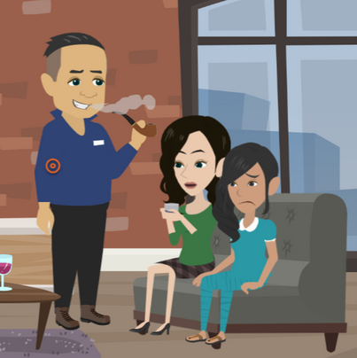
LESSON PLANS
MIND CONTROL
Why might young people NOT realize that sexual demands placed on them are wrong and illegal?
©2025 Walking Wise
60
3

Slide 61
MIND CONTROL
Normalized Abuse
Grooming and sexual abuse often start when children are young.
©2025 Walking Wise
61
Notes:
• EARLY AGE
Sexual crimes often begin very early during childhood, making it easier for sex acts to seem like a regular activity for children.
• NORMALIZED
Normalizing sexual abuse can cause children to think most other young people experience sexual activity with adults.
• PRIVILEGED
As it relates to sex trafficking, a common tactic used by family members is to convince children they are to serve the family in this way because they are "favored" and "special."
• FINANCIAL RESPONSIBILITY
Older children may be expected to contribute financially to the family to help pay for food and shelter for younger siblings.
• REVEALED
Often, it is not until victims become older that they understand the crimes committed against them.

Slide 62
MIND CONTROL
Normalized Abuse
Grooming and sexual abuse often start when children are young.
Some kids are made to believe that all young people go through the same experiences.
©2025 Walking Wise
62
Notes:
• EARLY AGE
Sexual crimes often begin very early during childhood, making it easier for sex acts to seem like a regular activity for children.
• NORMALIZED
Normalizing sexual abuse can cause children to think most other young people experience sexual activity with adults.
• PRIVILEGED
As it relates to sex trafficking, a common tactic used by family members is to convince children they are to serve the family in this way because they are "favored" and "special."
• FINANCIAL RESPONSIBILITY
Older children may be expected to contribute financially to the family to help pay for food and shelter for younger siblings.
• REVEALED
Often, it is not until victims become older that they understand the crimes committed against them.

Slide 63
MIND CONTROL
Normalized Abuse
Grooming and sexual abuse often start when children are young.
Some kids are made to believe that all young people go through the same experiences.
They may be told they are "special" or "chosen," making them think the abuse is a privilege.
©2025 Walking Wise
63
Notes:
• EARLY AGE
Sexual crimes often begin very early during childhood, making it easier for sex acts to seem like a regular activity for children.
• NORMALIZED
Normalizing sexual abuse can cause children to think most other young people experience sexual activity with adults.
• PRIVILEGED
As it relates to sex trafficking, a common tactic used by family members is to convince children they are to serve the family in this way because they are "favored" and "special."
• FINANCIAL RESPONSIBILITY
Older children may be expected to contribute financially to the family to help pay for food and shelter for younger siblings.
• REVEALED
Often, it is not until victims become older that they understand the crimes committed against them.

Slide 64
MIND CONTROL
Normalized Abuse
Grooming and sexual abuse often start when children are young.
Some kids are made to believe that all young people go through the same experiences.
They may be told they are "special" or "chosen," making them think the abuse is a privilege.
Some are pressured to believe it's their responsibility or “chore” to help support their family financially.
©2025 Walking Wise
64
Notes:
• EARLY AGE
Sexual crimes often begin very early during childhood, making it easier for sex acts to seem like a regular activity for children.
• NORMALIZED
Normalizing sexual abuse can cause children to think most other young people experience sexual activity with adults.
• PRIVILEGED
As it relates to sex trafficking, a common tactic used by family members is to convince children they are to serve the family in this way because they are "favored" and "special."
• FINANCIAL RESPONSIBILITY
Older children may be expected to contribute financially to the family to help pay for food and shelter for younger siblings.
• REVEALED
Often, it is not until victims become older that they understand the crimes committed against them.

Slide 65
EDUCATON GUIDE
VOCABULARY
GENERATIONAL
A repeated cycle of behaviors, beliefs, or traditions passed down from parents to their children, grandchildren, etc.
©2025 Walking Wise
65
3
Notes:
Assisting Source
OpenAI. (2024). ChatGPT [Large language model]. https://chatgpt.com

Slide 66
EDUCATON GUIDE
VOCABULARY
INFLUENCE
The ability to impact the actions, behavior, or opinions of others without using force or direct control.
©2025 Walking Wise
66
3
Notes:
Assisting Source
OpenAI. (2024). ChatGPT [Large language model]. https://chatgpt.com

Slide 67
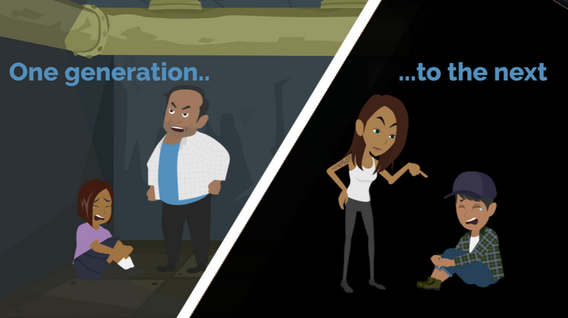
LESSON PLANS
GENERATIONAL
How does sexual exploitation continue from one generation to the next?
©2025 Walking Wise
67
3

Slide 68
GENERATIONAL
Family Life
Family influence plays a big role in shaping what behaviors are viewed as acceptable and normal.
©2025 Walking Wise
68
Notes:
• Family influences play a significant role in shaping what behaviors are seen as acceptable or normal.
• When children are exposed to pornography at home or made to witness sexual activity, they may become desensitized to such crimes.
• Growing up in an environment where pornography production or sex trafficking is present—whether within the family or the community—can lead to the belief that exchanging sex for money is a normal or necessary means of financial survival.
• These conditions increase the risk of children being subjected to exploitation and trauma.

Slide 69
GENERATIONAL
Family Life
Family influence plays a big role in shaping what behaviors are viewed as acceptable and normal.
Early exposure to pornography at home can cause children to be less sensitive to such images.
©2025 Walking Wise
69
Notes:
• Family influences play a significant role in shaping what behaviors are seen as acceptable or normal.
• When children are exposed to pornography at home or made to witness sexual activity, they may become desensitized to such crimes.
• Growing up in an environment where pornography production or sex trafficking is present—whether within the family or the community—can lead to the belief that exchanging sex for money is a normal or necessary means of financial survival.
• These conditions increase the risk of children being subjected to exploitation and trauma.

Slide 70
GENERATIONAL
False Behaviors & Beliefs
Being made to witness sexual activity is a form of grooming, which is child abuse.
©2025 Walking Wise
70
Notes:
• INFLUENCES
Family influences play a significant role in shaping what behaviors are seen as acceptable or normal.
• PORNOGRAPHY
When children are exposed to pornography at home or made to witness sexual activity, they may become desensitized to such crimes.
• NORMALIZING
Growing up in an environment where pornography production or sex trafficking is present—whether within the family or the community—can lead to the belief that exchanging sex for money is a normal or necessary means of financial survival.
• RISK FACTOR
These conditions increase the risk of children being subjected to exploitation and trauma.

Slide 71
GENERATIONAL
False Behaviors & Beliefs
Being made to witness sexual activity is a form of grooming, which is child abuse.
This kind of exposure can make young people believe it’s normal for kids to be involved in sexual activity.
©2025 Walking Wise
71
Notes:
• INFLUENCES
Family influences play a significant role in shaping what behaviors are seen as acceptable or normal.
• PORNOGRAPHY
When children are exposed to pornography at home or made to witness sexual activity, they may become desensitized to such crimes.
• NORMALIZING
Growing up in an environment where pornography production or sex trafficking is present—whether within the family or the community—can lead to the belief that exchanging sex for money is a normal or necessary means of financial survival.
• RISK FACTOR
These conditions increase the risk of children being subjected to exploitation and trauma.

Slide 72
GENERATIONAL
False Behaviors & Beliefs
Being made to witness sexual activity is a form of grooming, which is child abuse.
This kind of exposure can make young people believe it’s normal for kids to be involved in sexual activity.
Some kids may be swayed to believe that exchanging sex for money is a necessary way to support their family.
©2025 Walking Wise
72
Notes:
• INFLUENCES
Family influences play a significant role in shaping what behaviors are seen as acceptable or normal.
• PORNOGRAPHY
When children are exposed to pornography at home or made to witness sexual activity, they may become desensitized to such crimes.
• NORMALIZING
Growing up in an environment where pornography production or sex trafficking is present—whether within the family or the community—can lead to the belief that exchanging sex for money is a normal or necessary means of financial survival.
• RISK FACTOR
These conditions increase the risk of children being subjected to exploitation and trauma.

Slide 73
LESSON PLANS
PARENT TRAFFICKERS
Who is most likely to notify law enforcement about a child (under 18) being sex trafficked?
©2025 Walking Wise
Henderson, M. F. (2022, September). Human Trafficking by Families. University of North Carolina School of Government, Public Management Bulletin, No.24, Sog.unc.edu., p. 12.
73
3
Notes:
Slido.com: Multiple Choice
Who is most likely to notify law enforcement about a child (under 18) being sex trafficked?
A) Community Member
B) Family Member
C) School Staff Member
D) Medical Staff Member
ANSWER
A) Community Member
"[Familial trafficking] cases are more likely to be reported by anonymous community members rather than by professionals who work with vulnerable populations (such as teachers, health care providers, social workers, law enforcement officers)."
Source
Henderson, M. F. (2022, September). Human Trafficking by Families. University of North Carolina School of Government, Public Management Bulletin, No.24, Sog.unc.edu., p. 12. Retrieved March 3, 2024, from https://www.sog.unc.edu/sites/default/files/reports/PMB%2024_Henderson.pdf

Slide 74
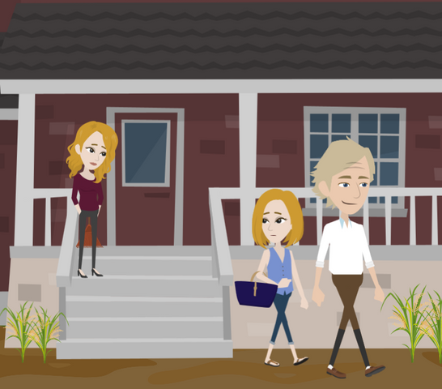
LESSON PLANS
PARENT TRAFFICKERS
Why might a parent believe they have no other choice but to exploit their children?
©2025 Walking Wise
74
3

Slide 75
PARENT TRAFFICKERS
Living Under Pressure
Sole financial provider as a single parent.
©2025 Walking Wise
75

Slide 76
PARENT TRAFFICKERS
Living Under Pressure
Sole financial provider as a single parent.
Experiencing financial crisis or poverty.
©2025 Walking Wise
76

Slide 77
PARENT TRAFFICKERS
Living Under Pressure
Sole financial provider as a single parent.
Experiencing financial crisis or poverty.
Loss of housing or unable to pay rent.
©2025 Walking Wise
77

Slide 78
PARENT TRAFFICKERS
Living Under Pressure
Sole financial provider as a single parent.
Experiencing financial crisis or poverty.
Loss of housing or unable to pay rent.
Owes money to drug dealers.
©2025 Walking Wise
78

Slide 79
PARENT TRAFFICKERS
Living Under Pressure
Sole financial provider as a single parent.
Experiencing financial crisis or poverty.
Loss of housing or unable to pay rent.
Owes money to drug dealers.
Under the control of a human trafficker or gang member.
©2025 Walking Wise
79

Slide 80
UNREPORTED CRIME
How do family traffickers or sex offenders often get away with their crimes against children?
©2025 Walking Wise
80
Notes:
SLIDO.com: Open Text
How do family traffickers or sex offenders often get away with their crimes against children?
POSSIBLE ANSWERS
• Parent's Authority
• Threaten Harm
• Seems Normal
• Isolate Victim
• Drug & Alcohol Use

Slide 81
UNREPORTED CRIME
Deceptive Tactics
Parental Authority: Young people are taught to trust and obey their parents, preventing them from recognizing abuse.
©2025 Walking Wise
81
Notes:
• PARENTAL AUTHORITY
Parents who engage in trafficking can easily make their children comply because children naturally obey their parents.
• NORMALIZATION
When children are exposed to a family’s history of selling sex or if they live in a community where prostitution is common, they may see prostitution as a normal way to earn a living.
• COERCION
Intimidation through isolation, confinement, and abuse (physical, emotional, verbal, and sexual abuse) can cause a child to feel helpless and obey the family trafficker’s demands.

Slide 82
UNREPORTED CRIME
Deceptive Tactics
Parental Authority: Young people are taught to trust and obey their parents, preventing them from recognizing abuse.
Normalization: When selling sex happens at home or in the community, it may seem normal instead of wrong and illegal.
©2025 Walking Wise
82
Notes:
• PARENTAL AUTHORITY
Parents who engage in trafficking can easily make their children comply because children naturally obey their parents.
• NORMALIZATION
When children are exposed to a family’s history of selling sex or if they live in a community where prostitution is common, they may see prostitution as a normal way to earn a living.
• COERCION
Intimidation through isolation, confinement, and abuse (physical, emotional, verbal, and sexual abuse) can cause a child to feel helpless and obey the family trafficker’s demands.

Slide 83
UNREPORTED CRIME
Deceptive Tactics
Parental Authority: Young people are taught to trust and obey their parents, preventing them from recognizing abuse.
Normalization: When selling sex happens at home or in the community, it may seem normal instead of wrong and illegal.
Coercion: Fear and threats cause young people to feel powerless and forced into sexual activity.
©2025 Walking Wise
83
Notes:
• PARENTAL AUTHORITY
Parents who engage in trafficking can easily make their children comply because children naturally obey their parents.
• NORMALIZATION
When children are exposed to a family’s history of selling sex or if they live in a community where prostitution is common, they may see prostitution as a normal way to earn a living.
• COERCION
Intimidation through isolation, confinement, and abuse (physical, emotional, verbal, and sexual abuse) can cause a child to feel helpless and obey the family trafficker’s demands.

Slide 84
UNREPORTED CRIME
Deceptive Tactics
Financial Pressure: Young people may feel forced to exchange sex for money to help pay family expenses.
©2025 Walking Wise
84
Notes:
• FINANCIAL PRESSURE
The family trafficker may require the youth to pay household expenses, using the threat of “no food” or the risk of “losing the family's home” to coerce the child into sex trafficking.
• DRUGS & ALCHOHOL
Family traffickers may use alcohol and illegal drugs to gain control over a young person by causing memory loss through intoxication or dependence on the continuous supply of drugs through addiction.

Slide 85
UNREPORTED CRIME
Deceptive Tactics
Financial Pressure: Young people may feel forced to exchange sex for money to help pay family expenses.
Drugs & Alcohol: Family traffickers may use drugs and alcohol to control victims through memory loss or addiction.
©2025 Walking Wise
85
Notes:
• FINANCIAL PRESSURE
The family trafficker may require the youth to pay household expenses, using the threat of “no food” or the risk of “losing the family's home” to coerce the child into sex trafficking.
• DRUGS & ALCHOHOL
Family traffickers may use alcohol and illegal drugs to gain control over a young person by causing memory loss through intoxication or dependence on the continuous supply of drugs through addiction.

Slide 86
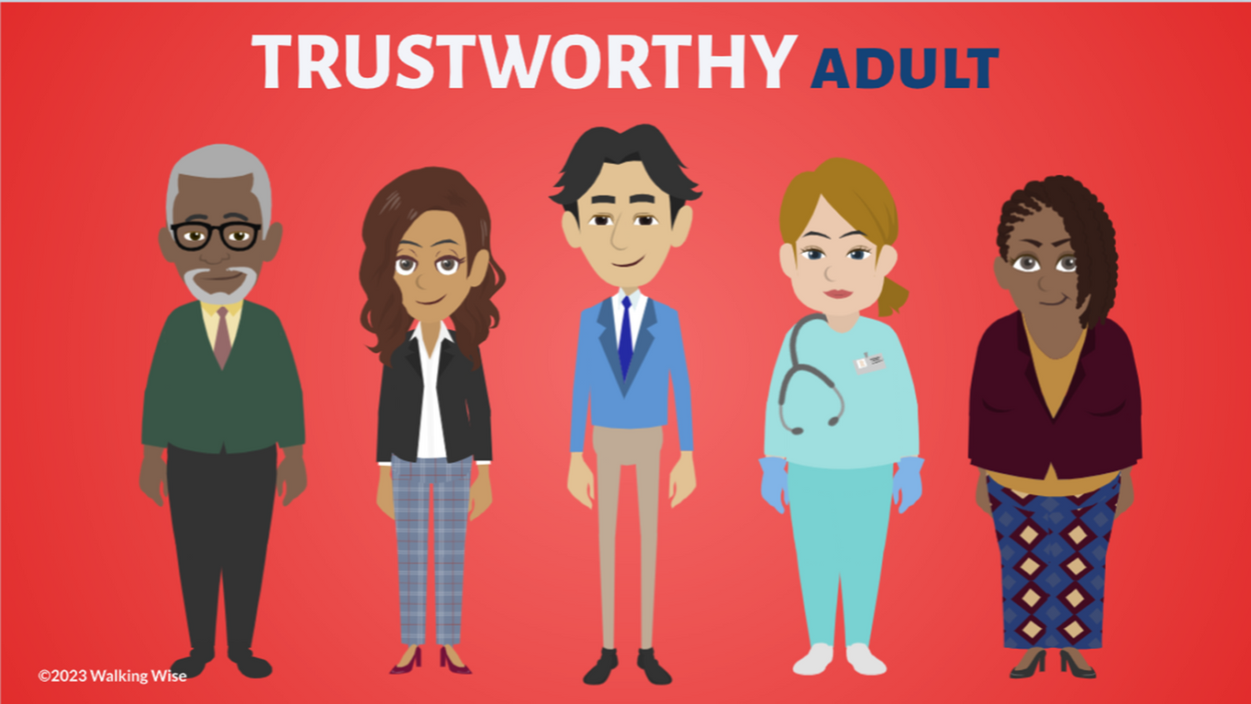
ASK FOR HELP
©2025 Walking Wise
86

Slide 87

ASK FOR HELP
What are ways young people can ask for help?
©2025 Walking Wise
87

Slide 88
ASK FOR HELP
How to Ask for Help
If you are in immediate danger, dial 911.
©2025 Walking Wise
88

Slide 89
ASK FOR HELP
How to Ask for Help
If you are in immediate danger, dial 911.
If the sexual predator IS a family member, consider telling a trustworthy adult.
©2025 Walking Wise
89

Slide 90
ASK FOR HELP
How to Ask for Help
If you are in immediate danger, dial 911.
If the sexual predator IS a family member, consider telling a trustworthy adult.
If the sexual predator is NOT family, consider telling a parent.
©2025 Walking Wise
90

Slide 91
ASK FOR HELP
How to Ask for Help
If you are in immediate danger, dial 911.
If the sexual predator IS a family member, consider telling a trustworthy adult.
If the sexual predator is NOT family, consider telling a parent.
If you are a student in school, consider telling a trustworthy teacher, coach, school nurse, social worker, counselor, resource officer, or principal.
©2025 Walking Wise
91

Slide 92
ASK FOR HELP
How to Ask for Help
If you are in immediate danger, dial 911.
If the sexual predator IS a family member, consider telling a trustworthy adult.
If the sexual predator is NOT family, consider telling a parent.
If you are a student in school, consider telling a trustworthy teacher, coach, school nurse, social worker, counselor, resource officer, or principal.
To gain internet access for help, consider using a computer at your school or a public library.
©2025 Walking Wise
92

Slide 93
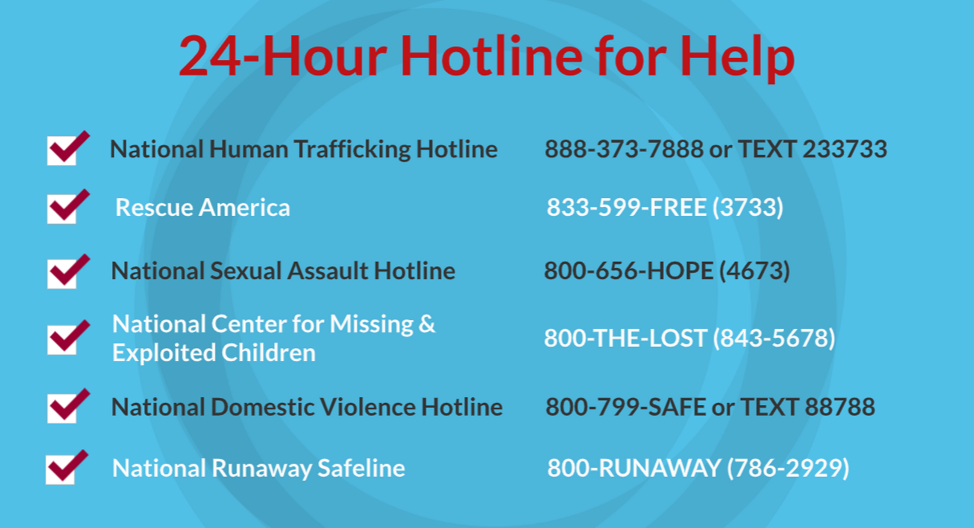
©2025 Walking Wise
93
Notes:
NOTE
Presenters may ask their audience to consider adding a few "hotline for help" phone numbers in their cell phone contacts or take a photo of this slide.

Slide 94
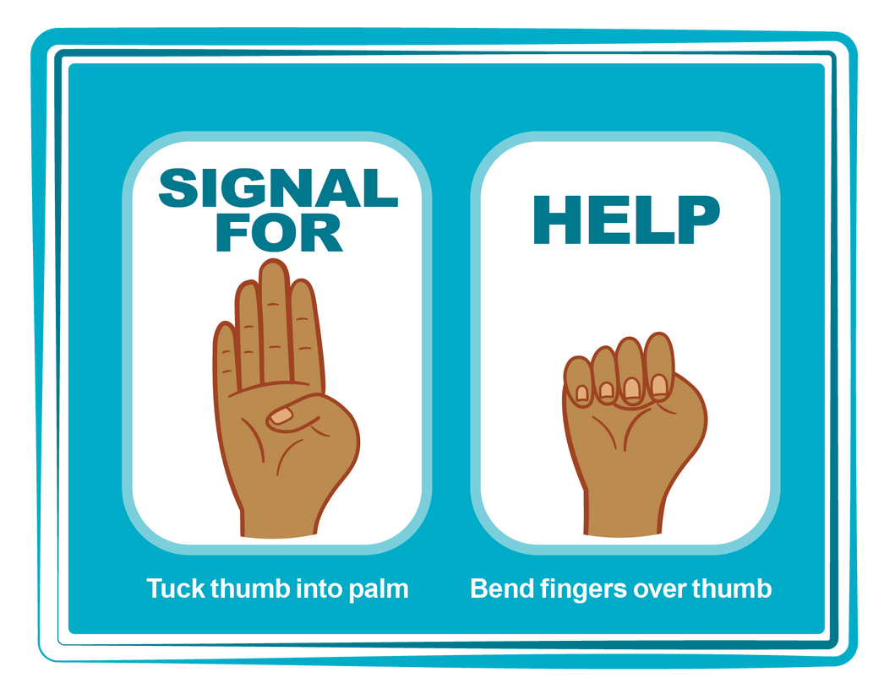
HAND SIGNAL FOR HELP
©2025 Walking Wise
Source: Canadian Women’s Foundation, April 2020
94
Notes:
Although the hand signal for help has not yet achieved universal recognition, it may discreetly get someone's attention in urgent situations.
• SILENT
It can be used silently.
• UNTRACKABLE
It leaves no digital footprint.
• CONCEALED
It can be done secretly when a perpetrator is in the vicinity.
• SIGNALS DISTRESS
Combining the hand signal with distressed facial expressions might help attract the attention of an individual who is unfamiliar with the signal's meaning.
Source
Canadian Women's Foundation, April 2020

Slide 95
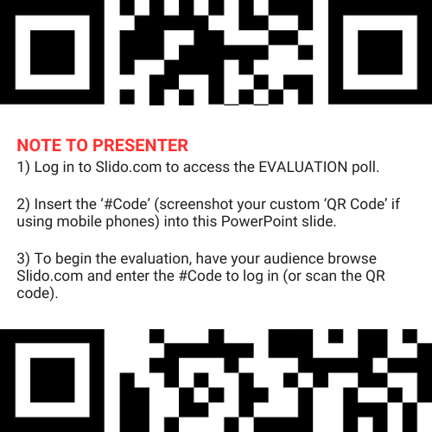
EVALUATION
©2025 Walking Wise
95
Notes:
SLIDO.com: 3-Question Survey
NOTE
Update this slide with your school/organization's custom QR code and #code.
Please encourage participants to scan your organization's custom QR code to share what they enjoyed and what could be improved about the lesson.
Please send any feedback you want to share to Walking Wise at support@WalkingWise.com.

Slide 96
SHARE YOUR THOUGHTS
1. How would you rate this lesson?
2. What was the one thing you liked?
3. What one thing should we improve?
Presenter: Replace “#XXXX” with your organization’s custom Slido code.
©2025 Walking Wise
96
Notes:
SLIDO.com: 3-Question Survey
NOTE
Follow the instructions provided on WalkingWise.com to access your school or organization's custom Slido QR code and #code, which will enable the audience to complete the 3-question evaluation.
Please encourage your audience to scan your organization's custom QR code to share what they enjoyed and what could be improved about the lesson.
Please send any feedback you want to share to Walking Wise at support@WalkingWise.com.

Slide 97


Thank you!
WalkingWise.com
Online Course for Adults Accredited by:
Postgraduate Institue for Medicine
Academy of Forensic Nursing
©2025 Walking Wise
97
Notes:
NOTE
To access additional resources about family traffickers, please refer to the last page of Lesson Plan #11 in the Walking Wise Education Guide.
We welcome your feedback at support@WalkingWise.com.
Thank you!
Karla Highman
Founder, WalkingWise.com

