Slide 1


SEXUAL EXPLOITATION
EDUCATION
GROOMING
PROCESS
LESSON #3
©2024-2026 Walking Wise
Notes:
NOTE
Log in to WalkingWise.com and refer to the Implementation Toolkit for classroom teaching tips.
Most importantly:
DEFINE SCHOOL POLICY
Establish a sexual exploitation reporting protocol with a trauma-informed response. The Walking Wise Implementation Toolkit provides a sample protocol.
AGE & AUDIENCE
This presentation can be edited by following the procedures on page 3 to align with your school policies, specific age groups, and the involvement of at-risk audiences.
SUPPORT PROCEDURE
Provide your students with guidance on how to access immediate help or arrange a private meeting with a social worker, counselor, nurse, school resource officer, or another trustworthy staff member to report concerns about themselves or a peer.
SECOND SAFE ADULT
Ensure a second trustworthy adult, such as a teacher, is present in the learning setting to observe student reactions and identify those who may benefit from a follow-up meeting. This person should remain focused and free from other duties during the presentation.

Slide 2

NOTE TO PRESENTER
This presentation is exclusively for Walking Wise® subscribers and not for redistribution.
Walking Wise encourages the use of Slido.com, an interactive digital tool, to enhance audience engagement. For more information, contact us at support@WalkingWise.com. Once configured, integrate Slido polling and add a post-evaluation to the PowerPoint presentation.
Presenters are encouraged to edit speaker notes to match their speaking style (viewable in presentation mode). You can also delete slides and content from this Walking Wise presentation to ensure the information aligns with your school policies, is age-appropriate, and fits within available class time. However, the slides are copyright-protected and may not be reworded without prior written permission from Walking Wise.
We encourage you to add your own content by following these instructions:
Insert new PowerPoint slides.
Remove the Walking Wise logo and copyright "©2026 Walking Wise" from the new slides.
Always add your organization's name or logo to each new slide.
Please delete this instruction page before presenting to audiences.
©2024-2026 Walking Wise
2
Notes:
NOTE TO PRESENTER
The presenter is welcome to customize this Walking Wise presentation according to the instructions provided on this page.
For revision requests, please email us at: support@WalkingWise.com.

Slide 3
STATISTICS
Why Study Results Can Vary
Some crimes are never reported, making it hard to reveal the entire issue.
Studies collect information in different ways, leading to different results.
Small studies may not represent everyone.
©2024-2026 Walking Wise
3
Notes:
In this presentation, we'll discuss statistics, but it's important to note that while statistics provide valuable insights into an issue, they cannot be relied upon entirely.
Here are a few reasons:
UNREPORTED
Victims often do not report the crimes committed against them due to fear, shame, or manipulation.
INCONSISTENT COLLECTION
Geographical areas have different legal definitions for sexual crimes, which may make data hard to compare.
FOCUS GROUPS
Small or specific focus groups participating in a study or survey may not accurately reflect the diversity or experiences of the broader population.

Slide 4
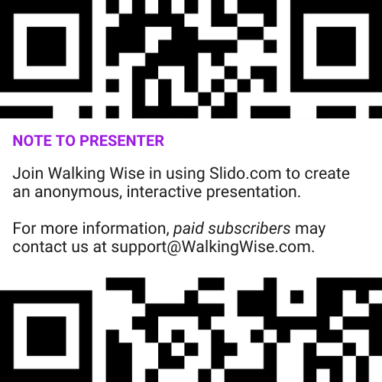
INTERACTIVE PARTICIPATION
Use Slido for Anonymous Questions
Presenter Instruction
After setting up Slido for this lesson, add the assigned access code or QR code to this slide so participants can join at Slido.com using their computers or phones.
©2024-2026 Walking Wise
4
Notes:
NOTE
For Online Interactive Polling with audiences:
Join Walking Wise in using Slido.com to create an anonymous user experience.
Contact us at support@WalkingWise.com for more information.
Upon activating Slido.com:
Determine whether the Q&A feature will be enabled. If activated, a staff member should monitor questions and comments to ensure they remain appropriate for the audience. Slido’s moderation tools allow administrators to delete or hide inappropriate submissions.

Slide 5
SENSITIVE TOPICS WILL BE DISCUSSED
CONTENT NOTICE
We’ll be discussing serious safety issues today.
Some topics may be difficult to hear.
If you ever feel uncomfortable, you can step out and speak with a trustworthy adult for support.
You’re not alone—help is available.
©2024-2026 Walking Wise
5
Notes:
NOTE TO PRESENTER
Presenter Guidelines for Delivery
Present the information in a calm, matter-of-fact way and avoid sensational language.
Avoid graphic details. Focus on understanding behaviors and staying safe.
Never blame victims. Responsibility always belongs to the person who caused harm.
Maintain a steady tone. Students often mirror the presenter’s emotional cues.
Do not ask students to share personal experiences.
If students laugh or react awkwardly, stay calm and continue teaching.
Always pair risk information with solutions and support.
Remind students they are not alone and help is available.

Slide 6

CONFRONTING SEXUAL EXPLOITATION
WALKING WISE
KNOWLEDGE serves as a
powerful defense against
a groomer.
©2024-2026 Walking Wise
6
Notes:
Education is one of the strongest tools for preventing exploitation.
When young people understand how predators operate, they are better able to recognize manipulation and avoid dangerous situations.
Reinforce that awareness increases safety.

Slide 7

CONFRONTING SEXUAL EXPLOITATION
WALKING WISE
SEXUAL EXPLOITATION includes grooming, sextortion, pornography
& sex trafficking.
©2024-2026 Walking Wise
7
Notes:
Sexual exploitation can include:
GROOMING
Building trust to manipulate someone.
SEXTORTION
Threatening to share private images.
PORNOGRAPHY
Involving vulnerable people in creating sexual images or videos.
SEX TRAFFICKING
Manipulating or forcing someone into sexual activity in exchange for money or something of value.

Slide 8
KNOWLEDGE
Understanding tricky or unsafe behavior can increase a young person’s safety.
©2024-2026 Walking Wise
8

Slide 9



KNOWLEDGE
Learning About Grooming
Understanding unsafe behavior is empowering.
©2024-2026 Walking Wise
9
Notes:
The goal of this lesson is to help young people be informed, not to make them feel afraid.
Most adults are caring and want to provide protection. However, unsafe adults, older teens, or peers may try to manipulate or take advantage of others.
By learning how grooming works, young people can better recognize unsafe behavior and feel confident asking a trustworthy adult for help.

Slide 10
KNOWLEDGE
Learning About Grooming
It helps us recognize warning signs.
©2024-2026 Walking Wise
10
Notes:
The goal of this lesson is to help young people be informed, not to make them feel afraid.
Most adults are caring and want to provide protection. However, unsafe adults, older teens, or peers may try to manipulate or take advantage of others.
By learning how grooming works, young people can better recognize unsafe behavior and feel confident asking a trustworthy adult for help.

Slide 11
KNOWLEDGE
Learning About Grooming
Increases confidence to ask a trustworthy adult for help.
©2024-2026 Walking Wise
11
Notes:
The goal of this lesson is to help young people be informed, not to make them feel afraid.
Most adults are caring and want to provide protection. However, unsafe adults, older teens, or peers may try to manipulate or take advantage of others.
By learning how grooming works, young people can better recognize unsafe behavior and feel confident asking a trustworthy adult for help.

Slide 12

EDUCATON GUIDE
VOCABULARY
VOCABULARY
Groomer
Opportunist
Boundary
Virtual Stranger
Brainwash
Isolate
Bond
Freedom
©2024-2026 Walking Wise
12
3
Notes:
Understanding vocabulary terms related to the behaviors of sexual predators can empower young people to recognize warning signs of harmful situations.
Knowing terminology helps them identify manipulative tactics predators use to build trust and exploit vulnerabilities.
With this knowledge, young people are better equipped to spot red flags, understand that these behaviors are abusive, and feel more confident reporting predators to trusted adults or authorities, potentially preventing further harm.

Slide 13
EDUCATON GUIDE
VOCABULARY
GROOMER
Someone who builds trust with a young person to manipulate or harm them.
©2024-2026 Walking Wise
13
3
Notes:
Grooming usually does not begin with obvious abuse. Instead, the person may act kind, supportive, or friendly at first. Over time, they slowly manipulate the young person.
Assisting Source
OpenAI. (2025). ChatGPT [Large language model]. https://chatgpt.com

Slide 14
EDUCATON GUIDE
VOCABULARY
OPPORTUNIST
A person who looks for chances to take advantage of others for their own benefit.
©2024-2026 Walking Wise
14
3
Notes:
Assisting Source
OpenAI. (2025). ChatGPT [Large language model]. https://chatgpt.com

Slide 15
EDUCATON GUIDE
VOCABULARY
BOUNDARY
A personal limit that protects our body, feelings, and values.
It helps us decide what behavior is acceptable or unacceptable.
©2024-2026 Walking Wise
15
3
Notes:
Assisting Source
OpenAI. (2025). ChatGPT [Large language model]. https://chatgpt.com

Slide 16
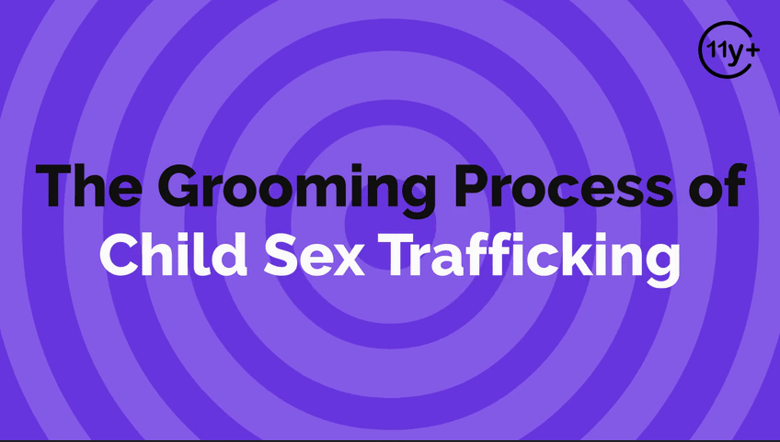
Log in to WalkingWise.com to access this animated video.
©2024-2026 Walking Wise
16
Notes:
Message Especially for Teens:
Explainer-style animation is used by businesses worldwide for employee training.
Similarly, the Walking Wise animated video series is designed for teenagers (ages 11+) and adults to understand how sexual predators use manipulation, intimidation, and coercion to exploit young people.
NOTE
Log in to Walking Wise.com to watch the three-minute animated video with audiences.

Slide 17
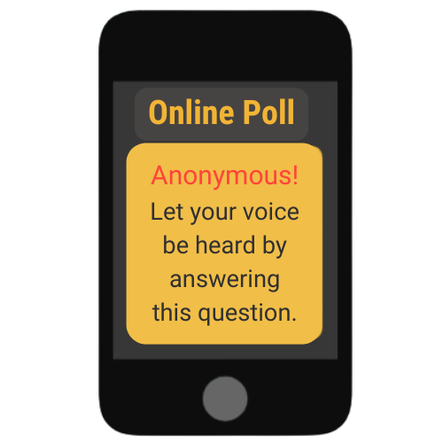
GROOMING PROCESS
In two words, name a way you think groomers target young people.
©2024-2026 Walking Wise
17
Notes:
Online Interactive Polling
SLIDO.com: Word Cloud
NOTE
The more frequently a word is used, the larger it appears in the cloud, making it easy to see which words or ideas are most common among the audience.
POSSIBLE ANSWERS
Gaining Trust
Giving Attention
Love & Care
Giving Gifts
Giving Money
Flattery
Compliments
Making Promises
Promising a Better Life

Slide 18
ANSWERS
Gaining Trust
Giving Attention
Love & Care
Giving Gifts
Giving Money
Flattery
Compliments
Promising a Better Life
©2024-2026 Walking Wise
18

Slide 19
GROOMING PROCESS
The Grooming Pattern
FRIENDSHIP → TRUST → DEPENDENCE → CONTROL
©2024-2026 Walking Wise
19
Notes:
To gain trust, groomers often begin by giving a young person things that make them feel valued and cared for. This may include extra attention, compliments, kindness, gifts, or promises of love and support.
At first, these behaviors may seem positive or harmless. However, the goal is often to build a special connection so the young person begins to trust the groomer more than others.
Once trust is established, the groomer usually begins to manipulate the relationship to gain influence and control.
Young people should learn that predators often start by acting kind and supportive before their behavior becomes harmful.

Slide 20
GROOMING PROCESS
Groomers Often Follow Patterns
Step 1: Gain Trust
They try to become someone the young person trusts.
©2024-2026 Walking Wise
20
Notes:
Grooming is usually a process that happens step by step.
The predator first becomes trusted, then looks for weaknesses or unmet needs, and finally tries to make the young person dependent on them.

Slide 21
GROOMING PROCESS
Groomers Often Follow Patterns
Step 2: Identify Vulnerabilities
They look for struggles or needs they can take advantage of.
©2024-2026 Walking Wise
21

Slide 22
GROOMING PROCESS
Grooming Often Follow Patterns
Step 3: Fulfill Needs
They provide attention, gifts, or support to make the young person rely on them.
©2024-2026 Walking Wise
22

Slide 23
GROOMING PROCESS
Grooming Often Follow Patterns
Step 3: Control
They begin making demands, using pressure, threats, or secrets to control the young person.
©2024-2026 Walking Wise
23

Slide 24

LESSON PLANS
WHY TRUST MATTERS
Why do groomers work to gain trust?
©2024-2026 Walking Wise
24

Slide 25
WHY TRUST MATTERS
How Trust is Used by Groomers
Once trusted, it is easier to determine a young person's needs or problems.
©2024-2026 Walking Wise
25
Notes:
Trust is normally healthy in relationships, but predators misuse it. When someone trusts another person deeply, they may ignore warning signs or feel pressure to cooperate.
Once the groomer earns trust, they can more easily identify the youths’ vulnerabilities and exploit them.

Slide 26
WHY TRUST MATTERS
How Trust is Used by Groomers
They gain more influence over a young person’s decisions.
©2024-2026 Walking Wise
26
Notes:
Targeted youth may sense that the expectation is inappropriate, unfair, or illegal, but once the groomer gains trust, they can persuade the victim to cooperate.

Slide 27
WHY TRUST MATTERS
How Trust is Used by Groomers
It is easier to cross personal boundaries.
©2024-2026 Walking Wise
27
Notes:
The targeted person is less likely to resist or challenge the requests made of them.

Slide 28
WHY TRUST MATTERS
How Trust is Used by Groomers
Trust reduces the chance a young person will say “no”.
©2024-2026 Walking Wise
28
Notes:
It is easier to manipulate and control the victims once trust is gained, especially when the victims are younger.

Slide 29
GAINING TRUST
What percent of victims said their trafficker gained their trust within one month?
n=86 minors
©2024-2026 Walking Wise
29
Notes:
Online Interactive Polling
SLIDO.com: Multiple Choice
What percent of victims said their trafficker (groomer) gained their trust within one month?
A) 12%
B) 22%
C) 32%
D) 42%
ANSWERS
D) 42% of victims said their trafficker gained their trust within one month.
Source
Thorn (2018). Survivor Insights: The Role of Technology in Domestic Minor
Sex Trafficking, p. 27.
https://www.thorn.org/wp-content/uploads/2018/06/Thorn_Survivor_Insights_061118.pdf

Slide 30
WHAT DO YOU THINK?
What percent of victims said their trafficker gained their trust within one month?
A) 12%
B) 22%
C) 32%
D) 42%
©2024-2026 Walking Wise
30
Notes:
NOTE TO PRESENTER:
Delete this slide if you are using Slido.com for audience interaction.

Slide 31
MULTIPLE CHOICE: D
ANSWER
42% of victims said their trafficker gained their trust within on month.
©2024-2026 Walking Wise
Thorn (2018). Survivor Insights: The Role of Technology in Domestic Minor Sex Trafficking, pl. 27.
31
Notes:
NOTE TO PRESENTER:
Delete this slide if you are using Slido.com for audience interaction.
Source
Thorn (2018). Survivor Insights: The Role of Technology in Domestic Minor
Sex Trafficking, p. 27.
https://www.thorn.org/wp-content/uploads/2018/06/Thorn_Survivor_Insights_061118.pdf

Slide 32
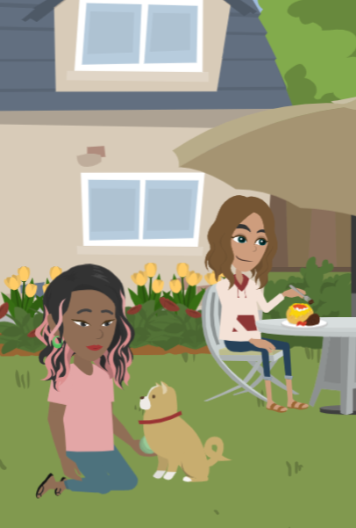
LESSON PLANS
HIDDEN IN PLAIN SIGHT
How can groomers be “hidden in plain sight”?
©2024-2026 Walking Wise
32
3
Notes:
The phrase “hidden in plain sight” means someone can appear normal or trustworthy while hiding harmful intentions.
Groomers often work to build a good reputation so others will not suspect them.
They may be respected adults, family friends, or people involved in school, sports, or community activities. Because they appear trustworthy, their behavior may go unnoticed for a long time.
It's important not to be afraid, but to recognize unsafe behaviors, even when the adult, older teen, or peer seems friendly or respected.

Slide 33
HIDDEN IN PLAIN SIGHT
Why Groomers Often Go Unnotice
They can appear as trustworthy adults or friends.
©2024-2026 Walking Wise
33

Slide 34
HIDDEN IN PLAIN SIGHT
Why Groomers Often Go Unnotice
They may hold positions of authority.
©2024-2026 Walking Wise
34

Slide 35
HIDDEN IN PLAIN SIGHT
Why Groomers Often Go Unnotice
They often already know the young person they target.
©2024-2026 Walking Wise
35

Slide 36
HIDDEN IN PLAIN SIGHT
Why Groomers Often Go Unnotice
They can earn the trust of parents and other adults.
©2024-2026 Walking Wise
36

Slide 37
HIDDEN IN PLAIN SIGHT
Why Groomers Often Go Unnotice
Groomers can fool everyone, even an entire community.
©2024-2026 Walking Wise
37

Slide 38
GROOMERS
In two words, what roles or positions might a groomer hold?
©2024-2026 Walking Wise
38
Notes:
Online Interactive Polling
SLIDO.com: Word Cloud
NOTE
The more frequently a word is used, the larger it appears in the cloud, making it easy to see which words or ideas are most common among the audience.

Slide 39
GROOMERS
Family Members
Parent, Stepparent, Foster Parent
Aunt or Uncle, Grandparent, Sibling
Other Relative
©2024-2026 Walking Wise
39
Notes:
Groomers are not usually strangers. In many cases, they are someone the young person already knows or trusts.
The purpose of this lesson is to help us understand that grooming can occur in many different types of relationships. Because of this, it is important to recognize unsafe behaviors, rather than focusing only on who the person is or what role they hold.
Most people in these roles genuinely care about young people and want to protect them. However, when someone manipulates, pressures, or crosses personal boundaries, that behavior is unsafe, no matter who the person is.

Slide 40
GROOMERS
Trusted Adult or Community Member
Teacher
Coach
Counselor
School Staff
©2024-2026 Walking Wise
40

Slide 41
GROOMERS
Trusted Adult or Community Member
Teacher
Coach
Counselor
School Staff
Religious Leader
Employer or Boss
Police Officer
Doctor / Dentist
©2024-2026 Walking Wise
41

Slide 42
GROOMERS
Peer or Other Relationships
Friend
Romantic Partner
Older Teen
©2024-2026 Walking Wise
42

Slide 43
GROOMERS
Peer or Other Relationships
Friend
Romantic Partner
Older Teen
Classmate
Neighbor
Acquaintance
©2024-2026 Walking Wise
43

Slide 44
GROOMERS
Stranger
Online Connection
Someone Unknown
©2024-2026 Walking Wise
44

Slide 45
EDUCATON GUIDE
VOCABULARY
‘VIRTUAL’ STRANGER
Someone met online whose true identity and intentions cannot be verified or confirmed.
©2024-2026 Walking Wise
45
3
Notes:
Assisting Source
OpenAI. (2024). ChatGPT [Large language model]. https://chatgpt.com

Slide 46
VIRTUAL STRANGER
What percent of minors (ages 9 to 17) reported connecting online with adults they don’t know in person?
n=1,200 minors
46
©2024-2026 Walking Wise
Notes:
Online Interactive Polling
SLIDO.com: Multiple Choice
What percent of minors (ages 9 to 17) report connecting online with adults they don’t know in person?
A) 22%
B) 52%
C) 82%
D) 92%
ANSWER
C) 82% of minors interact online with adults they do not know in person.
SOURCE
Thorn (2022, April). Online Grooming: Examining
risky encounters amid
everyday digital socialization, p. 14.
https://info.thorn.org/hubfs/Research/2022_Online_Grooming_Report.pdf

Slide 47
WHAT DO YOU THINK?
What percent of minors (ages 9 to 17) reported connecting online with adults they don’t know in person?
A) 22%
B) 52%
C) 82%
D) 92%
©2024-2026 Walking Wise
47
Notes:
NOTE TO PRESENTER:
Delete this slide if you are using Slido.com for audience interaction.

Slide 48
MULTIPLE CHOICE: C
ANSWER
82% of minors interact online with adults they do NOT know in person.
©2024-2026 Walking Wise
Thorn (2022, April). Online Grooming: Examining risky encounters amid everyday digital socialization, p. 14.
48
Notes:
NOTE TO PRESENTER:
Delete this slide if you are using Slido.com for audience interaction.
SOURCE
Thorn (2022, April). Online Grooming: Examining
risky encounters amid
everyday digital socialization, p. 14. Retrieved January 12, 2026, from https://info.thorn.org/hubfs/Research/2022_Online_Grooming_Report.pdf

Slide 49
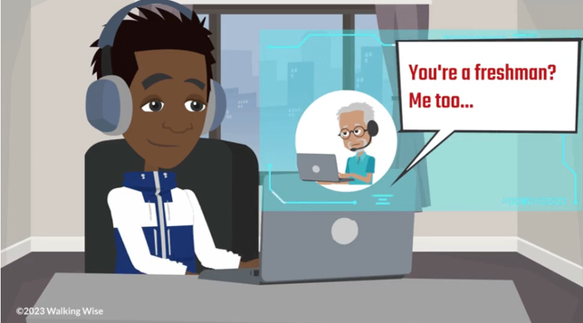
LESSON PLANS
VIRTUAL STRANGER
Adults online can pretend to be someone they are not.
©2024-2026 Walking Wise
49

Slide 50
VIRTUAL STRANGER
Adult Connections
Survey: 1-in-4 teens (ages 13-17) said they interact online with someone they believe is 30 or older.
Thorn (2022, April). Online Grooming: Examining risky encounters amid everyday digital socialization, p. 14.
n=1,200 minors
50
©2024-2026 Walking Wise
Notes:
SOURCE
Thorn (2022, April). Online Grooming: Examining
risky encounters amid
everyday digital socialization, p. 14. Retrieved on 10/31/2024 from:
https://info.thorn.org/hubfs/Research/2022_Online_Grooming_Report.pdf.

Slide 51
VIRTUAL STRANGER
Adult Connections
Survey: 2-in-3 children (ages 9-12) said they interact online with adults they don’t know in real life.
Thorn (2022, April). Online Grooming: Examining risky encounters amid everyday digital socialization, p. 14.
n=1,200 minors
51
©2024-2026 Walking Wise
Notes:
SOURCE
Thorn (2022, April). Online Grooming: Examining
risky encounters amid
everyday digital socialization, p. 14. Retrieved on 10/31/2024 from:
https://info.thorn.org/hubfs/Research/2022_Online_Grooming_Report.pdf.

Slide 52
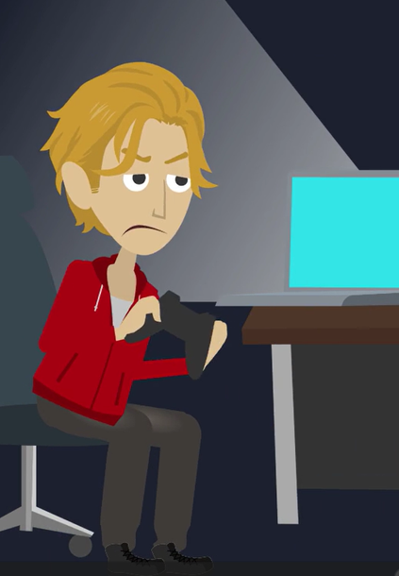
LESSON PLANS
CONNECTIONS
How do groomers often meet the young people they target?
©2024-2026 Walking Wise
52
Notes:
ONLINE
Groomers can attempt to gain a young person’s friendship online using social media apps and gaming platforms.
PUBLIC PLACES
They can meet young people in public places like parks, concerts, and shopping malls.
SOCIAL GATHERINGS
They might meet a youth at a friend’s or acquaintance’s party and pretend to be interested in developing a friendship or romantic relationship.
ACQUAINTANCES
They often already know the youth, so they work to build a special relationship by pretending to share interests or hobbies.

Slide 53
CONNECTIONS
Meeting Targeted Individuals
Online: Social media apps and gaming platforms
©2024-2026 Walking Wise
53

Slide 54
CONNECTIONS
Meeting Targeted Individuals
Public Places: Parks, concerts, shopping malls
©2024-2026 Walking Wise
54

Slide 55
CONNECTIONS
Meeting Targeted Individuals
Social Gatherings: Friends’ parties and local meet-up spots
©2024-2026 Walking Wise
55

Slide 56
CONNECTIONS
Meeting Targeted Individuals
Acquaintances: Someone who already knows the young person.
©2024-2026 Walking Wise
56

Slide 57
EDUCATON GUIDE
VOCABULARY
BRAINWASH
To manipulate someone’s thoughts and beliefs until they accept new ideas without question.
©2024-2026 Walking Wise
57
3
Notes:
Assisting Source
OpenAI. (2024). ChatGPT [Large language model]. https://chatgpt.com

Slide 58
EDUCATON GUIDE
VOCABULARY
ISOLATE
To separate or cut someone off from their support network of family or friends.
©2024-2026 Walking Wise
58
3
Notes:
Assisting Source
OpenAI. (2024). ChatGPT [Large language model]. https://chatgpt.com

Slide 59
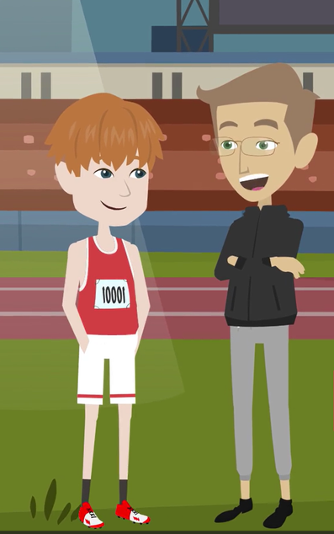
LESSON PLANS
OBLIGATION
Groomers often manipulate victims to create a sense of loyalty and obligation.
©2024-2026 Walking Wise
59
Notes:
Kindness should never come with pressure, secrecy, or expectations in return.
Groomers often create a feeling that the young person “owes” them something because of gifts, attention, or kindness.
This manipulation can make it harder for the young person to say no or recognize that something is wrong.
Groomers may also use compliments, sympathy, or favoritism to make the young person feel special and emotionally connected to them.
Over time, these tactics can create a sense of loyalty, guilt, or pressure, which the groomer later uses to influence the young person’s decisions.

Slide 60
LOYALTY & OBLIGATION
Feelings of Guilt or Pressure
Groomers can use gifts, money, or special favors to create a sense of owing something to them.
©2024-2026 Walking Wise
60

Slide 61
LOYALTY & OBLIGATION
Feelings of Guilt or Pressure
They often give praise or compliments, especially to someone who feels left out or unsure of themselves.
©2024-2026 Walking Wise
61

Slide 62
LOYALTY & OBLIGATION
Feelings of Guilt or Pressure
They may make risky or harmful behavior seem normal, exciting, or grown-up.
©2024-2026 Walking Wise
62

Slide 63
LOYALTY & OBLIGATION
Feelings of Guilt or Pressure
They often use guilt or sympathy to create emotional attachment.
©2024-2026 Walking Wise
63

Slide 64
LOYALTY & OBLIGATION
Feelings of Guilt or Pressure
They can use favoritism to separate a young person from their peers.
©2024-2026 Walking Wise
64

Slide 65
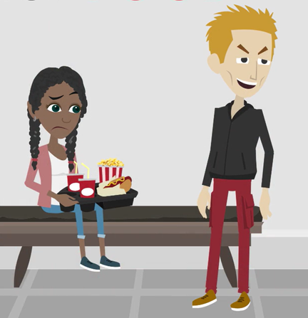
LESSON PLANS
CREATING DEPENDENCE
Groomers often manipulate young people to make them feel dependent?
©2024-2026 Walking Wise
65
Notes:
Healthy relationships do not create pressure, control, or dependence.
Some groomers try to make young people feel they need the predator to receive important things. This might include money, food, clothing, transportation, or a place to stay.
Over time, the young person may begin to rely on the groomer for their daily needs.

Slide 66
CREATING DEPENDENCE
How Groomers Become “Needed”
Groomers may provide basic needs like money, food, or a place to stay.
©2024-2026 Walking Wise
66

Slide 67
CREATING DEPENDENCE
How Groomers Become “Needed”
Groomers may provide basic needs like money, food, or a place to stay.
They might give clothing, phones, rides, or other favors.
©2024-2026 Walking Wise
67

Slide 68
CREATING DEPENDENCE
How Groomers Become “Needed”
Groomers may provide basic needs like money, food, or a place to stay.
They might give clothing, phones, rides, or other favors.
They may offer free alcohol or drugs.
©2024-2026 Walking Wise
68

Slide 69

LESSON PLANS
GROOMERS CHANGE
Once trust is gained, how do groomers change their behavior to control the victim?
©2024-2026 Walking Wise
69
3
Notes:
Healthy relationships do not involve pressure, threats, or isolation from family and friends.

Slide 70
GROOMERS CHANGE
The Shift from Kindness to Demands
Groomers take control by making demands.
©2024-2026 Walking Wise
70
Notes:
Once the groomer gains trust and influence, their behavior changes.

Slide 71
GROOMERS CHANGE
The Shift from Kindness to Demands
They might threaten to take away support, like money, housing, gifts, or affection.
©2024-2026 Walking Wise
71
Notes:
They usually start making demands, using pressure, or threatening to take away things they previously provided.

Slide 72
GROOMERS CHANGE
The Shift from Kindness to Demands
They often isolate the young person by pressuring them to pull away from family and friends.
©2024-2026 Walking Wise
72
Notes:
Groomers may also try to separate the young person from trusted adults and friends who might recognize the danger.

Slide 73
GROOMERS CHANGE
The Shift from Kindness to Demands
They may apply pressure to break rules or rebel against adults, such as parents, coaches, and teachers.
©2024-2026 Walking Wise
73
Notes:
Groomers may encourage the young person to rebel against trusted adults in their life, such as parents, teachers, or coaches, by breaking rules or ignoring expectations.
They may also pressure the young person to drop out of activities, teams, or clubs that keep them connected to supportive people.
This shift from kindness to control is an important warning sign.

Slide 74
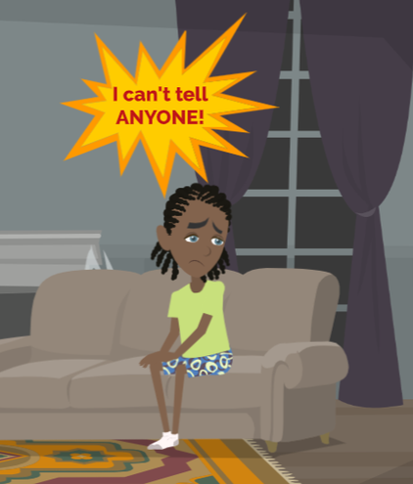
LESSON PLANS
UNREPORTED CRIME
Many crimes involving abuse are never reported.
©2024-2026 Walking Wise
74

Slide 75
UNREPORTED CRIME
Why Many Victims Stay Silent
Victims may feel threatened, scared, or embarrassed.
©2024-2026 Walking Wise
75
Notes:
Abuse is never the victim’s fault. Sometimes it can be hard to ask for help, but telling a trusted adult is an important step toward safety and support.
Many victims do not report abuse right away, and some may never tell anyone.
Groomers often use fear, threats, manipulation, or shame to keep victims silent.

Slide 76
UNREPORTED CRIME
Why Many Victims Stay Silent
They feel ashamed or blame themselves.
©2024-2026 Walking Wise
76
Notes:
Victims may also blame themselves or feel embarrassed about what happened.

Slide 77
UNREPORTED CRIME
Why Many Victims Stay Silent
The predator may make the abuse seem “normal”.
©2024-2026 Walking Wise
77
Notes:
Oftentimes, the groomer slowly normalizes the behavior so the young person does not immediately recognize that it is wrong or illegal.

Slide 78
UNREPORTED CRIME
Why Many Victims Stay Silent
Some do not realize that what is happening is a crime.
©2024-2026 Walking Wise
78
Notes:
Oftentimes, the groomer slowly normalizes the behavior so the young person does not immediately recognize that it is wrong or illegal.

Slide 79
LESSON PLANS
WHY STAY?
What might make it hard for a young person to leave an abusive situation?
©2024-2026 Walking Wise
79
3
Notes:
Online Polling Interaction
SLIDO.com: Open Text
NOTE
An open-text poll allows participants to type in their answers or comments, making it ideal for sharing detailed responses.

Slide 80
EDUCATON GUIDE
VOCABULARY
BOND
A strong emotional connection that makes someone feel attached, loyal, or dependent on another person.
©2024-2026 Walking Wise
80
3
Notes:
Assisting Source
OpenAI. (2024). ChatGPT [Large language model]. https://chatgpt.com

Slide 81
WHY STAY?
Bonds Can Make It Hard To Break Away
Love Bond: Predator creates an emotional attachment.
©2024-2026 Walking Wise
81
Notes:
Predators use bonds as forms of manipulation to control victims by causing them to feel emotionally or physically dependent upon them, making leaving feel impossible. However, help is available even when someone feels trapped or afraid.
LOVE BOND: A love bond forms when the predator pretends to care deeply, expresses love, or gives attention that makes the young person feel special and loyal.

Slide 82
WHY STAY?
Bonds Can Make It Hard To Break Away
Debt Bond: Victim fears losing basic needs they cannot afford.
©2024-2026 Walking Wise
82
Notes:
DEBT BOND
A debt bond occurs when the predator provides things the young person needs—such as money, food, housing, or transportation—so the victim feels they owe the predator something or fears losing those necessities.

Slide 83
WHY STAY?
Bonds Can Make It Hard To Break Away
Drug Bond: Predator controls access to drugs & alcohol.
©2024-2026 Walking Wise
83
Notes:
DRUG BOND
A drug bond develops when the predator introduces or controls access to drugs or alcohol, creating dependence that makes it harder for the victim to leave.

Slide 84
WHY STAY?
Bonds Can Make It Hard To Break Away
Family Bond: Victim fears they’ll be forced out of their family.
©2024-2026 Walking Wise
84
Notes:
FAMILY BOND
A family bond may occur when the victim fears rejection, punishment, or being forced out of their family if they do not comply.

Slide 85
WHY STAY?
Fear Can Make It Hard To Break Away
Sextortion: Predator threatens to release images of the victim.
©2024-2026 Walking Wise
85
Notes:
Predators often use fear and intimidation to make victims feel trapped and unable to leave.
SEXTORTION
Sextortion occurs when the predator threatens to share embarrassing or explicit images of the victim with friends, family, or online unless the victim continues to comply with demands.

Slide 86
WHY STAY?
Fear Can Make It Hard To Break Away
Isolation: Predator makes them believe they have no one else.
©2024-2026 Walking Wise
86
Notes:
ISOLATION
Isolation is another tactic where the predator slowly separates the victim from supportive people, convincing them that no one else cares about them or would believe them.

Slide 87
WHY STAY?
Fear Can Make It Hard To Break Away
Physical Threats: Victim fears harm to themself or loved ones.
©2024-2026 Walking Wise
87
Notes:
PHYSICAL THREATS
Physical threats may involve threats of harm toward the victim, their siblings, parents, or even pets, creating fear that speaking up will cause someone to get hurt.

Slide 88
WHY STAY?
Fear Can Make It Hard To Break Away
Legal Threats: Predator makes the victim feel like a criminal.
©2024-2026 Walking Wise
88
Notes:
LEGAL THREATS
Legal threats occur when predators lie about laws or police involvement, making the victim believe they will get in trouble or be arrested if they tell anyone.
These tactics are meant to create fear and silence, but victims are not criminals, and help is always available through trusted adults and authorities.

Slide 89
EDUCATON GUIDE
VOCABULARY
FREEDOM
To allow someone the power to move, think, speak, and choose for themselves without restriction.
©2024-2026 Walking Wise
89
3
Notes:
Assisting Source
OpenAI. (2024). ChatGPT [Large language model]. https://chatgpt.com

Slide 90

LESSON PLANS
EMPOWERMENT
How young people can help protect themselves.
©2024-2026 Walking Wise
90
3

Slide 91
EMPOWERMENT
Ways to Protect Yourself
Trust your instincts or feelings.
©2024-2026 Walking Wise
91
Notes:
If something feels wrong, trust your instincts or intuition. Groomers might try to make you feel obligated, but feeling uncomfortable is a valid signal.

Slide 92
EMPOWERMENT
Ways to Protect Yourself
Trust your instincts or feelings.
Set clear boundaries.
©2024-2026 Walking Wise
92
Notes:
Communicate your boundaries and stick to them. Don't let anyone cross the line to pressure you into doing something that makes you uncomfortable.

Slide 93
EMPOWERMENT
Ways to Protect Yourself
Trust your instincts or feelings.
Set clear boundaries.
Say “NO” confidently.
©2024-2026 Walking Wise
93
Notes:
Practice saying a firm "NO" without hesitation. If someone makes you feel uncomfortable, you're not obligated to give them any time, attention, or explanation.

Slide 94
EMPOWERMENT
Ways to Protect Yourself
Trust your instincts or feelings.
Set clear boundaries.
Say “NO” confidently.
Recognize manipulation.
©2024-2026 Walking Wise
94
Notes:
Think about the manipulation tactics you've just learned groomers use, such as guilt trips or emotional control. Being aware helps avoid falling into their traps.

Slide 95
EMPOWERMENT
Important Safety Steps
Stop communicating with the person.
©2024-2026 Walking Wise
95
Notes:
Remember that your well-being comes first. Don't feel obligated to hang out with someone who makes you feel awkward or asks you to do something that makes you feel uncomfortable.
Discontinue all communication, even if frightened by threats or embarrassed by what happened.

Slide 96
EMPOWERMENT
Important Safety Steps
Stop communicating with the person
Keep messages and images as evidence.
©2024-2026 Walking Wise
96
Notes:
Keep all communication received from the groomer, including any embarrassing texts, online messages, images, and threats, as evidence so law enforcement can investigate.

Slide 97
EMPOWERMENT
Important Safety Steps
Stop communicating with the person
Keep messages or evidence
Ask for help until someone listens.
©2024-2026 Walking Wise
97
Notes:
When feeling at risk, immediately inform a trustworthy adult.
If that adult does not help, go to other trustworthy adults, such as an adult who has the authority or connections to help you break free of a sexual predator's influence.

Slide 98

ASK FOR HELP
©2024-2026 Walking Wise
98
Notes:
If you are in immediate danger, dial 911.
If the sexual predator IS a family member, consider telling a trustworthy adult.
If the sexual predator is NOT family, consider telling a parent.
If you are a student in school, consider telling a trustworthy teacher, coach, school nurse, social worker, counselor, resource officer, or principal.
To get online for help, consider using a computer at your school or a public library.

Slide 99
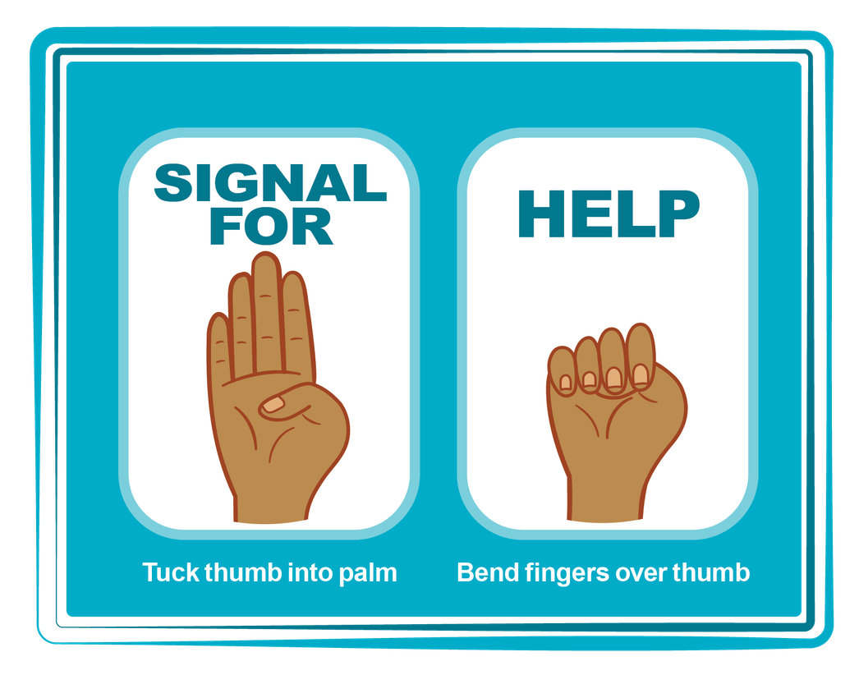
HAND SIGNAL FOR HELP
©2024-2026 Walking Wise
Source: Canadian Women’s Foundation, April 2020
99
Notes:
Although the hand signal for help has not yet achieved universal recognition, it may discreetly get someone's attention in urgent situations.
SILENT
It can be used silently.
UNTRACKABLE
It leaves no digital footprint.
CONCEALED
It can be done secretly when a perpetrator is nearby.
SIGNALS DISTRESS
Combining the hand signal with distressed facial expressions might help attract the attention of an individual who is unfamiliar with the signal's meaning.
Source
Canadian Women's Foundation, April 2020

Slide 100
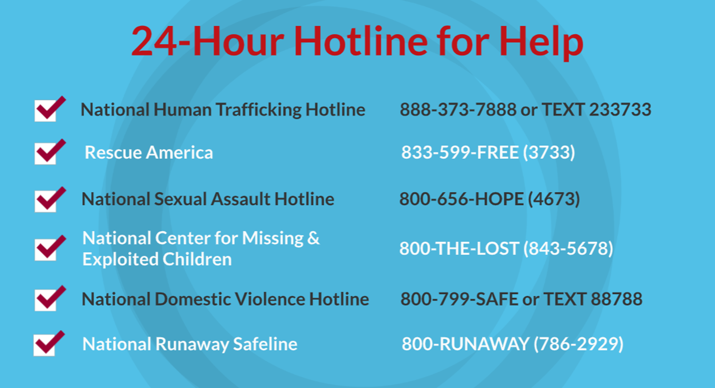
©2024-2026 Walking Wise
100
Notes:
NOTE
Presenters may ask their audience to consider adding a few "hotline for help" phone numbers in their cell phone contacts or take a photo of this slide.

Slide 101
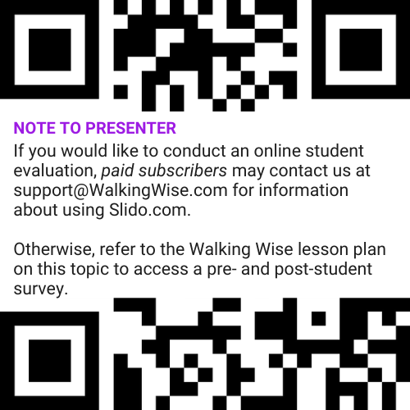
EVALUATION
©2024-2026 Walking Wise
101
Notes:
Two ways to conduct a pre-/post-student evaluation:
1) Use the pre/post survey in the Walking Wise lesson plan for this topic.
2) Activate Slido.com to conduct an online survey.

Slide 102

SHARE YOUR THOUGHTS
1. How would you rate this lesson?
2. What was the one thing you liked?
3. What one thing should we improve?
If Using Slido: Replace “#XXXX” with your organization’s custom Slido code.
©2024-2026 Walking Wise
102
Notes:
Online Interactive Polling
SLIDO.com: 3-Question Survey
IF SLIDO IS ACTIVATED:
Follow the instructions provided on WalkingWise.com to access your school or organization's custom Slido QR code and #code, which the audience will use to complete the 3-question evaluation.
Please encourage your audience to scan your organization's custom QR code to share what they enjoyed and what could be improved about the lesson.
Please send any feedback you want to share to Walking Wise at support@WalkingWise.com.

Slide 103



Thank you!
WalkingWise.com
Online Course for Adults Accredited by: Postgraduate Institue for Medicine Academy of Forensic Nursing
©2024-2026 Walking Wise
103
Notes:
NOTE TO PRESENTER
To access additional resources on the grooming process, please see the last page of Lesson Plan #3 on the Walking Wise Learning Platform.
We welcome your feedback at support@WalkingWise.com.

