Slide 1


CHILD EXPLOITATION
EDUCATION
GROOMING
PROCESS
BY WALKING WISE
©2024-2026 Walking Wise
Notes:
NOTE TO PRESENTER
Log in to WalkingWise.com and refer to the Implementation Toolkit for classroom teaching tips.
Most importantly:
DEFINE SCHOOL POLICY
Establish a sexual exploitation reporting protocol with a trauma-informed response. The Walking Wise Implementation Toolkit provides a sample protocol.
AGE & AUDIENCE
This presentation can be edited by following the procedures on page 3 to align with your school policies, specific age groups, and the involvement of at-risk audiences.
SUPPORT PROCEDURE
Provide your students with guidance on how to access immediate help or arrange a private meeting with a social worker, counselor, nurse, school resource officer, or another trustworthy staff member to report concerns about themselves or a peer.
SECOND SAFE ADULT
Ensure a second trustworthy adult, such as a teacher, is present in the learning setting to observe student reactions and identify those who may benefit from a follow-up meeting. This person should remain focused and free from other duties during the presentation.

Slide 2

6-Year Track
NOTE TO PRESENTER
Meaningful learning takes time. By introducing topics gradually over several years, educators can create steady growth in awareness and understanding.
Our recommended teaching plan offers a long-term path for middle and high school students to build knowledge and confidence.
PARENTS & STAFF
#1 Myths & Reality
6th GRADE
#2 Trustworthy vs. Unsafe Adult
#3 Grooming Process
7th GRADE
#4 Pornography Link
#5 Sextortion Scheme
8th GRADE
#6 Male Victims
#7 Runaways as Targets
#8 Rural Risks
9th GRADE
#9 Human Traffickers
#10 Female & Peer Recruiters
10th GRADE
#11 Family Secret
11th GRADE
#12 Hidden Buyers
©2024-2026 Walking Wise
2

Slide 3

NOTE TO PRESENTER
This presentation is exclusively for Walking Wise® subscribers and not for redistribution.
Presenters are encouraged to edit speaker notes to match their speaking style (viewable in presentation mode). You can also delete slides and content from this Walking Wise presentation to ensure the information aligns with your school policies, is age-appropriate, and fits within available class time. However, the slides are copyright-protected and may not be reworded without prior written permission from Walking Wise.
We encourage you to add your own content by following these instructions:
  Insert new PowerPoint slides.
  Remove the Walking Wise logo and copyright "©2026 Walking Wise" from the new slides.
  Always add your organization's name or logo to each new slide.
Please delete this instruction page before presenting to audiences.
R042726
©2024-2026 Walking Wise
3
Notes:
NOTE TO PRESENTER
The presenter is welcome to customize this Walking Wise presentation according to the instructions provided on this page.
For revision requests, please email us at: support@WalkingWise.com.

Slide 4
SENSITIVE TOPICS WILL BE DISCUSSED
CONTENT NOTICE
We’ll be discussing serious safety issues today.
Some topics may be difficult to hear.
If you ever feel uncomfortable, you can step out and speak with a trustworthy adult for support.
You’re not alone—help is available.
©2024-2026 Walking Wise
4
Notes:
NOTE TO PRESENTER
Trauma-Informed Delivery Guidelines
To support a safe and effective learning environment, please follow these guidelines:
• Present the information in a calm, matter-of-fact way and avoid sensational or alarming language.
• Avoid graphic details. Focus on helping students understand behaviors, risk, and ways to stay safe.
• Never blame victims. Responsibility always belongs to the person who caused harm.
• Maintain a steady, composed tone. Students often mirror the presenter's emotional cues.
• Do not ask students to share personal experiences or disclosures.
• If students laugh or react awkwardly, respond neutrally and gently redirect the focus.
• Pair all risk information with needed resources, practical solutions, and support options.
• Reinforce that students are not alone and that trustworthy adults are available to help.

Slide 5
STATISTICS
Why Study Results Can Vary
  Some crimes are never reported, making it hard to reveal the entire issue.
  Studies collect information in different ways, leading to different results.
  Small studies may not represent everyone.
©2024-2026 Walking Wise
5
Notes:
In this presentation, we'll discuss statistics, but it's important to note that while statistics provide valuable insights into an issue, they cannot be relied upon entirely.
Here are a few reasons:
UNREPORTED
Victims often do not report the crimes committed against them due to fear, shame, retaliation, or manipulation. Also, many don’t realize that what is happening to them is a crime.
INCONSISTENT COLLECTION
Areas may define sexual crimes in various ways or use different methods to collect data, making it hard to compare information.
FOCUS GROUPS
Small or specific focus groups participating in a study or survey may not accurately reflect the diversity or experiences of the broader population.

Slide 6

WHY LEARN ABOUT THIS
KNOWLEDGE helps keep us safe.
©2024-2026 Walking Wise
6
Notes:
Education is one of the strongest tools for prevention.
When young people understand how predators operate, they are better able to recognize manipulation and avoid dangerous situations.
Reinforce that awareness increases safety.

Slide 7
PREVENTION EDUCATION
SEXUAL EXPLOITATION includes grooming, sextortion, pornography
& sex trafficking.
©2024-2026 Walking Wise
7
Notes:
SEXUAL EXPLOITATION
Taking advantage of another person for their own benefit, especially in a sexual way, often using pressure, tricks, or control.
Below are different forms of exploitation:
GROOMING
Building trust, dependency, or an emotional connection to manipulate someone.
SEXTORTION
Threatening to share embarrassing or sexual images, videos, or information to pressure someone into following demands.
PORNOGRAPHY
Involving someone in creating sexual images who is under 18, or is pressured, or unable or unwilling to give consent.
SEX TRAFFICKING
Manipulating or forcing someone into sexual activity in exchange for money or something of value.
Trafficking and Violence Protection Act (TVPA) of 2000 (Legal Definition):
SEX TRAFFICKING is the recruitment, harboring, transportation, provision, obtaining, patronizing, or soliciting of a person under the age of 18 for the purpose of a commercial sex act.
TVPA link: Retrieved April 14, 2026, from https://www.govinfo.gov/content/pkg/BILLS-106hr3244enr/pdf/BILLS-106hr3244enr.pdf

Slide 8
KNOWLEDGE
Understanding tricky or unsafe behavior can increase a young person’s safety.
©2024-2026 Walking Wise
8

Slide 9



KNOWLEDGE
Learning About Grooming
Understanding unsafe behavior is empowering.
©2024-2026 Walking Wise
9
Notes:
The goal of this lesson is to help young people be informed, not to make them feel afraid.
Most adults are caring and want to provide protection. However, unsafe adults, older teens, or peers may try to manipulate, lie to, or take advantage of others.
By learning how grooming works, young people can better recognize unsafe behavior and feel confident asking a trustworthy adult for help.

Slide 10
KNOWLEDGE
Learning About Grooming
It helps us recognize warning signs.
©2024-2026 Walking Wise
10
Notes:
The goal of this lesson is to help young people be informed, not to make them feel afraid.
Most adults are caring and want to provide protection. However, unsafe adults, older teens, or peers may try to manipulate, lie to, or take advantage of others.
By learning how grooming works, young people can better recognize unsafe behavior and feel confident asking a trustworthy adult for help.

Slide 11
KNOWLEDGE
Learning About Grooming
Increases confidence to ask a trustworthy adult for help.
©2024-2026 Walking Wise
11
Notes:
The goal of this lesson is to help young people be informed, not to make them feel afraid.
Most adults are caring and want to provide protection. However, unsafe adults, older teens, or peers may try to manipulate, lie to, or take advantage of others.
By learning how grooming works, young people can better recognize unsafe behavior and feel confident asking a trustworthy adult for help.

Slide 12

EDUCATON GUIDE
VOCABULARY
Words to Understand
  Groomer
  Opportunist
  Boundary
  Virtual Stranger
  Mind Games
  Bond
  Isolate
  Freedom
©2024-2026 Walking Wise
12
3
Notes:
Understanding vocabulary terms related to the behaviors of sexual predators can empower young people to recognize warning signs of harmful situations.
Knowing these terms helps them identify manipulative tactics that unsafe people (predators/traffickers) use to build trust and exploit vulnerabilities.
With this knowledge, young people are better equipped to spot red flags, understand that these behaviors are abusive, and feel more confident reporting predators to trusted adults or authorities, potentially preventing further harm.

Slide 13
EDUCATON GUIDE
VOCABULARY
GROOMER
Someone who builds trust with a young person to manipulate or harm them.
©2024-2026 Walking Wise
13
3
Notes:
Grooming usually does not begin with obvious abuse. Instead, the person may initially act kind, supportive, or friendly. Over time, they slowly manipulate the young person.

Slide 14
EDUCATON GUIDE
VOCABULARY
OPPORTUNIST
A person who looks for chances to take advantage of others for their own benefit.
©2024-2026 Walking Wise
14
3
Notes:
An opportunist may also be referred to as a "manipulator."

Slide 15
EDUCATON GUIDE
VOCABULARY
BOUNDARY
A personal limit that protects our body, feelings, and values.
It helps us decide what behavior is acceptable or unacceptable.
©2024-2026 Walking Wise
15
3

Slide 16
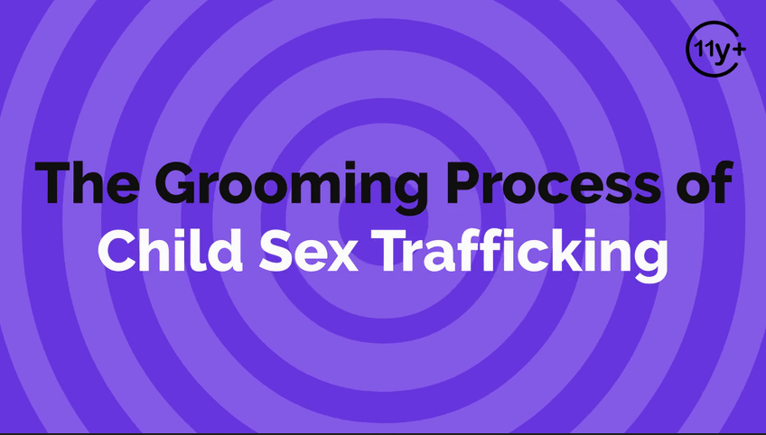
Log in to WalkingWise.com to access this animated video.
©2024-2026 Walking Wise
16
Notes:
This 3-minute Walking Wise animated video series teaches how sexual predators use manipulation, intimidation, and coercion to exploit young people.
NOTE
Log in to Walking Wise.com to watch the three-minute animated video with audiences.
Is animation appropriate for teens?
Yes, even businesses worldwide use explainer-style animation as a training tool for their employees.

Slide 17
WHAT DO YOU THINK?
What are ways a groomer might target young people?
©2024-2026 Walking Wise
17
Notes:
POSSIBLE ANSWERS
Gaining Trust
Giving Attention
Love & Care
Giving Gifts
Giving Money
Flattery
Compliments
Making Promises
Promising a Better Life

Slide 18
ANSWERS
Gaining Trust
Giving Attention
Love & Care
Giving Gifts
Giving Money
Flattery
Compliments
Promising a Better Life
©2024-2026 Walking Wise
18

Slide 19
GROOMING PROCESS
The Grooming Pattern
FRIENDSHIP → TRUST → DEPENDENCE → CONTROL
©2024-2026 Walking Wise
19
Notes:
To gain trust, groomers often begin by giving a young person things that make them feel valued and cared for. This may include extra attention, compliments, kindness, gifts, or promises of love and support.
At first, these behaviors may seem positive or harmless. However, the goal is often to build a special connection so the young person begins to trust the groomer more than others.
Once trust is established, the groomer usually begins to manipulate the relationship to gain influence and control.
Young people should learn that predators often start by acting kind and supportive before their behavior becomes harmful.

Slide 20
GROOMING PROCESS
Groomers Often Follow Patterns
Step 1: Gain Trust
They try to become someone the young person trusts.
©2024-2026 Walking Wise
20
Notes:
Grooming is usually a process that happens step by step.
The predator first becomes trusted, then looks for weaknesses or unmet needs, and finally tries to make the young person dependent on them.

Slide 21
GROOMING PROCESS
Groomers Often Follow Patterns
Step 2: Look for Needs
They look for struggles or needs they can take advantage of.
©2024-2026 Walking Wise
21

Slide 22
GROOMING PROCESS
Grooming Often Follow Patterns
Step 3: Fulfill Needs
They provide attention, gifts, or support to make the young person rely on them.
©2024-2026 Walking Wise
22

Slide 23
GROOMING PROCESS
Grooming Often Follow Patterns
Step 3: Control
They begin making demands, using pressure, threats, or secrets to control the young person.
©2024-2026 Walking Wise
23

Slide 24

LESSON PLANS
WHY TRUST MATTERS
Why do groomers work to gain trust?
©2024-2026 Walking Wise
24

Slide 25
WHY TRUST MATTERS
How Trust is Used by Groomers
Once trusted, it is easier to determine a young person's needs or problems.
©2024-2026 Walking Wise
25
Notes:
Trust is normally healthy in relationships, but predators misuse it. When someone trusts another person deeply, they may ignore warning signs or feel pressure to cooperate.
Once the groomer earns trust, they can more easily identify the youths’ vulnerabilities and exploit them.

Slide 26
WHY TRUST MATTERS
How Trust is Used by Groomers
It is more likely they will share their personal problems.
©2024-2026 Walking Wise
26
Notes:
Trust is normally healthy in relationships, but predators misuse it. When someone trusts another person deeply, they may ignore warning signs or feel pressure to cooperate.
Once the groomer earns trust, they can more easily identify the youths’ vulnerabilities and exploit them.

Slide 27
WHY TRUST MATTERS
How Trust is Used by Groomers
They gain more influence over a young person’s decisions.
©2024-2026 Walking Wise
27
Notes:
Targeted youth may sense that the expectation is inappropriate, unfair, or illegal, but once the groomer gains trust, they can persuade the victim to cooperate.

Slide 28
WHY TRUST MATTERS
How Trust is Used by Groomers
It is easier to cross personal boundaries.
©2024-2026 Walking Wise
28
Notes:
The targeted person is less likely to resist or challenge the requests made of them.

Slide 29
WHY TRUST MATTERS
How Trust is Used by Groomers
Trust reduces the chance a young person will say “no.”
©2024-2026 Walking Wise
29
Notes:
It is easier to manipulate and control the victims once trust is gained, especially when the victims are younger.

Slide 30
WHAT DO YOU THINK?
What percent of victims said their trafficker gained their trust within one month?
©2024-2026 Walking Wise
30

Slide 31
WHAT DO YOU THINK?
What percent of victims said their trafficker gained their trust within one month?
A) 12%
B) 22%
C) 32%
D) 42%
©2024-2026 Walking Wise
31

Slide 32
ANSWER
42% of victims said their trafficker gained their trust within one month.
©2024-2026 Walking Wise
Thorn (2018). Survivor Insights: The Role of Technology in Domestic Minor Sex Trafficking, pl. 27.
32
Notes:
Unsafe adults often move much faster than people expect. Building trust quickly helps them control the situation.
Source
Thorn (2018). Survivor Insights: The Role of Technology in Domestic Minor
Sex Trafficking, p. 27.
https://www.thorn.org/wp-content/uploads/2018/06/Thorn_Survivor_Insights_061118.pdf

Slide 33
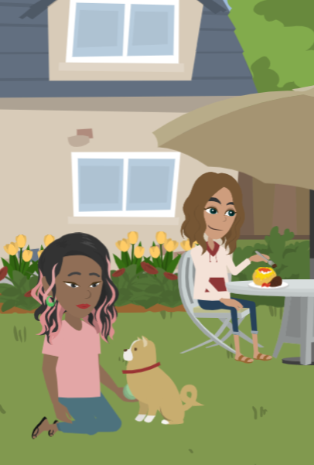
LESSON PLANS
HIDDEN IN PLAIN SIGHT
How can groomers be “hidden in plain sight”?
©2024-2026 Walking Wise
33
3
Notes:
The phrase “hidden in plain sight” means someone can appear normal or trustworthy while hiding harmful intentions.
Groomers often work to build a good reputation so others will not suspect them.
They may be respected adults, family friends, or people involved in school, sports, or community activities. Because they appear trustworthy, their behavior may go unnoticed for a long time.
It's important not to be afraid, but to recognize unsafe behaviors, even when the adult, older teen, or peer seems friendly or respected.

Slide 34
HIDDEN IN PLAIN SIGHT
Why Groomers Often Go Unnotice
They can appear as trustworthy adults or friends.
©2024-2026 Walking Wise
34

Slide 35
HIDDEN IN PLAIN SIGHT
Why Groomers Often Go Unnotice
They may hold positions of authority.
©2024-2026 Walking Wise
35

Slide 36
HIDDEN IN PLAIN SIGHT
Why Groomers Often Go Unnotice
They often already know the young person they target.
©2024-2026 Walking Wise
36

Slide 37
HIDDEN IN PLAIN SIGHT
Why Groomers Often Go Unnotice
They can earn the trust of parents and other adults.
©2024-2026 Walking Wise
37

Slide 38
HIDDEN IN PLAIN SIGHT
Why Groomers Often Go Unnotice
Groomers can fool everyone, even an entire community.
©2024-2026 Walking Wise
38

Slide 39
GROOMERS
What roles or positions might a groomer hold?
©2024-2026 Walking Wise
39

Slide 40
GROOMERS
Family Members
  Parent, Stepparent, Foster Parent
  Aunt or Uncle, Grandparent, Sibling
  Other Relative
©2024-2026 Walking Wise
40
Notes:
Groomers are not usually strangers. In many cases, they are someone the young person already knows or trusts.
The purpose of this lesson is to help us understand that grooming can occur in many different types of relationships. Because of this, it is important to recognize unsafe behaviors, rather than focusing only on who the person is or what role they hold.
Most people in these roles genuinely care about young people and want to protect them. However, when someone manipulates, pressures, or crosses personal boundaries, that behavior is unsafe.

Slide 41
GROOMERS
Trusted Adult or Community Member
  Teacher
  Coach
  Counselor
  School Staff
©2024-2026 Walking Wise
41

Slide 42
GROOMERS
Trusted Adult or Community Member
  Teacher
  Coach
  Counselor
  School Staff
  Religious Leader
  Employer or Boss
  Police Officer
  Doctor / Dentist
©2024-2026 Walking Wise
42

Slide 43
GROOMERS
Peer or Other Relationships
  Friend
  Romantic Partner
  Older Teen
©2024-2026 Walking Wise
43

Slide 44
GROOMERS
Peer or Other Relationships
  Friend
  Romantic Partner
  Older Teen
  Classmate
  Neighbor
  Acquaintance
©2024-2026 Walking Wise
44

Slide 45
GROOMERS
Stranger
  Online Connection
  Someone Unknown
©2024-2026 Walking Wise
45

Slide 46
EDUCATON GUIDE
VOCABULARY
‘VIRTUAL’ STRANGER
Someone met online whose true identity and intentions cannot be verified or confirmed.
©2024-2026 Walking Wise
46
3

Slide 47
WHAT DO YOU THINK?
What percent of minors (ages 9 to 17) reported connecting online with adults they don’t know in person?
©2024-2026 Walking Wise
47

Slide 48
WHAT DO YOU THINK?
What percent of minors (ages 9 to 17) reported connecting online with adults they don’t know in person?
A) 22%
B) 52%
C) 82%
D) 92%
©2024-2026 Walking Wise
48

Slide 49
ANSWER
82% of minors interact online with adults they do NOT know in person.
Thorn (2022, April). Online Grooming: Examining risky encounters amid everyday digital socialization, p. 14.
n=1,200 minors
49
©2024-2026 Walking Wise
Notes:
SOURCE
Thorn (2022, April). Online Grooming: Examining
risky encounters amid
everyday digital socialization, p. 14. Retrieved January 12, 2026, from https://info.thorn.org/hubfs/Research/2022_Online_Grooming_Report.pdf

Slide 50
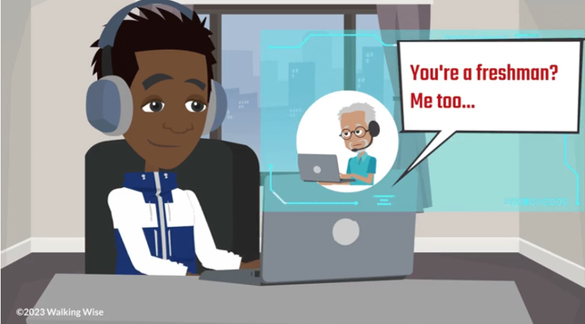
LESSON PLANS
VIRTUAL STRANGER
Adults online can pretend to be someone they are not.
©2024-2026 Walking Wise
50

Slide 51
VIRTUAL STRANGER
Adult Connections
Survey: 1-in-4 teens (ages 13-17) said they interact online with someone they believe is 30 or older.
Thorn (2022, April). Online Grooming: Examining risky encounters amid everyday digital socialization, p. 14.
n=1,200 minors
51
©2024-2026 Walking Wise
Notes:
SOURCE
Thorn (2022, April). Online Grooming: Examining risky encounters amid everyday digital socialization, p. 14. Retrieved on 10/31/2024 from: https://info.thorn.org/hubfs/Research/2022_Online_Grooming_Report.pdf.

Slide 52
VIRTUAL STRANGER
Adult Connections
Survey: 2-in-3 children (ages 9-12) said they interact online with adults they don’t know in real life.
Thorn (2022, April). Online Grooming: Examining risky encounters amid everyday digital socialization, p. 14.
n=1,200 minors
52
©2024-2026 Walking Wise
Notes:
SOURCE
Thorn (2022, April). Online Grooming: Examining risky encounters amid everyday digital socialization, p. 14. Retrieved on 10/31/2024 from: https://info.thorn.org/hubfs/Research/2022_Online_Grooming_Report.pdf.

Slide 53
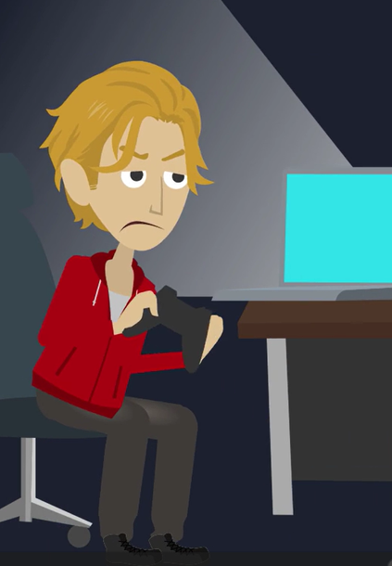
LESSON PLANS
CONNECTIONS
How do groomers often meet the young people they target?
©2024-2026 Walking Wise
53

Slide 54
CONNECTIONS
Meeting Targeted Individuals
Online: Social media apps and gaming platforms
©2024-2026 Walking Wise
54
Notes:
ONLINE
Groomers can attempt to gain a young person’s friendship online using social media apps and gaming platforms.

Slide 55
CONNECTIONS
Meeting Targeted Individuals
Public Places: Parks, concerts, shopping malls
©2024-2026 Walking Wise
55
Notes:
PUBLIC PLACES
They can meet young people in public places like parks, concerts, and shopping malls.

Slide 56
CONNECTIONS
Meeting Targeted Individuals
Social Gatherings: Friends’ parties and local meet-up spots
©2024-2026 Walking Wise
56
Notes:
SOCIAL GATHERINGS
They might meet a youth at a friend’s or acquaintance’s party and pretend to be interested in developing a friendship or romantic relationship.

Slide 57
CONNECTIONS
Meeting Targeted Individuals
Acquaintances: Someone who already knows the young person.
©2024-2026 Walking Wise
57
Notes:
ACQUAINTANCES
They often already know the youth, so they work to build a special relationship by pretending to share interests or hobbies.

Slide 58
EDUCATON GUIDE
VOCABULARY
MIND GAMES
Tricking or influencing someone’s thoughts and feelings so they begin to believe or follow along without questioning.
©2024-2026 Walking Wise
58
3

Slide 59
EDUCATON GUIDE
VOCABULARY
ISOLATE
To separate or cut someone off from their support network of family or friends.
©2024-2026 Walking Wise
59
3

Slide 60
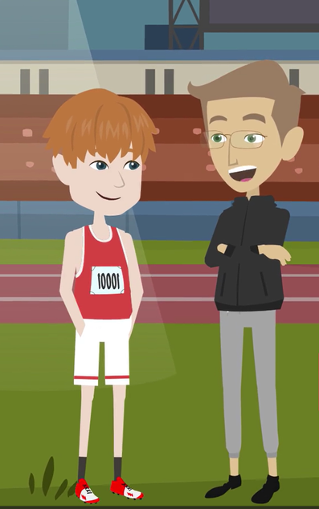
LESSON PLANS
OBLIGATION
Groomers often manipulate young people to create a false sense of loyalty or obligation.
©2024-2026 Walking Wise
60

Slide 61
LOYALTY & OBLIGATION
Feelings of Guilt or Pressure
Groomers can use gifts, money, basic needs, or special favors to create a sense of owing something to them.
©2024-2026 Walking Wise
61
Notes:
Kindness should never come with pressure, secrecy, or expectations in return.
Groomers often create a feeling that the young person “owes” them something because of gifts, attention, or kindness.
This manipulation can make it harder for the young person to say no or recognize that something is wrong.

Slide 62
LOYALTY & OBLIGATION
Feelings of Guilt or Pressure
They often give praise or compliments, especially to someone who feels left out or unsure of themselves.
©2024-2026 Walking Wise
62

Slide 63
LOYALTY & OBLIGATION
Feelings of Guilt or Pressure
They may make risky or harmful behavior seem normal, exciting, or grown-up.
©2024-2026 Walking Wise
63

Slide 64
LOYALTY & OBLIGATION
Feelings of Guilt or Pressure
They often use guilt or sympathy to create emotional attachment.
©2024-2026 Walking Wise
64
Notes:
Groomers may also use compliments, sympathy, or favoritism to make the young person feel special and emotionally connected to them.
Over time, these tactics can create a sense of loyalty, guilt, or pressure, which the groomer later uses to influence the young person’s decisions.

Slide 65
LOYALTY & OBLIGATION
Feelings of Guilt or Pressure
They can use favoritism to separate a young person from their peers.
©2024-2026 Walking Wise
65
Notes:
Groomers may also use compliments, sympathy, or favoritism to make the young person feel special and emotionally connected to them.
Over time, these tactics can create a sense of loyalty, guilt, or pressure, which the groomer later uses to influence the young person’s decisions.

Slide 66
EDUCATON GUIDE
VOCABULARY
BOND
A bond is something that makes a person feel connected, dependent, or unable to leave.
rural
RISKS
©2024-2026 Walking Wise
66
3

Slide 67
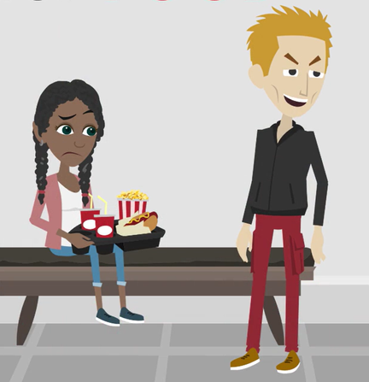
LESSON PLANS
CREATING DEPENDENCE
Groomers often manipulate young people to make them feel dependent?
©2024-2026 Walking Wise
67

Slide 68
CREATING DEPENDENCE
How Groomers Become “Needed”
  Groomers may provide basic needs like money, food, or a place to stay.
©2024-2026 Walking Wise
68
Notes:
Healthy relationships do not create pressure, control, or dependence.
Some groomers try to make young people feel they need them to receive important things. This might include money, food, clothing, transportation, or a place to stay.
Over time, the young person may begin to rely on the groomer for their daily needs.

Slide 69
CREATING DEPENDENCE
How Groomers Become “Needed”
  Groomers may provide basic needs like money, food, or a place to stay.
  They might give clothing, phones, rides, or other favors.
©2024-2026 Walking Wise
69
Notes:
Healthy relationships do not create pressure, control, or dependence.
Some groomers try to make young people feel they need them to receive important things. This might include money, food, clothing, transportation, or a place to stay.
Over time, the young person may begin to rely on the groomer for their daily needs.

Slide 70
CREATING DEPENDENCE
How Groomers Become “Needed”
  Groomers may provide basic needs like money, food, or a place to stay.
  They might give clothing, phones, rides, or other favors.
  They may offer free alcohol or drugs.
©2024-2026 Walking Wise
70
Notes:
Providing substances to young or vulnerable people creates dependency that often leads to control. Drugs and alcohol can increase a victim's economic, physical, and emotional reliance on their trafficker.

Slide 71

LESSON PLANS
GROOMERS CHANGE
After gaining trust, groomers change their behavior to gain control.
©2024-2026 Walking Wise
71
3

Slide 72
GROOMERS CHANGE
The Shift from Kindness to Demands
Groomers take control by making demands.
©2024-2026 Walking Wise
72
Notes:
Healthy relationships do not involve threats or isolation from family and friends.
Once the groomer gains trust and influence, their behavior changes.

Slide 73
GROOMERS CHANGE
The Shift from Kindness to Demands
They might threaten to take away support, like money, housing, gifts, or affection.
©2024-2026 Walking Wise
73
Notes:
They usually start making demands, using pressure, or threatening to take away things they previously provided.

Slide 74
GROOMERS CHANGE
The Shift from Kindness to Demands
They often isolate the young person by pressuring them to pull away from family and friends.
©2024-2026 Walking Wise
74
Notes:
Groomers may also try to separate the young person from trusted adults and friends who might recognize the danger.

Slide 75
GROOMERS CHANGE
The Shift from Kindness to Demands
They may apply pressure to break rules or rebel against adults, such as parents, coaches, and teachers.
©2024-2026 Walking Wise
75
Notes:
Groomers may encourage the young person to rebel against trusted adults in their life, such as parents, teachers, or coaches, by breaking rules or ignoring expectations.
They may also pressure the young person to drop out of activities, teams, or clubs that keep them connected to supportive people.
This shift from kindness to control is an important warning sign.

Slide 76
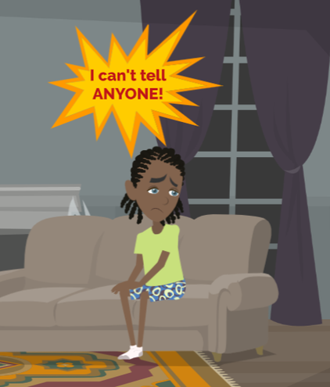
LESSON PLANS
UNREPORTED CRIME
Many crimes involving abuse are never reported.
©2024-2026 Walking Wise
76

Slide 77
UNREPORTED CRIME
Why Many Victims Stay Silent
Victims may feel threatened, scared, or embarrassed.
©2024-2026 Walking Wise
77
Notes:
Abuse is never a young or vulnerable person's fault.
Sometimes it can be hard to ask for help, but telling a trusted adult is an important step toward safety and support.
Many victims do not report abuse right away, and some may never tell anyone.
Groomers often use fear, threats, manipulation, or shame to keep victims silent.

Slide 78
UNREPORTED CRIME
Why Many Victims Stay Silent
They feel ashamed or blame themselves.
©2024-2026 Walking Wise
78
Notes:
Victims may also blame themselves or feel embarrassed about what happened.

Slide 79
UNREPORTED CRIME
Why Many Victims Stay Silent
The predator may make the abuse seem “normal.”
©2024-2026 Walking Wise
79
Notes:
Oftentimes, the groomer slowly normalizes the behavior so the young person does not immediately recognize that it is wrong or illegal.

Slide 80
UNREPORTED CRIME
Why Many Victims Stay Silent
Some do not realize that what is happening is a crime.
©2024-2026 Walking Wise
80
Notes:
Oftentimes, the groomer slowly normalizes the behavior so the young person does not immediately recognize that it is wrong or illegal.

Slide 81
EDUCATON GUIDE
VOCABULARY
FREEDOM
To allow someone the power to move, think, speak, and choose for themselves without restriction.
©2024-2026 Walking Wise
81
3

Slide 82

LESSON PLANS
EMPOWERMENT
How young people can help protect themselves.
©2024-2026 Walking Wise
82
3

Slide 83
EMPOWERMENT
Ways to Protect Yourself
  Trust your instincts or feelings.
©2024-2026 Walking Wise
83
Notes:
If something feels wrong, trust your instincts or intuition. Groomers might try to make you feel obligated, but feeling uncomfortable is a valid signal.

Slide 84
EMPOWERMENT
Ways to Protect Yourself
  Trust your instincts or feelings.
  Set clear boundaries.
©2024-2026 Walking Wise
84
Notes:
Communicate your boundaries and stick to them. Don't let anyone cross the line to pressure you into doing something that makes you uncomfortable.

Slide 85
EMPOWERMENT
Ways to Protect Yourself
  Trust your instincts or feelings.
  Set clear boundaries.
  Say “NO” confidently.
©2024-2026 Walking Wise
85
Notes:
Practice saying a firm "NO" without hesitation. If someone makes you feel uncomfortable, you're not obligated to give them any time, attention, or explanation.

Slide 86
EMPOWERMENT
Ways to Protect Yourself
  Trust your instincts or feelings.
  Set clear boundaries.
  Say “NO” confidently.
  Recognize manipulation.
©2024-2026 Walking Wise
86
Notes:
Think about the manipulation tactics you've just learned groomers use, such as guilt trips or emotional control. Being aware helps avoid falling into their traps.

Slide 87
EMPOWERMENT
Important Safety Steps
  Stop communicating with the person.
©2024-2026 Walking Wise
87
Notes:
Remember that your well-being comes first. Don't feel obligated to hang out with someone who makes you feel awkward or asks you to do something that makes you feel uncomfortable.
Discontinue all communication, even if frightened by threats or embarrassed by what happened.

Slide 88
EMPOWERMENT
Important Safety Steps
  Stop communicating with the person
  Keep messages and images as evidence.
©2024-2026 Walking Wise
88
Notes:
Keep all communication received from the groomer, including any embarrassing texts, online messages, images, and threats, as evidence so law enforcement can investigate.

Slide 89
EMPOWERMENT
Important Safety Steps
  Stop communicating with the person
  Keep messages or evidence
  Ask for help until someone listens.
©2024-2026 Walking Wise
89
Notes:
When feeling at risk, immediately inform a trustworthy adult.
If that adult does not help, go to other trustworthy adults, such as an adult who has the authority or connections to help you break free of a sexual predator's influence.
Call the National Human Trafficking Hotline 1-888-373-7888.

Slide 90

ASK FOR HELP
©2024-2026 Walking Wise
90
Notes:
Walking Wise asked a focus group of survivors:
What do you think young people should know about sex trafficking?
ANSWER
The survivors agreed that the most vital information teens should know is how to ask for help.
At the top of their list:
Tell a TRUSTWORTHY adult.

Slide 91
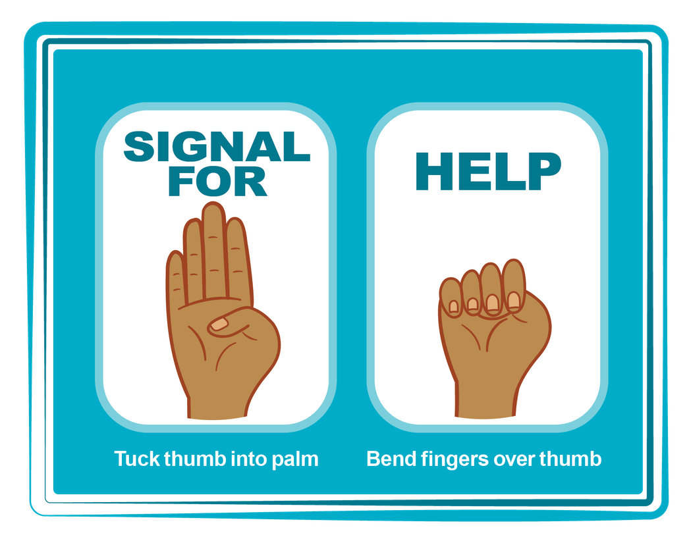
HAND SIGNAL FOR HELP
©2024-2026 Walking Wise
Source: Canadian Women’s Foundation, April 2020
91
Notes:
Although the hand signal for help has not yet achieved universal recognition, it may quietly get someone's attention in urgent situations.
SILENT
It can be used silently.
UNTRACKABLE
It leaves no digital footprint.
CONCEALED
It can be done secretly when a perpetrator is in the vicinity.
SIGNALS DISTRESS
A distressed facial expression can help others recognize that help is needed if the hand signal is not understood—but it is important not to alert the predator/trafficker, causing harm.
Source
Canadian Women's Foundation, April 2020

Slide 92
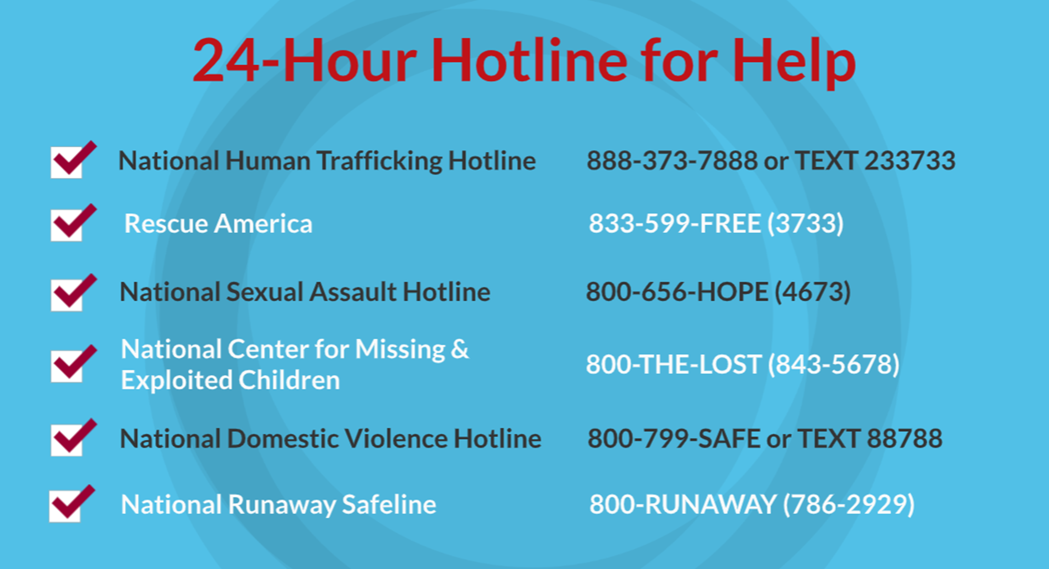
©2024-2026 Walking Wise
92
Notes:
NOTE TO PRESENTER
Presenters may ask their audience to consider adding a few "hotline for help" phone numbers to their cell phone contacts or take a photo of this slide.

Slide 93



Thank you!
WalkingWise.com
Online Course for Adults Accredited by: Postgraduate Institute for Medicine Academy of Forensic Nursing
©2024-2026 Walking Wise
93
Notes:
NOTE TO PRESENTER
To access additional resources on the grooming process, please see the last page of Lesson Plan #3 on the Walking Wise Learning Platform.
We welcome your feedback at support@WalkingWise.com.

