Slide 1


SEXUAL EXPLOITATION
EDUCATION
GROOMING
PROCESS
LESSON #3
Notes:
NOTE
Log in to WalkingWise.com and refer to the Walking Wise Education Guide to implement classroom teaching tips.
Most importantly:
• DEFINE SCHOOL POLICY
Establish a sexual exploitation reporting protocol with a trauma-informed response. The Walking Wise Implementation Guide provides a sample protocol.
• AGE & AUDIENCE
This presentation can be edited by following the procedures on page 3 to align with your school policies, specific age groups, and the involvement of at-risk audiences.
• SUPPORT PROCEDURE
Provide your audience with guidance on accessing immediate help or arranging a private meeting with a social worker, counselor, nurse, school resource officer, or another trustworthy staff member to report concerns for themselves or a peer.
• SECOND SAFE ADULT
Ensure a second trustworthy adult, such as a teacher, is present in the learning setting to observe audience reactions and identify those who may benefit from a follow-up meeting. This person should remain focused and free from other duties during the presentation.
• IMPLEMENT SLIDO.com
Please log in to WalkingWise.com for instructions on incorporating Slido into the PowerPoint presentation to engage your audience using digital polling.

Slide 2

NOTE TO PRESENTER
This presentation is exclusively for Walking Wise® subscribers and not for redistribution.
Walking Wise provides an interactive digital tool, Slido.com, to enhance audience engagement. To implement Slido for your organization, you can log in to WalkingWise.com for setup instructions. Once configured, integrate Slido polling and add a post-evaluation into the PowerPoint presentation.
Presenters are encouraged to edit speaker notes to match their speaking style (viewable in presentation mode). You can also delete slides from this Walking Wise presentation to make sure the content aligns with your school policies, is age-appropriate, and fits within available class time. However, the existing slides are copyright-protected and may not be modified without prior written permission from Walking Wise.
If you would like to add your own content, you may do so under the following conditions:
Insert new PowerPoint slides.
Remove the Walking Wise logo and copyright "©2025 Walking Wise" from the new slides.
Always add your organization's name or logo to each new slide.
Please delete this instruction page before presenting to audiences.
©2025 Walking Wise
2
Notes:
NOTE
The presenter is welcome to customize this Walking Wise presentation according to the instructions provided on this page.
For revision requests, please send an email to support@WalkingWise.com.

Slide 3

CONFRONTING SEXUAL EXPLOITATION
WALKING WISE
KNOWLEDGE serves as a
powerful defense against
sexual predators.
©2025 Walking Wise
3

Slide 4
CONFRONTING SEXUAL EXPLOITATION
WALKING WISE
SEXUAL EXPLOITATION includes grooming, sextortion, pornography
& sex trafficking.
©2025 Walking Wise
4

Slide 5
SENSITIVE DISCUSSION AHEAD
CONTENT ALERT
We’ll be discussing serious issues about sexual exploitation.
Some parts may be difficult to hear.
If you ever feel uncomfortable, you can step out and speak with a trustworthy adult for support.
You’re not alone—we’re here to help you.
©2025 Walking Wise
5
Notes:
NOTE TO PRESENTER
Please tailor this message to align with your organization's policies and protocols.
Please provide a confidential avenue for students to report concerns and seek help for themselves or their peers if they suspect sexual abuse, grooming, sextortion, pornography-related exploitation, or human trafficking. This may include a designated address or text line.
Consider displaying posters in your school or facility that outline various ways students can access immediate support or request a private meeting with a school safety team member or another trusted adult.

Slide 6

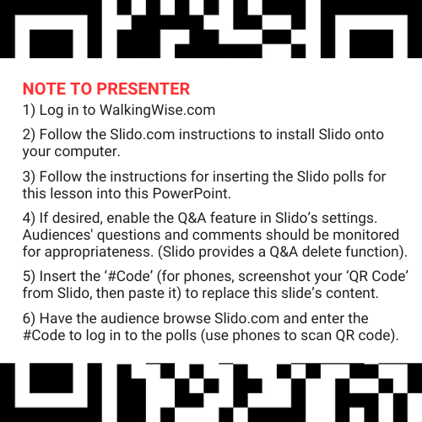
DIGITAL PARTICIPATION
©2025 Walking Wise
6
Notes:
NOTE
For digital interaction with audiences:
Log in to WalkingWise.com to follow instructions on setting up Slido questions/answers for this presentation. Then, replace the QR code and #code in this slide with your custom QR/#code.
Please verify whether the Q&A feature has been activated before presenting to audiences. An adult should monitor questions and comments to ensure appropriateness. Slido has a feature that allows you to delete unwanted questions and comments.

Slide 7



STATISTICS
Statistics are Only Estimates
Study results may be unreliable because most sexual crimes go unreported.
©2025 Walking Wise
7
Notes:
In this presentation, we'll discuss statistics, but it's important to note that while statistics provide valuable insights into an issue, they cannot be entirely relied upon.
Here are a few reasons:
• UNREPORTED
Victims may stay silent due to fear, shame, or manipulation.
• INCONSISTENT COLLECTION
Geographical areas have different legal definitions for sexual crimes, making data hard to compare.
• FOCUS GROUPS
Small or specific focus groups participating in a study or survey may not accurately reflect the diversity or experiences of the larger population.

Slide 8
STATISTICS
Statistics are Only Estimates
Study results may be unreliable because most sexual crimes go unreported.
The methods used to collect information can vary widely between studies, leading to inconsistency.
©2025 Walking Wise
8
Notes:
In this presentation, we'll discuss statistics, but it's important to note that while statistics provide valuable insights into an issue, they cannot be entirely relied upon.
Here are a few reasons:
• UNREPORTED
Victims may stay silent due to fear, shame, or manipulation.
• INCONSISTENT COLLECTION
Geographical areas have different legal definitions for sexual crimes, making data hard to compare.
• FOCUS GROUPS
Small or specific focus groups participating in a study or survey may not accurately reflect the diversity or experiences of the larger population.

Slide 9
STATISTICS
Statistics are Only Estimates
Study results may be unreliable because most sexual crimes go unreported.
The methods used to collect information can vary widely between studies, leading to inconsistency.
Focus groups in studies may not accurately represent the larger population.
©2025 Walking Wise
9
Notes:
In this presentation, we'll discuss statistics, but it's important to note that while statistics provide valuable insights into an issue, they cannot be entirely relied upon.
Here are a few reasons:
• UNREPORTED
Victims may stay silent due to fear, shame, or manipulation.
• INCONSISTENT COLLECTION
Geographical areas have different legal definitions for sexual crimes, making data hard to compare.
• FOCUS GROUPS
Small or specific focus groups participating in a study or survey may not accurately reflect the diversity or experiences of the broader population.

Slide 10

EDUCATON GUIDE
VOCABULARY
VOCABULARY
Groomer
Opportunist
Boundary
Virtual Stranger
Brainwash
Seduce
Isolate
Freedom
©2025 Walking Wise
10
3
Notes:
NOTE
Understanding vocabulary terms related to the behaviors of sexual predators can empower young people to recognize warning signs of harmful situations.
Knowing terminology helps them identify manipulative tactics predators use to build trust and exploit vulnerabilities.
With this knowledge, young people are better equipped to spot red flags, understand that these behaviors are abusive, and feel more confident reporting predators to trusted adults or authorities, potentially preventing further harm.

Slide 11
EDUCATON GUIDE
VOCABULARY
GROOMER
Someone who builds a relationship of trust with young or vulnerable people to use and sexually abuse them.
©2025 Walking Wise
11
3
Notes:
Assisting Source
OpenAI. (2024). ChatGPT [Large language model]. https://chatgpt.com

Slide 12
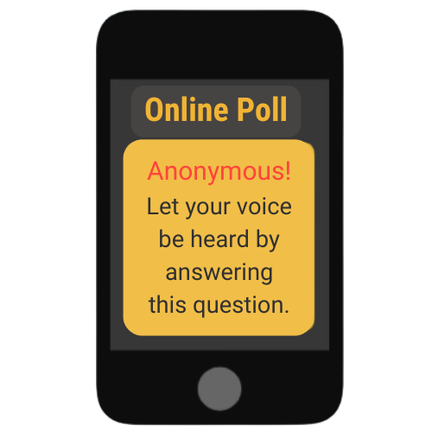
GAINING TRUST
What percent of child victims said their trafficker groomed or gained their trust within one month?
n=86 minors
©2025 Walking Wise
Thorn (2018). Survivor Insights: The Role of Technology in Domestic Minor Sex Trafficking, pl. 27.
12
Notes:
SLIDO.com: Multiple Choice
What percent of child victims said their trafficker groomed or gained their trust within one month?
A) 12%
B) 22%
C) 32%
D) 42%
ANSWERS
D) 42% of child victims said their trafficker gained their trust within one month.
Source
Thorn (2018). Survivor Insights: The Role of Technology in Domestic Minor
Sex Trafficking, p. 27.
https://www.thorn.org/wp-content/uploads/2018/06/Thorn_Survivor_Insights_061118.pdf

Slide 13
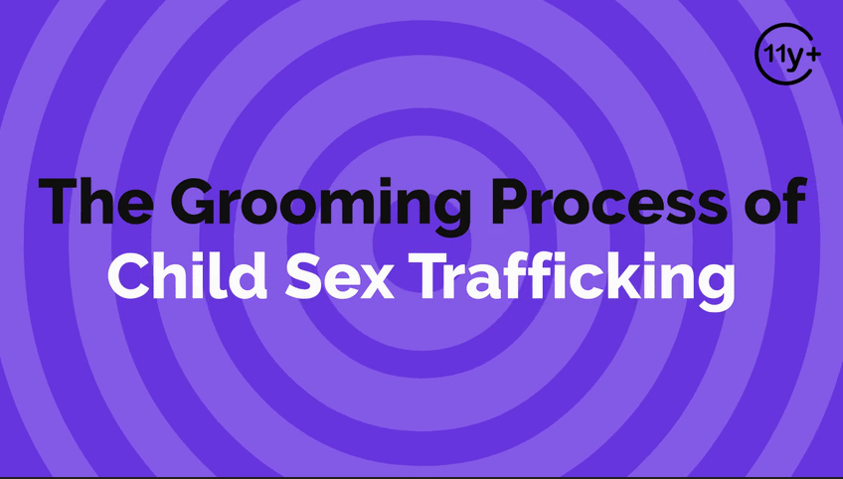
Log in to WalkingWise.com to access this animated video.
©2025 Walking Wise
13
Notes:
Message Especially for Teens:
Explainer-style animation is widely used by businesses worldwide for employee training.
Similarly, the Walking Wise animated video series is designed for teenagers (ages 11+) and adults to understand how sexual predators use manipulation, intimidation, and coercion to exploit young people.
NOTE
Log in to Walking Wise.com to watch the three-minute animated video with audiences.

Slide 14
EDUCATON GUIDE
VOCABULARY
OPPORTUNIST
A person who manipulates a situation to gain an immediate advantage over someone or something.
©2025 Walking Wise
14
3
Notes:
Assisting Source
OpenAI. (2024). ChatGPT [Large language model]. https://chatgpt.com

Slide 15
GROOMING METHODS
In two words, name the most common methods you think groomers use to target young people.
©2025 Walking Wise
15
Notes:
SLIDO.com: Word Cloud
NOTE
The more frequently a word is used, the larger it appears in the cloud, making it easy to see which words or ideas are most common among the audience.
POSSIBLE ANSWERS
Gaining Trust
Giving Attention
Love & Care
Giving Gifts
Giving Money
Flattery
Compliments
Making Promises
Better Life

Slide 16
GROOMING PROCESS
Grooming Process
Step 1: Gain Trust
©2025 Walking Wise
16
Notes:
• GAIN TRUST
Groomers identify minors who are more willing to form a bond.
• IDENTIFY VULNERABILITIES
Groomers identify vulnerabilities, such as minors who are passive, quiet, lonely, or lacking parental supervision.
• FULFILL NEEDS
Groomers provide basic needs, such as food, shelter, and clothing, to create a dependency for the victim.

Slide 17
GROOMING PROCESS
Grooming Process
Step 1: Gain Trust
Step 2: Identify Vulnerabilities
©2025 Walking Wise
17
Notes:
• GAIN TRUST
Groomers identify minors who are more willing to form a bond.
• IDENTIFY VULNERABILITIES
Groomers identify vulnerabilities, such as minors who are passive, quiet, lonely, or lacking parental supervision.
• FULFILL NEEDS
Groomers provide basic needs, such as food, shelter, and clothing, to create a dependency for the victim.

Slide 18
GROOMING PROCESS
Grooming Process
Step 1: Gain Trust
Step 2: Identify Vulnerabilities
Step 3: Fulfill Needs
©2025 Walking Wise
18
Notes:
• GAIN TRUST
Groomers identify minors who are more willing to form a bond.
• IDENTIFY VULNERABILITIES
Groomers identify vulnerabilities, such as minors who are passive, quiet, lonely, or lacking parental supervision.
• FULFILL NEEDS
Groomers provide basic needs, such as food, shelter, and clothing, to create a dependency for the victim.

Slide 19
EDUCATON GUIDE
VOCABULARY
BOUNDARY
A personal limit that defines one’s comfort level with physical space, emotional connection, and moral beliefs.
©2025 Walking Wise
19
3
Notes:
Assisting Source
OpenAI. (2024). ChatGPT [Large language model]. https://chatgpt.com

Slide 20

LESSON PLANS
GAINING TRUST
Why is gaining trust a top strategy for groomers?
©2025 Walking Wise
20

Slide 21
GAINING TRUST
The Trust Factor
Easier for groomers to identify a young person’s vulnerabilities.
©2025 Walking Wise
21
Notes:
• VULNERABILITIES
The groomer learns the youths’ vulnerabilities and how to exploit them.
• PERSUASION
Targeted youth may sense the expectation is inappropriate, unfair, or illegal, but once the groomer gains trust, they can persuade the victim to cooperate.
• LESS RESISTANCE
The targeted person is less likely to resist or challenge the requests made of them.
• CONTROL
It is easier to manipulate and control the victims once trust is gained, especially when victims are younger.

Slide 22
GAINING TRUST
The Trust Factor
Easier for groomers to identify a young person’s vulnerabilities.
Increases their ability to influence the victim.
©2025 Walking Wise
22
Notes:
• VULNERABILITIES
The groomer learns the youths’ vulnerabilities and how to exploit them.
• PERSUASION
Targeted youth may sense the expectation is inappropriate, unfair, or illegal, but once the groomer gains trust, they can persuade the victim to cooperate.
• LESS RESISTANCE
The targeted person is less likely to resist or challenge the requests made of them.
• CONTROL
It is easier to manipulate and control the victims once trust is gained, especially when victims are younger.

Slide 23
GAINING TRUST
The Trust Factor
Easier for groomers to identify a young person’s vulnerabilities.
Increases their ability to influence the victim.
Easier to cross the victim’s boundaries.
©2025 Walking Wise
23
Notes:
• VULNERABILITIES
The groomer learns the youths’ vulnerabilities and how to exploit them.
• PERSUASION
Targeted youth may sense the expectation is inappropriate, unfair, or illegal, but once the groomer gains trust, they can persuade the victim to cooperate.
• LESS RESISTANCE
The targeted person is less likely to resist or challenge the requests made of them.
• CONTROL
It is easier to manipulate and control the victims once trust is gained, especially when victims are younger.

Slide 24
GAINING TRUST
The Trust Factor
Easier for groomers to identify a young person’s vulnerabilities.
Increases their ability to influence the victim.
Easier to cross the victim’s boundaries.
Reduces the victims’ resistance.
©2025 Walking Wise
24
Notes:
• VULNERABILITIES
The groomer learns the youths’ vulnerabilities and how to exploit them.
• PERSUASION
Targeted youth may sense the expectation is inappropriate, unfair, or illegal, but once the groomer gains trust, they can persuade the victim to cooperate.
• LESS RESISTANCE
The targeted person is less likely to resist or challenge the requests made of them.
• CONTROL
It is easier to manipulate and control the victims once trust is gained, especially when victims are younger.

Slide 25
GAINING TRUST
The Trust Factor
Easier for groomers to identify a young person’s vulnerabilities.
Increases their ability to influence the victim.
Easier to cross the victim’s boundaries
Reduces the victims’ resistance
Easier to manipulate & control the victim
©2025 Walking Wise
25
Notes:
• VULNERABILITIES
The groomer learns the youths’ vulnerabilities and how to exploit them.
• PERSUASION
Targeted youth may sense the expectation is inappropriate, unfair, or illegal, but once the groomer gains trust, they can persuade the victim to cooperate.
• LESS RESISTANCE
The targeted person is less likely to resist or challenge the requests made of them.
• CONTROL
It is easier to manipulate and control the victims once trust is gained, especially when victims are younger.

Slide 26
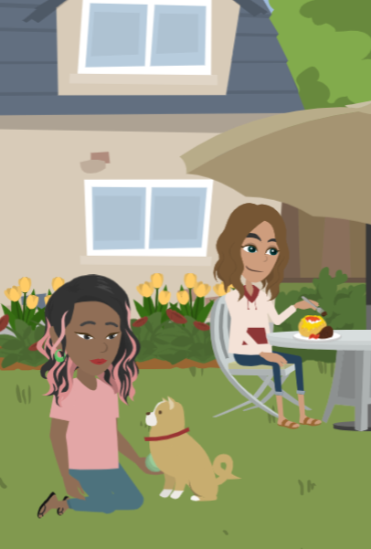
LESSON PLANS
HIDDEN IN PLAIN SIGHT
How does the phrase ‘hidden in plain sight’ apply to groomers?
©2025 Walking Wise
26
3

Slide 27
HIDDEN IN PLAIN SIGHT
Groomers Go Unnoticed
Predators go unnoticed despite being visible.
©2025 Walking Wise
27

Slide 28
HIDDEN IN PLAIN SIGHT
Groomers Go Unnoticed
Predators go unnoticed despite being visible.
They can behave as a trusted adult or friend.
©2025 Walking Wise
28

Slide 29
HIDDEN IN PLAIN SIGHT
Groomers Go Unnoticed
Predators go unnoticed despite being visible.
They can behave as a trusted adult or friend.
The targeted young person usually knows the predator.
©2025 Walking Wise
29

Slide 30
HIDDEN IN PLAIN SIGHT
Groomers Go Unnoticed
Predators go unnoticed despite being visible.
They can behave as a trusted adult or friend.
The targeted young person usually knows the predator.
The predator often earns the parent’s trust.
©2025 Walking Wise
30

Slide 31
HIDDEN IN PLAIN SIGHT
Groomers Go Unnoticed
Predators go unnoticed despite being visible.
They can behave as a trusted adult or friend.
The targeted young person usually knows the predator.
The predator often earns the parent’s trust.
They can fool an entire community.
©2025 Walking Wise
31

Slide 32
GROOMERS
In two words, name the types of people who can be a sexual groomer.
©2025 Walking Wise
32
Notes:
SLIDO.com: Word Cloud
NOTE
The more frequently a word is used, the larger it appears in the cloud, making it easy to see which words or ideas are most common among the audience.

Slide 33
GROOMERS
Family Members
Parent, Foster Parent, Stepparent
Aunt, Uncle, Grandparent, Sibling
Stepfamily Member
©2025 Walking Wise
33
Notes:
• FAMILY MEMBER
- Parent
- Foster Parent
- Stepparent
- Stepfamily Member
- Aunt
- Uncle
- Sibling
- Grandparent
• AUTHORITY FIGURE
- Teacher
- Coach
- Counselor
- Spiritual Leader
- Employer
- Police Officer
- Doctor / Dentist
• RELATIONSHIP
- Romantic Partner
- Friend
- Peer
- Neighbor
- Acquaintance
• STRANGER
- Online Connection
- Someone Unknown

Slide 34
GROOMERS
Authority Figures
Teacher
Coach
Counselor
Tutor
©2025 Walking Wise
34
Notes:
• FAMILY MEMBER
- Parent
- Foster Parent
- Stepparent
- Stepfamily Member
- Aunt
- Uncle
- Sibling
- Grandparent
• AUTHORITY FIGURE
- Teacher
- Coach
- Counselor
- Spiritual Leader
- Employer
- Police Officer
- Doctor / Dentist
• RELATIONSHIP
- Romantic Partner
- Friend
- Peer
- Neighbor
- Acquaintance
• STRANGER
- Online Connection
- Someone Unknown

Slide 35
GROOMERS
Authority Figures
Teacher
Coach
Counselor
Tutor
Spiritual Leader
Employer
Police Officer
Doctor / Dentist
©2025 Walking Wise
35
Notes:
• FAMILY MEMBER
- Parent
- Foster Parent
- Stepparent
- Stepfamily Member
- Aunt
- Uncle
- Sibling
- Grandparent
• AUTHORITY FIGURE
- Teacher
- Coach
- Counselor
- Spiritual Leader
- Employer
- Police Officer
- Doctor / Dentist
• RELATIONSHIP
- Romantic Partner
- Friend
- Peer
- Neighbor
- Acquaintance
• STRANGER
- Online Connection
- Someone Unknown

Slide 36
GROOMERS
Established Relationships
Romantic Partner
Friend
Peer
Neighbor
Acquaintance
©2025 Walking Wise
36
Notes:
• FAMILY MEMBER
- Parent
- Foster Parent
- Stepparent
- Stepfamily Member
- Aunt
- Uncle
- Sibling
- Grandparent
• AUTHORITY FIGURE
- Teacher
- Coach
- Counselor
- Spiritual Leader
- Employer
- Police Officer
- Doctor / Dentist
• RELATIONSHIP
- Romantic Partner
- Friend
- Peer
- Neighbor
- Acquaintance
• STRANGER
- Online Connection
- Someone Unknown

Slide 37
GROOMERS
Stranger
Online Connection
Someone Unknown
©2025 Walking Wise
37
Notes:
• FAMILY MEMBER
- Parent
- Foster Parent
- Stepparent
- Stepfamily Member
- Aunt
- Uncle
- Sibling
- Grandparent
• AUTHORITY FIGURE
- Teacher
- Coach
- Counselor
- Spiritual Leader
- Employer
- Police Officer
- Doctor / Dentist
• RELATIONSHIP
- Romantic Partner
- Friend
- Peer
- Neighbor
- Acquaintance
• STRANGER
- Online Connection
- Someone Unknown

Slide 38
EDUCATON GUIDE
VOCABULARY
‘VIRTUAL’ STRANGER
Someone met online whose true identity and intentions cannot be verified or confirmed.
©2025 Walking Wise
38
3
Notes:
Assisting Source
OpenAI. (2024). ChatGPT [Large language model]. https://chatgpt.com

Slide 39
VIRTUAL STRANGER
What percent of minors (ages 9 to 17) report connecting online with adults they don’t know in person?
n=1,200 minors
Thorn (2022, April). Online Grooming: Examining risky encounters amid everyday digital socialization, p. 14.
39
©2025 Walking Wise
Notes:
SLIDO.com: Multiple Choice
What percent of minors (ages 9 to 17) report connecting online with adults they don’t know in person?
A) 22%
B) 52%
C) 82%
D) 92%
ANSWER
C) 82% of minors interact online with adults they do not know in person.
SOURCE
Thorn (2022, April). Online Grooming: Examining
risky encounters amid
everyday digital socialization, p. 14.
https://info.thorn.org/hubfs/Research/2022_Online_Grooming_Report.pdf

Slide 40
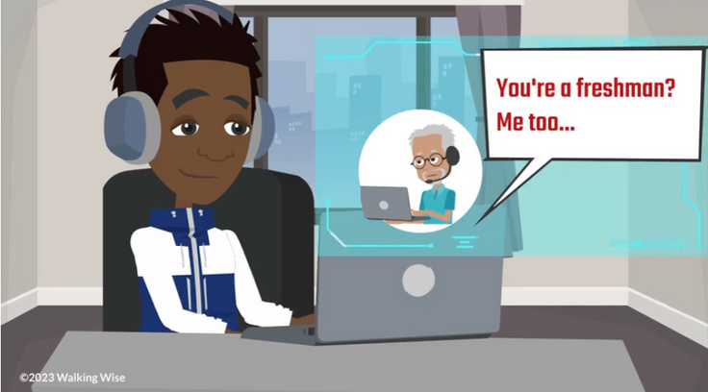
LESSON PLANS
VIRTUAL STRANGER
How many teens and children interact with adults online?
©2025 Walking Wise
40

Slide 41
VIRTUAL STRANGER
Adult Connections
n=1,200 minors
Survey: 1-in-4 teens (ages 13-17) interact online with someone they believe is age 30 or older.
Thorn (2022, April). Online Grooming: Examining risky encounters amid everyday digital socialization, p. 14.
41
©2025 Walking Wise
Notes:
SOURCE
Thorn (2022, April). Online Grooming: Examining
risky encounters amid
everyday digital socialization, p. 14. Retrieved on 10/31/2024 from:
https://info.thorn.org/hubfs/Research/2022_Online_Grooming_Report.pdf.

Slide 42
VIRTUAL STRANGER
Adult Connections
n=1,200 minors
Survey: 1-in-4 teens (ages 13-17) interact online with someone they believe is 30 or older.
Survey: 2-in-3 children (ages 9-12) interact online with unfamiliar adults.
Thorn (2022, April). Online Grooming: Examining risky encounters amid everyday digital socialization, p. 14.
42
©2025 Walking Wise
Notes:
SOURCE
Thorn (2022, April). Online Grooming: Examining
risky encounters amid
everyday digital socialization, p. 14. Retrieved on 10/31/2024 from:
https://info.thorn.org/hubfs/Research/2022_Online_Grooming_Report.pdf.

Slide 43
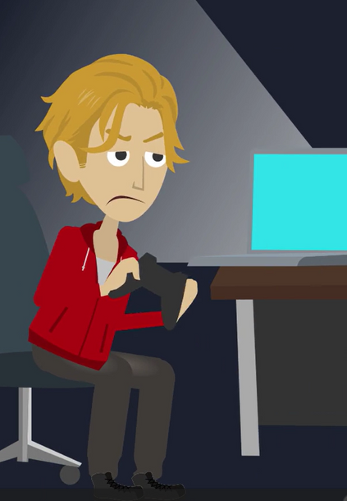
LESSON PLANS
CONNECTIONS
How do groomers often meet the young people they victimize?
©2025 Walking Wise
43

Slide 44
CONNECTIONS
Meeting Targeted Individuals
Online: Social media apps and gaming platforms
©2025 Walking Wise
44
Notes:
• ONLINE
They can attempt to gain a young person’s friendship online using social media apps and gaming platforms.
• PUBLIC PLACES
They can meet young people in public places like parks, concerts, and shopping malls.
• SOCIAL GATHERINGS
They might meet a youth at a friend’s or acquaintance’s party and approach the young person, pretending to be interested in developing a friendship or romantic relationship.
• ACQUAINTANCES
They often already know the youth, so they work to form a special relationship by pretending to have shared interests or hobbies.

Slide 45
CONNECTIONS
Meeting Targeted Individuals
Online: Social media apps and gaming platforms
Public Places: Parks, concerts, and shopping malls.
©2025 Walking Wise
45
Notes:
• ONLINE
They can attempt to gain a young person’s friendship online using social media apps and gaming platforms.
• PUBLIC PLACES
They can meet young people in public places like parks, concerts, and shopping malls.
• SOCIAL GATHERINGS
They might meet a youth at a friend’s or acquaintance’s party and approach the young person, pretending to be interested in developing a friendship or romantic relationship.
• ACQUAINTANCES
They often already know the youth, so they work to form a special relationship by pretending to have shared interests or hobbies.

Slide 46
CONNECTIONS
Meeting Targeted Individuals
Online: Social media apps and gaming platforms
Public Places: Parks, concerts, and shopping malls
Social Gatherings: Friend’s parties and local meet-up spots
©2025 Walking Wise
46
Notes:
• ONLINE
They can attempt to gain a young person’s friendship online using social media apps and gaming platforms.
• PUBLIC PLACES
They can meet young people in public places like parks, concerts, and shopping malls.
• SOCIAL GATHERINGS
They might meet a youth at a friend’s or acquaintance’s party and approach the young person, pretending to be interested in developing a friendship or romantic relationship.
• ACQUAINTANCES
They often already know the youth, so they work to form a special relationship by pretending to have shared interests or hobbies.

Slide 47
CONNECTIONS
Meeting Targeted Individuals
Online: Social media apps and gaming platforms
Public Places: Parks, concerts, and shopping malls
Social Gatherings: Friend’s parties and local meet-up spots
Acquaintances: Someone known to the young person
©2025 Walking Wise
47
Notes:
• ONLINE
They can attempt to gain a young person’s friendship online using social media apps and gaming platforms.
• PUBLIC PLACES
They can meet young people in public places like parks, concerts, and shopping malls.
• SOCIAL GATHERINGS
They might meet a youth at a friend’s or acquaintance’s party and approach the young person, pretending to be interested in developing a friendship or romantic relationship.
• ACQUAINTANCES
They often already know the youth, so they work to form a special relationship by pretending to have shared interests or hobbies and care about the child.

Slide 48
EDUCATON GUIDE
VOCABULARY
BRAINWASH
To manipulate someone’s thoughts and beliefs until they accept new ideas without question.
©2025 Walking Wise
48
3
Notes:
Assisting Source
OpenAI. (2024). ChatGPT [Large language model]. https://chatgpt.com

Slide 49
EDUCATON GUIDE
VOCABULARY
SEDUCE
To attract or tempt someone in a way that makes them want to engage in romantic or sexual activity, often by using charm, flattery, or allure.
©2025 Walking Wise
49
3
Notes:
Assisting Source
OpenAI. (2024). ChatGPT [Large language model]. https://chatgpt.com

Slide 50
EDUCATON GUIDE
VOCABULARY
ISOLATE
To separate or cut someone off from their support network of family or friends.
©2025 Walking Wise
50
3
Notes:
Assisting Source
OpenAI. (2024). ChatGPT [Large language model]. https://chatgpt.com

Slide 51
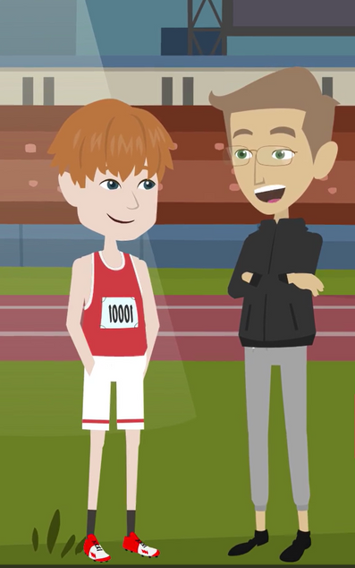
LESSON PLANS
OBLIGATION
How can groomers manipulate victims to create a sense of loyalty and obligation?
©2025 Walking Wise
51

Slide 52
OBLIGATION
Loyalty & Obligation
Groomers can use gifts to create a sense of obligation.
©2025 Walking Wise
52
Notes:
• GIFTS
Groomers frequently give gifts to trick their victims into believing they are special or loved to create a sense of loyalty.
• ATTENTION & FLATTERY
They often flatter and compliment potential victims to provide attention, particularly to neglected young people who feel inadequate.
• NORMALIZATION
Groomers often make dangerous behavior seem normal and fun, such as having sex at a young age or being invited into a partying lifestyle involving drugs and alcohol.
• SUBSTANCE ADDICTION
They often create substance addiction in the victim by introducing alcohol and drugs.
• EMOTIONAL CAPTIVITY
Groomers create a sense of emotional captivity in the victim through guilt or pity.
• SHOW FAVORITISM
They often provide specialized attention, pretending to develop the victim's talent or to create a sense of importance over their peers.

Slide 53
OBLIGATION
Loyalty & Obligation
Groomers can use gifts to create a sense of obligation.
They often flatter young people who feel neglected or inadequate.
©2025 Walking Wise
53
Notes:
• GIFTS
Groomers frequently give gifts to trick their victims into believing they are special or loved to create a sense of loyalty.
• ATTENTION & FLATTERY
They often flatter and compliment potential victims to provide attention, particularly to neglected young people who feel inadequate.
• NORMALIZATION
Groomers often make dangerous behavior seem normal and fun, such as having sex at a young age or being invited into a partying lifestyle involving drugs and alcohol.
• SUBSTANCE ADDICTION
They often create substance addiction in the victim by introducing alcohol and drugs.
• EMOTIONAL CAPTIVITY
Groomers create a sense of emotional captivity in the victim through guilt or pity.
• SHOW FAVORITISM
They often provide specialized attention, pretending to develop the victim's talent or to create a sense of importance over their peers.

Slide 54
OBLIGATION
Loyalty & Obligation
Groomers can use gifts to create a sense of obligation.
They often flatter young people who feel neglected or inadequate.
They make dangerous behavior seem ‘normal’ or fun.
©2025 Walking Wise
54
Notes:
• GIFTS
Groomers frequently give gifts to trick their victims into believing they are special or loved to create a sense of loyalty.
• ATTENTION & FLATTERY
They often flatter and compliment potential victims to provide attention, particularly to neglected young people who feel inadequate.
• NORMALIZATION
Groomers often make dangerous behavior seem normal and fun, such as having sex at a young age or being invited into a partying lifestyle involving drugs and alcohol.
• SUBSTANCE ADDICTION
They often create substance addiction in the victim by introducing alcohol and drugs.
• EMOTIONAL CAPTIVITY
Groomers create a sense of emotional captivity in the victim through guilt or pity.
• SHOW FAVORITISM
They often provide specialized attention, pretending to develop the victim's talent or to create a sense of importance over their peers.

Slide 55
OBLIGATION
Loyalty & Obligation
Groomers can use gifts to create a sense of obligation.
They often flatter young people who feel neglected or inadequate.
They make dangerous behavior seem ‘normal’ or fun.
They can seek pity or cause guilt to create emotional attachment.
©2025 Walking Wise
55
Notes:
• GIFTS
Groomers frequently give gifts to trick their victims into believing they are special or loved to create a sense of loyalty.
• ATTENTION & FLATTERY
They often flatter and compliment potential victims to provide attention, particularly to neglected young people who feel inadequate.
• NORMALIZATION
Groomers often make dangerous behavior seem normal and fun, such as having sex at a young age or being invited into a partying lifestyle involving drugs and alcohol.
• SUBSTANCE ADDICTION
They often create substance addiction in the victim by introducing alcohol and drugs.
• EMOTIONAL CAPTIVITY
Groomers create a sense of emotional captivity in the victim through guilt or pity.
• SHOW FAVORITISM
They often provide specialized attention, pretending to develop the victim's talent or to create a sense of importance over their peers.

Slide 56
OBLIGATION
Loyalty & Obligation
Groomers can use gifts to create a sense of obligation.
They often flatter young people who feel neglected or inadequate.
They make dangerous behavior seem ‘normal’ or fun.
They can seek pity or cause guilt to create emotional attachment.
They show favoritism by giving the victim an advantage over peers.
©2025 Walking Wise
56
Notes:
• GIFTS
Groomers frequently give gifts to trick their victims into believing they are special or loved to create a sense of loyalty.
• ATTENTION & FLATTERY
They often flatter and compliment potential victims to provide attention, particularly to neglected young people who feel inadequate.
• NORMALIZATION
Groomers often make dangerous behavior seem normal and fun, such as having sex at a young age or being invited into a partying lifestyle involving drugs and alcohol.
• SUBSTANCE ADDICTION
They often create substance addiction in the victim by introducing alcohol and drugs.
• EMOTIONAL CAPTIVITY
Groomers create a sense of emotional captivity in the victim through guilt or pity.
• SHOW FAVORITISM
They often provide specialized attention, pretending to develop the victim's talent or to create a sense of importance over their peers.

Slide 57
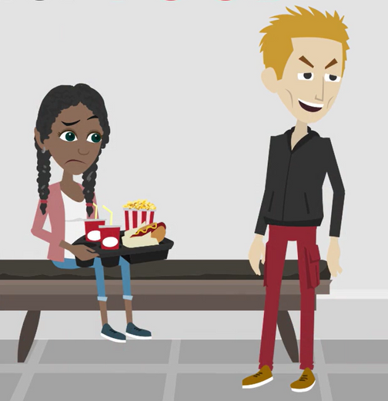
LESSON PLANS
DEPENDENCE
How can groomers manipulate young people to make them feel dependent?
©2025 Walking Wise
57

Slide 58
DEPENDENCE
Fulfill Needs
Groomers provide necessities like money, food, shelter, clothing, transportation, or protection.
©2025 Walking Wise
58
Notes:
• MEET NEEDS
Fulfill the victim's basic needs, such as providing money, food, shelter, clothing, transportation, or protection.
• ADDICTION
Create an addiction by intentionally serving drugs and alcohol to their targeted victim.
• ISOLATION
Separate victims from family and friends to eliminate their emotional support systems.

Slide 59
DEPENDENCE
Fulfill Needs
Groomers provide necessities like money, food, shelter, clothing, transportation, or protection.
They often supply addictive substances like alcohol and drugs.
©2025 Walking Wise
59
Notes:
• MEET NEEDS
Fulfill the victim's basic needs, such as providing money, food, shelter, clothing, transportation, or protection.
• ADDICTION
Create an addiction by intentionally serving drugs and alcohol to their targeted victim.
• ISOLATION
Separate victims from family and friends to eliminate their emotional support systems.

Slide 60
DEPENDENCE
Fulfill Needs
Groomers provide necessities like money, food, shelter, clothing, transportation, or protection.
They often supply addictive substances like alcohol and drugs.
They typically isolate victims from their emotional support system, like family and friends.
©2025 Walking Wise
60
Notes:
• MEET NEEDS
Fulfill the victim's basic needs, such as providing money, food, shelter, clothing, transportation, or protection.
• ADDICTION
Create an addiction by intentionally serving drugs and alcohol to their targeted victim.
• ISOLATION
Separate victims from family and friends to eliminate their emotional support systems.

Slide 61

LESSON PLANS
CHANGED BEHAVIOR
Once trust is gained, how do groomers change their behavior to control the victim?
©2025 Walking Wise
61
3

Slide 62
CHANGED BEHAVIOR
Demands & Threats
They change from pleasing the victim to making demands.
©2025 Walking Wise
62
Notes:
• FORCE
Groomers often shift from pleasing their victims to suddenly forcing unwanted demands.
• WITHDRAW SUPPORT
Groomers may initially fill a need or emptiness in their victim’s life (food, shelter, clothing, love, friendship) and then threaten to take it away.
• MIND CONTROL
Groomers typically turn their victims against their family and friends by urging them to rebel against the wishes and expectations of their family members, coaches, teachers, and friends.

Slide 63
CHANGED BEHAVIOR
Demands & Threats
They change from pleasing the victim to making demands.
They threaten to take away food/shelter, or love/friendship.
©2025 Walking Wise
63
Notes:
• FORCE
Groomers often shift from pleasing their victims to suddenly forcing unwanted demands.
• WITHDRAW SUPPORT
Groomers may initially fill a need or emptiness in their victim’s life (food, shelter, clothing, love, friendship) and then threaten to take it away.
• MIND CONTROL
Groomers typically turn their victims against their family and friends by urging them to rebel against the wishes and expectations of their family members, coaches, teachers, and friends.

Slide 64
CHANGED BEHAVIOR
Demands & Threats
They change from pleasing the victim to making demands.
They threaten to take away food/shelter, or love/friendship.
They pressure the victims to reject their family and friends.
©2025 Walking Wise
64
Notes:
• FORCE
Groomers often shift from pleasing their victims to suddenly forcing unwanted demands.
• WITHDRAW SUPPORT
Groomers may initially fill a need or emptiness in their victim’s life (food, shelter, clothing, love, friendship) and then threaten to take it away.
• MIND CONTROL
Groomers typically turn their victims against their family and friends by urging them to rebel against the wishes and expectations of their family members, coaches, teachers, and friends.

Slide 65
CHANGED BEHAVIOR
Demands & Threats
They change from pleasing the victim to making demands.
They threaten to take away food/shelter, or love/friendship.
They pressure the victims to reject their family and friends.
They may urge the victim to rebel against parents, coaches, and teachers.
©2025 Walking Wise
65
Notes:
• FORCE
Groomers often shift from pleasing their victims to suddenly forcing unwanted demands.
• WITHDRAW SUPPORT
Groomers may initially fill a need or emptiness in their victim’s life (food, shelter, clothing, love, friendship) and then threaten to take it away.
• MIND CONTROL
Groomers typically turn their victims against their family and friends by urging them to rebel against the wishes and expectations of their family members, coaches, teachers, and friends.

Slide 66
UNREPORTED CRIME
How long does it typically take a child (under 18) to report a sexual crime committed against them?
©2025 Walking Wise
The Children's Assessment Center (2024 website). Child Sexual Abuse Facts & Resources
66
Notes:
SLIDO.com: Multiple Choice
How long does it typically take a child (under 18) to report a sexual crime committed against them?
A) 73% do not tell for at least one year
B) 83% tell immediately
C) 45% do not tell for at least 5 years.
D) Some never tell anyone.
ANSWERS
A) 73% do not tell for at least one year
C) 45% do not tell for at least 5 years.
D) Some never tell anyone.
Source
The Children's Assessment Center, Child Sexual Abuse Facts & Resources, Retrieved 10/30/2024 from,
https://cachouston.org/prevention/child-sexual-abuse-facts/
Smith et al., 2000; Broman-Fulks et al., 2007

Slide 67
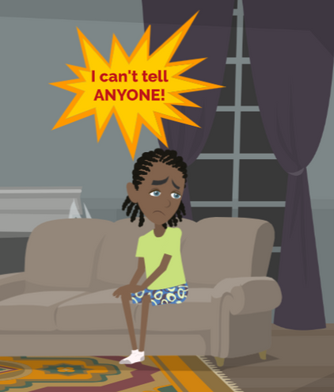
LESSON PLANS
UNREPORTED CRIME
Why do sex trafficking and sexual abuse crimes go unreported?
©2025 Walking Wise
67

Slide 68
UNREPORTED CRIME
Silent Victims
Victims experience threats of harm and humiliation.
©2025 Walking Wise
68
Notes:
• HUMILIATION
Often, sexual predators threaten young people with harm or humiliation to keep the crime a secret.
• BLAME
Sexual offenders and traffickers often blame victims for the crimes committed against them to cause feelings of shame.
• NORMALIZATION
Sexual abuse at a young age can normalize children having sex with adults.
• UNRECOGNIZED CRIME
Often, young people do not understand that the sexual acts committed against them are illegal, so they suffer in silence.

Slide 69
UNREPORTED CRIME
Silent Victims
Victims experience threats of harm and humiliation.
Predators blame victims to create shame and self-blame.
©2025 Walking Wise
69
Notes:
• HUMILIATION
Often, sexual predators threaten young people with harm or humiliation to keep the crime a secret.
• BLAME
Sexual offenders and traffickers often blame victims for the crimes committed against them to cause feelings of shame.
• NORMALIZATION
Sexual abuse at a young age can normalize children having sex with adults.
• UNRECOGNIZED CRIME
Often, young people do not understand that the sexual acts committed against them are illegal, so they suffer in silence.

Slide 70
UNREPORTED CRIME
Silent Victims
Victims experience threats of harm and humiliation.
Predators blame victims to create shame and self-blame.
They make sex between children and adults seem normal.
©2025 Walking Wise
70
Notes:
• HUMILIATION
Often, sexual predators threaten young people with harm or humiliation to keep the crime a secret.
• BLAME
Sexual offenders and traffickers often blame victims for the crimes committed against them to cause feelings of shame.
• NORMALIZATION
Sexual abuse at a young age can normalize children having sex with adults.
• UNRECOGNIZED CRIME
Often, young people do not understand that the sexual acts committed against them are illegal, so they suffer in silence.

Slide 71
UNREPORTED CRIME
Silent Victims
Victims experience threats of harm and humiliation.
Predators blame victims to create shame and self-blame.
They make sex between children and adults seem normal.
Victims are unaware that sexual abuse is a crime.
©2025 Walking Wise
71
Notes:
• HUMILIATION
Often, sexual predators threaten young people with harm or humiliation to keep the crime a secret.
• BLAME
Sexual offenders and traffickers often blame victims for the crimes committed against them to cause feelings of shame.
• NORMALIZATION
Sexual abuse at a young age can normalize children having sex with adults.
• UNRECOGNIZED CRIME
Often, young people do not understand that the sexual acts committed against them are illegal, so they suffer in silence.

Slide 72
LESSON PLANS
WHY STAY?
Why might a young person stay in an abusive or sex trafficking relationship?
©2025 Walking Wise
72
3
Notes:
SLIDO.com: Open Text
NOTE
An open text poll allows participants to type in their answers or comments, making it ideal for sharing a detailed response.

Slide 73
WHY STAY?
Emotional Dependency
Love Bond: To create an emotional loyalty to the predator.
©2025 Walking Wise
73
Notes:
• LOVE BOND
Forming emotional bonds by professing love for their victim is a powerful tool against them.
• DEBT BOND
Making victims feel financially dependent on the predator for food and housing.
• DRUG BOND
Substance dependency prevents victims from leaving when there is no other access to drugs and alcohol.
• FAMILY BOND
In cases of family trafficking, family members use common tactics to convince children they are to serve the family through sexual activity because they are “favored and special,” and they must contribute to the family income for housing and household expenses.

Slide 74
WHY STAY?
Emotional Dependency
Love Bond: To create an emotional loyalty to the predator.
Debt Bond: To develop fear of how to access food and housing.
©2025 Walking Wise
74
Notes:
• LOVE BOND
Forming emotional bonds by professing love for their victim is a powerful tool against them.
• DEBT BOND
Making victims feel financially dependent on the predator for food and housing.
• DRUG BOND
Substance dependency prevents victims from leaving when there is no other access to drugs and alcohol.
• FAMILY BOND
In cases of family trafficking, family members use common tactics to convince children they are to serve the family through sexual activity because they are “favored and special,” and they must contribute to the family income for housing and household expenses.

Slide 75
WHY STAY?
Emotional Dependency
Love Bond: To create an emotional loyalty to the predator.
Debt Bond: To develop fear of how to access food and housing.
Drug Bond: To tie the victim to the predator as their drug dealer.
©2025 Walking Wise
75
Notes:
• LOVE BOND
Forming emotional bonds by professing love for their victim is a powerful tool against them.
• DEBT BOND
Making victims feel financially dependent on the predator for food and housing.
• DRUG BOND
Substance dependency prevents victims from leaving when there is no other access to drugs and alcohol.
• FAMILY BOND
In cases of family trafficking, family members use common tactics to convince children they are to serve the family through sexual activity because they are “favored and special,” and they must contribute to the family income for housing and household expenses.

Slide 76
WHY STAY?
Emotional Dependency
Love Bond: To create an emotional loyalty to the predator.
Debt Bond: To develop fear of how to access food and housing.
Drug Bond: To tie the victim to the predator as their drug dealer.
Family Bond: To create a sense of belonging and connection, as if part of a family.
©2025 Walking Wise
76
Notes:
• LOVE BOND
Forming emotional bonds by professing love for their victim is a powerful tool against them.
• DEBT BOND
Making victims feel financially dependent on the predator for food and housing.
• DRUG BOND
Substance dependency prevents victims from leaving when there is no other access to drugs and alcohol.
• FAMILY BOND
In cases of family trafficking, family members use common tactics to convince children they are to serve the family through sexual activity because they are “favored and special,” and they must contribute to the family income for housing and household expenses.

Slide 77
WHY STAY?
Emotional Captivity
Sextortion Threats: To create fear of public humiliation.
©2025 Walking Wise
77
Notes:
• SEXTORTION THREATS
Predators maintain control by threatening to forward the young person’s nude selfies to family and friends.
• ISOLATING DEMANDS
Strict rules are set, such as dictating whom the victim can speak with to create isolation. Often, this is how traffickers isolate youth away from their families and friends.
• PHYSICAL THREATS
Threatening to hurt the youth, a loved one, or even a family pet.
• LEGAL THREATS
Threaten to report the victim for criminal activity like prostitution, drug dealing, or illegal immigration.

Slide 78
WHY STAY?
Emotional Captivity
Sextortion Threats: To create fear of public humiliation.
Isolating Demands: To dictate who the victim can speak with.
©2025 Walking Wise
78
Notes:
• SEXTORTION THREATS
Predators maintain control by threatening to forward the young person’s nude selfies to family and friends.
• ISOLATING DEMANDS
Strict rules are set, such as dictating whom the victim can speak with to create isolation. Often, this is how traffickers isolate youth away from their families and friends.
• PHYSICAL THREATS
Threatening to hurt the youth, a loved one, or even a family pet.
• LEGAL THREATS
Threaten to report the victim for criminal activity like prostitution, drug dealing, or illegal immigration.

Slide 79
WHY STAY?
Emotional Captivity
Sextortion Threats: To create fear of public humiliation.
Isolating Demands: To dictate who the victim can speak with.
Physical Threats: To harm the victim, siblings, parents, or pets.
©2025 Walking Wise
79
Notes:
• SEXTORTION THREATS
Predators maintain control by threatening to forward the young person’s nude selfies to family and friends.
• ISOLATING DEMANDS
Strict rules are set, such as dictating whom the victim can speak with to create isolation. Often, this is how traffickers isolate youth away from their families and friends.
• PHYSICAL THREATS
Threatening to hurt the youth, a loved one, or even a family pet.
• LEGAL THREATS
Threaten to report the victim for criminal activity like prostitution, drug dealing, or illegal immigration.

Slide 80
WHY STAY?
Emotional Captivity
Sextortion Threats: To create fear of public humiliation.
Isolating Demands: To dictate who the victim can speak with.
Physical Threats: To harm the victim, siblings, parents, or pets.
Legal Threats: To cause victims to fear law enforcement.
©2025 Walking Wise
80
Notes:
• SEXTORTION THREATS
Predators maintain control by threatening to forward the young person’s nude selfies to family and friends.
• ISOLATING DEMANDS
Strict rules are set, such as dictating whom the victim can speak with to create isolation. Often, this is how traffickers isolate youth away from their families and friends.
• PHYSICAL THREATS
Threatening to hurt the youth, a loved one, or even a family pet.
• LEGAL THREATS
Threaten to report the victim for criminal activity like prostitution, drug dealing, or illegal immigration.

Slide 81
EDUCATON GUIDE
VOCABULARY
FREEDOM
To allow someone the power to move, think, speak, and choose for themselves without restriction.
©2025 Walking Wise
81
3
Notes:
Assisting Source
OpenAI. (2024). ChatGPT [Large language model]. https://chatgpt.com

Slide 82

LESSON PLANS
EMPOWERMENT
How can young people protect themselves from a groomer or sexual predator?
©2025 Walking Wise
82
3

Slide 83
EMPOWERMENT
Self-Protection
Trust Your Gut Feelings: Your discomfort is a valid signal.
©2025 Walking Wise
83
Notes:
• TRUST YOUR FEELINGS
If something feels wrong, trust your instincts or intuition. Groomers might try to make you feel obligated, but feeling uncomfortable is a valid signal.
• SET BOUNDARIES Communicate your boundaries and stick to them. Don't let anyone cross the line to pressure you into doing something that makes you uncomfortable.
• BE ASSERTIVE
Practice saying a firm "NO" without hesitation. If someone makes you feel uncomfortable, you're not obligated to give them any time, attention, or explanation.
• RECOGNIZE MANIPULATION
Learn about common manipulation tactics groomers use, such as guilt trips or emotional blackmail. Being aware helps you avoid falling into their traps.

Slide 84
EMPOWERMENT
Self-Protection
Trust Your Gut Feelings: Your discomfort is a valid signal.
Set Boundaries: Don’t allow someone to pressure you.
©2025 Walking Wise
84
Notes:
• TRUST YOUR FEELINGS
If something feels wrong, trust your instincts or intuition. Groomers might try to make you feel obligated, but feeling uncomfortable is a valid signal.
• SET BOUNDARIES Communicate your boundaries and stick to them. Don't let anyone cross the line to pressure you into doing something that makes you uncomfortable.
• BE ASSERTIVE
Practice saying a firm "NO" without hesitation. If someone makes you feel uncomfortable, you're not obligated to give them any time, attention, or explanation.
• RECOGNIZE MANIPULATION
Learn about common manipulation tactics groomers use, such as guilt trips or emotional blackmail. Being aware helps you avoid falling into their traps.

Slide 85
EMPOWERMENT
Self-Protection
Trust Your Gut Feelings: Your discomfort is a valid signal.
Set Boundaries: Don’t allow someone to pressure you.
Be Assertive: Practice saying “no” without hesitation.
©2025 Walking Wise
85
Notes:
• TRUST YOUR FEELINGS
If something feels wrong, trust your instincts or intuition. Groomers might try to make you feel obligated, but feeling uncomfortable is a valid signal.
• SET BOUNDARIES Communicate your boundaries and stick to them. Don't let anyone cross the line to pressure you into doing something that makes you uncomfortable.
• BE ASSERTIVE
Practice saying a firm "NO" without hesitation. If someone makes you feel uncomfortable, you're not obligated to give them any time, attention, or explanation.
• RECOGNIZE MANIPULATION
Learn about common manipulation tactics groomers use, such as guilt trips or emotional blackmail. Being aware helps you avoid falling into their traps.

Slide 86
EMPOWERMENT
Self-Protection
Trust Your Gut Feelings: Your discomfort is a valid signal.
Set Boundaries: Don’t allow someone to pressure you.
Be Assertive: Practice saying “no” without hesitation.
Recognize Manipulation: Understand common tactics, such as guilt trips.
©2025 Walking Wise
86
Notes:
• TRUST YOUR FEELINGS
If something feels wrong, trust your instincts or intuition. Groomers might try to make you feel obligated, but feeling uncomfortable is a valid signal.
• SET BOUNDARIES Communicate your boundaries and stick to them. Don't let anyone cross the line to pressure you into doing something that makes you uncomfortable.
• BE ASSERTIVE
Practice saying a firm "NO" without hesitation. If someone makes you feel uncomfortable, you're not obligated to give them any time, attention, or explanation.
• RECOGNIZE MANIPULATION
Learn about common manipulation tactics groomers use, such as guilt trips or emotional blackmail. Being aware helps you avoid falling into their traps.

Slide 87
EMPOWERMENT
Self-Protection
Prioritize Yourself: Your well-being comes first.
©2025 Walking Wise
87
Notes:
• PRIORITIZE YOURSELF
Remember that your well-being comes first. Don't feel obligated to do something just to please someone else.
• END COMMUNICATION
Victims should discontinue all communication despite feeling frightened by the traffickers' threats or embarrassed by what the sexual predator pressured them into doing.
• ASK FOR HELP
When feeling at risk of grooming or trafficking, immediately inform a trustworthy adult. If that adult does not protect you, go to other trustworthy adults. Such as an adult who has the authority or connections to help you break free of a sexual predator's influence.
• PRESERVE EVIDENCE
Keep all communications from the predator, including any embarrassing texts, online messages, images, and any threats received for evidence so law enforcement can investigate.

Slide 88
EMPOWERMENT
Self-Protection
Prioritize Yourself: Your well-being comes first.
End Communication: Despite being intimidated or embarrassed.
©2025 Walking Wise
88
Notes:
• PRIORITIZE YOURSELF
Remember that your well-being comes first. Don't feel obligated to do something just to please someone else.
• END COMMUNICATION
Victims should discontinue all communication despite feeling frightened by the traffickers' threats or embarrassed by what the sexual predator pressured them into doing.
• ASK FOR HELP
When feeling at risk of grooming or trafficking, immediately inform a trustworthy adult. If that adult does not protect you, go to other trustworthy adults. Such as an adult who has the authority or connections to help you break free of a sexual predator's influence.
• PRESERVE EVIDENCE
Keep all communications from the predator, including any embarrassing texts, online messages, images, and any threats received for evidence so law enforcement can investigate.

Slide 89
EMPOWERMENT
Self-Protection
Prioritize Yourself: Your well-being comes first.
End Communication: Despite being intimidated or embarrassed.
Seek Help: Tell a trustworthy adult until someone helps you.
©2025 Walking Wise
89
Notes:
• PRIORITIZE YOURSELF
Remember that your well-being comes first. Don't feel obligated to do something just to please someone else.
• END COMMUNICATION
Victims should discontinue all communication despite feeling frightened by the traffickers' threats or embarrassed by what the sexual predator pressured them into doing.
• ASK FOR HELP
When feeling at risk of grooming or trafficking, immediately inform a trustworthy adult. If that adult does not protect you, go to other trustworthy adults. Such as an adult who has the authority or connections to help you break free of a sexual predator's influence.
• PRESERVE EVIDENCE
Keep all communications from the predator, including any embarrassing texts, online messages, images, and any threats received for evidence so law enforcement can investigate.

Slide 90
EMPOWERMENT
Self-Protection
Prioritize Yourself: Your well-being comes first.
End Communication: Despite being intimidated or embarrassed.
Seek Help: Tell a trustworthy adult until someone helps you.
Preserve Evidence: Keep all communication from the groomer for an investigation, even the embarrassing stuff.
©2025 Walking Wise
90
Notes:
• PRIORITIZE YOURSELF
Remember that your well-being comes first. Don't feel obligated to do something just to please someone else.
• END COMMUNICATION
Victims should discontinue all communication despite feeling frightened by the traffickers' threats or embarrassed by what the sexual predator pressured them into doing.
• ASK FOR HELP
When feeling at risk of grooming or trafficking, immediately inform a trustworthy adult. If that adult does not protect you, go to other trustworthy adults. Such as an adult who has the authority or connections to help you break free of a sexual predator's influence.
• PRESERVE EVIDENCE
Keep all communications from the predator, including any embarrassing texts, online messages, images, and any threats received for evidence so law enforcement can investigate.

Slide 91

ASK FOR HELP
©2025 Walking Wise
91

Slide 92
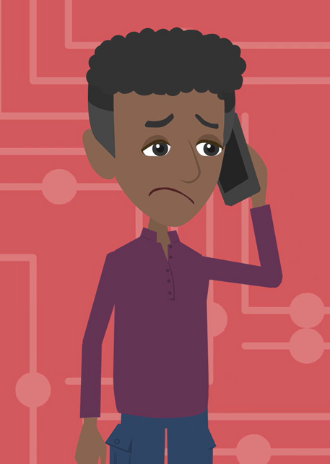
ASK FOR HELP
What are ways young people can ask for help?
©2025 Walking Wise
92

Slide 93
ASK FOR HELP
How to Ask for Help
If you are in immediate danger, dial 911.
©2025 Walking Wise
93

Slide 94
ASK FOR HELP
How to Ask for Help
If you are in immediate danger, dial 911.
If the sexual predator IS a family member, consider telling a trustworthy adult.
©2025 Walking Wise
94

Slide 95
ASK FOR HELP
How to Ask for Help
If you are in immediate danger, dial 911.
If the sexual predator IS a family member, consider telling a trustworthy adult.
If the sexual predator is NOT family, consider telling a parent.
©2025 Walking Wise
95

Slide 96
ASK FOR HELP
How to Ask for Help
If you are in immediate danger, dial 911.
If the sexual predator IS a family member, consider telling a trustworthy adult.
If the sexual predator is NOT family, consider telling a parent.
If you are a student in school, consider telling a trustworthy teacher, coach, school nurse, social worker, counselor, resource officer, or principal.
©2025 Walking Wise
96

Slide 97
ASK FOR HELP
How to Ask for Help
If you are in immediate danger, dial 911.
If the sexual predator IS a family member, consider telling a trustworthy adult.
If the sexual predator is NOT family, consider telling a parent.
If you are a student in school, consider telling a trustworthy teacher, coach, school nurse, social worker, counselor, resource officer, or principal.
To gain internet access for help, consider using a computer at your school or a public library.
©2025 Walking Wise
97

Slide 98
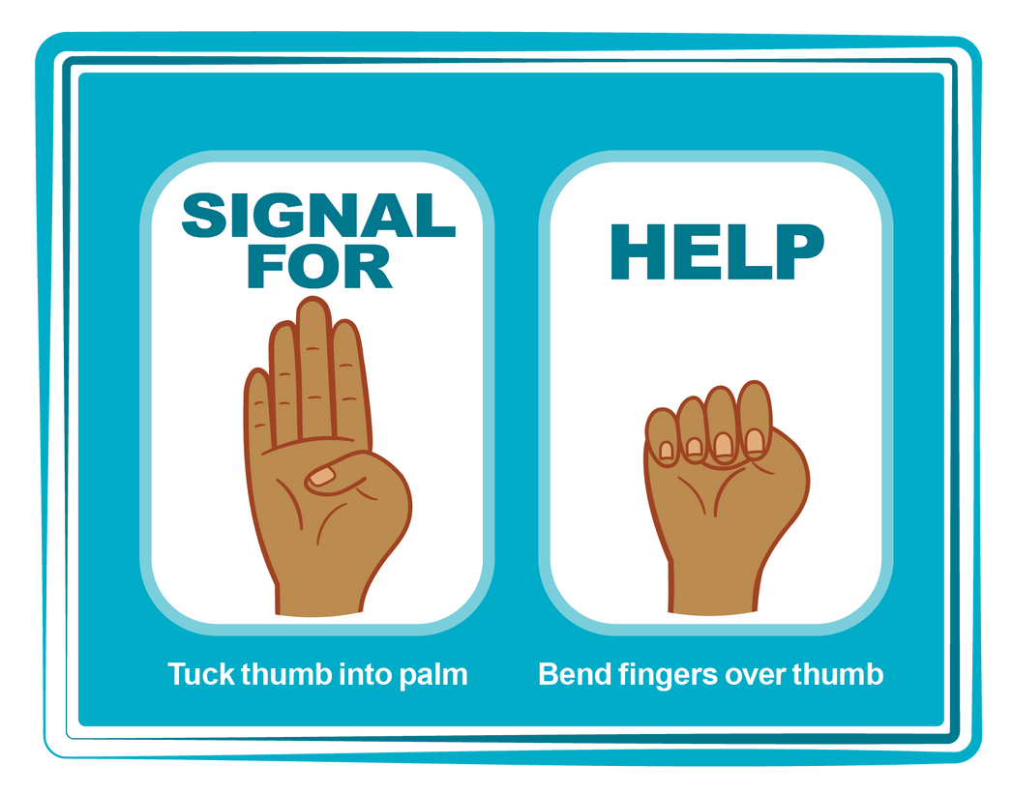
HAND SIGNAL FOR HELP
©2025 Walking Wise
Source: Canadian Women’s Foundation, April 2020
98
Notes:
Although the hand signal for help has not yet achieved universal recognition, it may discreetly get someone's attention in urgent situations.
• SILENT
It can be used silently.
• UNTRACKABLE
It leaves no digital footprint.
• CONCEALED
It can be done secretly when a perpetrator is in the vicinity.
• SIGNALS DISTRESS
Combining the hand signal with distressed facial expressions might help attract the attention of an individual who is unfamiliar with the signal's meaning.
Source
Canadian Women's Foundation, April 2020

Slide 99
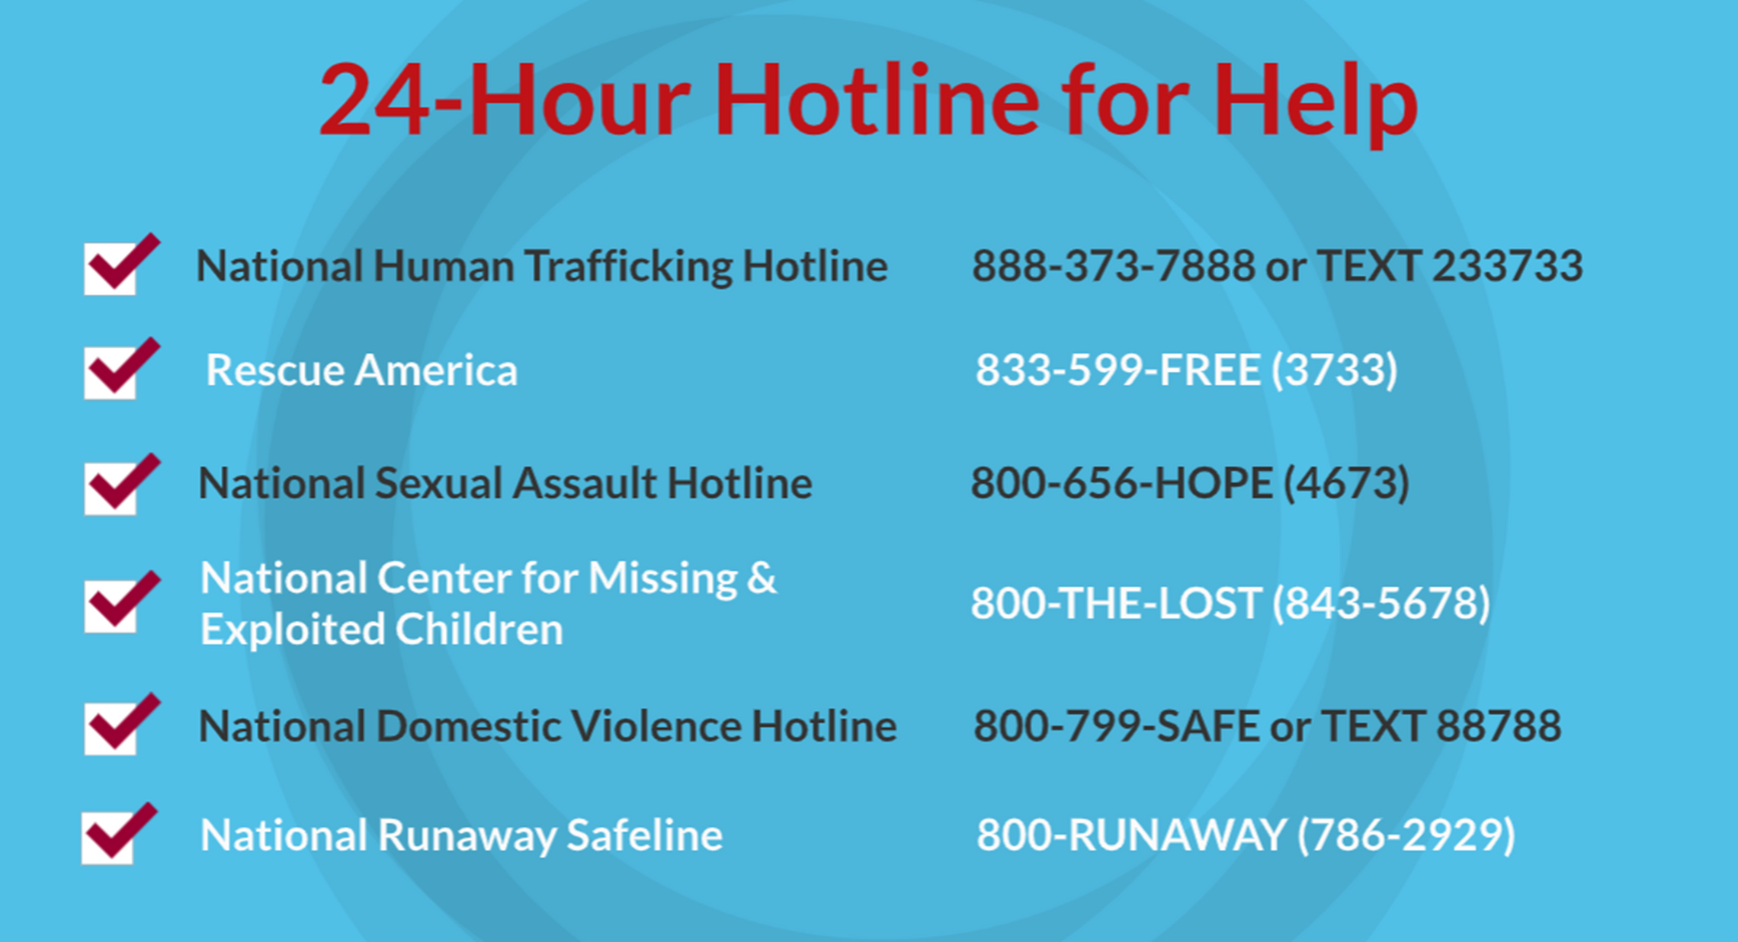
©2025 Walking Wise
99
Notes:
NOTE
Presenters may ask their audience to consider adding a few "hotline for help" phone numbers in their cell phone contacts or take a photo of this slide.

Slide 100
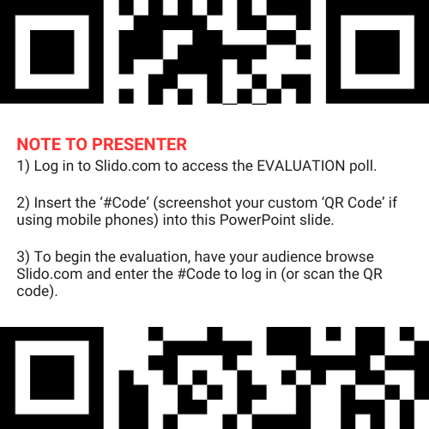
EVALUATION
©2025 Walking Wise
100
Notes:
SLIDO.com: 3-Question Survey
NOTE
Update this slide with your school/organization's custom QR code and #code.
Please encourage participants to scan your organization's custom QR code to share what they enjoyed and what could be improved about the lesson.
Please send any feedback you want to share to Walking Wise at support@WalkingWise.com.

Slide 101
SHARE YOUR THOUGHTS
1. How would you rate this lesson?
2. What was the one thing you liked?
3. What one thing should we improve?
Presenter: Replace “#XXXX” with your organization’s custom Slido code.
©2025 Walking Wise
101
Notes:
SLIDO.com: 3-Question Survey
NOTE
Follow the instructions provided on WalkingWise.com to access your school or organization's custom Slido QR code and #code, which will enable the audience to complete the 3-question evaluation.
Please encourage your audience to scan your organization's custom QR code to share what they enjoyed and what could be improved about the lesson.
Please send any feedback you want to share to Walking Wise at support@WalkingWise.com.

Slide 102



Thank you!
WalkingWise.com
Online Course for Adults Accredited by: Postgraduate Institue for Medicine Academy of Forensic Nursing
©2025 Walking Wise
102
Notes:
NOTE
To access additional resources about grooming, please refer to the last page of Lesson Plan #3 in the Walking Wise Education Guide.
We welcome your feedback at support@WalkingWise.com.
Thank you!
Karla Highman
Founder, WalkingWise.com

