Slide 1


SEXUAL EXPLOITATION
EDUCATION
HIDDEN
BUYERS
BY WALKING WISE
Presentation Updated: May 8, 2026
Notes:
NOTE TO PRESENTER
Log in to WalkingWise.com and refer to the Implementation Toolkit for classroom teaching tips.
Most importantly:
DEFINE SCHOOL POLICY
Establish a sexual exploitation reporting protocol with a trauma-informed response. The Walking Wise Implementation Toolkit provides a sample protocol.
AGE & AUDIENCE
This presentation can be edited by following the procedures on page 3 to align with your school policies, specific age groups, and the involvement of at-risk audiences.
SUPPORT PROCEDURE
Provide your students with guidance on how to access immediate help or arrange a private meeting with a social worker, counselor, nurse, school resource officer, or another trustworthy staff member to report concerns about themselves or a peer.
SECOND SAFE ADULT
Ensure a second trustworthy adult, such as a teacher, is present in the learning setting to observe student reactions and identify those who may benefit from a follow-up meeting. This person should remain focused and free from other duties during the presentation.

Slide 2

5-Year Track
NOTE TO PRESENTER
Meaningful learning takes time. By introducing topics gradually over several years, educators can create steady growth in awareness and understanding.
Our recommended teaching plan offers a long-term path for middle and high school students to build knowledge and confidence.
PARENTS & STAFF
#1 Myths & Reality
6th GRADE
#2 Trustworthy vs. Unsafe Adult
#3 Grooming Process
7th GRADE
#4 Pornography Link
#5 Sextortion Scheme
8th GRADE
#6 Male Victims
#7 Runaways as Targets
#8 Rural Risks
9th GRADE
#9 Human Traffickers
#10 Female & Peer Recruiters
10th GRADE
#11 Family Secret
$12 Hidden Buyers
©2024-2026 Walking Wise
2

Slide 3

NOTE TO PRESENTER
This presentation is exclusively for Walking Wise® subscribers and not for redistribution.
Presenters are encouraged to edit speaker notes to match their speaking style (viewable in presentation mode). You can also delete slides and content from this Walking Wise presentation to ensure the information aligns with your school policies, is age-appropriate, and fits within available class time. However, the slides are copyright-protected and may not be reworded without prior written permission from Walking Wise.
We encourage you to add your own content by following these instructions:
  Insert new PowerPoint slides.
  Remove the Walking Wise logo and copyright "©2026 Walking Wise" from the new slides.
  Always add your organization's name or logo to each new slide.
Please delete this instruction page before presenting to audiences.
©2024-2026 Walking Wise
3
Notes:
NOTE TO PRESENTER
The presenter is welcome to customize this Walking Wise presentation according to the instructions provided on this page.
For revision requests, please email us at: support@WalkingWise.com.

Slide 4
SENSITIVE TOPICS WILL BE DISCUSSED
CONTENT NOTICE
We’ll be discussing serious safety issues today.
Some topics may be difficult to hear.
If you ever feel uncomfortable, you can step out and speak with a trustworthy adult for support.
You’re not alone—help is available.
©2024-2026 Walking Wise
4
Notes:
NOTE TO PRESENTER
Trauma-Informed Delivery Guidelines
To support a safe and effective learning environment, please follow these guidelines:
• Present the information in a calm, matter-of-fact way and avoid sensational or alarming language.
• Avoid graphic details. Focus on helping students understand behaviors, risk, and ways to stay safe.
• Never blame victims. Responsibility always belongs to the person who caused harm.
• Maintain a steady, composed tone. Students often mirror the presenter's emotional cues.
• Do not ask students to share personal experiences or disclosures.
• If students laugh or react awkwardly, respond neutrally and gently redirect the focus.
• Pair all risk information with needed resources, practical solutions, and support options.
• Reinforce that students are not alone and that trustworthy adults are available to help.

Slide 5
STATISTICS
Why Study Results Can Vary
  Some crimes are never reported, making it hard to reveal the entire issue.
  Studies collect information in different ways, leading to different results.
  Small studies may not represent everyone.
©2024-2026 Walking Wise
5
Notes:
In this presentation, we'll discuss statistics, but it's important to note that while statistics provide valuable insights into an issue, they cannot be relied upon entirely.
Here are a few reasons:
UNREPORTED
Victims often do not report the crimes committed against them due to fear, shame, retaliation, or manipulation. Also, many don’t realize that what is happening to them is a crime.
INCONSISTENT COLLECTION
Areas may define sexual crimes in various ways or use different methods to collect data, making it hard to compare information.
FOCUS GROUPS
Small or specific focus groups participating in a study or survey may not accurately reflect the diversity or experiences of the broader population.

Slide 6

WHY LEARN ABOUT THIS
KNOWLEDGE serves as a
powerful defense against
sexual predators.
©2024-2026 Walking Wise
6
Notes:
Education is one of the strongest tools for preventing exploitation.
When young people understand how predators operate, they are better able to recognize manipulation and avoid dangerous situations.
Reinforce that awareness increases safety.

Slide 7
PREVENTION EDUCATION
SEXUAL EXPLOITATION includes grooming, sextortion, pornography
& sex trafficking.
©2024-2026 Walking Wise
7
Notes:
SEXUAL EXPLOITATION
Taking advantage of another person for their own benefit, especially in a sexual way, often using pressure, tricks, or control.
Below are different forms of exploitation:
GROOMING
Building trust, dependency, or an emotional connection to manipulate someone.
SEXTORTION
Threatening to share embarrassing or sexual images, videos, or information to pressure someone into following demands.
PORNOGRAPHY
Involving someone in creating sexual images who is under 18, or someone who is pressured, or unable/unwilling to give consent.
SEX TRAFFICKING
Manipulating or forcing someone into sexual activity in exchange for money or something of value.
Trafficking and Violence Protection Act (TVPA) of 2000 (Legal Definition):
SEX TRAFFICKING is the recruitment, harboring, transportation, provision, obtaining, patronizing, or soliciting of a person under the age of 18 for the purpose of a commercial sex act.
TVPA link: Retrieved April 14, 2026, from https://www.govinfo.gov/content/pkg/BILLS-106hr3244enr/pdf/BILLS-106hr3244enr.pdf

Slide 8



EDUCATON GUIDE
VOCABULARY
Words to Understand
  Human Trafficker (Pimp)
  Commercial Sex Trade
  Sex Buyer
  Grooming
  Sexual Innocence
  Trauma
HIDDEN
BUYERS
©2024-2026 Walking Wise
8
3
Notes:
Understanding vocabulary terms related to the behaviors of sexual predators can empower young people to recognize warning signs of harmful situations.
Knowing these terms helps them identify manipulative tactics that unsafe people (predators/traffickers) use to build trust and exploit vulnerabilities.
With this knowledge, young people are better equipped to spot red flags, understand that these behaviors are abusive, and feel more confident reporting predators to trusted adults or authorities, potentially preventing further harm.

Slide 9
EDUCATON GUIDE
VOCABULARY
COMMERCIAL SEX TRADE
An illegal system where sexual activity is bought, sold, or exchanged for money or something of value.
HIDDEN
BUYERS
©2024-2026 Walking Wise
9
3

Slide 10
EDUCATON GUIDE
VOCABULARY
HUMAN TRAFFICKER (PIMP)
A person who uses force (violence/captivity), fraud (tricks/lies), or coercion (pressure), or targets someone under 18, to make them engage in commercial sex or forced labor for profit.
HIDDEN
BUYERS
©2024-2026 Walking Wise
Cornell Law School (n.d.). Legal Information Institute: Prostitution. Law.Cornell.edu.
10
3
Notes:
LAWS AGAINST PROSTITUTION
In all U.S. states, prostitution laws make it illegal for anyone, including adults, to engage, agree, or offer to engage in sexual conduct with another person in return for a fee.*
Note to Educators:
*In certain counties of Nevada, the selling and buying of sex acts between ADULTS is legally regulated and controlled.
Source
Cornell Law School (n.d.). Legal Information Institute: Prostitution. Law.Cornell.edu. Retrieved January 21, 2026,
from https://www.law.cornell.edu/wex/prostitution#:~:text=Prostitution%20involves%20engaging%2C%
20agreeing%2C%20or,in%20the%20State%20of%20Nevada

Slide 11
EDUCATON GUIDE
VOCABULARY
SEX BUYER
A person who pays money or gives something of value in exchange for sexual activity.
Can also be referred to as a client, customer, trick, or john.
HIDDEN
BUYERS
©2024-2026 Walking Wise
11
3

Slide 12
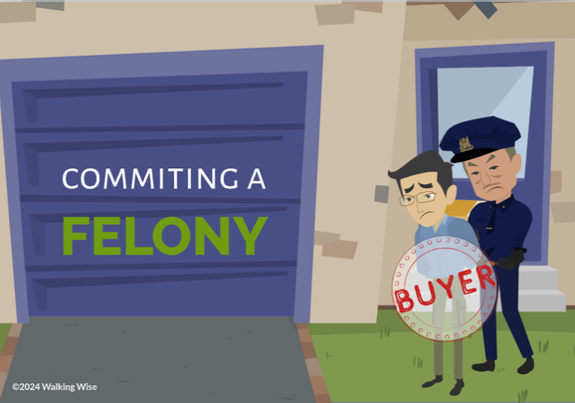
LESSON PLANS
CAUSE & EFFECT
How does purchasing sex connect someone to the commercial sex trade?
HIDDEN
BUYERS
©2024-2026 Walking Wise
12
3

Slide 13
CAUSE & EFFECT
Buyers of the Commercial Sex Trade
  Buying sex helps fund and grow this illegal system.
HIDDEN
BUYERS
©2024-2026 Walking Wise
13
Notes:
This illegal system is connected to human sex trafficking and involves the sexual exploitation of young and vulnerable people.

Slide 14
CAUSE & EFFECT
Buyers of the Commercial Sex Trade
  Buying sex helps fund and grow this illegal system.
  Sex buyers create “demand” that leads to harm.
HIDDEN
BUYERS
©2024-2026 Walking Wise
14
Notes:
This illegal system is connected to human sex trafficking and involves the sexual exploitation of young and vulnerable people.

Slide 15
CAUSE & EFFECT
Buyers of the Commercial Sex Trade
  Buying sex helps fund and grow this illegal system.
  Sex buyers create “demand” that leads to harm.
  Traffickers respond by targeting and exploiting young and vulnerable people for profit.
HIDDEN
BUYERS
©2024-2026 Walking Wise
15
Notes:
This illegal system is connected to human sex trafficking and involves the sexual exploitation of young and vulnerable people.

Slide 16
CAUSE & EFFECT
How “Demand” Works
  Businesses sell products (supply) that people want (demand).
©2024-2026 Walking Wise
16
Notes:
HOW SUPPLY & DEMAND WORK
To understand how the commercial sex trade works, it helps to think about supply and demand.
In any business, when people want something and are willing to pay for it, that creates demand. When demand increases, more people try to supply that product or service to make money.
For example, if people want to buy sneakers, companies will make and sell them.
The same pattern happens in the commercial sex trade. When sex buyers are willing to pay, traffickers respond by supplying victims to meet that demand.
This is how buying sex helps keep the system going—it creates a financial incentive for traffickers to exploit others.

Slide 17
CAUSE & EFFECT
How “Demand” Works
  Businesses sell products (supply) that people want (demand).
  The greater the demand, the more others try to supply it.
©2024-2026 Walking Wise
17
Notes:
HOW SUPPLY & DEMAND WORK
To understand how the commercial sex trade works, it helps to think about supply and demand.
In any business, when people want something and are willing to pay for it, that creates demand. When demand increases, more people try to supply that product or service to make money.
For example, if people want to buy sneakers, companies will make and sell them.
The same pattern happens in the commercial sex trade. When sex buyers are willing to pay, traffickers respond by supplying victims to meet that demand.
This is how buying sex helps keep the system going—it creates a financial incentive for traffickers to exploit others.

Slide 18
CAUSE & EFFECT
How “Demand” Works
  Businesses sell products (supply) that people want (demand).
  The greater the demand, the more others try to supply it.
  In the sex trade, buyers create the demand and traffickers supply victims to make a profit.
©2024-2026 Walking Wise
18
Notes:
HOW SUPPLY & DEMAND WORK
To understand how the commercial sex trade works, it helps to think about supply and demand.
In any business, when people want something and are willing to pay for it, that creates demand. When demand increases, more people try to supply that product or service to make money.
For example, if people want to buy sneakers, companies will make and sell them.
The same pattern happens in the commercial sex trade. When sex buyers are willing to pay, traffickers respond by supplying victims to meet that demand.
This is how buying sex helps keep the system going—it creates a financial incentive for traffickers to exploit others.

Slide 19
LESSON PLANS
WHAT DO YOU THINK?
Who is MOST likely to purchase sex in the United States?
©2024-2026 Walking Wise
19
3

Slide 20
WHAT DO YOU THINK?
Who is MOST likely to purchase sex in the United States?
A) Females
B) Males
C) Teenagers
D) Only Wealthy Individuals
©2024-2026 Walking Wise
20

Slide 21
ANSWER
Most sex buyers are Male.
©2024-2026 Walking Wise
Demand Abolition (2018). Who Buys Sex? Understanding and Disrupting Illicit Market Demand.
21
Notes:
Many people imagine a certain type of person—maybe someone older, wealthy, or obviously dangerous. But research shows that most sex buyers are male.
That might be different from what some people expected. At the same time, it’s important to understand that this doesn’t mean all buyers fit a single image; they are often the people we would least suspect, which is why we will focus on behaviors in this lesson rather than stereotypes.
Source
DemandAbolition.org. Retrieved June 11, 2025, from https://www.demandabolition.org/wp-content/uploads/2019/07/Demand-Buyer-Report-July-2019.pdf

Slide 22

LESSON PLANS
CHARACTERISTICS
What are some common characteristics among people who purchase sex?
HIDDEN
BUYERS
©2024-2026 Walking Wise
22
3

Slide 23
CHARACTERISTICS
Common Traits of Sex Buyers
  Gender: Studies reveal that sex buyers are mostly male.
HIDDEN
BUYERS
©2024-2026 Walking Wise
Demand Abolition (2018). Who Buys Sex? Understanding and Disrupting Illicit Market Demand.
23
Notes:
COMMON TRAITS
There is no single “type” of person who buys sex. Research shows that sex buyers are most often male, but they come from a wide range of ages, backgrounds, and life situations.
Some are young adults, while others are much older. Many have jobs, families, or relationships, and may appear ordinary to others.
This is important for us to understand because it challenges stereotypes and reinforces that buying sex is a behavior and choice, not a specific personality or appearance.
Source
Demand Abolition (2018, November). Who Buys Sex? Understanding and Disrupting Illicit Market Demand, p. 19. DemandAbolition.org. Retrieved June 11, 2025, from https://www.demandabolition.org/wp-content/uploads/2019/07/Demand-Buyer-Report-July-2019.pdf

Slide 24
CHARACTERISTICS
Common Traits of Sex Buyers
  Gender: Studies reveal that sex buyers are primarily male.
  Age: Sex buyers can range from 18 to 80+ years old.
HIDDEN
BUYERS
©2024-2026 Walking Wise
Demand Abolition (2018). Who Buys Sex? Understanding and Disrupting Illicit Market Demand.
24
Notes:
COMMON TRAITS
There is no single “type” of person who buys sex. Research shows that sex buyers are most often male, but they come from a wide range of ages, backgrounds, and life situations.
Some are young adults, while others are much older. Many have jobs, families, or relationships, and may appear ordinary to others.
This is important for us to understand because it challenges stereotypes and reinforces that buying sex is a behavior and choice, not a specific personality or appearance.
Source
Demand Abolition (2018, November). Who Buys Sex? Understanding and Disrupting Illicit Market Demand, p. 19. DemandAbolition.org. Retrieved June 11, 2025, from https://www.demandabolition.org/wp-content/uploads/2019/07/Demand-Buyer-Report-July-2019.pdf

Slide 25
CHARACTERISTICS
Common Traits of Sex Buyers
  Gender: Studies reveal that sex buyers are primarily male.
  Age: Sex buyers can range from 18 to 80+ years old.
  Relationships: Sex buyers may be single, dating, straight or gay, married, or have children.
HIDDEN
BUYERS
©2024-2026 Walking Wise
Demand Abolition (2018). Who Buys Sex? Understanding and Disrupting Illicit Market Demand.
25
Notes:
COMMON TRAITS
There is no single “type” of person who buys sex. Research shows that sex buyers are most often male, but they come from a wide range of ages, backgrounds, and life situations.
Some are young adults, while others are much older. Many have jobs, families, or relationships, and may appear ordinary to others.
This is important for us to understand because it challenges stereotypes and reinforces that buying sex is a behavior and choice, not a specific personality or appearance.
Source
Demand Abolition (2018, November). Who Buys Sex? Understanding and Disrupting Illicit Market Demand, p. 19. DemandAbolition.org. Retrieved June 11, 2025, from https://www.demandabolition.org/wp-content/uploads/2019/07/Demand-Buyer-Report-July-2019.pdf

Slide 26
CHARACTERISTICS
Common Traits of Sex Buyers
  Education: They achieve all levels of education.
HIDDEN
BUYERS
©2024-2026 Walking Wise
Demand Abolition (2018). Who Buys Sex? Understanding and Disrupting Illicit Market Demand.
26
Notes:
COMMON TRAITS
Sex buyers come from all educational and professional backgrounds. Some have little formal education, while others hold college degrees or advanced training. They are found in every type of job and industry, including positions that carry trust or authority.
Research also shows that people who buy sex more frequently often have higher disposable income (extra money), which makes it easier to pay for commercial sex.
These facts help us understand that sex trafficking is not caused by one social group. It is driven by choices and access to money, and it can even involve people who are respected by others in their communities.
Source
Demand Abolition (2018, November). Who Buys Sex? Understanding and Disrupting Illicit Market Demand, p. 19. DemandAbolition.org. Retrieved June 11, 2025, from https://www.demandabolition.org/wp-content/uploads/2019/07/Demand-Buyer-Report-July-2019.pdf

Slide 27
CHARACTERISTICS
Common Traits of Sex Buyers
  Education: They achieve all levels of education.
  Employment: Sex buyers are in all professions.
HIDDEN
BUYERS
©2024-2026 Walking Wise
Demand Abolition (2018). Who Buys Sex? Understanding and Disrupting Illicit Market Demand.
27
Notes:
COMMON TRAITS
Sex buyers come from all educational and professional backgrounds. Some have little formal education, while others hold college degrees or advanced training. They are found in every type of job and industry, including positions that carry trust or authority.
Research also shows that people who buy sex more frequently often have higher disposable income (extra money), which makes it easier to pay for commercial sex.
These facts help us understand that sex trafficking is not caused by one social group. It is driven by choices and access to money, and it can even involve people who are respected by others in their communities.
Source
Demand Abolition (2018, November). Who Buys Sex? Understanding and Disrupting Illicit Market Demand, p. 19. DemandAbolition.org. Retrieved June 11, 2025, from https://www.demandabolition.org/wp-content/uploads/2019/07/Demand-Buyer-Report-July-2019.pdf

Slide 28
CHARACTERISTICS
Common Traits of Sex Buyers
  Education: They achieve all levels of education.
  Employment: Sex buyers are in all professions.
  Income: People who frequently buy sex often make more money than the average person.
HIDDEN
BUYERS
©2024-2026 Walking Wise
Demand Abolition (2018). Who Buys Sex? Understanding and Disrupting Illicit Market Demand.
28
Notes:
COMMON TRAITS
Sex buyers come from all educational and professional backgrounds. Some have little formal education, while others hold college degrees or advanced training. They are found in every type of job and industry, including positions that carry trust or authority.
Research also shows that people who buy sex more frequently often have higher disposable income (extra money), which makes it easier to pay for commercial sex.
These facts help us understand that sex trafficking is not caused by one social group. It is driven by choices and access to money, and it can even involve people who are respected by others in their communities.
Source
Demand Abolition (2018, November). Who Buys Sex? Understanding and Disrupting Illicit Market Demand, p. 19. DemandAbolition.org. Retrieved June 11, 2025, from https://www.demandabolition.org/wp-content/uploads/2019/07/Demand-Buyer-Report-July-2019.pdf

Slide 29

hidden buyers
by walking wise
Log in to WalkingWise.com to access this animated video.
©2024-2026 Walking Wise
29
Notes:
This 3-minute Walking Wise animated video series teaches how sexual predators use manipulation, intimidation, and coercion to exploit young people.
NOTE
Log in to Walking Wise.com to watch the three-minute animated video with audiences.
Is animation appropriate for teens?
Yes, even businesses worldwide use explainer-style animation as a training tool for their employees.

Slide 30
LESSON PLANS
WHAT DO YOU THINK?
Which is one of the most influential factors that can lead some people to purchase sex?
©2024-2026 Walking Wise
30
3

Slide 31
WHAT DO YOU THINK?
Which is one of the most influential factors that can lead some people to purchase sex?
A) Peer Pressure
B) Parents' Attitudes
C) Parties
D) Pornography
©2024-2026 Walking Wise
31

Slide 32
ANSWER
Pornography is a powerful influence that can make buying sex seem acceptable.
©2024-2026 Walking Wise
Wilkinson Jr., Kevin L. (2023). The Breeding of Wolves: Understanding the Escalation Continuum & Escalation Dynamics of Contemporary Sex Trafficking.
32
Notes:
Source
Wilkinson Jr., Kevin L. (2023). The Breeding of Wolves: Understanding the Escalation Continuum & Escalation Dynamics of Contemporary Sex Trafficking. DigitalCommons.liberity.edu. Retrieved April 30, 2025, from https://digitalcommons.liberty.edu/doctoral/4600/

Slide 33
EDUCATON GUIDE
VOCABULARY
GROOMING
A process where someone manipulates a person by building trust with the intent to exploit or abuse them.
HIDDEN
BUYERS
©2024-2026 Walking Wise
33
3

Slide 34

LESSON PLANS
INFLUENCES
What are some factors that can influence people to purchase sex?
HIDDEN
BUYERS
©2024-2026 Walking Wise
34
3

Slide 35
INFLUENCES
Influences that Promote Buying Sex
Influential Adults: Some caregivers may normalize unsafe behaviors such as viewing pornography and buying sex.
©2024-2026 Walking Wise
Wilkinson Jr., Kevin L. (2023). The Breeding of Wolves: Understanding the Escalation Continuum & Escalation Dynamics of Contemporary Sex Trafficking.
35
Notes:
INFLUENCES
Deciding to buy sex usually doesn’t happen all at once. It often develops over time through repeated exposure to certain messages and influences.
These influences can come from people in someone’s life, such as parents, caregivers, or peers.
For example, if a young person grows up in an environment where pornography is common or where buying sex is not taken seriously, it can begin to feel normal.
Peer pressure can also play a role, especially if friends talk about it as something acceptable or even expected.
Over time, these influences can shape how a person thinks about relationships, boundaries, and respect for others.
Source
Wilkinson Jr., Kevin L. (2024, July 4). The Breeding of Wolves: Understanding the Escalation Continuum & Escalation Dynamics of Contemporary Sex Trafficking. DigitalCommons.liberity.edu. Retrieved April 30, 2025, from https://digitalcommons.liberty.edu/doctoral/4600/

Slide 36
INFLUENCES
Influences that Promote Buying Sex
Peer Pressure: Friends or social groups may encourage the behavior to make it seem common or cool.
©2024-2026 Walking Wise
Wilkinson Jr., Kevin L. (2023). The Breeding of Wolves: Understanding the Escalation Continuum & Escalation Dynamics of Contemporary Sex Trafficking.
36
Notes:
INFLUENCES
Deciding to buy sex usually doesn’t happen all at once. It often develops over time through repeated exposure to certain messages and influences.
These influences can come from people in someone’s life, such as parents, caregivers, or peers.
For example, if a young person grows up in an environment where pornography is common or where buying sex is not taken seriously, it can begin to feel normal.
Peer pressure can also play a role, especially if friends talk about it as something acceptable or even expected.
Over time, these influences can shape how a person thinks about relationships, boundaries, and respect for others.
Source
Wilkinson Jr., Kevin L. (2024, July 4). The Breeding of Wolves: Understanding the Escalation Continuum & Escalation Dynamics of Contemporary Sex Trafficking. DigitalCommons.liberity.edu. Retrieved April 30, 2025, from https://digitalcommons.liberty.edu/doctoral/4600/

Slide 37
INFLUENCES
Grooming Process of Buying Sex
Media: Highly sexualized media can make buying sex seem acceptable or even expected.
Wilkinson Jr., Kevin L. (2023). The Breeding of Wolves: Understanding the Escalation Continuum & Escalation Dynamics of Contemporary Sex Trafficking.
37
©2024-2026 Walking Wise
Notes:
MEDIA & ENTERTAINMENT
These influences can function as part of a grooming process, gradually shaping how someone thinks over time.
Sexualized media—like music, videos, and online content—can make harmful behaviors seem normal or acceptable.
Pornography can also affect how some people view relationships, sometimes reducing empathy and making others seem like objects instead of people.
As young people reach adulthood, environments like adult entertainment venues can further reinforce the idea that paying for sexual experiences is acceptable.
Research shows that these repeated influences can shape attitudes and increase the risk of someone viewing buying sex as normal behavior.
Source
Wilkinson Jr., Kevin L. (2024, July 4). The Breeding of Wolves: Understanding the Escalation Continuum & Escalation Dynamics of Contemporary Sex Trafficking. DigitalCommons.liberity.edu. Retrieved April 30, 2025, from https://digitalcommons.liberty.edu/doctoral/4600/

Slide 38
INFLUENCES
Grooming Process of Buying Sex
Pornography Exposure: Can create harmful attitudes and encourage treating others like objects.
Wilkinson Jr., Kevin L. (2023). The Breeding of Wolves: Understanding the Escalation Continuum & Escalation Dynamics of Contemporary Sex Trafficking.
38
©2024-2026 Walking Wise
Notes:
MEDIA & ENTERTAINMENT
These influences can function as part of a grooming process, gradually shaping how someone thinks over time.
Sexualized media—like music, videos, and online content—can make harmful behaviors seem normal or acceptable.
Pornography can also affect how some people view relationships, sometimes reducing empathy and making others seem like objects instead of people.
As young people reach adulthood, environments like adult entertainment venues can further reinforce the idea that paying for sexual experiences is acceptable.
Research shows that these repeated influences can shape attitudes and increase the risk of someone viewing buying sex as normal behavior.
Source
Wilkinson Jr., Kevin L. (2024, July 4). The Breeding of Wolves: Understanding the Escalation Continuum & Escalation Dynamics of Contemporary Sex Trafficking. DigitalCommons.liberity.edu. Retrieved April 30, 2025, from https://digitalcommons.liberty.edu/doctoral/4600/

Slide 39
INFLUENCES
Grooming Process of Buying Sex
Adult Clubs: Access to certain environments can reinforce the idea that sexual experiences can be bought.
Wilkinson Jr., Kevin L. (2023). The Breeding of Wolves: Understanding the Escalation Continuum & Escalation Dynamics of Contemporary Sex Trafficking.
39
©2024-2026 Walking Wise
Notes:
MEDIA & ENTERTAINMENT
These influences can function as part of a grooming process, gradually shaping how someone thinks over time.
Sexualized media—like music, videos, and online content—can make harmful behaviors seem normal or acceptable.
Pornography can also affect how some people view relationships, sometimes reducing empathy and making others seem like objects instead of people.
As young people reach adulthood, environments like adult entertainment venues can further reinforce the idea that paying for sexual experiences is acceptable.
Research shows that these repeated influences can shape attitudes and increase the risk of someone viewing buying sex as normal behavior.
Source
Wilkinson Jr., Kevin L. (2024, July 4). The Breeding of Wolves: Understanding the Escalation Continuum & Escalation Dynamics of Contemporary Sex Trafficking. DigitalCommons.liberity.edu. Retrieved April 30, 2025, from https://digitalcommons.liberty.edu/doctoral/4600/

Slide 40
LESSON PLANS
WHAT DO YOU THINK?
When pornography no longer feels exciting, what behavior might some people turn to next?
©2024-2026 Walking Wise
40
3

Slide 41
WHAT DO YOU THINK?
When pornography no longer feels exciting, what behavior might some people turn to next?
A) Stop using pornography
B) Talk to friends about it
C) Listen to sexualized music
D) Seek real-life sexual experiences
©2024-2026 Walking Wise
41

Slide 42
ANSWER
Some may seek real-life sexual experiences, which can increase the risk of sex buying.
©2024-2026 Walking Wise
Wilkinson Jr., Kevin L. (2023). The Breeding of Wolves: Understanding the Escalation Continuum & Escalation Dynamics of Contemporary Sex Trafficking.
42
Notes:
Source
Wilkinson Jr., Kevin L. (2023, July 4). The Breeding of Wolves: Understanding the Escalation Continuum & Escalation Dynamics of Contemporary Sex Trafficking, pp 32, 227. DigitalCommons.liberity.edu. Retrieved June 18, 2025, from https://digitalcommons.liberty.edu/doctoral/4600/

Slide 43
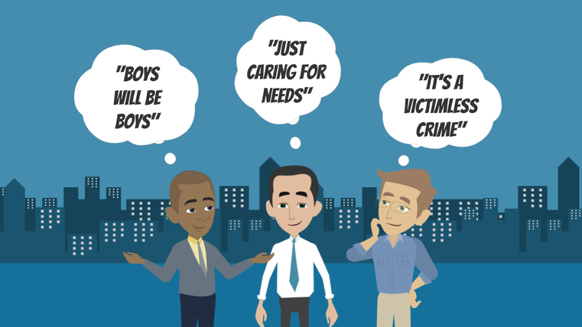
LESSON PLANS
BUYER JUSTIFICATION
What FALSE beliefs do some sex buyers use to justify their illegal behavior?
HIDDEN
BUYERS
©2024-2026 Walking Wise
43
3

Slide 44
BUYER JUSTIFICATION
False Beliefs that Hide the Truth
  Normalizing: “Boys will be boys.
©2024-2026 Walking Wise
Demand Abolition (2018). Who Buys Sex? Understanding and Disrupting Illicit Market Demand.
44
Notes:
BUYER JUSTIFICATION
Some people who buy sex rely on false beliefs to justify their actions. These beliefs help them avoid responsibility and ignore the harm they are causing.
For example, they may tell themselves that the behavior is normal, that they are just meeting a personal need, or that the person involved chose to participate.
Others may convince themselves that no one is being hurt or that the person enjoys the experience. In reality, many people in the commercial sex trade are being controlled, manipulated, or exploited.
These false beliefs allow buyers to ignore that reality and continue the behavior.
Understanding these justifications helps us recognize how harmful actions can be excused and why responsibility belongs to the person creating the demand—not the victim.
Source
Demand Abolition (2018, November). Who Buys Sex? Understanding and Disrupting Illicit Market Demand, p. 19. DemandAbolition.org. Retrieved June 11, 2025, from https://www.demandabolition.org/wp-content/uploads/2019/07/Demand-Buyer-Report-July-2019.pdf

Slide 45
BUYER JUSTIFICATION
False Beliefs that Hide the Truth
  Normalizing: “Boys will be boys.”
  Minimizing Harm: “I’m just meeting my needs.”
©2024-2026 Walking Wise
Demand Abolition (2018). Who Buys Sex? Understanding and Disrupting Illicit Market Demand.
45
Notes:
BUYER JUSTIFICATION
Some people who buy sex rely on false beliefs to justify their actions. These beliefs help them avoid responsibility and ignore the harm they are causing.
For example, they may tell themselves that the behavior is normal, that they are just meeting a personal need, or that the person involved chose to participate.
Others may convince themselves that no one is being hurt or that the person enjoys the experience. In reality, many people in the commercial sex trade are being controlled, manipulated, or exploited.
These false beliefs allow buyers to ignore that reality and continue the behavior.
Understanding these justifications helps us recognize how harmful actions can be excused and why responsibility belongs to the person creating the demand—not the victim.
Source
Demand Abolition (2018, November). Who Buys Sex? Understanding and Disrupting Illicit Market Demand, p. 19. DemandAbolition.org. Retrieved June 11, 2025, from https://www.demandabolition.org/wp-content/uploads/2019/07/Demand-Buyer-Report-July-2019.pdf

Slide 46
BUYER JUSTIFICATION
False Beliefs that Hide the Truth
  Normalizing: “Boys will be boys.”
  Minimizing Harm: “I’m just meeting my needs.”
  Denying Victims: “We’re both adults.”
©2024-2026 Walking Wise
Demand Abolition (2018). Who Buys Sex? Understanding and Disrupting Illicit Market Demand.
46
Notes:
BUYER JUSTIFICATION
Some people who buy sex rely on false beliefs to justify their actions. These beliefs help them avoid responsibility and ignore the harm they are causing.
For example, they may tell themselves that the behavior is normal, that they are just meeting a personal need, or that the person involved chose to participate.
Others may convince themselves that no one is being hurt or that the person enjoys the experience. In reality, many people in the commercial sex trade are being controlled, manipulated, or exploited.
These false beliefs allow buyers to ignore that reality and continue the behavior.
Understanding these justifications helps us recognize how harmful actions can be excused and why responsibility belongs to the person creating the demand—not the victim.
Source
Demand Abolition (2018, November). Who Buys Sex? Understanding and Disrupting Illicit Market Demand, p. 19. DemandAbolition.org. Retrieved June 11, 2025, from https://www.demandabolition.org/wp-content/uploads/2019/07/Demand-Buyer-Report-July-2019.pdf

Slide 47
BUYER JUSTIFICATION
False Beliefs that Hide the Truth
  Normalizing: “Boys will be boys.”
  Minimizing Harm: “I’m just meeting my needs.”
  Denying Victims: “We’re both adults.”
  False Choice: “They chose this.”
©2024-2026 Walking Wise
Demand Abolition (2018). Who Buys Sex? Understanding and Disrupting Illicit Market Demand.
47
Notes:
BUYER JUSTIFICATION
Some people who buy sex rely on false beliefs to justify their actions. These beliefs help them avoid responsibility and ignore the harm they are causing.
For example, they may tell themselves that the behavior is normal, that they are just meeting a personal need, or that the person involved chose to participate.
Others may convince themselves that no one is being hurt or that the person enjoys the experience. In reality, many people in the commercial sex trade are being controlled, manipulated, or exploited.
These false beliefs allow buyers to ignore that reality and continue the behavior.
Understanding these justifications helps us recognize how harmful actions can be excused and why responsibility belongs to the person creating the demand—not the victim.
Source
Demand Abolition (2018, November). Who Buys Sex? Understanding and Disrupting Illicit Market Demand, p. 19. DemandAbolition.org. Retrieved June 11, 2025, from https://www.demandabolition.org/wp-content/uploads/2019/07/Demand-Buyer-Report-July-2019.pdf

Slide 48
BUYER JUSTIFICATION
False Beliefs that Hide the Truth
  Normalizing: “Boys will be boys.”
  Minimizing Harm: “I’m just meeting my needs.”
  Denying Victims: “We’re both adults.”
  False Choice: “They chose this.”
  Self-Deception: “They enjoy it.”
©2024-2026 Walking Wise
Demand Abolition (2018). Who Buys Sex? Understanding and Disrupting Illicit Market Demand.
48
Notes:
BUYER JUSTIFICATION
Some people who buy sex rely on false beliefs to justify their actions. These beliefs help them avoid responsibility and ignore the harm they are causing.
For example, they may tell themselves that the behavior is normal, that they are just meeting a personal need, or that the person involved chose to participate.
Others may convince themselves that no one is being hurt or that the person enjoys the experience. In reality, many people in the commercial sex trade are being controlled, manipulated, or exploited.
These false beliefs allow buyers to ignore that reality and continue the behavior.
Understanding these justifications helps us recognize how harmful actions can be excused and why responsibility belongs to the person creating the demand—not the victim.
Source
Demand Abolition (2018, November). Who Buys Sex? Understanding and Disrupting Illicit Market Demand, p. 19. DemandAbolition.org. Retrieved June 11, 2025, from https://www.demandabolition.org/wp-content/uploads/2019/07/Demand-Buyer-Report-July-2019.pdf

Slide 49
LESSON PLANS
WHAT DO YOU THINK?
What percentage of males say they first purchased sex due to encouragement from someone they knew?
©2024-2026 Walking Wise
49
3

Slide 50
WHAT DO YOU THINK?
What percentage of males say they first purchased sex due to encouragement from someone they knew?
A) 11%
B) 18%
C) 21%
D) 29%
©2024-2026 Walking Wise
50

Slide 51
ANSWER
21% of males report their first purchase of sex was influenced by someone they knew.
©2024-2026 Walking Wise
Demand Abolition (2018). Who Buys Sex? Understanding and Disrupting Illicit Market Demand.
51
Notes:
Source
Demand Abolition (2018, November). Who Buys Sex? Understanding and Disrupting Illicit Market Demand, p. 4, 10, 41. DemandAbolition.org. Retrieved June 11, 2025, from https://www.demandabolition.org/wp-content/uploads/2019/07/Demand-Buyer-Report-July-2019.pdf

Slide 52
EDUCATON GUIDE
VOCABULARY
SEXUAL INNOCENCE
Having little or no knowledge or experience of sexual behavior, often due to being young or unaware.
HIDDEN
BUYERS
©2024-2026 Walking Wise
52
3

Slide 53
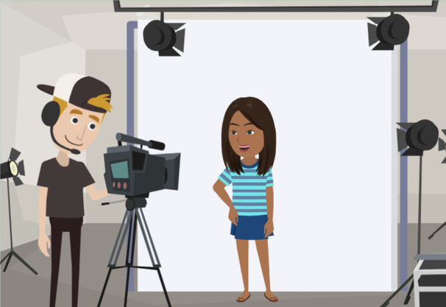
LESSON PLANS
RECRUITMENT TACTICS
What types of fake jobs can be offered to trick victims into sex trafficking?
HIDDEN
BUYERS
©2024-2026 Walking Wise
53
3

Slide 54
RECRUITMENT TACTICS
Fake Job Offers
Massage: Traffickers may advertise fake massage jobs or training, then pressure victims into sexual services.
©2024-2026 Walking Wise
Polaris. (2017). The typology of modern slavery: Defining sex and labor trafficking in the United States.
54
Notes:
RECRUITMENT TACTICS
Traffickers often use fake or misleading job offers to recruit victims because jobs feel safe and normal, especially to young people.
These opportunities may promise quick money, flexible hours, or exciting careers like modeling or entertainment.
At first, everything may seem legitimate. But over time, traffickers may begin to cross boundaries, apply pressure, or change the job's expectations. They may even make the victim believe that harmful behavior is just “part of the job.”
This is a form of grooming, where trust is built first, and exploitation happens later.
Understanding these tactics can help people recognize warning signs and avoid situations that seem too good to be true.
Source
Polaris. (2017). The typology of modern slavery: Defining sex and labor trafficking in the United States. Retrieved May 5, 2026, from https://polarisproject.org/resources/the-typology-of-modern-slavery-defining-sex-and-labor-trafficking-in-the-united-states/

Slide 55
RECRUITMENT TACTICS
Fake Job Offers
Acting & Modeling: Traffickers pose as agents or talent recruiters, promising auditions or photo shoots to gain trust.
©2024-2026 Walking Wise
Polaris. (2017). The typology of modern slavery: Defining sex and labor trafficking in the United States.
55
Notes:
RECRUITMENT TACTICS
Traffickers often use fake or misleading job offers to recruit victims because jobs feel safe and normal, especially to young people.
These opportunities may promise quick money, flexible hours, or exciting careers like modeling or entertainment.
At first, everything may seem legitimate. But over time, traffickers may begin to cross boundaries, apply pressure, or change the job's expectations. They may even make the victim believe that harmful behavior is just “part of the job.”
This is a form of grooming, where trust is built first, and exploitation happens later.
Understanding these tactics can help people recognize warning signs and avoid situations that seem too good to be true.
Source
Polaris. (2017). The typology of modern slavery: Defining sex and labor trafficking in the United States. Retrieved May 5, 2026, from https://polarisproject.org/resources/the-typology-of-modern-slavery-defining-sex-and-labor-trafficking-in-the-united-states/

Slide 56
RECRUITMENT TACTICS
Fake Job Offers
Food & Entertainment: They offer fake jobs as servers, hostesses, or dancers in certain bars, restaurants, or casinos.
©2024-2026 Walking Wise
Polaris. (2017). The typology of modern slavery: Defining sex and labor trafficking in the United States.
56
Notes:
RECRUITMENT TACTICS
Traffickers often use fake or misleading job offers to recruit victims because jobs feel safe and normal, especially to young people.
These opportunities may promise quick money, flexible hours, or exciting careers like modeling or entertainment.
At first, everything may seem legitimate. But over time, traffickers may begin to cross boundaries, apply pressure, or change the job's expectations. They may even make the victim believe that harmful behavior is just “part of the job.”
This is a form of grooming, where trust is built first, and exploitation happens later.
Understanding these tactics can help people recognize warning signs and avoid situations that seem too good to be true.
Source
Polaris. (2017). The typology of modern slavery: Defining sex and labor trafficking in the United States. Retrieved May 5, 2026, from https://polarisproject.org/resources/the-typology-of-modern-slavery-defining-sex-and-labor-trafficking-in-the-united-states/

Slide 57
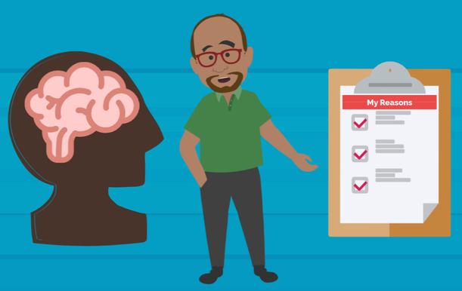
LESSON PLANS
MOTIVES & EMOTIONS
What might lead some people to buy sex?
HIDDEN
BUYERS
©2024-2026 Walking Wise
57
3

Slide 58
BUYER MOTIVES
Why People Choose to Buy Sex
Power & Control: Some want to feel power or control over another person.
©2024-2026 Walking Wise
Demand Abolition. (2018). Who buys sex? Understanding and disrupting illicit market demand.
58
Notes:
BUYER MOTIVES
Some people choose to buy sex for different reasons. For some, it is about power and control—they want to feel in charge of another person.
Others may not want the responsibility or commitment that comes with a real relationship, so they avoid it altogether.
Some people also view it as more convenient, believing it is easier than investing the time and effort required to build a healthy relationship.
These choices reflect a way of thinking that prioritizes personal desires over the well-being and safety of others.
Source
Demand Abolition. (2018). Who buys sex? Understanding and disrupting illicit market demand.
https://www.demandabolition.org/wp-content/uploads/2019/07/Demand-Buyer-Report-July-2019.pdf

Slide 59
BUYER MOTIVES
Why People Choose to Buy Sex
Avoiding Relationships: Some want to avoid the responsibility or commitment of a real relationship.
©2024-2026 Walking Wise
Demand Abolition. (2018). Who buys sex? Understanding and disrupting illicit market demand.
59
Notes:
BUYER MOTIVES
Some people choose to buy sex for different reasons. For some, it is about power and control—they want to feel in charge of another person.
Others may not want the responsibility or commitment that comes with a real relationship, so they avoid it altogether.
Some people also view it as more convenient, believing it is easier than investing the time and effort required to build a healthy relationship.
These choices reflect a way of thinking that prioritizes personal desires over the well-being and safety of others.
Source
Demand Abolition. (2018). Who buys sex? Understanding and disrupting illicit market demand.
https://www.demandabolition.org/wp-content/uploads/2019/07/Demand-Buyer-Report-July-2019.pdf

Slide 60
BUYER MOTIVES
Why People Choose to Buy Sex
Convenience: Some believe it is easier than building a healthy relationship.
©2024-2026 Walking Wise
Demand Abolition. (2018). Who buys sex? Understanding and disrupting illicit market demand.
60
Notes:
BUYER MOTIVES
Some people choose to buy sex for different reasons. For some, it is about power and control—they want to feel in charge of another person.
Others may not want the responsibility or commitment that comes with a real relationship, so they avoid it altogether.
Some people also view it as more convenient, believing it is easier than investing the time and effort required to build a healthy relationship.
These choices reflect a way of thinking that prioritizes personal desires over the well-being and safety of others.
Source
Demand Abolition. (2018). Who buys sex? Understanding and disrupting illicit market demand.
https://www.demandabolition.org/wp-content/uploads/2019/07/Demand-Buyer-Report-July-2019.pdf

Slide 61
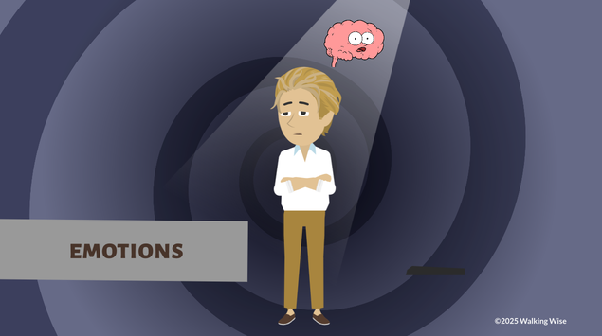
BUYERS’ EMOTIONS
Feelings That Can Influence Behavior
  Loneliness or Isolation
HIDDEN
BUYERS
©2024-2026 Walking Wise
She Has a Name (n.d.) Why People Solicit Sex.
61
Notes:
BUYERS' EMOTIONS
In addition to thoughts or choices, certain feelings can also influence behavior.
Some people may feel lonely, isolated, or have difficulty connecting with others.
Others may struggle with sadness, depression, or low self-esteem and may not feel confident in forming a healthy relationship. While some simply feel curious or bored and seek excitement.
These emotions are real, but they do not justify behavior that harms others.
Source
She Has a Name (n.d.) Why People Solicit Sex. Retrieved from an April 30, 2025, webinar presentation.

Slide 62
BUYERS’ EMOTIONS
Feelings That Can Influence Behavior
  Loneliness or Isolation
  Sadness or Depression
HIDDEN
BUYERS
©2024-2026 Walking Wise
She Has a Name (n.d.) Why People Solicit Sex.
62
Notes:
BUYERS' EMOTIONS
In addition to thoughts or choices, certain feelings can also influence behavior.
Some people may feel lonely, isolated, or have difficulty connecting with others.
Others may struggle with sadness, depression, or low self-esteem and may not feel confident in forming a healthy relationship. While some simply feel curious or bored and seek excitement.
These emotions are real, but they do not justify behavior that harms others.
Source
She Has a Name (n.d.) Why People Solicit Sex. Retrieved from an April 30, 2025, webinar presentation.

Slide 63
BUYERS’ EMOTIONS
Feelings That Can Influence Behavior
  Loneliness or Isolation
  Sadness or Depression
  Low Self-esteem or Feeling Unattractive
HIDDEN
BUYERS
©2024-2026 Walking Wise
She Has a Name (n.d.) Why People Solicit Sex.
63
Notes:
BUYERS' EMOTIONS
In addition to thoughts or choices, certain feelings can also influence behavior.
Some people may feel lonely, isolated, or have difficulty connecting with others.
Others may struggle with sadness, depression, or low self-esteem and may not feel confident in forming a healthy relationship. While some simply feel curious or bored and seek excitement.
These emotions are real, but they do not justify behavior that harms others.
Source
She Has a Name (n.d.) Why People Solicit Sex. Retrieved from an April 30, 2025, webinar presentation.

Slide 64
BUYERS’ EMOTIONS
Feelings That Can Influence Behavior
  Loneliness or Isolation
  Sadness or Depression
  Low Self-esteem or Feeling Unattractive
  Desire for Connection or Companionship
HIDDEN
BUYERS
©2024-2026 Walking Wise
She Has a Name (n.d.) Why People Solicit Sex.
64
Notes:
BUYERS' EMOTIONS
In addition to thoughts or choices, certain feelings can also influence behavior.
Some people may feel lonely, isolated, or have difficulty connecting with others.
Others may struggle with sadness, depression, or low self-esteem and may not feel confident in forming a healthy relationship. While some simply feel curious or bored and seek excitement.
These emotions are real, but they do not justify behavior that harms others.
Source
She Has a Name (n.d.) Why People Solicit Sex. Retrieved from an April 30, 2025, webinar presentation.

Slide 65
BUYERS’ EMOTIONS
Feelings That Can Influence Behavior
  Loneliness or Isolation
  Sadness or Depression
  Low Self-esteem or Feeling Unattractive
  Desire for Connection or Companionship
  Difficulty Connecting with Others
HIDDEN
BUYERS
©2024-2026 Walking Wise
She Has a Name (n.d.) Why People Solicit Sex.
65
Notes:
BUYERS' EMOTIONS
In addition to thoughts or choices, certain feelings can also influence behavior.
Some people may feel lonely, isolated, or have difficulty connecting with others.
Others may struggle with sadness, depression, or low self-esteem and may not feel confident in forming a healthy relationship. While some simply feel curious or bored and seek excitement.
These emotions are real, but they do not justify behavior that harms others.
Source
She Has a Name (n.d.) Why People Solicit Sex. Retrieved from an April 30, 2025, webinar presentation.

Slide 66
BUYERS’ EMOTIONS
Feelings That Can Influence Behavior
  Loneliness or Isolation
  Sadness or Depression
  Low Self-esteem or Feeling Unattractive
  Desire for Connection or Companionship
  Difficulty Connecting with Others
  Boredom or Desire for Excitement
HIDDEN
BUYERS
©2024-2026 Walking Wise
She Has a Name (n.d.) Why People Solicit Sex.
66
Notes:
BUYERS' EMOTIONS
In addition to thoughts or choices, certain feelings can also influence behavior.
Some people may feel lonely, isolated, or have difficulty connecting with others.
Others may struggle with sadness, depression, or low self-esteem and may not feel confident in forming a healthy relationship. While some simply feel curious or bored and seek excitement.
These emotions are real, but they do not justify behavior that harms others.
Source
She Has a Name (n.d.) Why People Solicit Sex. Retrieved from an April 30, 2025, webinar presentation.

Slide 67
LESSON PLANS
WHAT DO YOU THINK?
What percentage of men who purchase sex said they want to stop?
©2024-2026 Walking Wise
67
3

Slide 68
WHAT DO YOU THINK?
What percentage of men who purchase sex said they want to stop?
A) 11%
B) 21%
C) 31%
D) 41%
©2024-2026 Walking Wise
68

Slide 69
ANSWER
41% of men who reported purchasing sex said they want to stop.
©2024-2026 Walking Wise
Demand Abolition (2018). Who’s Buying Sex? Understanding and Disrupting Illicit Market Demand.
69
Notes:
Source
Demand Abolition (2018, November). Who Buys Sex? Understanding and Disrupting Illicit Market Demand, pp. 25-26. DemandAbolition.org. Retrieved June 18, 2025, from https://www.demandabolition.org/wp-content/uploads/2019/07/Demand-Buyer-Report-July-2019.pdf

Slide 70
EDUCATON GUIDE
VOCABULARY
TRAUMA
A deeply upsetting experience that affects a person's thoughts, feelings, behavior, and physical response to harm that lasts long after the event.
HIDDEN
BUYERS
©2024-2026 Walking Wise
70
3

Slide 71
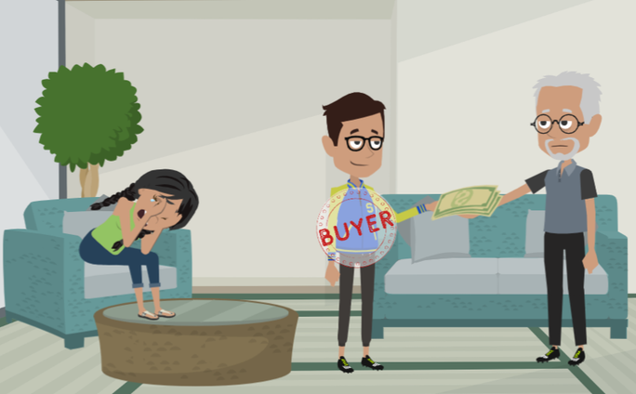
LESSON PLANS
VICTIM TRAUMA
How are victims harmed or traumatized when they are trafficked (sold) to sex buyers?
HIDDEN
BUYERS
©2024-2026 Walking Wise
71
3

Slide 72
VICTIM TRAUMA
Entrapment & Control
  Entrapment: Victims are often tricked, pressured, or forced into situations they did not choose.
©2024-2026 Walking Wise
Safe House Project (2026). Patterns of Exploitation: A National Analysis of Human Trafficking Trends, January 2023 - December 2025.
72
Notes:
ENTRAPMENT & CONTROL
Victims of trafficking are often trapped in situations they did not choose. This is called entrapment.
Traffickers first groom their victims and then use lies, pressure, or threats to get the victim into unsafe situations that are difficult to leave. Over time, victims feel like they have no control and no safe way out.
Traffickers also maintain control by moving victims to unfamiliar places and separating them from family, friends, or anyone who could help. This isolation makes victims feel alone and dependent on the trafficker.
These tactics are used to keep control and prevent victims from escaping.
Source
Reid, J. A., Baglivio, M. T., Piquero, A. R., Greenwald, M. A., & Epps, N. (2022). Family-controlled trafficking in the United States: Victim characteristics, system response, and case outcomes. Journal of Human Trafficking.
Retrieved May 6, 2026, from https://www.researchgate.net/publication/358899780_Family-Controlled_Trafficking_in_the_United_States_Victim_Characteristics_System_Response_and_Case_Outcomes

Slide 73
VICTIM TRAUMA
Entrapment & Control
  Entrapment: Victims are often tricked, pressured, or forced into situations they did not choose.
  Control: They are commonly moved to unfamiliar locations and isolated from family and friends.
©2024-2026 Walking Wise
Safe House Project (2026). Patterns of Exploitation: A National Analysis of Human Trafficking Trends, January 2023 - December 2025.
73
Notes:
ENTRAPMENT & CONTROL
Victims of trafficking are often trapped in situations they did not choose. This is called entrapment.
Traffickers first groom their victims and then use lies, pressure, or threats to get the victim into unsafe situations that are difficult to leave. Over time, victims feel like they have no control and no safe way out.
Traffickers also maintain control by moving victims to unfamiliar places and separating them from family, friends, or anyone who could help. This isolation makes victims feel alone and dependent on the trafficker.
These tactics are used to keep control and prevent victims from escaping.
Source
Reid, J. A., Baglivio, M. T., Piquero, A. R., Greenwald, M. A., & Epps, N. (2022). Family-controlled trafficking in the United States: Victim characteristics, system response, and case outcomes. Journal of Human Trafficking.
Retrieved May 6, 2026, from https://www.researchgate.net/publication/358899780_Family-Controlled_Trafficking_in_the_United_States_Victim_Characteristics_System_Response_and_Case_Outcomes

Slide 74
VICTIM TRAUMA
Emotional & Mental Harm
  Mental Health: Victims most often suffer from depression, anxiety, and thoughts of self-harm.
©2024-2026 Walking Wise
Demand Abolition (2018). Who’s Buying Sex? Understanding and Disrupting Illicit Market Demand.
74
Notes:
PSYCHOLOGICAL HARM
Victims of trafficking often experience deep emotional and mental harm that can affect how they think, feel, and respond to everyday situations.
Ongoing fear, stress, shame, and abuse can change how the brain reacts, making it harder to feel safe or trust others.
Depression and anxiety may develop as a result of repeated trauma, and these feelings can become overwhelming over time.
Substance use is sometimes connected to this experience, either as a way to cope with emotional pain or as a method used by traffickers to maintain control. This can create dependency, making it even harder for victims to leave or seek help.
Even after the trafficking situation ends, the effects of this trauma most often continue, and in some cases, it is a lifelong struggle.
Source
Demand Abolition (2018, November). Who Buys Sex? Understanding and Disrupting Illicit Market Demand, pp. 25-26. DemandAbolition.org. Retrieved June 18, 2025, from https://www.demandabolition.org/wp-content/uploads/2019/07/Demand-Buyer-Report-July-2019.pdf

Slide 75
VICTIM TRAUMA
Emotional & Mental Harm
  Mental Health: Victims most often suffer from depression, anxiety, and thoughts of self-harm.
  Substance Use: Many must use prescribed medications, or drugs and alcohol to cope with the trauma experienced.
©2024-2026 Walking Wise
Demand Abolition (2018). Who’s Buying Sex? Understanding and Disrupting Illicit Market Demand.
75
Notes:
PSYCHOLOGICAL HARM
Victims of trafficking often experience deep emotional and mental harm that can affect how they think, feel, and respond to everyday situations.
Ongoing fear, stress, shame, and abuse can change how the brain reacts, making it harder to feel safe or trust others.
Depression and anxiety may develop as a result of repeated trauma, and these feelings can become overwhelming over time.
Substance use is sometimes connected to this experience, either as a way to cope with emotional pain or as a method used by traffickers to maintain control. This can create dependency, making it even harder for victims to leave or seek help.
Even after the trafficking situation ends, the effects of this trauma most often continue, and in some cases, it is a lifelong struggle.
Source
Demand Abolition (2018, November). Who Buys Sex? Understanding and Disrupting Illicit Market Demand, pp. 25-26. DemandAbolition.org. Retrieved June 18, 2025, from https://www.demandabolition.org/wp-content/uploads/2019/07/Demand-Buyer-Report-July-2019.pdf

Slide 76
VICTIM TRAUMA
Lasting Health Effects
  Violence: When exposed to repeated physical and sexual abuse, victims often experience long-term health problems and pain.
  Wilkinson Jr., Kevin L. (2023). The Breeding of Wolves: Understanding the Escalation Continuum & Escalation Dynamics of Contemporary Sex Trafficking.
  Safe House Project (2026). Patterns of Exploitation: A National Analysis of Human Trafficking Trends, January 2023 - December 2025.
76
©2024-2026 Walking Wise
Notes:
ABUSE & ENTRAPMENT
The impact of trafficking doesn’t stop when the situation ends. Repeated exposure to violence can affect a person’s body over time, leading to lasting mental and physical health problems and ongoing pain. The emotional impact is serious and can last for the rest of the victim's life.
Survivors often carry fear with them, even in safe situations, because their bodies have been trained to stay on alert. Feelings like shame or stigma can also make it difficult to speak up or ask for help, especially if they believe others will judge or blame them.
In some cases, traffickers continue to manipulate victims even after they leave, using fear, guilt, or emotional control to keep influence over them. This shows that the effects of trafficking can last long after the abuse itself, affecting a person’s sense of safety, identity, and trust in others.
Source
Wilkinson Jr., Kevin L. (2023, July 4). The Breeding of Wolves: Understanding the Escalation Continuum & Escalation Dynamics of Contemporary Sex Trafficking, p. 230. DigitalCommons.liberity.edu. Retrieved June 18, 2025, from https://digitalcommons.liberty.edu/doctoral/4600/
Safe House Project (2026). Patterns of Exploitation: A National Analysis of Human Trafficking Trends, January 2023 - December 2025. Retrieved May 5, 2026, from https://22570428.fs1.hubspotusercontent-na1.net/hubfs/22570428/2026%20Data%20Analysis%20Safe%20House%20Project.pdf

Slide 77
VICTIM TRAUMA
Lasting Health Effects
  Violence: When exposed to repeated physical and sexual abuse, victims often experience long-term health problems and pain.
  Long-term Impact: Survivors can experience ongoing fear, shame, stigma, and continued manipulation by the trafficker.
  Wilkinson Jr., Kevin L. (2023). The Breeding of Wolves: Understanding the Escalation Continuum & Escalation Dynamics of Contemporary Sex Trafficking.
  Safe House Project (2026). Patterns of Exploitation: A National Analysis of Human Trafficking Trends, January 2023 - December 2025.
77
©2024-2026 Walking Wise
Notes:
ABUSE & ENTRAPMENT
The impact of trafficking doesn’t stop when the situation ends. Repeated exposure to violence can affect a person’s body over time, leading to lasting mental and physical health problems and ongoing pain. The emotional impact is serious and can last for the rest of the victim's life.
Survivors often carry fear with them, even in safe situations, because their bodies have been trained to stay on alert. Feelings like shame or stigma can also make it difficult to speak up or ask for help, especially if they believe others will judge or blame them.
In some cases, traffickers continue to manipulate victims even after they leave, using fear, guilt, or emotional control to keep influence over them. This shows that the effects of trafficking can last long after the abuse itself, affecting a person’s sense of safety, identity, and trust in others.
Source
Wilkinson Jr., Kevin L. (2023, July 4). The Breeding of Wolves: Understanding the Escalation Continuum & Escalation Dynamics of Contemporary Sex Trafficking, p. 230. DigitalCommons.liberity.edu. Retrieved June 18, 2025, from https://digitalcommons.liberty.edu/doctoral/4600/
Safe House Project (2026). Patterns of Exploitation: A National Analysis of Human Trafficking Trends, January 2023 - December 2025. Retrieved May 5, 2026, from https://22570428.fs1.hubspotusercontent-na1.net/hubfs/22570428/2026%20Data%20Analysis%20Safe%20House%20Project.pdf

Slide 78
VICTIM TRAUMA
Summary: Victim Experiences of Exploitation
  Control and Manipulation by Traffickers
Safe House Project (2026). Patterns of Exploitation: A National Analysis of Human Trafficking Trends, January 2023 - December 2025.
Demand Abolition (2018). Who’s Buying Sex? Understanding and Disrupting Illicit Market Demand.
78
©2024-2026 Walking Wise
Notes:
SUMMARY ON TRAUMA
Victims of exploitation often experience many forms of harm at the same time. Traffickers use manipulation, pressure, threats, isolation, and violence to gain and maintain control over people.
Many victims are separated from family and friends, making them feel alone and dependent on the trafficker. Over time, this can lead to serious emotional and mental health struggles, including fear, anxiety, depression, shame, and difficulty trusting others.
Victims may also experience physical injuries, substance dependency, and long-term health problems caused by ongoing abuse and trauma.
Sex buyers play an important role in this harm because their willingness to pay for sex creates the demand that allows traffickers to continue exploiting vulnerable people for profit.
In many cases, buyers themselves commit acts of physical or sexual violence against victims, causing additional trauma and harm.
When buyers treat people as products to purchase instead of human beings with dignity and rights, they contribute directly to the cycle of exploitation and victimization.
Source
Safe House Project (2026). Patterns of Exploitation: A National Analysis of Human Trafficking Trends, January 2023 - December 2025. Retrieved May 5, 2026, from https://22570428.fs1.hubspotusercontent-na1.net/hubfs/22570428/2026%20Data%20Analysis%20Safe%20House%20Project.pdf
Demand Abolition (2018, November). Who Buys Sex? Understanding and Disrupting Illicit Market Demand, pp. 4, 23, 29. DemandAbolition.org. Retrieved February 25, 2024, from https://www.demandabolition.org/wp-content/uploads/2019/07/Demand-Buyer-Report-July-2019.pdf

Slide 79
VICTIM TRAUMA
Summary: Victim Experiences of Exploitation
  Control and Manipulation by Traffickers
  Fear, Threats, and Pressure
Safe House Project (2026). Patterns of Exploitation: A National Analysis of Human Trafficking Trends, January 2023 - December 2025.
Demand Abolition (2018). Who’s Buying Sex? Understanding and Disrupting Illicit Market Demand.
79
©2024-2026 Walking Wise
Notes:
SUMMARY ON TRAUMA
Victims of exploitation often experience many forms of harm at the same time. Traffickers use manipulation, pressure, threats, isolation, and violence to gain and maintain control over people.
Many victims are separated from family and friends, making them feel alone and dependent on the trafficker. Over time, this can lead to serious emotional and mental health struggles, including fear, anxiety, depression, shame, and difficulty trusting others.
Victims may also experience physical injuries, substance dependency, and long-term health problems caused by ongoing abuse and trauma.
Sex buyers play an important role in this harm because their willingness to pay for sex creates the demand that allows traffickers to continue exploiting vulnerable people for profit.
In many cases, buyers themselves commit acts of physical or sexual violence against victims, causing additional trauma and harm.
When buyers treat people as products to purchase instead of human beings with dignity and rights, they contribute directly to the cycle of exploitation and victimization.
Source
Safe House Project (2026). Patterns of Exploitation: A National Analysis of Human Trafficking Trends, January 2023 - December 2025. Retrieved May 5, 2026, from https://22570428.fs1.hubspotusercontent-na1.net/hubfs/22570428/2026%20Data%20Analysis%20Safe%20House%20Project.pdf
Demand Abolition (2018, November). Who Buys Sex? Understanding and Disrupting Illicit Market Demand, pp. 4, 23, 29. DemandAbolition.org. Retrieved February 25, 2024, from https://www.demandabolition.org/wp-content/uploads/2019/07/Demand-Buyer-Report-July-2019.pdf

Slide 80
VICTIM TRAUMA
Summary: Victim Experiences of Exploitation
  Control and Manipulation by Traffickers
  Fear, Threats, and Pressure
  Physical & Sexual Harm
Safe House Project (2026). Patterns of Exploitation: A National Analysis of Human Trafficking Trends, January 2023 - December 2025.
Demand Abolition (2018). Who’s Buying Sex? Understanding and Disrupting Illicit Market Demand.
80
©2024-2026 Walking Wise
Notes:
SUMMARY ON TRAUMA
Victims of exploitation often experience many forms of harm at the same time. Traffickers use manipulation, pressure, threats, isolation, and violence to gain and maintain control over people.
Many victims are separated from family and friends, making them feel alone and dependent on the trafficker. Over time, this can lead to serious emotional and mental health struggles, including fear, anxiety, depression, shame, and difficulty trusting others.
Victims may also experience physical injuries, substance dependency, and long-term health problems caused by ongoing abuse and trauma.
Sex buyers play an important role in this harm because their willingness to pay for sex creates the demand that allows traffickers to continue exploiting vulnerable people for profit.
In many cases, buyers themselves commit acts of physical or sexual violence against victims, causing additional trauma and harm.
When buyers treat people as products to purchase instead of human beings with dignity and rights, they contribute directly to the cycle of exploitation and victimization.
Source
Safe House Project (2026). Patterns of Exploitation: A National Analysis of Human Trafficking Trends, January 2023 - December 2025. Retrieved May 5, 2026, from https://22570428.fs1.hubspotusercontent-na1.net/hubfs/22570428/2026%20Data%20Analysis%20Safe%20House%20Project.pdf
Demand Abolition (2018, November). Who Buys Sex? Understanding and Disrupting Illicit Market Demand, pp. 4, 23, 29. DemandAbolition.org. Retrieved February 25, 2024, from https://www.demandabolition.org/wp-content/uploads/2019/07/Demand-Buyer-Report-July-2019.pdf

Slide 81
VICTIM TRAUMA
Summary: Victim Experiences of Exploitation
  Control and Manipulation by Traffickers
  Fear, Threats, and Pressure
  Physical & Sexual Harm
  Emotional Trauma & Depression
Safe House Project (2026). Patterns of Exploitation: A National Analysis of Human Trafficking Trends, January 2023 - December 2025.
Demand Abolition (2018). Who’s Buying Sex? Understanding and Disrupting Illicit Market Demand.
81
©2024-2026 Walking Wise
Notes:
SUMMARY ON TRAUMA
Victims of exploitation often experience many forms of harm at the same time. Traffickers use manipulation, pressure, threats, isolation, and violence to gain and maintain control over people.
Many victims are separated from family and friends, making them feel alone and dependent on the trafficker. Over time, this can lead to serious emotional and mental health struggles, including fear, anxiety, depression, shame, and difficulty trusting others.
Victims may also experience physical injuries, substance dependency, and long-term health problems caused by ongoing abuse and trauma.
Sex buyers play an important role in this harm because their willingness to pay for sex creates the demand that allows traffickers to continue exploiting vulnerable people for profit.
In many cases, buyers themselves commit acts of physical or sexual violence against victims, causing additional trauma and harm.
When buyers treat people as products to purchase instead of human beings with dignity and rights, they contribute directly to the cycle of exploitation and victimization.
Source
Safe House Project (2026). Patterns of Exploitation: A National Analysis of Human Trafficking Trends, January 2023 - December 2025. Retrieved May 5, 2026, from https://22570428.fs1.hubspotusercontent-na1.net/hubfs/22570428/2026%20Data%20Analysis%20Safe%20House%20Project.pdf
Demand Abolition (2018, November). Who Buys Sex? Understanding and Disrupting Illicit Market Demand, pp. 4, 23, 29. DemandAbolition.org. Retrieved February 25, 2024, from https://www.demandabolition.org/wp-content/uploads/2019/07/Demand-Buyer-Report-July-2019.pdf

Slide 82
VICTIM TRAUMA
Summary: Victim Experiences of Exploitation
  Control and Manipulation by Traffickers
  Fear, Threats, and Pressure
  Physical & Sexual Harm
  Emotional Trauma & Depression
  Substance Use & Dependency
Safe House Project (2026). Patterns of Exploitation: A National Analysis of Human Trafficking Trends, January 2023 - December 2025.
Demand Abolition (2018). Who’s Buying Sex? Understanding and Disrupting Illicit Market Demand.
82
©2024-2026 Walking Wise
Notes:
SUMMARY ON TRAUMA
Victims of exploitation often experience many forms of harm at the same time. Traffickers use manipulation, pressure, threats, isolation, and violence to gain and maintain control over people.
Many victims are separated from family and friends, making them feel alone and dependent on the trafficker. Over time, this can lead to serious emotional and mental health struggles, including fear, anxiety, depression, shame, and difficulty trusting others.
Victims may also experience physical injuries, substance dependency, and long-term health problems caused by ongoing abuse and trauma.
Sex buyers play an important role in this harm because their willingness to pay for sex creates the demand that allows traffickers to continue exploiting vulnerable people for profit.
In many cases, buyers themselves commit acts of physical or sexual violence against victims, causing additional trauma and harm.
When buyers treat people as products to purchase instead of human beings with dignity and rights, they contribute directly to the cycle of exploitation and victimization.
Source
Safe House Project (2026). Patterns of Exploitation: A National Analysis of Human Trafficking Trends, January 2023 - December 2025. Retrieved May 5, 2026, from https://22570428.fs1.hubspotusercontent-na1.net/hubfs/22570428/2026%20Data%20Analysis%20Safe%20House%20Project.pdf
Demand Abolition (2018, November). Who Buys Sex? Understanding and Disrupting Illicit Market Demand, pp. 4, 23, 29. DemandAbolition.org. Retrieved February 25, 2024, from https://www.demandabolition.org/wp-content/uploads/2019/07/Demand-Buyer-Report-July-2019.pdf

Slide 83

LESSON PLANS
END DEMAND
How can society help put the commercial sex trade out of business?
HIDDEN
BUYERS
©2024-2026 Walking Wise
83
3

Slide 84
END DEMAND
Shut Down Sex Trafficking
Change Attitudes: Challenge beliefs that excuse or normalize buying sex.
Demand Abolition (2018). Who’s Buying Sex? Understanding and Disrupting Illicit Market Demand.
Wilkinson Jr., Kevin L. (2023). The Breeding of Wolves: Understanding the Escalation Continuum & Escalation Dynamics of Contemporary Sex Trafficking.
©2024-2026 Walking Wise
84
Notes:
END DEMAND
A powerful way to end sex trafficking is to stop the “demand,” which means an individual’s desire and willingness to pay for sex. Sex buyers create this “demand,” and traffickers respond by supplying people to meet the demand.
EDUCATE ADOLESCENTS
Education plays a critical role by helping young people understand the real harm caused by buying sex, challenging harmful social messages, and building skills to resist pressure or manipulation.
Teaching awareness and accountability helps prevent exploitation before it starts and supports safer communities for everyone.
Source
Demand Abolition (2018, November). Who Buys Sex? Understanding and Disrupting Illicit Market Demand, pp. 25-26. DemandAbolition.org. Retrieved February 25, 2024, from https://www.demandabolition.org/wp-content/uploads/2019/07/Demand-Buyer-Report-July-2019.pdf
Wilkinson Jr., Kevin L. (2023, July 4). The Breeding of Wolves: Understanding the Escalation Continuum & Escalation Dynamics of Contemporary Sex Trafficking, p. 230. DigitalCommons.liberity.edu. Retrieved June 18, 2025, from https://digitalcommons.liberty.edu/doctoral/4600/

Slide 85
END DEMAND
Shut Down Sex Trafficking
Build Awareness: Understand how traffickers manipulate and control people.
Demand Abolition (2018). Who’s Buying Sex? Understanding and Disrupting Illicit Market Demand.
Wilkinson Jr., Kevin L. (2023). The Breeding of Wolves: Understanding the Escalation Continuum & Escalation Dynamics of Contemporary Sex Trafficking.
©2024-2026 Walking Wise
85
Notes:
END DEMAND
A powerful way to end sex trafficking is to stop the “demand,” which means an individual’s desire and willingness to pay for sex. Sex buyers create this “demand,” and traffickers respond by supplying people to meet the demand.
EDUCATE ADOLESCENTS
Education plays a critical role by helping young people understand the real harm caused by buying sex, challenging harmful social messages, and building skills to resist pressure or manipulation.
Teaching awareness and accountability helps prevent exploitation before it starts and supports safer communities for everyone.
Source
Demand Abolition (2018, November). Who Buys Sex? Understanding and Disrupting Illicit Market Demand, pp. 25-26. DemandAbolition.org. Retrieved February 25, 2024, from https://www.demandabolition.org/wp-content/uploads/2019/07/Demand-Buyer-Report-July-2019.pdf
Wilkinson Jr., Kevin L. (2023, July 4). The Breeding of Wolves: Understanding the Escalation Continuum & Escalation Dynamics of Contemporary Sex Trafficking, p. 230. DigitalCommons.liberity.edu. Retrieved June 18, 2025, from https://digitalcommons.liberty.edu/doctoral/4600/

Slide 86
END DEMAND
Shut Down Sex Trafficking
Resist Pressure: Recognize and push back against unsafe people.
Demand Abolition (2018). Who’s Buying Sex? Understanding and Disrupting Illicit Market Demand.
Wilkinson Jr., Kevin L. (2023). The Breeding of Wolves: Understanding the Escalation Continuum & Escalation Dynamics of Contemporary Sex Trafficking.
©2024-2026 Walking Wise
86
Notes:
END DEMAND
A powerful way to end sex trafficking is to stop the “demand,” which means an individual’s desire and willingness to pay for sex. Sex buyers create this “demand,” and traffickers respond by supplying people to meet the demand.
EDUCATE ADOLESCENTS
Education plays a critical role by helping young people understand the real harm caused by buying sex, challenging harmful social messages, and building skills to resist pressure or manipulation.
Teaching awareness and accountability helps prevent exploitation before it starts and supports safer communities for everyone.
Source
Demand Abolition (2018, November). Who Buys Sex? Understanding and Disrupting Illicit Market Demand, pp. 25-26. DemandAbolition.org. Retrieved February 25, 2024, from https://www.demandabolition.org/wp-content/uploads/2019/07/Demand-Buyer-Report-July-2019.pdf
Wilkinson Jr., Kevin L. (2023, July 4). The Breeding of Wolves: Understanding the Escalation Continuum & Escalation Dynamics of Contemporary Sex Trafficking, p. 230. DigitalCommons.liberity.edu. Retrieved June 18, 2025, from https://digitalcommons.liberty.edu/doctoral/4600/

Slide 87
END DEMAND
Shut Down Sex Trafficking
Education: Know how to reach out to a trustworthy adult for help.
Demand Abolition (2018). Who’s Buying Sex? Understanding and Disrupting Illicit Market Demand.
Wilkinson Jr., Kevin L. (2023). The Breeding of Wolves: Understanding the Escalation Continuum & Escalation Dynamics of Contemporary Sex Trafficking.
©2024-2026 Walking Wise
87
Notes:
END DEMAND
A powerful way to end sex trafficking is to stop the “demand,” which means an individual’s desire and willingness to pay for sex. Sex buyers create this “demand,” and traffickers respond by supplying people to meet the demand.
EDUCATE ADOLESCENTS
Education plays a critical role by helping young people understand the real harm caused by buying sex, challenging harmful social messages, and building skills to resist pressure or manipulation.
Teaching awareness and accountability helps prevent exploitation before it starts and supports safer communities for everyone.
Source
Demand Abolition (2018, November). Who Buys Sex? Understanding and Disrupting Illicit Market Demand, pp. 25-26. DemandAbolition.org. Retrieved February 25, 2024, from https://www.demandabolition.org/wp-content/uploads/2019/07/Demand-Buyer-Report-July-2019.pdf
Wilkinson Jr., Kevin L. (2023, July 4). The Breeding of Wolves: Understanding the Escalation Continuum & Escalation Dynamics of Contemporary Sex Trafficking, p. 230. DigitalCommons.liberity.edu. Retrieved June 18, 2025, from https://digitalcommons.liberty.edu/doctoral/4600/

Slide 88

ASK FOR HELP
©2024-2026 Walking Wise
88
Notes:
HOW TO ASK FOR HELP
Walking Wise asked a focus group of survivors:
What do you think young people should know about sex trafficking?
ANSWER
The survivors agreed that the most vital information kids should know is how to ask for help.
At the top of their list:
Tell a TRUSTWORTHY adult.

Slide 89

ASK FOR HELP
What are ways young people can ask for help?
©2024-2026 Walking Wise
89

Slide 90
ASK FOR HELP
How to Ask for Help
  If you are in immediate danger, dial 911.
©2024-2026 Walking Wise
90

Slide 91
ASK FOR HELP
How to Ask for Help
  If you are in immediate danger, dial 911.
  If the sexual predator IS a family member, tell a trustworthy adult.
©2024-2026 Walking Wise
91

Slide 92
ASK FOR HELP
How to Ask for Help
  If you are in immediate danger, dial 911.
  If the sexual predator IS a family member, tell a trustworthy adult.
  If the sexual predator is NOT family, tell a parent or guardian
©2024-2026 Walking Wise
92

Slide 93
ASK FOR HELP
How to Ask for Help
  If you are in immediate danger, dial 911.
  If the sexual predator IS a family member, tell a trustworthy adult.
  If the sexual predator is NOT family, tell a parent or guardian
  If you are a student, tell a trustworthy teacher, coach, school nurse, social worker, counselor, resource officer, or principal.
©2024-2026 Walking Wise
93

Slide 94
ASK FOR HELP
How to Ask for Help
  If you are in immediate danger, dial 911.
  If the sexual predator IS a family member, tell a trustworthy adult.
  If the sexual predator is NOT family, tell a parent or guardian
  If you are a student, tell a trustworthy teacher, coach, school nurse, social worker, counselor, resource officer, or principal.
  To gain internet access for help, use a computer at school or a public library.
©2024-2026 Walking Wise
94

Slide 95
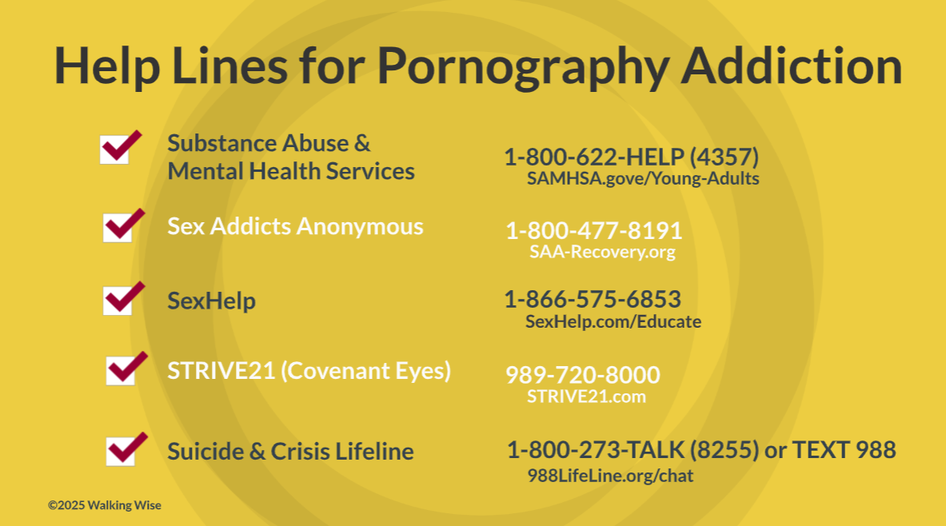
95
Notes:
NOTE TO PRESENTER
Presenters may ask their audience to consider adding a few "hotline for help" phone numbers to their cell phone contacts or take a photo of this slide.

Slide 96
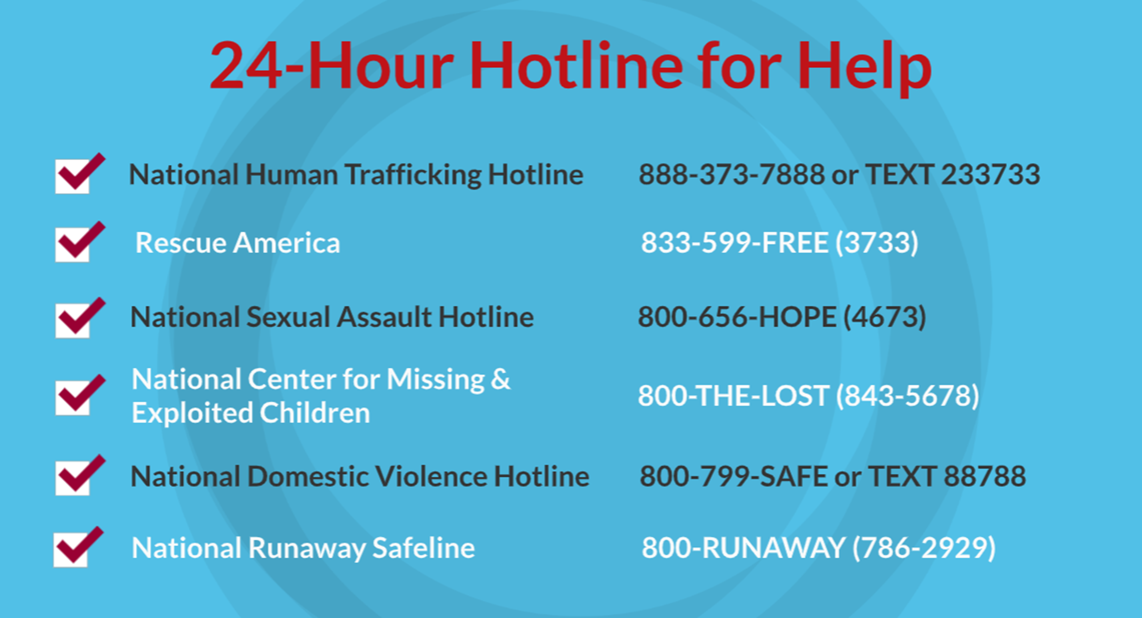
©2024-2026 Walking Wise
96
Notes:
NOTE TO PRESENTER
Presenters may ask their audience to consider adding a few "hotline for help" phone numbers to their cell phone contacts or take a photo of this slide.

Slide 97
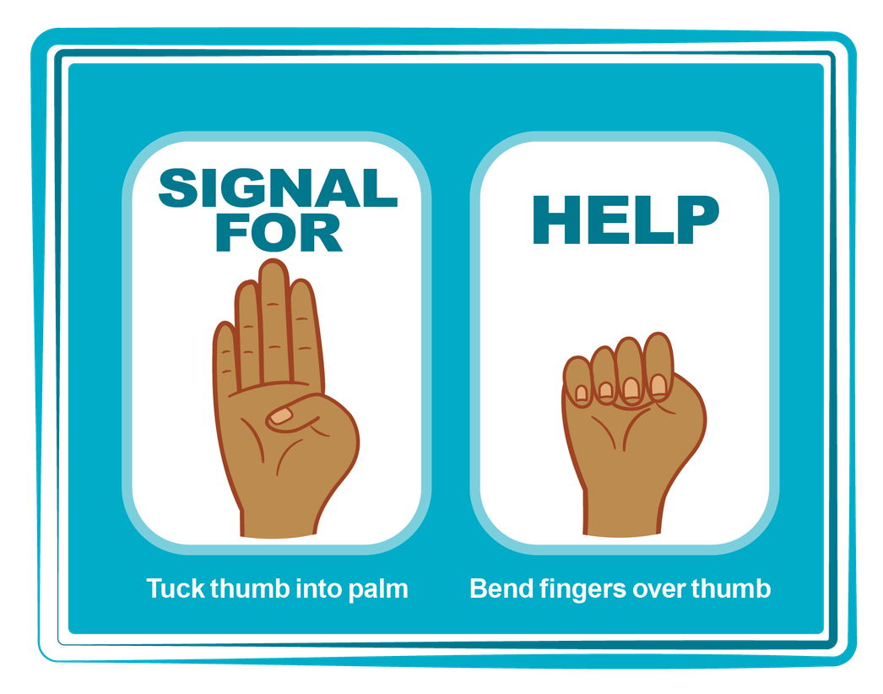
HAND SIGNAL FOR HELP
©2024-2026 Walking Wise
Source: Canadian Women’s Foundation, April 2020
97
Notes:
Although the hand signal for help has not yet achieved universal recognition, it may quietly get someone's attention in urgent situations.
SILENT
It can be used silently.
UNTRACKABLE
It leaves no digital footprint.
CONCEALED
It can be done secretly when a perpetrator is in the vicinity.
SIGNALS DISTRESS
A distressed facial expression can help others recognize that help is needed if the hand signal is not understood—but it is important not to alert the predator/trafficker, causing harm.
Source
Canadian Women's Foundation, April 2020

Slide 98


Thank you!
WalkingWise.com
Online Course for Adults Accredited by:
Postgraduate Institute for Medicine
Academy of Forensic Nursing
©2024-2026 Walking Wise
98
Notes:
NOTE TO PRESENTER
To access additional resources about the hidden buyers, please refer to the last page of Lesson Plan #12 on the Walking Wise Learning Platform.
We welcome your feedback at support@WalkingWise.com.

