Slide 1


SEXUAL EXPLOITATION
EDUCATION
HIDDEN
BUYERS
LESSON #12
©2025 Walking Wise
Notes:
NOTE TO PRESENTER
Log in to WalkingWise.com and refer to the Walking Wise Education Guide to implement classroom teaching tips.
Most importantly:
• DEFINE SCHOOL POLICY
Establish a sexual exploitation reporting protocol with a trauma-informed response. The Walking Wise Implementation Guide provides a sample protocol.
• AGE & AUDIENCE
This presentation can be edited by following the procedures on page 3 to align with your school policies, specific age groups, and the involvement of at-risk audiences.
• SUPPORT PROCEDURE
Provide your audience with guidance on accessing immediate help or arranging a private meeting with a social worker, counselor, nurse, school resource officer, or another trustworthy staff member to report concerns for themselves or a peer.
• SECOND SAFE ADULT
Ensure a second trustworthy adult, such as a teacher, is present in the learning setting to observe audience reactions and identify those who may benefit from a follow-up meeting. This person should remain focused and free from other duties during the presentation.
• IMPLEMENT SLIDO.com
Join Walking Wise in using Slido.com to create an anonymous user experience.
Contact us at support@WalkingWise.com for more information.

Slide 2

NOTE TO PRESENTER
This presentation is exclusively for Walking Wise® subscribers and not for redistribution.
Walking Wise encourages the use of Slido.com, an interactive digital tool, to enhance audience engagement. For more information, contact us at support@WalkingWise.com. Once configured, integrate Slido polling and add a post-evaluation to the PowerPoint presentation.
Presenters are encouraged to edit speaker notes to match their speaking style (viewable in presentation mode). You can also delete slides from this Walking Wise presentation to make sure the content aligns with your school policies, is age-appropriate, and fits within available class time. However, the existing slides are copyright-protected and may not be modified without prior written permission from Walking Wise.
We encourage you to add your own content by following these instructions:
Insert new PowerPoint slides.
Remove the Walking Wise logo and copyright "©2025 Walking Wise" from the new slides.
Always add your organization's name or logo to each new slide.
Please delete this instruction page before presenting to audiences.
©2024-2026 Walking Wise
2
Notes:
NOTE
The presenter is welcome to customize this Walking Wise presentation according to the instructions provided on this page.
For revision requests, please email us at:
support@WalkingWise.com.

Slide 3

CONFRONTING SEXUAL EXPLOITATION
WALKING WISE
KNOWLEDGE serves as a
powerful defense against
sexual predators.
©2024-2026 Walking Wise
3

Slide 4
CONFRONTING SEXUAL EXPLOITATION
WALKING WISE
SEXUAL EXPLOITATION includes grooming, sextortion, pornography
& sex trafficking.
©2024-2026 Walking Wise
4

Slide 5
SENSITIVE DISCUSSION AHEAD
CONTENT ALERT
We’ll be discussing serious issues about sexual exploitation.
Some parts may be difficult to hear.
If you ever feel uncomfortable, you can step out and speak with a trustworthy adult for support.
You’re not alone—we’re here to help you.
©2025 Walking Wise
5
Notes:
NOTE TO PRESENTER
Please tailor this message to align with your organization's policies and protocols.
Please provide a confidential avenue for students to report concerns and seek help for themselves or their peers if they suspect sexual abuse, grooming, sextortion, pornography-related exploitation, or human trafficking. This may include a designated address or text line.
Consider displaying posters in your school or facility that outline various ways students can access immediate support or request a private meeting with a school safety team member or another trusted adult.

Slide 6
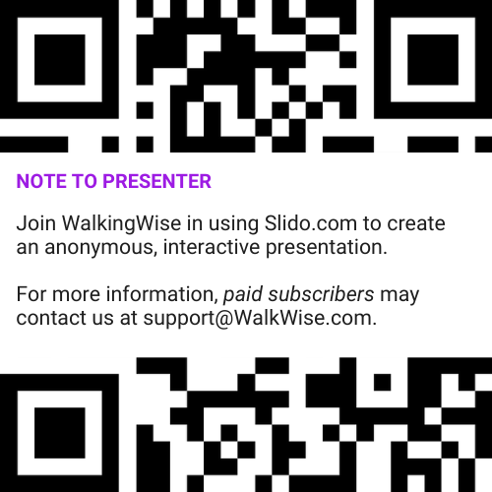
DIGITAL PARTICIPATION
©2024-2026 Walking Wise
6
Notes:
NOTE
For Online Interactive Polling with audiences:
Join Walking Wise in using Slido.com to create an anonymous user experience.
Contact us at support@WalkingWise.com for more information.
Upon Activating Slido.com:
Please verify that the Q&A feature is enabled before presenting to audiences. An adult should monitor questions and comments to ensure they are appropriate. Slido has a feature that allows you to delete unwanted questions and comments.

Slide 7


STATISTICS
Statistics are Only Estimates
🔍 Many sexual crimes are never reported, so study results may not fully reflect what is really happening.
HIDDEN
BUYERS
©2024-2026 Walking Wise
7
Notes:
In this presentation, we'll discuss statistics, but it's important to note that while statistics provide valuable insights into an issue, they cannot be relied upon entirely.
Here are a few reasons:
• UNREPORTED
Victims may stay silent due to fear, shame, or manipulation.
• INCONSISTENT COLLECTION
Geographical areas have different legal definitions for sexual crimes, making data hard to compare.
• FOCUS GROUPS
Small or specific focus groups participating in a study or survey may not accurately reflect the diversity or experiences of the broader population.

Slide 8
STATISTICS
Statistics are Only Estimates
📊 Studies collect information in different ways, which can lead to different results.
HIDDEN
BUYERS
©2024-2026 Walking Wise
8
Notes:
In this presentation, we'll discuss statistics, but it's important to note that while statistics provide valuable insights into an issue, they cannot be relied upon entirely.
Here are a few reasons:
• UNREPORTED
Victims may stay silent due to fear, shame, or manipulation.
• INCONSISTENT COLLECTION
Geographical areas have different legal definitions for sexual crimes, making data hard to compare.
• FOCUS GROUPS
Small or specific focus groups participating in a study or survey may not accurately reflect the diversity or experiences of the broader population.

Slide 9
STATISTICS
Statistics are Only Estimates
👥 Some studies use small groups of people, and those groups may not represent everyone.
HIDDEN
BUYERS
©2024-2026 Walking Wise
9
Notes:
In this presentation, we'll discuss statistics, but it's important to note that while statistics provide valuable insights into an issue, they cannot be relied upon entirely.
Here are a few reasons:
• UNREPORTED
Victims may stay silent due to fear, shame, or manipulation.
• INCONSISTENT COLLECTION
Geographical areas have different legal definitions for sexual crimes, making data hard to compare.
• FOCUS GROUPS
Small or specific focus groups participating in a study or survey may not accurately reflect the diversity or experiences of the broader population.

Slide 10

EDUCATON GUIDE
VOCABULARY
VOCABULARY
Pimp
Sexual Innocence
Sex Buyer
Groom
Human Sex Trafficker
Commercial Sex Trade
Trauma
HIDDEN
BUYERS
©2024-2026 Walking Wise
10
3
Notes:
NOTE
Understanding vocabulary terms related to the behaviors of sexual predators can empower young people to recognize warning signs of harmful situations.
Knowing terminology helps them identify manipulative tactics predators use to build trust and exploit vulnerabilities.
With this knowledge, young people are better equipped to spot red flags, understand that these behaviors are abusive, and feel more confident reporting predators to trusted adults or authorities, potentially preventing further harm.

Slide 11
EDUCATON GUIDE
VOCABULARY
COMMERCIAL SEX TRADE
The system in which sexual acts, services, or sexual images are bought, sold, or exchanged for money or something of value.
This is a business practice linked to the harms of exploitation and considered human trafficking.
HIDDEN
BUYERS
©2024-2026 Walking Wise
11
3
Notes:
Assisting Source
OpenAI. (2025). ChatGPT (GPT-4) [Large language model]. https://chatgpt.com

Slide 12
EDUCATON GUIDE
VOCABULARY
SEX BUYER
A person who pays money or something of value in exchange for sexual activity.
HIDDEN
BUYERS
©2024-2026 Walking Wise
12
3
Notes:
Assisting Source
OpenAI. (2025). ChatGPT (GPT-4) [Large language model]. https://chatgpt.com

Slide 13
EDUCATON GUIDE
VOCABULARY
PROSTITUTION
An adult knowingly agrees to take part in an illegal sex act in exchange for money or something of value
without experiencing force, fraud, or coercion.
HIDDEN
BUYERS
©2024-2026 Walking Wise
Cornell Law School (n.d.). Legal Information Institute: Prostitution. Law.Cornell.edu.
13
3
Notes:
LAWS AGAINST PROSTITUTION
In all U.S. states, prostitution laws make it illegal for anyone, including adults, to engage, agree, or offer to engage in sexual conduct with another person in return for a fee.*
Note to Educators:
*In certain counties of Nevada, the selling and buying of sex acts between ADULTS is legally regulated and controlled.
Source
Cornell Law School (n.d.). Legal Information Institute: Prostitution. Law.Cornell.edu. Retrieved January 21, 2026,
from https://www.law.cornell.edu/wex/prostitution#:~:text=Prostitution%20involves%20engaging%2C%
20agreeing%2C%20or,in%20the%20State%20of%20Nevada

Slide 14
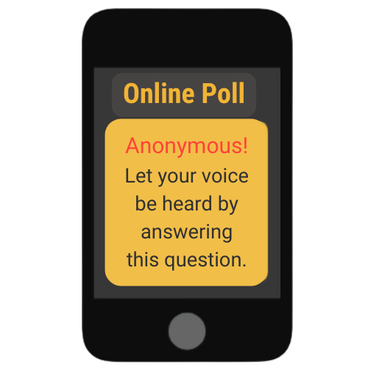
LESSON PLANS
SEX BUYERS
What type of people are MOST likely to purchase sex?
HIDDEN
BUYERS
©2024-2026 Walking Wise
14
3
Notes:
Online Interactive Polling
SLIDO.com Multiple Choice
What type of people are MOST likely to purchase sex?
A) Females
B) Males
C) Young Adults
D) Teenagers
ANSWER
B) Males are more likely to purchase sex than other people.
Studies about sex buyers revealed that up to 99% of individuals arrested for buying sex were male.
Source
DemandAbolition.org. Retrieved June 11, 2025, from https://www.demandabolition.org/wp-content/uploads/2019/07/Demand-Buyer-Report-July-2019.pdf

Slide 15
ANSWER
Males are more likely to purchase sex than other people.
©2024-2026 Walking Wise
Demand Abolition (2018). Who Buys Sex? Understanding and Disrupting Illicit Market Demand.
15
Notes:
Online Interactive Polling
SLIDO.com Multiple Choice
What type of people are MOST likely to purchase sex?
A) Females
B) Males
C) Young Adults
D) Teenagers
ANSWER
B) Males are far more likely to purchase sex than other people.
Studies about sex buyers revealed that up to 99% of individuals arrested for buying sex were male.
Source
DemandAbolition.org. Retrieved June 11, 2025, from https://www.demandabolition.org/wp-content/uploads/2019/07/Demand-Buyer-Report-July-2019.pdf

Slide 16

LESSON PLANS
CHARACTERISTICS
What are some common characteristics among people who purchase sex?
HIDDEN
BUYERS
©2024-2026 Walking Wise
16
3

Slide 17
CHARACTERISTICS
Common Traits of Sex Buyers
Gender: Studies reveal that sex buyers are primarily male.
HIDDEN
BUYERS
©2024-2026 Walking Wise
Demand Abolition (2018). Who Buys Sex? Understanding and Disrupting Illicit Market Demand.
17
Notes:
COMMON TRAITS
There is no single “type” of person who buys sex. Research shows that sex buyers are most often male, but they come from a wide range of ages, backgrounds, and life situations.
Some are young adults, while others are much older. Many have jobs, families, or relationships, and may appear ordinary to others.
This is important for us to understand because it challenges stereotypes and reinforces that buying sex is a behavior and choice, not a specific personality or appearance.
Source
Demand Abolition (2018, November). Who Buys Sex? Understanding and Disrupting Illicit Market Demand, p. 19. DemandAbolition.org. Retrieved June 11, 2025, from https://www.demandabolition.org/wp-content/uploads/2019/07/Demand-Buyer-Report-July-2019.pdf

Slide 18
CHARACTERISTICS
Common Traits of Sex Buyers
Gender: Studies reveal that sex buyers are primarily male.
Age: Sex buyers can range from 18 to 80+ years old.
HIDDEN
BUYERS
©2024-2026 Walking Wise
Demand Abolition (2018). Who Buys Sex? Understanding and Disrupting Illicit Market Demand.
18
Notes:
COMMON TRAITS
There is no single “type” of person who buys sex. Research shows that sex buyers are most often male, but they come from a wide range of ages, backgrounds, and life situations.
Some are young adults, while others are much older. Many have jobs, families, or relationships, and may appear ordinary to others.
This is important for us to understand because it challenges stereotypes and reinforces that buying sex is a behavior and choice, not a specific personality or appearance.
Source
Demand Abolition (2018, November). Who Buys Sex? Understanding and Disrupting Illicit Market Demand, p. 19. DemandAbolition.org. Retrieved June 11, 2025, from https://www.demandabolition.org/wp-content/uploads/2019/07/Demand-Buyer-Report-July-2019.pdf

Slide 19
CHARACTERISTICS
Common Traits of Sex Buyers
Gender: Studies reveal that sex buyers are primarily male.
Age: Sex buyers can range from 18 to 80+ years old.
Relationships: Sex buyers can be single, married, & have children.
HIDDEN
BUYERS
©2024-2026 Walking Wise
Demand Abolition (2018). Who Buys Sex? Understanding and Disrupting Illicit Market Demand.
19
Notes:
COMMON TRAITS
There is no single “type” of person who buys sex. Research shows that sex buyers are most often male, but they come from a wide range of ages, backgrounds, and life situations.
Some are young adults, while others are much older. Many have jobs, families, or relationships, and may appear ordinary to others.
This is important for us to understand because it challenges stereotypes and reinforces that buying sex is a behavior and choice, not a specific personality or appearance.
Source
Demand Abolition (2018, November). Who Buys Sex? Understanding and Disrupting Illicit Market Demand, p. 19. DemandAbolition.org. Retrieved June 11, 2025, from https://www.demandabolition.org/wp-content/uploads/2019/07/Demand-Buyer-Report-July-2019.pdf

Slide 20
CHARACTERISTICS
Common Traits of Sex Buyers
Education: They achieve all levels of education.
HIDDEN
BUYERS
©2024-2026 Walking Wise
Demand Abolition (2018). Who Buys Sex? Understanding and Disrupting Illicit Market Demand.
20
Notes:
COMMON TRAITS
Sex buyers come from all educational and professional backgrounds. Some have little formal education, while others hold college degrees or advanced training. They are found in every type of job and industry, including positions that carry trust or authority.
Research also shows that people who buy sex more frequently often have higher disposable income, which makes it easier to pay for exploitation.
These facts help us understand that sex trafficking is not caused by one social group. It is driven by choices and access to money, and it can involve people who appear successful or respected in their communities.
Source
Demand Abolition (2018, November). Who Buys Sex? Understanding and Disrupting Illicit Market Demand, p. 19. DemandAbolition.org. Retrieved June 11, 2025, from https://www.demandabolition.org/wp-content/uploads/2019/07/Demand-Buyer-Report-July-2019.pdf

Slide 21
CHARACTERISTICS
Common Traits of Sex Buyers
Education: They achieve all levels of education.
Employment: Sex buyers are found in all professions.
HIDDEN
BUYERS
©2024-2026 Walking Wise
Demand Abolition (2018). Who Buys Sex? Understanding and Disrupting Illicit Market Demand.
21
Notes:
COMMON TRAITS
Sex buyers come from all educational and professional backgrounds. Some have little formal education, while others hold college degrees or advanced training. They are found in every type of job and industry, including positions that carry trust or authority.
Research also shows that people who buy sex more frequently often have higher disposable income, which makes it easier to pay for exploitation.
These facts help us understand that sex trafficking is not caused by one social group. It is driven by choices and access to money, and it can involve people who appear successful or respected in their communities.
Source
Demand Abolition (2018, November). Who Buys Sex? Understanding and Disrupting Illicit Market Demand, p. 19. DemandAbolition.org. Retrieved June 11, 2025, from https://www.demandabolition.org/wp-content/uploads/2019/07/Demand-Buyer-Report-July-2019.pdf

Slide 22
CHARACTERISTICS
Common Traits of Sex Buyers
Education: They achieve all levels of education.
Employment: Sex buyers are found in all professions.
Income: People who frequently buy sex often make more money than the average person.
HIDDEN
BUYERS
©2024-2026 Walking Wise
Demand Abolition (2018). Who Buys Sex? Understanding and Disrupting Illicit Market Demand.
22
Notes:
COMMON TRAITS
Sex buyers come from all educational and professional backgrounds. Some have little formal education, while others hold college degrees or advanced training. They are found in every type of job and industry, including positions that carry trust or authority.
Research also shows that people who buy sex more frequently often have higher disposable income, which makes it easier to pay for exploitation.
These facts help us understand that sex trafficking is not caused by one social group. It is driven by choices and access to money, and it can involve people who appear successful or respected in their communities.
Source
Demand Abolition (2018, November). Who Buys Sex? Understanding and Disrupting Illicit Market Demand, p. 19. DemandAbolition.org. Retrieved June 11, 2025, from https://www.demandabolition.org/wp-content/uploads/2019/07/Demand-Buyer-Report-July-2019.pdf

Slide 23
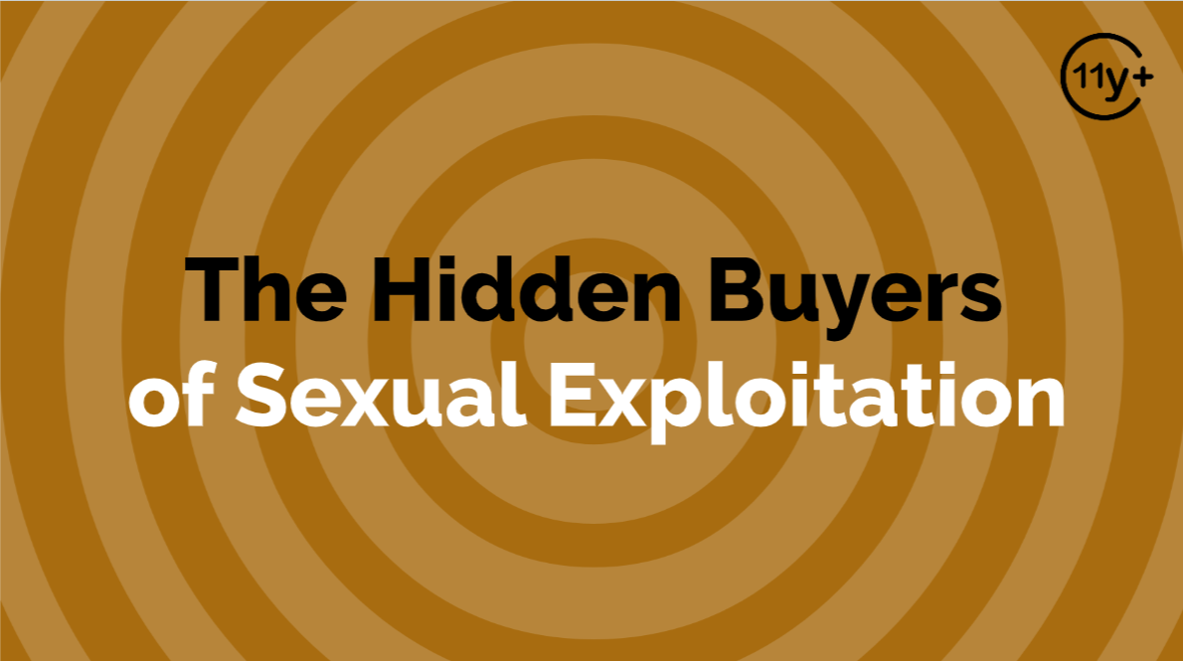
Log in to WalkingWise.com to access this animated video.
©2024-2026 Walking Wise
23
Notes:
Message Especially for Teens:
Explainer-style animation is widely used by businesses worldwide for employee training.
Similarly, the Walking Wise animated video series is designed for teenagers (ages 11+) and adults to understand how sexual predators use manipulation, intimidation, and coercion to exploit vulnerable people.
NOTE
Log in to Walking Wise.com to watch the three-minute animated video with audiences.

Slide 24
EDUCATON GUIDE
VOCABULARY
HUMAN SEX TRAFFICKER
Someone who tricks, pressures, or forces victims into performing sexual acts for their own financial gain.
HIDDEN
BUYERS
©2024-2026 Walking Wise
24
3
Notes:
Assisting Source
OpenAI. (2025). ChatGPT (GPT-4) [Large language model]. https://chatgpt.com

Slide 25
EDUCATON GUIDE
VOCABULARY
TRAFFICKER (PIMP)
A criminal who operates an illegal business requiring vulnerable people to perform sex acts, often using force, fraud, or coercion.
HIDDEN
BUYERS
©2024-2026 Walking Wise
25
3
Notes:
Assisting Source
OpenAI. (2025). ChatGPT (GPT-4) [Large language model]. https://chatgpt.com

Slide 26
SUPPLY & DEMAND
COMMERCIAL INDUSTRY
An industry exists when enough people want something (demand), and others are willing to provide it (supply) to make money.
HIDDEN
BUYERS
©2024-2026 Walking Wise
26
Notes:
INDUSTRY
An industry exists when enough people want something (demand), and others are willing to provide it (supply) to make money.
For example, if people want to buy sneakers, companies will make and sell them. If people want to buy sex, traffickers will find and exploit vulnerable people to meet that demand.

Slide 27
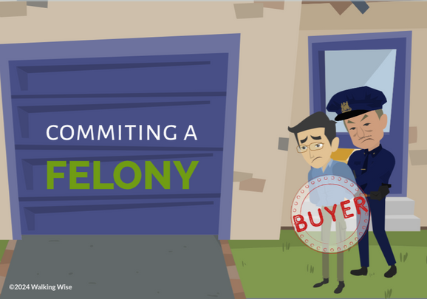
LESSON PLANS
ROLE OF SEX BUYERS
How does buying sex connect a person to sex trafficking?
HIDDEN
BUYERS
©2024-2026 Walking Wise
27
3

Slide 28
SUPPLY & DEMAND
Buyer & Trafficker
Creating Demand: Sex buyers fuel the sex trade by paying for sex or sexual content.
©2024-2026 Walking Wise
28
Notes:
COMMERCIAL SEX
Sex trafficking exists because there is demand from people willing to pay for sexual access to others.
Sex buyers play a direct role by creating financial incentives for traffickers. When people pay for sex, it encourages traffickers to exploit others. Without buyers, traffickers would have no market (reason) to sell victims.
Both traffickers and sex buyers contribute to the harm, and both are responsible for criminal behavior.
The consequences of this demand fall on victims, who often experience repeated abuse, trauma, and loss of safety.
Understanding the role of sex buyers helps shift focus from blaming victims to holding those who create demand accountable.

Slide 29
SUPPLY & DEMAND
Buyer & Trafficker
Driving Exploitation: Traffickers supply victims to meet buyers’ demand in exchange for money & other benefits.
©2024-2026 Walking Wise
29
Notes:
COMMERCIAL SEX
Sex trafficking exists because there is demand from people willing to pay for sexual access to others.
Sex buyers play a direct role by creating financial incentives for traffickers. When people pay for sex, it encourages traffickers to exploit others. Without buyers, traffickers would have no market (reason) to sell victims.
Both traffickers and sex buyers contribute to the harm, and both are responsible for criminal behavior.
The consequences of this demand fall on victims, who often experience repeated abuse, trauma, and loss of safety.
Understanding the role of sex buyers helps shift focus from blaming victims to holding those who create demand accountable.

Slide 30
SUPPLY & DEMAND
Buyer & Trafficker
Criminal Behavior: Buying sex is a crime, just like trafficking.
©2024-2026 Walking Wise
30
Notes:
COMMERCIAL SEX
Sex trafficking exists because there is demand from people willing to pay for sexual access to others.
Sex buyers play a direct role by creating financial incentives for traffickers. When people pay for sex, it encourages traffickers to exploit others. Without buyers, traffickers would have no market (reason) to sell victims.
Both traffickers and sex buyers contribute to the harm, and both are responsible for criminal behavior.
The consequences of this demand fall on victims, who often experience repeated abuse, trauma, and loss of safety.
Understanding the role of sex buyers helps shift focus from blaming victims to holding those who create demand accountable.

Slide 31
SUPPLY & DEMAND
Buyer & Trafficker
Harmful Impact: Victims experience emotional, physical, and sexual abuse as a result.
©2024-2026 Walking Wise
31
Notes:
COMMERCIAL SEX
Sex trafficking exists because there is demand from people willing to pay for sexual access to others.
Sex buyers play a direct role by creating financial incentives for traffickers. When people pay for sex, it encourages traffickers to exploit others. Without buyers, traffickers would have no market (reason) to sell victims.
Both traffickers and sex buyers contribute to the harm, and both are responsible for criminal behavior.
The consequences of this demand fall on victims, who often experience repeated abuse, trauma, and loss of safety.
Understanding the role of sex buyers helps shift focus from blaming victims to holding those who create demand accountable.

Slide 32
EDUCATON GUIDE
VOCABULARY
GROOM
To prepare or train someone over time for a specific purpose.
HIDDEN
BUYERS
©2024-2026 Walking Wise
32
3
Notes:
Assisting Source
OpenAI. (2025). ChatGPT (GPT-4) [Large language model]. https://chatgpt.com

Slide 33
LESSON PLANS
INFLUENCE
What is the MOST influential factor driving people to purchase sex?
HIDDEN
BUYERS
©2024-2026 Walking Wise
33
3
Notes:
Online Interactive Polling
SLIDO.com Multiple Choice
What is the MOST influential factor driving people to purchase sex?
A) Peer Pressure
B) Parents' Attitude
C) Parties
D) Pornography
ANSWER
D) Pornography is the MOST influential factor that leads some people to buy sex.
Source
Wilkinson Jr., Kevin L. (2023). The Breeding of Wolves: Understanding the Escalation Continuum & Escalation Dynamics of Contemporary Sex Trafficking. DigitalCommons.liberity.edu. Retrieved April 30, 2025, from https://digitalcommons.liberty.edu/doctoral/4600/

Slide 34
ANSWER
Pornography is the most influential factor that leads some people to buy sex.
©2024-2026 Walking Wise
Wilkinson Jr., Kevin L. (2023). The Breeding of Wolves: Understanding the Escalation Continuum & Escalation Dynamics of Contemporary Sex Trafficking.
34
Notes:
Online Interactive Polling
SLIDO.com Multiple Choice
What is the MOST influential factor driving people to purchase sex?
A) Peer Pressure
B) Parents' Attitude
C) Parties
D) Pornography
ANSWER
D) Pornography is the MOST influential factor that leads some people to buy sex.
Source
Wilkinson Jr., Kevin L. (2023). The Breeding of Wolves: Understanding the Escalation Continuum & Escalation Dynamics of Contemporary Sex Trafficking. DigitalCommons.liberity.edu. Retrieved April 30, 2025, from https://digitalcommons.liberty.edu/doctoral/4600/

Slide 35
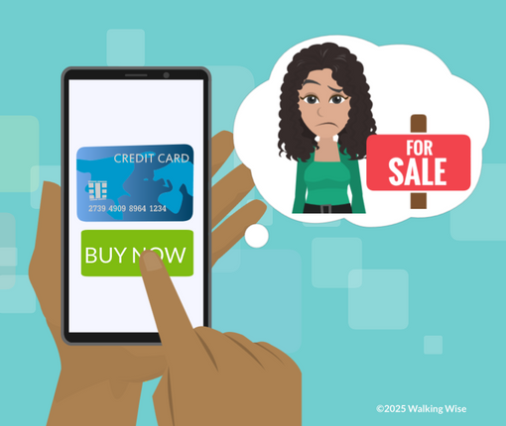
LESSON PLANS
GROOMING
What factors can lead males to purchase sex?
HIDDEN
BUYERS
©2024-2026 Walking Wise
35
3

Slide 36
GROOMING
Escalating Influences for Buying Sex
Adult Influence: Caregivers who normalize pornography use or paying for sex.
©2024-2026 Walking Wise
Wilkinson Jr., Kevin L. (2023). The Breeding of Wolves: Understanding the Escalation Continuum & Escalation Dynamics of Contemporary Sex Trafficking.
36
Notes:
EXCALATING INFLUENCES
Deciding to buy sex often happens gradually, through a grooming process that involves repeated exposure to messages that normalize or minimize harm.
Influences may come from adults, peers, media, or environments that portray sexual access as a commodity rather than a violation of boundaries.
Pornography and sexualized media can distort expectations about consent and relationships, while peer approval can reduce critical thinking. These influences do not cause someone to buy sex, but they can increase risk by shaping beliefs and attitudes over time.
Understanding these pathways helps highlight how exploitation is normalized and why prevention must address culture, media, and accountability—not victims.
Source
Wilkinson Jr., Kevin L. (2024, July 4). The Breeding of Wolves: Understanding the Escalation Continuum & Escalation Dynamics of Contemporary Sex Trafficking. DigitalCommons.liberity.edu. Retrieved April 30, 2025, from https://digitalcommons.liberty.edu/doctoral/4600/

Slide 37
GROOMING
Escalating Influences for Buying Sex
Peer Pressure: Social groups that portray buying sex as common or cool.
©2024-2026 Walking Wise
Wilkinson Jr., Kevin L. (2023). The Breeding of Wolves: Understanding the Escalation Continuum & Escalation Dynamics of Contemporary Sex Trafficking.
37
Notes:
EXCALATING INFLUENCES
Deciding to buy sex often happens gradually, through a grooming process that involves repeated exposure to messages that normalize or minimize harm.
Influences may come from adults, peers, media, or environments that portray sexual access as a commodity rather than a violation of boundaries.
Pornography and sexualized media can distort expectations about consent and relationships, while peer approval can reduce critical thinking. These influences do not cause someone to buy sex, but they can increase risk by shaping beliefs and attitudes over time.
Understanding these pathways helps highlight how exploitation is normalized and why prevention must address culture, media, and accountability—not victims.
Source
Wilkinson Jr., Kevin L. (2024, July 4). The Breeding of Wolves: Understanding the Escalation Continuum & Escalation Dynamics of Contemporary Sex Trafficking. DigitalCommons.liberity.edu. Retrieved April 30, 2025, from https://digitalcommons.liberty.edu/doctoral/4600/

Slide 38
GROOMING
Escalating Influences for Buying Sex
Sexualized Media: Music, games, and videos that glamorize pimps and the commercial sex trade.
Wilkinson Jr., Kevin L. (2023). The Breeding of Wolves: Understanding the Escalation Continuum & Escalation Dynamics of Contemporary Sex Trafficking.
38
©2024-2026 Walking Wise
Notes:
EXCALATING INFLUENCES
Deciding to buy sex often happens gradually, through a grooming process that involves repeated exposure to messages that normalize or minimize harm.
Influences may come from adults, peers, media, or environments that portray sexual access as a commodity rather than a violation of boundaries.
Pornography and sexualized media can distort expectations about consent and relationships, while peer approval can reduce critical thinking. These influences do not cause someone to buy sex, but they can increase risk by shaping beliefs and attitudes over time.
Understanding these pathways helps highlight how exploitation is normalized and why prevention must address culture, media, and accountability—not victims.
Source
Wilkinson Jr., Kevin L. (2024, July 4). The Breeding of Wolves: Understanding the Escalation Continuum & Escalation Dynamics of Contemporary Sex Trafficking. DigitalCommons.liberity.edu. Retrieved April 30, 2025, from https://digitalcommons.liberty.edu/doctoral/4600/

Slide 39
GROOMING
Escalating Influences for Buying Sex
Pornography Exposure: Studies reveal pornography impacts the brain and escalates the desire to buy sex.
Wilkinson Jr., Kevin L. (2023). The Breeding of Wolves: Understanding the Escalation Continuum & Escalation Dynamics of Contemporary Sex Trafficking.
39
©2024-2026 Walking Wise
Notes:
EXCALATING INFLUENCES
Deciding to buy sex often happens gradually, through a grooming process that involves repeated exposure to messages that normalize or minimize harm.
Influences may come from adults, peers, media, or environments that portray sexual access as a commodity rather than a violation of boundaries.
Pornography and sexualized media can distort expectations about consent and relationships, while peer approval can reduce critical thinking. These influences do not cause someone to buy sex, but they can increase risk by shaping beliefs and attitudes over time.
Understanding these pathways helps highlight how exploitation is normalized and why prevention must address culture, media, and accountability—not victims.
Source
Wilkinson Jr., Kevin L. (2024, July 4). The Breeding of Wolves: Understanding the Escalation Continuum & Escalation Dynamics of Contemporary Sex Trafficking. DigitalCommons.liberity.edu. Retrieved April 30, 2025, from https://digitalcommons.liberty.edu/doctoral/4600/

Slide 40
GROOMING
Escalating Influences for Buying Sex
Sexualized Venues: Strip clubs or similar spaces normalize paying for sexualized experiences.
Wilkinson Jr., Kevin L. (2023). The Breeding of Wolves: Understanding the Escalation Continuum & Escalation Dynamics of Contemporary Sex Trafficking.
40
©2024-2026 Walking Wise
Notes:
EXCALATING INFLUENCES
Deciding to buy sex often happens gradually, through a grooming process that involves repeated exposure to messages that normalize or minimize harm.
Influences may come from adults, peers, media, or environments that portray sexual access as a commodity rather than a violation of boundaries.
Pornography and sexualized media can distort expectations about consent and relationships, while peer approval can reduce critical thinking. These influences do not cause someone to buy sex, but they can increase risk by shaping beliefs and attitudes over time.
Understanding these pathways helps highlight how exploitation is normalized and why prevention must address culture, media, and accountability—not victims.
Source
Wilkinson Jr., Kevin L. (2024, July 4). The Breeding of Wolves: Understanding the Escalation Continuum & Escalation Dynamics of Contemporary Sex Trafficking. DigitalCommons.liberity.edu. Retrieved April 30, 2025, from https://digitalcommons.liberty.edu/doctoral/4600/

Slide 41
LESSON PLANS
FIRST TIME BUYERS
What percentage of males first purchased sex due to peer pressure or encouragement from someone they knew?
HIDDEN
BUYERS
©2024-2026 Walking Wise
41
3
Notes:
Online Interactive Polling
SLIDO.com Multiple Choice
What percentage of males first purchased sex due to peer pressure or encouragement from someone they knew?
A) 11%
B) 18%
C) 21%
D) 29%
ANSWER
B) 21% of males first purchased sex because someone in their social network influenced them.
Source
Demand Abolition (2018, November). Who Buys Sex? Understanding and Disrupting Illicit Market Demand, p. 4, 10, 41. DemandAbolition.org. Retrieved June 11, 2025, from https://www.demandabolition.org/wp-content/uploads/2019/07/Demand-Buyer-Report-July-2019.pdf

Slide 42
ANSWER
21% of males first purchased sex because someone in their social network influenced them.
©2024-2026 Walking Wise
Demand Abolition (2018). Who Buys Sex? Understanding and Disrupting Illicit Market Demand.
42
Notes:
Online Interactive Polling
SLIDO.com Multiple Choice
What percentage of males first purchased sex due to peer pressure or encouragement from someone they knew?
A) 11%
B) 18%
C) 21%
D) 29%
ANSWER
B) 21% of males first purchased sex because someone in their social network influenced them.
Source
Demand Abolition (2018, November). Who Buys Sex? Understanding and Disrupting Illicit Market Demand, p. 4, 10, 41. DemandAbolition.org. Retrieved June 11, 2025, from https://www.demandabolition.org/wp-content/uploads/2019/07/Demand-Buyer-Report-July-2019.pdf

Slide 43
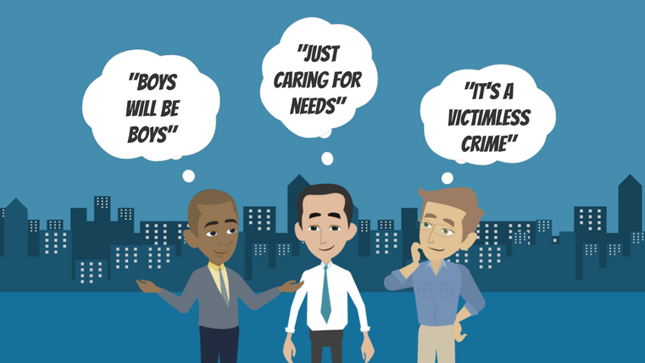
LESSON PLANS
FALSE BELIEFS
What common FALSE beliefs do sex buyers hold to justify their illegal behavior?
HIDDEN
BUYERS
©2024-2026 Walking Wise
43
3

Slide 44
FALSE BELIEFS
Buyers’ Justification
Excusing Behavior: “Boys will be boys.”
©2024-2026 Walking Wise
Demand Abolition (2018). Who Buys Sex? Understanding and Disrupting Illicit Market Demand.
44
Notes:
• BUYERS' JUSTIFICATION
Sex buyers often rely on false beliefs to justify harmful and illegal behavior. These beliefs minimize responsibility, deny the existence of victims, and shift blame away from the buyer. Ideas such as “people choose this” or “victimless crime” ignore the realities of coercion, manipulation, and abuse that are common in sexual exploitation.
Framing harm as normal behavior or a personal need helps buyers avoid accountability. Understanding these justifications helps us recognize how exploitation is normalized and why responsibility lies with those who create demand—not with the victims.
Source
Demand Abolition (2018, November). Who Buys Sex? Understanding and Disrupting Illicit Market Demand, p. 19. DemandAbolition.org. Retrieved June 11, 2025, from https://www.demandabolition.org/wp-content/uploads/2019/07/Demand-Buyer-Report-July-2019.pdf

Slide 45
FALSE BELIEFS
Buyers’ Justification
Excusing Behavior: “Boys will be boys.”
Minimizing Harm: “Just caring for personal needs.”
©2024-2026 Walking Wise
Demand Abolition (2018). Who Buys Sex? Understanding and Disrupting Illicit Market Demand.
45
Notes:
• BUYERS' JUSTIFICATION
Sex buyers often rely on false beliefs to justify harmful and illegal behavior. These beliefs minimize responsibility, deny the existence of victims, and shift blame away from the buyer. Ideas such as “people choose this” or “victimless crime” ignore the realities of coercion, manipulation, and abuse that are common in sexual exploitation.
Framing harm as normal behavior or a personal need helps buyers avoid accountability. Understanding these justifications helps us recognize how exploitation is normalized and why responsibility lies with those who create demand—not with the victims.
Source
Demand Abolition (2018, November). Who Buys Sex? Understanding and Disrupting Illicit Market Demand, p. 19. DemandAbolition.org. Retrieved June 11, 2025, from https://www.demandabolition.org/wp-content/uploads/2019/07/Demand-Buyer-Report-July-2019.pdf

Slide 46
FALSE BELIEFS
Buyers’ Justification
Excusing Behavior: “Boys will be boys.”
Minimizing Harm: “Just caring for personal needs.”
Denying Victims: “Prostitution doesn’t involve victims.”
©2024-2026 Walking Wise
Demand Abolition (2018). Who Buys Sex? Understanding and Disrupting Illicit Market Demand.
46
Notes:
• BUYERS' JUSTIFICATION
Sex buyers often rely on false beliefs to justify harmful and illegal behavior. These beliefs minimize responsibility, deny the existence of victims, and shift blame away from the buyer. Ideas such as “people choose this” or “victimless crime” ignore the realities of coercion, manipulation, and abuse that are common in sexual exploitation.
Framing harm as normal behavior or a personal need helps buyers avoid accountability. Understanding these justifications helps us recognize how exploitation is normalized and why responsibility lies with those who create demand—not with the victims.
Source
Demand Abolition (2018, November). Who Buys Sex? Understanding and Disrupting Illicit Market Demand, p. 19. DemandAbolition.org. Retrieved June 11, 2025, from https://www.demandabolition.org/wp-content/uploads/2019/07/Demand-Buyer-Report-July-2019.pdf

Slide 47
FALSE BELIEFS
Buyers’ Justification
Excusing Behavior: “Boys will be boys.”
Minimizing Harm: “Just caring for personal needs.”
Denying Victims: “Prostitution doesn’t involve victims.”
False Belief: “People being purchased choose to participate.”
©2024-2026 Walking Wise
Demand Abolition (2018). Who Buys Sex? Understanding and Disrupting Illicit Market Demand.
47
Notes:
• BUYERS' JUSTIFICATION
Sex buyers often rely on false beliefs to justify harmful and illegal behavior. These beliefs minimize responsibility, deny the existence of victims, and shift blame away from the buyer. Ideas such as “people choose this” or “victimless crime” ignore the realities of coercion, manipulation, and abuse that are common in sexual exploitation.
Framing harm as normal behavior or a personal need helps buyers avoid accountability. Understanding these justifications helps us recognize how exploitation is normalized and why responsibility lies with those who create demand—not with the victims.
Source
Demand Abolition (2018, November). Who Buys Sex? Understanding and Disrupting Illicit Market Demand, p. 19. DemandAbolition.org. Retrieved June 11, 2025, from https://www.demandabolition.org/wp-content/uploads/2019/07/Demand-Buyer-Report-July-2019.pdf

Slide 48
FALSE BELIEFS
Buyers’ Justification
Excusing Behavior: “Boys will be boys.”
Minimizing Harm: “Just caring for personal needs.”
Denying Victims: “Prostitution doesn’t involve victims.”
False Belief: “People being purchased choose to participate.”
Rationalization: “People being purchased enjoy the experience.”
©2024-2026 Walking Wise
Demand Abolition (2018). Who Buys Sex? Understanding and Disrupting Illicit Market Demand.
48
Notes:
• BUYERS' JUSTIFICATION
Sex buyers often rely on false beliefs to justify harmful and illegal behavior. These beliefs minimize responsibility, deny the existence of victims, and shift blame away from the buyer. Ideas such as “people choose this” or “victimless crime” ignore the realities of coercion, manipulation, and abuse that are common in sexual exploitation.
Framing harm as normal behavior or a personal need helps buyers avoid accountability. Understanding these justifications helps us recognize how exploitation is normalized and why responsibility lies with those who create demand—not with the victims.
Source
Demand Abolition (2018, November). Who Buys Sex? Understanding and Disrupting Illicit Market Demand, p. 19. DemandAbolition.org. Retrieved June 11, 2025, from https://www.demandabolition.org/wp-content/uploads/2019/07/Demand-Buyer-Report-July-2019.pdf

Slide 49
EDUCATON GUIDE
VOCABULARY
SEXUAL INNOCENCE
Having little to no knowledge, experience, or exposure to sexual conduct, due to being young or unaware.
HIDDEN
BUYERS
©2024-2026 Walking Wise
49
3
Notes:
Assisting Source
OpenAI. (2025). ChatGPT (GPT-4) [Large language model]. https://chatgpt.com

Slide 50
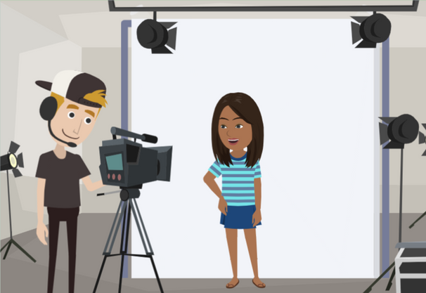
LESSON PLANS
FALSE EMPLOYMENT
What types of jobs are sometimes used to trick people into sex trafficking?
HIDDEN
BUYERS
©2024-2026 Walking Wise
50
3

Slide 51
FALSE EMPLOYMENT
Fake Jobs
Massage Services: Promises of massage training can be fake ads used by illegal massage parlors to lure and exploit victims.
©2024-2026 Walking Wise
51
Notes:
FALSE EMPLOYMENT OFFERS
Traffickers often use fake or misleading job offers to recruit victims because employment feels safe, normal, and appealing, especially to young people seeking money, independence, or opportunity.
These jobs may promise flexible hours, quick pay, or exciting careers, but instead lead to exploitation. Traffickers may disguise abuse by framing it as “part of the job” or by gradually crossing boundaries once trust is established.
Understanding how employment can be misused helps us recognize red flags and reinforces the importance of verifying job offers, especially when opportunities seem too good to be true.

Slide 52
FALSE EMPLOYMENT
Fake Jobs
Acting & Modeling: Traffickers pose as talent agents, offering fake career opportunities.
©2024-2026 Walking Wise
52
Notes:
FALSE EMPLOYMENT OFFERS
Traffickers often use fake or misleading job offers to recruit victims because employment feels safe, normal, and appealing, especially to young people seeking money, independence, or opportunity.
These jobs may promise flexible hours, quick pay, or exciting careers, but instead lead to exploitation. Traffickers may disguise abuse by framing it as “part of the job” or by gradually crossing boundaries once trust is established.
Understanding how employment can be misused helps us recognize red flags and reinforces the importance of verifying job offers, especially when opportunities seem too good to be true.

Slide 53
FALSE EMPLOYMENT
Fake Jobs
Food & Entertainment: Jobs in certain bars, restaurants, casinos, adult clubs, or strip clubs are used to lure victims.
©2024-2026 Walking Wise
53
Notes:
FALSE EMPLOYMENT OFFERS
Traffickers often use fake or misleading job offers to recruit victims because employment feels safe, normal, and appealing, especially to young people seeking money, independence, or opportunity.
These jobs may promise flexible hours, quick pay, or exciting careers, but instead lead to exploitation. Traffickers may disguise abuse by framing it as “part of the job” or by gradually crossing boundaries once trust is established.
Understanding how employment can be misused helps us recognize red flags and reinforces the importance of verifying job offers, especially when opportunities seem too good to be true.

Slide 54
FALSE EMPLOYMENT
Fake Jobs
Hospitality: Positions in hotels or motels can be used by traffickers to recruit victims.
©2024-2026 Walking Wise
54
Notes:
FALSE EMPLOYMENT OFFERS
Traffickers often use fake or misleading job offers to recruit victims because employment feels safe, normal, and appealing, especially to young people seeking money, independence, or opportunity.
These jobs may promise flexible hours, quick pay, or exciting careers, but instead lead to exploitation. Traffickers may disguise abuse by framing it as “part of the job” or by gradually crossing boundaries once trust is established.
Understanding how employment can be misused helps us recognize red flags and reinforces the importance of verifying job offers, especially when opportunities seem too good to be true.

Slide 55
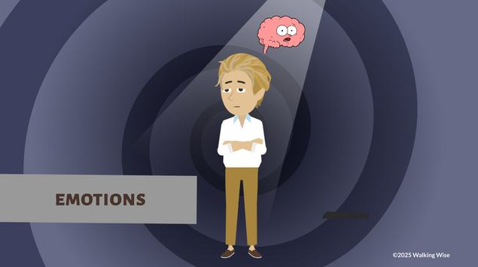
LESSON PLANS
BUYERS’ EMOTIONS
What emotions or feelings can lead some people to buy sex?
HIDDEN
BUYERS
©2024-2026 Walking Wise
55
3

Slide 56
BUYERS’ EMOTIONS
Common Emotions
Loneliness
Sadness
Depression
Frustration
Low Self-esteem
HIDDEN
BUYERS
©2024-2026 Walking Wise
She Has a Name (n.d.) Why People Solicit Sex.
56
Notes:
Source
She Has a Name (n.d.) Why People Solicit Sex. Retrieved from an April 30, 2025, webinar presentation.

Slide 57
BUYERS’ EMOTIONS
Common Emotions
Loneliness
Sadness
Depression
Frustration
Low Self-esteem
Feeling Unattractive
Desire for Companionship
Boredom
Searching for Excitement
Curiosity
HIDDEN
BUYERS
©2024-2026 Walking Wise
She Has a Name (n.d.) Why People Solicit Sex.
57
Notes:
Source
She Has a Name (n.d.) Why People Solicit Sex. Retrieved from an April 30, 2025, webinar presentation.

Slide 58
LESSON PLANS
BEHAVIOR ESCALATION
When pornography no longer feels exciting, what escalating behavior can happen next?
HIDDEN
BUYERS
©2024-2026 Walking Wise
58
3
Notes:
Online Interactive Polling
SLIDO.com Multiple Choice
When pornography no longer feels exciting, what escalating behavior can happen next?
A) Stop using pornography
B) Talk to friends about porn
C) Listen to sexualized music
D) Look for real-life sexual experiences
ANSWER
D) Looking for real-life sexual experiences can sometimes lead people to buy sex.
Source
Wilkinson Jr., Kevin L. (2023, July 4). The Breeding of Wolves: Understanding the Escalation Continuum & Escalation Dynamics of Contemporary Sex Trafficking, pp 32, 227. DigitalCommons.liberity.edu. Retrieved June 18, 2025, from https://digitalcommons.liberty.edu/doctoral/4600/

Slide 59
ANSWER
Looking for real-life sexual experiences can sometimes lead people to buy sex.
©2024-2026 Walking Wise
Wilkinson Jr., Kevin L. (2023). The Breeding of Wolves: Understanding the Escalation Continuum & Escalation Dynamics of Contemporary Sex Trafficking.
59
Notes:
Online Interactive Polling
SLIDO.com Multiple Choice
When pornography no longer feels exciting, what escalating behavior can happen next?
A) Stop using pornography
B) Talk to friends about porn
C) Listen to sexualized music
D) Look for real-life sexual experiences
ANSWER
D) Looking for real-life sexual experiences can sometimes lead people to buy sex.
Source
Wilkinson Jr., Kevin L. (2023, July 4). The Breeding of Wolves: Understanding the Escalation Continuum & Escalation Dynamics of Contemporary Sex Trafficking, pp 32, 227. DigitalCommons.liberity.edu. Retrieved June 18, 2025, from https://digitalcommons.liberty.edu/doctoral/4600/

Slide 60
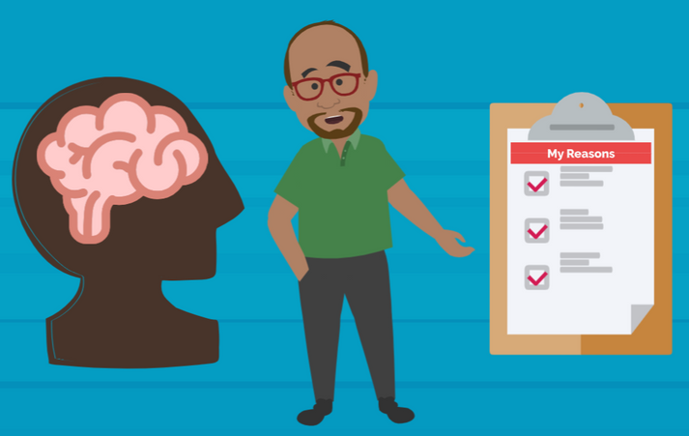
LESSON PLANS
BUYERS’ MINDSET
Why might some people choose to buy sex?
HIDDEN
BUYERS
©2024-2026 Walking Wise
60
3

Slide 61
BUYERS’ MINDSET
Common Reasons People Buy Sex
Avoid Relationships: Some buyers avoid emotional closeness or long-term relationships.
HIDDEN
BUYERS
©2024-2026 Walking Wise
Demand Abolition (2018). Who Buys Sex? Understanding and Disrupting Illicit Market Demand.
61
Notes:
REASONS PEOPLE BUY SEX
Some people buy sex for a combination of emotional, social, and learned reasons, though none of these justify the harm caused. Buyers may struggle with loneliness, social anxiety, or difficulty forming healthy relationships.
Instead of building mutual connections, buying sex can feel like an easier or faster way to meet sexual or emotional wants without vulnerability, communication, or commitment.
Others may be influenced by peer norms, sexualized media, or pornography, which can normalize the idea that sex is something that can be purchased rather than shared through consent and respect.
Source
Demand Abolition (2018, November). Who Buys Sex? Understanding and Disrupting Illicit Market Demand. DemandAbolition.org. Retrieved February 25, 2024, from https://www.demandabolition.org/wp-content/uploads/2019/07/Demand-Buyer-Report-July-2019.pdf
Source
She Has a Name (n.d.) Why People Solicit Sex. Retrieved from the Webinar presentation on April 30, 2025.

Slide 62
BUYERS’ MINDSET
Common Reasons People Buy Sex
Fear of Commitment: They may not want the responsibility that comes with a real relationship.
HIDDEN
BUYERS
©2024-2026 Walking Wise
Demand Abolition (2018). Who Buys Sex? Understanding and Disrupting Illicit Market Demand.
62
Notes:
REASONS PEOPLE BUY SEX
Some people buy sex for a combination of emotional, social, and learned reasons, though none of these justify the harm caused. Buyers may struggle with loneliness, social anxiety, or difficulty forming healthy relationships.
Instead of building mutual connections, buying sex can feel like an easier or faster way to meet sexual or emotional wants without vulnerability, communication, or commitment.
Others may be influenced by peer norms, sexualized media, or pornography, which can normalize the idea that sex is something that can be purchased rather than shared through consent and respect.
Source
Demand Abolition (2018, November). Who Buys Sex? Understanding and Disrupting Illicit Market Demand. DemandAbolition.org. Retrieved February 25, 2024, from https://www.demandabolition.org/wp-content/uploads/2019/07/Demand-Buyer-Report-July-2019.pdf
Source
She Has a Name (n.d.) Why People Solicit Sex. Retrieved from the Webinar presentation on April 30, 2025.

Slide 63
BUYERS’ MINDSET
Common Reasons People Buy Sex
Feeling Isolated: Loneliness or lack of connection can influence their choices.
HIDDEN
BUYERS
©2024-2026 Walking Wise
Demand Abolition (2018). Who Buys Sex? Understanding and Disrupting Illicit Market Demand.
63
Notes:
REASONS PEOPLE BUY SEX
Some people buy sex for a combination of emotional, social, and learned reasons, though none of these justify the harm caused. Buyers may struggle with loneliness, social anxiety, or difficulty forming healthy relationships.
Instead of building mutual connections, buying sex can feel like an easier or faster way to meet sexual or emotional wants without vulnerability, communication, or commitment.
Others may be influenced by peer norms, sexualized media, or pornography, which can normalize the idea that sex is something that can be purchased rather than shared through consent and respect.
Source
Demand Abolition (2018, November). Who Buys Sex? Understanding and Disrupting Illicit Market Demand. DemandAbolition.org. Retrieved February 25, 2024, from https://www.demandabolition.org/wp-content/uploads/2019/07/Demand-Buyer-Report-July-2019.pdf
Source
She Has a Name (n.d.) Why People Solicit Sex. Retrieved from the Webinar presentation on April 30, 2025.

Slide 64
BUYERS’ MINDSET
Common Reasons People Buy Sex
Limited Social Skills: Some struggle to make friends or feel unsure about dating.
HIDDEN
BUYERS
©2024-2026 Walking Wise
Demand Abolition (2018). Who Buys Sex? Understanding and Disrupting Illicit Market Demand.
64
Notes:
REASONS PEOPLE BUY SEX
Curiosity and thrill-seeking can also play a role, especially when exposure to explicit content escalates over time and no longer satisfies the brain in the same way.
In some cases, buyers are motivated by a desire for power or control, as purchasing sex allows them to avoid equality, boundaries, or rejection.
It is important for us to understand that buying sex is not a victimless act—it directly supports exploitation and abuse. Teaching young people about healthy relationships, emotional regulation, and respectful connections is a key prevention strategy that reduces demand and helps disrupt the cycle of trafficking.
Source
Demand Abolition (2018, November). Who Buys Sex? Understanding and Disrupting Illicit Market Demand. DemandAbolition.org. Retrieved February 25, 2024, from https://www.demandabolition.org/wp-content/uploads/2019/07/Demand-Buyer-Report-July-2019.pdf
She Has a Name (n.d.) Why People Solicit Sex. Retrieved from the Webinar presentation on April 30, 2025.

Slide 65
BUYERS’ MINDSET
Common Reasons People Buy Sex
Curiosity & Excitement: Some are curious or looking for thrill-seeking experiences.
HIDDEN
BUYERS
©2024-2026 Walking Wise
Demand Abolition (2018). Who Buys Sex? Understanding and Disrupting Illicit Market Demand.
65
Notes:
REASONS PEOPLE BUY SEX
Curiosity and thrill-seeking can also play a role, especially when exposure to explicit content escalates over time and no longer satisfies the brain in the same way.
In some cases, buyers are motivated by a desire for power or control, as purchasing sex allows them to avoid equality, boundaries, or rejection.
It is important for us to understand that buying sex is not a victimless act—it directly supports exploitation and abuse. Teaching young people about healthy relationships, emotional regulation, and respectful connections is a key prevention strategy that reduces demand and helps disrupt the cycle of trafficking.
Source
Demand Abolition (2018, November). Who Buys Sex? Understanding and Disrupting Illicit Market Demand. DemandAbolition.org. Retrieved February 25, 2024, from https://www.demandabolition.org/wp-content/uploads/2019/07/Demand-Buyer-Report-July-2019.pdf
She Has a Name (n.d.) Why People Solicit Sex. Retrieved from the Webinar presentation on April 30, 2025.

Slide 66
BUYERS’ MINDSET
Common Reasons People Buy Sex
Desire Control: Purchasing sex gives some buyers a desired power over another person.
HIDDEN
BUYERS
©2024-2026 Walking Wise
Demand Abolition (2018). Who Buys Sex? Understanding and Disrupting Illicit Market Demand.
66
Notes:
REASONS PEOPLE BUY SEX
Curiosity and thrill-seeking can also play a role, especially when exposure to explicit content escalates over time and no longer satisfies the brain in the same way.
In some cases, buyers are motivated by a desire for power or control, as purchasing sex allows them to avoid equality, boundaries, or rejection.
It is important for us to understand that buying sex is not a victimless act—it directly supports exploitation and abuse. Teaching young people about healthy relationships, emotional regulation, and respectful connections is a key prevention strategy that reduces demand and helps disrupt the cycle of trafficking.
Source
Demand Abolition (2018, November). Who Buys Sex? Understanding and Disrupting Illicit Market Demand. DemandAbolition.org. Retrieved February 25, 2024, from https://www.demandabolition.org/wp-content/uploads/2019/07/Demand-Buyer-Report-July-2019.pdf
She Has a Name (n.d.) Why People Solicit Sex. Retrieved from the Webinar presentation on April 30, 2025.

Slide 67
EDUCATON GUIDE
VOCABULARY
TRAUMA
A deeply distressing experience that impacts a person's thoughts, feelings, and behavior during and long after the event.
HIDDEN
BUYERS
©2024-2026 Walking Wise
67
3
Notes:
Assisting Source
OpenAI. (2025). ChatGPT (GPT-4) [Large language model]. https://chatgpt.com

Slide 68
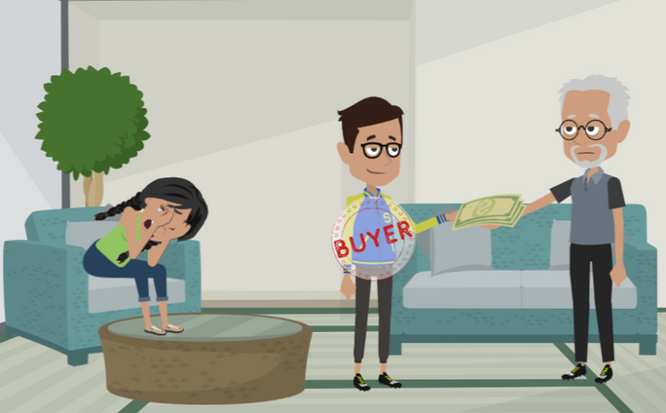
LESSON PLANS
TRAUMA
How are people harmed or traumatized when they are sold to sex buyers?
HIDDEN
BUYERS
©2024-2026 Walking Wise
68
3

Slide 69
TRAUMA
Harm Caused by Exploitation
Lack of Choice: Victims are forced or coerced into participating against their will.
HIDDEN
BUYERS
©2024-2026 Walking Wise
Demand Abolition (2018). Who’s Buying Sex? Understanding and Disrupting Illicit Market Demand.
69
Notes:
TRAUMA
Trafficking causes deep trauma because victims are denied choice, safety, and control over their own bodies.
Even when physical force is not present, coercion, manipulation, and fear are powerful tools that keep victims from leaving.
Traffickers often use threats, lies, or emotional pressure to create dependence and confusion, making victims feel trapped or powerless. This ongoing loss of control can lead to long-term emotional, psychological, and physical harm.
It is important for us to understand that exploitation is never consensual and that responsibility lies with the traffickers and buyers—not the victim.
Source
1. Demand Abolition (2018, November). Who Buys Sex? Understanding and Disrupting Illicit Market Demand, pp. 4, 23, 29. DemandAbolition.org. Retrieved June 18, 2025, from https://www.demandabolition.org/wp-content/uploads/2019/07/Demand-Buyer-Report-July-2019.pdf
2. Wilkinson Jr., Kevin L. (2024, July 4). The Breeding of Wolves: Understanding the Escalation Continuum & Escalation Dynamics of Contemporary Sex Trafficking, p. 79. DigitalCommons.liberity.edu. Retrieved April 30, 2025, from https://digitalcommons.liberty.edu/doctoral/4600/

Slide 70
TRAUMA
Harm Caused by Exploitation
Control & Entrapment: Traffickers use threats, fear, or isolation to keep victims trapped.
HIDDEN
BUYERS
©2024-2026 Walking Wise
Demand Abolition (2018). Who’s Buying Sex? Understanding and Disrupting Illicit Market Demand.
70
Notes:
TRAUMA
Trafficking causes deep trauma because victims are denied choice, safety, and control over their own bodies.
Even when physical force is not present, coercion, manipulation, and fear are powerful tools that keep victims from leaving.
Traffickers often use threats, lies, or emotional pressure to create dependence and confusion, making victims feel trapped or powerless. This ongoing loss of control can lead to long-term emotional, psychological, and physical harm.
It is important for us to understand that exploitation is never consensual and that responsibility lies with the traffickers and buyers—not the victim.
Source
1. Demand Abolition (2018, November). Who Buys Sex? Understanding and Disrupting Illicit Market Demand, pp. 4, 23, 29. DemandAbolition.org. Retrieved June 18, 2025, from https://www.demandabolition.org/wp-content/uploads/2019/07/Demand-Buyer-Report-July-2019.pdf
2. Wilkinson Jr., Kevin L. (2024, July 4). The Breeding of Wolves: Understanding the Escalation Continuum & Escalation Dynamics of Contemporary Sex Trafficking, p. 79. DigitalCommons.liberity.edu. Retrieved April 30, 2025, from https://digitalcommons.liberty.edu/doctoral/4600/

Slide 71
TRAUMA
Harm Caused by Exploitation
Manipulation: Lies, emotional abuse, and false promises are used to control behaviors.
HIDDEN
BUYERS
©2024-2026 Walking Wise
Demand Abolition (2018). Who’s Buying Sex? Understanding and Disrupting Illicit Market Demand.
71
Notes:
TRAUMA
Trafficking causes deep trauma because victims are denied choice, safety, and control over their own bodies.
Even when physical force is not present, coercion, manipulation, and fear are powerful tools that keep victims from leaving.
Traffickers often use threats, lies, or emotional pressure to create dependence and confusion, making victims feel trapped or powerless. This ongoing loss of control can lead to long-term emotional, psychological, and physical harm.
It is important for us to understand that exploitation is never consensual and that responsibility lies with the traffickers and buyers—not the victim.
Source
1. Demand Abolition (2018, November). Who Buys Sex? Understanding and Disrupting Illicit Market Demand, pp. 4, 23, 29. DemandAbolition.org. Retrieved June 18, 2025, from https://www.demandabolition.org/wp-content/uploads/2019/07/Demand-Buyer-Report-July-2019.pdf
2. Wilkinson Jr., Kevin L. (2024, July 4). The Breeding of Wolves: Understanding the Escalation Continuum & Escalation Dynamics of Contemporary Sex Trafficking, p. 79. DigitalCommons.liberity.edu. Retrieved April 30, 2025, from https://digitalcommons.liberty.edu/doctoral/4600/

Slide 72
TRAUMA
Common Harmful Experiences
Violence: Victims are often threatened or physically harmed.
Demand Abolition (2018). Who’s Buying Sex? Understanding and Disrupting Illicit Market Demand.
Edwards, E. et al, 2022, Family-Controlled Trafficking in the United States.
72
©2024-2026 Walking Wise
Notes:
ABUSE & ENTRAPMENT
Studies reveal that the individuals who are expected to serve sex buyers often suffer from depression, suicidal ideation, and substance use to numb their pain. Much of this is because they have repeatedly experienced extensive violence, such as physical and sexual abuse. (1)
Victims often experience entrapment, which means they have been coerced or forced into participating in something they would not normally do, as a result of the trafficker's pressure and manipulation that controls their decisions.
Victims are frequently relocated to unfamiliar communities where they do not have family or friends, keeping them disoriented. Traffickers often isolate victims to maintain control, preventing victims from leaving and making them feel they have no choice but to serve sex buyers. (2)
Source
1. Demand Abolition (2018, November). Who Buys Sex? Understanding and Disrupting Illicit Market Demand, pp. 4, 23, 29. DemandAbolition.org. Retrieved February 25, 2024, from https://www.demandabolition.org/wp-content/uploads/2019/07/Demand-Buyer-Report-July-2019.pdf
2. Edwards, E., Middleton, J., Cole, J. (2022, February 27). Family-Controlled Trafficking in the United States: Victim Characteristics, System Response, and Case Outcomes, Journal of Human Trafficking, p. 2. https://www.researchgate.net/publication/358899780_Family-Controlled_Trafficking_in_the_United_States_Victim_Characteristics_System_Response_and_Case_Outcomes

Slide 73
TRAUMA
Common Harmful Experiences
Ongoing Abuse: Many experience emotional, physical, and sexual abuse.
Demand Abolition (2018). Who’s Buying Sex? Understanding and Disrupting Illicit Market Demand.
Edwards, E. et al, 2022, Family-Controlled Trafficking in the United States.
73
©2024-2026 Walking Wise
Notes:
ABUSE & ENTRAPMENT
Studies reveal that the individuals who are expected to serve sex buyers often suffer from depression, suicidal ideation, and substance use to numb their pain. Much of this is because they have repeatedly experienced extensive violence, such as physical and sexual abuse. (1)
Victims often experience entrapment, which means they have been coerced or forced into participating in something they would not normally do, as a result of the trafficker's pressure and manipulation that controls their decisions.
Victims are frequently relocated to unfamiliar communities where they do not have family or friends, keeping them disoriented. Traffickers often isolate victims to maintain control, preventing victims from leaving and making them feel they have no choice but to serve sex buyers. (2)
Source
1. Demand Abolition (2018, November). Who Buys Sex? Understanding and Disrupting Illicit Market Demand, pp. 4, 23, 29. DemandAbolition.org. Retrieved February 25, 2024, from https://www.demandabolition.org/wp-content/uploads/2019/07/Demand-Buyer-Report-July-2019.pdf
2. Edwards, E., Middleton, J., Cole, J. (2022, February 27). Family-Controlled Trafficking in the United States: Victim Characteristics, System Response, and Case Outcomes, Journal of Human Trafficking, p. 2. https://www.researchgate.net/publication/358899780_Family-Controlled_Trafficking_in_the_United_States_Victim_Characteristics_System_Response_and_Case_Outcomes

Slide 74
TRAUMA
Common Harmful Experiences
Substance Use: Some use drugs or alcohol to numb fear, pain, or memories.
Demand Abolition (2018). Who’s Buying Sex? Understanding and Disrupting Illicit Market Demand.
Edwards, E. et al, 2022, Family-Controlled Trafficking in the United States.
74
©2024-2026 Walking Wise
Notes:
ABUSE & ENTRAPMENT
Studies reveal that the individuals who are expected to serve sex buyers often suffer from depression, suicidal ideation, and substance use to numb their pain. Much of this is because they have repeatedly experienced extensive violence, such as physical and sexual abuse. (1)
Victims often experience entrapment, which means they have been coerced or forced into participating in something they would not normally do, as a result of the trafficker's pressure and manipulation that controls their decisions.
Victims are frequently relocated to unfamiliar communities where they do not have family or friends, keeping them disoriented. Traffickers often isolate victims to maintain control, preventing victims from leaving and making them feel they have no choice but to serve sex buyers. (2)
Source
1. Demand Abolition (2018, November). Who Buys Sex? Understanding and Disrupting Illicit Market Demand, pp. 4, 23, 29. DemandAbolition.org. Retrieved February 25, 2024, from https://www.demandabolition.org/wp-content/uploads/2019/07/Demand-Buyer-Report-July-2019.pdf
2. Edwards, E., Middleton, J., Cole, J. (2022, February 27). Family-Controlled Trafficking in the United States: Victim Characteristics, System Response, and Case Outcomes, Journal of Human Trafficking, p. 2. https://www.researchgate.net/publication/358899780_Family-Controlled_Trafficking_in_the_United_States_Victim_Characteristics_System_Response_and_Case_Outcomes

Slide 75
TRAUMA
Common Harmful Experiences
Relocation: Victims may be moved to unfamiliar cities or states.
Demand Abolition (2018). Who’s Buying Sex? Understanding and Disrupting Illicit Market Demand.
Edwards, E. et al, 2022, Family-Controlled Trafficking in the United States.
75
©2024-2026 Walking Wise
Notes:
ABUSE & ENTRAPMENT
Studies reveal that the individuals who are expected to serve sex buyers often suffer from depression, suicidal ideation, and substance use to numb their pain. Much of this is because they have repeatedly experienced extensive violence, such as physical and sexual abuse. (1)
Victims often experience entrapment, which means they have been coerced or forced into participating in something they would not normally do, as a result of the trafficker's pressure and manipulation that controls their decisions.
Victims are frequently relocated to unfamiliar communities where they do not have family or friends, keeping them disoriented. Traffickers often isolate victims to maintain control, preventing victims from leaving and making them feel they have no choice but to serve sex buyers. (2)
Source
1. Demand Abolition (2018, November). Who Buys Sex? Understanding and Disrupting Illicit Market Demand, pp. 4, 23, 29. DemandAbolition.org. Retrieved February 25, 2024, from https://www.demandabolition.org/wp-content/uploads/2019/07/Demand-Buyer-Report-July-2019.pdf
2. Edwards, E., Middleton, J., Cole, J. (2022, February 27). Family-Controlled Trafficking in the United States: Victim Characteristics, System Response, and Case Outcomes, Journal of Human Trafficking, p. 2. https://www.researchgate.net/publication/358899780_Family-Controlled_Trafficking_in_the_United_States_Victim_Characteristics_System_Response_and_Case_Outcomes

Slide 76
TRAUMA
Common Harmful Experiences
Isolation: Many are cut off from family, friends, and trusted adults.
Demand Abolition (2018). Who’s Buying Sex? Understanding and Disrupting Illicit Market Demand.
Edwards, E. et al, 2022, Family-Controlled Trafficking in the United States.
76
©2024-2026 Walking Wise
Notes:
ABUSE & ENTRAPMENT
Studies reveal that the individuals who are expected to serve sex buyers often suffer from depression, suicidal ideation, and substance use to numb their pain. Much of this is because they have repeatedly experienced extensive violence, such as physical and sexual abuse. (1)
Victims often experience entrapment, which means they have been coerced or forced into participating in something they would not normally do, as a result of the trafficker's pressure and manipulation that controls their decisions.
Victims are frequently relocated to unfamiliar communities where they do not have family or friends, keeping them disoriented. Traffickers often isolate victims to maintain control, preventing victims from leaving and making them feel they have no choice but to serve sex buyers. (2)
Source
1. Demand Abolition (2018, November). Who Buys Sex? Understanding and Disrupting Illicit Market Demand, pp. 4, 23, 29. DemandAbolition.org. Retrieved February 25, 2024, from https://www.demandabolition.org/wp-content/uploads/2019/07/Demand-Buyer-Report-July-2019.pdf
2. Edwards, E., Middleton, J., Cole, J. (2022, February 27). Family-Controlled Trafficking in the United States: Victim Characteristics, System Response, and Case Outcomes, Journal of Human Trafficking, p. 2. https://www.researchgate.net/publication/358899780_Family-Controlled_Trafficking_in_the_United_States_Victim_Characteristics_System_Response_and_Case_Outcomes

Slide 77
LESSON PLANS
END DEMAND
What percentage of men who purchase sex said they want to stop?
HIDDEN
BUYERS
©2024-2026 Walking Wise
Demand Abolition (2018). Who’s Buying Sex? Understanding and Disrupting Illicit Market Demand.
77
3
Notes:
Online Interactive Polling
SLIDO.com Multiple Choice
What percentage of men who purchase sex said they want to stop?
A) 11%
B) 21%
C) 31%
D) 41%
ANSWER
D) 41% of men who admitted to purchasing sex said they would like to stop.
Source
Demand Abolition (2018, November). Who Buys Sex? Understanding and Disrupting Illicit Market Demand, pp. 25-26. DemandAbolition.org. Retrieved June 18, 2025, from https://www.demandabolition.org/wp-content/uploads/2019/07/Demand-Buyer-Report-July-2019.pdf

Slide 78
ANSWER
41% of men who admitted to purchasing sex said they would like to stop.
©2024-2026 Walking Wise
Demand Abolition (2018). Who’s Buying Sex? Understanding and Disrupting Illicit Market Demand.
78
Notes:
Online Interactive Polling
SLIDO.com Multiple Choice
What percentage of men who purchase sex said they want to stop?
A) 11%
B) 21%
C) 31%
D) 41%
ANSWER
D) 41% of men who admitted to purchasing sex said they would like to stop.
Source
Demand Abolition (2018, November). Who Buys Sex? Understanding and Disrupting Illicit Market Demand, pp. 25-26. DemandAbolition.org. Retrieved June 18, 2025, from https://www.demandabolition.org/wp-content/uploads/2019/07/Demand-Buyer-Report-July-2019.pdf

Slide 79
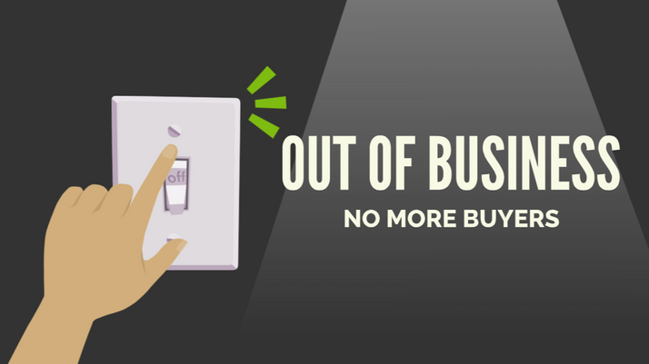
LESSON PLANS
END DEMAND
What would put the commercial sex trafficking trade out of business?
HIDDEN
BUYERS
©2024-2026 Walking Wise
79
3

Slide 80
END DEMAND
End Sex Trafficking
Shift Attitudes: Change beliefs that normalize or excuse buyers.
Demand Abolition (2018). Who’s Buying Sex? Understanding and Disrupting Illicit Market Demand.
Wilkinson Jr., Kevin L. (2023). The Breeding of Wolves: Understanding the Escalation Continuum & Escalation Dynamics of Contemporary Sex Trafficking.
©2024-2026 Walking Wise
80
Notes:
END DEMAND
A powerful way to end sex trafficking is to stop the “demand,” which means an individual’s desire and willingness to pay for sex. Sex buyers create this “demand,” and traffickers respond by supplying people to meet the demand.
EDUCATE ADOLESCENTS
Education plays a critical role by helping young people understand the real harm caused by buying sex, challenging harmful social messages, and building skills to resist pressure or manipulation.
Teaching awareness and accountability helps prevent exploitation before it starts and supports safer communities for everyone.
Source
Demand Abolition (2018, November). Who Buys Sex? Understanding and Disrupting Illicit Market Demand, pp. 25-26. DemandAbolition.org. Retrieved February 25, 2024, from https://www.demandabolition.org/wp-content/uploads/2019/07/Demand-Buyer-Report-July-2019.pdf
Wilkinson Jr., Kevin L. (2023, July 4). The Breeding of Wolves: Understanding the Escalation Continuum & Escalation Dynamics of Contemporary Sex Trafficking, p. 230. DigitalCommons.liberity.edu. Retrieved June 18, 2025, from https://digitalcommons.liberty.edu/doctoral/4600/

Slide 81
END DEMAND
End Sex Trafficking
Education: Teach how buying sex harms vulnerable people and fuels exploitation.
Demand Abolition (2018). Who’s Buying Sex? Understanding and Disrupting Illicit Market Demand.
Wilkinson Jr., Kevin L. (2023). The Breeding of Wolves: Understanding the Escalation Continuum & Escalation Dynamics of Contemporary Sex Trafficking.
©2024-2026 Walking Wise
81
Notes:
END DEMAND
A powerful way to end sex trafficking is to stop the “demand,” which means an individual’s desire and willingness to pay for sex. Sex buyers create this “demand,” and traffickers respond by supplying people to meet the demand.
EDUCATE ADOLESCENTS
Education plays a critical role by helping young people understand the real harm caused by buying sex, challenging harmful social messages, and building skills to resist pressure or manipulation.
Teaching awareness and accountability helps prevent exploitation before it starts and supports safer communities for everyone.
Source
Demand Abolition (2018, November). Who Buys Sex? Understanding and Disrupting Illicit Market Demand, pp. 25-26. DemandAbolition.org. Retrieved February 25, 2024, from https://www.demandabolition.org/wp-content/uploads/2019/07/Demand-Buyer-Report-July-2019.pdf
Wilkinson Jr., Kevin L. (2023, July 4). The Breeding of Wolves: Understanding the Escalation Continuum & Escalation Dynamics of Contemporary Sex Trafficking, p. 230. DigitalCommons.liberity.edu. Retrieved June 18, 2025, from https://digitalcommons.liberty.edu/doctoral/4600/

Slide 82
END DEMAND
End Sex Trafficking
Youth Empowerment: Help young people recognize and resist pressure to participate.
Demand Abolition (2018). Who’s Buying Sex? Understanding and Disrupting Illicit Market Demand.
Wilkinson Jr., Kevin L. (2023). The Breeding of Wolves: Understanding the Escalation Continuum & Escalation Dynamics of Contemporary Sex Trafficking.
©2024-2026 Walking Wise
82
Notes:
END DEMAND
A powerful way to end sex trafficking is to stop the “demand,” which means an individual’s desire and willingness to pay for sex. Sex buyers create this “demand,” and traffickers respond by supplying people to meet the demand.
EDUCATE ADOLESCENTS
Education plays a critical role by helping young people understand the real harm caused by buying sex, challenging harmful social messages, and building skills to resist pressure or manipulation.
Teaching awareness and accountability helps prevent exploitation before it starts and supports safer communities for everyone.
Source
Demand Abolition (2018, November). Who Buys Sex? Understanding and Disrupting Illicit Market Demand, pp. 25-26. DemandAbolition.org. Retrieved February 25, 2024, from https://www.demandabolition.org/wp-content/uploads/2019/07/Demand-Buyer-Report-July-2019.pdf
Wilkinson Jr., Kevin L. (2023, July 4). The Breeding of Wolves: Understanding the Escalation Continuum & Escalation Dynamics of Contemporary Sex Trafficking, p. 230. DigitalCommons.liberity.edu. Retrieved June 18, 2025, from https://digitalcommons.liberty.edu/doctoral/4600/

Slide 83
END DEMAND
End Sex Trafficking
Awareness: Teach the manipulative tactics used by traffickers.
Demand Abolition (2018). Who’s Buying Sex? Understanding and Disrupting Illicit Market Demand.
Wilkinson Jr., Kevin L. (2023). The Breeding of Wolves: Understanding the Escalation Continuum & Escalation Dynamics of Contemporary Sex Trafficking.
©2024-2026 Walking Wise
83
Notes:
END DEMAND
A powerful way to end sex trafficking is to stop the “demand,” which means an individual’s desire and willingness to pay for sex. Sex buyers create this “demand,” and traffickers respond by supplying people to meet the demand.
EDUCATE ADOLESCENTS
Education plays a critical role by helping young people understand the real harm caused by buying sex, challenging harmful social messages, and building skills to resist pressure or manipulation.
Teaching awareness and accountability helps prevent exploitation before it starts and supports safer communities for everyone.
Source
Demand Abolition (2018, November). Who Buys Sex? Understanding and Disrupting Illicit Market Demand, pp. 25-26. DemandAbolition.org. Retrieved February 25, 2024, from https://www.demandabolition.org/wp-content/uploads/2019/07/Demand-Buyer-Report-July-2019.pdf
Wilkinson Jr., Kevin L. (2023, July 4). The Breeding of Wolves: Understanding the Escalation Continuum & Escalation Dynamics of Contemporary Sex Trafficking, p. 230. DigitalCommons.liberity.edu. Retrieved June 18, 2025, from https://digitalcommons.liberty.edu/doctoral/4600/

Slide 84

ASK FOR HELP
©2024-2026 Walking Wise
84
Notes:
HOW TO ASK FOR HELP
Walking Wise asked a focus group who are survivors:
What do you think young people should know about sex trafficking?
ANSWER
• The survivors agreed that the most vital information kids should know is how to ask for help.
• At the top of their list: Tell a TRUSTWORTHY adult.
• In response, Walking Wise added a group of characters to its animated videos that represent trustworthy people to encourage teens to seek out adults whom they can trust.

Slide 85

ASK FOR HELP
What are ways young people can ask for help?
©2024-2026 Walking Wise
85

Slide 86
ASK FOR HELP
How to Ask for Help
If you are in immediate danger, dial 911.
©2024-2026 Walking Wise
86

Slide 87
ASK FOR HELP
How to Ask for Help
If you are in immediate danger, dial 911.
If the sexual predator IS a family member, consider telling a trustworthy adult.
©2024-2026 Walking Wise
87

Slide 88
ASK FOR HELP
How to Ask for Help
If you are in immediate danger, dial 911.
If the sexual predator IS a family member, consider telling a trustworthy adult.
If the sexual predator is NOT family, consider telling a parent.
©2024-2026 Walking Wise
88

Slide 89
ASK FOR HELP
How to Ask for Help
If you are in immediate danger, dial 911.
If the sexual predator IS a family member, consider telling a trustworthy adult.
If the sexual predator is NOT family, consider telling a parent.
If you are a student in school, consider telling a trustworthy teacher, coach, school nurse, social worker, counselor, resource officer, or principal.
©2024-2026 Walking Wise
89

Slide 90
ASK FOR HELP
How to Ask for Help
If you are in immediate danger, dial 911.
If the sexual predator IS a family member, consider telling a trustworthy adult.
If the sexual predator is NOT family, consider telling a parent.
If you are a student in school, consider telling a trustworthy teacher, coach, school nurse, social worker, counselor, resource officer, or principal.
To gain internet access for help, consider using a computer at your school or a public library.
©2024-2026 Walking Wise
90

Slide 91
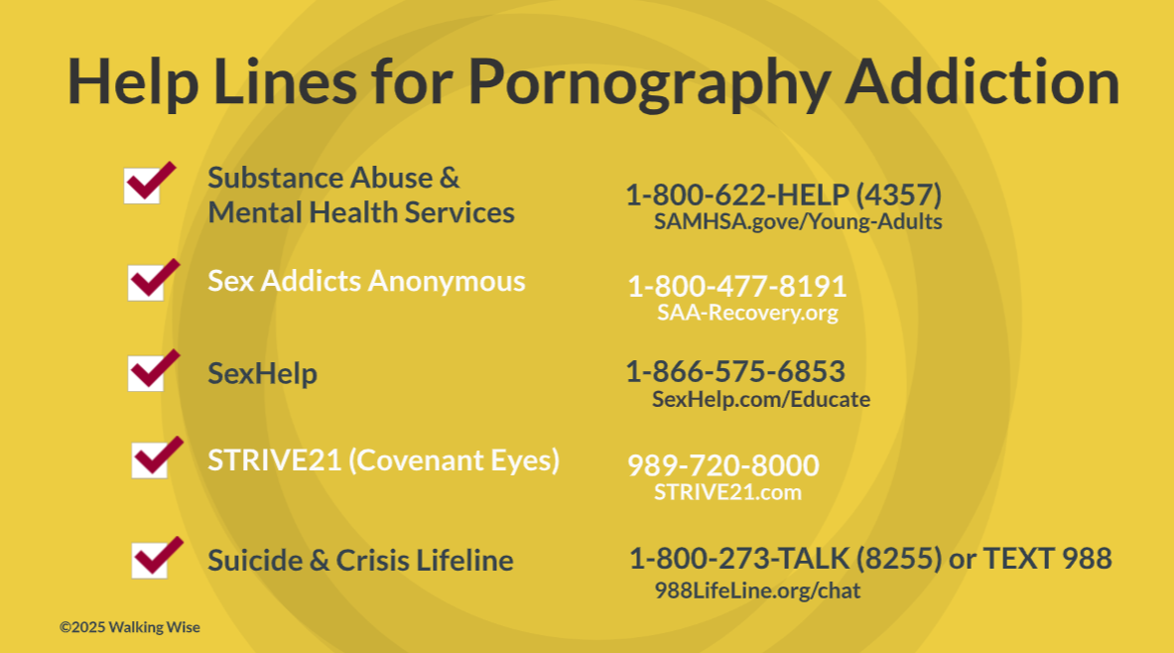
91

Slide 92
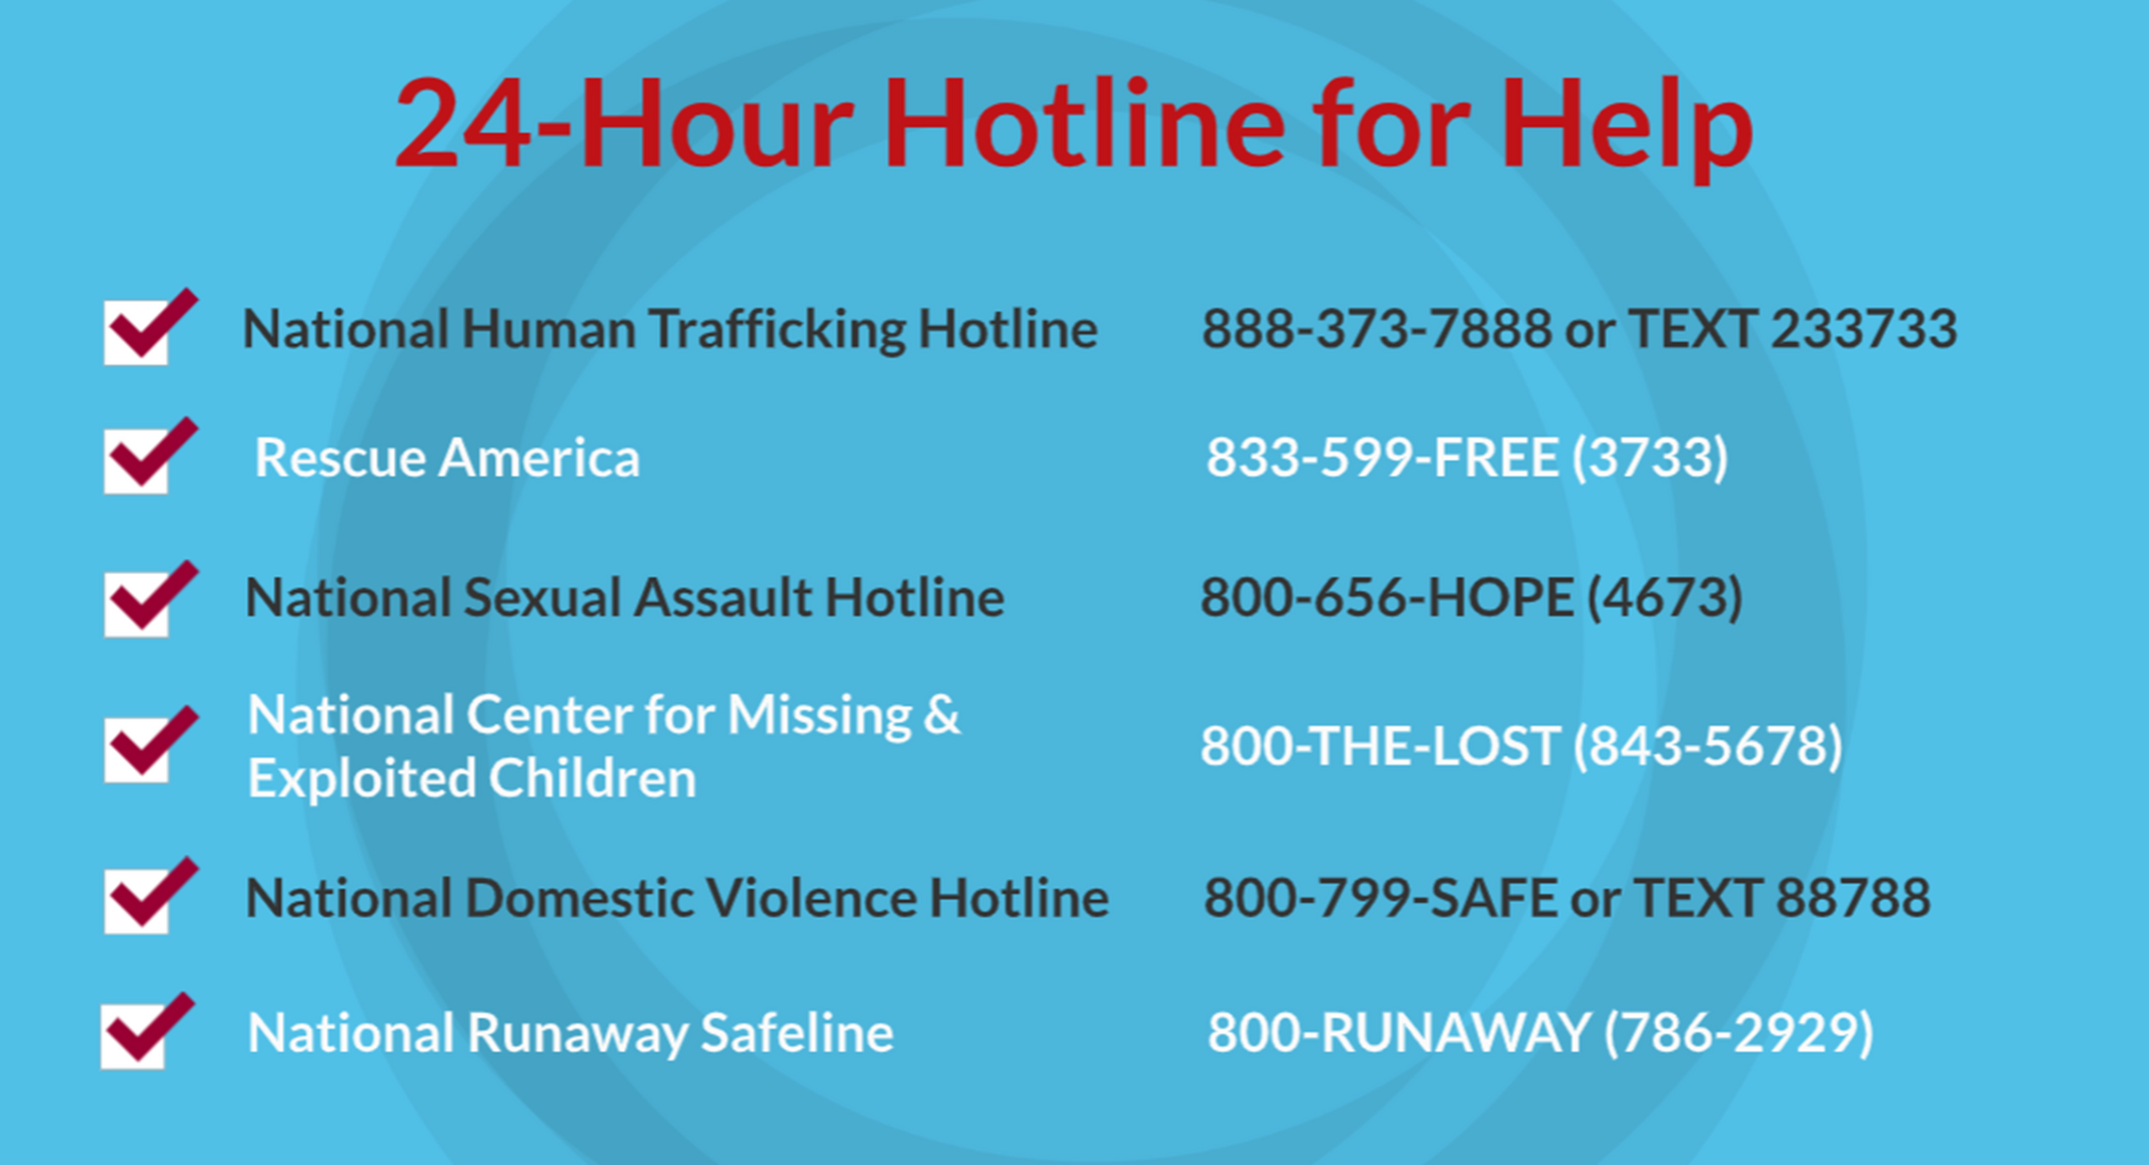
©2024-2026 Walking Wise
92
Notes:
NOTE
Presenters may ask their audience to consider adding a few "hotline for help" phone numbers in their cell phone contacts or take a photo of this slide.

Slide 93
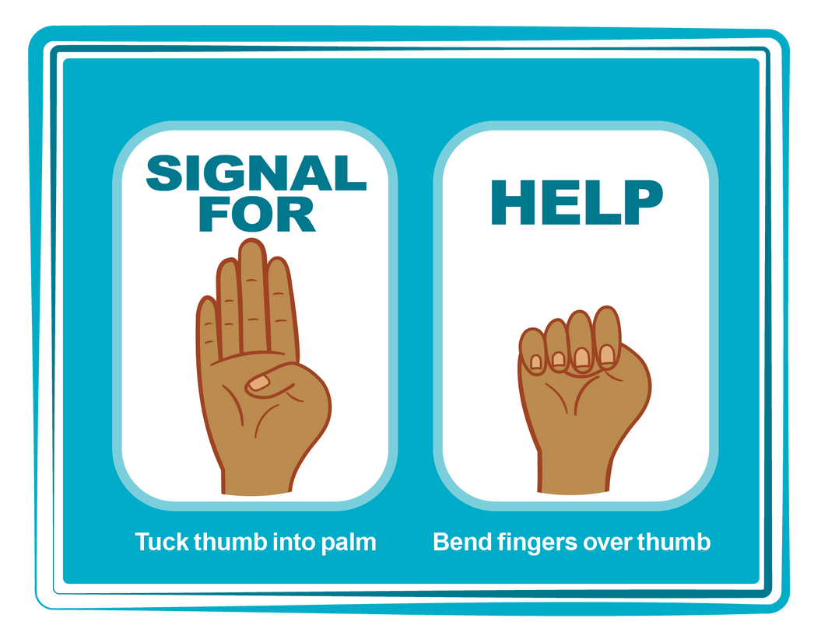
HAND SIGNAL FOR HELP
©2024-2026 Walking Wise
Source: Canadian Women’s Foundation, April 2020
93
Notes:
Although the hand signal for help has not yet achieved universal recognition, it may discreetly get someone's attention in urgent situations.
• SILENT
It can be used silently.
• UNTRACKABLE
It leaves no digital footprint.
• CONCEALED
It can be done secretly when a perpetrator is in the vicinity.
• SIGNALS DISTRESS
Combining the hand signal with distressed facial expressions might help attract the attention of an individual who is unfamiliar with the signal's meaning.
Source
Canadian Women's Foundation, April 2020

Slide 94
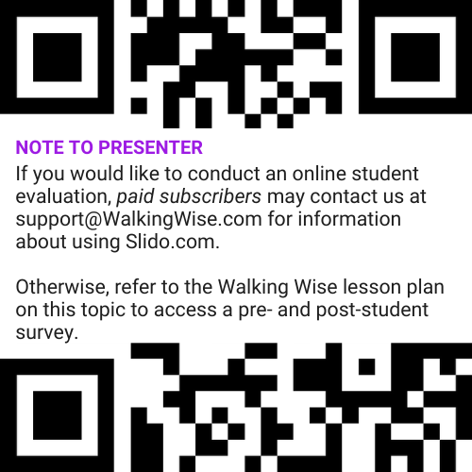
EVALUATION
©2024-2026 Walking Wise
94
Notes:
Two ways to conduct a pre-/post-student evaluation:
1) Use the pre/post survey in the Walking Wise lesson plan for this topic.
2) Activate Slido.com to conduct an online survey.

Slide 95

SHARE YOUR THOUGHTS
1. How would you rate this lesson?
2. What was the one thing you liked?
3. What one thing should we improve?
If using Slido: Replace “#XXXX” with your organization’s custom Slido code.
©2024-2026 Walking Wise
95
Notes:
Online Interactive Polling
SLIDO.com: 3-Question Survey
IF SLIDO IS ACTIVATED:
Follow the instructions provided on WalkingWise.com to access your school or organization's custom Slido QR code and #code, which the audience will use to complete the 3-question evaluation.
Please encourage your audience to scan your organization's custom QR code to share what they enjoyed and what could be improved about the lesson.
Please send any feedback you want to share to Walking Wise at support@WalkingWise.com.

Slide 96


Thank you!
WalkingWise.com
Online Course for Adults Accredited by:
Postgraduate Institue for Medicine
Academy of Forensic Nursing
©2024-2026 Walking Wise
96
Notes:
NOTE
To access additional resources about the hidden buyers, please refer to the last page of Lesson Plan #12 in the Walking Wise Education Guide.
We welcome your feedback at support@WalkingWise.com.
Thank you!
Karla Highman
Founder, WalkingWise.com

