Slide 1


SEXUAL EXPLOITATION
EDUCATION
Human
TRAFFICKERS
LESSON #9
©2025 Walking Wise
Notes:
NOTE
Log in to WalkingWise.com and refer to the Walking Wise Education Guide to implement classroom teaching tips and check out lesson plan #9.
Most importantly:
• DEFINE SCHOOL POLICY
Establish an anti-trafficking reporting protocol with a trauma-informed response. The Walking Wise Implementation Guide provides a sample protocol.
• AGE & AUDIENCE
This presentation can be edited by following the procedures on page 3 to align with your school policies, specific age groups, and the involvement of at-risk audiences.
• SUPPORT PROCEDURE
Provide your audience with guidance on accessing immediate help or arranging a private meeting with a social worker, counselor, nurse, school resource officer, or another trustworthy staff member to report concerns for themselves or a peer.
• SECOND SAFE ADULT
Ensure a second trustworthy adult, such as a teacher, is present in the learning setting to observe audience reactions and identify those who may benefit from a follow-up meeting. This person should remain focused and free from other duties during your presentation.
• IMPLEMENT SLIDO.com
Please log in to WalkingWise.com for instructions on incorporating Slido into this PowerPoint presentation to engage your audience using digital polling.

Slide 2

NOTE TO PRESENTER
This presentation is exclusively for Walking Wise® subscribers and not for redistribution.
Walking Wise provides an interactive digital tool, Slido.com, to enhance audience engagement. To implement Slido for your organization, please log in to WalkingWise.com for setup instructions. Once configured, integrate Slido polling and add a post-evaluation into the PowerPoint presentation.
Presenters are encouraged to edit speaker notes to align with their speaking style. You may also delete slides from this Walking Wise presentation to ensure the content aligns with your school policies, is age-appropriate, and fits within your allotted time frame. However, the existing slides are copyright-protected and may not be modified without prior written permission from Walking Wise.
If you would like to add your own content, you may do so under the following conditions:
  Insert new PowerPoint slides.
  Remove the Walking Wise logo and copyright "©2025 Walking Wise" from the new slides.
  Always add your organization's name or logo to each new slide.
Please delete this instruction page before presenting to audiences.
©2025 Walking Wise
2
Notes:
NOTE
The presenter is welcome to customize this Walking Wise presentation according to the instructions provided on this page.
For revision requests, please send an email to support@WalkingWise.com.

Slide 3

CONFRONTING SEXUAL EXPLOITATION
WALKING WISE
KNOWLEDGE serves as a
powerful defense against
sexual predators.
©2025 Walking Wise
3

Slide 4
CONFRONTING SEXUAL EXPLOITATION
WALKING WISE
SEXUAL EXPLOITATION includes grooming, sextortion, pornography
& sex trafficking.
©2025 Walking Wise
4

Slide 5
SENSITIVE DISCUSSION AHEAD
CONTENT ALERT
We’ll be discussing serious issues about sexual exploitation.
Some parts may be difficult to hear.
If you ever feel uncomfortable, you can step out and speak with a trustworthy adult for support.
You’re not alone—we’re here to help you.
©2025 Walking Wise
5
Notes:
NOTE TO PRESENTER
Please tailor this "content alert" message to align with your organization's policies and protocols.
Please provide a confidential avenue for students to report concerns and seek help for themselves or their peers if they suspect sexual abuse, grooming, sextortion, pornography-related exploitation, or human trafficking. This may include a designated email address or text line.
Please consider displaying posters in your school or facility that outline various ways students can access immediate support or request a private meeting with a school safety team member or another trusted adult.

Slide 6

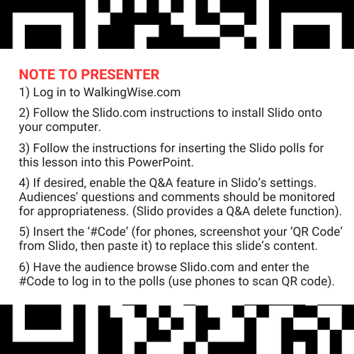
DIGITAL PARTICIPATION
©2025 Walking Wise
6
Notes:
NOTE
For digital interaction with audiences:
Log in to WalkingWise.com to follow the instructions on setting up Slido questions and answers for this presentation. Then, replace the QR code and #code in this slide with your own custom QR code and #code.
Please verify that the Q&A feature has been activated before presenting to your audience. Adults should monitor the questions and comments made by users. Slido has a feature that allows you to delete unwanted questions and comments.

Slide 7


STATISTICS
Statistics are Only Estimates
  Study results may be unreliable because most sexual crimes go unreported.
Human
TRAFFICKERS
©2025 Walking Wise
7
Notes:
In this presentation, we'll discuss statistics, but it's important to note that while statistics provide valuable insights into an issue, they cannot be entirely relied upon.
Here are a few reasons:
• UNREPORTED
Victims may stay silent due to fear, shame, or manipulation.
• INCONSISTENT COLLECTION
Geographical areas have different legal definitions for sexual crimes, making data hard to compare.
• FOCUS GROUPS
Small or specific focus groups participating in a study or survey may not accurately reflect the diversity or experiences of the broader population.

Slide 8
STATISTICS
Statistics are Only Estimates
  Study results may be unreliable because most sexual crimes go unreported.
  The methods used to collect information can vary widely between studies, leading to inconsistency.
Human
TRAFFICKERS
©2025 Walking Wise
8
Notes:
In this presentation, we'll discuss statistics, but it's important to note that while statistics provide valuable insights into an issue, they cannot be entirely relied upon.
Here are a few reasons:
• UNREPORTED
Victims may stay silent due to fear, shame, or manipulation.
• INCONSISTENT COLLECTION
Geographical areas have different legal definitions for sexual crimes, making data hard to compare.
• FOCUS GROUPS
Small or specific focus groups participating in a study or survey may not accurately reflect the diversity or experiences of the broader population.

Slide 9
STATISTICS
Statistics are Only Estimates
  Study results may be unreliable because most sexual crimes go unreported.
  The methods used to collect information can vary widely between studies, leading to inconsistency.
  Focus groups in studies may not accurately represent the larger population.
Human
TRAFFICKERS
©2025 Walking Wise
9
Notes:
In this presentation, we'll discuss statistics, but it's important to note that while statistics provide valuable insights into an issue, they cannot be entirely relied upon.
Here are a few reasons:
• UNREPORTED
Victims may stay silent due to fear, shame, or manipulation.
• INCONSISTENT COLLECTION
Geographical areas have different legal definitions for sexual crimes, making data hard to compare.
• FOCUS GROUPS
Small or specific focus groups participating in a study or survey may not accurately reflect the diversity or experiences of the broader population.

Slide 10

EDUCATON GUIDE
VOCABULARY
VOCABULARY
  Human Trafficker
  Pimp
  Persona
  Coercion
  Prostitution
  Flatter
  Seduce
  Vulnerable
Human
TRAFFICKERS
©2025 Walking Wise
10
3
Notes:
NOTE
Understanding vocabulary terms related to the behaviors of sexual predators can empower young people to recognize warning signs of harmful situations.
Knowing terminology helps them identify manipulative tactics predators use to build trust and exploit vulnerabilities.
With this knowledge, young people are better equipped to spot red flags, understand that these behaviors are abusive, and feel more confident reporting predators to trusted adults or authorities, potentially preventing further harm.

Slide 11
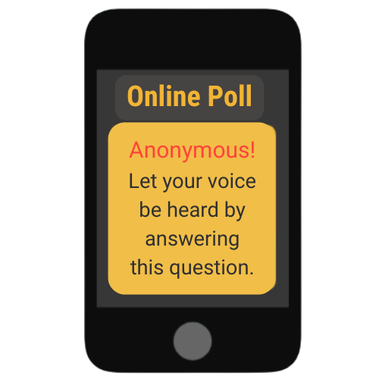
LESSON PLANS
ILLEGAL INDUSTRIES
What do you think are the top two illegal industries in the U.S.?
Human
TRAFFICKERS
©2025 Walking Wise
11
3
Notes:
SLIDO.com Open Text Poll
What are the top illegal industries in the U.S.?
ANSWER
#1 Drug Trafficking
#2 Human Trafficking
(sex & labor trafficking)

Slide 12
ILLEGAL INDUSTRIES
Most Profitable Illegal U.S. Industries
#1 Drug Trafficking
Human
TRAFFICKERS
©2025 Walking Wise
12
Notes:
What are the top, most profitable, illegal industries in the United States?
ANSWER
#1 Drug Trafficking
#2 Human Trafficking
(sex & labor trafficking)
Other top criminal industries in the U.S. include:
• Illegal Firearms Trade
• Counterfeit Goods
• Illegal Gambling
• Cybercrime & Identity Theft
• Prostitution
• Money Laundering
• Wildlife & Environmental crimes

Slide 13
ILLEGAL INDUSTRIES
Most Profitable Illegal U.S. Industries
#1 Drug Trafficking
#2 Human Trafficking
  Sex Trafficking
  Labor Trafficking
Human
TRAFFICKERS
©2025 Walking Wise
13
Notes:
What are the top, most profitable, illegal industries in the United States?
ANSWER
#1 Drug Trafficking
#2 Human Trafficking
(sex & labor trafficking)
Other top criminal industries in the U.S. include:
• Illegal Firearms Trade
• Counterfeit Goods
• Illegal Gambling
• Cybercrime & Identity Theft
• Prostitution
• Money Laundering
• Wildlife & Environmental crimes

Slide 14
EDUCATON GUIDE
VOCABULARY
HUMAN TRAFFICKER
Someone who tricks, pressures, or forces victims to work (labor) or sell sexual acts for the traffickers’ financial gain.
Human
TRAFFICKERS
©2025 Walking Wise
14
3
Notes:
Assisting Source
OpenAI. (2025). ChatGPT (GPT-4) [Large language model]. https://chatgpt.com

Slide 15
EDUCATON GUIDE
VOCABULARY
PIMP
A criminal who operates an illegal business requiring vulnerable people to perform sex acts, often using force, fraud, or coercion.
While the word “pimp” is used as slang in some songs or movies, in real life, pimps are traffickers who harm people; therefore, it’s important not to glamorize this word.
©2025 Walking Wise
15
3
Notes:
Assisting Source
OpenAI. (2025). ChatGPT (GPT-4) [Large language model]. https://chatgpt.com

Slide 16
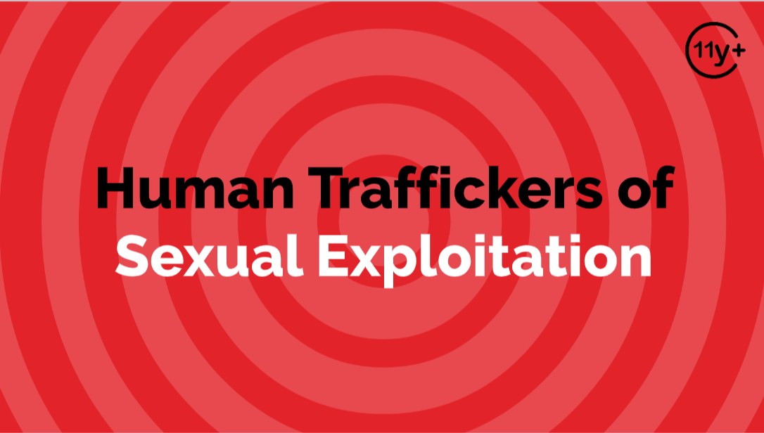
Log in to WalkingWise.com to access this animated video.
©2025 Walking Wise
16
Notes:
Message Especially for Teens:
Explainer-style animation is widely used by businesses worldwide for employee training.
Similarly, the Walking Wise animated video series is designed for teenagers (ages 11+) and adults to understand how sexual predators use manipulation, intimidation, and coercion to exploit young people.
NOTE
Log in to Walking Wise.com to watch the three-minute animated video with audiences.

Slide 17
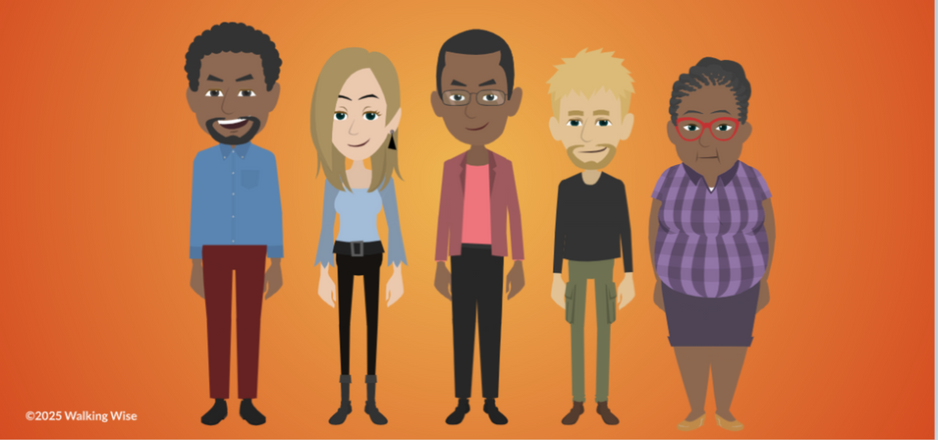
LESSON PLANS
TRAFFICKERS
Who can be a human trafficker?
Human
TRAFFICKERS
©2025 Walking Wise
17
3

Slide 18
TRAFFICKERS
Types of Human Traffickers
  Family Members
Human
TRAFFICKERS
Sprang, G., Cole, C. (2018, February 13). Familial Sex Trafficking of Minors: Trafficking Conditions, Clinical Presentation, and System Involvement, p. 1.
18
©2025 Walking Wise
Notes:
Source
Sprang, G., Cole, C. (2018, February 13). Familial Sex Trafficking of Minors: Trafficking Conditions, Clinical Presentation, and System Involvement, p. 1. Retrieved March 9, 2024, from https://www.researchgate.net/publication/323158066_Familial_Sex_Trafficking_of_Minors_Trafficking_Conditions_Clinical_Presentation_and_System_Involvement

Slide 19
TRAFFICKERS
Types of Human Traffickers
  Family Members
  Caregivers
Human
TRAFFICKERS
Sprang, G., Cole, C. (2018, February 13). Familial Sex Trafficking of Minors: Trafficking Conditions, Clinical Presentation, and System Involvement, p. 1.
19
©2025 Walking Wise
Notes:
Source
Sprang, G., Cole, C. (2018, February 13). Familial Sex Trafficking of Minors: Trafficking Conditions, Clinical Presentation, and System Involvement, p. 1. Retrieved March 9, 2024, from https://www.researchgate.net/publication/323158066_Familial_Sex_Trafficking_of_Minors_Trafficking_Conditions_Clinical_Presentation_and_System_Involvement

Slide 20
TRAFFICKERS
Types of Human Traffickers
  Family Members
  Caregivers
  Authority Figures
Human
TRAFFICKERS
Sprang, G., Cole, C. (2018, February 13). Familial Sex Trafficking of Minors: Trafficking Conditions, Clinical Presentation, and System Involvement, p. 1.
20
©2025 Walking Wise
Notes:
Source
Sprang, G., Cole, C. (2018, February 13). Familial Sex Trafficking of Minors: Trafficking Conditions, Clinical Presentation, and System Involvement, p. 1. Retrieved March 9, 2024, from https://www.researchgate.net/publication/323158066_Familial_Sex_Trafficking_of_Minors_Trafficking_Conditions_Clinical_Presentation_and_System_Involvement

Slide 21
TRAFFICKERS
Types of Human Traffickers
  Family Members
  Caregivers
  Authority Figures
  Acquaintances
Human
TRAFFICKERS
Sprang, G., Cole, C. (2018, February 13). Familial Sex Trafficking of Minors: Trafficking Conditions, Clinical Presentation, and System Involvement, p. 1.
21
©2025 Walking Wise
Notes:
Source
Sprang, G., Cole, C. (2018, February 13). Familial Sex Trafficking of Minors: Trafficking Conditions, Clinical Presentation, and System Involvement, p. 1. Retrieved March 9, 2024, from https://www.researchgate.net/publication/323158066_Familial_Sex_Trafficking_of_Minors_Trafficking_Conditions_Clinical_Presentation_and_System_Involvement

Slide 22
TRAFFICKERS
Types of Human Traffickers
  Family Members
  Caregivers
  Authority Figures
  Acquaintances
  Third-Party Exploiters (Pimps)
Human
TRAFFICKERS
Sprang, G., Cole, C. (2018, February 13). Familial Sex Trafficking of Minors: Trafficking Conditions, Clinical Presentation, and System Involvement, p. 1.
22
©2025 Walking Wise
Notes:
Source
Sprang, G., Cole, C. (2018, February 13). Familial Sex Trafficking of Minors: Trafficking Conditions, Clinical Presentation, and System Involvement, p. 1. Retrieved March 9, 2024, from https://www.researchgate.net/publication/323158066_Familial_Sex_Trafficking_of_Minors_Trafficking_Conditions_Clinical_Presentation_and_System_Involvement

Slide 23
VOCABULARY
PERSONA
The image or personality that a person presents in public or in a specific situations, which may be different from their true self.
©2025 Walking Wise
23

Slide 24
PERSONA / IMAGE
Displayed & Hidden Persona
  Some people have two very different sides to their personality (persona), for example:
©2025 Walking Wise
24

Slide 25
PERSONA / IMAGE
Displayed & Hidden Persona
  Some people have two very different sides to their personality (persona), for example:
    First Persona: Kind & Friendly
©2025 Walking Wise
25

Slide 26
PERSONA / IMAGE
Displayed & Hidden Persona
  Some people have two very different sides to their personality (persona), for example:
    First Persona: Kind & Friendly
    Second Persona: Cruel & Scary
©2025 Walking Wise
26

Slide 27
PERSONA / IMAGE
Displayed & Hidden Persona
  Some people have two very different sides to their personality (persona), for example.
    First Persona: Kind & Friendly
    Second Persona: Cruel & Scary
  A person might act kind at first, then suddenly change and become controlling and aggressive.
©2025 Walking Wise
27

Slide 28
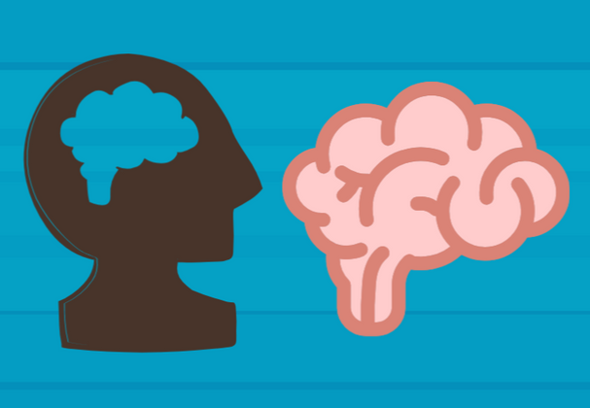
LESSON PLANS
TRAFFICER BEHAVIORS
What are some common character traits and behaviors of human traffickers?
Human
TRAFFICKERS
©2025 Walking Wise
28
3

Slide 29
TRAFFICER BEHAVIORS
Common Behavior
  Sense of entitlement or rules don’t apply to them
Human
TRAFFICKERS
©2025 Walking Wise
American Psychiatric Association (2022); Zeigler-Hill, V. et al. (2013).
29
Notes:
• CHARACTERISTICS
Traffickers often exhibit narcissistic traits, including an inflated sense of self-importance and a strong need for excessive attention and admiration.
Common characteristics among traffickers may include: a sense of entitlement, expecting others to meet their demands, along with a lack of empathy, a tendency to exploit others for personal gain, feelings of resentment, and displays of sexual aggression or hostility.
Source
American Psychiatric Association (2022, March 18). APA releases Diagnostic and Statistical Manual of Mental Disorders, Fifth Edition, Text Revision (DSM-5-TR).
Sprang, G., Cole, C. (2018, February 13). Familial Sex Trafficking of Minors: Trafficking Conditions, Clinical Presentation, and System Involvement, p. 1. Retrieved April 17, 2025, from https://www.researchgate.net/publication/323158066_Familial_Sex_Trafficking_of_Minors_Trafficking_Conditions_Clinical_Presentation_and_System_Involvement

Slide 30
TRAFFICER BEHAVIORS
Common Behavior
  Sense of entitlement or rules don’t apply to them
  Expect others to meet their demands
Human
TRAFFICKERS
©2025 Walking Wise
American Psychiatric Association (2022); Zeigler-Hill, V. et al. (2013).
30
Notes:
• CHARACTERISTICS
Traffickers often exhibit narcissistic traits, including an inflated sense of self-importance and a strong need for excessive attention and admiration.
Common characteristics among traffickers may include: a sense of entitlement, expecting others to meet their demands, along with a lack of empathy, a tendency to exploit others for personal gain, feelings of resentment, and displays of sexual aggression or hostility.
Source
American Psychiatric Association (2022, March 18). APA releases Diagnostic and Statistical Manual of Mental Disorders, Fifth Edition, Text Revision (DSM-5-TR).
Sprang, G., Cole, C. (2018, February 13). Familial Sex Trafficking of Minors: Trafficking Conditions, Clinical Presentation, and System Involvement, p. 1. Retrieved April 17, 2025, from https://www.researchgate.net/publication/323158066_Familial_Sex_Trafficking_of_Minors_Trafficking_Conditions_Clinical_Presentation_and_System_Involvement

Slide 31
TRAFFICER BEHAVIORS
Common Behavior
  Sense of entitlement or rules don’t apply to them
  Expect others to meet their demands
  Lacks empathy or has no concern for others
Human
TRAFFICKERS
©2025 Walking Wise
American Psychiatric Association (2022); Zeigler-Hill, V. et al. (2013).
31
Notes:
• CHARACTERISTICS
Traffickers often exhibit narcissistic traits, including an inflated sense of self-importance and a strong need for excessive attention and admiration.
Common characteristics among traffickers may include: a sense of entitlement, expecting others to meet their demands, along with a lack of empathy, a tendency to exploit others for personal gain, feelings of resentment, and displays of sexual aggression or hostility.
Source
American Psychiatric Association (2022, March 18). APA releases Diagnostic and Statistical Manual of Mental Disorders, Fifth Edition, Text Revision (DSM-5-TR).
Sprang, G., Cole, C. (2018, February 13). Familial Sex Trafficking of Minors: Trafficking Conditions, Clinical Presentation, and System Involvement, p. 1. Retrieved April 17, 2025, from https://www.researchgate.net/publication/323158066_Familial_Sex_Trafficking_of_Minors_Trafficking_Conditions_Clinical_Presentation_and_System_Involvement

Slide 32
TRAFFICER BEHAVIORS
Common Behavior
  Sense of entitlement or rules don’t apply to them
  Expect others to meet their demands
  Lacks empathy or has no concern for others
  Exploits or uses others for personal gain
Human
TRAFFICKERS
©2025 Walking Wise
American Psychiatric Association (2022); Zeigler-Hill, V. et al. (2013).
32
Notes:
• CHARACTERISTICS
Traffickers often exhibit narcissistic traits, including an inflated sense of self-importance and a strong need for excessive attention and admiration.
Common characteristics among traffickers may include: a sense of entitlement, expecting others to meet their demands, along with a lack of empathy, a tendency to exploit others for personal gain, feelings of resentment, and displays of sexual aggression or hostility.
Source
American Psychiatric Association (2022, March 18). APA releases Diagnostic and Statistical Manual of Mental Disorders, Fifth Edition, Text Revision (DSM-5-TR).
Sprang, G., Cole, C. (2018, February 13). Familial Sex Trafficking of Minors: Trafficking Conditions, Clinical Presentation, and System Involvement, p. 1. Retrieved April 17, 2025, from https://www.researchgate.net/publication/323158066_Familial_Sex_Trafficking_of_Minors_Trafficking_Conditions_Clinical_Presentation_and_System_Involvement

Slide 33
TRAFFICER BEHAVIORS
Common Behavior
  Sense of entitlement or rules don’t apply to them
  Expect others to meet their demands
  Lacks empathy or has no concern for others
  Exploits or uses others for personal gain
  Displays sexual aggression or hostility
Human
TRAFFICKERS
©2025 Walking Wise
American Psychiatric Association (2022); Zeigler-Hill, V. et al. (2013).
33
Notes:
• CHARACTERISTICS
Traffickers often exhibit narcissistic traits, including an inflated sense of self-importance and a strong need for excessive attention and admiration.
Common characteristics among traffickers may include: a sense of entitlement, expecting others to meet their demands, along with a lack of empathy, a tendency to exploit others for personal gain, feelings of resentment, and displays of sexual aggression or hostility.
Source
American Psychiatric Association (2022, March 18). APA releases Diagnostic and Statistical Manual of Mental Disorders, Fifth Edition, Text Revision (DSM-5-TR).
Sprang, G., Cole, C. (2018, February 13). Familial Sex Trafficking of Minors: Trafficking Conditions, Clinical Presentation, and System Involvement, p. 1. Retrieved April 17, 2025, from https://www.researchgate.net/publication/323158066_Familial_Sex_Trafficking_of_Minors_Trafficking_Conditions_Clinical_Presentation_and_System_Involvement

Slide 34
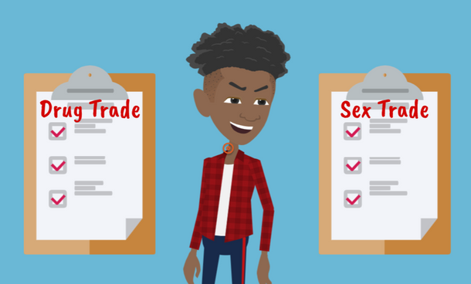
LESSON PLANS
CRIMINAL ACTIVITY
Why would criminals choose human sex trafficking over drug trafficking?
Human
TRAFFICKERS
©2025 Walking Wise
34
3

Slide 35
CRIMINAL ACTIVITY
Trafficking Industries
  A drug can only be sold once, but a person can be sold over and over again for money.
©2025 Walking Wise
Estimating the Size and Structure of the Underground Commercial Sex Economy in Eight Major US Cities (2014), Urban Institute.
35
Notes:
Traffickers often believe they can make more money trafficking people compared to selling drugs, since an individual can be sold repeatedly.
Human traffickers often perceive drug dealing as riskier in terms of legal penalties compared to trafficking vulnerable or young people, where they believe the risk of arrest is lower. (1)
Sex traffickers often coexist peacefully with each other, compared to the territorial behavior that drug dealers frequently display.(1)
Source
1. Dank, M., Khan, B., Downey, P. M., Kotonias, C., Mayer, D., Owens, C., Pacifici, L., & Yu, L. (March 2014). Estimating the Size and Structure of the Underground Commercial Sex Economy in Eight Major US Cities. The Urban Institute. Retrieved May 8, 2025, from https://www.urban.org/research/publication/estimating-size-and-structure-underground-commercial-sex-economy-eight-major-us-cities

Slide 36
CRIMINAL ACTIVITY
Trafficking Industries
  A drug can only be sold once, but a person can be sold over and over again for money.
  It is common for traffickers to engage in both human and drug trafficking.
©2025 Walking Wise
Estimating the Size and Structure of the Underground Commercial Sex Economy in Eight Major US Cities (2014), Urban Institute.
36
Notes:
Traffickers often believe they can make more money trafficking people compared to selling drugs, since an individual can be sold repeatedly.
Human traffickers often perceive drug dealing as riskier in terms of legal penalties compared to trafficking vulnerable or young people, where they believe the risk of arrest is lower. (1)
Sex traffickers often coexist peacefully with each other, compared to the territorial behavior that drug dealers frequently display.(1)
Source
1. Dank, M., Khan, B., Downey, P. M., Kotonias, C., Mayer, D., Owens, C., Pacifici, L., & Yu, L. (March 2014). Estimating the Size and Structure of the Underground Commercial Sex Economy in Eight Major US Cities. The Urban Institute. Retrieved May 8, 2025, from https://www.urban.org/research/publication/estimating-size-and-structure-underground-commercial-sex-economy-eight-major-us-cities

Slide 37
EDUCATON GUIDE
VOCABULARY
COERCION
To pressure, manipulate, threaten, or intimidate someone into acting against their will.
Human
TRAFFICKERS
©2025 Walking Wise
37
3
Notes:
Assisting Source
OpenAI. (2025). ChatGPT (GPT-4) [Large language model]. https://chatgpt.com

Slide 38
LESSON PLANS
CRIME AGAINST MINORS
What must occur for someone to be prosecuted for trafficking a minor (under 18)?
Human
TRAFFICKERS
©2025 Walking Wise
38
3
Notes:
SLIDO.com Multiple Choice
What must happen for someone to be charged with a trafficking crime against a child (under 18)?
A) Force (violence)
B) Fraud (lies)
C) Coercion (threats)
D) None of the above
ANSWER
D) None of the above.
Whenever a minor under the age of 18 is involved in selling a sexual act for anything of value, the offense is prosecuted as a sex trafficking crime.

Slide 39
HUMAN TRAFFICKING
Human Trafficking Laws
  It is illegal for anyone, including adults, to participate in sexual activity for a fee or in exchange for something of value.*
©2025 Walking Wise
H.R.3244 - Victims of Trafficking and Violence Protection Act of 2000
39
Notes:
*In all U.S. states, except for certain rural counties in Nevada, prostitution laws make it illegal for anyone, including adults, to engage, agree, or offer to engage in sexual conduct with another person in return for a fee.
These laws apply to all involved, including pimps, sex buyers, and those willingly or voluntarily engaging in prostitution. Federal laws prohibit involving children under 18 in commercial sex, mandating criminal punishment. (18 U.S. Code § 2421A)
The sale of sexual activity becomes judged as “sex trafficking” if the commercial sex act occurs using 1) force, 2) fraud, 3) coercion, or 4) if a minor under 18 is involved. The crime is judged as “sex trafficking,” even when there is no use of force, fraud, or coercion when involving a child under 18.
SOURCE
One Hundred Sixth Congress of the United States of America at the Second Session (2000, January 24). Victims of Trafficking and Violence Protection Act of 2000. Govinfo.gov. Retrieved May 8, 2025, from https://www.govinfo.gov/content/pkg/BILLS-106hr3244enr/pdf/BILLS-106hr3244enr.pdf

Slide 40
HUMAN TRAFFICKING
Human Trafficking Laws
  It is illegal for anyone, including adults, to participate in sexual activity for a fee or in exchange for something of value.*
  When force, fraud, or coercion is used to involve an adult (18+), the abuser is prosecuted as a sex trafficker.
©2025 Walking Wise
H.R.3244 - Victims of Trafficking and Violence Protection Act of 2000
40
Notes:
*In all U.S. states, except for certain rural counties in Nevada, prostitution laws make it illegal for anyone, including adults, to engage, agree, or offer to engage in sexual conduct with another person in return for a fee.
These laws apply to all involved, including pimps, sex buyers, and those willingly or voluntarily engaging in prostitution. Federal laws prohibit involving children under 18 in commercial sex, mandating criminal punishment. (18 U.S. Code § 2421A)
The sale of sexual activity becomes judged as “sex trafficking” if the commercial sex act occurs using 1) force, 2) fraud, 3) coercion, or 4) if a minor under 18 is involved. The crime is judged as “sex trafficking,” even when there is no use of force, fraud, or coercion when involving a child under 18.
SOURCE
One Hundred Sixth Congress of the United States of America at the Second Session (2000, January 24). Victims of Trafficking and Violence Protection Act of 2000. Govinfo.gov. Retrieved May 8, 2025, from https://www.govinfo.gov/content/pkg/BILLS-106hr3244enr/pdf/BILLS-106hr3244enr.pdf

Slide 41
HUMAN TRAFFICKING
Human Trafficking Laws
  It is illegal for anyone, including adults, to participate in sexual activity for a fee or in exchange for something of value.*
  When force, fraud, or coercion is used to involve an adult (18+), the abuser is prosecuted as a sex trafficker.
  Any time a minor (under 18) is involved in this crime, the abuser is prosecuted as a sex trafficker.
©2025 Walking Wise
H.R.3244 - Victims of Trafficking and Violence Protection Act of 2000
41
Notes:
*In all U.S. states, except for certain rural counties in Nevada, prostitution laws make it illegal for anyone, including adults, to engage, agree, or offer to engage in sexual conduct with another person in return for a fee.
These laws apply to all involved, including pimps, sex buyers, and those willingly or voluntarily engaging in prostitution. Federal laws prohibit involving children under 18 in commercial sex, mandating criminal punishment. (18 U.S. Code § 2421A)
The sale of sexual activity becomes judged as “sex trafficking” if the commercial sex act occurs using 1) force, 2) fraud, 3) coercion, or 4) if a minor under 18 is involved. The crime is judged as “sex trafficking,” even when there is no use of force, fraud, or coercion when involving a child under 18.
SOURCE
One Hundred Sixth Congress of the United States of America at the Second Session (2000, January 24). Victims of Trafficking and Violence Protection Act of 2000. Govinfo.gov. Retrieved May 8, 2025, from https://www.govinfo.gov/content/pkg/BILLS-106hr3244enr/pdf/BILLS-106hr3244enr.pdf

Slide 42
CRIME AGAINST MINORS
Safe Harbor Law
  Minors (under 18) are protected by federal law if they are involved in sex trafficking crimes.
©2025 Walking Wise
H.R.3244 - Victims of Trafficking and Violence Protection Act of 2000
42
Notes:
• SAFE HARBOR
When anyone under age 18 is involved in exchanging sex for something of value, the crime is never classified as prostitution, and the child is protected as a victim.
When involving an adult in the exchange of sex for something of value, the crime is considered sex trafficking if the victim was compelled through the use of: 1) force, 2) fraud, or 3) coercion.
In all U.S. states, except for certain rural counties in Nevada, prostitution laws make it illegal for anyone, including adults, to engage, agree, or offer to engage in sexual conduct with another person in return for a fee. Federal laws prohibit involving children under 18 in commercial sex, mandating criminal punishment for human traffickers and sex buyers.
Source
H.R.3244 - Victims of Trafficking and Violence Protection Act of 2000
https://www.congress.gov/bill/106th-congress/house-bill/3244

Slide 43
CRIME AGAINST MINORS
Safe Harbor Law
  Minors (under 18) are protected by federal law if they are involved in sex trafficking crimes.
  Minors are always considered victims and never have to prove they were forced, tricked, or threatened.
©2025 Walking Wise
H.R.3244 - Victims of Trafficking and Violence Protection Act of 2000
43
Notes:
• SAFE HARBOR
When anyone under age 18 is involved in exchanging sex for something of value, the crime is never classified as prostitution, and the child is protected as a victim.
When involving an adult in the exchange of sex for something of value, the crime is considered sex trafficking if the victim was compelled through the use of: 1) force, 2) fraud, or 3) coercion.
In all U.S. states, except for certain rural counties in Nevada, prostitution laws make it illegal for anyone, including adults, to engage, agree, or offer to engage in sexual conduct with another person in return for a fee. Federal laws prohibit involving children under 18 in commercial sex, mandating criminal punishment for human traffickers and sex buyers.
Source
H.R.3244 - Victims of Trafficking and Violence Protection Act of 2000
https://www.congress.gov/bill/106th-congress/house-bill/3244

Slide 44
CRIME AGAINST MINORS
Safe Harbor Law
  Minors (under 18) are protected by federal law if they are involved in sex trafficking crimes.
  Minors are always considered victims and never have to prove they were forced, tricked, or threatened.
  Safe Harbor Laws ensure that minors are treated as victims and not criminals, and are given access to care.
©2025 Walking Wise
H.R.3244 - Victims of Trafficking and Violence Protection Act of 2000
44
Notes:
• SAFE HARBOR
When anyone under age 18 is involved in exchanging sex for something of value, the crime is never classified as prostitution, and the child is protected as a victim.
When involving an adult in the exchange of sex for something of value, the crime is considered sex trafficking if the victim was compelled through the use of: 1) force, 2) fraud, or 3) coercion.
In all U.S. states, except for certain rural counties in Nevada, prostitution laws make it illegal for anyone, including adults, to engage, agree, or offer to engage in sexual conduct with another person in return for a fee. Federal laws prohibit involving children under 18 in commercial sex, mandating criminal punishment for human traffickers and sex buyers.
Source
H.R.3244 - Victims of Trafficking and Violence Protection Act of 2000
https://www.congress.gov/bill/106th-congress/house-bill/3244

Slide 45
EDUCATON GUIDE
VOCABULARY
PROSTITUTION
Prostitution is the illegal act of exchanging sexual activity for money or something of value, typically involving a sex buyer and an adult who consents to the act.*
Human
TRAFFICKERS
©2025 Walking Wise
45
3
Notes:
*In certain counties of one U.S. state, the selling and buying of sexual acts are legally regulated and controlled.
Assisting Source
OpenAI. (2025). ChatGPT (GPT-4) [Large language model]. https://chatgpt.com

Slide 46
LESSON PLANS
TRAFFICKER STYLES
Which term is NOT commonly used to describe sex trafficking tactics?
Human
TRAFFICKERS
©2025 Walking Wise
46
3
Notes:
SLIDO.com Multiple Choice
Which of the following is NOT a common term used to describe sex trafficking tactics?
A) Romeo Pimp
B) Chic Pimp
C) Gorilla Pimp
D) CEO Pimp
ANSWER
B) Chic Pimp is NOT a term used to describe sex trafficking tactics.

Slide 47
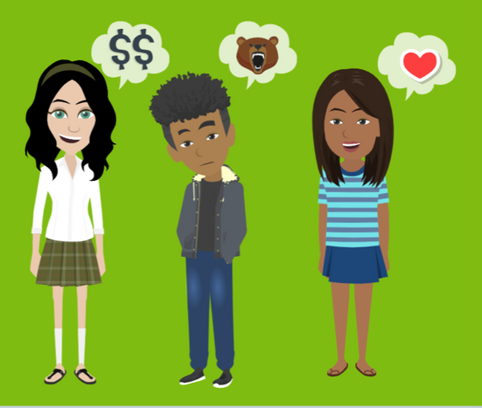
LESSON PLANS
TRAFFICKER STYLES
What strategies might the three types of traffickers use to maintain control over their victims?
Human
TRAFFICKERS
©2025 Walking Wise
47
3

Slide 48
TRAFFICKER STYLE
Romeo Pimp
  FIRST, they gain the victims’ trust:
    Attention, kindness & fulfill unmet needs
©2025 Walking Wise
48
Notes:
• ROMEO PIMPS
They use emotional connection to manipulate victims. Romeo pimps seduce or lure young people with charm, acts of kindness, gifts, affection, affirmation, love, and promises of a better life.
Once they have control by earning the victims' trust, Romeo pimps will isolate the victim from their family and friends, lower their self-esteem, and make them financially dependent.
“Romeo” refers to the famous romantic character in the tragic love story by William Shakespeare, Romeo and Juliet, published in 1597.

Slide 49
TRAFFICKER STYLE
Romeo Pimp
  FIRST, they gain the victims’ trust:
    Attention, kindness & fulfill unmet needs
  They use emotional bonding to manipulate victims:
    Gifts, promises, affection & love
©2025 Walking Wise
49
Notes:
• ROMEO PIMPS
They use emotional connection to manipulate victims. Romeo pimps seduce or lure young people with charm, acts of kindness, gifts, affection, affirmation, love, and promises of a better life.
Once they have control by earning the victims' trust, Romeo pimps will isolate the victim from their family and friends, lower their self-esteem, and make them financially dependent.
“Romeo” refers to the famous romantic character in the tragic love story by William Shakespeare, Romeo and Juliet, published in 1597.

Slide 50
TRAFFICKER STYLE
Romeo Pimp
  FIRST, they gain the victims’ trust:
    Attention, kindness & fulfill unmet needs
  They use emotional bonding to manipulate victims:
    Gifts, promises, affection & love
  THEN, they shift to using methods of control:
    Isolation & harming self-esteem
©2025 Walking Wise
50
Notes:
• ROMEO PIMPS
They use emotional connection to manipulate victims. Romeo pimps seduce or lure young people with charm, acts of kindness, gifts, affection, affirmation, love, and promises of a better life.
Once they have control by earning the victims' trust, Romeo pimps will isolate the victim from their family and friends, lower their self-esteem, and make them financially dependent.
“Romeo” refers to the famous romantic character in the tragic love story by William Shakespeare, Romeo and Juliet, published in 1597.

Slide 51
TRAFFICKER STYLE
Gorilla Pimp
  They’re known for their physical force & intimidation.
©2025 Walking Wise
51
Notes:
• GORILLA PIMPS
They are known for psychological intimidation and physical violence. They use force or threats that instill fear and maintain control over their victims’ lives.
Gorilla pimps commonly isolate victims from family and friends and force them into criminal activity such as drug trafficking and theft.

Slide 52
TRAFFICKER STYLE
Gorilla Pimp
  They’re known for their physical force & intimidation.
  They often isolate victims from their family & friends.
©2025 Walking Wise
52
Notes:
• GORILLA PIMPS
They are known for psychological intimidation and physical violence. They use force or threats that instill fear and maintain control over their victims’ lives.
Gorilla pimps commonly isolate victims from family and friends and force them into criminal activity such as drug trafficking and robbery.

Slide 53
TRAFFICKER STYLE
Gorilla Pimp
  They’re known for their physical force & intimidation.
  They often isolate victims from their family & friends.
  They commonly force victims into criminal activity, such as selling drugs and theft.
©2025 Walking Wise
53
Notes:
• GORILLA PIMPS
They are known for psychological intimidation and physical violence. They use force or threats that instill fear and maintain control over their victims’ lives.
Gorilla pimps commonly isolate victims from family and friends and force them into criminal activity such as drug trafficking and robbery.

Slide 54
TRAFFICKER STYLE
CEO Pimp
  They use a business-like approach to fool their victims.
©2025 Walking Wise
54
Notes:
• CEO PIMPS
They use a business-like approach to fool their victims. They display confidence, demonstrating they are intelligent and well-connected to influential people in various industries such as entertainment, fashion, and travel.
CEO pimps take advantage of a young person's desire for a better life by promising success, fame, and wealth.
Once they have gained their victims' trust, they will reveal the reality of their sex trafficking operation.
The acronym "CEO" stands for Chief Executive Officer, the highest-ranking person in a company.

Slide 55
TRAFFICKER STYLE
CEO Pimp
  They use a business-like approach to fool their victims.
  They portray confidence & intelligence.
©2025 Walking Wise
55
Notes:
• CEO PIMPS
They use a business-like approach to fool their victims. They display confidence, demonstrating they are intelligent and well-connected to influential people in various industries such as entertainment, fashion, and travel.
CEO pimps take advantage of a young person's desire for a better life by promising success, fame, and wealth.
Once they have gained their victims' trust, they will reveal the reality of their sex trafficking operation.
The acronym "CEO" stands for Chief Executive Officer, the highest-ranking person in a company.

Slide 56
TRAFFICKER STYLE
CEO Pimp
  They use a business-like approach to fool their victims.
  They portray confidence & intelligence.
  They often brag about their influential network, such as the entertainment, fashion & travel industries.
©2025 Walking Wise
56
Notes:
• CEO PIMPS
They use a business-like approach to fool their victims. They display confidence, demonstrating they are intelligent and well-connected to influential people in various industries such as entertainment, fashion, and travel.
CEO pimps take advantage of a young person's desire for a better life by promising success, fame, and wealth.
Once they have gained their victims' trust, they will reveal the reality of their sex trafficking operation.
The acronym "CEO" stands for Chief Executive Officer, the highest-ranking person in a company.

Slide 57
TRAFFICKER STYLE
CEO Pimp
  They use a business-like approach to fool their victims.
  They portray confidence & intelligence.
  They often brag about their influential network, such as the entertainment, fashion & travel industries.
  They make promises of success, fame & wealth.
©2025 Walking Wise
57
Notes:
• CEO PIMPS
They use a business-like approach to fool their victims. They display confidence, demonstrating they are intelligent and well-connected to influential people in various industries such as entertainment, fashion, and travel.
CEO pimps take advantage of a young person's desire for a better life by promising success, fame, and wealth.
Once they have gained their victims' trust, they will reveal the reality of their sex trafficking operation.
The acronym "CEO" stands for Chief Executive Officer, the highest-ranking person in a company.

Slide 58
EDUCATON GUIDE
VOCABULARY
FLATTER
To give excessive or insincere praise to a vulnerable person as a form of manipulation.
Human
TRAFFICKERS
©2025 Walking Wise
58
3
Notes:
Assisting Source
OpenAI. (2025). ChatGPT (GPT-4) [Large language model]. https://chatgpt.com

Slide 59
EDUCATON GUIDE
VOCABULARY
SEDUCE
To persuade or tempt someone using manipulation, like charm and flattery, to do something they might not normally do.
Human
TRAFFICKERS
©2025 Walking Wise
59
3
Notes:
Assisting Source
OpenAI. (2025). ChatGPT (GPT-4) [Large language model]. https://chatgpt.com

Slide 60
LESSON PLANS
CONTROL STRATEGY
Which is NOT a common bond used by traffickers to control victims?
Human
TRAFFICKERS
©2025 Walking Wise
60
3
Notes:
SLIDO.com Multiple Choice
Which is NOT a common form of bonding used by traffickers to control victims?
A) Trauma Bond
B) Debt Bond
C) Leader Bond
D) Drug Bond
ANSWER
C) Leader bond is NOT a common form of bonding used by human traffickers.

Slide 61
CONTROL STRATEGY
Trauma Bond Process
  Trust: Traffickers gain the victims’ trust by being supportive.
©2025 Walking Wise
Cleveland Clinic (2023, March 29). Here's What Trauma Bonding Really Is and How To Recognize the Signs.
61
Notes:
• TRAUMA BOND
This bond can occur through repetitive cycles of abuse, followed by moments of affection. These patterns create a psychological response in the victim, leading to a cycle of love and fear.
Ultimately, the dynamic can cause victims to form an attachment and be loyal to the trafficker due to their need to recapture the love they thought was genuine.
SOURCE
Cleveland Clinic (2023, March 29). Here's What Trauma Bonding Really Is and How To Recognize the Signs. Retrieved April 23, 2025, from https://health.clevelandclinic.org/trauma-bonding

Slide 62
CONTROL STRATEGY
Trauma Bond Process
  Trust: Traffickers gain the victims’ trust by being supportive.
  Love: They ‘act’ romantic, making victims feel special.
©2025 Walking Wise
Cleveland Clinic (2023, March 29). Here's What Trauma Bonding Really Is and How To Recognize the Signs.
62
Notes:
• TRAUMA BOND
This bond can occur through repetitive cycles of abuse, followed by moments of affection. These patterns create a psychological response in the victim, leading to a cycle of love and fear.
Ultimately, the dynamic can cause victims to form an attachment and be loyal to the trafficker due to their need to recapture the love they thought was genuine.
SOURCE
Cleveland Clinic (2023, March 29). Here's What Trauma Bonding Really Is and How To Recognize the Signs. Retrieved April 23, 2025, from https://health.clevelandclinic.org/trauma-bonding

Slide 63
CONTROL STRATEGY
Trauma Bond Process
  Trust: Traffickers gain the victims’ trust by being supportive.
  Love: They ‘act’ romantic, making victims feel special.
  Fear: Then they use threats or violence to gain control.
©2025 Walking Wise
Cleveland Clinic (2023, March 29). Here's What Trauma Bonding Really Is and How To Recognize the Signs.
63
Notes:
• TRAUMA BOND
This bond can occur through repetitive cycles of abuse, followed by moments of affection. These patterns create a psychological response in the victim, leading to a cycle of love and fear.
Ultimately, the dynamic can cause victims to form an attachment and be loyal to the trafficker due to their need to recapture the love they thought was genuine.
SOURCE
Cleveland Clinic (2023, March 29). Here's What Trauma Bonding Really Is and How To Recognize the Signs. Retrieved April 23, 2025, from https://health.clevelandclinic.org/trauma-bonding

Slide 64
CONTROL STRATEGY
Trauma Bond Process
  Trust: Traffickers gain the victims’ trust by being supportive.
  Love: They ‘act’ romantic, making victims feel special.
  Fear: Then they use threats or violence to gain control.
  Loyalty: They hook victims by switching between love and abuse.
©2025 Walking Wise
Cleveland Clinic (2023, March 29). Here's What Trauma Bonding Really Is and How To Recognize the Signs.
64
Notes:
• TRAUMA BOND
This bond can occur through repetitive cycles of abuse, followed by moments of affection. These patterns create a psychological response in the victim, leading to a cycle of love and fear.
Ultimately, the dynamic can cause victims to form an attachment and be loyal to the trafficker due to their need to recapture the love they thought was genuine.
SOURCE
Cleveland Clinic (2023, March 29). Here's What Trauma Bonding Really Is and How To Recognize the Signs. Retrieved April 23, 2025, from https://health.clevelandclinic.org/trauma-bonding

Slide 65
CONTROL STRATEGY
Trauma Bond Process
  Trust: Traffickers gain the victims’ trust by being supportive.
  Love: They ‘act’ romantic, making victims feel special.
  Fear: Then they use threats or violence to gain control.
  Loyalty: They hook victims by switching between love and abuse.
  Trauma Bond: The confused victim cannot escape their need to recapture the love they once felt.
©2025 Walking Wise
Cleveland Clinic (2023, March 29). Here's What Trauma Bonding Really Is and How To Recognize the Signs.
65
Notes:
• TRAUMA BOND
This bond can occur through repetitive cycles of abuse, followed by moments of affection. These patterns create a psychological response in the victim, leading to a cycle of love and fear.
Ultimately, the dynamic can cause victims to form an attachment and be loyal to the trafficker due to their need to recapture the love they thought was genuine.
SOURCE
Cleveland Clinic (2023, March 29). Here's What Trauma Bonding Really Is and How To Recognize the Signs. Retrieved April 23, 2025, from https://health.clevelandclinic.org/trauma-bonding

Slide 66
POWER OF LOVE
What percentage of female victims were trafficked by boyfriends or romantic partners?
Human
TRAFFICKERS
©2025 Walking Wise
Polaris Project (n.d.). Love and Trafficking: Grooming, Exploitation, and Control.
66
Notes:
SLIDO.com Multiple Choice
What percentage of female victims were trafficked by boyfriends or romantic partners?
A) 39%
B) 49%
C) 59%
D) 19%
ANSWER:
A) 39% of female victims are trafficked by a boyfriend, romantic partner, or husband, according to the Polaris Project.
Source
Polaris Project (n.d.). Love and Trafficking: Grooming, Exploitation, and Control. Retrieved May 8, 2025, from https://polarisproject.org/love-and-trafficking/

Slide 67
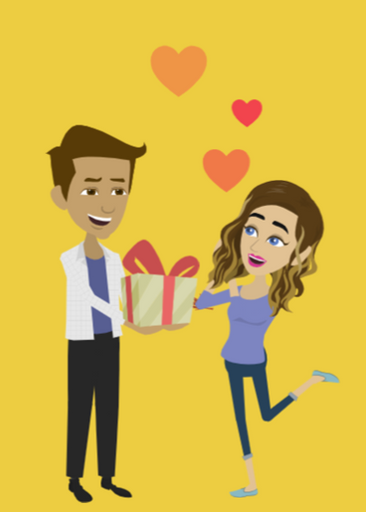
LESSON PLANS
POWER OF LOVE
What makes ‘love’ so powerful that it’s an effective control strategy for traffickers?
Human
TRAFFICKERS
©2025 Walking Wise
67
3

Slide 68
POWER OF LOVE
Chemical Reaction to Love
  Reward Circuit: The brain releases a chemical called dopamine and other hormones.
©2025 Walking Wise
Love and the Brain (2015), Harvard Medical School, hms.harvard.edu.
68
Notes:
• LOVE & THE BRAIN
Love is chemically induced through the brain's reward circuit, where dopamine and other potent hormones flood the brain.(1)
Traffickers often insincerely romance their victims because they understand that the brain-triggered emotions involved with falling in love create a bond that is extremely difficult to break.
Traffickers patiently nurture their victims with false love until this manipulation takes control over the victim’s emotional independence.
Source
1. Love and the Brain (2015).
Harvard Medical School
https://hms.harvard.edu/news-events/publications-archive/brain/love-brain#:~:text=Being%20love%2Dstruck%20also%20releases,use%20of%20cocaine%20or%20alcohol

Slide 69
POWER OF LOVE
Chemical Reaction to Love
  Reward Circuit: The brain releases a chemical called dopamine and other hormones.
  Emotional Bond: The brain-triggered emotion called love creates a powerful bond that’s hard to break.
©2025 Walking Wise
Love and the Brain (2015), Harvard Medical School, hms.harvard.edu.
69
Notes:
• LOVE & BRAIN
Love is chemically induced through the brain's reward circuit, where dopamine and other potent hormones flood the brain.(1)
Traffickers often insincerely romance their victims because they understand that the brain-triggered emotions involved with falling in love create a bond that is extremely difficult to break.
Traffickers patiently nurture their victims with false love until this manipulation takes control over the victim’s emotional independence.
Source
1. Love and the Brain (2015).
Harvard Medical School
https://hms.harvard.edu/news-events/publications-archive/brain/love-brain#:~:text=Being%20love%2Dstruck%20also%20releases,use%20of%20cocaine%20or%20alcohol

Slide 70
POWER OF LOVE
Chemical Reaction to Love
  Reward Circuit: The brain releases a chemical called dopamine and other hormones.
  Emotional Bond: The brain-triggered emotion called love creates a powerful bond that’s hard to break.
  Love Bond: These bonded relationships can be related to romance, a ‘parent’ figure, or a friendship.
©2025 Walking Wise
Love and the Brain (2015), Harvard Medical School, hms.harvard.edu.
70
Notes:
• LOVE & BRAIN
Love is chemically induced through the brain's reward circuit, where dopamine and other potent hormones flood the brain.(1)
Traffickers often insincerely romance their victims because they understand that the brain-triggered emotions involved with falling in love create a bond that is extremely difficult to break.
Traffickers patiently nurture their victims with false love until this manipulation takes control over the victim’s emotional independence.
Source
1. Love and the Brain (2015).
Harvard Medical School
https://hms.harvard.edu/news-events/publications-archive/brain/love-brain#:~:text=Being%20love%2Dstruck%20also%20releases,use%20of%20cocaine%20or%20alcohol

Slide 71
CONTROL STRATEGY
Debt Bond Process
  No Money: Victims rely on traffickers for basic needs, making it hard to leave.
©2025 Walking Wise
End Slavery Now (n.d.). Bonded Labor. Retrieved April 23, 2025.
71
Notes:
• DEBT BOND
Sex traffickers create a debt bond or economic dependence on their victims by imposing debt that continually accumulates and can be difficult or impossible to repay.
Traffickers often withhold victims' legal documents, demanding sex work until they pay a debt in full or simply preventing them from working outside of the traffickers' control.
SOURCE
End Slavery Now (n.d.). Bonded Labor. Retrieved April 23, 2025, from http://www.endslaverynow.org/learn/slavery-today/bonded-labor

Slide 72
CONTROL STRATEGY
Debt Bond Process
  No Money: Victims rely on traffickers for basic needs, making it hard to leave.
  Unending Debt: Victims are forced to pay off endless living costs and other expenses.
©2025 Walking Wise
End Slavery Now (n.d.). Bonded Labor. Retrieved April 23, 2025.
72
Notes:
• DEBT BOND
Sex traffickers create a debt bond or economic dependence on their victims by imposing debt that continually accumulates and can be difficult or impossible to repay.
Traffickers often withhold victims' legal documents, demanding sex work until they pay a debt in full or simply preventing them from working outside of the traffickers' control.
SOURCE
End Slavery Now (n.d.). Bonded Labor. Retrieved April 23, 2025, from http://www.endslaverynow.org/learn/slavery-today/bonded-labor

Slide 73
CONTROL STRATEGY
Debt Bond Process
  No Money: Victims rely on traffickers for basic needs, making it hard to leave.
  Unending Debt: Victims are forced to pay off endless living costs and other expenses.
  Stolen ID: Traffickers keep legal documents, preventing victims from earning money outside of their control.
©2025 Walking Wise
End Slavery Now (n.d.). Bonded Labor. Retrieved April 23, 2025.
73
Notes:
• DEBT BOND
Sex traffickers create a debt bond or economic dependence on their victims by imposing debt that continually accumulates and can be difficult or impossible to repay.
Traffickers often withhold victims' legal documents, demanding sex work until they pay a debt in full or simply preventing them from working outside of the traffickers' control.
SOURCE
End Slavery Now (n.d.). Bonded Labor. Retrieved April 23, 2025, from http://www.endslaverynow.org/learn/slavery-today/bonded-labor

Slide 74
CONTROL STRATEGY
Drug Bond Process
  Grooming: Traffickers lure young people with free drugs.
©2025 Walking Wise
Langton L, Planty M, BAnks D., Witwer A., Woods, D. Vermeer M., Jackson, B. (2022, February 24). Sex Trafficking and Substance Use, Rand.org.
74
Notes:
• DRUG BOND
Drug bondage can occur when drug dealers coerce users into sex trafficking in exchange for drugs.
Some sex traffickers are known to loiter outside drug rehab centers, seeking recruits.
Additionally, groomers may lure vulnerable people into an addiction by offering free illicit drugs.
SOURCE
Langton L, Planty M, BAnks D., Witwer A., Woods, D. Vermeer M., Jackson, B. (2022, February 24). Sex Trafficking and Substance Use, Rand.org. Retrieved April 23, 2025, from https://www.rand.org/pubs/research_reports/RRA108-13.html

Slide 75
CONTROL STRATEGY
Drug Bond Process
  Grooming: Traffickers lure young people with free drugs.
  Drug Trade: Users may find themselves forced to trade sex for drugs.
©2025 Walking Wise
Langton L, Planty M, BAnks D., Witwer A., Woods, D. Vermeer M., Jackson, B. (2022, February 24). Sex Trafficking and Substance Use, Rand.org.
75
Notes:
• DRUG BOND
Drug bondage can occur when drug dealers coerce users into sex trafficking in exchange for drugs.
Some sex traffickers are known to loiter outside drug rehab centers, seeking recruits.
Additionally, groomers may lure vulnerable people into an addiction by offering free illicit drugs.
SOURCE
Langton L, Planty M, BAnks D., Witwer A., Woods, D. Vermeer M., Jackson, B. (2022, February 24). Sex Trafficking and Substance Use, Rand.org. Retrieved April 23, 2025, from https://www.rand.org/pubs/research_reports/RRA108-13.html

Slide 76
CONTROL STRATEGY
Drug Bond Process
  Grooming: Traffickers lure young people with free drugs.
  Drug Trade: Users may find themselves forced to trade sex for drugs.
  Targeting: Traffickers can prey on people recovering from substance addiction.
©2025 Walking Wise
Langton L, Planty M, BAnks D., Witwer A., Woods, D. Vermeer M., Jackson, B. (2022, February 24). Sex Trafficking and Substance Use, Rand.org.
76
Notes:
• DRUG BOND
Drug bondage can occur when drug dealers coerce users into sex trafficking in exchange for drugs.
Some sex traffickers are known to loiter outside drug rehab centers, seeking recruits.
Additionally, groomers may lure vulnerable people into an addiction by offering free illicit drugs.
SOURCE
Langton L, Planty M, BAnks D., Witwer A., Woods, D. Vermeer M., Jackson, B. (2022, February 24). Sex Trafficking and Substance Use, Rand.org. Retrieved April 23, 2025, from https://www.rand.org/pubs/research_reports/RRA108-13.html

Slide 77
EDUCATON GUIDE
VOCABULARY
VULNERABLE
One who is at risk of physical or emotional harm due to a lack of knowledge, support, or protection.
Human
TRAFFICKERS
©2025 Walking Wise
77
3
Notes:
Assisting Source
OpenAI. (2025). ChatGPT (GPT-4) [Large language model]. https://chatgpt.com

Slide 78
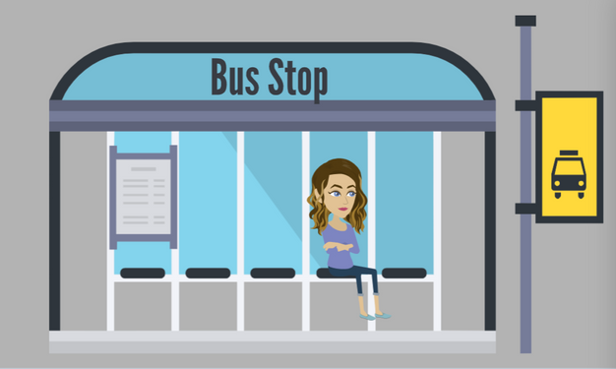
LESSON PLANS
TARGETED LOCATIONS
Where do traffickers commonly target vulnerable people?
Human
TRAFFICKERS
©2025 Walking Wise
78
3

Slide 79
TARGETED LOCATIONS
Targeted Areas
  Locations with little to no adult supervision:
    Near Schools & Bus Stops
Human
TRAFFICKERS
©2025 Walking Wise
79

Slide 80
TARGETED LOCATIONS
Targeted Areas
  Locations with little to no adult supervision:
    Near Schools & Bus Stops
    Parks & Playgrounds
Human
TRAFFICKERS
©2025 Walking Wise
80

Slide 81
TARGETED LOCATIONS
Targeted Areas
  Locations with little to no adult supervision:
    Near Schools & Bus Stops
    Parks & Playgrounds
    Malls & Convenience Stores
Human
TRAFFICKERS
©2025 Walking Wise
81

Slide 82
TARGETED LOCATIONS
Targeted Areas
  Locations with little to no adult supervision:
    Near Schools & Bus Stops
    Parks & Playgrounds
    Malls & Convenience Stores
    ONLINE
Human
TRAFFICKERS
©2025 Walking Wise
82

Slide 83
RECRUITMENT LOCATIONS
Targeted Areas
  Outside facilities where vulnerable people spend time:
    Juvenile Detention Centers
Human
TRAFFICKERS
©2025 Walking Wise
83

Slide 84
RECRUITMENT LOCATIONS
Targeted Areas
  Outside facilities where vulnerable people spend time:
    Juvenile Detention Centers
    Rehab Clinics
Human
TRAFFICKERS
©2025 Walking Wise
84

Slide 85
RECRUITMENT LOCATIONS
Targeted Areas
  Outside facilities where vulnerable people spend time:
    Juvenile Detention Centers
    Rehab Clinics
    Homeless Shelters
Human
TRAFFICKERS
©2025 Walking Wise
85

Slide 86
RECRUITMENT LOCATIONS
Targeted Areas
  Outside facilities where vulnerable people spend time:
    Juvenile Detention Centers
    Rehab Clinics
    Homeless Shelters
    Drop-in Centers
Human
TRAFFICKERS
©2025 Walking Wise
86

Slide 87
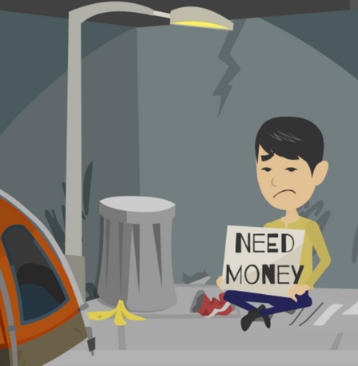
LESSON PLANS
INCREASED RISK
What circumstances can cause traffickers to target young people?
Human
TRAFFICKERS
©2025 Walking Wise
87
3

Slide 88
INCREASED RISK
Risk Factors
  Experiencing neglect or emotional abuse
Human
TRAFFICKERS
©2025 Walking Wise
88

Slide 89
INCREASED RISK
Risk Factors
  Experiencing neglect or emotional abuse
  Experiencing violence or sexual abuse
Human
TRAFFICKERS
©2025 Walking Wise
89

Slide 90
INCREASED RISK
Risk Factors
  Experiencing neglect or emotional abuse
  Experiencing violence or sexual abuse
  Using drugs or alcohol
Human
TRAFFICKERS
©2025 Walking Wise
90

Slide 91
INCREASED RISK
Risk Factors
  Experiencing neglect or emotional abuse
  Experiencing violence or sexual abuse
  Using drugs or alcohol
  Intellectual, mental, or physical disability
Human
TRAFFICKERS
©2025 Walking Wise
91

Slide 92
INCREASED RISK
Risk Factors
  Bullied by Peers
Human
TRAFFICKERS
©2025 Walking Wise
92

Slide 93
INCREASED RISK
Risk Factors
  Bullied by Peers
  Low Self-Esteem or Lonely
Human
TRAFFICKERS
©2025 Walking Wise
93

Slide 94
INCREASED RISK
Risk Factors
  Bullied by Peers
  Low Self-Esteem or Lonely
  Feeling Unloved or Broken-hearted
Human
TRAFFICKERS
©2025 Walking Wise
94

Slide 95
INCREASED RISK
Risk Factors
  Bullied by Peers
  Low Self-Esteem or Lonely
  Feeling Unloved or Broken-hearted
  Desires Wealth, Fame, Travel
Human
TRAFFICKERS
©2025 Walking Wise
95

Slide 96
INCREASED RISK
Risk Factors
  Family Living in Poverty
Human
TRAFFICKERS
©2025 Walking Wise
96

Slide 97
INCREASED RISK
Risk Factors
  Family Living in Poverty
  Parents’ Substance Use (drugs or alcohol)
Human
TRAFFICKERS
©2025 Walking Wise
97

Slide 98
INCREASED RISK
Risk Factors
  Family Living in Poverty
  Parents’ Substance Use (drugs or alcohol)
  Divorce or Death of a Parent
Human
TRAFFICKERS
©2025 Walking Wise
98

Slide 99
INCREASED RISK
Risk Factors
  Family Living in Poverty
  Parents’ Substance Use (drugs or alcohol)
  Divorce or Death of a Parent
  Blended Family Conflicts
Human
TRAFFICKERS
©2025 Walking Wise
99

Slide 100
INCREASED RISK
Risk Factors
  Family Living in Poverty
  Parents’ Substance Use (drugs or alcohol)
  Divorce or Death of a Parent
  Blended Family Conflicts
  Incarcerated Parent or Close Family Member
Human
TRAFFICKERS
©2025 Walking Wise
100

Slide 101
INCREASED RISK
Risk Factors
  Homelessness
Human
TRAFFICKERS
©2025 Walking Wise
101

Slide 102
INCREASED RISK
Risk Factors
  Homelessness
  Running Away from Home
Human
TRAFFICKERS
©2025 Walking Wise
102

Slide 103
INCREASED RISK
Risk Factors
  Homelessness
  Running Away from Home
  Involved in the Juvenile Justice System
Human
TRAFFICKERS
©2025 Walking Wise
103

Slide 104
INCREASED RISK
Risk Factors
  Homelessness
  Running Away from Home
  Involved in the Juvenile Justice System
  Living in Foster Care
Human
TRAFFICKERS
©2025 Walking Wise
104

Slide 105
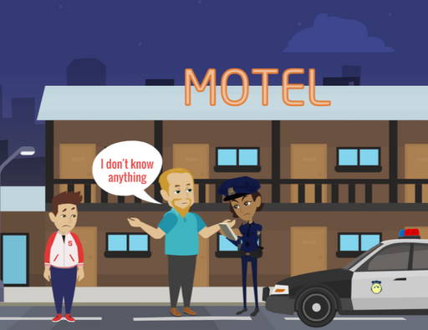
LESSON PLANS
UNDER REPORTED
Why do victims hesitate to report their traffickers to law enforcement?
Human
TRAFFICKERS
©2025 Walking Wise
105
3

Slide 106
UNDER REPORTED
Silenced Victims
  Victims may feel loyal to the trafficker because of trauma bonds or drug bonds.
©2025 Walking Wise
106

Slide 107
UNDER REPORTED
Silenced Victims
  Victims may feel loyal to the trafficker because of trauma bonds or drug bonds.
  Victims may feel obligated to the trafficker who provided for their basic needs.
©2025 Walking Wise
107

Slide 108
UNDER REPORTED
Silenced Victims
  Victims may feel loyal to the trafficker because of trauma or drug bonds.
  Victims may feel obligated to the trafficker who provided for their basic needs.
  Victims often feel intimidated due to threats of physical harm.
©2025 Walking Wise
108

Slide 109
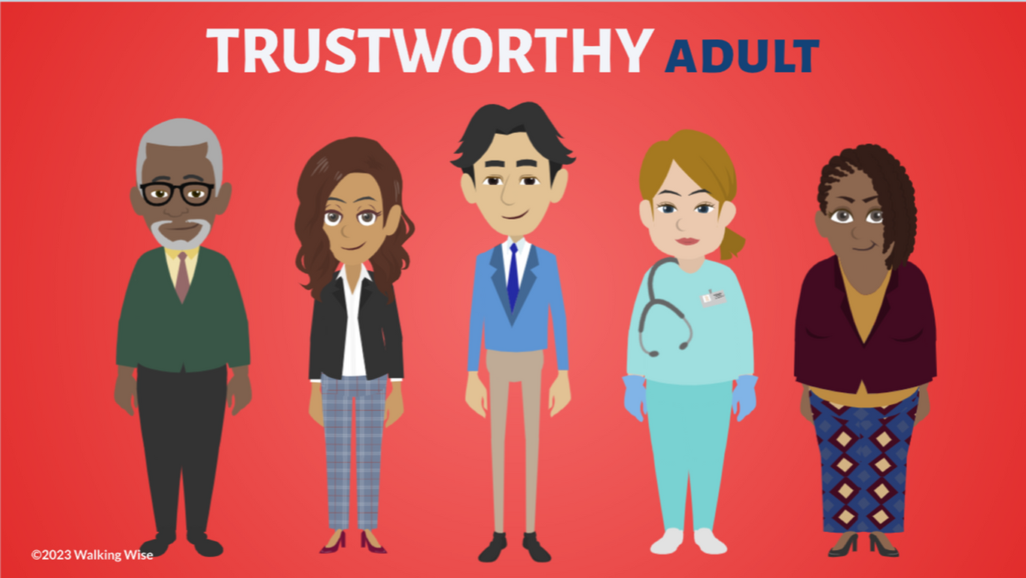
ASK FOR HELP
©2025 Walking Wise
109

Slide 110
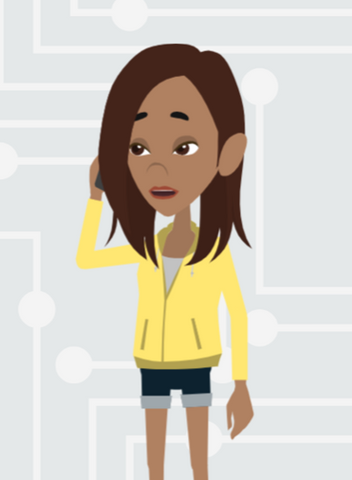
ASK FOR HELP
What are ways young people can ask for help?
©2025 Walking Wise
110

Slide 111
ASK FOR HELP
How to Ask for Help
  If you are in immediate danger, dial 911.
©2025 Walking Wise
111

Slide 112
ASK FOR HELP
How to Ask for Help
  If you are in immediate danger, dial 911.
  If the sexual predator IS a family member, consider telling a trustworthy adult.
©2025 Walking Wise
112

Slide 113
ASK FOR HELP
How to Ask for Help
  If you are in immediate danger, dial 911.
  If the sexual predator IS a family member, consider telling a trustworthy adult.
  If the sexual predator is NOT family, consider telling a parent.
©2025 Walking Wise
113

Slide 114
ASK FOR HELP
How to Ask for Help
  If you are in immediate danger, dial 911.
  If the sexual predator IS a family member, consider telling a trustworthy adult.
  If the sexual predator is NOT family, consider telling a parent.
  If you are a student in school, consider telling a trustworthy teacher, coach, school nurse, social worker, counselor, resource officer, or principal.
©2025 Walking Wise
114

Slide 115
ASK FOR HELP
How to Ask for Help
  If you are in immediate danger, dial 911.
  If the sexual predator IS a family member, consider telling a trustworthy adult.
  If the sexual predator is NOT family, consider telling a parent.
  If you are a student in school, consider telling a trustworthy teacher, coach, school nurse, social worker, counselor, resource officer, or principal.
  To gain internet access for help, consider using a computer at your school or a public library.
©2025 Walking Wise
115

Slide 116
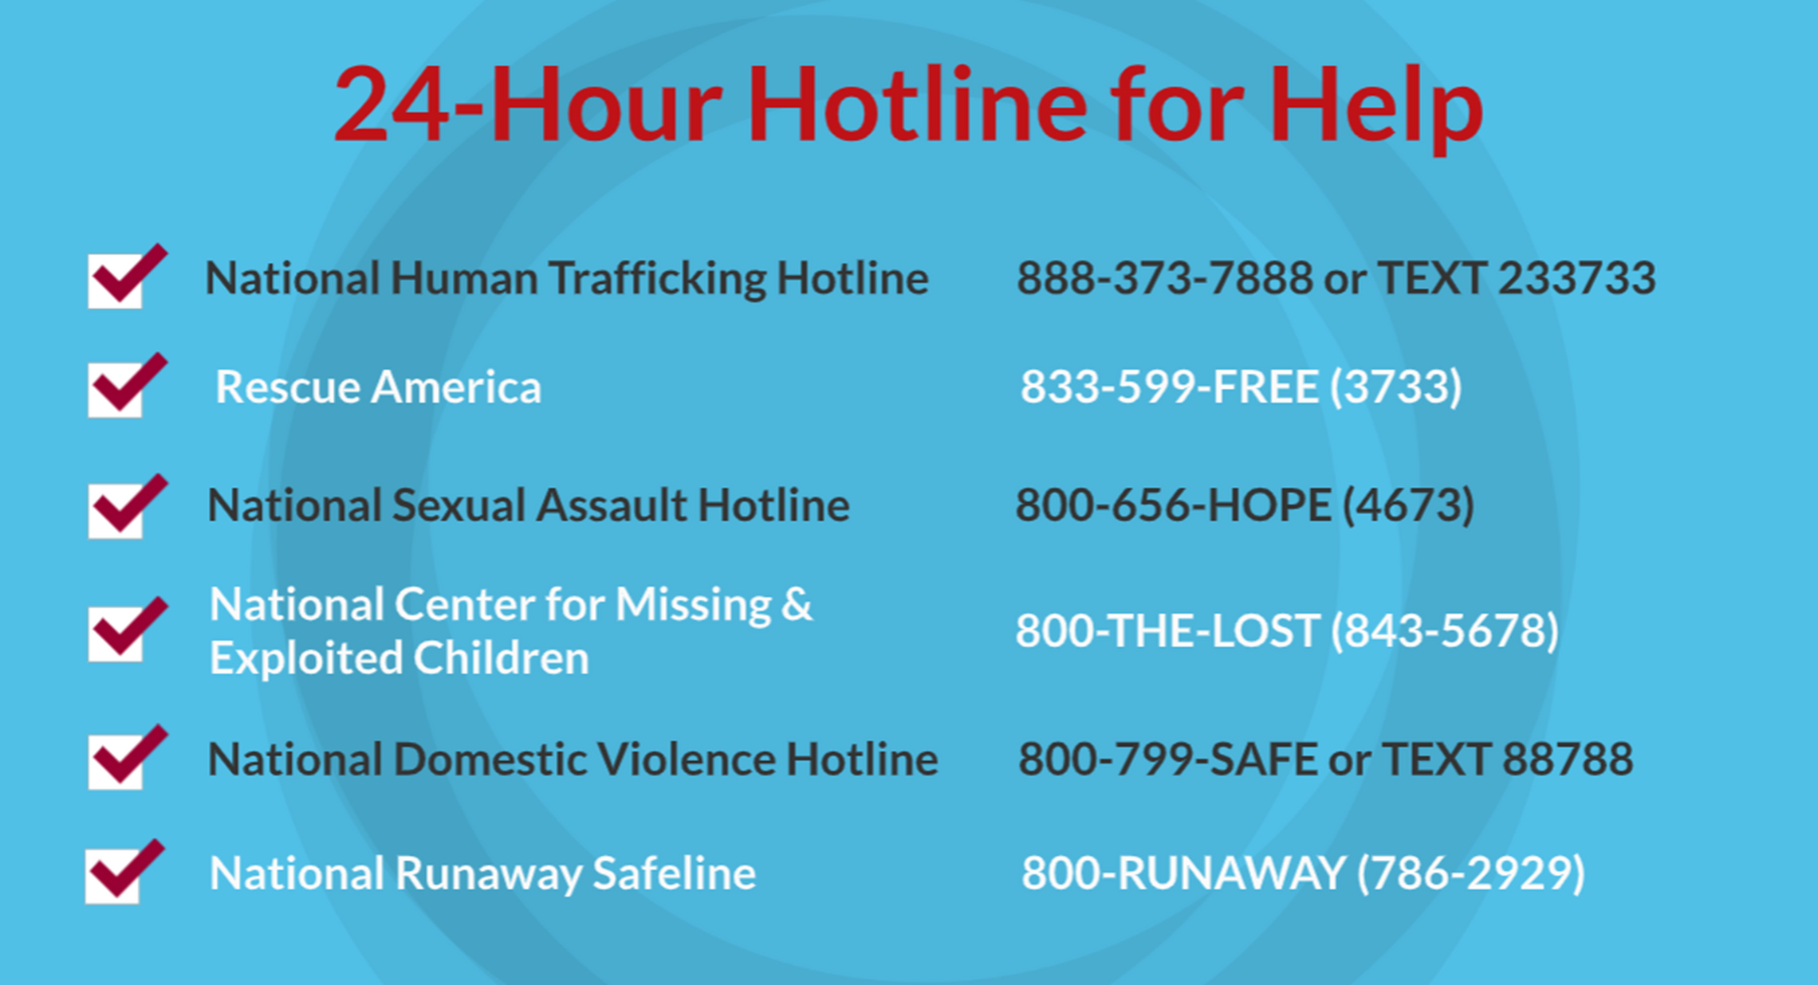
©2025 Walking Wise
116
Notes:
NOTE
Presenters may ask their audience to consider adding a few "hotline for help" phone numbers in their cell phone contacts or take a photo of this slide.

Slide 117
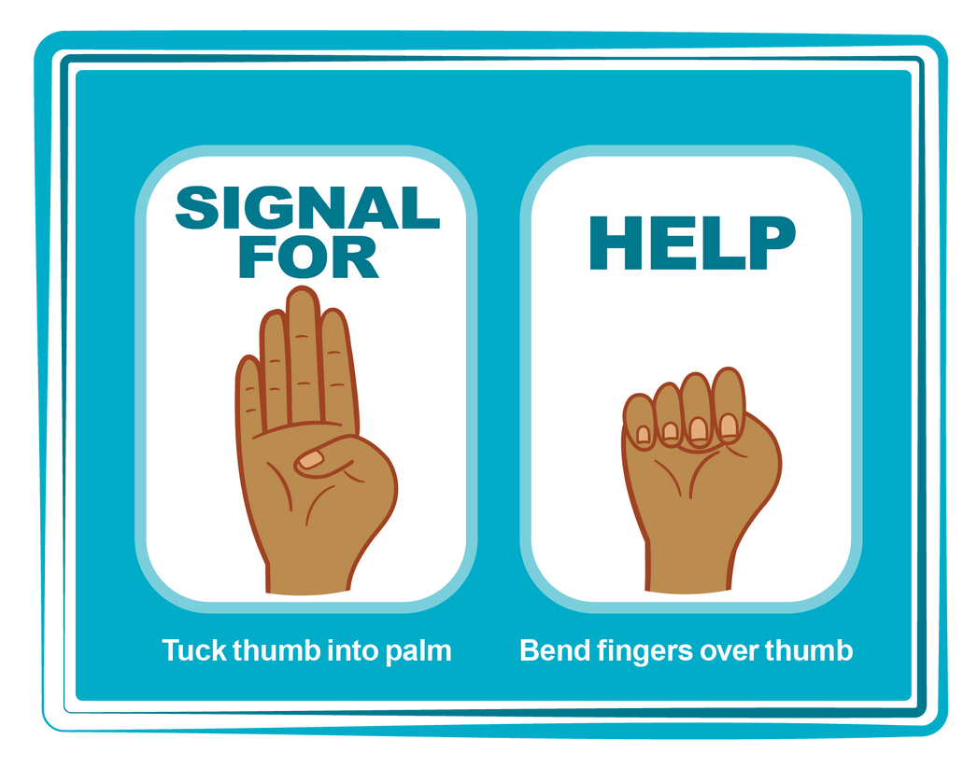
HAND SIGNAL FOR HELP
©2025 Walking Wise
Source: Canadian Women’s Foundation, April 2020
117
Notes:
Although the hand signal for help has not yet achieved universal recognition, it may discreetly get someone's attention in urgent situations.
• SILENT
It can be used silently.
• UNTRACKABLE
It leaves no digital footprint.
• CONCEALED
It can be done secretly when a perpetrator is in the vicinity.
• SIGNALS DISTRESS
Combining the hand signal with distressed facial expressions might help attract the attention of an individual who is unfamiliar with the signal's meaning.
Source
Canadian Women's Foundation, April 2020

Slide 118
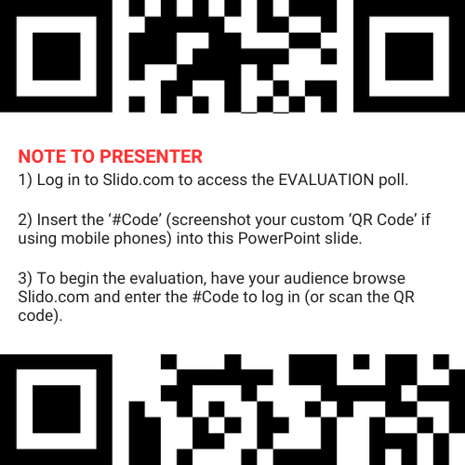
EVALUATION
©2025 Walking Wise
118
Notes:
SLIDO.com: 3-Question Survey
NOTE
Update this slide with your school/organization's custom QR code and #code.
Please encourage participants to scan your organization's custom QR code to share what they enjoyed and what could be improved about the lesson.
Please send any feedback you want to share to Walking Wise at support@WalkingWise.com.

Slide 119
SHARE YOUR THOUGHTS
1. How would you rate this lesson?
2. What was the one thing you liked?
3. What one thing should we improve?
Presenter: Replace “#XXXX” with your organization’s custom Slido code.
©2025 Walking Wise
119
Notes:
SLIDO.com: 3-Question Survey
NOTE
Follow the instructions provided on WalkingWise.com to access your school or organization's custom Slido QR code and #code, which will enable the audience to complete the 3-question evaluation.
Please encourage your audience to scan your organization's custom QR code to share what they enjoyed and what could be improved about the lesson.
Please send any feedback you want to share to Walking Wise at support@WalkingWise.com.

Slide 120


Thank you!
WalkingWise.com
Online Course for Adults Accredited by:
Postgraduate Institue for Medicine
Academy of Forensic Nursing
©2025 Walking Wise
120
Notes:
NOTE
To access additional resources about human traffickers, please refer to the last page of Lesson Plan #9 in the Walking Wise Education Guide.
We welcome your feedback at support@WalkingWise.com.
Thank you!
Karla Highman
Founder, WalkingWise.com

