Slide 1
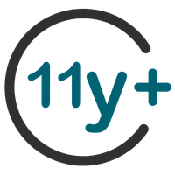

SEXUAL EXPLOITATION
EDUCATION
Human
TRAFFICKERS
BY WALKING WISE
Notes:
NOTE TO PRESENTER
Log in to WalkingWise.com and refer to the Implementation Toolkit for classroom teaching tips.
Most importantly:
DEFINE SCHOOL POLICY
Establish a sexual exploitation reporting protocol with a trauma-informed response. The Walking Wise Implementation Toolkit provides a sample protocol.
AGE & AUDIENCE
This presentation can be edited by following the procedures on page 3 to align with your school policies, specific age groups, and the involvement of at-risk audiences.
SUPPORT PROCEDURE
Provide your students with guidance on how to access immediate help or arrange a private meeting with a social worker, counselor, nurse, school resource officer, or another trustworthy staff member to report concerns about themselves or a peer.
SECOND SAFE ADULT
Ensure a second trustworthy adult, such as a teacher, is present in the learning setting to observe student reactions and identify those who may benefit from a follow-up meeting. This person should remain focused and free from other duties during the presentation.

Slide 2

6-Year Track
NOTE TO PRESENTER
Meaningful learning takes time. By introducing topics gradually over several years, educators can create steady growth in awareness and understanding.
Our recommended teaching plan offers a long-term path for middle and high school students to build knowledge and confidence.
PARENTS & STAFF
#1 Myths & Reality
6th GRADE
#2 Trustworthy vs. Unsafe Adult
#3 Grooming Process
7th GRADE
#4 Pornography Link
#5 Sextortion Scheme
8th GRADE
#6 Male Victims
#7 Runaways as Targets
#8 Rural Risks
9th GRADE
#9 Human Traffickers
#10 Female & Peer Recruiters
10th GRADE
#11 Family Secret
11th GRADE
#12 Hidden Buyers
©2024-2026 Walking Wise
2

Slide 3

NOTE TO PRESENTER
This presentation is exclusively for Walking Wise® subscribers and not for redistribution.
Presenters are encouraged to edit speaker notes to match their speaking style (viewable in presentation mode). You can also delete slides and content from this Walking Wise presentation to ensure the information aligns with your school policies, is age-appropriate, and fits within available class time. However, the slides are copyright-protected and may not be reworded without prior written permission from Walking Wise.
We encourage you to add your own content by following these instructions:
  Insert new PowerPoint slides.
  Remove the Walking Wise logo and copyright "©2026 Walking Wise" from the new slides.
  Always add your organization's name or logo to each new slide.
Please delete this instruction page before presenting to audiences.
R042726
©2024-2026 Walking Wise
3
Notes:
NOTE TO PRESENTER
The presenter is welcome to customize this Walking Wise presentation according to the instructions provided on this page.
For revision requests, please email us at: support@WalkingWise.com.

Slide 4
SENSITIVE TOPICS WILL BE DISCUSSED
CONTENT NOTICE
We’ll be discussing serious safety issues today.
Some topics may be difficult to hear.
If you ever feel uncomfortable, you can step out and speak with a trustworthy adult for support.
You’re not alone—help is available.
©2024-2026 Walking Wise
4
Notes:
NOTE TO PRESENTER
Trauma-Informed Delivery Guidelines
To support a safe and effective learning environment, please follow these guidelines:
• Present the information in a calm, matter-of-fact way and avoid sensational or alarming language.
• Avoid graphic details. Focus on helping students understand behaviors, risk, and ways to stay safe.
• Never blame victims. Responsibility always belongs to the person who caused harm.
• Maintain a steady, composed tone. Students often mirror the presenter's emotional cues.
• Do not ask students to share personal experiences or disclosures.
• If students laugh or react awkwardly, respond neutrally and gently redirect the focus.
• Pair all risk information with needed resources, practical solutions, and support options.
• Reinforce that students are not alone and that trustworthy adults are available to help.

Slide 5
STATISTICS
Why Study Results Can Vary
  Some crimes are never reported, making it hard to reveal the entire issue.
  Studies collect information in different ways, leading to different results.
  Small studies may not represent everyone.
©2024-2026 Walking Wise
5
Notes:
In this presentation, we'll discuss statistics, but it's important to note that while statistics provide valuable insights into an issue, they cannot be relied upon entirely.
Here are a few reasons:
UNREPORTED
Victims often do not report the crimes committed against them due to fear, shame, retaliation, or manipulation. Also, many don’t realize that what is happening to them is a crime.
INCONSISTENT COLLECTION
Areas may define sexual crimes in various ways or use different methods to collect data, making it hard to compare information.
FOCUS GROUPS
Small or specific focus groups participating in a study or survey may not accurately reflect the diversity or experiences of the broader population.

Slide 6

WHY LEARN ABOUT THIS
KNOWLEDGE serves as a
powerful defense against
sexual predators.
©2024-2026 Walking Wise
6
Notes:
Education is one of the strongest tools for preventing exploitation.
When young people understand how predators operate, they are better able to recognize manipulation and avoid dangerous situations.
Reinforce that awareness increases safety.

Slide 7
PREVENTION EDUCATION
SEXUAL EXPLOITATION includes grooming, sextortion, pornography
& sex trafficking.
©2024-2026 Walking Wise
7
Notes:
SEXUAL EXPLOITATION
Taking advantage of another person for their own benefit, especially in a sexual way, often using pressure, tricks, or control.
Below are different forms of exploitation:
GROOMING
Building trust, dependency, or an emotional connection to manipulate someone.
SEXTORTION
Threatening to share embarrassing or sexual images, videos, or information to pressure someone into following demands.
PORNOGRAPHY
Involving someone in creating sexual images who is under 18, or someone who is pressured, or unable/unwilling to give consent.
SEX TRAFFICKING
Manipulating or forcing someone into sexual activity in exchange for money or something of value.
Trafficking and Violence Protection Act (TVPA) of 2000 (Legal Definition):
SEX TRAFFICKING is the recruitment, harboring, transportation, provision, obtaining, patronizing, or soliciting of a person under the age of 18 for the purpose of a commercial sex act.
TVPA link: Retrieved April 14, 2026, from https://www.govinfo.gov/content/pkg/BILLS-106hr3244enr/pdf/BILLS-106hr3244enr.pdf

Slide 8



EDUCATON GUIDE
VOCABULARY
Words to Understand
  Vulnerable
  Human Trafficker (Pimp)
  Exploit
  Coercion
  Seduce
Human
TRAFFICKERS
©2024-2026 Walking Wise
8
3
Notes:
Understanding vocabulary terms related to the behaviors of sexual predators can empower young people to recognize warning signs of harmful situations.
Knowing these terms helps them identify manipulative tactics that unsafe people (predators/traffickers) use to build trust and exploit vulnerabilities.
With this knowledge, young people are better equipped to spot red flags, understand that these behaviors are abusive, and feel more confident reporting predators to trusted adults or authorities, potentially preventing further harm.

Slide 9
EDUCATON GUIDE
VOCABULARY
VULNERABLE
To be at greater risk of harm due to a lack of protection, support, or resources.
Human
TRAFFICKERS
©2024-2026 Walking Wise
9
3

Slide 10
EDUCATON GUIDE
VOCABULARY
HUMAN TRAFFICKER (PIMP)
A person who profits by making young or vulnerable people engage in commercial sex or forced labor.
PIMP is used as slang and glamorized in some songs and movies; in real life, pimps are traffickers who harm people.
©2024-2026 Walking Wise
10
3

Slide 11
EDUCATON GUIDE
VOCABULARY
EXPLOIT
To take advantage of someone's vulnerability in an unfair or harmful way for personal gain.
©2024-2026 Walking Wise
11
3

Slide 12
LESSON PLANS
WHAT DO YOU THINK?
What are the top most profitable illegal trades in the United States?
©2024-2026 Walking Wise
12
3
Notes:
Drug trafficking is widely considered the largest illicit market globally, while human trafficking is among the most profitable and fastest-growing forms of transnational crime (ILO, 2022; UNODC, 2023).
Sources
- International Labour Organization. (2022). Profits and poverty: The economics of forced labour. https://www.ilo.org
- United Nations Office on Drugs and Crime. (2023). World Drug Report 2023. https://www.unodc.org
- United Nations Office on Drugs and Crime. (2022). Global report on trafficking in persons 2022. https://www.unodc.org

Slide 13
ANSWER
#1 Drug Trafficking ~ #2 Human Trafficking are the top most profitable illegal U.S. trades.
(#2 includes Sex & Labor Trafficking)
©2024-2026 Walking Wise
Major Cities Chiefs Association (2025 April). Reference Guide. Highest Grossing Criminal Trades: Volume 5, Sections 5 and 6.
13
Notes:
Illegal activities involve extremely large, organized industries that generate billions of dollars each year.
According to estimates, drug trafficking is the biggest illegal industry in the United States, involving the movement and sale of illegal drugs. It is difficult to estimate profits generated in the U.S., but the global drug trade is estimated to be worth $426-652 billion each year.
Human trafficking — including both forced labor and commercial sexual exploitation — is often considered the second-largest illegal trade by profit, generating an estimated $52 billion annually in the U.S. ($236 billion globally).
These trades harm individuals and communities by promoting addiction, exploitation, violence, and the abuse of basic human rights.
Understanding the scale and impact of these crimes helps students see why awareness, prevention, and safe reporting are so important.
Source
Major Cities Chiefs Association (2025 April). Reference Guide. Highest Grossing Criminal Trades: Volume 5, Sections 5 and 6. Retrieved January 20, 2026, from https://majorcitieschiefs.com/wp-content/uploads/2025/04/MCCA_Highest-Grossing-Criminal-Trades-Reference-Guide_April-2025.pdf?utm_source=chatgpt.com

Slide 14
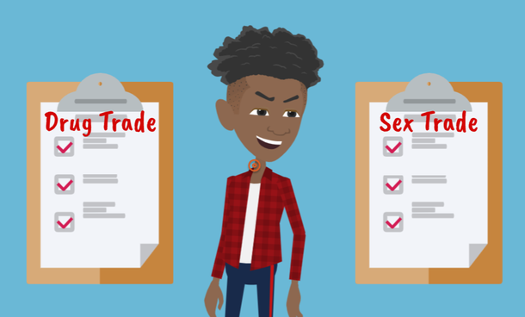
LESSON PLANS
ILLEGAL INDUSTRIES
Why might criminals choose sex trafficking over drug dealing?
Human
TRAFFICKERS
©2024-2026 Walking Wise
14
3

Slide 15
ILLEGAL TRADES
Why Criminals Choose Human Trafficking
Lower Risk: Some criminals believe they are less likely to be caught or face serious punishment.
©2024-2026 Walking Wise
Estimating the Size and Structure of the Underground Commercial Sex Economy in Eight Major US Cities (2014), Urban Institute.
15
Notes:
Traffickers often believe they can make more money trafficking people compared to selling drugs because an individual can be sold repeatedly.
Human traffickers often perceive drug dealing as riskier in terms of legal penalties compared to trafficking vulnerable or young people, where they believe the risk of arrest is lower. (1)
Sex traffickers often coincide peacefully with each other, compared to the territorial behavior of drug dealers.(1)
Source
1. Dank, M., Khan, B., Downey, P. M., Kotonias, C., Mayer, D., Owens, C., Pacifici, L., & Yu, L. (March 2014). Estimating the Size and Structure of the Underground Commercial Sex Economy in Eight Major US Cities. The Urban Institute. Retrieved May 8, 2025, from https://www.urban.org/research/publication/estimating-size-and-structure-underground-commercial-sex-economy-eight-major-us-cities

Slide 16
ILLEGAL TRADES
Why Criminals Choose Human Trafficking
Profit: Drugs can be sold once, but a person can be exploited repeatedly for money.
©2024-2026 Walking Wise
Estimating the Size and Structure of the Underground Commercial Sex Economy in Eight Major US Cities (2014), Urban Institute.
16
Notes:
Traffickers often believe they can make more money trafficking people compared to selling drugs because an individual can be sold repeatedly.
Human traffickers often perceive drug dealing as riskier in terms of legal penalties compared to trafficking vulnerable or young people, where they believe the risk of arrest is lower. (1)
Sex traffickers often coincide peacefully with each other, compared to the territorial behavior of drug dealers.(1)
Source
1. Dank, M., Khan, B., Downey, P. M., Kotonias, C., Mayer, D., Owens, C., Pacifici, L., & Yu, L. (March 2014). Estimating the Size and Structure of the Underground Commercial Sex Economy in Eight Major US Cities. The Urban Institute. Retrieved May 8, 2025, from https://www.urban.org/research/publication/estimating-size-and-structure-underground-commercial-sex-economy-eight-major-us-cities

Slide 17
ILLEGAL TRADES
Why Criminals Choose Human Trafficking
Turf Conflicts: Fewer turf fights compared to drug trafficking.
©2024-2026 Walking Wise
Estimating the Size and Structure of the Underground Commercial Sex Economy in Eight Major US Cities (2014), Urban Institute.
17
Notes:
Traffickers often believe they can make more money trafficking people compared to selling drugs because an individual can be sold repeatedly.
Human traffickers often perceive drug dealing as riskier in terms of legal penalties compared to trafficking vulnerable or young people, where they believe the risk of arrest is lower. (1)
Sex traffickers often coincide peacefully with each other, compared to the territorial behavior of drug dealers.(1)
Source
1. Dank, M., Khan, B., Downey, P. M., Kotonias, C., Mayer, D., Owens, C., Pacifici, L., & Yu, L. (March 2014). Estimating the Size and Structure of the Underground Commercial Sex Economy in Eight Major US Cities. The Urban Institute. Retrieved May 8, 2025, from https://www.urban.org/research/publication/estimating-size-and-structure-underground-commercial-sex-economy-eight-major-us-cities

Slide 18
ILLEGAL TRADES
Why Criminals Choose Human Trafficking
Overlap: Criminals can be in both drug and human trafficking.
©2024-2026 Walking Wise
Estimating the Size and Structure of the Underground Commercial Sex Economy in Eight Major US Cities (2014), Urban Institute.
18
Notes:
Traffickers often believe they can make more money trafficking people compared to selling drugs because an individual can be sold repeatedly.
Human traffickers often perceive drug dealing as riskier in terms of legal penalties compared to trafficking vulnerable or young people, where they believe the risk of arrest is lower. (1)
Sex traffickers often coincide peacefully with each other, compared to the territorial behavior of drug dealers.(1)
Source
1. Dank, M., Khan, B., Downey, P. M., Kotonias, C., Mayer, D., Owens, C., Pacifici, L., & Yu, L. (March 2014). Estimating the Size and Structure of the Underground Commercial Sex Economy in Eight Major US Cities. The Urban Institute. Retrieved May 8, 2025, from https://www.urban.org/research/publication/estimating-size-and-structure-underground-commercial-sex-economy-eight-major-us-cities

Slide 19
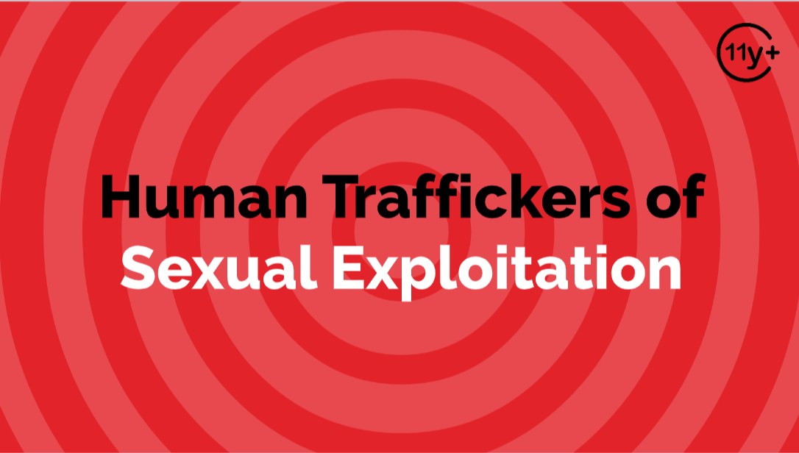
Log in to WalkingWise.com to access this animated video.
©2024-2026 Walking Wise
19
Notes:
This 3-minute Walking Wise animated video series teaches how sexual predators use manipulation, intimidation, and coercion to exploit young people.
NOTE
Log in to Walking Wise.com to watch the three-minute animated video with audiences.
Is animation appropriate for teens?
Yes, even businesses worldwide use explainer-style animation as a training tool for their employees.

Slide 20
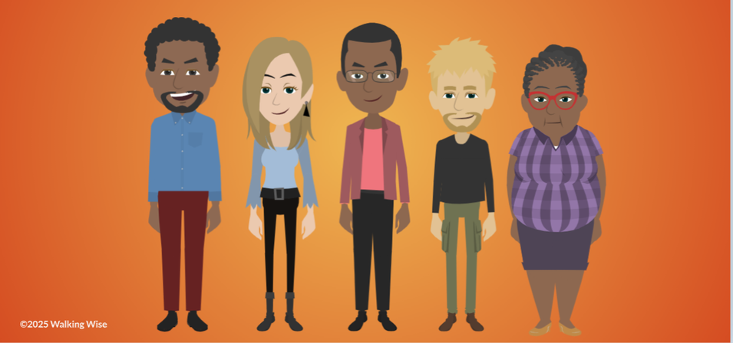
LESSON PLANS
TRAFFICKERS
Who can be human traffickers?
Human
TRAFFICKERS
©2024-2026 Walking Wise
20
3

Slide 21
TRAFFICKERS
Types of Human Traffickers
  Family Members
Human
TRAFFICKERS
©2024-2026 Walking Wise
Sprang, G., Cole, C. (2018, February 13). Familial Sex Trafficking of Minors: Trafficking Conditions, Clinical Presentation, and System Involvement, p. 1.
21
Notes:
Source
Sprang, G., Cole, C. (2018, February 13). Familial Sex Trafficking of Minors: Trafficking Conditions, Clinical Presentation, and System Involvement, p. 1. Retrieved March 9, 2024, from https://www.researchgate.net/publication/323158066_Familial_Sex_Trafficking_of_Minors_Trafficking_Conditions_Clinical_Presentation_and_System_Involvement

Slide 22
TRAFFICKERS
Types of Human Traffickers
  Family Members
  Caregivers
Human
TRAFFICKERS
©2024-2026 Walking Wise
Sprang, G., Cole, C. (2018, February 13). Familial Sex Trafficking of Minors: Trafficking Conditions, Clinical Presentation, and System Involvement, p. 1.
22
Notes:
Source
Sprang, G., Cole, C. (2018, February 13). Familial Sex Trafficking of Minors: Trafficking Conditions, Clinical Presentation, and System Involvement, p. 1. Retrieved March 9, 2024, from https://www.researchgate.net/publication/323158066_Familial_Sex_Trafficking_of_Minors_Trafficking_Conditions_Clinical_Presentation_and_System_Involvement

Slide 23
TRAFFICKERS
Types of Human Traffickers
  Family Members
  Caregivers
  Authority Figures
Human
TRAFFICKERS
©2024-2026 Walking Wise
Sprang, G., Cole, C. (2018, February 13). Familial Sex Trafficking of Minors: Trafficking Conditions, Clinical Presentation, and System Involvement, p. 1.
23
Notes:
Source
Sprang, G., Cole, C. (2018, February 13). Familial Sex Trafficking of Minors: Trafficking Conditions, Clinical Presentation, and System Involvement, p. 1. Retrieved March 9, 2024, from https://www.researchgate.net/publication/323158066_Familial_Sex_Trafficking_of_Minors_Trafficking_Conditions_Clinical_Presentation_and_System_Involvement

Slide 24
TRAFFICKERS
Types of Human Traffickers
  Family Members
  Caregivers
  Authority Figures
  Acquaintances
Human
TRAFFICKERS
©2024-2026 Walking Wise
Sprang, G., Cole, C. (2018, February 13). Familial Sex Trafficking of Minors: Trafficking Conditions, Clinical Presentation, and System Involvement, p. 1.
24
Notes:
Source
Sprang, G., Cole, C. (2018, February 13). Familial Sex Trafficking of Minors: Trafficking Conditions, Clinical Presentation, and System Involvement, p. 1. Retrieved March 9, 2024, from https://www.researchgate.net/publication/323158066_Familial_Sex_Trafficking_of_Minors_Trafficking_Conditions_Clinical_Presentation_and_System_Involvement

Slide 25
TRAFFICKERS
Types of Human Traffickers
  Family Members
  Caregivers
  Authority Figures
  Acquaintances
  Strangers
Human
TRAFFICKERS
©2024-2026 Walking Wise
Sprang, G., Cole, C. (2018, February 13). Familial Sex Trafficking of Minors: Trafficking Conditions, Clinical Presentation, and System Involvement, p. 1.
25
Notes:
Source
Sprang, G., Cole, C. (2018, February 13). Familial Sex Trafficking of Minors: Trafficking Conditions, Clinical Presentation, and System Involvement, p. 1. Retrieved March 9, 2024, from https://www.researchgate.net/publication/323158066_Familial_Sex_Trafficking_of_Minors_Trafficking_Conditions_Clinical_Presentation_and_System_Involvement

Slide 26
TRAFFICKERS
Types of Human Traffickers
  Family Members
  Caregivers
  Authority Figures
  Acquaintances
  Strangers
  Online Connections
Human
TRAFFICKERS
©2024-2026 Walking Wise
Sprang, G., Cole, C. (2018, February 13). Familial Sex Trafficking of Minors: Trafficking Conditions, Clinical Presentation, and System Involvement, p. 1.
26
Notes:
Source
Sprang, G., Cole, C. (2018, February 13). Familial Sex Trafficking of Minors: Trafficking Conditions, Clinical Presentation, and System Involvement, p. 1. Retrieved March 9, 2024, from https://www.researchgate.net/publication/323158066_Familial_Sex_Trafficking_of_Minors_Trafficking_Conditions_Clinical_Presentation_and_System_Involvement

Slide 27
EDUCATON GUIDE
VOCABULARY
COERCION
To pressure, manipulate, or threaten someone to make them do something against their will.
Human
TRAFFICKERS
©2024-2026 Walking Wise
27
3

Slide 28
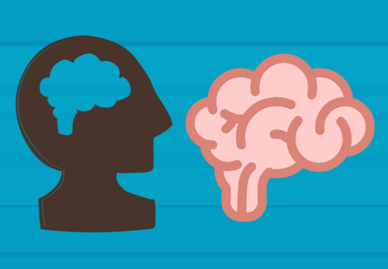
LESSON PLANS
TRAFFICKER BEHAVIORS
What are some common traits or behaviors of human traffickers?
Human
TRAFFICKERS
©2024-2026 Walking Wise
28
3

Slide 29
TRAFFICKER BEHAVIORS
Common Behaviors
  Sense of entitlement or rules don’t apply to them
Human
TRAFFICKERS
©2024-2026 Walking Wise
American Psychiatric Association (2022); Zeigler-Hill, V. et al. (2013).
29
Notes:
Traffickers often do not see others as equals; they see people as tools to get what they want, or even property they own.
They often believe rules do not apply to them and expect others to meet their needs without question. This sense of entitlement can show up as controlling or demanding behavior.
A key warning sign is a lack of empathy. Traffickers may not show real concern for how their actions affect others, even when harm is obvious.
They often focus on personal gain, using relationships, attention, or pressure to benefit themselves rather than care for others.
Some may also show signs of aggression or hostility, especially when they feel they are losing control.
These behaviors can be hidden at first, so it’s important to pay attention to patterns over time, not just first impressions.
Source
American Psychiatric Association (2022, March 18). APA releases Diagnostic and Statistical Manual of Mental Disorders, Fifth Edition, Text Revision (DSM-5-TR).
Sprang, G., Cole, C. (2018, February 13). Familial Sex Trafficking of Minors: Trafficking Conditions, Clinical Presentation, and System Involvement, p. 1. Retrieved April 17, 2025, from https://www.researchgate.net/publication/323158066_Familial_Sex_Trafficking_of_Minors_Trafficking_Conditions_Clinical_Presentation_and_System_Involvement

Slide 30
TRAFFICKER BEHAVIORS
Common Behaviors
  Sense of entitlement or rules don’t apply to them
  Expect others to meet their demands
Human
TRAFFICKERS
©2024-2026 Walking Wise
American Psychiatric Association (2022); Zeigler-Hill, V. et al. (2013).
30
Notes:
Traffickers often do not see others as equals; they see people as tools to get what they want, or even property they own.
They often believe rules do not apply to them and expect others to meet their needs without question. This sense of entitlement can show up as controlling or demanding behavior.
A key warning sign is a lack of empathy. Traffickers may not show real concern for how their actions affect others, even when harm is obvious.
They often focus on personal gain, using relationships, attention, or pressure to benefit themselves rather than care for others.
Some may also show signs of aggression or hostility, especially when they feel they are losing control.
These behaviors can be hidden at first, so it’s important to pay attention to patterns over time, not just first impressions.
Source
American Psychiatric Association (2022, March 18). APA releases Diagnostic and Statistical Manual of Mental Disorders, Fifth Edition, Text Revision (DSM-5-TR).
Sprang, G., Cole, C. (2018, February 13). Familial Sex Trafficking of Minors: Trafficking Conditions, Clinical Presentation, and System Involvement, p. 1. Retrieved April 17, 2025, from https://www.researchgate.net/publication/323158066_Familial_Sex_Trafficking_of_Minors_Trafficking_Conditions_Clinical_Presentation_and_System_Involvement

Slide 31
TRAFFICKER BEHAVIORS
Common Behaviors
  Sense of entitlement or rules don’t apply to them
  Expect others to meet their demands
  Lack of empathy or has no concern for others
Human
TRAFFICKERS
©2024-2026 Walking Wise
American Psychiatric Association (2022); Zeigler-Hill, V. et al. (2013).
31
Notes:
Traffickers often do not see others as equals; they see people as tools to get what they want, or even property they own.
They often believe rules do not apply to them and expect others to meet their needs without question. This sense of entitlement can show up as controlling or demanding behavior.
A key warning sign is a lack of empathy. Traffickers may not show real concern for how their actions affect others, even when harm is obvious.
They often focus on personal gain, using relationships, attention, or pressure to benefit themselves rather than care for others.
Some may also show signs of aggression or hostility, especially when they feel they are losing control.
These behaviors can be hidden at first, so it’s important to pay attention to patterns over time, not just first impressions.
Source
American Psychiatric Association (2022, March 18). APA releases Diagnostic and Statistical Manual of Mental Disorders, Fifth Edition, Text Revision (DSM-5-TR).
Sprang, G., Cole, C. (2018, February 13). Familial Sex Trafficking of Minors: Trafficking Conditions, Clinical Presentation, and System Involvement, p. 1. Retrieved April 17, 2025, from https://www.researchgate.net/publication/323158066_Familial_Sex_Trafficking_of_Minors_Trafficking_Conditions_Clinical_Presentation_and_System_Involvement

Slide 32
TRAFFICKER BEHAVIORS
Common Behaviors
  Sense of entitlement or rules don’t apply to them
  Expect others to meet their demands
  Lack of empathy or has no concern for others
  Exploit or use others for personal gain
Human
TRAFFICKERS
©2024-2026 Walking Wise
American Psychiatric Association (2022); Zeigler-Hill, V. et al. (2013).
32
Notes:
Traffickers often do not see others as equals; they see people as tools to get what they want, or even property they own.
They often believe rules do not apply to them and expect others to meet their needs without question. This sense of entitlement can show up as controlling or demanding behavior.
A key warning sign is a lack of empathy. Traffickers may not show real concern for how their actions affect others, even when harm is obvious.
They often focus on personal gain, using relationships, attention, or pressure to benefit themselves rather than care for others.
Some may also show signs of aggression or hostility, especially when they feel they are losing control.
These behaviors can be hidden at first, so it’s important to pay attention to patterns over time, not just first impressions.
Source
American Psychiatric Association (2022, March 18). APA releases Diagnostic and Statistical Manual of Mental Disorders, Fifth Edition, Text Revision (DSM-5-TR).
Sprang, G., Cole, C. (2018, February 13). Familial Sex Trafficking of Minors: Trafficking Conditions, Clinical Presentation, and System Involvement, p. 1. Retrieved April 17, 2025, from https://www.researchgate.net/publication/323158066_Familial_Sex_Trafficking_of_Minors_Trafficking_Conditions_Clinical_Presentation_and_System_Involvement

Slide 33
TRAFFICKER BEHAVIORS
Common Behaviors
  Sense of entitlement or rules don’t apply to them
  Expect others to meet their demands
  Lack of empathy or has no concern for others
  Exploit or use others for personal gain
  Display sexual aggression or hostility
Human
TRAFFICKERS
©2024-2026 Walking Wise
American Psychiatric Association (2022); Zeigler-Hill, V. et al. (2013).
33
Notes:
Traffickers often do not see others as equals; they see people as tools to get what they want, or even property they own.
They often believe rules do not apply to them and expect others to meet their needs without question. This sense of entitlement can show up as controlling or demanding behavior.
A key warning sign is a lack of empathy. Traffickers may not show real concern for how their actions affect others, even when harm is obvious.
They often focus on personal gain, using relationships, attention, or pressure to benefit themselves rather than care for others.
Some may also show signs of aggression or hostility, especially when they feel they are losing control.
These behaviors can be hidden at first, so it’s important to pay attention to patterns over time, not just first impressions.
Source
American Psychiatric Association (2022, March 18). APA releases Diagnostic and Statistical Manual of Mental Disorders, Fifth Edition, Text Revision (DSM-5-TR).
Sprang, G., Cole, C. (2018, February 13). Familial Sex Trafficking of Minors: Trafficking Conditions, Clinical Presentation, and System Involvement, p. 1. Retrieved April 17, 2025, from https://www.researchgate.net/publication/323158066_Familial_Sex_Trafficking_of_Minors_Trafficking_Conditions_Clinical_Presentation_and_System_Involvement

Slide 34
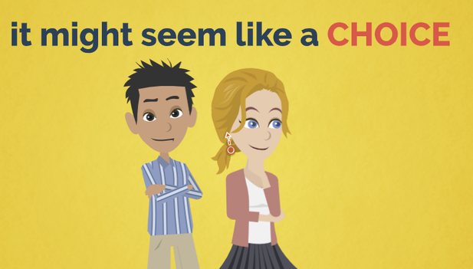
LESSON PLANS
EXPLOITATION TACTICS
What are three common tactics traffickers use to exploit someone?
Human
TRAFFICKERS
©2024-2026 Walking Wise
34
3

Slide 35
EXPLOITATION TACTICS
Illegal Tactics Used by Traffickers
  Force: Physical violence or trapping someone
Human
TRAFFICKERS
©2024-2026 Walking Wise
Victims of Trafficking and Violence Protection Act of 2000, 22 U.S.C. § 7102 (2000).
35
Notes:
FORCE: This means using physical violence or physically trapping someone so they cannot leave or protect themselves.
FRAUD: This involves tricking someone using lies or false promises, such as pretending to offer a job, relationship, or opportunity.
COERCION: This means pressuring, manipulating, or threatening someone to make them do something against their will.
Source
Polaris. (n.d.). Human trafficking definitions. https://polarisproject.org/human-trafficking/
Victims of Trafficking and Violence Protection Act of 2000, 22 U.S.C. § 7102 (2000). Retrieved on April 7, 2026 from https://www.govinfo.gov/content/pkg/BILLS-106hr3244enr/pdf/BILLS-106hr3244enr.pdf

Slide 36
EXPLOITATION TACTICS
Illegal Tactics Used by Traffickers
  Force: Physical violence or trapping someone
  Fraud: Trick someone by using lies
Human
TRAFFICKERS
©2024-2026 Walking Wise
Victims of Trafficking and Violence Protection Act of 2000, 22 U.S.C. § 7102 (2000).
36
Notes:
FORCE: This means using physical violence or physically trapping someone so they cannot leave or protect themselves.
FRAUD: This involves tricking someone using lies or false promises, such as pretending to offer a job, relationship, or opportunity.
COERCION: This means pressuring, manipulating, or threatening someone to make them do something against their will.
Source
Polaris. (n.d.). Human trafficking definitions. https://polarisproject.org/human-trafficking/
Victims of Trafficking and Violence Protection Act of 2000, 22 U.S.C. § 7102 (2000). Retrieved on April 7, 2026 from https://www.govinfo.gov/content/pkg/BILLS-106hr3244enr/pdf/BILLS-106hr3244enr.pdf

Slide 37
EXPLOITATION TACTICS
Illegal Tactics Used by Traffickers
  Force: Physical violence or trapping someone
  Fraud: Trick someone by using lies
  Coercion: Pressure, manipulate, or threaten someone
Human
TRAFFICKERS
©2024-2026 Walking Wise
Victims of Trafficking and Violence Protection Act of 2000, 22 U.S.C. § 7102 (2000).
37
Notes:
FORCE: This means using physical violence or physically trapping someone so they cannot leave or protect themselves.
FRAUD: This involves tricking someone using lies or false promises, such as pretending to offer a job, relationship, or opportunity.
COERCION: This means pressuring, manipulating, or threatening someone to make them do something against their will.
Source
Polaris. (n.d.). Human trafficking definitions. https://polarisproject.org/human-trafficking/
Victims of Trafficking and Violence Protection Act of 2000, 22 U.S.C. § 7102 (2000). Retrieved on April 7, 2026 from https://www.govinfo.gov/content/pkg/BILLS-106hr3244enr/pdf/BILLS-106hr3244enr.pdf

Slide 38
LESSON PLANS
WHAT DO YOU THINK?
What tactic must be used before person is charged with trafficking a child or teen (under 18)?
©2024-2026 Walking Wise
38
3

Slide 39
WHAT DO YOU THINK?
What tactic must be used before person is charged with trafficking a child or teen (under 18)?
A) Force (violence/trap)
B) Fraud (lies)
C) Coercion (pressure)
D) None of the above
©2024-2026 Walking Wise
39

Slide 40
ANSWER
None of the above. A child (under 18) is always protected. They never have to prove the trafficker used force, fraud, or coercion.
One Hundred Sixth Congress of the United States of America at the Second Session (2000). Victims of Trafficking and Violence Protection Act of 2000. GovInfo.gov.
40
©2024-2026 Walking Wise
Notes:
Force, fraud, and coercion are often grouped together because they explain how exploitation happens.
When a minor is involved in a sex act for anything of value, the law considers it trafficking even if none of these tactics are used.
Source
One Hundred Sixth Congress of the United States of America at the Second Session (2000, January
24) Victims of Trafficking and Violence Protection Act of 2000. GovInfo.gov. Retrieved January 20, 2026,
from https://www.govinfo.gov/content/pkg/BILLS-106hr3244enr/pdf/BILLS-106hr3244enr.pdf

Slide 41
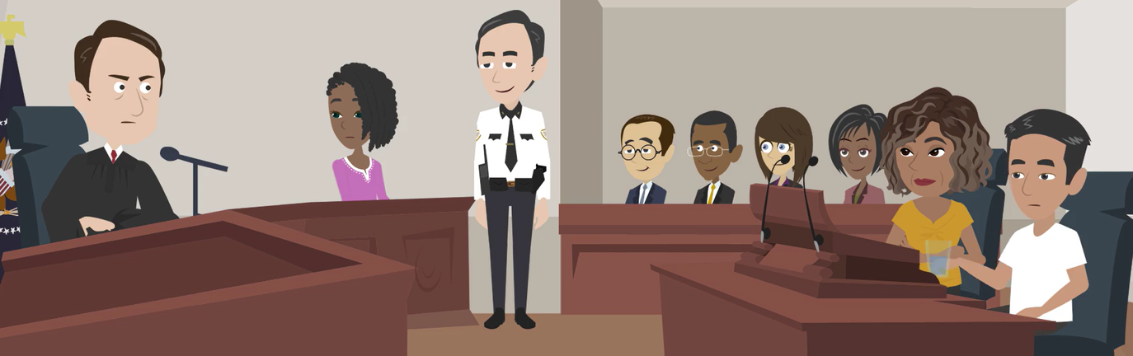
LESSON PLANS
TRAFFICKING LAWS
How do U.S. laws protect people from human sex trafficking crimes?
Human
TRAFFICKERS
©2024-2026 Walking Wise
41
3

Slide 42
TRAFFICKING LAWS
Legal Accountability
The law punishes sexual predators who cause an adult or child to become involved in a sexual exchange.
©2024-2026 Walking Wise
H.R.3244 - Victims of Trafficking and Violence Protection Act of 2000
42
Notes:
In the United States, human sex trafficking is addressed through both federal and state laws.
Federal laws (Victims of Trafficking and Violence Protection Act) create a nationwide standard for identifying trafficking crimes and prosecuting offenders, especially when crimes cross state lines.
Individual states also have their own laws that may add protections, increase penalties, or provide specific support for victims.
Together, these laws are designed to protect victims and hold abusers legally accountable.
Source
One Hundred Sixth Congress of the United States of America at the Second Session (2000, January 24). Victims of Trafficking and Violence Protection Act of 2000. Govinfo.gov. Retrieved May 8, 2025, from https://www.govinfo.gov/content/pkg/BILLS-106hr3244enr/pdf/BILLS-106hr3244enr.pdf

Slide 43
TRAFFICKING LAWS
Legal Accountability
The law punishes sexual predators who cause an adult or child to become involved in a sexual exchange as follows:
  Adults (18+): If force, fraud, or coercion is used to exploit an adult, the abuser is charged as a sex trafficker.
©2024-2026 Walking Wise
H.R.3244 - Victims of Trafficking and Violence Protection Act of 2000
43
Notes:
In the United States, human sex trafficking is addressed through both federal and state laws.
Federal laws (Victims of Trafficking and Violence Protection Act) create a nationwide standard for identifying trafficking crimes and prosecuting offenders, especially when crimes cross state lines.
Individual states also have their own laws that may add protections, increase penalties, or provide specific support for victims.
Together, these laws are designed to protect victims and hold abusers legally accountable.
Source
One Hundred Sixth Congress of the United States of America at the Second Session (2000, January 24). Victims of Trafficking and Violence Protection Act of 2000. Govinfo.gov. Retrieved May 8, 2025, from https://www.govinfo.gov/content/pkg/BILLS-106hr3244enr/pdf/BILLS-106hr3244enr.pdf

Slide 44
TRAFFICKING LAWS
Legal Accountability
The law punishes sexual predators who cause an adult or child to become involved in a sexual exchange as follows:
  Adults (18+): If force, fraud, or coercion is used to exploit an adult, the abuser is charged as a sex trafficker.
  Minors (Under 18): Any time a child is involved in a sex act for something of value, the abuser is charged as a sex trafficker.
©2024-2026 Walking Wise
H.R.3244 - Victims of Trafficking and Violence Protection Act of 2000
44
Notes:
In the United States, human sex trafficking is addressed through both federal and state laws.
Federal laws (Victims of Trafficking and Violence Protection Act) create a nationwide standard for identifying trafficking crimes and prosecuting offenders, especially when crimes cross state lines.
Individual states also have their own laws that may add protections, increase penalties, or provide specific support for victims.
Together, these laws are designed to protect victims and hold abusers legally accountable.
Source
One Hundred Sixth Congress of the United States of America at the Second Session (2000, January 24). Victims of Trafficking and Violence Protection Act of 2000. Govinfo.gov. Retrieved May 8, 2025, from https://www.govinfo.gov/content/pkg/BILLS-106hr3244enr/pdf/BILLS-106hr3244enr.pdf

Slide 45
LESSON PLANS
WHAT DO YOU THINK?
Which term is NOT used to describe how human sex traffickers operate?
©2024-2026 Walking Wise
45
3

Slide 46
WHAT DO YOU THINK?
Which term is NOT used to describe how a human sex trafficker operates?
A) Romeo Pimp
B) Liberty Pimp
C) Gorilla Pimp
D) CEO Pimp
©2024-2026 Walking Wise
Dank, M., Khan, B., Downey, P. M., Kotonias, C., Mayer, D., Owens, C., Pacifici, L., & Yu, L. (2014). Estimating the size and structure of the underground commercial sex economy in eight major U.S. cities. Urban Institute.
46

Slide 47
ANSWER
Liberty Pimp is NOT a real term.
Traffickers operate by taking a person’s freedom, independence, and ability to choose.
©2024-2026 Walking Wise
47

Slide 48
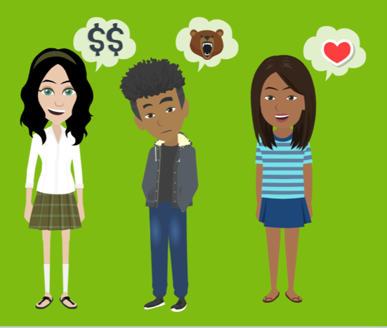
LESSON PLANS
TRAFFICKER STYLES
What strategies might the 3 types of traffickers use to keep control over their victims?
Human
TRAFFICKERS
©2024-2026 Walking Wise
48
3

Slide 49
TRAFFICKER STYLE
Romeo Pimp - The Groomer
Builds Trust First: Gives attention, kindness, and fulfills unmet needs.
©2024-2026 Walking Wise
Dank, M., Khan, B., Downey, P. M., Kotonias, C., Mayer, D., Owens, C., Pacifici, L., & Yu, L. (2014). Estimating the size and structure of the underground commercial sex economy in eight major U.S. cities. Urban Institute.
49
Notes:
These “styles” describe patterns of behavior, not labels traffickers use for themselves. A trafficker may use multiple styles over time, and each style is a form of manipulation and control.
Romeo Pimps are known for the grooming techniques they use to gain their victims' trust. They are often kind, empathetic, and good listeners.
The emotional connection Romeo traffickers create makes it hard for victims to recognize the situation as harmful, and it is extremely difficult for them to leave.
“Romeo” refers to the famous romantic character in the tragic love story by William Shakespeare, Romeo and Juliet, published in 1597.
Source
Dank, M., Khan, B., Downey, P. M., Kotonias, C., Mayer, D., Owens, C., Pacifici, L., & Yu, L. (2014). Estimating the size and structure of the underground commercial sex economy in eight major U.S. cities. Urban Institute. https://www.urban.org/research/publication/estimating-size-and-structure-underground-commercial-sex-economy-eight-major-us-cities

Slide 50
TRAFFICKER STYLE
Romeo Pimp - The Groomer
Creates Emotional Bonds: Uses gifts, promises, and affection to manipulate.
©2024-2026 Walking Wise
Dank, M., Khan, B., Downey, P. M., Kotonias, C., Mayer, D., Owens, C., Pacifici, L., & Yu, L. (2014). Estimating the size and structure of the underground commercial sex economy in eight major U.S. cities. Urban Institute.
50
Notes:
These “styles” describe patterns of behavior, not labels traffickers use for themselves. A trafficker may use multiple styles over time, and each style is a form of manipulation and control.
Romeo Pimps are known for the grooming techniques they use to gain their victims' trust. They are often kind, empathetic, and good listeners.
The emotional connection Romeo traffickers create makes it hard for victims to recognize the situation as harmful, and it is extremely difficult for them to leave.
“Romeo” refers to the famous romantic character in the tragic love story by William Shakespeare, Romeo and Juliet, published in 1597.
Source
Dank, M., Khan, B., Downey, P. M., Kotonias, C., Mayer, D., Owens, C., Pacifici, L., & Yu, L. (2014). Estimating the size and structure of the underground commercial sex economy in eight major U.S. cities. Urban Institute. https://www.urban.org/research/publication/estimating-size-and-structure-underground-commercial-sex-economy-eight-major-us-cities

Slide 51
TRAFFICKER STYLE
Romeo Pimp - The Groomer
Shifts to Control: Gradually isolates the victim and harms their self-esteem to create an emotional dependence.
©2024-2026 Walking Wise
Dank, M., Khan, B., Downey, P. M., Kotonias, C., Mayer, D., Owens, C., Pacifici, L., & Yu, L. (2014). Estimating the size and structure of the underground commercial sex economy in eight major U.S. cities. Urban Institute.
51
Notes:
These “styles” describe patterns of behavior, not labels traffickers use for themselves. A trafficker may use multiple styles over time, and each style is a form of manipulation and control.
Romeo Pimps are known for the grooming techniques they use to gain their victims' trust. They are often kind, empathetic, and good listeners.
The emotional connection Romeo traffickers create makes it hard for victims to recognize the situation as harmful, and it is extremely difficult for them to leave.
“Romeo” refers to the famous romantic character in the tragic love story by William Shakespeare, Romeo and Juliet, published in 1597.
Source
Dank, M., Khan, B., Downey, P. M., Kotonias, C., Mayer, D., Owens, C., Pacifici, L., & Yu, L. (2014). Estimating the size and structure of the underground commercial sex economy in eight major U.S. cities. Urban Institute. https://www.urban.org/research/publication/estimating-size-and-structure-underground-commercial-sex-economy-eight-major-us-cities

Slide 52
TRAFFICKER STYLE
Gorilla Pimp - The Abuser
Uses Fear & Violence: Relies on physical force, fear, or physically trap a victim to maintain power.
©2024-2026 Walking Wise
Dank, M., Khan, B., Downey, P. M., Kotonias, C., Mayer, D., Owens, C., Pacifici, L., & Yu, L. (2014). Estimating the size and structure of the underground commercial sex economy in eight major U.S. cities. Urban Institute.
52
Notes:
Gorilla traffickers use fear, threats, and violence to control victims.
They commonly isolate victims from family and friends and force them into criminal activity such as drug trafficking and theft.
Source
Dank, M., Khan, B., Downey, P. M., Kotonias, C., Mayer, D., Owens, C., Pacifici, L., & Yu, L. (2014). Estimating the size and structure of the underground commercial sex economy in eight major U.S. cities. Urban Institute. https://www.urban.org/research/publication/estimating-size-and-structure-underground-commercial-sex-economy-eight-major-us-cities

Slide 53
TRAFFICKER STYLE
Gorilla Pimp - The Abuser
Forced Crime: They may require the victim to commit crimes such as theft or drug-related activities.
©2024-2026 Walking Wise
Dank, M., Khan, B., Downey, P. M., Kotonias, C., Mayer, D., Owens, C., Pacifici, L., & Yu, L. (2014). Estimating the size and structure of the underground commercial sex economy in eight major U.S. cities. Urban Institute.
53
Notes:
Gorilla traffickers use fear, threats, and violence to control victims.
They commonly isolate victims from family and friends and force them into criminal activity such as drug trafficking and theft.
Source
Dank, M., Khan, B., Downey, P. M., Kotonias, C., Mayer, D., Owens, C., Pacifici, L., & Yu, L. (2014). Estimating the size and structure of the underground commercial sex economy in eight major U.S. cities. Urban Institute. https://www.urban.org/research/publication/estimating-size-and-structure-underground-commercial-sex-economy-eight-major-us-cities

Slide 54
TRAFFICKER STYLE
CEO Pimp - The Groomer
Business Manipulation: Pretends to be successful, inviting the victim into a business opportunity or partnership.
©2024-2026 Walking Wise
Dank, M., Khan, B., Downey, P. M., Kotonias, C., Mayer, D., Owens, C., Pacifici, L., & Yu, L. (2014). Estimating the size and structure of the underground commercial sex economy in eight major U.S. cities. Urban Institute.
54
Notes:
The acronym "CEO" stands for Chief Executive Officer, the highest-ranking person in a company.
CEO traffickers use a business-like approach to fool their victims.
They display confidence, demonstrating intelligence and connections to influential people across industries.
Source
Dank, M., Khan, B., Downey, P. M., Kotonias, C., Mayer, D., Owens, C., Pacifici, L., & Yu, L. (2014). Estimating the size and structure of the underground commercial sex economy in eight major U.S. cities. Urban Institute. https://www.urban.org/research/publication/estimating-size-and-structure-underground-commercial-sex-economy-eight-major-us-cities

Slide 55
TRAFFICKER STYLE
CEO Pimp - The Groomer
Appears Confident & Influential: Brags about connections in industries such as finance, entertainment, or fashion.
©2024-2026 Walking Wise
Dank, M., Khan, B., Downey, P. M., Kotonias, C., Mayer, D., Owens, C., Pacifici, L., & Yu, L. (2014). Estimating the size and structure of the underground commercial sex economy in eight major U.S. cities. Urban Institute.
55
Notes:
The acronym "CEO" stands for Chief Executive Officer, the highest-ranking person in a company.
CEO traffickers use a business-like approach to fool their victims.
They display confidence, demonstrating intelligence and connections to influential people across industries.
Source
Dank, M., Khan, B., Downey, P. M., Kotonias, C., Mayer, D., Owens, C., Pacifici, L., & Yu, L. (2014). Estimating the size and structure of the underground commercial sex economy in eight major U.S. cities. Urban Institute. https://www.urban.org/research/publication/estimating-size-and-structure-underground-commercial-sex-economy-eight-major-us-cities

Slide 56
TRAFFICKER STYLE
CEO Pimp - The Groomer
False Promises: Promises of success, money, fame, or a better life.
©2024-2026 Walking Wise
Dank, M., Khan, B., Downey, P. M., Kotonias, C., Mayer, D., Owens, C., Pacifici, L., & Yu, L. (2014). Estimating the size and structure of the underground commercial sex economy in eight major U.S. cities. Urban Institute.
56
Notes:
Source
Dank, M., Khan, B., Downey, P. M., Kotonias, C., Mayer, D., Owens, C., Pacifici, L., & Yu, L. (2014). Estimating the size and structure of the underground commercial sex economy in eight major U.S. cities. Urban Institute. https://www.urban.org/research/publication/estimating-size-and-structure-underground-commercial-sex-economy-eight-major-us-cities

Slide 57
TRAFFICKER STYLE
CEO Pimp - The Groomer
Isolation & Control: Separates victims from family and friends to create a dependence.
©2024-2026 Walking Wise
Dank, M., Khan, B., Downey, P. M., Kotonias, C., Mayer, D., Owens, C., Pacifici, L., & Yu, L. (2014). Estimating the size and structure of the underground commercial sex economy in eight major U.S. cities. Urban Institute.
57
Notes:
Source
Dank, M., Khan, B., Downey, P. M., Kotonias, C., Mayer, D., Owens, C., Pacifici, L., & Yu, L. (2014). Estimating the size and structure of the underground commercial sex economy in eight major U.S. cities. Urban Institute. https://www.urban.org/research/publication/estimating-size-and-structure-underground-commercial-sex-economy-eight-major-us-cities

Slide 58
EDUCATON GUIDE
VOCABULARY
FLATTER
To give excessive or insincere praise to gain someone’s trust or to influence their behavior.
Human
TRAFFICKERS
©2024-2026 Walking Wise
58
3

Slide 59
EDUCATON GUIDE
VOCABULARY
SEDUCE
To persuade or pressure someone using charm, attention, or manipulation to do something they might not normally do.
Human
TRAFFICKERS
©2024-2026 Walking Wise
59
3

Slide 60
WHAT DO YOU THINK?
What percentage of female victims were trafficked by ‘boyfriends’ or husbands?
©2024-2026 Walking Wise
60

Slide 61
WHAT DO YOU THINK?
What percentage of female victims were trafficked by 'boyfriends' or husbands?
A) 9%
B) 19%
C) 29%
D) 39%
©2024-2026 Walking Wise
61

Slide 62
ANSWER
~39% of female victims were trafficked by a boyfriend, romantic partner, or husband.
Referred to as: Boyfriending, Romeo Trafficker, or Romeo Pimp.
©2024-2026 Walking Wise
Polaris Project (n.d.). Love and Trafficking: Grooming, Exploitation, and Control.
62
Notes:
According to the Polaris Project, about 39% of female trafficking victims were trafficked by a boyfriend, romantic partner, or husband. This highlights how traffickers often use romantic relationships and trust as a way to groom, control, and exploit victims rather than relying only on force.
Source
Polaris Project (n.d.). Love and Trafficking: Grooming, Exploitation, and Control. Retrieved May 8, 2025, from https://polarisproject.org/love-and-trafficking/

Slide 63

LESSON PLANS
POWER OF LOVE
Why can feelings of ‘love’ make it harder for victims to break free from traffickers?
Human
TRAFFICKERS
©2024-2026 Walking Wise
63
3

Slide 64
POWER OF LOVE
Love’s Chemical Reaction
Brain Reward System: The brain releases chemicals (like dopamine) that create feelings of connection and trust.
©2024-2026 Walking Wise
Love and the Brain (2015), Harvard Medical School, hms.harvard.edu.
64
Notes:
TRAFFICKER BONDS
This bond is not real or healthy love. It is a form of manipulation that uses normal brain responses to control someone. The victim is not choosing this bond; it develops because of the brain's response to attention, care, and attachment.
LOVE & THE BRAIN
Love is chemically induced through the brain's reward circuit, where dopamine and other hormones flood the brain.[1]
Traffickers often insincerely romance their victims because they understand that the brain-triggered emotions involved with falling in love create a bond that is extremely difficult to break.
Traffickers patiently nurture their victims with false love until this manipulation takes control over the victim’s emotional independence.
Source
Love and the Brain (2015).
Harvard Medical School
https://hms.harvard.edu/news-events/publications-archive/brain/love-brain#:~:text=Being%20love%2Dstruck%20also%20releases,use%20of%20cocaine%20or%20alcohol

Slide 65
POWER OF LOVE
Love’s Chemical Reaction
Emotional Bond: These feelings can form a powerful bond that makes separation feel painful.
©2024-2026 Walking Wise
Love and the Brain (2015), Harvard Medical School, hms.harvard.edu.
65
Notes:
TRAFFICKER BONDS
This bond is not real or healthy love. It is a form of manipulation that uses normal brain responses to control someone. The victim is not choosing this bond; it develops because of the brain's response to attention, care, and attachment.
LOVE & THE BRAIN
Love is chemically induced through the brain's reward circuit, where dopamine and other hormones flood the brain.[1]
Traffickers often insincerely romance their victims because they understand that the brain-triggered emotions involved with falling in love create a bond that is extremely difficult to break.
Traffickers patiently nurture their victims with false love until this manipulation takes control over the victim’s emotional independence.
Source
Love and the Brain (2015).
Harvard Medical School
https://hms.harvard.edu/news-events/publications-archive/brain/love-brain#:~:text=Being%20love%2Dstruck%20also%20releases,use%20of%20cocaine%20or%20alcohol

Slide 66
POWER OF LOVE
Love’s Chemical Reaction
Love Bond: Traffickers may create this bond by acting as a romantic partner, caring adult (parent figure), or close friend.
©2024-2026 Walking Wise
Love and the Brain (2015), Harvard Medical School, hms.harvard.edu.
66
Notes:
TRAFFICKER BONDS
This bond is not real or healthy love. It is a form of manipulation that uses normal brain responses to control someone. The victim is not choosing this bond; it develops because of the brain's response to attention, care, and attachment.
LOVE & THE BRAIN
Love is chemically induced through the brain's reward circuit, where dopamine and other hormones flood the brain.[1]
Traffickers often insincerely romance their victims because they understand that the brain-triggered emotions involved with falling in love create a bond that is extremely difficult to break.
Traffickers patiently nurture their victims with false love until this manipulation takes control over the victim’s emotional independence.
Source
Love and the Brain (2015).
Harvard Medical School
https://hms.harvard.edu/news-events/publications-archive/brain/love-brain#:~:text=Being%20love%2Dstruck%20also%20releases,use%20of%20cocaine%20or%20alcohol

Slide 67
POWER OF LOVE
Trauma Bond Process
Trust: Traffickers build trust by acting supportive and caring.
©2024-2026 Walking Wise
Cleveland Clinic (2023, March 29). Here's What Trauma Bonding Really Is and How To Recognize the Signs.
67
Notes:
Traffickers rarely begin with fear. They often start by meeting emotional needs, offering attention, support, or understanding that may be missing in a young person’s life.
The mix of positive and harmful behavior can make it difficult for a victim to recognize danger or leave the situation.
This pattern is intentional. It is designed to create dependence and make control feel harder to escape.
SOURCE
Cleveland Clinic (2023, March 29). Here's What Trauma Bonding Really Is and How To Recognize the Signs. Retrieved April 23, 2025, from https://health.clevelandclinic.org/trauma-bonding

Slide 68
POWER OF LOVE
Trauma Bond Process
Love: They may act romantic or protective, making victims feel valued and special.
©2024-2026 Walking Wise
Cleveland Clinic (2023, March 29). Here's What Trauma Bonding Really Is and How To Recognize the Signs.
68
Notes:
Traffickers rarely begin with fear. They often start by meeting emotional needs, offering attention, support, or understanding that may be missing in a young person’s life.
The mix of positive and harmful behavior can make it difficult for a victim to recognize danger or leave the situation.
This pattern is intentional. It is designed to create dependence and make control feel harder to escape.
SOURCE
Cleveland Clinic (2023, March 29). Here's What Trauma Bonding Really Is and How To Recognize the Signs. Retrieved April 23, 2025, from https://health.clevelandclinic.org/trauma-bonding

Slide 69
POWER OF LOVE
Trauma Bond Process
Fear: Over time, they introduce threats or violence to gain control.
©2024-2026 Walking Wise
Cleveland Clinic (2023, March 29). Here's What Trauma Bonding Really Is and How To Recognize the Signs.
69
Notes:
Traffickers rarely begin with fear. They often start by meeting emotional needs, offering attention, support, or understanding that may be missing in a young person’s life.
The mix of positive and harmful behavior can make it difficult for a victim to recognize danger or leave the situation.
This pattern is intentional. It is designed to create dependence and make control feel harder to escape.
SOURCE
Cleveland Clinic (2023, March 29). Here's What Trauma Bonding Really Is and How To Recognize the Signs. Retrieved April 23, 2025, from https://health.clevelandclinic.org/trauma-bonding

Slide 70
POWER OF LOVE
Trauma Bond Process
Loyalty: By switching between kindness and harm, traffickers can create emotional confusion and dependence.
©2024-2026 Walking Wise
Cleveland Clinic (2023, March 29). Here's What Trauma Bonding Really Is and How To Recognize the Signs.
70
Notes:
A trauma bond can form when a person experiences repeated cycles of harm followed by moments of kindness or affection. These mixed signals can create confusion and strong emotional attachment.
Over time, this pattern can lead to a cycle of love and fear, where the victim feels connected to the trafficker despite being harmed.
Victims may become loyal or attached because they hope the kindness they experienced will return.
This bond is not a healthy relationship—it is a form of control created through manipulation.
SOURCE
Cleveland Clinic (2023, March 29). Here's What Trauma Bonding Really Is and How To Recognize the Signs. Retrieved April 23, 2025, from https://health.clevelandclinic.org/trauma-bonding

Slide 71
POWER OF LOVE
Trauma Bond Process
Trauma Bond: Confusion can make victims feel attached and unable to leave, trying to recapture the love they once felt.
©2024-2026 Walking Wise
Cleveland Clinic (2023, March 29). Here's What Trauma Bonding Really Is and How To Recognize the Signs.
71
Notes:
A trauma bond can form when a person experiences repeated cycles of harm followed by moments of kindness or affection. These mixed signals can create confusion and strong emotional attachment.
Over time, this pattern can lead to a cycle of love and fear, where the victim feels connected to the trafficker despite being harmed.
Victims may become loyal or attached because they hope the kindness they experienced will return.
This bond is not a healthy relationship—it is a form of control created through manipulation.
SOURCE
Cleveland Clinic (2023, March 29). Here's What Trauma Bonding Really Is and How To Recognize the Signs. Retrieved April 23, 2025, from https://health.clevelandclinic.org/trauma-bonding

Slide 72
LESSON PLANS
WHAT DO YOU THINK?
Which is NOT a common bond used by traffickers to control victims?
©2024-2026 Walking Wise
72
3

Slide 73
WHAT DO YOU THINK?
Which is NOT a common bond used by traffickers to control victims?
A) Trauma Bond
B) Debt Bond
C) Support Bond
D) Drug Bond
©2024-2026 Walking Wise
Baird, K., & Connolly, J. (2023). Recruitment and Entrapment Pathways of Minors into Sex Trafficking
in Canada and the United States: A Systematic Review, Trauma, violence & abuse, 24(1), 189–202.
73

Slide 74
ANSWER
Support Bond is NOT a recognized form of bonding used by human traffickers to gain control.
©2024-2026 Walking Wise
74
Notes:
Source
Baird, K., & Connolly, J. (2023). Recruitment and Entrapment Pathways of Minors into Sex Trafficking
in Canada and the United States: A Systematic Review, Trauma, violence & abuse, 24(1), 189–
202. Retrieved January 20, 2026, from https://doi.org/10.1177/15248380211025241

Slide 75
DEPENDENCE
Debt Bond Process
Financial Dependence: Victims may have little or no money and rely on the trafficker for basic needs, making it hard to leave.
©2024-2026 Walking Wise
End Slavery Now (n.d.). Bonded Labor. Retrieved April 23, 2025.
75
Notes:
Financial dependence can develop when a victim have no money for basic needs. This reliance can make leaving feel impossible.
Debt bonds are designed to make victims feel they can never “catch up” or leave. The debt is not real or fair—it is a tool used to maintain control.
Traffickers create a debt bond or economic dependence on their victims by imposing debt that continually accumulates and can be difficult or impossible to repay.
Traffickers often withhold victims' legal documents, demanding sex work until they pay a debt in full or simply preventing them from working outside of the traffickers' control.
SOURCE
End Slavery Now (n.d.). Bonded Labor. Retrieved April 23, 2025, from http://www.endslaverynow.org/learn/slavery-today/bonded-labor

Slide 76
DEPENDENCE
Debt Bond Process
Debt: Traffickers may create fake or growing debt for things like food or housing, making victims feel they must repay it.
©2024-2026 Walking Wise
End Slavery Now (n.d.). Bonded Labor. Retrieved April 23, 2025.
76
Notes:
Financial dependence can develop when a victim have no money for basic needs. This reliance can make leaving feel impossible.
Debt bonds are designed to make victims feel they can never “catch up” or leave. The debt is not real or fair—it is a tool used to maintain control.
Traffickers create a debt bond or economic dependence on their victims by imposing debt that continually accumulates and can be difficult or impossible to repay.
Traffickers often withhold victims' legal documents, demanding sex work until they pay a debt in full or simply preventing them from working outside of the traffickers' control.
SOURCE
End Slavery Now (n.d.). Bonded Labor. Retrieved April 23, 2025, from http://www.endslaverynow.org/learn/slavery-today/bonded-labor

Slide 77
DEPENDENCE
Debt Bond Process
Stolen ID: Traffickers may take documents (like an ID), making it difficult for victims to leave or earn money on their own.
©2024-2026 Walking Wise
End Slavery Now (n.d.). Bonded Labor. Retrieved April 23, 2025.
77
Notes:
Financial dependence can develop when a victim have no money for basic needs. This reliance can make leaving feel impossible.
Debt bonds are designed to make victims feel they can never “catch up” or leave. The debt is not real or fair—it is a tool used to maintain control.
Traffickers create a debt bond or economic dependence on their victims by imposing debt that continually accumulates and can be difficult or impossible to repay.
Traffickers often withhold victims' legal documents, demanding sex work until they pay a debt in full or simply preventing them from working outside of the traffickers' control.
SOURCE
End Slavery Now (n.d.). Bonded Labor. Retrieved April 23, 2025, from http://www.endslaverynow.org/learn/slavery-today/bonded-labor

Slide 78
DEPENDENCE
Drug Bond Process
Grooming: Traffickers may offer free drugs to build trust or create dependence.
Langton L, Planty M, BAnks D., Witwer A., Woods, D. Vermeer M., Jackson, B. (2022, February 24). Sex Trafficking and Substance Use, Rand.org.
78
©2024-2026 Walking Wise
Notes:
Drug bonds are a form of control. Traffickers use substances to create dependence, fear, and shame, making it very difficult for victims to leave. The goal is always to manipulate and exploit, not provide help.
Drug bondage can occur when drug dealers coerce users into sex trafficking in exchange for drugs. Some sex traffickers are known to loiter outside drug rehab centers, seeking recruits.
Source
Langton L, Planty M, Banks D., Witwer A., Woods, D., Vermeer M., Jackson, B. (2022, February 24). Sex Trafficking and Substance Use, Rand.org. Retrieved April 23, 2025, from https://www.rand.org/pubs/research_reports/RRA108-13.html

Slide 79
DEPENDENCE
Drug Bond Process
Exploitation: Victims may be pressured or forced into sexual activity in exchange for drugs.
Langton L, Planty M, BAnks D., Witwer A., Woods, D. Vermeer M., Jackson, B. (2022, February 24). Sex Trafficking and Substance Use, Rand.org.
79
©2024-2026 Walking Wise
Notes:
Drug bonds are a form of control. Traffickers use substances to create dependence, fear, and shame, making it very difficult for victims to leave. The goal is always to manipulate and exploit, not provide help.
Drug bondage can occur when drug dealers coerce users into sex trafficking in exchange for drugs. Some sex traffickers are known to loiter outside drug rehab centers, seeking recruits.
Source
Langton L, Planty M, Banks D., Witwer A., Woods, D., Vermeer M., Jackson, B. (2022, February 24). Sex Trafficking and Substance Use, Rand.org. Retrieved April 23, 2025, from https://www.rand.org/pubs/research_reports/RRA108-13.html

Slide 80
DEPENDENCE
Drug Bond Process
Targeting Vulnerabilities: Traffickers often target people who are recovering from substance use.
Langton L, Planty M, BAnks D., Witwer A., Woods, D. Vermeer M., Jackson, B. (2022, February 24). Sex Trafficking and Substance Use, Rand.org.
80
©2024-2026 Walking Wise
Notes:
Drug bonds are a form of control. Traffickers use substances to create dependence, fear, and shame, making it very difficult for victims to leave. The goal is always to manipulate and exploit, not provide help.
Drug bondage can occur when drug dealers coerce users into sex trafficking in exchange for drugs. Some sex traffickers are known to loiter outside drug rehab centers, seeking recruits.
Source
Langton L, Planty M, Banks D., Witwer A., Woods, D., Vermeer M., Jackson, B. (2022, February 24). Sex Trafficking and Substance Use, Rand.org. Retrieved April 23, 2025, from https://www.rand.org/pubs/research_reports/RRA108-13.html

Slide 81
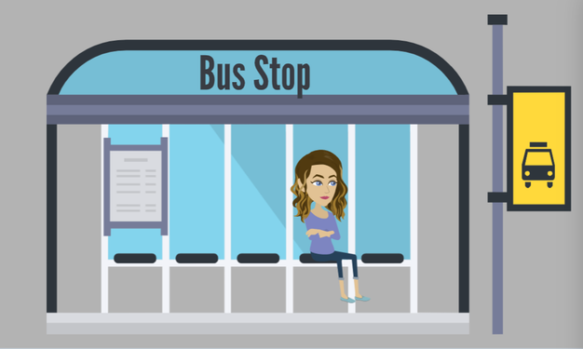
LESSON PLANS
RECRUITMENT LOCATIONS
Where do traffickers commonly target vulnerable people?
Human
TRAFFICKERS
©2024-2026 Walking Wise
81
3

Slide 82
RECRUITMENT LOCATIONS
Common Public Places
  Where teens spend time with little or no adult supervision:
Human
TRAFFICKERS
©2024-2026 Walking Wise
82

Slide 83
RECRUITMENT LOCATIONS
Common Public Places
  Where teens spend time with little or no adult supervision:
    Near Schools & Bus Stops
Human
TRAFFICKERS
©2024-2026 Walking Wise
83

Slide 84
RECRUITMENT LOCATIONS
Common Public Places
  Where teens spend time with little or no adult supervision:
    Near Schools & Bus Stops
    Parks & Playgrounds
Human
TRAFFICKERS
©2024-2026 Walking Wise
84

Slide 85
RECRUITMENT LOCATIONS
Common Public Places
  Where teens spend time with little or no adult supervision:
    Near Schools & Bus Stops
    Parks & Playgrounds
    Malls & Convenience Stores
Human
TRAFFICKERS
©2024-2026 Walking Wise
85

Slide 86
RECRUITMENT LOCATIONS
Higher-Risk Environments
  Places where individuals may be more vulnerable:
Human
TRAFFICKERS
©2024-2026 Walking Wise
86
Notes:
Traffickers look for locations where people may be more vulnerable or in need of support.
In these environments, people may be experiencing challenges such as instability, the lack of resources, or emotional stress.
Traffickers often try to take advantage of vulnerable people in these situations.

Slide 87
RECRUITMENT LOCATIONS
Higher-Risk Environments
  Places where individuals may be more vulnerable:
    Juvenile Centers
Human
TRAFFICKERS
©2024-2026 Walking Wise
87
Notes:
Traffickers look for locations where people may be more vulnerable or in need of support.
In these environments, people may be experiencing challenges such as instability, the lack of resources, or emotional stress.
Traffickers often try to take advantage of vulnerable people in these situations.

Slide 88
RECRUITMENT LOCATIONS
Higher-Risk Environments
  Places where individuals may be more vulnerable:
    Juvenile Centers
    Rehab Clinics
Human
TRAFFICKERS
©2024-2026 Walking Wise
88
Notes:
Traffickers look for locations where people may be more vulnerable or in need of support.
In these environments, people may be experiencing challenges such as instability, the lack of resources, or emotional stress.
Traffickers often try to take advantage of vulnerable people in these situations.

Slide 89
RECRUITMENT LOCATIONS
Higher-Risk Environments
  Places where individuals may be more vulnerable:
    Juvenile Centers
    Rehab Clinics
    Homeless Shelters
Human
TRAFFICKERS
©2024-2026 Walking Wise
89
Notes:
Traffickers look for locations where people may be more vulnerable or in need of support.
In these environments, people may be experiencing challenges such as instability, the lack of resources, or emotional stress.
Traffickers often try to take advantage of vulnerable people in these situations.

Slide 90
RECRUITMENT LOCATIONS
Higher-Risk Environments
  Places where individuals may be more vulnerable:
    Juvenile Centers
    Rehab Clinics
    Homeless Shelters
    Drop-in Centers
Human
TRAFFICKERS
©2024-2026 Walking Wise
90
Notes:
Traffickers look for locations where people may be more vulnerable or in need of support.
In these environments, people may be experiencing challenges such as instability, the lack of resources, or emotional stress.
Traffickers often try to take advantage of vulnerable people in these situations.

Slide 91
RECRUITMENT LOCATIONS
Higher-Risk Environments
  Places where individuals may be more vulnerable:
    Juvenile Centers
    Rehab Clinics
    Homeless Shelters
    Drop-in Centers
    On the Streets
Human
TRAFFICKERS
©2024-2026 Walking Wise
91
Notes:
Traffickers look for locations where people may be more vulnerable or in need of support.
In these environments, people may be experiencing challenges such as instability, the lack of resources, or emotional stress.
Traffickers often try to take advantage of vulnerable people in these situations.

Slide 92
RECRUITMENT LOCATIONS
Online Spaces
  Digital spaces where predators start friendly conversations:
Human
TRAFFICKERS
©2024-2026 Walking Wise
92
Notes:
Traffickers are highly active in online spaces where young people spend time.
These digital environments allow traffickers to easily start conversations that seem friendly, supportive, or even flirtatious.
Awareness of how these interactions begin can help young people recognize warning signs and seek help from a trustworthy adult if something feels uncomfortable.

Slide 93
RECRUITMENT LOCATIONS
Online Spaces
  Digital spaces where predators start friendly conversations:
    Social Media
Human
TRAFFICKERS
©2024-2026 Walking Wise
93
Notes:
Traffickers are highly active in online spaces where young people spend time.
These digital environments allow traffickers to easily start conversations that seem friendly, supportive, or even flirtatious.
Awareness of how these interactions begin can help young people recognize warning signs and seek help from a trustworthy adult if something feels uncomfortable.

Slide 94
RECRUITMENT LOCATIONS
Online Spaces
  Digital spaces where predators start friendly conversations:
    Social Media
    Gaming Platforms
Human
TRAFFICKERS
©2024-2026 Walking Wise
94
Notes:
Traffickers are highly active in online spaces where young people spend time.
These digital environments allow traffickers to easily start conversations that seem friendly, supportive, or even flirtatious.
Awareness of how these interactions begin can help young people recognize warning signs and seek help from a trustworthy adult if something feels uncomfortable.

Slide 95
RECRUITMENT LOCATIONS
Online Spaces
  Digital spaces where predators start friendly conversations:
    Social Media
    Gaming Platforms
    Messaging Apps
Human
TRAFFICKERS
©2024-2026 Walking Wise
95
Notes:
Traffickers are highly active in online spaces where young people spend time.
These digital environments allow traffickers to easily start conversations that seem friendly, supportive, or even flirtatious.
Awareness of how these interactions begin can help young people recognize warning signs and seek help from a trustworthy adult if something feels uncomfortable.

Slide 96
LESSON PLANS
RISK FACTORS
What situations are commonly targeted by traffickers?
Human
TRAFFICKERS
©2024-2026 Walking Wise
96
3

Slide 97
RISK FACTORS
Factors That Traffickers May Target
  Lack of basic needs or stability
©2024-2026 Walking Wise
97
Notes:
These situations can increase vulnerability, but they are never the victim’s fault.
Traffickers often look for unmet needs, such as a lack of safety, support, or stability, and take advantage of those situations.

Slide 98
RISK FACTORS
Factors That Traffickers May Target
  Lack of basic needs or stability
  Unsafe or difficult home environments
©2024-2026 Walking Wise
98
Notes:
These situations can increase vulnerability, but they are never the victim’s fault.
Traffickers often look for unmet needs, such as a lack of safety, support, or stability, and take advantage of those situations.

Slide 99
RISK FACTORS
Factors That Traffickers May Target
  Lack of basic needs or stability
  Unsafe or difficult home environments
  Emotional struggles or isolation
©2024-2026 Walking Wise
99
Notes:
These situations can increase vulnerability, but they are never the victim’s fault.
Traffickers often look for unmet needs, such as a lack of safety, support, or stability, and take advantage of those situations.

Slide 100
RISK FACTORS
Factors That Traffickers May Target
  Lack of basic needs or stability
  Unsafe or difficult home environments
  Emotional struggles or isolation
  Substance use or addiction
©2024-2026 Walking Wise
100
Notes:
These situations can increase vulnerability, but they are never the victim’s fault.
Traffickers often look for unmet needs, such as a lack of safety, support, or stability, and take advantage of those situations.

Slide 101
RISK FACTORS
Factors That Traffickers May Target
  Lack of basic needs or stability
  Unsafe or difficult home environments
  Emotional struggles or isolation
  Substance use or addiction
  Limited support or protection
©2024-2026 Walking Wise
101
Notes:
These situations can increase vulnerability, but they are never the victim’s fault.
Traffickers often look for unmet needs, such as a lack of safety, support, or stability, and take advantage of those situations.

Slide 102
RISK FACTORS
Factors That Traffickers May Target
  Lack of basic needs or stability
  Unsafe or difficult home environments
  Emotional struggles or isolation
  Substance use or addiction
  Limited support or protection
  Desire for change or new opportunities
©2024-2026 Walking Wise
102
Notes:
These situations can increase vulnerability, but they are never the victim’s fault.
Traffickers often look for unmet needs, such as a lack of safety, support, or stability, and take advantage of those situations.

Slide 103
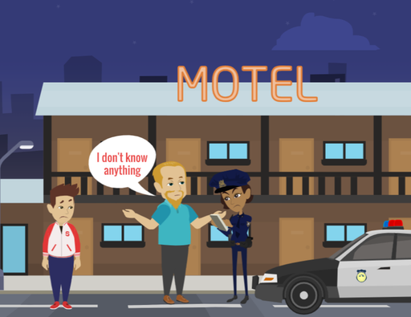
LESSON PLANS
UNREPORTED
Why do victims often hesitate to report traffickers to law enforcement?
Human
TRAFFICKERS
©2024-2026 Walking Wise
103
3

Slide 104
UNREPORTED
Reasons Victims May Not Speak Up
Obligation: Victims may feel a sense of love, loyalty, or believe they “owe” the trafficker for providing their basic needs.
©2024-2026 Walking Wise
104
Notes:
Victims often do not report traffickers because of control, not choice. Sometimes they don't report because of the emotional bond or love they have for the trafficker.
Hesitation to seek help is a result of manipulation, fear, and dependence—not weakness or unwillingness.
Understanding these barriers helps society see why victims need support and safe options, rather than judgment.

Slide 105
UNREPORTED
Reasons Victims May Not Speak Up
Fear & Intimidation: Victims may be afraid of physical harm or retaliation if they try to leave or seek help.
©2024-2026 Walking Wise
105
Notes:
Victims often do not report traffickers because of control, not choice. Sometimes they don't report because of the emotional bond or love they have for the trafficker.
Hesitation to seek help is a result of manipulation, fear, and dependence—not weakness or unwillingness.
Understanding these barriers helps society see why victims need support and safe options, rather than judgment.

Slide 106
UNREPORTED
Reasons Victims May Not Speak Up
Physical Dependence: They may develop a drug bond to the trafficker, making it difficult to leave their access to substances.
©2024-2026 Walking Wise
106
Notes:
Victims often do not report traffickers because of control, not choice. Sometimes they don't report because of the emotional bond or love they have for the trafficker.
Hesitation to seek help is a result of manipulation, fear, and dependence—not weakness or unwillingness.
Understanding these barriers helps society see why victims need support and safe options, rather than judgment.

Slide 107
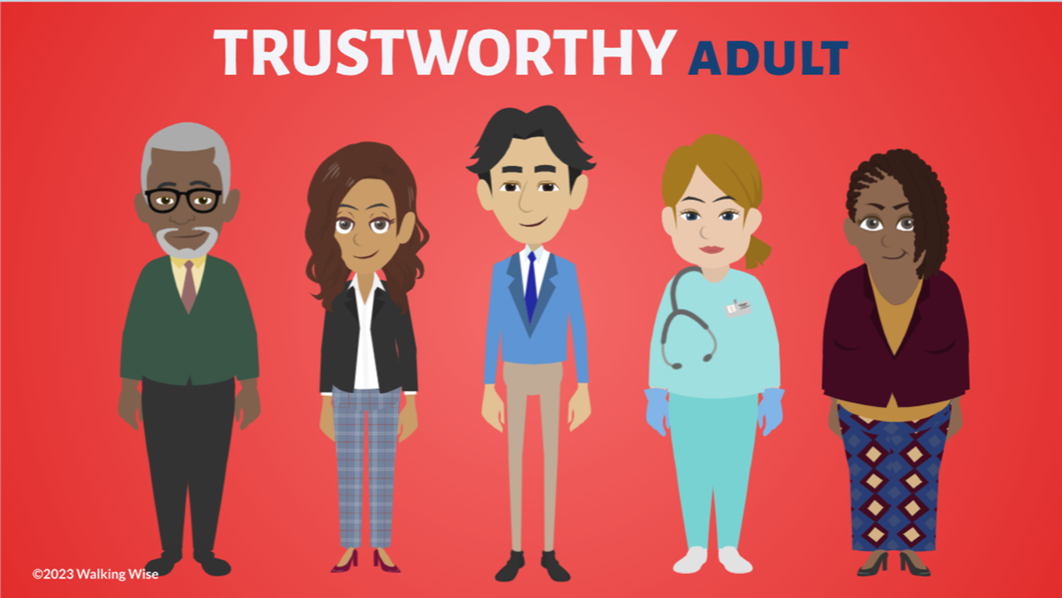
ASK FOR HELP
©2024-2026 Walking Wise
107
Notes:
Walking Wise asked a focus group of survivors:
What do you think young people should know about sex trafficking?
ANSWER
The survivors agreed that the most vital information teens should know is how to ask for help.
At the top of their list:
Tell a TRUSTWORTHY adult.

Slide 108
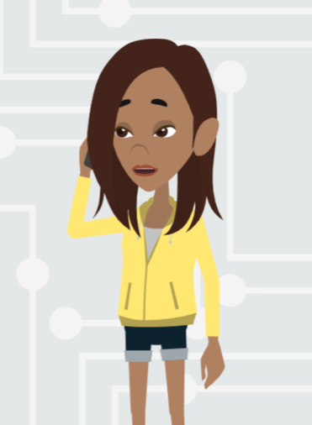
ASK FOR HELP
What are ways young people can ask for help?
©2024-2026 Walking Wise
108

Slide 109
ASK FOR HELP
How to Ask for Help
  If you are in immediate danger, dial 911.
©2024-2026 Walking Wise
109

Slide 110
ASK FOR HELP
How to Ask for Help
  If you are in immediate danger, dial 911.
  If the sexual predator IS a family member, tell a trustworthy adult.
©2024-2026 Walking Wise
110

Slide 111
ASK FOR HELP
How to Ask for Help
  If you are in immediate danger, dial 911.
  If the sexual predator IS a family member, tell a trustworthy adult.
  If the sexual predator is NOT family, tell a parent or guardian.
©2024-2026 Walking Wise
111

Slide 112
ASK FOR HELP
How to Ask for Help
  If you are in immediate danger, dial 911.
  If the sexual predator IS a family member, tell a trustworthy adult.
  If the sexual predator is NOT family, tell a parent or guardian.
  If you are a student, tell a trustworthy teacher, coach, school nurse, social worker, counselor, resource officer, or principal.
©2024-2026 Walking Wise
112

Slide 113
ASK FOR HELP
How to Ask for Help
  If you are in immediate danger, dial 911.
  If the sexual predator IS a family member, tell a trustworthy adult.
  If the sexual predator is NOT family, tell a parent or guardian.
  If you are a student, tell a trustworthy teacher, coach, school nurse, social worker, counselor, resource officer, or principal.
  To gain internet access for help, use a computer at school or a public library.
©2024-2026 Walking Wise
113

Slide 114
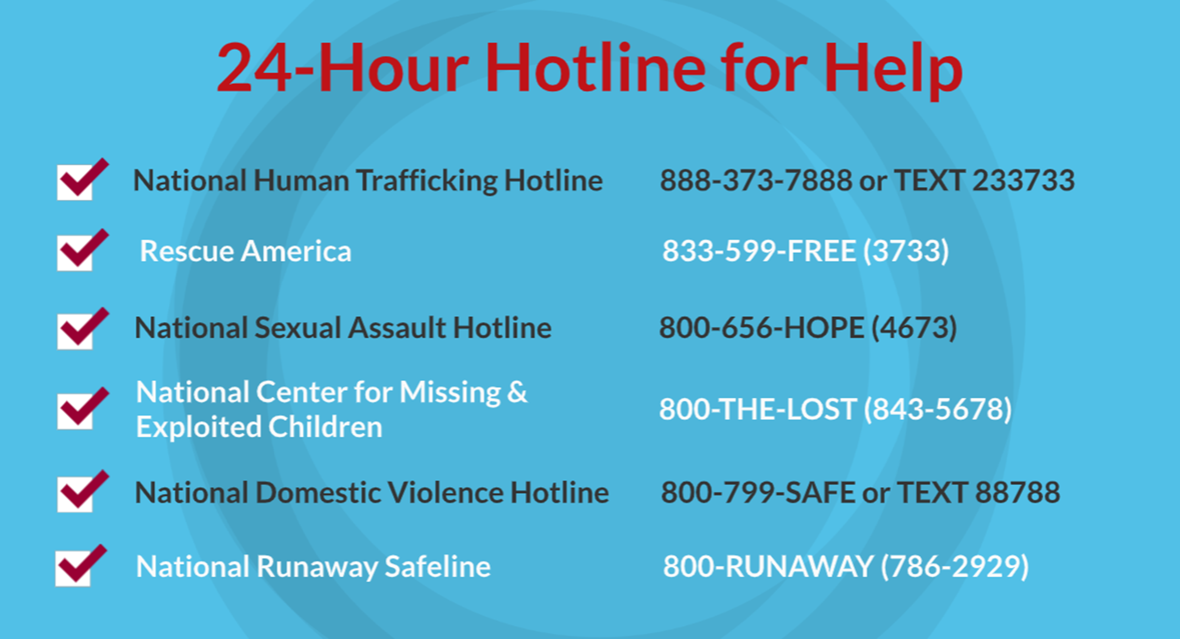
©2024-2026 Walking Wise
114
Notes:
NOTE TO PRESENTER
Presenters may ask their audience to consider adding a few "hotline for help" phone numbers to their cell phone contacts or take a photo of this slide.

Slide 115
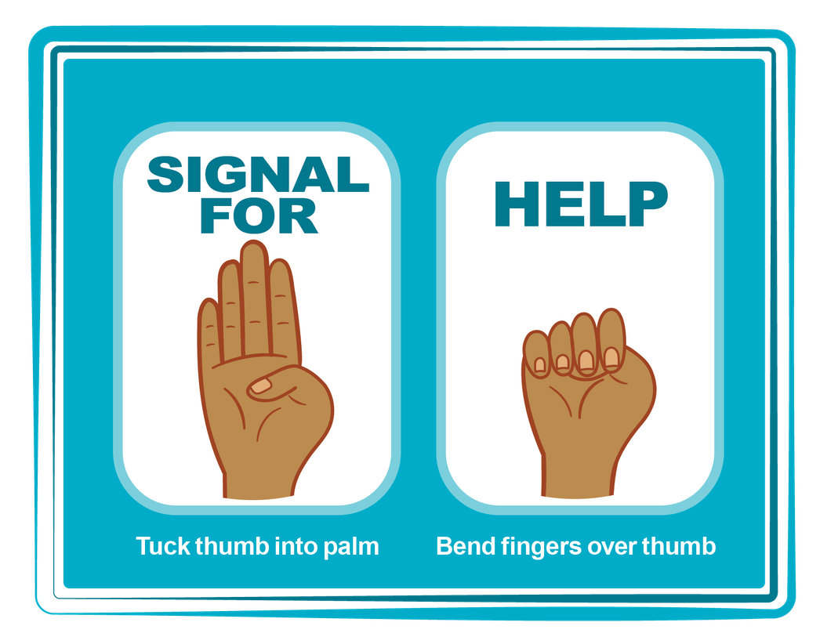
HAND SIGNAL FOR HELP
©2024-2026 Walking Wise
Source: Canadian Women’s Foundation, April 2020
115
Notes:
Although the hand signal for help has not yet achieved universal recognition, it may quietly get someone's attention in urgent situations.
SILENT
It can be used silently.
UNTRACKABLE
It leaves no digital footprint.
CONCEALED
It can be done secretly when a perpetrator is in the vicinity.
SIGNALS DISTRESS
A distressed facial expression can help others recognize that help is needed if the hand signal is not understood—but it is important not to alert the predator/trafficker, causing harm.
Source
Canadian Women's Foundation, April 2020

Slide 116


Thank you!
WalkingWise.com
Online Course for Adults Accredited by:
Postgraduate Institute for Medicine
Academy of Forensic Nursing
©2024-2026 Walking Wise
116
Notes:
NOTE TO PRESENTER
To access additional resources about human traffickers, please refer to the last page of Lesson Plan #9 on the Walking Wise Learning Platform.
We welcome your feedback at support@WalkingWise.com.

