Slide 1


SEXUAL EXPLOITATION
EDUCATION
Human
TRAFFICKERS
LESSON #9
Notes:
NOTE
Log in to WalkingWise.com and refer to the Walking Wise Education Guide to implement classroom teaching tips and check out lesson plan #9.
Most importantly:
• DEFINE SCHOOL POLICY
Establish an anti-trafficking reporting protocol with a trauma-informed response. The Walking Wise Implementation Guide provides a sample protocol.
• AGE & AUDIENCE
This presentation can be edited by following the procedures on page 3 to align with your school policies, specific age groups, and the involvement of at-risk audiences.
• SUPPORT PROCEDURE
Provide your audience with guidance on accessing immediate help or arranging a private meeting with a social worker, counselor, nurse, school resource officer, or another trustworthy staff member to report concerns for themselves or a peer.
• SECOND SAFE ADULT
Ensure a second trustworthy adult, such as a teacher, is present in the learning setting to observe audience reactions and identify those who may benefit from a follow-up meeting. This person should remain focused and free from other duties during your presentation.
• IMPLEMENT SLIDO.com
Join Walking Wise in using Slido.com to create an anonymous user experience.
Contact us at support@WalkingWise.com for more information.

Slide 2

NOTE TO PRESENTER
This presentation is exclusively for Walking Wise® subscribers and not for redistribution.
Walking Wise encourages the use of Slido.com, an interactive digital tool, to enhance audience engagement. For more information, contact us at support@WalkingWise.com. Once configured, integrate Slido polling and add a post-evaluation to the PowerPoint presentation.
Presenters are encouraged to edit speaker notes to match their speaking style (viewable in presentation mode). You can also delete slides from this Walking Wise presentation to make sure the content aligns with your school policies, is age-appropriate, and fits within available class time. However, the existing slides are copyright-protected and may not be modified without prior written permission from Walking Wise.
We encourage you to add your own content by following these instructions:
Insert new PowerPoint slides.
Remove the Walking Wise logo and copyright "©2025 Walking Wise" from the new slides.
Always add your organization's name or logo to each new slide.
Please delete this instruction page before presenting to audiences.
©2024-2026 Walking Wise
2
Notes:
NOTE
The presenter is welcome to customize this Walking Wise presentation according to the instructions provided on this page.
For revision requests, please email us at:
support@WalkingWise.com.

Slide 3

CONFRONTING SEXUAL EXPLOITATION
WALKING WISE
KNOWLEDGE serves as a
powerful defense against
sexual predators.
©2024-2026 Walking Wise
3

Slide 4
CONFRONTING SEXUAL EXPLOITATION
WALKING WISE
SEXUAL EXPLOITATION includes grooming, sextortion, pornography
& sex trafficking.
©2024-2026 Walking Wise
4

Slide 5
SENSITIVE DISCUSSION AHEAD
CONTENT ALERT
We’ll be discussing serious issues about sexual exploitation.
Some parts may be difficult to hear.
If you ever feel uncomfortable, you can step out and speak with a trustworthy adult for support.
You’re not alone—we’re here to help you.
©2024-2026 Walking Wise
5
Notes:
NOTE TO PRESENTER
Please tailor this "content alert" message to align with your organization's policies and protocols.
Please provide a confidential avenue for students to report concerns and seek help for themselves or their peers if they suspect sexual abuse, grooming, sextortion, pornography-related exploitation, or human trafficking. This may include a designated email address or text line.
Please consider displaying posters in your school or facility that outline various ways students can access immediate support or request a private meeting with a school safety team member or another trusted adult.

Slide 6
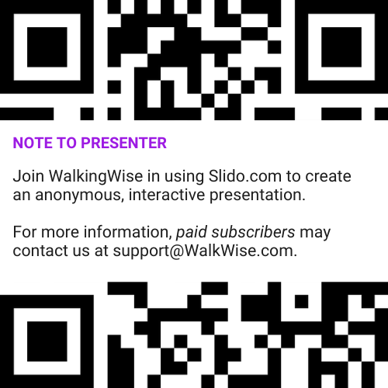
DIGITAL PARTICIPATION
©2024-2026 Walking Wise
6
Notes:
NOTE
For Online Interactive Polling with audiences:
Join Walking Wise in using Slido.com to create an anonymous user experience.
Contact us at support@WalkingWise.com for more information.
Upon Activating Slido.com:
Please verify that the Q&A feature is enabled before presenting to audiences. An adult should monitor questions and comments to ensure they are appropriate. Slido has a feature that allows you to delete unwanted questions and comments.

Slide 7


STATISTICS
Statistics are Only Estimates
🔍 Many sexual crimes are never reported, so study results may not fully reflect what is really happening.
Human
TRAFFICKERS
©2024-2026 Walking Wise
7
Notes:
In this presentation, we'll discuss statistics, but it's important to note that while statistics provide valuable insights into an issue, they cannot be relied upon entirely.
Here are a few reasons:
• UNREPORTED
Victims may stay silent due to fear, shame, or manipulation.
• INCONSISTENT COLLECTION
Geographical areas have different legal definitions for sexual crimes, making data hard to compare.
• FOCUS GROUPS
Small or specific focus groups participating in a study or survey may not accurately reflect the diversity or experiences of the broader population.

Slide 8
STATISTICS
Statistics are Only Estimates
📊 Studies collect information in different ways, which can lead to different results.
Human
TRAFFICKERS
©2024-2026 Walking Wise
8
Notes:
In this presentation, we'll discuss statistics, but it's important to note that while statistics provide valuable insights into an issue, they cannot be relied upon entirely.
Here are a few reasons:
• UNREPORTED
Victims may stay silent due to fear, shame, or manipulation.
• INCONSISTENT COLLECTION
Geographical areas have different legal definitions for sexual crimes, making data hard to compare.
• FOCUS GROUPS
Small or specific focus groups participating in a study or survey may not accurately reflect the diversity or experiences of the broader population.

Slide 9
STATISTICS
Statistics are Only Estimates
👥 Some studies use small groups of people, and those groups may not represent everyone.
Human
TRAFFICKERS
©2024-2026 Walking Wise
9
Notes:
In this presentation, we'll discuss statistics, but it's important to note that while statistics provide valuable insights into an issue, they cannot be relied upon entirely.
Here are a few reasons:
• UNREPORTED
Victims may stay silent due to fear, shame, or manipulation.
• INCONSISTENT COLLECTION
Geographical areas have different legal definitions for sexual crimes, making data hard to compare.
• FOCUS GROUPS
Small or specific focus groups participating in a study or survey may not accurately reflect the diversity or experiences of the broader population.

Slide 10

EDUCATON GUIDE
VOCABULARY
VOCABULARY
Human Trafficker
Pimp
Persona
Coercion
Prostitution
Flatter
Seduce
Vulnerable
Human
TRAFFICKERS
©2024-2026 Walking Wise
10
3
Notes:
NOTE
Understanding vocabulary terms related to the behaviors of sexual predators can empower young people to recognize warning signs of harmful situations.
Knowing terminology helps them identify manipulative tactics predators use to build trust and exploit vulnerabilities.
With this knowledge, young people are better equipped to spot red flags, understand that these behaviors are abusive, and feel more confident reporting predators to trusted adults or authorities, potentially preventing further harm.

Slide 11
EDUCATON GUIDE
VOCABULARY
HUMAN TRAFFICKER
Someone who tricks, pressures, or forces victims to work (labor) or sell sexual acts for the traffickers’ financial gain.
Human
TRAFFICKERS
©2024-2026 Walking Wise
11
3
Notes:
Assisting Source
OpenAI. (2025). ChatGPT (GPT-4) [Large language model]. https://chatgpt.com

Slide 12
EDUCATON GUIDE
VOCABULARY
PIMP
A criminal who operates an illegal business requiring vulnerable people to perform sex acts, often using force, fraud, or coercion.
While the word “pimp” is used as slang and glamorized in some songs and movies, in real life, pimps are traffickers who harm people.
©2024-2026 Walking Wise
12
3
Notes:
Assisting Source
OpenAI. (2025). ChatGPT (GPT-4) [Large language model]. https://chatgpt.com

Slide 13
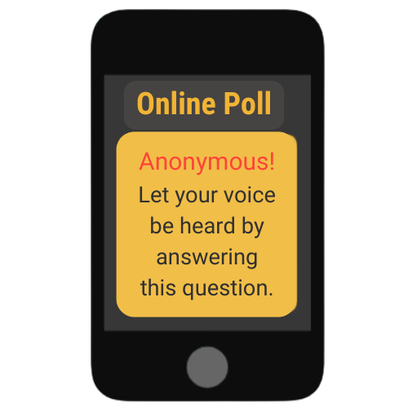
LESSON PLANS
ILLEGAL INDUSTRIES
What are two of the largest illegal industries in the United States?
Human
TRAFFICKERS
©2024-2026 Walking Wise
13
3
Notes:
Online Interactive Polling
SLIDO.com Open Text Poll
What are the two largest illegal industries in the United States?
ANSWER
#1 Drug Trafficking
#2 Human Trafficking
(sex & labor trafficking)
Illegal activities involve extremely large, organized industries that generate billions of dollars each year.
According to estimates, drug trafficking is the biggest illegal industry in the United States, involving the movement and sale of illegal drugs. It is difficult to estimate profits generated in the U.S., but the global drug trade is estimated to be worth $426-652 billion each year.
Human trafficking — including both forced labor and commercial sexual exploitation — is often considered the second-largest illegal industry by profit, generating an estimated $52 billion annually in the U.S. ($236 billion globally).
These industries harm individuals and communities by promoting addiction, exploitation, violence, and the abuse of basic human rights. Understanding the scale and impact of these crimes helps students see why awareness, prevention, and safe reporting are so important.
Source
Major Cities Chiefs Association (2025 April). Reference Guide. Highest Grossing Criminal Trades: Volume 5, Sections 5 and 6. Retrieved January 20, 2026, from https://majorcitieschiefs.com/wp-content/uploads/2025/04/MCCA_Highest-Grossing-Criminal-Trades-Reference-Guide_April-2025.pdf?utm_source=chatgpt.com

Slide 14
ANSWER
#1 Drug Trafficking ~ #2 Human Trafficking are the two largest illegal U.S. industries.
#2 includes Sex & Labor Trafficking
©2024-2026 Walking Wise
Major Cities Chiefs Association (2025 April). Reference Guide. Highest Grossing Criminal Trades: Volume 5, Sections 5 and 6.
14
Notes:
Online Interactive Polling
SLIDO.com Open Text Poll
What are the two largest illegal industries in the United States?
ANSWER
#1 Drug Trafficking
#2 Human Trafficking
(sex & labor trafficking)
Illegal activities involve extremely large, organized industries that generate billions of dollars each year.
According to estimates, drug trafficking is the biggest illegal industry in the United States, involving the movement and sale of illegal drugs. It is difficult to estimate profits generated in the U.S., but the global drug trade is estimated to be worth $426-652 billion each year.
Human trafficking — including both forced labor and commercial sexual exploitation — is often considered the second-largest illegal industry by profit, generating an estimated $52 billion annually in the U.S. ($236 billion globally).
These industries harm individuals and communities by promoting addiction, exploitation, violence, and the abuse of basic human rights. Understanding the scale and impact of these crimes helps students see why awareness, prevention, and safe reporting are so important.
Source
Major Cities Chiefs Association (2025 April). Reference Guide. Highest Grossing Criminal Trades: Volume 5, Sections 5 and 6. Retrieved January 20, 2026, from https://majorcitieschiefs.com/wp-content/uploads/2025/04/MCCA_Highest-Grossing-Criminal-Trades-Reference-Guide_April-2025.pdf?utm_source=chatgpt.com

Slide 15
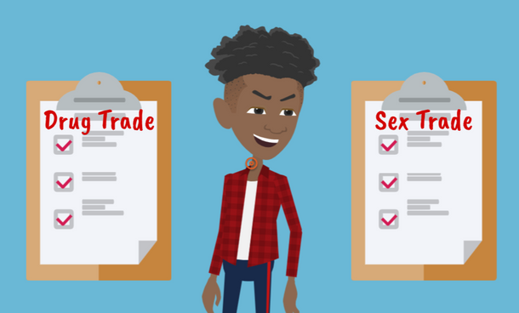
LESSON PLANS
ILLEGAL INDUSTRIES
Why would criminals choose human sex trafficking over drug trafficking?
Human
TRAFFICKERS
©2024-2026 Walking Wise
15
3

Slide 16
ILLEGAL INDUSTRIES
Trafficking Industries
A drug can only be sold once, but a person can be sold repeatedly for money or something of value.
©2024-2026 Walking Wise
Estimating the Size and Structure of the Underground Commercial Sex Economy in Eight Major US Cities (2014), Urban Institute.
16
Notes:
Traffickers often believe they can make more money trafficking people compared to selling drugs, since an individual can be sold repeatedly.
Human traffickers often perceive drug dealing as riskier in terms of legal penalties compared to trafficking vulnerable or young people, where they believe the risk of arrest is lower. (1)
Sex traffickers often coincide peacefully with each other, compared to the territorial behavior of drug dealers.(1)
Source
1. Dank, M., Khan, B., Downey, P. M., Kotonias, C., Mayer, D., Owens, C., Pacifici, L., & Yu, L. (March 2014). Estimating the Size and Structure of the Underground Commercial Sex Economy in Eight Major US Cities. The Urban Institute. Retrieved May 8, 2025, from https://www.urban.org/research/publication/estimating-size-and-structure-underground-commercial-sex-economy-eight-major-us-cities

Slide 17
ILLEGAL INDUSTRIES
Trafficking Industries
It is common for traffickers to engage in both human and drug trafficking.
©2024-2026 Walking Wise
Estimating the Size and Structure of the Underground Commercial Sex Economy in Eight Major US Cities (2014), Urban Institute.
17
Notes:
Traffickers often believe they can make more money trafficking people compared to selling drugs, since an individual can be sold repeatedly.
Human traffickers often perceive drug dealing as riskier in terms of legal penalties compared to trafficking vulnerable or young people, where they believe the risk of arrest is lower. (1)
Sex traffickers often coincide peacefully with each other, compared to the territorial behavior of drug dealers.(1)
Source
1. Dank, M., Khan, B., Downey, P. M., Kotonias, C., Mayer, D., Owens, C., Pacifici, L., & Yu, L. (March 2014). Estimating the Size and Structure of the Underground Commercial Sex Economy in Eight Major US Cities. The Urban Institute. Retrieved May 8, 2025, from https://www.urban.org/research/publication/estimating-size-and-structure-underground-commercial-sex-economy-eight-major-us-cities

Slide 18
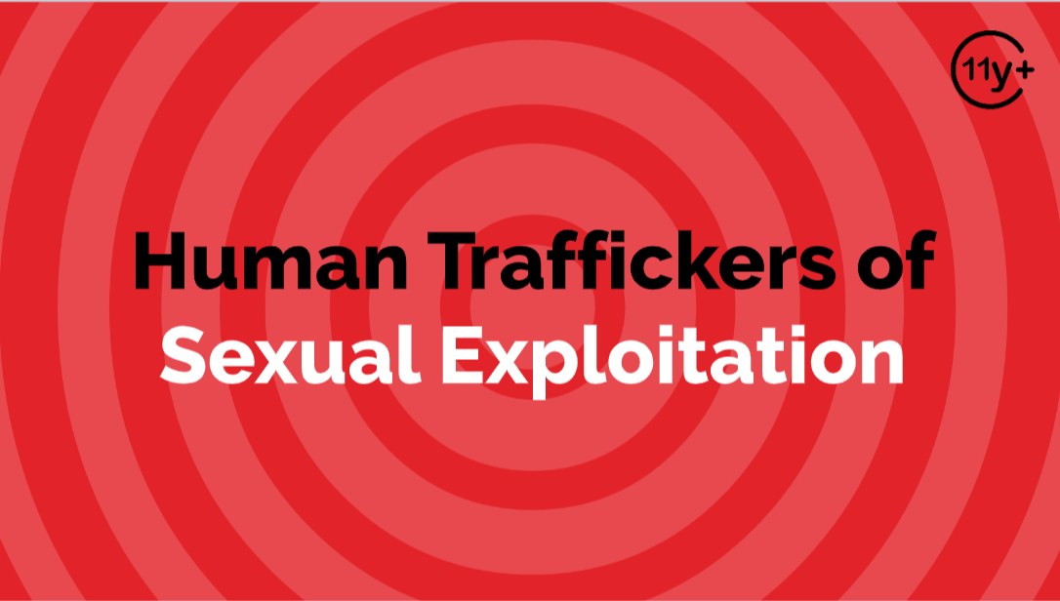
Log in to WalkingWise.com to access this animated video.
©2024-2026 Walking Wise
18
Notes:
Message Especially for Teens:
Explainer-style animation is widely used by businesses worldwide for employee training.
Similarly, the Walking Wise animated video series is designed for teenagers (ages 11+) and adults to understand how sexual predators use manipulation, intimidation, and coercion to exploit young people.
NOTE
Log in to Walking Wise.com to watch the three-minute animated video with audiences.

Slide 19
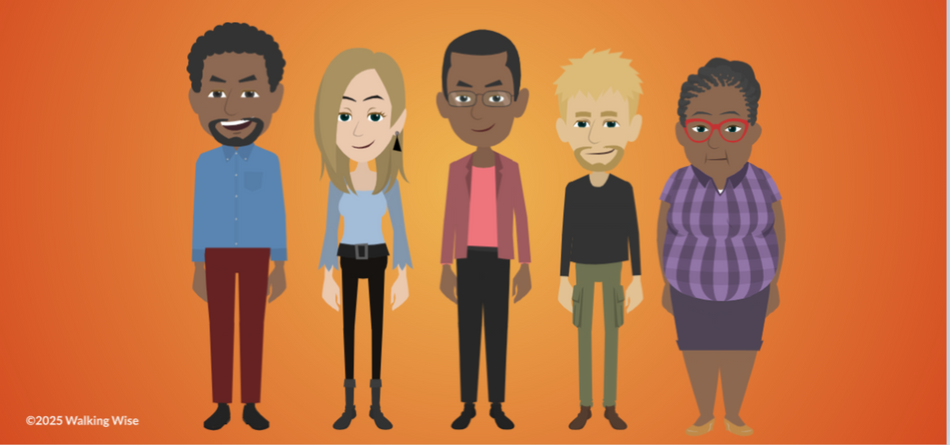
LESSON PLANS
TRAFFICKERS
Who can be a human trafficker?
Human
TRAFFICKERS
©2024-2026 Walking Wise
19
3

Slide 20
TRAFFICKERS
Types of Human Traffickers
Family Members
Human
TRAFFICKERS
©2024-2026 Walking Wise
Sprang, G., Cole, C. (2018, February 13). Familial Sex Trafficking of Minors: Trafficking Conditions, Clinical Presentation, and System Involvement, p. 1.
20
Notes:
Source
Sprang, G., Cole, C. (2018, February 13). Familial Sex Trafficking of Minors: Trafficking Conditions, Clinical Presentation, and System Involvement, p. 1. Retrieved March 9, 2024, from https://www.researchgate.net/publication/323158066_Familial_Sex_Trafficking_of_Minors_Trafficking_Conditions_Clinical_Presentation_and_System_Involvement

Slide 21
TRAFFICKERS
Types of Human Traffickers
Family Members
Caregivers
Human
TRAFFICKERS
©2024-2026 Walking Wise
Sprang, G., Cole, C. (2018, February 13). Familial Sex Trafficking of Minors: Trafficking Conditions, Clinical Presentation, and System Involvement, p. 1.
21
Notes:
Source
Sprang, G., Cole, C. (2018, February 13). Familial Sex Trafficking of Minors: Trafficking Conditions, Clinical Presentation, and System Involvement, p. 1. Retrieved March 9, 2024, from https://www.researchgate.net/publication/323158066_Familial_Sex_Trafficking_of_Minors_Trafficking_Conditions_Clinical_Presentation_and_System_Involvement

Slide 22
TRAFFICKERS
Types of Human Traffickers
Family Members
Caregivers
Authority Figures
Human
TRAFFICKERS
©2024-2026 Walking Wise
Sprang, G., Cole, C. (2018, February 13). Familial Sex Trafficking of Minors: Trafficking Conditions, Clinical Presentation, and System Involvement, p. 1.
22
Notes:
Source
Sprang, G., Cole, C. (2018, February 13). Familial Sex Trafficking of Minors: Trafficking Conditions, Clinical Presentation, and System Involvement, p. 1. Retrieved March 9, 2024, from https://www.researchgate.net/publication/323158066_Familial_Sex_Trafficking_of_Minors_Trafficking_Conditions_Clinical_Presentation_and_System_Involvement

Slide 23
TRAFFICKERS
Types of Human Traffickers
Family Members
Caregivers
Authority Figures
Acquaintances
Human
TRAFFICKERS
©2024-2026 Walking Wise
Sprang, G., Cole, C. (2018, February 13). Familial Sex Trafficking of Minors: Trafficking Conditions, Clinical Presentation, and System Involvement, p. 1.
23
Notes:
Source
Sprang, G., Cole, C. (2018, February 13). Familial Sex Trafficking of Minors: Trafficking Conditions, Clinical Presentation, and System Involvement, p. 1. Retrieved March 9, 2024, from https://www.researchgate.net/publication/323158066_Familial_Sex_Trafficking_of_Minors_Trafficking_Conditions_Clinical_Presentation_and_System_Involvement

Slide 24
TRAFFICKERS
Types of Human Traffickers
Family Members
Caregivers
Authority Figures
Acquaintances
Strangers
Human
TRAFFICKERS
©2024-2026 Walking Wise
Sprang, G., Cole, C. (2018, February 13). Familial Sex Trafficking of Minors: Trafficking Conditions, Clinical Presentation, and System Involvement, p. 1.
24
Notes:
Source
Sprang, G., Cole, C. (2018, February 13). Familial Sex Trafficking of Minors: Trafficking Conditions, Clinical Presentation, and System Involvement, p. 1. Retrieved March 9, 2024, from https://www.researchgate.net/publication/323158066_Familial_Sex_Trafficking_of_Minors_Trafficking_Conditions_Clinical_Presentation_and_System_Involvement

Slide 25
TRAFFICKERS
Types of Human Traffickers
Family Members
Caregivers
Authority Figures
Acquaintances
Strangers
Third-Party Exploiters (Pimps)
Human
TRAFFICKERS
©2024-2026 Walking Wise
Sprang, G., Cole, C. (2018, February 13). Familial Sex Trafficking of Minors: Trafficking Conditions, Clinical Presentation, and System Involvement, p. 1.
25
Notes:
Source
Sprang, G., Cole, C. (2018, February 13). Familial Sex Trafficking of Minors: Trafficking Conditions, Clinical Presentation, and System Involvement, p. 1. Retrieved March 9, 2024, from https://www.researchgate.net/publication/323158066_Familial_Sex_Trafficking_of_Minors_Trafficking_Conditions_Clinical_Presentation_and_System_Involvement

Slide 26
VOCABULARY
PERSONA
The image or personality that a person presents in public or to another person, which may be different from their true self.
©2024-2026 Walking Wise
26

Slide 27
PERSONA
Hidden Persona
Some people have two very different sides to their personality (persona).
©2024-2026 Walking Wise
27

Slide 28
PERSONA
Hidden Persona
Some people have two very different sides to their personality (persona), for example:
First Persona: Kind & Friendly
Second Persona: Cruel & Scary
©2024-2026 Walking Wise
28

Slide 29
PERSONA
Hidden Persona
The person might act kindly at first, then suddenly change and become controlling and aggressive.
©2024-2026 Walking Wise
29

Slide 30
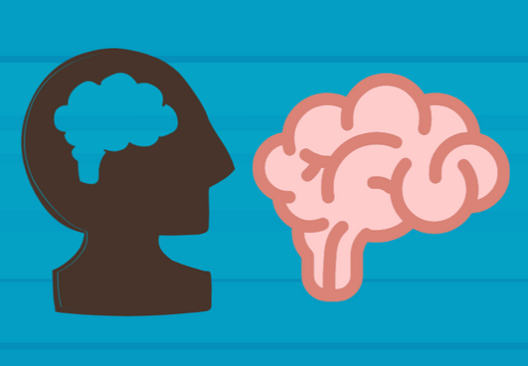
LESSON PLANS
TRAFFICKER BEHAVIORS
What are some common character traits and behaviors of human traffickers?
Human
TRAFFICKERS
©2024-2026 Walking Wise
30
3

Slide 31
TRAFFICKER BEHAVIORS
Common Behaviors
Sense of entitlement or that rules don’t apply to them
Human
TRAFFICKERS
©2024-2026 Walking Wise
American Psychiatric Association (2022); Zeigler-Hill, V. et al. (2013).
31
Notes:
• CHARACTERISTICS
Traffickers often exhibit narcissistic traits, including an inflated sense of self-importance and a strong need for excessive attention and admiration.
Common characteristics among traffickers may include: a sense of entitlement, expecting others to meet their demands, along with a lack of empathy, a tendency to exploit others for personal gain, feelings of resentment, and displays of sexual aggression or hostility.
Source
American Psychiatric Association (2022, March 18). APA releases Diagnostic and Statistical Manual of Mental Disorders, Fifth Edition, Text Revision (DSM-5-TR).
Sprang, G., Cole, C. (2018, February 13). Familial Sex Trafficking of Minors: Trafficking Conditions, Clinical Presentation, and System Involvement, p. 1. Retrieved April 17, 2025, from https://www.researchgate.net/publication/323158066_Familial_Sex_Trafficking_of_Minors_Trafficking_Conditions_Clinical_Presentation_and_System_Involvement

Slide 32
TRAFFICKER BEHAVIORS
Common Behaviors
Sense of entitlement or that rules don’t apply to them
Expect others to meet their demands
Human
TRAFFICKERS
©2024-2026 Walking Wise
American Psychiatric Association (2022); Zeigler-Hill, V. et al. (2013).
32
Notes:
• CHARACTERISTICS
Traffickers often exhibit narcissistic traits, including an inflated sense of self-importance and a strong need for excessive attention and admiration.
Common characteristics among traffickers may include: a sense of entitlement, expecting others to meet their demands, along with a lack of empathy, a tendency to exploit others for personal gain, feelings of resentment, and displays of sexual aggression or hostility.
Source
American Psychiatric Association (2022, March 18). APA releases Diagnostic and Statistical Manual of Mental Disorders, Fifth Edition, Text Revision (DSM-5-TR).
Sprang, G., Cole, C. (2018, February 13). Familial Sex Trafficking of Minors: Trafficking Conditions, Clinical Presentation, and System Involvement, p. 1. Retrieved April 17, 2025, from https://www.researchgate.net/publication/323158066_Familial_Sex_Trafficking_of_Minors_Trafficking_Conditions_Clinical_Presentation_and_System_Involvement

Slide 33
TRAFFICKER BEHAVIORS
Common Behaviors
Sense of entitlement or that rules don’t apply to them
Expect others to meet their demands
Lacks empathy or has no concern for others
Human
TRAFFICKERS
©2024-2026 Walking Wise
American Psychiatric Association (2022); Zeigler-Hill, V. et al. (2013).
33
Notes:
• CHARACTERISTICS
Traffickers often exhibit narcissistic traits, including an inflated sense of self-importance and a strong need for excessive attention and admiration.
Common characteristics among traffickers may include: a sense of entitlement, expecting others to meet their demands, along with a lack of empathy, a tendency to exploit others for personal gain, feelings of resentment, and displays of sexual aggression or hostility.
Source
American Psychiatric Association (2022, March 18). APA releases Diagnostic and Statistical Manual of Mental Disorders, Fifth Edition, Text Revision (DSM-5-TR).
Sprang, G., Cole, C. (2018, February 13). Familial Sex Trafficking of Minors: Trafficking Conditions, Clinical Presentation, and System Involvement, p. 1. Retrieved April 17, 2025, from https://www.researchgate.net/publication/323158066_Familial_Sex_Trafficking_of_Minors_Trafficking_Conditions_Clinical_Presentation_and_System_Involvement

Slide 34
TRAFFICKER BEHAVIORS
Common Behaviors
Sense of entitlement or that rules don’t apply to them
Expect others to meet their demands
Lacks empathy or has no concern for others
Exploits or uses others for personal gain
Human
TRAFFICKERS
©2024-2026 Walking Wise
American Psychiatric Association (2022); Zeigler-Hill, V. et al. (2013).
34
Notes:
• CHARACTERISTICS
Traffickers often exhibit narcissistic traits, including an inflated sense of self-importance and a strong need for excessive attention and admiration.
Common characteristics among traffickers may include: a sense of entitlement, expecting others to meet their demands, along with a lack of empathy, a tendency to exploit others for personal gain, feelings of resentment, and displays of sexual aggression or hostility.
Source
American Psychiatric Association (2022, March 18). APA releases Diagnostic and Statistical Manual of Mental Disorders, Fifth Edition, Text Revision (DSM-5-TR).
Sprang, G., Cole, C. (2018, February 13). Familial Sex Trafficking of Minors: Trafficking Conditions, Clinical Presentation, and System Involvement, p. 1. Retrieved April 17, 2025, from https://www.researchgate.net/publication/323158066_Familial_Sex_Trafficking_of_Minors_Trafficking_Conditions_Clinical_Presentation_and_System_Involvement

Slide 35
TRAFFICKER BEHAVIORS
Common Behaviors
Sense of entitlement or that rules don’t apply to them
Expect others to meet their demands
Lacks empathy or has no concern for others
Exploits or uses others for personal gain
Displays sexual aggression or hostility
Human
TRAFFICKERS
©2024-2026 Walking Wise
American Psychiatric Association (2022); Zeigler-Hill, V. et al. (2013).
35
Notes:
• CHARACTERISTICS
Traffickers often exhibit narcissistic traits, including an inflated sense of self-importance and a strong need for excessive attention and admiration.
Common characteristics among traffickers may include: a sense of entitlement, expecting others to meet their demands, along with a lack of empathy, a tendency to exploit others for personal gain, feelings of resentment, and displays of sexual aggression or hostility.
Source
American Psychiatric Association (2022, March 18). APA releases Diagnostic and Statistical Manual of Mental Disorders, Fifth Edition, Text Revision (DSM-5-TR).
Sprang, G., Cole, C. (2018, February 13). Familial Sex Trafficking of Minors: Trafficking Conditions, Clinical Presentation, and System Involvement, p. 1. Retrieved April 17, 2025, from https://www.researchgate.net/publication/323158066_Familial_Sex_Trafficking_of_Minors_Trafficking_Conditions_Clinical_Presentation_and_System_Involvement

Slide 36
EDUCATON GUIDE
VOCABULARY
COERCION
To pressure, manipulate, threaten, or intimidate someone into acting against their will.
Human
TRAFFICKERS
©2024-2026 Walking Wise
36
3
Notes:
Assisting Source
OpenAI. (2025). ChatGPT (GPT-4) [Large language model]. https://chatgpt.com

Slide 37
LESSON PLANS
CRIME AGAINST MINORS
What tactic must be used for someone to be charged with trafficking a child (under 18)?
Human
TRAFFICKERS
©2024-2026 Walking Wise
37
3
Notes:
Online Interactive Polling
SLIDO.com Multiple Choice
What tactic must be used for someone to be charged with a trafficking crime against a child (under 18)?
A) Force (violence)
B) Fraud (lies)
C) Coercion (threats)
D) None of the above
ANSWER
D) None of the above.
Force, fraud, and coercion are often grouped together because they explain how exploitation happens.
When a minor is involved in a sex act for anything of value, the law considers it trafficking even if none of these tactics are used.
Source
One Hundred Sixth Congress of the United States of America at the Second Session (2000, January
24) Victims of Trafficking and Violence Protection Act of 2000. GovInfo.gov. Retrieved January 20, 2026,
from https://www.govinfo.gov/content/pkg/BILLS-106hr3244enr/pdf/BILLS-106hr3244enr.pdf

Slide 38
ANSWER
None of the above. When a minor is involved in a sex act for anything of value, the law considers it trafficking even if force, fraud, and coercion are not used.
One Hundred Sixth Congress of the United States of America at the Second Session (2000). Victims of Trafficking and Violence Protection Act of 2000. GovInfo.gov.
38
©2024-2026 Walking Wise
Notes:
Online Interactive Polling
SLIDO.com Multiple Choice
What tactic must be used for someone to be charged with a trafficking crime against a child (under 18)?
A) Force (violence)
B) Fraud (lies)
C) Coercion (threats)
D) None of the above
ANSWER
D) None of the above.
Force, fraud, and coercion are often grouped together because they explain how exploitation happens.
When a minor is involved in a sex act for anything of value, the law considers it trafficking even if none of these tactics are used.
Source
One Hundred Sixth Congress of the United States of America at the Second Session (2000, January
24) Victims of Trafficking and Violence Protection Act of 2000. GovInfo.gov. Retrieved January 20, 2026,
from https://www.govinfo.gov/content/pkg/BILLS-106hr3244enr/pdf/BILLS-106hr3244enr.pdf

Slide 39
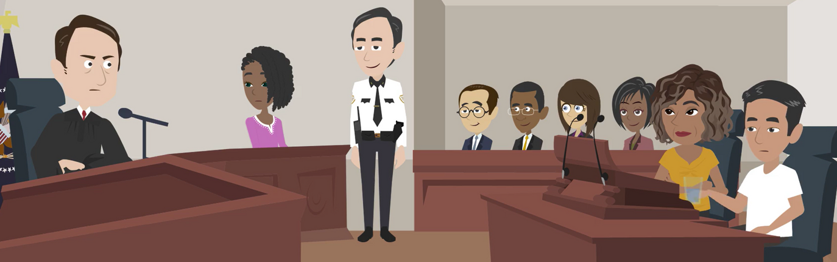
LESSON PLANS
TRAFFICKING LAWS
How do U.S. laws protect people from human sex trafficking crimes?
Human
TRAFFICKERS
©2024-2026 Walking Wise
39
3

Slide 40
TRAFFICKING LAWS
Legal Accountability
Illegal Exchange: No one can cause another person to take part in a sex act in exchange for anything of value.
©2024-2026 Walking Wise
H.R.3244 - Victims of Trafficking and Violence Protection Act of 2000
40
Notes:
In the United States, human sex trafficking is addressed through both federal and state laws.
Federal laws (Victims of Trafficking and Violence Protection Act) create a nationwide standard for identifying trafficking crimes and prosecuting offenders, especially when crimes cross state lines.
Individual states also have their own laws that may add protections, increase penalties, or provide specific support for victims.
Together, these laws are designed to protect victims and hold abusers legally accountable.
Source
One Hundred Sixth Congress of the United States of America at the Second Session (2000, January 24). Victims of Trafficking and Violence Protection Act of 2000. Govinfo.gov. Retrieved May 8, 2025, from https://www.govinfo.gov/content/pkg/BILLS-106hr3244enr/pdf/BILLS-106hr3244enr.pdf

Slide 41
TRAFFICKING LAWS
Legal Accountability
Adults 18+: If force, fraud, or coercion is used to exploit an adult, the abuser is charged as a sex trafficker.
©2024-2026 Walking Wise
H.R.3244 - Victims of Trafficking and Violence Protection Act of 2000
41
Notes:
In the United States, human sex trafficking is addressed through both federal and state laws.
Federal laws (Victims of Trafficking and Violence Protection Act) create a nationwide standard for identifying trafficking crimes and prosecuting offenders, especially when crimes cross state lines.
Individual states also have their own laws that may add protections, increase penalties, or provide specific support for victims.
Together, these laws are designed to protect victims and hold abusers legally accountable.
Source
One Hundred Sixth Congress of the United States of America at the Second Session (2000, January 24). Victims of Trafficking and Violence Protection Act of 2000. Govinfo.gov. Retrieved May 8, 2025, from https://www.govinfo.gov/content/pkg/BILLS-106hr3244enr/pdf/BILLS-106hr3244enr.pdf

Slide 42
TRAFFICKING LAWS
Legal Accountability
Minors (Under 18): Any time a child is involved in a sex act for something of value, the abuser is charged as a sex trafficker.
©2024-2026 Walking Wise
H.R.3244 - Victims of Trafficking and Violence Protection Act of 2000
42
Notes:
In the United States, human sex trafficking is addressed through both federal and state laws.
Federal laws (Victims of Trafficking and Violence Protection Act) create a nationwide standard for identifying trafficking crimes and prosecuting offenders, especially when crimes cross state lines.
Individual states also have their own laws that may add protections, increase penalties, or provide specific support for victims.
Together, these laws are designed to protect victims and hold abusers legally accountable.
Source
One Hundred Sixth Congress of the United States of America at the Second Session (2000, January 24). Victims of Trafficking and Violence Protection Act of 2000. Govinfo.gov. Retrieved May 8, 2025, from https://www.govinfo.gov/content/pkg/BILLS-106hr3244enr/pdf/BILLS-106hr3244enr.pdf

Slide 43
LESSON PLANS
TRAFFICKER STYLES
Which term is NOT used to describe how a human sex trafficker operates?
Human
TRAFFICKERS
©2024-2026 Walking Wise
43
3
Notes:
Online Interactive Polling
SLIDO.com Multiple Choice
Which term is NOT used to describe how a human sex trafficker operates?
A) Romeo Pimp
B) Liberty Pimp
C) Gorilla Pimp
D) CEO Pimp
ANSWER
B) Liberty Pimp is not a real trafficking term because trafficking involves taking away a person’s freedom, independence, and ability to choose.

Slide 44
ANSWER
Liberty Pimp is NOT a real term.
Trafficking involves depriving a person of their freedom, independence, and ability to choose.
©2024-2026 Walking Wise
44
Notes:
Online Interactive Polling
SLIDO.com Multiple Choice
Which term is NOT used to describe how a human sex trafficker operates?
A) Romeo Pimp
B) Liberty Pimp
C) Gorilla Pimp
D) CEO Pimp
ANSWER
B) Liberty Pimp is not a real trafficking term because trafficking involves taking away a person’s freedom, independence, and ability to choose.

Slide 45
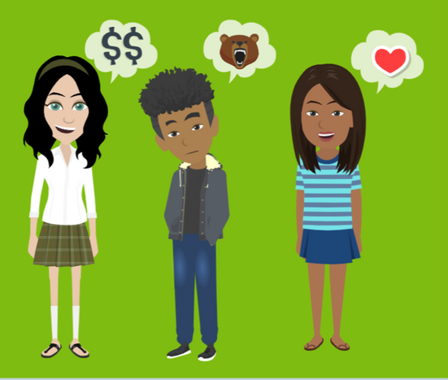
LESSON PLANS
TRAFFICKER STYLES
What strategies might the 3 types of traffickers use to maintain control over their victims?
Human
TRAFFICKERS
©2024-2026 Walking Wise
45
3

Slide 46
TRAFFICKER STYLE
Romeo Pimp
Builds Trust First: Gives attention, kindness, and fulfills unmet needs.
©2024-2026 Walking Wise
46
Notes:
The three “styles” describe patterns of behavior, not labels traffickers use for themselves. A trafficker may use more than one style over time, and all styles are forms of manipulation and control.
• ROMEO PIMPS
“Romeo” refers to the famous romantic character in the tragic love story by William Shakespeare, Romeo and Juliet, published in 1597.

Slide 47
TRAFFICKER STYLE
Romeo Pimp
Creates Emotional Bonds: Uses gifts, promises, and affection to manipulate.
©2024-2026 Walking Wise
47
Notes:
The three “styles” describe patterns of behavior, not labels traffickers use for themselves. A trafficker may use more than one style over time, and all styles are forms of manipulation and control.
• ROMEO PIMPS
“Romeo” refers to the famous romantic character in the tragic love story by William Shakespeare, Romeo and Juliet, published in 1597.

Slide 48
TRAFFICKER STYLE
Romeo Pimp
Shifts to Control: Gradually isolate victims and harm their self-esteem to increase dependence.
©2024-2026 Walking Wise
48
Notes:
The three “styles” describe patterns of behavior, not labels traffickers use for themselves. A trafficker may use more than one style over time, and all styles are forms of manipulation and control.
• ROMEO PIMPS
“Romeo” refers to the famous romantic character in the tragic love story by William Shakespeare, Romeo and Juliet, published in 1597.

Slide 49
TRAFFICKER STYLE
Gorilla Pimp
Uses Fear & Violence: Relies on physical force, threats, and intimidation to control victims.
©2024-2026 Walking Wise
49
Notes:
The three “styles” describe patterns of behavior, not labels traffickers use for themselves. A trafficker may use more than one style over time, and all styles are forms of manipulation and control.
• GORILLA PIMPS
Gorilla pimps commonly isolate victims from family and friends and force them into criminal activity such as drug trafficking and theft.

Slide 50
TRAFFICKER STYLE
Gorilla Pimp
Maintains Control: Instills fear by punishing victims if they disobey or try to leave.
©2024-2026 Walking Wise
50
Notes:
The three “styles” describe patterns of behavior, not labels traffickers use for themselves. A trafficker may use more than one style over time, and all styles are forms of manipulation and control.
• GORILLA PIMPS
Gorilla pimps commonly isolate victims from family and friends and force them into criminal activity such as drug trafficking and theft.

Slide 51
TRAFFICKER STYLE
CEO Pimp
Business-Like Manipulation: Presents exploitation as a business opportunity or partnership.
©2024-2026 Walking Wise
51
Notes:
• CEO PIMPS
They use a business-like approach to fool their victims. They display confidence, demonstrating intelligence and connections to influential people across industries such as entertainment, fashion, and travel.
The acronym "CEO" stands for Chief Executive Officer, the highest-ranking person in a company.

Slide 52
TRAFFICKER STYLE
CEO Pimp
Appears Confident & Influential: Brags about connections in industries such as entertainment, fashion, or travel.
©2024-2026 Walking Wise
52
Notes:
• CEO PIMPS
They use a business-like approach to fool their victims. They display confidence, demonstrating intelligence and connections to influential people across industries such as entertainment, fashion, and travel.
The acronym "CEO" stands for Chief Executive Officer, the highest-ranking person in a company.

Slide 53
TRAFFICKER STYLE
CEO Pimp
False Promises: Promises of success, money, fame, or a better life.
©2024-2026 Walking Wise
53
Notes:
• CEO PIMPS
They use a business-like approach to fool their victims. They display confidence, demonstrating intelligence and connections to influential people across industries such as entertainment, fashion, and travel.
The acronym "CEO" stands for Chief Executive Officer, the highest-ranking person in a company.

Slide 54
TRAFFICKER STYLE
CEO Pimp
Isolation & Control: Separates victims from family and friends to maintain dependence.
©2024-2026 Walking Wise
54
Notes:
• CEO PIMPS
They use a business-like approach to fool their victims. They display confidence, demonstrating intelligence and connections to influential people across industries such as entertainment, fashion, and travel.
The acronym "CEO" stands for Chief Executive Officer, the highest-ranking person in a company.

Slide 55
TRAFFICKER STYLE
CEO Pimp
Forces Criminal Activity: May pressure or force victims to commit crimes, like theft or selling illegal drugs.
©2024-2026 Walking Wise
55
Notes:
• CEO PIMPS
They use a business-like approach to fool their victims. They display confidence, demonstrating intelligence and connections to influential people across industries such as entertainment, fashion, and travel.
The acronym "CEO" stands for Chief Executive Officer, the highest-ranking person in a company.

Slide 56
EDUCATON GUIDE
VOCABULARY
VULNERABLE
One who is at risk of physical or emotional harm due to a lack of knowledge, support, or protection.
Human
TRAFFICKERS
©2024-2026 Walking Wise
56
3
Notes:
Assisting Source
OpenAI. (2025). ChatGPT (GPT-4) [Large language model]. https://chatgpt.com

Slide 57
EDUCATON GUIDE
VOCABULARY
FLATTER
To give excessive or insincere praise to a vulnerable person as a form of manipulation.
Human
TRAFFICKERS
©2024-2026 Walking Wise
57
3
Notes:
Assisting Source
OpenAI. (2025). ChatGPT (GPT-4) [Large language model]. https://chatgpt.com

Slide 58
EDUCATON GUIDE
VOCABULARY
SEDUCE
To persuade or tempt someone using manipulation, like charm and flattery, to do something they might not normally do.
Human
TRAFFICKERS
©2024-2026 Walking Wise
58
3
Notes:
Assisting Source
OpenAI. (2025). ChatGPT (GPT-4) [Large language model]. https://chatgpt.com

Slide 59
POWER OF LOVE
What percentage of female victims are exploited by ‘boyfriends’ or husbands?
Human
TRAFFICKERS
©2024-2026 Walking Wise
59
Notes:
Online Interactive Polling
SLIDO.com Multiple Choice
What percentage of female victims were trafficked by "boyfriends" or husbands?
A) ~9%
B) ~19%
C) ~29%
D) ~39%
ANSWER:
D) ~39% of female victims are trafficked by a boyfriend, romantic partner, or husband.
According to the Polaris Project, about 39% of female trafficking victims were trafficked by a boyfriend, romantic partner, or husband. This highlights how traffickers often use romantic relationships and trust as a way to groom, control, and exploit victims rather than relying only on force.
Source
Polaris Project (n.d.). Love and Trafficking: Grooming, Exploitation, and Control. Retrieved May 8, 2025, from https://polarisproject.org/love-and-trafficking/

Slide 60
ANSWER
~39% of female victims were trafficked by a boyfriend, romantic partner, or husband.
©2024-2026 Walking Wise
Polaris Project (n.d.). Love and Trafficking: Grooming, Exploitation, and Control.
60
Notes:
SLIDO.com Multiple Choice
What percentage of female victims were trafficked by 'boyfriends' or husbands?
A) ~9%
B) ~19%
C) ~29%
D) ~39%
ANSWER:
D) ~39% of female victims are trafficked by a boyfriend, romantic partner, or husband.
According to the Polaris Project, about 39% of female trafficking victims were trafficked by a boyfriend, romantic partner, or husband. This highlights how traffickers often use romantic relationships and trust as a way to groom, control, and exploit victims rather than relying only on force.
Source
Polaris Project (n.d.). Love and Trafficking: Grooming, Exploitation, and Control. Retrieved May 8, 2025, from https://polarisproject.org/love-and-trafficking/

Slide 61

LESSON PLANS
POWER OF LOVE
Why can feelings of ‘love’ make it harder for victims to break free from traffickers?
Human
TRAFFICKERS
©2024-2026 Walking Wise
61
3

Slide 62
POWER OF LOVE
Love’s Chemical Reaction
Brain Reward System: The brain releases chemicals like dopamine, which create feelings of connection and trust.
©2024-2026 Walking Wise
Love and the Brain (2015), Harvard Medical School, hms.harvard.edu.
62
Notes:
• TRAFFICKER'S BONDS
This bond is not real or healthy love. It is a form of manipulation that uses normal brain responses to control someone. The victim is not choosing this bond—it develops because of how the brain responds to attention, care, and attachment.
• LOVE & THE BRAIN
Love is chemically induced through the brain's reward circuit, where dopamine and other potent hormones flood the brain.[1]
Traffickers often insincerely romance their victims because they understand that the brain-triggered emotions involved with falling in love create a bond that is extremely difficult to break.
Traffickers patiently nurture their victims with false love until this manipulation takes control over the victim’s emotional independence.
Source
Love and the Brain (2015).
Harvard Medical School
https://hms.harvard.edu/news-events/publications-archive/brain/love-brain#:~:text=Being%20love%2Dstruck%20also%20releases,use%20of%20cocaine%20or%20alcohol

Slide 63
POWER OF LOVE
Love’s Chemical Reaction
Emotional Bond: These brain-driven feelings can form a powerful bond that makes separation feel painful.
©2024-2026 Walking Wise
Love and the Brain (2015), Harvard Medical School, hms.harvard.edu.
63
Notes:
• TRAFFICKER'S BONDS
This bond is not real or healthy love. It is a form of manipulation that uses normal brain responses to control someone. The victim is not choosing this bond—it develops because of how the brain responds to attention, care, and attachment.
• LOVE & THE BRAIN
Love is chemically induced through the brain's reward circuit, where dopamine and other potent hormones flood the brain.[1]
Traffickers often insincerely romance their victims because they understand that the brain-triggered emotions involved with falling in love create a bond that is extremely difficult to break.
Traffickers patiently nurture their victims with false love until this manipulation takes control over the victim’s emotional independence.
Source
Love and the Brain (2015).
Harvard Medical School
https://hms.harvard.edu/news-events/publications-archive/brain/love-brain#:~:text=Being%20love%2Dstruck%20also%20releases,use%20of%20cocaine%20or%20alcohol

Slide 64
POWER OF LOVE
Love’s Chemical Reaction
Love Bond: Traffickers can create this bond by acting like a romantic partner, caring adult (parent figure), or close friend.
©2024-2026 Walking Wise
Love and the Brain (2015), Harvard Medical School, hms.harvard.edu.
64
Notes:
• TRAFFICKER'S BONDS
This bond is not real or healthy love. It is a form of manipulation that uses normal brain responses to control someone. The victim is not choosing this bond—it develops because of how the brain responds to attention, care, and attachment.
• LOVE & THE BRAIN
Love is chemically induced through the brain's reward circuit, where dopamine and other potent hormones flood the brain.[1]
Traffickers often insincerely romance their victims because they understand that the brain-triggered emotions involved with falling in love create a bond that is extremely difficult to break.
Traffickers patiently nurture their victims with false love until this manipulation takes control over the victim’s emotional independence.
Source
Love and the Brain (2015).
Harvard Medical School
https://hms.harvard.edu/news-events/publications-archive/brain/love-brain#:~:text=Being%20love%2Dstruck%20also%20releases,use%20of%20cocaine%20or%20alcohol

Slide 65
POWER OF LOVE
Trauma Bond Process
Trust: Traffickers build trust by being supportive and caring.
©2024-2026 Walking Wise
Cleveland Clinic (2023, March 29). Here's What Trauma Bonding Really Is and How To Recognize the Signs.
65
Notes:
• TRAUMA BOND
This bond can occur through repetitive cycles of abuse, followed by moments of affection. These patterns create a psychological response in the victim, leading to a cycle of love and fear.
Ultimately, the dynamic can cause victims to form an attachment and be loyal to the trafficker due to their need to recapture the love they thought was genuine.
SOURCE
Cleveland Clinic (2023, March 29). Here's What Trauma Bonding Really Is and How To Recognize the Signs. Retrieved April 23, 2025, from https://health.clevelandclinic.org/trauma-bonding

Slide 66
POWER OF LOVE
Trauma Bond Process
Love: They ‘act’ romantic or protective, making victims feel valued and special.
©2024-2026 Walking Wise
Cleveland Clinic (2023, March 29). Here's What Trauma Bonding Really Is and How To Recognize the Signs.
66
Notes:
• TRAUMA BOND
This bond can occur through repetitive cycles of abuse, followed by moments of affection. These patterns create a psychological response in the victim, leading to a cycle of love and fear.
Ultimately, the dynamic can cause victims to form an attachment and be loyal to the trafficker due to their need to recapture the love they thought was genuine.
SOURCE
Cleveland Clinic (2023, March 29). Here's What Trauma Bonding Really Is and How To Recognize the Signs. Retrieved April 23, 2025, from https://health.clevelandclinic.org/trauma-bonding

Slide 67
POWER OF LOVE
Trauma Bond Process
Fear: Over time, threats or violence are introduced to gain control.
©2024-2026 Walking Wise
Cleveland Clinic (2023, March 29). Here's What Trauma Bonding Really Is and How To Recognize the Signs.
67
Notes:
• TRAUMA BOND
This bond can occur through repetitive cycles of abuse, followed by moments of affection. These patterns create a psychological response in the victim, leading to a cycle of love and fear.
Ultimately, the dynamic can cause victims to form an attachment and be loyal to the trafficker due to their need to recapture the love they thought was genuine.
SOURCE
Cleveland Clinic (2023, March 29). Here's What Trauma Bonding Really Is and How To Recognize the Signs. Retrieved April 23, 2025, from https://health.clevelandclinic.org/trauma-bonding

Slide 68
POWER OF LOVE
Trauma Bond Process
Loyalty: By switching between kindness and abuse, traffickers create emotional confusion and dependence.
©2024-2026 Walking Wise
Cleveland Clinic (2023, March 29). Here's What Trauma Bonding Really Is and How To Recognize the Signs.
68
Notes:
• TRAUMA BOND
This bond can occur through repetitive cycles of abuse, followed by moments of affection. These patterns create a psychological response in the victim, leading to a cycle of love and fear.
Ultimately, the dynamic can cause victims to form an attachment and be loyal to the trafficker due to their need to recapture the love they thought was genuine.
SOURCE
Cleveland Clinic (2023, March 29). Here's What Trauma Bonding Really Is and How To Recognize the Signs. Retrieved April 23, 2025, from https://health.clevelandclinic.org/trauma-bonding

Slide 69
POWER OF LOVE
Trauma Bond Process
Trauma Bond: The confused victim cannot escape their need to recapture the love they once felt.
©2024-2026 Walking Wise
Cleveland Clinic (2023, March 29). Here's What Trauma Bonding Really Is and How To Recognize the Signs.
69
Notes:
• TRAUMA BOND
This bond can occur through repetitive cycles of abuse, followed by moments of affection. These patterns create a psychological response in the victim, leading to a cycle of love and fear.
Ultimately, the dynamic can cause victims to form an attachment and be loyal to the trafficker due to their need to recapture the love they thought was genuine.
SOURCE
Cleveland Clinic (2023, March 29). Here's What Trauma Bonding Really Is and How To Recognize the Signs. Retrieved April 23, 2025, from https://health.clevelandclinic.org/trauma-bonding

Slide 70
LESSON PLANS
CONTROL STRATEGY
Which is NOT a common bond used by traffickers to control victims?
Human
TRAFFICKERS
©2024-2026 Walking Wise
70
3
Notes:
Online Interactive Polling
SLIDO.com Multiple Choice
Which is NOT a common bonding used by traffickers to control victims?
A) Trauma Bond
B) Debt Bond
C) Support Bond
D) Drug Bond
ANSWER
C) Support bond is NOT a recognized form of bonding used by human traffickers to gain control.
Traffickers often maintain control by creating bonds that make it difficult for a young person to leave. These bonds are not healthy relationships; they are ways of tying someone to the trafficker through fear, obligation, or emotional attachment.
Examples include trauma bonds, where harm and kindness are mixed; debt bonds, where a person is told they owe money or favors; drug bonds, where substances are used to create dependence; love bonds, where affection is used to manipulate; and family bonds, where a trafficker presents themselves as a caregiver or protector. Understanding these bonds helps students recognize how control can be hidden behind feelings of loyalty, fear, or attachment.
Source
Baird, K., & Connolly, J. (2023). Recruitment and Entrapment Pathways of Minors into Sex Trafficking
in Canada and the United States: A Systematic Review, Trauma, violence & abuse, 24(1), 189–
202. Retrieved January 20, 2026, from https://doi.org/10.1177/15248380211025241

Slide 71
ANSWER
Support Bond is NOT a recognized form of bonding used by human traffickers to gain control.
©2024-2026 Walking Wise
71
Notes:
Online Interactive Polling
SLIDO.com Multiple Choice
Which is NOT a common bonding used by traffickers to control victims?
A) Trauma Bond
B) Debt Bond
C) Support Bond
D) Drug Bond
ANSWER
C) Support bond is NOT a recognized form of bonding used by human traffickers to gain control.
Traffickers often maintain control by creating bonds that make it difficult for a young person to leave. These bonds are not healthy relationships; they are ways of tying someone to the trafficker through fear, obligation, or emotional attachment.
Examples include trauma bonds, where harm and kindness are mixed; debt bonds, where a person is told they owe money or favors; drug bonds, where substances are used to create dependence; love bonds, where affection is used to manipulate; and family bonds, where a trafficker presents themselves as a caregiver or protector. Understanding these bonds helps students recognize how control can be hidden behind feelings of loyalty, fear, or attachment.
Source
Baird, K., & Connolly, J. (2023). Recruitment and Entrapment Pathways of Minors into Sex Trafficking
in Canada and the United States: A Systematic Review, Trauma, violence & abuse, 24(1), 189–
202. Retrieved January 20, 2026, from https://doi.org/10.1177/15248380211025241

Slide 72
CONTROL STRATEGY
Debt Bond Process
Financial Dependence: Victims may have no money, relying on the trafficker for basic needs, making it hard to leave.
©2024-2026 Walking Wise
End Slavery Now (n.d.). Bonded Labor. Retrieved April 23, 2025.
72
Notes:
• DEBT BOND
Debt bonds are designed to make victims feel they can never “catch up” or leave. The debt is not real or fair—it is a tool used to maintain control.
Traffickers create a debt bond or economic dependence on their victims by imposing debt that continually accumulates and can be difficult or impossible to repay.
Traffickers often withhold victims' legal documents, demanding sex work until they pay a debt in full or simply preventing them from working outside of the traffickers' control.
SOURCE
End Slavery Now (n.d.). Bonded Labor. Retrieved April 23, 2025, from http://www.endslaverynow.org/learn/slavery-today/bonded-labor

Slide 73
CONTROL STRATEGY
Debt Bond Process
Unending Debt: Traffickers often create fake or growing debt for things like food, housing, or transportation.
©2024-2026 Walking Wise
End Slavery Now (n.d.). Bonded Labor. Retrieved April 23, 2025.
73
Notes:
• DEBT BOND
Debt bonds are designed to make victims feel they can never “catch up” or leave. The debt is not real or fair—it is a tool used to maintain control.
Traffickers create a debt bond or economic dependence on their victims by imposing debt that continually accumulates and can be difficult or impossible to repay.
Traffickers often withhold victims' legal documents, demanding sex work until they pay a debt in full or simply preventing them from working outside of the traffickers' control.
SOURCE
End Slavery Now (n.d.). Bonded Labor. Retrieved April 23, 2025, from http://www.endslaverynow.org/learn/slavery-today/bonded-labor

Slide 74
CONTROL STRATEGY
Debt Bond Process
Stolen ID: Traffickers take legal documents, preventing victims from leaving or earning money outside of their control.
©2024-2026 Walking Wise
End Slavery Now (n.d.). Bonded Labor. Retrieved April 23, 2025.
74
Notes:
• DEBT BOND
Debt bonds are designed to make victims feel they can never “catch up” or leave. The debt is not real or fair—it is a tool used to maintain control.
Traffickers create a debt bond or economic dependence on their victims by imposing debt that continually accumulates and can be difficult or impossible to repay.
Traffickers often withhold victims' legal documents, demanding sex work until they pay a debt in full or simply preventing them from working outside of the traffickers' control.
SOURCE
End Slavery Now (n.d.). Bonded Labor. Retrieved April 23, 2025, from http://www.endslaverynow.org/learn/slavery-today/bonded-labor

Slide 75
CONTROL STRATEGY
Drug Bond Process
Grooming: Traffickers may offer free drugs to gain trust or start dependence.
Langton L, Planty M, BAnks D., Witwer A., Woods, D. Vermeer M., Jackson, B. (2022, February 24). Sex Trafficking and Substance Use, Rand.org.
75
©2024-2026 Walking Wise
Notes:
• DRUG BOND
Drug bonds are a form of control. Traffickers use substances to create dependence, fear, and shame, making it very difficult for victims to leave. The goal is always to manipulate and exploit, not provide help.
Drug bondage can occur when drug dealers coerce users into sex trafficking in exchange for drugs. Some sex traffickers are known to loiter outside drug rehab centers, seeking recruits.
SOURCE
Langton L, Planty M, Banks D., Witwer A., Woods, D., Vermeer M., Jackson, B. (2022, February 24). Sex Trafficking and Substance Use, Rand.org. Retrieved April 23, 2025, from https://www.rand.org/pubs/research_reports/RRA108-13.html

Slide 76
CONTROL STRATEGY
Drug Bond Process
Exploitation: Victims may be forced to trade sex to obtain drugs.
Langton L, Planty M, BAnks D., Witwer A., Woods, D. Vermeer M., Jackson, B. (2022, February 24). Sex Trafficking and Substance Use, Rand.org.
76
©2024-2026 Walking Wise
Notes:
• DRUG BOND
Drug bonds are a form of control. Traffickers use substances to create dependence, fear, and shame, making it very difficult for victims to leave. The goal is always to manipulate and exploit, not provide help.
Drug bondage can occur when drug dealers coerce users into sex trafficking in exchange for drugs. Some sex traffickers are known to loiter outside drug rehab centers, seeking recruits.
SOURCE
Langton L, Planty M, Banks D., Witwer A., Woods, D., Vermeer M., Jackson, B. (2022, February 24). Sex Trafficking and Substance Use, Rand.org. Retrieved April 23, 2025, from https://www.rand.org/pubs/research_reports/RRA108-13.html

Slide 77
CONTROL STRATEGY
Drug Bond Process
Targeting Vulnerabilities: Traffickers often prey on people who are recovering from addiction.
Langton L, Planty M, BAnks D., Witwer A., Woods, D. Vermeer M., Jackson, B. (2022, February 24). Sex Trafficking and Substance Use, Rand.org.
77
©2024-2026 Walking Wise
Notes:
• DRUG BOND
Drug bonds are a form of control. Traffickers use substances to create dependence, fear, and shame, making it very difficult for victims to leave. The goal is always to manipulate and exploit, not provide help.
Drug bondage can occur when drug dealers coerce users into sex trafficking in exchange for drugs. Some sex traffickers are known to loiter outside drug rehab centers, seeking recruits.
SOURCE
Langton L, Planty M, Banks D., Witwer A., Woods, D., Vermeer M., Jackson, B. (2022, February 24). Sex Trafficking and Substance Use, Rand.org. Retrieved April 23, 2025, from https://www.rand.org/pubs/research_reports/RRA108-13.html

Slide 78
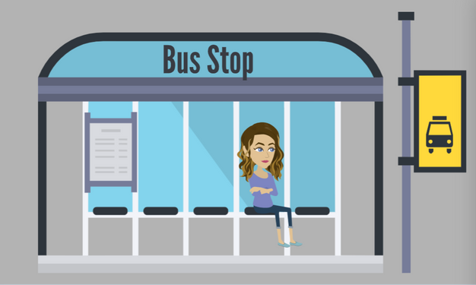
LESSON PLANS
RECRUITMENT LOCATIONS
Where do traffickers commonly target vulnerable people?
Human
TRAFFICKERS
©2024-2026 Walking Wise
78
3

Slide 79
TARGETED LOCATIONS
Targeted Areas
Locations with little to no adult supervision:
Near Schools & Bus Stops
Human
TRAFFICKERS
©2024-2026 Walking Wise
79

Slide 80
TARGETED LOCATIONS
Targeted Areas
Locations with little to no adult supervision:
Near Schools & Bus Stops
Parks & Playgrounds
Human
TRAFFICKERS
©2024-2026 Walking Wise
80

Slide 81
TARGETED LOCATIONS
Targeted Areas
Locations with little to no adult supervision:
Near Schools & Bus Stops
Parks & Playgrounds
Malls & Convenience Stores
Human
TRAFFICKERS
©2024-2026 Walking Wise
81

Slide 82
TARGETED LOCATIONS
Targeted Areas
Locations with little to no adult supervision:
Near Schools & Bus Stops
Parks & Playgrounds
Malls & Convenience Stores
ONLINE
Human
TRAFFICKERS
©2024-2026 Walking Wise
82

Slide 83
RECRUITMENT LOCATIONS
Targeted Areas
Outside facilities where vulnerable people spend time:
Juvenile Detention Centers
Human
TRAFFICKERS
©2024-2026 Walking Wise
83

Slide 84
RECRUITMENT LOCATIONS
Targeted Areas
Outside facilities where vulnerable people spend time:
Juvenile Detention Centers
Rehab Clinics
Human
TRAFFICKERS
©2024-2026 Walking Wise
84

Slide 85
RECRUITMENT LOCATIONS
Targeted Areas
Outside facilities where vulnerable people spend time:
Juvenile Detention Centers
Rehab Clinics
Homeless Shelters
Human
TRAFFICKERS
©2024-2026 Walking Wise
85

Slide 86
RECRUITMENT LOCATIONS
Targeted Areas
Outside facilities where vulnerable people spend time:
Juvenile Detention Centers
Rehab Clinics
Homeless Shelters
Drop-in Centers
Human
TRAFFICKERS
©2024-2026 Walking Wise
86

Slide 87
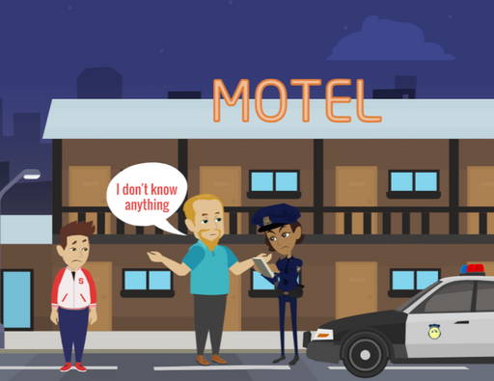
LESSON PLANS
UNDERREPORTED
Why do victims often hesitate to report traffickers to law enforcement?
Human
TRAFFICKERS
©2024-2026 Walking Wise
87
3

Slide 88
UNDERREPORTED
Silenced Victims
Emotional Bond: Victims may feel loyal or attached to the trafficker through love bonds or trauma bonds.
©2024-2026 Walking Wise
88
Notes:
UNDERREPORTED
Victims’ hesitation is not a sign of consent or weakness. Bonds created through manipulation, fear, and control make it extremely difficult for them to leave or ask for help.
Understanding these barriers helps society see why victims need support and safe options, rather than judgment.

Slide 89
UNDERREPORTED
Silenced Victims
Obligation: Victims may feel indebted to the trafficker who provided their basic needs.
©2024-2026 Walking Wise
89
Notes:
UNDERREPORTED
Victims’ hesitation is not a sign of consent or weakness. Bonds created through manipulation, fear, and control make it extremely difficult for them to leave or ask for help.
Understanding these barriers helps society see why victims need support and safe options, rather than judgment.

Slide 90
UNDERREPORTED
Silenced Victims
Fear & Intimidation: Victims may be afraid of physical harm or retaliation if they seek help.
©2024-2026 Walking Wise
90
Notes:
UNDERREPORTED
Victims’ hesitation is not a sign of consent or weakness. Bonds created through manipulation, fear, and control make it extremely difficult for them to leave or ask for help.
Understanding these barriers helps society see why victims need support and safe options, rather than judgment.

Slide 91
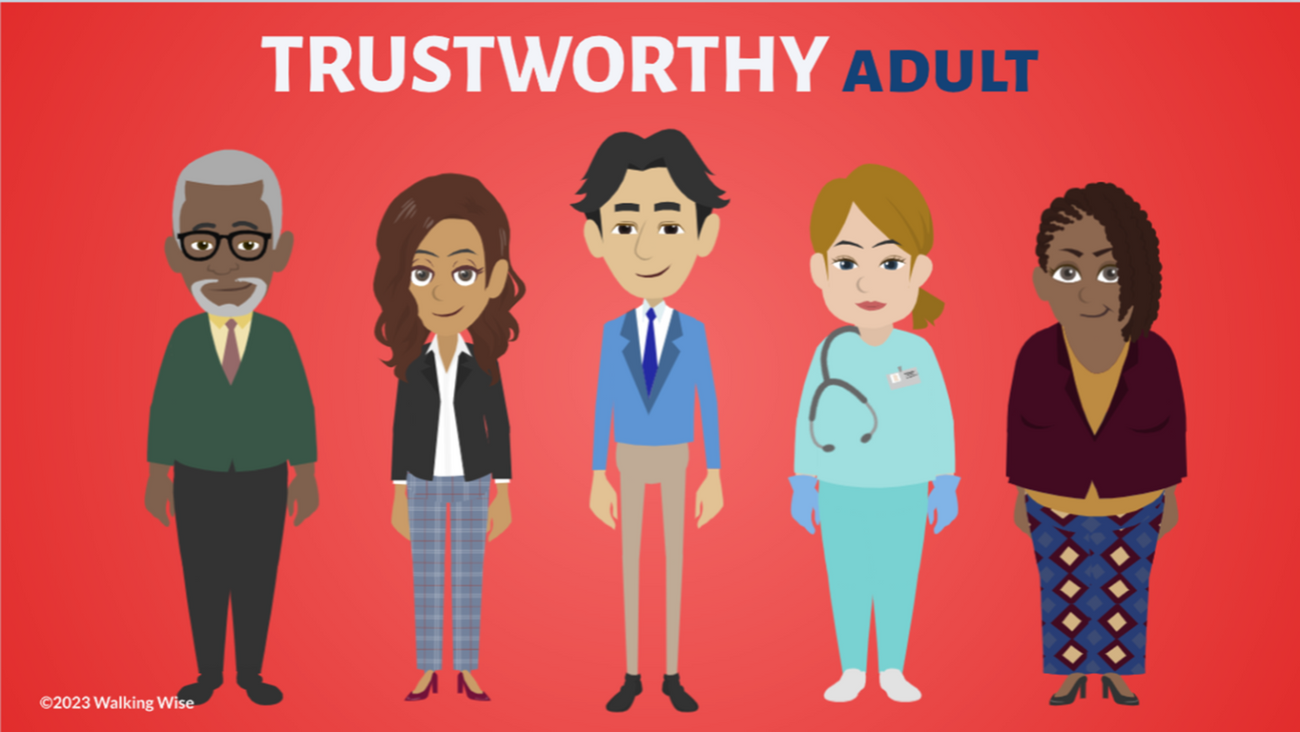
ASK FOR HELP
©2024-2026 Walking Wise
91

Slide 92
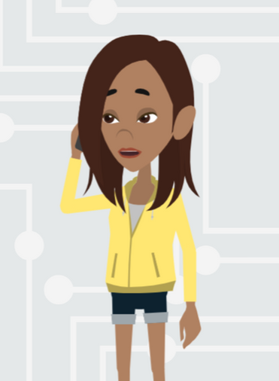
ASK FOR HELP
What are ways young people can ask for help?
©2024-2026 Walking Wise
92

Slide 93
ASK FOR HELP
How to Ask for Help
If you are in immediate danger, dial 911.
©2024-2026 Walking Wise
93

Slide 94
ASK FOR HELP
How to Ask for Help
If you are in immediate danger, dial 911.
If the sexual predator IS a family member, consider telling a trustworthy adult.
©2024-2026 Walking Wise
94

Slide 95
ASK FOR HELP
How to Ask for Help
If you are in immediate danger, dial 911.
If the sexual predator IS a family member, consider telling a trustworthy adult.
If the sexual predator is NOT family, consider telling a parent.
©2024-2026 Walking Wise
95

Slide 96
ASK FOR HELP
How to Ask for Help
If you are in immediate danger, dial 911.
If the sexual predator IS a family member, consider telling a trustworthy adult.
If the sexual predator is NOT family, consider telling a parent.
If you are a student in school, consider telling a trustworthy teacher, coach, school nurse, social worker, counselor, resource officer, or principal.
©2024-2026 Walking Wise
96

Slide 97
ASK FOR HELP
How to Ask for Help
If you are in immediate danger, dial 911.
If the sexual predator IS a family member, consider telling a trustworthy adult.
If the sexual predator is NOT family, consider telling a parent.
If you are a student in school, consider telling a trustworthy teacher, coach, school nurse, social worker, counselor, resource officer, or principal.
To gain internet access for help, consider using a computer at your school or a public library.
©2024-2026 Walking Wise
97

Slide 98
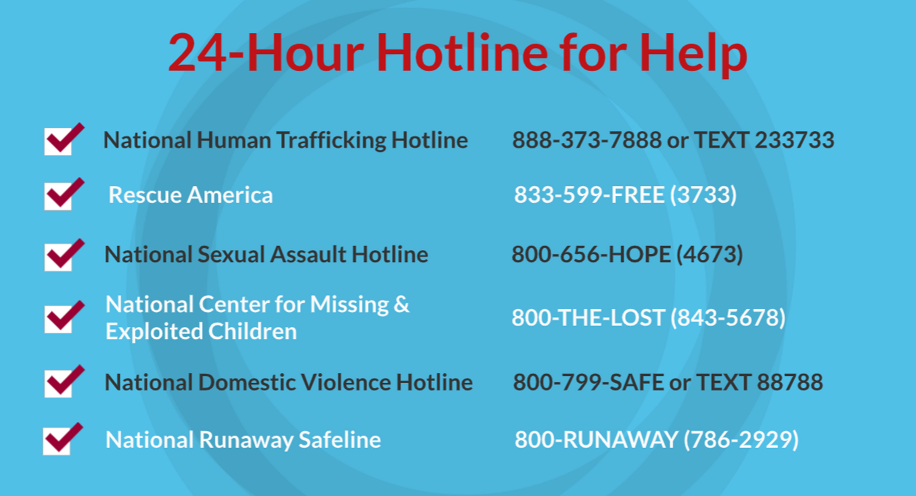
©2024-2026 Walking Wise
98
Notes:
NOTE
Presenters may ask their audience to consider adding a few "hotline for help" phone numbers in their cell phone contacts or take a photo of this slide.

Slide 99
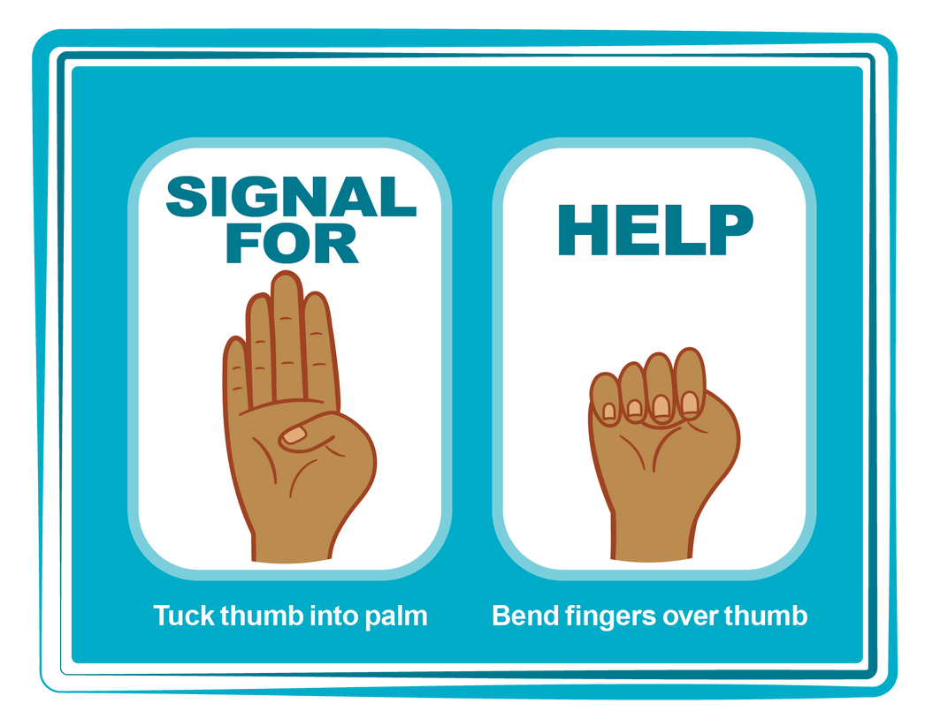
HAND SIGNAL FOR HELP
©2024-2026 Walking Wise
Source: Canadian Women’s Foundation, April 2020
99
Notes:
Although the hand signal for help has not yet achieved universal recognition, it may discreetly get someone's attention in urgent situations.
• SILENT
It can be used silently.
• UNTRACKABLE
It leaves no digital footprint.
• CONCEALED
It can be done secretly when a perpetrator is in the vicinity.
• SIGNALS DISTRESS
Combining the hand signal with distressed facial expressions might help attract the attention of an individual who is unfamiliar with the signal's meaning.
Source
Canadian Women's Foundation, April 2020

Slide 100
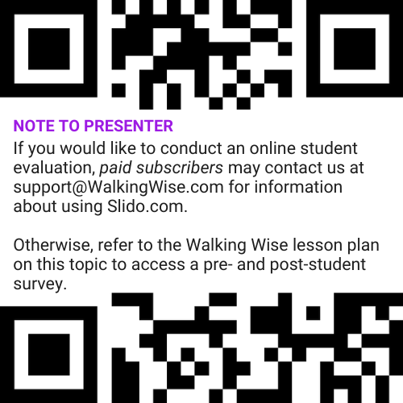
EVALUATION
©2024-2026 Walking Wise
100
Notes:
Two ways to conduct a pre-/post-student evaluation:
1) Use the pre/post survey in the Walking Wise lesson plan for this topic.
2) Activate Slido.com to conduct an online survey.

Slide 101

SHARE YOUR THOUGHTS
1. How would you rate this lesson?
2. What was the one thing you liked?
3. What one thing should we improve?
If using Slido: Replace “#XXXX” with your organization’s custom Slido code.
©2024-2026 Walking Wise
101
Notes:
SLIDO.com: 3-Question Survey
IF SLIDO IS ACTIVATED:
Follow the instructions provided on WalkingWise.com to access your school or organization's custom Slido QR code and #code, which the audience will use to complete the 3-question evaluation.
Please encourage your audience to scan your organization's custom QR code to share what they enjoyed and what could be improved about the lesson.
Please send any feedback you want to share to Walking Wise at support@WalkingWise.com.

Slide 102


Thank you!
WalkingWise.com
Online Course for Adults Accredited by:
Postgraduate Institue for Medicine
Academy of Forensic Nursing
©2024-2026 Walking Wise
102
Notes:
NOTE
To access additional resources about human traffickers, please refer to the last page of Lesson Plan #9 in the Walking Wise Education Guide.
We welcome your feedback at support@WalkingWise.com.
Thank you!
Karla Highman
Founder, WalkingWise.com

