Slide 1


SEXUAL EXPLOITATION
EDUCATION
male
VICTIMS
LESSON #6
Notes:
NOTE
Log in to WalkingWise.com and refer to the Walking Wise Education Guide to implement classroom teaching tips.
Most importantly:
• DEFINE SCHOOL POLICY
Establish a sexual exploitation reporting protocol with a trauma-informed response. The Walking Wise Implementation Guide provides a sample protocol.
• AGE & AUDIENCE
This presentation can be edited by following the procedures on page 3 to align with your school policies, specific age groups, and the involvement of at-risk audiences.
• SUPPORT PROCEDURE
Provide your audience with guidance on accessing immediate help or arranging a private meeting with a social worker, counselor, nurse, school resource officer, or another trustworthy staff member to report concerns for themselves or a peer.
• SECOND SAFE ADULT
Ensure a second trustworthy adult, such as a teacher, is present in the learning setting to observe audience reactions and identify those who may benefit from a follow-up meeting. This person should remain focused and free from other duties during the presentation.
• IMPLEMENT SLIDO.com
Join Walking Wise in using Slido.com to create an anonymous user experience.
Contact us at support@WalkingWise.com if you would like more information.

Slide 2

NOTE TO PRESENTER
This presentation is exclusively for Walking Wise® subscribers and not for redistribution.
Walking Wise encourages the use of Slido.com, an interactive digital tool, to enhance audience engagement. For more information, contact us at support@WalkingWise.com. Once configured, integrate Slido polling and add a post-evaluation to the PowerPoint presentation.
Presenters are encouraged to edit speaker notes to match their speaking style (viewable in presentation mode). You can also delete slides from this Walking Wise presentation to make sure the content aligns with your school policies, is age-appropriate, and fits within available class time. However, the existing slides are copyright-protected and may not be modified without prior written permission from Walking Wise.
We encourage you to add your own content by following these instructions:
  Insert new PowerPoint slides.
  Remove the Walking Wise logo and copyright "©2025 Walking Wise" from the new slides.
  Always add your organization's name or logo to each new slide.
Please delete this instruction page before presenting to audiences.
©2024-2026 Walking Wise
2
Notes:
NOTE
The presenter is welcome to customize this Walking Wise presentation according to the instructions provided on this page.
For revision requests, please email us at:
support@WalkingWise.com.

Slide 3

CONFRONTING SEXUAL EXPLOITATION
WALKING WISE
KNOWLEDGE serves as a
powerful defense against
sexual predators.
©2024-2026 Walking Wise
3

Slide 4
CONFRONTING SEXUAL EXPLOITATION
WALKING WISE
SEXUAL EXPLOITATION includes grooming, sextortion, pornography
& sex trafficking.
©2024-2026 Walking Wise
4

Slide 5
SENSITIVE DISCUSSION AHEAD
CONTENT ALERT
We’ll be discussing serious issues about sexual exploitation.
Some parts may be difficult to hear.
If you ever feel uncomfortable, you can step out and speak with a trustworthy adult for support.
You’re not alone—we’re here to help you.
©2024-2026 Walking Wise
5
Notes:
NOTE TO PRESENTER
Please tailor this message to align with your organization's policies and protocols.
Please provide a confidential avenue for students to report concerns and seek help for themselves or their peers if they suspect sexual abuse, grooming, sextortion, pornography-related exploitation, or human trafficking. This may include a designated address or text line.
Consider displaying posters in your school or facility that outline various ways students can access immediate support or request a private meeting with a school safety team member or another trusted adult.

Slide 6
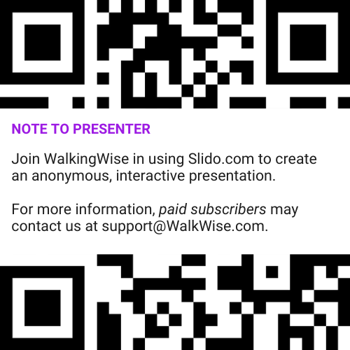
DIGITAL PARTICIPATION
©2024-2026 Walking Wise
6
Notes:
NOTE
For digital interaction with audiences:
Join Walking Wise in using Slido.com to create an anonymous user experience.
Contact us at support@WalkingWise.com if you would like more information.
Upon Activating Slido.com:
Please verify that the Q&A feature is enabled before presenting to audiences. An adult should monitor questions and comments to ensure they are appropriate. Slido has a feature that allows you to delete unwanted questions and comments.

Slide 7



STATISTICS
Statistics are Only Estimates
🔍 Many sexual crimes are never reported, so study results may not fully reflect what is really happening.
©2024-2026 Walking Wise
7
Notes:
In this presentation, we'll discuss statistics, but it's important to note that while statistics provide valuable insights into an issue, they cannot be relied upon entirely.
Here are a few reasons:
• UNREPORTED
Victims may stay silent due to fear, shame, or manipulation.
• INCONSISTENT COLLECTION
Geographical areas have different legal definitions for sexual crimes, making data hard to compare.
• FOCUS GROUPS
Small or specific focus groups participating in a study or survey may not accurately reflect the diversity or experiences of the broader population.

Slide 8
STATISTICS
Statistics are Only Estimates
📊 Studies collect information in different ways, which can lead to different results.
©2024-2026 Walking Wise
8
Notes:
In this presentation, we'll discuss statistics, but it's important to note that while statistics provide valuable insights into an issue, they cannot be relied upon entirely.
Here are a few reasons:
• UNREPORTED
Victims may stay silent due to fear, shame, or manipulation.
• INCONSISTENT COLLECTION
Geographical areas have different legal definitions for sexual crimes, making data hard to compare.
• FOCUS GROUPS
Small or specific focus groups participating in a study or survey may not accurately reflect the diversity or experiences of the broader population.

Slide 9
STATISTICS
Statistics are Only Estimates
👥 Some studies use small groups of people, and those groups may not represent everyone.
©2024-2026 Walking Wise
9
Notes:
In this presentation, we'll discuss statistics, but it's important to note that while statistics provide valuable insights into an issue, they cannot be relied upon entirely.
Here are a few reasons:
• UNREPORTED
Victims may stay silent due to fear, shame, or manipulation.
• INCONSISTENT COLLECTION
Geographical areas have different legal definitions for sexual crimes, making data hard to compare.
• FOCUS GROUPS
Small or specific focus groups participating in a study or survey may not accurately reflect the diversity or experiences of the broader population.

Slide 10

EDUCATON GUIDE
VOCABULARY
VOCABULARY
  Vulnerable
  Predator
  Sterotype
  Humiliation
  Disgrace
  Survival Sex
©2024-2026 Walking Wise
10
3
Notes:
NOTE
Understanding vocabulary terms related to the behaviors of sexual predators can empower young people to recognize warning signs of harmful situations.
Knowing terminology helps them identify manipulative tactics predators use to build trust and exploit vulnerabilities.
With this knowledge, young people are better equipped to spot red flags, understand that these behaviors are abusive, and feel more confident reporting predators to trusted adults or authorities, potentially preventing further harm.

Slide 11
EDUCATON GUIDE
VOCABULARY
VULNERABLE
At risk of physical or emotional harm due to weakness or lack of protection.
©2024-2026 Walking Wise
11
3
Notes:
Assisting Source
OpenAI. (2024). ChatGPT [Large language model]. https://chatgpt.com

Slide 12
EDUCATON GUIDE
VOCABULARY
PREDATOR
Someone who injures, abuses, or takes advantage of others for personal gain or profit.
©2024-2026 Walking Wise
12
3
Notes:
Assisting Source
OpenAI. (2024). ChatGPT [Large language model]. https://chatgpt.com

Slide 13
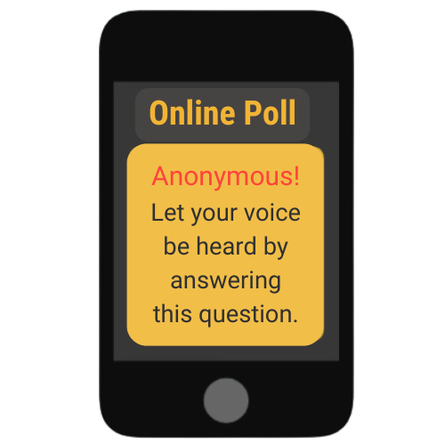
MALE VICTIMS
What is the percentage of MALES who reported they were sex trafficked in the U.S.?
©2024-2026 Walking Wise
13
Notes:
Online Interactive Polling
SLIDO.com Multiple Choice
What percentage of sex trafficked victims in the U.S. are believed to be MALE?
A) Up to 6%
B) Up to 16%
C) Up to 36%
D) Up to 46%
ANSWER:
C) Up to 36% of U.S. trafficking victims are believed to be male.
Coercion into the commercial sex trade is more common among females. However, a national report found that 36% of sex trafficking victims are male, while 4% are transgender females, and less than 1% are transgender males. Traffickers exploit similar vulnerabilities to groom and coerce young males as they do with females.[1]
Source
1. Swaner, R., et al. (2016, June). Youth involved in the sex trade: A national study, p. 36. U.S. Department of Justice. Retrieved November 23, 2024, from https://www.ojp.gov/pdffiles1/ojjdp/grants/249952.pdf

Slide 14
ANSWER
Up to 36% of U.S. trafficking victims are believed to be male.
n = 341
14
©2024-2026 Walking Wise
Swaner, R., et al. (2016, June). Youth involved in the sex trade: A national study, p. 36. U.S. Department of Justice.
Notes:
Online Interactive Polling
SLIDO.com Multiple Choice
What percentage of sex trafficked victims in the U.S. are believed to be MALE?
A) Up to 6%
B) Up to 16%
C) Up to 36%
D) Up to 46%
ANSWER:
C) Up to 36% of U.S. trafficking victims are believed to be male.
Coercion into the commercial sex trade is more common among females. However, a national report found that 36% of sex trafficking victims are male, while 4% are transgender females, and less than 1% are transgender males. Traffickers exploit similar vulnerabilities to groom and coerce young males as they do with females.[1]
Source
1. Swaner, R., et al. (2016, June). Youth involved in the sex trade: A national study, p. 36. U.S. Department of Justice. Retrieved November 23, 2024, from https://www.ojp.gov/pdffiles1/ojjdp/grants/249952.pdf

Slide 15
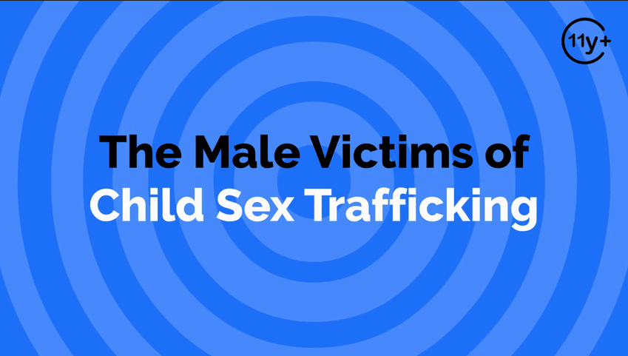
Log in to WakingWise.com to access this animated video.
©2024-2026 Walking Wise
15
Notes:
Message Especially for Teens:
Businesses worldwide use explainer-style animation as a training tool for their employees. So, this 3-minute Walking Wise animated video is appropriate for both teens (ages 11+) and adults to learn how sexual predators use manipulation, intimidation, and coercion to exploit young people.
NOTE
Log in to Walking Wise.com to watch the three-minute animated video with audiences.

Slide 16
EDUCATON GUIDE
VOCABULARY
STEREOTYPE
An untrue or inaccurate belief about a group of people or things.
©2024-2026 Walking Wise
16
3
Notes:
Assisting Source
OpenAI. (2024). ChatGPT [Large language model]. https://chatgpt.com

Slide 17

LESSON PLANS
STEREOTYPES
What are common stereotypes of males versus females?
©2024-2026 Walking Wise
17
3

Slide 18
STEREOTYPES
Common Stereotypes
Boys are considered better at math and science, while girls are assumed to be better at reading and the arts.
©2024-2026 Walking Wise
18
Notes:
• STEREOTYPES
These stereotypes reinforce the idea that males should suppress their emotions, leading many to feel ashamed or emasculated if they share experiences of victimization. As a result, male survivors may be less likely to report sexual abuse and commercial exploitation and seek help.

Slide 19
STEREOTYPES
Common Stereotypes
Boys are expected to hide their feelings, while girls are expected to be emotionally expressive.
©2024-2026 Walking Wise
19
Notes:
• STEREOTYPES
These stereotypes reinforce the idea that males should suppress their emotions, leading many to feel ashamed or emasculated if they share experiences of victimization. As a result, male survivors may be less likely to report sexual abuse and commercial exploitation and seek help.

Slide 20
STEREOTYPES
Common Stereotypes
Boys are often believed to be sexual aggressors, while girls are assumed to be the victims.
©2024-2026 Walking Wise
20
Notes:
• STEREOTYPES
These stereotypes reinforce the idea that males should suppress their emotions, leading many to feel ashamed or emasculated if they share experiences of victimization. As a result, male survivors may be less likely to report sexual abuse and commercial exploitation and seek help.

Slide 21
STEREOTYPES
Common Stereotypes
Boys are thought to be victims of labor trafficking, while girls are assumed to be victims of sex trafficking.
©2024-2026 Walking Wise
21
Notes:
• STEREOTYPES
These stereotypes reinforce the idea that males should suppress their emotions, leading many to feel ashamed or emasculated if they share experiences of victimization. As a result, male survivors may be less likely to report sexual abuse and commercial exploitation and seek help.

Slide 22
LESSON PLANS
TRAFFICKING MYTH
How does the myth that only girls are sex trafficked impact boys?
©2024-2026 Walking Wise
22
3

Slide 23
TRAFFICKING MYTH
Impact of the Myth
Male victims are more likely to be overlooked or dismissed.
United States Department of State (2023, June). Overlooked for Too Long: Boys and Human Trafficking. Office to Monitor and Combat Trafficking In Persons.
23
©2024-2026 Walking Wise
Notes:
• OVERLOOKED CASES
Stereotyping often causes adults, including law enforcement and medical professionals, to overlook young males being sex trafficked.[1]
• UNDERESTIMATED IMPACT
Sexual crime is just as devastating for males as it is for females, but society tends to underestimate the traumatic effects sexual abuse and exploitation have on males. As a result, there tends to be a misconception that young males enjoy experiencing unlimited or unrestricted sex.
• LACK OF RESOURCES
Because of underreporting and a lack of awareness of male vulnerability, resources are often not allocated to support the needs of young males. Instead, the focus tends to be on females.
Source
1. United States Department of State (2023, June). Overlooked for Too Long: Boys and Human Trafficking. Office to Monitor and Combat Trafficking In Persons. Retrieved on December 30, 2024, from https://www.state.gov/wp-content/uploads/2023/12/Overlooked-for-Too-Long-Boys-and-Human-Trafficking.pdf

Slide 24
TRAFFICKING MYTH
Impact of the Myth
Sexual harm against boys is often taken less seriously.
United States Department of State (2023, June). Overlooked for Too Long: Boys and Human Trafficking. Office to Monitor and Combat Trafficking In Persons.
24
©2024-2026 Walking Wise
Notes:
• OVERLOOKED CASES
Stereotyping often causes adults, including law enforcement and medical professionals, to overlook young males being sex trafficked.[1]
• UNDERESTIMATED IMPACT
Sexual crime is just as devastating for males as it is for females, but society tends to underestimate the traumatic effects sexual abuse and exploitation have on males. As a result, there tends to be a misconception that young males enjoy experiencing unlimited or unrestricted sex.
• LACK OF RESOURCES
Because of underreporting and a lack of awareness of male vulnerability, resources are often not allocated to support the needs of young males. Instead, the focus tends to be on females.
Source
1. United States Department of State (2023, June). Overlooked for Too Long: Boys and Human Trafficking. Office to Monitor and Combat Trafficking In Persons. Retrieved on December 30, 2024, from https://www.state.gov/wp-content/uploads/2023/12/Overlooked-for-Too-Long-Boys-and-Human-Trafficking.pdf

Slide 25
TRAFFICKING MYTH
Impact of the Myth
Fewer resources for support and recovery are available for boys.
United States Department of State (2023, June). Overlooked for Too Long: Boys and Human Trafficking. Office to Monitor and Combat Trafficking In Persons.
25
©2024-2026 Walking Wise
Notes:
• OVERLOOKED CASES
Stereotyping often causes adults, including law enforcement and medical professionals, to overlook young males being sex trafficked.[1]
• UNDERESTIMATED IMPACT
Sexual crime is just as devastating for males as it is for females, but society tends to underestimate the traumatic effects sexual abuse and exploitation have on males. As a result, there tends to be a misconception that young males enjoy experiencing unlimited or unrestricted sex.
• LACK OF RESOURCES
Because of underreporting and a lack of awareness of male vulnerability, resources are often not allocated to support the needs of young males. Instead, the focus tends to be on females.
Source
1. United States Department of State (2023, June). Overlooked for Too Long: Boys and Human Trafficking. Office to Monitor and Combat Trafficking In Persons. Retrieved on December 30, 2024, from https://www.state.gov/wp-content/uploads/2023/12/Overlooked-for-Too-Long-Boys-and-Human-Trafficking.pdf

Slide 26
EDUCATON GUIDE
VOCABULARY
HUMILIATION
The feeling of shame or embarrassment caused by being degraded or dishonored.
©2024-2026 Walking Wise
26
3
Notes:
Assisting Source
OpenAI. (2024). ChatGPT [Large language model]. https://chatgpt.com

Slide 27
EDUCATON GUIDE
VOCABULARY
DISGRACE
A deep sense of shame or loss of respect, often caused by a specific event or action.
©2024-2026 Walking Wise
27
3
Notes:
Assisting Source
OpenAI. (2024). ChatGPT [Large language model]. https://chatgpt.com

Slide 28
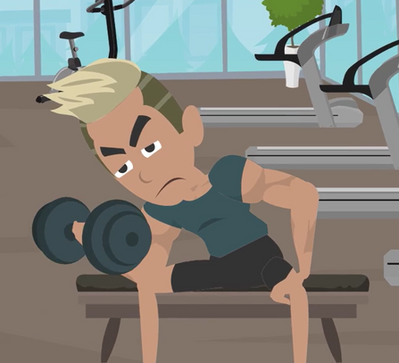
LESSON PLANS
GENDER EXPECTATIONS
How do gender expectations impact boys who experience sexual abuse or trafficking?
©2024-2026 Walking Wise
28
3

Slide 29
GENDER EXPECTATIONS
Impact of Social Messages
Boys may blame themselves because vulnerability is often associated with girls.
United States Department of State (2023, June). Overlooked for Too Long: Boys and Human Trafficking. Office to Monitor and Combat Trafficking In Persons.
29
©2024-2026 Walking Wise
Notes:
• MALE IDENTITY
As young as toddlers, boys receive social messaging that implies males are a symbol of physical power and mental strength. The superheroes in today’s entertainment can reinforce this notion while using female characters to portray vulnerability, submissiveness, and victimization.
• FEAR & SHAME
National studies identify that most male victims are heterosexual; however, victimized young males often fear others will make an inaccurate conclusion about their sexual orientation. As a result, they struggle with confusion and shame, often questioning their own gender identity after becoming forced into having sex with men.[1]
• SELF BLAME
Most young males keep sexual abuse or sex trafficking a secret because of their sense of shame and humiliation. Gender expectations often magnify the self-blame experienced by males.
• PORN CONDITIONING
Most often, pornography displays forced sex upon young women, conditioning male teens to believe men are dominant or even sexual aggressors (Alexander, 2016).
Source
1. United States Department of State (2023, June). Overlooked for Too Long: Boys and Human Trafficking. Office to Monitor and Combat Trafficking In Persons. Retrieved on December 30, 2024, from https://www.state.gov/wp-content/uploads/2023/12/Overlooked-for-Too-Long-Boys-and-Human-Trafficking.pdf

Slide 30
GENDER EXPECTATIONS
Impact of Social Messages
Boys may fear their sexual identity will be questioned or misunderstood.
United States Department of State (2023, June). Overlooked for Too Long: Boys and Human Trafficking. Office to Monitor and Combat Trafficking In Persons.
30
©2024-2026 Walking Wise
Notes:
• MALE IDENTITY
As young as toddlers, boys receive social messaging that implies males are a symbol of physical power and mental strength. The superheroes in today’s entertainment can reinforce this notion while using female characters to portray vulnerability, submissiveness, and victimization.
• FEAR & SHAME
National studies identify that most male victims are heterosexual; however, victimized young males often fear others will make an inaccurate conclusion about their sexual orientation. As a result, they struggle with confusion and shame, often questioning their own gender identity after becoming forced into having sex with men.[1]
• SELF BLAME
Most young males keep sexual abuse or sex trafficking a secret because of their sense of shame and humiliation. Gender expectations often magnify the self-blame experienced by males.
• PORN CONDITIONING
Most often, pornography displays forced sex upon young women, conditioning male teens to believe men are dominant or even sexual aggressors (Alexander, 2016).
Source
1. United States Department of State (2023, June). Overlooked for Too Long: Boys and Human Trafficking. Office to Monitor and Combat Trafficking In Persons. Retrieved on December 30, 2024, from https://www.state.gov/wp-content/uploads/2023/12/Overlooked-for-Too-Long-Boys-and-Human-Trafficking.pdf

Slide 31
GENDER EXPECTATIONS
Impact of Social Messages
Boys may feel shame for not being able to stop or escape the abuse.
United States Department of State (2023, June). Overlooked for Too Long: Boys and Human Trafficking. Office to Monitor and Combat Trafficking In Persons.
31
©2024-2026 Walking Wise
Notes:
• MALE IDENTITY
As young as toddlers, boys receive social messaging that implies males are a symbol of physical power and mental strength. The superheroes in today’s entertainment can reinforce this notion while using female characters to portray vulnerability, submissiveness, and victimization.
• FEAR & SHAME
National studies identify that most male victims are heterosexual; however, victimized young males often fear others will make an inaccurate conclusion about their sexual orientation. As a result, they struggle with confusion and shame, often questioning their own gender identity after becoming forced into having sex with men.[1]
• SELF BLAME
Most young males keep sexual abuse or sex trafficking a secret because of their sense of shame and humiliation. Gender expectations often magnify the self-blame experienced by males.
• PORN CONDITIONING
Most often, pornography displays forced sex upon young women, conditioning male teens to believe men are dominant or even sexual aggressors (Alexander, 2016).
Source
1. United States Department of State (2023, June). Overlooked for Too Long: Boys and Human Trafficking. Office to Monitor and Combat Trafficking In Persons. Retrieved on December 30, 2024, from https://www.state.gov/wp-content/uploads/2023/12/Overlooked-for-Too-Long-Boys-and-Human-Trafficking.pdf

Slide 32
LESSON PLANS
AGE GROUP
What are the most common ages for males to be sex trafficked?
©2024-2026 Walking Wise
32
3
Notes:
Online Interactive Polling
Slido.com: Multiple Choice
What was the most common age for cis males to be sex trafficked?
A) 9 to 12 years old
B) 13 to 17 years old
C) 18 to 24 years old
ANSWER
B) 13 to 17 years old was the most common age for cis males to be sex trafficked.
NOTE
A 2016 national study reported:
UNDERAGE YOUTH
77% of all respondents (199 underage youth) indicated that their first experience trading sex
took place while under the age of 18. The average age was 15.8 years old.
AGES 13 to 17 YEARS
The percentage of study respondents who were first trafficked during childhood:
Cis Males: 66%
Trans Females: 62%
Trans Males: Unknown
Cis Females: 74%
AGES 18 to 24 Years
The study indicated the percentage of young adults who were first sex trafficked by gender:
Cis Males: 28%
Trans Females: 32%
Trans Males: No Data
Cis Females:
AGES 0 to 12 YEARS
The study revealed the percentage of small children who were first sex trafficked by gender:
Cis Males: 7%
Trans Females: 6%
Trans Males: No Data
Cis Females: 7%
Source
Swaner, R., Labriola, M., Rempel, M., Walker, A., & Spadafore, J. (2016, March). Youth Involvement in the Sex Trade: A National Study, pp. 40, 41. CourtInnovation.org. Retrieved November 25, 2024, from https://www.ojp.gov/pdffiles1/ojjdp/grants/249952.pdf

Slide 33
ANSWER
66% of males were trafficked between the ages of 13 and 17 years.
©2024-2026 Walking Wise
Swaner, R., Labriola, M., Rempel, M., Walker, A., & Spadafore, J. (2016, March). Youth Involvement in the Sex Trade: A National Study.
33
Notes:
Online Interactive Polling
Slido.com: Multiple Choice
What is the most common age for cis males to be sex trafficked?
A) 9 to 12 years old
B) 13 to 17 years old
C) 18 to 24 years old
ANSWER
B) 13 to 17 years old was the most common age for males to be sex trafficked.
NOTE
A 2016 national study reported:
UNDERAGE YOUTH
77% of all respondents (199 underage youth) indicated that their first experience trading sex took place while under the age of 18. The average age was 15.8 years old.
AGES 13 to 17 YEARS
The percentage of study respondents who were first trafficked during childhood:
Cis Males: 66%
Trans Females: 62%
Trans Males: Unknown
Cis Females: 74%
AGES 18 to 24 Years
The study indicated the percentage of young adults who were first sex trafficked by gender:
Cis Males: 28%
Trans Females: 32%
Trans Males: No Data
Cis Females: 19%
AGES 0 to 12 YEARS
The study revealed the percentage of small children who were first sex trafficked by gender:
Cis Males: 7%
Trans Females: 6%
Trans Males: No Data
Cis Females: 7%
Source
Swaner, R., Labriola, M., Rempel, M., Walker, A., & Spadafore, J. (2016, March). Youth Involvement in the Sex Trade: A National Study, pp. 40, 41. CourtInnovation.org. Retrieved November 25, 2024, from https://www.ojp.gov/pdffiles1/ojjdp/grants/249952.pdf

Slide 34
LESSON PLANS
LGBTQ+ TRAFFICKING RISKS
What factors increase the risk of sex trafficking for LGBTQ+ (cisgender male) teens?
©2024-2026 Walking Wise
34
3
Notes:
NOTE
The 2023 Thorn study quantified the attitudes, perceptions, and behaviors of teens and young adults, focusing on how LGBTQ+ youth's online experiences are different from those of non-LGBTQ+ youth. The study involved 658 LGBTQ+ youth, of whom 69% were aged 13 to 17, and 31% identified as male.
Secondary online accounts, often called "finstas," are created by young people to share content more privately or outside their usual social circle. Thorn reports, "Among teens, the rate of reporting secondary accounts was higher for LGBTQ+ respondents than non-LGBTQ+ respondents, with LGBTQ+ teens were twice as likely to have a secondary account (36% vs. 18%). Among teen respondents with a secondary account, 1 in 3 reported creating it before the age of 13."
Source
Thorn. (2023). LGBTQ+ Youth Perspectives: How LGBTQ+ youth are navigating exploration and risks of sexual exploitation online, p. 5. Retrieved November 26, 2024, from https://info.thorn.org/hubfs/Research/Thorn_LGBTQ+YouthPerspectives_June2023_FNL.pdf

Slide 35
LGBTQ+ TRAFFICKING RISKS
Increased Risk Factors
Some teens spend more time in online communities, increasing contact with people they have not met in real life.
©2024-2026 Walking Wise
Thorn. (2023). LGBTQ+ Youth Perspectives: How LGBTQ+ youth are navigating exploration and risks of sexual exploitation online.
35
Notes:
NOTE
The 2023 Thorn study quantified the attitudes, perceptions, and behaviors of teens and young adults, focusing on how LGBTQ+ youth's online experiences are different from those of non-LGBTQ+ youth. The study involved 658 LGBTQ+ youth, of whom 69% were aged 13 to 17, and 31% identified as male.
Secondary online accounts, often called "finstas," are created by young people to share content more privately or outside their usual social circle. Thorn reports, "Among teens, the rate of reporting secondary accounts was higher for LGBTQ+ respondents than non-LGBTQ+ respondents, with LGBTQ+ teens were twice as likely to have a secondary account (36% vs. 18%). Among teen respondents with a secondary account, 1 in 3 reported creating it before the age of 13."
Source
Thorn. (2023). LGBTQ+ Youth Perspectives: How LGBTQ+ youth are navigating exploration and risks of sexual exploitation online, p. 5. Retrieved November 26, 2024, from https://info.thorn.org/hubfs/Research/Thorn_LGBTQ+YouthPerspectives_June2023_FNL.pdf

Slide 36
LGBTQ+ TRAFFICKING RISKS
Increased Risk Factors
Many teens try to handle unsafe situations on their own rather than ask for help.
©2024-2026 Walking Wise
Thorn. (2023). LGBTQ+ Youth Perspectives: How LGBTQ+ youth are navigating exploration and risks of sexual exploitation online.
36
Notes:
NOTE
The 2023 Thorn study quantified the attitudes, perceptions, and behaviors of teens and young adults, focusing on how LGBTQ+ youth's online experiences are different from those of non-LGBTQ+ youth. The study involved 658 LGBTQ+ youth, of whom 69% were aged 13 to 17, and 31% identified as male.
Secondary online accounts, often called "finstas," are created by young people to share content more privately or outside their usual social circle. Thorn reports, "Among teens, the rate of reporting secondary accounts was higher for LGBTQ+ respondents than non-LGBTQ+ respondents, with LGBTQ+ teens were twice as likely to have a secondary account (36% vs. 18%). Among teen respondents with a secondary account, 1 in 3 reported creating it before the age of 13."
Source
Thorn. (2023). LGBTQ+ Youth Perspectives: How LGBTQ+ youth are navigating exploration and risks of sexual exploitation online, p. 5. Retrieved November 26, 2024, from https://info.thorn.org/hubfs/Research/Thorn_LGBTQ+YouthPerspectives_June2023_FNL.pdf

Slide 37
LGBTQ+ TRAFFICKING RISKS
Increased Risk Factors
These teens are more likely to receive unsolicited sexual images, which predators may use for pressure or blackmail.
©2024-2026 Walking Wise
Thorn. (2023). LGBTQ+ Youth Perspectives: How LGBTQ+ youth are navigating exploration and risks of sexual exploitation online.
37
Notes:
NOTE
The 2023 Thorn study quantified the attitudes, perceptions, and behaviors of teens and young adults, focusing on how LGBTQ+ youth's online experiences are different from those of non-LGBTQ+ youth. The study involved 658 LGBTQ+ youth, of whom 69% were aged 13 to 17, and 31% identified as male.
Secondary online accounts, often called "finstas," are created by young people to share content more privately or outside their usual social circle. Thorn reports, "Among teens, the rate of reporting secondary accounts was higher for LGBTQ+ respondents than non-LGBTQ+ respondents, with LGBTQ+ teens were twice as likely to have a secondary account (36% vs. 18%). Among teen respondents with a secondary account, 1 in 3 reported creating it before the age of 13."
Source
Thorn. (2023). LGBTQ+ Youth Perspectives: How LGBTQ+ youth are navigating exploration and risks of sexual exploitation online, p. 5. Retrieved November 26, 2024, from https://info.thorn.org/hubfs/Research/Thorn_LGBTQ+YouthPerspectives_June2023_FNL.pdf

Slide 38

LESSON PLANS
UNRECOGNIZED
Why can male victims be harder to recognize?
©2024-2026 Walking Wise
38
3

Slide 39
UNRECOGNIZED
Often Overlooked
Boys are often assumed to be the initiators rather than the victims of sexual activity.
©2024-2026 Walking Wise
NPR News, 2021. https://www.npr.org/2021/05/24/999726614/growing-number-of-male-survivors-talk-about-being-a-sex-trade-victim
39
Notes:
Some survivor advocates believe social awareness around the sex trafficking of boys is about 15 years behind that of girls.[1]
• SEXUAL INSTIGATORS
Society can perceive teenage boys as sexual instigators, making them more easily mistaken as “willing participants” when becoming victimized by sex traffickers.
• REDUCED PROTECTION
Community members can be less watchful over the well-being of boys compared to that of girls, causing at-risk young males to go unnoticed, even when surrounded by suspicious strangers.
• LACK OF AWARENESS
Society’s limited awareness about the victimization of males can cause adults to overlook the key indicators of trafficking or sexual abuse that may appear.
Source:
1. NPR News, 2021. Retrieved January 15, 2026, from https://www.npr.org/2021/05/24/999726614/growing-number-of-male-survivors-talk-about-being-a-sex-trade-victim

Slide 40
UNRECOGNIZED
Often Overlooked
Adults may be less watchful or protective of boys than girls.
©2024-2026 Walking Wise
NPR News, 2021. https://www.npr.org/2021/05/24/999726614/growing-number-of-male-survivors-talk-about-being-a-sex-trade-victim
40
Notes:
Some survivor advocates believe social awareness around the sex trafficking of boys is about 15 years behind that of girls.[1]
• SEXUAL INSTIGATORS
Society can perceive teenage boys as sexual instigators, making them more easily mistaken as “willing participants” when becoming victimized by sex traffickers.
• REDUCED PROTECTION
Community members can be less watchful over the well-being of boys compared to that of girls, causing at-risk young males to go unnoticed, even when surrounded by suspicious strangers.
• LACK OF AWARENESS
Society’s limited awareness about the victimization of males can cause adults to overlook the key indicators of trafficking or sexual abuse that may appear.
Source:
1. NPR News, 2021. Retrieved January 15, 2026, from https://www.npr.org/2021/05/24/999726614/growing-number-of-male-survivors-talk-about-being-a-sex-trade-victim

Slide 41
UNRECOGNIZED
Often Overlooked
Warning signs of abuse or trafficking in boys may be missed or misunderstood.
©2024-2026 Walking Wise
NPR News, 2021. https://www.npr.org/2021/05/24/999726614/growing-number-of-male-survivors-talk-about-being-a-sex-trade-victim
41
Notes:
Some survivor advocates believe social awareness around the sex trafficking of boys is about 15 years behind that of girls.[1]
• SEXUAL INSTIGATORS
Society can perceive teenage boys as sexual instigators, making them more easily mistaken as “willing participants” when becoming victimized by sex traffickers.
• REDUCED PROTECTION
Community members can be less watchful over the well-being of boys compared to that of girls, causing at-risk young males to go unnoticed, even when surrounded by suspicious strangers.
• LACK OF AWARENESS
Society’s limited awareness about the victimization of males can cause adults to overlook the key indicators of trafficking or sexual abuse that may appear.
Source:
1. NPR News, 2021. Retrieved January 15, 2026, from https://www.npr.org/2021/05/24/999726614/growing-number-of-male-survivors-talk-about-being-a-sex-trade-victim

Slide 42
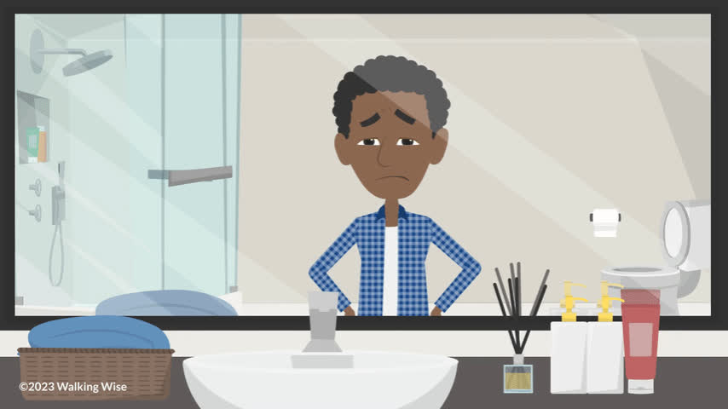
LESSON PLANS
UNREPORTED CRIME
What happens when boys keep sexual crimes a secret?
©2024-2026 Walking Wise
42
3

Slide 43
UNREPORTED CRIME
Impact of Secrecy
When crimes aren’t reported, information is not included in research data, leading to less funding for support services.
©2024-2026 Walking Wise
43
Notes:
• UNADDRESSED EFFECTS
If left untreated, male victims are at a greater risk of depression, suicide, substance abuse, and even incarceration.
• DATA IMPACT
When sex crimes against young males go unreported, the incidents are omitted from law enforcement data that is reported to the government and advocacy agencies, which also negatively impacts research studies.
• UNDERFUNDED
Underreporting prevents the allocation of government funds for the support services needed to rescue and recover young males.

Slide 44
UNREPORTED CRIME
Impact of Secrecy
Without support, boys may face long-term effects like depression, substance use, or trouble with the law.
©2024-2026 Walking Wise
44
Notes:
• UNADDRESSED EFFECTS
If left untreated, male victims are at a greater risk of depression, suicide, substance abuse, and even incarceration.
• DATA IMPACT
When sex crimes against young males go unreported, the incidents are omitted from law enforcement data that is reported to the government and advocacy agencies, which also negatively impacts research studies.
• UNDERFUNDED
Underreporting prevents the allocation of government funds for the support services needed to rescue and recover young males.

Slide 45
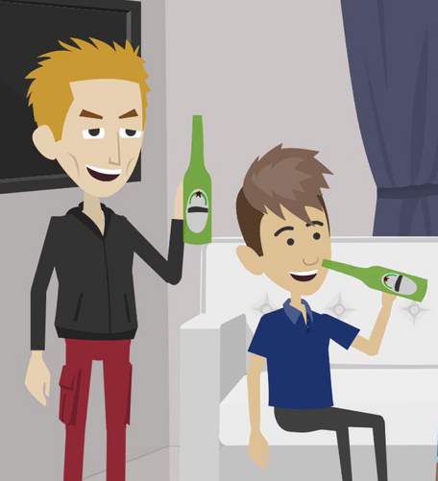
LESSON PLANS
VULNERABILITIES
What vulnerabilities do traffickers target in boys?
©2024-2026 Walking Wise
45
3

Slide 46
VULNERABILITIES
Risk Factors: Unstable Conditions
  Unable to access basic needs like food or shelter.
Kinnish, K., Barba, A., Blacker, D., Dierkhising, C., Garrett, R., Grady, J.B., Greenbaum, V.J., Griffin, D., Rubiales, R., Spring, G., Wozniak, J., and Child Sex Trafficking Collaborative Group. (2021). Child sex trafficking: Who is vulnerable to being trafficked? Los Angeles, CA, and Durham, NC: National Center for Child Traumatic Stress.
46
©2024-2026 Walking Wise
Notes:
Groomers often build close relationships with young males, using the personal information shared to manipulate, coerce, or brainwash them into engaging in sexual acts. The likelihood of a young male being trafficked increases with the number of vulnerabilities he faces.
Risk factors of sex trafficking include:
• ONLINE RELATIONSHIPS
Predators prey on young males seeking online friendships and those who exchange nude images online.
• LIVING CONDITIONS
Predators seek to befriend young males who live in poverty, lack basic needs, or live in foster care.
• EMOTIONAL RISKS
Predators build relationships with males experiencing loneliness, low self-esteem, or those being bullied.
Source:
Kinnish, K., Barba, A., Blacker, D., Dierkhising, C., Garrett, R., Grady, J.B., Greenbaum, V.J., Griffin, D., Rubiales, R., Spring, G., Wozniak, J., and Child Sex Trafficking Collaborative Group. (2021). Child sex
trafficking: Who is vulnerable to being trafficked? Los Angeles, CA, and Durham, NC: National Center for Child Traumatic Stress. Retrieved January 16, 2026, from https://www.nctsn.org/sites/default/files/resources/fact-sheet/child_sex_trafficking_who_is_vulnerable_to_being_trafficked.pdf

Slide 47
VULNERABILITIES
Risk Factors: Unstable Conditions
  Unable to access basic needs like food or shelter.
  Living in foster care or without stable housing.
Kinnish, K., Barba, A., Blacker, D., Dierkhising, C., Garrett, R., Grady, J.B., Greenbaum, V.J., Griffin, D., Rubiales, R., Spring, G., Wozniak, J., and Child Sex Trafficking Collaborative Group. (2021). Child sex trafficking: Who is vulnerable to being trafficked? Los Angeles, CA, and Durham, NC: National Center for Child Traumatic Stress.
47
©2024-2026 Walking Wise
Notes:
Groomers often build close relationships with young males, using the personal information shared to manipulate, coerce, or brainwash them into engaging in sexual acts. The likelihood of a young male being trafficked increases with the number of vulnerabilities he faces.
Risk factors of sex trafficking include:
• ONLINE RELATIONSHIPS
Predators prey on young males seeking online friendships and those who exchange nude images online.
• LIVING CONDITIONS
Predators seek to befriend young males who live in poverty, lack basic needs, or live in foster care.
• EMOTIONAL RISKS
Predators build relationships with males experiencing loneliness, low self-esteem, or those being bullied.
Source:
Kinnish, K., Barba, A., Blacker, D., Dierkhising, C., Garrett, R., Grady, J.B., Greenbaum, V.J., Griffin, D., Rubiales, R., Spring, G., Wozniak, J., and Child Sex Trafficking Collaborative Group. (2021). Child sex
trafficking: Who is vulnerable to being trafficked? Los Angeles, CA, and Durham, NC: National Center for Child Traumatic Stress. Retrieved January 16, 2026, from https://www.nctsn.org/sites/default/files/resources/fact-sheet/child_sex_trafficking_who_is_vulnerable_to_being_trafficked.pdf

Slide 48
VULNERABILITIES
Risk Factors: Unstable Conditions
  Unable to access basic needs like food or shelter.
  Living in foster care or without stable housing.
  Experiencing family rejection due to sexual orientation.
Kinnish, K., Barba, A., Blacker, D., Dierkhising, C., Garrett, R., Grady, J.B., Greenbaum, V.J., Griffin, D., Rubiales, R., Spring, G., Wozniak, J., and Child Sex Trafficking Collaborative Group. (2021). Child sex trafficking: Who is vulnerable to being trafficked? Los Angeles, CA, and Durham, NC: National Center for Child Traumatic Stress.
48
©2024-2026 Walking Wise
Notes:
Groomers often build close relationships with young males, using the personal information shared to manipulate, coerce, or brainwash them into engaging in sexual acts. The likelihood of a young male being trafficked increases with the number of vulnerabilities he faces.
Risk factors of sex trafficking include:
• ONLINE RELATIONSHIPS
Predators prey on young males seeking online friendships and those who exchange nude images online.
• LIVING CONDITIONS
Predators seek to befriend young males who live in poverty, lack basic needs, or live in foster care.
• EMOTIONAL RISKS
Predators build relationships with males experiencing loneliness, low self-esteem, or those being bullied.
Source:
Kinnish, K., Barba, A., Blacker, D., Dierkhising, C., Garrett, R., Grady, J.B., Greenbaum, V.J., Griffin, D., Rubiales, R., Spring, G., Wozniak, J., and Child Sex Trafficking Collaborative Group. (2021). Child sex
trafficking: Who is vulnerable to being trafficked? Los Angeles, CA, and Durham, NC: National Center for Child Traumatic Stress. Retrieved January 16, 2026, from https://www.nctsn.org/sites/default/files/resources/fact-sheet/child_sex_trafficking_who_is_vulnerable_to_being_trafficked.pdf

Slide 49
VULNERABILITIES
Risk Factors: Social & Behavior Challenges
  Facing bullying, loneliness, or low self-esteem.
Kinnish, K., Barba, A., Blacker, D., Dierkhising, C., Garrett, R., Grady, J.B., Greenbaum, V.J., Griffin, D., Rubiales, R., Spring, G., Wozniak, J., and Child Sex Trafficking Collaborative Group. (2021). Child sex trafficking: Who is vulnerable to being trafficked? Los Angeles, CA, and Durham, NC: National Center for Child Traumatic Stress.
49
©2024-2026 Walking Wise
Notes:
Groomers often build close relationships with young males, using the personal information shared to manipulate, coerce, or brainwash them into engaging in sexual acts. The likelihood of a young male being trafficked increases with the number of vulnerabilities he faces.
Risk factors of sex trafficking include:
• ONLINE RELATIONSHIPS
Predators prey on young males seeking online friendships and those who exchange nude images online.
• LIVING CONDITIONS
Predators seek to befriend young males who live in poverty, lack basic needs, or live in foster care.
• EMOTIONAL RISKS
Predators build relationships with males experiencing loneliness, low self-esteem, or those being bullied.
Source:
Kinnish, K., Barba, A., Blacker, D., Dierkhising, C., Garrett, R., Grady, J.B., Greenbaum, V.J., Griffin, D., Rubiales, R., Spring, G., Wozniak, J., and Child Sex Trafficking Collaborative Group. (2021). Child sex
trafficking: Who is vulnerable to being trafficked? Los Angeles, CA, and Durham, NC: National Center for Child Traumatic Stress. Retrieved January 16, 2026, from https://www.nctsn.org/sites/default/files/resources/fact-sheet/child_sex_trafficking_who_is_vulnerable_to_being_trafficked.pdf

Slide 50
VULNERABILITIES
Risk Factors: Social & Behavior Challenges
  Facing bullying, loneliness, or low self-esteem.
  Easily influenced by peer pressure.
Kinnish, K., Barba, A., Blacker, D., Dierkhising, C., Garrett, R., Grady, J.B., Greenbaum, V.J., Griffin, D., Rubiales, R., Spring, G., Wozniak, J., and Child Sex Trafficking Collaborative Group. (2021). Child sex trafficking: Who is vulnerable to being trafficked? Los Angeles, CA, and Durham, NC: National Center for Child Traumatic Stress.
50
©2024-2026 Walking Wise
Notes:
Groomers often build close relationships with young males, using the personal information shared to manipulate, coerce, or brainwash them into engaging in sexual acts. The likelihood of a young male being trafficked increases with the number of vulnerabilities he faces.
Risk factors of sex trafficking include:
• ONLINE RELATIONSHIPS
Predators prey on young males seeking online friendships and those who exchange nude images online.
• LIVING CONDITIONS
Predators seek to befriend young males who live in poverty, lack basic needs, or live in foster care.
• EMOTIONAL RISKS
Predators build relationships with males experiencing loneliness, low self-esteem, or those being bullied.
Source:
Kinnish, K., Barba, A., Blacker, D., Dierkhising, C., Garrett, R., Grady, J.B., Greenbaum, V.J., Griffin, D., Rubiales, R., Spring, G., Wozniak, J., and Child Sex Trafficking Collaborative Group. (2021). Child sex
trafficking: Who is vulnerable to being trafficked? Los Angeles, CA, and Durham, NC: National Center for Child Traumatic Stress. Retrieved January 16, 2026, from https://www.nctsn.org/sites/default/files/resources/fact-sheet/child_sex_trafficking_who_is_vulnerable_to_being_trafficked.pdf

Slide 51
VULNERABILITIES
Risk Factors: Social & Behavior Challenges
  Facing bullying, loneliness, or low self-esteem.
  Easily influenced by peer pressure.
  Spending a lot of time with online-only friends.
Kinnish, K., Barba, A., Blacker, D., Dierkhising, C., Garrett, R., Grady, J.B., Greenbaum, V.J., Griffin, D., Rubiales, R., Spring, G., Wozniak, J., and Child Sex Trafficking Collaborative Group. (2021). Child sex trafficking: Who is vulnerable to being trafficked? Los Angeles, CA, and Durham, NC: National Center for Child Traumatic Stress.
Thorn. (2025). Sexual Extortion & Young People: Navigating threats in digital environments. Retrieved January 16, 2016, from https://www.thorn.org/research/library/sexual-extortion-young-people/
©2024-2026 Walking Wise
51
Notes:
Groomers often build close relationships with young males, using the personal information shared to manipulate, coerce, or brainwash them into engaging in sexual acts. The likelihood of a young male being trafficked increases with the number of vulnerabilities he faces.
Risk factors of sex trafficking include:
• ONLINE RELATIONSHIPS
Predators prey on young males seeking online friendships and those who exchange nude images online.
• LIVING CONDITIONS
Predators seek to befriend young males who live in poverty, lack basic needs, or live in foster care.
• EMOTIONAL RISKS
Predators build relationships with males experiencing loneliness, low self-esteem, or those being bullied.
Source:
Kinnish, K., Barba, A., Blacker, D., Dierkhising, C., Garrett, R., Grady, J.B., Greenbaum, V.J., Griffin, D., Rubiales, R., Spring, G., Wozniak, J., and Child Sex Trafficking Collaborative Group. (2021). Child sex
trafficking: Who is vulnerable to being trafficked? Los Angeles, CA, and Durham, NC: National Center for Child Traumatic Stress. Retrieved January 16, 2026, from https://www.nctsn.org/sites/default/files/resources/fact-sheet/child_sex_trafficking_who_is_vulnerable_to_being_trafficked.pdf
Thorn. (2025). Sexual Extortion & Young People: Navigating threats in digital environments. Retrieved January 16, 2016, from https://www.thorn.org/research/library/sexual-extortion-young-people/

Slide 52
VULNERABILITIES
Risk Factors: Emotional & Physical Challenges
  Lacking motivation to participate in school or other activities.
Kinnish, K., Barba, A., Blacker, D., Dierkhising, C., Garrett, R., Grady, J.B., Greenbaum, V.J., Griffin, D., Rubiales, R., Spring, G., Wozniak, J., and Child Sex Trafficking Collaborative Group. (2021). Child sex trafficking: Who is vulnerable to being trafficked? Los Angeles, CA, and Durham, NC: National Center for Child Traumatic Stress.
52
©2024-2026 Walking Wise
Notes:
Groomers often build close relationships with young males, using the personal information shared to manipulate, coerce, or brainwash them into engaging in sexual acts. The likelihood of a young male being trafficked increases with the number of vulnerabilities he faces.
Risk factors of sex trafficking include:
• ONLINE RELATIONSHIPS
Predators prey on young males seeking online friendships and those who exchange nude images online.
• LIVING CONDITIONS
Predators seek to befriend young males who live in poverty, lack basic needs, or live in foster care.
• EMOTIONAL RISKS
Predators build relationships with males experiencing loneliness, low self-esteem, or those being bullied.
Source:
Kinnish, K., Barba, A., Blacker, D., Dierkhising, C., Garrett, R., Grady, J.B., Greenbaum, V.J., Griffin, D., Rubiales, R., Spring, G., Wozniak, J., and Child Sex Trafficking Collaborative Group. (2021). Child sex
trafficking: Who is vulnerable to being trafficked? Los Angeles, CA, and Durham, NC: National Center for Child Traumatic Stress. Retrieved January 16, 2026, from https://www.nctsn.org/sites/default/files/resources/fact-sheet/child_sex_trafficking_who_is_vulnerable_to_being_trafficked.pdf

Slide 53
VULNERABILITIES
Risk Factors: Emotional & Physical Challenges
  Lacking motivation to participate in school or other activities.
  Experiencing neglect or physical or sexual abuse.
Kinnish, K., Barba, A., Blacker, D., Dierkhising, C., Garrett, R., Grady, J.B., Greenbaum, V.J., Griffin, D., Rubiales, R., Spring, G., Wozniak, J., and Child Sex Trafficking Collaborative Group. (2021). Child sex trafficking: Who is vulnerable to being trafficked? Los Angeles, CA, and Durham, NC: National Center for Child Traumatic Stress.
53
©2024-2026 Walking Wise
Notes:
Groomers often build close relationships with young males, using the personal information shared to manipulate, coerce, or brainwash them into engaging in sexual acts. The likelihood of a young male being trafficked increases with the number of vulnerabilities he faces.
Risk factors of sex trafficking include:
• ONLINE RELATIONSHIPS
Predators prey on young males seeking online friendships and those who exchange nude images online.
• LIVING CONDITIONS
Predators seek to befriend young males who live in poverty, lack basic needs, or live in foster care.
• EMOTIONAL RISKS
Predators build relationships with males experiencing loneliness, low self-esteem, or those being bullied.
Source:
Kinnish, K., Barba, A., Blacker, D., Dierkhising, C., Garrett, R., Grady, J.B., Greenbaum, V.J., Griffin, D., Rubiales, R., Spring, G., Wozniak, J., and Child Sex Trafficking Collaborative Group. (2021). Child sex
trafficking: Who is vulnerable to being trafficked? Los Angeles, CA, and Durham, NC: National Center for Child Traumatic Stress. Retrieved January 16, 2026, from https://www.nctsn.org/sites/default/files/resources/fact-sheet/child_sex_trafficking_who_is_vulnerable_to_being_trafficked.pdf

Slide 54
VULNERABILITIES
Risk Factors: Emotional & Physical Challenges
  Lacking motivation to participate in school or other activities.
  Experiencing neglect or physical or sexual abuse.
  Living with physical or mental health challenges.
Kinnish, K., Barba, A., Blacker, D., Dierkhising, C., Garrett, R., Grady, J.B., Greenbaum, V.J., Griffin, D., Rubiales, R., Spring, G., Wozniak, J., and Child Sex Trafficking Collaborative Group. (2021). Child sex trafficking: Who is vulnerable to being trafficked? Los Angeles, CA, and Durham, NC: National Center for Child Traumatic Stress.
54
©2024-2026 Walking Wise
Notes:
Groomers often build close relationships with young males, using the personal information shared to manipulate, coerce, or brainwash them into engaging in sexual acts. The likelihood of a young male being trafficked increases with the number of vulnerabilities he faces.
Risk factors of sex trafficking include:
• ONLINE RELATIONSHIPS
Predators prey on young males seeking online friendships and those who exchange nude images online.
• LIVING CONDITIONS
Predators seek to befriend young males who live in poverty, lack basic needs, or live in foster care.
• EMOTIONAL RISKS
Predators build relationships with males experiencing loneliness, low self-esteem, or those being bullied.
Source:
Kinnish, K., Barba, A., Blacker, D., Dierkhising, C., Garrett, R., Grady, J.B., Greenbaum, V.J., Griffin, D., Rubiales, R., Spring, G., Wozniak, J., and Child Sex Trafficking Collaborative Group. (2021). Child sex
trafficking: Who is vulnerable to being trafficked? Los Angeles, CA, and Durham, NC: National Center for Child Traumatic Stress. Retrieved January 16, 2026, from https://www.nctsn.org/sites/default/files/resources/fact-sheet/child_sex_trafficking_who_is_vulnerable_to_being_trafficked.pdf

Slide 55
VULNERABILITIES
Risk Factors: Emotional & Physical Challenges
  Struggling with schoolwork or lacking motivation.
  Experiencing neglect or physical or sexual abuse.
  Living with mental health or physical challenges.
  Using drugs or alcohol.
Kinnish, K., Barba, A., Blacker, D., Dierkhising, C., Garrett, R., Grady, J.B., Greenbaum, V.J., Griffin, D., Rubiales, R., Spring, G., Wozniak, J., and Child Sex Trafficking Collaborative Group. (2021). Child sex trafficking: Who is vulnerable to being trafficked? Los Angeles, CA, and Durham, NC: National Center for Child Traumatic Stress.
55
©2024-2026 Walking Wise
Notes:
Groomers often build close relationships with young males, using the personal information shared to manipulate, coerce, or brainwash them into engaging in sexual acts. The likelihood of a young male being trafficked increases with the number of vulnerabilities he faces.
Risk factors of sex trafficking include:
• ONLINE RELATIONSHIPS
Predators prey on young males seeking online friendships and those who exchange nude images online.
• LIVING CONDITIONS
Predators seek to befriend young males who live in poverty, lack basic needs, or live in foster care.
• EMOTIONAL RISKS
Predators build relationships with males experiencing loneliness, low self-esteem, or those being bullied.
Source:
Kinnish, K., Barba, A., Blacker, D., Dierkhising, C., Garrett, R., Grady, J.B., Greenbaum, V.J., Griffin, D., Rubiales, R., Spring, G., Wozniak, J., and Child Sex Trafficking Collaborative Group. (2021). Child sex
trafficking: Who is vulnerable to being trafficked? Los Angeles, CA, and Durham, NC: National Center for Child Traumatic Stress. Retrieved January 16, 2026, from https://www.nctsn.org/sites/default/files/resources/fact-sheet/child_sex_trafficking_who_is_vulnerable_to_being_trafficked.pdf

Slide 56
LESSON PLANS
RISKY ACTIVITIES
In one or two words, name a risky activity that can increase vulnerability.
©2024-2026 Walking Wise
56
3
Notes:
Online Interactive Polling
Slido.com: Word Cloud
NOTE
The more frequently a word is used, the larger it appears in the cloud, making it easy to see which words or ideas are most common among the audience.
POSSIBLE ANSWERS
Online Relationships
Gaming Platforms
Sexting
Homelessness
Substance Use & Addiction

Slide 57
RISKY ACTIVITIES
Common Risks Factors for Males
  Online Relationships
  Gaming Platforms
  Sexting
  Unstable Housing
  Thorn. (2025). Sexual Extortion & Young People: Navigating threats in digital environments.
  Kinnish, K., Barba, A., Blacker, D., Dierkhising, C., Garrett, R., Grady, J.B., Greenbaum, V.J., Griffin, D., Rubiales, R., Spring, G., Wozniak, J., and Child Sex Trafficking Collaborative Group. (2021). Child sex trafficking: Who is vulnerable to being trafficked? Los Angeles, CA, and Durham, NC: National Center for Child Traumatic Stress.
©2024-2026 Walking Wise
57
Notes:
TRAFFICKING RISK FACTORS
• Experience neglect, mental, physical & sexual abuse
• Food insecurity, unhoused, or lack of basic needs
• Poor self-esteem
• Struggles academically or has learning differences
• Lacks peer relationships or is a target of bullying
• Submits to peer pressure
• Unmotivated to achieve in school or activities
• Unprotected use of social media platforms
• Intellectual disabilities or mental health issues
• Older boyfriend, girlfriend, or partner
• Family rejection over sexual orientation
• Drug and alcohol use
• Romantic partner uses drugs
• Isolated by a romantic partner or friend
• Family member abuses drugs or alcohol
• Unstable home life or unhealthy family dynamics
• History of running away
• Lives in Foster Care or a group home
• Unhoused or lives in a homeless shelter
• Lives near a wealthy tourist location
• Targeted by cults or gangs, or is a cult or gang member
• Family member participates in trafficking
• Exposed to prostitution within the neighborhood
• Involved in the Juvenile Justice system
Source:
1. Thorn. (2025). Sexual Extortion & Young People: Navigating threats in digital environments. Retrieved January 16, 2016, from https://www.thorn.org/research/library/sexual-extortion-young-people/
2. Kinnish, K., Barba, A., Blacker, D., Dierkhising, C., Garrett, R., Grady, J.B., Greenbaum, V.J., Griffin, D., Rubiales, R., Spring, G., Wozniak, J., and Child Sex Trafficking Collaborative Group. (2021). Child sex
trafficking: Who is vulnerable to being trafficked? Los Angeles, CA, and Durham, NC: National Center for Child Traumatic Stress. Retrieved January 16, 2026, from https://www.nctsn.org/sites/default/files/resources/fact-sheet/child_sex_trafficking_who_is_vulnerable_to_being_trafficked.pdf

Slide 58
RISKY ACTIVITIES
Online Relationships
Predators may pretend to be the same age and have things in common.
©2024-2026 Walking Wise
58

Slide 59
RISKY ACTIVITIES
Online Relationships
They try to build trust before making unsafe or uncomfortable requests.
©2024-2026 Walking Wise
59

Slide 60
RISKY ACTIVITIES
Gaming Platforms
Playing online video games with strangers can increase the risk of being manipulated.
©2024-2026 Walking Wise
60

Slide 61
RISKY ACTIVITIES
Gaming Platforms
Victims are often persuaded to move the conversation to a private platform.
©2024-2026 Walking Wise
61

Slide 62
RISKY ACTIVITIES
Gaming Platforms
Victims may be enticed to meet in person or to run off together on an adventure.
©2024-2026 Walking Wise
62

Slide 63
RISKY ACTIVITIES
Sexting
Teen males and LGBTQ+ youth are more likely to engage in sexting with online connections.
©2024-2026 Walking Wise
63

Slide 64
RISKY ACTIVITIES
Sexting
They may believe the person is romantically interested in them, which lowers their guard.
©2024-2026 Walking Wise
64

Slide 65
RISKY ACTIVITIES
Sexting
Predators send a nude photo FIRST and request a nude in return.
©2024-2026 Walking Wise
65

Slide 66
RISKY ACTIVITIES
Homelessness
Running away from home leaves boys without basic needs like food and shelter.
©2024-2026 Walking Wise
66
Notes:
• HOMELESSNESS
The reason young males run away, couch surf, and become homeless is often due to family rejection, abuse, or disapproval over their sexual orientation. All of which can cause them to be heavily preyed upon.

Slide 67
RISKY ACTIVITIES
Homelessness
Staying temporarily with friends (couch surfing) often doesn’t last and can lead to homelessness.
©2024-2026 Walking Wise
67
Notes:
• HOMELESSNESS
The reason young males run away, couch surf, and become homeless is often due to family rejection, abuse, or disapproval over their sexual orientation. All of which can cause them to be heavily preyed upon.

Slide 68
RISKY ACTIVITIES
Homelessness
Teens without housing may feel pressured to engage in “survival sex” to access food, shelter, and protection.
©2024-2026 Walking Wise
68
Notes:
• HOMELESSNESS
The reason young males run away, couch surf, and become homeless is often due to family rejection, abuse, or disapproval over their sexual orientation. All of which can cause them to be heavily preyed upon.

Slide 69
EDUCATON GUIDE
VOCABULARY
SURVIVAL SEX
Engaging in sexual activity under desperate circumstances in exchange for basic needs like food, shelter, and protection.
©2024-2026 Walking Wise
69
3
Notes:
Assisting Source
OpenAI. (2024). ChatGPT [Large language model]. https://chatgpt.com

Slide 70
RISKY ACTIVITIES
Substance Use & Addiction
Some teens use drugs and alcohol to cope with stress, pain, or past trauma.
©2024-2026 Walking Wise
70
Notes:
• ADDICTION
Addiction creates a form of bondage to the victims’ abuser or trafficker.
Illegal drugs often serve as a coping mechanism for victims to numb the pain of the physical and emotional trauma of sexual abuse or sex trafficking.
Groomers often use drugs and alcohol as tools to coerce young people to become addicted to substances.
Traffickers can exploit an addict’s existing drug or alcohol habit by becoming their supplier or preying on those who are exiting treatment or recovery facilities.

Slide 71
RISKY ACTIVITIES
Substance Use & Addiction
Groomers may use substances to build trust or gain control.
©2024-2026 Walking Wise
71
Notes:
• ADDICTION
Addiction creates a form of bondage to the victims’ abuser or trafficker.
Illegal drugs often serve as a coping mechanism for victims to numb the pain of the physical and emotional trauma of sexual abuse or sex trafficking.
Groomers often use drugs and alcohol as tools to coerce young people to become addicted to substances.
Traffickers can exploit an addict’s existing drug or alcohol habit by becoming their supplier or preying on those who are exiting treatment or recovery facilities.

Slide 72
RISKY ACTIVITIES
Substance Use & Addiction
Predators may target teens who use substances by giving them access to drugs.
©2024-2026 Walking Wise
72
Notes:
• ADDICTION
Addiction creates a form of bondage to the victims’ abuser or trafficker.
Illegal drugs often serve as a coping mechanism for victims to numb the pain of the physical and emotional trauma of sexual abuse or sex trafficking.
Groomers often use drugs and alcohol as tools to coerce young people to become addicted to substances.
Traffickers can exploit an addict’s existing drug or alcohol habit by becoming their supplier or preying on those who are exiting treatment or recovery facilities.

Slide 73
LESSON PLANS
BRAIN DEVELOPMENT
At about what age is the male brain fully developed?
©2024-2026 Walking Wise
73
3
Notes:
Slido.com: Multiple Choice
At about what age is the male brain fully developed?
A) 16 years old
B) 18 years old
C) 20 years old
D) 25 years old
ANSWER
D) 25 years old is when a male's brain is typically fully developed.
• BRAIN DEVELOPMENT
Although the size of the brain may no longer be growing, the brain is not fully developed until young people are in their twenties. Some studies suggest that for males, the age is closer to twenty-five.
Source:
Casey, B., Jones, R. M., & Somerville, L. H. (2011). Braking and Accelerating of the Adolescent Brain. Journal of Research on Adolescence: The Official Journal of the Society for Research on Adolescence, 21(1), 21–33. https://doi.org/10.1111/j.1532-7795.2010.00712.x

Slide 74
ANSWER
The male brain is fully developed at about 25 years old.
©2024-2026 Walking Wise
Casey, B., Jones, R. M., & Somerville, L. H. (2011). Braking and Accelerating of the Adolescent Brain. Journal of Research on Adolescence: The Official Journal of the Society for Research on Adolescence, 21(1), 21–33.
74
Notes:
Online Interactive Polling
Slido.com: Multiple Choice
At about what age is the male brain fully developed?
A) 16 years old
B) 18 years old
C) 20 years old
D) 25 years old
ANSWER
D) 25 years old is when a male's brain is typically fully developed.
• BRAIN DEVELOPMENT
Although the brain's size may no longer grow, it is not fully developed until young people are in their twenties. Some studies suggest that for males, the age is closer to twenty-five.
Source:
Casey, B., Jones, R. M., & Somerville, L. H. (2011). Braking and Accelerating of the Adolescent Brain. Journal of Research on Adolescence: The Official Journal of the Society for Research on Adolescence, 21(1), 21–33. Retrieve January 15, 2026, from https://doi.org/10.1111/j.1532-7795.2010.00712.x

Slide 75
BRAIN DEVELOPMENT
How the Brain Matures
During adolescence, the brain stops growing in size but continues to develop.
©2024-2026 Walking Wise
75
Notes:
• BRAIN DEVELOPMENT
Although the size of the brain may no longer be growing, the brain is not fully developed until young people are in their twenties. Some studies suggest that for males, the age is closer to twenty-five.
• BRAIN FUNCTION
The front part of the brain, the prefrontal cortex, is one of the last regions to mature. [1] The brain's prefrontal cortex "is responsible for skills such as planning, prioritizing, and controlling impulse. Because these skills are still developing, teens are more likely to engage in risky behaviors without considering the possible results of their decisions" (National Institutes of Mental Health).
• IMPULSIVENESS
Since traffickers understand the impulsive nature of young people, they exploit this vulnerability to manipulate teens into making decisions that keep them under their control.
Source:
Casey, B., Jones, R. M., & Somerville, L. H. (2011). Braking and Accelerating of the Adolescent Brain. Journal of Research on Adolescence: The Official Journal of the Society for Research on Adolescence, 21(1), 21–33. https://doi.org/10.1111/j.1532-7795.2010.00712.x

Slide 76
BRAIN DEVELOPMENT
How the Brain Matures
In males, brain development continues until about age 25.
©2024-2026 Walking Wise
76
Notes:
• BRAIN DEVELOPMENT
Although the size of the brain may no longer be growing, the brain is not fully developed until young people are in their twenties. Some studies suggest that for males, the age is closer to twenty-five.
• BRAIN FUNCTION
The front part of the brain, the prefrontal cortex, is one of the last regions to mature. [1] The brain's prefrontal cortex "is responsible for skills such as planning, prioritizing, and controlling impulse. Because these skills are still developing, teens are more likely to engage in risky behaviors without considering the possible results of their decisions" (National Institutes of Mental Health).
• IMPULSIVENESS
Since traffickers understand the impulsive nature of young people, they exploit this vulnerability to manipulate teens into making decisions that keep them under their control.
Source:
Casey, B., Jones, R. M., & Somerville, L. H. (2011). Braking and Accelerating of the Adolescent Brain. Journal of Research on Adolescence: The Official Journal of the Society for Research on Adolescence, 21(1), 21–33. https://doi.org/10.1111/j.1532-7795.2010.00712.x

Slide 77
BRAIN DEVELOPMENT
How the Brain Matures
Prefrontal Cortex: This part of the brain, which helps with choices and self-control, develops last.
©2024-2026 Walking Wise
77
Notes:
• BRAIN DEVELOPMENT
Although the size of the brain may no longer be growing, the brain is not fully developed until young people are in their twenties. Some studies suggest that for males, the age is closer to twenty-five.
• BRAIN FUNCTION
The front part of the brain, the prefrontal cortex, is one of the last regions to mature. [1] The brain's prefrontal cortex "is responsible for skills such as planning, prioritizing, and controlling impulse. Because these skills are still developing, teens are more likely to engage in risky behaviors without considering the possible results of their decisions" (National Institutes of Mental Health).
• IMPULSIVENESS
Since traffickers understand the impulsive nature of young people, they exploit this vulnerability to manipulate teens into making decisions that keep them under their control.
Source:
Casey, B., Jones, R. M., & Somerville, L. H. (2011). Braking and Accelerating of the Adolescent Brain. Journal of Research on Adolescence: The Official Journal of the Society for Research on Adolescence, 21(1), 21–33. https://doi.org/10.1111/j.1532-7795.2010.00712.x

Slide 78

LESSON PLANS
BRAIN DEVELOPMENT
How can slower brain development increase vulnerability in boys?
©2024-2026 Walking Wise
78
3

Slide 79
BRAIN DEVELOPMENT
Brain Development in Boys
Teens may take more risks because decision-making skills are still developing.
©2024-2026 Walking Wise
79
Notes:
• BRAIN FUNCTION
The prefrontal cortex, the front part of the brain, is one of the last regions to mature.[1] The brain's prefrontal cortex "is responsible for various skills like planning, prioritizing, and controlling impulse. Because these skills are still developing, teens are more likely to engage in risky behaviors without considering the possible results of their decisions" (National Institutes of Mental Health).
• IMPULSIVENESS
Since traffickers understand the impulsive nature of young people, they exploit this vulnerability to manipulate teens into making decisions that keep them under their control.
Source:
Casey, B., Jones, R. M., & Somerville, L. H. (2011). Braking and Accelerating of the Adolescent Brain. Journal of Research on Adolescence: The Official Journal of the Society for Research on Adolescence, 21(1), 21–33. https://doi.org/10.1111/j.1532-7795.2010.00712.x

Slide 80
BRAIN DEVELOPMENT
Brain Development in Boys
The prefrontal cortex, which helps with impulse control, planning, and judgment, is not fully mature yet.
©2024-2026 Walking Wise
80
Notes:
• BRAIN FUNCTION
The prefrontal cortex, the front part of the brain, is one of the last regions to mature.[1] The brain's prefrontal cortex "is responsible for various skills like planning, prioritizing, and controlling impulse. Because these skills are still developing, teens are more likely to engage in risky behaviors without considering the possible results of their decisions" (National Institutes of Mental Health).
• IMPULSIVENESS
Since traffickers understand the impulsive nature of young people, they exploit this vulnerability to manipulate teens into making decisions that keep them under their control.
Source:
Casey, B., Jones, R. M., & Somerville, L. H. (2011). Braking and Accelerating of the Adolescent Brain. Journal of Research on Adolescence: The Official Journal of the Society for Research on Adolescence, 21(1), 21–33. https://doi.org/10.1111/j.1532-7795.2010.00712.x

Slide 81
BRAIN DEVELOPMENT
Brain Development in Boys
This can make it harder for teens to pause, think through consequences, and avoid risky situations.
©2024-2026 Walking Wise
81
Notes:
• BRAIN FUNCTION
The prefrontal cortex, the front part of the brain, is one of the last regions to mature.[1] The brain's prefrontal cortex "is responsible for various skills like planning, prioritizing, and controlling impulse. Because these skills are still developing, teens are more likely to engage in risky behaviors without considering the possible results of their decisions" (National Institutes of Mental Health).
• IMPULSIVENESS
Since traffickers understand the impulsive nature of young people, they exploit this vulnerability to manipulate teens into making decisions that keep them under their control.
Source:
Casey, B., Jones, R. M., & Somerville, L. H. (2011). Braking and Accelerating of the Adolescent Brain. Journal of Research on Adolescence: The Official Journal of the Society for Research on Adolescence, 21(1), 21–33. https://doi.org/10.1111/j.1532-7795.2010.00712.x

Slide 82
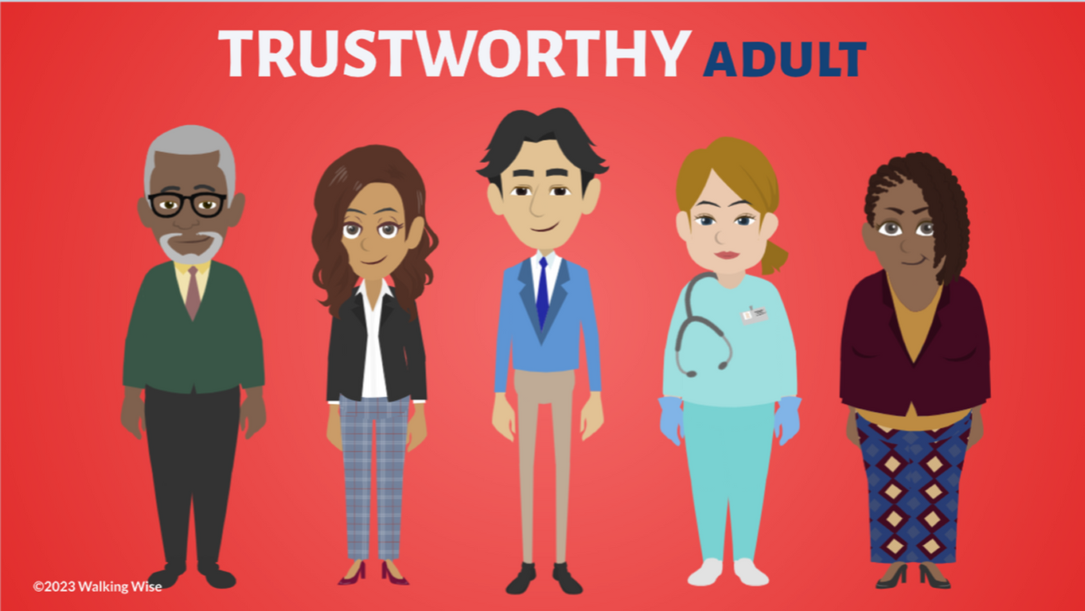
ASK FOR HELP
©2024-2026 Walking Wise
82

Slide 83
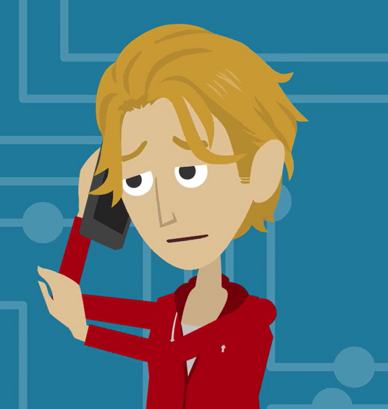
ASK FOR HELP
What are ways young people can ask for help?
©2024-2026 Walking Wise
83

Slide 84
ASK FOR HELP
HOW TO ASK FOR HELP
  If you are in immediate danger, dial 911.
©2024-2026 Walking Wise
84

Slide 85
ASK FOR HELP
HOW TO ASK FOR HELP
  If you are in immediate danger, dial 911.
  If the sexual predator IS a family member, consider telling a trustworthy adult.
©2024-2026 Walking Wise
85

Slide 86
ASK FOR HELP
HOW TO ASK FOR HELP
  If you are in immediate danger, dial 911.
  If the sexual predator IS a family member, consider telling a trustworthy adult.
  If the sexual predator is NOT family, consider telling a parent.
©2024-2026 Walking Wise
86

Slide 87
ASK FOR HELP
HOW TO ASK FOR HELP
  If you are in immediate danger, dial 911.
  If the sexual predator IS a family member, consider telling a trustworthy adult.
  If the sexual predator is NOT family, consider telling a parent.
  If you are a student in school, consider telling a trustworthy teacher, coach, school nurse, social worker, counselor, resource officer, or principal.
©2024-2026 Walking Wise
87

Slide 88
ASK FOR HELP
HOW TO ASK FOR HELP
  If you are in immediate danger, dial 911.
  If the sexual predator IS a family member, consider telling a trustworthy adult.
  If the sexual predator is NOT family, consider telling a parent.
  If you are a student in school, consider telling a trustworthy teacher, coach, school nurse, social worker, counselor, resource officer, or principal.
  To gain internet access for help, consider using a computer at your school or a public library.
©2024-2026 Walking Wise
88

Slide 89
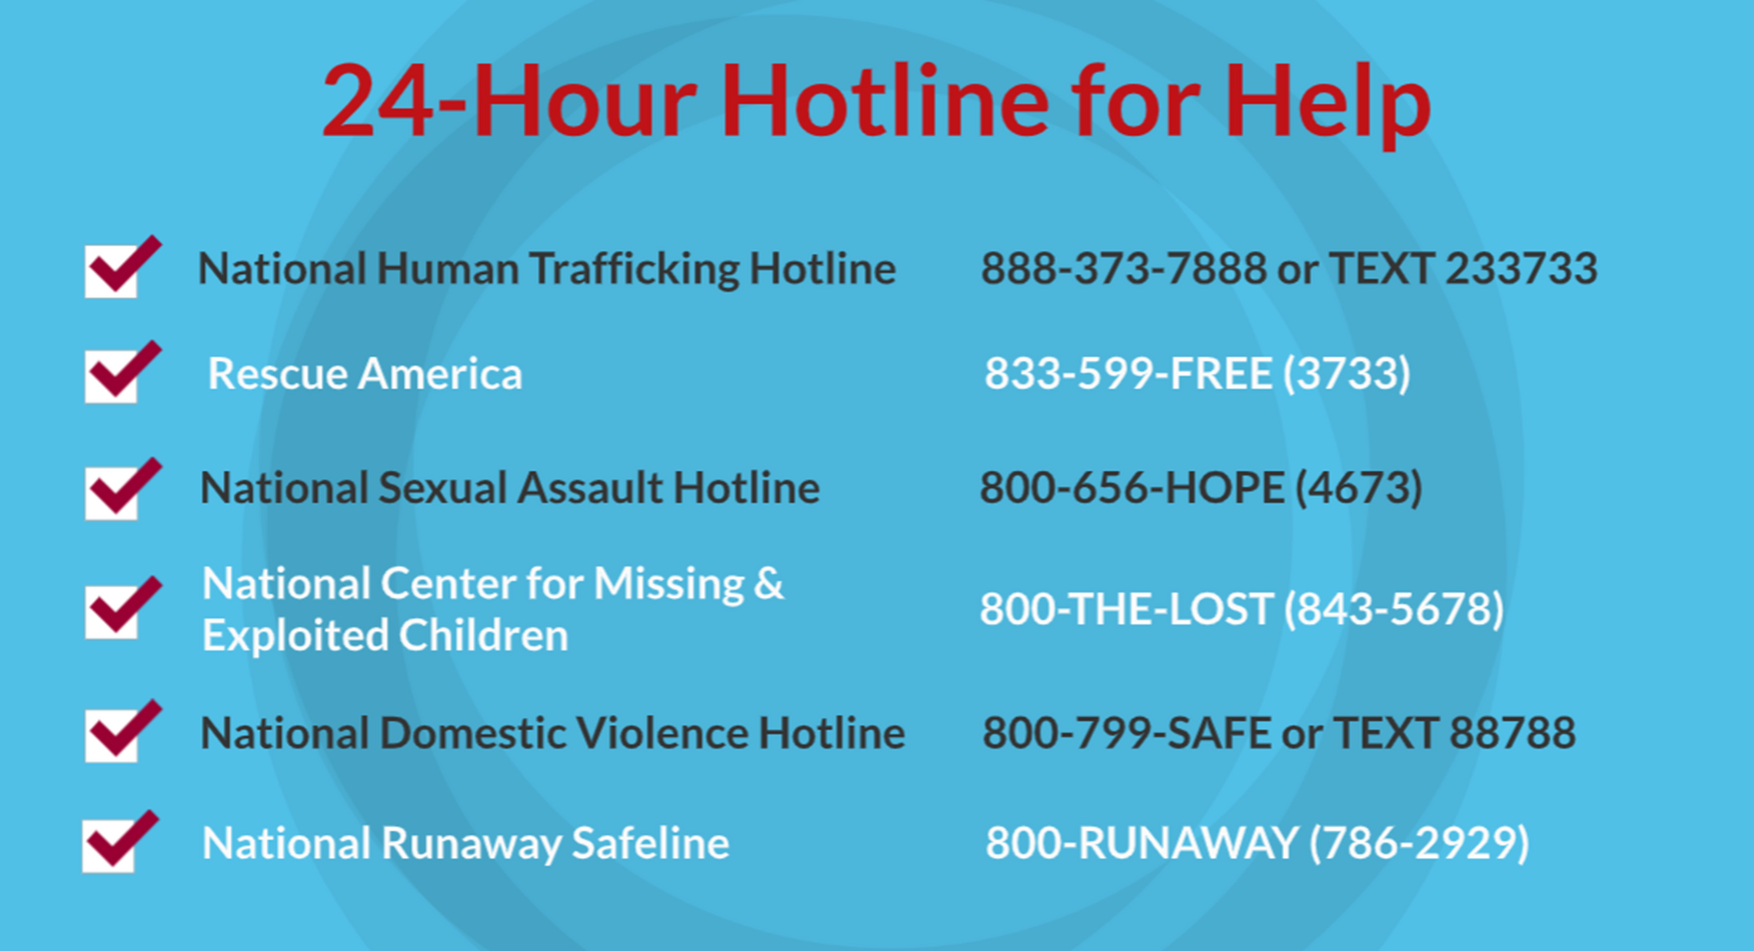
©2024-2026 Walking Wise
89
Notes:
NOTE
Presenters may ask their audience to consider adding a few "hotline for help" phone numbers in their cell phone contacts or take a photo of this slide.

Slide 90
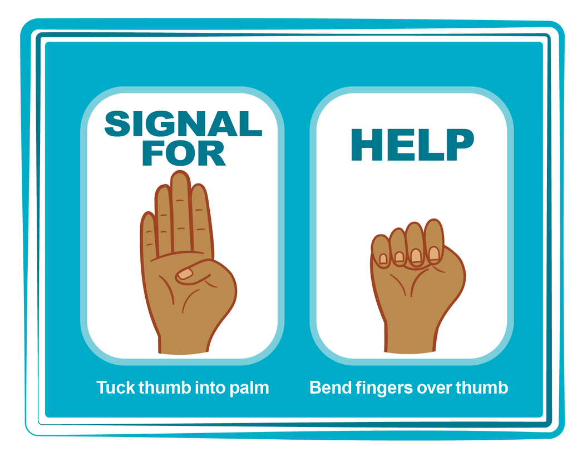
HAND SIGNAL FOR HELP
©2024-2026 Walking Wise
Source: Canadian Women’s Foundation, April 2020
90
Notes:
Although the hand signal for help has not yet achieved universal recognition, it may discreetly get someone's attention in urgent situations.
• SILENT
It can be used silently.
• UNTRACKABLE
It leaves no digital footprint.
• CONCEALED
It can be done secretly when a perpetrator is in the vicinity.
• SIGNALS DISTRESS
Combining the hand signal with distressed facial expressions might help attract the attention of an individual who is unfamiliar with the signal's meaning.
Source
Canadian Women's Foundation, April 2020

Slide 91
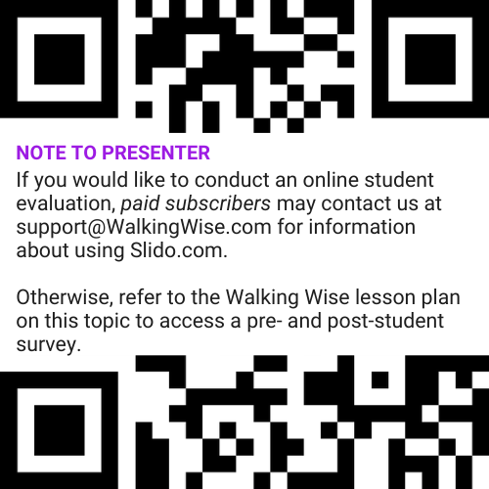
EVALUATION
©2024-2026 Walking Wise
91
Notes:
Two ways to conduct a pre-/post-student evaluation:
1) Use the pre/post survey in the Walking Wise lesson plan for this topic.
2) Activate Slido.com to conduct an online survey.

Slide 92

SHARE YOUR THOUGHTS
1. How would you rate this lesson?
2. What was the one thing you liked?
3. What one thing should we improve?
If using Slido: Replace “#XXXX” with your organization’s custom Slido code.
©2024-2026 Walking Wise
92
Notes:
SLIDO.com: 3-Question Survey
IF SLIDO IS ACTIVATED:
Follow the instructions provided on WalkingWise.com to access your school or organization's custom Slido QR code and #code, which the audience will use to complete the 3-question evaluation.
Please encourage your audience to scan your organization's custom QR code to share what they enjoyed and what could be improved about the lesson.
Please send any feedback you want to share to Walking Wise at support@WalkingWise.com.

Slide 93


Thank you!
WalkingWise.com
Online Course for Adults Accredited by:
Postgraduate Institue for Medicine
Academy of Forensic Nursing
©2024-2026 Walking Wise
93
Notes:
NOTE
To access additional resources about male victims, please refer to the last page of Lesson Plan #6 in the Walking Wise Education Guide.
We welcome your feedback at support@WalkingWise.com.
Thank you!
Karla Highman
Founder, WalkingWise.com

