Slide 1


SEXUAL EXPLOITATION
EDUCATION
male
VICTIMS
BY WALKING WISE
Notes:
NOTE TO PRESENTER
Log in to WalkingWise.com and refer to the Implementation Toolkit for classroom teaching tips.
Most importantly:
DEFINE SCHOOL POLICY
Establish a sexual exploitation reporting protocol with a trauma-informed response. The Walking Wise Implementation Toolkit provides a sample protocol.
AGE & AUDIENCE
This presentation can be edited by following the procedures on the next page to align with your school policies, specific age groups, and the involvement of at-risk audiences.
SUPPORT PROCEDURE
Provide your students with guidance on how to access immediate help or arrange a private meeting with a social worker, counselor, nurse, school resource officer, or another trustworthy staff member to report concerns about themselves or a peer.
SECOND SAFE ADULT
Ensure a second trustworthy adult, such as a teacher, is present in the learning setting to observe student reactions and identify those who may benefit from a follow-up meeting. This person should remain focused and free from other duties during the presentation.

Slide 2

6-Year Track
NOTE TO PRESENTER
Meaningful learning takes time. By introducing topics gradually over several years, educators can create steady growth in awareness and understanding.
Our recommended teaching plan offers a long-term path for middle and high school students to build knowledge and confidence.
PARENTS & STAFF
#1 Myths & Reality
6th GRADE
#2 Trustworthy vs. Unsafe Adult
#3 Grooming Process
7th GRADE
#4 Pornography Link
#5 Sextortion Scheme
8th GRADE
#6 Male Victims
#7 Runaways as Targets
#8 Rural Risks
9th GRADE
#9 Human Traffickers
#10 Female & Peer Recruiters
10th GRADE
#11 Family Secret
11th GRADE
#12 Hidden Buyers
©2024-2026 Walking Wise
2

Slide 3

NOTE TO PRESENTER
This presentation is exclusively for Walking Wise® subscribers and not for redistribution.
Presenters are encouraged to edit speaker notes to match their speaking style (viewable in presentation mode). You can also delete slides and content from this Walking Wise presentation to ensure the information aligns with your school policies, is age-appropriate, and fits within available class time. However, the slides are copyright-protected and may not be reworded without prior written permission from Walking Wise.
We encourage you to add your own content by following these instructions:
Insert new PowerPoint slides.
Remove the Walking Wise logo and copyright "©2026 Walking Wise" from the new slides.
Always add your organization's name or logo to each new slide.
Please delete this instruction page before presenting to audiences.
R042726
©2024-2026 Walking Wise
3
Notes:
NOTE TO PRESENTER
The presenter is welcome to customize this Walking Wise presentation according to the instructions provided on this page.
For revision requests, please email us at: support@WalkingWise.com.

Slide 4
STAYING SAFE FROM EXPLOITATION
CONTENT NOTICE
We’ll be discussing serious safety issues today.
Some topics may be difficult to hear.
If you ever feel uncomfortable, you can step out and speak with a trustworthy adult for support.
You’re not alone—help is available.
©2024-2026 Walking Wise
4
Notes:
NOTE TO PRESENTER
Trauma-Informed Delivery Guidelines
To support a safe and effective learning environment, please follow these guidelines:
• Present the information in a calm, matter-of-fact way and avoid sensational or alarming language.
• Avoid graphic details. Focus on helping students understand behaviors, risk, and ways to stay safe.
• Never blame victims. Responsibility always belongs to the person who caused harm.
• Maintain a steady, composed tone. Students often mirror the presenter's emotional cues.
• Do not ask students to share personal experiences or disclosures.
• If students laugh or react awkwardly, respond neutrally and gently redirect the focus.
• Pair all risk information with needed resources, practical solutions, and support options.
• Reinforce that students are not alone and that trustworthy adults are available to help.

Slide 5
STATISTICS
Why Study Results Can Vary
Some crimes are never reported, making it hard to reveal the entire issue.
Studies collect information in different ways, leading to different results.
Small studies may not represent everyone.
©2024-2026 Walking Wise
5
Notes:
In this presentation, we'll discuss statistics, but it's important to note that while statistics provide valuable insights into an issue, they cannot be relied upon entirely.
Here are a few reasons:
UNREPORTED
Victims often do not report the crimes committed against them due to fear, shame, retaliation, or manipulation. Also, many don’t realize that what is happening to them is a crime.
INCONSISTENT COLLECTION
Areas may define sexual crimes in various ways or use different methods to collect data, making it hard to compare information.
FOCUS GROUPS
Small or specific focus groups participating in a study or survey may not accurately reflect the diversity or experiences of the broader population.

Slide 6

WHY LEARN ABOUT THIS
KNOWLEDGE serves as a
powerful defense against
sexual predators.
©2024-2026 Walking Wise
6
Notes:
Education is one of the strongest tools for prevention.
When young people understand how predators operate, they are better able to recognize manipulation and avoid dangerous situations.
Reinforce that awareness increases safety.

Slide 7
PREVENTION EDUCATION
SEXUAL EXPLOITATION includes grooming, sextortion, pornography
& sex trafficking.
©2024-2026 Walking Wise
7
Notes:
SEXUAL EXPLOITATION
Taking advantage of another person for their own benefit, especially in a sexual way, often using pressure, tricks, or control.
Below are different forms of exploitation:
GROOMING
Building trust, dependency, or an emotional connection to manipulate someone.
SEXTORTION
Threatening to share embarrassing or sexual images, videos, or information to pressure someone into following demands.
PORNOGRAPHY
Involving someone in creating sexual images who is under 18, or someone who is pressured, or unable/unwilling to give consent.
SEX TRAFFICKING
Manipulating or forcing someone into sexual activity in exchange for money or something of value.
Trafficking and Violence Protection Act (TVPA) of 2000 (Legal Definition):
SEX TRAFFICKING is the recruitment, harboring, transportation, provision, obtaining, patronizing, or soliciting of a person under the age of 18 for the purpose of a commercial sex act.
TVPA link: Retrieved April 14, 2026, from https://www.govinfo.gov/content/pkg/BILLS-106hr3244enr/pdf/BILLS-106hr3244enr.pdf

Slide 8




EDUCATON GUIDE
VOCABULARY
Words to Understand
Vulnerable
Predator
Sterotype
Myth
Humiliation
Survival Sex
©2024-2026 Walking Wise
8
3
Notes:
Understanding vocabulary terms related to the behaviors of sexual predators can empower young people to recognize warning signs of harmful situations.
Knowing these terms helps them identify manipulative tactics that unsafe people (predators/traffickers) use to build trust and exploit vulnerabilities.
With this knowledge, young people are better equipped to spot red flags, understand that these behaviors are abusive, and feel more confident reporting predators to trusted adults or authorities, potentially preventing further harm.

Slide 9
EDUCATON GUIDE
VOCABULARY
PREDATOR
A person who harms, abuses, or takes advantage of others for personal gain.
©2024-2026 Walking Wise
9
3

Slide 10
WHAT DO YOU THINK?
What percentage of sex trafficking victims in the U.S. are believed to be MALE?
©2024-2026 Walking Wise
10
Notes:
Source
Swaner, R., et al. (2016, June). Youth involved in the sex trade: A national study, p. 36. U.S. Department of Justice. Retrieved November 23, 2024, from https://www.ojp.gov/pdffiles1/ojjdp/grants/249952.pdf

Slide 11
WHAT DO YOU THINK?
What percentage of sex trafficked victims in the U.S. are believed to be MALE?
A) Up to 6%
B) Up to 16%
C) Up to 36%
D) Up to 46%
©2024-2026 Walking Wise
11

Slide 12
ANSWER
Up to 36% of U.S. trafficking victims are believed to be male.
n = 341
12
©2024-2026 Walking Wise
Swaner, R., et al. (2016, June). Youth involved in the sex trade: A national study, p. 36. U.S. Department of Justice.
Notes:
Traffickers exploit similar vulnerabilities to groom and coerce all young people and genders.
A 2016 national report revealed the following about sex trafficking victims: 36% of victims were male, 4% are transgender females, while less than 1% were transgender males.
Source
1. Swaner, R., et al. (2016, June). Youth involved in the sex trade: A national study, p. 36. U.S. Department of Justice. Retrieved November 23, 2024, from https://www.ojp.gov/pdffiles1/ojjdp/grants/249952.pdf

Slide 13
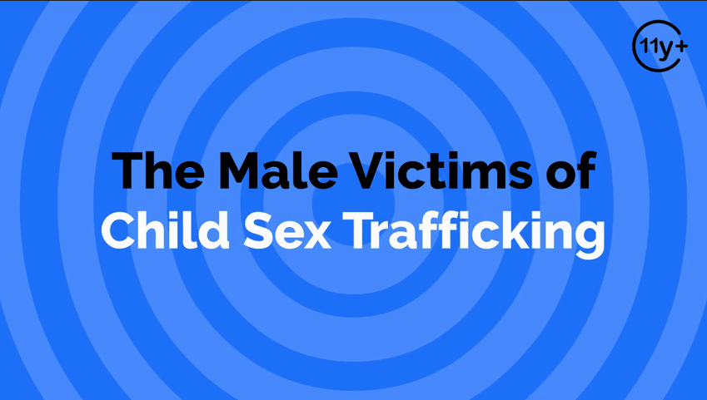
Log in to WalkingWise.com to access this animated video.
©2024-2026 Walking Wise
13
Notes:
This 3-minute Walking Wise animated video series teaches how sexual predators use manipulation, intimidation, and coercion to exploit young people.
NOTE
Log in to Walking Wise.com to watch the three-minute animated video with audiences.
Is animation appropriate for teens?
Yes, even businesses worldwide use explainer-style animation as a training tool for their employees.

Slide 14
EDUCATON GUIDE
VOCABULARY
STEREOTYPE
An idea or belief about a group of people that is not always true.
©2024-2026 Walking Wise
14
3

Slide 15
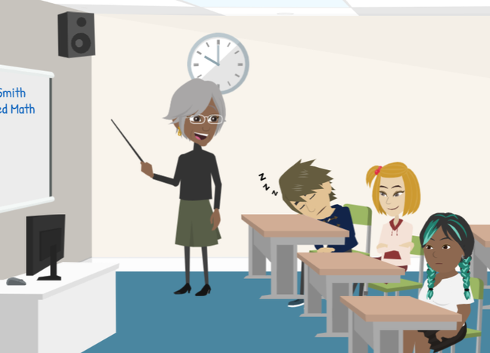
LESSON PLANS
STEREOTYPES
What are common stereotypes about males and females?
©2024-2026 Walking Wise
15
3

Slide 16
STEREOTYPES
Examples of Stereotypes
Males are better at math, while females are better at reading.
©2024-2026 Walking Wise
16
Notes:
Stereotypes can affect how people are treated.
For boys, messages like “be tough” or “don’t cry” can make them feel ashamed or weak for speaking up.
This is especially important in cases of abuse or exploitation, because it often prevents boys from reporting harm or asking for help.

Slide 17
STEREOTYPES
Examples of Stereotypes
Males hide their feelings, while females show emotions.
©2024-2026 Walking Wise
17
Notes:
Stereotypes can affect how people are treated.
For boys, messages like “be tough” or “don’t cry” can make them feel ashamed or weak for speaking up.
This is especially important in cases of abuse or exploitation, because it often prevents boys from reporting harm or asking for help.

Slide 18
STEREOTYPES
Examples of Stereotypes
Males can cause harm, while females are more likely to get hurt.
©2024-2026 Walking Wise
18
Notes:
Stereotypes can affect how people are treated.
For boys, messages like “be tough” or “don’t cry” can make them feel ashamed or weak for speaking up.
This is especially important in cases of abuse or exploitation, because it often prevents boys from reporting harm or asking for help.

Slide 19
EDUCATON GUIDE
VOCABULARY
MYTH
A false belief commonly held by a group of people.
©2024-2026 Walking Wise
19
3

Slide 20
TRAFFICKING MYTH
Stereotype & Myth
Males are victims of labor trafficking.
Females are the victims of sex trafficking.
©2024-2026 Walking Wise
20
Notes:
Myths can prevent people from seeing the real problem.
In the case of this trafficking myth, both males and females can be victims of both labor and/or sex trafficking.
Myths often cause people to overlook signs or red flags that someone is being harmed.

Slide 21
LESSON PLANS
TRAFFICKING MYTH
How does the myth that only females are sex trafficked impact males?
©2024-2026 Walking Wise
21
3

Slide 22
TRAFFICKING MYTH
Impact of the Myth
Male victims may go unnoticed.
United States Department of State (2023, June). Overlooked for Too Long: Boys and Human Trafficking. Office to Monitor and Combat Trafficking In Persons.
22
©2024-2026 Walking Wise
Notes:
OVERLOOKED CASES: Sometimes, because of stereotypes, adults may not realize that boys can be victims. This can include family members, teachers, doctors, or law enforcement officers. As a result, some boys who need help may go unnoticed.
Source
1. United States Department of State (2023, June). Overlooked for Too Long: Boys and Human Trafficking. Office to Monitor and Combat Trafficking In Persons. Retrieved on December 30, 2024, from https://www.state.gov/wp-content/uploads/2023/12/Overlooked-for-Too-Long-Boys-and-Human-Trafficking.pdf

Slide 23
TRAFFICKING MYTH
Impact of the Myth
Abuse against males may be taken less seriously.
United States Department of State (2023, June). Overlooked for Too Long: Boys and Human Trafficking. Office to Monitor and Combat Trafficking In Persons.
23
©2024-2026 Walking Wise
Notes:
UNDERESTIMATED IMPACT: Harmful experiences can affect boys just as seriously as girls. However, some people may not fully understand how much it can harm boys emotionally. This can lead to misunderstandings about what boys are going through.
Source
1. United States Department of State (2023, June). Overlooked for Too Long: Boys and Human Trafficking. Office to Monitor and Combat Trafficking In Persons. Retrieved on December 30, 2024, from https://www.state.gov/wp-content/uploads/2023/12/Overlooked-for-Too-Long-Boys-and-Human-Trafficking.pdf

Slide 24
TRAFFICKING MYTH
Impact of the Myth
Fewer support services are available to help male.
United States Department of State (2023, June). Overlooked for Too Long: Boys and Human Trafficking. Office to Monitor and Combat Trafficking In Persons.
24
©2024-2026 Walking Wise
Notes:
LACK OF RESOURCES: Because fewer cases involving boys are reported, people may not realize how often this happens. This can lead to fewer support services being created for boys, even though they need help too.
Source
1. United States Department of State (2023, June). Overlooked for Too Long: Boys and Human Trafficking. Office to Monitor and Combat Trafficking In Persons. Retrieved on December 30, 2024, from https://www.state.gov/wp-content/uploads/2023/12/Overlooked-for-Too-Long-Boys-and-Human-Trafficking.pdf

Slide 25
EDUCATON GUIDE
VOCABULARY
HUMILIATION
The strong feeling of shame or embarrassment caused by how someone is treated.
©2024-2026 Walking Wise
25
3

Slide 26
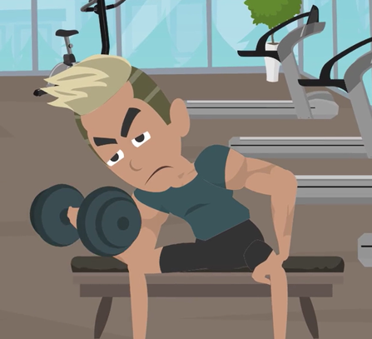
LESSON PLANS
MESSAGES ABOUT MALES
Stereotypes about males often make it harder for them to ask for help.
©2024-2026 Walking Wise
26
3

Slide 27
MESSAGES ABOUT MALES
Impact of Social Messages
Males may blame themselves because they may think only females can be victims.
United States Department of State (2023, June). Overlooked for Too Long: Boys and Human Trafficking. Office to Monitor and Combat Trafficking In Persons.
27
©2024-2026 Walking Wise
Notes:
MALE IDENTITY: From a young age, boys often receive messages that they should be strong and not show emotions. Movies, games, and superheroes sometimes reinforce this idea by showing boys as powerful and girls as more vulnerable. These messages can make it harder for boys to admit when they need help.
Source
1. United States Department of State (2023, June). Overlooked for Too Long: Boys and Human Trafficking. Office to Monitor and Combat Trafficking In Persons. Retrieved on December 30, 2024, from https://www.state.gov/wp-content/uploads/2023/12/Overlooked-for-Too-Long-Boys-and-Human-Trafficking.pdf

Slide 28
MESSAGES ABOUT MALES
Impact of Social Messages
Males may fear others will make wrong assumptions about their identity.
United States Department of State (2023, June). Overlooked for Too Long: Boys and Human Trafficking. Office to Monitor and Combat Trafficking In Persons.
28
©2024-2026 Walking Wise
Notes:
FEAR & CONFUSION: Boys who are harmed may worry that others will misunderstand them or make wrong assumptions about who they are. This can leave them feeling confused, worried, or unsure about how to talk about what happened.
SELF-BLAME: Many boys may blame themselves for what happened, even though it is never their fault. Because of this, they may keep it a secret rather than ask for help.
MEDIA INFLUENCE: Some media can send unhealthy messages about relationships and behavior. These messages may make it seem like boys are always in control or should act a certain way, which is not true and can be harmful.
(Alexander, 2016).
Source
1. United States Department of State (2023, June). Overlooked for Too Long: Boys and Human Trafficking. Office to Monitor and Combat Trafficking In Persons. Retrieved on December 30, 2024, from https://www.state.gov/wp-content/uploads/2023/12/Overlooked-for-Too-Long-Boys-and-Human-Trafficking.pdf

Slide 29
MESSAGES ABOUT MALES
Impact of Social Messages
Males may feel shame because they were unable to stop what happened.
United States Department of State (2023, June). Overlooked for Too Long: Boys and Human Trafficking. Office to Monitor and Combat Trafficking In Persons.
29
©2024-2026 Walking Wise
Notes:
SELF-BLAME: Many boys may blame themselves for what happened, even though it is never their fault. Because of this, they may keep it a secret rather than ask for help.
Source
1. United States Department of State (2023, June). Overlooked for Too Long: Boys and Human Trafficking. Office to Monitor and Combat Trafficking In Persons. Retrieved on December 30, 2024, from https://www.state.gov/wp-content/uploads/2023/12/Overlooked-for-Too-Long-Boys-and-Human-Trafficking.pdf

Slide 30
LESSON PLANS
WHAT DO YOU THINK?
What age group of males is most commonly targeted by traffickers?
©2024-2026 Walking Wise
30
3
Notes:
Source
Swaner, R., Labriola, M., Rempel, M., Walker, A., & Spadafore, J. (2016, March). Youth Involvement in the Sex Trade: A National Study, pp. 40, 41. CourtInnovation.org. Retrieved November 25, 2024, from https://www.ojp.gov/pdffiles1/ojjdp/grants/249952.pdf

Slide 31
WHAT DO YOU THINK?
What age group of males is most commonly targeted by traffickers?
A) 9 to 12 years old
B) 13 to 17 years old
C) 18 to 24 years old
©2024-2026 Walking Wise
31

Slide 32
ANSWER
Ages 13 to 17 are when males are commonly targeted by traffickers.
©2024-2026 Walking Wise
Swaner, R., Labriola, M., Rempel, M., Walker, A., & Spadafore, J. (2016, March). Youth Involvement in the Sex Trade: A National Study.
32
Notes:
NOTE TO PRESENTER:
A 2016 national study reported: 77% of all respondents (199 underage youth) indicated that their first trafficking experience took place while under the age of 18. The average age was 15.8 years old.
Source
Swaner, R., Labriola, M., Rempel, M., Walker, A., & Spadafore, J. (2016, March). Youth Involvement in the Sex Trade: A National Study, pp. 40, 41. CourtInnovation.org. Retrieved November 25, 2024, from https://www.ojp.gov/pdffiles1/ojjdp/grants/249952.pdf

Slide 33

LESSON PLANS
UNRECOGNIZED
Why can it be harder to notice or recognize male victims?
©2024-2026 Walking Wise
33
3

Slide 34
UNRECOGNIZED
Why Some Victims Are Overlooked
People may assume males are willing participants.
©2024-2026 Walking Wise
NPR News, 2021. https://www.npr.org/2021/05/24/999726614/growing-number-of-male-survivors-talk-about-being-a-sex-trade-victim
34
Notes:
MISUNDERSTOOD SITUATIONS: Sometimes people assume boys are choosing or causing situations, instead of recognizing that they may be experiencing harm. This can lead people to misunderstand what is really happening.
Source:
1. NPR News, 2021. Retrieved January 15, 2026, from https://www.npr.org/2021/05/24/999726614/growing-number-of-male-survivors-talk-about-being-a-sex-trade-victim

Slide 35
UNRECOGNIZED
Why Some Victims Are Overlooked
People may assume males are willing participants.
Adults may be less protective of males than of females.
©2024-2026 Walking Wise
NPR News, 2021. https://www.npr.org/2021/05/24/999726614/growing-number-of-male-survivors-talk-about-being-a-sex-trade-victim
35
Notes:
LESS WATCHFUL PROTECTION:
Adults and community members may not watch over boys as closely as girls. They may believe that boys are not at risk or that they can take care of themselves.
Source:
1. NPR News, 2021. Retrieved January 15, 2026, from https://www.npr.org/2021/05/24/999726614/growing-number-of-male-survivors-talk-about-being-a-sex-trade-victim

Slide 36
UNRECOGNIZED
Why Some Victims Are Overlooked
Males may be assumed to be willing participants.
Adults may be less protective of males than of females.
Warning signs may be misunderstood or unnoticed.
©2024-2026 Walking Wise
NPR News, 2021. https://www.npr.org/2021/05/24/999726614/growing-number-of-male-survivors-talk-about-being-a-sex-trade-victim
36
Notes:
LIMITED AWARENESS: When people don’t realize that boys can be victims, they may overlook or misunderstand important warning signs. This can delay help for someone who needs support.
Source:
1. NPR News, 2021. Retrieved January 15, 2026, from https://www.npr.org/2021/05/24/999726614/growing-number-of-male-survivors-talk-about-being-a-sex-trade-victim

Slide 37
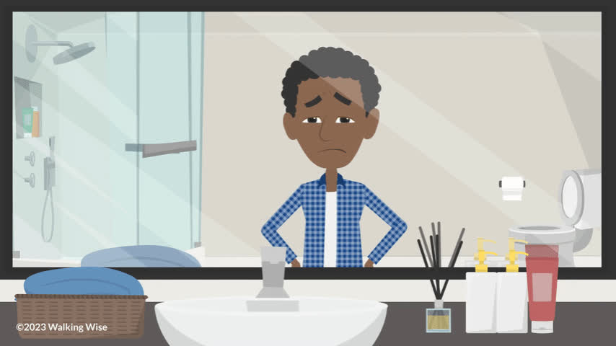
LESSON PLANS
UNREPORTED CRIME
What happens when crimes are kept a secret?
©2024-2026 Walking Wise
37
3

Slide 38
UNREPORTED CRIME
Impact of Not Asking for Help
Victims do not receive the help they need to stop the crime.
©2024-2026 Walking Wise
38

Slide 39
UNREPORTED CRIME
Impact of Not Asking for Help
Victims often experience stress, sadness, or may use substances to cover their pain.
©2024-2026 Walking Wise
39
Notes:
UNADDRESSED EFFECTS: When boys do not get help, the effects can last a long time. They may feel very sad or stressed, or struggle to make safe choices. This is why getting help early is important.

Slide 40
UNREPORTED CRIME
Impact of Not Asking for Help
Fewer support systems are offered to males.
©2024-2026 Walking Wise
40
Notes:
MISSING INFORMATION: If harmful situations are not reported, they are not counted. This means adults may not fully understand how often this happens or how many boys need help.
LESS SUPPORT AVAILABLE: When people don’t realize how big the problem is, fewer programs and resources may be created to support boys. This can make it harder for them to get the help they need to heal.

Slide 41
EDUCATON GUIDE
VOCABULARY
VULNERABLE
More likely to be hurt, tricked, or taken advantage of by others.
©2024-2026 Walking Wise
41
3

Slide 42

LESSON PLANS
INCREASED RISK
What could make someone vulnerable to being targeted?
©2024-2026 Walking Wise
42
3

Slide 43
INCREASED RISK
Risk Factors: Difficulty at Home
Unable to access basic needs such as food.
Kinnish, K., Barba, A., Blacker, D., Dierkhising, C., Garrett, R., Grady, J.B., Greenbaum, V.J., Griffin, D., Rubiales, R., Spring, G., Wozniak, J., and Child Sex Trafficking Collaborative Group. (2021). Child sex trafficking: Who is vulnerable to being trafficked? Los Angeles, CA, and Durham, NC: National Center for Child Traumatic Stress.
43
©2024-2026 Walking Wise
Notes:
Source:
Kinnish, K., Barba, A., Blacker, D., Dierkhising, C., Garrett, R., Grady, J.B., Greenbaum, V.J., Griffin, D., Rubiales, R., Spring, G., Wozniak, J., and Child Sex Trafficking Collaborative Group. (2021). Child sex
trafficking: Who is vulnerable to being trafficked? Los Angeles, CA, and Durham, NC: National Center for Child Traumatic Stress. Retrieved January 16, 2026, from https://www.nctsn.org/sites/default/files/resources/fact-sheet/child_sex_trafficking_who_is_vulnerable_to_being_trafficked.pdf

Slide 44
INCREASED RISK
Risk Factors: Difficulty at Home
Unable to access basic needs like food.
Not having a stable place to live.
Kinnish, K., Barba, A., Blacker, D., Dierkhising, C., Garrett, R., Grady, J.B., Greenbaum, V.J., Griffin, D., Rubiales, R., Spring, G., Wozniak, J., and Child Sex Trafficking Collaborative Group. (2021). Child sex trafficking: Who is vulnerable to being trafficked? Los Angeles, CA, and Durham, NC: National Center for Child Traumatic Stress.
44
©2024-2026 Walking Wise
Notes:
Source:
Kinnish, K., Barba, A., Blacker, D., Dierkhising, C., Garrett, R., Grady, J.B., Greenbaum, V.J., Griffin, D., Rubiales, R., Spring, G., Wozniak, J., and Child Sex Trafficking Collaborative Group. (2021). Child sex
trafficking: Who is vulnerable to being trafficked? Los Angeles, CA, and Durham, NC: National Center for Child Traumatic Stress. Retrieved January 16, 2026, from https://www.nctsn.org/sites/default/files/resources/fact-sheet/child_sex_trafficking_who_is_vulnerable_to_being_trafficked.pdf

Slide 45
INCREASED RISK
Risk Factors: Difficulty at Home
Unable to access basic needs like food.
Not having a stable place to live.
Experiencing rejection by family.
Kinnish, K., Barba, A., Blacker, D., Dierkhising, C., Garrett, R., Grady, J.B., Greenbaum, V.J., Griffin, D., Rubiales, R., Spring, G., Wozniak, J., and Child Sex Trafficking Collaborative Group. (2021). Child sex trafficking: Who is vulnerable to being trafficked? Los Angeles, CA, and Durham, NC: National Center for Child Traumatic Stress.
45
©2024-2026 Walking Wise
Notes:
Source:
Kinnish, K., Barba, A., Blacker, D., Dierkhising, C., Garrett, R., Grady, J.B., Greenbaum, V.J., Griffin, D., Rubiales, R., Spring, G., Wozniak, J., and Child Sex Trafficking Collaborative Group. (2021). Child sex
trafficking: Who is vulnerable to being trafficked? Los Angeles, CA, and Durham, NC: National Center for Child Traumatic Stress. Retrieved January 16, 2026, from https://www.nctsn.org/sites/default/files/resources/fact-sheet/child_sex_trafficking_who_is_vulnerable_to_being_trafficked.pdf

Slide 46
INCREASED RISK
Risk Factors: Social Challenges
Facing bullying, loneliness, or low self-esteem.
Kinnish, K., Barba, A., Blacker, D., Dierkhising, C., Garrett, R., Grady, J.B., Greenbaum, V.J., Griffin, D., Rubiales, R., Spring, G., Wozniak, J., and Child Sex Trafficking Collaborative Group. (2021). Child sex trafficking: Who is vulnerable to being trafficked? Los Angeles, CA, and Durham, NC: National Center for Child Traumatic Stress.
Thorn. (2025). Sexual Extortion & Young People: Navigating threats in digital environments.
©2024-2026 Walking Wise
46
Notes:
Source:
1. Kinnish, K., Barba, A., Blacker, D., Dierkhising, C., Garrett, R., Grady, J.B., Greenbaum, V.J., Griffin, D., Rubiales, R., Spring, G., Wozniak, J., and Child Sex Trafficking Collaborative Group. (2021). Child sex
trafficking: Who is vulnerable to being trafficked? Los Angeles, CA, and Durham, NC: National Center for Child Traumatic Stress. Retrieved January 16, 2026, from https://www.nctsn.org/sites/default/files/resources/fact-sheet/child_sex_trafficking_who_is_vulnerable_to_being_trafficked.pdf
2. Thorn. (2025). Sexual Extortion & Young People: Navigating threats in digital environments. Retrieved January 16, 2016, from https://www.thorn.org/research/library/sexual-extortion-young-people/

Slide 47
INCREASED RISK
Risk Factors: Social Challenges
Facing bullying, loneliness, or low self-esteem.
Being easily influenced by peer pressure.
Kinnish, K., Barba, A., Blacker, D., Dierkhising, C., Garrett, R., Grady, J.B., Greenbaum, V.J., Griffin, D., Rubiales, R., Spring, G., Wozniak, J., and Child Sex Trafficking Collaborative Group. (2021). Child sex trafficking: Who is vulnerable to being trafficked? Los Angeles, CA, and Durham, NC: National Center for Child Traumatic Stress.
Thorn. (2025). Sexual Extortion & Young People: Navigating threats in digital environments.
©2024-2026 Walking Wise
47
Notes:
Source:
1. Kinnish, K., Barba, A., Blacker, D., Dierkhising, C., Garrett, R., Grady, J.B., Greenbaum, V.J., Griffin, D., Rubiales, R., Spring, G., Wozniak, J., and Child Sex Trafficking Collaborative Group. (2021). Child sex
trafficking: Who is vulnerable to being trafficked? Los Angeles, CA, and Durham, NC: National Center for Child Traumatic Stress. Retrieved January 16, 2026, from https://www.nctsn.org/sites/default/files/resources/fact-sheet/child_sex_trafficking_who_is_vulnerable_to_being_trafficked.pdf
2. Thorn. (2025). Sexual Extortion & Young People: Navigating threats in digital environments. Retrieved January 16, 2016, from https://www.thorn.org/research/library/sexual-extortion-young-people/

Slide 48
INCREASED RISK
Risk Factors: Social Challenges
Facing bullying, loneliness, or low self-esteem.
Being easily influenced by peer pressure.
Spending a lot of time with online-only friends.
Kinnish, K., Barba, A., Blacker, D., Dierkhising, C., Garrett, R., Grady, J.B., Greenbaum, V.J., Griffin, D., Rubiales, R., Spring, G., Wozniak, J., and Child Sex Trafficking Collaborative Group. (2021). Child sex trafficking: Who is vulnerable to being trafficked? Los Angeles, CA, and Durham, NC: National Center for Child Traumatic Stress.
Thorn. (2025). Sexual Extortion & Young People: Navigating threats in digital environments.
©2024-2026 Walking Wise
48
Notes:
Source:
1. Kinnish, K., Barba, A., Blacker, D., Dierkhising, C., Garrett, R., Grady, J.B., Greenbaum, V.J., Griffin, D., Rubiales, R., Spring, G., Wozniak, J., and Child Sex Trafficking Collaborative Group. (2021). Child sex
trafficking: Who is vulnerable to being trafficked? Los Angeles, CA, and Durham, NC: National Center for Child Traumatic Stress. Retrieved January 16, 2026, from https://www.nctsn.org/sites/default/files/resources/fact-sheet/child_sex_trafficking_who_is_vulnerable_to_being_trafficked.pdf
2. Thorn. (2025). Sexual Extortion & Young People: Navigating threats in digital environments. Retrieved January 16, 2016, from https://www.thorn.org/research/library/sexual-extortion-young-people/

Slide 49
INCREASED RISK
Risk Factors: Emotional & Physical Challenges
Having no interest in school or other activities.
Kinnish, K., Barba, A., Blacker, D., Dierkhising, C., Garrett, R., Grady, J.B., Greenbaum, V.J., Griffin, D., Rubiales, R., Spring, G., Wozniak, J., and Child Sex Trafficking Collaborative Group. (2021). Child sex trafficking: Who is vulnerable to being trafficked? Los Angeles, CA, and Durham, NC: National Center for Child Traumatic Stress.
49
©2024-2026 Walking Wise
Notes:
Source:
Kinnish, K., Barba, A., Blacker, D., Dierkhising, C., Garrett, R., Grady, J.B., Greenbaum, V.J., Griffin, D., Rubiales, R., Spring, G., Wozniak, J., and Child Sex Trafficking Collaborative Group. (2021). Child sex
trafficking: Who is vulnerable to being trafficked? Los Angeles, CA, and Durham, NC: National Center for Child Traumatic Stress. Retrieved January 16, 2026, from https://www.nctsn.org/sites/default/files/resources/fact-sheet/child_sex_trafficking_who_is_vulnerable_to_being_trafficked.pdf

Slide 50
INCREASED RISK
Risk Factors: Emotional & Physical Challenges
Having no interest in school or other activities.
Experiencing neglect or abuse.
Kinnish, K., Barba, A., Blacker, D., Dierkhising, C., Garrett, R., Grady, J.B., Greenbaum, V.J., Griffin, D., Rubiales, R., Spring, G., Wozniak, J., and Child Sex Trafficking Collaborative Group. (2021). Child sex trafficking: Who is vulnerable to being trafficked? Los Angeles, CA, and Durham, NC: National Center for Child Traumatic Stress.
50
©2024-2026 Walking Wise
Notes:
Source:
Kinnish, K., Barba, A., Blacker, D., Dierkhising, C., Garrett, R., Grady, J.B., Greenbaum, V.J., Griffin, D., Rubiales, R., Spring, G., Wozniak, J., and Child Sex Trafficking Collaborative Group. (2021). Child sex
trafficking: Who is vulnerable to being trafficked? Los Angeles, CA, and Durham, NC: National Center for Child Traumatic Stress. Retrieved January 16, 2026, from https://www.nctsn.org/sites/default/files/resources/fact-sheet/child_sex_trafficking_who_is_vulnerable_to_being_trafficked.pdf

Slide 51
INCREASED RISK
Risk Factors: Emotional & Physical Challenges
Having no interest in school or other activities.
Experiencing neglect or abuse.
Living with physical or mental health challenges.
Kinnish, K., Barba, A., Blacker, D., Dierkhising, C., Garrett, R., Grady, J.B., Greenbaum, V.J., Griffin, D., Rubiales, R., Spring, G., Wozniak, J., and Child Sex Trafficking Collaborative Group. (2021). Child sex trafficking: Who is vulnerable to being trafficked? Los Angeles, CA, and Durham, NC: National Center for Child Traumatic Stress.
51
©2024-2026 Walking Wise
Notes:
Source:
Kinnish, K., Barba, A., Blacker, D., Dierkhising, C., Garrett, R., Grady, J.B., Greenbaum, V.J., Griffin, D., Rubiales, R., Spring, G., Wozniak, J., and Child Sex Trafficking Collaborative Group. (2021). Child sex
trafficking: Who is vulnerable to being trafficked? Los Angeles, CA, and Durham, NC: National Center for Child Traumatic Stress. Retrieved January 16, 2026, from https://www.nctsn.org/sites/default/files/resources/fact-sheet/child_sex_trafficking_who_is_vulnerable_to_being_trafficked.pdf

Slide 52
INCREASED RISK
Risk Factors: Emotional & Physical Challenges
Having no interest in school or other activities.
Experiencing neglect or abuse.
Living with physical or mental health challenges.
Using substances, such as drugs or alcohol.
Kinnish, K., Barba, A., Blacker, D., Dierkhising, C., Garrett, R., Grady, J.B., Greenbaum, V.J., Griffin, D., Rubiales, R., Spring, G., Wozniak, J., and Child Sex Trafficking Collaborative Group. (2021). Child sex trafficking: Who is vulnerable to being trafficked? Los Angeles, CA, and Durham, NC: National Center for Child Traumatic Stress.
52
©2024-2026 Walking Wise
Notes:
Source:
Kinnish, K., Barba, A., Blacker, D., Dierkhising, C., Garrett, R., Grady, J.B., Greenbaum, V.J., Griffin, D., Rubiales, R., Spring, G., Wozniak, J., and Child Sex Trafficking Collaborative Group. (2021). Child sex
trafficking: Who is vulnerable to being trafficked? Los Angeles, CA, and Durham, NC: National Center for Child Traumatic Stress. Retrieved January 16, 2026, from https://www.nctsn.org/sites/default/files/resources/fact-sheet/child_sex_trafficking_who_is_vulnerable_to_being_trafficked.pdf

Slide 53
LESSON PLANS
RISK FACTORS
What activities could make it easier for someone to become targeted?
©2024-2026 Walking Wise
53
3
Notes:
NOTE TO PRESENTER
TRAFFICKING RISK FACTORS
• Experience neglect, mental, physical & sexual abuse
• Food insecurity, unhoused, or lack of basic needs
• Poor self-esteem
• Struggles academically or has learning differences
• Lacks peer relationships or is a target of bullying
• Submits to peer pressure
• Unmotivated to achieve in school or activities
• Unprotected use of social media platforms
• Intellectual disabilities or mental health issues
• Older boyfriend, girlfriend, or partner
• Family rejection over sexual orientation
• Drug and alcohol use
• Romantic partner uses drugs
• Isolated by a romantic partner or friend
• Family member abuses drugs or alcohol
• Unstable home life or unhealthy family dynamics
• History of running away
• Lives in foster care or a group home
• Unhoused or lives in a homeless shelter
• Lives near a wealthy tourist location
• Targeted by cults or gangs, or is a cult or gang member
• Family member participates in trafficking
• Exposed to prostitution within the neighborhood
• Involved in the Juvenile Justice system
Source:
1. Thorn. (2025). Sexual Extortion & Young People: Navigating threats in digital environments. Retrieved January 16, 2016, from https://www.thorn.org/research/library/sexual-extortion-young-people/
Kinnish, K., Barba, A., Blacker, D., Dierkhising, C., Garrett, R., Grady, J.B., Greenbaum, V.J., Griffin, D., Rubiales, R., Spring, G., Wozniak, J., and Child Sex Trafficking Collaborative Group. (2021). Child sex
trafficking: Who is vulnerable to being trafficked? Los Angeles, CA, and Durham, NC: National Center for Child Traumatic Stress. Retrieved January 16, 2026, from https://www.nctsn.org/sites/default/files/resources/fact-sheet/child_sex_trafficking_who_is_vulnerable_to_being_trafficked.pdf

Slide 54
RISK FACTORS
Common Risks Factors for Males
Online friendships with strangers
Thorn. (2025). Sexual Extortion & Young People: Navigating threats in digital environments.
Kinnish, K., Barba, A., Blacker, D., Dierkhising, C., Garrett, R., Grady, J.B., Greenbaum, V.J., Griffin, D., Rubiales, R., Spring, G., Wozniak, J., and Child Sex Trafficking Collaborative Group. (2021). Child sex trafficking: Who is vulnerable to being trafficked? Los Angeles, CA, and Durham, NC: National Center for Child Traumatic Stress.
©2024-2026 Walking Wise
54
Notes:
Source:
Thorn. (2025). Sexual Extortion & Young People: Navigating threats in digital environments. Retrieved January 16, 2016, from https://www.thorn.org/research/library/sexual-extortion-young-people/
Kinnish, K., Barba, A., Blacker, D., Dierkhising, C., Garrett, R., Grady, J.B., Greenbaum, V.J., Griffin, D., Rubiales, R., Spring, G., Wozniak, J., and Child Sex Trafficking Collaborative Group. (2021). Child sex
trafficking: Who is vulnerable to being trafficked? Los Angeles, CA, and Durham, NC: National Center for Child Traumatic Stress. Retrieved January 16, 2026, from https://www.nctsn.org/sites/default/files/resources/fact-sheet/child_sex_trafficking_who_is_vulnerable_to_being_trafficked.pdf

Slide 55
RISK FACTORS
Common Risks Factors for Males
Online friendships with strangers
Gaming platforms with unknown players
Thorn. (2025). Sexual Extortion & Young People: Navigating threats in digital environments.
Kinnish, K., Barba, A., Blacker, D., Dierkhising, C., Garrett, R., Grady, J.B., Greenbaum, V.J., Griffin, D., Rubiales, R., Spring, G., Wozniak, J., and Child Sex Trafficking Collaborative Group. (2021). Child sex trafficking: Who is vulnerable to being trafficked? Los Angeles, CA, and Durham, NC: National Center for Child Traumatic Stress.
©2024-2026 Walking Wise
55
Notes:
Source:
Thorn. (2025). Sexual Extortion & Young People: Navigating threats in digital environments. Retrieved January 16, 2016, from https://www.thorn.org/research/library/sexual-extortion-young-people/
Kinnish, K., Barba, A., Blacker, D., Dierkhising, C., Garrett, R., Grady, J.B., Greenbaum, V.J., Griffin, D., Rubiales, R., Spring, G., Wozniak, J., and Child Sex Trafficking Collaborative Group. (2021). Child sex
trafficking: Who is vulnerable to being trafficked? Los Angeles, CA, and Durham, NC: National Center for Child Traumatic Stress. Retrieved January 16, 2026, from https://www.nctsn.org/sites/default/files/resources/fact-sheet/child_sex_trafficking_who_is_vulnerable_to_being_trafficked.pdf

Slide 56
RISK FACTORS
Common Risks Factors for Males
Online friendships with strangers
Gaming platforms with unknown players
Sharing private images (sexting)
Thorn. (2025). Sexual Extortion & Young People: Navigating threats in digital environments.
Kinnish, K., Barba, A., Blacker, D., Dierkhising, C., Garrett, R., Grady, J.B., Greenbaum, V.J., Griffin, D., Rubiales, R., Spring, G., Wozniak, J., and Child Sex Trafficking Collaborative Group. (2021). Child sex trafficking: Who is vulnerable to being trafficked? Los Angeles, CA, and Durham, NC: National Center for Child Traumatic Stress.
©2024-2026 Walking Wise
56
Notes:
Source:
Thorn. (2025). Sexual Extortion & Young People: Navigating threats in digital environments. Retrieved January 16, 2016, from https://www.thorn.org/research/library/sexual-extortion-young-people/
Kinnish, K., Barba, A., Blacker, D., Dierkhising, C., Garrett, R., Grady, J.B., Greenbaum, V.J., Griffin, D., Rubiales, R., Spring, G., Wozniak, J., and Child Sex Trafficking Collaborative Group. (2021). Child sex
trafficking: Who is vulnerable to being trafficked? Los Angeles, CA, and Durham, NC: National Center for Child Traumatic Stress. Retrieved January 16, 2026, from https://www.nctsn.org/sites/default/files/resources/fact-sheet/child_sex_trafficking_who_is_vulnerable_to_being_trafficked.pdf

Slide 57
RISK FACTORS
Common Risks Factors for Males
Online friendships with strangers
Gaming platforms with unknown players
Sharing private images (sexting)
Running away from home
Thorn. (2025). Sexual Extortion & Young People: Navigating threats in digital environments.
Kinnish, K., Barba, A., Blacker, D., Dierkhising, C., Garrett, R., Grady, J.B., Greenbaum, V.J., Griffin, D., Rubiales, R., Spring, G., Wozniak, J., and Child Sex Trafficking Collaborative Group. (2021). Child sex trafficking: Who is vulnerable to being trafficked? Los Angeles, CA, and Durham, NC: National Center for Child Traumatic Stress.
©2024-2026 Walking Wise
57
Notes:
Source:
Thorn. (2025). Sexual Extortion & Young People: Navigating threats in digital environments. Retrieved January 16, 2016, from https://www.thorn.org/research/library/sexual-extortion-young-people/
Kinnish, K., Barba, A., Blacker, D., Dierkhising, C., Garrett, R., Grady, J.B., Greenbaum, V.J., Griffin, D., Rubiales, R., Spring, G., Wozniak, J., and Child Sex Trafficking Collaborative Group. (2021). Child sex
trafficking: Who is vulnerable to being trafficked? Los Angeles, CA, and Durham, NC: National Center for Child Traumatic Stress. Retrieved January 16, 2026, from https://www.nctsn.org/sites/default/files/resources/fact-sheet/child_sex_trafficking_who_is_vulnerable_to_being_trafficked.pdf

Slide 58
RISK FACTORS
Tricky Online Strangers
Predators often pretend to be the same age and have things in common.
©2024-2026 Walking Wise
58

Slide 59
RISK FACTORS
Tricky Online Strangers
They build trust before making awkward or unsafe requests.
©2024-2026 Walking Wise
59

Slide 60
RISK FACTORS
Tricky Online Strangers
They often try to move the conversation to a private chat.
©2024-2026 Walking Wise
60

Slide 61
RISK FACTORS
Tricky Online Strangers
Sometimes they suggest meeting in person for an adventure.
©2024-2026 Walking Wise
61

Slide 62
RISK FACTORS
Tricky Online Strangers
They pretend to have a romantic interest, which can cause them to lower their guard.
©2024-2026 Walking Wise
62

Slide 63
RISK FACTORS
Tricky Online Strangers
Predators often send sexual photos FIRST, then request one in return.
©2024-2026 Walking Wise
63

Slide 64
RISK FACTORS
Homelessness
Running away leaves teens without protection.
©2024-2026 Walking Wise
64

Slide 65
RISK FACTORS
Homelessness
Staying with friends (couch surfing) often doesn’t last.
©2024-2026 Walking Wise
65

Slide 66
RISK FACTORS
Homelessness
Teens without housing may feel pressured to engage in “survival sex” for food and shelter.
©2024-2026 Walking Wise
66

Slide 67
EDUCATON GUIDE
VOCABULARY
SURVIVAL SEX
When someone is pressured to exchange sexual activity for basic needs such as food, shelter, or safety.
©2024-2026 Walking Wise
67
3

Slide 68
RISK FACTORS
Substance Use & Addiction
Predators may target teens by giving them access to free drugs and alcohol.
©2024-2026 Walking Wise
68
Notes:
SUBSTANCE USE & CONTROL: Sometimes, people may use drugs or alcohol to cope with stress, pain, or difficult experiences. This can make it harder for them to think clearly or make safe decisions.
Predators may use substances to gain trust or control. For example, they might offer drugs or alcohol to make someone feel dependent on them.
If someone is already struggling with substance use, it can make them more vulnerable to being taken advantage of, especially if someone is providing those substances.

Slide 69
RISK FACTORS
Substance Use & Addiction
Predators often use substances to build trust and gain control.
©2024-2026 Walking Wise
69
Notes:
SUBSTANCE USE & CONTROL: Sometimes, people may use drugs or alcohol to cope with stress, pain, or difficult experiences. This can make it harder for them to think clearly or make safe decisions.
Predators may use substances to gain trust or control. For example, they might offer drugs or alcohol to make someone feel dependent on them.
If someone is already struggling with substance use, it can make them more vulnerable to being taken advantage of, especially if someone is providing those substances.

Slide 70

LESSON PLANS
BRAIN DEVELOPMENT
The developing brain can increase a teen’s vulnerability.
©2024-2026 Walking Wise
70
3

Slide 71
LESSON PLANS
WHAT DO YOU THINK?
At about what age is the male brain fully developed?
©2024-2026 Walking Wise
71
3
Notes:
Source:
Casey, B., Jones, R. M., & Somerville, L. H. (2011). Braking and Accelerating of the Adolescent Brain. Journal of Research on Adolescence: The Official Journal of the Society for Research on Adolescence, 21(1), 21–33. Retrieve January 15, 2026, from https://doi.org/10.1111/j.1532-7795.2010.00712.x

Slide 72
WHAT DO YOU THINK?
At about what age is the male brain fully developed?
A) 16 years old
B) 18 years old
C) 20 years old
D) 25 years old
©2024-2026 Walking Wise
72

Slide 73
ANSWER
The male brain is fully developed at about 25 years old.
©2024-2026 Walking Wise
Casey, B., Jones, R. M., & Somerville, L. H. (2011). Braking and Accelerating of the Adolescent Brain. Journal of Research on Adolescence: The Official Journal of the Society for Research on Adolescence, 21(1), 21–33.
73
Notes:
BRAIN DEVELOPMENT
Although the brain's size may no longer grow, it is not fully developed until young people are in their twenties. Some studies suggest that for males, the age is closer to twenty-five.
Source:
Casey, B., Jones, R. M., & Somerville, L. H. (2011). Braking and Accelerating of the Adolescent Brain. Journal of Research on Adolescence: The Official Journal of the Society for Research on Adolescence, 21(1), 21–33. Retrieve January 15, 2026, from https://doi.org/10.1111/j.1532-7795.2010.00712.x

Slide 74
BRAIN DEVELOPMENT
The Brain Is Our Control Center
The brain grows to its full size in the teenage years.
©2024-2026 Walking Wise
Casey, B., Jones, R. M., & Somerville, L. H. (2011). Braking and Accelerating of the Adolescent Brain. Journal of Research on Adolescence: The Official Journal of the Society for Research on Adolescence, 21(1), 21–33.
74
Notes:
BRAIN DEVELOPMENT: Even though the brain may look fully grown, it is still developing into a person’s twenties. This means young people are still learning how to make decisions and handle challenges.
Source:
Casey, B., Jones, R. M., & Somerville, L. H. (2011). Braking and Accelerating of the Adolescent Brain. Journal of Research on Adolescence: The Official Journal of the Society for Research on Adolescence, 21(1), 21–33. https://doi.org/10.1111/j.1532-7795.2010.00712.x

Slide 75
BRAIN DEVELOPMENT
The Brain Is Our Control Center
Brain development continues until about age 25.
©2024-2026 Walking Wise
Casey, B., Jones, R. M., & Somerville, L. H. (2011). Braking and Accelerating of the Adolescent Brain. Journal of Research on Adolescence: The Official Journal of the Society for Research on Adolescence, 21(1), 21–33.
75
Notes:
BRAIN FUNCTION: The front part of the brain supports important skills such as making good choices, planning ahead, and controlling impulses. Since this part is still developing, it can be harder for teens to pause and think before acting.
Source:
Casey, B., Jones, R. M., & Somerville, L. H. (2011). Braking and Accelerating of the Adolescent Brain. Journal of Research on Adolescence: The Official Journal of the Society for Research on Adolescence, 21(1), 21–33. https://doi.org/10.1111/j.1532-7795.2010.00712.x

Slide 76
BRAIN DEVELOPMENT
The Brain Is Our Control Center
The brain’s prefrontal cortex helps with decision-making and self-control.
©2024-2026 Walking Wise
Casey, B., Jones, R. M., & Somerville, L. H. (2011). Braking and Accelerating of the Adolescent Brain. Journal of Research on Adolescence: The Official Journal of the Society for Research on Adolescence, 21(1), 21–33.
76
Notes:
DECISION-MAKING & RISK: Because these skills are still growing, young people may sometimes take risks without thinking about the consequences.
People who want to take advantage of others may exploit this by pressuring teens into making quick or unsafe decisions.
Source:
Casey, B., Jones, R. M., & Somerville, L. H. (2011). Braking and Accelerating of the Adolescent Brain. Journal of Research on Adolescence: The Official Journal of the Society for Research on Adolescence, 21(1), 21–33. https://doi.org/10.1111/j.1532-7795.2010.00712.x

Slide 77
BRAIN DEVELOPMENT
Prefrontal Cortex: The Brain’s Control Center
Decision-Making: Helps us decide what to do
©2024-2026 Walking Wise
Cleveland Clinic. (2025). Prefrontal cortex. Cleveland Clinic.
77
Notes:
The prefrontal cortex serves as the brain's control center and often does not fully mature until about age 25.
Source
Cleveland Clinic. (2025). Prefrontal cortex. Cleveland Clinic. Retrieved March 2026, from https://my.clevelandclinic.org/health/body/prefrontal-cortex

Slide 78
BRAIN DEVELOPMENT
Prefrontal Cortex: The Brain’s Control Center
Decision-Making: Helps us choose what to do
Plan Ahead: Think about the future
©2024-2026 Walking Wise
Cleveland Clinic. (2025). Prefrontal cortex. Cleveland Clinic.
78
Notes:
The prefrontal cortex serves as the brain's control center and often does not fully mature until about age 25.
Source
Cleveland Clinic. (2025). Prefrontal cortex. Cleveland Clinic. Retrieved March 2026, from https://my.clevelandclinic.org/health/body/prefrontal-cortex

Slide 79
BRAIN DEVELOPMENT
Prefrontal Cortex: The Brain’s Control Center
Decision-Making: Helps us choose what to do
Plan Ahead: Think about the future
Self-Control: Stop and think before acting
©2024-2026 Walking Wise
Cleveland Clinic. (2025). Prefrontal cortex. Cleveland Clinic.
79
Notes:
The prefrontal cortex serves as the brain's control center and often does not fully mature until about age 25.
Source
Cleveland Clinic. (2025). Prefrontal cortex. Cleveland Clinic. Retrieved March 2026, from https://my.clevelandclinic.org/health/body/prefrontal-cortex

Slide 80
BRAIN DEVELOPMENT
Prefrontal Cortex: The Brain’s Control Center
Decision-Making: Helps us choose what to do
Plan Ahead: Think about the future
Self-Control: Stop and think before acting
Understand Consequences: Predict what might happen next
©2024-2026 Walking Wise
Cleveland Clinic. (2025). Prefrontal cortex. Cleveland Clinic.
80
Notes:
The prefrontal cortex serves as the brain's control center and often does not fully mature until about age 25.
Source
Cleveland Clinic. (2025). Prefrontal cortex. Cleveland Clinic. Retrieved March 2026, from https://my.clevelandclinic.org/health/body/prefrontal-cortex

Slide 81
BRAIN DEVELOPMENT
Prefrontal Cortex: The Brain’s Control Center
Decision-Making: Helps us choose what to do
Plan Ahead: Think about the future
Self-Control: Stop and think before acting
Understand Consequences: Predict what might happen next
Problem-Solve: Figure things out
©2024-2026 Walking Wise
Cleveland Clinic. (2025). Prefrontal cortex. Cleveland Clinic.
81
Notes:
The prefrontal cortex serves as the brain's control center and often does not fully mature until about age 25.
Source
Cleveland Clinic. (2025). Prefrontal cortex. Cleveland Clinic. Retrieved March 2026, from https://my.clevelandclinic.org/health/body/prefrontal-cortex

Slide 82
BRAIN DEVELOPMENT
Prefrontal Cortex: The Brain’s Control Center
Decision-Making: Helps us choose what to do
Plan Ahead: Think about the future
Self-Control: Stop and think before acting
Understand Consequences: Predict what might happen next
Problem-Solve: Figure things out
Manage Emotions: Helps us stay calm and in control
©2024-2026 Walking Wise
Cleveland Clinic. (2025). Prefrontal cortex. Cleveland Clinic.
82
Notes:
The prefrontal cortex serves as the brain's control center and often does not fully mature until about age 25.
Source
Cleveland Clinic. (2025). Prefrontal cortex. Cleveland Clinic. Retrieved March 2026, from https://my.clevelandclinic.org/health/body/prefrontal-cortex

Slide 83
BRAIN DEVELOPMENT
Pausing Gives Time To Think
Teen brains are still learning how to make safe decisions.
©2024-2026 Walking Wise
83
Notes:
Teen brains are still developing, especially the parts that support decision-making and self-control.
This is completely normal, but it can make it easier to act on impulse, especially in emotional or exciting situations.

Slide 84
BRAIN DEVELOPMENT
Pausing Gives Time To Think
Feeling strong emotions or excitement in the moment is normal.
©2024-2026 Walking Wise
84
Notes:
Teen brains are still developing, especially the parts that support decision-making and self-control.
This is completely normal, but it can make it easier to act on impulse, especially in emotional or exciting situations.

Slide 85
BRAIN DEVELOPMENT
Pausing Gives Time To Think
It can be hard to slow down and think about consequences.
©2024-2026 Walking Wise
85
Notes:
Teen brains are still developing, especially the parts that support decision-making and self-control.
This is completely normal, but it can make it easier to act on impulse, especially in emotional or exciting situations.

Slide 86
BRAIN DEVELOPMENT
Pausing Gives Time To Think
Learning how to make decisions is part of growing up.
©2024-2026 Walking Wise
86
Notes:
Teen brains are still developing, especially the parts that support decision-making and self-control.
This is completely normal, but it can make it easier to act on impulse, especially in emotional or exciting situations.

Slide 87
BRAIN DEVELOPMENT
How Predators Might Take Advantage
They may pressure teens to act quickly.
©2024-2026 Walking Wise
87
Notes:
It's important to understand that predators take advantage of young brains by creating a sense of urgency, secrecy, or excitement, so teens don’t stop to think.

Slide 88
BRAIN DEVELOPMENT
How Predators Might Take Advantage
They might say, “Don’t tell anyone.”
©2024-2026 Walking Wise
88
Notes:
It's important to understand that predators take advantage of young brains by creating a sense of urgency, secrecy, or excitement, so teens don’t stop to think.

Slide 89
BRAIN DEVELOPMENT
How Predators Might Take Advantage
They may offer something that seems exciting or special.
©2024-2026 Walking Wise
89
Notes:
It's important to understand that predators take advantage of young brains by creating a sense of urgency, secrecy, or excitement, so teens don’t stop to think.

Slide 90
BRAIN DEVELOPMENT
How Predators Might Take Advantage
They try to stop teens from pausing to think it through.
©2024-2026 Walking Wise
90
Notes:
It's important to understand that predators take advantage of young brains by creating a sense of urgency, secrecy, or excitement, so teens don’t stop to think.

Slide 91
BRAIN DEVELOPMENT
Pause. Think. Then Decide.
Pause: Take a moment before responding.
©2024-2026 Walking Wise
91
Notes:
Slowing down when making decisions is a powerful safety skill.

Slide 92
BRAIN DEVELOPMENT
Pause. Think. Then Decide.
Pause: Take a moment before responding.
Think: Does this feel safe or right?
©2024-2026 Walking Wise
92
Notes:
Slowing down when making decisions is a powerful safety skill.

Slide 93
BRAIN DEVELOPMENT
Pause. Think. Then Decide.
Pause: Take a moment before responding.
Think: Does this feel safe or right?
Check: Take time to talk to a trustworthy adult.
©2024-2026 Walking Wise
93
Notes:
Slowing down when making decisions is a powerful safety skill.

Slide 94
BRAIN DEVELOPMENT
Pause. Think. Then Decide.
Pause: Take a moment before responding.
Think: Does this feel safe or right?
Check: Take time to talk to a trustworthy adult.
Walk Away: It’s okay to say ‘no’ or leave.
©2024-2026 Walking Wise
94
Notes:
Slowing down when making decisions is a powerful safety skill.

Slide 95
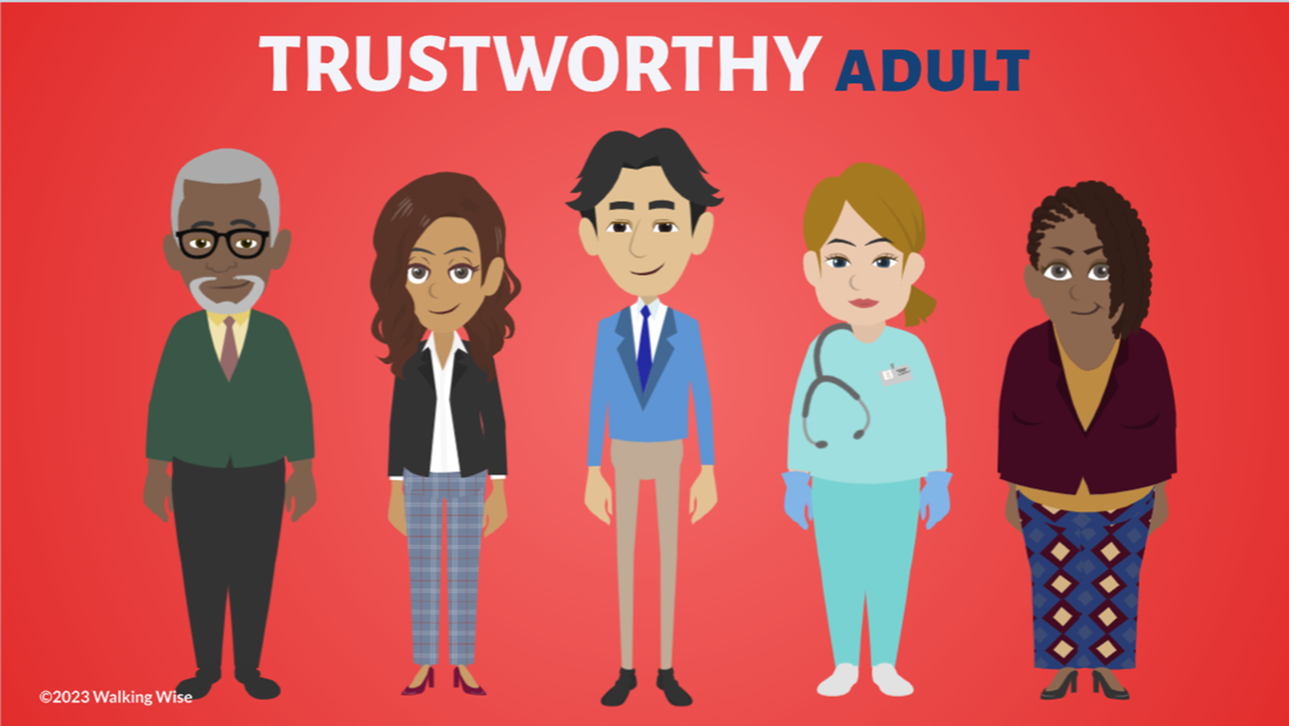
ASK FOR HELP
©2024-2026 Walking Wise
95
Notes:
Walking Wise asked a focus group of survivors:
What do you think young people should know about sex trafficking?
ANSWER
The survivors agreed that the most vital information teens should know is how to ask for help.
At the top of their list:
Tell a TRUSTWORTHY adult.

Slide 96
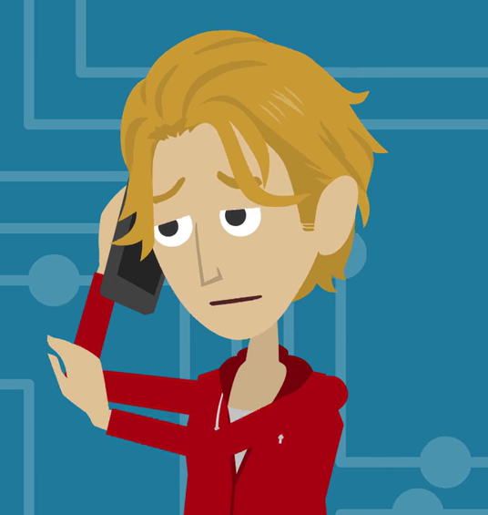
ASK FOR HELP
Here are ways young people can ask for help.
©2024-2026 Walking Wise
96

Slide 97
ASK FOR HELP
How to Ask for Help
If you are in immediate danger, dial 911.
If the sexual predator IS a family member, tell a trustworthy adult.
If the sexual predator is NOT family, tell a parent or guardian.
If you are a student in school, tell a trustworthy teacher, coach, school nurse, social worker, counselor, resource officer, or principal.
To gain internet access for help, use a computer at your school or a public library.
©2024-2026 Walking Wise
97

Slide 98
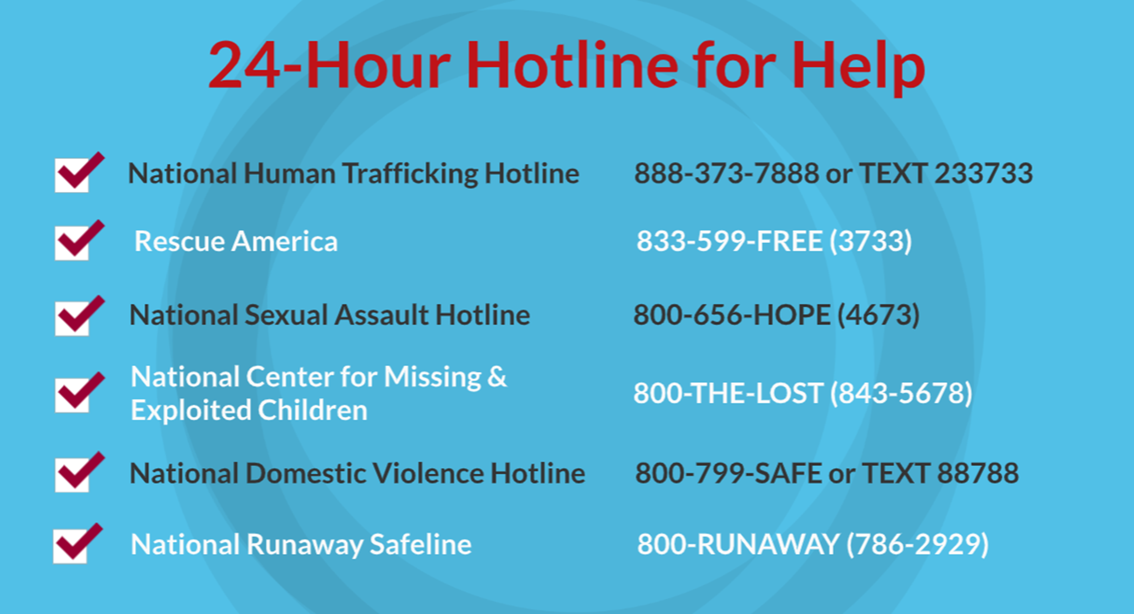
©2024-2026 Walking Wise
98
Notes:
NOTE TO PRESENTER
Presenters may ask their audience to consider adding a few "hotline for help" phone numbers to their cell phone contacts or take a photo of this slide.

Slide 99
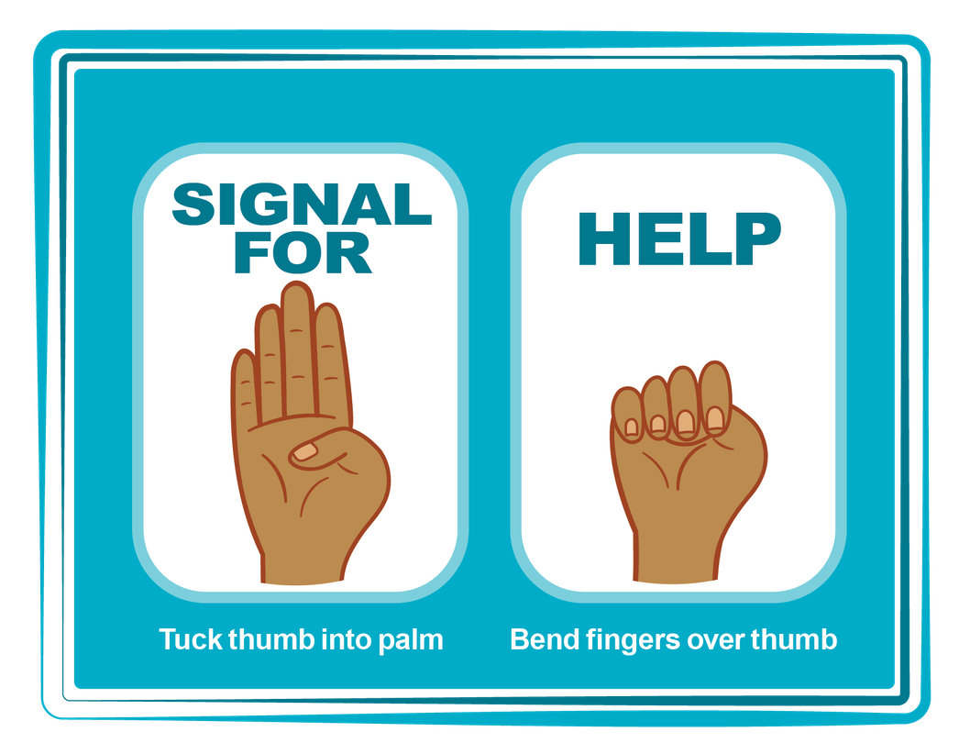
HAND SIGNAL FOR HELP
©2024-2026 Walking Wise
Source: Canadian Women’s Foundation, April 2020
99
Notes:
Although the hand signal for help has not yet achieved universal recognition, it may quietly get someone's attention in urgent situations.
SILENT
It can be used silently.
UNTRACKABLE
It leaves no digital footprint.
CONCEALED
It can be done secretly when a perpetrator is in the vicinity.
SIGNALS DISTRESS
A distressed facial expression can help others recognize that help is needed if the hand signal is not understood—but it is important not to alert the predator/trafficker, causing harm.
Source
Canadian Women's Foundation, April 2020

Slide 100



Thank you!
WalkingWise.com
Online Course for Adults Accredited by:
Postgraduate Institute for Medicine
Academy of Forensic Nursing
©2024-2026 Walking Wise
100
Notes:
NOTE TO PRESENTER
To access additional resources on male victims, please refer to the last page of Lesson Plan #6 on the Walking Wise Learning Platform.
We welcome your feedback at support@WalkingWise.com.

