Slide 1


SEXUAL EXPLOITATION
EDUCATION
male
VICTIMS
LESSON #6
Notes:
NOTE
Log in to WalkingWise.com and refer to the Walking Wise Education Guide to implement classroom teaching tips.
Most importantly:
• DEFINE SCHOOL POLICY
Establish a sexual exploitation reporting protocol with a trauma-informed response. The Walking Wise Implementation Guide provides a sample protocol.
• AGE & AUDIENCE
This presentation can be edited by following the procedures on page 3 to align with your school policies, specific age groups, and the involvement of at-risk audiences.
• SUPPORT PROCEDURE
Provide your audience with guidance on accessing immediate help or arranging a private meeting with a social worker, counselor, nurse, school resource officer, or another trustworthy staff member to report concerns for themselves or a peer.
• SECOND SAFE ADULT
Ensure a second trustworthy adult, such as a teacher, is present in the learning setting to observe audience reactions and identify those who may benefit from a follow-up meeting. This person should remain focused and free from other duties during the presentation.
• IMPLEMENT SLIDO.com
Please log in to WalkingWise.com for instructions on incorporating Slido into the PowerPoint presentation to engage your audience using digital polling.

Slide 2
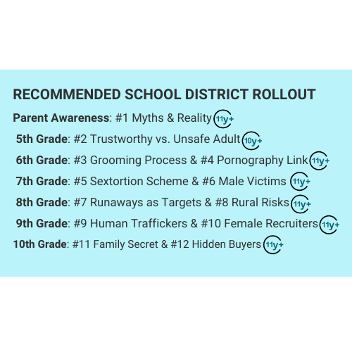

NOTE TO PRESENTER
This PDF contains the same content as the PowerPoint presentation but has been condensed into fewer pages for easier reference.
For live presentations, please use the PowerPoint version. It reveals bullet points one at a time, with previous points fading to a white font for clarity and comprehension. Additionally, presenters can integrate Slido polling into the PowerPoint presentation to digitally engage with audiences.
Presenters may also edit the speaker notes in the PowerPoint presentation to help effectively deliver information to audiences.
©2025 Walking Wise
2

Slide 3
NOTE TO PRESENTER
This presentation is exclusively for Walking Wise® subscribers and not for redistribution.
Walking Wise provides an interactive digital tool, Slido.com, to enhance audience engagement. To implement Slido for your organization, you can log in to WalkingWise.com for setup instructions. Once configured, integrate Slido polling and add a post-evaluation into the PowerPoint presentation.
Presenters are encouraged to edit speaker notes to match their speaking style (viewable in presentation mode). You can also delete slides from this Walking Wise presentation to make sure the content aligns with your school policies, is age-appropriate, and fits within available class time. However, the existing slides are copyright-protected and may not be modified without prior written permission from Walking Wise.
If you would like to add your own content, you may do so under the following conditions:
  Insert new PowerPoint slides.
  Remove the Walking Wise logo and copyright "©2025 Walking Wise" from the new slides.
  Always add your organization's name or logo to each new slide.
Please delete this instruction page before presenting to audiences.
©2025 Walking Wise
3
Notes:
NOTE
The presenter is welcome to customize this Walking Wise presentation according to the instructions provided on this page.
For revision requests, please send an email to support@WalkingWise.com.

Slide 4

CONFRONTING SEXUAL EXPLOITATION
WALKING WISE
KNOWLEDGE serves as a
powerful defense against
sexual predators.
©2025 Walking Wise
4

Slide 5
CONFRONTING SEXUAL EXPLOITATION
WALKING WISE
SEXUAL EXPLOITATION includes grooming, sextortion, pornography
& sex trafficking.
©2025 Walking Wise
5

Slide 6
SENSITIVE DISCUSSION AHEAD
CONTENT ALERT
We’ll be discussing serious issues about sexual exploitation.
Some parts may be difficult to hear.
If you ever feel uncomfortable, you can step out and speak with a trustworthy adult for support.
You’re not alone—we’re here to help you.
©2025 Walking Wise
6
Notes:
NOTE TO PRESENTER
Please tailor this message to align with your organization's policies and protocols.
Please provide a confidential avenue for students to report concerns and seek help for themselves or their peers if they suspect sexual abuse, grooming, sextortion, pornography-related exploitation, or human trafficking. This may include a designated address or text line.
Consider displaying posters in your school or facility that outline various ways students can access immediate support or request a private meeting with a school safety team member or another trusted adult.

Slide 7

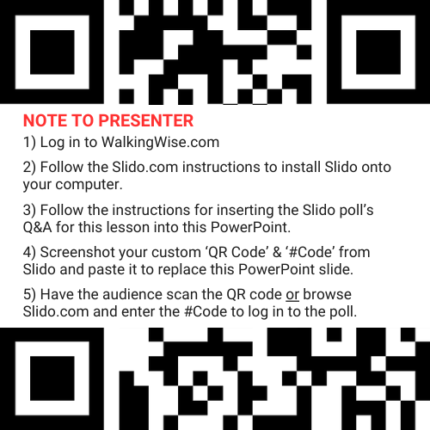
SCAN QR CODE
©2025 Walking Wise
7
Notes:
NOTE
For digital interaction with audiences:
Log in to WalkingWise.com to follow instructions on setting up Slido questions/answers for this presentation. Then, replace the QR code and #code in this slide with your custom QR/#code.

Slide 8



STATISTICS
Statistics are Only Estimates
  Study results may be unreliable because most sexual crimes go unreported.
©2025 Walking Wise
8
Notes:
In this presentation, we'll discuss statistics, but it's important to note that while statistics provide valuable insights into an issue, they cannot be entirely relied upon.
Here are a few reasons:
• UNREPORTED
Victims may stay silent due to fear, shame, or manipulation.
• INCONSISTENT COLLECTION
Geographical areas have different legal definitions for sexual crimes, making data hard to compare.
• FOCUS GROUPS
Small or specific focus groups participating in a study or survey may not accurately reflect the diversity or experiences of the broader population.

Slide 9
STATISTICS
Statistics are Only Estimates
  Study results may be unreliable because most sexual crimes go unreported.
  The methods used to collect information can vary widely between studies, leading to inconsistency.
©2025 Walking Wise
9
Notes:
In this presentation, we'll discuss statistics, but it's important to note that while statistics provide valuable insights into an issue, they cannot be entirely relied upon.
Here are a few reasons:
• UNREPORTED
Victims may stay silent due to fear, shame, or manipulation.
• INCONSISTENT COLLECTION
Geographical areas have different legal definitions for sexual crimes, making data hard to compare.
• FOCUS GROUPS
Small or specific focus groups participating in a study or survey may not accurately reflect the diversity or experiences of the broader population.

Slide 10
STATISTICS
Statistics are Only Estimates
  Study results may be unreliable because most sexual crimes go unreported.
  The methods used to collect information can vary widely between studies, leading to inconsistency.
  Focus groups in studies may not accurately represent the larger population.
©2025 Walking Wise
10
Notes:
In this presentation, we'll discuss statistics, but it's important to note that while statistics provide valuable insights into an issue, they cannot be entirely relied upon.
Here are a few reasons:
• UNREPORTED
Victims may stay silent due to fear, shame, or manipulation.
• INCONSISTENT COLLECTION
Geographical areas have different legal definitions for sexual crimes, making data hard to compare.
• FOCUS GROUPS
Small or specific focus groups participating in a study or survey may not accurately reflect the diversity or experiences of the broader population.

Slide 11

EDUCATON GUIDE
VOCABULARY
VOCABULARY
  Vulnerable
  Predator
  Stereotype
  Humiliation
  Disgrace
  Survival Sex
©2025 Walking Wise
11
3
Notes:
NOTE
Understanding vocabulary terms related to the behaviors of sexual predators can empower young people to recognize warning signs of harmful situations.
Knowing terminology helps them identify manipulative tactics predators use to build trust and exploit vulnerabilities.
With this knowledge, young people are better equipped to spot red flags, understand that these behaviors are abusive, and feel more confident reporting predators to trusted adults or authorities, potentially preventing further harm.

Slide 12
EDUCATON GUIDE
VOCABULARY
VULNERABLE
At risk of physical or emotional harm due to weakness or lack of protection.
©2025 Walking Wise
12
3
Notes:
Assisting Source
OpenAI. (2024). ChatGPT [Large language model]. https://chatgpt.com

Slide 13
EDUCATON GUIDE
VOCABULARY
PREDATOR
Someone who injures, abuses, or takes advantage of others for personal gain or profit.
©2025 Walking Wise
13
3
Notes:
Assisting Source
OpenAI. (2024). ChatGPT [Large language model]. https://chatgpt.com

Slide 14
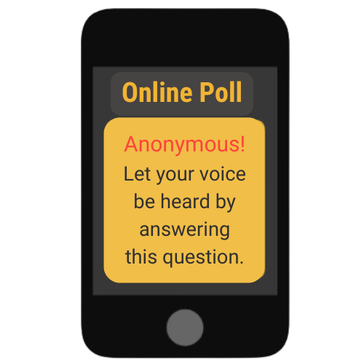
MALE VICTIMS
What percent of male sex trafficking victims in the U.S. were BORN in America?
Based on a 2016 study: n = 949
©2025 Walking Wise
Swaner, R. et al., (2016, June). Youth Involved in the Sex Trade: A National Study, p. 106. U.S. Department of Justice.
14
Notes:
SLIDO.com: Multiple Choice
What percent of male sex trafficking victims in the U.S. were born in America?
A) 47% are male citizens
B) 67% are male citizens
C) 87% are male citizens
D) 97% are male citizens
ANSWER:
D) 97% of males who were U.S. sex trafficking victims were born in America.
Domestic Minor Child Sex Trafficking:
It is believed that the majority of child sex trafficking cases involve children who are U.S. citizens. Most of the 949 young people who participated in the 2016 study identified as a U.S. citizen:
Cis Males: 97% U.S. Born
Cis Female: 96% U.S. Born
Trans Female: 100% U.S. Born
Trans Male: Not Indicated
Source
1. Swaner, R., et al. (2016, June). Youth involved in the sex trade: A national study, p. 37. U.S. Department of Justice. Retrieved November 23, 2024, from https://www.ojp.gov/pdffiles1/ojjdp/grants/249952.pdf

Slide 15
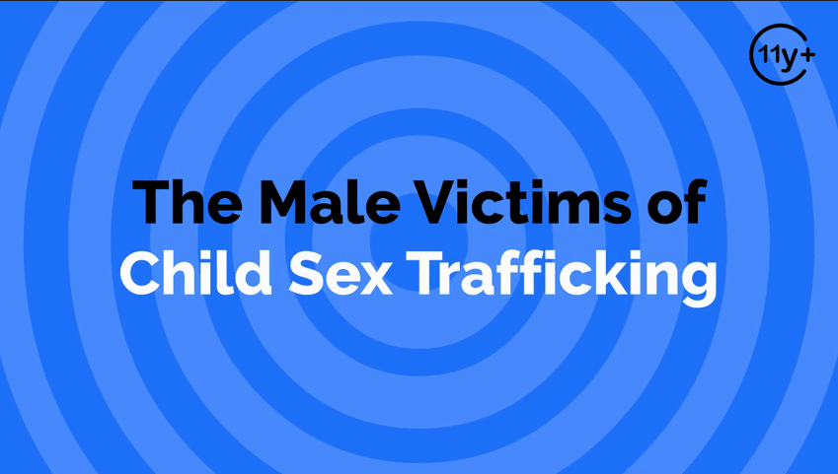
Log in to WakingWise.com to access this animated video.
©2025 Walking Wise
15
Notes:
Message Especially for Teens:
Businesses worldwide use explainer-style animation as a training tool for their employees. So, this 3-minute Walking Wise animated video is appropriate for both teens (ages 11+) and adults to learn how sexual predators use manipulation, intimidation, and coercion to exploit young people.
NOTE
Log in to Walking Wise.com to watch the three-minute animated video with audiences.

Slide 16
EDUCATON GUIDE
VOCABULARY
STEREOTYPE
An untrue or inaccurate belief about a group of people or things.
©2025 Walking Wise
16
3
Notes:
Assisting Source
OpenAI. (2024). ChatGPT [Large language model]. https://chatgpt.com

Slide 17
MALE VICTIMS
What is the percentage of cis MALES who reported they were sex trafficked in the U.S.?
n = 341
©2025 Walking Wise
Swaner, R. et al., (2016, June). Youth Involved in the Sex Trade: A National Study, p. 106. U.S. Department of Justice.
17
Notes:
SLIDO.com: Multiple Choice
What is the percentage of cis MALES who reported they were sex trafficked in the U.S.?
A) Up to 6%
B) Up to 16%
C) Up to 36%
D) Up to 46%
ANSWER:
C) Up to 36% of cis males are believed to be sex trafficked in the U.S.
Coercion into the commercial sex trade is more common among females. However, a national report found that 36% of sex trafficking victims are male, while 4% are transgender females, and less than 1% are transgender males. Traffickers exploit similar vulnerabilities to groom and coerce young males as they do with females.[1]
NOTE
The term "cis" (short for "cisgender") describes a person whose gender identity aligns with the sex they were assigned at birth. For example: If someone was assigned female at birth and identifies as a woman, they are cisgender. Similarly, if someone was assigned male at birth and identifies as a man, they are cisgender.[2]
Source
1. Swaner, R., et al. (2016, June). Youth involved in the sex trade: A national study, p. 36. U.S. Department of Justice. Retrieved November 23, 2024, from https://www.ojp.gov/pdffiles1/ojjdp/grants/249952.pdf
2. OpenAI. (2024). ChatGPT [Large language model]. https://chatgpt.com

Slide 18
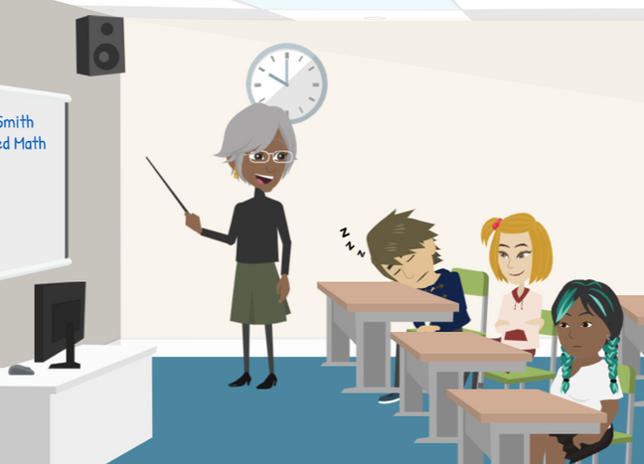
LESSON PLANS
STEREOTYPES
What are common stereotypes of males versus females?
©2025 Walking Wise
18
3

Slide 19
STEREOTYPES
Common Stereotypes
  Males are good at math and science, while females are good at English and the arts.
©2025 Walking Wise
19

Slide 20
STEREOTYPES
Common Stereotypes
  Males are good at math and science, while females are good at English and the arts.
  Males dress for comfort, while females dress for style.
©2025 Walking Wise
20
Notes:
A stereotype is often an unfair and/or untrue belief people have about a characteristic related to a group of people or things.

Slide 21
STEREOTYPES
Common Stereotypes
  Males are good at math and science, while females are good at English and the arts.
  Males dress for comfort, while females dress for style.
  Males like sports, while females love to shop.
©2025 Walking Wise
21

Slide 22
STEREOTYPES
Common Stereotypes
  Males hide their feelings, while females are emotionally expressive.
©2025 Walking Wise
22
Notes:
These stereotypes reinforce the idea that males should suppress their emotions, leading many to feel ashamed or emasculated if they share experiences of victimization. As a result, male survivors may be less likely to report sexual abuse and commercial exploitation and seek help.

Slide 23
STEREOTYPES
Common Stereotypes
  Males hide their feelings, while females are emotionally expressive.
  Males tend to be sexual aggressors, while females are the victims.
©2025 Walking Wise
23
Notes:
These stereotypes reinforce the idea that males should suppress their emotions, leading many to feel ashamed or emasculated if they share experiences of victimization. As a result, male survivors may be less likely to report sexual abuse and commercial exploitation and seek help.

Slide 24
STEREOTYPES
Common Stereotypes
  Males hide their feelings, while females are emotionally expressive.
  Males tend to be sexual aggressors, while females are the victims.
  Males are victims of labor trafficking, while females are victims of sex trafficking.
©2025 Walking Wise
24
Notes:
These stereotypes reinforce the idea that males should suppress their emotions, leading many to feel ashamed or emasculated if they share experiences of victimization. As a result, male survivors may be less likely to report sexual abuse and commercial exploitation and seek help.

Slide 25
LESSON PLANS
TRAFFICKING MYTH
How are boys impacted by the stereotype (or myth) that only girls are sex trafficked?
©2025 Walking Wise
25
3

Slide 26
EDUCATON GUIDE
VOCABULARY
HUMILIATION
The feeling of shame or embarrassment resulting from a situation that causes a loss of self-respect.
©2025 Walking Wise
26
3
Notes:
Assisting Source
OpenAI. (2024). ChatGPT [Large language model]. https://chatgpt.com

Slide 27
EDUCATON GUIDE
VOCABULARY
DISGRACE
A loss of honor, respect, or reputation, often due to shameful actions or behavior.
©2025 Walking Wise
27
3
Notes:
Assisting Source
OpenAI. (2024). ChatGPT [Large language model]. https://chatgpt.com

Slide 28
TRAFFICKING MYTH
Impact of Myth
  Male victims commonly get overlooked.
©2025 Walking Wise
28
Notes:
• OVERLOOKED CASES
Stereotyping often causes adults, including law enforcement and medical professionals, to overlook young males being sex trafficked.
• UNDERESTIMATED IMPACT
Sexual crime is just as devastating for males as it is for females, but society tends to underestimate the traumatic effects sexual abuse and exploitation have on males. As a result, there tends to be a misconception that young males enjoy experiencing unlimited or unrestricted sex.
• LACK OF RESOURCES
Because of underreporting and a lack of awareness of vulnerability, resources are often not allocated to support the needs of young males, as the focus tends to be on young females.

Slide 29
TRAFFICKING MYTH
Impact of Myth
  Male victims commonly get overlooked.
  Society incorrectly believes sexual crimes are less traumatic for males.
©2025 Walking Wise
29
Notes:
• OVERLOOKED CASES
Stereotyping often causes adults, including law enforcement and medical professionals, to overlook young males being sex trafficked.
• UNDERESTIMATED IMPACT
Sexual crime is just as devastating for males as it is for females, but society tends to underestimate the traumatic effects sexual abuse and exploitation have on males. As a result, there tends to be a misconception that young males enjoy experiencing unlimited or unrestricted sex.
• LACK OF RESOURCES
Because of underreporting and a lack of awareness of male vulnerability, resources are often not allocated to support the needs of young males. Instead, the focus tends to be on females.

Slide 30
TRAFFICKING MYTH
Impact of Myth
  Male victims commonly get overlooked.
  Society incorrectly believes sexual crimes are less traumatic for males.
  Fewer ‘care’ resources are available to males, as most are directed to females.
©2025 Walking Wise
30
Notes:
• OVERLOOKED CASES
Stereotyping often causes adults, including law enforcement and medical professionals, to overlook young males being sex trafficked.
• UNDERESTIMATED IMPACT
Sexual crime is just as devastating for males as it is for females, but society tends to underestimate the traumatic effects sexual abuse and exploitation have on males. As a result, there tends to be a misconception that young males enjoy experiencing unlimited or unrestricted sex.
• LACK OF RESOURCES
Because of underreporting and a lack of awareness of male vulnerability, resources are often not allocated to support the needs of young males. Instead, the focus tends to be on females.

Slide 31
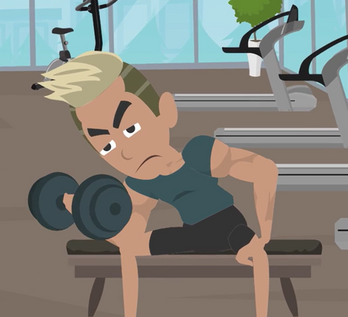
LESSON PLANS
GENDER EXPECTATIONS
How do gender expectations impact young males regarding sexual abuse or trafficking?
©2025 Walking Wise
31
3

Slide 32
GENDER EXPECTATIONS
Impact of Social Messaging
  Males may blame themselves for being targeted, as society often associates vulnerability with females.
©2025 Walking Wise
32
Notes:
• MALE IDENTITY
As young as toddlers, boys receive social messaging that implies males are a symbol of physical power and mental strength. The superheroes in today’s entertainment can reinforce this notion while using female characters to portray vulnerability, submissiveness, and victimization.
• FEAR & SHAME
National studies identify that most male victims are heterosexual; however, victimized young males often fear others will make an inaccurate conclusion about their sexual orientation. As a result, they struggle with confusion and shame, often questioning their own gender identity after becoming forced into having sex with men.
• SELF BLAME
Most young males keep sexual abuse or sex trafficking a secret because of their sense of shame and humiliation. Gender expectations often magnify the self-blame experienced by males.
• PORN CONDITIONING
Most often, pornography displays forced sex upon young women, conditioning male teens to believe men are dominant or even sexual aggressors (Alexander, 2016).

Slide 33
GENDER EXPECTATIONS
Impact of Social Messaging
  Males may blame themselves for being targeted, as society often associates vulnerability with females.
  This can lead to fear of their sexual identity being questioned.
©2025 Walking Wise
33
Notes:
• MALE IDENTITY
As young as toddlers, boys receive social messaging that implies males are a symbol of physical power and mental strength. The superheroes in today’s entertainment can reinforce this notion while using female characters to portray vulnerability, submissiveness, and victimization.
• FEAR & SHAME
National studies identify that most male victims are heterosexual; however, victimized young males often fear others will make an inaccurate conclusion about their sexual orientation. As a result, they struggle with confusion and shame, often questioning their own gender identity after becoming forced into having sex with men.
• SELF BLAME
Most young males keep sexual abuse or sex trafficking a secret because of their sense of shame and humiliation. Gender expectations often magnify the self-blame experienced by males.
• PORN CONDITIONING
Most often, pornography displays forced sex upon young women, conditioning male teens to believe men are dominant or even sexual aggressors (Alexander, 2016).

Slide 34
GENDER EXPECTATIONS
Impact of Social Messaging
  Males may blame themselves for being targeted, as society often associates vulnerability with females.
  This can lead to fear of their sexual identity being questioned.
  They may experience shame or humiliation for being unable to fight off the predator.
©2025 Walking Wise
34
Notes:
• MALE IDENTITY
As young as toddlers, boys receive social messaging that implies males are a symbol of physical power and mental strength. The superheroes in today’s entertainment can reinforce this notion while using female characters to portray vulnerability, submissiveness, and victimization.
• FEAR & SHAME
National studies identify that most male victims are heterosexual; however, victimized young males often fear others will make an inaccurate conclusion about their sexual orientation. As a result, they struggle with confusion and shame, often questioning their own gender identity after becoming forced into having sex with men.
• SELF BLAME
Most young males keep sexual abuse or sex trafficking a secret because of their sense of shame and humiliation. Gender expectations often magnify the self-blame experienced by males.
• PORN CONDITIONING
Most often, pornography displays forced sex upon young women, conditioning male teens to believe men are dominant or even sexual aggressors (Alexander, 2016).

Slide 35
LESSON PLANS
AGE GROUP
What was the most common age for cis males to be sex trafficked?
©2025 Walking Wise
Swaner, R., Labriola, M., Rempel, M., Walker, A., & Spadafore, J. (2016, March). Youth Involvement in the Sex Trade: A National Study.
35
3
Notes:
Slido.com: Multiple Choice
What was the most common age for cis males to be sex trafficked?
A) 9 to 12 years old
B) 13 to 17 years old
C) 18 to 24 years old
ANSWER
B) 13 to 17 years old was the most common age for cis males to be sex trafficked.
NOTE
A 2016 national study reported:
UNDERAGE YOUTH
77% of all respondents (199 underage youth) indicated that their first experience trading sex
took place while under the age of 18. The average age was 15.8 years old.
AGES 13 to 17 YEARS
The percentage of study respondents who were first trafficked during childhood:
Cis Males: 66%
Trans Females: 62%
Trans Males: Unknown
Cis Females: 74%
AGES 18 to 24 Years
The study indicated the percentage of young adults who were first sex trafficked by gender:
Cis Males: 28%
Trans Females: 32%
Trans Males: No Data
Cis Females:
AGES 0 to 12 YEARS
The study revealed the percentage of small children who were first sex trafficked by gender:
Cis Males: 7%
Trans Females: 6%
Trans Males: No Data
Cis Females: 7%
Source
Swaner, R., Labriola, M., Rempel, M., Walker, A., & Spadafore, J. (2016, March). Youth Involvement in the Sex Trade: A National Study, pp. 40, 41. CourtInnovation.org. Retrieved November 25, 2024, from https://www.ojp.gov/pdffiles1/ojjdp/grants/249952.pdf

Slide 36
LESSON PLANS
LGBTQ+ TRAFFICKING RISKS
What factors increase the risk of LGBTQ+ (cisgender male) teens being sex trafficked?
©2025 Walking Wise
Thorn. (2023). LGBTQ+ Youth Perspectives: How LGBTQ+ youth are navigating exploration and risks of sexual exploitation online.
36
3

Slide 37
LGBTQ+ TRAFFICKING RISKS
Risks for LGBTQ+ (cisgender male) Teens
  LGBTQ teens rely more on their online communities, feeling online friendships are essential to them.
©2025 Walking Wise
Thorn. (2023). LGBTQ+ Youth Perspectives: How LGBTQ+ youth are navigating exploration and risks of sexual exploitation online.
37
Notes:
NOTE
The 2023 Thorn study quantified the attitudes, perceptions, and behaviors of teens and young adults, focusing on how LGBTQ+ youth's online experiences are different from those of non-LGBTQ+ youth. The study involved 658 LGBTQ+ youth, of whom 69% were aged 13 to 17, and 31% indicated their gender as male.
Secondary online accounts, often called "finstas," are created by young people to share content more privately or outside their usual social circle. Thorn reports, "Among teens, the rate of reporting secondary accounts was higher for LGBTQ+ respondents than non-LGBTQ+ respondents, with
LGBTQ+ teens were twice as likely to have a secondary account (36% vs. 18%). Among teen respondents with a secondary account, 1 in 3 reported creating it before the age of 13."
Source
Thorn. (2023). LGBTQ+ Youth Perspectives: How LGBTQ+ youth are navigating exploration and risks of sexual exploitation online, p. 5. Retrieved November 26, 2024, from https://info.thorn.org/hubfs/Research/Thorn_LGBTQ+YouthPerspectives_June2023_FNL.pdf

Slide 38
LGBTQ+ TRAFFICKING RISKS
Risks for LGBTQ+ (cisgender male) Teens
  LGBTQ teens rely more on their online communities, feeling online friendships are essential to them.
  They are much more likely to attempt to handle unsafe online situations alone.
©2025 Walking Wise
Thorn. (2023). LGBTQ+ Youth Perspectives: How LGBTQ+ youth are navigating exploration and risks of sexual exploitation online.
38
Notes:
NOTE
The 2023 Thorn study quantified the attitudes, perceptions, and behaviors of teens and young adults, focusing on how LGBTQ+ youth's online experiences are different from those of non-LGBTQ+ youth. The study involved 658 LGBTQ+ youth, of whom 69% were aged 13 to 17, and 31% indicated their gender as male.
Secondary online accounts, often called "finstas," are created by young people to share content more privately or outside their usual social circle. Thorn reports, "Among teens, the rate of reporting secondary accounts was higher for LGBTQ+ respondents than non-LGBTQ+ respondents, with
LGBTQ+ teens were twice as likely to have a secondary account (36% vs. 18%). Among teen respondents with a secondary account, 1 in 3 reported creating it before the age of 13."
Source
Thorn. (2023). LGBTQ+ Youth Perspectives: How LGBTQ+ youth are navigating exploration and risks of sexual exploitation online, p. 5. Retrieved November 26, 2024, from https://info.thorn.org/hubfs/Research/Thorn_LGBTQ+YouthPerspectives_June2023_FNL.pdf

Slide 39
LGBTQ+ TRAFFICKING RISKS
Risks for LGBTQ+ (cisgender male) Teens
  LGBTQ teens rely more on their online communities, feeling online friendships are essential to them.
  They are much more likely to attempt to handle unsafe online situations alone.
  They are significantly more likely to receive nude images they did not ask for.
©2025 Walking Wise
Thorn. (2023). LGBTQ+ Youth Perspectives: How LGBTQ+ youth are navigating exploration and risks of sexual exploitation online.
39
Notes:
NOTE
The 2023 Thorn study quantified the attitudes, perceptions, and behaviors of teens and young adults, focusing on how LGBTQ+ youth's online experiences are different from those of non-LGBTQ+ youth. The study involved 658 LGBTQ+ youth, of whom 69% were aged 13 to 17, and 31% indicated their gender as male.
Secondary online accounts, often called "finstas," are created by young people to share content more privately or outside their usual social circle. Thorn reports, "Among teens, the rate of reporting secondary accounts was higher for LGBTQ+ respondents than non-LGBTQ+ respondents, with
LGBTQ+ teens were twice as likely to have a secondary account (36% vs. 18%). Among teen respondents with a secondary account, 1 in 3 reported creating it before the age of 13."
Source
Thorn. (2023). LGBTQ+ Youth Perspectives: How LGBTQ+ youth are navigating exploration and risks of sexual exploitation online, p. 5. Retrieved November 26, 2024, from https://info.thorn.org/hubfs/Research/Thorn_LGBTQ+YouthPerspectives_June2023_FNL.pdf

Slide 40

LESSON PLANS
UNRECOGNIZED
Why can it be challenging to recognize male victims?
©2025 Walking Wise
40
3

Slide 41
UNRECOGNIZED
Overlooked by Adults
  Society often sees males as those who initiate sexual activity.
©2025 Walking Wise
41
Notes:
Some survivor advocates believe social awareness around the sex trafficking of boys is about 15 years behind that of girls.[1]
• SEXUAL INSTIGATORS
Society can perceive teenage boys as sexual instigators, making them more easily mistaken as “willing participants” when becoming victimized by sex traffickers.
• REDUCED PROTECTION
Community members can be less watchful over the well-being of boys compared to that of girls, causing at-risk young males to go unnoticed, even when surrounded by suspicious strangers.
• LACK OF AWARENESS
Society’s limited awareness about the victimization of males can cause adults to overlook the key indicators of trafficking or sexual abuse that may appear.
Source:
1. NPR News, 2021. https://www.npr.org/2021/05/24/999726614/growing-number-of-male-survivors-talk-about-being-a-sex-trade-victim

Slide 42
UNRECOGNIZED
Overlooked by Adults
  Society often sees males as those who initiate sexual activity.
  Adults are often less watchful or protective of boys than girls.
©2025 Walking Wise
42
Notes:
Some survivor advocates believe social awareness around the sex trafficking of boys is about 15 years behind that of girls.[1]
• SEXUAL INSTIGATORS
Society can perceive teenage boys as sexual instigators, making them more easily mistaken as “willing participants” when becoming victimized by sex traffickers.
• REDUCED PROTECTION
Community members can be less watchful over the well-being of boys compared to that of girls, causing at-risk young males to go unnoticed, even when surrounded by suspicious strangers.
• LACK OF AWARENESS
Society’s limited awareness about the victimization of males can cause adults to overlook the key indicators of trafficking or sexual abuse that may appear.
Source:
1. NPR News, 2021. https://www.npr.org/2021/05/24/999726614/growing-number-of-male-survivors-talk-about-being-a-sex-trade-victim

Slide 43
UNRECOGNIZED
Overlooked by Adults
  Society often sees males as the ones who initiate sexual activity.
  Adults are often less watchful or protective of boys than girls.
  Adults may overlook signs of sexual abuse or trafficking because they are unaware of warning signs.
©2025 Walking Wise
43
Notes:
Some survivor advocates believe social awareness around the sex trafficking of boys is about 15 years behind that of girls.[1]
• SEXUAL INSTIGATORS
Society can perceive teenage boys as sexual instigators, making them more easily mistaken as “willing participants” when becoming victimized by sex traffickers.
• REDUCED PROTECTION
Community members can be less watchful over the well-being of boys compared to that of girls, causing at-risk young males to go unnoticed, even when surrounded by suspicious strangers.
• LACK OF AWARENESS
Society’s limited awareness about the victimization of males can cause adults to overlook the key indicators of trafficking or sexual abuse that may appear.
Source:
1. NPR News, 2021. https://www.npr.org/2021/05/24/999726614/growing-number-of-male-survivors-talk-about-being-a-sex-trade-victim

Slide 44
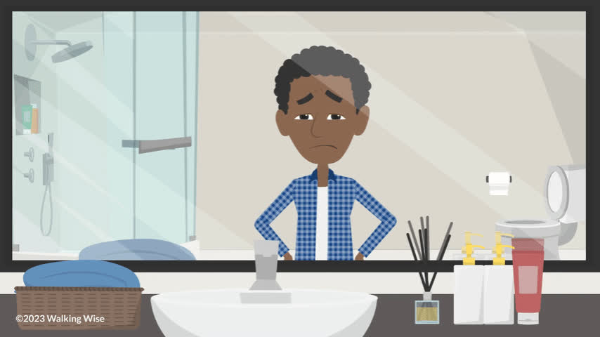
LESSON PLANS
UNREPORTED CRIME
What happens when young males keep sexual crimes a secret?
©2025 Walking Wise
44
3

Slide 45
UNREPORTED CRIME
Impact of Secrecy
  Information is NOT shared with the government or researchers when a crime is NOT reported.
©2025 Walking Wise
45
Notes:
• UNADDRESSED EFFECTS
If left untreated, male victims are at a greater risk of depression, suicide, substance abuse, and even incarceration.
• DATA IMPACT
When sex crimes against young males go unreported, the incidences are omitted from law enforcement data that is reported to the government and advocacy agencies, which also negatively impacts research studies.
• UNDERFUNDED
The underreporting prevents the allocation of government funds for support services necessary for the rescue and recovery of young males.

Slide 46
UNREPORTED CRIME
Impact of Secrecy
  Information is NOT shared with the government or researchers when a crime is NOT reported.
  As a result, support services for males often go underfunded, making it harder for them to receive care.
©2025 Walking Wise
46
Notes:
• UNADDRESSED EFFECTS
If left untreated, male victims are at a greater risk of depression, suicide, substance abuse, and even incarceration.
• DATA IMPACT
When sex crimes against young males go unreported, the incidences are omitted from law enforcement data that is reported to the government and advocacy agencies, which also negatively impacts research studies.
• UNDERFUNDED
The underreporting prevents the allocation of government funds for support services necessary for the rescue and recovery of young males.

Slide 47
UNREPORTED CRIME
Impact of Secrecy
  Information is NOT shared with the government or researchers when a crime is not reported.
  As a result, support services for males often go underfunded, making it harder for them to receive care.
  Left untreated, male victims are at higher risk for depression, suicide, drug abuse, and even prison sentences.
©2025 Walking Wise
47
Notes:
• UNADDRESSED EFFECTS
If left untreated, male victims are at a greater risk of depression, suicide, substance abuse, and even incarceration.
• DATA IMPACT
When sex crimes against young males go unreported, the incidences are omitted from law enforcement data that is reported to the government and advocacy agencies, which also negatively impacts research studies.
• UNDERFUNDED
The underreporting prevents the allocation of government funds for support services necessary for the rescue and recovery of young males.

Slide 48
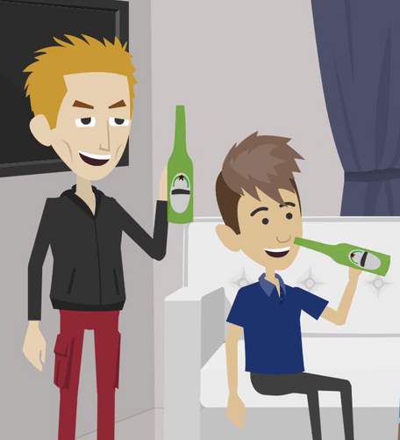
LESSON PLANS
VULNERABILITIES
What are the vulnerabilities of young males that traffickers prey upon?
©2025 Walking Wise
48
3

Slide 49
VULNERABILITIES
Risk Factors of Trafficking
  Males who look for online-only friends.
©2025 Walking Wise
49
Notes:
Groomers often build close relationships with young males, using the personal information shared to manipulate, coerce, or brainwash them into engaging in sexual acts. The likelihood of a young male being trafficked increases with the number of vulnerabilities he faces.
Risk factors of sex trafficking include:
• ONLINE RELATIONSHIPS
They prey on young males seeking online friendships and those who exchange nude images online.
• LIVING CONDITIONS
They seek to befriend young males who live in poverty, lack basic needs, or live in foster care.
• EMOTIONAL RISKS
They build relationships with males experiencing loneliness, low self-esteem, or being bullied.

Slide 50
VULNERABILITIES
Risk Factors of Trafficking
  Males who look for online-only friends.
  Living in foster care or experiencing homelessness.
©2025 Walking Wise
50
Notes:
Groomers often build close relationships with young males, using the personal information shared to manipulate, coerce, or brainwash them into engaging in sexual acts. The likelihood of a young male being trafficked increases with the number of vulnerabilities he faces.
Risk factors of sex trafficking include:
• ONLINE RELATIONSHIPS
They prey on young males seeking online friendships and those who exchange nude images online.
• LIVING CONDITIONS
They seek to befriend young males who live in poverty, lack basic needs, or live in foster care.
• EMOTIONAL RISKS
They build relationships with males experiencing loneliness, low self-esteem, or being bullied.

Slide 51
VULNERABILITIES
Risk Factors of Trafficking
  Males who look for online-only friends.
  Living in foster care or experiencing homelessness.
  Rejected by family, often due to their sexual orientation.
©2025 Walking Wise
51
Notes:
Groomers often build close relationships with young males, using the personal information shared to manipulate, coerce, or brainwash them into engaging in sexual acts. The likelihood of a young male being trafficked increases with the number of vulnerabilities he faces.
Risk factors of sex trafficking include:
• ONLINE RELATIONSHIPS
They prey on young males seeking online friendships and those who exchange nude images online.
• LIVING CONDITIONS
They seek to befriend young males who live in poverty, lack basic needs, or live in foster care.
• EMOTIONAL RISKS
They build relationships with males experiencing loneliness, low self-esteem, or being bullied.

Slide 52
VULNERABILITIES
Risk Factors of Trafficking
  Males who look for online-only friends.
  Living in foster care or experiencing homelessness.
  Rejected by family, often due to their sexual orientation.
  Lack of access to basic needs like food and shelter.
©2025 Walking Wise
52
Notes:
Groomers often build close relationships with young males, using the personal information shared to manipulate, coerce, or brainwash them into engaging in sexual acts. The likelihood of a young male being trafficked increases with the number of vulnerabilities he faces.
Risk factors of sex trafficking include:
• ONLINE RELATIONSHIPS
They prey on young males seeking online friendships and those who exchange nude images online.
• LIVING CONDITIONS
They seek to befriend young males who live in poverty, lack basic needs, or live in foster care.
• EMOTIONAL RISKS
They build relationships with males experiencing loneliness, low self-esteem, or being bullied.

Slide 53
VULNERABILITIES
Risk Factors of Trafficking
  Males who look for online-only friends.
  Living in foster care or experiencing homelessness.
  Rejected by family, often due to their sexual orientation.
  Lack of access to basic needs like food and shelter.
  Experiencing bullying, loneliness, or low self-esteem.
©2025 Walking Wise
53
Notes:
Groomers often build close relationships with young males, using the personal information shared to manipulate, coerce, or brainwash them into engaging in sexual acts. The likelihood of a young male being trafficked increases with the number of vulnerabilities he faces.
Risk factors of sex trafficking include:
• ONLINE RELATIONSHIPS
They prey on young males seeking online friendships and those who exchange nude images online.
• LIVING CONDITIONS
They seek to befriend young males who live in poverty, lack basic needs, or live in foster care.
• EMOTIONAL RISKS
They build relationships with males experiencing loneliness, low self-esteem, or being bullied.

Slide 54
VULNERABILITIES
Risk Factors of Trafficking
  Experienced neglect or physical and sexual abuse.
©2025 Walking Wise
54
Notes:
Groomers often build close relationships with young males, using the personal information shared to manipulate, coerce, or brainwash them into engaging in sexual acts. The likelihood of a young male being trafficked increases with the number of vulnerabilities he faces.
Risk factors of sex trafficking include:
• ABUSE
Predators seek young males who have experienced neglect and physical, emotional, or sexual abuse.
• SUBSTANCE USE
Predators prey on those who use drugs and alcohol and submit to peer pressure.
• SCHOOL
Predators seek out male teens who are unmotivated to perform at school or do not participate in activities.
• DISABILITIES
Predators prey on young males with learning differences, mental health issues, or physical challenges.

Slide 55
VULNERABILITIES
Risk Factors of Trafficking
  Experienced neglect or physical and sexual abuse.
  Use drugs and alcohol.
©2025 Walking Wise
55
Notes:
Groomers often build close relationships with young males, using the personal information shared to manipulate, coerce, or brainwash them into engaging in sexual acts. The likelihood of a young male being trafficked increases with the number of vulnerabilities he faces.
Risk factors of sex trafficking include:
• ABUSE
Predators seek young males who have experienced neglect and physical, emotional, or sexual abuse.
• SUBSTANCE USE
Predators prey on those who use drugs and alcohol and submit to peer pressure.
• SCHOOL
Predators seek out male teens who are unmotivated to perform at school or do not participate in activities.
• DISABILITIES
Predators prey on young males with learning differences, mental health issues, or physical challenges.

Slide 56
VULNERABILITIES
Risk Factors of Trafficking
  Experienced neglect or physical and sexual abuse.
  Use drugs and alcohol.
  Easily influenced by peer pressure.
©2025 Walking Wise
56
Notes:
Groomers often build close relationships with young males, using the personal information shared to manipulate, coerce, or brainwash them into engaging in sexual acts. The likelihood of a young male being trafficked increases with the number of vulnerabilities he faces.
Risk factors of sex trafficking include:
• ABUSE
Predators seek young males who have experienced neglect and physical, emotional, or sexual abuse.
• SUBSTANCE USE
Predators prey on those who use drugs and alcohol and submit to peer pressure.
• SCHOOL
Predators seek out male teens who are unmotivated to perform at school or do not participate in activities.
• DISABILITIES
Predators prey on young males with learning differences, mental health issues, or physical challenges.

Slide 57
VULNERABILITIES
Risk Factors of Trafficking
  Experienced neglect or physical and sexual abuse.
  Use drugs and alcohol.
  Easily influenced by peer pressure.
  Struggle with schoolwork or lack motivation.
©2025 Walking Wise
57
Notes:
Groomers often build close relationships with young males, using the personal information shared to manipulate, coerce, or brainwash them into engaging in sexual acts. The likelihood of a young male being trafficked increases with the number of vulnerabilities he faces.
Risk factors of sex trafficking include:
• ABUSE
Predators seek young males who have experienced neglect and physical, emotional, or sexual abuse.
• SUBSTANCE USE
Predators prey on those who use drugs and alcohol and submit to peer pressure.
• SCHOOL
Predators seek out male teens who are unmotivated to perform at school or do not participate in activities.
• DISABILITIES
Predators prey on young males with learning differences, mental health issues, or physical challenges.

Slide 58
VULNERABILITIES
Risk Factors of Trafficking
  Experienced neglect or physical and sexual abuse.
  Use drugs and alcohol.
  Easily influenced by peer pressure.
  Struggle with schoolwork or lack motivation.
  Those with mental health issues or physical challenges.
©2025 Walking Wise
58
Notes:
Groomers often build close relationships with young males, using the personal information shared to manipulate, coerce, or brainwash them into engaging in sexual acts. The likelihood of a young male being trafficked increases with the number of vulnerabilities he faces.
Risk factors of sex trafficking include:
• ABUSE
Predators seek young males who have experienced neglect and physical, emotional, or sexual abuse.
• SUBSTANCE USE
Predators prey on those who use drugs and alcohol and submit to peer pressure.
• SCHOOL
Predators seek out male teens who are unmotivated to perform at school or do not participate in activities.
• DISABILITIES
Predators prey on young males with learning differences, mental health issues, or physical challenges.

Slide 59
LESSON PLANS
PATHWAYS
In one or two words, name ricky activities that can make males more vulnerable to sex traffickers?
©2025 Walking Wise
59
3
Notes:
Slido.com: Word Cloud
NOTE
The more frequently a word is used, the larger it appears in the cloud, making it easy to see which words or ideas are most common among the audience.
POSSIBLE ANSWERS
Online Relationships
Gaming Platforms
Sexting
Homelessness
Substance Use & Addiction

Slide 60
RISKY ACTIVITIES
Common Risks Factors for Males
  Online Relationships
  Gaming Platforms
  Sexting
  Homelessness
©2025 Walking Wise
60
Notes:
TRAFFICKING RISK FACTORS
• Experience neglect, mental, physical & sexual abuse
• Food insecurity, unhoused, or lack of basic needs
• Poor self-esteem
• Struggles academically or has learning differences
• Lacks peer relationships or is a target of bullying
• Submits to peer pressure
• Unmotivated to achieve in school or activities
• Unprotected use of social media platforms
• Intellectual disabilities or mental health issues
• Older boyfriend, girlfriend, or partner
• Family rejection over sexual orientation
• Drug and alcohol use
• Romantic partner uses drugs
• Isolated by a romantic partner or friend
• Family member abuses drugs or alcohol
• Unstable home life or unhealthy family dynamics
• History of running away
• Lives in Foster Care or group home
• Unhoused or lives in a homeless shelter
• Lives near a wealthy tourist location
• Targeted by cults or gangs or is a cult or gang member
• Family member participates in trafficking
• Exposed to prostitution within the neighborhood
• Involved in the Juvenile Justice system

Slide 61
RISKY ACTIVITIES
Online Relationships
  Traffickers and sextortionists often target males and LGBTQ+ teens seeking new online friendships.
©2025 Walking Wise
61
Notes:
• ONLINE RELATIONSHIPS
Traffickers connect with young males looking to make new online friends. They pretend to be the same age and have similar interests as the young male they are pursuing.

Slide 62
RISKY ACTIVITIES
Online Relationships
  Traffickers and sextortionists often target males and LGBTQ+ teens seeking new online friendships.
  They pretend to be the same age and share similar interests.
©2025 Walking Wise
62
Notes:
• ONLINE RELATIONSHIPS
Traffickers connect with young males looking to make new online friends. They pretend to be the same age and have similar interests as the young male they are pursuing.

Slide 63
RISKY ACTIVITIES
Online Relationships
  Traffickers and sextortionists often target males and LGBTQ+ teens seeking new online friendships.
  They pretend to be the same age and share similar interests.
  They first focus on gaining trust before exploiting the young person.
©2025 Walking Wise
63
Notes:
• ONLINE RELATIONSHIPS
Traffickers connect with young males looking to make new online friends. They pretend to be the same age and have similar interests as the young male they are pursuing.

Slide 64
RISKY ACTIVITIES
Gaming Platforms
  Playing online video games with strangers can increase the risk of males being manipulated.
©2025 Walking Wise
64
Notes:
• GAMING PLATFORMS
Playing prolonged video games with online strangers increases the threat of being manipulated into risky situations, such as in-person meetups at the mall, movie theaters, parties, etc.

Slide 65
RISKY ACTIVITIES
Gaming Platforms
  Playing online video games with strangers can increase the risk of males being manipulated.
  This manipulation might involve being persuaded to move the conversaton to a private platform.
©2025 Walking Wise
65
Notes:
• GAMING PLATFORMS
Playing prolonged video games with online strangers increases the threat of being manipulated into risky situations, such as in-person meetups at the mall, movie theaters, parties, etc.

Slide 66
RISKY ACTIVITIES
Gaming Platforms
  Playing online video games with strangers can increase the risk of males being manipulated.
  This manipulation might involve being persuaded to move the conversation to a private platform.
  It can escalate to risky situations, like meeting in person at malls, parks, movie theaters, parties, etc.
©2025 Walking Wise
66
Notes:
• GAMING PLATFORMS
Playing prolonged video games with online strangers increases the threat of being manipulated into risky situations, such as in-person meetups at the mall, movie theaters, parties, etc.

Slide 67
RISKY ACTIVITIES
Sexting
  Young males and LGBTQ+ teens are often more likely to engage in sexting with online connections.
©2025 Walking Wise
67
Notes:
• SEXTING
Young males can be more susceptible to engaging in sexting with online connections. Males often believe they are in an online romantic relationship, which can cause them to let their guard down. Once a groomer obtains a victim's sexual image, exposing their identity, the trafficker’s sextortion begins.

Slide 68
RISKY ACTIVITIES
Sexting
  Young males and LGBTQ+ teens are often more likely to engage in sexting with online connections.
  They may believe the person is romantically interested in them, causing the victim to lower their guard.
©2025 Walking Wise
68
Notes:
• SEXTING
Young males can be more susceptible to engaging in sexting with online connections. Males often believe they are in an online romantic relationship, which can cause them to let their guard down. Once a groomer obtains a victim's sexual image, exposing their identity, the trafficker’s sextortion begins.

Slide 69
RISKY ACTIVITIES
Sexting
  Young males and LGBTQ+ teens are often more likely to engage in sexting with online connections.
  They may believe the person is romantically interested in them, causing the victim to lower their guard.
  Sextortionists frequently target males ages 14 to 17.
©2025 Walking Wise
69
Notes:
• SEXTING
Young males can be more susceptible to engaging in sexting with online connections. Males often believe they are in an online romantic relationship, which can cause them to let their guard down. Once a groomer obtains a victim's sexual image, exposing their identity, the trafficker’s sextortion begins.

Slide 70
RISKY ACTIVITIES
Sexting
  Young males and LGBTQ+ teens are often more likely to engage in sexting with online connections.
  They may believe the person is romantically interested in them, causing the victim to lower their guard.
  Sextortionists frequently target males ages 14 to 17.
  They send a nude photo FIRST and request a nude in return.
©2025 Walking Wise
70
Notes:
• SEXTING
Young males can be more susceptible to engaging in sexting with online connections. Males often believe they are in an online romantic relationship, which can cause them to let their guard down. Once a groomer obtains a victim's sexual image, exposing their identity, the trafficker’s sextortion begins.

Slide 71
RISKY ACTIVITIES
Homelessness
  Running away from home causes males to lose access to basic needs.
©2025 Walking Wise
71
Notes:
• HOMELESSNESS
The reason young males run away, couch surf, and become homeless is often due to family rejection, abuse, or disapproval over their sexual orientation. All of which can cause them to be heavily preyed upon.
Homeless youth often find themselves forced to engage in “survival sex” to gain access to necessities like food, shelter, and protection.

Slide 72
RISKY ACTIVITIES
Homelessness
  Running away from home causes males to lose access to basic needs.
  Staying at a friend’s house, called couch surfing, rarely lasts long and can lead to living on the streets.
©2025 Walking Wise
72
Notes:
• HOMELESSNESS
The reason young males run away, couch surf, and become homeless is often due to family rejection, abuse, or disapproval over their sexual orientation. All of which can cause them to be heavily preyed upon.
Homeless youth often find themselves forced to engage in “survival sex” to gain access to necessities like food, shelter, and protection.

Slide 73
RISKY ACTIVITIES
Homelessness
  Running away from home causes males to lose access to basic needs.
  Staying at a friend’s house, called couch surfing, rarely lasts long and can lead to living on the streets.
  Homeless young people tend to feel forced to engage in survival sex to access food, shelter, or protection.
©2025 Walking Wise
73
Notes:
• HOMELESSNESS
The reason young males run away, couch surf, and become homeless is often due to family rejection, abuse, or disapproval over their sexual orientation. All of which can cause them to be heavily preyed upon.
Homeless youth often find themselves forced to engage in “survival sex” to gain access to necessities like food, shelter, and protection.

Slide 74
EDUCATON GUIDE
VOCABULARY
SURVIVAL SEX
Engaging in sexual activity under desperate circumstances in exchange for basic needs like food, shelter, and protection.
©2025 Walking Wise
74
3
Notes:
Assisting Source
OpenAI. (2024). ChatGPT [Large language model]. https://chatgpt.com

Slide 75
RISKY ACTIVITIES
Substance Use & Addiction
  Victims often turn to drugs and alcohol as a way to cope with pain caused by physical and emotional trauma.
©2025 Walking Wise
75
Notes:
• ADDICTION
Addiction creates a form of bondage to the victims’ abuser or trafficker.
Illegal drugs often serve as a coping mechanism for victims to numb the pain of the physical and emotional trauma of sexual abuse or sex trafficking.
Groomers often use drugs and alcohol as tools to coerce young people to become addicted to substances.
Traffickers can exploit an addict’s existing drug or alcohol habit by becoming their supplier or preying on those who are exiting treatment or recovery facilities.

Slide 76
RISKY ACTIVITIES
Substance Use & Addiction
  Victims often turn to drugs and alcohol as a way to cope with pain caused by physical and emotional trauma.
  Groomers may introduce drugs as a tool to manipulate and gain control over their victims.
©2025 Walking Wise
76
Notes:
• ADDICTION
Addiction creates a form of bondage to the victims’ abuser or trafficker.
Illegal drugs often serve as a coping mechanism for victims to numb the pain of the physical and emotional trauma of sexual abuse or sex trafficking.
Groomers often use drugs and alcohol as tools to coerce young people to become addicted to substances.
Traffickers can exploit an addict’s existing drug or alcohol habit by becoming their supplier or preying on those who are exiting treatment or recovery facilities.

Slide 77
RISKY ACTIVITIES
Substance Use & Addiction
  Victims often turn to drugs and alcohol as a way to cope with pain caused by physical and emotional trauma.
  Groomers may introduce drugs as a tool to manipulate and gain control over their victims.
  Traffickers frequently target individuals with existing substance addiction to become their supplier.
©2025 Walking Wise
77
Notes:
• ADDICTION
Addiction creates a form of bondage to the victims’ abuser or trafficker.
Illegal drugs often serve as a coping mechanism for victims to numb the pain of the physical and emotional trauma of sexual abuse or sex trafficking.
Groomers often use drugs and alcohol as tools to coerce young people to become addicted to substances.
Traffickers can exploit an addict’s existing drug or alcohol habit by becoming their supplier or preying on those who are exiting treatment or recovery facilities.

Slide 78
RISKY ACTIVITIES
Debt Owed to Trafficker
  Traffickers create financial debt for victims to trap them in a cycle of servitude or bondage.
©2025 Walking Wise
78
Notes:
• INDEBTEDNESS
Traffickers can place victims experiencing homelessness or drug dependence into a position of indebtedness or servitude.
Victims accumulate debts for drugs, rent, and food supplied to them by their trafficker and are then forced into selling sexual activity for repayment. These growing debts are intentionally made impossible to repay, preventing victims from “earning” their freedom.

Slide 79
RISKY ACTIVITIES
Debt Owed to Trafficker
  Traffickers create financial debt for victims to trap them in a cycle of servitude or bondage.
  They make false promises that victims can earn their freedom by repaying debts owed for drugs, food, and housing.
©2025 Walking Wise
79
Notes:
• INDEBTEDNESS
Traffickers can place their victim's experiencing homelessness or drug addiction into a position of indebtedness or servitude.
Victims accumulate debts for drugs, rent, and food supplied to them by their trafficker and become forced into selling sex for repayment. These growing debts are intentionally made impossible to repay, preventing victims from earning their freedom.

Slide 80
RISKY ACTIVITIES
Debt Owed to Trafficker
  Traffickers create financial debt for victims to trap them in a cycle of servitude or bondage.
  They make false promises that victims can earn their freedom by repaying debts owed for drugs, food, and housing.
  The debt grows, becoming impossible to pay back, which keeps victims under the traffickers’ control.
©2025 Walking Wise
80
Notes:
• INDEBTEDNESS
Traffickers can place their victim's experiencing homelessness or drug addiction into a position of indebtedness or servitude.
Victims accumulate debts for drugs, rent, and food supplied to them by their trafficker and become forced into selling sex for repayment. These growing debts are intentionally made impossible to repay, preventing victims from earning their freedom.

Slide 81
LESSON PLANS
BRAIN DEVELOPMENT
At about what age is the male brain fully developed?
©2025 Walking Wise
81
3
Notes:
Slido.com: Multiple Choice
At about what age is the male brain fully developed?
A) 16 years old
B) 18 years old
C) 20 years old
D) 25 years old
ANSWER
D) 25 years old is when a male's brain is typically fully developed.
• BRAIN DEVELOPMENT
Although the size of the brain may no longer be growing, the brain is not fully developed until young people are in their twenties. Some studies suggest that for males, the age is closer to twenty-five.
Source:
Casey, B., Jones, R. M., & Somerville, L. H. (2011). Braking and Accelerating of the Adolescent Brain. Journal of Research on Adolescence: The Official Journal of the Society for Research on Adolescence, 21(1), 21–33. https://doi.org/10.1111/j.1532-7795.2010.00712.x

Slide 82
BRAIN DEVELOPMENT
Brain Development
  During adolescence, the brain stops growing in size but continues to develop until young people are in their 20s.
©2025 Walking Wise
82
Notes:
• BRAIN DEVELOPMENT
Although the size of the brain may no longer be growing, the brain is not fully developed until young people are in their twenties. Some studies suggest that for males, the age is closer to twenty-five.
• BRAIN FUNCTION
The front part of the brain, the prefrontal cortex, is one of the last regions to mature. [1] The brain's prefrontal cortex "is responsible for skills such as planning, prioritizing, and controlling impulse. Because these skills are still developing, teens are more likely to engage in risky behaviors without considering the possible results of their decisions" (National Institutes of Mental Health).
• IMPULSIVENESS
Since traffickers understand the impulsive nature of young people, they exploit this vulnerability to manipulate teens into making decisions that keep them under their control.
Source:
Casey, B., Jones, R. M., & Somerville, L. H. (2011). Braking and Accelerating of the Adolescent Brain. Journal of Research on Adolescence: The Official Journal of the Society for Research on Adolescence, 21(1), 21–33. https://doi.org/10.1111/j.1532-7795.2010.00712.x

Slide 83
GROWTH
Brain Development
  During adolescence, the brain stops growing in size but continues to develop until young people are in their 20s.
  For male brains, development continues until around age 25.
©2025 Walking Wise
83
Notes:
• BRAIN FUNCTION
The front part of the brain, the prefrontal cortex, is one of the last regions to mature. [1] The brain's prefrontal cortex "is responsible for skills such as planning, prioritizing, and controlling impulse. Because these skills are still developing, teens are more likely to engage in risky behaviors without considering the possible results of their decisions" (National Institutes of Mental Health).
• IMPULSIVENESS
Since traffickers understand the impulsive nature of young people, they exploit this vulnerability to manipulate teens into making decisions that keep them under their control.
Source:
Casey, B., Jones, R. M., & Somerville, L. H. (2011). Braking and Accelerating of the Adolescent Brain. Journal of Research on Adolescence: The Official Journal of the Society for Research on Adolescence, 21(1), 21–33. https://doi.org/10.1111/j.1532-7795.2010.00712.x

Slide 84
GROWTH
Brain Development
  During adolescence, the brain stops growing in size but continues to develop until young people are in their 20s.
  For male brains, development continues until around age 25.
  Prefrontal Cortex: Responsible for decision-making and impulse control. It is one of the LAST areas to mature fully.
©2025 Walking Wise
84
Notes:
• BRAIN FUNCTION
The front part of the brain, the prefrontal cortex, is one of the last regions to mature. [1] The brain's prefrontal cortex "is responsible for skills such as planning, prioritizing, and controlling impulse. Because these skills are still developing, teens are more likely to engage in risky behaviors without considering the possible results of their decisions" (National Institutes of Mental Health).
• IMPULSIVENESS
Since traffickers understand the impulsive nature of young people, they exploit this vulnerability to manipulate teens into making decisions that keep them under their control.
Source:
Casey, B., Jones, R. M., & Somerville, L. H. (2011). Braking and Accelerating of the Adolescent Brain. Journal of Research on Adolescence: The Official Journal of the Society for Research on Adolescence, 21(1), 21–33. https://doi.org/10.1111/j.1532-7795.2010.00712.x

Slide 85

LESSON PLANS
GROWTH
How can the slower maturity of young male brains increase their vulnerability?
©2025 Walking Wise
85
3

Slide 86
BRAIN DEVELOPMENT
Brain Function
  Teens often make risky or impulsive choices because their brains’ decision-making skills are still developing.
©2025 Walking Wise
86
Notes:
• BRAIN FUNCTION
The prefrontal cortex, the front part of the brain, is one of the last regions to mature.[1] The brain's prefrontal cortex "is responsible for various skills like planning, prioritizing, and controlling impulse. Because these skills are still developing, teens are more likely to engage in risky behaviors without considering the possible results of their decisions" (National Institutes of Mental Health).
• IMPULSIVENESS
Since traffickers understand the impulsive nature of young people, they exploit this vulnerability to manipulate teens into making decisions that keep them under their control.
Source:
Casey, B., Jones, R. M., & Somerville, L. H. (2011). Braking and Accelerating of the Adolescent Brain. Journal of Research on Adolescence: The Official Journal of the Society for Research on Adolescence, 21(1), 21–33. https://doi.org/10.1111/j.1532-7795.2010.00712.x

Slide 87
BRAIN DEVELOPMENT
Brain Function
  Teens often make risky or impulsive choices because their brains’ decision-making skills are still developing.
  The prefrontal cortex, which controls impulses, planning, prioritizing, does not mature during adolescence.
©2025 Walking Wise
87
Notes:
• BRAIN FUNCTION
The prefrontal cortex, the front part of the brain, is one of the last regions to mature.[1] The brain's prefrontal cortex "is responsible for various skills like planning, prioritizing, and controlling impulse. Because these skills are still developing, teens are more likely to engage in risky behaviors without considering the possible results of their decisions" (National Institutes of Mental Health).
• IMPULSIVENESS
Since traffickers understand the impulsive nature of young people, they exploit this vulnerability to manipulate teens into making decisions that keep them under their control.
Source:
Casey, B., Jones, R. M., & Somerville, L. H. (2011). Braking and Accelerating of the Adolescent Brain. Journal of Research on Adolescence: The Official Journal of the Society for Research on Adolescence, 21(1), 21–33. https://doi.org/10.1111/j.1532-7795.2010.00712.x

Slide 88
BRAIN DEVELOPMENT
Brain Function
  Teens often make risky or impulsive choices because their brains’ decision-making skills are still developing.
  The prefrontal cortex, which controls planning, prioritizing, and impulses, is not mature during adolescence.
  Teens are unable to fully consider the negative outcomes of risky behavior, making them especially vulnerable.
©2025 Walking Wise
88
Notes:
• BRAIN FUNCTION
The prefrontal cortex, the front part of the brain, is one of the last regions to mature.[1] The brain's prefrontal cortex "is responsible for various skills like planning, prioritizing, and controlling impulse. Because these skills are still developing, teens are more likely to engage in risky behaviors without considering the possible results of their decisions" (National Institutes of Mental Health).
• IMPULSIVENESS
Since traffickers understand the impulsive nature of young people, they exploit this vulnerability to manipulate teens into making decisions that keep them under their control.
Source:
Casey, B., Jones, R. M., & Somerville, L. H. (2011). Braking and Accelerating of the Adolescent Brain. Journal of Research on Adolescence: The Official Journal of the Society for Research on Adolescence, 21(1), 21–33. https://doi.org/10.1111/j.1532-7795.2010.00712.x

Slide 89
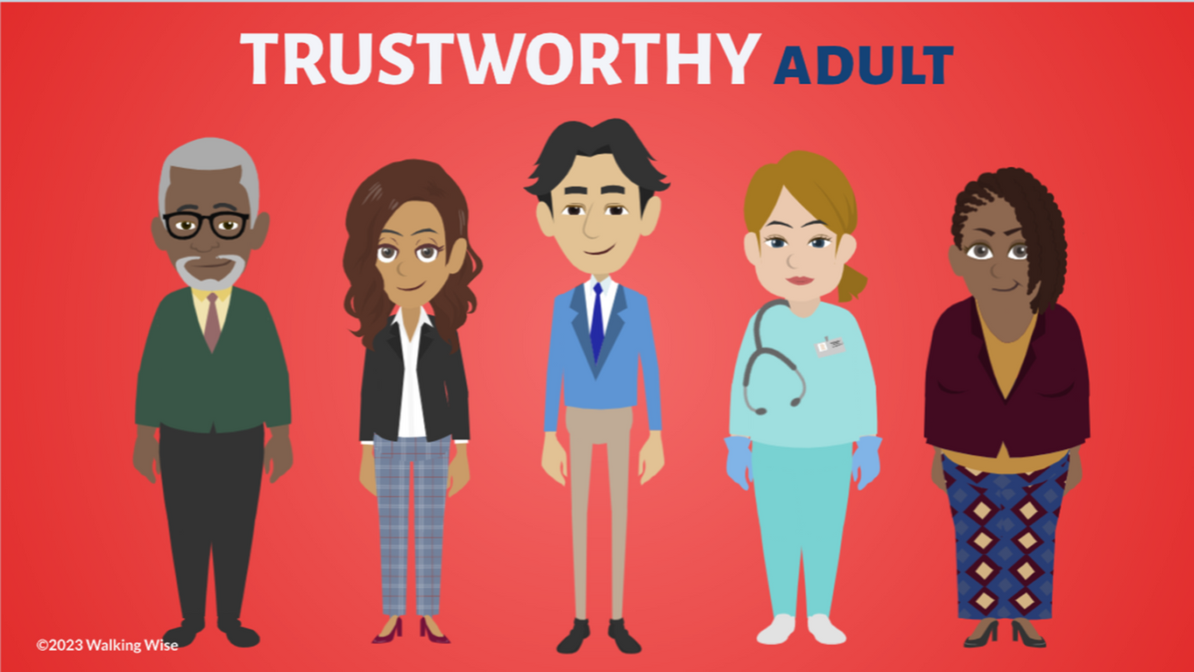
ASK FOR HELP
©2025 Walking Wise
89

Slide 90
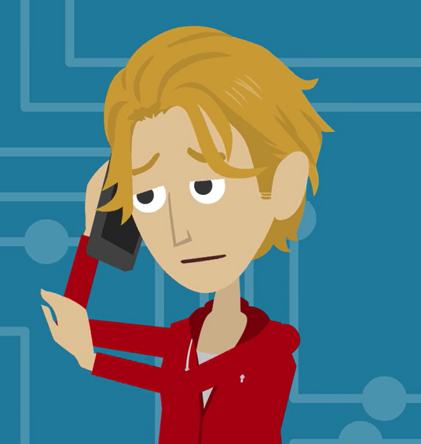
ASK FOR HELP
What are ways young people can ask for help?
©2025 Walking Wise
90

Slide 91
ASK FOR HELP
HOW TO ASK FOR HELP
  If you are in immediate danger, dial 911.
©2025 Walking Wise
91

Slide 92
ASK FOR HELP
HOW TO ASK FOR HELP
  If you are in immediate danger, dial 911.
  If the sexual predator IS a family member, consider telling a trustworthy adult.
©2025 Walking Wise
92

Slide 93
ASK FOR HELP
HOW TO ASK FOR HELP
  If you are in immediate danger, dial 911.
  If the sexual predator IS a family member, consider telling a trustworthy adult.
  If the sexual predator is NOT family, consider telling a parent.
©2025 Walking Wise
93

Slide 94
ASK FOR HELP
HOW TO ASK FOR HELP
  If you are in immediate danger, dial 911.
  If the sexual predator IS a family member, consider telling a trustworthy adult.
  If the sexual predator is NOT family, consider telling a parent.
  If you are a student in school, consider telling a trustworthy teacher, coach, school nurse, social worker, counselor, resource officer, or principal.
©2025 Walking Wise
94

Slide 95
ASK FOR HELP
HOW TO ASK FOR HELP
  If you are in immediate danger, dial 911.
  If the sexual predator IS a family member, consider telling a trustworthy adult.
  If the sexual predator is NOT family, consider telling a parent.
  If you are a student in school, consider telling a trustworthy teacher, coach, school nurse, social worker, counselor, resource officer, or principal.
  To gain internet access for help, consider using a computer at your school or a public library.
©2025 Walking Wise
95

Slide 96
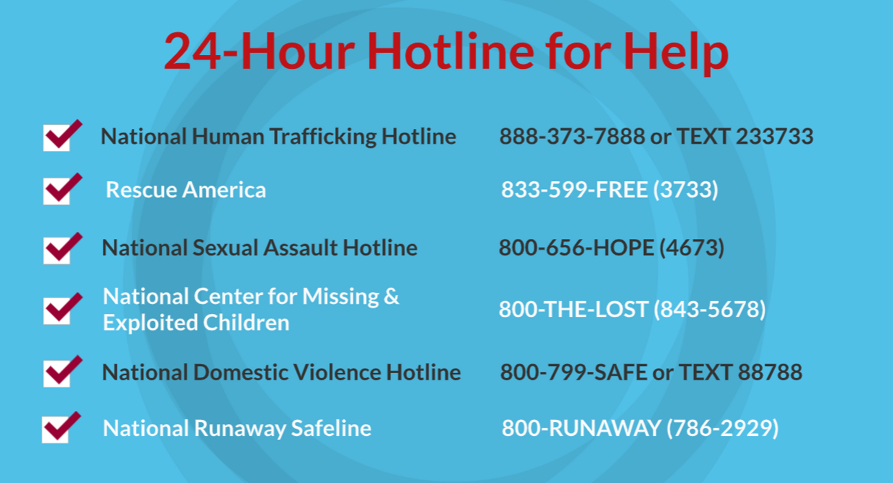
©2025 Walking Wise
96
Notes:
NOTE
Presenters may ask their audience to consider adding a few "hotline for help" phone numbers in their cell phone contacts or take a photo of this slide.

Slide 97
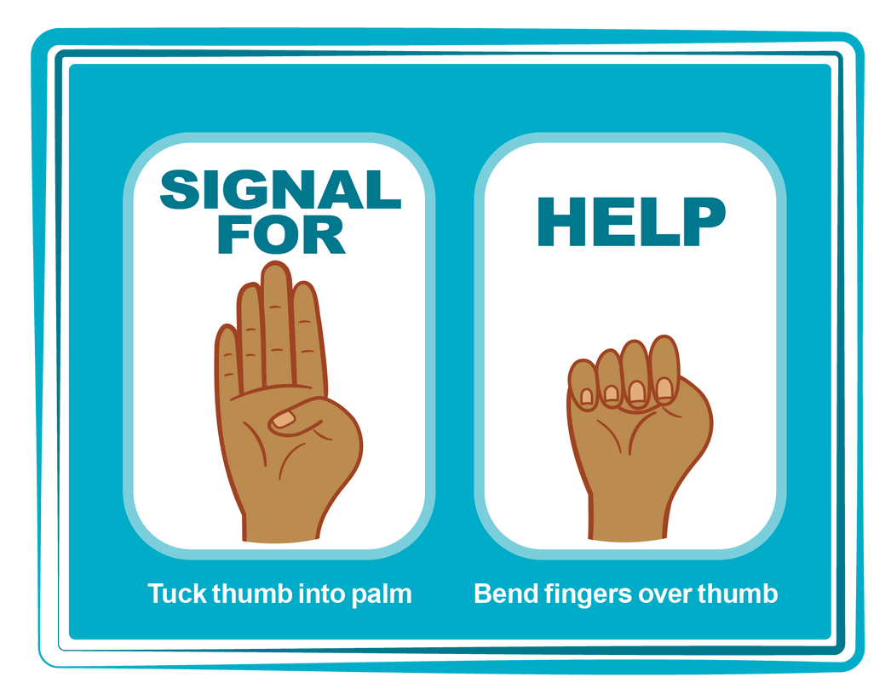
HAND SIGNAL FOR HELP
©2025 Walking Wise
Source: Canadian Women’s Foundation, April 2020
97
Notes:
Although the hand signal for help has not yet achieved universal recognition, it may discreetly get someone's attention in urgent situations.
• SILENT
It can be used silently.
• UNTRACKABLE
It leaves no digital footprint.
• CONCEALED
It can be done secretly when a perpetrator is in the vicinity.
• SIGNALS DISTRESS
Combining the hand signal with distressed facial expressions might help attract the attention of an individual who is unfamiliar with the signal's meaning.
Source
Canadian Women's Foundation, April 2020

Slide 98
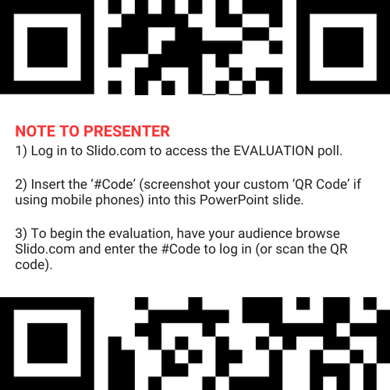
EVALUATION
©2025 Walking Wise
98
Notes:
SLIDO.com: 3-Question Survey
NOTE
Update this slide with your school/organization's custom QR code and #code.
Please encourage participants to scan your organization's custom QR code to share what they enjoyed and what could be improved about the lesson.
Please send any feedback you want to share to Walking Wise at support@WalkingWise.com.

Slide 99
SHARE YOUR THOUGHTS
1. How would you rate this lesson?
2. What was the one thing you liked?
3. What one thing should we improve?
Presenter: Replace “#XXXX” with your organization’s custom Slido code.
©2025 Walking Wise
99
Notes:
SLIDO.com: 3-Question Survey
NOTE
Follow the instructions provided on WalkingWise.com to access your school or organization's custom Slido QR code and #code, which will enable the audience to complete the 3-question evaluation.
Please encourage your audience to scan your organization's custom QR code to share what they enjoyed and what could be improved about the lesson.
Please send any feedback you want to share to Walking Wise at support@WalkingWise.com.

Slide 100


Thank you!
WalkingWise.com
Online Course for Adults Accredited by:
Postgraduate Institue for Medicine
Academy of Forensic Nursing
©2025 Walking Wise
100
Notes:
NOTE
To access additional resources about male victims, please refer to the last page of Lesson Plan #6 in the Walking Wise Education Guide.
We welcome your feedback at support@WalkingWise.com.
Thank you!
Karla Highman
Founder, WalkingWise.com

