Slide 1


SEXUAL EXPLOITATION
EDUCATION
Myths
&REALITY
LESSON #1
Notes:
NOTE
Log in to WalkingWise.com and refer to the Implementation Toolkit to access classroom teaching tips.
Most importantly:
• DEFINE SCHOOL POLICY
Establish a sexual exploitation reporting protocol with a trauma-informed response. The Walking Wise Implementation Toolkit provides a sample protocol.
• AGE & AUDIENCE
This presentation can be edited by following the procedures on page 3 to align with your school policies, specific age groups, and the involvement of at-risk audiences.
• SUPPORT PROCEDURE
Provide your audience with guidance on accessing immediate help or arranging a private meeting with a social worker, counselor, nurse, school resource officer, or another trustworthy staff member to report concerns for themselves or a peer.
• SECOND SAFE ADULT
Ensure a second trustworthy adult, such as a teacher, is present in the learning setting to observe student reactions and identify those who may benefit from a follow-up meeting. This person should remain focused and free from other duties during the presentation.
• IMPLEMENT SLIDO.com
Join Walking Wise in using Slido.com to create an anonymous user experience.
Contact us at support@WalkingWise.com if you would like more information.

Slide 2
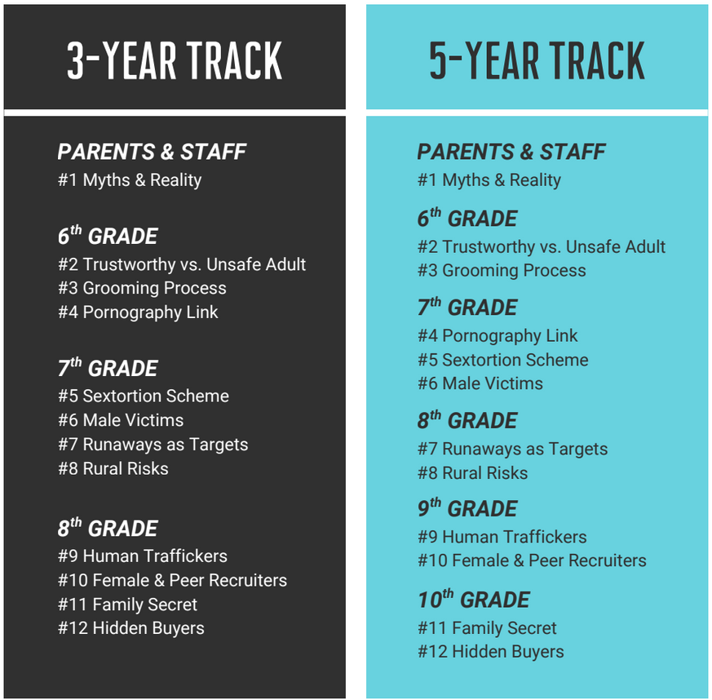


NOTE TO PRESENTER
Meaningful learning takes time. By introducing topics gradually over several years, schools can create steady growth in awareness and understanding.
Our three- to five-year teaching plan offers a flexible path for middle and high school students to build knowledge and confidence. Parts of lesson #2, Trustworthy vs. Unsafe Adult, may begin in the 5th grade.
Download our Teaching Track.
©2024-2026 Walking Wise
2
Notes:
This slide is intended to be deleted before presenting to audiences.

Slide 3
NOTE TO PRESENTER
This presentation is exclusively for Walking Wise® subscribers and not for redistribution.
Walking Wise encourages the use of Slido.com, an interactive digital tool, to enhance audience engagement. For more information, contact us at support@WalkingWise.com. Once configured, integrate Slido polling and add a post-evaluation to the PowerPoint presentation.
Presenters are encouraged to edit speaker notes to match their speaking style (viewable in presentation mode). You can also delete slides from this Walking Wise presentation to make sure the content aligns with your school policies, is age-appropriate, and fits within available class time. However, the existing slides are copyright-protected and may not be modified without prior written permission from Walking Wise.
We encourage you to add your own content by following these instructions:
  Insert new PowerPoint slides.
  Remove the Walking Wise logo and copyright "©2025 Walking Wise" from the new slides.
  Always add your organization's name or logo to each new slide.
Please delete this instruction page before presenting to audiences.
©2024-2026 Walking Wise
3
Notes:
NOTE
The presenter is welcome to customize this Walking Wise presentation according to the instructions provided on this page.
For revision requests, please email us at:
support@WalkingWise.com.

Slide 4

CONFRONTING SEXUAL EXPLOITATION
WALKING WISE
KNOWLEDGE serves as a
powerful defense against
sexual predators.
©2024-2026 Walking Wise
4

Slide 5
CONFRONTING SEXUAL EXPLOITATION
WALKING WISE
SEXUAL EXPLOITATION includes grooming, sextortion, pornography
& sex trafficking.
©2024-2026 Walking Wise
5

Slide 6
SENSITIVE DISCUSSION AHEAD
CONTENT ALERT
We’ll be discussing serious issues about sexual exploitation.
Some parts may be difficult to hear.
If you ever feel uncomfortable, you can step out and speak with a trustworthy adult for support.
You’re not alone—we’re here to help you.
©2024-2026 Walking Wise
6
Notes:
NOTE TO PRESENTER
Please tailor this message to align with your organization's policies and protocols.
Please provide a confidential avenue for students to report concerns and seek help for themselves or their peers if they suspect sexual abuse, grooming, sextortion, pornography-related exploitation, or human trafficking. This may include a designated address or text line.
Consider displaying posters in your school or facility that outline various ways students can access immediate support or request a private meeting with a school safety team member or another trusted adult.

Slide 7
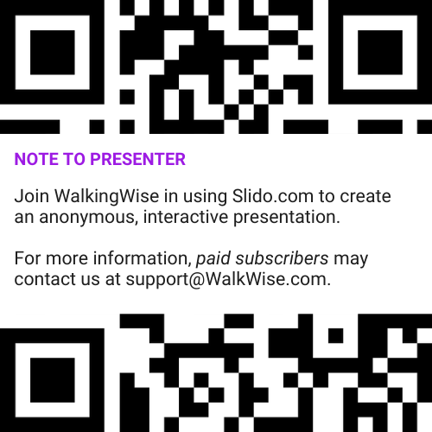
DIGITAL PARTICIPATION
©2024-2026 Walking Wise
7
Notes:
NOTE
For digital interaction with audiences:
Join Walking Wise in using Slido.com to create an anonymous user experience.
Contact us at support@WalkingWise.com if you would like more information.
Upon Activating Slido.com:
Please verify that the Q&A feature is enabled before presenting to audiences. An adult should monitor questions and comments to ensure they are appropriate. Slido has a feature that allows you to delete unwanted questions and comments.

Slide 8


STATISTICS
Statistics are Only Estimates
🔍 Many sexual crimes are never reported, so study results may not fully reflect what is really happening.
Myths
&REALITY
©2024-2026 Walking Wise
8
Notes:
In this presentation, we'll discuss statistics, but it's important to note that while statistics provide valuable insights into an issue, they cannot be relied upon entirely.
Here are a few reasons:
• UNREPORTED
Victims may stay silent due to fear, shame, or manipulation.
• INCONSISTENT COLLECTION
Geographical areas have different legal definitions for sexual crimes, making data hard to compare.
• FOCUS GROUPS
Small or specific focus groups participating in a study or survey may not accurately reflect the diversity or experiences of the broader population.

Slide 9
STATISTICS
Statistics are Only Estimates
📊 Studies collect information in different ways, which can lead to different results.
Myths
&REALITY
©2024-2026 Walking Wise
9
Notes:
In this presentation, we'll discuss statistics, but it's important to note that while statistics provide valuable insights into an issue, they cannot be relied upon entirely.
Here are a few reasons:
• UNREPORTED
Victims may stay silent due to fear, shame, or manipulation.
• INCONSISTENT COLLECTION
Geographical areas have different legal definitions for sexual crimes, making data hard to compare.
• FOCUS GROUPS
Small or specific focus groups participating in a study or survey may not accurately reflect the diversity or experiences of the broader population.

Slide 10
STATISTICS
Statistics are Only Estimates
👥 Some studies use small groups of people, and those groups may not represent everyone.
Myths
&REALITY
©2024-2026 Walking Wise
10
Notes:
In this presentation, we'll discuss statistics, but it's important to note that while statistics provide valuable insights into an issue, they cannot be relied upon entirely.
Here are a few reasons:
• UNREPORTED
Victims may stay silent due to fear, shame, or manipulation.
• INCONSISTENT COLLECTION
Geographical areas have different legal definitions for sexual crimes, making data hard to compare.
• FOCUS GROUPS
Small or specific focus groups participating in a study or survey may not accurately reflect the diversity or experiences of the broader population.

Slide 11

EDUCATON GUIDE
VOCABULARY
VOCABULARY
  Child Exploitation
  Sex Trafficking
  Myth
  Reality
  Coercion
  Manipulation
  Intimidation
Myths
&REALITY
©2024-2026 Walking Wise
11
3
Notes:
NOTE
Understanding vocabulary terms related to the behaviors of sexual predators can empower young people to recognize warning signs of harmful situations.
Knowing terminology helps them identify manipulative tactics predators use to build trust and exploit vulnerabilities.
With this knowledge, young people are better equipped to spot red flags, understand that these behaviors are abusive, and feel more confident reporting predators to trusted adults or authorities, potentially preventing further harm.

Slide 12
EDUCATON GUIDE
VOCABULARY
CHILD EXPLOITATION
The use of a child for someone else’s benefit, often in an abusive, unfair, or harmful manner.
Includes: Sexual exploitation (grooming & sex trafficking), sextortion,
labor trafficking, and criminal activity (such as drug dealing & theft).
Myths
&REALITY
©2024-2026 Walking Wise
Section 7102. 22 USC Ch. 78: Trafficking Victims Protection, From Title 22—Foreign Relations and Intercourse.
12
3
Notes:
Assisting Source
OpenAI. (2024). ChatGPT [Large language model]. https://chatgpt.com
FOR LEGAL DEFINITION:
Section 7102. 22 USC Ch. 78: Trafficking Victims Protection, From Title 22—Foreign Relations and Intercourse. Retrieved January 3, 2025, from https://uscode.house.gov/view.xhtml?hl=false&edition=prelim&path=%2Fprelim%40title22%2Fchapter78&req=granuleid%3AUSC-prelim-title22-chapter78&num=0&saved=L3ByZWxpbUB0aXRsZTIyL2NoYXB0ZXI3OA%3D%3D%7CZ3JhbnVsZWlkOlVTQy1wcmVsaW0tdGl0bGUyMi1jaGFwdGVyNzg%3D%7C%7C%7C0%7Cfalse%7Cprelim
Criminal Division, U.S. Department of Justice. Citizen's Guide To U.S. Federal Law On Child Sex Trafficking. Retrieved January 3, 2025, from https://www.justice.gov/criminal/criminal-ceos/citizens-guide-us-federal-law-child-sex-trafficking

Slide 13
EDUCATON GUIDE
VOCABULARY
CHILD SEX TRAFFICKING
A child (under age 18) is made to take part in sexual activity for money or something of value, like food, shelter, or gifts.
Myths
&REALITY
©2024-2026 Walking Wise
Section 7102. 22 USC Ch. 78: Trafficking Victims Protection, From Title 22—Foreign Relations and Intercourse.
13
3
Notes:
Assisting Source
OpenAI. (2024). ChatGPT [Large language model]. https://chatgpt.com
FOR LEGAL DEFINITION:
Section 7102. 22 USC Ch. 78: Trafficking Victims Protection, From Title 22—Foreign Relations and Intercourse. Retrieved January 3, 2025, from https://uscode.house.gov/view.xhtml?hl=false&edition=prelim&path=%2Fprelim%40title22%2Fchapter78&req=granuleid%3AUSC-prelim-title22-chapter78&num=0&saved=L3ByZWxpbUB0aXRsZTIyL2NoYXB0ZXI3OA%3D%3D%7CZ3JhbnVsZWlkOlVTQy1wcmVsaW0tdGl0bGUyMi1jaGFwdGVyNzg%3D%7C%7C%7C0%7Cfalse%7Cprelim

Slide 14
EDUCATON GUIDE
VOCABULARY
SEX TRAFFICKING OF ADULTS
An adult is made to take part in sexual activity in exchange for something of value (like money, food, or housing), through the use of FORCE, FRAUD, or COERCION.
Myths
&REALITY
©2024-2026 Walking Wise
Section 7102. 22 USC Ch. 78: Trafficking Victims Protection, From Title 22—Foreign Relations and Intercourse.
14
3
Notes:
Assisting Source
OpenAI. (2024). ChatGPT [Large language model]. https://chatgpt.com
FOR LEGAL DEFINITION:
Section 7102. 22 USC Ch. 78: Trafficking Victims Protection, From Title 22—Foreign Relations and Intercourse. Retrieved January 3, 2025, from https://uscode.house.gov/view.xhtml?hl=false&edition=prelim&path=%2Fprelim%40title22%2Fchapter78&req=granuleid%3AUSC-prelim-title22-chapter78&num=0&saved=L3ByZWxpbUB0aXRsZTIyL2NoYXB0ZXI3OA%3D%3D%7CZ3JhbnVsZWlkOlVTQy1wcmVsaW0tdGl0bGUyMi1jaGFwdGVyNzg%3D%7C%7C%7C0%7Cfalse%7Cprelim

Slide 15

FORCEFUL TACTICS
force
Physical Abuse
Sexual Abuse
Threats Using a Weapon
Isolation
Myths
&REALITY
©2024-2026 Walking Wise
2020-2022 U.S. National Human Trafficking Hotline Report
15
Notes:
Source
Polaris Project (n.d.). Human Trafficking During the COVID and Post-COVID Era. Polarisproject.org, pp. 3, 6. Retrieved February 27, 2024, from https://polarisproject.org/wp-content/uploads/2020/07/Hotline-Trends-Report-2023.pdf

Slide 16
FRAUDULANT TACTICS
fraud
Fake Modeling Career
Fake Entertainment Career
Promises of Scholarships
Promoting Free Education
Loan Assistance Scam
Myths
&REALITY
©2024-2026 Walking Wise
2020-2022 U.S. National Human Trafficking Hotline Report
16
Notes:
Source
Polaris Project (n.d.). Human Trafficking During the COVID and Post-COVID Era. Polarisproject.org, pp. 3, 6. Retrieved February 27, 2024, from https://polarisproject.org/wp-content/uploads/2020/07/Hotline-Trends-Report-2023.pdf

Slide 17
EDUCATON GUIDE
VOCABULARY
COERCE
To manipulate, threaten, or intimidate someone to act against their will.
Myths
&REALITY
©2024-2026 Walking Wise
Section 7102. 22 USC Ch. 78: Trafficking Victims Protection, From Title 22—Foreign Relations and Intercourse.
17
3
Notes:
Assisting Source
OpenAI. (2024). ChatGPT [Large language model]. https://chatgpt.com
FOR LEGAL DEFINITION:
18 USC 1591: Sex trafficking of children or by force, fraud, or coercion. (n.d.). Title 18- Crimes and Criminal Procedure, Part 1 - Crimes Chapter 77 - Peonage and Slavery. Retrieved January 3, 2025, from https://uscode.house.gov/view.xhtml?req=granuleid%3AUSC-2000-title18-section1591&num=0&edition=2000#sourcecredit

Slide 18

COERCIVE TACTICS
COERCION
Creates Substance Addiction
Expliots Substance Use
Threatens Harm to Family or Pets
Emotional or Verbal Abuse
Manipulation or Intimidation
Stalking or Monitoring
Withholding Food & Shelter
Myths
&REALITY
©2024-2026 Walking Wise
2020-2022 U.S. National Human Trafficking Hotline Report
18
Notes:
Source
Polaris Project (n.d.). Human Trafficking During the COVID and Post-COVID Era. Polarisproject.org, pp. 3, 6. Retrieved February 27, 2024, from https://polarisproject.org/wp-content/uploads/2020/07/Hotline-Trends-Report-2023.pdf

Slide 19
EDUCATON GUIDE
VOCABULARY
MYTH
A false belief commonly held by a group.
Myths
&REALITY
©2024-2026 Walking Wise
19
3
Notes:
Assisting Source
OpenAI. (2024). ChatGPT [Large language model]. https://chatgpt.com

Slide 20
EDUCATON GUIDE
VOCABULARY
REALITY
A true fact based on what actually happens.
Myths
&REALITY
©2024-2026 Walking Wise
20
3
Notes:
Assisting Source
OpenAI. (2024). ChatGPT [Large language model]. https://chatgpt.com

Slide 21
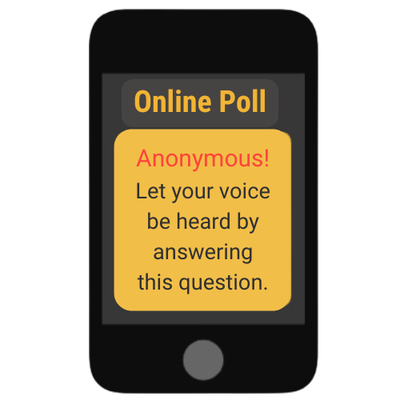
LESSON PLANS
MYTH OR REALITY?
Myth or Reality? Sex traffickers mostly target young people living in dangerous communities.
Myths
&REALITY
©2024-2026 Walking Wise
Polaris Project (2025) Myths, Facts, and Statistics. PolarisProject.org.
21
3
Notes:
Slido.com
Online Polling Interaction
Sex traffickers mostly target young people living in dangerous communities.
A) Myth
B) Reality
ANSWER
A) Myth - Sex traffickers target young people from all types of communities, including urban, suburban, rural, and online communities.
Source
Polaris Project (2025) Myths, Facts, and Statistics. PolarisProject.org. Retrieved January 6, 2025, from https://polarisproject.org/myths-facts-and-statistics/?gad_source=1&gclid=CjwKCAiAm-67BhBlEiwAEVftNpjEBS3aD54aH9qHzJjL01wnVgSL4rc8WgP7CHE_PvAjOR1wN9AchBoCgk8QAvD_BwE

Slide 22
ANSWER
MYTH. Traffickers target young people from all types of communities, including urban, suburban, rural, and online communities.
©2024-2026 Walking Wise
Polaris Project (2025). Myths, Facts, and Statistics. PolarisProject.org.
22
Notes:
Slido.com
Online Polling Interaction
Sex traffickers mostly target young people living in dangerous communities.
A) Myth
B) Reality
ANSWER
A) Myth - Sex traffickers target young people from all types of communities, including urban, suburban, rural, and online communities.
Source
Polaris Project (2025). Myths, Facts, and Statistics. PolarisProject.org. Retrieved January 6, 2025, from https://polarisproject.org/myths-facts-and-statistics/?gad_source=1&gclid=CjwKCAiAm-67BhBlEiwAEVftNpjEBS3aD54aH9qHzJjL01wnVgSL4rc8WgP7CHE_PvAjOR1wN9AchBoCgk8QAvD_BwE

Slide 23
LESSON PLANS
MYTH OR REALITY?
Myth or Reality? Human traffickers mainly target young people they don’t know.
Myths
&REALITY
©2024-2026 Walking Wise
Polaris Project (2025) Myths, Facts, and Statistics. PolarisProject.org.
23
3
Notes:
Slido.com
Online Polling Interaction
Human traffickers mainly target young people they don’t know.
A) Myth
B) Reality
ANSWER:
A) Myth - Victims often know their trafficker. Traffickers can be family members - including parents, intimate partners - including older boyfriends and spouses, and other known and trusted members of the community.
Source
Polaris Project (2025). Myths, Facts, and Statistics. PolarisProject.org. Retrieved January 6, 2025, from https://polarisproject.org/myths-facts-and-statistics/?gad_source=1&gclid=CjwKCAiAm-67BhBlEiwAEVftNpjEBS3aD54aH9qHzJjL01wnVgSL4rc8WgP7CHE_PvAjOR1wN9AchBoCgk8QAvD_BwE

Slide 24
ANSWER
MYTH. Victims often know their trafficker.
©2024-2026 Walking Wise
Polaris Project (2025). Myths, Facts, and Statistics. PolarisProject.org.
24
Notes:
Slido.com
Online Polling Interaction
Human traffickers mainly target young people they don’t know.
A) Myth
B) Reality
ANSWER:
A) Myth - Victims often know their trafficker. Traffickers can be family members - including parents, intimate partners - including older boyfriends and spouses, and other known and trusted members of the community.
Source
Polaris Project (2025). Myths, Facts, and Statistics. PolarisProject.org. Retrieved January 6, 2025, from https://polarisproject.org/myths-facts-and-statistics/?gad_source=1&gclid=CjwKCAiAm-67BhBlEiwAEVftNpjEBS3aD54aH9qHzJjL01wnVgSL4rc8WgP7CHE_PvAjOR1wN9AchBoCgk8QAvD_BwE

Slide 25
LESSON PLANS
MYTH OR REALITY?
Myth or Reality? Sex trafficking usually involves violence against victims.
Myths
&REALITY
©2024-2026 Walking Wise
Polaris Project (2025) Myths, Facts, and Statistics. PolarisProject.org.
25
3
Notes:
Slido.com
Online Polling Interaction
Sex trafficking usually involves violence against victims.
A) Myth
B) Reality
ANSWER
A) Myth. Sometimes violence is involved; however, traffickers often use manipulation, intimidation, and threats to control their victims.
Source
Polaris Project (2025). Myths, Facts, and Statistics. PolarisProject.org. Retrieved January 6, 2025, from https://polarisproject.org/myths-facts-and-statistics/?gad_source=1&gclid=CjwKCAiAm-67BhBlEiwAEVftNpjEBS3aD54aH9qHzJjL01wnVgSL4rc8WgP7CHE_PvAjOR1wN9AchBoCgk8QAvD_BwE

Slide 26
ANSWER
MYTH. Traffickers more often use manipulation, intimidation, and threats to control their victims.
©2024-2026 Walking Wise
Polaris Project (2025). Myths, Facts, and Statistics. PolarisProject.org.
26
Notes:
Slido.com
Online Polling Interaction
Sex trafficking usually involves violence against victims.
A) Myth
B) Reality
ANSWER
A) Myth. Sometimes violence is involved; however, traffickers often use manipulation, intimidation, and threats to control their victims.
Source
Polaris Project (2025). Myths, Facts, and Statistics. PolarisProject.org. Retrieved January 6, 2025, from https://polarisproject.org/myths-facts-and-statistics/?gad_source=1&gclid=CjwKCAiAm-67BhBlEiwAEVftNpjEBS3aD54aH9qHzJjL01wnVgSL4rc8WgP7CHE_PvAjOR1wN9AchBoCgk8QAvD_BwE

Slide 27
LESSON PLANS
MYTH OR REALITY?
Myth or Reality? Sex trafficking victims are usually kidnapped.
Myths
&REALITY
©2024-2026 Walking Wise
27
3
Notes:
Slido.com
Online Polling Interaction
Sex trafficking victims are usually kidnapped.
A) Myth
B) Reality
ANSWER
A) Myth. It’s possible for someone to be kidnapped by a trafficker, but this is uncommon. Most traffickers use lies, manipulation, or pressure to trap people into trafficking situations.
Source
National Human Trafficking Hotline (n.d.). Fact Sheet: Human Trafficking. The Administration for Children and Families. Retrieved May 1, 2024, from https://www.acf.hhs.gov/otip/fact-sheet/resource/fshumantrafficking

Slide 28
ANSWER
MYTH. Most trafficking does not involve kidnapping. Traffickers more often trick their victims.
©2024-2026 Walking Wise
National Human Trafficking Hotline (n.d.). Fact Sheet: Human Trafficking. The Administration for Children and Families.
28
Notes:
Slido.com
Online Polling Interaction
Sex trafficking victims are usually kidnapped.
A) Myth
B) Reality
ANSWER
A) Myth. It’s possible for someone to be kidnapped by a trafficker, but this is uncommon. Most traffickers use lies, manipulation, or pressure to trap people into trafficking situations.
Source
National Human Trafficking Hotline (n.d.). Fact Sheet: Human Trafficking. The Administration for Children and Families. Retrieved May 1, 2024, from https://www.acf.hhs.gov/otip/fact-sheet/resource/fshumantrafficking

Slide 29
LESSON PLANS
MYTH OR REALITY?
Myth or Reality? Sex traffickers usually hold victims physically captive.
Myths
&REALITY
©2024-2026 Walking Wise
29
3
Notes:
Slido.com
Online Polling Interaction
Sex traffickers usually hold victims physically captive.
A) Myth
B) Reality
ANSWER
A) Myth. Some traffickers may hold victims captive, but most people in trafficking situations stay for more complicated reasons:
- They don’t have the basics to leave, like transportation or a safe place.
- They fear for their safety if they try to escape.
- They’ve been manipulated so much that they may not realize they’re being controlled.
Source
National Human Trafficking Hotline (n.d.). Fact Sheet: Human Trafficking. The Administration for Children and Families. Retrieved May 1, 2024, from https://www.acf.hhs.gov/otip/fact-sheet/resource/fshumantrafficking

Slide 30
ANSWER
MYTH. Most victims are not locked in. People usually stay because they are scared, controlled, or feel they have no choice.
©2024-2026 Walking Wise
National Human Trafficking Hotline (n.d.). Fact Sheet: Human Trafficking. The Administration for Children and Families.
30
Notes:
Slido.com
Online Polling Interaction
Sex traffickers usually hold victims physically captive.
A) Myth
B) Reality
ANSWER
A) Myth. Some traffickers may hold victims captive, but most people in trafficking situations stay for more complicated reasons:
- They don’t have the basics to leave, like transportation or a safe place.
- They fear for their safety if they try to escape.
- They’ve been manipulated so much that they may not realize they’re being controlled.
Source
National Human Trafficking Hotline (n.d.). Fact Sheet: Human Trafficking. The Administration for Children and Families. Retrieved May 1, 2024, from https://www.acf.hhs.gov/otip/fact-sheet/resource/fshumantrafficking

Slide 31
LESSON PLANS
TRAFFICKING MYTH
Myth or Reality? Sex traffickers only target females.
Myths
&REALITY
©2024-2026 Walking Wise
31
3
Notes:
Slido.com
Online Polling Interaction
Sex traffickers only target females.
A) Myth
B) Reality
ANSWER
A) Myth. Both men and boys are also victimized by sex traffickers. Additionally, LGBTQ+ males are especially vulnerable to traffickers.
Source
National Human Trafficking Hotline (n.d.). Fact Sheet: Human Trafficking. The Administration for Children and Families. Retrieved May 1, 2024, from https://www.acf.hhs.gov/otip/fact-sheet/resource/fshumantrafficking

Slide 32
ANSWER
MYTH. Females are most victimized, but males and boys are also trafficked.
©2024-2026 Walking Wise
National Human Trafficking Hotline (n.d.). Fact Sheet: Human Trafficking. The Administration for Children and Families.
32
Notes:
Slido.com
Online Polling Interaction
Sex traffickers only target females.
A) Myth
B) Reality
ANSWER
A) Myth. Both men and boys are also victimized by sex traffickers. Additionally, LGBTQ+ males are especially vulnerable to traffickers.
Source
National Human Trafficking Hotline (n.d.). Fact Sheet: Human Trafficking. The Administration for Children and Families. Retrieved May 1, 2024, from https://www.acf.hhs.gov/otip/fact-sheet/resource/fshumantrafficking

Slide 33
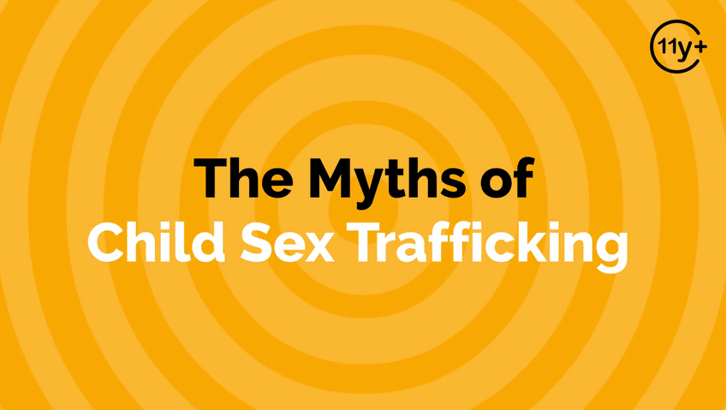
LOGIN or go to WalkingWise.com/demo to access this animated video.
©2024-2026 Walking Wise
33
Notes:
Message Especially for Teens:
Businesses worldwide use explainer-style animation as a training tool for their employees.
So, this 3-minute Walking Wise animated video series is appropriate for both teens (ages 11+) and adults to learn how sexual predators use manipulation, intimidation, and coercion to exploit young people.
NOTE
Log in to Walking Wise.com to watch the three-minute animated video with audiences.

Slide 34
LESSON PLANS
BUSINESS & INDUSTY
In what types of business or industry are people commonly trafficked?
Myths
&REALITY
©2024-2026 Walking Wise
34
3

Slide 35
BUSINESS & INDUSTY
Industries Impacted by Sex Trafficking
  Social Media Platforms
  Illegal Massage Parlors
  Entertainment Industry: Strip Clubs & Casinos
  Hospitality Industry: Hotels & Motels
Myths
&REALITY
©2024-2026 Walking Wise
35
Notes:
Myth: People are only trafficked in illegal businesses.
Reality: Trafficking can happen anywhere people can be controlled or exploited, even in legal businesses and industries.

Slide 36
BUSINESS & INDUSTY
Industries Impacted by Labor Trafficking
  Hotel Housekeeping & Maintenance
  Restaurants & Tourism
  Agriculture: Crops, Livestock, Fisheries
  Logging & Mining
  Construction, Factories, & Carnivals
Myths
&REALITY
©2024-2026 Walking Wise
36
Notes:
Myth: People are only trafficked in illegal businesses.
Reality: Trafficking can happen anywhere people can be controlled or exploited, even in legal businesses and industries.

Slide 37
EDUCATON GUIDE
VOCABULARY
MANIPULATION
Influencing or controlling someone’s behavior or decisions deceptively or unfairly, usually for personal gain.
Myths
&REALITY
©2024-2026 Walking Wise
37
3
Notes:
Assisting Source
OpenAI. (2024). ChatGPT [Large language model]. https://chatgpt.com

Slide 38
EDUCATON GUIDE
VOCABULARY
INTIMIDATION
To influence or control another person’s actions or behavior by causing fear.
Myths
&REALITY
©2024-2026 Walking Wise
38
3
Notes:
Assisting Source
OpenAI. (2024). ChatGPT [Large language model]. https://chatgpt.com

Slide 39
FALSE SENSE OF SECURITY
When can young people experience a false sense of security?
Myths
&REALITY
©2024-2026 Walking Wise
39
Notes:
FALSE SENSE OF SECURITY
A false sense of security refers to the feeling of being safer than one actually is.

Slide 40
FALSE SENSE OF SECURITY
Stay Alert — Even When Things Seem Safe
💬 Hanging out with an “Online-only” friend.
Myths
&REALITY
©2024-2026 Walking Wise
40
Notes:
A false sense of security refers to the feeling of being safer than one actually is.
For example, parents may mistakenly believe they have protected their children from sex traffickers because they moved into a safe neighborhood. Still, the threat unknowingly exists if they forget to set up or enforce the necessary safety settings on
their child's or teen’s social media apps.

Slide 41
FALSE SENSE OF SECURITY
Stay Alert — Even When Things Seem Safe
👤 Spending time with an older peer.
Myths
&REALITY
©2024-2026 Walking Wise
41
Notes:
A false sense of security refers to the feeling of being safer than one actually is.
For example, parents may mistakenly believe they have protected their children from sex traffickers because they moved into a safe neighborhood. Still, the threat unknowingly exists if they forget to set up or enforce the necessary safety settings on
their child's or teen’s social media apps.

Slide 42
FALSE SENSE OF SECURITY
Stay Alert — Even When Things Seem Safe
⭐ Receiving unusual attention or favors from an adult.
Myths
&REALITY
©2024-2026 Walking Wise
42
Notes:
A false sense of security refers to the feeling of being safer than one actually is.
For example, parents may mistakenly believe they have protected their children from sex traffickers because they moved into a safe neighborhood. Still, the threat unknowingly exists if they forget to set up or enforce the necessary safety settings on
their child's or teen’s social media apps.

Slide 43
FALSE SENSE OF SECURITY
Stay Alert — Even When Things Seem Safe
📍 Spending time at unfamiliar places with acquaintances.
©2024-2026 Walking Wise
43
Notes:
A false sense of security refers to the feeling of being safer than one actually is.
For example, parents may mistakenly believe they have protected their children from sex traffickers because they moved into a safe neighborhood. Still, the threat unknowingly exists if they forget to set up or enforce the necessary safety settings on
their child's or teen’s social media apps.

Slide 44
PLAIN SIGHT
How do human traffickers operate in plain sight?
Myths
&REALITY
©2024-2026 Walking Wise
44

Slide 45
PLAIN SIGHT
Someone We Wouldn’t Suspect
🧑‍🏫 Authority Figure: Adult in charge where young people spend time.
Myths
&REALITY
©2024-2026 Walking Wise
45
Notes:
“Operating in plain sight” refers to visibly engaging in activities without attempting to conceal them or behaving in a way that attracts no suspicion despite the potentially harmful intentions.
Often, people believe criminal activity happens in dark alleys or places not visited by the average person. However, illegal activity occurs frequently and in areas where people commonly spend time.

Slide 46
PLAIN SIGHT
Someone We Wouldn’t Suspect
🏘️ Neighbor: Adult or peer in the local communities
Myths
&REALITY
©2024-2026 Walking Wise
46
Notes:
“Operating in plain sight” refers to visibly engaging in activities without attempting to conceal them or behaving in a way that attracts no suspicion despite the potentially harmful intentions.
Often, people believe criminal activity happens in dark alleys or places not visited by the average person. However, illegal activity occurs frequently and in areas where people commonly spend time.

Slide 47
PLAIN SIGHT
Someone We Wouldn’t Suspect
🧑‍💼 Employer: Boss or co-worker
Myths
&REALITY
©2024-2026 Walking Wise
47
Notes:
“Operating in plain sight” refers to visibly engaging in activities without attempting to conceal them or behaving in a way that attracts no suspicion despite the potentially harmful intentions.
Often, people believe criminal activity happens in dark alleys or places not visited by the average person. However, illegal activity occurs frequently and in areas where people commonly spend time.

Slide 48
PLAIN SIGHT
Someone We Wouldn’t Suspect
👪 Family Member: Close or distant relative
Myths
&REALITY
©2024-2026 Walking Wise
48
Notes:
“Operating in plain sight” refers to visibly engaging in activities without attempting to conceal them or behaving in a way that attracts no suspicion despite the potentially harmful intentions.
Often, people believe criminal activity happens in dark alleys or places not visited by the average person. However, illegal activity occurs frequently and in areas where people commonly spend time.

Slide 49
NOT MY COMMUNITY
What happens when we ignore sexual exploitation in our community?
Myths
&REALITY
©2024-2026 Walking Wise
49

Slide 50
NOT MY COMMUNITY
Looking the Other Way
🚫 Ignoring human trafficking makes the problem worse.
Myths
&REALITY
©2024-2026 Walking Wise
50
Notes:
The phrase “not in my community" often reflects a mindset that underestimates or denies the presence of harmful or challenging issues within one’s community despite the evidence. Adults can mistakenly believe their neighbors are law-abiding citizens. Therefore, they are not on the lookout for sex offenders or traffickers
who could bring harm to young people in their community.

Slide 51
NOT MY COMMUNITY
Looking the Other Way
⚠️ Vulnerable people face increased risk.
Myths
&REALITY
©2024-2026 Walking Wise
51
Notes:
The phrase “not in my community" often reflects a mindset that underestimates or denies the presence of harmful or challenging issues within one’s community despite the evidence. Adults can mistakenly believe their neighbors are law-abiding citizens. Therefore, they are not on the lookout for sex offenders or traffickers
who could bring harm to young people in their community.

Slide 52
NOT MY COMMUNITY
Looking the Other Way
🆘 Victims don’t learn how to ask for help.
Myths
&REALITY
©2024-2026 Walking Wise
52
Notes:
The phrase “not in my community" often reflects a mindset that underestimates or denies the presence of harmful or challenging issues within one’s community despite the evidence. Adults can mistakenly believe their neighbors are law-abiding citizens. Therefore, they are not on the lookout for sex offenders or traffickers
who could bring harm to young people in their community.

Slide 53
AUTHORITY FIGURES
In what ways can someone in authority misuse their power to harm others?
Myths
&REALITY
©2024-2026 Walking Wise
53

Slide 54
AUTHORITY FIGURES
Abuse of Power
💔 They build trust using lies and manipulation.
Myths
&REALITY
©2024-2026 Walking Wise
54
Notes:
An authority figure can be anyone who commands or inspires obedience from someone else, regardless of
holding legitimate power over that person.
Often, traffickers can be authority figures, so young people believe
they have no choice but to comply with harmful expectations, including demands that involve sexual abuse. However, a trustworthy person of authority will never use their power to ask or command someone to do
something illegal or inappropriate

Slide 55
AUTHORITY FIGURES
Abuse of Power
🫵 They expect their demands to be followed without question.
Myths
&REALITY
©2024-2026 Walking Wise
55
Notes:
An authority figure can be anyone who commands or inspires obedience from someone else, regardless of
holding legitimate power over that person.
Often, traffickers can be authority figures, so young people believe
they have no choice but to comply with harmful expectations, including demands that involve sexual abuse. However, a trustworthy person of authority will never use their power to ask or command someone to do
something illegal or inappropriate

Slide 56
AUTHORITY FIGURES
Abuse of Power
😨 They threaten punishment if expectations are resisted.
Myths
&REALITY
©2024-2026 Walking Wise
56
Notes:
An authority figure can be anyone who commands or inspires obedience from someone else, regardless of
holding legitimate power over that person.
Often, traffickers can be authority figures, so young people believe
they have no choice but to comply with harmful expectations, including demands that involve sexual abuse. However, a trustworthy person of authority will never use their power to ask or command someone to do
something illegal or inappropriate

Slide 57
BROKEN PROMISES
What types of false promises are used to manipulate young people into sexual exploitation?
Myths
&REALITY
©2024-2026 Walking Wise
57

Slide 58
BROKEN PROMISES
Fraud & False Promises
💍 Fake love or marriage proposals are used to gain trust.
Myths
&REALITY
©2024-2026 Walking Wise
58
Notes:
A “false promise” is a commitment made with no intention of carrying it out. It occurs when the intent is to
deceive or defraud others. Often, traffickers trick young people into complying with harmful requests by telling
lies such as their “dedicated love” for the youth or promises of fame and fortune.

Slide 59
BROKEN PROMISES
Fraud & False Promises
🎬 Promises of fame or a dream job are used to lure and control.
Myths
&REALITY
©2024-2026 Walking Wise
59
Notes:
A “false promise” is a commitment made with no intention of carrying it out. It occurs when the intent is to
deceive or defraud others. Often, traffickers trick young people into complying with harmful requests by telling
lies such as their “dedicated love” for the youth or promises of fame and fortune.

Slide 60
BROKEN PROMISES
Fraud & False Promises
✈️ Promises of adventure are used to entice running away together.
Myths
&REALITY
©2024-2026 Walking Wise
60
Notes:
A “false promise” is a commitment made with no intention of carrying it out. It occurs when the intent is to
deceive or defraud others. Often, traffickers trick young people into complying with harmful requests by telling
lies such as their “dedicated love” for the youth or promises of fame and fortune.

Slide 61
POWER OF PERSUASION
How can traffickers gain “mental control” over young people?
Myths
&REALITY
©2024-2026 Walking Wise
61

Slide 62
POWER OF PERSUASION
Controlling Thoughts & Emotions
💭 Influencing beliefs and choices to shape decisions.
Myths
&REALITY
©2024-2026 Walking Wise
62
Notes:
"Mental control" refers to manipulating a person's thoughts, emotions, and perceptions to limit their ability to make independent choices.
Traffickers control victims by:
- Exerting influence over a young person's thoughts, beliefs, and decision-making processes.
- Employing psychological manipulation to sway or control a youth’s actions.
- Using tactics such as gaslighting makes victims doubt their perceptions and reality.
o Creating a dependency on the trafficker for emotional support and validation.
Victims must first determine how to override the powerful influence their trafficker holds over them before they can begin to consider ways to escape or exit their trafficking situation.

Slide 63
POWER OF PERSUASION
Controlling Thoughts & Emotions
🌀 Pusing someone to do something they normally wouldn’t.
Myths
&REALITY
©2024-2026 Walking Wise
63
Notes:
"Mental control" refers to manipulating a person's thoughts, emotions, and perceptions to limit their ability to make independent choices.
Traffickers control victims by:
- Exerting influence over a young person's thoughts, beliefs, and decision-making processes.
- Employing psychological manipulation to sway or control a youth’s actions.
- Using tactics such as gaslighting makes victims doubt their perceptions and reality.
o Creating a dependency on the trafficker for emotional support and validation.
Victims must first determine how to override the powerful influence their trafficker holds over them before they can begin to consider ways to escape or exit their trafficking situation.

Slide 64
POWER OF PERSUASION
Controlling Thoughts & Emotions
🤯 Playing mind games to cause confusion or self-doubt.
Myths
&REALITY
©2024-2026 Walking Wise
64
Notes:
"Mental control" refers to manipulating a person's thoughts, emotions, and perceptions to limit their ability to make independent choices.
Traffickers control victims by:
- Exerting influence over a young person's thoughts, beliefs, and decision-making processes.
- Employing psychological manipulation to sway or control a youth’s actions.
- Using tactics such as gaslighting makes victims doubt their perceptions and reality.
o Creating a dependency on the trafficker for emotional support and validation.
Victims must first determine how to override the powerful influence their trafficker holds over them before they can begin to consider ways to escape or exit their trafficking situation.

Slide 65
SOCIAL LIFE
How do traffickers enter a young person’s “social circle”?
Myths
&REALITY
©2024-2026 Walking Wise
65

Slide 66
SOCIAL LIFE
Getting Too Close
🎯 They fake having common interests to align and gain trust.
Myths
&REALITY
©2024-2026 Walking Wise
66
Notes:
A “social circle” refers to people who connect because of their shared interests. They regularly spend time together to socialize and grow friendships.
Traffickers use a form of trickery: They pretend to share common interests and work to blend into an established friend group to identify the vulnerabilities of the young person they are attempting to groom

Slide 67
SOCIAL LIFE
Getting Too Close
🤝 They show up everywhere the targeted person hangs out.
Myths
&REALITY
©2024-2026 Walking Wise
67
Notes:
A “social circle” refers to people who connect because of their shared interests. They regularly spend time together to socialize and grow friendships.
Traffickers use a form of trickery: They pretend to share common interests and work to blend into an established friend group to identify the vulnerabilities of the young person they are attempting to groom

Slide 68
SOCIAL LIFE
Getting Too Close
❓ They encourage sharing personal info to identify weaknesses.
Myths
&REALITY
©2024-2026 Walking Wise
68
Notes:
A “social circle” refers to people who connect because of their shared interests. They regularly spend time together to socialize and grow friendships.
Traffickers use a form of trickery: They pretend to share common interests and work to blend into an established friend group to identify the vulnerabilities of the young person they are attempting to groom

Slide 69
HELD CAPTIVE
What are the ways traffickers can hold a victim captive?
Myths
&REALITY
©2024-2026 Walking Wise
69

Slide 70
HELD CAPTIVE
Emotional Captivity
🧠 Brainwash: Manipulation can change beliefs, attitudes, & choices.
Myths
&REALITY
©2024-2026 Walking Wise
70
Notes:
• Brainwashing:
Traffickers use manipulative techniques to change an individual's thought process, giving them control of the victims' beliefs, attitudes, and behaviors.
• Trauma Bonding or Emotional Bondage: Traffickers use rewards and punishments in cycles to foster a powerful emotional connection with their victims. This form of abuse causes the victim to experience positive and negative emotions for the trafficker, such as love or loyalty, while also living in fear.
• Economic Dependency:
Traffickers can gain control over young people who cannot earn enough money to obtain necessities like food and shelter. Victims often feel stuck because they have no means to support themselves when wanting to break free from a trafficker who fulfills their basic needs.
• Drug and Alcohol Addiction:
Traffickers work to influence an individual's substance use or introduce the individual to drugs and alcohol to create dependency. Substance abuse can increase a victim's economic, physical, and emotional dependency on their trafficker, significantly reducing their ability to end their exploitation.
• Imprisonment:
“Imprisonment” is the physical or emotional restriction of a person’s freedom to move about or make independent decisions. Even if not physically confined, traffickers often maintain control over victims by setting strict rules or causing isolation from friends and family members.

Slide 71
HELD CAPTIVE
Emotional Captivity
🔗 Trauma Bond: Rewards & punishments create loyalty & fear.
Myths
&REALITY
©2024-2026 Walking Wise
71
Notes:
• Brainwashing:
Traffickers use manipulative techniques to change an individual's thought process, giving them control of the victims' beliefs, attitudes, and behaviors.
• Trauma Bonding or Emotional Bondage: Traffickers use rewards and punishments in cycles to foster a powerful emotional connection with their victims. This form of abuse causes the victim to experience positive and negative emotions for the trafficker, such as love or loyalty, while also living in fear.
• Economic Dependency:
Traffickers can gain control over young people who cannot earn enough money to obtain necessities like food and shelter. Victims often feel stuck because they have no means to support themselves when wanting to break free from a trafficker who fulfills their basic needs.
• Drug and Alcohol Addiction:
Traffickers work to influence an individual's substance use or introduce the individual to drugs and alcohol to create dependency. Substance abuse can increase a victim's economic, physical, and emotional dependency on their trafficker, significantly reducing their ability to end their exploitation.
• Imprisonment:
“Imprisonment” is the physical or emotional restriction of a person’s freedom to move about or make independent decisions. Even if not physically confined, traffickers often maintain control over victims by setting strict rules or causing isolation from friends and family members.

Slide 72
HELD CAPTIVE
Emotional Captivity
💵 Financial Control: Receiving basic needs can feel like a trap.
Myths
&REALITY
©2024-2026 Walking Wise
72
Notes:
• Brainwashing:
Traffickers use manipulative techniques to change an individual's thought process, giving them control of the victims' beliefs, attitudes, and behaviors.
• Trauma Bonding or Emotional Bondage: Traffickers use rewards and punishments in cycles to foster a powerful emotional connection with their victims. This form of abuse causes the victim to experience positive and negative emotions for the trafficker, such as love or loyalty, while also living in fear.
• Economic Dependency:
Traffickers can gain control over young people who cannot earn enough money to obtain necessities like food and shelter. Victims often feel stuck because they have no means to support themselves when wanting to break free from a trafficker who fulfills their basic needs.
• Drug and Alcohol Addiction:
Traffickers work to influence an individual's substance use or introduce the individual to drugs and alcohol to create dependency. Substance abuse can increase a victim's economic, physical, and emotional dependency on their trafficker, significantly reducing their ability to end their exploitation.
• Imprisonment:
“Imprisonment” is the physical or emotional restriction of a person’s freedom to move about or make independent decisions. Even if not physically confined, traffickers often maintain control over victims by setting strict rules or causing isolation from friends and family members.

Slide 73
HELD CAPTIVE
Emotional Captivity
🍺 Substance Use: Alcohol or drugs can be used to control people.
Myths
&REALITY
©2024-2026 Walking Wise
73
Notes:
• Brainwashing:
Traffickers use manipulative techniques to change an individual's thought process, giving them control of the victims' beliefs, attitudes, and behaviors.
• Trauma Bonding or Emotional Bondage: Traffickers use rewards and punishments in cycles to foster a powerful emotional connection with their victims. This form of abuse causes the victim to experience positive and negative emotions for the trafficker, such as love or loyalty, while also living in fear.
• Economic Dependency:
Traffickers can gain control over young people who cannot earn enough money to obtain necessities like food and shelter. Victims often feel stuck because they have no means to support themselves when wanting to break free from a trafficker who fulfills their basic needs.
• Drug and Alcohol Addiction:
Traffickers work to influence an individual's substance use or introduce the individual to drugs and alcohol to create dependency. Substance abuse can increase a victim's economic, physical, and emotional dependency on their trafficker, significantly reducing their ability to end their exploitation.
• Imprisonment:
“Imprisonment” is the physical or emotional restriction of a person’s freedom to move about or make independent decisions. Even if not physically confined, traffickers often maintain control over victims by setting strict rules or causing isolation from friends and family members.

Slide 74

ASK FOR HELP
©2024-2026 Walking Wise
74

Slide 75

ASK FOR HELP
What are ways young people can ask for help?
©2024-2026 Walking Wise
75

Slide 76
ASK FOR HELP
How to Ask for Help
  If you are in immediate danger, dial 911.
©2024-2026 Walking Wise
76

Slide 77
ASK FOR HELP
How to Ask for Help
  If you are in immediate danger, dial 911.
  If the sexual predator IS a family member, consider telling a trustworthy adult.
©2024-2026 Walking Wise
77

Slide 78
ASK FOR HELP
How to Ask for Help
  If you are in immediate danger, dial 911.
  If the sexual predator IS a family member, consider telling a trustworthy adult.
  If the sexual predator is NOT family, consider telling a parent.
©2024-2026 Walking Wise
78

Slide 79
ASK FOR HELP
How to Ask for Help
  If you are in immediate danger, dial 911.
  If the sexual predator IS a family member, consider telling a trustworthy adult.
  If the sexual predator is NOT family, consider telling a parent.
  If you are a student in school, consider telling a trustworthy teacher, coach, school nurse, social worker, counselor, resource officer, or principal.
©2024-2026 Walking Wise
79

Slide 80
ASK FOR HELP
How to Ask for Help
  If you are in immediate danger, dial 911.
  If the sexual predator IS a family member, consider telling a trustworthy adult.
  If the sexual predator is NOT family, consider telling a parent.
  If you are a student in school, consider telling a trustworthy teacher, coach, school nurse, social worker, counselor, resource officer, or principal.
  To gain internet access for help, consider using a computer at your school or a public library.
©2024-2026 Walking Wise
80

Slide 81
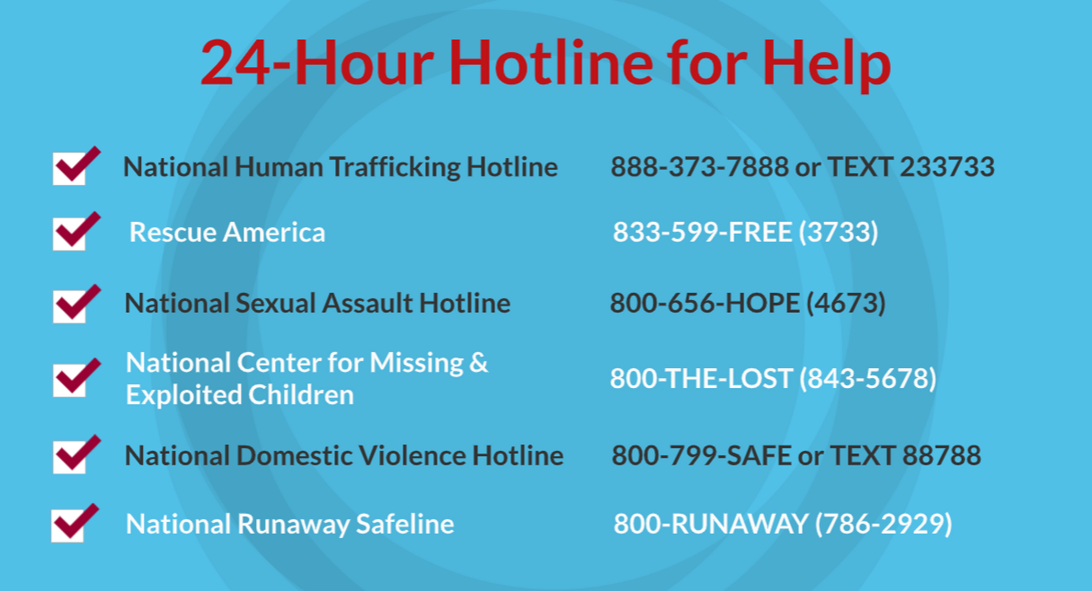
©2024-2026 Walking Wise
81
Notes:
NOTE
Presenters may ask their audience to consider adding a few "hotline for help" phone numbers in their cell phone contacts or take a photo of this slide.

Slide 82
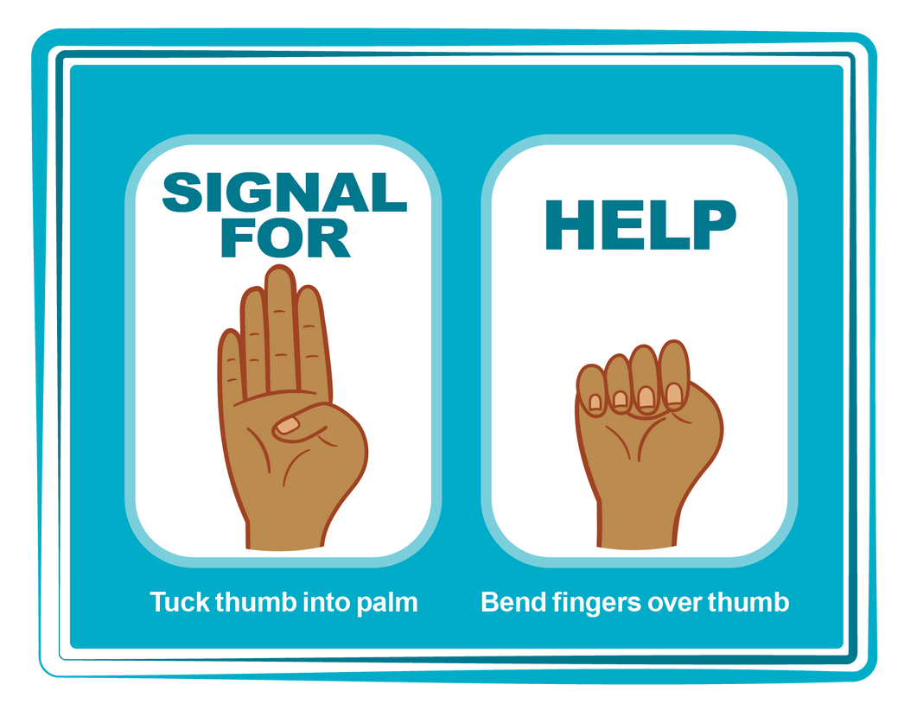
HAND SIGNAL FOR HELP
©2024-2026 Walking Wise
Source: Canadian Women’s Foundation, April 2020
82
Notes:
Although the hand signal for help has not yet achieved universal recognition, it may discreetly get someone's attention in urgent situations.
• SILENT
It can be used silently.
• UNTRACKABLE
It leaves no digital footprint.
• CONCEALED
It can be done secretly when a perpetrator is in the vicinity.
• SIGNALS DISTRESS
Combining the hand signal with distressed facial expressions might help attract the attention of an individual who is unfamiliar with the signal's meaning.
Source
Canadian Women's Foundation, April 2020

Slide 83
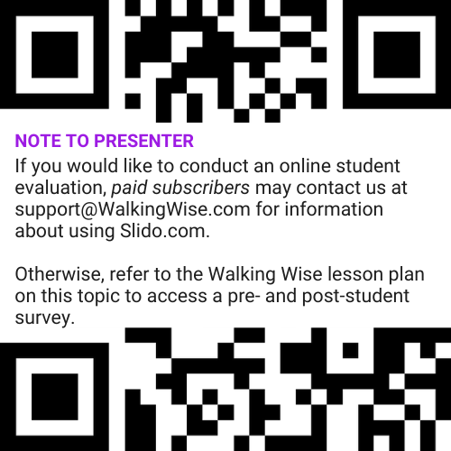
EVALUATION
©2024-2026 Walking Wise
83
Notes:
Two ways to conduct a pre-/post-student evaluation:
1) Use the pre/post survey in the Walking Wise lesson plan for this topic.
2) Activate Slido.com to conduct an online survey.

Slide 84

SHARE YOUR THOUGHTS
1. How would you rate this lesson?
2. What was the one thing you liked?
3. What one thing should we improve?
If Using Slido: Replace “#XXXX” with your organization’s custom Slido code.
©2024-2026 Walking Wise
84
Notes:
SLIDO.com: 3-Question Survey
IF SLIDO IS ACTIVATED:
Follow the instructions provided on WalkingWise.com to access your school or organization's custom Slido QR code and #code, which the audience will use to complete the 3-question evaluation.
Please encourage your audience to scan your organization's custom QR code to share what they enjoyed and what could be improved about the lesson.
Please send any feedback you want to share to Walking Wise at support@WalkingWise.com.

Slide 85



Thank you!
WalkingWise.com
Online Course for Adults Accredited by:
Postgraduate Institue for Medicine
Academy of Forensic Nursing
©2024-2026 Walking Wise
85
Notes:
NOTE
To access additional resources about the myths, please refer to the last page of Lesson Plan #1 in the Walking Wise Education Guide.
We welcome your feedback at support@WalkingWise.com.
Thank you!
Karla Highman
Founder, WalkingWise.com

