Slide 1


SEXUAL EXPLOITATION
EDUCATION
Myths
&REALITY
LESSON #1
Notes:
NOTE
Log in to WalkingWise.com and refer to the Implementation Toolkit for classroom teaching tips.
Most importantly:
DEFINE SCHOOL POLICY
Establish a sexual exploitation reporting protocol with a trauma-informed response. The Walking Wise Implementation Toolkit provides a sample protocol.
AGE & AUDIENCE
This presentation can be edited by following the procedures on page 3 to align with your school policies, specific age groups, and the involvement of at-risk audiences.
SUPPORT PROCEDURE
Provide your students with guidance on accessing immediate help or arranging a private meeting with a social worker, counselor, nurse, school resource officer, or another trustworthy staff member to report concerns for themselves or a peer.
SECOND SAFE ADULT
Ensure a second trustworthy adult, such as a teacher, is present in the learning setting to observe student reactions and identify those who may benefit from a follow-up meeting. This person should remain focused and free from other duties during the presentation.

Slide 2

NOTE TO PRESENTER
Meaningful learning takes time. By introducing topics gradually over several years, schools can create steady growth in awareness and understanding.
Our recommended teaching track offers a long-term path for middle and high school students to build knowledge and confidence.
5-Year Track
PARENTS & STAFF
#1 Myths & Reality
6th GRADE
#2 Trustworthy vs. Unsafe Adult
#3 Grooming Process
7th GRADE
#4 Pornography Link
#5 Sextortion Scheme
8th GRADE
#6 Male Victims
#7 Runaways as Targets
#8 Rural Risks
9th GRADE
#9 Human Traffickers
#10 Female & Peer Recruiters
10th GRADE
#11 Family Secret
#12 Hidden Buyers
©2024-2026 Walking Wise
2

Slide 3

NOTE TO PRESENTER
This presentation is exclusively for Walking Wise® subscribers and not for redistribution.
Walking Wise encourages the use of Slido.com, an interactive digital tool, to enhance audience engagement. For more information, contact us at support@WalkingWise.com. Once configured, integrate Slido polling and add a post-evaluation to the PowerPoint presentation.
Presenters are encouraged to edit speaker notes to match their speaking style (viewable in presentation mode). You can also delete slides and content from this Walking Wise presentation to ensure the information aligns with your school policies, is age-appropriate, and fits within available class time. However, the slides are copyright-protected and may not be reworded without prior written permission from Walking Wise.
We encourage you to add your own content by following these instructions:
  Insert new PowerPoint slides.
  Remove the Walking Wise logo and copyright "©2026 Walking Wise" from the new slides.
  Always add your organization's name or logo to each new slide.
Please delete this instruction page before presenting to audiences.
©2024-2026 Walking Wise
3
Notes:
NOTE TO PRESENTER
The presenter is welcome to customize this Walking Wise presentation according to the instructions provided on this page.
For revision requests, please email us at: support@WalkingWise.com.

Slide 4
STATISTICS
Why Study Results Can Vary
  Some crimes are never reported, making it hard to reveal the entire issue.
  Studies collect information in different ways, leading to different results.
  Small studies may not represent everyone.
©2024-2026 Walking Wise
4
Notes:
In this presentation, we'll discuss statistics, but it's important to note that while statistics provide valuable insights into an issue, they cannot be relied upon entirely.
Here are a few reasons:
UNREPORTED
Victims often do not report the crimes committed against them due to fear, shame, or manipulation.
INCONSISTENT COLLECTION
Geographical areas have different legal definitions for sexual crimes, which may make data hard to compare.
FOCUS GROUPS
Small or specific focus groups participating in a study or survey may not accurately reflect the diversity or experiences of the broader population.

Slide 5
SENSITIVE TOPICS WILL BE DISCUSSED
CONTENT NOTICE
We’ll be discussing serious safety issues today.
Some topics may be difficult to hear.
If you ever feel uncomfortable, you can step out and speak with a trustworthy adult for support.
You’re not alone—help is available.
©2024-2026 Walking Wise
5
Notes:
NOTE TO PRESENTER
Presenter Guidelines for Delivery
Present the information in a calm, matter-of-fact way and avoid sensational language.
Avoid graphic details. Focus on understanding behaviors and staying safe.
Never blame victims. Responsibility always belongs to the person who caused harm.
Maintain a steady tone. Students often mirror the presenter’s emotional cues.
Do not ask students to share personal experiences.
If students laugh or react awkwardly, stay calm and continue teaching.
Always pair risk information with solutions and support.
Remind students they are not alone and help is available.

Slide 6

CONFRONTING SEXUAL EXPLOITATION
WALKING WISE
KNOWLEDGE serves as a
powerful defense against
sexual predators.
©2024-2026 Walking Wise
6
Notes:
Education is one of the strongest tools for preventing exploitation.
When young people understand how predators operate, they are better able to recognize manipulation and avoid dangerous situations.
Reinforce that awareness increases safety.

Slide 7

CONFRONTING SEXUAL EXPLOITATION
WALKING WISE
SEXUAL EXPLOITATION includes grooming, sextortion, pornography
& sex trafficking.
©2024-2026 Walking Wise
7
Notes:
Sexual exploitation can include:
GROOMING
Building trust to manipulate someone.
SEXTORTION
Threatening to share private images.
PORNOGRAPHY
Involving vulnerable people in creating sexual images or videos.
SEX TRAFFICKING
Manipulating or forcing someone into sexual activity in exchange for money or something of value.

Slide 8



EDUCATON GUIDE
VOCABULARY
VOCABULARY
  Child Exploitation
  Sex Trafficking
  Myth
  Reality
  Coercion
  Manipulation
  Intimidation
Myths
&REALITY
©2024-2026 Walking Wise
8
3
Notes:
Understanding vocabulary terms related to the behaviors of sexual predators can empower young people to recognize warning signs of harmful situations.
Knowing terminology helps them identify manipulative tactics predators use to build trust and exploit vulnerabilities.
With this knowledge, young people are better equipped to spot red flags, understand that these behaviors are abusive, and feel more confident reporting predators to trusted adults or authorities, potentially preventing further harm.

Slide 9
EDUCATON GUIDE
VOCABULARY
CHILD EXPLOITATION
The use of a child for someone else’s benefit, often in an abusive, unfair, or harmful manner.
Includes: Sexual exploitation (grooming & sex trafficking), sextortion,
labor trafficking, and criminal activity (such as drug dealing & theft).
Myths
&REALITY
©2024-2026 Walking Wise
Section 7102. 22 USC Ch. 78: Trafficking Victims Protection, From Title 22—Foreign Relations and Intercourse.
9
3
Notes:
Assisting Source
OpenAI. (2024). ChatGPT [Large language model]. https://chatgpt.com
FOR LEGAL DEFINITION:
Section 7102. 22 USC Ch. 78: Trafficking Victims Protection, From Title 22—Foreign Relations and Intercourse. Retrieved January 3, 2025, from https://uscode.house.gov/view.xhtml?hl=false&edition=prelim&path=%2Fprelim%40title22%2Fchapter78&req=granuleid%3AUSC-prelim-title22-chapter78&num=0&saved=L3ByZWxpbUB0aXRsZTIyL2NoYXB0ZXI3OA%3D%3D%7CZ3JhbnVsZWlkOlVTQy1wcmVsaW0tdGl0bGUyMi1jaGFwdGVyNzg%3D%7C%7C%7C0%7Cfalse%7Cprelim
Criminal Division, U.S. Department of Justice. Citizen's Guide To U.S. Federal Law On Child Sex Trafficking. Retrieved January 3, 2025, from https://www.justice.gov/criminal/criminal-ceos/citizens-guide-us-federal-law-child-sex-trafficking

Slide 10
EDUCATON GUIDE
VOCABULARY
CHILD SEX TRAFFICKING
A child (under age 18) is made to take part in sexual activity for money or something of value, like food, shelter, or gifts.
Myths
&REALITY
©2024-2026 Walking Wise
Section 7102. 22 USC Ch. 78: Trafficking Victims Protection, From Title 22—Foreign Relations and Intercourse.
10
3
Notes:
Assisting Source
OpenAI. (2024). ChatGPT [Large language model]. https://chatgpt.com
FOR LEGAL DEFINITION:
Section 7102. 22 USC Ch. 78: Trafficking Victims Protection, From Title 22—Foreign Relations and Intercourse. Retrieved January 3, 2025, from https://uscode.house.gov/view.xhtml?hl=false&edition=prelim&path=%2Fprelim%40title22%2Fchapter78&req=granuleid%3AUSC-prelim-title22-chapter78&num=0&saved=L3ByZWxpbUB0aXRsZTIyL2NoYXB0ZXI3OA%3D%3D%7CZ3JhbnVsZWlkOlVTQy1wcmVsaW0tdGl0bGUyMi1jaGFwdGVyNzg%3D%7C%7C%7C0%7Cfalse%7Cprelim

Slide 11
EDUCATON GUIDE
VOCABULARY
SEX TRAFFICKING OF ADULTS
An adult is made to take part in sexual activity in exchange for something of value (like money, food, or housing), through the use of FORCE, FRAUD, or COERCION.
Myths
&REALITY
©2024-2026 Walking Wise
Section 7102. 22 USC Ch. 78: Trafficking Victims Protection, From Title 22—Foreign Relations and Intercourse.
11
3
Notes:
Assisting Source
OpenAI. (2024). ChatGPT [Large language model]. https://chatgpt.com
FOR LEGAL DEFINITION:
Section 7102. 22 USC Ch. 78: Trafficking Victims Protection, From Title 22—Foreign Relations and Intercourse. Retrieved January 3, 2025, from https://uscode.house.gov/view.xhtml?hl=false&edition=prelim&path=%2Fprelim%40title22%2Fchapter78&req=granuleid%3AUSC-prelim-title22-chapter78&num=0&saved=L3ByZWxpbUB0aXRsZTIyL2NoYXB0ZXI3OA%3D%3D%7CZ3JhbnVsZWlkOlVTQy1wcmVsaW0tdGl0bGUyMi1jaGFwdGVyNzg%3D%7C%7C%7C0%7Cfalse%7Cprelim

Slide 12

FORCEFUL TACTICS
force
Physical Abuse
Sexual Abuse
Threats Using a Weapon
Isolation
Myths
&REALITY
©2024-2026 Walking Wise
2020-2022 U.S. National Human Trafficking Hotline Report
12
Notes:
Source
Polaris Project (n.d.). Human Trafficking During the COVID and Post-COVID Era. Polarisproject.org, pp. 3, 6. Retrieved February 27, 2024, from https://polarisproject.org/wp-content/uploads/2020/07/Hotline-Trends-Report-2023.pdf

Slide 13
FRAUDULANT TACTICS
fraud
Fake Modeling Career
Fake Entertainment Career
Promises of Scholarships
Promoting Free Education
Loan Assistance Scam
Myths
&REALITY
©2024-2026 Walking Wise
2020-2022 U.S. National Human Trafficking Hotline Report
13
Notes:
Source
Polaris Project (n.d.). Human Trafficking During the COVID and Post-COVID Era. Polarisproject.org, pp. 3, 6. Retrieved February 27, 2024, from https://polarisproject.org/wp-content/uploads/2020/07/Hotline-Trends-Report-2023.pdf

Slide 14
EDUCATON GUIDE
VOCABULARY
COERCE
To manipulate, threaten, or intimidate someone to act against their will.
Myths
&REALITY
©2024-2026 Walking Wise
Section 7102. 22 USC Ch. 78: Trafficking Victims Protection, From Title 22—Foreign Relations and Intercourse.
14
3
Notes:
Assisting Source
OpenAI. (2024). ChatGPT [Large language model]. https://chatgpt.com
FOR LEGAL DEFINITION:
18 USC 1591: Sex trafficking of children or by force, fraud, or coercion. (n.d.). Title 18- Crimes and Criminal Procedure, Part 1 - Crimes Chapter 77 - Peonage and Slavery. Retrieved January 3, 2025, from https://uscode.house.gov/view.xhtml?req=granuleid%3AUSC-2000-title18-section1591&num=0&edition=2000#sourcecredit

Slide 15

COERCIVE TACTICS
COERCION
Creates Substance Addiction
Expliots Substance Use
Threatens Harm to Family or Pets
Emotional or Verbal Abuse
Manipulation or Intimidation
Stalking or Monitoring
Withholding Food & Shelter
Myths
&REALITY
©2024-2026 Walking Wise
2020-2022 U.S. National Human Trafficking Hotline Report
15
Notes:
Source
Polaris Project (n.d.). Human Trafficking During the COVID and Post-COVID Era. Polarisproject.org, pp. 3, 6. Retrieved February 27, 2024, from https://polarisproject.org/wp-content/uploads/2020/07/Hotline-Trends-Report-2023.pdf

Slide 16
EDUCATON GUIDE
VOCABULARY
MYTH
A false belief commonly held by a group.
Myths
&REALITY
©2024-2026 Walking Wise
16
3
Notes:
Assisting Source
OpenAI. (2024). ChatGPT [Large language model]. https://chatgpt.com

Slide 17
EDUCATON GUIDE
VOCABULARY
REALITY
A true fact based on what actually happens.
Myths
&REALITY
©2024-2026 Walking Wise
17
3
Notes:
Assisting Source
OpenAI. (2024). ChatGPT [Large language model]. https://chatgpt.com

Slide 18
LESSON PLANS
MYTH OR REALITY?
Myth or Reality? Sex traffickers mostly target young people living in dangerous communities.
Myths
&REALITY
©2024-2026 Walking Wise
Polaris Project (2025) Myths, Facts, and Statistics. PolarisProject.org.
18
3
Notes:
Online Polling Interaction
Slido.com: Multiple Choice
Sex traffickers mostly target young people living in dangerous communities.
A) Myth
B) Reality
ANSWER
A) Myth - Sex traffickers target young people from all types of communities, including urban, suburban, rural, and online communities.
Source
Polaris Project (2025) Myths, Facts, and Statistics. PolarisProject.org. Retrieved January 6, 2025, from https://polarisproject.org/myths-facts-and-statistics/?gad_source=1&gclid=CjwKCAiAm-67BhBlEiwAEVftNpjEBS3aD54aH9qHzJjL01wnVgSL4rc8WgP7CHE_PvAjOR1wN9AchBoCgk8QAvD_BwE

Slide 19
ANSWER
MYTH. Reality is, traffickers target young people from all types of communities, including urban, suburban, rural, and online communities.
©2024-2026 Walking Wise
Polaris Project (2025). Myths, Facts, and Statistics. PolarisProject.org.
19
Notes:
Online Polling Interaction
Slido.com: Multiple Choice
Sex traffickers mostly target young people living in dangerous communities.
A) Myth
B) Reality
ANSWER
A) Myth - Sex traffickers target young people from all types of communities, including urban, suburban, rural, and online communities.
Source
Polaris Project (2025). Myths, Facts, and Statistics. PolarisProject.org. Retrieved January 6, 2025, from https://polarisproject.org/myths-facts-and-statistics/?gad_source=1&gclid=CjwKCAiAm-67BhBlEiwAEVftNpjEBS3aD54aH9qHzJjL01wnVgSL4rc8WgP7CHE_PvAjOR1wN9AchBoCgk8QAvD_BwE

Slide 20
LESSON PLANS
MYTH OR REALITY?
Myth or Reality? Human traffickers mainly target young people they don’t know.
Myths
&REALITY
©2024-2026 Walking Wise
Polaris Project (2025) Myths, Facts, and Statistics. PolarisProject.org.
20
3
Notes:
Online Polling Interaction
Slido.com: Multiple Choice
Human traffickers mainly target young people they don’t know.
A) Myth
B) Reality
ANSWER:
A) Myth - Victims often know their trafficker. Traffickers can be family members - including parents, intimate partners - including older boyfriends and spouses, and other known and trusted members of the community.
Source
Polaris Project (2025). Myths, Facts, and Statistics. PolarisProject.org. Retrieved January 6, 2025, from https://polarisproject.org/myths-facts-and-statistics/?gad_source=1&gclid=CjwKCAiAm-67BhBlEiwAEVftNpjEBS3aD54aH9qHzJjL01wnVgSL4rc8WgP7CHE_PvAjOR1wN9AchBoCgk8QAvD_BwE

Slide 21
ANSWER
MYTH. Reality is, victims often know their trafficker.
©2024-2026 Walking Wise
Polaris Project (2025). Myths, Facts, and Statistics. PolarisProject.org.
21
Notes:
Online Polling Interaction
Slido.com: Multiple Choice
Human traffickers mainly target young people they don’t know.
A) Myth
B) Reality
ANSWER:
A) Myth - Victims often know their trafficker. Traffickers can be family members - including parents, intimate partners - including older boyfriends and spouses, and other known and trusted members of the community.
Source
Polaris Project (2025). Myths, Facts, and Statistics. PolarisProject.org. Retrieved January 6, 2025, from https://polarisproject.org/myths-facts-and-statistics/?gad_source=1&gclid=CjwKCAiAm-67BhBlEiwAEVftNpjEBS3aD54aH9qHzJjL01wnVgSL4rc8WgP7CHE_PvAjOR1wN9AchBoCgk8QAvD_BwE

Slide 22
LESSON PLANS
MYTH OR REALITY?
Myth or Reality? Sex trafficking usually involves violence against victims.
Myths
&REALITY
©2024-2026 Walking Wise
Polaris Project (2025) Myths, Facts, and Statistics. PolarisProject.org.
22
3
Notes:
Online Polling Interaction
Slido.com: Multiple Choice
Sex trafficking usually involves violence against victims.
A) Myth
B) Reality
ANSWER
A) Myth. Sometimes violence is involved; however, traffickers often use manipulation, intimidation, and threats to control their victims.
Source
Polaris Project (2025). Myths, Facts, and Statistics. PolarisProject.org. Retrieved January 6, 2025, from https://polarisproject.org/myths-facts-and-statistics/?gad_source=1&gclid=CjwKCAiAm-67BhBlEiwAEVftNpjEBS3aD54aH9qHzJjL01wnVgSL4rc8WgP7CHE_PvAjOR1wN9AchBoCgk8QAvD_BwE

Slide 23
ANSWER
MYTH. Reality is, traffickers more often use manipulation, intimidation, and threats to control their victims.
©2024-2026 Walking Wise
Polaris Project (2025). Myths, Facts, and Statistics. PolarisProject.org.
23
Notes:
Online Polling Interaction
Slido.com: Multiple Choice
Sex trafficking usually involves violence against victims.
A) Myth
B) Reality
ANSWER
A) Myth. Sometimes violence is involved; however, traffickers often use manipulation, intimidation, and threats to control their victims.
Source
Polaris Project (2025). Myths, Facts, and Statistics. PolarisProject.org. Retrieved January 6, 2025, from https://polarisproject.org/myths-facts-and-statistics/?gad_source=1&gclid=CjwKCAiAm-67BhBlEiwAEVftNpjEBS3aD54aH9qHzJjL01wnVgSL4rc8WgP7CHE_PvAjOR1wN9AchBoCgk8QAvD_BwE

Slide 24
LESSON PLANS
MYTH OR REALITY?
Myth or Reality? Sex trafficking victims are usually kidnapped.
Myths
&REALITY
©2024-2026 Walking Wise
24
3
Notes:
Online Polling Interaction
Slido.com: Multiple Choice
Sex trafficking victims are usually kidnapped.
A) Myth
B) Reality
ANSWER
A) Myth. It’s possible for someone to be kidnapped by a trafficker, but this is uncommon. Most traffickers use lies, manipulation, or pressure to trap people into trafficking situations.
Source
National Human Trafficking Hotline (n.d.). Fact Sheet: Human Trafficking. The Administration for Children and Families. Retrieved May 1, 2024, from https://www.acf.hhs.gov/otip/fact-sheet/resource/fshumantrafficking

Slide 25
ANSWER
MYTH. Reality is, most trafficking does not involve kidnapping. Traffickers more often trick their victims.
©2024-2026 Walking Wise
National Human Trafficking Hotline (n.d.). Fact Sheet: Human Trafficking. The Administration for Children and Families.
25
Notes:
Online Polling Interaction
Slido.com: Multiple Choice
Sex trafficking victims are usually kidnapped.
A) Myth
B) Reality
ANSWER
A) Myth. It’s possible for someone to be kidnapped by a trafficker, but this is uncommon. Most traffickers use lies, manipulation, or pressure to trap people into trafficking situations.
Source
National Human Trafficking Hotline (n.d.). Fact Sheet: Human Trafficking. The Administration for Children and Families. Retrieved May 1, 2024, from https://www.acf.hhs.gov/otip/fact-sheet/resource/fshumantrafficking

Slide 26
LESSON PLANS
MYTH OR REALITY?
Myth or Reality? Sex traffickers usually hold victims physically captive.
Myths
&REALITY
©2024-2026 Walking Wise
26
3
Notes:
Online Polling Interaction
Slido.com: Multiple Choice
Sex traffickers usually hold victims physically captive.
A) Myth
B) Reality
ANSWER
A) Myth. Some traffickers may hold victims captive, but most people in trafficking situations stay for more complicated reasons:
- They don’t have the basics to leave, like transportation or a safe place.
- They fear for their safety if they try to escape.
- They’ve been manipulated so much that they may not realize they’re being controlled.
Source
National Human Trafficking Hotline (n.d.). Fact Sheet: Human Trafficking. The Administration for Children and Families. Retrieved May 1, 2024, from https://www.acf.hhs.gov/otip/fact-sheet/resource/fshumantrafficking

Slide 27
ANSWER
MYTH. Reality is, most victims are not locked in. People usually stay because they are scared, controlled, or feel they have no choice.
©2024-2026 Walking Wise
National Human Trafficking Hotline (n.d.). Fact Sheet: Human Trafficking. The Administration for Children and Families.
27
Notes:
Online Polling Interaction
Slido.com: Multiple Choice
Sex traffickers usually hold victims physically captive.
A) Myth
B) Reality
ANSWER
A) Myth. Some traffickers may hold victims captive, but most people in trafficking situations stay for more complicated reasons:
- They don’t have the basics to leave, like transportation or a safe place.
- They fear for their safety if they try to escape.
- They’ve been manipulated so much that they may not realize they’re being controlled.
Source
National Human Trafficking Hotline (n.d.). Fact Sheet: Human Trafficking. The Administration for Children and Families. Retrieved May 1, 2024, from https://www.acf.hhs.gov/otip/fact-sheet/resource/fshumantrafficking

Slide 28
LESSON PLANS
TRAFFICKING MYTH
Myth or Reality? Sex traffickers only target females.
Myths
&REALITY
©2024-2026 Walking Wise
28
3
Notes:
Online Polling Interaction
Slido.com: Multiple Choice
Sex traffickers only target females.
A) Myth
B) Reality
ANSWER
A) Myth. Both men and boys are also victimized by sex traffickers. Additionally, LGBTQ+ males are especially vulnerable to traffickers.
Source
National Human Trafficking Hotline (n.d.). Fact Sheet: Human Trafficking. The Administration for Children and Families. Retrieved May 1, 2024, from https://www.acf.hhs.gov/otip/fact-sheet/resource/fshumantrafficking

Slide 29
ANSWER
MYTH. Reality is, females are most targeted, but males and boys are also trafficked.
©2024-2026 Walking Wise
National Human Trafficking Hotline (n.d.). Fact Sheet: Human Trafficking. The Administration for Children and Families.
29
Notes:
Online Polling Interaction
Slido.com: Multiple Choice
Sex traffickers only target females.
A) Myth
B) Reality
ANSWER
A) Myth. Both men and boys are also victimized by sex traffickers. Additionally, LGBTQ+ males are especially vulnerable to traffickers.
Source
National Human Trafficking Hotline (n.d.). Fact Sheet: Human Trafficking. The Administration for Children and Families. Retrieved May 1, 2024, from https://www.acf.hhs.gov/otip/fact-sheet/resource/fshumantrafficking

Slide 30
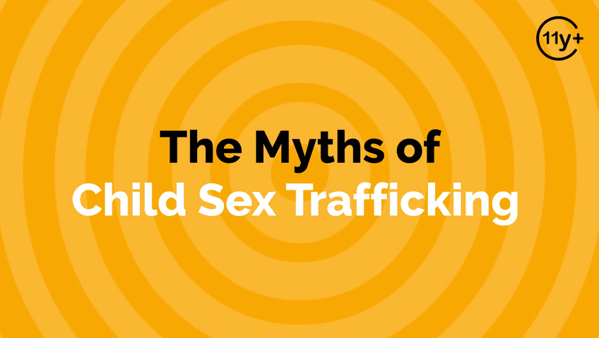
LOGIN or go to WalkingWise.com/demo to access this animated video.
©2024-2026 Walking Wise
30
Notes:
Message Especially for Teens:
Businesses worldwide use explainer-style animation as a training tool for their employees.
So, this 3-minute Walking Wise animated video series is appropriate for both teens (ages 11+) and adults to learn how sexual predators use manipulation, intimidation, and coercion to exploit young people.
NOTE
Log in to Walking Wise.com to watch the three-minute animated video with audiences.

Slide 31
LESSON PLANS
BUSINESS & INDUSTY
In what types of business or industry are people commonly trafficked?
Myths
&REALITY
©2024-2026 Walking Wise
31
3

Slide 32
BUSINESS & INDUSTY
Industries Impacted by Sex Trafficking
  Social Media Platforms
  Illegal Massage Parlors
  Entertainment Industry: Strip Clubs & Casinos
  Hospitality Industry: Hotels & Motels
Myths
&REALITY
©2024-2026 Walking Wise
32
Notes:
Myth: People are only trafficked in illegal businesses.
Reality: Trafficking can happen anywhere people can be controlled or exploited, even in legal businesses and industries.

Slide 33
BUSINESS & INDUSTY
Industries Impacted by Labor Trafficking
  Hotel Housekeeping & Maintenance
  Restaurants & Tourism
  Agriculture: Crops, Livestock, Fisheries
  Logging & Mining
  Construction, Factories, & Carnivals
Myths
&REALITY
©2024-2026 Walking Wise
33
Notes:
Myth: People are only trafficked in illegal businesses.
Reality: Trafficking can happen anywhere people can be controlled or exploited, even in legal businesses and industries.

Slide 34
EDUCATON GUIDE
VOCABULARY
MANIPULATION
Influencing or controlling someone’s behavior or decisions deceptively or unfairly, usually for personal gain.
Myths
&REALITY
©2024-2026 Walking Wise
34
3
Notes:
Assisting Source
OpenAI. (2024). ChatGPT [Large language model]. https://chatgpt.com

Slide 35
EDUCATON GUIDE
VOCABULARY
INTIMIDATION
To influence or control another person’s actions or behavior by causing fear.
Myths
&REALITY
©2024-2026 Walking Wise
35
3
Notes:
Assisting Source
OpenAI. (2024). ChatGPT [Large language model]. https://chatgpt.com

Slide 36
FALSE SENSE OF SECURITY
When can young people experience a false sense of security?
Myths
&REALITY
©2024-2026 Walking Wise
36
Notes:
FALSE SENSE OF SECURITY
A false sense of security refers to the feeling of being safer than one actually is.

Slide 37
FALSE SENSE OF SECURITY
Stay Alert — Even When Things Seem Safe
Talking or hanging out with an “Online-only” friend.
Myths
&REALITY
©2024-2026 Walking Wise
37
Notes:
A false sense of security occurs when a situation feels safe or normal despite the presence of certain risk factors.
Young people may feel comfortable with someone they only know online because of frequent conversations or shared interests.

Slide 38
FALSE SENSE OF SECURITY
Stay Alert — Even When Things Seem Safe
Spending time with an older peer or adult.
Myths
&REALITY
©2024-2026 Walking Wise
38
Notes:
Spending time alone with someone significantly older or an older peer, especially in private settings, increases vulnerability due to power differences.

Slide 39
FALSE SENSE OF SECURITY
Stay Alert — Even When Things Seem Safe
Receiving special attention, gifts, or favors from an adult.
©2024-2026 Walking Wise
39
Notes:
Unusual attention, gifts, or favors from an adult can be part of boundary-testing behaviors.

Slide 40
FALSE SENSE OF SECURITY
Stay Alert — Even When Things Seem Safe
Going to unfamiliar places with people they don’t know well.
©2024-2026 Walking Wise
40
Notes:
Likewise, being in unfamiliar places with acquaintances reduces natural safeguards.
Safety is not about fear; it’s about awareness, boundaries, and ensuring that relationships remain transparent and appropriate.

Slide 41
PLAIN SIGHT
What makes it possible for human traffickers to operate in plain sight?
Myths
&REALITY
©2024-2026 Walking Wise
41

Slide 42
PLAIN SIGHT
Someone We Wouldn’t Suspect
Authority Figure: An adult in charge of young or vulnerable people.
Myths
&REALITY
©2024-2026 Walking Wise
42
Notes:
“Operating in plain sight” refers to visibly engaging in activities without attempting to conceal them or behaving in a way that attracts no suspicion despite the potentially harmful intentions.
Often, people believe criminal activity happens in dark alleys or places not visited by the average person. However, illegal activity can occur in areas where people commonly spend time.

Slide 43
PLAIN SIGHT
Someone We Wouldn’t Suspect
Neighbor: Adult or peer in the local community
Myths
&REALITY
©2024-2026 Walking Wise
43
Notes:
“Operating in plain sight” refers to visibly engaging in activities without attempting to conceal them or behaving in a way that attracts no suspicion despite the potentially harmful intentions.
Often, people believe criminal activity happens in dark alleys or places not visited by the average person. However, illegal activity can occur in areas where people commonly spend time.

Slide 44
PLAIN SIGHT
Someone We Wouldn’t Suspect
Employer: Boss or co-worker
Myths
&REALITY
©2024-2026 Walking Wise
44
Notes:
“Operating in plain sight” refers to visibly engaging in activities without attempting to conceal them or behaving in a way that attracts no suspicion despite the potentially harmful intentions.
Often, people believe criminal activity happens in dark alleys or places not visited by the average person. However, illegal activity can occur in areas where people commonly spend time.

Slide 45
PLAIN SIGHT
Someone We Wouldn’t Suspect
Family Member: Close or distant relative
Myths
&REALITY
©2024-2026 Walking Wise
45
Notes:
“Operating in plain sight” refers to visibly engaging in activities without attempting to conceal them or behaving in a way that attracts no suspicion despite the potentially harmful intentions.
Often, people believe criminal activity happens in dark alleys or places not visited by the average person. However, illegal activity can occur in areas where people commonly spend time.

Slide 46
NOT MY COMMUNITY
What can happen if sexual exploitation is ignored in a community?
Myths
&REALITY
©2024-2026 Walking Wise
46

Slide 47
NOT MY COMMUNITY
Cost of Looking the Other Way
Silence can enable exploitation to grow.
Myths
&REALITY
©2024-2026 Walking Wise
47
Notes:
When communities avoid talking about sexual exploitation, traffickers and exploiters benefit.
Silence creates space for manipulation, grooming, and abuse to continue unchecked.
Exploitation thrives in secrecy. When no one is watching, asking questions, or speaking up, harmful behavior becomes easier to hide.

Slide 48
NOT MY COMMUNITY
Cost of Looking the Other Way
Vulnerable individuals may face greater danger.
Myths
&REALITY
©2024-2026 Walking Wise
48
Notes:
When communities avoid talking about sexual exploitation, traffickers and exploiters benefit.
Silence creates space for manipulation, grooming, and abuse to continue unchecked.
Exploitation thrives in secrecy. When no one is watching, asking questions, or speaking up, harmful behavior becomes easier to hide.

Slide 49
NOT MY COMMUNITY
Cost of Looking the Other Way
Victims can remain unseen and unsupported.
Myths
&REALITY
©2024-2026 Walking Wise
49
Notes:
When communities avoid talking about sexual exploitation, traffickers and exploiters benefit.
Silence creates space for manipulation, grooming, and abuse to continue unchecked.
Exploitation thrives in secrecy. When no one is watching, asking questions, or speaking up, harmful behavior becomes easier to hide.

Slide 50
NOT MY COMMUNITY
Cost of Looking the Other Way
Communities may lose the chance to prevent harm.
Myths
&REALITY
©2024-2026 Walking Wise
50
Notes:
When communities avoid talking about sexual exploitation, traffickers and exploiters benefit.
Silence creates space for manipulation, grooming, and abuse to continue unchecked.
Exploitation thrives in secrecy. When no one is watching, asking questions, or speaking up, harmful behavior becomes easier to hide.

Slide 51
AUTHORITY FIGURES
In what ways can someone in authority misuse their power to harm others?
Myths
&REALITY
©2024-2026 Walking Wise
51

Slide 52
AUTHORITY FIGURES
How Power is Misused
They build trust through manipulation and deception.
©2024-2026 Walking Wise
52
Notes:
Traffickers rarely begin with force — they begin with persuasion. They slowly influence how a young person thinks about themselves, relationships, money, or loyalty.
Over time, this shapes decisions in ways the person might not have made before. They may apply pressure to push someone beyond their comfort zone, framing harmful behavior as normal, necessary, or proof of trust.
Mind games, such as guilt, blame, or mixed messages, create confusion and self-doubt, making it harder to think clearly or ask for help. Mental control works by weakening confidence and increasing dependence.

Slide 53
AUTHORITY FIGURES
How Power is Misused
They can use their position to discourage questions from others.
©2024-2026 Walking Wise
53
Notes:
Traffickers rarely begin with force — they begin with persuasion. They slowly influence how a young person thinks about themselves, relationships, money, or loyalty.
Over time, this shapes decisions in ways the person might not have made before. They may apply pressure to push someone beyond their comfort zone, framing harmful behavior as normal, necessary, or proof of trust.
Mind games, such as guilt, blame, or mixed messages, create confusion and self-doubt, making it harder to think clearly or ask for help. Mental control works by weakening confidence and increasing dependence.

Slide 54
AUTHORITY FIGURES
How Power is Misused
They often threaten consequences to maintain control.
©2024-2026 Walking Wise
54
Notes:
Traffickers rarely begin with force — they begin with persuasion. They slowly influence how a young person thinks about themselves, relationships, money, or loyalty.
Over time, this shapes decisions in ways the person might not have made before. They may apply pressure to push someone beyond their comfort zone, framing harmful behavior as normal, necessary, or proof of trust.
Mind games, such as guilt, blame, or mixed messages, create confusion and self-doubt, making it harder to think clearly or ask for help. Mental control works by weakening confidence and increasing dependence.

Slide 55
AUTHORITY FIGURES
How Power is Misused
They blur boundaries to test what they can get away with.
©2024-2026 Walking Wise
55
Notes:
Traffickers rarely begin with force — they begin with persuasion. They slowly influence how a young person thinks about themselves, relationships, money, or loyalty.
Over time, this shapes decisions in ways the person might not have made before. They may apply pressure to push someone beyond their comfort zone, framing harmful behavior as normal, necessary, or proof of trust.
Mind games, such as guilt, blame, or mixed messages, create confusion and self-doubt, making it harder to think clearly or ask for help.

Slide 56
BROKEN PROMISES
What types of false promises are used to manipulate young people into sexual exploitation?
Myths
&REALITY
©2024-2026 Walking Wise
56

Slide 57
BROKEN PROMISES
Fraud & False Promises
Fake love or marriage proposals are used to gain trust.
Myths
&REALITY
©2024-2026 Walking Wise
57
Notes:
A “false promise” is a commitment made with no intention of carrying it out. It occurs when the intent is to
deceive or defraud others. Often, traffickers trick young people into complying with harmful requests by telling
lies such as their “dedicated love” for the youth or promises of fame and fortune.

Slide 58
BROKEN PROMISES
Fraud & False Promises
Promises of fame or a dream job can be used to lure and control.
Myths
&REALITY
©2024-2026 Walking Wise
58
Notes:
A “false promise” is a commitment made with no intention of carrying it out. It occurs when the intent is to
deceive or defraud others. Often, traffickers trick young people into complying with harmful requests by telling
lies such as their “dedicated love” for the youth or promises of fame and fortune.

Slide 59
BROKEN PROMISES
Fraud & False Promises
Promises of adventure are often used to entice running away together.
Myths
&REALITY
©2024-2026 Walking Wise
59
Notes:
A “false promise” is a commitment made with no intention of carrying it out. It occurs when the intent is to
deceive or defraud others. Often, traffickers trick young people into complying with harmful requests by telling
lies such as their “dedicated love” for the youth or promises of fame and fortune.

Slide 60
POWER OF PERSUASION
How can traffickers gain “mental control” over young and vulnerable people?
Myths
&REALITY
©2024-2026 Walking Wise
60

Slide 61
POWER OF PERSUASION
Controlling Thoughts & Emotions
They can influence beliefs and shape decisions.
Myths
&REALITY
©2024-2026 Walking Wise
61
Notes:
Mental control works by weakening confidence and increasing dependence.
Traffickers rarely begin with force; they begin with persuasion.
They slowly influence how a young person thinks about themselves, relationships, money, or loyalty.

Slide 62
POWER OF PERSUASION
Controlling Thoughts & Emotions
They pressure individuals to act against their values or comfort level.
©2024-2026 Walking Wise
62
Notes:
Over time, this shapes decisions in ways the person might not have made before. They may apply pressure to push someone beyond their comfort zone, framing harmful behavior as normal, necessary, or proof of trust.

Slide 63
POWER OF PERSUASION
Controlling Thoughts & Emotions
They create confusion, guilt, or self-doubt to gain control.
©2024-2026 Walking Wise
63
Notes:
Mind games, such as guilt, blame, or mixed messages, create confusion and self-doubt, making it harder to think clearly or ask for help.

Slide 64
SOCIAL LIFE
How do traffickers enter a young person’s “social circle”?
Myths
&REALITY
©2024-2026 Walking Wise
64

Slide 65
SOCIAL LIFE
Getting Too Close
They pretend to share interests to build connection and trust.
Myths
&REALITY
©2024-2026 Walking Wise
65
Notes:
Traffickers often enter a young person’s world by blending in.
They may pretend to share hobbies, music tastes, struggles, or goals to create a fast sense of connection.

Slide 66
SOCIAL LIFE
Getting Too Close
They insert themselves into locations, online or in person, to spend time together.
Myths
&REALITY
©2024-2026 Walking Wise
66
Notes:
They position themselves in familiar spaces, social media platforms, gaming communities, friend groups, schools, or local hangouts, to increase access and visibility.

Slide 67
SOCIAL LIFE
Getting Too Close
They encourage oversharing to identify an individual’s vulnerability.
Myths
&REALITY
©2024-2026 Walking Wise
67
Notes:
As trust grows, they encourage personal sharing to learn about insecurities, family conflict, financial stress, or emotional needs. That information can later be used to manipulate, isolate, or control.

Slide 68
HELD CAPTIVE
What are the ways traffickers can hold a person captive?
Myths
&REALITY
©2024-2026 Walking Wise
68

Slide 69
HELD CAPTIVE
Emotional Captivity
Brainwash: Use manipulation to change beliefs, attitudes, and decisions.
Myths
&REALITY
©2024-2026 Walking Wise
69
Notes:
Being held captive does not always mean being locked in a room. Sometimes control happens emotionally.
Brainwashing:
Traffickers use manipulative techniques to change an individual's thought process, giving them control of the victims' beliefs, attitudes, and behaviors.

Slide 70
HELD CAPTIVE
Emotional Captivity
Trauma Bond: Using rewards and punishments to create loyalty and fear.
Myths
&REALITY
©2024-2026 Walking Wise
70
Notes:
Trauma Bonding or Emotional Bondage: Traffickers use rewards and punishments in cycles to foster a powerful emotional connection with their victims. This form of abuse causes the victim to experience positive and negative emotions for the trafficker, such as love or loyalty, while also living in fear.

Slide 71
HELD CAPTIVE
Emotional Captivity
Financial Control: Providing basic needs leaves victims feeling trapped.
Myths
&REALITY
©2024-2026 Walking Wise
71
Notes:
Economic Dependency:
Traffickers can gain control over young people who cannot earn enough money to obtain necessities like food and shelter. Victims often feel stuck because they have no means to support themselves when wanting to break free from a trafficker who fulfills their basic needs.

Slide 72
HELD CAPTIVE
Emotional Captivity
Substance Use: Alcohol or drugs can be used to control people.
Myths
&REALITY
©2024-2026 Walking Wise
72
Notes:
Drug and Alcohol Addiction:
Traffickers work to influence an individual's substance use or introduce the individual to drugs and alcohol to create dependency. Substance abuse can increase a victim's economic, physical, and emotional dependency on their trafficker, significantly reducing their ability to end their exploitation.
Imprisonment:
“Imprisonment” is the physical or emotional restriction of a person’s freedom to move about or make independent decisions. Even if not physically confined, traffickers often maintain control over victims by setting strict rules or causing isolation from friends and family members.

Slide 73

ASK FOR HELP
©2024-2026 Walking Wise
73

Slide 74

ASK FOR HELP
What are ways young people can ask for help?
©2024-2026 Walking Wise
74

Slide 75
ASK FOR HELP
How to Ask for Help
  If you are in immediate danger, dial 911.
©2024-2026 Walking Wise
75

Slide 76
ASK FOR HELP
How to Ask for Help
  If you are in immediate danger, dial 911.
  If the sexual predator IS a family member, consider telling a trustworthy adult.
©2024-2026 Walking Wise
76

Slide 77
ASK FOR HELP
How to Ask for Help
  If you are in immediate danger, dial 911.
  If the sexual predator IS a family member, consider telling a trustworthy adult.
  If the sexual predator is NOT family, consider telling a parent.
©2024-2026 Walking Wise
77

Slide 78
ASK FOR HELP
How to Ask for Help
  If you are in immediate danger, dial 911.
  If the sexual predator IS a family member, consider telling a trustworthy adult.
  If the sexual predator is NOT family, consider telling a parent.
  If you are a student in school, consider telling a trustworthy teacher, coach, school nurse, social worker, counselor, resource officer, or principal.
©2024-2026 Walking Wise
78

Slide 79
ASK FOR HELP
How to Ask for Help
  If you are in immediate danger, dial 911.
  If the sexual predator IS a family member, consider telling a trustworthy adult.
  If the sexual predator is NOT family, consider telling a parent.
  If you are a student in school, consider telling a trustworthy teacher, coach, school nurse, social worker, counselor, resource officer, or principal.
  To gain internet access for help, consider using a computer at your school or a public library.
©2024-2026 Walking Wise
79

Slide 80
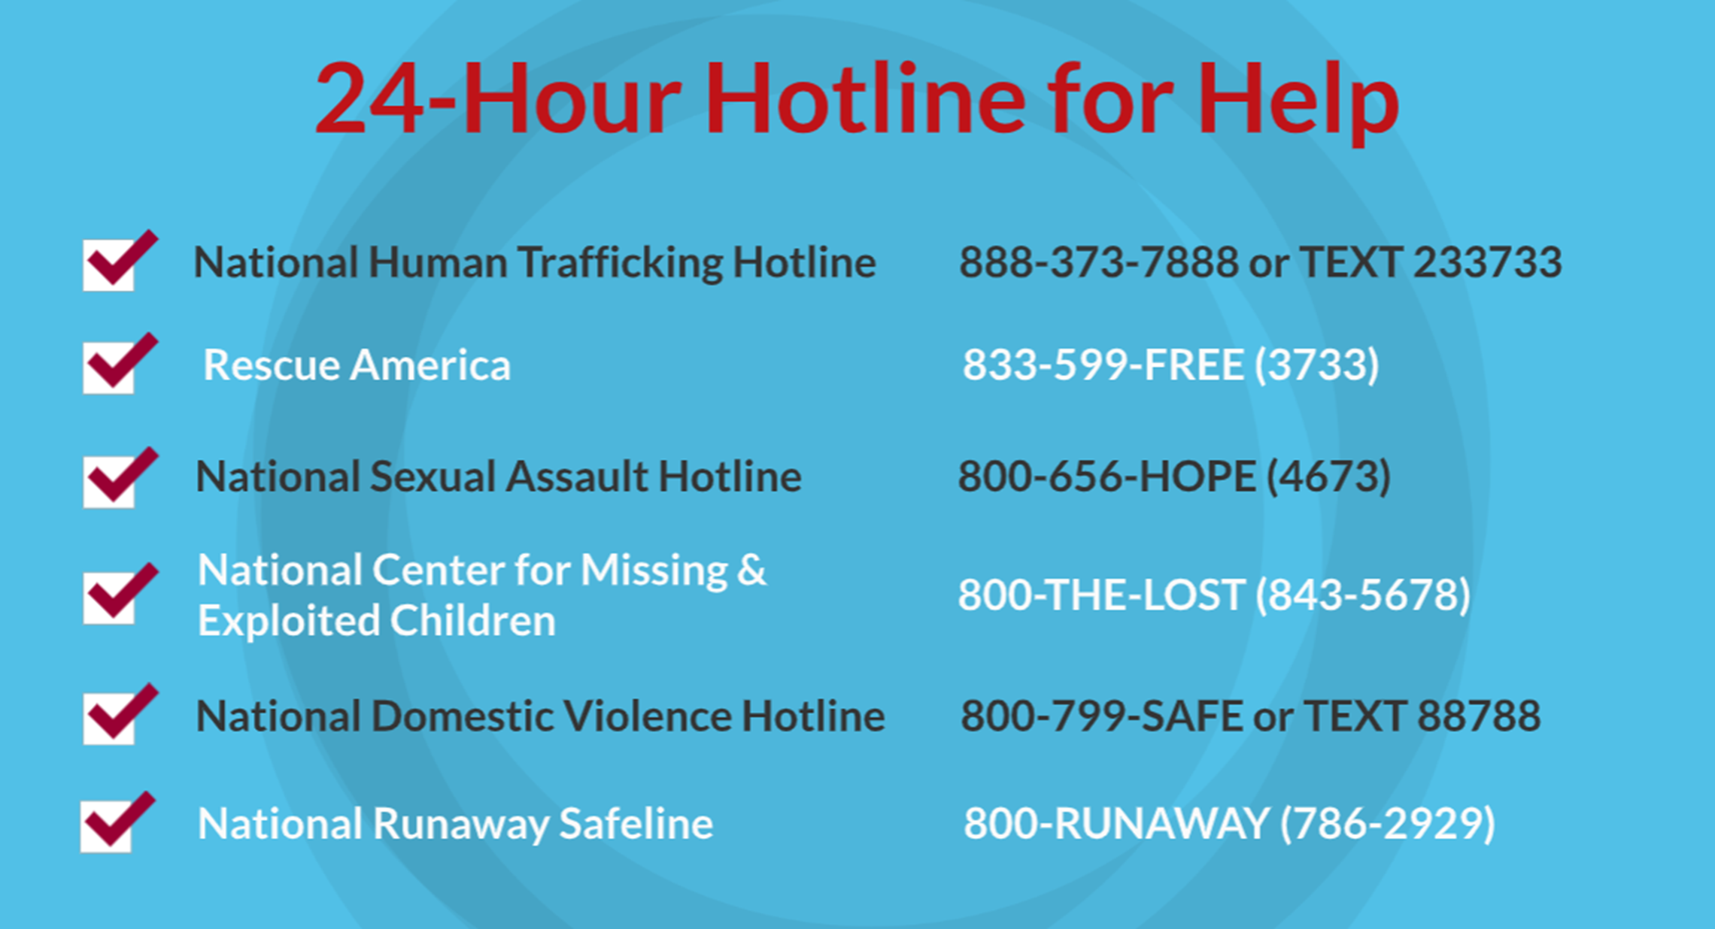
©2024-2026 Walking Wise
80
Notes:
NOTE
Presenters may ask their audience to consider adding a few "hotline for help" phone numbers in their cell phone contacts or take a photo of this slide.

Slide 81
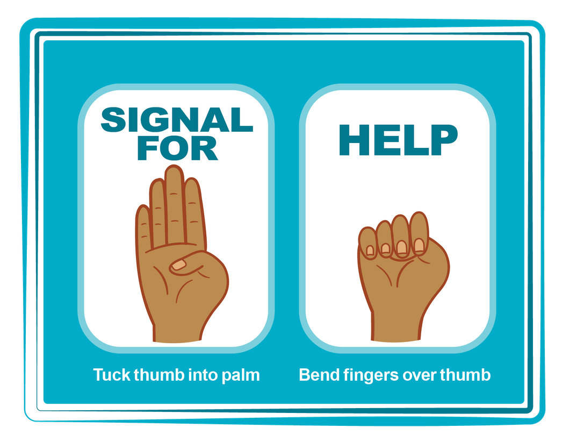
HAND SIGNAL FOR HELP
©2024-2026 Walking Wise
Source: Canadian Women’s Foundation, April 2020
81
Notes:
Although the hand signal for help has not yet achieved universal recognition, it may discreetly get someone's attention in urgent situations.
SILENT
It can be used silently.
UNTRACKABLE
It leaves no digital footprint.
CONCEALED
It can be done secretly when a perpetrator is nearby.
SIGNALS DISTRESS
Combining the hand signal with distressed facial expressions might help attract the attention of an individual who is unfamiliar with the signal's meaning.
Source
Canadian Women's Foundation, April 2020

Slide 82
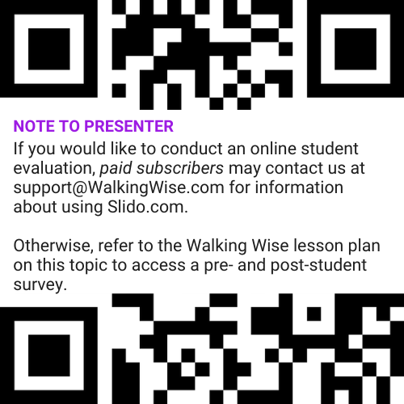
EVALUATION
©2024-2026 Walking Wise
82
Notes:
Two ways to conduct a pre-/post-student evaluation:
1) Use the pre/post survey in the Walking Wise lesson plan for this topic.
2) Activate Slido.com to conduct an online survey.

Slide 83
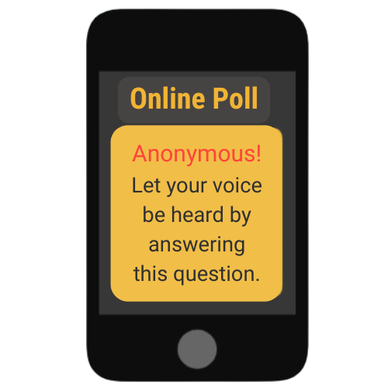

SHARE YOUR THOUGHTS
1. How would you rate this lesson?
2. What was the one thing you liked?
3. What one thing should we improve?
If Using Slido: Replace “#XXXX” with your organization’s custom Slido code.
©2024-2026 Walking Wise
83
Notes:
SLIDO.com: 3-Question Survey
IF SLIDO IS ACTIVATED:
Follow the instructions provided on WalkingWise.com to access your school or organization's custom Slido QR code and #code, which the audience will use to complete the 3-question evaluation.
Please encourage your audience to scan your organization's custom QR code to share what they enjoyed and what could be improved about the lesson.
Please send any feedback you want to share to Walking Wise at support@WalkingWise.com.

Slide 84



Thank you!
WalkingWise.com
Online Course for Adults Accredited by:
Postgraduate Institue for Medicine
Academy of Forensic Nursing
©2024-2026 Walking Wise
84
Notes:
NOTE TO PRESENTER
To access additional resources about the myths, please refer to the last page of Lesson Plan #1 by logging in to the Walking Wise Learning Platform.
We welcome your feedback at support@WalkingWise.com.

