Slide 1


SEXUAL EXPLOITATION
EDUCATION
Myths
&REALITY
LESSON #1
Notes:
NOTE
Log in to WalkingWise.com and refer to the Implementation Toolkit for classroom teaching tips.
Most importantly:
DEFINE SCHOOL POLICY
Establish a sexual exploitation reporting protocol with a trauma-informed response. The Walking Wise Implementation Toolkit provides a sample protocol.
AGE & AUDIENCE
This presentation can be edited by following the procedures on page 3 to align with your school policies, specific age groups, and the involvement of at-risk audiences.
SUPPORT PROCEDURE
Provide your students with guidance on accessing immediate help or arranging a private meeting with a social worker, counselor, nurse, school resource officer, or another trustworthy staff member to report concerns for themselves or a peer.
SECOND SAFE ADULT
Ensure a second trustworthy adult, such as a teacher, is present in the learning setting to observe student reactions and identify those who may benefit from a follow-up meeting. This person should remain focused and free from other duties during the presentation.

Slide 2

NOTE TO PRESENTER
Meaningful learning takes time. By introducing topics gradually over several years, educators can create steady growth in awareness and understanding.
Our recommended teaching plan offers a long-term path for middle and high school students to build knowledge and confidence.
5-Year Track
PARENTS & STAFF
#1 Myths & Reality
6th GRADE
#2 Trustworthy vs. Unsafe Adult
#3 Grooming Process
7th GRADE
#4 Pornography Link
#5 Sextortion Scheme
8th GRADE
#6 Male Victims
#7 Runaways as Targets
#8 Rural Risks
9th GRADE
#9 Human Traffickers
#10 Female & Peer Recruiters
10th GRADE
#11 Family Secret
#12 Hidden Buyers
©2024-2026 Walking Wise
2

Slide 3

NOTE TO PRESENTER
This presentation is exclusively for Walking Wise® subscribers and not for redistribution.
Presenters are encouraged to edit speaker notes to match their speaking style (viewable in presentation mode). You can also delete slides and content from this Walking Wise presentation to ensure the information aligns with your school policies, is age-appropriate, and fits within available class time. However, the slides are copyright-protected and may not be reworded without prior written permission from Walking Wise.
We encourage you to add your own content by following these instructions:
  Insert new PowerPoint slides.
  Remove the Walking Wise logo and copyright "©2026 Walking Wise" from the new slides.
  Always add your organization's name or logo to each new slide.
Please delete this instruction page before presenting to audiences.
R33126
©2024-2026 Walking Wise
3
Notes:
NOTE TO PRESENTER
The presenter is welcome to customize this Walking Wise presentation according to the instructions provided on this page.
For revision requests, please email us at: support@WalkingWise.com.

Slide 4
STATISTICS
Why Study Results Can Vary
  Some crimes are never reported, making it hard to reveal the entire issue.
  Studies collect information in different ways, leading to different results.
  Small studies may not represent everyone.
©2024-2026 Walking Wise
4
Notes:
UNREPORTED
Victims often do not report the crimes committed against them due to fear, shame, retaliation, or manipulation.
INCONSISTENT COLLECTION
Geographical areas have different legal definitions for sexual crimes, which may make data hard to compare. Also, different data-collection tools can make it difficult to compare the data.
FOCUS GROUPS
Small or specific focus groups participating in a study or survey may not accurately reflect the diversity or experiences of the broader population.

Slide 5
SENSITIVE TOPICS WILL BE DISCUSSED
CONTENT NOTICE
We’ll be discussing serious safety issues today.
Some topics may be difficult to hear.
If you ever feel uncomfortable, you can step out and speak with a trustworthy adult for support.
You’re not alone—help is available.
©2024-2026 Walking Wise
5
Notes:
NOTE TO PRESENTER
Trauma-Informed Delivery Guidelines
To support a safe and effective learning environment, please follow these guidelines:
• Present the information in a calm, matter-of-fact way and avoid sensational or alarming language.
• Avoid graphic details. Focus on helping students understand behaviors, risk, and ways to stay safe.
• Never blame victims. Responsibility always belongs to the person who caused harm.
• Maintain a steady, composed tone. Students often mirror the presenter's emotional cues.
• Do not ask students to share personal experiences or disclosures.
• If students laugh or react awkwardly, respond neutrally and gently redirect the focus.
• Pair all risk information with needed resources, practical solutions, and support options.
• Reinforce that students are not alone and that trustworthy adults are available to help.

Slide 6

WHY LEARN ABOUT THIS
KNOWLEDGE serves as a
powerful defense against
sexual predators.
©2024-2026 Walking Wise
6
Notes:
Education is one of the strongest tools for preventing exploitation.
When young people understand how predators operate, they are better able to recognize manipulation and avoid dangerous situations.
Reinforce that awareness increases safety.

Slide 7

PREVENTION EDUCATION
SEXUAL EXPLOITATION includes grooming, sextortion, pornography
& sex trafficking.
©2024-2026 Walking Wise
7
Notes:
SEXUAL EXPLOITATION
When someone takes advantage of another person for their own benefit, especially in a sexual way, often using pressure, tricks, or control.
GROOMING
Building trust, dependency, or an emotional connection to manipulate someone.
SEXTORTION
Threatening to share private sexual images, videos, or information to pressure someone into following demands.
PORNOGRAPHY
Involving vulnerable people in creating sexual images or videos.
SEX TRAFFICKING
Manipulating or forcing someone into sexual activity in exchange for money or something of value.
TVPA's Legal Definition:
SEX TRAFFICKING is the recruitment, harboring, transportation, provision, obtaining, patronizing, or soliciting of a person under the age of 18 for the purpose of a commercial sex act.

Slide 8



EDUCATON GUIDE
VOCABULARY
Words to Understand
  Child Exploitation
  Sex Trafficking
  Myth
  Reality
  Coercion
  Manipulation
  Intimidation
Myths
&REALITY
©2024-2026 Walking Wise
8
3
Notes:
Understanding vocabulary terms related to the behaviors of sexual predators can empower young people to recognize warning signs of harmful situations.
Knowing these terms helps them identify manipulative tactics that unsafe people (predators/traffickers) use to build trust and exploit vulnerabilities.
With this knowledge, young people are better equipped to spot red flags, understand that these behaviors are abusive, and feel more confident reporting predators to trusted adults or authorities, potentially preventing further harm.

Slide 9
EDUCATON GUIDE
VOCABULARY
CHILD EXPLOITATION
The use of a child for someone else’s benefit, often in an abusive, unfair, or harmful manner.
Legal Definition: The recruitment, harboring, transportation, provision, obtaining, patronizing, or soliciting of a person under the age of 18 for the purpose of a commercial sex act.
©2024-2026 Walking Wise
Section 7102. 22 USC Ch. 78: Trafficking Victims Protection, From Title 22—Foreign Relations and Intercourse.
9
3
Notes:
The following is included under child exploitation:
Sexual exploitation (grooming & sex trafficking), sextortion,
labor trafficking, and criminal activity (such as drug dealing & theft).
Source
Section 7102. 22 USC Ch. 78: Trafficking Victims Protection, From Title 22—Foreign Relations and Intercourse. Retrieved January 3, 2025, from https://uscode.house.gov/view.xhtml?hl=false&edition=prelim&path=%2Fprelim%40title22%2Fchapter78&req=granuleid%3AUSC-prelim-title22-chapter78&num=0&saved=L3ByZWxpbUB0aXRsZTIyL2NoYXB0ZXI3OA%3D%3D%7CZ3JhbnVsZWlkOlVTQy1wcmVsaW0tdGl0bGUyMi1jaGFwdGVyNzg%3D%7C%7C%7C0%7Cfalse%7Cprelim
Criminal Division, U.S. Department of Justice. Citizen's Guide To U.S. Federal Law On Child Sex Trafficking. Retrieved January 3, 2025, from https://www.justice.gov/criminal/criminal-ceos/citizens-guide-us-federal-law-child-sex-trafficking

Slide 10
EDUCATON GUIDE
VOCABULARY
CHILD SEX TRAFFICKING
A child (under age 18) is made to take part in sexual activity for money or something of value, like food, shelter, or gifts.
Legal Definition: The recruitment, harboring, transportation, provision, obtaining, patronizing, or soliciting of a person under the age of 18 for the purpose of a commercial sex act.
©2024-2026 Walking Wise
Section 7102. 22 USC Ch. 78: Trafficking Victims Protection, From Title 22—Foreign Relations and Intercourse.
10
3
Notes:
Source
Section 7102. 22 USC Ch. 78: Trafficking Victims Protection, From Title 22—Foreign Relations and Intercourse. Retrieved January 3, 2025, from https://uscode.house.gov/view.xhtml?hl=false&edition=prelim&path=%2Fprelim%40title22%2Fchapter78&req=granuleid%3AUSC-prelim-title22-chapter78&num=0&saved=L3ByZWxpbUB0aXRsZTIyL2NoYXB0ZXI3OA%3D%3D%7CZ3JhbnVsZWlkOlVTQy1wcmVsaW0tdGl0bGUyMi1jaGFwdGVyNzg%3D%7C%7C%7C0%7Cfalse%7Cprelim

Slide 11
EDUCATON GUIDE
VOCABULARY
SEX TRAFFICKING OF ADULTS
To take part in sexual activity in exchange for something of value because of the use of FORCE, FRAUD, or COERCION.
Legal Definition: The recruitment, harboring, transportation, provision, obtaining, patronizing, or soliciting of a person for the purpose of a commercial sex act, in which the commercial sex act is induced by force, fraud, or coercion.
©2024-2026 Walking Wise
Section 7102. 22 USC Ch. 78: Trafficking Victims Protection, From Title 22—Foreign Relations and Intercourse.
11
3
Notes:
Source
Section 7102. 22 USC Ch. 78: Trafficking Victims Protection, From Title 22—Foreign Relations and Intercourse. Retrieved January 3, 2025, from https://uscode.house.gov/view.xhtml?hl=false&edition=prelim&path=%2Fprelim%40title22%2Fchapter78&req=granuleid%3AUSC-prelim-title22-chapter78&num=0&saved=L3ByZWxpbUB0aXRsZTIyL2NoYXB0ZXI3OA%3D%3D%7CZ3JhbnVsZWlkOlVTQy1wcmVsaW0tdGl0bGUyMi1jaGFwdGVyNzg%3D%7C%7C%7C0%7Cfalse%7Cprelim

Slide 12

FORCEFUL TACTICS
force
Physical Abuse
Sexual Abuse
Threats Using a Weapon
Isolation
Myths
&REALITY
©2024-2026 Walking Wise
2020-2022 U.S. National Human Trafficking Hotline Report
12
Notes:
Source
Polaris Project (n.d.). Human Trafficking During the COVID and Post-COVID Era. Polarisproject.org, pp. 3, 6. Retrieved February 27, 2024, from https://polarisproject.org/wp-content/uploads/2020/07/Hotline-Trends-Report-2023.pdf

Slide 13
FRAUDULANT TACTICS
fraud
Fake Marriage Proposal
Fake Romantic Relationship
Fake Promises of Scholarships
Promoting Free Education
Loan Assistance Scam
Myths
&REALITY
©2024-2026 Walking Wise
2020-2022 U.S. National Human Trafficking Hotline Report
13
Notes:
Source
Polaris Project (n.d.). Human Trafficking During the COVID and Post-COVID Era. Polarisproject.org, pp. 3, 6. Retrieved February 27, 2024, from https://polarisproject.org/wp-content/uploads/2020/07/Hotline-Trends-Report-2023.pdf

Slide 14
EDUCATON GUIDE
VOCABULARY
COERCE
To manipulate, threaten, or intimidate someone to act against their will.
Myths
&REALITY
©2024-2026 Walking Wise
Section 7102. 22 USC Ch. 78: Trafficking Victims Protection, From Title 22—Foreign Relations and Intercourse.
14
3
Notes:
TVPA Legal Definition (18 U.S.C. § 1591(e)(2))
“Coercion” means:
(A) Threats of serious harm to or physical restraint against any person;
(B) Any scheme, plan, or pattern intended to cause a person to believe that failure to perform an act would result in serious harm to or physical restraint against any person; or
(C) The abuse or threatened abuse of law or the legal process.
Source
18 USC 1591: Sex trafficking of children or by force, fraud, or coercion. (n.d.). Title 18- Crimes and Criminal Procedure, Part 1 - Crimes Chapter 77 - Peonage and Slavery. Retrieved January 3, 2025, from https://uscode.house.gov/view.xhtml?req=granuleid%3AUSC-2000-title18-section1591&num=0&edition=2000#sourcecredit

Slide 15

COERCIVE TACTICS
COERCION
Taking Legal Documents
Threatens Harm to Family or Pets
Emotional or Verbal Abuse
Manipulation or Intimidation
Stalking or Monitoring
Withholding Food & Shelter
Myths
&REALITY
©2024-2026 Walking Wise
2020-2022 U.S. National Human Trafficking Hotline Report
15
Notes:
Source
Polaris Project (n.d.). Human Trafficking During the COVID and Post-COVID Era. Polarisproject.org, pp. 3, 6. Retrieved February 27, 2024, from https://polarisproject.org/wp-content/uploads/2020/07/Hotline-Trends-Report-2023.pdf

Slide 16
EDUCATON GUIDE
VOCABULARY
MYTH
A false belief commonly held by a group.
Myths
&REALITY
©2024-2026 Walking Wise
16
3

Slide 17
EDUCATON GUIDE
VOCABULARY
REALITY
A true fact based on what actually happens.
Myths
&REALITY
©2024-2026 Walking Wise
17
3

Slide 18
LESSON PLANS
MYTH OR REALITY?
Myth or Reality? Sex traffickers mostly target young people living in dangerous communities.
Myths
&REALITY
©2024-2026 Walking Wise
Polaris Project (2025) Myths, Facts, and Statistics. PolarisProject.org.
18
3
Notes:
Source
Polaris Project (2025). Myths, Facts, and Statistics. PolarisProject.org. Retrieved January 6, 2025, from https://polarisproject.org/myths-facts-and-statistics/?gad_source=1&gclid=CjwKCAiAm-67BhBlEiwAEVftNpjEBS3aD54aH9qHzJjL01wnVgSL4rc8WgP7CHE_PvAjOR1wN9AchBoCgk8QAvD_BwE

Slide 19
ANSWER
MYTH. Reality is, traffickers target young people from all types of communities, including urban, suburban, rural, and online communities.
©2024-2026 Walking Wise
Polaris Project (2025). Myths, Facts, and Statistics. PolarisProject.org.
19
Notes:
Source
Polaris Project (2025). Myths, Facts, and Statistics. PolarisProject.org. Retrieved January 6, 2025, from https://polarisproject.org/myths-facts-and-statistics/?gad_source=1&gclid=CjwKCAiAm-67BhBlEiwAEVftNpjEBS3aD54aH9qHzJjL01wnVgSL4rc8WgP7CHE_PvAjOR1wN9AchBoCgk8QAvD_BwE

Slide 20
LESSON PLANS
MYTH OR REALITY?
Myth or Reality? Sex traffickers mainly target young people they don’t know.
Myths
&REALITY
©2024-2026 Walking Wise
Polaris Project (2025) Myths, Facts, and Statistics. PolarisProject.org.
20
3
Notes:
Source
Polaris Project (2025). Myths, Facts, and Statistics. PolarisProject.org. Retrieved January 6, 2025, from https://polarisproject.org/myths-facts-and-statistics/?gad_source=1&gclid=CjwKCAiAm-67BhBlEiwAEVftNpjEBS3aD54aH9qHzJjL01wnVgSL4rc8WgP7CHE_PvAjOR1wN9AchBoCgk8QAvD_BwE

Slide 21
ANSWER
MYTH. Reality is, victims often know their trafficker.
©2024-2026 Walking Wise
Polaris Project (2025). Myths, Facts, and Statistics. PolarisProject.org.
21
Notes:
Victims often know their trafficker.
Traffickers can be family members - including parents, intimate partners - including older boyfriends and spouses, and other known and trusted members of the community.
Source
Polaris Project (2025). Myths, Facts, and Statistics. PolarisProject.org. Retrieved January 6, 2025, from https://polarisproject.org/myths-facts-and-statistics/?gad_source=1&gclid=CjwKCAiAm-67BhBlEiwAEVftNpjEBS3aD54aH9qHzJjL01wnVgSL4rc8WgP7CHE_PvAjOR1wN9AchBoCgk8QAvD_BwE

Slide 22
LESSON PLANS
MYTH OR REALITY?
Myth or Reality? Sex trafficking usually involves violence against victims.
Myths
&REALITY
©2024-2026 Walking Wise
Polaris Project (2025) Myths, Facts, and Statistics. PolarisProject.org.
22
3
Notes:
Source
Polaris Project (2025). Myths, Facts, and Statistics. PolarisProject.org. Retrieved January 6, 2025, from https://polarisproject.org/myths-facts-and-statistics/?gad_source=1&gclid=CjwKCAiAm-67BhBlEiwAEVftNpjEBS3aD54aH9qHzJjL01wnVgSL4rc8WgP7CHE_PvAjOR1wN9AchBoCgk8QAvD_BwE

Slide 23
ANSWER
MYTH. Reality is, more often traffickers use manipulation, intimidation, and threats to control their victims.
©2024-2026 Walking Wise
Polaris Project (2025). Myths, Facts, and Statistics. PolarisProject.org.
23
Notes:
Sometimes violence is involved; however, traffickers often use manipulation, intimidation to control their victims.
Source
Polaris Project (2025). Myths, Facts, and Statistics. PolarisProject.org. Retrieved January 6, 2025, from https://polarisproject.org/myths-facts-and-statistics/?gad_source=1&gclid=CjwKCAiAm-67BhBlEiwAEVftNpjEBS3aD54aH9qHzJjL01wnVgSL4rc8WgP7CHE_PvAjOR1wN9AchBoCgk8QAvD_BwE

Slide 24
LESSON PLANS
MYTH OR REALITY?
Myth or Reality? Sex trafficking victims are usually kidnapped.
Myths
&REALITY
©2024-2026 Walking Wise
24
3
Notes:
Source
National Human Trafficking Hotline (n.d.). Fact Sheet: Human Trafficking. The Administration for Children and Families. Retrieved May 1, 2024, from https://www.acf.hhs.gov/otip/fact-sheet/resource/fshumantrafficking

Slide 25
ANSWER
MYTH. Reality is, most trafficking does not involve kidnapping. Traffickers more often manipulate their victims.
©2024-2026 Walking Wise
National Human Trafficking Hotline (n.d.). Fact Sheet: Human Trafficking. The Administration for Children and Families.
25
Notes:
It’s possible for someone to be kidnapped by a trafficker, but this is uncommon.
Most traffickers use lies, manipulation, or pressure to trap people into trafficking situations.
Source
National Human Trafficking Hotline (n.d.). Fact Sheet: Human Trafficking. The Administration for Children and Families. Retrieved May 1, 2024, from https://www.acf.hhs.gov/otip/fact-sheet/resource/fshumantrafficking

Slide 26
LESSON PLANS
MYTH OR REALITY?
Myth or Reality? Sex traffickers usually hold victims physically captive.
Myths
&REALITY
©2024-2026 Walking Wise
26
3
Notes:
Source
National Human Trafficking Hotline (n.d.). Fact Sheet: Human Trafficking. The Administration for Children and Families. Retrieved May 1, 2024, from https://www.acf.hhs.gov/otip/fact-sheet/resource/fshumantrafficking

Slide 27
ANSWER
MYTH. Reality is, most victims are not locked in. People usually stay because they are scared, controlled, or feel they have no choice.
©2024-2026 Walking Wise
National Human Trafficking Hotline (n.d.). Fact Sheet: Human Trafficking. The Administration for Children and Families.
27
Notes:
Some traffickers may hold victims captive, but most people in trafficking situations stay for more complicated reasons:
- They don’t have the basics to leave, like transportation or a safe place.
- They fear for their safety if they try to escape.
- They’ve been manipulated so much that they may not realize they’re being controlled.
Source
National Human Trafficking Hotline (n.d.). Fact Sheet: Human Trafficking. The Administration for Children and Families. Retrieved May 1, 2024, from https://www.acf.hhs.gov/otip/fact-sheet/resource/fshumantrafficking

Slide 28
LESSON PLANS
TRAFFICKING MYTH
Myth or Reality? Sex traffickers only target females.
Myths
&REALITY
©2024-2026 Walking Wise
28
3
Notes:
Source
National Human Trafficking Hotline (n.d.). Fact Sheet: Human Trafficking. The Administration for Children and Families. Retrieved May 1, 2024, from https://www.acf.hhs.gov/otip/fact-sheet/resource/fshumantrafficking

Slide 29
ANSWER
MYTH. Reality is, females are most targeted, but males and boys are also trafficked.
©2024-2026 Walking Wise
National Human Trafficking Hotline (n.d.). Fact Sheet: Human Trafficking. The Administration for Children and Families.
29
Notes:
Sex traffickers also victimize both men and boys, including LGBTQ+ males and females.
Source
National Human Trafficking Hotline (n.d.). Fact Sheet: Human Trafficking. The Administration for Children and Families. Retrieved May 1, 2024, from https://www.acf.hhs.gov/otip/fact-sheet/resource/fshumantrafficking

Slide 30
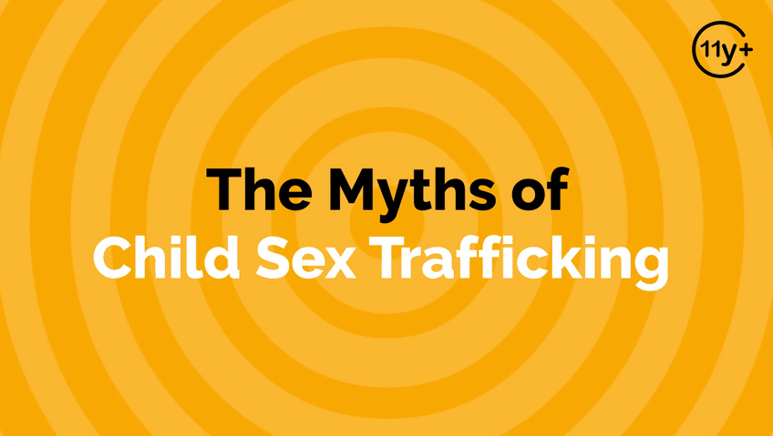
LOGIN or go to WalkingWise.com/demo to access this animated video.
©2024-2026 Walking Wise
30
Notes:
This 3-minute Walking Wise animated video series teaches how sexual predators use manipulation, intimidation, and coercion to exploit young people.
NOTE
Log in to Walking Wise.com to watch the three-minute animated video with audiences.
Is animation appropriate for teens?
Businesses worldwide use explainer-style animation as a training tool for their employees.

Slide 31
LESSON PLANS
VENUES & BUSINESS
In what types of venues or businesses are people commonly trafficked?
Myths
&REALITY
©2024-2026 Walking Wise
31
3

Slide 32
VENUES & BUSINESS
Venues Used by Sex Traffickers
  Social Media Platforms
Myths
&REALITY
©2024-2026 Walking Wise
32
Notes:
Myth: People are only trafficked in illegal businesses.
Reality: Trafficking can happen anywhere people can be controlled or exploited, even in legal businesses and industries.

Slide 33
VENUES & BUSINESS
Venues Used by Sex Traffickers
  Social Media Platforms
  Illegal Massage Parlors
Myths
&REALITY
©2024-2026 Walking Wise
33
Notes:
Myth: People are only trafficked in illegal businesses.
Reality: Trafficking can happen anywhere people can be controlled or exploited, even in legal businesses and industries.

Slide 34
VENUES & BUSINESS
Venues Used by Sex Traffickers
  Social Media Platforms
  Illegal Massage Parlors
  Bars & Casinos
Myths
&REALITY
©2024-2026 Walking Wise
34
Notes:
Myth: People are only trafficked in illegal businesses.
Reality: Trafficking can happen anywhere people can be controlled or exploited, even in legal businesses and industries.

Slide 35
VENUES & BUSINESS
Venues Used by Sex Traffickers
  Social Media Platforms
  Illegal Massage Parlors
  Bars & Casinos
  Hotels & Motels
Myths
&REALITY
©2024-2026 Walking Wise
35
Notes:
Myth: People are only trafficked in illegal businesses.
Reality: Trafficking can happen anywhere people can be controlled or exploited, even in legal businesses and industries.

Slide 36
BUSINESS & INDUSTY
Industries Impacted by Labor Trafficking
  Hotel Housekeeping & Maintenance
Myths
&REALITY
©2024-2026 Walking Wise
36
Notes:
Myth: People are only trafficked in illegal businesses.
Reality: Trafficking can happen anywhere people can be controlled or exploited, even in legal businesses and industries.

Slide 37
BUSINESS & INDUSTY
Industries Impacted by Labor Trafficking
  Hotel Housekeeping & Maintenance
  Restaurants & Tourism
Myths
&REALITY
©2024-2026 Walking Wise
37
Notes:
Myth: People are only trafficked in illegal businesses.
Reality: Trafficking can happen anywhere people can be controlled or exploited, even in legal businesses and industries.

Slide 38
BUSINESS & INDUSTY
Industries Impacted by Labor Trafficking
  Hotel Housekeeping & Maintenance
  Restaurants & Tourism
  Agriculture: Crops, Livestock, Fisheries
Myths
&REALITY
©2024-2026 Walking Wise
38
Notes:
Myth: People are only trafficked in illegal businesses.
Reality: Trafficking can happen anywhere people can be controlled or exploited, even in legal businesses and industries.

Slide 39
BUSINESS & INDUSTY
Industries Impacted by Labor Trafficking
  Hotel Housekeeping & Maintenance
  Restaurants & Tourism
  Agriculture: Crops, Livestock, Fisheries
  Logging & Mining
Myths
&REALITY
©2024-2026 Walking Wise
39
Notes:
Myth: People are only trafficked in illegal businesses.
Reality: Trafficking can happen anywhere people can be controlled or exploited, even in legal businesses and industries.

Slide 40
BUSINESS & INDUSTY
Industries Impacted by Labor Trafficking
  Hotel Housekeeping & Maintenance
  Restaurants & Tourism
  Agriculture: Crops, Livestock, Fisheries
  Logging & Mining
  Construction, Factories, & Carnivals
Myths
&REALITY
©2024-2026 Walking Wise
40
Notes:
Myth: People are only trafficked in illegal businesses.
Reality: Trafficking can happen anywhere people can be controlled or exploited, even in legal businesses and industries.

Slide 41
EDUCATON GUIDE
VOCABULARY
MANIPULATION
Influencing or controlling someone’s behavior or decisions deceptively or unfairly, usually for personal gain.
Myths
&REALITY
©2024-2026 Walking Wise
41
3

Slide 42
EDUCATON GUIDE
VOCABULARY
INTIMIDATION
To influence or control another person’s actions or behavior by causing fear.
Myths
&REALITY
©2024-2026 Walking Wise
42
3

Slide 43
FALSE SENSE OF SECURITY
When can young people experience a false sense of security?
Myths
&REALITY
©2024-2026 Walking Wise
43

Slide 44
FALSE SENSE OF SECURITY
Stay Alert — Even When Things Seem Safe
Talking or hanging out with an “Online-only” friend.
©2024-2026 Walking Wise
44
Notes:
A false sense of security is when someone feels safe in a situation where hidden risks may still exist.
Young people may feel comfortable with someone they only know online because of frequent conversations or shared interests.
Spending time alone with someone significantly older, especially in private settings, increases vulnerability due to power differences.
Unusual attention, gifts, or favors from an adult can be part of boundary-testing behaviors.
Likewise, being in unfamiliar places with acquaintances reduces natural safeguards.
Safety is not about fear; it’s about awareness, boundaries, and ensuring that relationships remain transparent and appropriate.

Slide 45
FALSE SENSE OF SECURITY
Stay Alert — Even When Things Seem Safe
Spending time with an older peer or adult.
©2024-2026 Walking Wise
45
Notes:
A false sense of security is when someone feels safe in a situation where hidden risks may still exist.
Young people may feel comfortable with someone they only know online because of frequent conversations or shared interests.
Spending time alone with someone significantly older, especially in private settings, increases vulnerability due to power differences.
Unusual attention, gifts, or favors from an adult can be part of boundary-testing behaviors.
Likewise, being in unfamiliar places with acquaintances reduces natural safeguards.
Safety is not about fear; it’s about awareness, boundaries, and ensuring that relationships remain transparent and appropriate.

Slide 46
FALSE SENSE OF SECURITY
Stay Alert — Even When Things Seem Safe
Receiving special attention, gifts, or favors from an adult.
©2024-2026 Walking Wise
46
Notes:
A false sense of security is when someone feels safe in a situation where hidden risks may still exist.
Young people may feel comfortable with someone they only know online because of frequent conversations or shared interests.
Spending time alone with someone significantly older, especially in private settings, increases vulnerability due to power differences.
Unusual attention, gifts, or favors from an adult can be part of boundary-testing behaviors.
Likewise, being in unfamiliar places with acquaintances reduces natural safeguards.
Safety is not about fear; it’s about awareness, boundaries, and ensuring that relationships remain transparent and appropriate.

Slide 47
FALSE SENSE OF SECURITY
Stay Alert — Even When Things Seem Safe
Going to unfamiliar places with people they don’t know well.
©2024-2026 Walking Wise
47
Notes:
A false sense of security is when someone feels safe in a situation where hidden risks may still exist.
Young people may feel comfortable with someone they only know online because of frequent conversations or shared interests.
Spending time alone with someone significantly older, especially in private settings, increases vulnerability due to power differences.
Unusual attention, gifts, or favors from an adult can be part of boundary-testing behaviors.
Likewise, being in unfamiliar places with acquaintances reduces natural safeguards.
Safety is not about fear; it’s about awareness, boundaries, and ensuring that relationships remain transparent and appropriate.

Slide 48
PLAIN SIGHT
What makes it possible for human traffickers to operate in plain sight?
Myths
&REALITY
©2024-2026 Walking Wise
48

Slide 49
PLAIN SIGHT
Someone We Wouldn’t Suspect
  Authority Figure: Adult in charge of young or vulnerable people
Myths
&REALITY
©2024-2026 Walking Wise
49
Notes:
“Operating in plain sight” refers to visibly engaging in activities without attempting to conceal them or behaving in a way that attracts no suspicion despite the potentially harmful intentions.
Often, people believe criminal activity happens in dark alleys or places not visited by the average person. However, illegal activity often occurs in areas where people commonly spend time.

Slide 50
PLAIN SIGHT
Someone We Wouldn’t Suspect
  Authority Figure: Adult in charge of young or vulnerable people
  Neighbor: Adult or peer in the local community
Myths
&REALITY
©2024-2026 Walking Wise
50
Notes:
“Operating in plain sight” refers to visibly engaging in activities without attempting to conceal them or behaving in a way that attracts no suspicion despite the potentially harmful intentions.
Often, people believe criminal activity happens in dark alleys or places not visited by the average person. However, illegal activity often occurs in areas where people commonly spend time.

Slide 51
PLAIN SIGHT
Someone We Wouldn’t Suspect
  Authority Figure: Adult in charge of young or vulnerable people
  Neighbor: Adult or peer in the local community
  Employer: Boss or co-worker
Myths
&REALITY
©2024-2026 Walking Wise
51
Notes:
“Operating in plain sight” refers to visibly engaging in activities without attempting to conceal them or behaving in a way that attracts no suspicion despite the potentially harmful intentions.
Often, people believe criminal activity happens in dark alleys or places not visited by the average person. However, illegal activity often occurs in areas where people commonly spend time.

Slide 52
PLAIN SIGHT
Someone We Wouldn’t Suspect
  Authority Figure: Adult in charge of young or vulnerable people
  Neighbor: Adult or peer in the local community
  Employer: Boss or co-worker
  Family Member: Close or distant relative
Myths
&REALITY
©2024-2026 Walking Wise
52
Notes:
“Operating in plain sight” refers to visibly engaging in activities without attempting to conceal them or behaving in a way that attracts no suspicion despite the potentially harmful intentions.
Often, people believe criminal activity happens in dark alleys or places not visited by the average person. However, illegal activity often occurs in areas where people commonly spend time.

Slide 53
NOT MY COMMUNITY
What can happen if sexual exploitation is ignored in a community?
Myths
&REALITY
©2024-2026 Walking Wise
53

Slide 54
NOT MY COMMUNITY
Cost of Looking the Other Way
Silence can enable exploitation to grow.
©2024-2026 Walking Wise
54
Notes:
When communities avoid talking about sexual exploitation, traffickers and exploiters benefit.
Silence creates space for manipulation, grooming, and abuse to continue unchecked.
Exploitation thrives in secrecy. When no one is watching, asking questions, or speaking up, harmful behavior becomes easier to hide.

Slide 55
NOT MY COMMUNITY
Cost of Looking the Other Way
Vulnerable people may face greater danger.
©2024-2026 Walking Wise
55
Notes:
When communities avoid talking about sexual exploitation, traffickers and exploiters benefit.
Silence creates space for manipulation, grooming, and abuse to continue unchecked.
Exploitation thrives in secrecy. When no one is watching, asking questions, or speaking up, harmful behavior becomes easier to hide.

Slide 56
NOT MY COMMUNITY
Cost of Looking the Other Way
Victims can remain unseen and unsupported.
©2024-2026 Walking Wise
56
Notes:
When communities avoid talking about sexual exploitation, traffickers and exploiters benefit.
Silence creates space for manipulation, grooming, and abuse to continue unchecked.
Exploitation thrives in secrecy. When no one is watching, asking questions, or speaking up, harmful behavior becomes easier to hide.

Slide 57
NOT MY COMMUNITY
Cost of Looking the Other Way
Communities may lose the chance to prevent harm.
©2024-2026 Walking Wise
57
Notes:
When communities avoid talking about sexual exploitation, traffickers and exploiters benefit.
Silence creates space for manipulation, grooming, and abuse to continue unchecked.
Exploitation thrives in secrecy. When no one is watching, asking questions, or speaking up, harmful behavior becomes easier to hide.

Slide 58
AUTHORITY FIGURES
How can someone in authority misuse their power to harm others?
Myths
&REALITY
©2024-2026 Walking Wise
58

Slide 59
AUTHORITY FIGURES
How Power is Misused
They build trust through manipulation and deception.
©2024-2026 Walking Wise
59
Notes:
An authority figure is a person who leads or oversees others, such as a teacher, coach, boss, or community leader.
Sometimes, young people may feel they must obey an authority figure, even if the person does not actually have the right to control them.
Unsafe people may try to use their position or influence to pressure young people into doing things that feel wrong or unsafe.
A trustworthy authority figure will never ask someone to do something illegal, harmful, or inappropriate.

Slide 60
AUTHORITY FIGURES
How Power is Misused
They can use their position to discourage people from asking questions.
©2024-2026 Walking Wise
60
Notes:
An authority figure is a person who leads or oversees others, such as a teacher, coach, boss, or community leader.
Sometimes, young people may feel they must obey an authority figure, even if the person does not actually have the right to control them.
Unsafe people may try to use their position or influence to pressure young people into doing things that feel wrong or unsafe.
A trustworthy authority figure will never ask someone to do something illegal, harmful, or inappropriate.

Slide 61
AUTHORITY FIGURES
How Power is Misused
They often threaten consequences to maintain control.
©2024-2026 Walking Wise
61
Notes:
An authority figure is a person who leads or oversees others, such as a teacher, coach, boss, or community leader.
Sometimes, young people may feel they must obey an authority figure, even if the person does not actually have the right to control them.
Unsafe people may try to use their position or influence to pressure young people into doing things that feel wrong or unsafe.
A trustworthy authority figure will never ask someone to do something illegal, harmful, or inappropriate.

Slide 62
AUTHORITY FIGURES
How Power is Misused
They blur boundaries to test what they can get away with.
©2024-2026 Walking Wise
62
Notes:
An authority figure is a person who leads or oversees others, such as a teacher, coach, boss, or community leader.
Sometimes, young people may feel they must obey an authority figure, even if the person does not actually have the right to control them.
Unsafe people may try to use their position or influence to pressure young people into doing things that feel wrong or unsafe.
A trustworthy authority figure will never ask someone to do something illegal, harmful, or inappropriate.

Slide 63
FALSE PROMISES
What types of false promises are used to manipulate young people into sexual exploitation?
Myths
&REALITY
©2024-2026 Walking Wise
63

Slide 64
BROKEN PROMISES
Fraud & False Promises
Fake love or marriage proposals are used to gain trust.
Myths
&REALITY
©2024-2026 Walking Wise
64
Notes:
A “false promise” is when someone says they will do something but never plans to keep the commitment.
They may say things that sound exciting or caring to trick someone into doing something harmful or even illegal.
For example, an unsafe person might promise money, a special opportunity, fame, or love to gain a young person’s trust.
These promises are used to manipulate someone into doing things they would not normally do.

Slide 65
BROKEN PROMISES
Fraud & False Promises
Promises of fame or a dream job can be used to lure and control.
Myths
&REALITY
©2024-2026 Walking Wise
65
Notes:
A “false promise” is when someone says they will do something but never plans to keep the commitment.
They may say things that sound exciting or caring to trick someone into doing something harmful or even illegal.
For example, an unsafe person might promise money, a special opportunity, fame, or love to gain a young person’s trust.
These promises are used to manipulate someone into doing things they would not normally do.

Slide 66
BROKEN PROMISES
Fraud & False Promises
Promises of adventure are often used to entice “running away together.”
Myths
&REALITY
©2024-2026 Walking Wise
66
Notes:
A “false promise” is when someone says they will do something but never plans to keep the commitment.
They may say things that sound exciting or caring to trick someone into doing something harmful or even illegal.
For example, an unsafe person might promise money, a special opportunity, fame, or love to gain a young person’s trust.
These promises are used to manipulate someone into doing things they would not normally do.

Slide 67
POWER OF PERSUASION
How can traffickers gain “mental control” over young and vulnerable people?
Myths
&REALITY
©2024-2026 Walking Wise
67

Slide 68
POWER OF PERSUASION
Controlling Thoughts & Emotions
They gradually influence beliefs to shape decisions.
©2024-2026 Walking Wise
68
Notes:
Mental control works by weakening confidence and increasing dependence.
Traffickers rarely begin with force; they begin with persuasion.
They slowly influence how a young person thinks about themselves, relationships, money, or loyalty.
Over time, this shapes decisions in ways the person might not have made before. They may apply pressure to push someone beyond their comfort zone, framing harmful behavior as normal, necessary, or proof of trust.
Mind games, such as guilt, blame, or mixed messages, create confusion and self-doubt, making it harder to think clearly or ask for help.

Slide 69
POWER OF PERSUASION
Controlling Thoughts & Emotions
They pressure people to act against their values or comfort level.
©2024-2026 Walking Wise
69
Notes:
Mental control works by weakening confidence and increasing dependence.
Traffickers rarely begin with force; they begin with persuasion.
They slowly influence how a young person thinks about themselves, relationships, money, or loyalty.
Over time, this shapes decisions in ways the person might not have made before. They may apply pressure to push someone beyond their comfort zone, framing harmful behavior as normal, necessary, or proof of trust.
Mind games, such as guilt, blame, or mixed messages, create confusion and self-doubt, making it harder to think clearly or ask for help.

Slide 70
POWER OF PERSUASION
Controlling Thoughts & Emotions
They create confusion, guilt, or self-doubt to gain control.
©2024-2026 Walking Wise
70
Notes:
Mental control works by weakening confidence and increasing dependence.
Traffickers rarely begin with force; they begin with persuasion.
They slowly influence how a young person thinks about themselves, relationships, money, or loyalty.
Over time, this shapes decisions in ways the person might not have made before. They may apply pressure to push someone beyond their comfort zone, framing harmful behavior as normal, necessary, or proof of trust.
Mind games, such as guilt, blame, or mixed messages, create confusion and self-doubt, making it harder to think clearly or ask for help.

Slide 71
SOCIAL LIFE
How do traffickers enter a young person’s “social circle”?
Myths
&REALITY
©2024-2026 Walking Wise
71

Slide 72
SOCIAL LIFE
Getting Too Close
They pretend to share interests to build connection and trust.
©2024-2026 Walking Wise
72
Notes:
Traffickers often enter a young person’s world by blending in.
They may pretend to share hobbies, music tastes, struggles, or goals to create a fast sense of connection.
They position themselves where vulnerable young people are, such as in familiar spaces, social media platforms, gaming communities, friend groups, schools, or local hangouts, to increase access and visibility.
As trust grows, they encourage personal sharing to learn about insecurities, family conflict, financial stress, or emotional needs. That information can later be used to manipulate, isolate, or control.

Slide 73
SOCIAL LIFE
Getting Too Close
They insert themselves into locations, online or in person, to spend time together.
©2024-2026 Walking Wise
73
Notes:
Traffickers often enter a young person’s world by blending in.
They may pretend to share hobbies, music tastes, struggles, or goals to create a fast sense of connection.
They position themselves where vulnerable young people are, such as in familiar spaces, social media platforms, gaming communities, friend groups, schools, or local hangouts, to increase access and visibility.
As trust grows, they encourage personal sharing to learn about insecurities, family conflict, financial stress, or emotional needs. That information can later be used to manipulate, isolate, or control.

Slide 74
SOCIAL LIFE
Getting Too Close
They encourage oversharing to identify an individual’s vulnerability.
©2024-2026 Walking Wise
74
Notes:
Traffickers often enter a young person’s world by blending in.
They may pretend to share hobbies, music tastes, struggles, or goals to create a fast sense of connection.
They position themselves where vulnerable young people are, such as in familiar spaces, social media platforms, gaming communities, friend groups, schools, or local hangouts, to increase access and visibility.
As trust grows, they encourage personal sharing to learn about insecurities, family conflict, financial stress, or emotional needs. That information can later be used to manipulate, isolate, or control.

Slide 75
HELD CAPTIVE
What are the ways traffickers can hold a person captive?
Myths
&REALITY
©2024-2026 Walking Wise
75

Slide 76
HELD CAPTIVE
Emotional Captivity
  Mind Games: Manipulation can change beliefs, attitudes, & decisions.
©2024-2026 Walking Wise
76
Notes:
Being held captive does not always mean being locked in a room. Sometimes control happens emotionally.
Mind Games: Using manipulative techniques to change an individual's thought process, giving them control of the victim's beliefs, attitudes, and behaviors.
Trauma Bonding or Emotional Bondage: Using rewards and punishments in cycles to foster a powerful emotional connection with their victims. This form of abuse causes the victim to experience positive and negative emotions for the trafficker, such as love or loyalty, while also living in fear.
Financial Dependency:
Gaining control over young people who cannot earn enough money to obtain necessities like food and shelter. Victims often feel stuck because they have no means to support themselves when wanting to break free from a trafficker who fulfills their basic needs.
Drug and Alcohol Addiction:
Influencing an individual's substance use or introducing the individual to drugs and alcohol to create dependency. Substance abuse can increase a victim's economic, physical, and emotional dependency on their trafficker, significantly reducing their ability to end their exploitation.
Imprisonment and isolation:
Physically or emotionally restricting a person’s freedom to move about or make independent decisions, or causing isolation from friends and family members.

Slide 77
HELD CAPTIVE
Emotional Captivity
  Mind Games: Manipulation can change beliefs, attitudes, & decisions.
  Trauma Bond: Rewards & punishments can create loyalty & fear.
©2024-2026 Walking Wise
77
Notes:
Being held captive does not always mean being locked in a room. Sometimes control happens emotionally.
Mind Games: Using manipulative techniques to change an individual's thought process, giving them control of the victim's beliefs, attitudes, and behaviors.
Trauma Bonding or Emotional Bondage: Using rewards and punishments in cycles to foster a powerful emotional connection with their victims. This form of abuse causes the victim to experience positive and negative emotions for the trafficker, such as love or loyalty, while also living in fear.
Financial Dependency:
Gaining control over young people who cannot earn enough money to obtain necessities like food and shelter. Victims often feel stuck because they have no means to support themselves when wanting to break free from a trafficker who fulfills their basic needs.
Drug and Alcohol Addiction:
Influencing an individual's substance use or introducing the individual to drugs and alcohol to create dependency. Substance abuse can increase a victim's economic, physical, and emotional dependency on their trafficker, significantly reducing their ability to end their exploitation.
Imprisonment and isolation:
Physically or emotionally restricting a person’s freedom to move about or make independent decisions, or causing isolation from friends and family members.

Slide 78
HELD CAPTIVE
Emotional Captivity
  Mind Games: Manipulation can change beliefs, attitudes, & decisions.
  Trauma Bond: Rewards & punishments can create loyalty & fear.
  Financial Control: Providing needs can cause victims to feel trapped.
©2024-2026 Walking Wise
78
Notes:
Being held captive does not always mean being locked in a room. Sometimes control happens emotionally.
Mind Games: Using manipulative techniques to change an individual's thought process, giving them control of the victim's beliefs, attitudes, and behaviors.
Trauma Bonding or Emotional Bondage: Using rewards and punishments in cycles to foster a powerful emotional connection with their victims. This form of abuse causes the victim to experience positive and negative emotions for the trafficker, such as love or loyalty, while also living in fear.
Financial Dependency:
Gaining control over young people who cannot earn enough money to obtain necessities like food and shelter. Victims often feel stuck because they have no means to support themselves when wanting to break free from a trafficker who fulfills their basic needs.
Drug and Alcohol Addiction:
Influencing an individual's substance use or introducing the individual to drugs and alcohol to create dependency. Substance abuse can increase a victim's economic, physical, and emotional dependency on their trafficker, significantly reducing their ability to end their exploitation.
Imprisonment and isolation:
Physically or emotionally restricting a person’s freedom to move about or make independent decisions, or causing isolation from friends and family members.

Slide 79
HELD CAPTIVE
Emotional Captivity
  Mind Games: Manipulation can change beliefs, attitudes, & decisions.
  Trauma Bond: Rewards & punishments can create loyalty & fear.
  Financial Control: Providing needs can cause victims to feel trapped.
  Substance Use: Alcohol or drugs can be used to increase control.
©2024-2026 Walking Wise
79
Notes:
Being held captive does not always mean being locked in a room. Sometimes control happens emotionally.
Mind Games: Using manipulative techniques to change an individual's thought process, giving them control of the victim's beliefs, attitudes, and behaviors.
Trauma Bonding or Emotional Bondage: Using rewards and punishments in cycles to foster a powerful emotional connection with their victims. This form of abuse causes the victim to experience positive and negative emotions for the trafficker, such as love or loyalty, while also living in fear.
Financial Dependency:
Gaining control over young people who cannot earn enough money to obtain necessities like food and shelter. Victims often feel stuck because they have no means to support themselves when wanting to break free from a trafficker who fulfills their basic needs.
Drug and Alcohol Addiction:
Influencing an individual's substance use or introducing the individual to drugs and alcohol to create dependency. Substance abuse can increase a victim's economic, physical, and emotional dependency on their trafficker, significantly reducing their ability to end their exploitation.
Imprisonment and isolation:
Physically or emotionally restricting a person’s freedom to move about or make independent decisions, or causing isolation from friends and family members.

Slide 80

ASK FOR HELP
©2024-2026 Walking Wise
80
Notes:
Walking Wise asked a focus group of survivors:
What do you think young people should know about sex trafficking?
ANSWER
The survivors agreed that the most vital information teens should know is how to ask for help.
At the top of their list: Tell a TRUSTWORTHY adult.
The request was that Walking Wise add a group of characters to its animated videos to represent trustworthy adults, encouraging teens to seek out adults they can trust.

Slide 81

ASK FOR HELP
What are ways young people can ask for help?
©2024-2026 Walking Wise
81

Slide 82
ASK FOR HELP
How to Ask for Help
  If you are in immediate danger, dial 911.
©2024-2026 Walking Wise
82

Slide 83
ASK FOR HELP
How to Ask for Help
  If you are in immediate danger, dial 911.
  If the sexual predator IS a family member, tell a trustworthy adult.
©2024-2026 Walking Wise
83

Slide 84
ASK FOR HELP
How to Ask for Help
  If you are in immediate danger, dial 911.
  If the sexual predator IS a family member, tell a trustworthy adult.
  If the sexual predator is NOT family, tell a parent.
©2024-2026 Walking Wise
84

Slide 85
ASK FOR HELP
How to Ask for Help
  If you are in immediate danger, dial 911.
  If the sexual predator IS a family member, tell a trustworthy adult.
  If the sexual predator is NOT family, tell a parent.
  If you are a student in school, tell a trustworthy teacher, coach, school nurse, social worker, counselor, resource officer, or principal.
©2024-2026 Walking Wise
85

Slide 86
ASK FOR HELP
How to Ask for Help
  If you are in immediate danger, dial 911.
  If the sexual predator IS a family member, tell a trustworthy adult.
  If the sexual predator is NOT family, tell a parent.
  If you are a student in school, tell a trustworthy teacher, coach, school nurse, social worker, counselor, resource officer, or principal.
  To gain internet access for help, use a computer at your school or a public library.
©2024-2026 Walking Wise
86

Slide 87
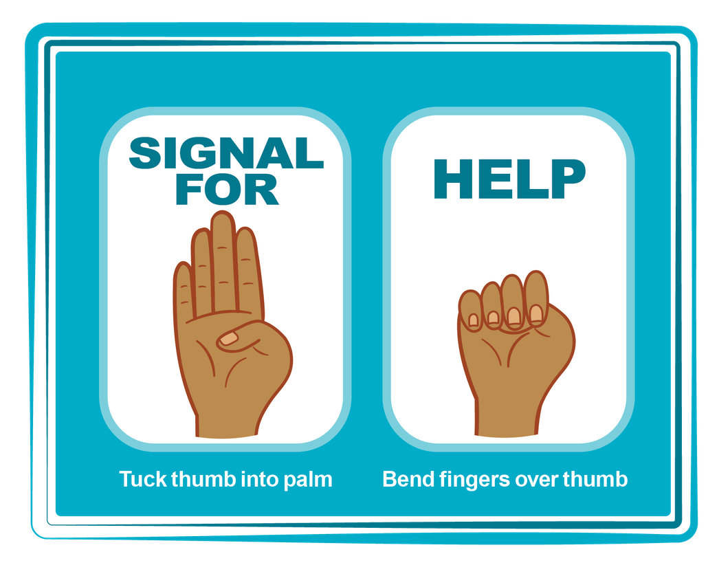
HAND SIGNAL FOR HELP
©2024-2026 Walking Wise
Source: Canadian Women’s Foundation, April 2020
87
Notes:
Although the hand signal for help has not yet achieved universal recognition, it may discreetly get someone's attention in urgent situations.
SILENT
It can be used silently.
UNTRACKABLE
It leaves no digital footprint.
CONCEALED
It can be done secretly when a perpetrator is nearby.
SIGNALS DISTRESS
Combining the hand signal with distressed facial expressions might help attract the attention of an individual who is unfamiliar with the signal's meaning.
Source
Canadian Women's Foundation, April 2020

Slide 88
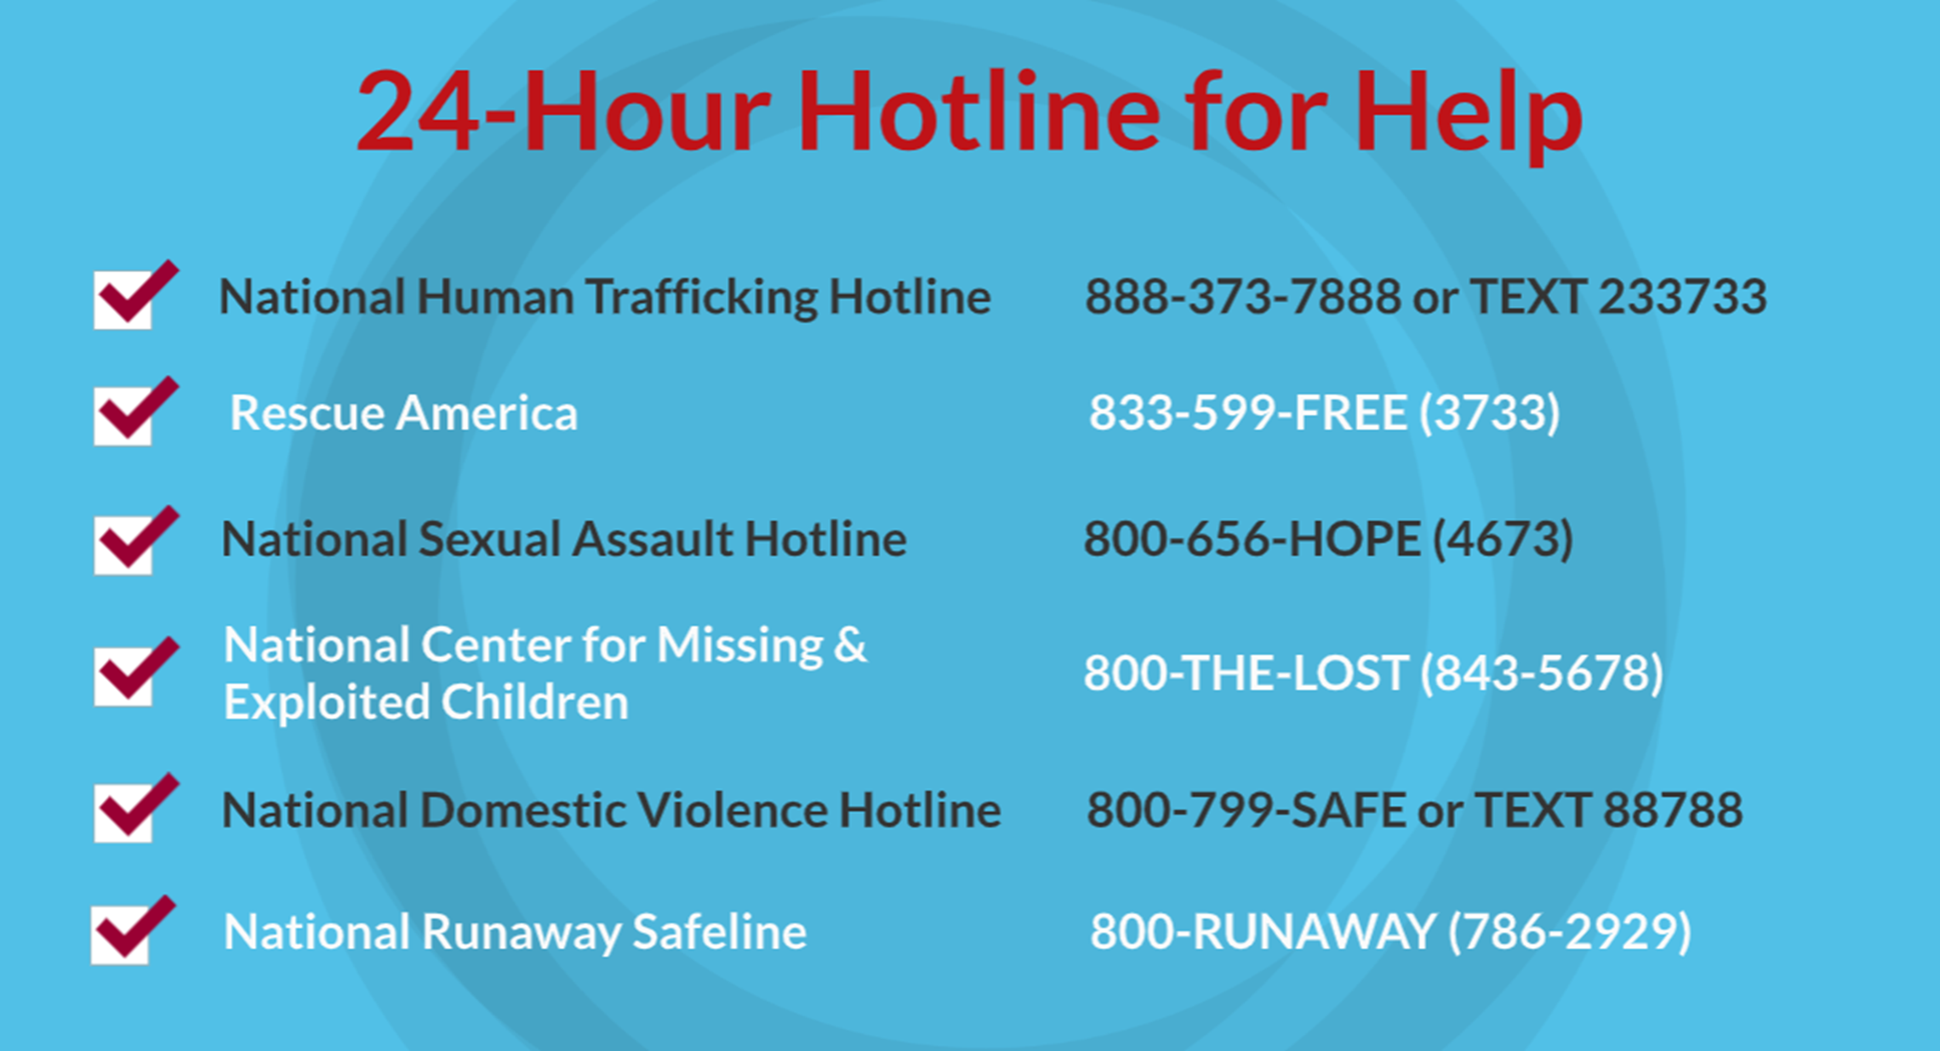
©2024-2026 Walking Wise
88
Notes:
NOTE TO PRESENTER
Presenters may ask their audience to consider adding a few "hotline for help" phone numbers to their cell phone contacts or take a photo of this slide.

Slide 89



Thank you!
WalkingWise.com
Online Course for Adults Accredited by:
Postgraduate Institue for Medicine
Academy of Forensic Nursing
©2024-2026 Walking Wise
89
Notes:
NOTE TO PRESENTER
To access additional resources about the myths, please refer to the last page of Lesson Plan #1 by logging in to the Walking Wise Learning Platform.
We welcome your feedback at support@WalkingWise.com.

