Slide 1


SEXUAL EXPLOITATION
EDUCATION
FOR PARENTS, STAFF MEMBERS, & OLDER YOUTH
Myths
&REALITY
LESSON #1
Notes:
NOTE
Log in to WalkingWise.com and refer to the Walking Wise Education Guide to implement classroom teaching tips.
Most importantly:
• DEFINE SCHOOL POLICY
Establish a sexual exploitation reporting protocol with a trauma-informed response. The Walking Wise Implementation Guide provides a sample protocol.
• AGE & AUDIENCE
This presentation can be edited by following the procedures on page 3 to align with your school policies, specific age groups, and the involvement of at-risk audiences.
• SUPPORT PROCEDURE
Provide your audience with guidance on accessing immediate help or arranging a private meeting with a social worker, counselor, nurse, school resource officer, or another trustworthy staff member to report concerns for themselves or a peer.
• SECOND SAFE ADULT
Ensure a second trustworthy adult, such as a teacher, is present in the learning setting to observe audience reactions and identify those who may benefit from a follow-up meeting. This person should remain focused and free from other duties during the presentation.
• IMPLEMENT SLIDO.com
Please log in to WalkingWise.com for instructions on incorporating Slido into the PowerPoint presentation to engage your audience using digital polling.

Slide 2

NOTE TO PRESENTER
This Myths & Reality presentation was created for parents, staff members, and young adults. It can also be shared with older high school students (juniors and seniors); however, please ensure the sextortion slide (p. 48)—containing sexting acronyms is removed before presenting.
Trafficking risk factors and indicators are shared at the end of this presentation on pages 100-168 (one bullet point is populated per page). If time constraints prevent covering this information during your presentation, consider providing adult audiences with a handout summarizing the risk factors, indicators, and sexting acronyms used by sextortionists and groomers. These handouts are available at WalkingWise.com under Classroom Presentations > Myths & Reality.
Please delete this instruction page before presenting to audiences.
Myths
&REALITY
©2025 Walking Wise
2

Slide 3
NOTE TO PRESENTER
This presentation is exclusively for Walking Wise® subscribers and not for redistribution.
Walking Wise provides an interactive digital tool, Slido.com, to enhance audience engagement. To implement Slido for your organization, you can log in to WalkingWise.com for setup instructions. Once configured, integrate Slido polling and add a post-evaluation into the PowerPoint presentation.
Presenters are encouraged to edit speaker notes to match their speaking style (viewable in presentation mode). You can also delete slides from this Walking Wise presentation to make sure the content aligns with your school policies, is age-appropriate, and fits within available class time. However, the existing slides are copyright-protected and may not be modified without prior written permission from Walking Wise.
If you would like to add your own content, you may do so under the following conditions:
  Insert new PowerPoint slides.
  Remove the Walking Wise logo and copyright "©2025 Walking Wise" from the new slides.
  Always add your organization's name or logo to each new slide.
Please delete this instruction page before presenting to audiences.
©2025 Walking Wise
3
Notes:
NOTE
The presenter is welcome to customize this Walking Wise presentation according to the instructions provided on this page.
For revision requests, please send an email to support@WalkingWise.com.

Slide 4

CONFRONTING SEXUAL EXPLOITATION
WALKING WISE
KNOWLEDGE serves as a
powerful defense against
sexual predators.
©2025 Walking Wise
4

Slide 5
CONFRONTING SEXUAL EXPLOITATION
WALKING WISE
SEXUAL EXPLOITATION includes grooming, sextortion, pornography
& sex trafficking.
©2025 Walking Wise
5

Slide 6
SENSITIVE DISCUSSION AHEAD
CONTENT ALERT
We’ll be discussing serious issues about sexual exploitation.
Some parts may be difficult to hear.
If you ever feel uncomfortable, you can step out and speak with a trustworthy adult for support.
You’re not alone—we’re here to help you.
©2025 Walking Wise
6
Notes:
NOTE TO PRESENTER
Please tailor this message to align with your organization's policies and protocols.
Please provide a confidential avenue for students to report concerns and seek help for themselves or their peers if they suspect sexual abuse, grooming, sextortion, pornography-related exploitation, or human trafficking. This may include a designated address or text line.
Consider displaying posters in your school or facility that outline various ways students can access immediate support or request a private meeting with a school safety team member or another trusted adult.

Slide 7

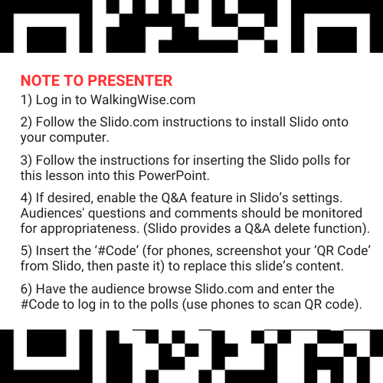
DIGITAL PARTICIPATION
©2025 Walking Wise
7
Notes:
NOTE
For digital interaction with audiences:
Log in to WalkingWise.com to follow instructions on setting up Slido questions/answers for this presentation. Then, replace the QR code and #code in this slide with your custom QR/#code.
Please verify whether the Q&A feature has been activated before presenting to audiences. An adult should monitor questions and comments to ensure appropriateness. Slido has a feature that allows you to delete unwanted questions and comments.

Slide 8


STATISTICS
Statistics are Only Estimates
  Study results may be unreliable because most sexual crimes go unreported.
Myths
&REALITY
©2025 Walking Wise
8
Notes:
In this presentation, we'll discuss statistics, but it's important to note that while statistics provide valuable insights into an issue, they cannot be entirely relied upon.
Here are a few reasons:
• UNREPORTED
Victims may stay silent due to fear, shame, or manipulation.
• INCONSISTENT COLLECTION
Geographical areas have different legal definitions for sexual crimes, making data hard to compare.
• FOCUS GROUPS
Small or specific focus groups participating in a study or survey may not accurately reflect the diversity or experiences of the broader population.

Slide 9
STATISTICS
Statistics are Only Estimates
  Study results may be unreliable because most sexual crimes go unreported.
  The methods used to collect information can vary widely between studies, leading to inconsistency.
Myths
&REALITY
©2025 Walking Wise
9
Notes:
In this presentation, we'll discuss statistics, but it's important to note that while statistics provide valuable insights into an issue, they cannot be entirely relied upon.
Here are a few reasons:
• UNREPORTED
Victims may stay silent due to fear, shame, or manipulation.
• INCONSISTENT COLLECTION
Geographical areas have different legal definitions for sexual crimes, making data hard to compare.
• FOCUS GROUPS
Small or specific focus groups participating in a study or survey may not accurately reflect the diversity or experiences of the broader population.

Slide 10
STATISTICS
Statistics are Only Estimates
  Study results may be unreliable because most sexual crimes go unreported.
  The methods used to collect information can vary widely between studies, leading to inconsistency.
  Focus groups in studies may not accurately represent the larger population.
Myths
&REALITY
©2025 Walking Wise
10
Notes:
In this presentation, we'll discuss statistics, but it's important to note that while statistics provide valuable insights into an issue, they cannot be entirely relied upon.
Here are a few reasons:
• UNREPORTED
Victims may stay silent due to fear, shame, or manipulation.
• INCONSISTENT COLLECTION
Geographical areas have different legal definitions for sexual crimes, making data hard to compare.
• FOCUS GROUPS
Small or specific focus groups participating in a study or survey may not accurately reflect the diversity or experiences of the broader population.

Slide 11

EDUCATON GUIDE
VOCABULARY
VOCABULARY
  Child Exploitation
  Commercial Sex
  Child Sex Trafficking
  Myth
  Sex Trafficking
  Coercion
  Labor Trafficking
  Safe Harbor
  Manipulation
  Intimidation
Myths
&REALITY
©2025 Walking Wise
11
3
Notes:
NOTE
Understanding vocabulary terms related to the behaviors of sexual predators can empower young people to recognize warning signs of harmful situations.
Knowing terminology helps them identify manipulative tactics predators use to build trust and exploit vulnerabilities.
With this knowledge, young people are better equipped to spot red flags, understand that these behaviors are abusive, and feel more confident reporting predators to trusted adults or authorities, potentially preventing further harm.

Slide 12
EDUCATON GUIDE
VOCABULARY
CHILD EXPLOITATION
The use of a child for someone else’s benefit, often in an abusive, unfair, or harmful manner.
Includes: Sexual exploitation (grooming & sex trafficking), sextortion,
labor trafficking, and criminal activity (i.e., drug dealing and theft).
Myths
&REALITY
©2025 Walking Wise
Section 7102. 22 USC Ch. 78: Trafficking Victims Protection, From Title 22—Foreign Relations and Intercourse.
12
3
Notes:
Assisting Source
OpenAI. (2024). ChatGPT [Large language model]. https://chatgpt.com
FOR LEGAL DEFINITION:
Section 7102. 22 USC Ch. 78: Trafficking Victims Protection, From Title 22—Foreign Relations and Intercourse. Retrieved January 3, 2025, from https://uscode.house.gov/view.xhtml?hl=false&edition=prelim&path=%2Fprelim%40title22%2Fchapter78&req=granuleid%3AUSC-prelim-title22-chapter78&num=0&saved=L3ByZWxpbUB0aXRsZTIyL2NoYXB0ZXI3OA%3D%3D%7CZ3JhbnVsZWlkOlVTQy1wcmVsaW0tdGl0bGUyMi1jaGFwdGVyNzg%3D%7C%7C%7C0%7Cfalse%7Cprelim
Criminal Division, U.S. Department of Justice. Citizen's Guide To U.S. Federal Law On Child Sex Trafficking. Retrieved January 3, 2025, from https://www.justice.gov/criminal/criminal-ceos/citizens-guide-us-federal-law-child-sex-trafficking

Slide 13
EDUCATON GUIDE
VOCABULARY
COMMERCIAL SEX
Any sex act on account of which anything of value is given to or received by any person.
Myths
&REALITY
©2025 Walking Wise
Section 7102. 22 USC Ch. 78: Trafficking Victims Protection, From Title 22—Foreign Relations and Intercourse.
13
3
Notes:
Assisting Source
OpenAI. (2024). ChatGPT [Large language model]. https://chatgpt.com
FOR LEGAL DEFINITION:
Section 7102. 22 USC Ch. 78: Trafficking Victims Protection, From Title 22—Foreign Relations and Intercourse. Retrieved January 3, 2025, from https://uscode.house.gov/view.xhtml?hl=false&edition=prelim&path=%2Fprelim%40title22%2Fchapter78&req=granuleid%3AUSC-prelim-title22-chapter78&num=0&saved=L3ByZWxpbUB0aXRsZTIyL2NoYXB0ZXI3OA%3D%3D%7CZ3JhbnVsZWlkOlVTQy1wcmVsaW0tdGl0bGUyMi1jaGFwdGVyNzg%3D%7C%7C%7C0%7Cfalse%7Cprelim
Criminal Division, U.S. Department of Justice. Citizen's Guide To U.S. Federal Law On Child Sex Trafficking. Retrieved January 3, 2025, from https://www.justice.gov/criminal/criminal-ceos/citizens-guide-us-federal-law-child-sex-trafficking

Slide 14
EDUCATON GUIDE
VOCABULARY
MYTH
A false belief commonly held by a group.
Myths
&REALITY
©2025 Walking Wise
14
3
Notes:
Assisting Source
OpenAI. (2024). ChatGPT [Large language model]. https://chatgpt.com

Slide 15
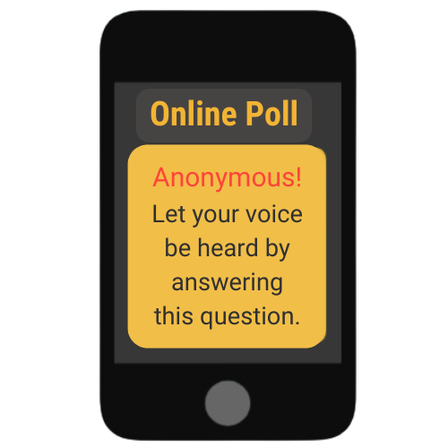
LESSON PLANS
MYTH OR REALITY?
Myth or Reality? All commercial sex is considered human trafficking.
Myths
&REALITY
©2025 Walking Wise
Polaris Project (2025) Myths, Facts, and Statistics. PolarisProject.org.
15
3
Notes:
Online Polling Interaction
All commercial sex is considered human trafficking.
A) Myth
B) Reality
ANSWER
A) Myth - Not all commercial sex is human trafficking, as some adults willfully choose to participate in what is described as 'sex work.'
Commercial sex involving a minor is always legally considered human trafficking.
Commercial sex involving an adult is human trafficking if the person providing commercial sex is doing so against his or her will as a result of force, fraud, or coercion.
Source
Polaris Project (2025) Myths, Facts, and Statistics. PolarisProject.org., Retrieved January 6, 2025, from https://polarisproject.org/myths-facts-and-statistics/?gad_source=1&gclid=CjwKCAiAm-67BhBlEiwAEVftNpjEBS3aD54aH9qHzJjL01wnVgSL4rc8WgP7CHE_PvAjOR1wN9AchBoCgk8QAvD_BwE

Slide 16
EDUCATON GUIDE
VOCABULARY
SEX TRAFFICKING
A commercial sex act that involves an adult through the use of FORCE, FRAUD, COERCION, OR a CHILD under age 18.
Myths
&REALITY
©2025 Walking Wise
Section 7102. 22 USC Ch. 78: Trafficking Victims Protection, From Title 22—Foreign Relations and Intercourse.
16
3
Notes:
Assisting Source
OpenAI. (2024). ChatGPT [Large language model]. https://chatgpt.com
FOR LEGAL DEFINITION:
Section 7102. 22 USC Ch. 78: Trafficking Victims Protection, From Title 22—Foreign Relations and Intercourse. Retrieved January 3, 2025, from https://uscode.house.gov/view.xhtml?hl=false&edition=prelim&path=%2Fprelim%40title22%2Fchapter78&req=granuleid%3AUSC-prelim-title22-chapter78&num=0&saved=L3ByZWxpbUB0aXRsZTIyL2NoYXB0ZXI3OA%3D%3D%7CZ3JhbnVsZWlkOlVTQy1wcmVsaW0tdGl0bGUyMi1jaGFwdGVyNzg%3D%7C%7C%7C0%7Cfalse%7Cprelim

Slide 17
EDUCATON GUIDE
VOCABULARY
CHILD SEX TRAFFICKING
It is illegal to knowingly recruit, entice, transport, harbor, or maintain a minor, knowing or disregarding the fact that they are underage, for the purpose of engaging them in a sex act in exchange for anything of value.
Myths
&REALITY
©2025 Walking Wise
Criminal Division, U.S. Department of Justice (2025). Citizen's Guide To U.S. Federal Law On Child Sex Trafficking.
17
3
Notes:
Assisting Source
OpenAI. (2024). ChatGPT [Large language model]. https://chatgpt.com
Criminal Division, U.S. Department of Justice. Citizen's Guide To U.S. Federal Law On Child Sex Trafficking. Retrieved January 3, 2025, from https://www.justice.gov/criminal/criminal-ceos/citizens-guide-us-federal-law-child-sex-trafficking
For Legal Definition:
18 USC 1591: Sex trafficking of children or by force, fraud, or coercion. (n.d.). Title 18- Crimes and Criminal Procedure, Part 1 - Crimes Chapter 77 - Peonage and Slavery. Retrieved January 3, 2025, from https://uscode.house.gov/view.xhtml?req=granuleid%3AUSC-2000-title18-section1591&num=0&edition=2000#sourcecredit

Slide 18
COMMERCIAL SEX INDUSTRY
Prostitution
  Involves adults (18+) willfully engaging, agreeing, or offering to engage in sexual conduct with another person in return for a fee.[1]
©2025 Walking Wise
Cornell Law School (n.d.). Legal Information Institute: Prostitution. Law.Cornell.edu.
18
Notes:
Source
Cornell Law School (n.d.). Legal Information Institute: Prostitution. Law.Cornell.edu. Retrieved January 13, 2025, from Cornell Law School (n.d.). Legal Information Institute: Prostitution. Law.Cornell.edu.

Slide 19
COMMERCIAL SEX INDUSTRY
Prostitution
  Involves adults (18+) willfully engaging, agreeing, or offering to engage in sexual conduct with another person in return for a fee.[1]
  Prostitution is illegal throughout the U.S. except in certain rural counties in Nevada.
©2025 Walking Wise
  Cornell Law School (n.d.). Legal Information Institute: Prostitution. Law.Cornell.edu.
19
Notes:
Source
Cornell Law School (n.d.). Legal Information Institute: Prostitution. Law.Cornell.edu. Retrieved January 13, 2025, from Cornell Law School (n.d.). Legal Information Institute: Prostitution. Law.Cornell.edu.

Slide 20
COMMERCIAL SEX INDUSTRY
Prostitution
  Involves adults (18+) willfully engaging, agreeing, or offering to engage in sexual conduct with another person in return for a fee.[1]
  Prostitution is illegal throughout the U.S. except in certain rural counties in Nevada.[1]
  Those held accountable for involvement include traffickers (pimps), sex buyers, and volunteered adult 'sex workers.'
©2025 Walking Wise
  Cornell Law School (n.d.). Legal Information Institute: Prostitution. Law.Cornell.edu.
20
Notes:
Source
Cornell Law School (n.d.). Legal Information Institute: Prostitution. Law.Cornell.edu. Retrieved January 13, 2025, from Cornell Law School (n.d.). Legal Information Institute: Prostitution. Law.Cornell.edu.

Slide 21
LESSON PLANS
TRAFFICKING INDUSTRIES
Myth or Reality? Human trafficking only happens in illegal or underground industries in the U.S.
Myths
&REALITY
©2025 Walking Wise
Polaris Project (2025) Myths, Facts, and Statistics. PolarisProject.org.
21
3
Notes:
Online Polling Interaction
Human trafficking happens in illegal or underground industries in the U.S.
A) Myth
B) Reality
ANSWER:
A) Myth - Human trafficking occurs in both legal and illegal businesses and industries.
Source
Polaris Project (2025) Myths, Facts, and Statistics. PolarisProject.org., Retrieved January 6, 2025, from https://polarisproject.org/myths-facts-and-statistics/?gad_source=1&gclid=CjwKCAiAm-67BhBlEiwAEVftNpjEBS3aD54aH9qHzJjL01wnVgSL4rc8WgP7CHE_PvAjOR1wN9AchBoCgk8QAvD_BwE

Slide 22
EDUCATON GUIDE
VOCABULARY
LABOR TRAFFICKING
The recruitment, harboring, transportation, provision, or obtaining of a person for labor or services through the use of force, fraud, or coercion.
Includes: involuntary servitude, peonage, debt bondage, or slavery.
Myths
&REALITY
©2025 Walking Wise
Section 7102. 22 USC Ch. 78: Trafficking Victims Protection, From Title 22—Foreign Relations and Intercourse.
22
3
Notes:
• HARBORING
An act of providing shelter or concealment for someone to engage in illegal activities, such as human trafficking.
• INVOLUNTARY SERVITUDE
A condition where individuals are forced to work against their will through threats, coercion, or abuse and are unable to leave freely.
• DEBT BONDAGE
A form of exploitation where individuals are forced to work to repay a debt, often under unfair conditions that make it impossible to fully pay off, trapping them in a cycle of servitude.
• PEONAGE
A system of forced labor where individuals are compelled to work to pay off a debt, often under exploitative and coercive conditions.
• SLAVERY
The practice of owning and controlling individuals as property, depriving them of freedom and forcing them to work without consent or fair compensation.
Source
OpenAI. (2024). ChatGPT [Large language model]. https://chatgpt.com
FOR LEGAL DEFINITION:
Section 7102. 22 USC Ch. 78: Trafficking Victims Protection, From Title 22—Foreign Relations and Intercourse. Retrieved January 3, 2025, from https://uscode.house.gov/view.xhtml?hl=false&edition=prelim&path=%2Fprelim%40title22%2Fchapter78&req=granuleid%3AUSC-prelim-title22-chapter78&num=0&saved=L3ByZWxpbUB0aXRsZTIyL2NoYXB0ZXI3OA%3D%3D%7CZ3JhbnVsZWlkOlVTQy1wcmVsaW0tdGl0bGUyMi1jaGFwdGVyNzg%3D%7C%7C%7C0%7Cfalse%7Cprelim

Slide 23
BUSINESSES & INDUSTRIES
Illicit Industries in Sex Trafficking
  Social Media Platforms
  Illicit Massage Parlors
  Entertainment Industry: Strip Clubs & Casinos
  Hospitality Industry: Hotels & Motels
  Sex Tourism
Myths
&REALITY
©2025 Walking Wise
23

Slide 24
BUSINESSES & INDUSTRIES
Illicit Industries in Labor Trafficking
  Hotel Housekeeping
  Restaurants & Tourism
  Agriculture: Crops, Livestock, Fisheries
  Logging & Mining
  Construction & Factories
  Carnivals
Myths
&REALITY
©2025 Walking Wise
24

Slide 25
LESSON PLANS
MY COMMUNITY
Myth or Reality? Sex trafficking involves violence against victims.
Myths
&REALITY
©2025 Walking Wise
Polaris Project (2025) Myths, Facts, and Statistics. PolarisProject.org.
25
3
Notes:
Online Polling Interaction
Sex trafficking involves violence against victims.
A) Myth
B) Reality
ANSWER
A) Myth. Sometimes violence is involved; however, traffickers often use manipulation, intimidation, and threats to control their victims.
Source
Polaris Project (2025) Myths, Facts, and Statistics. PolarisProject.org., Retrieved January 6, 2025, from https://polarisproject.org/myths-facts-and-statistics/?gad_source=1&gclid=CjwKCAiAm-67BhBlEiwAEVftNpjEBS3aD54aH9qHzJjL01wnVgSL4rc8WgP7CHE_PvAjOR1wN9AchBoCgk8QAvD_BwE

Slide 26
EDUCATON GUIDE
VOCABULARY
COERCE
To manipulate, threaten, or intimidate someone to act against their will.
Myths
&REALITY
©2025 Walking Wise
Section 7102. 22 USC Ch. 78: Trafficking Victims Protection, From Title 22—Foreign Relations and Intercourse.
26
3
Notes:
Assisting Source
OpenAI. (2024). ChatGPT [Large language model]. https://chatgpt.com
FOR LEGAL DEFINITION:
18 USC 1591: Sex trafficking of children or by force, fraud, or coercion. (n.d.). Title 18- Crimes and Criminal Procedure, Part 1 - Crimes Chapter 77 - Peonage and Slavery. Retrieved January 3, 2025, from https://uscode.house.gov/view.xhtml?req=granuleid%3AUSC-2000-title18-section1591&num=0&edition=2000#sourcecredit

Slide 27
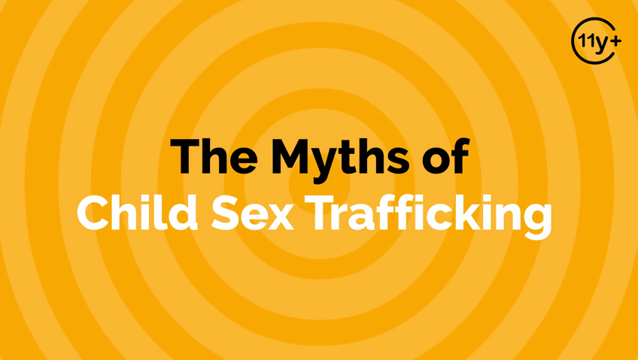
Log in to WalkingWise.com to access this animated video.
©2025 Walking Wise
27
Notes:
Message Especially for Teens:
Businesses worldwide use explainer-style animation as a training tool for their employees.
So, this 3-minute Walking Wise animated video series is appropriate for both teens (ages 11+) and adults to learn how sexual predators use manipulation, intimidation, and coercion to exploit young people.
NOTE
Log in to Walking Wise.com to watch the three-minute animated video with audiences.

Slide 28
EDUCATON GUIDE
PROTECTING CHILDREN
SAFE HARBOR ACT
State safe harbor laws recognize trafficked minors and disabled adults as victims, NOT criminals, and ensure their access to protection and care.
Myths
&REALITY
©2025 Walking Wise
Section 7102. 22 USC Ch. 78: Trafficking Victims Protection, From Title 22—Foreign Relations and Intercourse.
Shared Hope International Institute for Justice & Advocacy (n.d.). Report Cards on Child & Youth Sex Trafficking 2023 Toolkit, p. 33.
28
3
Notes:
Source
Shared Hope International Institute for Justice & Advocacy (n.d.). Report Cards on Child & Youth Sex Trafficking 2023 Toolkit, p. 33. Sharedhope.org. Retrieved January 5, 2025, from https://reportcards.sharedhope.org/wp-content/uploads/2023/11/2023_Toolkit.pdf
FOR LEGAL DEFINITION:
Section 7102. 22 USC Ch. 78: Trafficking Victims Protection, From Title 22—Foreign Relations and Intercourse. Retrieved January 3, 2025, from https://uscode.house.gov/view.xhtml?hl=false&edition=prelim&path=%2Fprelim%40title22%2Fchapter78&req=granuleid%3AUSC-prelim-title22-chapter78&num=0&saved=L3ByZWxpbUB0aXRsZTIyL2NoYXB0ZXI3OA%3D%3D%7CZ3JhbnVsZWlkOlVTQy1wcmVsaW0tdGl0bGUyMi1jaGFwdGVyNzg%3D%7C%7C%7C0%7Cfalse%7Cprelim

Slide 29
SAFE HARBOR
Abolishing the Prosecution of Children
  Without Safe Harbor Laws, child victims are arrested and prosecuted for prostitution crimes.
  Mullen, K., Lloyd, R. (n.d.) The Passage of the Safe Harbor Act and the Voice of Sexually Exploited Youth.
  Clayton E., Krugman, R., Simon, P. (2013). Confronting Commercial Sexual Exploitation and Sex Trafficking of Minors in the United States. Institute of Medicine and National Research Council of The National Academies.
  Shared Hope International Institute for Justice & Advocacy (n.d.). Report Cards on Child & Youth Sex Trafficking 2023 Toolkit, p. 33.
©2025 Walking Wise
29
Notes:
• NEW YORK
The first safe harbor law in the United States was enacted in New York in 2008. This legislation, known as the Safe Harbor Act, was signed into law by Governor David Paterson on September 25, 2008. It marked New York as the first state to recognize that minors subjected to sexual trafficking required protection rather than detention.[1]
• 2013 STUDY
Confronting Commercial Sexual Exploitation and Sex Trafficking of Minors in the United States[2]
Source
Mullen, K., Lloyd, R. (n.d.) The Passage of the Safe Harbor Act and the Voice of Sexually Exploited Youth. Retrieved January 6, 2025, from https://ww2.nycourts.gov/sites/default/files/document/files/2018-07/MULLEN%20_HUMAN%20TRAFFICKING_1_d_0.pdf
2. Clayton E., Krugman, R., Simon, P. (2013). Confronting Commercial Sexual Exploitation and Sex Trafficking of Minors in the United States. Institute of Medicine and National Research Council of The National Academies. Retrieved January 6, 2025, from https://ojjdp.ojp.gov/sites/g/files/xyckuh176/files/pubs/243838.pdf

Slide 30
SAFE HARBOR
Abolishing the Prosecution of Children
  Without Safe Harbor laws, child victims are arrested and prosecuted for prostitution crimes.
  The Safe Harbor Act was FIRST signed into law by the State of New York in 2008.[1]
  Mullen, K., Lloyd, R. (n.d.) The Passage of the Safe Harbor Act and the Voice of Sexually Exploited Youth.
  Clayton E., Krugman, R., Simon, P. (2013). Confronting Commercial Sexual Exploitation and Sex Trafficking of Minors in the United States. Institute of Medicine and National Research Council of The National Academies.
  Shared Hope International Institute for Justice & Advocacy (n.d.). Report Cards on Child & Youth Sex Trafficking 2023 Toolkit, p. 33.
©2025 Walking Wise
30
Notes:
• NEW YORK
The first safe harbor law in the United States was enacted in New York in 2008. This legislation, known as the Safe Harbor Act, was signed into law by Governor David Paterson on September 25, 2008. It marked New York as the first state to recognize that minors subjected to sexual trafficking required protection rather than detention.[1]
• 2013 STUDY
Confronting Commercial Sexual Exploitation and Sex Trafficking of Minors in the United States[2]
Source
Mullen, K., Lloyd, R. (n.d.) The Passage of the Safe Harbor Act and the Voice of Sexually Exploited Youth. Retrieved January 6, 2025, from https://ww2.nycourts.gov/sites/default/files/document/files/2018-07/MULLEN%20_HUMAN%20TRAFFICKING_1_d_0.pdf
2. Clayton E., Krugman, R., Simon, P. (2013). Confronting Commercial Sexual Exploitation and Sex Trafficking of Minors in the United States. Institute of Medicine and National Research Council of The National Academies. Retrieved January 6, 2025, from https://ojjdp.ojp.gov/sites/g/files/xyckuh176/files/pubs/243838.pdf

Slide 31
SAFE HARBOR
Abolishing the Prosecution of Children
  Without Safe Harbor laws, child victims are arrested and prosecuted for prostitution crimes.
  The Safe Harbor Act was FIRST signed into law by the State of New York in 2008.[1]
  A 2013 study on the trafficking of minors raised awareness, which led to other states passing Safe Harbor legislation.[2]
  Mullen, K., Lloyd, R. (n.d.) The Passage of the Safe Harbor Act and the Voice of Sexually Exploited Youth.
  Clayton E., Krugman, R., Simon, P. (2013). Confronting Commercial Sexual Exploitation and Sex Trafficking of Minors in the United States. Institute of Medicine and National Research Council of The National Academies.
  Shared Hope International Institute for Justice & Advocacy (n.d.). Report Cards on Child & Youth Sex Trafficking 2023 Toolkit, p. 33.
©2025 Walking Wise
31
Notes:
• NEW YORK
The first safe harbor law in the United States was enacted in New York in 2008. This legislation, known as the Safe Harbor Act, was signed into law by Governor David Paterson on September 25, 2008. It marked New York as the first state to recognize that minors subjected to sexual trafficking required protection rather than detention.[1]
• 2013 STUDY
Confronting Commercial Sexual Exploitation and Sex Trafficking of Minors in the United States[2]
Source
Mullen, K., Lloyd, R. (n.d.) The Passage of the Safe Harbor Act and the Voice of Sexually Exploited Youth. Retrieved January 6, 2025, from https://ww2.nycourts.gov/sites/default/files/document/files/2018-07/MULLEN%20_HUMAN%20TRAFFICKING_1_d_0.pdf
2. Clayton E., Krugman, R., Simon, P. (2013). Confronting Commercial Sexual Exploitation and Sex Trafficking of Minors in the United States. Institute of Medicine and National Research Council of The National Academies. Retrieved January 6, 2025, from https://ojjdp.ojp.gov/sites/g/files/xyckuh176/files/pubs/243838.pdf

Slide 32
SAFE HARBOR
Federal Law Calls for State Enforcement
  Treat a child (under 18) as a victim rather than a criminal.
©2025 Walking Wise
22 USC 7101: Purposes and findings. Title 22-Foreign Relations and Intercourse. Chapter 78 - Trafficking Victims Protection.
32
Notes:
NOTE
The U.S. government provides legal guidance for states to enact State Harbor laws, as indicated in this slide.
Source
United States Code (n.d.). Title 22, Chapter 78 – Trafficking Victims Protection, §7101. Purposes and findings.USC.house.gov. Retrieved January 5, 2025, from https://uscode.house.gov/view.xhtml?hl=false&edition=prelim&path=%2Fprelim%40title22%2Fchapter78&req=granuleid%3AUSC-prelim-title22-section7101&num=0&saved=L3ByZWxpbUB0aXRsZTIyL2NoYXB0ZXI3OA%3D%3D%7CZ3JhbnVsZWlkOlVTQy1wcmVsaW0tdGl0bGUyMi1jaGFwdGVyNzg%3D%7C%7C%7C0%7Cfalse%7Cprelim

Slide 33
SAFE HARBOR
Federal Law Calls for State Enforcement
  Treat a child (under 18) as a victim rather than a criminal.
  Prohibit prosecuting children for prostitution offenses.
©2025 Walking Wise
22 USC 7101: Purposes and findings. Title 22-Foreign Relations and Intercourse. Chapter 78 - Trafficking Victims Protection.
33
Notes:
NOTE
The U.S. government provides legal guidance for states to enact State Harbor laws, as indicated in this slide.
Source
United States Code (n.d.). Title 22, Chapter 78 – Trafficking Victims Protection, §7101. Purposes and findings.USC.house.gov. Retrieved January 5, 2025, from https://uscode.house.gov/view.xhtml?hl=false&edition=prelim&path=%2Fprelim%40title22%2Fchapter78&req=granuleid%3AUSC-prelim-title22-section7101&num=0&saved=L3ByZWxpbUB0aXRsZTIyL2NoYXB0ZXI3OA%3D%3D%7CZ3JhbnVsZWlkOlVTQy1wcmVsaW0tdGl0bGUyMi1jaGFwdGVyNzg%3D%7C%7C%7C0%7Cfalse%7Cprelim

Slide 34
SAFE HARBOR
Federal Law Calls for State Enforcement
  Treat a child (under 18) as a victim rather than a criminal.
  Prohibit prosecuting children for prostitution offenses.
  Ensure that children are referred to appropriate service providers for necessary care and support.
©2025 Walking Wise
22 USC 7101: Purposes and findings. Title 22-Foreign Relations and Intercourse. Chapter 78 - Trafficking Victims Protection.
34
Notes:
NOTE
The U.S. government provides legal guidance for states to enact State Harbor laws, as indicated in this slide.
Source
United States Code (n.d.). Title 22, Chapter 78 – Trafficking Victims Protection, §7101. Purposes and findings.USC.house.gov. Retrieved January 5, 2025, from https://uscode.house.gov/view.xhtml?hl=false&edition=prelim&path=%2Fprelim%40title22%2Fchapter78&req=granuleid%3AUSC-prelim-title22-section7101&num=0&saved=L3ByZWxpbUB0aXRsZTIyL2NoYXB0ZXI3OA%3D%3D%7CZ3JhbnVsZWlkOlVTQy1wcmVsaW0tdGl0bGUyMi1jaGFwdGVyNzg%3D%7C%7C%7C0%7Cfalse%7Cprelim

Slide 35
SAFE HARBOR
Federal Law Calls for State Enforcement
  Treat children (under 18) as victims rather than criminals.
  Prohibit prosecuting children for prostitution offenses.
  Ensure children are referred to appropriate service providers for necessary care and support.
  Ensure the children are NOT required to prove they have been victimized by force, fraud, or coercion in order to receive protection and care.
©2025 Walking Wise
22 USC 7101: Purposes and findings. Title 22-Foreign Relations and Intercourse. Chapter 78 - Trafficking Victims Protection.
35
Notes:
NOTE
The U.S. government provides legal guidance for states to enact State Harbor laws, as indicated in this slide.
Source
United States Code (n.d.). Title 22, Chapter 78 – Trafficking Victims Protection, §7101. Purposes and findings.USC.house.gov. Retrieved January 5, 2025, from https://uscode.house.gov/view.xhtml?hl=false&edition=prelim&path=%2Fprelim%40title22%2Fchapter78&req=granuleid%3AUSC-prelim-title22-section7101&num=0&saved=L3ByZWxpbUB0aXRsZTIyL2NoYXB0ZXI3OA%3D%3D%7CZ3JhbnVsZWlkOlVTQy1wcmVsaW0tdGl0bGUyMi1jaGFwdGVyNzg%3D%7C%7C%7C0%7Cfalse%7Cprelim

Slide 36
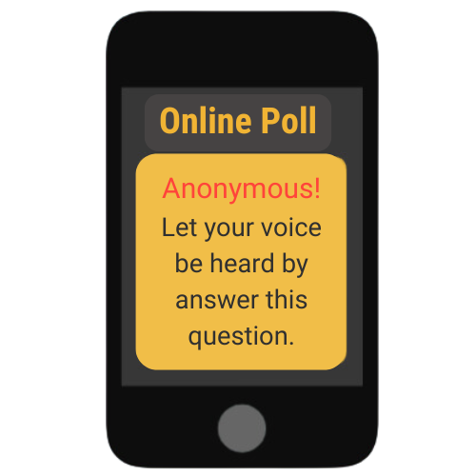
LESSON PLANS
MYTH OR REALITY?
Myth or Reality? Sex trafficking requires the transportation of victims across state or international borders.
Myths
&REALITY
©2025 Walking Wise
36
3
Notes:
Online Polling Interaction
Sex trafficking requires the transportation of victims across state or international borders.
A) Myth
B) Reality
ANSWER
A) Myth. Human trafficking crimes often occur within victims' own communities, as well as across state or international boarders.
The Trafficking Victims Protection Act (TVPA) prohibits the transportation of victims across state and national borders.
Source
National Human Trafficking Hotline (n.d.). Fact Sheet: Human Trafficking. The Administration for Children and Families. Retrieved May 1, 2024, from https://www.acf.hhs.gov/otip/fact-sheet/resource/fshumantrafficking

Slide 37
TRANSPORTATION
Local vs. Long Distance
  Victims can be trafficked near their homes, in their homes, and long distances from their communities.
©2025 Walking Wise
  National Human Trafficking Hotline (n.d.). Fact Sheet: Human Trafficking. The Administration for Children and Families.
  One Hundred Sixth Congress of the United States of America at the Second Session (2000, January 24). Victims of Trafficking and Violence Protection Act of 2000
37
Notes:
Source
1. National Human Trafficking Hotline (n.d.). Fact Sheet: Human Trafficking. The Administration for Children and Families. Retrieved January 25, 2025, from https://www.acf.hhs.gov/otip/fact-sheet/resource/fshumantrafficking
2. One Hundred Sixth Congress of the United States of America at the Second Session (2000, January 24). Victims of Trafficking and Violence Protection Act of 2000. GovInfo.gov. Retrieved January 6, 2025, from https://www.govinfo.gov/content/pkg/BILLS-106hr3244enr/pdf/BILLS-106hr3244enr.pdf

Slide 38
TRANSPORTATION
Local vs. Long Distance
  Victims can be trafficked near their homes, in their homes, and long distances from their communities.
  Traffickers often relocate victims across state lines to serve new buyers.[1]
©2025 Walking Wise
  National Human Trafficking Hotline (n.d.). Fact Sheet: Human Trafficking. The Administration for Children and Families.
  One Hundred Sixth Congress of the United States of America at the Second Session (2000, January 24). Victims of Trafficking and Violence Protection Act of 2000
38
Notes:
Source
1. National Human Trafficking Hotline (n.d.). Fact Sheet: Human Trafficking. The Administration for Children and Families. Retrieved January 25, 2025, from https://www.acf.hhs.gov/otip/fact-sheet/resource/fshumantrafficking
2. One Hundred Sixth Congress of the United States of America at the Second Session (2000, January 24). Victims of Trafficking and Violence Protection Act of 2000. GovInfo.gov. Retrieved January 6, 2025, from https://www.govinfo.gov/content/pkg/BILLS-106hr3244enr/pdf/BILLS-106hr3244enr.pdf

Slide 39
TRANSPORTATION
Local vs. Long Distance
  Victims can be trafficked near their homes, in their homes, and long distances from their communities.
  Traffickers often relocate victims across state lines to serve new buyers.[1]
  Trafficking Victims Protection Act (TVPA) makes it illegal to move or arrange the travel of victims.[2]
©2025 Walking Wise
  National Human Trafficking Hotline (n.d.). Fact Sheet: Human Trafficking. The Administration for Children and Families.
  One Hundred Sixth Congress of the United States of America at the Second Session (2000, January 24). Victims of Trafficking and Violence Protection Act of 2000
39
Notes:
Source
1. National Human Trafficking Hotline (n.d.). Fact Sheet: Human Trafficking. The Administration for Children and Families. Retrieved January 25, 2025, from https://www.acf.hhs.gov/otip/fact-sheet/resource/fshumantrafficking
2. One Hundred Sixth Congress of the United States of America at the Second Session (2000, January 24). Victims of Trafficking and Violence Protection Act of 2000. GovInfo.gov. Retrieved January 6, 2025, from https://www.govinfo.gov/content/pkg/BILLS-106hr3244enr/pdf/BILLS-106hr3244enr.pdf

Slide 40
LESSON PLANS
TRAFFICKING MYTH
MYTH: Sex traffickers only target females.
Myths
&REALITY
©2025 Walking Wise
40
3
Notes:
MYTH: It is a myth that sex traffickers only target females.

Slide 41
LESSON PLANS
MALE VICTIM
What percent of males are trafficked in the U.S. commercial sex trade?
Myths
&REALITY
©2025 Walking Wise
Swaner, R., Labriola, M., Rempel, M., Walker, A., & Spadafore, J. (2016, March). Youth Involvement in the Sex Trade: A National Study, p. 40.
41
3
Notes:
Online Polling Interaction
What percent of males are trafficked in the U.S. commercial sex trade?
A) 6%
B) 16%
C) 26%
D) 36%
ANSWER
D) 36% of males are believed to be victims of sex trafficking.
Source
Swaner, R., Labriola, M., Rempel, M., Walker, A., & Spadafore, J. (2016, March). Youth Involvement in the Sex Trade: A National Study, p. 40. Courtinnovation.org. Retrieved February 25, 2024, from https://www.ojp.gov/pdffiles1/ojjdp/grants/249952.pdf

Slide 42
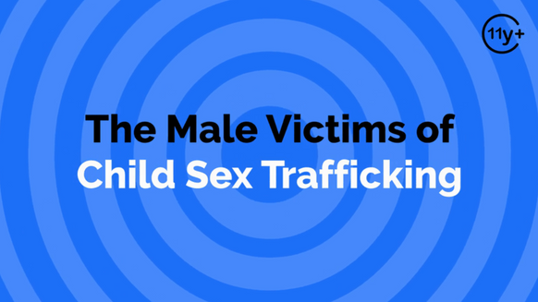
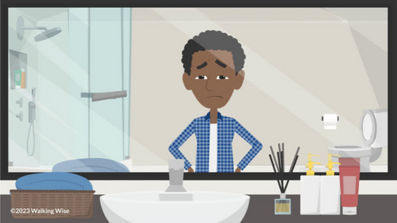
REALITY
Males are Victims Too
  90% to 95% of sexual violations against males are not reported.[1]
  Thomas, J. C., & Kopel, J. (2023). Male Victims of Sexual Assault: A Review of the Literature. Behavioral Sciences (Basel, Switzerland), 13(4), 304
  Dube, S. R., Anda, R. F., Whitfield, C. L., Brown, D. W., Felitti, V. J., Dong, M., & Giles, W. H. (2005). Long-term consequences of childhood sexual abuse by gender of victim. American Journal of Preventive Medicine, 28(5), 430–438.
©2025 Walking Wise
42
Notes:
Source
1. Thomas, J. C., & Kopel, J. (2023). Male Victims of Sexual Assault: A Review of the Literature. Behavioral sciences (Basel, Switzerland), 13(4), 304. https://doi.org/10.3390/bs13040304. Retrieved April 21, 2024, from https://www.ncbi.nlm.nih.gov/pmc/articles/PMC10135558/
2. Dube, S. R., Anda, R. F., Whitfield, C. L., Brown, D. W., Felitti, V. J., Dong, M., & Giles, W. H. (2005). Long-term consequences of childhood sexual abuse by gender of victim. American Journal of Preventive Medicine, 28(5), 430–438. Retrieved April 23, 2024, from https://pubmed.ncbi.nlm.nih.gov/15894146/

Slide 43
REALITY
Males are Victims Too
  90% to 95% of sexual violations against males are not reported.[1]
  Female predators commit 40% of sexual abuse against males.[2]
  Thomas, J. C., & Kopel, J. (2023). Male Victims of Sexual Assault: A Review of the Literature. Behavioral Sciences (Basel, Switzerland), 13(4), 304
  Dube, S. R., Anda, R. F., Whitfield, C. L., Brown, D. W., Felitti, V. J., Dong, M., & Giles, W. H. (2005). Long-term consequences of childhood sexual abuse by gender of victim. American Journal of Preventive Medicine, 28(5), 430–438.
©2025 Walking Wise
43
Notes:
Source
1. Thomas, J. C., & Kopel, J. (2023). Male Victims of Sexual Assault: A Review of the Literature. Behavioral sciences (Basel, Switzerland), 13(4), 304. https://doi.org/10.3390/bs13040304. Retrieved April 21, 2024, from https://www.ncbi.nlm.nih.gov/pmc/articles/PMC10135558/
2. Dube, S. R., Anda, R. F., Whitfield, C. L., Brown, D. W., Felitti, V. J., Dong, M., & Giles, W. H. (2005). Long-term consequences of childhood sexual abuse by gender of victim. American Journal of Preventive Medicine, 28(5), 430–438. Retrieved April 23, 2024, from https://pubmed.ncbi.nlm.nih.gov/15894146/

Slide 44
REALITY
Males are Victims Too
  90% to 95% of sexual violations against males are not reported.[1]
  Female predators commit 40% of sexual abuse against males.[2]
  Most males don’t disclose due to fear of social stigma and shame.
  Thomas, J. C., & Kopel, J. (2023). Male Victims of Sexual Assault: A Review of the Literature. Behavioral Sciences (Basel, Switzerland), 13(4), 304
  Dube, S. R., Anda, R. F., Whitfield, C. L., Brown, D. W., Felitti, V. J., Dong, M., & Giles, W. H. (2005). Long-term consequences of childhood sexual abuse by gender of victim. American Journal of Preventive Medicine, 28(5), 430–438.
©2025 Walking Wise
44
Notes:
Source
1. Thomas, J. C., & Kopel, J. (2023). Male Victims of Sexual Assault: A Review of the Literature. Behavioral sciences (Basel, Switzerland), 13(4), 304. https://doi.org/10.3390/bs13040304. Retrieved April 21, 2024, from https://www.ncbi.nlm.nih.gov/pmc/articles/PMC10135558/
2. Dube, S. R., Anda, R. F., Whitfield, C. L., Brown, D. W., Felitti, V. J., Dong, M., & Giles, W. H. (2005). Long-term consequences of childhood sexual abuse by gender of victim. American Journal of Preventive Medicine, 28(5), 430–438. Retrieved April 23, 2024, from https://pubmed.ncbi.nlm.nih.gov/15894146/

Slide 45
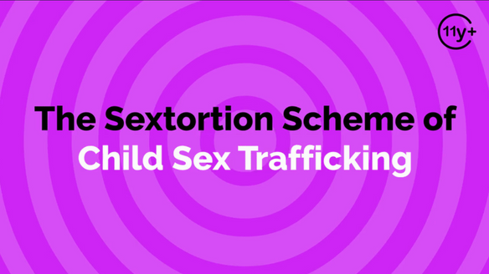
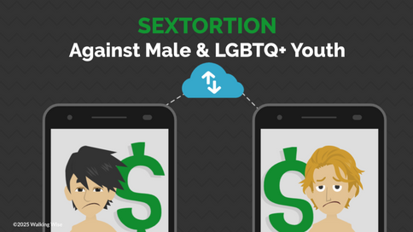
REALITY
Males Are Targets of Sextortion
  36.2 million reports of online child exploitation in 2023.[1]
  National Center for Missing & Exploited Children (2023). 2023 CyberTipline Report, p. 3.
  Thorn and National Center for Missing and Exploited Children (NCMEC). (2024). Trends in Financial Sextortion: An investigation of sextortion reports in NCMEC CyberTipline data, pp. 9, 13.
  Thorn (2023). LGBTQ+ Youth Perspectives: How LGBTQ+ Youth are Navigating Exploration and Risks of Sexual Exploitation Online, p. 10, 14.
©2025 Walking Wise
45
Notes:
Source
1. National Center for Missing & Exploited Children (2023). 2023 CyberTipline Report, p. 3. Missingkids.org. Retrieved May 9, 2024, from https://www.missingkids.org/content/dam/missingkids/pdfs/2023-CyberTipline-Report.pdf
2. Thorn and National Center for Missing and Exploited Children (NCMEC). (2024). Trends in Financial Sextortion: An investigation of sextortion reports in NCMEC CyberTipline data, pp. 9, 13. Retrieved October 19, 2024, from https://info.thorn.org/hubfs/Research/Thorn_TrendsInFinancialSextortion_June2024.pdf
3. Thorn (2023). LGBTQ+ Youth Perspectives: How LGBTQ+ Youth are Navigating Exploration and Risks of Sexual Exploitation Online, p. 10, 14.
https://info.thorn.org/hubfs/Research/Thorn_LGBTQ+YouthPerspectives_June2023_FNL.pdf

Slide 46
REALITY
Males Are Targets of Sextortion
  36.2 million reports of online child exploitation in 2023.[1]
  Males, ages 14 to 17, are especially targeted by Sextortionists.[2]
  National Center for Missing & Exploited Children (2023). 2023 CyberTipline Report, p. 3.
  Thorn and National Center for Missing and Exploited Children (NCMEC). (2024). Trends in Financial Sextortion: An investigation of sextortion reports in NCMEC CyberTipline data, pp. 9, 13.
  Thorn (2023). LGBTQ+ Youth Perspectives: How LGBTQ+ Youth are Navigating Exploration and Risks of Sexual Exploitation Online, p. 10, 14.
©2025 Walking Wise
46
Notes:
Source
1. National Center for Missing & Exploited Children (2023). 2023 CyberTipline Report, p. 3. Missingkids.org. Retrieved May 9, 2024, from https://www.missingkids.org/content/dam/missingkids/pdfs/2023-CyberTipline-Report.pdf
2. Thorn and National Center for Missing and Exploited Children (NCMEC). (2024). Trends in Financial Sextortion: An investigation of sextortion reports in NCMEC CyberTipline data, pp. 9, 13. Retrieved October 19, 2024, from https://info.thorn.org/hubfs/Research/Thorn_TrendsInFinancialSextortion_June2024.pdf
3. Thorn (2023). LGBTQ+ Youth Perspectives: How LGBTQ+ Youth are Navigating Exploration and Risks of Sexual Exploitation Online, p. 10, 14.
https://info.thorn.org/hubfs/Research/Thorn_LGBTQ+YouthPerspectives_June2023_FNL.pdf

Slide 47
REALITY
Males Are Targets of Sextortion
  36.2 million reports of online child exploitation in 2023.[1]
  Males, ages 14 to 17, are especially targeted by Sextortionists.[2]
  90% of male victims are ‘sextorted’ for money, while females are often ‘sextorted’ for sexual content or sex acts.[2]
  National Center for Missing & Exploited Children (2023). 2023 CyberTipline Report, p. 3.
  Thorn and National Center for Missing and Exploited Children (NCMEC). (2024). Trends in Financial Sextortion: An investigation of sextortion reports in NCMEC CyberTipline data, pp. 9, 13.
  Thorn (2023). LGBTQ+ Youth Perspectives: How LGBTQ+ Youth are Navigating Exploration and Risks of Sexual Exploitation Online, p. 10, 14.
©2025 Walking Wise
47
Notes:
Source
1. National Center for Missing & Exploited Children (2023). 2023 CyberTipline Report, p. 3. Missingkids.org. Retrieved May 9, 2024, from https://www.missingkids.org/content/dam/missingkids/pdfs/2023-CyberTipline-Report.pdf
2. Thorn and National Center for Missing and Exploited Children (NCMEC). (2024). Trends in Financial Sextortion: An investigation of sextortion reports in NCMEC CyberTipline data, pp. 9, 13. Retrieved October 19, 2024, from https://info.thorn.org/hubfs/Research/Thorn_TrendsInFinancialSextortion_June2024.pdf
3. Thorn (2023). LGBTQ+ Youth Perspectives: How LGBTQ+ Youth are Navigating Exploration and Risks of Sexual Exploitation Online, p. 10, 14.
https://info.thorn.org/hubfs/Research/Thorn_LGBTQ+YouthPerspectives_June2023_FNL.pdf

Slide 48
REALITY
Males Are Targets of Sextortion
  36.2 million reports of online child exploitation in 2023.[1]
  Males, ages 14 to 17, are especially targeted by Sextortionists.[2]
  90% of male victims are ‘sextorted’ for money, while females are often ‘sextorted’ for sexual content or sex acts.[2]
  Most LGBTQ+ youth rely heavily on online social circles, significantly increasing their exposure to predators.[3]
  National Center for Missing & Exploited Children (2023). 2023 CyberTipline Report, p. 3.
  Thorn and National Center for Missing and Exploited Children (NCMEC). (2024). Trends in Financial Sextortion: An investigation of sextortion reports in NCMEC CyberTipline data, pp. 9, 13.
  Thorn (2023). LGBTQ+ Youth Perspectives: How LGBTQ+ Youth are Navigating Exploration and Risks of Sexual Exploitation Online, p. 10, 14.
©2025 Walking Wise
48
Notes:
Source
1. National Center for Missing & Exploited Children (2023). 2023 CyberTipline Report, p. 3. Missingkids.org. Retrieved May 9, 2024, from https://www.missingkids.org/content/dam/missingkids/pdfs/2023-CyberTipline-Report.pdf
2. Thorn and National Center for Missing and Exploited Children (NCMEC). (2024). Trends in Financial Sextortion: An investigation of sextortion reports in NCMEC CyberTipline data, pp. 9, 13. Retrieved October 19, 2024, from https://info.thorn.org/hubfs/Research/Thorn_TrendsInFinancialSextortion_June2024.pdf
3. Thorn (2023). LGBTQ+ Youth Perspectives: How LGBTQ+ Youth are Navigating Exploration and Risks of Sexual Exploitation Online, p. 10, 14.
https://info.thorn.org/hubfs/Research/Thorn_LGBTQ+YouthPerspectives_June2023_FNL.pdf

Slide 49
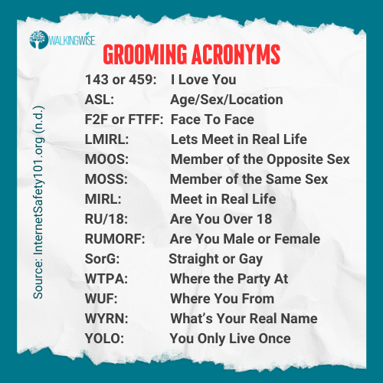
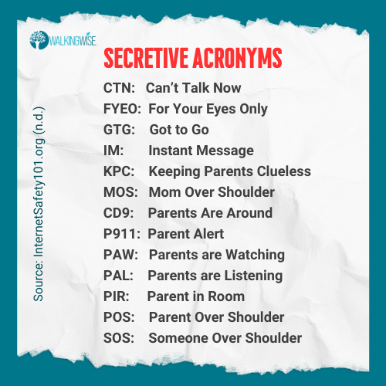
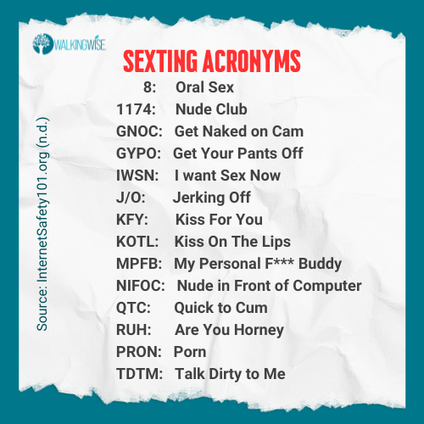
LESSON PLANS
ACRONYMS PARENTS SHOULD KNOW
This information is only intended for adult education.
©2025 Walking Wise
Enough is Enough (n.d.). Prevention 101: Acronyms Parents Should Know. InternetSafety101.org.
West Windsor Township (n.d.). 50 Sexting Acronyms. WestWindsornj.org
49
3
Notes:
NOTE TO PRESENTER
Walking Wise advises that the acronyms on this slide are meant exclusively for parents and other adults; however, the information should not be shared with children. This content is intended to support parental guidance and understanding.
• HANDOUT
A one-page handout is available for distribution and can be found at:
WalkingWalking.com > Classroom Presentations > Myths & Reality.
Source
Enough is Enough (n.d.). Prevention 101: Acronyms Parents Should Know. InternetSafety101.org. Retrieved January 8, 2024, from https://internetsafety101.org/acronyms
West Windsor Township (n.d.). 50 Sexting Acronyms. WestWindsornj.org

Slide 50
LESSON PLANS
TRAFFICKING MYTH
MYTH: Victims of sex trafficking are usually kidnapped.
Myths
&REALITY
©2025 Walking Wise
50
3

Slide 51
LESSON PLANS
MISSING CHILDREN
What percent of U.S. domestic children go missing every year?
Myths
&REALITY
©2025 Walking Wise
U.S. Department of Justice (2023, May 24). National Missing Children's Day: 2023 Commemoration. ojjdp.ojp.gov.
51
3
Notes:
SLIDO.com: Multiple Choice
What percent of U.S. domestic children go missing every year?
A) 160,000
B) 260,000
C) 460,000
D) 660,000
ANSWER
D) 460,000 U.S. domestic children go missing every year.
Source
U.S. Department of Justice (2023, May 24). National Missing Children's Day: 2023 Commemoration. ojjdp.ojp.gov. Retrieved March 3, 2024, from https://ojjdp.ojp.gov/events/nmcd/2023-national-missing-childrens-day

Slide 52
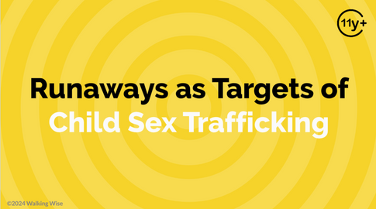
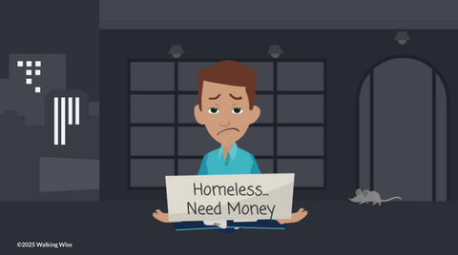
REALITY
Homeless & Runaway Youth are Targeted
  Predators often target children in Foster Care.
©2025 Walking Wise
52

Slide 53
REALITY
Homeless & Runaway Youth are Targeted
  Predators often target children in Foster Care.
  They target children who run away from home, often due to abuse or other difficult situations.
©2025 Walking Wise
53

Slide 54
REALITY
Homeless & Runaway Youth are Targeted
  Predators often target children in Foster Care.
  They target children who run away from home, often due to abuse or other difficult situations.
  They target young people who have been rejected or forced out of their family homes.
©2025 Walking Wise
54

Slide 55
REALITY
Homeless & Runaway Youth are Targeted
  Predators often target children in Foster Care.
  They target children who run away from home, often due to abuse or other difficult situations.
  They target young people who have been rejected or forced out of their family homes.
  Traffickers target youth lacking basic needs like food & shelter.
©2025 Walking Wise
55

Slide 56
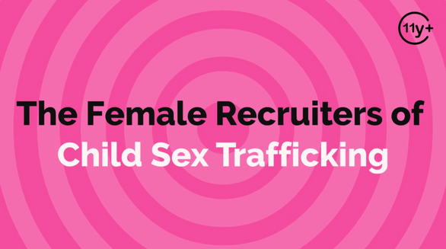
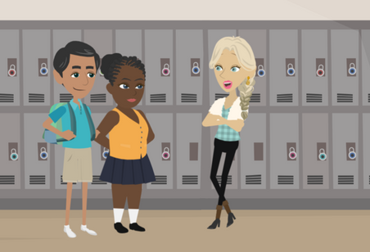
REALITY
Recruiters
  Recruiters disguise their true intentions, operating like "wolves in sheep's clothing."
Myths
&REALITY
©2025 Walking Wise
Baird, K., & Connolly, J. (2023). Recruitment and Entrapment Pathways of Minors into Sex Trafficking in Canada and the United States: A Systematic Review, Trauma, violence & abuse, 24(1), 189–190.
56
Notes:
• METAPHOR
A wolf in sheep's clothing is a metaphorical expression that describes someone who outwardly appears gentle, harmless, or innocent but conceals evil or deceitful intentions. This facade allows the individual to infiltrate or gain the trust of others before revealing their true, often sinister, motives.
Just like a wolf disguising itself among sheep to approach without being noticed, human traffickers and recruiters can enter a victim's social circle using charm or a nonthreatening appearance to mask their true character.
Source
1. Baird, K., & Connolly, J. (2023). Recruitment and Entrapment Pathways of Minors into Sex Trafficking in Canada and the United States: A Systematic Review, Trauma, violence & abuse, 24(1), 189–190. https://doi.org/10.1177/15248380211025241

Slide 57
REALITY
Recruiters
  Recruiters disguise their true intentions, operating like "wolves in sheep's clothing."
  Older boyfriends are top recruiters.
Myths
&REALITY
©2025 Walking Wise
Baird, K., & Connolly, J. (2023). Recruitment and Entrapment Pathways of Minors into Sex Trafficking in Canada and the United States: A Systematic Review, Trauma, violence & abuse, 24(1), 189–190.
57
Notes:
• METAPHOR
A wolf in sheep's clothing is a metaphorical expression that describes someone who outwardly appears gentle, harmless, or innocent but conceals evil or deceitful intentions. This facade allows the individual to infiltrate or gain the trust of others before revealing their true, often sinister, motives.
Just like a wolf disguising itself among sheep to approach without being noticed, human traffickers and recruiters can enter a victim's social circle using charm or a nonthreatening appearance to mask their true character.
Source
1. Baird, K., & Connolly, J. (2023). Recruitment and Entrapment Pathways of Minors into Sex Trafficking in Canada and the United States: A Systematic Review, Trauma, violence & abuse, 24(1), 189–190. https://doi.org/10.1177/15248380211025241

Slide 58
REALITY
Recruiters
  Recruiters disguise their true intentions, operating like "wolves in sheep's clothing."
  Older boyfriends are top recruiters.
  Victims are often forced into recruiting their peers.
Myths
&REALITY
©2025 Walking Wise
Baird, K., & Connolly, J. (2023). Recruitment and Entrapment Pathways of Minors into Sex Trafficking in Canada and the United States: A Systematic Review, Trauma, violence & abuse, 24(1), 189–190.
58
Notes:
• METAPHOR
A wolf in sheep's clothing is a metaphorical expression that describes someone who outwardly appears gentle, harmless, or innocent but conceals evil or deceitful intentions. This facade allows the individual to infiltrate or gain the trust of others before revealing their true, often sinister, motives.
Just like a wolf disguising itself among sheep to approach without being noticed, human traffickers and recruiters can enter a victim's social circle using charm or a nonthreatening appearance to mask their true character.
Source
1. Baird, K., & Connolly, J. (2023). Recruitment and Entrapment Pathways of Minors into Sex Trafficking in Canada and the United States: A Systematic Review, Trauma, violence & abuse, 24(1), 189–190. https://doi.org/10.1177/15248380211025241

Slide 59
REALITY
Recruiters
  Recruiters disguise their true intentions, operating like "wolves in sheep's clothing."
  Older boyfriends are top recruiters.
  Victims are often forced into recruiting their peers.
  Traffickers often use females to recruit young girls.
Myths
&REALITY
©2025 Walking Wise
Baird, K., & Connolly, J. (2023). Recruitment and Entrapment Pathways of Minors into Sex Trafficking in Canada and the United States: A Systematic Review, Trauma, violence & abuse, 24(1), 189–190.
59
Notes:
• METAPHOR
A wolf in sheep's clothing is a metaphorical expression that describes someone who outwardly appears gentle, harmless, or innocent but conceals evil or deceitful intentions. This facade allows the individual to infiltrate or gain the trust of others before revealing their true, often sinister, motives.
Just like a wolf disguising itself among sheep to approach without being noticed, human traffickers and recruiters can enter a victim's social circle using charm or a nonthreatening appearance to mask their true character.
Source
1. Baird, K., & Connolly, J. (2023). Recruitment and Entrapment Pathways of Minors into Sex Trafficking in Canada and the United States: A Systematic Review, Trauma, violence & abuse, 24(1), 189–190. https://doi.org/10.1177/15248380211025241

Slide 60
LESSON PLANS
TRAFFICKING MYTH
MYTH: Sex traffickers usually target kids they don't know.
Myths
&REALITY
©2025 Walking Wise
60
3

Slide 61
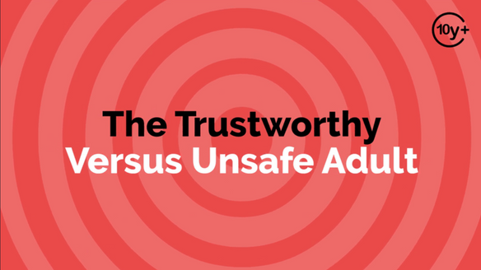
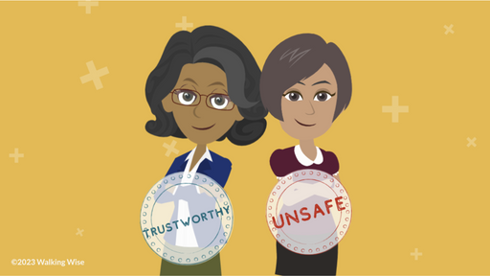
REALITY
Hidden in Plain Sight
  91% of child sexual abuse crimes are committed by someone the child or the child's family knows and trusts.[1]
  Centers for Disease Control and Prevention (n.d.). Fast Facts: Preventing Child Sexual Abuse. CDC.gov.
  Dube, S. R., Anda, R. F., Whitfield, C. L., Brown, D. W., Felitti, V. J., Dong, M., & Giles, W. H. (2005). Long-term consequences of childhood sexual abuse by gender of victim. American journal of preventive medicine, 28(5), 430–438.
  Finkelhor, D., & Shattuck, A. (2012). Characteristics of crimes against juveniles. Durham, NH: Crimes Against Children Research Center, p. 2.
©2025 Walking Wise
61
Notes:
• HIDDEN IN PLAIN SIGHT
The phrase "hidden in plain sight" is a chilling reminder that traffickers often conduct their illegal activities right before our eyes without raising suspicion.
They recruit, exploit, or sell victims without overtly trying to hide their actions. It is a misconception to assume that criminal activities like sex trafficking only take place in shadowy, remote locations.
It is a reality that traffickers often operate within communities or even families, presenting themselves as ordinary people. They can effortlessly exploit vulnerable victims within plain sight of those who care for the child, yet may not recognize the signs of this heinous crime.
Source
1. Centers for Disease Control and Prevention (n.d.). Fast Facts: Preventing Child Sexual Abuse. CDC.gov. Retrieved February 27, 2024, from https://www.cdc.gov/violenceprevention/childsexualabuse/fastfact.html
2. Dube, S. R., Anda, R. F., Whitfield, C. L., Brown, D. W., Felitti, V. J., Dong, M., & Giles, W. H. (2005). Long-term consequences of childhood sexual abuse by gender of victim. American journal of preventive medicine, 28(5), 430–438. https://doi.org/10.1016/j.amepre.2005.01.015
3. Finkelhor, D., & Shattuck, A. (2012). Characteristics of crimes against juveniles. Durham, NH: Crimes Against Children Research Center, p. 2. Retrieved November 12, 2024, from https://www.unh.edu/ccrc/sites/default/files/media/2022-03/characteristics-of-crimes-against-juveniles_0.pdf

Slide 62
REALITY
Hidden in Plain Sight
  91% of child sexual abuse crimes are committed by someone the child or the child's family knows and trusts.[1]
  About 1-in-4 girls and 1-in-6 boys experience child sexual abuse.[2]
  Centers for Disease Control and Prevention (n.d.). Fast Facts: Preventing Child Sexual Abuse. CDC.gov.
  Dube, S. R., Anda, R. F., Whitfield, C. L., Brown, D. W., Felitti, V. J., Dong, M., & Giles, W. H. (2005). Long-term consequences of childhood sexual abuse by gender of victim. American journal of preventive medicine, 28(5), 430–438.
  Finkelhor, D., & Shattuck, A. (2012). Characteristics of crimes against juveniles. Durham, NH: Crimes Against Children Research Center, p. 2.
©2025 Walking Wise
62
Notes:
• HIDDEN IN PLAIN SIGHT
The phrase "hidden in plain sight" is a chilling reminder that traffickers often conduct their illegal activities right before our eyes without raising suspicion.
They recruit, exploit, or sell victims without overtly trying to hide their actions. It is a misconception to assume that criminal activities like sex trafficking only take place in shadowy, remote locations.
It is a reality that traffickers often operate within communities or even families, presenting themselves as ordinary people. They can effortlessly exploit vulnerable victims within plain sight of those who care for the child, yet may not recognize the signs of this heinous crime.
Source
1. Centers for Disease Control and Prevention (n.d.). Fast Facts: Preventing Child Sexual Abuse. CDC.gov. Retrieved February 27, 2024, from https://www.cdc.gov/violenceprevention/childsexualabuse/fastfact.html
2. Dube, S. R., Anda, R. F., Whitfield, C. L., Brown, D. W., Felitti, V. J., Dong, M., & Giles, W. H. (2005). Long-term consequences of childhood sexual abuse by gender of victim. American journal of preventive medicine, 28(5), 430–438. https://doi.org/10.1016/j.amepre.2005.01.015
3. Finkelhor, D., & Shattuck, A. (2012). Characteristics of crimes against juveniles. Durham, NH: Crimes Against Children Research Center, p. 2. Retrieved November 12, 2024, from https://www.unh.edu/ccrc/sites/default/files/media/2022-03/characteristics-of-crimes-against-juveniles_0.pdf

Slide 63
REALITY
Hidden in Plain Sight
  91% of child sexual abuse crimes are committed by someone the child or the child's family knows and trusts.[1]
  About 1-in-4 girls and 1-in-6 boys experience child sexual abuse.[2]
  An estimated 66% of reported sexual offense victims are minors.[3]
  Centers for Disease Control and Prevention (n.d.). Fast Facts: Preventing Child Sexual Abuse. CDC.gov.
  Dube, S. R., Anda, R. F., Whitfield, C. L., Brown, D. W., Felitti, V. J., Dong, M., & Giles, W. H. (2005). Long-term consequences of childhood sexual abuse by gender of victim. American journal of preventive medicine, 28(5), 430–438.
  Finkelhor, D., & Shattuck, A. (2012). Characteristics of crimes against juveniles. Durham, NH: Crimes Against Children Research Center, p. 2.
©2025 Walking Wise
63
Notes:
• HIDDEN IN PLAIN SIGHT
The phrase "hidden in plain sight" is a chilling reminder that traffickers often conduct their illegal activities right before our eyes without raising suspicion.
They recruit, exploit, or sell victims without overtly trying to hide their actions. It is a misconception to assume that criminal activities like sex trafficking only take place in shadowy, remote locations.
It is a reality that traffickers often operate within communities or even families, presenting themselves as ordinary people. They can effortlessly exploit vulnerable victims within plain sight of those who care for the child, yet may not recognize the signs of this heinous crime.
Source
1. Centers for Disease Control and Prevention (n.d.). Fast Facts: Preventing Child Sexual Abuse. CDC.gov. Retrieved February 27, 2024, from https://www.cdc.gov/violenceprevention/childsexualabuse/fastfact.html
2. Dube, S. R., Anda, R. F., Whitfield, C. L., Brown, D. W., Felitti, V. J., Dong, M., & Giles, W. H. (2005). Long-term consequences of childhood sexual abuse by gender of victim. American journal of preventive medicine, 28(5), 430–438. https://doi.org/10.1016/j.amepre.2005.01.015
3. Finkelhor, D., & Shattuck, A. (2012). Characteristics of crimes against juveniles. Durham, NH: Crimes Against Children Research Center, p. 2. Retrieved November 12, 2024, from https://www.unh.edu/ccrc/sites/default/files/media/2022-03/characteristics-of-crimes-against-juveniles_0.pdf

Slide 64
REALITY
Hidden in Plain Sight
  91% of child sexual abuse crimes are committed by someone the child or the child's family knows and trusts.[1]
  About 1-in-4 girls and 1-in-6 boys experience child sexual abuse.[2]
  An estimated 66% of reported sexual offense victims are minors.[3]
  Traffickers commonly target victims of sexual abuse.
  Centers for Disease Control and Prevention (n.d.). Fast Facts: Preventing Child Sexual Abuse. CDC.gov.
  Dube, S. R., Anda, R. F., Whitfield, C. L., Brown, D. W., Felitti, V. J., Dong, M., & Giles, W. H. (2005). Long-term consequences of childhood sexual abuse by gender of victim. American journal of preventive medicine, 28(5), 430–438.
  Finkelhor, D., & Shattuck, A. (2012). Characteristics of crimes against juveniles. Durham, NH: Crimes Against Children Research Center, p. 2.
©2025 Walking Wise
64
Notes:
• HIDDEN IN PLAIN SIGHT
The phrase "hidden in plain sight" is a chilling reminder that traffickers often conduct their illegal activities right before our eyes without raising suspicion.
They recruit, exploit, or sell victims without overtly trying to hide their actions. It is a misconception to assume that criminal activities like sex trafficking only take place in shadowy, remote locations.
It is a reality that traffickers often operate within communities or even families, presenting themselves as ordinary people. They can effortlessly exploit vulnerable victims within plain sight of those who care for the child, yet may not recognize the signs of this heinous crime.
Source
1. Centers for Disease Control and Prevention (n.d.). Fast Facts: Preventing Child Sexual Abuse. CDC.gov. Retrieved February 27, 2024, from https://www.cdc.gov/violenceprevention/childsexualabuse/fastfact.html
2. Dube, S. R., Anda, R. F., Whitfield, C. L., Brown, D. W., Felitti, V. J., Dong, M., & Giles, W. H. (2005). Long-term consequences of childhood sexual abuse by gender of victim. American journal of preventive medicine, 28(5), 430–438. https://doi.org/10.1016/j.amepre.2005.01.015
3. Finkelhor, D., & Shattuck, A. (2012). Characteristics of crimes against juveniles. Durham, NH: Crimes Against Children Research Center, p. 2. Retrieved November 12, 2024, from https://www.unh.edu/ccrc/sites/default/files/media/2022-03/characteristics-of-crimes-against-juveniles_0.pdf

Slide 65
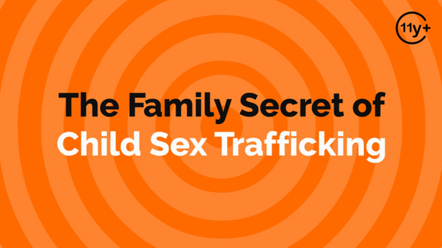
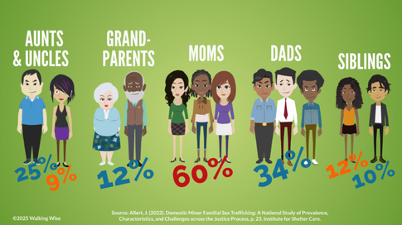
REALITY
Familial Trafficking
  42% of victims are trafficked by a member of their family.[1]
  Polaris Project (n.d.). Human Trafficking Trends in 2020, p. 2. PolarisProject.org.
  Allert, J. (2022). Domestic Minor Familial Sex Trafficking: A National Study of Prevalence, Characteristics, and Challenges across the Justice Process, p. 23. Institute for Shelter Care.
©2025 Walking Wise
65
Notes:
Source
1. Polaris Project (n.d.). Human Trafficking Trends in 2020, p. 2. PolarisProject.org. Retrieved February 27, 2024, from https://polarisproject.org/wp-content/uploads/2022/01/Human-Trafficking-Trends-in-2020-by-Polaris.pdf
2. Allert, J. (2022). Domestic Minor Familial Sex Trafficking: A National Study of Prevalence, Characteristics, and Challenges across the Justice Process, p. 23. Institute for Shelter Care. Retrieved March 15, 2024, from https://instituteforsheltercare.org/familial/

Slide 66
REALITY
Familial Trafficking
  42% of victims are trafficked by a member of their family.[1]
  Biological mothers are the most common familial trafficker.[2]
  Polaris Project (n.d.). Human Trafficking Trends in 2020, p. 2. PolarisProject.org.
  Allert, J. (2022). Domestic Minor Familial Sex Trafficking: A National Study of Prevalence, Characteristics, and Challenges across the Justice Process, p. 23. Institute for Shelter Care.
©2025 Walking Wise
66
Notes:
Source
1. Polaris Project (n.d.). Human Trafficking Trends in 2020, p. 2. PolarisProject.org. Retrieved February 27, 2024, from https://polarisproject.org/wp-content/uploads/2022/01/Human-Trafficking-Trends-in-2020-by-Polaris.pdf
2. Allert, J. (2022). Domestic Minor Familial Sex Trafficking: A National Study of Prevalence, Characteristics, and Challenges across the Justice Process, p. 23. Institute for Shelter Care. Retrieved March 15, 2024, from https://instituteforsheltercare.org/familial/

Slide 67
REALITY
Familial Trafficking
  42% of victims are trafficked by a member of their family.[1]
  Biological mothers are the most common familial traffickers.[2]
  Risk factors, like poverty and family substance use, increase a young person’s likelihood of being trafficked.
  Polaris Project (n.d.). Human Trafficking Trends in 2020, p. 2. PolarisProject.org.
  Allert, J. (2022). Domestic Minor Familial Sex Trafficking: A National Study of Prevalence, Characteristics, and Challenges across the Justice Process, p. 23. Institute for Shelter Care.
©2025 Walking Wise
67
Notes:
Source
1. Polaris Project (n.d.). Human Trafficking Trends in 2020, p. 2. PolarisProject.org. Retrieved February 27, 2024, from https://polarisproject.org/wp-content/uploads/2022/01/Human-Trafficking-Trends-in-2020-by-Polaris.pdf
2. Allert, J. (2022). Domestic Minor Familial Sex Trafficking: A National Study of Prevalence, Characteristics, and Challenges across the Justice Process, p. 23. Institute for Shelter Care. Retrieved March 15, 2024, from https://instituteforsheltercare.org/familial/

Slide 68
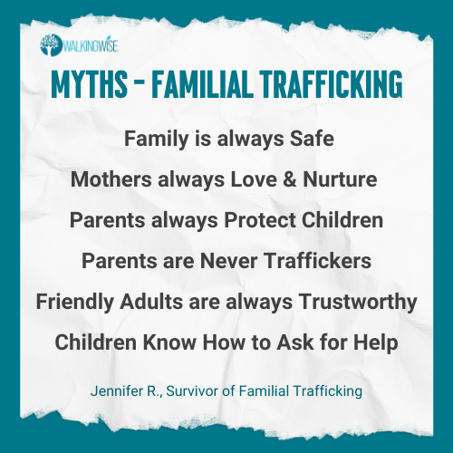
LESSON PLANS
FAMILY MYTHS
Myths
&REALITY
©2025 Walking Wise
68
3
Notes:
• FAMILY MYTHS
Some family members are unsafe. Not all mothers and fathers show love or provide protection.
In recent years, law enforcement has recognized that familial trafficking is occurring in the U.S. at much higher rates than previously realized.
Children trafficked by family members endure extremely difficult circumstances. These children do not know how to seek help or escape without education and intervention from safe adults.
Source
Highman, K. (2024), Walking Wise Sex Trafficking Education. Retrieved January 11, 2025, from WalkingWise.com.

Slide 69
LESSON PLANS
TRAFFICKING MYTH
MYTH: Sex trafficking usually involves violence.
Myths
&REALITY
©2025 Walking Wise
69
3

Slide 70
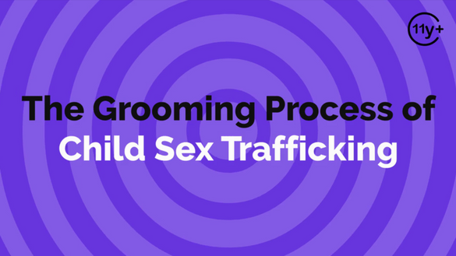

REALITY
Predators Often Nurture Relationships
  Groomers form relationships with children intending to sexually harm them in the future.
  Bouche', V. (2018, January). Survivor Insights: The Role of Technology in Domestic Minor Sex Trafficking. Thorn.org.
  U.S. House of Representatives (n.d.). §2422. Coercion and enticement. Uscode.House.gov.
70
©2025 Walking Wise
Notes:
Source
1. Bouche', V. (January, 2018). Survivor Insights: The Role of Technology in Domestic Minor Sex Trafficking. Thorn.org. Retrieved February 27, 2024, from https://www.thorn.org/wp-content/uploads/2018/06/Thorn_Survivor_Insights_061118.pdf
2. U.S. House of Representatives (n.d.). §2422. Coercion and enticement. Uscode.House.gov. Retrieved February 27, 2024, from https://uscode.house.gov/view.xhtml?req=granuleid:USC-prelim-title18-section2422&num=0&edition=prelim

Slide 71
REALITY
Predators Often Nurture Relationships
  Groomers form relationships with children intending to sexually harm them in the future.
  42% of victims said their trafficker gained their trust within one month.[1]
  Bouche', V. (2018, January). Survivor Insights: The Role of Technology in Domestic Minor Sex Trafficking. Thorn.org.
  U.S. House of Representatives (n.d.). §2422. Coercion and enticement. Uscode.House.gov.
71
©2025 Walking Wise
Notes:
Source
1. Bouche', V. (January, 2018). Survivor Insights: The Role of Technology in Domestic Minor Sex Trafficking. Thorn.org. Retrieved February 27, 2024, from https://www.thorn.org/wp-content/uploads/2018/06/Thorn_Survivor_Insights_061118.pdf
2. U.S. House of Representatives (n.d.). §2422. Coercion and enticement. Uscode.House.gov. Retrieved February 27, 2024, from https://uscode.house.gov/view.xhtml?req=granuleid:USC-prelim-title18-section2422&num=0&edition=prelim

Slide 72
REALITY
Predators Often Nurture Relationships
  Groomers form relationships with children intending to sexually harm them in the future.
  42% of victims said their trafficker gained their trust within one month.[1]
  Child grooming in the U.S. is considered a federal offense.[2]
  Bouche', V. (2018, January). Survivor Insights: The Role of Technology in Domestic Minor Sex Trafficking. Thorn.org.
  U.S. House of Representatives (n.d.). §2422. Coercion and enticement. Uscode.House.gov.
72
©2025 Walking Wise
Notes:
Source
1. Bouche', V. (January, 2018). Survivor Insights: The Role of Technology in Domestic Minor Sex Trafficking. Thorn.org. Retrieved February 27, 2024, from https://www.thorn.org/wp-content/uploads/2018/06/Thorn_Survivor_Insights_061118.pdf
2. U.S. House of Representatives (n.d.). §2422. Coercion and enticement. Uscode.House.gov. Retrieved February 27, 2024, from https://uscode.house.gov/view.xhtml?req=granuleid:USC-prelim-title18-section2422&num=0&edition=prelim

Slide 73
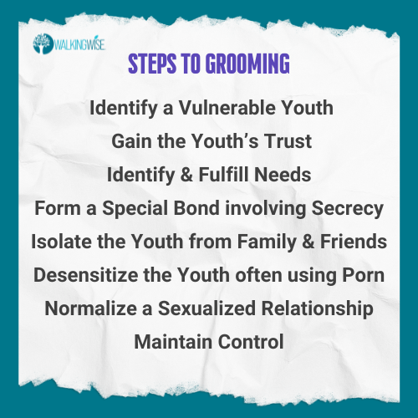
GROOMING PROCESS
Myths
&REALITY
©2025 Walking Wise
73
Notes:
Source
1. Bouche', V. (January, 2018). Survivor Insights: The Role of Technology in Domestic Minor Sex Trafficking. Thorn.org. Retrieved February 27, 2024, from https://www.thorn.org/wp-content/uploads/2018/06/Thorn_Survivor_Insights_061118.pdf
2. U.S. House of Representatives (n.d.). §2422. Coercion and enticement. Uscode.House.gov. Retrieved February 27, 2024, from https://uscode.house.gov/view.xhtml?req=granuleid:USC-prelim-title18-section2422&num=0&edition=prelim

Slide 74
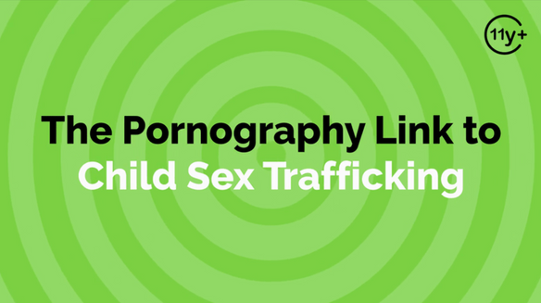
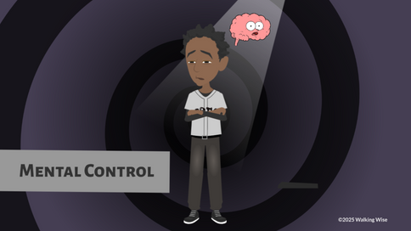
REALITY
Grooming through Pornography
  Predators use porn to normalize adults having sex with children.
©2025 Walking Wise
  Wilkinson Jr., Kevin L. (2024, July 4). The Breeding of Wolves: Understanding the Escalation Continuum & Escalation Dynamics of Contemporary Sex Trafficking. DigitalCommons.liberity.edu.
74
Notes:
Source
1. Wilkinson Jr., Kevin L. (2024, July 4). The Breeding of Wolves: Understanding the Escalation Continuum & Escalation Dynamics of Contemporary Sex Trafficking. DigitalCommons.liberity.edu. Retrieved July 31, 2024, from https://digitalcommons.liberty.edu/doctoral/4600/

Slide 75
REALITY
Grooming through Pornography
  Predators use porn to normalize adults having sex with children.
  Traffickers commonly use pornography to train victims on the sexual expectations of buyers.
©2025 Walking Wise
  Wilkinson Jr., Kevin L. (2024, July 4). The Breeding of Wolves: Understanding the Escalation Continuum & Escalation Dynamics of Contemporary Sex Trafficking. DigitalCommons.liberity.edu.
75
Notes:
Source
1. Wilkinson Jr., Kevin L. (2024, July 4). The Breeding of Wolves: Understanding the Escalation Continuum & Escalation Dynamics of Contemporary Sex Trafficking. DigitalCommons.liberity.edu. Retrieved July 31, 2024, from https://digitalcommons.liberty.edu/doctoral/4600/

Slide 76
REALITY
Grooming through Pornography
  Predators use porn to normalize adults having sex with children.
  Traffickers commonly use pornography to train victims on the sexual expectations of buyers.
  Study suggests pornography is introduced to adolescent boys as a tactic to groom them into becoming sex buyers in adulthood.[1]
©2025 Walking Wise
  Wilkinson Jr., Kevin L. (2024, July 4). The Breeding of Wolves: Understanding the Escalation Continuum & Escalation Dynamics of Contemporary Sex Trafficking. DigitalCommons.liberity.edu.
76
Notes:
Source
1. Wilkinson Jr., Kevin L. (2024, July 4). The Breeding of Wolves: Understanding the Escalation Continuum & Escalation Dynamics of Contemporary Sex Trafficking. DigitalCommons.liberity.edu. Retrieved July 31, 2024, from https://digitalcommons.liberty.edu/doctoral/4600/

Slide 77

NORMALIZING PORNOGRAPHY
  Animated pornography, called HENTAI, was ranked as the fourth most viewed pornographic category on Pornhub’s website in 2021.
  Fight the New Drug (n.d.). Pornhub's 2021 Annual Report Reveals This Year's Most-Watched Porn Categories. FightTheNewDrug.org.
  Reysen, Stephen & Plante, Courtney & Roberts, Sharon & Gerbasi, Kathleen & Mohebpour, Ida & Gamboa, Amanda. (2016). Pale and geeky: Prevailing stereotypes of anime fans. The Phoenix Papers. 2. 78-103.
77
©2025 Walking Wise
Notes:
• ANIMATED PORNOGRAPHY
Hentai is a form of animated pornography that originated in Japan. The term "hentai" translates to "perverted" in English and draws its roots from Manga (comic books) and Anime (animated movies).
This genre often depicts exaggerated sexual body parts and unsettling scenarios, such as fetishes involving tentacles from monsters, demons, or giant plants and insects engaging in explicit acts, including rape, with childlike female cartoon characters.
Source
1. Fight the New Drug (n.d.). Pornhub's 2021 Annual Report Reveals This Year's Most-Watched Porn Categories. FightTheNewDrug.org. Retrieved February 21, 2024, from https://fightthenewdrug.org/2021-pornhub-annual-report/
2. Reysen, Stephen & Plante, Courtney & Roberts, Sharon & Gerbasi, Kathleen & Mohebpour, Ida & Gamboa, Amanda. (2016). Pale and geeky: Prevailing stereotypes of anime fans. The Phoenix Papers. 2. 78-103. Retrieved March 8, 2024, from https://www.academia.edu/24286823/Pale_and_Geeky_Prevailing_Stereotypes_of_Anime_Fans

Slide 78
NORMALIZING PORNOGRAPHY
  Animated pornography, called HENTAI, was ranked as the fourth most viewed pornographic category on Pornhub’s website in 2021.
  Hentai fans typically become followers around age 14.
  Fight the New Drug (n.d.). Pornhub's 2021 Annual Report Reveals This Year's Most-Watched Porn Categories. FightTheNewDrug.org.
  Reysen, Stephen & Plante, Courtney & Roberts, Sharon & Gerbasi, Kathleen & Mohebpour, Ida & Gamboa, Amanda. (2016). Pale and geeky: Prevailing stereotypes of anime fans. The Phoenix Papers. 2. 78-103.
78
©2025 Walking Wise
Notes:
• ANIMATED PORNOGRAPHY
Hentai is a form of animated pornography that originated in Japan. The term "hentai" translates to "perverted" in English and draws its roots from Manga (comic books) and Anime (animated movies).
This genre often depicts exaggerated sexual body parts and unsettling scenarios, such as fetishes involving tentacles from monsters, demons, or giant plants and insects engaging in explicit acts, including rape, with childlike female cartoon characters.
Source
1. Fight the New Drug (n.d.). Pornhub's 2021 Annual Report Reveals This Year's Most-Watched Porn Categories. FightTheNewDrug.org. Retrieved February 21, 2024, from https://fightthenewdrug.org/2021-pornhub-annual-report/
2. Reysen, Stephen & Plante, Courtney & Roberts, Sharon & Gerbasi, Kathleen & Mohebpour, Ida & Gamboa, Amanda. (2016). Pale and geeky: Prevailing stereotypes of anime fans. The Phoenix Papers. 2. 78-103. Retrieved March 8, 2024, from https://www.academia.edu/24286823/Pale_and_Geeky_Prevailing_Stereotypes_of_Anime_Fans

Slide 79
LESSON PLANS
TRAFFICKING MYTH
MYTH: Sex traffickers mostly hold victims physically captive.
Myths
&REALITY
©2025 Walking Wise
79
3

Slide 80
EDUCATON GUIDE
VOCABULARY
MANIPULATION
Influencing or controlling someone’s behavior or decisions deceptively or unfairly, usually for personal gain.
Myths
&REALITY
©2025 Walking Wise
80
3
Notes:
Assisting Source
OpenAI. (2024). ChatGPT [Large language model]. https://chatgpt.com

Slide 81
EDUCATON GUIDE
VOCABULARY
INTIMIDATION
To influence or control another person’s actions or behavior by causing fear.
Myths
&REALITY
©2025 Walking Wise
81
3
Notes:
Assisting Source
OpenAI. (2024). ChatGPT [Large language model]. https://chatgpt.com

Slide 82
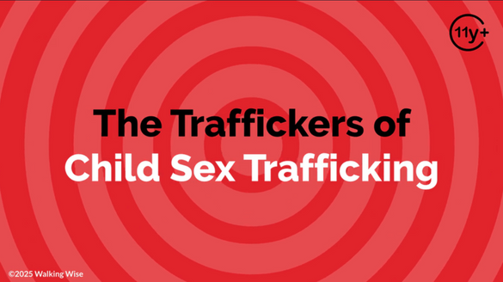

REALITY
Trafficker’s Control
  Traffickers use emotional manipulation to control victims.
©2025 Walking Wise
Cleveland Clinic (2023, March 28). Here's What Trauma Bonding Really Is and How To Recognize the Signs. Health.ClevelendClinic.org.
82
Notes:
Source
Cleveland Clinic (2023, March 28). Here's What Trauma Bonding Really Is and How To Recognize the Signs. Health.ClevelendClinic.org. Retrieved February 25, 2024, from https://health.clevelandclinic.org/trauma-bonding

Slide 83
REALITY
Trafficker’s Control
  Traffickers use emotional manipulation to control victims.
  They use love bonds, debt bonds, drug bonds, & family bonds.
©2025 Walking Wise
Cleveland Clinic (2023, March 28). Here's What Trauma Bonding Really Is and How To Recognize the Signs. Health.ClevelendClinic.org.
83
Notes:
Source
Cleveland Clinic (2023, March 28). Here's What Trauma Bonding Really Is and How To Recognize the Signs. Health.ClevelendClinic.org. Retrieved February 25, 2024, from https://health.clevelandclinic.org/trauma-bonding

Slide 84
REALITY
Trafficker’s Control
  Traffickers use emotional manipulation to control victims.
  They use love bonds, debt bonds, drug bonds, & family bonds.
  Traffickers employ various forms of force, fraud, & coercion.
©2025 Walking Wise
Cleveland Clinic (2023, March 28). Here's What Trauma Bonding Really Is and How To Recognize the Signs. Health.ClevelendClinic.org.
84
Notes:
Source
Cleveland Clinic (2023, March 28). Here's What Trauma Bonding Really Is and How To Recognize the Signs. Health.ClevelendClinic.org. Retrieved February 25, 2024, from https://health.clevelandclinic.org/trauma-bonding

Slide 85
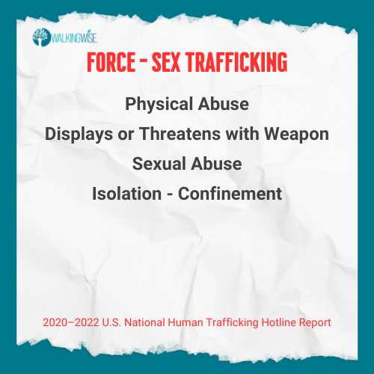
FORCEFUL TACTICS
Myths
&REALITY
©2025 Walking Wise
85
Notes:
Source
Polaris Project (n.d.). Human Trafficking During the COVID and Post-COVID Era. Polarisproject.org, pp. 3, 6. Retrieved February 27, 2024, from https://polarisproject.org/wp-content/uploads/2020/07/Hotline-Trends-Report-2023.pdf

Slide 86
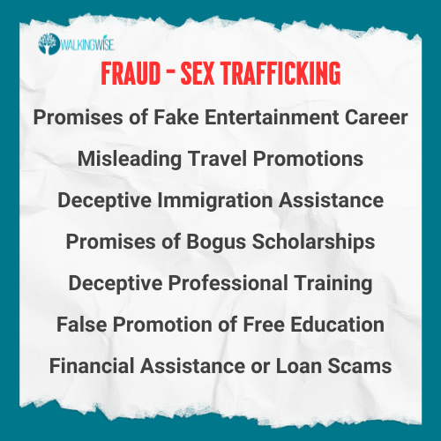
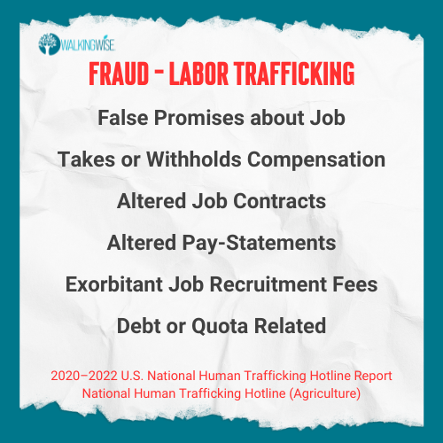
FRAUDULANT TACTICS
©2025 Walking Wise
86
Notes:
Source
Polaris Project (n.d.). Human Trafficking During the COVID and Post-COVID Era. Polarisproject.org, pp. 3, 6. Retrieved February 27, 2024, from https://polarisproject.org/wp-content/uploads/2020/07/Hotline-Trends-Report-2023.pdf
Highman, K. (2024). Walking Wise Sex Trafficking Education. Retrieved January 11, 2025, from WalkingWise.com.

Slide 87
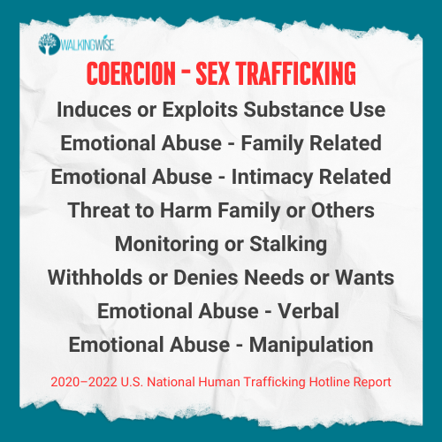
COERCIVE TACTICS
Myths
&REALITY
©2025 Walking Wise
87
Notes:
Source
Polaris Project (n.d.). Human Trafficking During the COVID and Post-COVID Era. Polarisproject.org, pp. 3, 6. Retrieved February 27, 2024, from https://polarisproject.org/wp-content/uploads/2020/07/Hotline-Trends-Report-2023.pdf

Slide 88
LESSON PLANS
TRAFFICKING MYTH
MYTH: Trafficked victims want immediate help out of their situation.
Myths
&REALITY
©2025 Walking Wise
88
3

Slide 89
UNAWARE VICTIMS
Exploited Innocence
  Predators normalize sexual activity with their victims.
©2025 Walking Wise
Chambers R., Gibson M., Chaffin S., Takagi T., Nguyen N., Mears-Clark, T. (2022, January 30). Trauma-coerced Attachment and Complex PTSD: Informed Care for Survivors of Human Trafficking. Journal of Human Trafficking, Volume 10, 2024 – Issue 1, p. 43.
89
Notes:
Source
Chambers R., Gibson M., Chaffin S., Takagi T., Nguyen N., Mears-Clark, T. (2022, January 30). Trauma-coerced Attachment and Complex PTSD: Informed Care for Survivors of Human Trafficking. Journal of Human Trafficking, Volume 10, 2024 – Issue 1, p. 43. Retrieved April 24, 2024, from https://www.tandfonline.com/doi/full/10.1080/23322705.2021.2012386

Slide 90
UNAWARE VICTIMS
Exploited Innocence
  Predators normalize sexual activity with their victims.
  Predators make victims believe they chose to participate.
©2025 Walking Wise
Chambers R., Gibson M., Chaffin S., Takagi T., Nguyen N., Mears-Clark, T. (2022, January 30). Trauma-coerced Attachment and Complex PTSD: Informed Care for Survivors of Human Trafficking. Journal of Human Trafficking, Volume 10, 2024 – Issue 1, p. 43.
90
Notes:
Source
Chambers R., Gibson M., Chaffin S., Takagi T., Nguyen N., Mears-Clark, T. (2022, January 30). Trauma-coerced Attachment and Complex PTSD: Informed Care for Survivors of Human Trafficking. Journal of Human Trafficking, Volume 10, 2024 – Issue 1, p. 43. Retrieved April 24, 2024, from https://www.tandfonline.com/doi/full/10.1080/23322705.2021.2012386

Slide 91
UNAWARE VICTIMS
Exploited Innocence
  Predators normalize sexual activity with their victims.
  Predators make victims believe they chose to participate.
  Victims don’t recognize that crimes are being committed against them.
©2025 Walking Wise
Chambers R., Gibson M., Chaffin S., Takagi T., Nguyen N., Mears-Clark, T. (2022, January 30). Trauma-coerced Attachment and Complex PTSD: Informed Care for Survivors of Human Trafficking. Journal of Human Trafficking, Volume 10, 2024 – Issue 1, p. 43.
91
Notes:
Source
Chambers R., Gibson M., Chaffin S., Takagi T., Nguyen N., Mears-Clark, T. (2022, January 30). Trauma-coerced Attachment and Complex PTSD: Informed Care for Survivors of Human Trafficking. Journal of Human Trafficking, Volume 10, 2024 – Issue 1, p. 43. Retrieved April 24, 2024, from https://www.tandfonline.com/doi/full/10.1080/23322705.2021.2012386

Slide 92
UNAWARE VICTIMS
Exploited Innocence
  Predators normalize sexual activity with their victims.
  Predators make victims believe they chose to participate.
  Victims don’t recognize that crimes are being committed against them.
  Predators silence their victims using blame and shame.
©2025 Walking Wise
Chambers R., Gibson M., Chaffin S., Takagi T., Nguyen N., Mears-Clark, T. (2022, January 30). Trauma-coerced Attachment and Complex PTSD: Informed Care for Survivors of Human Trafficking. Journal of Human Trafficking, Volume 10, 2024 – Issue 1, p. 43.
92
Notes:
Source
Chambers R., Gibson M., Chaffin S., Takagi T., Nguyen N., Mears-Clark, T. (2022, January 30). Trauma-coerced Attachment and Complex PTSD: Informed Care for Survivors of Human Trafficking. Journal of Human Trafficking, Volume 10, 2024 – Issue 1, p. 43. Retrieved April 24, 2024, from https://www.tandfonline.com/doi/full/10.1080/23322705.2021.2012386

Slide 93
TRAUMA BONDS
Cycles of Reward & Punishment
  Grooming: Predators give attention, affection, and gifts, striving to fill unmet needs to create a love bond.
©2025 Walking Wise
Chambers R., Gibson M., Chaffin S., Takagi T., Nguyen N., Mears-Clark, T. (2022, January 30). Trauma-coerced Attachment and Complex PTSD: Informed Care for Survivors of Human Trafficking. Journal of Human Trafficking, Volume 10, 2024 – Issue 1, p. 43.
93
Notes:
Source
Chambers R., Gibson M., Chaffin S., Takagi T., Nguyen N., Mears-Clark, T. (2022, January 30). Trauma-coerced Attachment and Complex PTSD: Informed Care for Survivors of Human Trafficking. Journal of Human Trafficking, Volume 10, 2024 – Issue 1, p. 43. Retrieved April 24, 2024, from https://www.tandfonline.com/doi/full/10.1080/23322705.2021.2012386

Slide 94
TRAUMA BONDS
Cycles of Reward & Punishment
  Grooming: Predators give attention, affection, and gifts, striving to fill unmet needs to create a love bond.
  Abuse: Traffickers then gain control through fear, using physical and psychological punishment to enforce compliance.
©2025 Walking Wise
Chambers R., Gibson M., Chaffin S., Takagi T., Nguyen N., Mears-Clark, T. (2022, January 30). Trauma-coerced Attachment and Complex PTSD: Informed Care for Survivors of Human Trafficking. Journal of Human Trafficking, Volume 10, 2024 – Issue 1, p. 43.
94
Notes:
Source
Chambers R., Gibson M., Chaffin S., Takagi T., Nguyen N., Mears-Clark, T. (2022, January 30). Trauma-coerced Attachment and Complex PTSD: Informed Care for Survivors of Human Trafficking. Journal of Human Trafficking, Volume 10, 2024 – Issue 1, p. 43. Retrieved April 24, 2024, from https://www.tandfonline.com/doi/full/10.1080/23322705.2021.2012386

Slide 95
TRAUMA BONDS
Cycles of Reward & Punishment
  Grooming: Predators give attention, affection, and gifts, striving to fill unmet needs to create a love bond.
  Abuse: Traffickers then gain control through fear, using physical and psychological punishment to enforce compliance.
  Trauma Bond: Victims’ sense of loyalty and love toward their trafficker often causes them to overlook the abuse, which can prevent or delay their escape.
©2025 Walking Wise
Chambers R., Gibson M., Chaffin S., Takagi T., Nguyen N., Mears-Clark, T. (2022, January 30). Trauma-coerced Attachment and Complex PTSD: Informed Care for Survivors of Human Trafficking. Journal of Human Trafficking, Volume 10, 2024 – Issue 1, p. 43.
95
Notes:
Source
Chambers R., Gibson M., Chaffin S., Takagi T., Nguyen N., Mears-Clark, T. (2022, January 30). Trauma-coerced Attachment and Complex PTSD: Informed Care for Survivors of Human Trafficking. Journal of Human Trafficking, Volume 10, 2024 – Issue 1, p. 43. Retrieved April 24, 2024, from https://www.tandfonline.com/doi/full/10.1080/23322705.2021.2012386

Slide 96
WALKING WISE
How can you make a difference in a child’s life?
reality
©2025 Walking Wise
96

Slide 97
PROTECTIVE FACTOR
Trustworthy Adults Reduce Vulnerability
  Children are more likely to report sexual abuse if they have a trustworthy adult.
©2025 Walking Wise
97

Slide 98
PROTECTIVE FACTOR
Trustworthy Adults Reduce Vulnerability
  Children are more likely to report sexual abuse if they have a trustworthy adult.
  Predators are less likely to target a child who has a trustworthy adult in their life.
©2025 Walking Wise
98

Slide 99
PROTECTIVE FACTOR
Trustworthy Adults Reduce Vulnerability
  Children are more likely to report sexual abuse if they have a trustworthy adult.
  Predators are less likely to target a child who has a trustworthy adult in their life.
  Survivor leaders emphasize that having JUST ONE trusted adult plays a vital role in a childs’ resilience.[1]
©2025 Walking Wise
99

Slide 100

WALKING WISE
WalkingWise.com
Learn more about trustworthy adults, groomers, and sexual predators by taking the Walking Wise online course for adults.
©2025 Walking Wise
100

Slide 101
LESSON PLANS
RISK FACTORS
What factors (vulnerabilities) increase a young person’s risk of being preyed upon by a sexual predator or trafficker?
Myths
&REALITY
©2025 Walking Wise
U.S. Department of Education, Office of Safe and Supportive Schools. (2021). Human Trafficking in America's Schools: What Schools Can Do to Prevent, Respond, and Help Students To Recover From Human Trafficking, (2nd ed.).
101
3
Notes:
• PRESENTATION HANDOUT
A handout on the risk factors of sex trafficking is available for distribution and can be found at:
WalkingWalking.com > Classroom Presentations > Myths & Reality.
Source
U.S. Department of Education, Office of Safe and Supportive Schools. (2021). Human Trafficking in America's Schools: What Schools Can Do to Prevent, Respond, and Help Students To Recover From Human Trafficking, (2nd ed.). Retrieved January 13, 2025, from https://www2.ed.gov/documents/human-trafficking/human-trafficking-americas-schools.pdf

Slide 102
RISK FACTORS
Physical & Emotional Factors
  Experienced neglect, abandonment, emotional, physical, or sexual abuse.
reality
©2025 Walking Wise
102
Notes:
Source
U.S. Department of Education, Office of Safe and Supportive Schools. (2021). Human Trafficking in America's Schools: What Schools Can Do to Prevent, Respond, and Help Students To Recover From Human Trafficking, (2nd ed.). Retrieved January 13, 2025, from https://www2.ed.gov/documents/human-trafficking/human-trafficking-americas-schools.pdf

Slide 103
RISK FACTORS
Physical & Emotional Factors
  Experienced neglect, abandonment, emotional, physical, or sexual abuse.
  Has poor self-esteem
reality
©2025 Walking Wise
103
Notes:
Source
U.S. Department of Education, Office of Safe and Supportive Schools. (2021). Human Trafficking in America's Schools: What Schools Can Do to Prevent, Respond, and Help Students To Recover From Human Trafficking, (2nd ed.). Retrieved January 13, 2025, from https://www2.ed.gov/documents/human-trafficking/human-trafficking-americas-schools.pdf

Slide 104
RISK FACTORS
Physical & Emotional Factors
  Experienced neglect, abandonment, emotional, physical, or sexual abuse.
  Has poor self-esteem
  Experiences mental health challenges
reality
©2025 Walking Wise
104
Notes:
Source
U.S. Department of Education, Office of Safe and Supportive Schools. (2021). Human Trafficking in America's Schools: What Schools Can Do to Prevent, Respond, and Help Students To Recover From Human Trafficking, (2nd ed.). Retrieved January 13, 2025, from https://www2.ed.gov/documents/human-trafficking/human-trafficking-americas-schools.pdf

Slide 105
RISK FACTORS
Physical & Emotional Factors
  Experienced neglect, abandonment, emotional, physical, or sexual abuse.
  Has poor self-esteem
  Experiences mental health challenges
  Experiences medical or physical challenges
reality
©2025 Walking Wise
105
Notes:
Source
U.S. Department of Education, Office of Safe and Supportive Schools. (2021). Human Trafficking in America's Schools: What Schools Can Do to Prevent, Respond, and Help Students To Recover From Human Trafficking, (2nd ed.). Retrieved January 13, 2025, from https://www2.ed.gov/documents/human-trafficking/human-trafficking-americas-schools.pdf

Slide 106
RISK FACTORS
Financial Factors
  Lives in poverty
reality
©2025 Walking Wise
106
Notes:
Source
U.S. Department of Education, Office of Safe and Supportive Schools. (2021). Human Trafficking in America's Schools: What Schools Can Do to Prevent, Respond, and Help Students To Recover From Human Trafficking, (2nd ed.). Retrieved January 13, 2025, from https://www2.ed.gov/documents/human-trafficking/human-trafficking-americas-schools.pdf

Slide 107
RISK FACTORS
Financial Factors
  Lives in poverty
  Lacks basic needs like shelter, food, & clothing
reality
©2025 Walking Wise
107
Notes:
Source
U.S. Department of Education, Office of Safe and Supportive Schools. (2021). Human Trafficking in America's Schools: What Schools Can Do to Prevent, Respond, and Help Students To Recover From Human Trafficking, (2nd ed.). Retrieved January 13, 2025, from https://www2.ed.gov/documents/human-trafficking/human-trafficking-americas-schools.pdf

Slide 108
RISK FACTORS
Relational Factors
  Lacks peer relationships
reality
©2025 Walking Wise
108
Notes:
Source
U.S. Department of Education, Office of Safe and Supportive Schools. (2021). Human Trafficking in America's Schools: What Schools Can Do to Prevent, Respond, and Help Students To Recover From Human Trafficking, (2nd ed.). Retrieved January 13, 2025, from https://www2.ed.gov/documents/human-trafficking/human-trafficking-americas-schools.pdf

Slide 109
RISK FACTORS
Relational Factors
  Lacks peer relationships
  Involved with an older boyfriend, girlfriend, or partner
reality
©2025 Walking Wise
109
Notes:
Source
U.S. Department of Education, Office of Safe and Supportive Schools. (2021). Human Trafficking in America's Schools: What Schools Can Do to Prevent, Respond, and Help Students To Recover From Human Trafficking, (2nd ed.). Retrieved January 13, 2025, from https://www2.ed.gov/documents/human-trafficking/human-trafficking-americas-schools.pdf

Slide 110
RISK FACTORS
Relational Factors
  Lacks peer relationships
  Involved with an older boyfriend, girlfriend, or partner
  Is a target of bullying
reality
©2025 Walking Wise
110
Notes:
Source
U.S. Department of Education, Office of Safe and Supportive Schools. (2021). Human Trafficking in America's Schools: What Schools Can Do to Prevent, Respond, and Help Students To Recover From Human Trafficking, (2nd ed.). Retrieved January 13, 2025, from https://www2.ed.gov/documents/human-trafficking/human-trafficking-americas-schools.pdf

Slide 111
RISK FACTORS
Relational Factors
  Lacks peer relationships
  Involved with an older boyfriend, girlfriend, or partner
  Is a target of bullying
  Submits to peer pressure
reality
©2025 Walking Wise
111
Notes:
Source
U.S. Department of Education, Office of Safe and Supportive Schools. (2021). Human Trafficking in America's Schools: What Schools Can Do to Prevent, Respond, and Help Students To Recover From Human Trafficking, (2nd ed.). Retrieved January 13, 2025, from https://www2.ed.gov/documents/human-trafficking/human-trafficking-americas-schools.pdf

Slide 112
RISK FACTORS
Relational Factors
  Lacks peer relationships
  Involved with an older boyfriend, girlfriend, or partner
  Is a target of bullying
  Submits to peer pressure
  Experiences family rejection over sexual orientation
reality
©2025 Walking Wise
112
Notes:
Source
U.S. Department of Education, Office of Safe and Supportive Schools. (2021). Human Trafficking in America's Schools: What Schools Can Do to Prevent, Respond, and Help Students To Recover From Human Trafficking, (2nd ed.). Retrieved January 13, 2025, from https://www2.ed.gov/documents/human-trafficking/human-trafficking-americas-schools.pdf

Slide 113
RISK FACTORS
Relational Factors
  Lacks peer relationships
  Involved with an older boyfriend, girlfriend, or partner
  Is a target of bullying
  Submits to peer pressure
  Experiences family rejection over sexual orientation
  Romantic partner uses drugs
reality
©2025 Walking Wise
113
Notes:
Source
U.S. Department of Education, Office of Safe and Supportive Schools. (2021). Human Trafficking in America's Schools: What Schools Can Do to Prevent, Respond, and Help Students To Recover From Human Trafficking, (2nd ed.). Retrieved January 13, 2025, from https://www2.ed.gov/documents/human-trafficking/human-trafficking-americas-schools.pdf

Slide 114
RISK FACTORS
Relational Factors (cont.)
  Isolated by a romantic partner, parent, or friend
reality
©2025 Walking Wise
114
Notes:
Source
U.S. Department of Education, Office of Safe and Supportive Schools. (2021). Human Trafficking in America's Schools: What Schools Can Do to Prevent, Respond, and Help Students To Recover From Human Trafficking, (2nd ed.). Retrieved January 13, 2025, from https://www2.ed.gov/documents/human-trafficking/human-trafficking-americas-schools.pdf

Slide 115
RISK FACTORS
Relational Factors
  Isolated by a romantic partner, parent, or friend
  Family members abuse drugs or alcohol
reality
©2025 Walking Wise
115
Notes:
Source
U.S. Department of Education, Office of Safe and Supportive Schools. (2021). Human Trafficking in America's Schools: What Schools Can Do to Prevent, Respond, and Help Students To Recover From Human Trafficking, (2nd ed.). Retrieved January 13, 2025, from https://www2.ed.gov/documents/human-trafficking/human-trafficking-americas-schools.pdf

Slide 116
RISK FACTORS
Relational Factors
  Isolated by a romantic partner, parent, or friend
  Family members abuse drugs or alcohol
  Volatile home life due to family dynamics
reality
©2025 Walking Wise
116
Notes:
Source
U.S. Department of Education, Office of Safe and Supportive Schools. (2021). Human Trafficking in America's Schools: What Schools Can Do to Prevent, Respond, and Help Students To Recover From Human Trafficking, (2nd ed.). Retrieved January 13, 2025, from https://www2.ed.gov/documents/human-trafficking/human-trafficking-americas-schools.pdf

Slide 117
RISK FACTORS
Relational Factors
  Isolated by a romantic partner, parent, or friend
  Family members abuse drugs or alcohol
  Volatile home life due to family dynamics
  Targeted by gangs or is a gang member
reality
©2025 Walking Wise
117
Notes:
Source
U.S. Department of Education, Office of Safe and Supportive Schools. (2021). Human Trafficking in America's Schools: What Schools Can Do to Prevent, Respond, and Help Students To Recover From Human Trafficking, (2nd ed.). Retrieved January 13, 2025, from https://www2.ed.gov/documents/human-trafficking/human-trafficking-americas-schools.pdf

Slide 118
RISK FACTORS
Relational Factors
  Isolated by a romantic partner, parent, or friend
  Family members abuse drugs or alcohol
  Volatile home life due to family dynamics
  Targeted by gangs or is a gang member
  Family member is involved in human trafficking
reality
©2025 Walking Wise
118
Notes:
Source
U.S. Department of Education, Office of Safe and Supportive Schools. (2021). Human Trafficking in America's Schools: What Schools Can Do to Prevent, Respond, and Help Students To Recover From Human Trafficking, (2nd ed.). Retrieved January 13, 2025, from https://www2.ed.gov/documents/human-trafficking/human-trafficking-americas-schools.pdf

Slide 119
RISK FACTORS
Residential Risk Factors
  History of running away
reality
©2025 Walking Wise
119
Notes:
Source
U.S. Department of Education, Office of Safe and Supportive Schools. (2021). Human Trafficking in America's Schools: What Schools Can Do to Prevent, Respond, and Help Students To Recover From Human Trafficking, (2nd ed.). Retrieved January 13, 2025, from https://www2.ed.gov/documents/human-trafficking/human-trafficking-americas-schools.pdf

Slide 120
RISK FACTORS
Residential Risk Factors
  History of running away
  Lives in foster care
reality
©2025 Walking Wise
120
Notes:
Source
U.S. Department of Education, Office of Safe and Supportive Schools. (2021). Human Trafficking in America's Schools: What Schools Can Do to Prevent, Respond, and Help Students To Recover From Human Trafficking, (2nd ed.). Retrieved January 13, 2025, from https://www2.ed.gov/documents/human-trafficking/human-trafficking-americas-schools.pdf

Slide 121
RISK FACTORS
Residential Risk Factors
  History of running away
  Lives in foster care
  Experiencing homelessness or couch surfing
reality
©2025 Walking Wise
121
Notes:
Source
U.S. Department of Education, Office of Safe and Supportive Schools. (2021). Human Trafficking in America's Schools: What Schools Can Do to Prevent, Respond, and Help Students To Recover From Human Trafficking, (2nd ed.). Retrieved January 13, 2025, from https://www2.ed.gov/documents/human-trafficking/human-trafficking-americas-schools.pdf

Slide 122
RISK FACTORS
Residential Risk Factors
  History of running away
  Lives in foster care
  Experiencing homelessness or couch surfing
  Lives in a homeless shelter or group home
reality
©2025 Walking Wise
122
Notes:
Source
U.S. Department of Education, Office of Safe and Supportive Schools. (2021). Human Trafficking in America's Schools: What Schools Can Do to Prevent, Respond, and Help Students To Recover From Human Trafficking, (2nd ed.). Retrieved January 13, 2025, from https://www2.ed.gov/documents/human-trafficking/human-trafficking-americas-schools.pdf

Slide 123
RISK FACTORS
Residential Risk Factors
  History of running away
  Lives in foster care
  Experiencing homelessness or couch surfing
  Lives in a homeless shelter or group home
  Exposed to prostitution within the neighborhood
reality
©2025 Walking Wise
123
Notes:
Source
U.S. Department of Education, Office of Safe and Supportive Schools. (2021). Human Trafficking in America's Schools: What Schools Can Do to Prevent, Respond, and Help Students To Recover From Human Trafficking, (2nd ed.). Retrieved January 13, 2025, from https://www2.ed.gov/documents/human-trafficking/human-trafficking-americas-schools.pdf

Slide 124
RISK FACTORS
Residential Risk Factors
  History of running away
  Lives in foster care
  Experiencing homelessness or couch surfing
  Lives in a homeless shelter or group home
  Exposed to prostitution within the neighborhood
  Lives near a wealthy tourist location
reality
©2025 Walking Wise
124
Notes:
Source
U.S. Department of Education, Office of Safe and Supportive Schools. (2021). Human Trafficking in America's Schools: What Schools Can Do to Prevent, Respond, and Help Students To Recover From Human Trafficking, (2nd ed.). Retrieved January 13, 2025, from https://www2.ed.gov/documents/human-trafficking/human-trafficking-americas-schools.pdf

Slide 125
RISK FACTORS
Behavioral Factors
  Unsecured use of social media platforms
reality
©2025 Walking Wise
125
Notes:
Source
U.S. Department of Education, Office of Safe and Supportive Schools. (2021). Human Trafficking in America's Schools: What Schools Can Do to Prevent, Respond, and Help Students To Recover From Human Trafficking, (2nd ed.). Retrieved January 13, 2025, from https://www2.ed.gov/documents/human-trafficking/human-trafficking-americas-schools.pdf

Slide 126
RISK FACTORS
Behavioral Factors
  Unsecured use of social media platforms
  Involved in the juvenile justice system
reality
©2025 Walking Wise
126
Notes:
Source
U.S. Department of Education, Office of Safe and Supportive Schools. (2021). Human Trafficking in America's Schools: What Schools Can Do to Prevent, Respond, and Help Students To Recover From Human Trafficking, (2nd ed.). Retrieved January 13, 2025, from https://www2.ed.gov/documents/human-trafficking/human-trafficking-americas-schools.pdf

Slide 127
RISK FACTORS
Behavioral Factors
  Unsecured use of social media platforms
  Involved in the juvenile justice system
  Uses drugs or alcohol
reality
©2025 Walking Wise
127
Notes:
Source
U.S. Department of Education, Office of Safe and Supportive Schools. (2021). Human Trafficking in America's Schools: What Schools Can Do to Prevent, Respond, and Help Students To Recover From Human Trafficking, (2nd ed.). Retrieved January 13, 2025, from https://www2.ed.gov/documents/human-trafficking/human-trafficking-americas-schools.pdf

Slide 128
RISK FACTORS
Educational Risk Factors
  Struggles academically
reality
©2025 Walking Wise
128
Notes:
Source
U.S. Department of Education, Office of Safe and Supportive Schools. (2021). Human Trafficking in America's Schools: What Schools Can Do to Prevent, Respond, and Help Students To Recover From Human Trafficking, (2nd ed.). Retrieved January 13, 2025, from https://www2.ed.gov/documents/human-trafficking/human-trafficking-americas-schools.pdf

Slide 129
RISK FACTORS
Educational Risk Factors
  Struggles academically
  Has learning differences or challenges
reality
©2025 Walking Wise
129
Notes:
Source
U.S. Department of Education, Office of Safe and Supportive Schools. (2021). Human Trafficking in America's Schools: What Schools Can Do to Prevent, Respond, and Help Students To Recover From Human Trafficking, (2nd ed.). Retrieved January 13, 2025, from https://www2.ed.gov/documents/human-trafficking/human-trafficking-americas-schools.pdf

Slide 130
RISK FACTORS
Educational Risk Factors
  Struggles academically
  Has learning differences or challenges
  Chronic tardiness or absenteeism
reality
©2025 Walking Wise
130
Notes:
Source
U.S. Department of Education, Office of Safe and Supportive Schools. (2021). Human Trafficking in America's Schools: What Schools Can Do to Prevent, Respond, and Help Students To Recover From Human Trafficking, (2nd ed.). Retrieved January 13, 2025, from https://www2.ed.gov/documents/human-trafficking/human-trafficking-americas-schools.pdf

Slide 131
RISK FACTORS
Educational Risk Factors
  Struggles academically
  Has learning differences or challenges
  Chronic tardiness or absenteeism
  Unmotivated to achieve in school
reality
©2025 Walking Wise
131
Notes:
Source
U.S. Department of Education, Office of Safe and Supportive Schools. (2021). Human Trafficking in America's Schools: What Schools Can Do to Prevent, Respond, and Help Students To Recover From Human Trafficking, (2nd ed.). Retrieved January 13, 2025, from https://www2.ed.gov/documents/human-trafficking/human-trafficking-americas-schools.pdf

Slide 132
RISK FACTORS
Educational Risk Factors
  Struggles academically
  Has learning differences or challenges
  Chronic tardiness or absenteeism
  Unmotivated to achieve in school
  Unmotivated to participate in school activities
reality
©2025 Walking Wise
132
Notes:
Source
U.S. Department of Education, Office of Safe and Supportive Schools. (2021). Human Trafficking in America's Schools: What Schools Can Do to Prevent, Respond, and Help Students To Recover From Human Trafficking, (2nd ed.). Retrieved January 13, 2025, from https://www2.ed.gov/documents/human-trafficking/human-trafficking-americas-schools.pdf

Slide 133
LESSON PLANS
INDICATORS OF TRAFFICKING
What signs might appear when a young person is being trafficked?
Myths
&REALITY
©2025 Walking Wise
U.S. Department of Education, Office of Safe and Supportive Schools. (2021). Human Trafficking in America's Schools: What Schools Can Do to Prevent, Respond, and Help Students To Recover From Human Trafficking, (2nd ed.).
133
3
Notes:
• PRESENTATION HANDOUT
A handout on the indicators of sex trafficking is available for distribution and can be found at:
WalkingWalking.com > Classroom Presentations > Myths & Reality.
Source
U.S. Department of Education, Office of Safe and Supportive Schools. (2021). Human Trafficking in America's Schools: What Schools Can Do to Prevent, Respond, and Help Students To Recover From Human Trafficking, (2nd ed.). Retrieved January 13, 2025, from https://www2.ed.gov/documents/human-trafficking/human-trafficking-americas-schools.pdf

Slide 134
INDICATORS
Physical & Emotional Indicators
  Scars, cuts, bruises, new tattoos
reality
©2025 Walking Wise
134
Notes:
Source
U.S. Department of Education, Office of Safe and Supportive Schools. (2021). Human Trafficking in America's Schools: What Schools Can Do to Prevent, Respond, and Help Students To Recover From Human Trafficking, (2nd ed.). Retrieved January 13, 2025, from https://www2.ed.gov/documents/human-trafficking/human-trafficking-americas-schools.pdf

Slide 135
INDICATORS
Physical & Emotional Indicators
  Scars, cuts, bruises, new tattoos
  Poor physical health or malnutrition
reality
©2025 Walking Wise
135
Notes:
Source
U.S. Department of Education, Office of Safe and Supportive Schools. (2021). Human Trafficking in America's Schools: What Schools Can Do to Prevent, Respond, and Help Students To Recover From Human Trafficking, (2nd ed.). Retrieved January 13, 2025, from https://www2.ed.gov/documents/human-trafficking/human-trafficking-americas-schools.pdf

Slide 136
INDICATORS
Physical & Emotional Indicators
  Scars, cuts, bruises, new tattoos
  Poor physical health or malnutrition
  Change in behavior, appearance, or personal hygiene
reality
©2025 Walking Wise
136
Notes:
Source
U.S. Department of Education, Office of Safe and Supportive Schools. (2021). Human Trafficking in America's Schools: What Schools Can Do to Prevent, Respond, and Help Students To Recover From Human Trafficking, (2nd ed.). Retrieved January 13, 2025, from https://www2.ed.gov/documents/human-trafficking/human-trafficking-americas-schools.pdf

Slide 137
INDICATORS
Physical & Emotional Indicators
  Scars, cuts, bruises, new tattoos
  Poor physical health or malnutrition
  Change in behavior, appearance, or personal hygiene
  Displays exhaustion, depression, or distress
reality
©2025 Walking Wise
137
Notes:
Source
U.S. Department of Education, Office of Safe and Supportive Schools. (2021). Human Trafficking in America's Schools: What Schools Can Do to Prevent, Respond, and Help Students To Recover From Human Trafficking, (2nd ed.). Retrieved January 13, 2025, from https://www2.ed.gov/documents/human-trafficking/human-trafficking-americas-schools.pdf

Slide 138
INDICATORS
Physical & Emotional Indicators
  Scars, cuts, bruises, new tattoos
  Poor physical health or malnutrition
  Change in behavior, appearance, or personal hygiene
  Displays exhaustion, depression, or distress
  Seeks medical care or diagnosed with STIs
reality
©2025 Walking Wise
138
Notes:
Source
U.S. Department of Education, Office of Safe and Supportive Schools. (2021). Human Trafficking in America's Schools: What Schools Can Do to Prevent, Respond, and Help Students To Recover From Human Trafficking, (2nd ed.). Retrieved January 13, 2025, from https://www2.ed.gov/documents/human-trafficking/human-trafficking-americas-schools.pdf

Slide 139
INDICATORS
Financial & Material Indicators
  Lacks basic needs like food, shelter, and money.
reality
©2025 Walking Wise
139
Notes:
Source
U.S. Department of Education, Office of Safe and Supportive Schools. (2021). Human Trafficking in America's Schools: What Schools Can Do to Prevent, Respond, and Help Students To Recover From Human Trafficking, (2nd ed.). Retrieved January 13, 2025, from https://www2.ed.gov/documents/human-trafficking/human-trafficking-americas-schools.pdf

Slide 140
INDICATORS
Financial & Material Indicators
  Lacks basic needs like food, shelter, and money.
  Dressed inappropriately for weather or season.
reality
©2025 Walking Wise
140
Notes:
Source
U.S. Department of Education, Office of Safe and Supportive Schools. (2021). Human Trafficking in America's Schools: What Schools Can Do to Prevent, Respond, and Help Students To Recover From Human Trafficking, (2nd ed.). Retrieved January 13, 2025, from https://www2.ed.gov/documents/human-trafficking/human-trafficking-americas-schools.pdf

Slide 141
INDICATORS
Financial & Material Indicators
  Lacks basic needs like food, shelter, and money.
  Dressed inappropriately for weather or season.
  Displays expensive salon care: hairstyles, make-up, manicures
reality
©2025 Walking Wise
141
Notes:
Source
U.S. Department of Education, Office of Safe and Supportive Schools. (2021). Human Trafficking in America's Schools: What Schools Can Do to Prevent, Respond, and Help Students To Recover From Human Trafficking, (2nd ed.). Retrieved January 13, 2025, from https://www2.ed.gov/documents/human-trafficking/human-trafficking-americas-schools.pdf

Slide 142
INDICATORS
Financial & Material Indicators
  Lacks basic needs like food, shelter, and money.
  Dressed inappropriately for weather or season.
  Displays expensive salon care: hairstyles, make-up, manicures
  Wears new or expensive clothing and jewelry
reality
©2025 Walking Wise
142
Notes:
Source
U.S. Department of Education, Office of Safe and Supportive Schools. (2021). Human Trafficking in America's Schools: What Schools Can Do to Prevent, Respond, and Help Students To Recover From Human Trafficking, (2nd ed.). Retrieved January 13, 2025, from https://www2.ed.gov/documents/human-trafficking/human-trafficking-americas-schools.pdf

Slide 143
INDICATORS
Financial & Material Indicators (cont.)
  Possession of excessive cash or credit cards
reality
©2025 Walking Wise
143
Notes:
Source
U.S. Department of Education, Office of Safe and Supportive Schools. (2021). Human Trafficking in America's Schools: What Schools Can Do to Prevent, Respond, and Help Students To Recover From Human Trafficking, (2nd ed.). Retrieved January 13, 2025, from https://www2.ed.gov/documents/human-trafficking/human-trafficking-americas-schools.pdf

Slide 144
INDICATORS
Financial & Material Indicators
  Possession of excessive cash or credit cards
  Possession of a new phone, prepaid phone, multiple phones
reality
©2025 Walking Wise
144
Notes:
Source
U.S. Department of Education, Office of Safe and Supportive Schools. (2021). Human Trafficking in America's Schools: What Schools Can Do to Prevent, Respond, and Help Students To Recover From Human Trafficking, (2nd ed.). Retrieved January 13, 2025, from https://www2.ed.gov/documents/human-trafficking/human-trafficking-americas-schools.pdf

Slide 145
INDICATORS
Financial & Material Indicators
  Possession of excessive cash or credit cards
  Possession of a new phone, prepaid phone, multiple phones
  Possession of hotel keys or key cards
reality
©2025 Walking Wise
145
Notes:
Source
U.S. Department of Education, Office of Safe and Supportive Schools. (2021). Human Trafficking in America's Schools: What Schools Can Do to Prevent, Respond, and Help Students To Recover From Human Trafficking, (2nd ed.). Retrieved January 13, 2025, from https://www2.ed.gov/documents/human-trafficking/human-trafficking-americas-schools.pdf

Slide 146
INDICATORS
Financial & Material Indicators
  Possession of excessive cash or credit cards
  Possession of a new phone, prepaid phone, multiple phones
  Possession of hotel keys or key cards
  Regularly travels to other cities or out-of-state
reality
©2025 Walking Wise
146
Notes:
Source
U.S. Department of Education, Office of Safe and Supportive Schools. (2021). Human Trafficking in America's Schools: What Schools Can Do to Prevent, Respond, and Help Students To Recover From Human Trafficking, (2nd ed.). Retrieved January 13, 2025, from https://www2.ed.gov/documents/human-trafficking/human-trafficking-americas-schools.pdf

Slide 147
INDICATORS
Relational Indicators
  Change in peer relationships or social connections
reality
©2025 Walking Wise
147
Notes:
Source
U.S. Department of Education, Office of Safe and Supportive Schools. (2021). Human Trafficking in America's Schools: What Schools Can Do to Prevent, Respond, and Help Students To Recover From Human Trafficking, (2nd ed.). Retrieved January 13, 2025, from https://www2.ed.gov/documents/human-trafficking/human-trafficking-americas-schools.pdf

Slide 148
INDICATORS
Relational Indicators
  Change in peer relationships or social connections
  Over-attachment to school staff
reality
©2025 Walking Wise
148
Notes:
Source
U.S. Department of Education, Office of Safe and Supportive Schools. (2021). Human Trafficking in America's Schools: What Schools Can Do to Prevent, Respond, and Help Students To Recover From Human Trafficking, (2nd ed.). Retrieved January 13, 2025, from https://www2.ed.gov/documents/human-trafficking/human-trafficking-americas-schools.pdf

Slide 149
INDICATORS
Relational Indicators
  Change in peer relationships or social connections
  Over-attachment to school staff
  Older or controlling romantic partner or controlling parents
reality
©2025 Walking Wise
149
Notes:
Source
U.S. Department of Education, Office of Safe and Supportive Schools. (2021). Human Trafficking in America's Schools: What Schools Can Do to Prevent, Respond, and Help Students To Recover From Human Trafficking, (2nd ed.). Retrieved January 13, 2025, from https://www2.ed.gov/documents/human-trafficking/human-trafficking-americas-schools.pdf

Slide 150
INDICATORS
Relational Indicators
  Change in peer relationships or social connections
  Over-attachment to school staff
  Older or controlling romantic partner or controlling parents
  Unknown person transporting a student to and from school
reality
©2025 Walking Wise
150
Notes:
Source
U.S. Department of Education, Office of Safe and Supportive Schools. (2021). Human Trafficking in America's Schools: What Schools Can Do to Prevent, Respond, and Help Students To Recover From Human Trafficking, (2nd ed.). Retrieved January 13, 2025, from https://www2.ed.gov/documents/human-trafficking/human-trafficking-americas-schools.pdf

Slide 151
INDICATORS
Relational Indicators (cont.)
  Isolated from friends and family
reality
©2025 Walking Wise
151
Notes:
Source
U.S. Department of Education, Office of Safe and Supportive Schools. (2021). Human Trafficking in America's Schools: What Schools Can Do to Prevent, Respond, and Help Students To Recover From Human Trafficking, (2nd ed.). Retrieved January 13, 2025, from https://www2.ed.gov/documents/human-trafficking/human-trafficking-americas-schools.pdf

Slide 152
INDICATORS
Relational Indicators
  Isolated from friends and family
  Has multiple sex partners
reality
©2025 Walking Wise
152
Notes:
Source
U.S. Department of Education, Office of Safe and Supportive Schools. (2021). Human Trafficking in America's Schools: What Schools Can Do to Prevent, Respond, and Help Students To Recover From Human Trafficking, (2nd ed.). Retrieved January 13, 2025, from https://www2.ed.gov/documents/human-trafficking/human-trafficking-americas-schools.pdf

Slide 153
INDICATORS
Relational Indicators
  Isolated from friends and family
  Has multiple sex partners
  Associates with gangs, drug dealers, traffickers
reality
©2025 Walking Wise
153
Notes:
Source
U.S. Department of Education, Office of Safe and Supportive Schools. (2021). Human Trafficking in America's Schools: What Schools Can Do to Prevent, Respond, and Help Students To Recover From Human Trafficking, (2nd ed.). Retrieved January 13, 2025, from https://www2.ed.gov/documents/human-trafficking/human-trafficking-americas-schools.pdf

Slide 154
INDICATORS
Residential Indicators
  Runs away from home or is couch-surfing
reality
©2025 Walking Wise
154
Notes:
Source
U.S. Department of Education, Office of Safe and Supportive Schools. (2021). Human Trafficking in America's Schools: What Schools Can Do to Prevent, Respond, and Help Students To Recover From Human Trafficking, (2nd ed.). Retrieved January 13, 2025, from https://www2.ed.gov/documents/human-trafficking/human-trafficking-americas-schools.pdf

Slide 155
INDICATORS
Residential Indicators
  Runs away from home or is couch-surfing
  Unhoused, living in a shelter
reality
©2025 Walking Wise
155
Notes:
Source
U.S. Department of Education, Office of Safe and Supportive Schools. (2021). Human Trafficking in America's Schools: What Schools Can Do to Prevent, Respond, and Help Students To Recover From Human Trafficking, (2nd ed.). Retrieved January 13, 2025, from https://www2.ed.gov/documents/human-trafficking/human-trafficking-americas-schools.pdf

Slide 156
INDICATORS
Residential Indicators
  Runs away from home or is couch-surfing
  Unhoused, living in a shelter
  Lives in a foster care home or group home
reality
©2025 Walking Wise
156
Notes:
Source
U.S. Department of Education, Office of Safe and Supportive Schools. (2021). Human Trafficking in America's Schools: What Schools Can Do to Prevent, Respond, and Help Students To Recover From Human Trafficking, (2nd ed.). Retrieved January 13, 2025, from https://www2.ed.gov/documents/human-trafficking/human-trafficking-americas-schools.pdf

Slide 157
INDICATORS
Residential Indicators
  Runs away from home or is couch-surfing
  Unhoused, living in a shelter
  Lives in a foster care home or group home
  Living in a home with people who are not immediate family
reality
©2025 Walking Wise
157
Notes:
Source
U.S. Department of Education, Office of Safe and Supportive Schools. (2021). Human Trafficking in America's Schools: What Schools Can Do to Prevent, Respond, and Help Students To Recover From Human Trafficking, (2nd ed.). Retrieved January 13, 2025, from https://www2.ed.gov/documents/human-trafficking/human-trafficking-americas-schools.pdf

Slide 158
INDICATORS
Behavioral Indicators
  Uses drugs or alcohol
reality
©2025 Walking Wise
158
Notes:
Source
U.S. Department of Education, Office of Safe and Supportive Schools. (2021). Human Trafficking in America's Schools: What Schools Can Do to Prevent, Respond, and Help Students To Recover From Human Trafficking, (2nd ed.). Retrieved January 13, 2025, from https://www2.ed.gov/documents/human-trafficking/human-trafficking-americas-schools.pdf

Slide 159
INDICATORS
Behavioral Indicators
  Uses drugs or alcohol
  Responds to questions that sound rehearsed
reality
©2025 Walking Wise
159
Notes:
Source
U.S. Department of Education, Office of Safe and Supportive Schools. (2021). Human Trafficking in America's Schools: What Schools Can Do to Prevent, Respond, and Help Students To Recover From Human Trafficking, (2nd ed.). Retrieved January 13, 2025, from https://www2.ed.gov/documents/human-trafficking/human-trafficking-americas-schools.pdf

Slide 160
INDICATORS
Behavioral Indicators
  Uses drugs or alcohol
  Responds to questions that sound rehearsed
  Constantly checks phone or will not part from their phone
reality
©2025 Walking Wise
160
Notes:
Source
U.S. Department of Education, Office of Safe and Supportive Schools. (2021). Human Trafficking in America's Schools: What Schools Can Do to Prevent, Respond, and Help Students To Recover From Human Trafficking, (2nd ed.). Retrieved January 13, 2025, from https://www2.ed.gov/documents/human-trafficking/human-trafficking-americas-schools.pdf

Slide 161
INDICATORS
Behavioral Indicators
  Uses drugs or alcohol
  Responds to questions that sound rehearsed
  Constantly checks phone or will not part from their phone
  Expresses extreme emotions or people-pleasing
reality
©2025 Walking Wise
161
Notes:
Source
U.S. Department of Education, Office of Safe and Supportive Schools. (2021). Human Trafficking in America's Schools: What Schools Can Do to Prevent, Respond, and Help Students To Recover From Human Trafficking, (2nd ed.). Retrieved January 13, 2025, from https://www2.ed.gov/documents/human-trafficking/human-trafficking-americas-schools.pdf

Slide 162
INDICATORS
Behavioral Indicators (cont.)
  Displays uncharacteristic promiscuity
reality
©2025 Walking Wise
162
Notes:
Source
U.S. Department of Education, Office of Safe and Supportive Schools. (2021). Human Trafficking in America's Schools: What Schools Can Do to Prevent, Respond, and Help Students To Recover From Human Trafficking, (2nd ed.). Retrieved January 13, 2025, from https://www2.ed.gov/documents/human-trafficking/human-trafficking-americas-schools.pdf

Slide 163
INDICATORS
Behavioral Indicators
  Displays uncharacteristic promiscuity
  Makes inappropriate sexual references
reality
©2025 Walking Wise
163
Notes:
Source
U.S. Department of Education, Office of Safe and Supportive Schools. (2021). Human Trafficking in America's Schools: What Schools Can Do to Prevent, Respond, and Help Students To Recover From Human Trafficking, (2nd ed.). Retrieved January 13, 2025, from https://www2.ed.gov/documents/human-trafficking/human-trafficking-americas-schools.pdf

Slide 164
INDICATORS
Behavioral Indicators
  Displays uncharacteristic promiscuity
  Makes inappropriate sexual references
  Sexualized online persona
reality
©2025 Walking Wise
164
Notes:
Source
U.S. Department of Education, Office of Safe and Supportive Schools. (2021). Human Trafficking in America's Schools: What Schools Can Do to Prevent, Respond, and Help Students To Recover From Human Trafficking, (2nd ed.). Retrieved January 13, 2025, from https://www2.ed.gov/documents/human-trafficking/human-trafficking-americas-schools.pdf

Slide 165
INDICATORS
Behavioral Indicators
  Displays uncharacteristic promiscuity
  Makes inappropriate sexual references
  Sexualized online persona
  Involved in the juvenile justice system
reality
©2025 Walking Wise
165
Notes:
Source
U.S. Department of Education, Office of Safe and Supportive Schools. (2021). Human Trafficking in America's Schools: What Schools Can Do to Prevent, Respond, and Help Students To Recover From Human Trafficking, (2nd ed.). Retrieved January 13, 2025, from https://www2.ed.gov/documents/human-trafficking/human-trafficking-americas-schools.pdf

Slide 166
INDICATORS
Educational Indicators
  Sudden academic decline
reality
©2025 Walking Wise
166
Notes:
Source
U.S. Department of Education, Office of Safe and Supportive Schools. (2021). Human Trafficking in America's Schools: What Schools Can Do to Prevent, Respond, and Help Students To Recover From Human Trafficking, (2nd ed.). Retrieved January 13, 2025, from https://www2.ed.gov/documents/human-trafficking/human-trafficking-americas-schools.pdf

Slide 167
INDICATORS
Educational Indicators
  Sudden academic decline
  Academic overachiever, panic response to grades
reality
©2025 Walking Wise
167
Notes:
Source
U.S. Department of Education, Office of Safe and Supportive Schools. (2021). Human Trafficking in America's Schools: What Schools Can Do to Prevent, Respond, and Help Students To Recover From Human Trafficking, (2nd ed.). Retrieved January 13, 2025, from https://www2.ed.gov/documents/human-trafficking/human-trafficking-americas-schools.pdf

Slide 168
INDICATORS
Educational Indicators
  Sudden academic decline
  Academic overachiever, panic response to grades
  Truancy, frequent school absenteeism, chronic tardiness
reality
©2025 Walking Wise
168
Notes:
Source
U.S. Department of Education, Office of Safe and Supportive Schools. (2021). Human Trafficking in America's Schools: What Schools Can Do to Prevent, Respond, and Help Students To Recover From Human Trafficking, (2nd ed.). Retrieved January 13, 2025, from https://www2.ed.gov/documents/human-trafficking/human-trafficking-americas-schools.pdf

Slide 169
INDICATORS
Educational Indicators
  Sudden academic decline
  Academic overachiever, panic response to grades
  Truancy, frequent school absenteeism, chronic tardiness
  Frequent early dismissal from school
reality
©2025 Walking Wise
169
Notes:
Source
U.S. Department of Education, Office of Safe and Supportive Schools. (2021). Human Trafficking in America's Schools: What Schools Can Do to Prevent, Respond, and Help Students To Recover From Human Trafficking, (2nd ed.). Retrieved January 13, 2025, from https://www2.ed.gov/documents/human-trafficking/human-trafficking-americas-schools.pdf

Slide 170
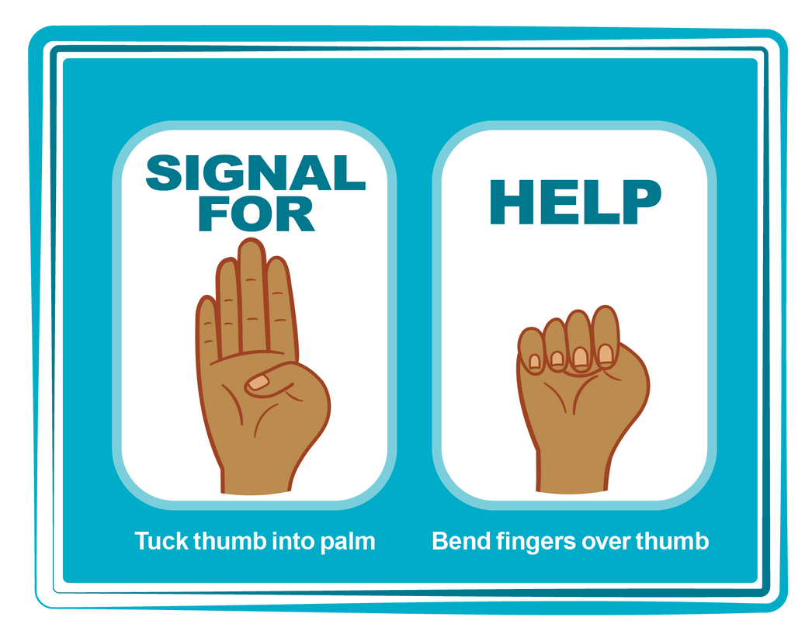
HAND SIGNAL FOR HELP
©2025 Walking Wise
Source: Canadian Women’s Foundation, April 2020
170
Notes:
Although the hand signal for help has not yet achieved universal recognition, it may discreetly get someone's attention in urgent situations.
• SILENT
It can be used silently.
• UNTRACKABLE
It leaves no digital footprint.
• CONCEALED
It can be done secretly when a perpetrator is in the vicinity.
• SIGNALS DISTRESS
Combining the hand signal with distressed facial expressions might help attract the attention of an individual who is unfamiliar with the signal's meaning.
Source
Canadian Women's Foundation, April 2020

Slide 171
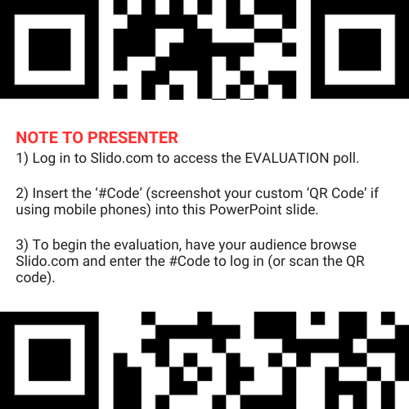
EVALUATION
©2025 Walking Wise
171
Notes:
SLIDO.com: 3-Question Survey
NOTE
Update this slide with your school/organization's custom QR code and #code.
Please encourage participants to scan your organization's custom QR code to share what they enjoyed and what could be improved about the lesson.
Please send any feedback you want to share to Walking Wise at support@WalkingWise.com.

Slide 172
SHARE YOUR THOUGHTS
1. How would you rate this lesson?
2. What was the one thing you liked?
3. What one thing should we improve?
Presenter: Replace “#XXXX” with your organization’s custom Slido code.
©2025 Walking Wise
172
Notes:
SLIDO.com: 3-Question Survey
NOTE
Follow the instructions provided on WalkingWise.com to access your school or organization's custom Slido QR code and #code, which the audience will use to complete the 3-question evaluation.
Please encourage your audience to scan your organization's custom QR code to share what they enjoyed and what could be improved about the lesson.
Please send any feedback you want to share to Walking Wise at support@WalkingWise.com.

Slide 173



Thank you!
WalkingWise.com
Online Course for Adults Accredited by:
Postgraduate Institue for Medicine
Academy of Forensic Nursing
©2025 Walking Wise
173
Notes:
NOTE
To access additional resources about the myths, please refer to the last page of Lesson Plan #1 in the Walking Wise Education Guide.
We welcome your feedback at support@WalkingWise.com.
Thank you!
Karla Highman
Founder, WalkingWise.com

