Slide 1


SEXUAL EXPLOITATION
EDUCATION
pornography
LINK
LESSON #4
Notes:
NOTE
Log in to WalkingWise.com and refer to the Implementation Toolkit for classroom teaching tips.
Most importantly:
DEFINE SCHOOL POLICY
Establish a sexual exploitation reporting protocol with a trauma-informed response. The Walking Wise Implementation Toolkit provides a sample protocol.
AGE & AUDIENCE
This presentation can be edited by following the procedures on page 3 to align with your school policies, specific age groups, and the involvement of at-risk audiences.
SUPPORT PROCEDURE
Provide your students with guidance on how to access immediate help or arrange a private meeting with a social worker, counselor, nurse, school resource officer, or another trustworthy staff member to report concerns about themselves or a peer.
SECOND SAFE ADULT
Ensure a second trustworthy adult, such as a teacher, is present in the learning setting to observe student reactions and identify those who may benefit from a follow-up meeting. This person should remain focused and free from other duties during the presentation.

Slide 2

NOTE TO PRESENTER
This presentation is exclusively for Walking Wise® subscribers and not for redistribution.
Walking Wise encourages the use of Slido.com, an interactive digital tool, to enhance audience engagement. For more information, contact us at support@WalkingWise.com. Once configured, integrate Slido polling and add a post-evaluation to the PowerPoint presentation.
Presenters are encouraged to edit speaker notes to match their speaking style (viewable in presentation mode). You can also delete slides and content from this Walking Wise presentation to ensure the information aligns with your school policies, is age-appropriate, and fits within available class time. However, the slides are copyright-protected and may not be reworded without prior written permission from Walking Wise.
We encourage you to add your own content by following these instructions:
  Insert new PowerPoint slides.
  Remove the Walking Wise logo and copyright "©2026 Walking Wise" from the new slides.
  Always add your organization's name or logo to each new slide.
Please delete this instruction page before presenting to audiences.
©2024-2026 Walking Wise
2
Notes:
NOTE TO PRESENTER
The presenter is welcome to customize this Walking Wise presentation according to the instructions provided on this page.
For revision requests, please email us at: support@WalkingWise.com.

Slide 3
STATISTICS
Why Study Results Can Vary
  Some crimes are never reported, making it hard to reveal the entire issue.
  Studies collect information in different ways, leading to different results.
  Small studies may not represent everyone.
©2024-2026 Walking Wise
3
Notes:
In this presentation, we'll discuss statistics, but it's important to note that while statistics provide valuable insights into an issue, they cannot be relied upon entirely.
Here are a few reasons:
UNREPORTED
Victims often do not report the crimes committed against them due to fear, shame, or manipulation.
INCONSISTENT COLLECTION
Geographical areas have different legal definitions for sexual crimes, which may make data hard to compare.
FOCUS GROUPS
Small or specific focus groups participating in a study or survey may not accurately reflect the diversity or experiences of the broader population.

Slide 4
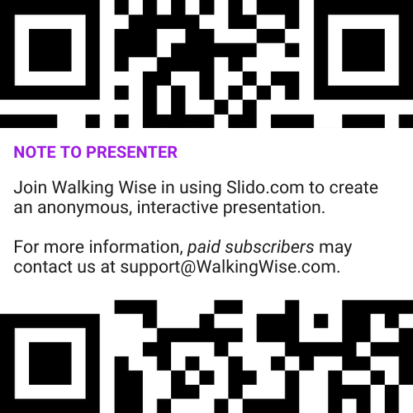
INTERACTIVE PARTICIPATION
Use Slido for Anonymous Questions
Presenter Instruction
After setting up Slido for this lesson, add the assigned access code or QR code to this slide so participants can join at Slido.com using their computers or phones.
©2024-2026 Walking Wise
4
Notes:
NOTE
For Online Interactive Polling with audiences:
Join Walking Wise in using Slido.com to create an anonymous user experience.
Contact us at support@WalkingWise.com for more information.
Upon activating Slido.com:
Determine whether the Q&A feature will be enabled. If activated, a staff member should monitor questions and comments to ensure they remain appropriate for the audience. Slido’s moderation tools allow administrators to delete or hide inappropriate submissions.

Slide 5
SENSITIVE TOPICS WILL BE DISCUSSED
CONTENT NOTICE
We’ll be discussing serious safety issues today.
Some topics may be difficult to hear.
If you ever feel uncomfortable, you can step out and speak with a trustworthy adult for support.
You’re not alone—help is available.
©2024-2026 Walking Wise
5
Notes:
NOTE TO PRESENTER
Presenter Guidelines for Delivery
Present the information in a calm, matter-of-fact way and avoid sensational language.
Avoid graphic details. Focus on understanding behaviors and staying safe.
Never blame victims. Responsibility always belongs to the person who caused harm.
Maintain a steady tone. Students often mirror the presenter’s emotional cues.
Do not ask students to share personal experiences.
If students laugh or react awkwardly, stay calm and continue teaching.
Always pair risk information with solutions and support.
Remind students they are not alone and help is available.

Slide 6

CONFRONTING SEXUAL EXPLOITATION
WALKING WISE
KNOWLEDGE serves as a
powerful defense against
exposure to pornography.
©2024-2026 Walking Wise
6
Notes:
Education is one of the strongest tools for preventing exploitation.
When young people understand how predators operate, they are better able to recognize manipulation and avoid dangerous situations.
Reinforce that awareness increases safety.

Slide 7
CONFRONTING SEXUAL EXPLOITATION
WALKING WISE
SEXUAL EXPLOITATION includes grooming, sextortion, pornography
& sex trafficking.
©2024-2026 Walking Wise
7
Notes:
Sexual exploitation can include:
GROOMING
Building trust to manipulate someone.
SEXTORTION
Threatening to share private images.
PORNOGRAPHY
Involving vulnerable people in creating sexual images or videos.
SEX TRAFFICKING
Manipulating or forcing someone into sexual activity in exchange for money or something of value.

Slide 8




EDUCATON GUIDE
VOCABULARY
VOCABULARY
  Pornography
  Overexposure
  Habit
  Addiction
  Dopamine
  Reward Circuit
  Brain Fog
©2024-2026 Walking Wise
8
3
Notes:
Understanding vocabulary terms related to the behaviors of sexual predators can empower young people to recognize warning signs of harmful situations.
Knowing terminology helps them identify manipulative tactics predators use to build trust and exploit vulnerabilities.
With this knowledge, young people are better equipped to spot red flags, understand that these behaviors are abusive, and feel more confident reporting predators to trusted adults or authorities, potentially preventing further harm.

Slide 9
EDUCATON GUIDE
VOCABULARY
PORNOGRAPHY
Pictures, videos, or media that show sexual behavior to create excitement—often displaying unrealistic or harmful behavior.
©2024-2026 Walking Wise
9
3
Notes:
Assisting Source
OpenAI. (2025). ChatGPT [Large language model]. https://chatgpt.com

Slide 10
EDUCATON GUIDE
VOCABULARY
HABIT
Something a person does regularly or repeatedly, often without thinking about it.
©2024-2026 Walking Wise
10
3
Notes:
Assisting Source
OpenAI. (2025). ChatGPT [Large language model]. https://chatgpt.com

Slide 11
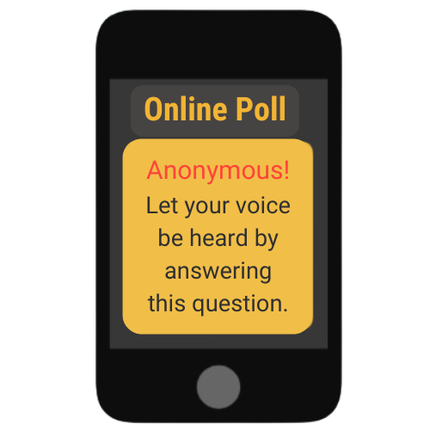
LESSON PLANS
IMPACT ON BEHAVIOR
OPINION: Can viewing pornography change a person’s behavior?
©2024-2026 Walking Wise
11
Notes:
Online Interactive Polling
SLIDO.com: Multiple Choice
OPINION: Can viewing pornography change a person’s behavior?
A) Yes
B) No
C) Not Sure
Researchers study how repeated exposure to different types of media can affect the brain and behavior.
Today, we will learn what science says about how habits form and how repeated exposure to pornography can affect the brain, habits, and behavior.

Slide 12

Log in to WalkingWise.com to access this animated video.
©2024-2026 Walking Wise
12
Notes:
Message Especially for Teens:
Businesses worldwide use explainer-style animation as a training tool for their employees. So, this 3-minute Walking Wise animated video series is for both teens (ages 11+) and adults to learn how sexual predators use manipulation, intimidation, and coercion to exploit young people.
NOTE
Log in to Walking Wise.com to watch the three-minute animated video with audiences.

Slide 13
NORMALIZED
What percent of teens say their friends talk about pornography in a normal or accepting way?
©2024-2026 Walking Wise
13
Notes:
Online Interactive Polling
SLIDO.com: Multiple Choice
What percent of teens say their friends talk about pornography in a normal or accepting way?
A) 59%
B) 69%
C) 79%
D) 89%
ANSWER
D) 89% of teens talk about pornography with friends in a normal and accepting way.[1]
NOTE TO PRESENTER
CommonSense Media research revealed that "45% of teen respondents agreed that online pornography provides helpful information about sex, and about 1 in 4 teens said pornography accurately shows the way most people have sex."[2]
Source
1. Josh McDowell Ministry (2016). The Porn Phenomenon: The Impact of Pornography in the Digital Age. Barna.com. Retrieved July 21, 2024, from https://www.barna.com/the-porn-phenomenon/
2. Robb, M.B., & Mann, S. (2023). Teens and pornography. San Francisco, CA: Common Sense, p. 6. CommonSenseMedia.org. Retrieved June 19, 2024, from https://www.commonsensemedia.org/sites/default/files/research/report/2022-teens-and-pornography-final-web.pdf

Slide 14
WHAT DO YOU THINK?
What percent of teens say their friends talk about pornography in a normal or accepting way?
A) 59%
B) 69%
C) 79%
D) 89%
©2024-2026 Walking Wise
14
Notes:
NOTE TO PRESENTER:
Delete this slide if you are using Slido.com for audience interaction.

Slide 15
MULTIPLE CHOICE: D
ANSWER
89% of teens talk about pornography with friends in a normal or accepting way.
©2024-2026 Walking Wise
Josh McDowell Ministry (2016). The Porn Phenomenon: The Impact of Pornography in the Digital Age.
Robb, M.B., & Mann, S. (2023). Teens and pornography. San Francisco, CA: Common Sense, p. 6. CommonSenseMedia.org.
15
Notes:
NOTE TO PRESENTER:
Delete this slide if you are using Slido.com for audience interaction.

Slide 16
EDUCATON GUIDE
VOCABULARY
OVEREXPOSURE
Seeing or experiencing something so often that it begins to influence your thoughts, feelings, or behavior.
©2024-2026 Walking Wise
16
3
Notes:
Assisting Source
OpenAI. (2025). ChatGPT [Large language model]. https://chatgpt.com

Slide 17
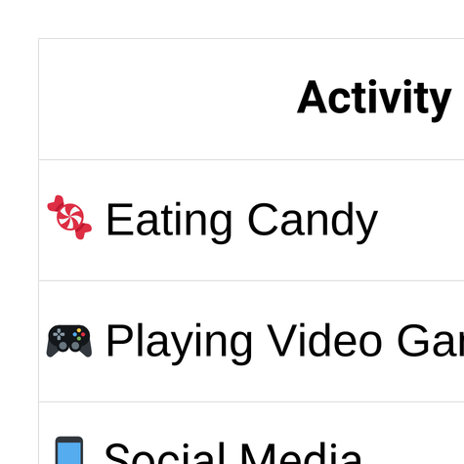
LESSON PLANS
OVEREXPOSURE
©2024-2026 Walking Wise
17
3

Slide 18
EDUCATON GUIDE
VOCABULARY
DOPAMINE
A chemical released by the brain that creates feelings of pleasure and motivation.
©2024-2026 Walking Wise
18
3
Notes:
Assisting Source
OpenAI. (2024). ChatGPT [Large language model]. https://chatgpt.com

Slide 19
LESSON PLANS
BRAIN CHEMICAL
Dopamine: The Brain’s “Feel-Good” Chemical
Dopamine creates feelings of enjoyment and motivation.
©2024-2026 Walking Wise
19
3

Slide 20
LESSON PLANS
BRAIN CHEMICAL
Dopamine: The Brain’s “Feel-Good” Chemical
It is released when people experience something they like.
©2024-2026 Walking Wise
20
3

Slide 21
LESSON PLANS
BRAIN CHEMICAL
Dopamine: The Brain’s “Feel-Good” Chemical
Dopamine helps the brain remember what was enjoyable.
©2024-2026 Walking Wise
21
3

Slide 22
EDUCATON GUIDE
VOCABULARY
REWARD CIRCUIT
A system in the brain that connects certain actions with pleasure, encouraging the brain to repeat those actions.
©2024-2026 Walking Wise
22
3
Notes:
Assisting Source
OpenAI. (2025). ChatGPT [Large language model]. https://chatgpt.com

Slide 23
REWARD CIRCUIT
Repeated Exposure Can Turn Into Habits
ACTION→ DOPAMINE→ REWARD→ REPEAT ACTION
©2024-2026 Walking Wise
23

Slide 24
EDUCATON GUIDE
VOCABULARY
ADDICTION
A strong urge to keep doing something even when it starts causing problems or harm.
©2024-2026 Walking Wise
24
3
Notes:
Assisting Source
OpenAI. (2025). ChatGPT [Large language model]. https://chatgpt.com

Slide 25
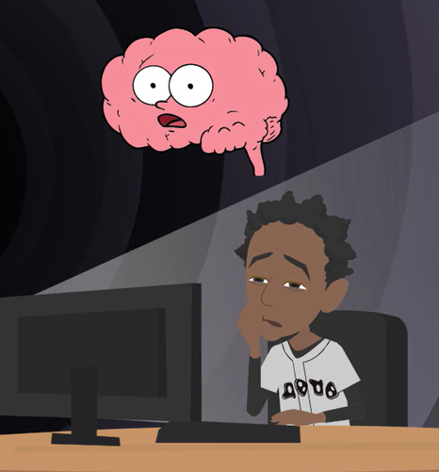
LESSON PLANS
HABIT VS. ADDICTION
Habits can sometimes grow stronger and turn into an addiction.
©2024-2026 Walking Wise
25
3

Slide 26
REWARD CIRCUIT
Repeated Exposure Can Change the Brain
REPEAT OFTEN→ HABIT
SOME HABITS→ POSSIBLE ADDICTION
©2024-2026 Walking Wise
26
Notes:
Many behaviors begin as habits. A habit means doing something repeatedly until it becomes automatic.
In some situations, habits can grow stronger and eventually turn into addictions, which means it becomes very difficult to stop the behavior.

Slide 27
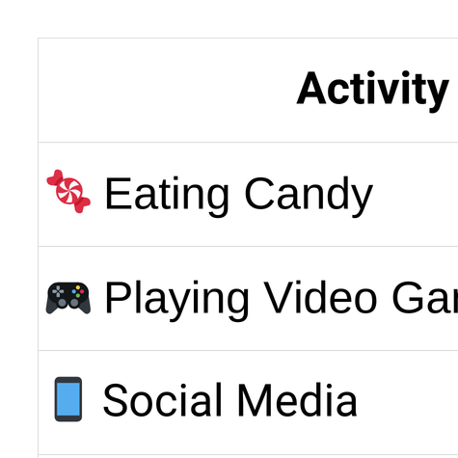
LESSON PLANS
OVEREXPOSURE
©2024-2026 Walking Wise
27
3

Slide 28

LESSON PLANS
EARLY EXPOSURE
Why is the younger brain more affected by repeated exposure to activities?
©2024-2026 Walking Wise
28
3
Notes:
Young brains are still developing. That means they learn quickly from repeated experiences.
This ability helps young people learn new skills, but it also means repeated exposure to harmful content can influence habits more easily.

Slide 29
LESSON PLANS
EARLY EXPOSURE
Why Young Brains Are More Vulnerable
Neuroplasticity: Young brains change quickly in response to experiences and repeated behaviors.
Wilson, G. (2014). Your Brain On Porn: Internet Pornography and the Emerging Science of Addiction (1st ed.). Commonwealth Publishing.
Casey, B., Jones, R. M., & Somerville, L. H. (2011). Braking and Accelerating of the Adolescent Brain. Journal of Research on Adolescence: The Official Journal of the Society for Research on Adolescence, 21(1), 21–33.
29
©2024-2026 Walking Wise
3
Notes:
NEUROPLASTICITY
The brain changes in response to life experiences. Because young brains are in the crucial stages of development, they are more malleable or “plastic.” This increases the risk of addiction because the young brain is highly receptive to repeated exposure to addictive substances.(1)
PREFRONTAL CORTEX
The prefrontal cortex is responsible for decision-making and impulse control. It continues to develop throughout adolescence and into early adulthood until approximately age 25. This prolonged development can make teenagers less equipped to make rational decisions and resist impulsive behavior, further increasing their vulnerability to addiction.(2)
Source
1. Wilson, G. (2014). Your Brain On Porn: Internet Pornography and the Emerging Science of Addiction (1st ed.). Commonwealth Publishing. https://www.dirzon.com/file/telegram/somali%20educational%20books/Your_Brain_on_Porn_Internet_Pornography_and_the_Emerging_Science.pdf
2. Casey, B., Jones, R. M., & Somerville, L. H. (2011). Braking and Accelerating of the Adolescent Brain. Journal of Research on Adolescence: The Official Journal of the Society for Research on Adolescence, 21(1), 21–33. https://doi.org/10.1111/j.1532-7795.2010.00712.x

Slide 30
LESSON PLANS
EARLY EXPOSURE
Why Young Brains Are More Vulnerable
Prefrontal Cortex: The part of the brain that helps with decision-making and impulse control doesn’t fully mature until about age 25.
Wilson, G. (2014). Your Brain On Porn: Internet Pornography and the Emerging Science of Addiction (1st ed.). Commonwealth Publishing.
Casey, B., Jones, R. M., & Somerville, L. H. (2011). Braking and Accelerating of the Adolescent Brain. Journal of Research on Adolescence: The Official Journal of the Society for Research on Adolescence, 21(1), 21–33.
30
©2024-2026 Walking Wise
3
Notes:
NEUROPLASTICITY
The brain changes in response to life experiences. Because young brains are in the crucial stages of development, they are more malleable or “plastic.” This increases the risk of addiction because the young brain is highly receptive to repeated exposure to addictive substances.(1)
PREFRONTAL CORTEX
The prefrontal cortex is responsible for decision-making and impulse control. It continues to develop throughout adolescence and into early adulthood until approximately age 25. This prolonged development can make teenagers less equipped to make rational decisions and resist impulsive behavior, further increasing their vulnerability to addiction.(2)
Source
1. Wilson, G. (2014). Your Brain On Porn: Internet Pornography and the Emerging Science of Addiction (1st ed.). Commonwealth Publishing. https://www.dirzon.com/file/telegram/somali%20educational%20books/Your_Brain_on_Porn_Internet_Pornography_and_the_Emerging_Science.pdf
2. Casey, B., Jones, R. M., & Somerville, L. H. (2011). Braking and Accelerating of the Adolescent Brain. Journal of Research on Adolescence: The Official Journal of the Society for Research on Adolescence, 21(1), 21–33. https://doi.org/10.1111/j.1532-7795.2010.00712.x

Slide 31
LESSON PLANS
EARLY EXPOSURE
What percent of children say they have seen pornography by age 13?
©2024-2026 Walking Wise
31
Notes:
Online Interactive Polling
SLIDO.com: Multiple Choice
What percent of children say they have seen pornography by age 13?
A) 14%
B) 34%
C) 54%
D) 74%
ANSWER
C) 54% of children say they have seen pornography by age 13.
Common Sense Media reported in 2023 that 73% of teens have viewed pornography:
15% of kids 10 yr. or younger
54% of youth 13 yr. or younger
73% of teens 17 or younger
Furthermore, 41% of teens reported viewing pornography during the school day. Of these, 31% had watched pornography while attending school in person, and 44% of those teens viewed porn on school-owned devices.
Source
Robb, M.B., & Mann, S. (2023). Teens and pornography. San Francisco, CA: Common Sense, p. 5. Retrieved November 26, 2024, from https://www.commonsensemedia.org/sites/default/files/research/report/2022-teens-and-pornography-final-web.pdf

Slide 32
WHAT DO YOU THINK?
What percent of children say they have seen pornography by age 13?
A) 14%
B) 34%
C) 54%
D) 74%
©2024-2026 Walking Wise
32
Notes:
NOTE TO PRESENTER:
Delete this slide if you are using Slido.com for audience interaction.
Many young people see pornography accidentally online, which is why online safety education is important.

Slide 33
MULTIPLE CHOICE: D
ANSWER
About 54% of children say they have seen pornography by age 13.
©2024-2026 Walking Wise
Robb, M.B., & Mann, S. (2023). Teens and pornography. San Francisco, CA: Common Sense, p. 11.
33
Notes:
NOTE TO PRESENTER:
Delete this slide if you are using Slido.com for audience interaction.
Source
Robb, M.B., & Mann, S. (2023). Teens and pornography. San Francisco, CA: Common Sense, p. 5. Retrieved November 26, 2024, from https://www.commonsensemedia.org/sites/default/files/research/report/2022-teens-and-pornography-final-web.pdf

Slide 34

LESSON PLANS
GROOMING
Why might some websites try to get young people interested in pornography?
©2024-2026 Walking Wise
34
3

Slide 35
LESSON PLANS
GROOMING
Exposing Young Viewers
Companies that produce pornography make money from people who watch it.
©2024-2026 Walking Wise
Wilkinson Jr., Kevin L. (2024, July 4). The Breeding of Wolves: Understanding the Escalation
Continuum & Escalation Dynamics of Contemporary Sex Trafficking.
35
3
Notes:
This discussion is centered around business incentives, rather than morality:
Some websites or companies try to build lifelong customers, just like video game companies or social media platforms. The concern is that pornography can create harm for the people who view it.
Source
Wilkinson Jr., Kevin L. (2024, July 4). The Breeding of Wolves: Understanding the Escalation
Continuum & Escalation Dynamics of Contemporary Sex Trafficking. DigitalCommons.liberity.edu.
Retrieved July 31, 2024, from https://digitalcommons.liberty.edu/doctoral/4600/

Slide 36
LESSON PLANS
GROOMING
Exposing Young Viewers
Repeated viewing can train the brain to form habits.
©2024-2026 Walking Wise
Wilkinson Jr., Kevin L. (2024, July 4). The Breeding of Wolves: Understanding the Escalation
Continuum & Escalation Dynamics of Contemporary Sex Trafficking.
36
3
Notes:
This discussion is centered around business incentives, rather than morality:
Some websites or companies try to build lifelong customers, just like video game companies or social media platforms. The concern is that pornography can create harm for the people who view it.
Source
Wilkinson Jr., Kevin L. (2024, July 4). The Breeding of Wolves: Understanding the Escalation
Continuum & Escalation Dynamics of Contemporary Sex Trafficking. DigitalCommons.liberity.edu.
Retrieved July 31, 2024, from https://digitalcommons.liberty.edu/doctoral/4600/

Slide 37
LESSON PLANS
GROOMING
Exposing Young Viewers
Some websites try to attract young viewers who may become future customers.
©2024-2026 Walking Wise
Wilkinson Jr., Kevin L. (2024, July 4). The Breeding of Wolves: Understanding the Escalation
Continuum & Escalation Dynamics of Contemporary Sex Trafficking.
37
3
Notes:
This discussion is centered around business incentives, rather than morality:
Some websites or companies try to build lifelong customers, just like video game companies or social media platforms. The concern is that pornography can create harm for the people who view it.
Source
Wilkinson Jr., Kevin L. (2024, July 4). The Breeding of Wolves: Understanding the Escalation
Continuum & Escalation Dynamics of Contemporary Sex Trafficking. DigitalCommons.liberity.edu.
Retrieved July 31, 2024, from https://digitalcommons.liberty.edu/doctoral/4600/

Slide 38

LESSON PLANS
PUBLIC CRISIS
How many states declared pornography a public health concern between 2016 and 2019?
©2024-2026 Walking Wise
38
Notes:
Online Interactive Polling
SLIDO.com: Multiple Choice
How many states declared pornography a public health concern between 2016 and 2019?
A) 6
B) 10
C) 16
D) 20
ANSWER
B) 16 states declared pornography a public health concern.
Between 2016 and 2019, 16 states passed resolutions declaring pornography a public health crisis. These states aimed to address concerns about the potential societal and individual harms associated with pornography.
Source
Utah State Legislature (2016). Concurrent Resolution on the Public Health Crisis S.C.R.9. Le.Utah.gov. Retrieved February 25, 2024, from
https://le.utah.gov/~2016/bills/static/SCR009.html

Slide 39
WHAT DO YOU THINK?
How many states declared pornography a public health concern between 2016 and 2019?
A) 6
B) 10
C) 16
D) 20
©2024-2026 Walking Wise
39
Notes:
NOTE TO PRESENTER:
Delete this slide if you are using Slido.com for audience interaction.

Slide 40
MULTIPLE CHOICE: C
ANSWER
16 states declared pornography a public health concern.
©2024-2026 Walking Wise
Utah State Legislature (2016). Concurrent Resolution on the Public Health Crisis S.C.R.9. Le.Utah.gov.
40
Notes:
NOTE TO PRESENTER:
Delete this slide if you are using Slido.com for audience interaction.

Slide 41
EDUCATON GUIDE
VOCABULARY
BRAIN FOG
A temporary feeling where it is harder to think clearly, focus, or remember things.
©2024-2026 Walking Wise
41
3
Notes:
Assisting Source
OpenAI. (2025). ChatGPT [Large language model]. https://chatgpt.com

Slide 42
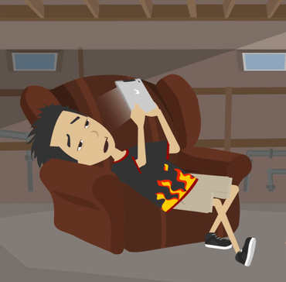
LESSON PLANS
POSSIBLE WARNING SIGNS
What changes might happen if someone spends too much time viewing harmful online images?
©2024-2026 Walking Wise
42
3

Slide 43
LESSON PLANS
POSSIBLE WARNING SIGNS
Possible Effects
  Brain fog
  Depression
  Academic decline
  Poor memory
©2024-2026 Walking Wise
Wilson, G. (2014). Your Brain On Porn: Internet Pornography and the Emerging Science of Addiction (1st ed.). Commonwealth Publishing.
43
3
Notes:
These changes do not happen to everyone.
However, researchers have observed that repeated exposure to harmful online content can sometimes affect mood, focus, or relationships.
These signs can also occur with other unhealthy habits.

Slide 44
LESSON PLANS
POSSIBLE WARNING SIGNS
Possible Effects
  Secrecy & Isolation
  Physically inactive
  Lower interest in dating & friends
  Less interest in hobbies or activities
©2024-2026 Walking Wise
Wilson, G. (2014). Your Brain On Porn: Internet Pornography and the Emerging Science of Addiction (1st ed.). Commonwealth Publishing.
44
3

Slide 45
LESSON PLANS
POSSIBLE WARNING SIGNS
Possible Effects
  Irritability & Shame
  Lower self-esteem
  Lower empathy to suffering
  Increased aggression
©2024-2026 Walking Wise
Wilson, G. (2014). Your Brain On Porn: Internet Pornography and the Emerging Science of Addiction (1st ed.). Commonwealth Publishing.
45
3

Slide 46
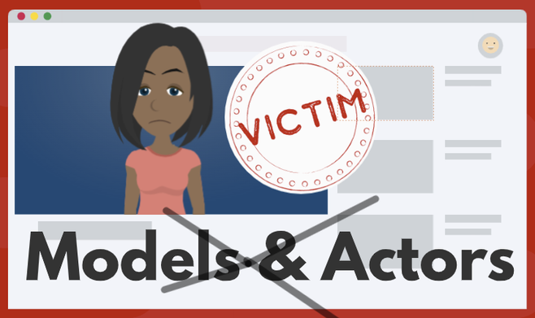
LESSON PLANS
MANIPULATION
Some pornography is made by pressuring, tricking, or taking advantage of vulnerable people.
©2024-2026 Walking Wise
46
3

Slide 47
LESSON PLANS
MANIPULATION
How Predators Lure Vulnerable People
Threats: Some may threaten to share a private photo unless the person does what they say.
©2024-2026 Walking Wise
47
3
Notes:
Not everyone involved in pornography participates willingly.
In some cases, people are pressured, tricked, or threatened. This is why understanding exploitation is important for safety education.

Slide 48
LESSON PLANS
MANIPULATION
How Predators Lure Vulnerable People
Pressured: Some promise money for basic needs, like food and shelter, in exchange for sexual images and videos.
©2024-2026 Walking Wise
48
3
Notes:
Not everyone involved in pornography participates willingly.
In some cases, people are pressured, tricked, or threatened. This is why understanding exploitation is important for safety education.

Slide 49
LESSON PLANS
MANIPULATION
How Predators Lure Vulnerable People
Tricked: Some make promises of fake opportunities, like acting or modeling, to trick vulnerable people.
©2024-2026 Walking Wise
49
3
Notes:
Not everyone involved in pornography participates willingly.
In some cases, people are pressured, tricked, or threatened. This is why understanding exploitation is important for safety education.

Slide 50
STUDY EVALUATION
What percent of scenes in pornography are reported to show aggression?
©2024-2026 Walking Wise
50
Notes:
Online Interactive Polling
SLIDO.com: Word Cloud
What percent of scenes in pornography are reported to show aggression?
A) 28%
B) 48%
C) 68%
D) 88%
ANSWER
D) 88% of scenes in pornographic videos contain visible aggression or violence.
As far back as 2010, a study by Dr. Gail Dines revealed that 88% of pornography featured graphic displays of aggression and violence against women.
Source:
Dr. Gail Dines (n.d.). The Porn Crisis. CultureReframed.org. Retrieved February 25, 2024, from https://culturereframed.org/the-crisis/

Slide 51
WHAT DO YOU THINK?
What percent of scenes in pornography are reported to show aggression?
A) 28%
B) 48%
C) 68%
D) 88%
©2024-2026 Walking Wise
51
Notes:
NOTE TO PRESENTER:
Delete this slide if you are using Slido.com for audience interaction.
Many experts say pornography often shows unhealthy or unrealistic behavior, which can affect how people think about relationships.

Slide 52
MULTIPLE CHOICE: D
ANSWER
88% of scenes in pornography are reported to show aggression.
©2024-2026 Walking Wise
Dr. Gail Dines (n.d.). The Dr. Gail Dines (n.d.). The Porn Crisis. CultureReframed.org.
52
Notes:
NOTE TO PRESENTER:
Delete this slide if you are using Slido.com for audience interaction.
Many experts say pornography often shows unhealthy or unrealistic behavior, which can negatively affect how people think about relationships.
Source:
Dr. Gail Dines (n.d.). The Porn Crisis. CultureReframed.org. Retrieved February 25, 2024, from https://culturereframed.org/the-crisis/

Slide 53

LESSON PLANS
LEGAL PROTECTION
Some pornography is connected to exploitation and human trafficking.
©2024-2026 Walking Wise
53
3

Slide 54
LESSON PLANS
LEGAL PROTECTION
US Laws Protect Children & Teens
U.S. laws state that involving children under 18 in pornography is treated as a human trafficking crime.
©2024-2026 Walking Wise
One Hundred Sixth Congress of the United States of America at the Second Session (2000, January 24). Victims of Trafficking and Violence Protection Act of 2000. Govinfo.gov.
54
3
Notes:
The Victims of Trafficking and Violence Protection Act of 2000 is a federal law aimed at combating human trafficking and exploitation. It identifies child sexual abuse material (CSAM) as a form of sex trafficking.
Additionally, most states have enacted similar laws that address the production and distribution of CSAM.
Source
One Hundred Sixth Congress of the United States of America at the Second Session (2000, January). Victims of Trafficking and Violence Protection Act of 2000. Govinfo.gov. Retrieved November 7, 2024,
from https://www.govinfo.gov/content/pkg/BILLS-106hr3244enr/pdf/BILLS-106hr3244enr.pdf

Slide 55
LESSON PLANS
LEGAL PROTECTION
The Law Protects Victims
Exploitation is never the victim’s fault.
©2024-2026 Walking Wise
55
3
Notes:
People who exploit others often rely on secrecy and fear.
Victims sometimes feel embarrassed or think they will get in trouble, which can cause them to hesitate to ask for help.
It is important for students to understand that exploitation is never the victim’s fault, and trusted adults are there to help protect them.
Encourage students to think about at least two adults they could talk to if something online ever made them uncomfortable.

Slide 56
LESSON PLANS
LEGAL PROTECTION
The Law Protects Victims
People who exploit others often use pressure, tricks, or threats.
©2024-2026 Walking Wise
56
3
Notes:
People who exploit others often rely on secrecy and fear.
Victims sometimes feel embarrassed or think they will get in trouble, which can cause them to hesitate to ask for help.
It is important for students to understand that exploitation is never the victim’s fault, and trusted adults are there to help protect them.
Encourage students to think about at least two adults they could talk to if something online ever made them uncomfortable.

Slide 57
LESSON PLANS
LEGAL PROTECTION
The Law Protects Victims
Many people encounter harmful situations by accident.
©2024-2026 Walking Wise
57
3
Notes:
People who exploit others often rely on secrecy and fear.
Victims sometimes feel embarrassed or think they will get in trouble, which can cause them to hesitate to ask for help.
It is important for students to understand that exploitation is never the victim’s fault, and trusted adults are there to help protect them.
Encourage students to think about at least two adults they could talk to if something online ever made them uncomfortable.

Slide 58
LESSON PLANS
LEGAL PROTECTION
The Law Protects Victims
Ask a trustworthy adult for help when feeling uncomfortable.
©2024-2026 Walking Wise
58
3
Notes:
People who exploit others often rely on secrecy and fear.
Victims sometimes feel embarrassed or think they will get in trouble, which can cause them to hesitate to ask for help.
It is important for students to understand that exploitation is never the victim’s fault, and trusted adults are there to help protect them.
Encourage students to think about at least two adults they could talk to if something online ever made them uncomfortable.

Slide 59

ASK FOR HELP
©2024-2026 Walking Wise
59

Slide 60
LESSON PLANS
ASK FOR HELP
If You See Something Online
  Close the webpage or app
©2024-2026 Walking Wise
60
3
Notes:
Sometimes young people encounter harmful images or messages online by accident, especially when using search engines, social media, games, or video platforms.
Seeing something inappropriate or uncomfortable online does not mean they did anything wrong. The most important thing is knowing how to respond safely.
First, close the page or exit the app to avoid looking at the content.

Slide 61
LESSON PLANS
ASK FOR HELP
If You See Something Online
  Close the webpage or app
  Do not share the image
©2024-2026 Walking Wise
61
3
Notes:
Next, avoid sharing or forwarding the image or message, as doing so can harm others and may even violate school rules or laws.

Slide 62
LESSON PLANS
ASK FOR HELP
If You See Something Online
  Close the webpage or app
  Do not share the image
  Tell a trustworthy adult
©2024-2026 Walking Wise
62
3
Notes:
Then, tell a trusted adult as soon as possible. Trusted adults might include a parent or guardian, a teacher, a school counselor, a coach, or another responsible adult they feel safe talking to. Adults can help report harmful content and take any necessary steps to provide protection.

Slide 63
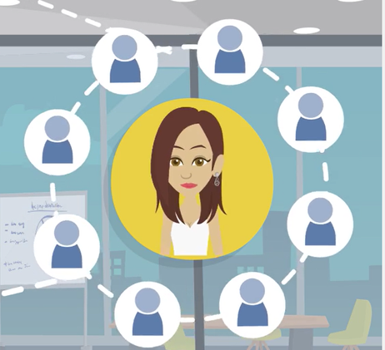
LESSON PLANS
TAKE IT DOWN
It is possible to get help removing a private image or video from online platforms.
©2024-2026 Walking Wise
63
3
Notes:
NOTE TO PRESENTER
The TAKE IT DOWN Act is a federal law that makes it illegal to publish or threaten to publish non-consensual intimate images — including both real and AI-generated deepfake pornography — and requires online platforms to remove such content within 48 hours after a victim reports it. It was passed with strong bipartisan support and gives victims legal protections and tools to have harmful intimate imagery taken down quickly.[2]
The TAKE IT DOWN Act was signed into law on May 19, 2025. The law’s criminal provisions took effect right away, and covered online platforms were given one year — until May 19, 2026 — to set up the required notice-and-removal processes to take down nonconsensual intimate images when victims report them.
Source
2. U.S. Senate Committee on Commerce, Science, & Transportation (2025, May 19). Sen. Cruz Applauds Presidential Signing of the TAKE IT DOWN Act into Law. Retrieved on January 10, 2026 from, https://www.commerce.senate.gov/2025/5/sen-cruz-applauds-presidential-signing-of-the-take-it-down-act-into-law?utm_source=chatgpt.com

Slide 64
TAKE IT DOWN
Take It Down Service (by NCMEC)
Take It Down is a free service.
©2024-2026 Walking Wise
National Center for Missing & Exploited Children (n.d.). CyberTipline. Report.Cybertip.org.
64
Notes:
In the context of NCMEC's Take It Down program, a hash refers to a unique digital fingerprint or identifier generated from an image or video file. This fingerprint is created using specialized algorithms that convert the file into a string of characters or numbers.
Here's how it works:
HASH CREATION: When someone uses Take It Down, the program generates a hash from the image or video they want removed without uploading the actual file.
MATCHING: These hashes are stored in a secure database. Online platforms participating in the program can then use the hashes to identify and remove matching content from their platforms.
PRIVACY PROTECTION: The hash cannot be reversed to recreate the original image or video, ensuring the privacy of the person submitting the request. This system enables platforms to efficiently identify and remove harmful content while protecting the anonymity of individuals seeking help.
Source:
National Center for Missing & Exploited Children (n.d.). CyberTipline. Report.Cybertip.org.
https://takeitdown.ncmec.org/

Slide 65
TAKE IT DOWN
Take It Down Service (by NCMEC)
It stops online sharing of nude or sexual images involving children and teens.
©2024-2026 Walking Wise
National Center for Missing & Exploited Children (n.d.). CyberTipline. Report.Cybertip.org.
65

Slide 66
TAKE IT DOWN
Take It Down Service (by NCMEC)
This process protects the victim’s privacy and keeps their identity confidential.
©2024-2026 Walking Wise
National Center for Missing & Exploited Children (n.d.). CyberTipline. Report.Cybertip.org.
66

Slide 67
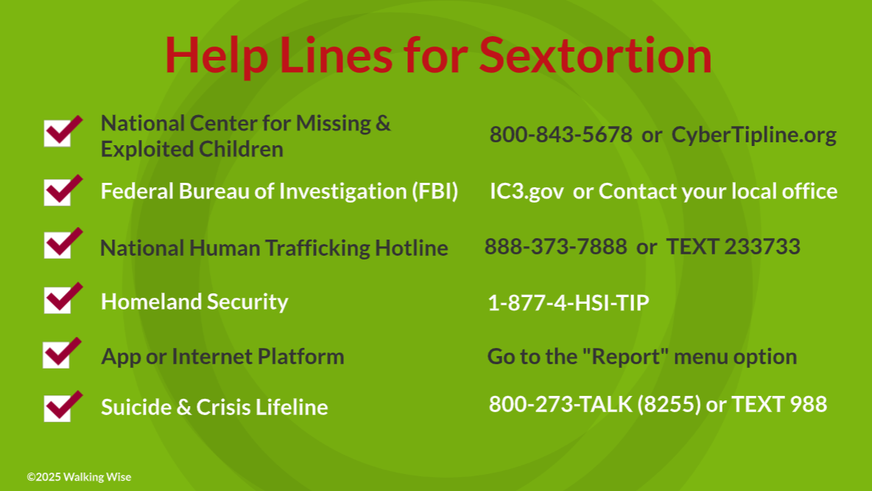
67
Notes:
NOTE
Presenters may ask their audience to consider adding a few "hotline for help" phone numbers in their cell phone contacts or take a photo of this slide.

Slide 68
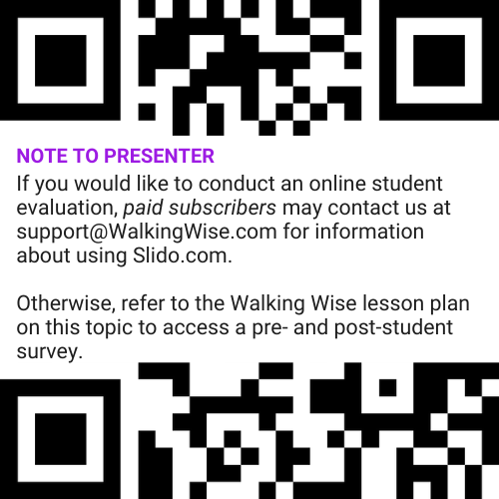
EVALUATION
©2024-2026 Walking Wise
68
Notes:
Two ways to conduct a pre-/post-student evaluation:
1) Use the pre/post survey in the Walking Wise lesson plan for this topic.
2) Activate Slido.com to conduct an online survey.

Slide 69

SHARE YOUR THOUGHTS
1. How would you rate this lesson?
2. What was the one thing you liked?
3. What one thing should we improve?
If Using Slido: Replace “#XXXX” with your organization’s custom Slido code.
©2024-2026 Walking Wise
69
Notes:
Online Interactive Polling
SLIDO.com: 3-Question Survey
IF SLIDO IS ACTIVATED:
Follow the instructions provided on WalkingWise.com to access your school or organization's custom Slido QR code and #code, which the audience will use to complete the 3-question evaluation.
Please encourage your audience to scan your organization's custom QR code to share what they enjoyed and what could be improved about the lesson.
Please send any feedback you want to share to Walking Wise at support@WalkingWise.com.

Slide 70



Thank you!
WalkingWise.com
Online Course for Adults Accredited by:
Postgraduate Institue for Medicine
Academy of Forensic Nursing
©2024-2026 Walking Wise
70
Notes:
NOTE
To access additional resources about pornography, please refer to the last page of Lesson Plan #4 in the Walking Wise Learning Platform.
We welcome your feedback at support@WalkingWise.com.
Thank you!
WalkingWise.com

