Slide 1


SEXUAL EXPLOITATION
EDUCATION
pornography
LINK
BY WALKING WISE
Notes:
NOTE
Log in to WalkingWise.com and refer to the Implementation Toolkit for classroom teaching tips.
Most importantly:
DEFINE SCHOOL POLICY
Establish a sexual exploitation reporting protocol with a trauma-informed response. The Walking Wise Implementation Toolkit provides a sample protocol.
AGE & AUDIENCE
This presentation can be edited by following the procedures on page 3 to align with your school policies, specific age groups, and the involvement of at-risk audiences.
SUPPORT PROCEDURE
Provide your students with guidance on how to access immediate help or arrange a private meeting with a social worker, counselor, nurse, school resource officer, or another trustworthy staff member to report concerns about themselves or a peer.
SECOND SAFE ADULT
Ensure a second trustworthy adult, such as a teacher, is present in the learning setting to observe student reactions and identify those who may benefit from a follow-up meeting. This person should remain focused and free from other duties during the presentation.

Slide 2

6-Year Track
NOTE TO PRESENTER
Meaningful learning takes time. By introducing topics gradually over several years, educators can create steady growth in awareness and understanding.
Our recommended teaching plan offers a long-term path for middle and high school students to build knowledge and confidence.
PARENTS & STAFF
#1 Myths & Reality
6th GRADE
#2 Trustworthy vs. Unsafe Adult
#3 Grooming Process
7th GRADE
#4 Pornography Link
#5 Sextortion Scheme
8th GRADE
#6 Male Victims
#7 Runaways as Targets
#8 Rural Risks
9th GRADE
#9 Human Traffickers
#10 Female & Peer Recruiters
10th GRADE
#11 Family Secret
11th GRADE
#12 Hidden Buyers
©2024-2026 Walking Wise
2

Slide 3

NOTE TO PRESENTER
This presentation is exclusively for Walking Wise® subscribers and not for redistribution.
Presenters are encouraged to edit speaker notes to match their speaking style (viewable in presentation mode). You can also delete slides and content from this Walking Wise presentation to ensure the information aligns with your school policies, is age-appropriate, and fits within available class time. However, the slides are copyright-protected and may not be reworded without prior written permission from Walking Wise.
We encourage you to add your own content by following these instructions:
Insert new PowerPoint slides.
Remove the Walking Wise logo and copyright "©2026 Walking Wise" from the new slides.
Always add your organization's name or logo to each new slide.
Please delete this instruction page before presenting to audiences.
R042726
©2024-2026 Walking Wise
3
Notes:
NOTE TO PRESENTER
The presenter is welcome to customize this Walking Wise presentation according to the instructions provided on this page.
For revision requests, please email us at: support@WalkingWise.com.

Slide 4
SENSITIVE TOPICS WILL BE DISCUSSED
CONTENT NOTICE
We’ll be discussing serious safety issues today.
Some topics may be difficult to hear.
If you ever feel uncomfortable, you can step out and speak with a trustworthy adult for support.
You’re not alone—help is available.
©2024-2026 Walking Wise
4
Notes:
NOTE TO PRESENTER
Trauma-Informed Delivery Guidelines
To support a safe and effective learning environment, please follow these guidelines:
• Present the information in a calm, matter-of-fact way and avoid sensational or alarming language.
• Avoid graphic details. Focus on helping students understand behaviors, risk, and ways to stay safe.
• Never blame victims. Responsibility always belongs to the person who caused harm.
• Maintain a steady, composed tone. Students often mirror the presenter's emotional cues.
• Do not ask students to share personal experiences or disclosures.
• If students laugh or react awkwardly, respond neutrally and gently redirect the focus.
• Pair all risk information with needed resources, practical solutions, and support options.
• Reinforce that students are not alone and that trustworthy adults are available to help.

Slide 5
STATISTICS
Why Study Results Can Vary
Some crimes are never reported, making it hard to reveal the entire issue.
Studies collect information in different ways, leading to different results.
Small studies may not represent everyone.
©2024-2026 Walking Wise
5
Notes:
In this presentation, we'll discuss statistics, but it's important to note that while statistics provide valuable insights into an issue, they cannot be relied upon entirely.
Here are a few reasons:
UNREPORTED
Victims often do not report the crimes committed against them due to fear, shame, retaliation, or manipulation. Also, many don’t realize that what is happening to them is a crime.
INCONSISTENT COLLECTION
Areas may define sexual crimes in various ways or use different methods to collect data, making it hard to compare information.
FOCUS GROUPS
Small or specific focus groups participating in a study or survey may not accurately reflect the diversity or experiences of the broader population.

Slide 6

WHY LEARN ABOUT THIS
KNOWLEDGE helps keep us safe.
©2024-2026 Walking Wise
6
Notes:
Education is one of the strongest tools for prevention.
When young people understand how predators operate, they are better able to recognize manipulation and avoid dangerous situations.
Reinforce that awareness increases safety.

Slide 7
PREVENTION EDUCATION
SEXUAL EXPLOITATION includes grooming, sextortion, pornography
& sex trafficking.
©2024-2026 Walking Wise
7
Notes:
SEXUAL EXPLOITATION
Taking advantage of another person for their own benefit, especially in a sexual way, often using pressure, tricks, or control.
Below are different forms of exploitation:
GROOMING
Building trust, dependency, or an emotional connection to manipulate someone.
SEXTORTION
Threatening to share embarrassing or sexual images, videos, or information to pressure someone into following demands.
PORNOGRAPHY
Involving someone in creating sexual images who is under 18, or someone who is pressured, or unable/unwilling to give consent.
SEX TRAFFICKING
Manipulating or forcing someone into sexual activity in exchange for money or something of value.
Trafficking and Violence Protection Act (TVPA) of 2000 (Legal Definition):
SEX TRAFFICKING is the recruitment, harboring, transportation, provision, obtaining, patronizing, or soliciting of a person under the age of 18 for the purpose of a commercial sex act.
TVPA link: Retrieved April 14, 2026, from https://www.govinfo.gov/content/pkg/BILLS-106hr3244enr/pdf/BILLS-106hr3244enr.pdf

Slide 8




EDUCATON GUIDE
VOCABULARY
Words to Understand
Pornography
Overexposure
Habit
Addiction
Dopamine
Reward Circuit
Brain Fog
©2024-2026 Walking Wise
8
3
Notes:
Understanding vocabulary terms related to the behaviors of sexual predators can empower young people to recognize warning signs of harmful situations.
Knowing these terms helps them identify manipulative tactics that unsafe people (predators/traffickers) use to build trust and exploit vulnerabilities.
With this knowledge, young people are better equipped to spot red flags, understand that these behaviors are abusive, and feel more confident reporting predators to trusted adults or authorities, potentially preventing further harm.

Slide 9
EDUCATON GUIDE
VOCABULARY
PORNOGRAPHY
Pictures, videos, or media that show sexual behavior to create excitement—often displaying unrealistic or harmful behavior.
©2024-2026 Walking Wise
9
3

Slide 10
EDUCATON GUIDE
VOCABULARY
HABIT
Something a person does regularly or repeatedly, often without thinking about it.
©2024-2026 Walking Wise
10
3

Slide 11
LESSON PLANS
WHAT DO YOU THINK?
Can viewing pornography often impact the human brain and a person’s behavior?
©2024-2026 Walking Wise
11
Notes:
Researchers study how repeated exposure to different types of media can affect the brain and behavior.
Today, we will learn what science says about how habits form and how repeated exposure to pornography can affect the brain, habits, and behavior.

Slide 12

Log in to WalkingWise.com to access this animated video.
©2024-2026 Walking Wise
12
Notes:
This 3-minute Walking Wise animated video series teaches how sexual predators use manipulation, intimidation, and coercion to exploit young people.
NOTE
Log in to Walking Wise.com to watch the three-minute animated video with audiences.
Is animation appropriate for teens?
Yes, even businesses worldwide use explainer-style animation as a training tool for their employees.

Slide 13
WHAT DO YOU THINK?
What percent of teens say their friends talk about pornography in a normal or accepting way?
©2024-2026 Walking Wise
13
Notes:
NOTE TO PRESENTER
CommonSense Media research revealed that "45% of teen respondents agreed that online pornography provides helpful information about sex, and about 1 in 4 teens said pornography accurately shows the way most people have sex."[2]
Source
1. Josh McDowell Ministry (2016). The Porn Phenomenon: The Impact of Pornography in the Digital Age. Barna.com. Retrieved July 21, 2024, from https://www.barna.com/the-porn-phenomenon/
2. Robb, M.B., & Mann, S. (2023). Teens and pornography. San Francisco, CA: Common Sense, p. 6. CommonSenseMedia.org. Retrieved June 19, 2024, from https://www.commonsensemedia.org/sites/default/files/research/report/2022-teens-and-pornography-final-web.pdf

Slide 14
WHAT DO YOU THINK?
What percent of teens say their friends talk about pornography in a normal or accepting way?
A) 59%
B) 69%
C) 79%
D) 89%
©2024-2026 Walking Wise
14

Slide 15
ANSWER
89% of teens talk about pornography with friends in a normal or accepting way.
©2024-2026 Walking Wise
Josh McDowell Ministry (2016). The Porn Phenomenon: The Impact of Pornography in the Digital Age.
Robb, M.B., & Mann, S. (2023). Teens and pornography. San Francisco, CA: Common Sense, p. 6. CommonSenseMedia.org.
15

Slide 16
EDUCATON GUIDE
VOCABULARY
OVEREXPOSURE
Seeing or experiencing something so often that it begins to influence your thoughts, feelings, or behavior.
©2024-2026 Walking Wise
16
3

Slide 17
LESSON PLANS
OVEREXPOSURE
Activity | What Can Happen With Too Much:
🍬 Eating Candy | Too much sugar can cause energy crashes and unhealthy habits.
🎮 Playing Video Games | Long hours can make it hard to stop and reduce time for sleep, school, and activities.
📱 Social Media | Constant scrolling can lead to distraction, comparison, and less real-life connection.
©2024-2026 Walking Wise
17
3

Slide 18
EDUCATON GUIDE
VOCABULARY
DOPAMINE
A chemical released by the brain that creates feelings of pleasure and motivation.
©2024-2026 Walking Wise
18
3

Slide 19
LESSON PLANS
BRAIN CHEMICAL
Dopamine: The Brain’s “Feel-Good” Chemical
Dopamine creates feelings of enjoyment and motivation.
©2024-2026 Walking Wise
19
3

Slide 20
LESSON PLANS
BRAIN CHEMICAL
Dopamine: The Brain’s “Feel-Good” Chemical
It is released when people experience something they like.
©2024-2026 Walking Wise
20
3

Slide 21
LESSON PLANS
BRAIN CHEMICAL
Dopamine: The Brain’s “Feel-Good” Chemical
Dopamine helps the brain remember what was enjoyable.
©2024-2026 Walking Wise
21
3

Slide 22
EDUCATON GUIDE
VOCABULARY
REWARD CIRCUIT
A system in the brain that connects certain actions with pleasure, encouraging the brain to repeat those actions.
©2024-2026 Walking Wise
22
3

Slide 23
REWARD CIRCUIT
Repeated Exposure Can Turn Into Habits
ACTION→ DOPAMINE→ REWARD→ REPEAT ACTION
©2024-2026 Walking Wise
23

Slide 24
EDUCATON GUIDE
VOCABULARY
ADDICTION
A strong urge to keep doing something even when it starts causing problems or harm.
©2024-2026 Walking Wise
24
3

Slide 25
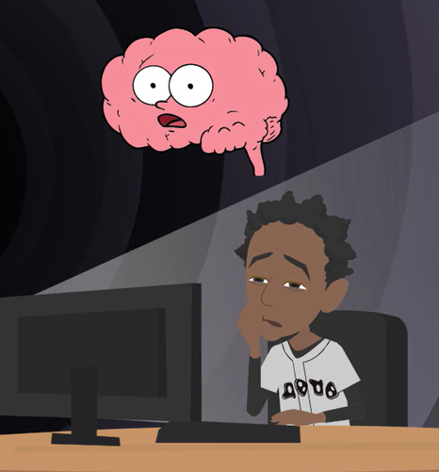
LESSON PLANS
HABIT VS. ADDICTION
Habits can sometimes grow stronger and turn into an addiction.
©2024-2026 Walking Wise
25
3

Slide 26
REWARD CIRCUIT
Repeated Exposure Can Change the Brain
REPEAT OFTEN→ HABIT
SOME HABITS→ POSSIBLE ADDICTION
©2024-2026 Walking Wise
26
Notes:
Many behaviors begin as habits. A habit means doing something repeatedly until it becomes automatic.
In some situations, habits can grow stronger and eventually turn into addictions, which means it becomes very difficult to stop the behavior.

Slide 27
LESSON PLANS
OVEREXPOSURE
Activity | What Can Happen With Too Much:
🍬 Eating Candy | Too much sugar can cause energy crashes and unhealthy habits.
🎮 Playing Video Games | Long hours can make it hard to stop and reduce time for sleep, school, and activities.
📱 Social Media | Constant scrolling can lead to distraction, comparison, and less real-life connection.
🍺 Drugs or Alcohol | These substances strongly affect the brain and can lead to serious health problems.
🖥 Pornographic Images | Repeated viewing can overstimulate the brain and negatively affect how people think about relationships.
©2024-2026 Walking Wise
27
3

Slide 28

LESSON PLANS
EARLY EXPOSURE
Why is the younger brain more affected by repeated exposure to activities?
©2024-2026 Walking Wise
28
3
Notes:
Young brains are still developing. That means they learn quickly from repeated experiences.
This ability helps young people learn new skills, but it also means repeated exposure to harmful content can influence habits more easily.

Slide 29
LESSON PLANS
EARLY EXPOSURE
Why Young Brains Are More Vulnerable
Neuroplasticity: Young brains change quickly in response to experiences and repeated behaviors.
Wilson, G. (2014). Your Brain On Porn: Internet Pornography and the Emerging Science of Addiction (1st ed.). Commonwealth Publishing.
Casey, B., Jones, R. M., & Somerville, L. H. (2011). Braking and Accelerating of the Adolescent Brain. Journal of Research on Adolescence: The Official Journal of the Society for Research on Adolescence, 21(1), 21–33.
29
©2024-2026 Walking Wise
3
Notes:
NEUROPLASTICITY
The brain changes in response to life experiences. Because young brains are in the crucial stages of development, they are more malleable or “plastic.” This increases the risk of addiction because the young brain is highly receptive to repeated exposure to addictive substances.(1)
PREFRONTAL CORTEX
The prefrontal cortex is responsible for decision-making and impulse control. It continues to develop throughout adolescence and into early adulthood until approximately age 25. This prolonged development can make teenagers less equipped to make rational decisions and resist impulsive behavior, further increasing their vulnerability to addiction.(2)
Source
1. Wilson, G. (2014). Your Brain On Porn: Internet Pornography and the Emerging Science of Addiction (1st ed.). Commonwealth Publishing. https://www.dirzon.com/file/telegram/somali%20educational%20books/Your_Brain_on_Porn_Internet_Pornography_and_the_Emerging_Science.pdf
2. Casey, B., Jones, R. M., & Somerville, L. H. (2011). Braking and Accelerating of the Adolescent Brain. Journal of Research on Adolescence: The Official Journal of the Society for Research on Adolescence, 21(1), 21–33. https://doi.org/10.1111/j.1532-7795.2010.00712.x

Slide 30
LESSON PLANS
EARLY EXPOSURE
Why Young Brains Are More Vulnerable
Prefrontal Cortex: The part of the brain that helps with decision-making and impulse control doesn’t fully mature until about age 25.
Wilson, G. (2014). Your Brain On Porn: Internet Pornography and the Emerging Science of Addiction (1st ed.). Commonwealth Publishing.
Casey, B., Jones, R. M., & Somerville, L. H. (2011). Braking and Accelerating of the Adolescent Brain. Journal of Research on Adolescence: The Official Journal of the Society for Research on Adolescence, 21(1), 21–33.
30
©2024-2026 Walking Wise
3
Notes:
NEUROPLASTICITY
The brain changes in response to life experiences. Because young brains are in the crucial stages of development, they are more malleable or “plastic.” This increases the risk of addiction because the young brain is highly receptive to repeated exposure to addictive substances.(1)
PREFRONTAL CORTEX
The prefrontal cortex is responsible for decision-making and impulse control. It continues to develop throughout adolescence and into early adulthood until approximately age 25. This prolonged development can make teenagers less equipped to make rational decisions and resist impulsive behavior, further increasing their vulnerability to addiction.(2)
Source
1. Wilson, G. (2014). Your Brain On Porn: Internet Pornography and the Emerging Science of Addiction (1st ed.). Commonwealth Publishing. https://www.dirzon.com/file/telegram/somali%20educational%20books/Your_Brain_on_Porn_Internet_Pornography_and_the_Emerging_Science.pdf
2. Casey, B., Jones, R. M., & Somerville, L. H. (2011). Braking and Accelerating of the Adolescent Brain. Journal of Research on Adolescence: The Official Journal of the Society for Research on Adolescence, 21(1), 21–33. https://doi.org/10.1111/j.1532-7795.2010.00712.x

Slide 31
LESSON PLANS
WHAT DO YOU THINK?
What percent of children say they have seen pornography by age 13?
©2024-2026 Walking Wise
31
Notes:
NOTE TO PRESENTER
Common Sense Media reported in 2023 that 73% of teens have viewed pornography:
15% of kids 10 yr. or younger
54% of youth 13 yr. or younger
73% of teens 17 or younger
Furthermore, 41% of teens reported viewing pornography during the school day. Of these, 31% had watched pornography while attending school in person, and 44% of those teens viewed porn on school-owned devices.
Source
Robb, M.B., & Mann, S. (2023). Teens and pornography. San Francisco, CA: Common Sense, p. 5. Retrieved November 26, 2024, from https://www.commonsensemedia.org/sites/default/files/research/report/2022-teens-and-pornography-final-web.pdf

Slide 32
WHAT DO YOU THINK?
What percent of children say they have seen pornography by age 13?
A) 14%
B) 34%
C) 54%
D) 74%
©2024-2026 Walking Wise
32
Notes:
Many young people see pornography accidentally online, which is why online safety education is important.

Slide 33
ANSWER
About 54% of children say they have seen pornography by age 13.
©2024-2026 Walking Wise
Robb, M.B., & Mann, S. (2023). Teens and pornography. San Francisco, CA: Common Sense, p. 11.
33
Notes:
Source
Robb, M.B., & Mann, S. (2023). Teens and pornography. San Francisco, CA: Common Sense, p. 5. Retrieved November 26, 2024, from https://www.commonsensemedia.org/sites/default/files/research/report/2022-teens-and-pornography-final-web.pdf

Slide 34

LESSON PLANS
GROOMING
Why might some websites try to get young people interested in pornography?
©2024-2026 Walking Wise
34
3

Slide 35
LESSON PLANS
GROOMING
Exposing Young Viewers
Companies that produce pornography make money from people who watch it.
©2024-2026 Walking Wise
Wilkinson Jr., Kevin L. (2024, July 4). The Breeding of Wolves: Understanding the Escalation
Continuum & Escalation Dynamics of Contemporary Sex Trafficking.
35
3
Notes:
This discussion is centered around business incentives, rather than morality:
Some websites or companies try to build lifelong customers, just like video game companies or social media platforms. The concern is that pornography can create harm for the people who view it.
Source
Wilkinson Jr., Kevin L. (2024, July 4). The Breeding of Wolves: Understanding the Escalation
Continuum & Escalation Dynamics of Contemporary Sex Trafficking. DigitalCommons.liberity.edu.
Retrieved July 31, 2024, from https://digitalcommons.liberty.edu/doctoral/4600/

Slide 36
LESSON PLANS
GROOMING
Exposing Young Viewers
Repeated viewing can train the brain to form habits.
©2024-2026 Walking Wise
Wilkinson Jr., Kevin L. (2024, July 4). The Breeding of Wolves: Understanding the Escalation
Continuum & Escalation Dynamics of Contemporary Sex Trafficking.
36
3
Notes:
This discussion is centered around business incentives, rather than morality:
Some websites or companies try to build lifelong customers, just like video game companies or social media platforms. The concern is that pornography can create harm for the people who view it.
Source
Wilkinson Jr., Kevin L. (2024, July 4). The Breeding of Wolves: Understanding the Escalation
Continuum & Escalation Dynamics of Contemporary Sex Trafficking. DigitalCommons.liberity.edu.
Retrieved July 31, 2024, from https://digitalcommons.liberty.edu/doctoral/4600/

Slide 37
LESSON PLANS
GROOMING
Exposing Young Viewers
Some websites try to attract young viewers who may become future customers.
©2024-2026 Walking Wise
Wilkinson Jr., Kevin L. (2024, July 4). The Breeding of Wolves: Understanding the Escalation
Continuum & Escalation Dynamics of Contemporary Sex Trafficking.
37
3
Notes:
This discussion is centered around business incentives, rather than morality:
Some websites or companies try to build lifelong customers, just like video game companies or social media platforms. The concern is that pornography can create harm for the people who view it.
Source
Wilkinson Jr., Kevin L. (2024, July 4). The Breeding of Wolves: Understanding the Escalation
Continuum & Escalation Dynamics of Contemporary Sex Trafficking. DigitalCommons.liberity.edu.
Retrieved July 31, 2024, from https://digitalcommons.liberty.edu/doctoral/4600/

Slide 38
LESSON PLANS
WHAT DO YOU THINK?
How many states declared pornography a public health concern between 2016 and 2019?
©2024-2026 Walking Wise
38
Notes:
Between 2016 and 2019, 16 states passed resolutions declaring pornography a public health crisis. These states aimed to address concerns about the potential societal and individual harms associated with pornography.
Source
Utah State Legislature (2016). Concurrent Resolution on the Public Health Crisis S.C.R.9. Le.Utah.gov. Retrieved February 25, 2024, from
https://le.utah.gov/~2016/bills/static/SCR009.html

Slide 39
WHAT DO YOU THINK?
How many states declared pornography a public health concern between 2016 and 2019?
A) 6
B) 10
C) 16
D) 20
©2024-2026 Walking Wise
39

Slide 40
ANSWER
16 states declared pornography a public health concern.
©2024-2026 Walking Wise
Utah State Legislature (2016). Concurrent Resolution on the Public Health Crisis S.C.R.9. Le.Utah.gov.
40

Slide 41
EDUCATON GUIDE
VOCABULARY
BRAIN FOG
A temporary feeling where it is harder to think clearly, focus, or remember things.
©2024-2026 Walking Wise
41
3

Slide 42
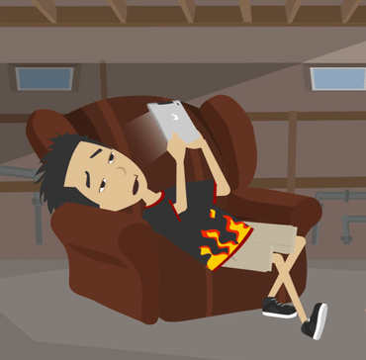
LESSON PLANS
POSSIBLE WARNING SIGNS
What changes might happen if someone spends too much time viewing harmful online images?
©2024-2026 Walking Wise
42
3

Slide 43
LESSON PLANS
POSSIBLE WARNING SIGNS
Possible Effects
Brain fog
Depression
Academic decline
Poor memory
©2024-2026 Walking Wise
Wilson, G. (2014). Your Brain On Porn: Internet Pornography and the Emerging Science of Addiction (1st ed.). Commonwealth Publishing.
43
3
Notes:
These changes do not happen to everyone.
However, researchers have observed that repeated exposure to harmful online content can sometimes affect mood, focus, or relationships.
These signs can also occur with other unhealthy habits.

Slide 44
LESSON PLANS
POSSIBLE WARNING SIGNS
Possible Effects
Secrecy & isolation
Physically inactive
Lower interest in dating & friends
Less interest in hobbies or activities
©2024-2026 Walking Wise
Wilson, G. (2014). Your Brain On Porn: Internet Pornography and the Emerging Science of Addiction (1st ed.). Commonwealth Publishing.
44
3

Slide 45
LESSON PLANS
POSSIBLE WARNING SIGNS
Possible Effects
Irritability & shame
Lower self-esteem
Lower empathy for suffering
Increased aggression
©2024-2026 Walking Wise
Wilson, G. (2014). Your Brain On Porn: Internet Pornography and the Emerging Science of Addiction (1st ed.). Commonwealth Publishing.
45
3

Slide 46
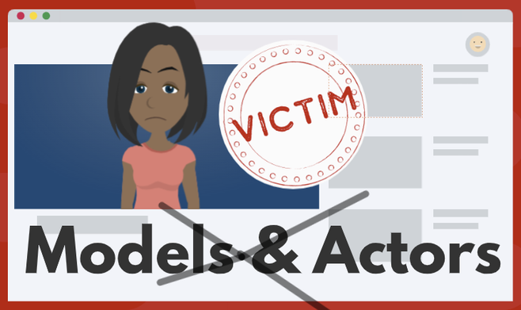
LESSON PLANS
MANIPULATION
Some pornography is made by pressuring, tricking, or taking advantage of vulnerable people.
©2024-2026 Walking Wise
46
3

Slide 47
LESSON PLANS
MANIPULATION
How Predators Lure Vulnerable People
Threats: Some may threaten to share a private photo unless the person does what they say.
©2024-2026 Walking Wise
47
3
Notes:
Not everyone involved in pornography participates willingly.
In some cases, people are pressured, tricked, or threatened. This is why understanding exploitation is important for safety education.

Slide 48
LESSON PLANS
MANIPULATION
How Predators Lure Vulnerable People
Pressured: Some promise money for basic needs, like food and shelter, in exchange for sexual images and videos.
©2024-2026 Walking Wise
48
3
Notes:
Not everyone involved in pornography participates willingly.
In some cases, people are pressured, tricked, or threatened. This is why understanding exploitation is important for safety education.

Slide 49
LESSON PLANS
MANIPULATION
How Predators Lure Vulnerable People
Tricked: Some make promises of fake opportunities, like acting or modeling, to trick vulnerable people.
©2024-2026 Walking Wise
49
3
Notes:
Not everyone involved in pornography participates willingly.
In some cases, people are pressured, tricked, or threatened. This is why understanding exploitation is important for safety education.

Slide 50
WHAT DO YOU THINK?
What percent of scenes in pornography are reported to show aggression?
©2024-2026 Walking Wise
50
Notes:
As far back as 2010, a study by Dr. Gail Dines revealed that 88% of pornography featured graphic displays of aggression and violence against women.
Source:
Dr. Gail Dines (n.d.). The Porn Crisis. CultureReframed.org. Retrieved February 25, 2024, from https://culturereframed.org/the-crisis/

Slide 51
WHAT DO YOU THINK?
What percent of scenes in pornography are reported to show aggression?
A) 28%
B) 48%
C) 68%
D) 88%
©2024-2026 Walking Wise
51

Slide 52
MULTIPLE CHOICE: D
ANSWER
88% of scenes in pornography are reported to show aggression.
©2024-2026 Walking Wise
Dr. Gail Dines (n.d.). The Dr. Gail Dines (n.d.). The Porn Crisis. CultureReframed.org.
52
Notes:
Many experts say pornography often shows unhealthy or unrealistic behavior, which can negatively affect how people think about relationships.
Source:
Dr. Gail Dines (n.d.). The Porn Crisis. CultureReframed.org. Retrieved February 25, 2024, from https://culturereframed.org/the-crisis/

Slide 53
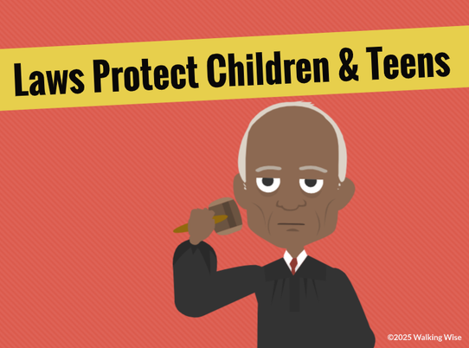
LESSON PLANS
LEGAL PROTECTION
Some pornography is connected to exploitation and human trafficking.
©2024-2026 Walking Wise
53
3

Slide 54
LESSON PLANS
LEGAL PROTECTION
US Laws Protect Children & Teens
U.S. laws state that involving children under 18 in pornography is treated as a human trafficking crime.
©2024-2026 Walking Wise
One Hundred Sixth Congress of the United States of America at the Second Session (2000, January 24). Victims of Trafficking and Violence Protection Act of 2000. Govinfo.gov.
54
3
Notes:
The Victims of Trafficking and Violence Protection Act of 2000 is a federal law aimed at combating human trafficking and exploitation. It identifies child sexual abuse material (CSAM) as a form of sex trafficking.
Additionally, most states have enacted similar laws that address the production and distribution of CSAM.
Source
One Hundred Sixth Congress of the United States of America at the Second Session (2000, January). Victims of Trafficking and Violence Protection Act of 2000. Govinfo.gov. Retrieved November 7, 2024,
from https://www.govinfo.gov/content/pkg/BILLS-106hr3244enr/pdf/BILLS-106hr3244enr.pdf

Slide 55
LESSON PLANS
LEGAL PROTECTION
The Law Protects Victims
Exploitation is never the victim’s fault.
©2024-2026 Walking Wise
55
3
Notes:
People who exploit others often rely on secrecy and fear.
Victims sometimes feel embarrassed or think they will get in trouble, which can cause them to hesitate to ask for help.
It is important for students to understand that exploitation is never the victim’s fault, and trusted adults are there to help protect them.
Encourage students to think about at least two adults they could talk to if something online ever made them uncomfortable.

Slide 56
LESSON PLANS
LEGAL PROTECTION
The Law Protects Victims
People who exploit others often use pressure, tricks, or threats.
©2024-2026 Walking Wise
56
3
Notes:
People who exploit others often rely on secrecy and fear.
Victims sometimes feel embarrassed or think they will get in trouble, which can cause them to hesitate to ask for help.
It is important for students to understand that exploitation is never the victim’s fault, and trusted adults are there to help protect them.
Encourage students to think about at least two adults they could talk to if something online ever made them uncomfortable.

Slide 57
LESSON PLANS
LEGAL PROTECTION
The Law Protects Victims
Many people encounter harmful situations by accident.
©2024-2026 Walking Wise
57
3
Notes:
People who exploit others often rely on secrecy and fear.
Victims sometimes feel embarrassed or think they will get in trouble, which can cause them to hesitate to ask for help.
It is important for students to understand that exploitation is never the victim’s fault, and trusted adults are there to help protect them.
Encourage students to think about at least two adults they could talk to if something online ever made them uncomfortable.

Slide 58
LESSON PLANS
LEGAL PROTECTION
The Law Protects Victims
Ask a trustworthy adult for help when feeling uncomfortable.
©2024-2026 Walking Wise
58
3
Notes:
People who exploit others often rely on secrecy and fear.
Victims sometimes feel embarrassed or think they will get in trouble, which can cause them to hesitate to ask for help.
It is important for students to understand that exploitation is never the victim’s fault, and trusted adults are there to help protect them.
Encourage students to think about at least two adults they could talk to if something online ever made them uncomfortable.

Slide 59

ASK FOR HELP
©2024-2026 Walking Wise
59
Notes:
Walking Wise asked a focus group of survivors:
What do you think young people should know about sex trafficking?
ANSWER
The survivors agreed that the most vital information teens should know is how to ask for help.
At the top of their list:
Tell a TRUSTWORTHY adult.

Slide 60
LESSON PLANS
ASK FOR HELP
If You See Something Online
Close the webpage or app
©2024-2026 Walking Wise
60
3
Notes:
Sometimes young people encounter harmful images or messages online by accident, especially when using search engines, social media, games, or video platforms.
Seeing something inappropriate or uncomfortable online does not mean they did anything wrong. The most important thing is knowing how to respond safely.
First, close the page or exit the app to avoid looking at the content.

Slide 61
LESSON PLANS
ASK FOR HELP
If You See Something Online
Close the webpage or app
Do not share the image
©2024-2026 Walking Wise
61
3
Notes:
Next, avoid sharing or forwarding the image or message, as doing so can harm others and may even violate school rules or laws.

Slide 62
LESSON PLANS
ASK FOR HELP
If You See Something Online
Close the webpage or app
Do not share the image
Tell a trustworthy adult
©2024-2026 Walking Wise
62
3
Notes:
Then, tell a trusted adult as soon as possible. Trusted adults might include a parent or guardian, a teacher, a school counselor, a coach, or another responsible adult they feel safe talking to. Adults can help report harmful content and take any necessary steps to provide protection.

Slide 63

LESSON PLANS
TAKE IT DOWN
It is possible to get help removing a private image or video from online platforms.
©2024-2026 Walking Wise
63
3
Notes:
NOTE TO PRESENTER
The TAKE IT DOWN Act is a federal law that makes it illegal to publish or threaten to publish non-consensual intimate images — including both real and AI-generated deepfake pornography — and requires online platforms to remove such content within 48 hours after a victim reports it. It was passed with strong bipartisan support and gives victims legal protections and tools to have harmful intimate imagery taken down quickly.[2]
The TAKE IT DOWN Act was signed into law on May 19, 2025. The law’s criminal provisions took effect right away, and covered online platforms were given one year — until May 19, 2026 — to set up the required notice-and-removal processes to take down nonconsensual intimate images when victims report them.
Source
2. U.S. Senate Committee on Commerce, Science, & Transportation (2025, May 19). Sen. Cruz Applauds Presidential Signing of the TAKE IT DOWN Act into Law. Retrieved on January 10, 2026 from, https://www.commerce.senate.gov/2025/5/sen-cruz-applauds-presidential-signing-of-the-take-it-down-act-into-law?utm_source=chatgpt.com

Slide 64
TAKE IT DOWN
Take It Down Service (by NCMEC)
Take It Down is a free service.
©2024-2026 Walking Wise
National Center for Missing & Exploited Children (n.d.). CyberTipline. Report.Cybertip.org.
64
Notes:
In the context of NCMEC's Take It Down program, a hash refers to a unique digital fingerprint or identifier generated from an image or video file. This fingerprint is created using specialized algorithms that convert the file into a string of characters or numbers.
Here's how it works:
HASH CREATION: When someone uses Take It Down, the program generates a hash from the image or video they want removed without uploading the actual file.
MATCHING: These hashes are stored in a secure database. Online platforms participating in the program can then use the hashes to identify and remove matching content from their platforms.
PRIVACY PROTECTION: The hash cannot be reversed to recreate the original image or video, ensuring the privacy of the person submitting the request. This system enables platforms to efficiently identify and remove harmful content while protecting the anonymity of individuals seeking help.
Source:
National Center for Missing & Exploited Children (n.d.). CyberTipline. Report.Cybertip.org.
https://takeitdown.ncmec.org/

Slide 65
TAKE IT DOWN
Take It Down Service (by NCMEC)
It stops online sharing of nude or sexual images involving children and teens.
©2024-2026 Walking Wise
National Center for Missing & Exploited Children (n.d.). CyberTipline. Report.Cybertip.org.
65

Slide 66
TAKE IT DOWN
Take It Down Service (by NCMEC)
This process protects the victim’s privacy and keeps their identity confidential.
©2024-2026 Walking Wise
National Center for Missing & Exploited Children (n.d.). CyberTipline. Report.Cybertip.org.
66

Slide 67
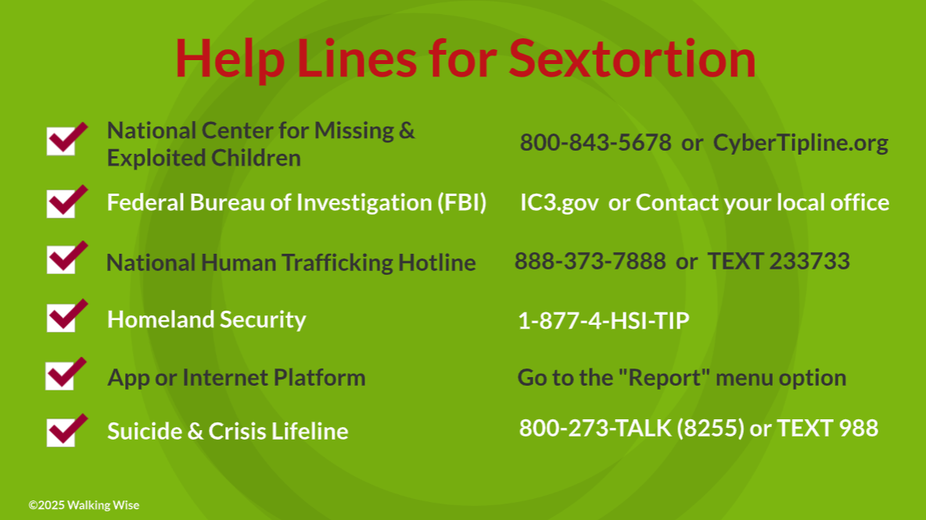
67
Notes:
NOTE TO PRESENTER
Presenters may ask their audience to consider adding a few "hotline for help" phone numbers to their cell phone contacts or take a photo of this slide.

Slide 68



Thank you!
WalkingWise.com
Online Course for Adults Accredited by:
Postgraduate Institute for Medicine
Academy of Forensic Nursing
©2024-2026 Walking Wise
68
Notes:
NOTE TO PRESENTER
To access additional resources about pornography, please refer to the last page of Lesson Plan #4 in the Walking Wise Learning Platform.
We welcome your feedback at support@WalkingWise.com.
Thank you!
WalkingWise.com

