Slide 1


SEXUAL EXPLOITATION
EDUCATION
RUNAWAYS
AS TARGETS
LESSON #7
Notes:
NOTE
Log in to WalkingWise.com and refer to the Walking Wise Education Guide to implement classroom teaching tips.
Most importantly:
• DEFINE SCHOOL POLICY
Establish a sexual exploitation reporting protocol with a trauma-informed response. The Walking Wise Implementation Guide provides a sample protocol.
• AGE & AUDIENCE
This presentation can be edited by following the procedures on page 3 to align with your school policies, specific age groups, and the involvement of at-risk audiences.
• SUPPORT PROCEDURE
Provide your audience with guidance on accessing immediate help or arranging a private meeting with a social worker, counselor, nurse, school resource officer, or another trustworthy staff member to report concerns for themselves or a peer.
• SECOND SAFE ADULT
Ensure a second trustworthy adult, such as a teacher, is present in the learning setting to observe audience reactions and identify those who may benefit from a follow-up meeting. This person should remain focused and free from other duties during the presentation.
• IMPLEMENT SLIDO.com
Join Walking Wise in using Slido.com to create an anonymous user experience.
Contact us at support@WalkingWise.com for more information.

Slide 2

NOTE TO PRESENTER
This presentation is exclusively for Walking Wise® subscribers and not for redistribution.
Walking Wise encourages the use of Slido.com, an interactive digital tool, to enhance audience engagement. For more information, contact us at support@WalkingWise.com. Once configured, integrate Slido polling and add a post-evaluation to the PowerPoint presentation.
Presenters are encouraged to edit speaker notes to match their speaking style (viewable in presentation mode). You can also delete slides from this Walking Wise presentation to make sure the content aligns with your school policies, is age-appropriate, and fits within available class time. However, the existing slides are copyright-protected and may not be modified without prior written permission from Walking Wise.
We encourage you to add your own content by following these instructions:
  Insert new PowerPoint slides.
  Remove the Walking Wise logo and copyright "©2025 Walking Wise" from the new slides.
  Always add your organization's name or logo to each new slide.
Please delete this instruction page before presenting to audiences.
©2024-2026 Walking Wise
2
Notes:
NOTE
The presenter is welcome to customize this Walking Wise presentation according to the instructions provided on this page.
For revision requests, please email us at:
support@WalkingWise.com.

Slide 3

CONFRONTING SEXUAL EXPLOITATION
WALKING WISE
KNOWLEDGE serves as a
powerful defense against
sexual predators.
©2024-2026 Walking Wise
3

Slide 4
CONFRONTING SEXUAL EXPLOITATION
WALKING WISE
SEXUAL EXPLOITATION includes grooming, sextortion, pornography
& sex trafficking.
©2024-2026 Walking Wise
4

Slide 5
SENSITIVE DISCUSSION AHEAD
CONTENT ALERT
We’ll be discussing serious issues about sexual exploitation.
Some parts may be difficult to hear.
If you ever feel uncomfortable, you can step out and speak with a trustworthy adult for support.
You’re not alone—we’re here to help you.
©2024-2026 Walking Wise
5
Notes:
NOTE TO PRESENTER
Please tailor this message to align with your organization's policies and protocols.
Please provide a confidential avenue for students to report concerns and seek help for themselves or their peers if they suspect sexual abuse, grooming, sextortion, pornography-related exploitation, or human trafficking. This may include a designated address or text line.
Consider displaying posters in your school or facility that outline various ways students can access immediate support or request a private meeting with a school safety team member or another trusted adult.

Slide 6

DIGITAL PARTICIPATION
©2024-2026 Walking Wise
6
Notes:
NOTE
For digital interaction with audiences:
Join Walking Wise in using Slido.com to create an anonymous user experience.
Contact us at support@WalkingWise.com if you would like more information.
Upon Activating Slido.com:
Please verify that the Q&A feature is enabled before presenting to audiences. An adult should monitor questions and comments to ensure they are appropriate. Slido has a feature that allows you to delete unwanted questions and comments.

Slide 7


STATISTICS
Statistics are Only Estimates
🔍 Many sexual crimes are never reported, so study results may not fully reflect what is really happening.
RUNAWAYS
AS TARGETS
©2024-2026 Walking Wise
7
Notes:
In this presentation, we'll discuss statistics, but it's important to note that while statistics provide valuable insights into an issue, they cannot be relied upon entirely.
Here are a few reasons:
• UNREPORTED
Victims may stay silent due to fear, shame, or manipulation.
• INCONSISTENT COLLECTION
Geographical areas have different legal definitions for sexual crimes, making data hard to compare.
• FOCUS GROUPS
Small or specific focus groups participating in a study or survey may not accurately reflect the diversity or experiences of the broader population.

Slide 8
STATISTICS
Statistics are Only Estimates
📊 Studies collect information in different ways, which can lead to different results.
RUNAWAYS
AS TARGETS
©2024-2026 Walking Wise
8
Notes:
In this presentation, we'll discuss statistics, but it's important to note that while statistics provide valuable insights into an issue, they cannot be relied upon entirely.
Here are a few reasons:
• UNREPORTED
Victims may stay silent due to fear, shame, or manipulation.
• INCONSISTENT COLLECTION
Geographical areas have different legal definitions for sexual crimes, making data hard to compare.
• FOCUS GROUPS
Small or specific focus groups participating in a study or survey may not accurately reflect the diversity or experiences of the broader population.

Slide 9
STATISTICS
Statistics are Only Estimates
👥 Some studies use small groups of people, and those groups may not represent everyone.
RUNAWAYS
AS TARGETS
©2024-2026 Walking Wise
9
Notes:
In this presentation, we'll discuss statistics, but it's important to note that while statistics provide valuable insights into an issue, they cannot be relied upon entirely.
Here are a few reasons:
• UNREPORTED
Victims may stay silent due to fear, shame, or manipulation.
• INCONSISTENT COLLECTION
Geographical areas have different legal definitions for sexual crimes, making data hard to compare.
• FOCUS GROUPS
Small or specific focus groups participating in a study or survey may not accurately reflect the diversity or experiences of the broader population.

Slide 10

EDUCATON GUIDE
VOCABULARY
VOCABULARY
  Runaway
  Family Dynamics
  Trauma
  Target
  Prey
  Disorient
  Survival Sex
RUNAWAYS
AS TARGETS
©2024-2026 Walking Wise
10
3
Notes:
NOTE
Understanding vocabulary terms related to the behaviors of sexual predators can empower young people to recognize warning signs of harmful situations.
Knowing terminology helps them identify manipulative tactics predators use to build trust and exploit vulnerabilities.
With this knowledge, young people are better equipped to spot red flags, understand that these behaviors are abusive, and feel more confident reporting predators to trusted adults or authorities, potentially preventing further harm.

Slide 11
EDUCATON GUIDE
VOCABULARY
RUNAWAY
A young person under 18 who chooses to leave, making their whereabouts unknown to their parents or guardians.
RUNAWAYS
AS TARGETS
©2025 Walking Wise
11
3
Notes:
Assisting Source
OpenAI. (2024). ChatGPT [Large language model]. https://chatgpt.com

Slide 12

LESSON PLANS
MISSING CHILDREN
How many U.S. children, under age 18, go missing every year?
RUNAWAYS
AS TARGETS
©2024-2026 Walking Wise
12
3
Notes:
Online Interactive Polling
SLIDO.com: Multiple Choice
How many U.S. children under age 18 go missing in the U.S. every year?
A) ~30,000 children
B) ~130,000 children
C) ~330,000 children
D) ~530,000 children
ANSWER
C) Approximately 330,00 U.S. children go missing every year.
Source
Federal Bureau of Investigation. (2025). 2024 NCIC missing person and unidentified person statistics (Table: Missing Person Circumstances — Runaway). Retrieved January 18, 2026, from https://www.fbi.gov/file-repository/cjis/2024-ncic-missing-and-unidentified-person-statistics.pdf/view

Slide 13
ANSWER
~330,000 U.S. children (under 18) go missing every year.
©2024-2026 Walking Wise
Federal Bureau of Investigation. (2025). 2024 NCIC missing person and unidentified person statistics (Table: Missing Person Circumstances — Runaway).
13
Notes:
Online Interactive Polling
SLIDO.com: Multiple Choice
How many U.S. children under age 18 go missing in the U.S. every year?
A) ~30,000 children
B) ~130,000 children
C) ~330,000 children
D) ~530,000 children
ANSWER
C) Approximately 330,00 U.S. children go missing every year.
Source
Federal Bureau of Investigation. (2025). 2024 NCIC missing person and unidentified person statistics (Table: Missing Person Circumstances — Runaway). Retrieved January 18, 2026, from https://www.fbi.gov/file-repository/cjis/2024-ncic-missing-and-unidentified-person-statistics.pdf/view

Slide 14


runaways as targets
of Child Sex Trafficking
Log in to WalkingWise.com to access this animated video.
©2024-2026 Walking Wise
14
Notes:
Message Especially for Teens:
Businesses worldwide use explainer-style animation as a training tool for their employees. So, this 3-minute Walking Wise animated video is appropriate for both teens (ages 11+) and adults to learn how sexual predators use manipulation, intimidation, and coercion to exploit young people.
NOTE
Log in to Walking Wise.com to watch the three-minute animated video with audiences.

Slide 15
LESSON PLANS
RUNAWAY CHILDREN
Of the U.S. children reported missing, what percent RAN AWAY?
RUNAWAYS
AS TARGETS
©2024-2026 Walking Wise
15
3
Notes:
Online Interactive Polling
SLIDO.com: Multiple Choice
Of the U.S. children reported missing, what percent actually ran away?
A) ~35%
B) ~55%
C) ~75%
D) ~95%
ANSWER
D) About 95% of U.S. children reported missing in 2024 were runaways, according to the FBI's 2024 NCIC data on Missing Person Circumstances.
Source
Federal Bureau of Investigation. (2025). 2024 NCIC missing person and unidentified person statistics (Table: Missing Person Circumstances — Runaway). Retrieved January 18, 2026, from https://www.fbi.gov/file-repository/cjis/2024-ncic-missing-and-unidentified-person-statistics.pdf/view

Slide 16
ANSWER
~95% of U.S. children reported missing are identified as youth who have run away.
Federal Bureau of Investigation. (2025). 2024 NCIC missing person and unidentified person statistics (Table: Missing Person Circumstances — Runaway).
16
©2024-2026 Walking Wise
Notes:
Online Interactive Polling
SLIDO.com: Multiple Choice
Of the U.S. children reported missing, what percent actually ran away?
A) ~35%
B) ~55%
C) ~75%
D) ~95%
ANSWER
D) About 95% of U.S. children reported missing in 2024 were runaways, according to the FBI's 2024 NCIC data on Missing Person Circumstances.
Source
Federal Bureau of Investigation. (2025). 2024 NCIC missing person and unidentified person statistics (Table: Missing Person Circumstances — Runaway). Retrieved January 18, 2026, from https://www.fbi.gov/file-repository/cjis/2024-ncic-missing-and-unidentified-person-statistics.pdf/view

Slide 17
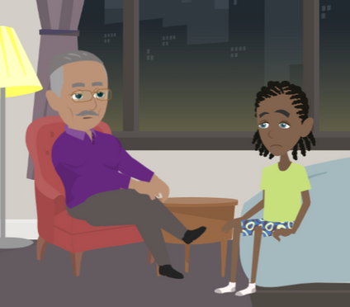
LESSON PLANS
MISSING CHILDREN
Why do some young people want to escape or run away from their home lives?
RUNAWAYS
AS TARGETS
©2024-2026 Walking Wise
17
3

Slide 18
EDUCATON GUIDE
VOCABULARY
TRAUMA
A deeply distressing or disturbing experience that impacts a person's emotional, mental, or physical well-being.
RUNAWAYS
AS TARGETS
©2024-2026 Walking Wise
18
3
Notes:
Assisting Source
OpenAI. (2024). ChatGPT [Large language model]. https://chatgpt.com

Slide 19
MISSING CHILDREN
Reasons for Leaving: Harm
Abuse or Neglect: Physical, emotional, sexual harm, or not having basic needs.
RUNAWAYS
AS TARGETS
©2024-2026 Walking Wise
19
Notes:
Running away is more often about escaping pain or fear than about seeking adventure or independence.
Many middle and high schoolers run away not only because of abuse, but because they feel emotionally unsafe, ignored, or powerless, even if adults don’t see the situation as “serious.” This is a key developmental factor at this age.

Slide 20
MISSING CHILDREN
Reasons for Leaving: Harm
Feeling Unsafe: Fear of harm or punishment.
RUNAWAYS
AS TARGETS
©2024-2026 Walking Wise
20
Notes:
Running away is more often about escaping pain or fear than about seeking adventure or independence.
Many middle and high schoolers run away not only because of abuse, but because they feel emotionally unsafe, ignored, or powerless, even if adults don’t see the situation as “serious.” This is a key developmental factor at this age.

Slide 21
EDUCATON GUIDE
VOCABULARY
FAMILY DYNAMICS
The interactions and relationships between family members.
RUNAWAYS
AS TARGETS
©2024-2026 Walking Wise
21
3
Notes:
Assisting Source
OpenAI. (2024). ChatGPT [Large language model]. https://chatgpt.com

Slide 22
MISSING CHILDREN
Reasons: Family Challenges
Family Conflict: Arguments or tension with parents, caregivers, or siblings.
RUNAWAYS
AS TARGETS
©2024-2026 Walking Wise
22
Notes:
Running away is more often about escaping pain or fear than about seeking adventure or independence.
Many middle and high schoolers run away not only because of abuse, but because they feel emotionally unsafe, ignored, or powerless, even if adults don’t see the situation as “serious.” This is a key developmental factor at this age.

Slide 23
MISSING CHILDREN
Reasons: Family Challenges
Family Stress: Challenges related to divorce, death, substance use, or incarceration.
RUNAWAYS
AS TARGETS
©2024-2026 Walking Wise
23
Notes:
Running away is more often about escaping pain or fear than about seeking adventure or independence.
Many middle and high schoolers run away not only because of abuse, but because they feel emotionally unsafe, ignored, or powerless, even if adults don’t see the situation as “serious.” This is a key developmental factor at this age.

Slide 24
MISSING CHILDREN
Reasons: Family Challenges
Rejection: Being pushed away or not accepted because of beliefs, behaviors, identity, or sexual orientation.
RUNAWAYS
AS TARGETS
©2024-2026 Walking Wise
24
Notes:
Running away is more often about escaping pain or fear than about seeking adventure or independence.
Many middle and high schoolers run away not only because of abuse, but because they feel emotionally unsafe, ignored, or powerless, even if adults don’t see the situation as “serious.” This is a key developmental factor at this age.

Slide 25
MISSING CHILDREN
Reasons: Emotions
Emotional Distress: Feeling overwhelmed, anxious, depressed, or hopeless.
RUNAWAYS
AS TARGETS
©2024-2026 Walking Wise
25
Notes:
Running away is more often about escaping pain or fear than about seeking adventure or independence.
Many middle and high schoolers run away not only because of abuse, but because they feel emotionally unsafe, ignored, or powerless, even if adults don’t see the situation as “serious.” This is a key developmental factor at this age.

Slide 26
MISSING CHILDREN
Reasons: Emotions
Shame & Guilt: Often linked to abuse, family problems, or health concerns.
RUNAWAYS
AS TARGETS
©2024-2026 Walking Wise
26
Notes:
Running away is more often about escaping pain or fear than about seeking adventure or independence.
Many middle and high schoolers run away not only because of abuse, but because they feel emotionally unsafe, ignored, or powerless, even if adults don’t see the situation as “serious.” This is a key developmental factor at this age.

Slide 27
MISSING CHILDREN
Reasons: Emotions
Feeling Unheard: Believing no one is listening or cares about concerns.
RUNAWAYS
AS TARGETS
©2024-2026 Walking Wise
27
Notes:
Running away is more often about escaping pain or fear than about seeking adventure or independence.
Many middle and high schoolers run away not only because of abuse, but because they feel emotionally unsafe, ignored, or powerless, even if adults don’t see the situation as “serious.” This is a key developmental factor at this age.

Slide 28
MISSING CHILDREN
Reasons: Pressure
Fearing Consequences: Stress over pregnancy or raising a child as a teen.
RUNAWAYS
AS TARGETS
©2024-2026 Walking Wise
28
Notes:
Running away is more often about escaping pain or fear than about seeking adventure or independence.
Many middle and high schoolers run away not only because of abuse, but because they feel emotionally unsafe, ignored, or powerless, even if adults don’t see the situation as “serious.” This is a key developmental factor at this age.

Slide 29
MISSING CHILDREN
Reasons: Pressure
Shame: Hiding problems or escaping a situation instead of asking for help.
RUNAWAYS
AS TARGETS
©2024-2026 Walking Wise
29
Notes:
Running away is more often about escaping pain or fear than about seeking adventure or independence.
Many middle and high schoolers run away not only because of abuse, but because they feel emotionally unsafe, ignored, or powerless, even if adults don’t see the situation as “serious.” This is a key developmental factor at this age.

Slide 30

LESSON PLANS
SCHOOL FACTORS
What school experiences can contribute to a young person wanting to run away from home?
RUNAWAYS
AS TARGETS
©2024-2026 Walking Wise
30
3

Slide 31
SCHOOL FACTORS
Reasons: School Life
Peer Rejection: Bullying, social exclusion, or cyberbullying.
RUNAWAYS
AS TARGETS
©2024-2026 Walking Wise
31
Notes:
• PEER REJECTION
Children run away from home over emotional distress associated with social rejection, bullying, or cyberbullying.
• PEER PRESSURE
Children are often enticed by a friend to leave home.
• OVERACHIEVEMENT
The anxiety associated with academic/athletic/artistic expectations or performance can cause children to want to escape home life.
• SEXTORTION
Children run from home due to humiliating circumstances associated with sextortion – such as embarrassing sexual photos or videos posted on social media platforms.

Slide 32
SCHOOL FACTORS
Reasons: School Life
Peer Pressure: Being encouraged by a school friend.
RUNAWAYS
AS TARGETS
©2024-2026 Walking Wise
32
Notes:
• PEER REJECTION
Children run away from home over emotional distress associated with social rejection, bullying, or cyberbullying.
• PEER PRESSURE
Children are often enticed by a friend to leave home.
• OVERACHIEVEMENT
The anxiety associated with academic/athletic/artistic expectations or performance can cause children to want to escape home life.
• SEXTORTION
Children run from home due to humiliating circumstances associated with sextortion – such as embarrassing sexual photos or videos posted on social media platforms.

Slide 33
SCHOOL FACTORS
Reasons: School Life
Expectations: Feeling overwhelmed by grades, sports, or performance expectations.
RUNAWAYS
AS TARGETS
©2024-2026 Walking Wise
33
Notes:
• PEER REJECTION
Children run away from home over emotional distress associated with social rejection, bullying, or cyberbullying.
• PEER PRESSURE
Children are often enticed by a friend to leave home.
• EXPECTATIONS
The anxiety associated with academic/athletic/artistic expectations or performance can cause children to want to escape home life.
• SEXTORTION
Children run from home due to humiliating circumstances associated with sextortion – such as embarrassing sexual photos or videos posted on social media platforms.

Slide 34
SCHOOL FACTORS
Reasons: School Life
Sextortion: Fear or embarrassment after images are shared with classmates or threatened to be shared online.
RUNAWAYS
AS TARGETS
©2024-2026 Walking Wise
34
Notes:
• PEER REJECTION
Children run away from home over emotional distress associated with social rejection, bullying, or cyberbullying.
• PEER PRESSURE
Children are often enticed by a friend to leave home.
• OVERACHIEVEMENT
The anxiety associated with academic/athletic/artistic expectations or performance can cause children to want to escape home life.
• SEXTORTION
Children run from home due to humiliating circumstances associated with sextortion – such as embarrassing sexual photos or videos posted on social media platforms.

Slide 35
LESSON PLANS
RUNNING RISK
Who is more likely to run away from home?
RUNAWAYS
AS TARGETS
©2024-2026 Walking Wise
35
3
Notes:
Online Interactive Polling
SLIDO.com: Multiple Choice
Who is more likely to run away from home?
A) Female Teens
B) Male Teens
C) LGBTQ+ Teens
D) Children Under Age 13
ANSWER
C) LGBTQ+ teens experience a higher rate of running away than their peers.
Research shows that LGBTQ+ teens report higher rates of running away, often due to family rejection, bullying, or lack of support. The Polaris Project reports that "nearly 40% of homeless youth identify as LGBTQ+, compared to 7% of the [LGBTQ+] general population."
Source
Polaris (2019, June 1). Sex Trafficking and LGBTQ+ Youth. PolarisProject.org. Retrieved March 3, 2024, from https://polarisproject.org/resources/sex-trafficking-and-lgbtq-youth/

Slide 36
ANSWER
LGBTQ+ teens experience a higher rate of running away than their peers.
©2024-2026 Walking Wise
Polaris (2019, June 1). Sex Trafficking and LGBTQ+ Youth. PolarisProject.org.
36
Notes:
Online Interactive Polling
SLIDO.com: Multiple Choice
Who is more likely to run away from home?
A) Female Teens
B) Male Teens
C) LGBTQ+ Teens
D) Children Under Age 13
ANSWER
C) LGBTQ+ teens experience a higher rate of running away than their peers.
Research shows that LGBTQ+ teens report higher rates of running away, often due to family rejection, bullying, or lack of support. The Polaris Project reports that "nearly 40% of homeless youth identify as LGBTQ+, compared to 7% of the [LGBTQ+] general population."
Source
Polaris (2019, June 1). Sex Trafficking and LGBTQ+ Youth. PolarisProject.org. Retrieved March 3, 2024, from https://polarisproject.org/resources/sex-trafficking-and-lgbtq-youth/

Slide 37
EDUCATON GUIDE
VOCABULARY
TARGET
A person (or object) intentionally chosen as the focus for an attack.
RUNAWAYS
AS TARGETS
©2025 Walking Wise
37
3
Notes:
Assisting Source
OpenAI. (2024). ChatGPT [Large language model]. https://chatgpt.com

Slide 38
EDUCATON GUIDE
VOCABULARY
PREY
A person (or group) targeted to be taken advantage or exploited of by others.
RUNAWAYS
AS TARGETS
©2025 Walking Wise
38
3
Notes:
Assisting Source
OpenAI. (2024). ChatGPT [Large language model]. https://chatgpt.com

Slide 39
MISSING CHILDREN
Reasons: Sexual Exploitation
False Promises: Someone offers love, protection, or a “better life.”
RUNAWAYS
AS TARGETS
©2025 Walking Wise
39
Notes:
• FALSE PROMISES
Children can be lured away from home to join a friend, romantic partner, biological family member, etc.
• ONLINE DECEPTION
Children can be convinced to leave home by an online predator posing as a friend, a romantic partner, etc.
• PEER PRESSURE
Children are often pressured or coerced to leave home by friends involved in the commercial sex trade, cults, or gangs.
• FAMILY TRAFFICKING
Children can run away from home to escape sex or labor trafficking crimes committed against them by a family member.

Slide 40
MISSING CHILDREN
Reasons: Sexual Exploitation
Online Deception: An online stranger pretends to be trustworthy.
RUNAWAYS
AS TARGETS
©2025 Walking Wise
40
Notes:
• FALSE PROMISES
Children can be lured away from home to join a friend, romantic partner, biological family member, etc.
• ONLINE DECEPTION
Children can be convinced to leave home by an online predator posing as a friend, a romantic partner, etc.
• PEER PRESSURE
Children are often pressured or coerced to leave home by friends involved in the commercial sex trade, cults, or gangs.
• FAMILY TRAFFICKING
Children can run away from home to escape sex or labor trafficking crimes committed against them by a family member.

Slide 41
MISSING CHILDREN
Reasons: Sexual Exploitation
Peer Pressure: Coerced to join a gang, cult, or trafficking ring.
RUNAWAYS
AS TARGETS
©2025 Walking Wise
41
Notes:
• FALSE PROMISES
Children can be lured away from home to join a friend, romantic partner, biological family member, etc.
• ONLINE DECEPTION
Children can be convinced to leave home by an online predator posing as a friend, a romantic partner, etc.
• PEER PRESSURE
Children are often pressured or coerced to leave home by friends involved in the commercial sex trade, cults, or gangs.
• FAMILY TRAFFICKING
Children can run away from home to escape sex or labor trafficking crimes committed against them by a family member.

Slide 42
MISSING CHILDREN
Reasons: Sexual Exploitation
Family Trafficking: A family member is involved in exploiting a youth.
RUNAWAYS
AS TARGETS
©2025 Walking Wise
42
Notes:
• FALSE PROMISES
Children can be lured away from home to join a friend, romantic partner, biological family member, etc.
• ONLINE DECEPTION
Children can be convinced to leave home by an online predator posing as a friend, a romantic partner, etc.
• PEER PRESSURE
Children are often pressured or coerced to leave home by friends involved in the commercial sex trade, cults, or gangs.
• FAMILY TRAFFICKING
Children can run away from home to escape sex or labor trafficking crimes committed against them by a family member.

Slide 43
LESSON PLANS
MISSING REPORT
How long must parents wait before reporting their child missing to the police?
RUNAWAYS
AS TARGETS
©2024-2026 Walking Wise
43
3
Notes:
Online Interactive Polling
SLIDO.com: Multiple Choice
How long must parents wait before reporting to the police that their child is missing?
A) Wait 12 Hours
B) Wait 24 Hours
C) Wait 48 Hours
D) Report Immediately
ANSWER
D) Report Immediately. Parents or guardians should never wait; they should report a missing child immediately.
There is no required waiting period to report a missing or overdue child. Parents and caregivers should not delay notifying authorities while conducting their own extensive searches for missing children, as law enforcement has specialized tools to conduct thorough, efficient investigations.
Source
U.S. Department of Justice (2023). When Your Child Is Missing: A Family Survival Guide, p. 7. ojjdp.ojp.gov. Retrieved December 2, 2024, from https://ojjdp.ojp.gov/publications/family-survival-guide.pdf

Slide 44
ANSWER
Report immediately. Parents should never wait to report a missing child.
©2024-2026 Walking Wise
U.S. Department of Justice (2023). When Your Child Is Missing: A Family Survival Guide, p. 7. ojjdp.ojp.gov.
44
Notes:
Online Interactive Polling
SLIDO.com: Multiple Choice
How long must parents wait before reporting to the police that their child is missing?
A) Wait 12 Hours
B) Wait 24 Hours
C) Wait 48 Hours
D) Report Immediately
ANSWER
D) Report Immediately. Parents or guardians should never wait; they should report a missing child immediately.
There is no required waiting period to report a missing or overdue child. Parents and caregivers should not delay notifying authorities while conducting their own extensive searches for missing children, as law enforcement has specialized tools to conduct thorough, efficient investigations.
Source
U.S. Department of Justice (2023). When Your Child Is Missing: A Family Survival Guide, p. 7. ojjdp.ojp.gov. Retrieved December 2, 2024, from https://ojjdp.ojp.gov/publications/family-survival-guide.pdf

Slide 45
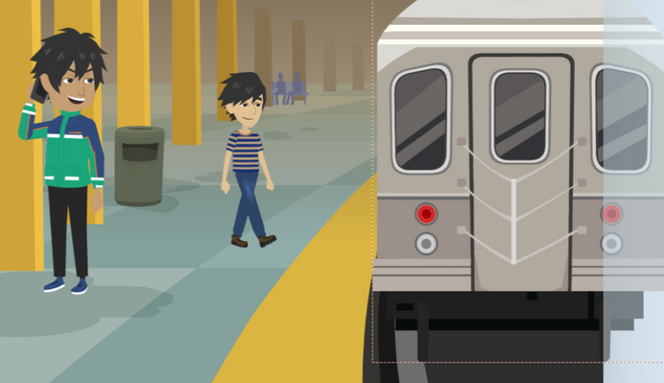
RISKY LOCATION
What locations make teens who run away or are homeless more vulnerable to traffickers?
RUNAWAYS
AS TARGETS
©2024-2026 Walking Wise
45

Slide 46
RISKY LOCATIONS
Vulnerable to Traffickers
  Transportation Hubs: Bus/train stations, subways, airports
RUNAWAYS
AS TARGETS
©2024-2026 Walking Wise
46
Notes:
• TRANSPORTATION HUBS
Bus stations, train stations, and airports where youths may be waiting for a ride or trying to get to another location.
• SHELTERS
Homeless shelters, where traffickers may target vulnerable youth in need of a place to stay, and makeshift living spaces or tent cities, where traffickers can exploit vulnerable individuals.
• ABANDONED BUILDINGS
Empty or unsafe buildings where youth may seek refuge when having nowhere else to go.
• LODGING
Low-cost motels or hotels, especially in areas with high levels of human trafficking activity.
Source
OpenAI. (2024). ChatGPT [Large language model]. https://chatgpt.com

Slide 47
RISKY LOCATIONS
Vulnerable to Traffickers
  Transportation Hubs: Bus/train stations, subways, airports
  Shelters: Homeless shelters, drop-in centers, halfway homes, tent cities
RUNAWAYS
AS TARGETS
©2024-2026 Walking Wise
47
Notes:
• TRANSPORTATION HUBS
Bus stations, train stations, and airports where youths may be waiting for a ride or trying to get to another location.
• SHELTERS
Homeless shelters, where traffickers may target vulnerable youth in need of a place to stay, and makeshift living spaces or tent cities, where traffickers can exploit vulnerable individuals.
• ABANDONED BUILDINGS
Empty or unsafe buildings where youth may seek refuge when having nowhere else to go.
• LODGING
Low-cost motels or hotels, especially in areas with high levels of human trafficking activity.
Source
OpenAI. (2024). ChatGPT [Large language model]. https://chatgpt.com

Slide 48
RISKY LOCATIONS
Vulnerable to Traffickers
  Transportation Hubs: Bus/train stations, subways, airports
  Shelters: Homeless shelters, drop-in centers, halfway homes, tent cities
  Abandoned Buildings: Empty or unsafe buildings
RUNAWAYS
AS TARGETS
©2024-2026 Walking Wise
48
Notes:
• TRANSPORTATION HUBS
Bus stations, train stations, and airports where youths may be waiting for a ride or trying to get to another location.
• SHELTERS
Homeless shelters, where traffickers may target vulnerable youth in need of a place to stay, and makeshift living spaces or tent cities, where traffickers can exploit vulnerable individuals.
• ABANDONED BUILDINGS
Empty or unsafe buildings where youth may seek refuge when having nowhere else to go.
• LODGING
Low-cost motels or hotels, especially in areas with high levels of human trafficking activity.
Source
OpenAI. (2024). ChatGPT [Large language model]. https://chatgpt.com

Slide 49
RISKY LOCATIONS
Vulnerable to Traffickers
  Transportation Hubs: Bus/train stations, subways, airports
  Shelters: Homeless shelters, drop-in centers, halfway homes, tent cities
  Abandoned Buildings: Empty or unsafe buildings
  Lodging: Motels, hotels, Airbnbs
RUNAWAYS
AS TARGETS
©2024-2026 Walking Wise
49
Notes:
• TRANSPORTATION HUBS
Bus stations, train stations, and airports where youths may be waiting for a ride or trying to get to another location.
• SHELTERS
Homeless shelters, where traffickers may target vulnerable youth in need of a place to stay, and makeshift living spaces or tent cities, where traffickers can exploit vulnerable individuals.
• ABANDONED BUILDINGS
Empty or unsafe buildings where youth may seek refuge when having nowhere else to go.
• LODGING
Low-cost motels or hotels, especially in areas with high levels of human trafficking activity.
Source
OpenAI. (2024). ChatGPT [Large language model]. https://chatgpt.com

Slide 50
RISKY LOCATIONS
Vulnerable to Traffickers
  Public Places: Street corners, shopping malls, parks
RUNAWAYS
AS TARGETS
©2024-2026 Walking Wise
50
Notes:
• PUBLIC PLACES
Remote or isolated areas where youth may go to hide or rest, exposing them as easy targets for traffickers.
• GATHERING SPOTS
Nightclubs, Bars, or Strip Clubs: Places where young people may be invited by traffickers to work, leading them into exploitation. Also, in high-traffic neighborhoods or street corners where traffickers can easily approach youth, as well as 24-hour diners that typically serve breakfast all night.
• CROWDED EVENTS
Concerts, festivals, and other public events where traffickers can easily blend in and target isolated youth.
• ONLINE PLATFORMS
Social media, dating apps, and other online platforms where traffickers can contact youth to make deceptive promises.
Source
OpenAI. (2024). ChatGPT [Large language model]. https://chatgpt.com

Slide 51
RISKY LOCATIONS
Vulnerable to Traffickers
  Public Places: Street corners, shopping malls, parks
  Gathering Spots: Bars, strip clubs, nightclubs, 24-hour diners
RUNAWAYS
AS TARGETS
©2024-2026 Walking Wise
51
Notes:
• PUBLIC PLACES
Remote or isolated areas where youth may go to hide or rest, exposing them as easy targets for traffickers.
• GATHERING SPOTS
Nightclubs, Bars, or Strip Clubs: Places where young people may be invited by traffickers to work, leading them into exploitation. Also, in high-traffic neighborhoods or street corners where traffickers can easily approach youth, as well as 24-hour diners that typically serve breakfast all night.
• CROWDED EVENTS
Concerts, festivals, and other public events where traffickers can easily blend in and target isolated youth.
• ONLINE PLATFORMS
Social media, dating apps, and other online platforms where traffickers can contact youth to make deceptive promises.
Source
OpenAI. (2024). ChatGPT [Large language model]. https://chatgpt.com

Slide 52
RISKY LOCATIONS
Vulnerable to Traffickers
  Public Places: Street corners, shopping malls, parks
  Gathering Spots: Bars, strip clubs, nightclubs, 24-hour diners
  Crowded Events: Concerts, festivals, fairs
RUNAWAYS
AS TARGETS
©2024-2026 Walking Wise
52
Notes:
• PUBLIC PLACES
Remote or isolated areas where youth may go to hide or rest, exposing them as easy targets for traffickers.
• GATHERING SPOTS
Nightclubs, Bars, or Strip Clubs: Places where young people may be invited by traffickers to work, leading them into exploitation. Also, in high-traffic neighborhoods or street corners where traffickers can easily approach youth, as well as 24-hour diners that typically serve breakfast all night.
• CROWDED EVENTS
Concerts, festivals, and other public events where traffickers can easily blend in and target isolated youth.
• ONLINE PLATFORMS
Social media, dating apps, and other online platforms where traffickers can contact youth to make deceptive promises.
Source
OpenAI. (2024). ChatGPT [Large language model]. https://chatgpt.com

Slide 53
RISKY LOCATIONS
Vulnerable to Traffickers
  Public Places: Street corners, shopping malls, parks
  Gathering Spots: Bars, strip clubs, nightclubs, 24-hour diners
  Crowded Events: Concerts, festivals, fairs
  Online: Dating apps, social media platforms
RUNAWAYS
AS TARGETS
©2024-2026 Walking Wise
53
Notes:
• PUBLIC PLACES
Remote or isolated areas where youth may go to hide or rest, exposing them as easy targets for traffickers.
• GATHERING SPOTS
Nightclubs, Bars, or Strip Clubs: Places where young people may be invited by traffickers to work, leading them into exploitation. Also, in high-traffic neighborhoods or street corners where traffickers can easily approach youth, as well as 24-hour diners that typically serve breakfast all night.
• CROWDED EVENTS
Concerts, festivals, and other public events where traffickers can easily blend in and target isolated youth.
• ONLINE PLATFORMS
Social media, dating apps, and other online platforms where traffickers can contact youth to make deceptive promises.
Source
OpenAI. (2024). ChatGPT [Large language model]. https://chatgpt.com

Slide 54
LESSON PLANS
MISSING REPORT
What percentage of children who run away are likely victims of child sex trafficking?
RUNAWAYS
AS TARGETS
©2024-2026 Walking Wise
54
3
Notes:
Online Interactive Polling
SLIDO.com: Multiple Choice
What percentage of children who run away are likely victims of child sex trafficking?
A) 1 in 7 children
B) 1 in 27 children
C) 1 in 47 children
D) 1 in 67 children
ANSWER
A) 1 in 7 children are at risk for child sex trafficking.
In 2024, approximately 91% of children reported missing to the National Center for Missing & Exploited Children (NCMEC) were recovered. As in prior years, the majority of reports involved runaway youth. Children who run away face heightened vulnerability, including increased risk of physical and sexual violence, homelessness, substance use exposure, and child sex trafficking.
Source:
NCMEC Cyber Tipline Report (2024). Child Sex Trafficking. Retrieved December 30, 2025, from https://www.missingkids.org/ourwork/impact#:~:text=Table_title:%20Reports%20by%20Type%20Table_content:%20header:%20%7C,Active:%2066%20%7C%20Grand%20Total:%20836%20%7C

Slide 55
ANSWER
~1 in 7 children who run away are likely victims of child sex trafficking.
©2024-2026 Walking Wise
NCMEC Cyber Tipline Report (2024). Child Sex Trafficking, MissingKids.org.
55
Notes:
SLIDO.com: Multiple Choice
What percentage of children who run away are likely victims of child sex trafficking?
A) 1 in 7 children
B) 1 in 27 children
C) 1 in 47 children
D) 1 in 67 children
ANSWER
A) 1 in 7 children who run away are likely victims of child sex trafficking.
In 2024, approximately 91% of children reported missing to the National Center for Missing & Exploited Children (NCMEC) were recovered.
As in prior years, the majority of reports involved runaway youth. Children who run away face heightened vulnerability, including increased risk of physical and sexual violence, homelessness, substance use exposure, and child sex trafficking.
Source:
NCMEC Cyber Tipline Report (2024). Child Sex Trafficking. Retrieved December 30, 2025, from https://www.missingkids.org/ourwork/impact#:~:text=Table_title:%20Reports%20by%20Type%20Table_content:%20header:%20%7C,Active:%2066%20%7C%20Grand%20Total:%20836%20%7C

Slide 56
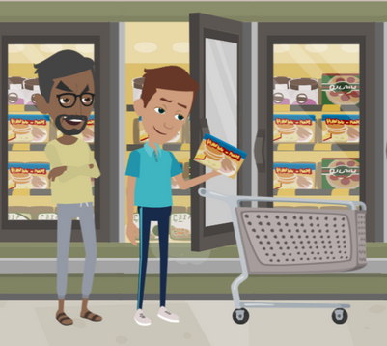
LESSON PLANS
MANIPULATION
What behaviors do traffickers display when trying to convince a homeless young person to trust them?
RUNAWAYS
AS TARGETS
©2024-2026 Walking Wise
56
3

Slide 57
MANIPULATION
Manipulative Traffickers
  Kind: Predators can offer to help resolve problems.
©2024-2026 Walking Wise
57
Notes:
In addition to using force or intimidation, traffickers fool young people through manipulation to gain trust:
• KIND & GENEROUS
Predators can seem genuinely concerned about a vulnerable youth and offer to help solve the young person’s problems. Traffickers often pretend to be kindhearted people who want to help by providing food, shelter, and other necessities.
• PROTECTOR
Traffickers can pretend to offer protection from gangs, cults, or other dangerous people.
• HOSPITABLE
Sex traffickers often invite runaways to parties to partake in drugs and alcohol, or they may offer substances to help soothe a runaway’s stress and pain, giving traffickers complete control over their victims.

Slide 58
MANIPULATION
Manipulative Traffickers
  Kind: Predators can offer to help resolve problems.
  Generous: They can offer food and housing.
©2024-2026 Walking Wise
58
Notes:
In addition to using force or intimidation, traffickers fool young people through manipulation to gain trust:
• KIND & GENEROUS
Predators can seem genuinely concerned about a vulnerable youth and offer to help solve the young person’s problems. Traffickers often pretend to be kindhearted people who want to help by providing food, shelter, and other necessities.
• PROTECTOR
Traffickers can pretend to offer protection from gangs, cults, or other dangerous people.
• HOSPITABLE
Sex traffickers often invite runaways to parties to partake in drugs and alcohol, or they may offer substances to help soothe a runaway’s stress and pain, giving traffickers complete control over their victims.

Slide 59
MANIPULATION
Manipulative Traffickers
  Kind: Predators can offer to help resolve problems.
  Generous: They can offer food and housing.
  Protective: Offer protection from gangs or dangerous people.
©2024-2026 Walking Wise
59
Notes:
In addition to using force or intimidation, traffickers fool young people through manipulation to gain trust:
• KIND & GENEROUS
Predators can seem genuinely concerned about a vulnerable youth and offer to help solve the young person’s problems. Traffickers often pretend to be kindhearted people who want to help by providing food, shelter, and other necessities.
• PROTECTOR
Traffickers can pretend to offer protection from gangs, cults, or other dangerous people.
• HOSPITABLE
Sex traffickers often invite runaways to parties to partake in drugs and alcohol, or they may offer substances to help soothe a runaway’s stress and pain, giving traffickers complete control over their victims.

Slide 60
MANIPULATION
Manipulative Traffickers
  Kind: Predators can offer to help resolve problems.
  Generous: They can offer food and housing.
  Protective: Offer protection from gangs or dangerous people.
  Hospitable: Invite teens to parties & provide drugs and alcohol.
©2024-2026 Walking Wise
60
Notes:
In addition to using force or intimidation, traffickers fool young people through manipulation to gain trust:
• KIND & GENEROUS
Predators can seem genuinely concerned about a vulnerable youth and offer to help solve the young person’s problems. Traffickers often pretend to be kindhearted people who want to help by providing food, shelter, and other necessities.
• PROTECTOR
Traffickers can pretend to offer protection from gangs, cults, or other dangerous people.
• HOSPITABLE
Sex traffickers often invite runaways to parties to partake in drugs and alcohol, or they may offer substances to help soothe a runaway’s stress and pain, giving traffickers complete control over their victims.

Slide 61
EDUCATON GUIDE
VOCABULARY
DISORIENT
To cause someone to feel confused or lost regarding time, direction, or understanding.
RUNAWAYS
AS TARGETS
©2024-2026 Walking Wise
61
3
Notes:
Assisting Source
OpenAI. (2024). ChatGPT [Large language model]. https://chatgpt.com

Slide 62
LESSON PLANS
BASIC NEEDS
In one or two words, name a basic need that is hard to access after running away.
RUNAWAYS
AS TARGETS
©2024-2026 Walking Wise
62
3
Notes:
Online Interactive Polling
SLIDO.com: Word Cloud
NOTE
The more frequently a word is used, the larger it appears in the cloud, making it easy to see which words or ideas are most common among the audience.
In one or two words, name a basic need that is hard to access after running away.
POSSIBLE ANSWERS
o Money
o Food
o Shelter
o Electricity for cell phones
o Protection
o Friends
o Education
o Job

Slide 63
BASIC NEEDS
Hard to Obtain when Homeless
  Money
  Food
  Clean Water
  Clothing
  Shelter
RUNAWAYS
AS TARGETS
©2024-2026 Walking Wise
63
Notes:
When a child runs away, the sudden loss of access to basic needs—such as food, shelter, and transportation—can quickly create economic dependency on others, including unsafe adults.
Predators often exploit this state of poverty as a lure, initially offering help that later becomes a means of control. In these circumstances, youth may feel pressured to engage in the exchange of sexual activity simply to meet basic survival needs, a situation commonly referred to as survival sex. This constitutes exploitation and meets the legal definition of child sex trafficking.

Slide 64
LOSS OF BASIC NEEDS
Hard to Obtain when Homeless
  Money
  Food
  Clean Water
  Clothing
  Shelter
  Hygiene Products
  Restroom
  Electricity/WiFi
  Phone/Computer
  Friends
RUNAWAYS
AS TARGETS
©2024-2026 Walking Wise
64
Notes:
When a child runs away, the sudden loss of access to basic needs—such as food, shelter, and transportation—can quickly create economic dependency on others, including unsafe adults.
Predators often exploit this state of poverty as a lure, initially offering help that later becomes a means of control. In these circumstances, youth may feel pressured to engage in the exchange of sexual activity simply to meet basic survival needs, a situation commonly referred to as survival sex. This constitutes exploitation and meets the legal definition of child sex trafficking.

Slide 65
LOSS OF BASIC NEEDS
Hard to Obtain when Homeless
  Money
  Food
  Clean Water
  Clothing
  Shelter
  Hygiene Products
  Restroom
  Electricity/WiFi
  Phone/Computer
  Friends
  Transportation
  Protection
  Medical Care
  Education
  Employment
RUNAWAYS
AS TARGETS
©2024-2026 Walking Wise
65
Notes:
When a child runs away, the sudden loss of access to basic needs—such as food, shelter, and transportation—can quickly create economic dependency on others, including unsafe adults.
Predators often exploit this state of poverty as a lure, initially offering help that later becomes a means of control. In these circumstances, youth may feel pressured to engage in the exchange of sexual activity simply to meet basic survival needs, a situation commonly referred to as survival sex. This constitutes exploitation and meets the legal definition of child sex trafficking.

Slide 66
EDUCATON GUIDE
VOCABULARY
SURVIVAL SEX
Being coerced into sexual activity due to desperate situations, often in exchange for meeting basic needs like food and shelter.
RUNAWAYS
AS TARGETS
©2024-2026 Walking Wise
66
3
Notes:
When a child runs away, the sudden loss of access to basic needs—such as food, shelter, and transportation—can quickly create economic dependency on others, including unsafe adults.
Predators often exploit this state of poverty as a lure, initially offering help that later becomes a means of control. In these circumstances, youth may feel pressured to engage in the exchange of sexual activity simply to meet basic survival needs, a situation commonly referred to as survival sex. This constitutes exploitation and meets the legal definition of child sex trafficking.
Assisting Source
OpenAI. (2024). ChatGPT [Large language model]. https://chatgpt.com

Slide 67
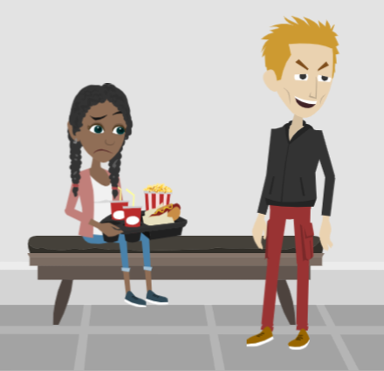
LESSON PLANS
UNLAWFUL EXCHANGE
How do predators often trick young people into sexual exploitation?
RUNAWAYS
AS TARGETS
©2024-2026 Walking Wise
67
3

Slide 68
UNLAWFUL EXCHANGE
Survival Transactions
  Predators trade food in exchange for sexual activity.
©2024-2026 Walking Wise
Polaris Project (2019). Freedom happens now. Sex Trafficking and LGBTQ Youth.
68
Notes:
• SURVIVAL SEX
Young people often do not realize the classification of a sex trafficking crime includes survival sex, which is the exchange of a sex act for something of value.
Survival sex is when young people feel pressured to perform sex acts in exchange for necessities, such as money, food, shelter, drugs, protection, or transportation.
The Polaris Project reports that LGBTQ+ youth are “3 to 7 times more likely to engage in survival sex than their non-LGBTQ peers because of discrimination and lack of social support.[1]
Source
1. Polaris Project (2019). Freedom happens now. Sex Trafficking and LGBTQ Youth.
https://polarisproject.org/wp-content/uploads/2019/09/LGBTQ-Sex-Trafficking.pdf

Slide 69
UNLAWFUL EXCHANGE
Survival Transactions
  Predators trade food in exchange for sexual activity.
  They can offer housing in exchange for sexual activity.
©2024-2026 Walking Wise
Polaris Project (2019). Freedom happens now. Sex Trafficking and LGBTQ Youth.
69
Notes:
• SURVIVAL SEX
Young people often do not realize the classification of a sex trafficking crime includes survival sex, which is the exchange of a sex act for something of value.
Survival sex is when young people feel pressured to perform sex acts in exchange for necessities, such as money, food, shelter, drugs, protection, or transportation.
The Polaris Project reports that LGBTQ+ youth are “3 to 7 times more likely to engage in survival sex than their non-LGBTQ peers because of discrimination and lack of social support.[1]
Source
1. Polaris Project (2019). Freedom happens now. Sex Trafficking and LGBTQ Youth.
https://polarisproject.org/wp-content/uploads/2019/09/LGBTQ-Sex-Trafficking.pdf

Slide 70
UNLAWFUL EXCHANGE
Survival Transactions
  Predators trade food in exchange for sexual activity.
  They can offer housing in exchange for sexual activity.
  Predators often trade drugs in exchange for sexual activity.
©2024-2026 Walking Wise
Polaris Project (2019). Freedom happens now. Sex Trafficking and LGBTQ Youth.
70
Notes:
• SURVIVAL SEX
Young people often do not realize the classification of a sex trafficking crime includes survival sex, which is the exchange of a sex act for something of value.
Survival sex is when young people feel pressured to perform sex acts in exchange for necessities, such as money, food, shelter, drugs, protection, or transportation.
The Polaris Project reports that LGBTQ+ youth are “3 to 7 times more likely to engage in survival sex than their non-LGBTQ peers because of discrimination and lack of social support.[1]
Source
1. Polaris Project (2019). Freedom happens now. Sex Trafficking and LGBTQ Youth.
https://polarisproject.org/wp-content/uploads/2019/09/LGBTQ-Sex-Trafficking.pdf

Slide 71
UNLAWFUL EXCHANGE
Survival Transactions
  Predators trade food in exchange for sexual activity.
  They can offer housing in exchange for sexual activity.
  Predators often trade drugs in exchange for sexual activity.
  They can promise protection in exchange for sexual activity.
©2024-2026 Walking Wise
Polaris Project (2019). Freedom happens now. Sex Trafficking and LGBTQ Youth.
71
Notes:
• SURVIVAL SEX
Young people often do not realize the classification of a sex trafficking crime includes survival sex, which is the exchange of a sex act for something of value.
Survival sex is when young people feel pressured to perform sex acts in exchange for necessities, such as money, food, shelter, drugs, protection, or transportation.
The Polaris Project reports that LGBTQ+ youth are “3 to 7 times more likely to engage in survival sex than their non-LGBTQ peers because of discrimination and lack of social support.[1]
Source
1. Polaris Project (2019). Freedom happens now. Sex Trafficking and LGBTQ Youth.
https://polarisproject.org/wp-content/uploads/2019/09/LGBTQ-Sex-Trafficking.pdf

Slide 72
UNLAWFUL EXCHANGE
Survival Transactions
  Predators trade food in exchange for sexual activity.
  They can offer housing in exchange for sexual activity.
  Predators often trade drugs in exchange for sexual activity.
  They can promise protection in exchange for sexual activity.
  Predators can provide transportation for sexual activity.
©2024-2026 Walking Wise
Polaris Project (2019). Freedom happens now. Sex Trafficking and LGBTQ Youth.
72
Notes:
• SURVIVAL SEX
Young people often do not realize the classification of a sex trafficking crime includes survival sex, which is the exchange of a sex act for something of value.
Survival sex is when young people feel pressured to perform sex acts in exchange for necessities, such as money, food, shelter, drugs, protection, or transportation.
The Polaris Project reports that LGBTQ+ youth are “3 to 7 times more likely to engage in survival sex than their non-LGBTQ peers because of discrimination and lack of social support.[1]
Source
1. Polaris Project (2019). Freedom happens now. Sex Trafficking and LGBTQ Youth.
https://polarisproject.org/wp-content/uploads/2019/09/LGBTQ-Sex-Trafficking.pdf

Slide 73

GOING HOME
Transportation Back Home
If wanting to RETURN home, contact the National Runaway Safeline:
FREE bus ticket from Greyhound Buses
1-800-RUN-AWAY
1-800-786-2929
©2024-2026 Walking Wise
73
Notes:
• HOME FREE PROGRAM
Greyhound assists the National Runaway Safeline with reuniting children and their families. They offer a free bus ticket to children who want to go home. The Home Free program is for youth ages 12 to 21 who self-identify as homeless, runaways, and victims of human trafficking.

Slide 74

ASK FOR HELP
©2024-2026 Walking Wise
74

Slide 75
ASK FOR HELP
Who should a young person talk to when considering running away from home or have already run away?
©2024-2026 Walking Wise
75

Slide 76
ASK FOR HELP
Instead of Running Away
  Talk to a trustworthy parent, family member, or other adult.
©2024-2026 Walking Wise
76

Slide 77
ASK FOR HELP
Instead of Running Away
  Talk to a trustworthy parent, family member, or other adult.
  If you are a student in school, consider telling a trustworthy teacher, coach, school nurse, social worker, counselor, resource officer, or principal.
©2024-2026 Walking Wise
77

Slide 78
ASK FOR HELP
Instead of Running Away
  Talk to a trustworthy parent, family member, or other adult.
  If you are a student in school, consider telling a trustworthy teacher, coach, school nurse, social worker, counselor, resource officer, or principal.
  Consider talking to a friend’s trustworthy parent or a trusted spiritual leader.
©2024-2026 Walking Wise
78

Slide 79
ASK FOR HELP
Instead of Running Away
  Talk to a trustworthy parent, family member, or other adult.
  If you are a student in school, consider telling a trustworthy teacher, coach, school nurse, social worker, counselor, resource officer, or principal.
  Consider talking to a friend’s trustworthy parent or a trusted spiritual leader.
  Call the National Runaway Safeline for advice: 1-800-RUN-AWAY (786-2929).
©2024-2026 Walking Wise
79

Slide 80
ASK FOR HELP
Instead of Running Away
  Talk to a trustworthy parent, family member, or other adult.
  If you are a student in school, consider telling a trustworthy teacher, coach, school nurse, social worker, counselor, resource officer, or principal.
  Consider talking to a friend’s trustworthy parent or a trusted spiritual leader.
  Call the National Runaway Safeline for advice: 1-800-RUN-AWAY (786-2929)
  National Center for Missing & Exploited Children 1-800-THE-LOST (843-5678)
©2024-2026 Walking Wise
80

Slide 81
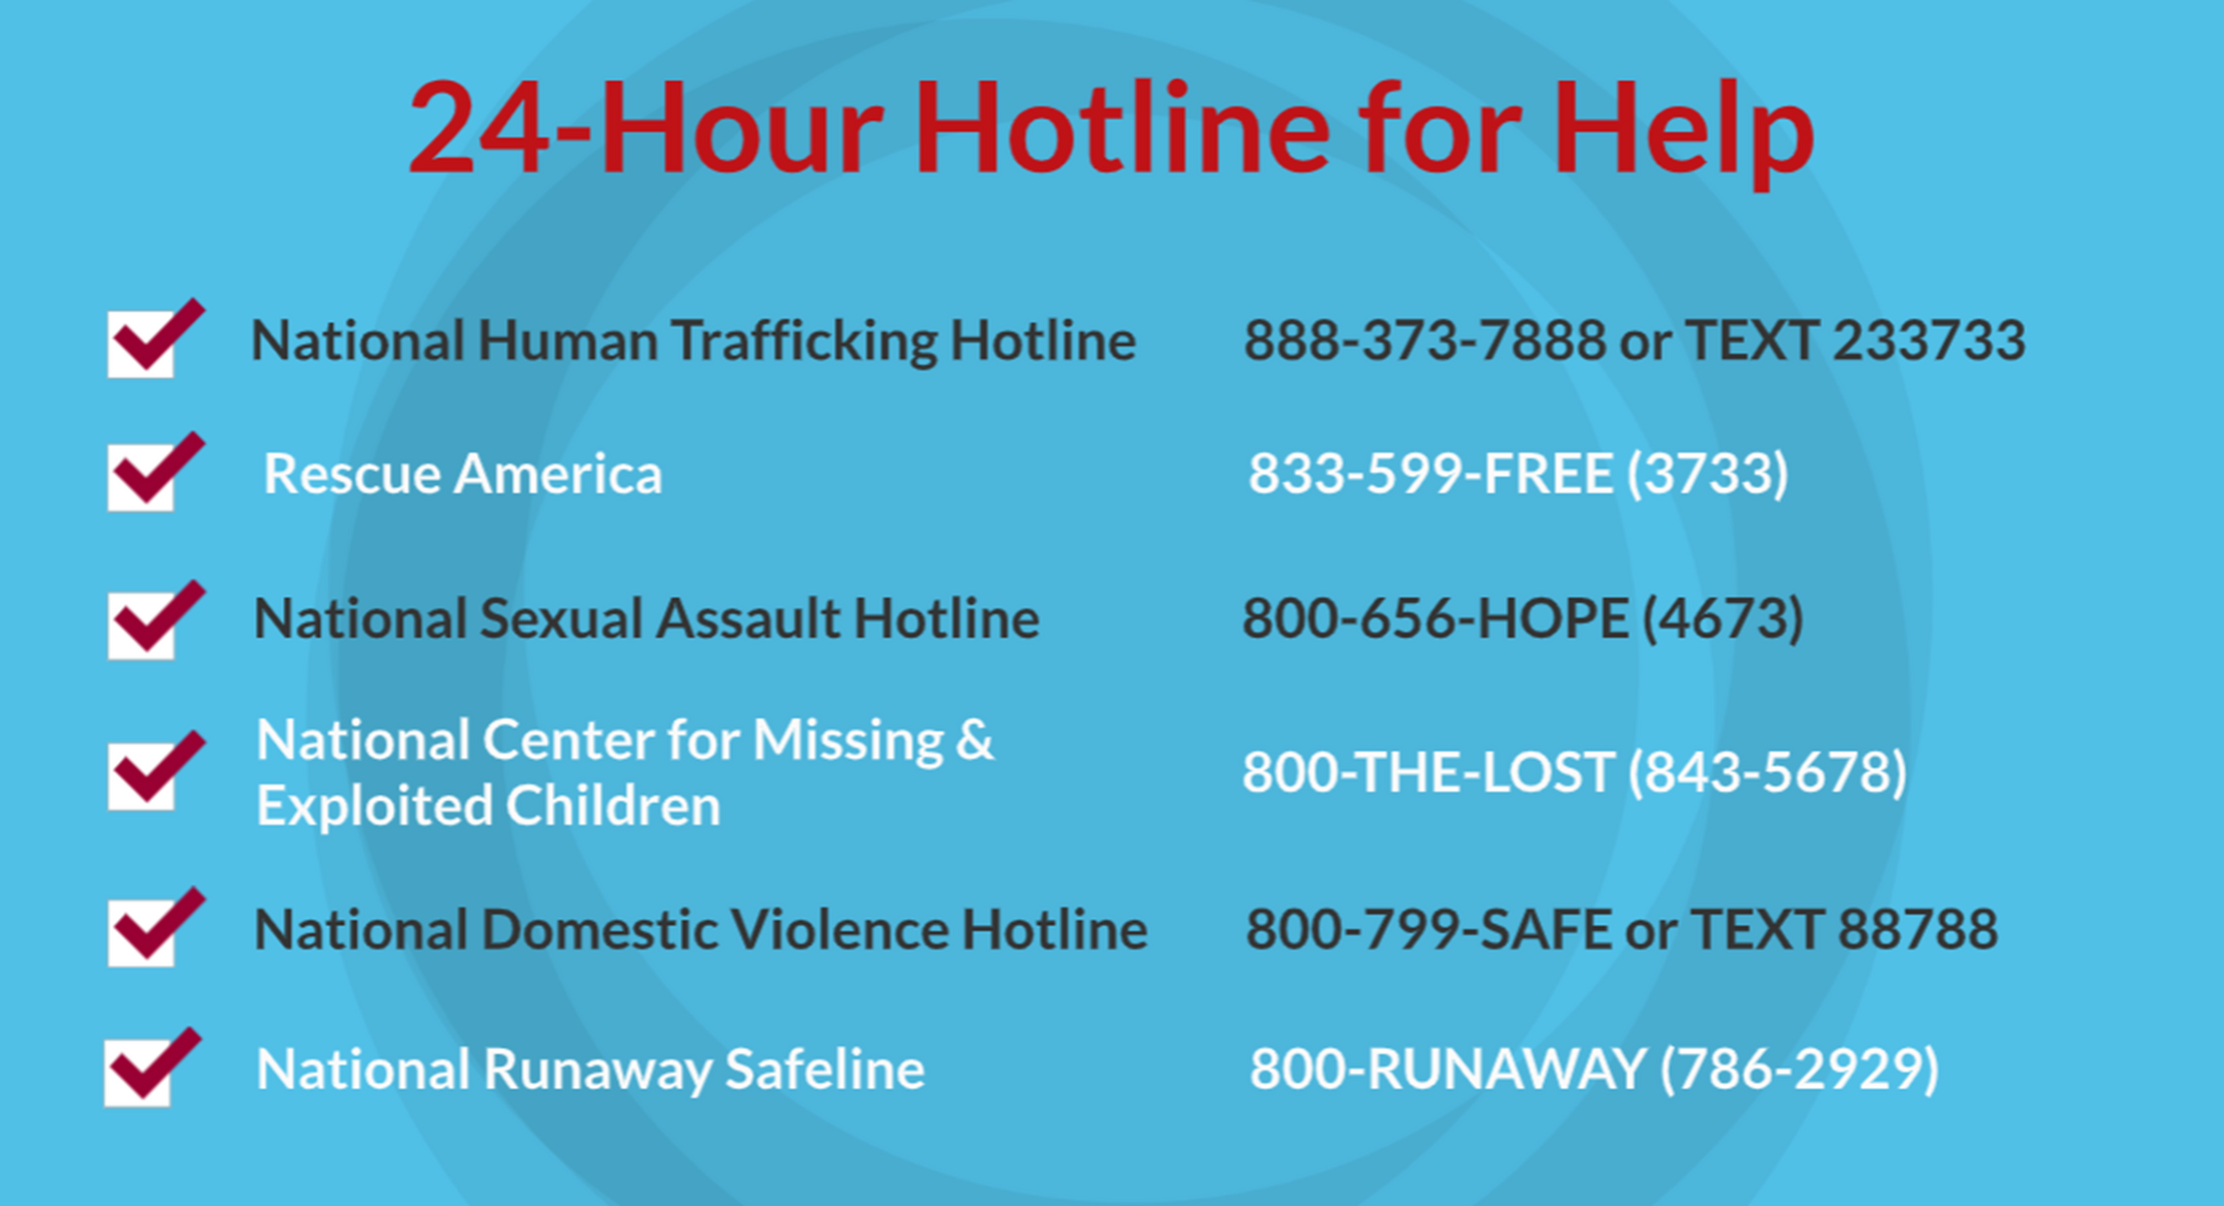
©2024-2026 Walking Wise
81
Notes:
NOTE
Presenters may ask their audience to consider adding a few "hotline for help" phone numbers in their cell phone contacts or take a photo of this slide.

Slide 82
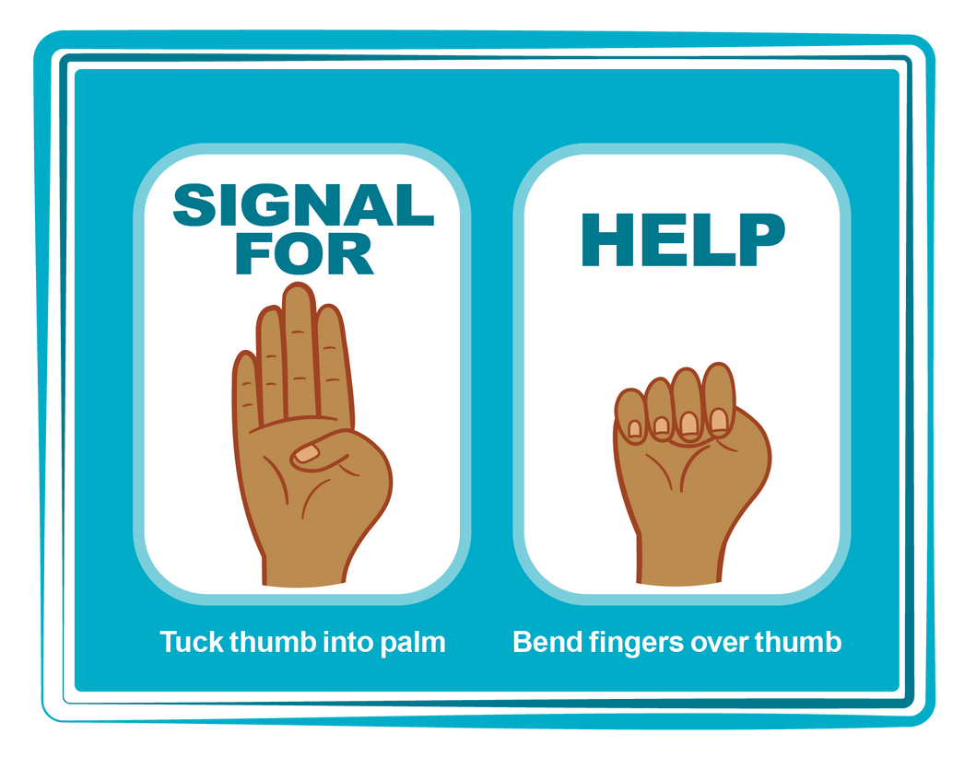
HAND SIGNAL FOR HELP
©2024-2026 Walking Wise
Source: Canadian Women’s Foundation, April 2020
82
Notes:
Although the hand signal for help has not yet achieved universal recognition, it may discreetly get someone's attention in urgent situations.
• SILENT
It can be used silently.
• UNTRACKABLE
It leaves no digital footprint.
• CONCEALED
It can be done secretly when a perpetrator is in the vicinity.
• SIGNALS DISTRESS
Combining the hand signal with distressed facial expressions might help attract the attention of an individual who is unfamiliar with the signal's meaning.
Source
Canadian Women's Foundation, April 2020

Slide 83
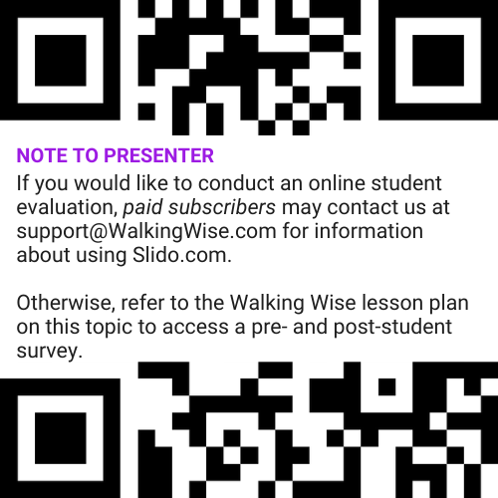
EVALUATION
©2024-2026 Walking Wise
83
Notes:
Two ways to conduct a pre-/post-student evaluation:
1) Use the pre/post survey in the Walking Wise lesson plan for this topic.
2) Activate Slido.com to conduct an online survey.

Slide 84

SHARE YOUR THOUGHTS
1. How would you rate this lesson?
2. What was the one thing you liked?
3. What one thing should we improve?
If Using Slido: Replace “#XXXX” with your organization’s custom Slido code.
©2024-2026 Walking Wise
84
Notes:
Online Interactive Polling
SLIDO.com: 3-Question Survey
IF SLIDO IS ACTIVATED:
Follow the instructions provided on WalkingWise.com to access your school or organization's custom Slido QR code and #code, which the audience will use to complete the 3-question evaluation.
Please encourage your audience to scan your organization's custom QR code to share what they enjoyed and what could be improved about the lesson.
Please send any feedback you want to share to Walking Wise at support@WalkingWise.com.

Slide 85


Thank you!
WalkingWise.com
Online Course for Adults Accredited by:
Postgraduate Institue for Medicine
Academy of Forensic Nursing
©2024-2026 Walking Wise
85
Notes:
NOTE
To access additional resources about running away, please refer to the last page of Lesson Plan #7 in the Walking Wise Education Guide.
We welcome your feedback at support@WalkingWise.com.
Thank you!
Karla Highman
Founder, WalkingWise.com

