Slide 1


SEXUAL EXPLOITATION
EDUCATION
RUNAWAYS
AS TARGETS
BY WALKING WISE
Notes:
NOTE TO PRESENTER
Log in to WalkingWise.com and refer to the Implementation Toolkit for classroom teaching tips.
Most importantly:
DEFINE SCHOOL POLICY
Establish a sexual exploitation reporting protocol with a trauma-informed response. The Walking Wise Implementation Toolkit provides a sample protocol.
AGE & AUDIENCE
This presentation can be edited by following the procedures on page 3 to align with your school policies, specific age groups, and the involvement of at-risk audiences.
SUPPORT PROCEDURE
Provide your students with guidance on how to access immediate help or arrange a private meeting with a social worker, counselor, nurse, school resource officer, or another trustworthy staff member to report concerns about themselves or a peer.
SECOND SAFE ADULT
Ensure a second trustworthy adult, such as a teacher, is present in the learning setting to observe student reactions and identify those who may benefit from a follow-up meeting. This person should remain focused and free from other duties during the presentation.

Slide 2

6-Year Track
NOTE TO PRESENTER
Meaningful learning takes time. By introducing topics gradually over several years, educators can create steady growth in awareness and understanding.
Our recommended teaching plan offers a long-term path for middle and high school students to build knowledge and confidence.
PARENTS & STAFF
#1 Myths & Reality
6th GRADE
#2 Trustworthy vs. Unsafe Adult
#3 Grooming Process
7th GRADE
#4 Pornography Link
#5 Sextortion Scheme
8th GRADE
#6 Male Victims
#7 Runaways as Targets
#8 Rural Risks
9th GRADE
#9 Human Traffickers
#10 Female & Peer Recruiters
10th GRADE
#11 Family Secret
11th GRADE
#12 Hidden Buyers
©2024-2026 Walking Wise
2

Slide 3

NOTE TO PRESENTER
This presentation is exclusively for Walking Wise® subscribers and not for redistribution.
Presenters are encouraged to edit speaker notes to match their speaking style (viewable in presentation mode). You can also delete slides and content from this Walking Wise presentation to ensure the information aligns with your school policies, is age-appropriate, and fits within available class time. However, the slides are copyright-protected and may not be reworded without prior written permission from Walking Wise.
We encourage you to add your own content by following these instructions:
Insert new PowerPoint slides.
Remove the Walking Wise logo and copyright "©2026 Walking Wise" from the new slides.
Always add your organization's name or logo to each new slide.
Please delete this instruction page before presenting to audiences.
R042726
©2024-2026 Walking Wise
3
Notes:
NOTE TO PRESENTER
The presenter is welcome to customize this Walking Wise presentation according to the instructions provided on this page.
For revision requests, please email us at: support@WalkingWise.com.

Slide 4
SENSITIVE TOPICS WILL BE DISCUSSED
CONTENT NOTICE
We’ll be discussing serious safety issues today.
Some topics may be difficult to hear.
If you ever feel uncomfortable, you can step out and speak with a trustworthy adult for support.
You’re not alone—help is available.
©2024-2026 Walking Wise
4
Notes:
NOTE TO PRESENTER
Trauma-Informed Delivery Guidelines
To support a safe and effective learning environment, please follow these guidelines:
• Present the information in a calm, matter-of-fact way and avoid sensational or alarming language.
• Avoid graphic details. Focus on helping students understand behaviors, risk, and ways to stay safe.
• Never blame victims. Responsibility always belongs to the person who caused harm.
• Maintain a steady, composed tone. Students often mirror the presenter's emotional cues.
• Do not ask students to share personal experiences or disclosures.
• If students laugh or react awkwardly, respond neutrally and gently redirect the focus.
• Pair all risk information with needed resources, practical solutions, and support options.
• Reinforce that students are not alone and that trustworthy adults are available to help.

Slide 5
STATISTICS
Why Study Results Can Vary
Some crimes are never reported, making it hard to reveal the entire issue.
Studies collect information in different ways, leading to different results.
Small studies may not represent everyone.
©2024-2026 Walking Wise
5
Notes:
In this presentation, we'll discuss statistics, but it's important to note that while statistics provide valuable insights into an issue, they cannot be relied upon entirely.
Here are a few reasons:
UNREPORTED
Victims often do not report the crimes committed against them due to fear, shame, retaliation, or manipulation. Also, many don’t realize that what is happening to them is a crime.
INCONSISTENT COLLECTION
Areas may define sexual crimes in various ways or use different methods to collect data, making it hard to compare information.
FOCUS GROUPS
Small or specific focus groups participating in a study or survey may not accurately reflect the diversity or experiences of the broader population.

Slide 6

WHY LEARN ABOUT THIS
KNOWLEDGE serves as a
powerful defense against
sexual predators.
©2024-2026 Walking Wise
6
Notes:
Education is one of the strongest tools for prevention.
When young people understand how predators operate, they are better able to recognize manipulation and avoid dangerous situations.
Reinforce that awareness increases safety.

Slide 7
PREVENTION EDUCATION
SEXUAL EXPLOITATION includes grooming, sextortion, pornography
& sex trafficking.
©2024-2026 Walking Wise
7
Notes:
SEXUAL EXPLOITATION
Taking advantage of another person for their own benefit, especially in a sexual way, often using pressure, tricks, or control.
Below are different forms of exploitation:
GROOMING
Building trust, dependency, or an emotional connection to manipulate someone.
SEXTORTION
Threatening to share embarrassing or sexual images, videos, or information to pressure someone into following demands.
PORNOGRAPHY
Involving someone in creating sexual images who is under 18, or someone who is pressured, or unable/unwilling to give consent.
SEX TRAFFICKING
Manipulating or forcing someone into sexual activity in exchange for money or something of value.
Trafficking and Violence Protection Act (TVPA) of 2000 (Legal Definition):
SEX TRAFFICKING is the recruitment, harboring, transportation, provision, obtaining, patronizing, or soliciting of a person under the age of 18 for the purpose of a commercial sex act.
TVPA link: Retrieved April 14, 2026, from https://www.govinfo.gov/content/pkg/BILLS-106hr3244enr/pdf/BILLS-106hr3244enr.pdf

Slide 8



EDUCATON GUIDE
VOCABULARY
Words to Understand
Missing Child
Runaway
Basic Need
Trauma
Target
Prey
Disorient
Survival Sex
RUNAWAYS
AS TARGETS
©2024-2026 Walking Wise
8
3
Notes:
Understanding vocabulary terms related to the behaviors of sexual predators can empower young people to recognize warning signs of harmful situations.
Knowing these terms helps them identify manipulative tactics that unsafe people (predators/traffickers) use to build trust and exploit vulnerabilities.
With this knowledge, young people are better equipped to spot red flags, understand that these behaviors are abusive, and feel more confident reporting predators to trusted adults or authorities, potentially preventing further harm.

Slide 9
EDUCATON GUIDE
VOCABULARY
MISSING CHILD
A child (under 18) whose whereabouts are not known to their parent or caregiver and who is reported missing.
RUNAWAYS
AS TARGETS
©2024-2026 Walking Wise
9
3

Slide 10
LESSON PLANS
WHAT DO YOU THINK?
About how many U.S. children (under 18) go missing every year?
RUNAWAYS
AS TARGETS
©2024-2026 Walking Wise
10
3

Slide 11
WHAT DO YOU THINK?
About how many U.S. children (under 18) go missing every year?
A) 30,000 children
B) 130,000 children
C) 330,000 children
D) 530,000 children
©2024-2026 Walking Wise
11

Slide 12
ANSWER
About 330,000 U.S. children (under 18) go missing every year.
©2024-2026 Walking Wise
Federal Bureau of Investigation. (2025). 2024 NCIC missing person and unidentified person statistics (Table: Missing Person Circumstances — Runaway).
12
Notes:
Source
Federal Bureau of Investigation. (2025). 2024 NCIC missing person and unidentified person statistics (Table: Missing Person Circumstances — Runaway). Retrieved January 18, 2026, from https://www.fbi.gov/file-repository/cjis/2024-ncic-missing-and-unidentified-person-statistics.pdf/view

Slide 13
EDUCATON GUIDE
VOCABULARY
RUNAWAY
A child (under 18) who leaves home without permission and whose location is unknown to their parents or caregivers.
RUNAWAYS
AS TARGETS
©2024-2026 Walking Wise
13
3

Slide 14
LESSON PLANS
CONSIDER THE RISK
Sometimes teens think about leaving home without fully understanding the risks.
RUNAWAYS
AS TARGETS
©2024-2026 Walking Wise
14
3

Slide 15
CONSIDER THE RISK
Understanding Running Away
Why would someone want to leave?
RUNAWAYS
AS TARGETS
©2024-2026 Walking Wise
15
Notes:
Young people may sometimes think about running away when they feel overwhelmed, but may not fully understand the risks involved.
Running away may seem like a solution, but we will learn that it often introduces new risks and challenges, especially regarding safety and basic needs.

Slide 16
CONSIDER THE RISK
Understanding Running Away
Why would someone want to leave?
What might they be trying to escape?
RUNAWAYS
AS TARGETS
©2024-2026 Walking Wise
16
Notes:
Young people may sometimes think about running away when they feel overwhelmed, but may not fully understand the risks involved.
Running away may seem like a solution, but we will learn that it often introduces new risks and challenges, especially regarding safety and basic needs.

Slide 17
CONSIDER THE RISK
Understanding Running Away
Why would someone want to leave?
What might they be trying to escape?
What are they running to?
RUNAWAYS
AS TARGETS
©2024-2026 Walking Wise
17
Notes:
Young people may sometimes think about running away when they feel overwhelmed, but may not fully understand the risks involved.
Running away may seem like a solution, but we will learn that it often introduces new risks and challenges, especially regarding safety and basic needs.

Slide 18
CONSIDER THE RISK
Understand Running Away
Why would someone want to leave?
What might they be trying to escape?
What are they running to?
What could they be hoping to find?
RUNAWAYS
AS TARGETS
©2024-2026 Walking Wise
18
Notes:
Young people may sometimes think about running away when they feel overwhelmed, but may not fully understand the risks involved.
Running away may seem like a solution, but we will learn that it often introduces new risks and challenges, especially regarding safety and basic needs.

Slide 19
CONSIDER THE RISK
Understand Running Away
Why would someone want to leave?
What might they be trying to escape?
What are they running to?
What could they be hoping to find?
What risks and challenges could they face?
RUNAWAYS
AS TARGETS
©2024-2026 Walking Wise
19
Notes:
Young people may sometimes think about running away when they feel overwhelmed, but may not fully understand the risks involved.
Running away may seem like a solution, but we will learn that it often introduces new risks and challenges, especially regarding safety and basic needs.

Slide 20


runaways as targets
of Child Sex Trafficking
Log in to WalkingWise.com to access this animated video.
©2024-2026 Walking Wise
20
Notes:
This 3-minute Walking Wise animated video series teaches how sexual predators use manipulation, intimidation, and coercion to exploit young people.
NOTE
Log in to Walking Wise.com to watch the three-minute animated video with audiences.
Is animation appropriate for teens?
Businesses worldwide use explainer-style animation as a training tool for their employees.

Slide 21
LESSON PLANS
WHAT DO YOU THINK?
Of the U.S. children reported missing, what percent ran away?
RUNAWAYS
AS TARGETS
©2024-2026 Walking Wise
21
3

Slide 22
WHAT DO YOU THINK?
Of the U.S. children reported missing, what percent ran away?
A) 35%
B) 55%
C) 75%
D) 95%
©2024-2026 Walking Wise
22

Slide 23
ANSWER
About 95% of U.S. missing children are runaway youth.
Federal Bureau of Investigation. (2025). 2024 NCIC missing person and unidentified person statistics (Table: Missing Person Circumstances — Runaway).
23
©2024-2026 Walking Wise
Notes:
Source
Federal Bureau of Investigation. (2025). 2024 NCIC missing person and unidentified person statistics (Table: Missing Person Circumstances — Runaway). Retrieved January 18, 2026, from https://www.fbi.gov/file-repository/cjis/2024-ncic-missing-and-unidentified-person-statistics.pdf/view

Slide 24
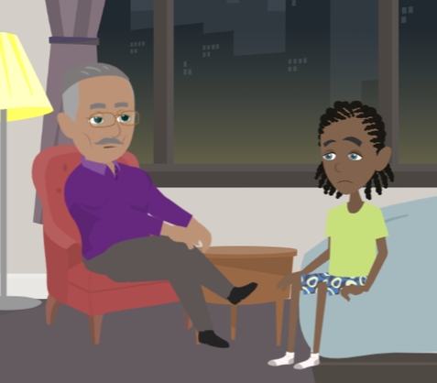
LESSON PLANS
REASONS FOR LEAVING
Why do some young people run away from home?
RUNAWAYS
AS TARGETS
©2024-2026 Walking Wise
24
3

Slide 25
REASONS FOR LEAVING
Feeling Unsafe
Fear: Worried about threats or punishment.
RUNAWAYS
AS TARGETS
©2024-2026 Walking Wise
25
Notes:
Some young people may feel unsafe in their home environment due to fear of harm, punishment, or ongoing abuse or neglect.
Safety is a basic need, and when it is not met, a young person may consider leaving home to protect themselves.

Slide 26
REASONS FOR LEAVING
Feeling Unsafe
Fear: Worried about threats or punishment.
Abuse: Experiencing harm or neglect.
RUNAWAYS
AS TARGETS
©2024-2026 Walking Wise
26
Notes:
Some young people may feel unsafe in their home environment due to fear of harm, punishment, or ongoing abuse or neglect.
Safety is a basic need, and when it is not met, a young person may consider leaving home to protect themselves.

Slide 27
EDUCATON GUIDE
VOCABULARY
TRAUMA
A very upsetting experience that can affect a person’s thoughts, feelings, behavior, and how their body responds to that stress.
RUNAWAYS
AS TARGETS
©2024-2026 Walking Wise
27
3

Slide 28
REASONS FOR LEAVING
Family Challenges
Conflict: Not getting along with parents or caregivers.
©2024-2026 Walking Wise
28
Notes:
Ongoing conflict, major changes, a parent losing their job, abuse by a parent/guardian, or instability within a family, such as divorce, loss, or substance use, can create stress for young people.
These challenges may lead some teens to feel disconnected or unsupported, increasing the desire to leave home.

Slide 29
REASONS FOR LEAVING
Family Challenges
Conflict: Not getting along with parents or caregivers.
Family Stress: Such as divorce, a death, or substance use.
©2024-2026 Walking Wise
29
Notes:
Ongoing conflict, major changes, a parent losing their job, abuse by a parent/guardian, or instability within a family, such as divorce, loss, or substance use, can create stress for young people.
These challenges may lead some teens to feel disconnected or unsupported, increasing the desire to leave home.

Slide 30
REASONS FOR LEAVING
Family Challenges
Conflict: Not getting along with parents or caregivers.
Family Stress: Such as divorce, a death, or substance use.
Rejection: Not feeling accepted by family.
©2024-2026 Walking Wise
30
Notes:
Ongoing conflict, major changes, a parent losing their job, abuse by a parent/guardian, or instability within a family, such as divorce, loss, or substance use, can create stress for young people.
These challenges may lead some teens to feel disconnected or unsupported, increasing the desire to leave home.

Slide 31
REASONS FOR LEAVING
Emotions
Feeling anxious, overwhelmed, or depressed
©2024-2026 Walking Wise
31
Notes:
Strong emotions like feeling overwhelmed, anxious, depressed, or ashamed can influence decision-making.
When emotions build up, and a young person feels unheard or unsupported, running away may seem like a way to escape the issues.

Slide 32
REASONS FOR LEAVING
Emotions
Feeling anxious, overwhelmed, or depressed
Feeling shame or guilt
©2024-2026 Walking Wise
32
Notes:
Strong emotions like feeling overwhelmed, anxious, depressed, or ashamed can influence decision-making.
When emotions build up, and a young person feels unheard or unsupported, running away may seem like a way to escape the issues.

Slide 33
REASONS FOR LEAVING
Emotions
Feeling anxious, overwhelmed, or depressed
Feeling shame or guilt
Feeling unheard or unsupported
©2024-2026 Walking Wise
33
Notes:
Strong emotions like feeling overwhelmed, anxious, depressed, or ashamed can influence decision-making.
When emotions build up, and a young person feels unheard or unsupported, running away may seem like a way to escape the issues.

Slide 34

LESSON PLANS
REASONS FOR LEAVING
How can school or social pressure cause a young person to want to run away?
RUNAWAYS
AS TARGETS
©2024-2026 Walking Wise
34
3

Slide 35
REASONS FOR LEAVING
School or Social Pressure
Peer Conflict: Experiencing bullying or cyberbullying.
©2024-2026 Walking Wise
35
Notes:
Experiences at school, such as bullying, peer conflict, learning challenges, or academic stress, can impact a young person’s well-being.
Feelings of rejection or not being accepted by peers can increase emotional distress and contribute to thoughts of leaving.

Slide 36
REASONS FOR LEAVING
School or Social Pressure
Peer Conflict: Experiencing bullying or cyberbullying.
Stress: Feeling overwhelmed by school or activities.
©2024-2026 Walking Wise
36
Notes:
Experiences at school, such as bullying, peer conflict, learning challenges, or academic stress, can impact a young person’s well-being.
Feelings of rejection or not being accepted by peers can increase emotional distress and contribute to thoughts of leaving.

Slide 37
REASONS FOR LEAVING
School or Social Pressure
Peer Conflict: Experiencing bullying or cyberbullying.
Stress: Feeling overwhelmed by school or activities.
Rejection: Feeling left out or not accepted by peers.
©2024-2026 Walking Wise
37
Notes:
Experiences at school, such as bullying, peer conflict, learning challenges, or academic stress, can impact a young person’s well-being.
Feelings of rejection or not being accepted by peers can increase emotional distress and contribute to thoughts of leaving.

Slide 38
EDUCATON GUIDE
VOCABULARY
TARGET
A person chosen by someone who intends to take advantage of them.
RUNAWAYS
AS TARGETS
©2024-2026 Walking Wise
38
3

Slide 39
EDUCATON GUIDE
VOCABULARY
PREY
A person who is seen as vulnerable and easier to manipulate, control, or harm.
RUNAWAYS
AS TARGETS
©2024-2026 Walking Wise
39
3

Slide 40
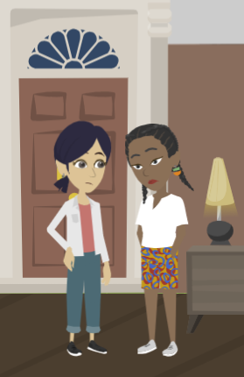
LESSON PLANS
MANIPULATION
How can others influence a young person to run away?
RUNAWAYS
AS TARGETS
©2024-2026 Walking Wise
40
3

Slide 41
MANIPULATION
Outside Influences
Peer Pressure: Being encouraged by friends to leave home.
©2024-2026 Walking Wise
41
Notes:
Friends, peers, or individuals online (predators) may influence a young person’s decisions.
Some young people may be encouraged or convinced to leave home by others who promise a better situation or offer support.
Others may cause a young person to feel at risk of humiliation due to exposure of embarrassing private images. They may see running away as their only option when in a state of panic.

Slide 42
MANIPULATION
Outside Influences
Peer Pressure: Being encouraged by friends to leave home.
Lured: Being convinced by promises of a “better life.”
©2024-2026 Walking Wise
42
Notes:
Friends, peers, or individuals online (predators) may influence a young person’s decisions.
Some young people may be encouraged or convinced to leave home by others who promise a better situation or offer support.
Others may cause a young person to feel at risk of humiliation due to exposure of embarrassing private images. They may see running away as their only option when in a state of panic.

Slide 43
MANIPULATION
Outside Influences
Peer Pressure: Being encouraged by friends to leave home.
Lured: Being convinced by promises of a “better life.”
Sextortion: Being threatened with exposing private images.
©2024-2026 Walking Wise
43
Notes:
Friends, peers, or individuals online (predators) may influence a young person’s decisions.
Some young people may be encouraged or convinced to leave home by others who promise a better situation or offer support.
Others may cause a young person to feel at risk of humiliation due to exposure of embarrassing private images. They may see running away as their only option when in a state of panic.

Slide 44
MANIPULATION
Outside Influences
False Promises: Promises of love, adventure, or protection.
©2024-2026 Walking Wise
44
Notes:
Some predators often use manipulation, pressure, or threats to influence a young person to leave home.
This may include false promises, coercion, or sextortion to gain control over vulnerable youth.

Slide 45
MANIPULATION
Outside Influences
False Promises: Promises of love, adventure, or protection.
Online Tricks: An online stranger pretends to be trustworthy.
©2024-2026 Walking Wise
45
Notes:
Some predators often use manipulation, pressure, or threats to influence a young person to leave home.
This may include false promises, coercion, or sextortion to gain control over vulnerable youth.

Slide 46
MANIPULATION
Outside Influences
False Promises: Promises of love, adventure, or protection.
Online Tricks: An online stranger pretends to be trustworthy.
Criminal Pressure: Being pressured to join a gang or commit a crime.
©2024-2026 Walking Wise
46
Notes:
Some predators often use manipulation, pressure, or threats to influence a young person to leave home.
This may include false promises, coercion, or sextortion to gain control over vulnerable youth.

Slide 47
EDUCATON GUIDE
VOCABULARY
BASIC NEEDS
The things a person needs to live, stay safe, and be healthy.
RUNAWAYS
AS TARGETS
©2024-2026 Walking Wise
47
3

Slide 48
LESSON PLANS
FINDING BASIC NEEDS
What are some basic needs that may be hard to access after running away?
RUNAWAYS
AS TARGETS
©2024-2026 Walking Wise
48
3
Notes:
POSSIBLE ANSWERS
o Money
o Food
o Shelter
o Electricity for cell phones
o Protection
o Friends
o Education
o Job

Slide 49
FINDING BASIC NEEDS
Hard to Find When Homeless
Money
Food
Clean Water
Clean Clothes
Shelter
©2024-2026 Walking Wise
49
Notes:
When a child runs away, the sudden loss of access to basic needs, such as food, shelter, and transportation, can quickly create economic dependency on others. Sometimes, this may include unsafe adults.
Predators often exploit this state of homelessness as a lure, initially offering help, which later becomes a means of control.

Slide 50
FINDING BASIC NEEDS
Hard to Find When Homeless
Money
Food
Clean Water
Clean Clothes
Shelter
Hygiene Products
Restroom
Electricity/WiFi
Phone/Computer
Friends
©2024-2026 Walking Wise
50
Notes:
When a child runs away, the sudden loss of access to basic needs, such as food, shelter, and transportation, can quickly create economic dependency on others. Sometimes, this may include unsafe adults.
Predators often exploit this state of homelessness as a lure, initially offering help, which later becomes a means of control.

Slide 51
FINDING BASIC NEEDS
Hard to Find When Homeless
Money
Food
Clean Water
Clean Clothes
Shelter
Hygiene Products
Restroom
Electricity/WiFi
Phone/Computer
Friends
Transportation
Protection
Medical Care
Education
Employment
©2024-2026 Walking Wise
51
Notes:
When a child runs away, the sudden loss of access to basic needs, such as food, shelter, and transportation, can quickly create economic dependency on others. Sometimes, this may include unsafe adults.
Predators often exploit this state of homelessness as a lure, initially offering help, which later becomes a means of control.

Slide 52
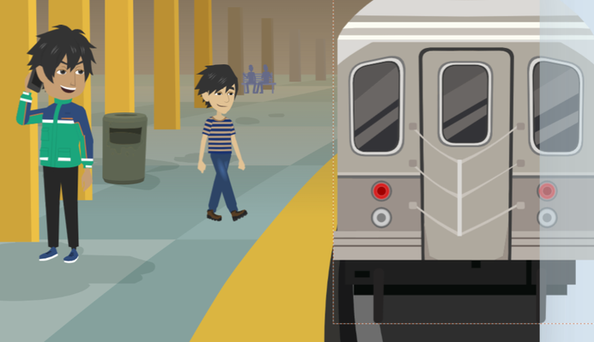
RISKIER LOCATIONS
What locations can cause young people to be more vulnerable?
RUNAWAYS
AS TARGETS
©2024-2026 Walking Wise
52

Slide 53
RISKIER LOCATIONS
High-Risk Locations
Transportation Hubs: Bus stations, train stations, airports
RUNAWAYS
AS TARGETS
©2024-2026 Walking Wise
53
Notes:
TRANSPORTATION HUBS: Bus stations, train stations, and airports are where youth may be waiting for a ride or trying to reach another location.
UNSTABLE HOUSING: Homeless shelters, where traffickers may target vulnerable youth in need of a place to stay, and makeshift living spaces where traffickers can exploit vulnerable individuals.
ABANDONED BUILDINGS: Empty or unsafe buildings that youth may seek refuge in when they have nowhere else to go.
LODGING: Low-cost motels or hotels, especially in areas with high levels of human trafficking activity.

Slide 54
RISKIER LOCATIONS
High-Risk Locations
Transportation Hubs: Bus stations, train stations, airports
Unstable Housing: Shelters or staying with friends
RUNAWAYS
AS TARGETS
©2024-2026 Walking Wise
54
Notes:
TRANSPORTATION HUBS: Bus stations, train stations, and airports are where youth may be waiting for a ride or trying to reach another location.
UNSTABLE HOUSING: Homeless shelters, where traffickers may target vulnerable youth in need of a place to stay, and makeshift living spaces where traffickers can exploit vulnerable individuals.
ABANDONED BUILDINGS: Empty or unsafe buildings that youth may seek refuge in when they have nowhere else to go.
LODGING: Low-cost motels or hotels, especially in areas with high levels of human trafficking activity.

Slide 55
RISKIER LOCATIONS
High-Risk Locations
Transportation Hubs: Bus stations, train stations, airports
Unstable Housing: Shelters or staying with friends
Abandoned Buildings: Empty or unsafe buildings
RUNAWAYS
AS TARGETS
©2024-2026 Walking Wise
55
Notes:
TRANSPORTATION HUBS: Bus stations, train stations, and airports are where youth may be waiting for a ride or trying to reach another location.
UNSTABLE HOUSING: Homeless shelters, where traffickers may target vulnerable youth in need of a place to stay, and makeshift living spaces where traffickers can exploit vulnerable individuals.
ABANDONED BUILDINGS: Empty or unsafe buildings that youth may seek refuge in when they have nowhere else to go.
LODGING: Low-cost motels or hotels, especially in areas with high levels of human trafficking activity.

Slide 56
RISKIER LOCATIONS
High-Risk Locations
Transportation Hubs: Bus stations, train stations, airports
Unstable Housing: Shelters or staying with friends
Abandoned Buildings: Empty or unsafe buildings
Lodging: Low-cost hotels and motels
RUNAWAYS
AS TARGETS
©2024-2026 Walking Wise
56
Notes:
TRANSPORTATION HUBS: Bus stations, train stations, and airports are where youth may be waiting for a ride or trying to reach another location.
UNSTABLE HOUSING: Homeless shelters, where traffickers may target vulnerable youth in need of a place to stay, and makeshift living spaces where traffickers can exploit vulnerable individuals.
ABANDONED BUILDINGS: Empty or unsafe buildings that youth may seek refuge in when they have nowhere else to go.
LODGING: Low-cost motels or hotels, especially in areas with high levels of human trafficking activity.

Slide 57
RISKIER LOCATIONS
Other Risky Areas
Public Places: Malls, truck stops, libraries, juvenile courts
RUNAWAYS
AS TARGETS
©2024-2026 Walking Wise
57
Notes:
Anywhere young people hang out:
PUBLIC PLACES: Remote or isolated areas where youth may go to hide or rest, exposing them as easy targets for traffickers.
CROWDED EVENTS: Concerts, festivals, and other public events are where traffickers can easily blend in and target isolated youth.
GATHERING SPOTS: Nightclubs or Bars: Places where young people may be invited by traffickers to work, leading them into exploitation. Also, 24-hour diners, where food is typically served throughout the night.
ONLINE PLATFORMS: Social media, dating apps, gaming platforms, and other online sites where traffickers can contact young people to make false promises.

Slide 58
RISKIER LOCATIONS
Other Risky Areas
Public Places: Shopping malls, truck stops
Crowded Events: Concerts, festivals, fairs
RUNAWAYS
AS TARGETS
©2024-2026 Walking Wise
58
Notes:
Anywhere young people hang out:
PUBLIC PLACES: Remote or isolated areas where youth may go to hide or rest, exposing them as easy targets for traffickers.
CROWDED EVENTS: Concerts, festivals, and other public events are where traffickers can easily blend in and target isolated youth.
GATHERING SPOTS: Nightclubs or Bars: Places where young people may be invited by traffickers to work, leading them into exploitation. Also, 24-hour diners, where food is typically served throughout the night.
ONLINE PLATFORMS: Social media, dating apps, gaming platforms, and other online sites where traffickers can contact young people to make false promises.

Slide 59
RISKIER LOCATIONS
Other Risky Areas
Public Places: Shopping malls, truck stops
Crowded Events: Concerts, festivals, fairs
Online: Social media, gaming platforms, dating apps
RUNAWAYS
AS TARGETS
©2024-2026 Walking Wise
59
Notes:
Anywhere young people hang out:
PUBLIC PLACES: Remote or isolated areas where youth may go to hide or rest, exposing them as easy targets for traffickers.
CROWDED EVENTS: Concerts, festivals, and other public events are where traffickers can easily blend in and target isolated youth.
GATHERING SPOTS: Nightclubs or Bars: Places where young people may be invited by traffickers to work, leading them into exploitation. Also, 24-hour diners, where food is typically served throughout the night.
ONLINE PLATFORMS: Social media, dating apps, gaming platforms, and other online sites where traffickers can contact young people to make false promises.

Slide 60
RISKIER LOCATIONS
Other Risky Areas
Public Places: Shopping malls, truck stops
Crowded Events: Concerts, festivals, fairs
Online: Social media, gaming platforms, dating apps
Isolated Areas: Rest areas, parks
RUNAWAYS
AS TARGETS
©2024-2026 Walking Wise
60
Notes:
Anywhere young people hang out:
PUBLIC PLACES: Remote or isolated areas where youth may go to hide or rest, exposing them as easy targets for traffickers.
CROWDED EVENTS: Concerts, festivals, and other public events are where traffickers can easily blend in and target isolated youth.
GATHERING SPOTS: Nightclubs or Bars: Places where young people may be invited by traffickers to work, leading them into exploitation. Also, 24-hour diners, where food is typically served throughout the night.
ONLINE PLATFORMS: Social media, dating apps, gaming platforms, and other online sites where traffickers can contact young people to make false promises.

Slide 61
LESSON PLANS
WHAT DO YOU THINK?
What percentage of children who run away are at risk of sex trafficking?
RUNAWAYS
AS TARGETS
©2024-2026 Walking Wise
61
3

Slide 62
WHAT DO YOU THINK?
What percentage of children who run away are at risk of sex trafficking?
A) 1 in 7 children
B) 1 in 27 children
C) 1 in 47 children
D) 1 in 67 children
©2024-2026 Walking Wise
62

Slide 63
ANSWER
About 1 in 7 children who run away are at risk of sex trafficking.
©2024-2026 Walking Wise
NCMEC Cyber Tipline Report (2024). Child Sex Trafficking, MissingKids.org.
63
Notes:
Source:
NCMEC Cyber Tipline Report (2024). Child Sex Trafficking. Retrieved December 30, 2025, from https://www.missingkids.org/ourwork/impact#:~:text=Table_title:%20Reports%20by%20Type%20Table_content:%20header:%20%7C,Active:%2066%20%7C%20Grand%20Total:%20836%20%7C

Slide 64
EDUCATON GUIDE
VOCABULARY
DISORIENT
To confuse someone so that they have difficulty thinking clearly or making safe decisions.
RUNAWAYS
AS TARGETS
©2024-2026 Walking Wise
64
3

Slide 65
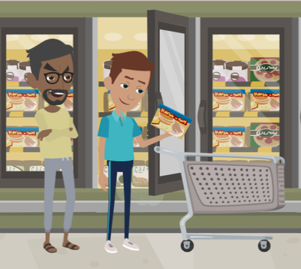
LESSON PLANS
GAINS TRUST
How do traffickers gain a runaway youth’s trust?
RUNAWAYS
AS TARGETS
©2024-2026 Walking Wise
65
3

Slide 66
GAINS TRUST
Common Tactics
Kind: Predators can offer to help resolve problems.
©2024-2026 Walking Wise
66
Notes:
Although force and threats may be used at later stages, traffickers typically start by manipulating and building trust, making it difficult for young people to recognize the exploitation as it unfolds.
KIND & GENEROUS: Predators can seem genuinely concerned about a vulnerable youth and offer to help solve the young person’s problems. They often pretend to be kindhearted people who want to help by providing food, shelter, and other necessities.
PROTECTOR: Unsafe people can pretend to offer protection from gangs or other dangerous people.
HOSPITABLE: They often invite runaway youth to parties to partake in drugs and alcohol, or they may offer substances to help soothe a young person’s stress and pain.

Slide 67
GAINS TRUST
Common Tactics
Kind: Predators can offer to help resolve problems.
Generous: They can offer food, housing, showers, & money.
©2024-2026 Walking Wise
67
Notes:
Although force and threats may be used at later stages, traffickers typically start by manipulating and building trust, making it difficult for young people to recognize the exploitation as it unfolds.
KIND & GENEROUS: Predators can seem genuinely concerned about a vulnerable youth and offer to help solve the young person’s problems. They often pretend to be kindhearted people who want to help by providing food, shelter, and other necessities.
PROTECTOR: Unsafe people can pretend to offer protection from gangs or other dangerous people.
HOSPITABLE: They often invite runaway youth to parties to partake in drugs and alcohol, or they may offer substances to help soothe a young person’s stress and pain.

Slide 68
GAINS TRUST
Common Tactics
Kind: Predators can offer to help resolve problems.
Generous: They can offer food, housing, showers, & money.
Protective: Can offer protection from dangerous people.
©2024-2026 Walking Wise
68
Notes:
Although force and threats may be used at later stages, traffickers typically start by manipulating and building trust, making it difficult for young people to recognize the exploitation as it unfolds.
KIND & GENEROUS: Predators can seem genuinely concerned about a vulnerable youth and offer to help solve the young person’s problems. They often pretend to be kindhearted people who want to help by providing food, shelter, and other necessities.
PROTECTOR: Unsafe people can pretend to offer protection from gangs or other dangerous people.
HOSPITABLE: They often invite runaway youth to parties to partake in drugs and alcohol, or they may offer substances to help soothe a young person’s stress and pain.

Slide 69
GAINS TRUST
Common Tactics
Kind: Predators can offer to help resolve problems.
Generous: They can offer food, housing, showers, & money.
Protective: Can offer protection from dangerous people.
Inclusive: Can invite youth to parties & offer drugs/alcohol.
©2024-2026 Walking Wise
69
Notes:
Although force and threats may be used at later stages, traffickers typically start by manipulating and building trust, making it difficult for young people to recognize the exploitation as it unfolds.
KIND & GENEROUS: Predators can seem genuinely concerned about a vulnerable youth and offer to help solve the young person’s problems. They often pretend to be kindhearted people who want to help by providing food, shelter, and other necessities.
PROTECTOR: Unsafe people can pretend to offer protection from gangs or other dangerous people.
HOSPITABLE: They often invite runaway youth to parties to partake in drugs and alcohol, or they may offer substances to help soothe a young person’s stress and pain.

Slide 70
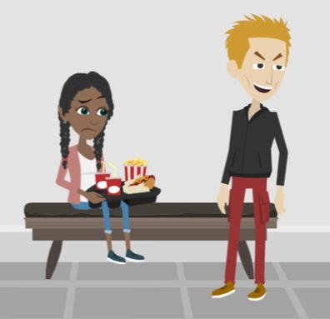
LESSON PLANS
SURVIVAL
What is surval sex and why is it dangerous?
RUNAWAYS
AS TARGETS
©2024-2026 Walking Wise
70
3

Slide 71
SURVIVAL
Exploiting Basic Needs
Survial sex is a form of human trafficking
©2024-2026 Walking Wise
Polaris Project (2019). Freedom happens now. Sex Trafficking and LGBTQ Youth.
71
Notes:
When a young person runs away, they often lose access to basic needs like food, shelter, and transportation. This can make them depend on others for help, including people who may not be safe.
Some predators take advantage of this situation by offering help at first, such as a place to stay or food. Over time, that help can turn into control.
In some cases, a young person may feel pressured to trade sexual activity in order to receive basic needs. This is called survival sex. It is a form of exploitation and is considered child sex trafficking under the law.
Source
Polaris Project (2019). Freedom happens now. Sex Trafficking and LGBTQ Youth.
https://polarisproject.org/wp-content/uploads/2019/09/LGBTQ-Sex-Trafficking.pdf

Slide 72
SURVIVAL
Exploiting Basic Needs
Survial sex is a form of human trafficking
Vulnerable people are often tricked or manipulated
©2024-2026 Walking Wise
Polaris Project (2019). Freedom happens now. Sex Trafficking and LGBTQ Youth.
72
Notes:
When a young person runs away, they often lose access to basic needs like food, shelter, and transportation. This can make them depend on others for help, including people who may not be safe.
Some predators take advantage of this situation by offering help at first, such as a place to stay or food. Over time, that help can turn into control.
In some cases, a young person may feel pressured to trade sexual activity in order to receive basic needs. This is called survival sex. It is a form of exploitation and is considered child sex trafficking under the law.
Source
Polaris Project (2019). Freedom happens now. Sex Trafficking and LGBTQ Youth.
https://polarisproject.org/wp-content/uploads/2019/09/LGBTQ-Sex-Trafficking.pdf

Slide 73
SURVIVAL
Exploiting Basic Needs
Survial sex is a form of human trafficking
Vulnerable people are often tricked or manipulated
Involves the exchange of basic needs for sexual activity
©2024-2026 Walking Wise
Polaris Project (2019). Freedom happens now. Sex Trafficking and LGBTQ Youth.
73
Notes:
When a young person runs away, they often lose access to basic needs like food, shelter, and transportation. This can make them depend on others for help, including people who may not be safe.
Some predators take advantage of this situation by offering help at first, such as a place to stay or food. Over time, that help can turn into control.
In some cases, a young person may feel pressured to trade sexual activity in order to receive basic needs. This is called survival sex. It is a form of exploitation and is considered child sex trafficking under the law.
Source
Polaris Project (2019). Freedom happens now. Sex Trafficking and LGBTQ Youth.
https://polarisproject.org/wp-content/uploads/2019/09/LGBTQ-Sex-Trafficking.pdf

Slide 74
SURVIVAL
Exploiting Basic Needs
Survial sex is a form of human trafficking
Vulnerable people are often tricked or manipulated
Involves the exchange of basic needs for sexual activity
Food, housing, substances, clothing, protection
©2024-2026 Walking Wise
Polaris Project (2019). Freedom happens now. Sex Trafficking and LGBTQ Youth.
74
Notes:
When a young person runs away, they often lose access to basic needs like food, shelter, and transportation. This can make them depend on others for help, including people who may not be safe.
Some predators take advantage of this situation by offering help at first, such as a place to stay or food. Over time, that help can turn into control.
In some cases, a young person may feel pressured to trade sexual activity in order to receive basic needs. This is called survival sex. It is a form of exploitation and is considered child sex trafficking under the law.
Source
Polaris Project (2019). Freedom happens now. Sex Trafficking and LGBTQ Youth.
https://polarisproject.org/wp-content/uploads/2019/09/LGBTQ-Sex-Trafficking.pdf

Slide 75
EDUCATON GUIDE
VOCABULARY
SURVIVAL SEX
Being pressured, tricked, or manipulated into sexual activity in exchange for basic needs like food, shelter, or protection.
RUNAWAYS
AS TARGETS
©2024-2026 Walking Wise
75
3

Slide 76
LESSON PLANS
WHAT DO YOU THINK?
How long should an adult wait before reporting their child missing to the police?
RUNAWAYS
AS TARGETS
©2024-2026 Walking Wise
76
3

Slide 77
WHAT DO YOU THINK?
How long should an adult wait before reporting their child missing to the police?
A) Wait 12 Hours
B) Wait 24 Hours
C) Wait 48 Hours
D) Report Immediately
©2024-2026 Walking Wise
77

Slide 78
ANSWER
Report immediately. An adult should never wait to report their child is missing.
©2024-2026 Walking Wise
U.S. Department of Justice (2023). When Your Child Is Missing: A Family Survival Guide, p. 7. ojjdp.ojp.gov.
78
Notes:
The first few hours matter most—never wait.
There is no required waiting period to report a missing or overdue child.
Parents and caregivers should not delay notifying authorities while conducting their own searches for missing children.
Law enforcement has specialized tools to conduct thorough, efficient investigations.
Source
U.S. Department of Justice (2023). When Your Child Is Missing: A Family Survival Guide, p. 7. ojjdp.ojp.gov. Retrieved December 2, 2024, from https://ojjdp.ojp.gov/publications/family-survival-guide.pdf

Slide 79

GOING HOME
Transportation Back Home
If wanting to RETURN home, contact the National Runaway Safeline:
FREE bus ticket from Greyhound Buses
1-800-RUN-AWAY
1-800-786-2929
©2024-2026 Walking Wise
79
Notes:
HOME FREE PROGRAM
Greyhound assists the National Runaway Safeline with reuniting children and their families.
They offer a free bus ticket to children who want to go home.
The Home Free program is for youth ages 12 to 21 who self-identify as homeless, runaways, and victims of human trafficking.

Slide 80

ASK FOR HELP
©2024-2026 Walking Wise
80
Notes:
Walking Wise asked a focus group of survivors:
What do you think young people should know about sex trafficking?
ANSWER
The survivors agreed that the most vital information teens should know is how to ask for help.
At the top of their list:
Tell a TRUSTWORTHY adult.

Slide 81
ASK FOR HELP
Who should a young person talk to if they are thinking about running away or need help?
©2024-2026 Walking Wise
81

Slide 82
ASK FOR HELP
Instead of Running Away
Talk to a trustworthy parent, family member, or other adult.
©2024-2026 Walking Wise
82

Slide 83
ASK FOR HELP
Instead of Running Away
Talk to a trustworthy parent, family member, or other adult.
If you are in school, tell a trustworthy teacher, coach, school nurse, social worker, counselor, resource officer, or principal.
©2024-2026 Walking Wise
83

Slide 84
ASK FOR HELP
Instead of Running Away
Talk to a trustworthy parent, family member, or other adult.
If you are in school, tell a trustworthy teacher, coach, school nurse, social worker, counselor, resource officer, or principal.
Talk to a friend’s trustworthy parent or family friend.
©2024-2026 Walking Wise
84

Slide 85
ASK FOR HELP
Instead of Running Away
Talk to a trustworthy parent, family member, or other adult.
If you are in school, tell a trustworthy teacher, coach, school nurse, social worker, counselor, resource officer, or principal.
Talk to a friend’s trustworthy parent or family friend.
Ask the National Runaway Safeline for advice: 1-800-RUN-AWAY (786-2929)
©2024-2026 Walking Wise
85

Slide 86
ASK FOR HELP
Instead of Running Away
Talk to a trustworthy parent, family member, or other adult.
If you are in school, tell a trustworthy teacher, coach, school nurse, social worker, counselor, resource officer, or principal.
Talk to a friend’s trustworthy parent or family friend.
Ask the National Runaway Safeline for advice: 1-800-RUN-AWAY (786-2929)
National Center for Missing & Exploited Children 1-800-THE-LOST (843-5678)
©2024-2026 Walking Wise
86

Slide 87
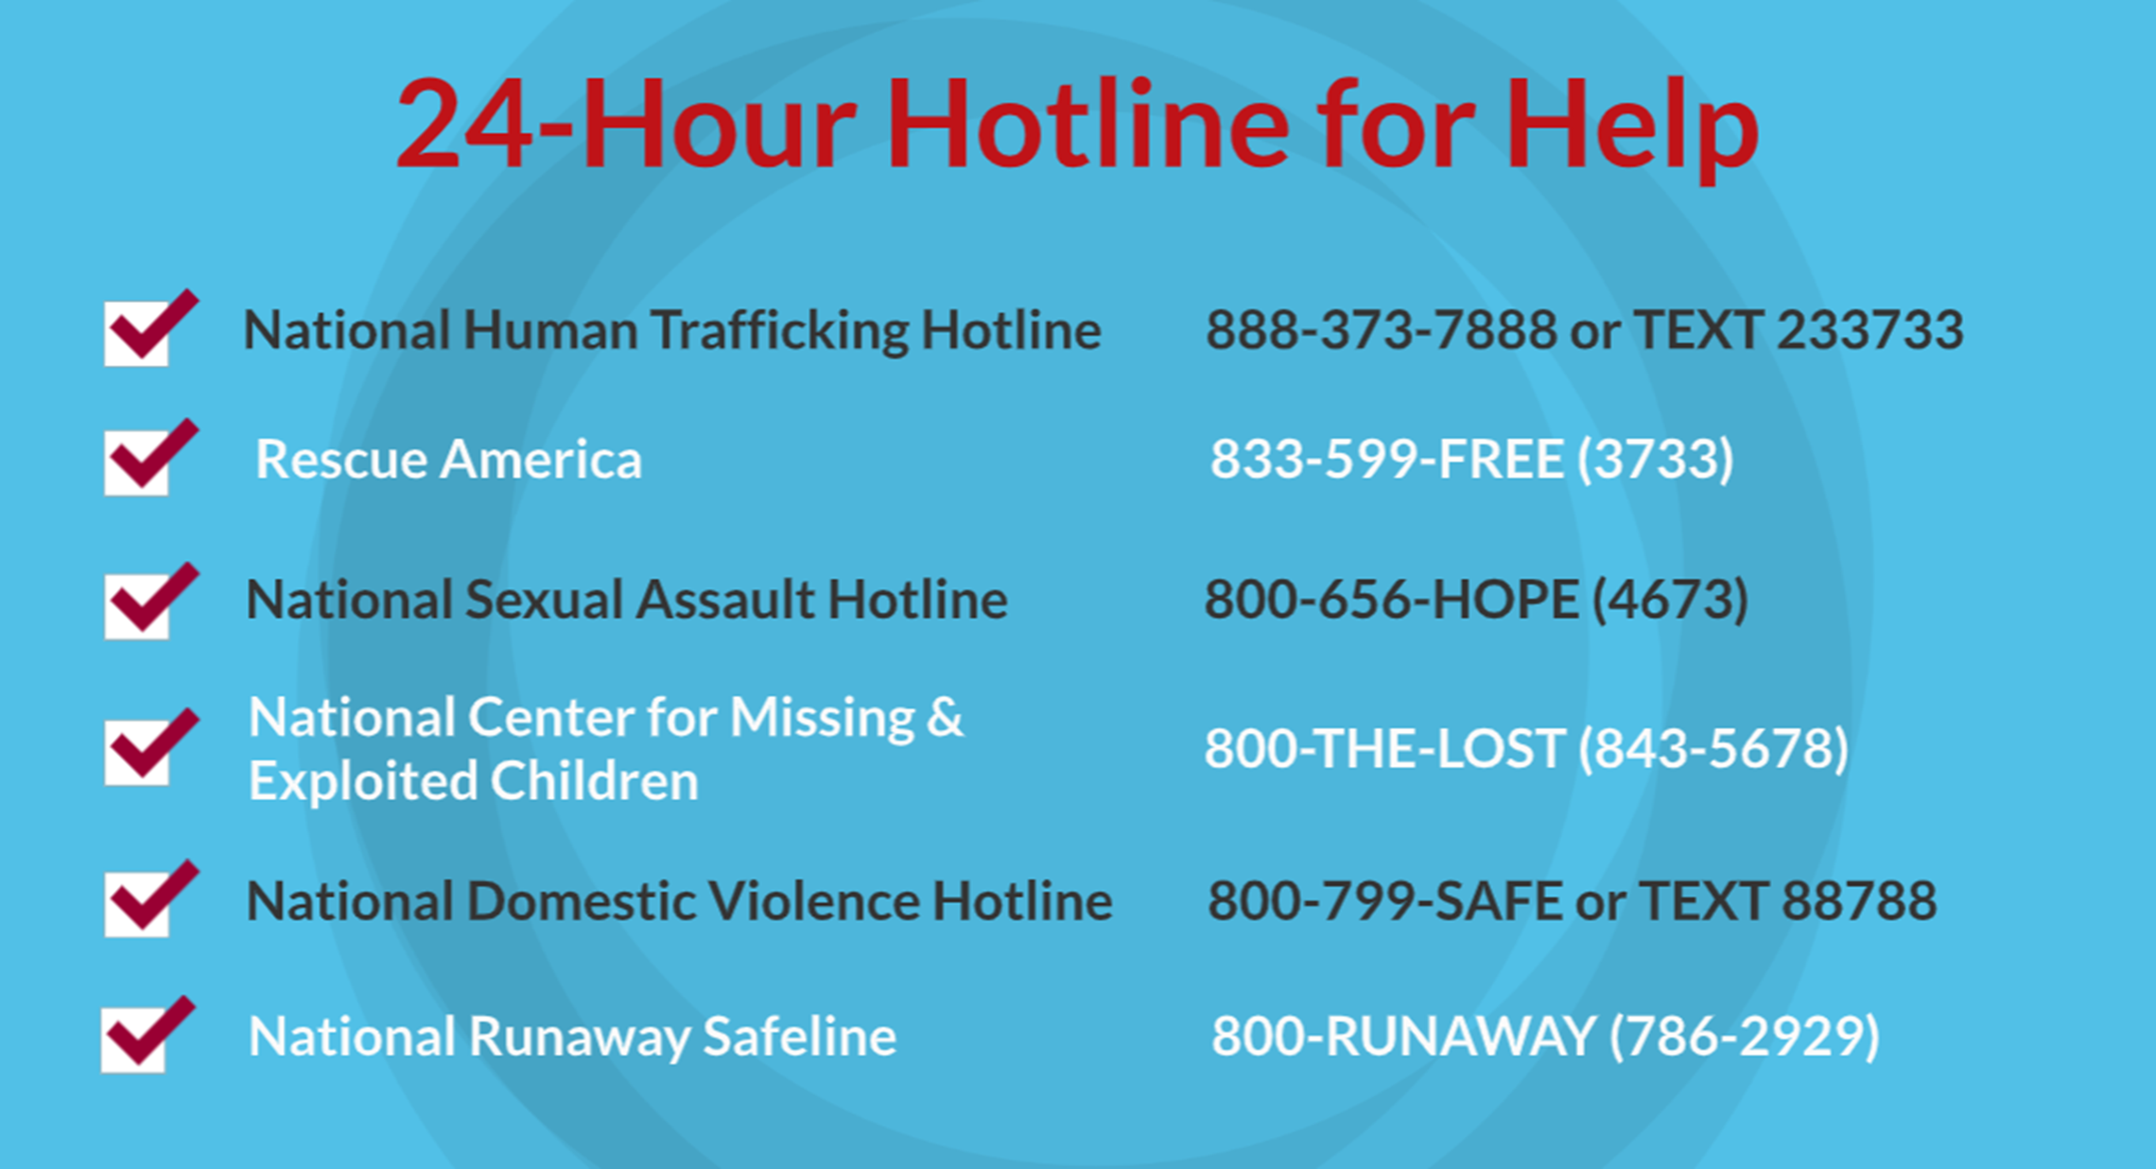
©2024-2026 Walking Wise
87
Notes:
NOTE TO PRESENTER
Presenters may ask their audience to consider adding a few "hotline for help" phone numbers to their cell phone contacts or take a photo of this slide.

Slide 88
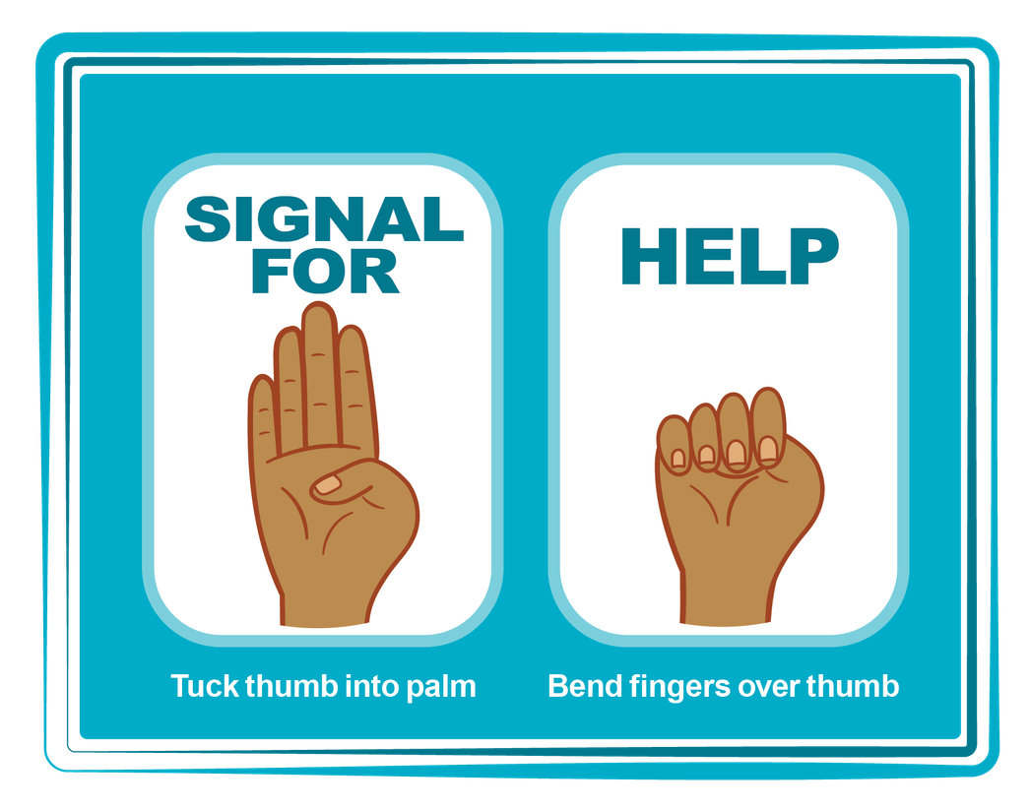
HAND SIGNAL FOR HELP
©2024-2026 Walking Wise
Source: Canadian Women’s Foundation, April 2020
88
Notes:
Although the hand signal for help has not yet achieved universal recognition, it may quietly get someone's attention in urgent situations.
SILENT
It can be used silently.
UNTRACKABLE
It leaves no digital footprint.
CONCEALED
It can be done secretly when a perpetrator is in the vicinity.
SIGNALS DISTRESS
A distressed facial expression can help others recognize that help is needed if the hand signal is not understood—but it is important not to alert the predator/trafficker, causing harm.
Source
Canadian Women's Foundation, April 2020

Slide 89


Thank you!
WalkingWise.com
Online Course for Adults Accredited by:
Postgraduate Institute for Medicine
Academy of Forensic Nursing
©2024-2026 Walking Wise
89
Notes:
NOTE TO PRESENTER
To access additional resources on targeting runaway youth, please refer to the last page of Lesson Plan #7 on the Walking Wise Learning Platform.
We welcome your feedback at support@WalkingWise.com.

