Slide 1


SEXUAL EXPLOITATION
EDUCATION
RUNAWAYS
AS TARGETS
LESSON #7
Notes:
NOTE
Log in to WalkingWise.com and refer to the Walking Wise Education Guide to implement classroom teaching tips.
Most importantly:
• DEFINE SCHOOL POLICY
Establish a sexual exploitation reporting protocol with a trauma-informed response. The Walking Wise Implementation Guide provides a sample protocol.
• AGE & AUDIENCE
This presentation can be edited by following the procedures on page 3 to align with your school policies, specific age groups, and the involvement of at-risk audiences.
• SUPPORT PROCEDURE
Provide your audience with guidance on accessing immediate help or arranging a private meeting with a social worker, counselor, nurse, school resource officer, or another trustworthy staff member to report concerns for themselves or a peer.
• SECOND SAFE ADULT
Ensure a second trustworthy adult, such as a teacher, is present in the learning setting to observe audience reactions and identify those who may benefit from a follow-up meeting. This person should remain focused and free from other duties during the presentation.
• IMPLEMENT SLIDO.com
Please log in to WalkingWise.com for instructions on incorporating Slido into the PowerPoint presentation to engage your audience using digital polling.

Slide 2

NOTE TO PRESENTER
This presentation is exclusively for Walking Wise® subscribers and not for redistribution.
Walking Wise provides an interactive digital tool, Slido.com, to enhance audience engagement. To implement Slido for your organization, you can log in to WalkingWise.com for setup instructions. Once configured, integrate Slido polling and add a post-evaluation into the PowerPoint presentation.
Presenters are encouraged to edit speaker notes to match their speaking style (viewable in presentation mode). You can also delete slides from this Walking Wise presentation to make sure the content aligns with your school policies, is age-appropriate, and fits within available class time. However, the existing slides are copyright-protected and may not be modified without prior written permission from Walking Wise.
If you would like to add your own content, you may do so under the following conditions:
Insert new PowerPoint slides.
Remove the Walking Wise logo and copyright "©2025 Walking Wise" from the new slides.
Always add your organization's name or logo to each new slide.
Please delete this instruction page before presenting to audiences.
©2025 Walking Wise
2
Notes:
NOTE
The presenter is welcome to customize this Walking Wise presentation according to the instructions provided on this page.
For revision requests, please send an email to support@WalkingWise.com.

Slide 3

CONFRONTING SEXUAL EXPLOITATION
WALKING WISE
KNOWLEDGE serves as a
powerful defense against
sexual predators.
©2025 Walking Wise
3

Slide 4
CONFRONTING SEXUAL EXPLOITATION
WALKING WISE
SEXUAL EXPLOITATION includes grooming, sextortion, pornography
& sex trafficking.
©2025 Walking Wise
4

Slide 5
SENSITIVE DISCUSSION AHEAD
CONTENT ALERT
We’ll be discussing serious issues about sexual exploitation.
Some parts may be difficult to hear.
If you ever feel uncomfortable, you can step out and speak with a trustworthy adult for support.
You’re not alone—we’re here to help you.
©2025 Walking Wise
5
Notes:
NOTE TO PRESENTER
Please tailor this message to align with your organization's policies and protocols.
Please provide a confidential avenue for students to report concerns and seek help for themselves or their peers if they suspect sexual abuse, grooming, sextortion, pornography-related exploitation, or human trafficking. This may include a designated address or text line.
Consider displaying posters in your school or facility that outline various ways students can access immediate support or request a private meeting with a school safety team member or another trusted adult.

Slide 6

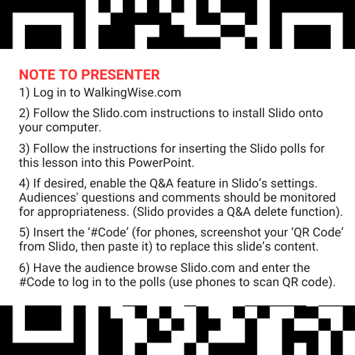
DIGITAL PARTICIPATION
©2025 Walking Wise
6
Notes:
NOTE
For digital interaction with audiences:
Log in to WalkingWise.com to follow instructions on setting up Slido questions/answers for this presentation. Then, replace the QR code and #code in this slide with your custom QR/#code.
Please verify whether the Q&A feature has been activated before presenting to audiences. An adult should monitor questions and comments to ensure appropriateness. Slido has a feature that allows you to delete unwanted questions and comments.

Slide 7


STATISTICS
Statistics are Only Estimates
Study results may be unreliable because most sexual crimes go unreported.
RUNAWAYS
AS TARGETS
©2025 Walking Wise
7
Notes:
In this presentation, we'll discuss statistics, but it's important to note that while statistics provide valuable insights into an issue, they cannot be entirely relied upon.
Here are a few reasons:
• UNREPORTED
Victims may stay silent due to fear, shame, or manipulation.
• INCONSISTENT COLLECTION
Geographical areas have different legal definitions for sexual crimes, making data hard to compare.
• FOCUS GROUPS
Small or specific focus groups participating in a study or survey may not accurately reflect the diversity or experiences of the broader population.

Slide 8
STATISTICS
Statistics are Only Estimates
Study results may be unreliable because most sexual crimes go unreported.
The methods used to collect information can vary widely between studies, leading to inconsistency.
RUNAWAYS
AS TARGETS
©2025 Walking Wise
8
Notes:
In this presentation, we'll discuss statistics, but it's important to note that while statistics provide valuable insights into an issue, they cannot be entirely relied upon.
Here are a few reasons:
• UNREPORTED
Victims may stay silent due to fear, shame, or manipulation.
• INCONSISTENT COLLECTION
Geographical areas have different legal definitions for sexual crimes, making data hard to compare.
• FOCUS GROUPS
Small or specific focus groups participating in a study or survey may not accurately reflect the diversity or experiences of the broader population.

Slide 9
STATISTICS
Statistics are Only Estimates
Study results may be unreliable because most sexual crimes go unreported.
The methods used to collect information can vary widely between studies, leading to inconsistency.
Focus groups in studies may not accurately represent the larger population.
RUNAWAYS
AS TARGETS
©2025 Walking Wise
9
Notes:
In this presentation, we'll discuss statistics, but it's important to note that while statistics provide valuable insights into an issue, they cannot be entirely relied upon.
Here are a few reasons:
• UNREPORTED
Victims may stay silent due to fear, shame, or manipulation.
• INCONSISTENT COLLECTION
Geographical areas have different legal definitions for sexual crimes, making data hard to compare.
• FOCUS GROUPS
Small or specific focus groups participating in a study or survey may not accurately reflect the diversity or experiences of the broader population.

Slide 10

EDUCATON GUIDE
VOCABULARY
VOCABULARY
Runaway
Family Dynamics
Trauma
Target
Prey
Disorient
Survival Sex
RUNAWAYS
AS TARGETS
©2025 Walking Wise
10
3
Notes:
NOTE
Understanding vocabulary terms related to the behaviors of sexual predators can empower young people to recognize warning signs of harmful situations.
Knowing terminology helps them identify manipulative tactics predators use to build trust and exploit vulnerabilities.
With this knowledge, young people are better equipped to spot red flags, understand that these behaviors are abusive, and feel more confident reporting predators to trusted adults or authorities, potentially preventing further harm.

Slide 11
EDUCATON GUIDE
VOCABULARY
RUNAWAY
A young person under 18 who chooses to leave, making their whereabouts unknown to their parents or guardians.
RUNAWAYS
AS TARGETS
©2025 Walking Wise
11
3
Notes:
Assisting Source
OpenAI. (2024). ChatGPT [Large language model]. https://chatgpt.com

Slide 12

LESSON PLANS
MISSING CHILDREN
How many U.S. children under age 18 go missing every year?
RUNAWAYS
AS TARGETS
©2025 Walking Wise
U.S. Department of Justice (2023, May 24). National Missing Children's Day: 2023 Commemoration.
12
3
Notes:
SLIDO.com: Multiple Choice
How many U.S. children under age 18 go missing in the U.S. every year?
A) ~160,000 children
B) ~360,000 children
C) ~460,000 children
D) ~760,000 children
ANSWER
C) Approximately 460,000 U.S. children go missing each year.
Source
U.S. Department of Justice (2023, May 24). National Missing Children's Day: 2023 Commemoration. ojjdp.ojp.gov. Retrieved March 3, 2024, from https://ojjdp.ojp.gov/events/nmcd/2023-national-missing-childrens-day

Slide 13
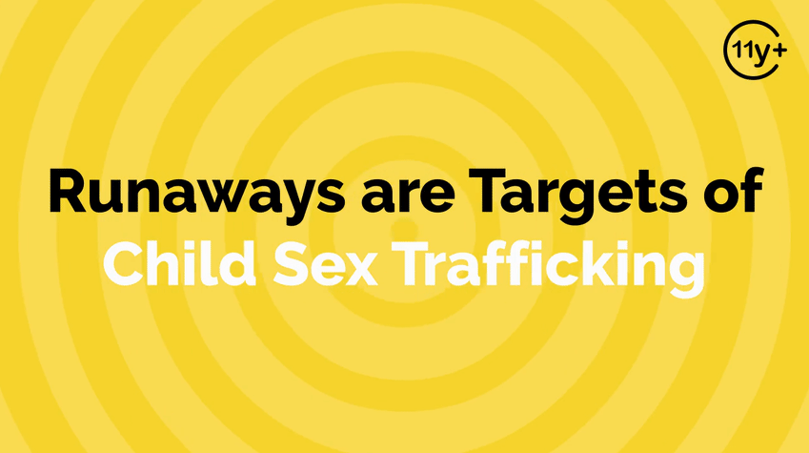
Log in to WalkingWise.com to access this animated video.
©2025 Walking Wise
13
Notes:
Message Especially for Teens:
Businesses worldwide use explainer-style animation as a training tool for their employees. So, this 3-minute Walking Wise animated video is appropriate for both teens (ages 11+) and adults to learn how sexual predators use manipulation, intimidation, and coercion to exploit young people.
NOTE
Log in to Walking Wise.com to watch the three-minute animated video with audiences.

Slide 14
EDUCATON GUIDE
VOCABULARY
FAMILY DYNAMICS
The interactions and relationships between family members.
RUNAWAYS
AS TARGETS
©2025 Walking Wise
14
3
Notes:
Assisting Source
OpenAI. (2024). ChatGPT [Large language model]. https://chatgpt.com

Slide 15
EDUCATON GUIDE
VOCABULARY
TRAUMA
A deeply distressing or disturbing experience that impacts a person's emotional, mental, or physical well-being.
RUNAWAYS
AS TARGETS
©2025 Walking Wise
15
3
Notes:
Assisting Source
OpenAI. (2024). ChatGPT [Large language model]. https://chatgpt.com

Slide 16
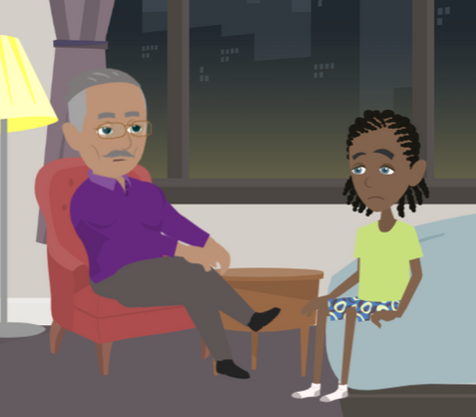
LESSON PLANS
MISSING CHILDREN
Why do some young people want to escape or run away from their home lives?
RUNAWAYS
AS TARGETS
©2025 Walking Wise
16
3

Slide 17
MISSING CHILDREN
Reasons for Leaving Home
Abuse: Physical, emotional, or sexual abuse or neglect.
©2025 Walking Wise
17
Notes:
• ABUSE
Physical, emotional, or sexual abuse or neglect by a family member.
• FAMILY DYNAMICS
Youth's conflicts with their parents, foster family, guardians, siblings, or other family members.
Emotional distress over the death of a parent or sibling, a divorce, or when a member of the family uses drugs or alcohol.
• REJECTION
Family members may reject a child due to differences in beliefs, unmet expectations, personal struggles, or inability to cope with the child's behavior or identity, often resulting from a lack of understanding or support. An example is a parent's rejection of a child over their sexual orientation.

Slide 18
MISSING CHILDREN
Reasons for Leaving Home
Abuse: Physical, emotional, or sexual abuse and neglect.
Family Dynamics: Struggles with parents, siblings, or caregivers.
©2025 Walking Wise
18
Notes:
• ABUSE
Physical, emotional, or sexual abuse or neglect by a family member.
• FAMILY DYNAMICS
Youth's conflicts with their parents, foster family, guardians, siblings, or other family members.
Emotional distress over the death of a parent or sibling, a divorce, or when a member of the family uses drugs or alcohol.
• REJECTION
Family members may reject a child due to differences in beliefs, unmet expectations, personal struggles, or inability to cope with the child's behavior or identity, often resulting from a lack of understanding or support. An example is a parent's rejection of a child over their sexual orientation.

Slide 19
MISSING CHILDREN
Reasons for Leaving Home
Abuse: Physical, emotional, or sexual abuse and neglect.
Family Dynamics: Struggles with parents, siblings, or caregivers.
Family Dynamics: Stress over death, divorce, drug/alcohol use.
©2025 Walking Wise
19
Notes:
• ABUSE
Physical, emotional, or sexual abuse or neglect by a family member.
• FAMILY DYNAMICS
Youth's conflicts with their parents, foster family, guardians, siblings, or other family members.
Emotional distress over the death of a parent or sibling, a divorce, or when a member of the family uses drugs or alcohol.
• REJECTION
Family members may reject a child due to differences in beliefs, unmet expectations, personal struggles, or inability to cope with the child's behavior or identity, often resulting from a lack of understanding or support. An example is a parent's rejection of a child over their sexual orientation.

Slide 20
MISSING CHILDREN
Reasons for Leaving Home
Abuse: Physical, emotional, or sexual abuse and neglect.
Family Dynamics: Struggles with parents, siblings, or caregivers.
Family Dynamics: Stress over death, divorce, drug/alcohol use.
Rejection: Family members turn a child away because of differences in beliefs, behaviors, or sexual orientation.
©2025 Walking Wise
20
Notes:
• ABUSE
Physical, emotional, or sexual abuse or neglect by a family member.
• FAMILY DYNAMICS
Youth's conflicts with their parents, foster family, guardians, siblings, or other family members.
Emotional distress over the death of a parent or sibling, a divorce, or when a member of the family uses drugs or alcohol.
• REJECTION
Family members may reject a child due to differences in beliefs, unmet expectations, personal struggles, or inability to cope with the child's behavior or identity, often resulting from a lack of understanding or support. An example is a parent's rejection of a child over their sexual orientation.

Slide 21
MISSING CHILDREN
Reasons for Leaving Home
Emotional Distress: Experiencing anxiety or depression.
©2025 Walking Wise
21
Notes:
• EMOTIONAL DISTRESS
Struggling to manage mental health such as anxiety or depression.
• HEALTH
Challenges with developmental or physical disabilities.
• FEAR
Examples that can trigger fear include sexual and physical abuse, becoming pregnant, or the pressures of raising a child as a teenager.
SHAME
• Examples of reasons for shame include sexual abuse, family circumstances, and emotional or physical health issues.

Slide 22
MISSING CHILDREN
Reasons for Leaving Home
Emotional Distress: Experiencing anxiety or depression.
Health: Challenges with developmental or physical disabilities.
©2025 Walking Wise
22
Notes:
• EMOTIONAL DISTRESS
Struggling to manage mental health such as anxiety or depression.
• HEALTH
Challenges with developmental or physical disabilities.
• FEAR
Examples that can trigger fear include sexual and physical abuse, becoming pregnant, or the pressures of raising a child as a teenager.
SHAME
• Examples of reasons for shame include sexual abuse, family circumstances, and emotional or physical health issues.

Slide 23
MISSING CHILDREN
Reasons for Leaving Home
Emotional Distress: Experiencing anxiety or depression.
Health: Challenges with developmental or physical disabilities.
Fear: Stress over pregnancy or raising a child as a teenager.
©2025 Walking Wise
23
Notes:
• EMOTIONAL DISTRESS
Struggling to manage mental health such as anxiety or depression.
• HEALTH
Challenges with developmental or physical disabilities.
• FEAR
Examples that can trigger fear include sexual and physical abuse, becoming pregnant, or the pressures of raising a child as a teenager.
SHAME
• Examples of reasons for shame include sexual abuse, family circumstances, and emotional or physical health issues.

Slide 24
MISSING CHILDREN
Reasons for Leaving Home
Emotional Distress: Experiencing anxiety or depression.
Health: Challenges with developmental or physical disabilities.
Fear: Stress over pregnancy or raising a child as a teenager.
Shame: Caused by abuse, family dynamics & health conditions.
©2025 Walking Wise
24
Notes:
• EMOTIONAL DISTRESS
Struggling to manage mental health such as anxiety or depression.
• HEALTH
Challenges with developmental or physical disabilities.
• FEAR
Examples that can trigger fear include sexual and physical abuse, becoming pregnant, or the pressures of raising a child as a teenager.
SHAME
• Examples of reasons for shame include sexual abuse, family circumstances, and emotional or physical health issues.

Slide 25
EDUCATON GUIDE
VOCABULARY
TARGET
A person (or object) intentionally chosen as the focus for an attack.
RUNAWAYS
AS TARGETS
©2025 Walking Wise
25
3
Notes:
Assisting Source
OpenAI. (2024). ChatGPT [Large language model]. https://chatgpt.com

Slide 26
EDUCATON GUIDE
VOCABULARY
PREY
A person (or group) targeted to be taken advantage or exploited of by others.
RUNAWAYS
AS TARGETS
©2025 Walking Wise
26
3
Notes:
Assisting Source
OpenAI. (2024). ChatGPT [Large language model]. https://chatgpt.com

Slide 27
MISSING CHILDREN
Reasons for Leaving Home
Lured: Coaxed by a romantic partner or family member.
©2025 Walking Wise
27
Notes:
• LURED
Children can be lured away from home to join a friend, romantic partner, biological family member, etc.
• ENTICEMENT
Children can be convinced to leave home by an online predator posing as a friend, a romantic partner, etc.
• PEER PRESSURE
Children are often pressured or coerced to leave home by friends involved in the commercial sex trade, cults, or gangs.
• FAMILY TRAFFICKING
Children can run away from home to escape sex or labor trafficking crimes committed against them by a family member.

Slide 28
MISSING CHILDREN
Reasons for Leaving Home
Lured: Coaxed by a romantic partner or family member.
Online Enticement: Online predator who poses as a friend, etc.
©2025 Walking Wise
28
Notes:
• LURED
Children can be lured away from home to join a friend, romantic partner, biological family member, etc.
• ENTICEMENT
Children can be convinced to leave home by an online predator posing as a friend, a romantic partner, etc.
• PEER PRESSURE
Children are often pressured or coerced to leave home by friends involved in the commercial sex trade, cults, or gangs.
• FAMILY TRAFFICKING
Children can run away from home to escape sex or labor trafficking crimes committed against them by a family member.

Slide 29
MISSING CHILDREN
Reasons for Leaving Home
Lured: Coaxed by a romantic partner or family member.
Online Enticement: Online predator who poses as a friend, etc.
Peer Pressure: Coerced to join a gang, cult, or trafficking ring.
©2025 Walking Wise
29
Notes:
• LURED
Children can be lured away from home to join a friend, romantic partner, biological family member, etc.
• ENTICEMENT
Children can be convinced to leave home by an online predator posing as a friend, a romantic partner, etc.
• PEER PRESSURE
Children are often pressured or coerced to leave home by friends involved in the commercial sex trade, cults, or gangs.
• FAMILY TRAFFICKING
Children can run away from home to escape sex or labor trafficking crimes committed against them by a family member.

Slide 30
MISSING CHILDREN
Reasons for Leaving Home
Lured: Coaxed by a romantic partner or family member.
Online Enticement: Online predator who poses as a friend, etc.
Peer Pressure: Coerced to join a gang, cult, or trafficking ring.
Family Trafficking: Trafficked by a family member.
©2025 Walking Wise
30
Notes:
• LURED
Children can be lured away from home to join a friend, romantic partner, biological family member, etc.
• ENTICEMENT
Children can be convinced to leave home by an online predator posing as a friend, a romantic partner, etc.
• PEER PRESSURE
Children are often pressured or coerced to leave home by friends involved in the commercial sex trade, cults, or gangs.
• FAMILY TRAFFICKING
Children can run away from home to escape sex or labor trafficking crimes committed against them by a family member.

Slide 31

LESSON PLANS
SCHOOL FACTORS
What school experiences can contribute to a young person wanting to run away from home?
RUNAWAYS
AS TARGETS
©2025 Walking Wise
31
3

Slide 32
SCHOOL FACTORS
Reasons for Leaving Home
Peer Rejection: Social rejection, bullying, or cyberbullying.
©2025 Walking Wise
32
Notes:
• PEER REJECTION
Children run away from home over emotional distress associated with social rejection, bullying, or cyberbullying.
• PEER PRESSURE
Children are often enticed by a friend to leave home.
• STRESS
The anxiety associated with academic/athletic/artistic expectations or performance can cause children to want to escape home life.
• SEXTORTION
Children run from home due to humiliating circumstances associated with sextortion – such as embarrassing sexual photos or videos posted on social media platforms.

Slide 33
SCHOOL FACTORS
Reasons for Leaving Home
Peer Rejection: Social rejection, bullying, or cyberbullying.
Peer Pressure: Enticement by a school friend.
©2025 Walking Wise
33
Notes:
• PEER REJECTION
Children run away from home over emotional distress associated with social rejection, bullying, or cyberbullying.
• PEER PRESSURE
Children are often enticed by a friend to leave home.
• STRESS
The anxiety associated with academic/athletic/artistic expectations or performance can cause children to want to escape home life.
• SEXTORTION
Children run from home due to humiliating circumstances associated with sextortion – such as embarrassing sexual photos or videos posted on social media platforms.

Slide 34
SCHOOL FACTORS
Reasons for Leaving Home
Peer Rejection: Social rejection, bullying, or cyberbullying.
Peer Pressure: Enticement by a school friend.
Stress: Anxiety over grades, sports, or arts performance.
©2025 Walking Wise
34
Notes:
• PEER REJECTION
Children run away from home over emotional distress associated with social rejection, bullying, or cyberbullying.
• PEER PRESSURE
Children are often enticed by a friend to leave home.
• STRESS
The anxiety associated with academic/athletic/artistic expectations or performance can cause children to want to escape home life.
• SEXTORTION
Children run from home due to humiliating circumstances associated with sextortion – such as embarrassing sexual photos or videos posted on social media platforms.

Slide 35
SCHOOL FACTORS
Reasons for Leaving Home
Peer Rejection: Social rejection, bullying, or cyberbullying.
Peer Pressure: Enticement by a school friend.
Stress: Anxiety over grades, sports, or arts performance.
Sextortion: Humiliation over images posted on social media.
©2025 Walking Wise
35
Notes:
• PEER REJECTION
Children run away from home over emotional distress associated with social rejection, bullying, or cyberbullying.
• PEER PRESSURE
Children are often enticed by a friend to leave home.
• STRESS
The anxiety associated with academic/athletic/artistic expectations or performance can cause children to want to escape home life.
• SEXTORTION
Children run from home due to humiliating circumstances associated with sextortion – such as embarrassing sexual photos or videos posted on social media platforms.

Slide 36
LESSON PLANS
NO ACCESS
In one or two words, name items that are difficult to access after running away and becoming homeless.
RUNAWAYS
AS TARGETS
©2025 Walking Wise
36
3
Notes:
SLIDO.com: Word Cloud
NOTE
The more frequently a word is used, the larger it appears in the cloud, making it easy to see which words or ideas are most common among the audience.
In one or two words, name things that are difficult to access after running away and becoming homeless.
POSSIBLE ANSWERS
Runaways face obstacles to obtaining:
o Money
o Food
o Shelter
o Electricity for cell phones
o Protection
o Friends
o Education
o Job

Slide 37
NO ACCESS
Hard to Obtain when Homeless
Money
Food
Clean Water
Clothing
Shelter
RUNAWAYS
AS TARGETS
©2025 Walking Wise
37

Slide 38
NO ACCESS
Hard to Obtain when Homeless
Money
Food
Clean Water
Clothing
Shelter
Hygiene Products
Restroom
Electricity/WiFi
Phone/Computer
Friends
RUNAWAYS
AS TARGETS
©2025 Walking Wise
38

Slide 39
NO ACCESS
Hard to Obtain when Homeless
Money
Food
Clean Water
Clothing
Shelter
Hygiene Products
Restroom
Electricity/WiFi
Phone/Computer
Friends
Transportation
Protection
Medical Care
Education
Employment
RUNAWAYS
AS TARGETS
©2025 Walking Wise
39

Slide 40
LESSON PLANS
RUNNING RISK
Who is more likely to run away from home?
RUNAWAYS
AS TARGETS
©2025 Walking Wise
Polaris (2019, June 1). Sex Trafficking and LGBTQ+ Youth. PolarisProject.org.
40
3
Notes:
SLIDO.com: Multiple Choice
Who is more likely to run away from home?
A) Female Teens
B) Male Teens
C) LGBTQ+ Teens
D) Children Under Age 13
ANSWER
C) LGBTQ+ teens are more likely to run away from home than their peers.
LGBTQ+ children are more likely to run away than heterosexual youth, which is often a result of their family's rejection of their sexual orientation. The Polaris Project reports that "nearly 40% of homeless youth identify as LGBTQ+, compared to 7% of the [LGBTQ+] general population."
Source
Polaris (2019, June 1). Sex Trafficking and LGBTQ+ Youth. PolarisProject.org. Retrieved March 3, 2024, from https://polarisproject.org/resources/sex-trafficking-and-lgbtq-youth/

Slide 41
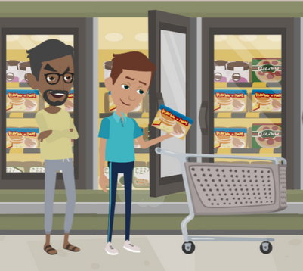
LESSON PLANS
MANIPULATION
What behaviors do traffickers display when trying to convince a homeless young person to trust them?
RUNAWAYS
AS TARGETS
©2025 Walking Wise
41
3

Slide 42
MANIPULATION
Manipulative Traffickers
Kind: Predators can offer to help resolve problems.
©2025 Walking Wise
42
Notes:
In addition to using force or intimidation, traffickers fool young people through manipulation to gain trust:
• KIND & GENEROUS
Predators can seem genuinely concerned about a vulnerable youth and offer to help solve the young person’s problems. Traffickers often pretend to be kindhearted people who want to help by providing food, shelter, and other necessities.
• PROTECTOR
Traffickers can pretend to offer protection from gangs, cults, or other dangerous people.
• HOSPITABLE
Sex traffickers often invite runaways to parties to partake in drugs and alcohol, or they may offer substances to help soothe a runaway’s stress and pain, giving traffickers complete control over their victims.

Slide 43
MANIPULATION
Manipulative Traffickers
Kind: Predators can offer to help resolve problems.
Generous: They can offer food and housing.
©2025 Walking Wise
43
Notes:
In addition to using force or intimidation, traffickers fool young people through manipulation to gain trust:
• KIND & GENEROUS
Predators can seem genuinely concerned about a vulnerable youth and offer to help solve the young person’s problems. Traffickers often pretend to be kindhearted people who want to help by providing food, shelter, and other necessities.
• PROTECTOR
Traffickers can pretend to offer protection from gangs, cults, or other dangerous people.
• HOSPITABLE
Sex traffickers often invite runaways to parties to partake in drugs and alcohol, or they may offer substances to help soothe a runaway’s stress and pain, giving traffickers complete control over their victims.

Slide 44
MANIPULATION
Manipulative Traffickers
Kind: Predators can offer to help resolve problems.
Generous: They can offer food and housing.
Protective: Offer protection from gangs or dangerous people.
©2025 Walking Wise
44
Notes:
In addition to using force or intimidation, traffickers fool young people through manipulation to gain trust:
• KIND & GENEROUS
Predators can seem genuinely concerned about a vulnerable youth and offer to help solve the young person’s problems. Traffickers often pretend to be kindhearted people who want to help by providing food, shelter, and other necessities.
• PROTECTOR
Traffickers can pretend to offer protection from gangs, cults, or other dangerous people.
• HOSPITABLE
Sex traffickers often invite runaways to parties to partake in drugs and alcohol, or they may offer substances to help soothe a runaway’s stress and pain, giving traffickers complete control over their victims.

Slide 45
MANIPULATION
Manipulative Traffickers
Kind: Predators can offer to help resolve problems.
Generous: They can offer food and housing.
Protective: Offer protection from gangs or dangerous people.
Hospitable: Invite youth to parties & provide drugs and alcohol.
©2025 Walking Wise
45
Notes:
In addition to using force or intimidation, traffickers fool young people through manipulation to gain trust:
• KIND & GENEROUS
Predators can seem genuinely concerned about a vulnerable youth and offer to help solve the young person’s problems. Traffickers often pretend to be kindhearted people who want to help by providing food, shelter, and other necessities.
• PROTECTOR
Traffickers can pretend to offer protection from gangs, cults, or other dangerous people.
• HOSPITABLE
Sex traffickers often invite runaways to parties to partake in drugs and alcohol, or they may offer substances to help soothe a runaway’s stress and pain, giving traffickers complete control over their victims.

Slide 46
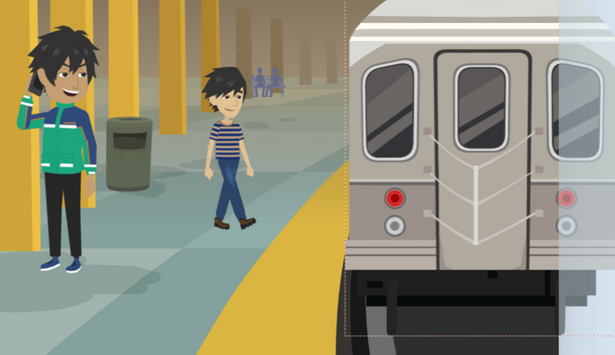
RISKY LOCATION
What locations make teens who run away or are homeless more vulnerable to traffickers?
RUNAWAYS
AS TARGETS
©2025 Walking Wise
46

Slide 47
RISKY LOCATIONS
Vulnerable to Traffickers
Transportation Hubs: bus/train stations, subways, airports
©2025 Walking Wise
47
Notes:
• TRANSPORTATION HUBS
Bus stations, train stations, and airports where youths may be waiting for a ride or trying to get to another location.
• SHELTERS
Homeless shelters, where traffickers may target vulnerable youth in need of a place to stay, and makeshift living spaces or tent cities, where traffickers can exploit vulnerable individuals.
• ABANDONED BUILDINGS
Empty or unsafe buildings where youth may seek refuge when having nowhere else to go.
• LODGING
Low-cost motels or hotels, especially in areas with high levels of human trafficking activity.
Source
OpenAI. (2024). ChatGPT [Large language model]. https://chatgpt.com

Slide 48
RISKY LOCATIONS
Vulnerable to Traffickers
Transportation Hubs: bus/train stations, subways, airports
Shelters: homeless shelters, drop-in centers, halfway homes, tent cities
©2025 Walking Wise
48
Notes:
• TRANSPORTATION HUBS
Bus stations, train stations, and airports where youths may be waiting for a ride or trying to get to another location.
• SHELTERS
Homeless shelters, where traffickers may target vulnerable youth in need of a place to stay, and makeshift living spaces or tent cities, where traffickers can exploit vulnerable individuals.
• ABANDONED BUILDINGS
Empty or unsafe buildings where youth may seek refuge when having nowhere else to go.
• LODGING
Low-cost motels or hotels, especially in areas with high levels of human trafficking activity.
Source
OpenAI. (2024). ChatGPT [Large language model]. https://chatgpt.com

Slide 49
RISKY LOCATIONS
Vulnerable to Traffickers
Transportation Hubs: bus/train stations, subways, airports
Shelters: homeless shelters, drop-in centers, halfway homes, tent cities
Abandoned Buildings: empty or unsafe buildings
©2025 Walking Wise
49
Notes:
• TRANSPORTATION HUBS
Bus stations, train stations, and airports where youths may be waiting for a ride or trying to get to another location.
• SHELTERS
Homeless shelters, where traffickers may target vulnerable youth in need of a place to stay, and makeshift living spaces or tent cities, where traffickers can exploit vulnerable individuals.
• ABANDONED BUILDINGS
Empty or unsafe buildings where youth may seek refuge when having nowhere else to go.
• LODGING
Low-cost motels or hotels, especially in areas with high levels of human trafficking activity.
Source
OpenAI. (2024). ChatGPT [Large language model]. https://chatgpt.com

Slide 50
RISKY LOCATIONS
Vulnerable to Traffickers
Transportation Hubs: bus/train stations, subways, airports
Shelters: homeless shelters, drop-in centers, halfway homes, tent cities
Abandoned Buildings: empty or unsafe buildings
Lodging: motels, hotels, Airbnbs
©2025 Walking Wise
50
Notes:
• TRANSPORTATION HUBS
Bus stations, train stations, and airports where youths may be waiting for a ride or trying to get to another location.
• SHELTERS
Homeless shelters, where traffickers may target vulnerable youth in need of a place to stay, and makeshift living spaces or tent cities, where traffickers can exploit vulnerable individuals.
• ABANDONED BUILDINGS
Empty or unsafe buildings where youth may seek refuge when having nowhere else to go.
• LODGING
Low-cost motels or hotels, especially in areas with high levels of human trafficking activity.
Source
OpenAI. (2024). ChatGPT [Large language model]. https://chatgpt.com

Slide 51
RISKY LOCATIONS
Vulnerable to Traffickers
Public Places: street corners, shopping malls, parks
©2025 Walking Wise
51
Notes:
• PUBLIC PLACES
Remote or isolated areas where youth may go to hide or rest, exposing them as easy targets for traffickers.
• GATHERING SPOTS
Nightclubs, Bars, or Strip Clubs: Places where young people may be invited by traffickers to work, leading them into exploitation. Also, in high-traffic neighborhoods or street corners where traffickers can easily approach youth, as well as 24-hour diners that typically serve breakfast all night.
• CROWDED EVENTS
Concerts, festivals, and other public events where traffickers can easily blend in and target isolated youth.
• ONLINE PLATFORMS
Social media, dating apps, and other online platforms where traffickers can contact youth to make deceptive promises.
Source
OpenAI. (2024). ChatGPT [Large language model]. https://chatgpt.com

Slide 52
RISKY LOCATIONS
Vulnerable to Traffickers
Public Places: street corners, shopping malls, parks
Gathering Spots: bars, strip clubs, nightclubs, 24-hour diners
©2025 Walking Wise
52
Notes:
• PUBLIC PLACES
Remote or isolated areas where youth may go to hide or rest, exposing them as easy targets for traffickers.
• GATHERING SPOTS
Nightclubs, Bars, or Strip Clubs: Places where young people may be invited by traffickers to work, leading them into exploitation. Also, in high-traffic neighborhoods or street corners where traffickers can easily approach youth, as well as 24-hour diners that typically serve breakfast all night.
• CROWDED EVENTS
Concerts, festivals, and other public events where traffickers can easily blend in and target isolated youth.
• ONLINE PLATFORMS
Social media, dating apps, and other online platforms where traffickers can contact youth to make deceptive promises.
Source
OpenAI. (2024). ChatGPT [Large language model]. https://chatgpt.com

Slide 53
RISKY LOCATIONS
Vulnerable to Traffickers
Public Places: street corners, shopping malls, parks
Gathering Spots: bars, strip clubs, nightclubs, 24-hour diners
Crowded Events: concerts, festivals, fairs
©2025 Walking Wise
53
Notes:
• PUBLIC PLACES
Remote or isolated areas where youth may go to hide or rest, exposing them as easy targets for traffickers.
• GATHERING SPOTS
Nightclubs, Bars, or Strip Clubs: Places where young people may be invited by traffickers to work, leading them into exploitation. Also, in high-traffic neighborhoods or street corners where traffickers can easily approach youth, as well as 24-hour diners that typically serve breakfast all night.
• CROWDED EVENTS
Concerts, festivals, and other public events where traffickers can easily blend in and target isolated youth.
• ONLINE PLATFORMS
Social media, dating apps, and other online platforms where traffickers can contact youth to make deceptive promises.
Source
OpenAI. (2024). ChatGPT [Large language model]. https://chatgpt.com

Slide 54
RISKY LOCATIONS
Vulnerable to Traffickers
Public Places: street corners, shopping malls, parks
Gathering Spots: bars, strip clubs, nightclubs, 24-hour diners
Crowded Events: concerts, festivals, fairs
Online: dating apps, social media platforms
©2025 Walking Wise
54
Notes:
• PUBLIC PLACES
Remote or isolated areas where youth may go to hide or rest, exposing them as easy targets for traffickers.
• GATHERING SPOTS
Nightclubs, Bars, or Strip Clubs: Places where young people may be invited by traffickers to work, leading them into exploitation. Also, in high-traffic neighborhoods or street corners where traffickers can easily approach youth, as well as 24-hour diners that typically serve breakfast all night.
• CROWDED EVENTS
Concerts, festivals, and other public events where traffickers can easily blend in and target isolated youth.
• ONLINE PLATFORMS
Social media, dating apps, and other online platforms where traffickers can contact youth to make deceptive promises.
Source
OpenAI. (2024). ChatGPT [Large language model]. https://chatgpt.com

Slide 55
LESSON PLANS
MISSING REPORT
How long must parents wait before reporting to the police that their child is missing?
RUNAWAYS
AS TARGETS
©2025 Walking Wise
U.S. Department of Justice (2023). When Your Child Is Missing: A Family Survival Guide, p. 7. ojjdp.ojp.gov.
55
3
Notes:
SLIDO.com: Multiple Choice
How long must parents wait before reporting to the police that their child is missing?
A) Wait 12 Hours
B) Wait 24 Hours
C) Wait 48 Hours
D) Report Immediately
ANSWER
D) Never wait; report immediately. Parents or guardians should report a missing child immediately.
There is no required waiting period to report a missing or overdue child. Parents and caregivers should not delay notifying authorities while conducting their own extensive search for missing children because law enforcement has specialized tools to carry out thorough and efficient investigations.
Source
U.S. Department of Justice (2023). When Your Child Is Missing: A Family Survival Guide, p. 7. ojjdp.ojp.gov. Retrieved December 2, 2024, from https://ojjdp.ojp.gov/publications/family-survival-guide.pdf

Slide 56
EDUCATON GUIDE
VOCABULARY
DISORIENT
To cause someone to feel confused or lost regarding time, direction, or understanding.
RUNAWAYS
AS TARGETS
©2025 Walking Wise
56
3
Notes:
Assisting Source
OpenAI. (2024). ChatGPT [Large language model]. https://chatgpt.com

Slide 57
EDUCATON GUIDE
VOCABULARY
SURVIVAL SEX
Being coerced into sexual activity due to desperate situations, often in exchange for meeting basic needs like food and shelter.
RUNAWAYS
AS TARGETS
©2025 Walking Wise
57
3

Slide 58
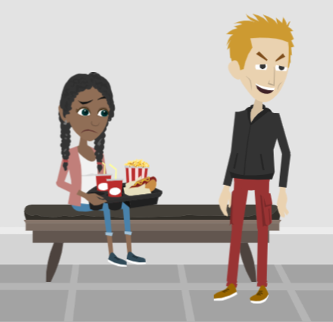
LESSON PLANS
UNLAWFUL EXCHANGE
How do predators often trick young people into sexual exploitation?
RUNAWAYS
AS TARGETS
©2025 Walking Wise
58
3

Slide 59
UNLAWFUL EXCHANGE
Survival Transactions
Predators trade food in exchange for sexual activity.
©2025 Walking Wise
Polaris Project (2019). Freedom happens now. Sex Trafficking and LGBTQ Youth.
59
Notes:
• SURVIVAL SEX
Young people often do not realize the classification of a sex trafficking crime includes survival sex, which is the exchange of a sex act for something of value.
Survival sex is when young people feel pressured to perform sex acts in exchange for necessities, such as money, food, shelter, drugs, protection, or transportation.
The Polaris Project reports that LGBTQ+ youth are “3 to 7 times more likely to engage in survival sex than their non-LGBTQ peers because of discrimination and lack of social support.[1]
Source
1. Polaris Project (2019). Freedom happens now. Sex Trafficking and LGBTQ Youth.
https://polarisproject.org/wp-content/uploads/2019/09/LGBTQ-Sex-Trafficking.pdf

Slide 60
UNLAWFUL EXCHANGE
Survival Transactions
Predators trade food in exchange for sexual activity.
They can offer housing in exchange for sexual activity.
©2025 Walking Wise
Polaris Project (2019). Freedom happens now. Sex Trafficking and LGBTQ Youth.
60
Notes:
• SURVIVAL SEX
Young people often do not realize the classification of a sex trafficking crime includes survival sex, which is the exchange of a sex act for something of value.
Survival sex is when young people feel pressured to perform sex acts in exchange for necessities, such as money, food, shelter, drugs, protection, or transportation.
The Polaris Project reports that LGBTQ+ youth are “3 to 7 times more likely to engage in survival sex than their non-LGBTQ peers because of discrimination and lack of social support.[1]
Source
1. Polaris Project (2019). Freedom happens now. Sex Trafficking and LGBTQ Youth.
https://polarisproject.org/wp-content/uploads/2019/09/LGBTQ-Sex-Trafficking.pdf

Slide 61
UNLAWFUL EXCHANGE
Survival Transactions
Predators trade food in exchange for sexual activity.
They can offer housing in exchange for sexual activity.
Predators often trade drugs in exchange for sexual activity.
©2025 Walking Wise
Polaris Project (2019). Freedom happens now. Sex Trafficking and LGBTQ Youth.
61
Notes:
• SURVIVAL SEX
Young people often do not realize the classification of a sex trafficking crime includes survival sex, which is the exchange of a sex act for something of value.
Survival sex is when young people feel pressured to perform sex acts in exchange for necessities, such as money, food, shelter, drugs, protection, or transportation.
The Polaris Project reports that LGBTQ+ youth are “3 to 7 times more likely to engage in survival sex than their non-LGBTQ peers because of discrimination and lack of social support.[1]
Source
1. Polaris Project (2019). Freedom happens now. Sex Trafficking and LGBTQ Youth.
https://polarisproject.org/wp-content/uploads/2019/09/LGBTQ-Sex-Trafficking.pdf

Slide 62
UNLAWFUL EXCHANGE
Survival Transactions
Predators trade food in exchange for sexual activity.
They can offer housing in exchange for sexual activity.
Predators often trade drugs in exchange for sexual activity.
They can promise protection in exchange for sexual activity.
©2025 Walking Wise
Polaris Project (2019). Freedom happens now. Sex Trafficking and LGBTQ Youth.
62
Notes:
• SURVIVAL SEX
Young people often do not realize the classification of a sex trafficking crime includes survival sex, which is the exchange of a sex act for something of value.
Survival sex is when young people feel pressured to perform sex acts in exchange for necessities, such as money, food, shelter, drugs, protection, or transportation.
The Polaris Project reports that LGBTQ+ youth are “3 to 7 times more likely to engage in survival sex than their non-LGBTQ peers because of discrimination and lack of social support.[1]
Source
1. Polaris Project (2019). Freedom happens now. Sex Trafficking and LGBTQ Youth.
https://polarisproject.org/wp-content/uploads/2019/09/LGBTQ-Sex-Trafficking.pdf

Slide 63
UNLAWFUL EXCHANGE
Survival Transactions
Predators trade food in exchange for sexual activity.
They can offer housing in exchange for sexual activity.
Predators often trade drugs in exchange for sexual activity.
They can promise protection in exchange for sexual activity.
Predators can provide transportation for sexual activity.
©2025 Walking Wise
Polaris Project (2019). Freedom happens now. Sex Trafficking and LGBTQ Youth.
63
Notes:
• SURVIVAL SEX
Young people often do not realize the classification of a sex trafficking crime includes survival sex, which is the exchange of a sex act for something of value.
Survival sex is when young people feel pressured to perform sex acts in exchange for necessities, such as money, food, shelter, drugs, protection, or transportation.
The Polaris Project reports that LGBTQ+ youth are “3 to 7 times more likely to engage in survival sex than their non-LGBTQ peers because of discrimination and lack of social support.[1]
Source
1. Polaris Project (2019). Freedom happens now. Sex Trafficking and LGBTQ Youth.
https://polarisproject.org/wp-content/uploads/2019/09/LGBTQ-Sex-Trafficking.pdf

Slide 64

ASK FOR HELP
©2025 Walking Wise
64

Slide 65

ASK FOR HELP
Who should a young person talk to when considering running away from home or have already run away?
©2025 Walking Wise
65

Slide 66
ASK FOR HELP
Instead of Running Away
Talk to a trustworthy parent, family member, or other adult.
©2025 Walking Wise
66

Slide 67
ASK FOR HELP
Instead of Running Away
Talk to a trustworthy parent, family member, or other adult.
If you are a student in school, consider telling a trustworthy teacher, coach, school nurse, social worker, counselor, resource officer, or principal.
©2025 Walking Wise
67

Slide 68
ASK FOR HELP
Instead of Running Away
Talk to a trustworthy parent, family member, or other adult.
If you are a student in school, consider telling a trustworthy teacher, coach, school nurse, social worker, counselor, resource officer, or principal.
Consider talking to a friend’s trustworthy parent or a trusted spiritual leader.
©2025 Walking Wise
68

Slide 69
ASK FOR HELP
Instead of Running Away
Talk to a trustworthy parent, family member, or other adult.
If you are a student in school, consider telling a trustworthy teacher, coach, school nurse, social worker, counselor, resource officer, or principal.
Consider talking to a friend’s trustworthy parent or a trusted spiritual leader.
Call the National Runaway Safeline for advice: 1-800-RUN-AWAY (786-2929).
©2025 Walking Wise
69

Slide 70
ASK FOR HELP
Instead of Running Away
Talk to a trustworthy parent, family member, or other adult.
If you are a student in school, consider telling a trustworthy teacher, coach, school nurse, social worker, counselor, resource officer, or principal.
Consider talking to a friend’s trustworthy parent or a trusted spiritual leader.
Call the National Runaway Safeline for advice: 1-800-RUN-AWAY (786-2929)
National Center for Missing & Exploited Children 1-800-THE-LOST (843-5678)
©2025 Walking Wise
70

Slide 71
RETURN HOME
Transportation Back Home
If wanting to RETURN home, contact the National Runaway Safeline:
FREE bus ticket from Greyhound Buses
1-800-RUN-AWAY
1-800-786-2929
©2025 Walking Wise
71
Notes:
• HOME FREE PROGRAM
Greyhound assists the National Runaway Safeline with reuniting children and their families. They offer a free bus ticket to children who want to go home. The Home Free program is for youth ages 12 to 21 who self-identify as homeless, runaways, and victims of human trafficking.

Slide 72
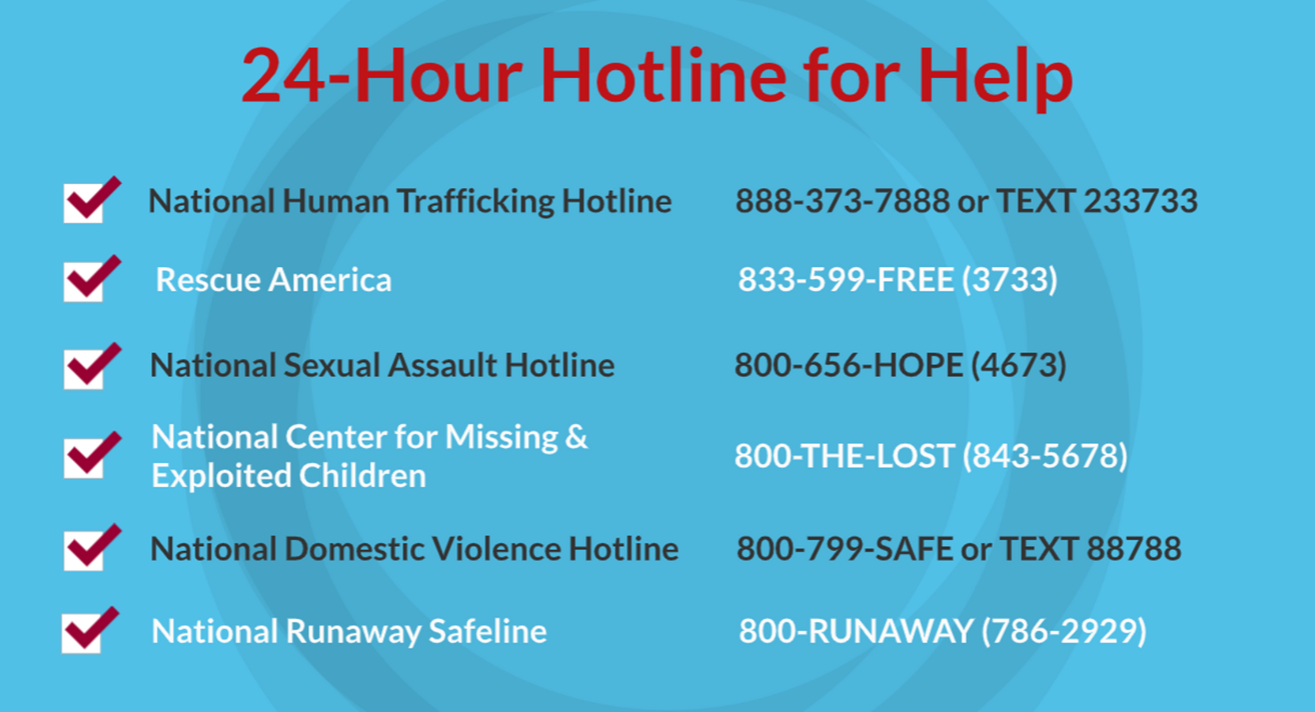
©2025 Walking Wise
72
Notes:
NOTE
Presenters may ask their audience to consider adding a few "hotline for help" phone numbers in their cell phone contacts or take a photo of this slide.

Slide 73
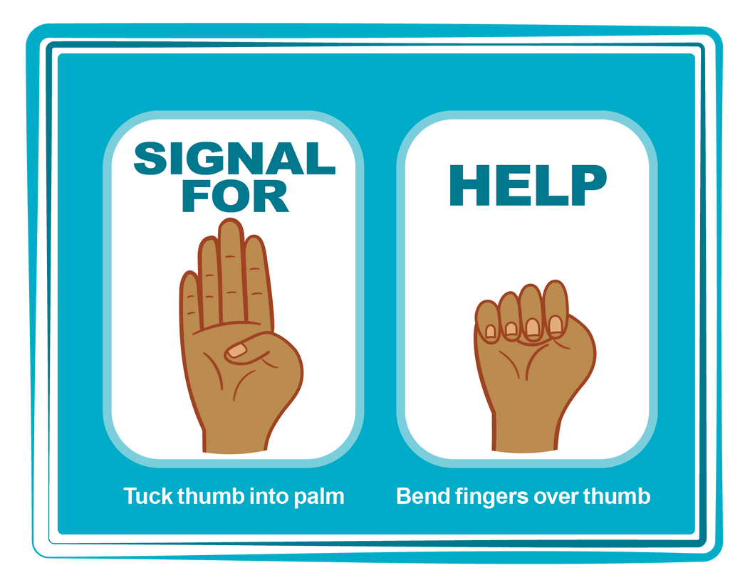
HAND SIGNAL FOR HELP
©2025 Walking Wise
Source: Canadian Women’s Foundation, April 2020
73
Notes:
Although the hand signal for help has not yet achieved universal recognition, it may discreetly get someone's attention in urgent situations.
• SILENT
It can be used silently.
• UNTRACKABLE
It leaves no digital footprint.
• CONCEALED
It can be done secretly when a perpetrator is in the vicinity.
• SIGNALS DISTRESS
Combining the hand signal with distressed facial expressions might help attract the attention of an individual who is unfamiliar with the signal's meaning.
Source
Canadian Women's Foundation, April 2020

Slide 74
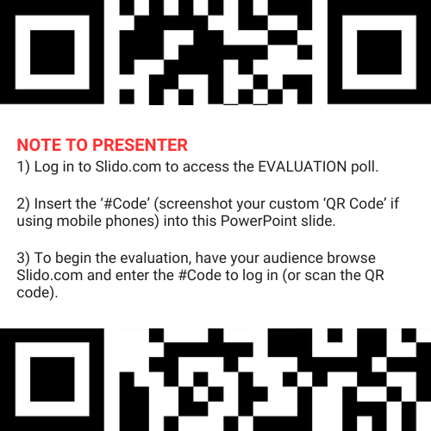
EVALUATION
©2025 Walking Wise
74
Notes:
SLIDO.com: 3-Question Survey
NOTE
Update this slide with your school/organization's custom QR code and #code.
Please encourage participants to scan your organization's custom QR code to share what they enjoyed and what could be improved about the lesson.
Please send any feedback you want to share to Walking Wise at support@WalkingWise.com.

Slide 75
SHARE YOUR THOUGHTS
1. How would you rate this lesson?
2. What was the one thing you liked?
3. What one thing should we improve?
Presenter: Replace “#XXXX” with your organization’s custom Slido code.
©2025 Walking Wise
75
Notes:
SLIDO.com: 3-Question Survey
NOTE
Follow the instructions provided on WalkingWise.com to access your school or organization's custom Slido QR code and #code, which will enable the audience to complete the 3-question evaluation.
Please encourage your audience to scan your organization's custom QR code to share what they enjoyed and what could be improved about the lesson.
Please send any feedback you want to share to Walking Wise at support@WalkingWise.com.

Slide 76


Thank you!
WalkingWise.com
Online Course for Adults Accredited by:
Postgraduate Institue for Medicine
Academy of Forensic Nursing
©2025 Walking Wise
76
Notes:
NOTE
To access additional resources about running away, please refer to the last page of Lesson Plan #7 in the Walking Wise Education Guide.
We welcome your feedback at support@WalkingWise.com.
Thank you!
Karla Highman
Founder, WalkingWise.com

