Slide 1


SEXUAL EXPLOITATION
EDUCATION
rural
RISKS
LESSON #8
Notes:
NOTE
Log in to WalkingWise.com and refer to the Walking Wise Education Guide to implement classroom teaching tips.
Most importantly:
• DEFINE SCHOOL POLICY
Establish a sexual exploitation reporting protocol with a trauma-informed response. The Walking Wise Implementation Guide provides a sample protocol.
• AGE & AUDIENCE
This presentation can be edited by following the procedures on page 3 to align with your school policies, specific age groups, and the involvement of at-risk audiences.
• SUPPORT PROCEDURE
Please give your audience guidance on how to access immediate help or arrange a private meeting with a social worker, counselor, nurse, school resource officer, or another trustworthy staff member to report concerns for themselves or a peer.
• SECOND SAFE ADULT
Ensure a second trustworthy adult, such as a teacher, is present in the learning setting to observe audience reactions and identify those who may benefit from a follow-up meeting. This person should remain focused and free from other duties during the presentation.
• IMPLEMENT SLIDO.com
Join Walking Wise in using Slido.com to create an anonymous user experience.
Contact us at support@WalkingWise.com for more information.

Slide 2

NOTE TO PRESENTER
This presentation is exclusively for Walking Wise® subscribers and not for redistribution.
Walking Wise encourages the use of Slido.com, an interactive digital tool, to enhance audience engagement. For more information, contact us at support@WalkingWise.com. Once configured, integrate Slido polling and add a post-evaluation to the PowerPoint presentation.
Presenters are encouraged to edit speaker notes to match their speaking style (viewable in presentation mode). You can also delete slides from this Walking Wise presentation to make sure the content aligns with your school policies, is age-appropriate, and fits within available class time. However, the existing slides are copyright-protected and may not be modified without prior written permission from Walking Wise.
We encourage you to add your own content by following these instructions:
Insert new PowerPoint slides.
Remove the Walking Wise logo and copyright "©2025 Walking Wise" from the new slides.
Always add your organization's name or logo to each new slide.
Please delete this instruction page before presenting to audiences.
©2024-2026 Walking Wise
2
Notes:
NOTE
The presenter is welcome to customize this Walking Wise presentation according to the instructions provided on this page.
For revision requests, please email us at:
support@WalkingWise.com.

Slide 3

CONFRONTING SEXUAL EXPLOITATION
WALKING WISE
KNOWLEDGE serves as a
powerful defense against
sexual predators.
©2024-2026 Walking Wise
3

Slide 4
CONFRONTING SEXUAL EXPLOITATION
WALKING WISE
SEXUAL EXPLOITATION includes grooming, sextortion, pornography
& sex trafficking.
©2024-2026 Walking Wise
4

Slide 5
SENSITIVE DISCUSSION AHEAD
CONTENT ALERT
We’ll be discussing serious issues about sexual exploitation.
Some parts may be difficult to hear.
If you ever feel uncomfortable, you can step out and speak with a trustworthy adult for support.
You’re not alone—we’re here to help you.
©2024-2026 Walking Wise
5
Notes:
NOTE TO PRESENTER
Please tailor this message to align with your organization's policies and protocols.
Please provide a confidential avenue for students to report concerns and seek help for themselves or their peers if they suspect sexual abuse, grooming, sextortion, pornography-related exploitation, or human trafficking. This may include a designated address or text line.
Consider displaying posters in your school or facility that outline various ways students can access immediate support or request a private meeting with a school safety team member or another trusted adult.

Slide 6
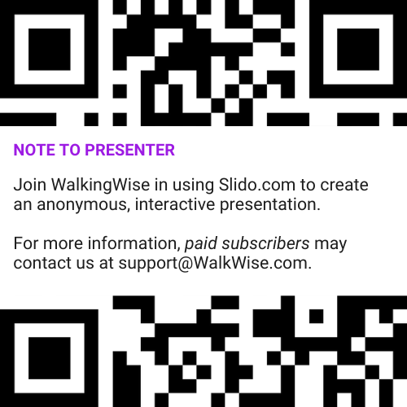
DIGITAL PARTICIPATION
©2024-2026 Walking Wise
6
Notes:
NOTE
For Online Interactive Polling with audiences:
Join Walking Wise in using Slido.com to create an anonymous user experience.
Contact us at support@WalkingWise.com for more information.
Upon Activating Slido.com:
Please verify that the Q&A feature is enabled before presenting to audiences. An adult should monitor questions and comments to ensure they are appropriate. Slido has a feature that allows you to delete unwanted questions and comments.

Slide 7


STATISTICS
Statistics are Only Estimates
🔍 Many sexual crimes are never reported, so study results may not fully reflect what is really happening.
Myths
&REALITY
©2024-2026 Walking Wise
7
Notes:
In this presentation, we'll discuss statistics, but it's important to note that while statistics provide valuable insights into an issue, they cannot be relied upon entirely.
Here are a few reasons:
• UNREPORTED
Victims may stay silent due to fear, shame, or manipulation.
• INCONSISTENT COLLECTION
Geographical areas have different legal definitions for sexual crimes, making data hard to compare.
• FOCUS GROUPS
Small or specific focus groups participating in a study or survey may not accurately reflect the diversity or experiences of the broader population.

Slide 8
STATISTICS
Statistics are Only Estimates
📊 Studies collect information in different ways, which can lead to different results.
Myths
&REALITY
©2024-2026 Walking Wise
8
Notes:
In this presentation, we'll discuss statistics, but it's important to note that while statistics provide valuable insights into an issue, they cannot be relied upon entirely.
Here are a few reasons:
• UNREPORTED
Victims may stay silent due to fear, shame, or manipulation.
• INCONSISTENT COLLECTION
Geographical areas have different legal definitions for sexual crimes, making data hard to compare.
• FOCUS GROUPS
Small or specific focus groups participating in a study or survey may not accurately reflect the diversity or experiences of the broader population.

Slide 9
STATISTICS
Statistics are Only Estimates
👥 Some studies use small groups of people, and those groups may not represent everyone.
Myths
&REALITY
©2024-2026 Walking Wise
9
Notes:
In this presentation, we'll discuss statistics, but it's important to note that while statistics provide valuable insights into an issue, they cannot be relied upon entirely.
Here are a few reasons:
• UNREPORTED
Victims may stay silent due to fear, shame, or manipulation.
• INCONSISTENT COLLECTION
Geographical areas have different legal definitions for sexual crimes, making data hard to compare.
• FOCUS GROUPS
Small or specific focus groups participating in a study or survey may not accurately reflect the diversity or experiences of the broader population.

Slide 10

EDUCATON GUIDE
VOCABULARY
VOCABULARY
Rural
Tight Knit
Rumor
Poverty
Desolate
Isolate
rural
RISKS
©2024-2026 Walking Wise
10
3
Notes:
NOTE
Understanding vocabulary terms related to the behaviors of sexual predators can empower young people to recognize warning signs of harmful situations.
Knowing terminology helps them identify manipulative tactics predators use to build trust and exploit vulnerabilities.
With this knowledge, young people are better equipped to spot red flags, understand that these behaviors are abusive, and feel more confident reporting predators to trusted adults or authorities, potentially preventing further harm.

Slide 11
EDUCATON GUIDE
VOCABULARY
RURAL
Areas located outside of cities with low populations, open spaces, and an emphasis on agriculture and natural resources.
rural
RISKS
©2024-2026 Walking Wise
11
3
Notes:
Assisting Source
OpenAI. (2024). ChatGPT [Large language model]. https://chatgpt.com

Slide 12
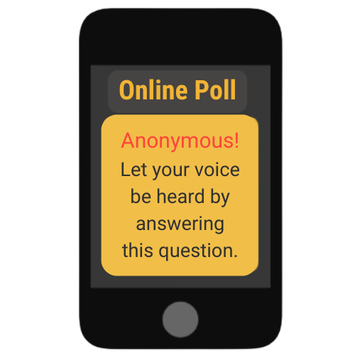
LESSON PLANS
U.S. COMMUNITIES
What percentage of U.S. land and population is considered rural?
rural
RISKS
©2024-2026 Walking Wise
12
3
Notes:
Online Interactive Polling
SLIDO.com: Multiple Choice
What percentage of the U.S. land and population is considered rural?
A) 57% Land & 40% Population
B) 77% Land & 50% Population
C) 87% Land & 60% Population
D) 97% land & 20% Population
ANSWER:
D) 97% of land & 20% of population make up the rural communities in the U.S.
• LANDMASS
In the United States, 97% of its land area is rural.[1]
• POPULATION
Approximately one in five (20%) or 66.3 million Americans live in rural communities.[2]
Source
1. U.S. Census.gov, 2017
2. U.S. Census.gov, 2020
https://www.census.gov/programs-surveys/geography/guidance/geo-areas/urban-rural/2020-ua-facts.html

Slide 13
ANSWER
97% of land and 20% of the population
make up the rural communities in the U.S.
©2024-2026 Walking Wise
U.S. Census.gov, 2020. https://www.census.gov/programs-surveys/geography/guidance/geo-areas/urban-rural/2020-ua-facts.html
13
Notes:
Online Interactive Polling
SLIDO.com: Multiple Choice
What percentage of the U.S. land and population is considered rural?
A) 57% Land & 40% Population
B) 77% Land & 50% Population
C) 87% Land & 60% Population
D) 97% land & 20% Population
ANSWER:
D) 97% of land & 20% of population make up the rural communities in the U.S.
• LANDMASS
In the United States, 97% of its land area is rural.[1]
• POPULATION
Approximately one in five (20%) or 66.3 million Americans live in rural communities.[2]
Source
1. U.S. Census.gov, 2017
2. U.S. Census.gov, 2020
https://www.census.gov/programs-surveys/geography/guidance/geo-areas/urban-rural/2020-ua-facts.html

Slide 14
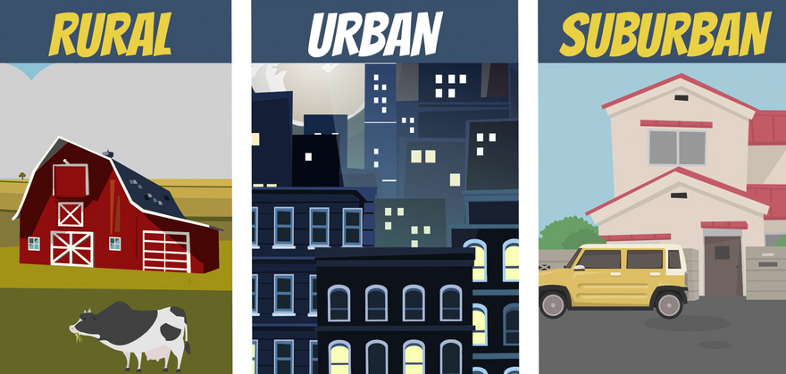
RURAL VS. URBAN
Does where you live change the type of risks you might face?
rural
RISKS
©2024-2026 Walking Wise
14

Slide 15
RURAL VS. URBAN
Living Conditions
Rural America: Small towns and farmlands have fewer people, lower incomes, and limited transportation.
©2024-2026 Walking Wise
15
Notes:
Where a person lives can affect the types of risks they may face related to human trafficking.
In urban areas, large populations, busy transportation systems, and many visitors can make it easier for traffickers to blend in and target people without being noticed.
In rural areas, fewer services, longer distances, and limited access to help can increase vulnerability in different ways.
These differences do not mean one type of community is “safe,” and another is “dangerous,” but they do show why prevention and awareness may vary across communities.

Slide 16
RURAL VS. URBAN
Living Conditions
Urban Centers: Busy cities have fast-paced lifestyles, diverse cultures, public transportation, and crowded spaces.
©2024-2026 Walking Wise
16
Notes:
Where a person lives can affect the types of risks they may face related to human trafficking.
In urban areas, large populations, busy transportation systems, and many visitors can make it easier for traffickers to blend in and target people without being noticed.
In rural areas, fewer services, longer distances, and limited access to help can increase vulnerability in different ways.
These differences do not mean one type of community is “safe,” and another is “dangerous,” but they do show why prevention and awareness may vary across communities.

Slide 17
RURAL VS. URBAN
Living Conditions
Suburban Areas: Neighborhoods outside cities offer spacious family housing, many jobs and schools, and access to services.
©2024-2026 Walking Wise
17
Notes:
Where a person lives can affect the types of risks they may face related to human trafficking.
In urban areas, large populations, busy transportation systems, and many visitors can make it easier for traffickers to blend in and target people without being noticed.
In rural areas, fewer services, longer distances, and limited access to help can increase vulnerability in different ways.
These differences do not mean one type of community is “safe,” and another is “dangerous,” but they do show why prevention and awareness may vary across communities.

Slide 18
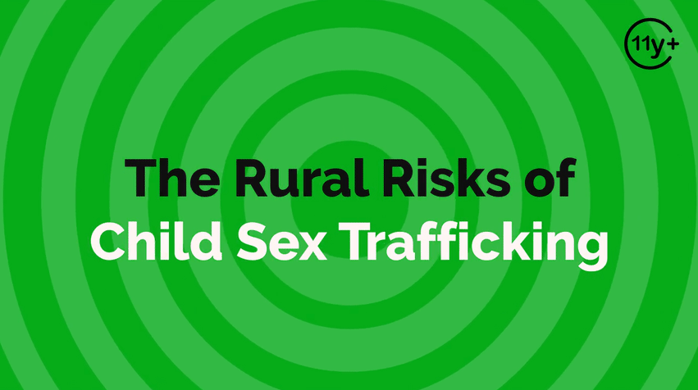
Log in to WalkingWise.com to access this animated video.
©2024-2026 Walking Wise
18
Notes:
Message Especially for Teens:
Businesses worldwide use explainer-style animation as a training tool for their employees. So, this 3-minute Walking Wise animated video series is appropriate for both teens (ages 11+) and adults to learn how sexual predators use manipulation, intimidation, and coercion to exploit young people.
NOTE
Log in to Walking Wise.com to watch the three-minute animated video with audiences.

Slide 19
LESSON PLANS
U.S. COMMUNITIES
In which communities might young people face higher risks of human trafficking?
rural
RISKS
©2024-2026 Walking Wise
19
3
Notes:
Online Interactive Polling
SLIDO.com: Multiple Choice
In which communities might young people face higher risks of human trafficking?
A) Urban Cities
B) Suburbs
C) Rural America
D) All Communities
ANSWER:
D) All Communities.
Human trafficking impacts people living in ALL types of U.S. communities and worldwide.

Slide 20
ANSWER
All Communities. Human trafficking impacts people living in ALL types of U.S. communities and worldwide.
©2024-2026 Walking Wise
20
Notes:
Online Interactive Polling
SLIDO.com: Multiple Choice
In which communities might young people face higher risks of human trafficking?
A) Urban Cities
B) Suburbs
C) Rural America
D) All Communities
ANSWER:
D) All Communities.
Human trafficking impacts people living in ALL types of U.S. communities and worldwide.

Slide 21
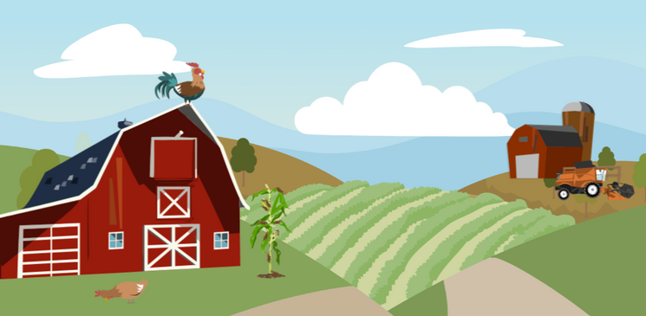
RURAL VS. URBAN
What conditions make young people vulnerable in rural areas and big cities?
rural
RISKS
©2024-2026 Walking Wise
21

Slide 22
RURAL VS. URBAN
Trafficking Across Communities
Traffickers use similar tactics to exploit young people in rural, suburban, and urban areas.
rural
RISKS
©2024-2026 Walking Wise
Polaris Project (n.d.). Human Trafficking During the COVID and Post-COVID Era. Polarisproject.org, p. 6.
22
Notes:
• TRAFFICKING CONDITIONS
The risk factors that can make young people vulnerable to sex traffickers and the methods used to entrap them are often very similar among the various communities.[1]
• FORCE
Physical power or violence to compel someone to act against their will.
• FRAUD
The use of deception, false promises, or lies to exploit individuals. This can include offering fake job opportunities, misrepresenting working conditions, or pretending to provide help or support, all with the intent of trapping victims in situations of exploitation.[2]
• COERCION
To use threats or physical force to make someone act against their will.
Source
1. Demand Abolition (2018, November). Who Buys Sex? Understanding and Disrupting Illicit Market Demand. DemandAbolition.org. Retrieved December 31, 2024, from https://www.demandabolition.org/wp-content/uploads/2019/07/Demand-Buyer-Report-July-2019.pdf
2. Polaris Project (n.d.). Human Trafficking During the COVID and Post-COVID Era. Polarisproject.org, p. 6. Retrieved December 31, 2024, from https://polarisproject.org/wp-content/uploads/2020/07/Hotline-Trends-Report-2023.pdf

Slide 23
RURAL VS. URBAN
Trafficking Across Communities
They use the same methods everywhere:
Force: Using threats and violence.
©2024-2026 Walking Wise
Polaris Project (n.d.). Human Trafficking During the COVID and Post-COVID Era. Polarisproject.org, p. 6.
23
Notes:
• TRAFFICKING CONDITIONS
The risk factors that can make young people vulnerable to sex traffickers and the methods used to entrap them are often very similar among the various communities.[1]
• FORCE
Physical power or violence to compel someone to act against their will.
• FRAUD
The use of deception, false promises, or lies to exploit individuals. This can include offering fake job opportunities, misrepresenting working conditions, or pretending to provide help or support, all with the intent of trapping victims in situations of exploitation.[2]
• COERCION
To use threats or physical force to make someone act against their will.
Source
1. Demand Abolition (2018, November). Who Buys Sex? Understanding and Disrupting Illicit Market Demand. DemandAbolition.org. Retrieved December 31, 2024, from https://www.demandabolition.org/wp-content/uploads/2019/07/Demand-Buyer-Report-July-2019.pdf
2. Polaris Project (n.d.). Human Trafficking During the COVID and Post-COVID Era. Polarisproject.org, p. 6. Retrieved December 31, 2024, from https://polarisproject.org/wp-content/uploads/2020/07/Hotline-Trends-Report-2023.pdf

Slide 24
RURAL VS. URBAN
Trafficking Across Communities
They use the same methods everywhere:
Force: Using threats and violence.
Fraud: Lying or making false promises.
©2024-2026 Walking Wise
Polaris Project (n.d.). Human Trafficking During the COVID and Post-COVID Era. Polarisproject.org, p. 6.
24
Notes:
• TRAFFICKING CONDITIONS
The risk factors that can make young people vulnerable to sex traffickers and the methods used to entrap them are often very similar among the various communities.[1]
• FORCE
Physical power or violence to compel someone to act against their will.
• FRAUD
The use of deception, false promises, or lies to exploit individuals. This can include offering fake job opportunities, misrepresenting working conditions, or pretending to provide help or support, all with the intent of trapping victims in situations of exploitation.[2]
• COERCION
To use threats or physical force to make someone act against their will.
Source
1. Demand Abolition (2018, November). Who Buys Sex? Understanding and Disrupting Illicit Market Demand. DemandAbolition.org. Retrieved December 31, 2024, from https://www.demandabolition.org/wp-content/uploads/2019/07/Demand-Buyer-Report-July-2019.pdf
2. Polaris Project (n.d.). Human Trafficking During the COVID and Post-COVID Era. Polarisproject.org, p. 6. Retrieved December 31, 2024, from https://polarisproject.org/wp-content/uploads/2020/07/Hotline-Trends-Report-2023.pdf

Slide 25
RURAL VS. URBAN
Trafficking Across Communities
They use the same methods everywhere:
Force: Using threats and violence.
Fraud: Lying or making false promises.
Coercion: Pressuring someone to act against their will.
©2024-2026 Walking Wise
Polaris Project (n.d.). Human Trafficking During the COVID and Post-COVID Era. Polarisproject.org, p. 6.
25
Notes:
• TRAFFICKING CONDITIONS
The risk factors that can make young people vulnerable to sex traffickers and the methods used to entrap them are often very similar among the various communities.[1]
• FORCE
Physical power or violence to compel someone to act against their will.
• FRAUD
The use of deception, false promises, or lies to exploit individuals. This can include offering fake job opportunities, misrepresenting working conditions, or pretending to provide help or support, all with the intent of trapping victims in situations of exploitation.[2]
• COERCION
To use threats or physical force to make someone act against their will.
Source
1. Demand Abolition (2018, November). Who Buys Sex? Understanding and Disrupting Illicit Market Demand. DemandAbolition.org. Retrieved December 31, 2024, from https://www.demandabolition.org/wp-content/uploads/2019/07/Demand-Buyer-Report-July-2019.pdf
2. Polaris Project (n.d.). Human Trafficking During the COVID and Post-COVID Era. Polarisproject.org, p. 6. Retrieved December 31, 2024, from https://polarisproject.org/wp-content/uploads/2020/07/Hotline-Trends-Report-2023.pdf

Slide 26
RURAL VS. URBAN
Trafficking Across Communities
Traffickers target similar vulnerabilities in young people, no matter where they live.
rural
RISKS
©2024-2026 Walking Wise
Demand Abolition (2018, November). Who Buys Sex? Understanding and Disrupting Illicit Market Demand, pp. 24-26.
26
Notes:
A 2014 study compared responses from professionals who worked with at-risk youth and crime victims from metropolitan, micropolitan, and rural communities in a southern, rural state. The sex trafficking of minors was reportedly very similar across the three community types in terms of “victim characteristics, vulnerability factors, and trafficking situations (e.g., relationship to the trafficker, traffickers’ techniques for controlling victims, transportation, and Internet-facilitation of trafficking).
Source
Demand Abolition (2018, November). Who Buys Sex? Understanding and Disrupting Illicit Market Demand, pp. 24-26. Demandabolition.org. Retrieved December 31, 2024, from https://www.demandabolition.org/wp-content/uploads/2019/07/Demand-Buyer-Report-July-2019.pdf

Slide 27
RURAL VS. URBAN
Trafficking Across Communities
They often look for the same risk factors everywhere:
Harm: Experienced emotional, physical, and sexual abuse.
©2024-2026 Walking Wise
Demand Abolition (2018, November). Who Buys Sex? Understanding and Disrupting Illicit Market Demand, pp. 24-26.
27
Notes:
A 2014 study compared responses from professionals who worked with at-risk youth and crime victims from metropolitan, micropolitan, and rural communities in a southern, rural state. The sex trafficking of minors was reportedly very similar across the three community types in terms of “victim characteristics, vulnerability factors, and trafficking situations (e.g., relationship to the trafficker, traffickers’ techniques for controlling victims, transportation, and Internet-facilitation of trafficking).
Source
Demand Abolition (2018, November). Who Buys Sex? Understanding and Disrupting Illicit Market Demand, pp. 24-26. Demandabolition.org. Retrieved December 31, 2024, from https://www.demandabolition.org/wp-content/uploads/2019/07/Demand-Buyer-Report-July-2019.pdf

Slide 28
RURAL VS. URBAN
Trafficking Across Communities
They often look for the same risk factors everywhere:
Harm: Experienced emotional, physical, and sexual abuse.
Poverty: Unstable housing & limited access to basic needs.
©2024-2026 Walking Wise
Demand Abolition (2018, November). Who Buys Sex? Understanding and Disrupting Illicit Market Demand, pp. 24-26.
28
Notes:
A 2014 study compared responses from professionals who worked with at-risk youth and crime victims from metropolitan, micropolitan, and rural communities in a southern, rural state. The sex trafficking of minors was reportedly very similar across the three community types in terms of “victim characteristics, vulnerability factors, and trafficking situations (e.g., relationship to the trafficker, traffickers’ techniques for controlling victims, transportation, and Internet-facilitation of trafficking).
Source
Demand Abolition (2018, November). Who Buys Sex? Understanding and Disrupting Illicit Market Demand, pp. 24-26. Demandabolition.org. Retrieved December 31, 2024, from https://www.demandabolition.org/wp-content/uploads/2019/07/Demand-Buyer-Report-July-2019.pdf

Slide 29
RURAL VS. URBAN
Trafficking Across Communities
They often look for the same risk factors everywhere:
Harm: Experienced emotional, physical, and sexual abuse.
Poverty: Unstable housing & limited access to basic needs.
Pressure: Manipulation by family, peers, or romantic partner.
©2024-2026 Walking Wise
Demand Abolition (2018, November). Who Buys Sex? Understanding and Disrupting Illicit Market Demand, pp. 24-26.
29
Notes:
A 2014 study compared responses from professionals who worked with at-risk youth and crime victims from metropolitan, micropolitan, and rural communities in a southern, rural state. The sex trafficking of minors was reportedly very similar across the three community types in terms of “victim characteristics, vulnerability factors, and trafficking situations (e.g., relationship to the trafficker, traffickers’ techniques for controlling victims, transportation, and Internet-facilitation of trafficking).
Source
Demand Abolition (2018, November). Who Buys Sex? Understanding and Disrupting Illicit Market Demand, pp. 24-26. Demandabolition.org. Retrieved December 31, 2024, from https://www.demandabolition.org/wp-content/uploads/2019/07/Demand-Buyer-Report-July-2019.pdf

Slide 30
RURAL VS. URBAN
Trafficking Across Communities
Traffickers use similar control tactics to maintain power over victims across all types of communities.
rural
RISKS
©2024-2026 Walking Wise
Demand Abolition (2018, November). Who Buys Sex? Understanding and Disrupting Illicit Market Demand, pp. 24-26.
30
Notes:
A 2014 study compared responses from professionals who worked with at-risk youth and crime victims from metropolitan, micropolitan, and rural communities in a southern, rural state. The sex trafficking of minors was reportedly very similar across the three community types in terms of “victim characteristics, vulnerability factors, and trafficking situations (e.g., relationship to the trafficker, traffickers’ techniques for controlling victims, transportation, and Internet-facilitation of trafficking).
Source
Demand Abolition (2018, November). Who Buys Sex? Understanding and Disrupting Illicit Market Demand, pp. 24-26. Demandabolition.org. Retrieved December 31, 2024, from https://www.demandabolition.org/wp-content/uploads/2019/07/Demand-Buyer-Report-July-2019.pdf

Slide 31
RURAL VS. URBAN
Trafficking Across Communities
They use the same methods everywhere:
Threats: Instill fear using intimidation.
©2024-2026 Walking Wise
Demand Abolition (2018, November). Who Buys Sex? Understanding and Disrupting Illicit Market Demand, pp. 24-26.
31
Notes:
A 2014 study compared responses from professionals who worked with at-risk youth and crime victims from metropolitan, micropolitan, and rural communities in a southern, rural state. The sex trafficking of minors was reportedly very similar across the three community types in terms of “victim characteristics, vulnerability factors, and trafficking situations (e.g., relationship to the trafficker, traffickers’ techniques for controlling victims, transportation, and Internet-facilitation of trafficking).
Source
Demand Abolition (2018, November). Who Buys Sex? Understanding and Disrupting Illicit Market Demand, pp. 24-26. Demandabolition.org. Retrieved December 31, 2024, from https://www.demandabolition.org/wp-content/uploads/2019/07/Demand-Buyer-Report-July-2019.pdf

Slide 32
RURAL VS. URBAN
Trafficking Across Communities
They use the same methods everywhere:
Threats: Instill fear using intimidation.
Shame: Instill guilt by blaming victims for the crime.
©2024-2026 Walking Wise
Demand Abolition (2018, November). Who Buys Sex? Understanding and Disrupting Illicit Market Demand, pp. 24-26.
32
Notes:
A 2014 study compared responses from professionals who worked with at-risk youth and crime victims from metropolitan, micropolitan, and rural communities in a southern, rural state. The sex trafficking of minors was reportedly very similar across the three community types in terms of “victim characteristics, vulnerability factors, and trafficking situations (e.g., relationship to the trafficker, traffickers’ techniques for controlling victims, transportation, and Internet-facilitation of trafficking).
Source
Demand Abolition (2018, November). Who Buys Sex? Understanding and Disrupting Illicit Market Demand, pp. 24-26. Demandabolition.org. Retrieved December 31, 2024, from https://www.demandabolition.org/wp-content/uploads/2019/07/Demand-Buyer-Report-July-2019.pdf

Slide 33
RURAL VS. URBAN
Trafficking Across Communities
They use the same methods everywhere:
Threats: Instill fear using intimidation.
Shame: Instill guilt by blaming victims for the crime.
Attachment: Use love bonds, debt bonds, drug bonds, and family bonds.
©2024-2026 Walking Wise
Demand Abolition (2018, November). Who Buys Sex? Understanding and Disrupting Illicit Market Demand, pp. 24-26.
33
Notes:
A 2014 study compared responses from professionals who worked with at-risk youth and crime victims from metropolitan, micropolitan, and rural communities in a southern, rural state. The sex trafficking of minors was reportedly very similar across the three community types in terms of “victim characteristics, vulnerability factors, and trafficking situations (e.g., relationship to the trafficker, traffickers’ techniques for controlling victims, transportation, and Internet-facilitation of trafficking).
Source
Demand Abolition (2018, November). Who Buys Sex? Understanding and Disrupting Illicit Market Demand, pp. 24-26. Demandabolition.org. Retrieved December 31, 2024, from https://www.demandabolition.org/wp-content/uploads/2019/07/Demand-Buyer-Report-July-2019.pdf

Slide 34
LESSON PLANS
COMMON TRAFFICKERS
Who are the more common traffickers in rural communities?
rural
RISKS
©2024-2026 Walking Wise
34
3
Notes:
Online Interactive Polling
SLIDO.com: Multiple Choice
Who are the more common traffickers in rural communities?
A) Friends
B) Family Members
C) Neighbors
D) Strangers
ANSWER
A) Family Members are the more common traffickers in rural communities.

Slide 35
ANSWER
Family Members are the more common traffickers in rural communities.
©2024-2026 Walking Wise
Sibo, Nancy & Cudjoe-Mensah, Yvonne. (2025). The Impact of Rural Community Awareness and Social Work Interventions in Addressing Underage Sex Trafficking in the United States. International Journal of Scientific and Research Publications.
35
Notes:
Online Interactive Polling
SLIDO.com: Multiple Choice
Who are the more common traffickers in rural communities?
A) Friends
B) Family Members
C) Neighbors
D) Strangers
ANSWER
A) Family Members are the more common traffickers in rural communities.
Source
Sibo, Nancy & Cudjoe-Mensah, Yvonne. (2025). The Impact of Rural Community Awareness and Social Work Interventions in Addressing Underage Sex Trafficking in the United States. International Journal of Scientific and Research Publications. Retrieved January 20, 2026, from https://www.researchgate.net/publication/391806782_The_Impact_of_Rural_Community_Awareness_and_Social_Work_Interventions_in_Addressing_Underage_Sex_Trafficking_in_the_United_States

Slide 36
COMMON TRAFFICKERS
Rural vs. Urban Communities
The common relationships between a trafficker and a victim tend to vary depending on the community.
rural
RISKS
Perkins, E.B., Ruiz, C. (2016, August 16) Domestic Minor Sex Trafficking in a Rural State: Interviews with Adjudicated Female Juveniles. Child Adolescent Social Work Journal Vol 34, pp. 172, 177.
36
©2024-2026 Walking Wise
Notes:
• TRAFFICKING CONDITIONS
Human traffickers are made of many demographics, but studies also find that the types of traffickers can vary depending on the types of communities:
• RURAL
Traffickers in rural areas are often family members.
• URBAN
Victims from urban areas are commonly introduced to the commercial sex trade by a boyfriend, friend, or a peer's boyfriend.
Source
Perkins, E.B., Ruiz, C. (2016, August 16). Domestic Minor Sex Trafficking in a Rural State: Interviews with Adjudicated Female Juveniles. Child Adolescent Social Work Journal Vol 34, pp. 172, 177. Retrieved January 20, 2026, from https://doi.org/10.1007/s10560-016-0455-3. Retrieved May 27, 2024, from https://www.researchgate.net/publication/306244427_Domestic_Minor_Sex_Trafficking_in_a_Rural_State_Interviews_with_Adjudicated_Female_Juveniles

Slide 37
COMMON TRAFFICKERS
Rural vs. Urban Communities
Rural Areas: Traffickers are often closely linked to the young person, like a family member or trusted individual.
rural
RISKS
Perkins, E.B., Ruiz, C. (2016, August 16) Domestic Minor Sex Trafficking in a Rural State: Interviews with Adjudicated Female Juveniles. Child Adolescent Social Work Journal Vol 34, pp. 172, 177.
37
©2024-2026 Walking Wise
Notes:
• TRAFFICKING CONDITIONS
Human traffickers are made of many demographics, but studies also find that the types of traffickers can vary depending on the types of communities:
• RURAL
Traffickers in rural areas are often family members.
• URBAN
Victims from urban areas are commonly introduced to the commercial sex trade by a boyfriend, friend, or a peer's boyfriend.
Source
Perkins, E.B., Ruiz, C. (2016, August 16) Domestic Minor Sex Trafficking in a Rural State: Interviews with Adjudicated Female Juveniles. Child Adolescent Social Work Journal Vol 34, pp. 172, 177. https://doi.org/10.1007/s10560-016-0455-3 Retrieved May 27, 2024, from https://www.researchgate.net/publication/306244427_Domestic_Minor_Sex_Trafficking_in_a_Rural_State_Interviews_with_Adjudicated_Female_Juveniles

Slide 38
COMMON TRAFFICKERS
Rural vs. Urban Communities
Rural Areas: Traffickers are often closely linked to the young person, like a family member or trusted individual.
Urban Areas: Traffickers are often peers or romantic partners, like a boyfriend, friend, or friend’s partner.
rural
RISKS
Perkins, E.B., Ruiz, C. (2016, August 16) Domestic Minor Sex Trafficking in a Rural State: Interviews with Adjudicated Female Juveniles. Child Adolescent Social Work Journal Vol 34, pp. 172, 177.
38
©2024-2026 Walking Wise
Notes:
• TRAFFICKING CONDITIONS
Human traffickers are made of many demographics, but studies also find that the types of traffickers can vary depending on the types of communities:
• RURAL
Traffickers in rural areas are often family members.
• URBAN
Victims from urban areas are commonly introduced to the commercial sex trade by a boyfriend, friend, or a peer's boyfriend.
Source
Perkins, E.B., Ruiz, C. (2016, August 16) Domestic Minor Sex Trafficking in a Rural State: Interviews with Adjudicated Female Juveniles. Child Adolescent Social Work Journal Vol 34, pp. 172, 177. https://doi.org/10.1007/s10560-016-0455-3 Retrieved May 27, 2024, from https://www.researchgate.net/publication/306244427_Domestic_Minor_Sex_Trafficking_in_a_Rural_State_Interviews_with_Adjudicated_Female_Juveniles

Slide 39
EDUCATON GUIDE
VOCABULARY
TIGHT KNIT
A group of closely connected and supportive people who maintain strong relationships.
rural
RISKS
©2024-2026 Walking Wise
39
3
Notes:
Assisting Source
OpenAI. (2024). ChatGPT [Large language model]. https://chatgpt.com

Slide 40
EDUCATON GUIDE
VOCABULARY
RUMOR
A story or statement that spreads from person to person, often as gossip, and can lack evidence to support it.
rural
RISKS
©2024-2026 Walking Wise
40
3
Notes:
Assisting Source
OpenAI. (2024). ChatGPT [Large language model]. https://chatgpt.com

Slide 41
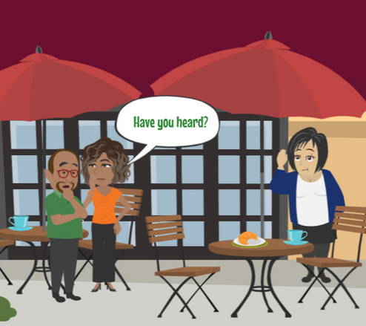
LESSON PLANS
SOCIAL PRESSURES
What social pressures in rural communities can increase risk for young people?
rural
RISKS
©2024-2026 Walking Wise
41
3

Slide 42
SOCIAL PRESSURES
Why Some Victims Don’t Report
Mistrust of Adults: Family secrets or past abuse can make it hard for young people to trust adults and ask for help.
©2024-2026 Walking Wise
42
Notes:
• MISTRUST
Family bonds and relationships among community members can cause youth not to trust adults with secrets of past or current verbal, physical, and sexual abuse.
• FEAR OF GOSSIP
A young person’s fear of betrayal through gossip helps empower a trafficker’s harmful threats. Teaching youth how to recognize trustworthy versus unsafe adults may provide the guidance they need to ask for help.
• CRIMINAL ACCOMPLICES
Because people within rural communities tend to know one another, traffickers understand which in-dividuals pose a threat to their illicit activities and which individuals they can solicit. For example, some individuals can abuse their position of power by working in partnership with traffickers, while others in positions of authority will enforce anti-trafficking and child protection laws.

Slide 43
SOCIAL PRESSURES
Why Some Victims Don’t Report
Fear of Gossip: In small communities, fear of rumors can stop young people from speaking out, giving traffickers more power.
©2024-2026 Walking Wise
43
Notes:
• MISTRUST
Family bonds and relationships among community members can cause youth not to trust adults with secrets of past or current verbal, physical, and sexual abuse.
• FEAR OF GOSSIP
A young person’s fear of betrayal through gossip helps empower a trafficker’s harmful threats. Teaching youth how to recognize trustworthy versus unsafe adults may provide the guidance they need to ask for help.
• CRIMINAL ACCOMPLICES
Because people within rural communities tend to know one another, traffickers understand which in-dividuals pose a threat to their illicit activities and which individuals they can solicit. For example, some individuals can abuse their position of power by working in partnership with traffickers, while others in positions of authority will enforce anti-trafficking and child protection laws.

Slide 44
SOCIAL PRESSURES
Why Some Victims Don’t Report
Whom to Trust: It may be difficult to tell who is safe to trust and who may be protecting the trafficker.
©2024-2026 Walking Wise
44
Notes:
• MISTRUST
Family bonds and relationships among community members can cause youth not to trust adults with secrets of past or current verbal, physical, and sexual abuse.
• FEAR OF GOSSIP
A young person’s fear of betrayal through gossip helps empower a trafficker’s harmful threats. Teaching youth how to recognize trustworthy versus unsafe adults may provide the guidance they need to ask for help.
• CRIMINAL ACCOMPLICES
Because people within rural communities tend to know one another, traffickers understand which in-dividuals pose a threat to their illicit activities and which individuals they can solicit. For example, some individuals can abuse their position of power by working in partnership with traffickers, while others in positions of authority will enforce anti-trafficking and child protection laws.

Slide 45
EDUCATON GUIDE
VOCABULARY
POVERTY
The lack of money or resources to meet basic needs and having fewer possessions than is socially acceptable.
rural
RISKS
©2024-2026 Walking Wise
45
3
Notes:
Assisting Source
OpenAI. (2024). ChatGPT [Large language model]. https://chatgpt.com

Slide 46
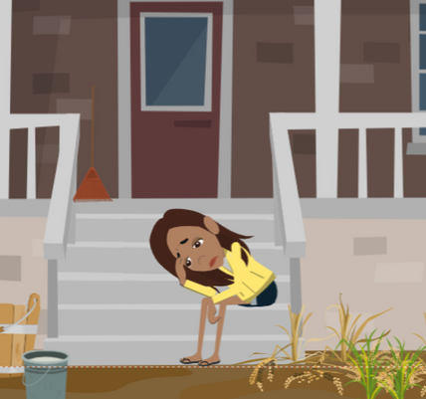
LESSON PLANS
ECONOMIC FACTORS
What economic conditions can increase risk in rural communities?
rural
RISKS
©2024-2026 Walking Wise
46
3

Slide 47
ECONOMIC PRESSURES
Trafficking Risk Factors
Limited Jobs: Fewer local jobs can make it hard for families and teens to earn an income.
rural
RISKS
©2024-2026 Walking Wise
47
Notes:
• PROFESSIONALS
Many professionals in a community—such as law enforcement, healthcare workers, educators, and social service providers—care deeply about keeping young people safe. In rural or low-population areas, however, there are often fewer staff, less funding, and limited access to specialized training. These challenges can make it harder to recognize and respond to trafficking situations. This does not mean people are ignoring the problem; it means resources are limited. Education and awareness help strengthen a community’s ability to protect and support victims.
• SCARCE EMPLOYMENT
Fewer employers and job opportunities are available to adults from rural communities, which can make it harder for some families to make ends meet on lower incomes.
• POVERTY
This is a critical condition that may cause an adult to exploit children from their own family, often requiring them to help pay for rent, food, alcohol, or support drug habits.
• TRANSPORTATION
A lack of transportation access limits workforce participation.

Slide 48
ECONOMIC PRESSURES
Trafficking Risk Factors
Lower Wages: Many rural jobs pay less, making it harder to meet basic needs.
rural
RISKS
©2024-2026 Walking Wise
48
Notes:
• PROFESSIONALS
Many professionals in a community—such as law enforcement, healthcare workers, educators, and social service providers—care deeply about keeping young people safe. In rural or low-population areas, however, there are often fewer staff, less funding, and limited access to specialized training. These challenges can make it harder to recognize and respond to trafficking situations. This does not mean people are ignoring the problem; it means resources are limited. Education and awareness help strengthen a community’s ability to protect and support victims.
• SCARCE EMPLOYMENT
Fewer employers and job opportunities are available to adults from rural communities, which can make it harder for some families to make ends meet on lower incomes.
• POVERTY
This is a critical condition that may cause an adult to exploit children from their own family, often requiring them to help pay for rent, food, alcohol, or support drug habits.
• TRANSPORTATION
A lack of transportation access limits workforce participation.

Slide 49
ECONOMIC PRESSURES
Trafficking Risk Factors
Limited Transportation: Without reliable transportation, getting to work can be difficult.
rural
RISKS
©2024-2026 Walking Wise
49
Notes:
• PROFESSIONALS
Many professionals in a community—such as law enforcement, healthcare workers, educators, and social service providers—care deeply about keeping young people safe. In rural or low-population areas, however, there are often fewer staff, less funding, and limited access to specialized training. These challenges can make it harder to recognize and respond to trafficking situations. This does not mean people are ignoring the problem; it means resources are limited. Education and awareness help strengthen a community’s ability to protect and support victims.
• SCARCE EMPLOYMENT
Fewer employers and job opportunities are available to adults from rural communities, which can make it harder for some families to make ends meet on lower incomes.
• POVERTY
This is a critical condition that may cause an adult to exploit children from their own family, often requiring them to help pay for rent, food, alcohol, or support drug habits.
• TRANSPORTATION
A lack of transportation access limits workforce participation.

Slide 50
ECONOMIC PRESSURES
Trafficking Risk Factors
Financial Strain: Some rural families struggle when expenses are higher than their income.
rural
RISKS
©2024-2026 Walking Wise
50
Notes:
• PROFESSIONALS
Many professionals in a community—such as law enforcement, healthcare workers, educators, and social service providers—care deeply about keeping young people safe. In rural or low-population areas, however, there are often fewer staff, less funding, and limited access to specialized training. These challenges can make it harder to recognize and respond to trafficking situations. This does not mean people are ignoring the problem; it means resources are limited. Education and awareness help strengthen a community’s ability to protect and support victims.
• SCARCE EMPLOYMENT
Fewer employers and job opportunities are available to adults from rural communities, which can make it harder for some families to make ends meet on lower incomes.
• POVERTY
This is a critical condition that may cause an adult to exploit children from their own family, often requiring them to help pay for rent, food, alcohol, or support drug habits.
• TRANSPORTATION
A lack of transportation access limits workforce participation.

Slide 51
ECONOMIC PRESSURES
Trafficking Risk Factors
Financial Strain: Some rural families struggle when expenses are higher than their income. This can cause a family to begin trafficking their children.
rural
RISKS
©2024-2026 Walking Wise
51
Notes:
• PROFESSIONALS
Many professionals in a community—such as law enforcement, healthcare workers, educators, and social service providers—care deeply about keeping young people safe. In rural or low-population areas, however, there are often fewer staff, less funding, and limited access to specialized training. These challenges can make it harder to recognize and respond to trafficking situations. This does not mean people are ignoring the problem; it means resources are limited. Education and awareness help strengthen a community’s ability to protect and support victims.
• SCARCE EMPLOYMENT
Fewer employers and job opportunities are available to adults from rural communities, which can make it harder for some families to make ends meet on lower incomes.
• POVERTY
This is a critical condition that may cause an adult to exploit children from their own family, often requiring them to help pay for rent, food, alcohol, or support drug habits.
• TRANSPORTATION
A lack of transportation access limits workforce participation.

Slide 52
EDUCATON GUIDE
VOCABULARY
DESOLATE
A place or situation that is empty, lonely, or abandoned, often making people feel isolated.
rural
RISKS
©2024-2026 Walking Wise
52
3
Notes:
Assisting Source
OpenAI. (2024). ChatGPT [Large language model]. https://chatgpt.com

Slide 53
EDUCATON GUIDE
VOCABULARY
ISOLATE
To separate or cut off from a support network, such as family, friends, or trustworthy adults.
rural
RISKS
©2024-2026 Walking Wise
53
3
Notes:
Assisting Source
OpenAI. (2024). ChatGPT [Large language model]. https://chatgpt.com

Slide 54

LESSON PLANS
HIGHWAY SYSTEM
How do highways help traffickers move quickly and stay hidden?
rural
RISKS
©2024-2026 Walking Wise
54
3

Slide 55
HIGHWAY SYSTEM
Trafficking Risk Factors
Easy Movement: Highways make it easier for traffickers to move victims quickly, making them harder to find.
rural
RISKS
Jarrell, K. L., Pulvino, C., Kimmel, A., Stark, B., Khokhar, H., Janneck, L., & Santen, S. A. (2023). A Case of Human Trafficking in Appalachia and What Emergency Physicians Can Learn from It. Western Journal of Emergency Medicine, 24(3), pp. 465-466.
Federal Highway Administration, U.S. Department of Transportation (n.d.). National Highway System. Fhwa.dot.gov.
©2024-2026 Walking Wise
55
Notes:
• TRANSPORTATION
Due to the length of U.S. highways and the distance that can be achieved in short periods of time, transporting victims can improve a trafficker's likelihood of keeping their criminal activity undetected. Relocating a young person from their community makes it difficult for law enforcement to investigate the victim's disappearance. [1]
• MOTORISTS
The steady flow of out-of-town drivers using freeway systems increases the demand for sex trafficking. The National Highway System (NHS) spans more than 160,000 miles across the U.S. Nearly 1.2 million travelers use the NHS, and a significant 74% of the NHS mileage stretches across rural areas.[2]
• DESOLATE LOCATIONS
Local rest areas, welcome centers, and truck stops along the national highway system and other roadways can make these isolated spots easier to sell victims of sex trafficking to high-way motorists.
Source
1. Jarrell, K. L., Pulvino, C., Kimmel, A., Stark, B., Khokhar, H., Janneck, L., & Santen, S. A. (2023). A Case
of Human Trafficking in Appalachia and What Emergency Physicians Can Learn from It. Western Journal
of Emergency Medicine, 24(3), pp. 465-466. Retrieved May 26, 2024,
from https://www.ncbi.nlm.nih.gov/pmc/articles/PMC10284530/
2. Federal Highway Administration, U.S. Department of Transportation (n.d.). National Highway System. Fhwa.dot.gov. Retrieved March 25, 2024, from https://www.fhwa.dot.gov/ohim/onh00/onh2p6.htm

Slide 56
HIGHWAY SYSTEM
Trafficking Risk Factors
Out-of-Town Drivers: Some criminals use rural highways to reach victims located far from their homes.
rural
RISKS
Jarrell, K. L., Pulvino, C., Kimmel, A., Stark, B., Khokhar, H., Janneck, L., & Santen, S. A. (2023). A Case of Human Trafficking in Appalachia and What Emergency Physicians Can Learn from It. Western Journal of Emergency Medicine, 24(3), pp. 465-466.
Federal Highway Administration, U.S. Department of Transportation (n.d.). National Highway System. Fhwa.dot.gov.
©2024-2026 Walking Wise
56
Notes:
• TRANSPORTATION
Due to the length of U.S. highways and the distance that can be achieved in short periods of time, transporting victims can improve a trafficker's likelihood of keeping their criminal activity undetected. Relocating a young person from their community makes it difficult for law enforcement to investigate the victim's disappearance. [1]
• MOTORISTS
The steady flow of out-of-town drivers using freeway systems increases the demand for sex trafficking. The National Highway System (NHS) spans more than 160,000 miles across the U.S. Nearly 1.2 million travelers use the NHS, and a significant 74% of the NHS mileage stretches across rural areas.[2]
• DESOLATE LOCATIONS
Local rest areas, welcome centers, and truck stops along the national highway system and other roadways can make these isolated spots easier to sell victims of sex trafficking to high-way motorists.
Source
1. Jarrell, K. L., Pulvino, C., Kimmel, A., Stark, B., Khokhar, H., Janneck, L., & Santen, S. A. (2023). A Case
of Human Trafficking in Appalachia and What Emergency Physicians Can Learn from It. Western Journal
of Emergency Medicine, 24(3), pp. 465-466. Retrieved May 26, 2024,
from https://www.ncbi.nlm.nih.gov/pmc/articles/PMC10284530/
2. Federal Highway Administration, U.S. Department of Transportation (n.d.). National Highway System. Fhwa.dot.gov. Retrieved March 25, 2024, from https://www.fhwa.dot.gov/ohim/onh00/onh2p6.htm

Slide 57
HIGHWAY SYSTEM
Trafficking Risk Factors
Isolated Locations: Rest areas, welcome centers, & truck stops can be isolated, making it easy to hide crimes.
rural
RISKS
Jarrell, K. L., Pulvino, C., Kimmel, A., Stark, B., Khokhar, H., Janneck, L., & Santen, S. A. (2023). A Case of Human Trafficking in Appalachia and What Emergency Physicians Can Learn from It. Western Journal of Emergency Medicine, 24(3), pp. 465-466.
Federal Highway Administration, U.S. Department of Transportation (n.d.). National Highway System. Fhwa.dot.gov.
©2024-2026 Walking Wise
57
Notes:
• TRANSPORTATION
Due to the length of U.S. highways and the distance that can be achieved in short periods of time, transporting victims can improve a trafficker's likelihood of keeping their criminal activity undetected. Relocating a young person from their community makes it difficult for law enforcement to investigate the victim's disappearance. [1]
• MOTORISTS
The steady flow of out-of-town drivers using freeway systems increases the demand for sex trafficking. The National Highway System (NHS) spans more than 160,000 miles across the U.S. Nearly 1.2 million travelers use the NHS, and a significant 74% of the NHS mileage stretches across rural areas.[2]
• DESOLATE LOCATIONS
Local rest areas, welcome centers, and truck stops along the national highway system and other roadways can make these isolated spots easier to sell victims of sex trafficking to high-way motorists.
Source
1. Jarrell, K. L., Pulvino, C., Kimmel, A., Stark, B., Khokhar, H., Janneck, L., & Santen, S. A. (2023). A Case
of Human Trafficking in Appalachia and What Emergency Physicians Can Learn from It. Western Journal
of Emergency Medicine, 24(3), pp. 465-466. Retrieved May 26, 2024,
from https://www.ncbi.nlm.nih.gov/pmc/articles/PMC10284530/
2. Federal Highway Administration, U.S. Department of Transportation (n.d.). National Highway System. Fhwa.dot.gov. Retrieved March 25, 2024, from https://www.fhwa.dot.gov/ohim/onh00/onh2p6.htm

Slide 58
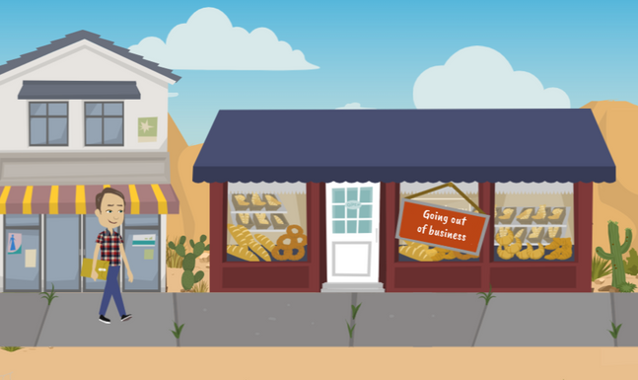
LESSON PLANS
LOW POPULATION
Why can living in a low-population community make it harder for victims to get help?
rural
RISKS
©2024-2026 Walking Wise
58
3

Slide 59
LOW POPULATION
Rural Community Challenges
Law Enforcement: Rural areas often have fewer officers and less training to recognize and respond to trafficking cases.
rural
RISKS
Cole, J., & Sprang, G. (2015). Sex trafficking of minors in Metropolitan, Micropolitan, and Rural Communities. Child Abuse & Neglect, 40, 114.
Jarrell, K. L., Pulvino, C., Kimmel, A., Stark, B., Khokhar, H., Janneck, L., & Santen, S. A. (2023). A Case of Human Trafficking in Appalachia and What Emergency Physicians Can Learn from It. Western Journal of Emergency Medicine, 24(3), p. 463.
©2024-2026 Walking Wise
59
Notes:
• LAW ENFORCEMENT
Rural areas tend to have smaller police departments and are often under-resourced. Often, police officers receive limited training; therefore, they are less experienced in identifying and eliminating sex trafficking crimes.[1]
• HEALTHCARE
A 2023 Appalachia study shared that as many as 60% to 88% of survey respondents were actively being trafficked when they sought medical treatment at a hospital emergency department. Due to training limitations, clinicians often lack confidence in recognizing and caring for victims. The study found that less than 5% of emergency physicians believed they could identify trafficked victims among their patients.[2]
• SUPPORT SERVICES
The smaller the community, the less likely support services are available locally for victims to receive the care needed for recovery. As a result, survivors often must travel long distances to receive the help they need. Transportation can be difficult because victims may be under driving age, do not have a driver's license, or do not have access to transportation.
Source
1. Cole, J., & Sprang, G. (2015). Sex trafficking of minors in Metropolitan, Micropolitan, and Rural Communities. Child Abuse & Neglect, 40, 114. https://doi.org/10.1016/j.chiabu.2014.07.015. Retrieved December 14, 2024, from https://www.researchgate.net/publication/265019363_Sex_trafficking_of_minors_in_metropolitan_micropolitan_and_rural_communities
2. Jarrell, K. L., Pulvino, C., Kimmel, A., Stark, B., Khokhar, H., Janneck, L., & Santen, S. A. (2023). A Case of Human Trafficking in Appalachia and What Emergency Physicians Can Learn from It. Western Journal of Emergency Medicine, 24(3), p. 463. Retrieved December 14, 2024, from https://www.ncbi.nlm.nih.gov/pmc/articles/PMC10284530/

Slide 60
LOW POPULATION
Rural Community Challenges
Healthcare: Some doctors and nurses may not be trained to spot trafficking, making it harder to identify victims.
rural
RISKS
Cole, J., & Sprang, G. (2015). Sex trafficking of minors in Metropolitan, Micropolitan, and Rural Communities. Child Abuse & Neglect, 40, 114.
Jarrell, K. L., Pulvino, C., Kimmel, A., Stark, B., Khokhar, H., Janneck, L., & Santen, S. A. (2023). A Case of Human Trafficking in Appalachia and What Emergency Physicians Can Learn from It. Western Journal of Emergency Medicine, 24(3), p. 463.
©2024-2026 Walking Wise
60
Notes:
• LAW ENFORCEMENT
Rural areas tend to have smaller police departments and are often under-resourced. Often, police officers receive limited training; therefore, they are less experienced in identifying and eliminating sex trafficking crimes.[1]
• HEALTHCARE
A 2023 Appalachia study shared that as many as 60% to 88% of survey respondents were actively being trafficked when they sought medical treatment at a hospital emergency department. Due to training limitations, clinicians often lack confidence in recognizing and caring for victims. The study found that less than 5% of emergency physicians believed they could identify trafficked victims among their patients.[2]
• SUPPORT SERVICES
The smaller the community, the less likely support services are available locally for victims to receive the care needed for recovery. As a result, survivors often must travel long distances to receive the help they need. Transportation can be difficult because victims may be under driving age, do not have a driver's license, or do not have access to transportation.
Source
1. Cole, J., & Sprang, G. (2015). Sex trafficking of minors in Metropolitan, Micropolitan, and Rural Communities. Child Abuse & Neglect, 40, 114. https://doi.org/10.1016/j.chiabu.2014.07.015. Retrieved December 14, 2024, from https://www.researchgate.net/publication/265019363_Sex_trafficking_of_minors_in_metropolitan_micropolitan_and_rural_communities
2. Jarrell, K. L., Pulvino, C., Kimmel, A., Stark, B., Khokhar, H., Janneck, L., & Santen, S. A. (2023). A Case of Human Trafficking in Appalachia and What Emergency Physicians Can Learn from It. Western Journal of Emergency Medicine, 24(3), p. 463. Retrieved December 14, 2024, from https://www.ncbi.nlm.nih.gov/pmc/articles/PMC10284530/

Slide 61
LOW POPULATION
Rural Community Challenges
Support Services: Small towns may lack nearby shelters or counselors, and victims may lack transportation to reach help.
rural
RISKS
Cole, J., & Sprang, G. (2015). Sex trafficking of minors in Metropolitan, Micropolitan, and Rural Communities. Child Abuse & Neglect, 40, 114.
Jarrell, K. L., Pulvino, C., Kimmel, A., Stark, B., Khokhar, H., Janneck, L., & Santen, S. A. (2023). A Case of Human Trafficking in Appalachia and What Emergency Physicians Can Learn from It. Western Journal of Emergency Medicine, 24(3), p. 463.
©2024-2026 Walking Wise
61
Notes:
• LAW ENFORCEMENT
Rural areas tend to have smaller police departments and are often under-resourced. Often, police officers receive limited training; therefore, they are less experienced in identifying and eliminating sex trafficking crimes.[1]
• HEALTHCARE
A 2023 Appalachia study shared that as many as 60% to 88% of survey respondents were actively being trafficked when they sought medical treatment at a hospital emergency department. Due to training limitations, clinicians often lack confidence in recognizing and caring for victims. The study found that less than 5% of emergency physicians believed they could identify trafficked victims among their patients.[2]
• SUPPORT SERVICES
The smaller the community, the less likely support services are available locally for victims to receive the care needed for recovery. As a result, survivors often must travel long distances to receive the help they need. Transportation can be difficult because victims may be under driving age, do not have a driver's license, or do not have access to transportation.
Source
1. Cole, J., & Sprang, G. (2015). Sex trafficking of minors in Metropolitan, Micropolitan, and Rural Communities. Child Abuse & Neglect, 40, 114. https://doi.org/10.1016/j.chiabu.2014.07.015. Retrieved December 14, 2024, from https://www.researchgate.net/publication/265019363_Sex_trafficking_of_minors_in_metropolitan_micropolitan_and_rural_communities
2. Jarrell, K. L., Pulvino, C., Kimmel, A., Stark, B., Khokhar, H., Janneck, L., & Santen, S. A. (2023). A Case of Human Trafficking in Appalachia and What Emergency Physicians Can Learn from It. Western Journal of Emergency Medicine, 24(3), p. 463. Retrieved December 14, 2024, from https://www.ncbi.nlm.nih.gov/pmc/articles/PMC10284530/

Slide 62
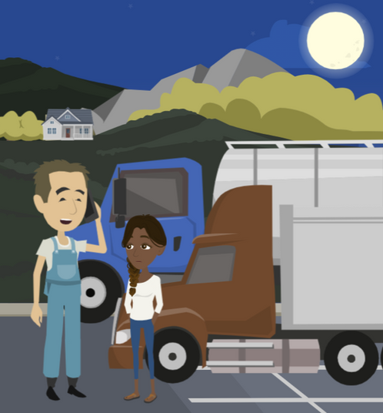
TRUCKER TRAINING
How can truck and bus drivers help combat human trafficking crimes?
rural
RISKS
©2024-2026 Walking Wise
62

Slide 63
TRUCKER TRAINING
Truckers Against Trafficking (TAT)
Training: Drivers learn how to notice warning signs and safely report situations that may involve trafficking.
rural
RISKS
©2024-2026 Walking Wise
TAT - Truckers Against Trafficking (2024), tatnonprofit.org.
63
Notes:
• TRUCKING INDUSTRY
Some national trucking organizations educate their drivers to recognize suspicious activity along their driving routes and train them on how to report suspected instances of human trafficking to law enforcement and the National Human Trafficking Hotline.
• TRUCKERS AGAINST TRAFFICKING (TAT)
TAT trains employees from the transportation industry, such as trucking companies, truck stop companies, bussing companies, public transit agencies, energy companies, and moving companies, to recognize the indicators that can appear when a person is trafficked.
Source
TAT - Truckers Against Trafficking (2024), tatnonprofit.org. Retrieved December 14, 2024, from https://truckersagainsttrafficking.org/app/?gad_source=1&gclid=CjwKCAiA0PuuBhBsEiwAS7fsNSq5oE6knuvrvM82A3hQizmWflNfJ5m_MohWoOz5cnTTF5nhibztyBoCj3YQAvD_BwE

Slide 64
TRUCKER TRAINING
Truckers Against Trafficking (TAT)
TAT App: A free app allows drivers to learn red flags and report suspicious activity related to sex and labor trafficking.
rural
RISKS
©2024-2026 Walking Wise
TAT - Truckers Against Trafficking (2024), tatnonprofit.org.
64
Notes:
• TRUCKING INDUSTRY
Some national trucking organizations educate their drivers to recognize suspicious activity along their driving routes and train them on how to report suspected instances of human trafficking to law enforcement and the National Human Trafficking Hotline.
• TRUCKERS AGAINST TRAFFICKING (TAT)
TAT trains employees from the transportation industry, such as trucking companies, truck stop companies, bussing companies, public transit agencies, energy companies, and moving companies, to recognize the indicators that can appear when a person is trafficked.
Source
TAT - Truckers Against Trafficking (2024), tatnonprofit.org. Retrieved December 14, 2024, from https://truckersagainsttrafficking.org/app/?gad_source=1&gclid=CjwKCAiA0PuuBhBsEiwAS7fsNSq5oE6knuvrvM82A3hQizmWflNfJ5m_MohWoOz5cnTTF5nhibztyBoCj3YQAvD_BwE

Slide 65
TRUCKER TRAINING
Truckers Against Trafficking (TAT)
School Bus Drivers: Some bus drivers receive TAT training to recognize signs of exploitation to help protect students.
rural
RISKS
©2024-2026 Walking Wise
TAT - Truckers Against Trafficking (2024), tatnonprofit.org.
65
Notes:
• TRUCKING INDUSTRY
Some national trucking organizations educate their drivers to recognize suspicious activity along their driving routes and train them on how to report suspected instances of human trafficking to law enforcement and the National Human Trafficking Hotline.
• TRUCKERS AGAINST TRAFFICKING (TAT)
TAT trains employees from the transportation industry, such as trucking companies, truck stop companies, bussing companies, public transit agencies, energy companies, and moving companies, to recognize the indicators that can appear when a person is trafficked.
Source
TAT - Truckers Against Trafficking (2024), tatnonprofit.org. Retrieved December 14, 2024, from https://truckersagainsttrafficking.org/app/?gad_source=1&gclid=CjwKCAiA0PuuBhBsEiwAS7fsNSq5oE6knuvrvM82A3hQizmWflNfJ5m_MohWoOz5cnTTF5nhibztyBoCj3YQAvD_BwE

Slide 66
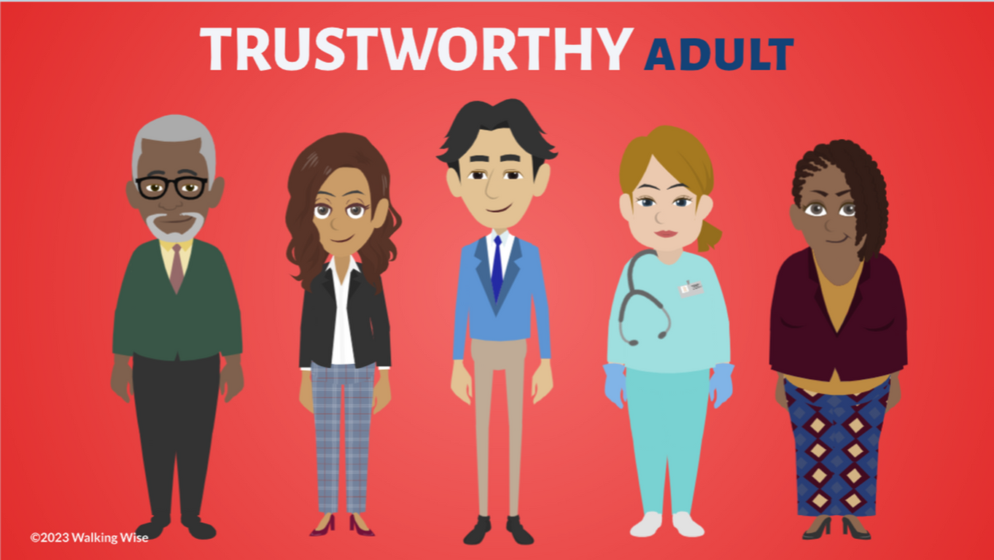
ASK FOR HELP
©2024-2026 Walking Wise
66

Slide 67

ASK FOR HELP
What are ways young people can ask for help?
©2024-2026 Walking Wise
67

Slide 68
ASK FOR HELP
How to Ask for Help
If you are in immediate danger, dial 911.
©2024-2026 Walking Wise
68

Slide 69
ASK FOR HELP
How to Ask for Help
If you are in immediate danger, dial 911.
If the sexual predator IS a family member, consider telling a trustworthy adult.
©2024-2026 Walking Wise
69

Slide 70
ASK FOR HELP
How to Ask for Help
If you are in immediate danger, dial 911.
If the sexual predator IS a family member, consider telling a trustworthy adult.
If the sexual predator is NOT family, consider telling a parent.
©2024-2026 Walking Wise
70

Slide 71
ASK FOR HELP
How to Ask for Help
If you are in immediate danger, dial 911.
If the sexual predator IS a family member, consider telling a trustworthy adult.
If the sexual predator is NOT family, consider telling a parent.
If you are a student in school, consider telling a trustworthy teacher, coach, school nurse, social worker, counselor, resource officer, or principal.
©2024-2026 Walking Wise
71

Slide 72
ASK FOR HELP
How to Ask for Help
If you are in immediate danger, dial 911.
If the sexual predator IS a family member, consider telling a trustworthy adult.
If the sexual predator is NOT family, consider telling a parent.
If you are a student in school, consider telling a trustworthy teacher, coach, school nurse, social worker, counselor, resource officer, or principal.
To gain internet access for help, consider using a computer at your school or a public library.
©2024-2026 Walking Wise
72

Slide 73
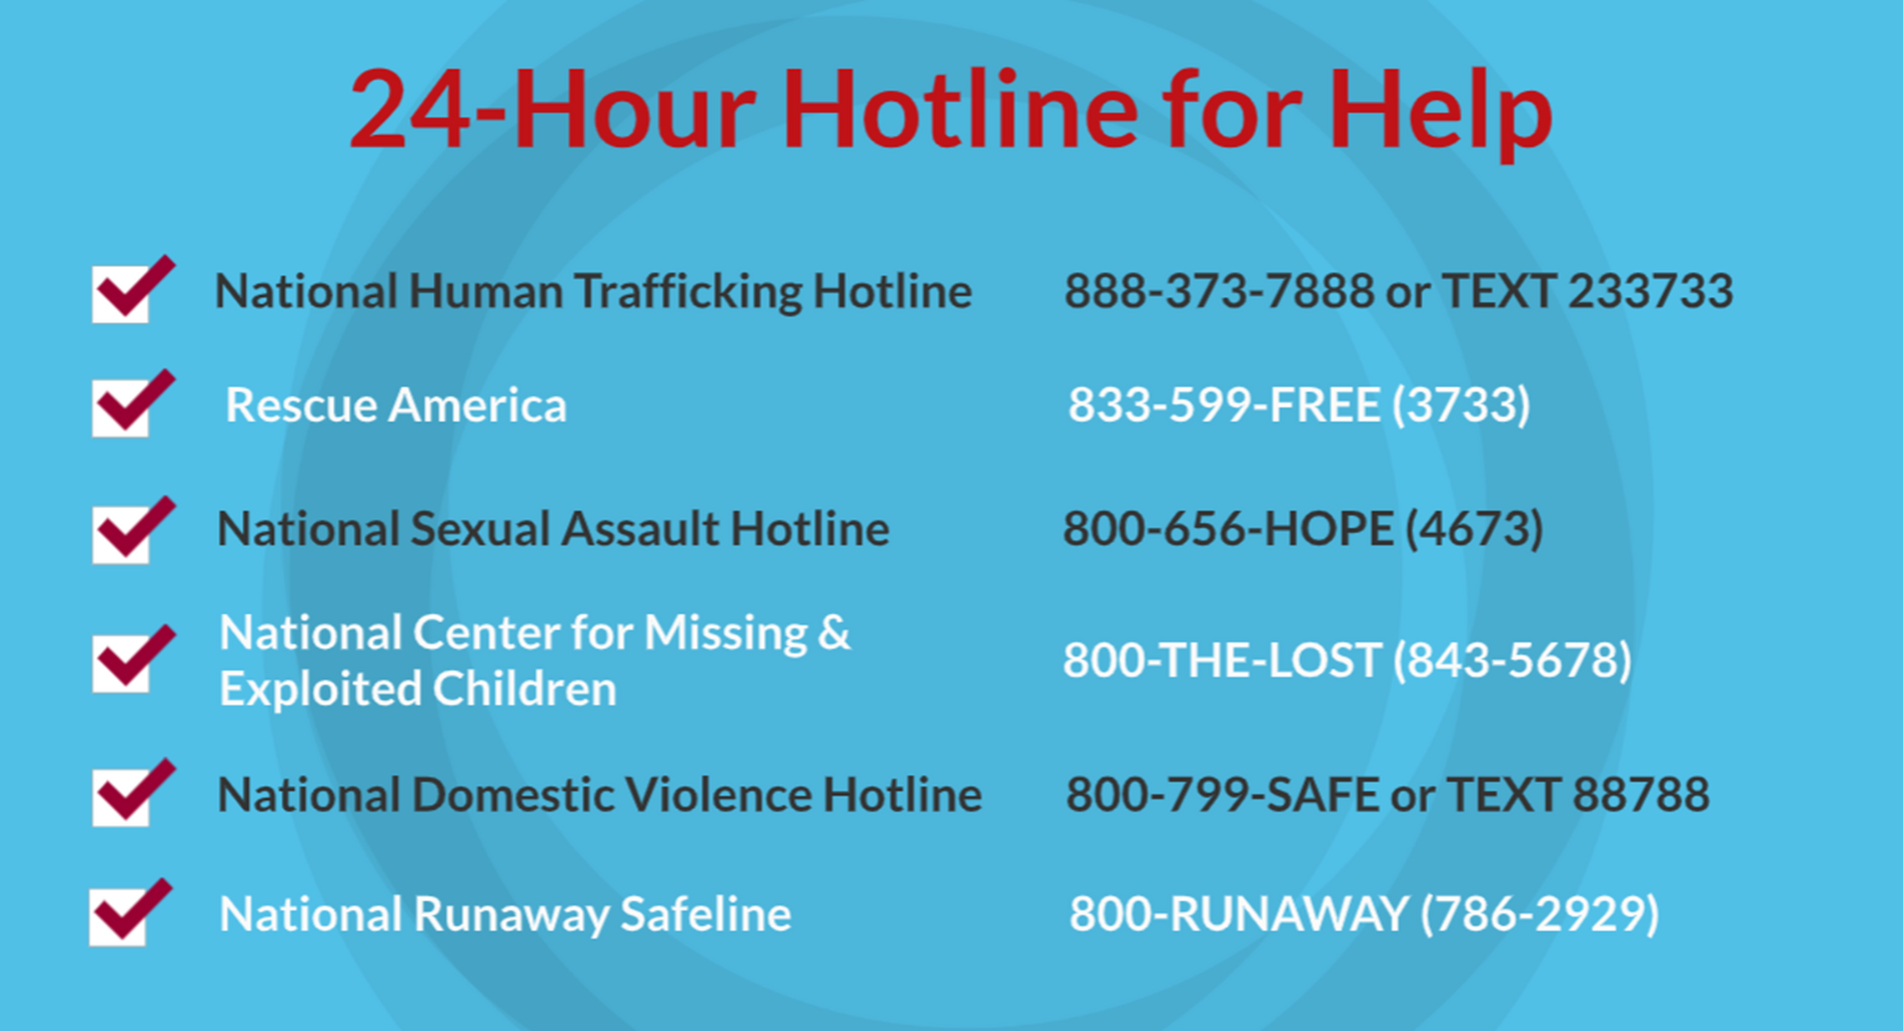
©2024-2026 Walking Wise
73
Notes:
NOTE
Presenters may ask their audience to consider adding a few "hotline for help" phone numbers in their cell phone contacts or take a photo of this slide.

Slide 74
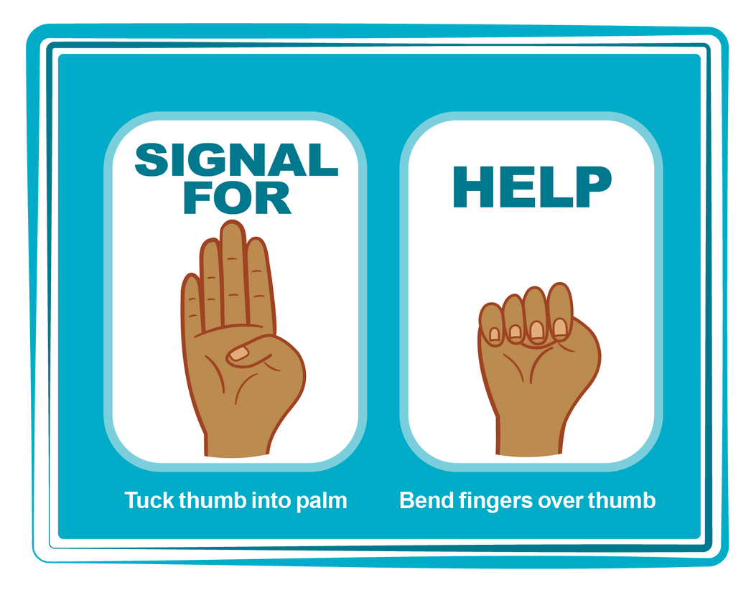
HAND SIGNAL FOR HELP
©2024-2026 Walking Wise
Source: Canadian Women’s Foundation, April 2020
74
Notes:
Although the hand signal for help has not yet achieved universal recognition, it may discreetly get someone's attention in urgent situations.
• SILENT
It can be used silently.
• UNTRACKABLE
It leaves no digital footprint.
• CONCEALED
It can be done secretly when a perpetrator is in the vicinity.
• SIGNALS DISTRESS
Combining the hand signal with distressed facial expressions might help attract the attention of an individual who is unfamiliar with the signal's meaning.
Source
Canadian Women's Foundation, April 2020

Slide 75
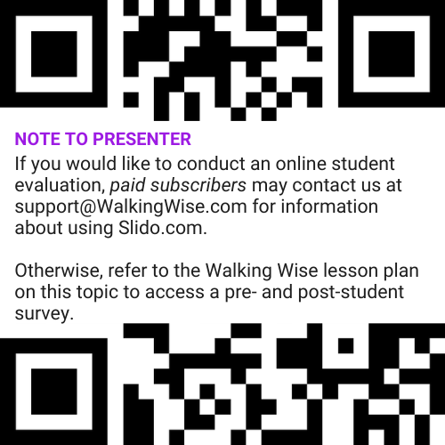
EVALUATION
©2024-2026 Walking Wise
75
Notes:
Two ways to conduct a pre-/post-student evaluation:
1) Use the pre/post survey in the Walking Wise lesson plan for this topic.
2) Activate Slido.com to conduct an online survey.

Slide 76

SHARE YOUR THOUGHTS
1. How would you rate this lesson?
2. What was the one thing you liked?
3. What one thing should we improve?
If using Slido: Replace “#XXXX” with your organization’s custom Slido code.
©2024-2026 Walking Wise
76
Notes:
SLIDO.com: 3-Question Survey
IF SLIDO IS ACTIVATED:
Follow the instructions provided on WalkingWise.com to access your school or organization's custom Slido QR code and #code, which the audience will use to complete the 3-question evaluation.
Please encourage your audience to scan your organization's custom QR code to share what they enjoyed and what could be improved about the lesson.
Please send any feedback you want to share to Walking Wise at support@WalkingWise.com.

Slide 77


Thank you!
WalkingWise.com
Online Course for Adults Accredited by:
Postgraduate Institue for Medicine
Academy of Forensic Nursing
©2024-2026 Walking Wise
77
Notes:
NOTE
To access additional resources on rural risks, please refer to the last page of Lesson Plan #8 in the Walking Wise Education Guide.
We welcome your feedback at support@WalkingWise.com.
Thank you!
Karla Highman
Founder, WalkingWise.com

