Slide 1


SEXUAL EXPLOITATION
EDUCATION
rural
RISKS
BY WALKING WISE
Notes:
NOTE TO PRESENTER
Log in to WalkingWise.com and refer to the Implementation Toolkit for classroom teaching tips.
Most importantly:
DEFINE SCHOOL POLICY
Establish a sexual exploitation reporting protocol with a trauma-informed response. The Walking Wise Implementation Toolkit provides a sample protocol.
AGE & AUDIENCE
This presentation can be edited by following the procedures on page 3 to align with your school policies, specific age groups, and the involvement of at-risk audiences.
SUPPORT PROCEDURE
Provide your students with guidance on how to access immediate help or arrange a private meeting with a social worker, counselor, nurse, school resource officer, or another trustworthy staff member to report concerns about themselves or a peer.
SECOND SAFE ADULT
Ensure a second trustworthy adult, such as a teacher, is present in the learning setting to observe student reactions and identify those who may benefit from a follow-up meeting. This person should remain focused and free from other duties during the presentation.

Slide 2

6-Year Track
NOTE TO PRESENTER
Meaningful learning takes time. By introducing topics gradually over several years, educators can create steady growth in awareness and understanding.
Our recommended teaching plan offers a long-term path for middle and high school students to build knowledge and confidence.
PARENTS & STAFF
#1 Myths & Reality
6th GRADE
#2 Trustworthy vs. Unsafe Adult
#3 Grooming Process
7th GRADE
#4 Pornography Link
#5 Sextortion Scheme
8th GRADE
#6 Male Victims
#7 Runaways as Targets
#8 Rural Risks
9th GRADE
#9 Human Traffickers
#10 Female & Peer Recruiters
10th GRADE
#11 Family Secret
11th GRADE
#12 Hidden Buyers
©2024-2026 Walking Wise
2

Slide 3

NOTE TO PRESENTER
This presentation is exclusively for Walking Wise® subscribers and not for redistribution.
Presenters are encouraged to edit speaker notes to match their speaking style (viewable in presentation mode). You can also delete slides and content from this Walking Wise presentation to ensure the information aligns with your school policies, is age-appropriate, and fits within available class time. However, the slides are copyright-protected and may not be reworded without prior written permission from Walking Wise.
We encourage you to add your own content by following these instructions:
Insert new PowerPoint slides.
Remove the Walking Wise logo and copyright "©2026 Walking Wise" from the new slides.
Always add your organization's name or logo to each new slide.
Please delete this instruction page before presenting to audiences.
R042726
©2024-2026 Walking Wise
3
Notes:
NOTE TO PRESENTER
The presenter is welcome to customize this Walking Wise presentation according to the instructions provided on this page.
For revision requests, please email us at: support@WalkingWise.com.

Slide 4
SENSITIVE TOPICS WILL BE DISCUSSED
CONTENT NOTICE
We’ll be discussing serious safety issues today.
Some topics may be difficult to hear.
If you ever feel uncomfortable, you can step out and speak with a trustworthy adult for support.
You’re not alone—help is available.
©2024-2026 Walking Wise
4
Notes:
NOTE TO PRESENTER
Trauma-Informed Delivery Guidelines
To support a safe and effective learning environment, please follow these guidelines:
• Present the information in a calm, matter-of-fact way and avoid sensational or alarming language.
• Avoid graphic details. Focus on helping students understand behaviors, risk, and ways to stay safe.
• Never blame victims. Responsibility always belongs to the person who caused harm.
• Maintain a steady, composed tone. Students often mirror the presenter's emotional cues.
• Do not ask students to share personal experiences or disclosures.
• If students laugh or react awkwardly, respond neutrally and gently redirect the focus.
• Pair all risk information with needed resources, practical solutions, and support options.
• Reinforce that students are not alone and that trustworthy adults are available to help.

Slide 5
STATISTICS
Why Study Results Can Vary
Some crimes are never reported, making it hard to reveal the entire issue.
Studies collect information in different ways, leading to different results.
Small studies may not represent everyone.
©2024-2026 Walking Wise
5
Notes:
In this presentation, we'll discuss statistics, but it's important to note that while statistics provide valuable insights into an issue, they cannot be relied upon entirely.
Here are a few reasons:
UNREPORTED
Victims often do not report the crimes committed against them due to fear, shame, retaliation, or manipulation. Also, many don’t realize that what is happening to them is a crime.
INCONSISTENT COLLECTION
Areas may define sexual crimes in various ways or use different methods to collect data, making it hard to compare information.
FOCUS GROUPS
Small or specific focus groups participating in a study or survey may not accurately reflect the diversity or experiences of the broader population.

Slide 6

WHY LEARN ABOUT THIS
KNOWLEDGE serves as a
powerful defense against
sexual predators.
©2024-2026 Walking Wise
6
Notes:
Education is one of the strongest tools for preventing exploitation.
When young people understand how predators operate, they are better able to recognize manipulation and avoid dangerous situations.
Reinforce that awareness increases safety.

Slide 7
PREVENTION EDUCATION
SEXUAL EXPLOITATION includes grooming, sextortion, pornography
& sex trafficking.
©2024-2026 Walking Wise
7
Notes:
SEXUAL EXPLOITATION
Taking advantage of another person for their own benefit, especially in a sexual way, often using pressure, tricks, or control.
Below are different forms of exploitation:
GROOMING
Building trust, dependency, or an emotional connection to manipulate someone.
SEXTORTION
Threatening to share embarrassing or sexual images, videos, or information to pressure someone into following demands.
PORNOGRAPHY
Involving someone in creating sexual images who is under 18, or someone who is pressured, or unable/unwilling to give consent.
SEX TRAFFICKING
Manipulating or forcing someone into sexual activity in exchange for money or something of value.
Trafficking and Violence Protection Act (TVPA) of 2000 (Legal Definition):
SEX TRAFFICKING is the recruitment, harboring, transportation, provision, obtaining, patronizing, or soliciting of a person under the age of 18 for the purpose of a commercial sex act.
TVPA link: Retrieved April 14, 2026, from https://www.govinfo.gov/content/pkg/BILLS-106hr3244enr/pdf/BILLS-106hr3244enr.pdf

Slide 8
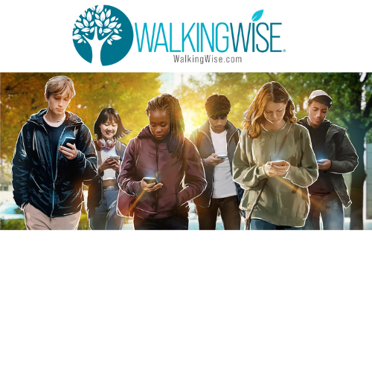


EDUCATON GUIDE
VOCABULARY
Words to Understand
Rural
Bond
Tight Knit
Rumor
Family Trafficking
Poverty
Desolate
Isolate
rural
RISKS
©2024-2026 Walking Wise
8
3
Notes:
Understanding vocabulary terms related to the behaviors of sexual predators can empower young people to recognize warning signs of harmful situations.
Knowing these terms helps them identify manipulative tactics that unsafe people (predators/traffickers) use to build trust and exploit vulnerabilities.
With this knowledge, young people are better equipped to spot red flags, understand that these behaviors are abusive, and feel more confident reporting predators to trusted adults or authorities, potentially preventing further harm.

Slide 9
EDUCATON GUIDE
VOCABULARY
RURAL
Areas located outside of cities with low populations, open spaces, and an emphasis on agriculture and natural resources.
rural
RISKS
©2024-2026 Walking Wise
9
3

Slide 10
LESSON PLANS
WHAT DO YOU THINK?
What percentage of U.S. land and population is considered rural?
©2024-2026 Walking Wise
10
3

Slide 11
WHAT DO YOU THINK?
What percentage of the U.S. land and population is considered rural?
A) 57% Land & 40% Population
B) 77% Land & 50% Population
C) 87% Land & 60% Population
D) 97% land & 20% Population
©2024-2026 Walking Wise
11

Slide 12
ANSWER
97% of land and 20% of the population
make up the rural communities in the U.S.
©2024-2026 Walking Wise
U.S. Census.gov, 2020. https://www.census.gov/programs-surveys/geography/guidance/geo-areas/urban-rural/2020-ua-facts.html
12
Notes:
LANDMASS
In the United States, 97% of its land area is rural.[1]
POPULATION
Approximately one in five (20%) Americans, or 66.3 million, live in rural communities.[2]
Source
1. U.S. Census.gov, 2017
2. U.S. Census.gov, 2020
https://www.census.gov/programs-surveys/geography/guidance/geo-areas/urban-rural/2020-ua-facts.html

Slide 13
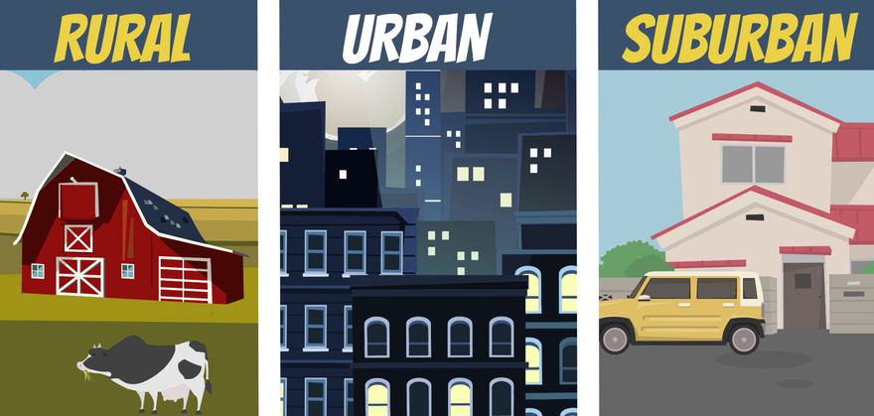
U.S. COMMUNITIES
What are the differences between rural, urban, and suburban communities?
rural
RISKS
©2024-2026 Walking Wise
13

Slide 14
U.S. COMMUNITIES
What Makes Each Community Different?
Rural Areas: Small towns and farmlands with fewer people, long distances between places, and limited transportation.
©2024-2026 Walking Wise
14
Notes:
Where a person lives can affect the types of risks they may face related to human trafficking.
RURAL: In rural areas, distance and isolation may make it harder to get help.
URBAN: In urban areas, crowded spaces may make it easier for traffickers to blend in and target people without being noticed.
SUBURBAN: In suburban areas, risks may come from people who are known or trusted.
These differences do not mean one type of community is “safe,” and another is “dangerous,” but they do show why prevention and awareness may vary across communities.

Slide 15
U.S. COMMUNITIES
What Makes Each Community Different?
Urban Areas: Large, busy cities with many people, public transportation, and crowded spaces.
©2024-2026 Walking Wise
15
Notes:
Where a person lives can affect the types of risks they may face related to human trafficking.
RURAL: In rural areas, distance and isolation may make it harder to get help.
URBAN: In urban areas, crowded spaces may make it easier for traffickers to blend in and target people without being noticed.
SUBURBAN: In suburban areas, risks may come from people who are known or trusted.
These differences do not mean one type of community is “safe,” and another is “dangerous,” but they do show why prevention and awareness may vary across communities.

Slide 16
U.S. COMMUNITIES
What Makes Each Community Different?
Suburban Areas: Neighborhoods outside cities where people often have easier access to nearby schools, jobs, and services.
©2024-2026 Walking Wise
16
Notes:
Where a person lives can affect the types of risks they may face related to human trafficking.
RURAL: In rural areas, distance and isolation may make it harder to get help.
URBAN: In urban areas, crowded spaces may make it easier for traffickers to blend in and target people without being noticed.
SUBURBAN: In suburban areas, risks may come from people who are known or trusted.
These differences do not mean one type of community is “safe,” and another is “dangerous,” but they do show why prevention and awareness may vary across communities.

Slide 17
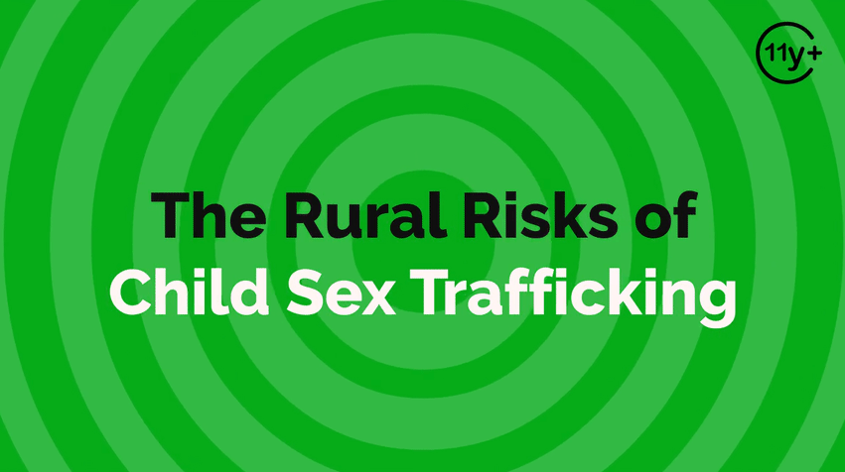
Log in to WalkingWise.com to access this animated video.
©2024-2026 Walking Wise
17
Notes:
This 3-minute Walking Wise animated video series teaches how sexual predators use manipulation, intimidation, and coercion to exploit young people.
NOTE
Log in to Walking Wise.com to watch the three-minute animated video with audiences.
Is animation appropriate for teens?
Yes, even businesses worldwide use explainer-style animation as a training tool for their employees.

Slide 18
LESSON PLANS
WHAT DO YOU THINK?
In which communities might young people face higher risks of human trafficking?
©2024-2026 Walking Wise
18
3

Slide 19
WHAT DO YOU THINK?
In which communities might young people face higher risks of human trafficking?
A) Urban Cities
B) Suburbs
C) Rural America
D) All Communities
©2024-2026 Walking Wise
19

Slide 20
ANSWER
All Communities. Human trafficking impacts people living in ALL types of U.S. communities.
©2024-2026 Walking Wise
20

Slide 21
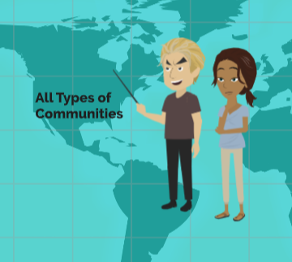
COMMON RISKS
What conditions can make young people vulnerable in any community?
rural
RISKS
©2024-2026 Walking Wise
21

Slide 22
COMMON RISKS
Trafficking Across Communities
Traffickers use similar tactics in rural, suburban, and urban areas.
©2024-2026 Walking Wise
Polaris Project (n.d.). Human Trafficking During the COVID and Post-COVID Era. Polarisproject.org, p. 6.
22
Notes:
Even though communities may look different—whether rural, suburban, or urban—the risks of trafficking can exist everywhere.
It’s important to understand that no community is completely safe or completely unsafe. Trafficking can occur in any setting, but some groups of people are at greater risk than others.
While the environment may change, traffickers' behaviors remain very similar. They use the same kinds of tactics and look for similar situations, no matter where they are.
Source
Demand Abolition (2018, November). Who Buys Sex? Understanding and Disrupting Illicit Market Demand. DemandAbolition.org. Retrieved December 31, 2024, from https://www.demandabolition.org/wp-content/uploads/2019/07/Demand-Buyer-Report-July-2019.pdf
Polaris Project (n.d.). Human Trafficking During the COVID and Post-COVID Era. Polarisproject.org, p. 6. Retrieved December 31, 2024, from https://polarisproject.org/wp-content/uploads/2020/07/Hotline-Trends-Report-2023.pdf

Slide 23
COMMON RISKS
Trafficking Across Communities
The location may look different, but the risks are often the same.
©2024-2026 Walking Wise
Polaris Project (n.d.). Human Trafficking During the COVID and Post-COVID Era. Polarisproject.org, p. 6.
23
Notes:
Even though communities may look different—whether rural, suburban, or urban—the risks of trafficking can exist everywhere.
It’s important to understand that no community is completely safe or completely unsafe. Trafficking can occur in any setting, but some groups of people are at greater risk than others.
While the environment may change, traffickers' behaviors remain very similar. They use the same kinds of tactics and look for similar situations, no matter where they are.
Source
Demand Abolition (2018, November). Who Buys Sex? Understanding and Disrupting Illicit Market Demand. DemandAbolition.org. Retrieved December 31, 2024, from https://www.demandabolition.org/wp-content/uploads/2019/07/Demand-Buyer-Report-July-2019.pdf
Polaris Project (n.d.). Human Trafficking During the COVID and Post-COVID Era. Polarisproject.org, p. 6. Retrieved December 31, 2024, from https://polarisproject.org/wp-content/uploads/2020/07/Hotline-Trends-Report-2023.pdf

Slide 24
AT GREATER RISK
Although anyone can be trafficked, what groups face a higher risk?
rural
RISKS
©2024-2026 Walking Wise
24

Slide 25
AT GREATER RISK
Groups More Vulnerable to Exploitation
People living in poverty
©2024-2026 Walking Wise
Cole, J., & Sprang, G. (2015). Sex trafficking of minors in metropolitan, micropolitan, and rural communities. Child Abuse & Neglect, 40, 113–123.
25
Notes:
Source
Cole, J., & Sprang, G. (2015). Sex trafficking of minors in metropolitan, micropolitan, and rural communities. Child Abuse & Neglect, 40, 113–123. Retrieved April 13, 2026, from https://doi.org/10.1016/j.chiabu.2014.07.015

Slide 26
AT GREATER RISK
Groups More Vulnerable to Exploitation
People living in poverty
People who are foreign-born or immigrants
©2024-2026 Walking Wise
Cole, J., & Sprang, G. (2015). Sex trafficking of minors in metropolitan, micropolitan, and rural communities. Child Abuse & Neglect, 40, 113–123.
26
Notes:
Source
Cole, J., & Sprang, G. (2015). Sex trafficking of minors in metropolitan, micropolitan, and rural communities. Child Abuse & Neglect, 40, 113–123. Retrieved April 13, 2026, from https://doi.org/10.1016/j.chiabu.2014.07.015

Slide 27
AT GREATER RISK
Groups More Vulnerable to Exploitation
People living in poverty
People who are foreign-born or immigrants
People who identify as LGBTQ+
©2024-2026 Walking Wise
Cole, J., & Sprang, G. (2015). Sex trafficking of minors in metropolitan, micropolitan, and rural communities. Child Abuse & Neglect, 40, 113–123.
27
Notes:
Source
Cole, J., & Sprang, G. (2015). Sex trafficking of minors in metropolitan, micropolitan, and rural communities. Child Abuse & Neglect, 40, 113–123. Retrieved April 13, 2026, from https://doi.org/10.1016/j.chiabu.2014.07.015

Slide 28
AT GREATER RISK
Groups More Vulnerable to Exploitation
People living in poverty
People who are foreign-born or immigrants
People who identify as LGBTQ+
People from racial or ethnic minority groups
©2024-2026 Walking Wise
Cole, J., & Sprang, G. (2015). Sex trafficking of minors in metropolitan, micropolitan, and rural communities. Child Abuse & Neglect, 40, 113–123.
28
Notes:
Source
Cole, J., & Sprang, G. (2015). Sex trafficking of minors in metropolitan, micropolitan, and rural communities. Child Abuse & Neglect, 40, 113–123. Retrieved April 13, 2026, from https://doi.org/10.1016/j.chiabu.2014.07.015

Slide 29
AT GREATER RISK
Groups More Vulnerable to Exploitation
People living in poverty
People who are foreign-born or immigrants
People who identify as LGBTQ+
People from racial or ethnic minority groups
Migrant and seasonal farm workers
©2024-2026 Walking Wise
Cole, J., & Sprang, G. (2015). Sex trafficking of minors in metropolitan, micropolitan, and rural communities. Child Abuse & Neglect, 40, 113–123.
29
Notes:
Source
Cole, J., & Sprang, G. (2015). Sex trafficking of minors in metropolitan, micropolitan, and rural communities. Child Abuse & Neglect, 40, 113–123. Retrieved April 13, 2026, from https://doi.org/10.1016/j.chiabu.2014.07.015

Slide 30
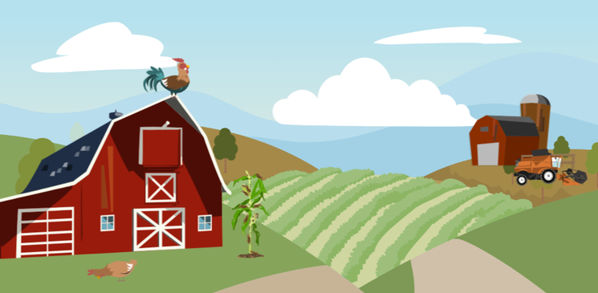
COMMON RISKS
Traffickers often look for the same risk factors, no matter where someone lives.
rural
RISKS
©2024-2026 Walking Wise
30

Slide 31
COMMON RISKS
Traffickers Target Vulnerability
Harm: Young people who have experienced harm or past sexual abuse.
©2024-2026 Walking Wise
Polaris Project (n.d.). Human Trafficking During the COVID and Post-COVID Era. Polarisproject.org, p. 6.
31
Notes:
TAKING ADVANTAGE
Traffickers often look for certain situations that can make young people more vulnerable. These situations can happen in any community—rural, suburban, or urban.
HARM: Young people who have experienced emotional, physical, or sexual abuse may be looking for support, safety, or connection. Traffickers may take advantage of this by pretending to care or offering help.
POVERTY: When someone does not have enough money or basic needs like food or housing, traffickers may offer money, gifts, or a place to stay. These offers may seem helpful at first, but they are often used to gain control.
PRESSURE: Sometimes pressure can come from people a young person knows, such as family members, friends, or a romantic partner. This pressure can make it harder to say no or recognize that something is unsafe.
Remind students:
Traffickers look for situations, and not necessarily specific types of people. Anyone can be at risk, and help is always available.
Source
Demand Abolition (2018, November). Who Buys Sex? Understanding and Disrupting Illicit Market Demand. DemandAbolition.org. Retrieved December 31, 2024, from https://www.demandabolition.org/wp-content/uploads/2019/07/Demand-Buyer-Report-July-2019.pdf
Polaris Project (n.d.). Human Trafficking During the COVID and Post-COVID Era. Polarisproject.org, p. 6. Retrieved December 31, 2024, from https://polarisproject.org/wp-content/uploads/2020/07/Hotline-Trends-Report-2023.pdf

Slide 32
COMMON RISKS
Traffickers Target Vulnerability
Poverty: Not having enough money or basic needs like food, housing, or even a shower.
©2024-2026 Walking Wise
Polaris Project (n.d.). Human Trafficking During the COVID and Post-COVID Era. Polarisproject.org, p. 6.
32
Notes:
TAKING ADVANTAGE
Traffickers often look for certain situations that can make young people more vulnerable. These situations can happen in any community—rural, suburban, or urban.
HARM: Young people who have experienced emotional, physical, or sexual abuse may be looking for support, safety, or connection. Traffickers may take advantage of this by pretending to care or offering help.
POVERTY: When someone does not have enough money or basic needs like food or housing, traffickers may offer money, gifts, or a place to stay. These offers may seem helpful at first, but they are often used to gain control.
PRESSURE: Sometimes pressure can come from people a young person knows, such as family members, friends, or a romantic partner. This pressure can make it harder to say no or recognize that something is unsafe.
Remind students:
Traffickers look for situations, and not necessarily specific types of people. Anyone can be at risk, and help is always available.
Source
Demand Abolition (2018, November). Who Buys Sex? Understanding and Disrupting Illicit Market Demand. DemandAbolition.org. Retrieved December 31, 2024, from https://www.demandabolition.org/wp-content/uploads/2019/07/Demand-Buyer-Report-July-2019.pdf
Polaris Project (n.d.). Human Trafficking During the COVID and Post-COVID Era. Polarisproject.org, p. 6. Retrieved December 31, 2024, from https://polarisproject.org/wp-content/uploads/2020/07/Hotline-Trends-Report-2023.pdf

Slide 33
COMMON RISKS
Traffickers Target Vulnerability
Pressure: Feeling pressure from unsafe people, including family members, peers, or a romantic partner.
©2024-2026 Walking Wise
Polaris Project (n.d.). Human Trafficking During the COVID and Post-COVID Era. Polarisproject.org, p. 6.
33
Notes:
TAKING ADVANTAGE
Traffickers often look for certain situations that can make young people more vulnerable. These situations can happen in any community—rural, suburban, or urban.
HARM: Young people who have experienced emotional, physical, or sexual abuse may be looking for support, safety, or connection. Traffickers may take advantage of this by pretending to care or offering help.
POVERTY: When someone does not have enough money or basic needs like food or housing, traffickers may offer money, gifts, or a place to stay. These offers may seem helpful at first, but they are often used to gain control.
PRESSURE: Sometimes pressure can come from people a young person knows, such as family members, friends, or a romantic partner. This pressure can make it harder to say no or recognize that something is unsafe.
Remind students:
Traffickers look for situations, and not necessarily specific types of people. Anyone can be at risk, and help is always available.
Source
Demand Abolition (2018, November). Who Buys Sex? Understanding and Disrupting Illicit Market Demand. DemandAbolition.org. Retrieved December 31, 2024, from https://www.demandabolition.org/wp-content/uploads/2019/07/Demand-Buyer-Report-July-2019.pdf
Polaris Project (n.d.). Human Trafficking During the COVID and Post-COVID Era. Polarisproject.org, p. 6. Retrieved December 31, 2024, from https://polarisproject.org/wp-content/uploads/2020/07/Hotline-Trends-Report-2023.pdf

Slide 34
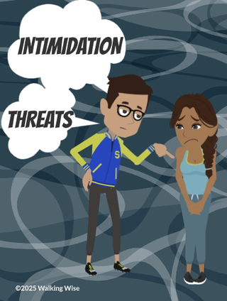
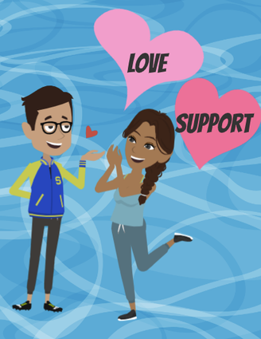
COMMON TACTICS
How do traffickers gain control over someone?
rural
RISKS
©2024-2026 Walking Wise
34

Slide 35
COMMON TACTICS
Traffickers Use the Same Tactics Everywhere
Force: Using threats or violence
©2024-2026 Walking Wise
Polaris Project (n.d.). Human Trafficking During the COVID and Post-COVID Era. Polarisproject.org, p. 6.
35
Notes:
TRAFFICKING CONDITIONS
Even though communities may look different, the situations that make young people vulnerable and the ways traffickers take advantage of them are often very similar everywhere.[1]
FORCE: This means using physical power, threats, or violence to make someone do something against their will.
FRAUD: This means using lies or false promises to trick someone. For example, a trafficker might offer a fake job, make promises about money or opportunities, or pretend to help, when their real goal is to take advantage of the person.[2]
COERCION: This means pressuring someone through threats, fear, or manipulation to make them do something they do not want to do.
Source
Demand Abolition (2018, November). Who Buys Sex? Understanding and Disrupting Illicit Market Demand. DemandAbolition.org. Retrieved December 31, 2024, from https://www.demandabolition.org/wp-content/uploads/2019/07/Demand-Buyer-Report-July-2019.pdf
Polaris Project (n.d.). Human Trafficking During the COVID and Post-COVID Era. Polarisproject.org, p. 6. Retrieved December 31, 2024, from https://polarisproject.org/wp-content/uploads/2020/07/Hotline-Trends-Report-2023.pdf

Slide 36
COMMON TACTICS
Traffickers Use the Same Tactics Everywhere
Force: Using threats or violence
Fraud: Making false promises or lying
©2024-2026 Walking Wise
Polaris Project (n.d.). Human Trafficking During the COVID and Post-COVID Era. Polarisproject.org, p. 6.
36
Notes:
TRAFFICKING CONDITIONS
Even though communities may look different, the situations that make young people vulnerable and the ways traffickers take advantage of them are often very similar everywhere.[1]
FORCE: This means using physical power, threats, or violence to make someone do something against their will.
FRAUD: This means using lies or false promises to trick someone. For example, a trafficker might offer a fake job, make promises about money or opportunities, or pretend to help, when their real goal is to take advantage of the person.[2]
COERCION: This means pressuring someone through threats, fear, or manipulation to make them do something they do not want to do.
Source
Demand Abolition (2018, November). Who Buys Sex? Understanding and Disrupting Illicit Market Demand. DemandAbolition.org. Retrieved December 31, 2024, from https://www.demandabolition.org/wp-content/uploads/2019/07/Demand-Buyer-Report-July-2019.pdf
Polaris Project (n.d.). Human Trafficking During the COVID and Post-COVID Era. Polarisproject.org, p. 6. Retrieved December 31, 2024, from https://polarisproject.org/wp-content/uploads/2020/07/Hotline-Trends-Report-2023.pdf

Slide 37
COMMON TACTICS
Traffickers Use the Same Tactics Everywhere
Force: Using threats or violence
Fraud: Making false promises or lying
Coercion: Pressuring someone into something they don’t want to do
©2024-2026 Walking Wise
Polaris Project (n.d.). Human Trafficking During the COVID and Post-COVID Era. Polarisproject.org, p. 6.
37
Notes:
TRAFFICKING CONDITIONS
Even though communities may look different, the situations that make young people vulnerable and the ways traffickers take advantage of them are often very similar everywhere.[1]
FORCE: This means using physical power, threats, or violence to make someone do something against their will.
FRAUD: This means using lies or false promises to trick someone. For example, a trafficker might offer a fake job, make promises about money or opportunities, or pretend to help, when their real goal is to take advantage of the person.[2]
COERCION: This means pressuring someone through threats, fear, or manipulation to make them do something they do not want to do.
Source
Demand Abolition (2018, November). Who Buys Sex? Understanding and Disrupting Illicit Market Demand. DemandAbolition.org. Retrieved December 31, 2024, from https://www.demandabolition.org/wp-content/uploads/2019/07/Demand-Buyer-Report-July-2019.pdf
Polaris Project (n.d.). Human Trafficking During the COVID and Post-COVID Era. Polarisproject.org, p. 6. Retrieved December 31, 2024, from https://polarisproject.org/wp-content/uploads/2020/07/Hotline-Trends-Report-2023.pdf

Slide 38
COMMON TACTICS
Coercion Tactics
Shame: Making the victim feel responsible for what is happening.
©2024-2026 Walking Wise
Polaris Project (n.d.). Human Trafficking During the COVID and Post-COVID Era. Polarisproject.org, p. 6.
38
Notes:
COERCION TACTICS
Traffickers often use emotional and psychological tactics (or mind games), not just threats, to stay in control. These can be harder to recognize because they may not seem dangerous at first.
SHAME: Traffickers may try to make the victim feel like what is happening is their fault. They might say things like, “You chose this,” or “No one will believe you.” This can make the victim feel guilty or too embarrassed to ask for help.
ATTACHMENT: Sometimes traffickers pretend to care about the victim. They may act like a friend, a romantic partner, or someone who understands them. This creates a sense of trust or emotional connection, which makes it harder for the victim to leave.
BONDS: Traffickers may use different types of pressure related to love, money, substances, and family.
Source
Demand Abolition (2018, November). Who Buys Sex? Understanding and Disrupting Illicit Market Demand. DemandAbolition.org. Retrieved December 31, 2024, from https://www.demandabolition.org/wp-content/uploads/2019/07/Demand-Buyer-Report-July-2019.pdf
Polaris Project (n.d.). Human Trafficking During the COVID and Post-COVID Era. Polarisproject.org, p. 6. Retrieved December 31, 2024, from https://polarisproject.org/wp-content/uploads/2020/07/Hotline-Trends-Report-2023.pdf

Slide 39
COMMON TACTICS
Coercion Tactics
Attachment: Using relationships, trust, or feelings to stay in control.
©2024-2026 Walking Wise
Polaris Project (n.d.). Human Trafficking During the COVID and Post-COVID Era. Polarisproject.org, p. 6.
39
Notes:
COERCION TACTICS
Traffickers often use emotional and psychological tactics (or mind games), not just threats, to stay in control. These can be harder to recognize because they may not seem dangerous at first.
SHAME: Traffickers may try to make the victim feel like what is happening is their fault. They might say things like, “You chose this,” or “No one will believe you.” This can make the victim feel guilty or too embarrassed to ask for help.
ATTACHMENT: Sometimes traffickers pretend to care about the victim. They may act like a friend, a romantic partner, or someone who understands them. This creates a sense of trust or emotional connection, which makes it harder for the victim to leave.
BONDS: Traffickers may use different types of pressure related to love, money, substances, and family.
Source
Demand Abolition (2018, November). Who Buys Sex? Understanding and Disrupting Illicit Market Demand. DemandAbolition.org. Retrieved December 31, 2024, from https://www.demandabolition.org/wp-content/uploads/2019/07/Demand-Buyer-Report-July-2019.pdf
Polaris Project (n.d.). Human Trafficking During the COVID and Post-COVID Era. Polarisproject.org, p. 6. Retrieved December 31, 2024, from https://polarisproject.org/wp-content/uploads/2020/07/Hotline-Trends-Report-2023.pdf

Slide 40
COMMON TACTICS
Coercion Tactics
Bonds: Using things like love, money, drugs, or family pressure to control the victim.
©2024-2026 Walking Wise
Polaris Project (n.d.). Human Trafficking During the COVID and Post-COVID Era. Polarisproject.org, p. 6.
40
Notes:
COERCION TACTICS
Traffickers often use emotional and psychological tactics (or mind games), not just threats, to stay in control. These can be harder to recognize because they may not seem dangerous at first.
SHAME: Traffickers may try to make the victim feel like what is happening is their fault. They might say things like, “You chose this,” or “No one will believe you.” This can make the victim feel guilty or too embarrassed to ask for help.
ATTACHMENT: Sometimes traffickers pretend to care about the victim. They may act like a friend, a romantic partner, or someone who understands them. This creates a sense of trust or emotional connection, which makes it harder for the victim to leave.
BONDS: Traffickers may use different types of pressure related to love, money, substances, and family.
Source
Demand Abolition (2018, November). Who Buys Sex? Understanding and Disrupting Illicit Market Demand. DemandAbolition.org. Retrieved December 31, 2024, from https://www.demandabolition.org/wp-content/uploads/2019/07/Demand-Buyer-Report-July-2019.pdf
Polaris Project (n.d.). Human Trafficking During the COVID and Post-COVID Era. Polarisproject.org, p. 6. Retrieved December 31, 2024, from https://polarisproject.org/wp-content/uploads/2020/07/Hotline-Trends-Report-2023.pdf

Slide 41
EDUCATON GUIDE
VOCABULARY
BOND
A bond is something that makes a person feel connected, dependent, or unable to leave.
rural
RISKS
©2024-2026 Walking Wise
41
3

Slide 42
EDUCATON GUIDE
VOCABULARY
FAMILY TRAFFICKING
A family member pressures the family’s child into sexual exploitation or forced labor.
Also called Familial Trafficking
rural
RISKS
©2024-2026 Walking Wise
42
3

Slide 43
COMMON TACTICS
Coercion Tactics May Include Bonds
Love Bonds: Making the victim feel emotionally attached
©2024-2026 Walking Wise
Polaris Project (n.d.). Human Trafficking During the COVID and Post-COVID Era. Polarisproject.org, p. 6.
43
Notes:
TYPES OF BOND
Traffickers often use different types of “bonds” to confuse and control a victim.
These bonds can be confusing because they may feel real or important to the victim.
LOVE BONDS: A trafficker may pretend to care about the victim, showing attention, kindness, or affection. This can make the victim feel valued or loved, even though the relationship is unhealthy and controlling.
DEBT BONDS: A trafficker may tell the victim they “owe” money for things like food, clothing, or transportation. The trafficker may keep adding to this debt, making it feel impossible to pay off and leave.
DRUG BONDS: A trafficker may give or control access to drugs or alcohol. This can create dependence, making it harder for the victim to leave or think clearly about the situation.
FAMILY BONDS: A trafficker may be a family member or may use family relationships to control the victim. The victim may feel pressure to stay loyal, protect the family, or follow what they are told.
Source
1. Demand Abolition (2018, November). Who Buys Sex? Understanding and Disrupting Illicit Market Demand. DemandAbolition.org. Retrieved December 31, 2024, from https://www.demandabolition.org/wp-content/uploads/2019/07/Demand-Buyer-Report-July-2019.pdf
2. Polaris Project (n.d.). Human Trafficking During the COVID and Post-COVID Era. Polarisproject.org, p. 6. Retrieved December 31, 2024, from https://polarisproject.org/wp-content/uploads/2020/07/Hotline-Trends-Report-2023.pdf

Slide 44
COMMON TACTICS
Coercion Tactics May Include Bonds
Love Bonds: Making the victim feel emotionally attached
Debt Bonds: Saying the victim “owes” them repayment
©2024-2026 Walking Wise
Polaris Project (n.d.). Human Trafficking During the COVID and Post-COVID Era. Polarisproject.org, p. 6.
44
Notes:
TYPES OF BOND
Traffickers often use different types of “bonds” to confuse and control a victim.
These bonds can be confusing because they may feel real or important to the victim.
LOVE BONDS: A trafficker may pretend to care about the victim, showing attention, kindness, or affection. This can make the victim feel valued or loved, even though the relationship is unhealthy and controlling.
DEBT BONDS: A trafficker may tell the victim they “owe” money for things like food, clothing, or transportation. The trafficker may keep adding to this debt, making it feel impossible to pay off and leave.
DRUG BONDS: A trafficker may give or control access to drugs or alcohol. This can create dependence, making it harder for the victim to leave or think clearly about the situation.
FAMILY BONDS: A trafficker may be a family member or may use family relationships to control the victim. The victim may feel pressure to stay loyal, protect the family, or follow what they are told.
Source
1. Demand Abolition (2018, November). Who Buys Sex? Understanding and Disrupting Illicit Market Demand. DemandAbolition.org. Retrieved December 31, 2024, from https://www.demandabolition.org/wp-content/uploads/2019/07/Demand-Buyer-Report-July-2019.pdf
2. Polaris Project (n.d.). Human Trafficking During the COVID and Post-COVID Era. Polarisproject.org, p. 6. Retrieved December 31, 2024, from https://polarisproject.org/wp-content/uploads/2020/07/Hotline-Trends-Report-2023.pdf

Slide 45
COMMON TACTICS
Coercion Tactics May Include Bonds
Love Bonds: Making the victim feel emotionally attached
Debt Bonds: Saying the victim “owes” them repayment
Drug Bonds: Controlling access to substances
©2024-2026 Walking Wise
Polaris Project (n.d.). Human Trafficking During the COVID and Post-COVID Era. Polarisproject.org, p. 6.
45
Notes:
TYPES OF BOND
Traffickers often use different types of “bonds” to confuse and control a victim.
These bonds can be confusing because they may feel real or important to the victim.
LOVE BONDS: A trafficker may pretend to care about the victim, showing attention, kindness, or affection. This can make the victim feel valued or loved, even though the relationship is unhealthy and controlling.
DEBT BONDS: A trafficker may tell the victim they “owe” money for things like food, clothing, or transportation. The trafficker may keep adding to this debt, making it feel impossible to pay off and leave.
DRUG BONDS: A trafficker may give or control access to drugs or alcohol. This can create dependence, making it harder for the victim to leave or think clearly about the situation.
FAMILY BONDS: A trafficker may be a family member or may use family relationships to control the victim. The victim may feel pressure to stay loyal, protect the family, or follow what they are told.
Source
1. Demand Abolition (2018, November). Who Buys Sex? Understanding and Disrupting Illicit Market Demand. DemandAbolition.org. Retrieved December 31, 2024, from https://www.demandabolition.org/wp-content/uploads/2019/07/Demand-Buyer-Report-July-2019.pdf
2. Polaris Project (n.d.). Human Trafficking During the COVID and Post-COVID Era. Polarisproject.org, p. 6. Retrieved December 31, 2024, from https://polarisproject.org/wp-content/uploads/2020/07/Hotline-Trends-Report-2023.pdf

Slide 46
COMMON TACTICS
Coercion Tactics May Include Bonds
Love Bonds: Making the victim feel emotionally attached
Debt Bonds: Saying the victim “owes” them repayment
Drug Bonds: Controlling access to substances
Family Bonds: Using family relationships as pressure
©2024-2026 Walking Wise
Polaris Project (n.d.). Human Trafficking During the COVID and Post-COVID Era. Polarisproject.org, p. 6.
46
Notes:
TYPES OF BOND
Traffickers often use different types of “bonds” to confuse and control a victim.
These bonds can be confusing because they may feel real or important to the victim.
LOVE BONDS: A trafficker may pretend to care about the victim, showing attention, kindness, or affection. This can make the victim feel valued or loved, even though the relationship is unhealthy and controlling.
DEBT BONDS: A trafficker may tell the victim they “owe” money for things like food, clothing, or transportation. The trafficker may keep adding to this debt, making it feel impossible to pay off and leave.
DRUG BONDS: A trafficker may give or control access to drugs or alcohol. This can create dependence, making it harder for the victim to leave or think clearly about the situation.
FAMILY BONDS: A trafficker may be a family member or may use family relationships to control the victim. The victim may feel pressure to stay loyal, protect the family, or follow what they are told.
Source
1. Demand Abolition (2018, November). Who Buys Sex? Understanding and Disrupting Illicit Market Demand. DemandAbolition.org. Retrieved December 31, 2024, from https://www.demandabolition.org/wp-content/uploads/2019/07/Demand-Buyer-Report-July-2019.pdf
2. Polaris Project (n.d.). Human Trafficking During the COVID and Post-COVID Era. Polarisproject.org, p. 6. Retrieved December 31, 2024, from https://polarisproject.org/wp-content/uploads/2020/07/Hotline-Trends-Report-2023.pdf

Slide 47
LESSON PLANS
WHAT DO YOU THINK?
Who are the more common traffickers in rural communities?
©2024-2026 Walking Wise
47
3

Slide 48
WHAT DO YOU THINK?
Who are the more common traffickers in rural communities?
A) Friends
B) Family Members
C) Neighbors
D) Strangers
©2024-2026 Walking Wise
48

Slide 49
ANSWER
Family Members are the more common traffickers in rural communities.
©2024-2026 Walking Wise
Sibo, Nancy & Cudjoe-Mensah, Yvonne. (2025). The Impact of Rural Community Awareness and Social Work Interventions in Addressing Underage Sex Trafficking in the United States. International Journal of Scientific and Research Publications.
49
Notes:
Source
Sibo, Nancy & Cudjoe-Mensah, Yvonne. (2025). The Impact of Rural Community Awareness and Social Work Interventions in Addressing Underage Sex Trafficking in the United States. International Journal of Scientific and Research Publications. Retrieved January 20, 2026, from https://www.researchgate.net/publication/391806782_The_Impact_of_Rural_Community_Awareness_and_Social_Work_Interventions_in_Addressing_Underage_Sex_Trafficking_in_the_United_States

Slide 50
COMMON TRAFFICKERS
Rural vs. Urban Traffickers
Common types of traffickers may be different based on the community.
Perkins, E.B., Ruiz, C. (2016, August 16) Domestic Minor Sex Trafficking in a Rural State: Interviews with Adjudicated Female Juveniles. Child Adolescent Social Work Journal Vol 34, pp. 172, 177.
50
©2024-2026 Walking Wise
Notes:
COMMON TRAFFICKERS
Even though trafficking can happen in any community, the type of person involved may look different depending on where someone lives.
It’s important to understand that traffickers are not always strangers. In many cases, they are people the victim already knows.
RURAL AREAS: In rural communities, traffickers are often someone the young person already knows. This could be a family member or another trusted person. Because communities are smaller and more connected, it can be harder to recognize when someone is unsafe.
URBAN AREAS: In urban areas, victims are often introduced to a trafficker by someone they know. Or, the trafficker is more often a peer or romantic partner. This might include a boyfriend or girlfriend, a friend, or someone connected to a friend group. These relationships can make it easier for traffickers to build trust and influence.
Source
Perkins, E.B., Ruiz, C. (2016, August 16). Domestic Minor Sex Trafficking in a Rural State: Interviews with Adjudicated Female Juveniles. Child Adolescent Social Work Journal Vol 34, pp. 172, 177. https://doi.org/10.1007/s10560-016-0455-3 Retrieved May 27, 2024, from https://www.researchgate.net/publication/306244427_Domestic_Minor_Sex_Trafficking_in_a_Rural_State_Interviews_with_Adjudicated_Female_Juveniles

Slide 51
COMMON TRAFFICKERS
Rural vs. Urban Traffickers
Rural Areas: Traffickers are often someone the victim already knows, such as a family member or trusted person.
Perkins, E.B., Ruiz, C. (2016, August 16) Domestic Minor Sex Trafficking in a Rural State: Interviews with Adjudicated Female Juveniles. Child Adolescent Social Work Journal Vol 34, pp. 172, 177.
51
©2024-2026 Walking Wise
Notes:
COMMON TRAFFICKERS
Even though trafficking can happen in any community, the type of person involved may look different depending on where someone lives.
It’s important to understand that traffickers are not always strangers. In many cases, they are people the victim already knows.
RURAL AREAS: In rural communities, traffickers are often someone the young person already knows. This could be a family member or another trusted person. Because communities are smaller and more connected, it can be harder to recognize when someone is unsafe.
URBAN AREAS: In urban areas, victims are often introduced to a trafficker by someone they know. Or, the trafficker is more often a peer or romantic partner. This might include a boyfriend or girlfriend, a friend, or someone connected to a friend group. These relationships can make it easier for traffickers to build trust and influence.
Source
Perkins, E.B., Ruiz, C. (2016, August 16). Domestic Minor Sex Trafficking in a Rural State: Interviews with Adjudicated Female Juveniles. Child Adolescent Social Work Journal Vol 34, pp. 172, 177. https://doi.org/10.1007/s10560-016-0455-3 Retrieved May 27, 2024, from https://www.researchgate.net/publication/306244427_Domestic_Minor_Sex_Trafficking_in_a_Rural_State_Interviews_with_Adjudicated_Female_Juveniles

Slide 52
COMMON TRAFFICKERS
Rural vs. Urban Traffickers
Urban Areas: Traffickers are often peers or romantic partners, like a boyfriend, friend, or friend’s connection.
Perkins, E.B., Ruiz, C. (2016, August 16) Domestic Minor Sex Trafficking in a Rural State: Interviews with Adjudicated Female Juveniles. Child Adolescent Social Work Journal Vol 34, pp. 172, 177.
52
©2024-2026 Walking Wise
Notes:
COMMON TRAFFICKERS
Even though trafficking can happen in any community, the type of person involved may look different depending on where someone lives.
It’s important to understand that traffickers are not always strangers. In many cases, they are people the victim already knows.
RURAL AREAS: In rural communities, traffickers are often someone the young person already knows. This could be a family member or another trusted person. Because communities are smaller and more connected, it can be harder to recognize when someone is unsafe.
URBAN AREAS: In urban areas, victims are often introduced to a trafficker by someone they know. Or, the trafficker is more often a peer or romantic partner. This might include a boyfriend or girlfriend, a friend, or someone connected to a friend group. These relationships can make it easier for traffickers to build trust and influence.
Source
Perkins, E.B., Ruiz, C. (2016, August 16). Domestic Minor Sex Trafficking in a Rural State: Interviews with Adjudicated Female Juveniles. Child Adolescent Social Work Journal Vol 34, pp. 172, 177. https://doi.org/10.1007/s10560-016-0455-3 Retrieved May 27, 2024, from https://www.researchgate.net/publication/306244427_Domestic_Minor_Sex_Trafficking_in_a_Rural_State_Interviews_with_Adjudicated_Female_Juveniles

Slide 53
EDUCATON GUIDE
VOCABULARY
TIGHT KNIT
A group of closely connected and supportive people who maintain strong relationships.
rural
RISKS
©2024-2026 Walking Wise
53
3

Slide 54
EDUCATON GUIDE
VOCABULARY
RUMOR
A story or statement that spreads from person to person, often as gossip, and can lack evidence to support it.
rural
RISKS
©2024-2026 Walking Wise
54
3

Slide 55
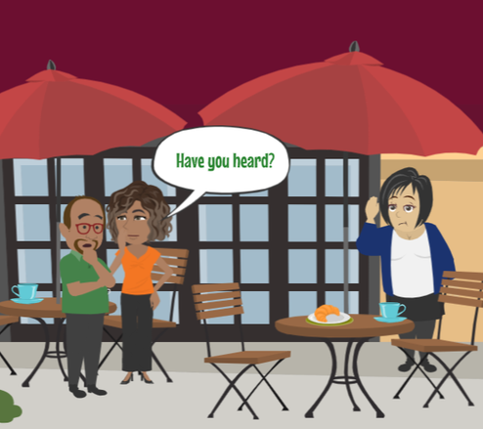
LESSON PLANS
SOCIAL PRESSURES
What social pressures in rural communities can increase risk for young people?
rural
RISKS
©2024-2026 Walking Wise
55
3

Slide 56
SOCIAL PRESSURES
Why Some Victims Don’t Speak Up
Mistrust of Adults: Past harm or family secrets may make it hard for young people to trust adults or ask for help.
©2024-2026 Walking Wise
56
Notes:
SOCIAL PRESSURES
In rural communities, people are often closely connected. While this can be a positive thing, it can also create challenges when someone needs help.
MISTRUST OF ADULTS:
If a young person has experienced harm in the past or if there are family secrets, they may feel unsure about trusting adults. This can make it harder to ask for help, even when they need it.
FEAR OF GOSSIP
In small communities, information can spread quickly. A young person may worry that others will find out about their situation and talk about them. This fear can keep them silent.
KNOWING WHO TO TRUST:
Because many people know each other, it can be difficult to tell who is truly safe. Some people may ignore warning signs or protect someone who is causing harm, while others will help and support. This uncertainty can make it harder to reach out.
If something feels unsafe, it’s important to keep reaching out until you find a trustworthy adult who will listen and help.

Slide 57
SOCIAL PRESSURES
Why Some Victims Don’t Speak Up
Fear of Gossip: In small communities, young people may worry that others will find out and talk about them.
©2024-2026 Walking Wise
57
Notes:
SOCIAL PRESSURES
In rural communities, people are often closely connected. While this can be a positive thing, it can also create challenges when someone needs help.
MISTRUST OF ADULTS:
If a young person has experienced harm in the past or if there are family secrets, they may feel unsure about trusting adults. This can make it harder to ask for help, even when they need it.
FEAR OF GOSSIP
In small communities, information can spread quickly. A young person may worry that others will find out about their situation and talk about them. This fear can keep them silent.
KNOWING WHO TO TRUST:
Because many people know each other, it can be difficult to tell who is truly safe. Some people may ignore warning signs or protect someone who is causing harm, while others will help and support. This uncertainty can make it harder to reach out.
If something feels unsafe, it’s important to keep reaching out until you find a trustworthy adult who will listen and help.

Slide 58
SOCIAL PRESSURES
Why Some Victims Don’t Speak Up
Knowing Whom to Trust: It may be hard to tell which adults are safe to trust and who might protect the person causing harm.
©2024-2026 Walking Wise
58
Notes:
SOCIAL PRESSURES
In rural communities, people are often closely connected. While this can be a positive thing, it can also create challenges when someone needs help.
MISTRUST OF ADULTS:
If a young person has experienced harm in the past or if there are family secrets, they may feel unsure about trusting adults. This can make it harder to ask for help, even when they need it.
FEAR OF GOSSIP
In small communities, information can spread quickly. A young person may worry that others will find out about their situation and talk about them. This fear can keep them silent.
KNOWING WHO TO TRUST:
Because many people know each other, it can be difficult to tell who is truly safe. Some people may ignore warning signs or protect someone who is causing harm, while others will help and support. This uncertainty can make it harder to reach out.
If something feels unsafe, it’s important to keep reaching out until you find a trustworthy adult who will listen and help.

Slide 59
EDUCATON GUIDE
VOCABULARY
POVERTY
The lack of money or resources to meet basic needs and having fewer possessions than is socially acceptable.
rural
RISKS
©2024-2026 Walking Wise
59
3

Slide 60
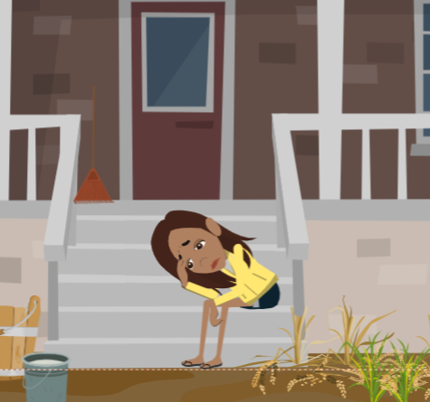
LESSON PLANS
MONEY CHALLENGES
What money-related challenges can increase risk in rural communities?
rural
RISKS
©2024-2026 Walking Wise
60
3

Slide 61
MONEY CHALLENGES
Trafficking Risk Factor
Financial Stress: When families struggle to afford basic needs, it can create unsafe situations for some young people.
rural
RISKS
©2024-2026 Walking Wise
61
Notes:
FINANCIAL STRESS
When families are under financial stress, it can create difficult and sometimes unsafe situations. Traffickers may take advantage of these challenges by offering money, help, or basic needs as a way to gain control.

Slide 62
MONEY CHALLENGES
Challenges That Can Increase Risk
Limited Jobs: Fewer local jobs can make it harder for families and teens to earn money.
©2024-2026 Walking Wise
62
Notes:
Economic challenges can affect families in many communities, especially in rural areas where there may be fewer jobs and resources.
LIMITED JOBS: When there are fewer job opportunities, it can be harder for families and teens to earn money.
LOWER WAGES:
Even when jobs are available, they may not pay enough to cover basic needs like food, housing, and transportation.
LIMITED TRANSPORTATION:
In rural areas, places are often far apart. Without reliable transportation, it can be difficult to get to work or school, or to access help and services.

Slide 63
MONEY CHALLENGES
Challenges That Can Increase Risk
Lower Wages: Some jobs may not pay enough to meet basic needs.
©2024-2026 Walking Wise
63
Notes:
Economic challenges can affect families in many communities, especially in rural areas where there may be fewer jobs and resources.
LIMITED JOBS: When there are fewer job opportunities, it can be harder for families and teens to earn money.
LOWER WAGES:
Even when jobs are available, they may not pay enough to cover basic needs like food, housing, and transportation.
LIMITED TRANSPORTATION:
In rural areas, places are often far apart. Without reliable transportation, it can be difficult to get to work or school, or to access help and services.

Slide 64
MONEY CHALLENGES
Challenges That Can Increase Risk
Limited Transportation: Without reliable transportation, getting to work can be difficult.
©2024-2026 Walking Wise
64
Notes:
Economic challenges can affect families in many communities, especially in rural areas where there may be fewer jobs and resources.
LIMITED JOBS: When there are fewer job opportunities, it can be harder for families and teens to earn money.
LOWER WAGES:
Even when jobs are available, they may not pay enough to cover basic needs like food, housing, and transportation.
LIMITED TRANSPORTATION:
In rural areas, places are often far apart. Without reliable transportation, it can be difficult to get to work or school, or to access help and services.

Slide 65
EDUCATON GUIDE
VOCABULARY
DESOLATE
A place or situation that is empty, lonely, or abandoned, often making people feel isolated.
rural
RISKS
©2024-2026 Walking Wise
65
3

Slide 66
EDUCATON GUIDE
VOCABULARY
ISOLATE
To separate or cut off from a support network, such as family, friends, or trustworthy adults.
rural
RISKS
©2024-2026 Walking Wise
66
3

Slide 67
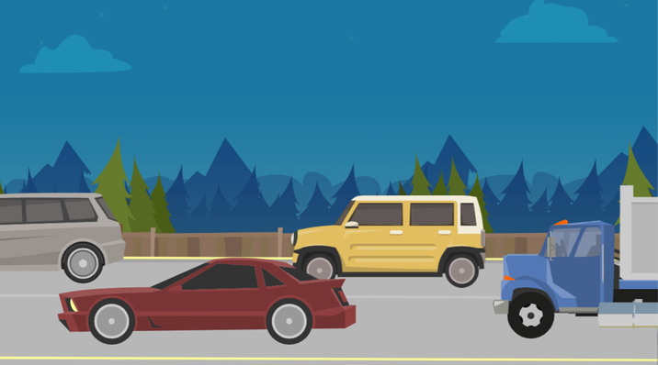
LESSON PLANS
HIGHWAY SYSTEM
How can highways increase risk for trafficking in rural communities?
rural
RISKS
©2024-2026 Walking Wise
67
3

Slide 68
HIGHWAY SYSTEM
Risks Along Highways
Easy Movement: Highways enable traffickers to move people quickly, making it easier to avoid being noticed.
Jarrell, K. L., Pulvino, C., Kimmel, A., Stark, B., Khokhar, H., Janneck, L., & Santen, S. A. (2023). A Case of Human Trafficking in Appalachia and What Emergency Physicians Can Learn from It. Western Journal of Emergency Medicine, 24(3), pp. 465-466.
Federal Highway Administration, U.S. Department of Transportation (n.d.). National Highway System. Fhwa.dot.gov.
©2024-2026 Walking Wise
68
Notes:
Highways connect many different places, including small towns and rural areas. While highways are helpful for travel, they can also create risks.
EASY MOVEMENT: Highways make it possible to travel long distances quickly, making it easier for traffickers to move people and harder to track or locate them.
OUT-OF-TOWN DRIVERS: Highways bring in people from outside the community. Some unsafe people may take advantage of this by entering rural areas to participate in harmful situations without being identified.
ISOLATED LOCATIONS: Places such as rest areas, welcome centers, and truck stops are often dark at night and isolated, far from towns. Because there are fewer people around, unsafe situations may be harder to notice or report.
Source
1. Jarrell, K. L., Pulvino, C., Kimmel, A., Stark, B., Khokhar, H., Janneck, L., & Santen, S. A. (2023). A Case
of Human Trafficking in Appalachia and What Emergency Physicians Can Learn from It. Western Journal
of Emergency Medicine, 24(3), pp. 465-466. Retrieved May 26, 2024,
from https://www.ncbi.nlm.nih.gov/pmc/articles/PMC10284530/
2. Federal Highway Administration, U.S. Department of Transportation (n.d.). National Highway System. Fhwa.dot.gov. Retrieved March 25, 2024, from https://www.fhwa.dot.gov/ohim/onh00/onh2p6.htm

Slide 69
HIGHWAY SYSTEM
Risks Along Highways
Out-of-Town Drivers: Highways bring people from other areas into small towns, increasing the risk for unsafe situations.
Jarrell, K. L., Pulvino, C., Kimmel, A., Stark, B., Khokhar, H., Janneck, L., & Santen, S. A. (2023). A Case of Human Trafficking in Appalachia and What Emergency Physicians Can Learn from It. Western Journal of Emergency Medicine, 24(3), pp. 465-466.
Federal Highway Administration, U.S. Department of Transportation (n.d.). National Highway System. Fhwa.dot.gov.
©2024-2026 Walking Wise
69
Notes:
Highways connect many different places, including small towns and rural areas. While highways are helpful for travel, they can also create risks.
EASY MOVEMENT: Highways make it possible to travel long distances quickly, making it easier for traffickers to move people and harder to track or locate them.
OUT-OF-TOWN DRIVERS: Highways bring in people from outside the community. Some unsafe people may take advantage of this by entering rural areas to participate in harmful situations without being identified.
ISOLATED LOCATIONS: Places such as rest areas, welcome centers, and truck stops are often dark at night and isolated, far from towns. Because there are fewer people around, unsafe situations may be harder to notice or report.
Source
1. Jarrell, K. L., Pulvino, C., Kimmel, A., Stark, B., Khokhar, H., Janneck, L., & Santen, S. A. (2023). A Case
of Human Trafficking in Appalachia and What Emergency Physicians Can Learn from It. Western Journal
of Emergency Medicine, 24(3), pp. 465-466. Retrieved May 26, 2024,
from https://www.ncbi.nlm.nih.gov/pmc/articles/PMC10284530/
2. Federal Highway Administration, U.S. Department of Transportation (n.d.). National Highway System. Fhwa.dot.gov. Retrieved March 25, 2024, from https://www.fhwa.dot.gov/ohim/onh00/onh2p6.htm

Slide 70
HIGHWAY SYSTEM
Risks Along Highways
Isolated Locations: Rest areas, welcome centers, & truck stops are often long distances from towns, making unsafe situations easier to hide.
Jarrell, K. L., Pulvino, C., Kimmel, A., Stark, B., Khokhar, H., Janneck, L., & Santen, S. A. (2023). A Case of Human Trafficking in Appalachia and What Emergency Physicians Can Learn from It. Western Journal of Emergency Medicine, 24(3), pp. 465-466.
Federal Highway Administration, U.S. Department of Transportation (n.d.). National Highway System. Fhwa.dot.gov.
©2024-2026 Walking Wise
70
Notes:
Highways connect many different places, including small towns and rural areas. While highways are helpful for travel, they can also create risks.
EASY MOVEMENT: Highways make it possible to travel long distances quickly, making it easier for traffickers to move people and harder to track or locate them.
OUT-OF-TOWN DRIVERS: Highways bring in people from outside the community. Some unsafe people may take advantage of this by entering rural areas to participate in harmful situations without being identified.
ISOLATED LOCATIONS: Places such as rest areas, welcome centers, and truck stops are often dark at night and isolated, far from towns. Because there are fewer people around, unsafe situations may be harder to notice or report.
Source
1. Jarrell, K. L., Pulvino, C., Kimmel, A., Stark, B., Khokhar, H., Janneck, L., & Santen, S. A. (2023). A Case
of Human Trafficking in Appalachia and What Emergency Physicians Can Learn from It. Western Journal
of Emergency Medicine, 24(3), pp. 465-466. Retrieved May 26, 2024,
from https://www.ncbi.nlm.nih.gov/pmc/articles/PMC10284530/
2. Federal Highway Administration, U.S. Department of Transportation (n.d.). National Highway System. Fhwa.dot.gov. Retrieved March 25, 2024, from https://www.fhwa.dot.gov/ohim/onh00/onh2p6.htm

Slide 71
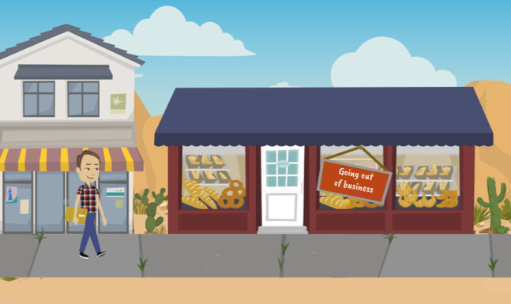
LESSON PLANS
LOW POPULATION
Why can living in a low-population community make it harder to get help?
rural
RISKS
©2024-2026 Walking Wise
71
3

Slide 72
LOW POPULATION
Challenges in Rural Communities
Law Enforcement: There may be fewer police officers and less training to recognize trafficking.
Cole, J., & Sprang, G. (2015). Sex trafficking of minors in Metropolitan, Micropolitan, and Rural Communities. Child Abuse & Neglect, 40, 114.
Jarrell, K. L., Pulvino, C., Kimmel, A., Stark, B., Khokhar, H., Janneck, L., & Santen, S. A. (2023). A Case of Human Trafficking in Appalachia and What Emergency Physicians Can Learn from It. Western Journal of Emergency Medicine, 24(3), p. 463.
©2024-2026 Walking Wise
72
Notes:
Even when someone wants help, it’s not always easy to get it, especially in rural areas.
LAW ENFORCEMENT: In smaller communities, there may be fewer police officers. That means it might take longer for someone to respond, or they may not have as much experience recognizing trafficking situations.[1]
HEALTHCARE: If someone goes to a doctor or hospital, the adults there may not always recognize the signs right away. This can make it harder for someone to be identified and helped.[2]
SUPPORT SERVICES: In big cities, there are often shelters, counselors, and support centers nearby. In rural areas, those services might be far away.
👉 “Which situation would make it harder to get help?”
• In a city → help might be 5 minutes away.
• In a rural area → help might be 60 minutes away.
👉 “If someone doesn't have a car, how would they get there?”
Source
1. Cole, J., & Sprang, G. (2015). Sex trafficking of minors in Metropolitan, Micropolitan, and Rural Communities. Child Abuse & Neglect, 40, 114. https://doi.org/10.1016/j.chiabu.2014.07.015. Retrieved December 14, 2024, from https://www.researchgate.net/publication/265019363_Sex_trafficking_of_minors_in_metropolitan_micropolitan_and_rural_communities
2. Jarrell, K. L., Pulvino, C., Kimmel, A., Stark, B., Khokhar, H., Janneck, L., & Santen, S. A. (2023). A Case of Human Trafficking in Appalachia and What Emergency Physicians Can Learn from It. Western Journal of Emergency Medicine, 24(3), p. 463. Retrieved December 14, 2024, from https://www.ncbi.nlm.nih.gov/pmc/articles/PMC10284530/

Slide 73
LOW POPULATION
Challenges in Rural Communities
Healthcare: Some doctors and nurses may not recognize the signs of trafficking.
Cole, J., & Sprang, G. (2015). Sex trafficking of minors in Metropolitan, Micropolitan, and Rural Communities. Child Abuse & Neglect, 40, 114.
Jarrell, K. L., Pulvino, C., Kimmel, A., Stark, B., Khokhar, H., Janneck, L., & Santen, S. A. (2023). A Case of Human Trafficking in Appalachia and What Emergency Physicians Can Learn from It. Western Journal of Emergency Medicine, 24(3), p. 463.
©2024-2026 Walking Wise
73
Notes:
Even when someone wants help, it’s not always easy to get it, especially in rural areas.
LAW ENFORCEMENT: In smaller communities, there may be fewer police officers. That means it might take longer for someone to respond, or they may not have as much experience recognizing trafficking situations.[1]
HEALTHCARE: If someone goes to a doctor or hospital, the adults there may not always recognize the signs right away. This can make it harder for someone to be identified and helped.[2]
SUPPORT SERVICES: In big cities, there are often shelters, counselors, and support centers nearby. In rural areas, those services might be far away.
👉 “Which situation would make it harder to get help?”
• In a city → help might be 5 minutes away.
• In a rural area → help might be 60 minutes away.
👉 “If someone doesn't have a car, how would they get there?”
Source
1. Cole, J., & Sprang, G. (2015). Sex trafficking of minors in Metropolitan, Micropolitan, and Rural Communities. Child Abuse & Neglect, 40, 114. https://doi.org/10.1016/j.chiabu.2014.07.015. Retrieved December 14, 2024, from https://www.researchgate.net/publication/265019363_Sex_trafficking_of_minors_in_metropolitan_micropolitan_and_rural_communities
2. Jarrell, K. L., Pulvino, C., Kimmel, A., Stark, B., Khokhar, H., Janneck, L., & Santen, S. A. (2023). A Case of Human Trafficking in Appalachia and What Emergency Physicians Can Learn from It. Western Journal of Emergency Medicine, 24(3), p. 463. Retrieved December 14, 2024, from https://www.ncbi.nlm.nih.gov/pmc/articles/PMC10284530/

Slide 74
LOW POPULATION
Challenges in Rural Communities
Support Services: There may be fewer nearby places to get help, and it can be hard to get there without transportation.
Cole, J., & Sprang, G. (2015). Sex trafficking of minors in Metropolitan, Micropolitan, and Rural Communities. Child Abuse & Neglect, 40, 114.
Jarrell, K. L., Pulvino, C., Kimmel, A., Stark, B., Khokhar, H., Janneck, L., & Santen, S. A. (2023). A Case of Human Trafficking in Appalachia and What Emergency Physicians Can Learn from It. Western Journal of Emergency Medicine, 24(3), p. 463.
©2024-2026 Walking Wise
74
Notes:
Even when someone wants help, it’s not always easy to get it, especially in rural areas.
LAW ENFORCEMENT: In smaller communities, there may be fewer police officers. That means it might take longer for someone to respond, or they may not have as much experience recognizing trafficking situations.[1]
HEALTHCARE: If someone goes to a doctor or hospital, the adults there may not always recognize the signs right away. This can make it harder for someone to be identified and helped.[2]
SUPPORT SERVICES: In big cities, there are often shelters, counselors, and support centers nearby. In rural areas, those services might be far away.
👉 “Which situation would make it harder to get help?”
• In a city → help might be 5 minutes away.
• In a rural area → help might be 60 minutes away.
👉 “If someone doesn't have a car, how would they get there?”
Source
1. Cole, J., & Sprang, G. (2015). Sex trafficking of minors in Metropolitan, Micropolitan, and Rural Communities. Child Abuse & Neglect, 40, 114. https://doi.org/10.1016/j.chiabu.2014.07.015. Retrieved December 14, 2024, from https://www.researchgate.net/publication/265019363_Sex_trafficking_of_minors_in_metropolitan_micropolitan_and_rural_communities
2. Jarrell, K. L., Pulvino, C., Kimmel, A., Stark, B., Khokhar, H., Janneck, L., & Santen, S. A. (2023). A Case of Human Trafficking in Appalachia and What Emergency Physicians Can Learn from It. Western Journal of Emergency Medicine, 24(3), p. 463. Retrieved December 14, 2024, from https://www.ncbi.nlm.nih.gov/pmc/articles/PMC10284530/

Slide 75
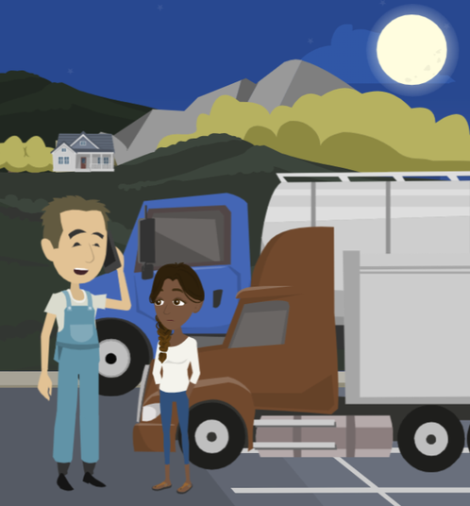
DRIVER TRAINING
How can truck and bus drivers recognize and help stop human trafficking?
rural
RISKS
©2024-2026 Walking Wise
75

Slide 76
DRIVER TRAINING
Truckers Against Trafficking (TAT)
Training: Drivers are taught how to notice warning signs.
©2024-2026 Walking Wise
TAT - Truckers Against Trafficking (2024), tatnonprofit.org.
76
Notes:
Some trucking organizations educate their drivers to recognize suspicious activity along their driving routes and train them on how to report suspected instances of human trafficking to law enforcement and the National Human Trafficking Hotline.
TAT FREE APP: A free app is offered by Truckers Against Trafficking (TAT) to help drivers learn red flags and report suspicious activity.
TRANSPORTATION INDUSTRY: TAT trains employees from the various industries:
- Trucking companies
- Truck stop companies
- Bussing companies
- Public transit agencies
- Energy companies
- Moving companies
Source
TAT - Truckers Against Trafficking (2024), tatnonprofit.org. Retrieved December 14, 2024, from https://truckersagainsttrafficking.org/app/?gad_source=1&gclid=CjwKCAiA0PuuBhBsEiwAS7fsNSq5oE6knuvrvM82A3hQizmWflNfJ5m_MohWoOz5cnTTF5nhibztyBoCj3YQAvD_BwE

Slide 77
DRIVER TRAINING
Truckers Against Trafficking (TAT)
Reporting: They learn how to safely report situations that may involve trafficking.
©2024-2026 Walking Wise
TAT - Truckers Against Trafficking (2024), tatnonprofit.org.
77
Notes:
Some trucking organizations educate their drivers to recognize suspicious activity along their driving routes and train them on how to report suspected instances of human trafficking to law enforcement and the National Human Trafficking Hotline.
TAT FREE APP: A free app is offered by Truckers Against Trafficking (TAT) to help drivers learn red flags and report suspicious activity.
TRANSPORTATION INDUSTRY: TAT trains employees from the various industries:
- Trucking companies
- Truck stop companies
- Bussing companies
- Public transit agencies
- Energy companies
- Moving companies
Source
TAT - Truckers Against Trafficking (2024), tatnonprofit.org. Retrieved December 14, 2024, from https://truckersagainsttrafficking.org/app/?gad_source=1&gclid=CjwKCAiA0PuuBhBsEiwAS7fsNSq5oE6knuvrvM82A3hQizmWflNfJ5m_MohWoOz5cnTTF5nhibztyBoCj3YQAvD_BwE

Slide 78
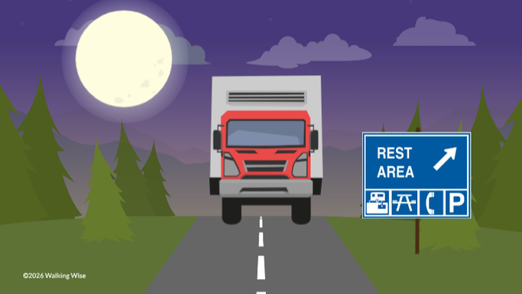
DRIVER TRAINING
Why might truck and bus drivers notice things others don’t?
rural
RISKS
©2024-2026 Walking Wise
78

Slide 79
DRIVER TRAINING
Why Drivers Notice More
Drivers use the highways all day and night
©2024-2026 Walking Wise
TAT - Truckers Against Trafficking (2024), tatnonprofit.org.
79
Notes:
DRIVERS: Truck and bus drivers travel long distances and see many different places. Because of this, they are in a unique position to notice when something doesn’t seem right. They are trained to recognize warning signs and report concerns safely.
SCHOOL BUS DRIVERS:
Some school bus drivers also receive this training. Since they work closely with students, they may notice signs that someone needs help and are trained on how to take action to protect them.
Source
TAT - Truckers Against Trafficking (2024), tatnonprofit.org. Retrieved December 14, 2024, from https://truckersagainsttrafficking.org/app/?gad_source=1&gclid=CjwKCAiA0PuuBhBsEiwAS7fsNSq5oE6knuvrvM82A3hQizmWflNfJ5m_MohWoOz5cnTTF5nhibztyBoCj3YQAvD_BwE

Slide 80
DRIVER TRAINING
Why Drivers Notice More
Drivers use the highways all day and night
They often travel long distances and see many places
©2024-2026 Walking Wise
TAT - Truckers Against Trafficking (2024), tatnonprofit.org.
80
Notes:
DRIVERS: Truck and bus drivers travel long distances and see many different places. Because of this, they are in a unique position to notice when something doesn’t seem right. They are trained to recognize warning signs and report concerns safely.
SCHOOL BUS DRIVERS:
Some school bus drivers also receive this training. Since they work closely with students, they may notice signs that someone needs help and are trained on how to take action to protect them.
Source
TAT - Truckers Against Trafficking (2024), tatnonprofit.org. Retrieved December 14, 2024, from https://truckersagainsttrafficking.org/app/?gad_source=1&gclid=CjwKCAiA0PuuBhBsEiwAS7fsNSq5oE6knuvrvM82A3hQizmWflNfJ5m_MohWoOz5cnTTF5nhibztyBoCj3YQAvD_BwE

Slide 81
DRIVER TRAINING
Why Drivers Notice More
Drivers use the highways all day and night
They often travel long distances and see many places
They use truck stops to get gas and eat
©2024-2026 Walking Wise
TAT - Truckers Against Trafficking (2024), tatnonprofit.org.
81
Notes:
DRIVERS: Truck and bus drivers travel long distances and see many different places. Because of this, they are in a unique position to notice when something doesn’t seem right. They are trained to recognize warning signs and report concerns safely.
SCHOOL BUS DRIVERS:
Some school bus drivers also receive this training. Since they work closely with students, they may notice signs that someone needs help and are trained on how to take action to protect them.
Source
TAT - Truckers Against Trafficking (2024), tatnonprofit.org. Retrieved December 14, 2024, from https://truckersagainsttrafficking.org/app/?gad_source=1&gclid=CjwKCAiA0PuuBhBsEiwAS7fsNSq5oE6knuvrvM82A3hQizmWflNfJ5m_MohWoOz5cnTTF5nhibztyBoCj3YQAvD_BwE

Slide 82
DRIVER TRAINING
Why Drivers Notice More
Drivers use the highways all day and night
They often travel long distances and see many places
They use truck stops to get gas and eat
They often use rest areas and welcome centers
©2024-2026 Walking Wise
TAT - Truckers Against Trafficking (2024), tatnonprofit.org.
82
Notes:
DRIVERS: Truck and bus drivers travel long distances and see many different places. Because of this, they are in a unique position to notice when something doesn’t seem right. They are trained to recognize warning signs and report concerns safely.
SCHOOL BUS DRIVERS:
Some school bus drivers also receive this training. Since they work closely with students, they may notice signs that someone needs help and are trained on how to take action to protect them.
Source
TAT - Truckers Against Trafficking (2024), tatnonprofit.org. Retrieved December 14, 2024, from https://truckersagainsttrafficking.org/app/?gad_source=1&gclid=CjwKCAiA0PuuBhBsEiwAS7fsNSq5oE6knuvrvM82A3hQizmWflNfJ5m_MohWoOz5cnTTF5nhibztyBoCj3YQAvD_BwE

Slide 83
DRIVER TRAINING
Why Drivers Notice More
Drivers use the highways all day and night
They often travel long distances and see many places
They use truck stops to get gas and eat
They often use rest areas and welcome centers
They may have radios to communicate
©2024-2026 Walking Wise
TAT - Truckers Against Trafficking (2024), tatnonprofit.org.
83
Notes:
DRIVERS: Truck and bus drivers travel long distances and see many different places. Because of this, they are in a unique position to notice when something doesn’t seem right. They are trained to recognize warning signs and report concerns safely.
SCHOOL BUS DRIVERS:
Some school bus drivers also receive this training. Since they work closely with students, they may notice signs that someone needs help and are trained on how to take action to protect them.
Source
TAT - Truckers Against Trafficking (2024), tatnonprofit.org. Retrieved December 14, 2024, from https://truckersagainsttrafficking.org/app/?gad_source=1&gclid=CjwKCAiA0PuuBhBsEiwAS7fsNSq5oE6knuvrvM82A3hQizmWflNfJ5m_MohWoOz5cnTTF5nhibztyBoCj3YQAvD_BwE

Slide 84
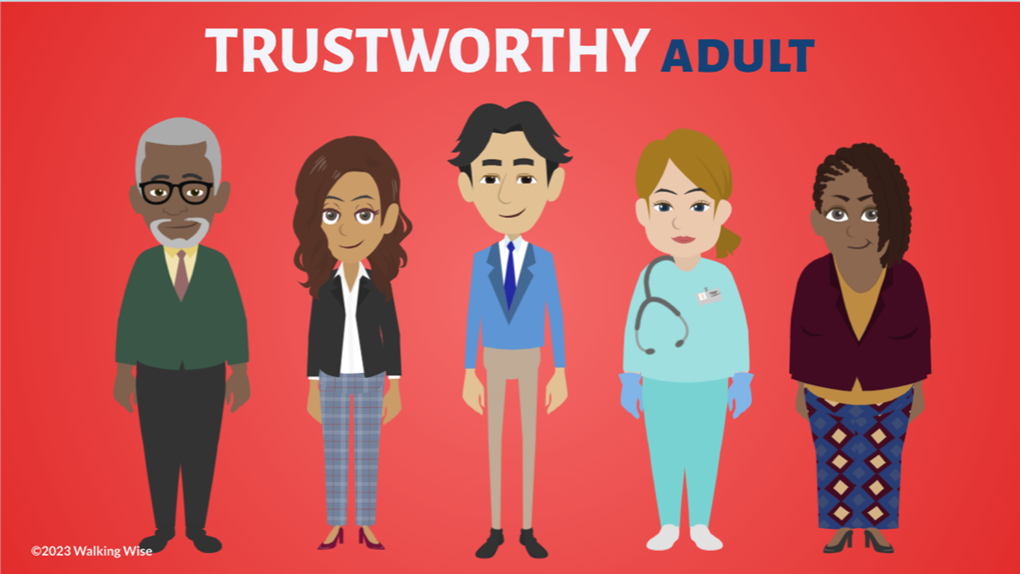
ASK FOR HELP
©2024-2026 Walking Wise
84
Notes:
Walking Wise asked a focus group of survivors:
What do you think young people should know about sex trafficking?
ANSWER
The survivors agreed that the most vital information teens should know is how to ask for help.
At the top of their list:
Tell a TRUSTWORTHY adult.

Slide 85
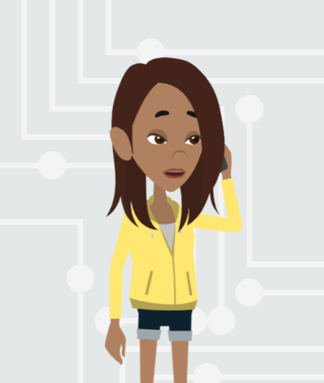
ASK FOR HELP
What are ways young people can ask for help?
©2024-2026 Walking Wise
85

Slide 86
ASK FOR HELP
How to Ask for Help
If you are in immediate danger, dial 911.
©2024-2026 Walking Wise
86

Slide 87
ASK FOR HELP
How to Ask for Help
If you are in immediate danger, dial 911.
If the sexual predator IS a family member, tell a trustworthy adult.
©2024-2026 Walking Wise
87

Slide 88
ASK FOR HELP
How to Ask for Help
If you are in immediate danger, dial 911.
If the sexual predator IS a family member, tell a trustworthy adult.
If the sexual predator is NOT family, tell a parent or guardian
©2024-2026 Walking Wise
88

Slide 89
ASK FOR HELP
How to Ask for Help
If you are in immediate danger, dial 911.
If the sexual predator IS a family member, tell a trustworthy adult.
If the sexual predator is NOT family, tell a parent or guardian
If you are a student, tell a trustworthy teacher, coach, school nurse, social worker, counselor, resource officer, or principal.
©2024-2026 Walking Wise
89

Slide 90
ASK FOR HELP
How to Ask for Help
If you are in immediate danger, dial 911.
If the sexual predator IS a family member, tell a trustworthy adult.
If the sexual predator is NOT family, tell a parent or guardian
If you are a student, tell a trustworthy teacher, coach, school nurse, social worker, counselor, resource officer, or principal.
To gain internet access for help, use a computer at school or a public library.
©2024-2026 Walking Wise
90

Slide 91
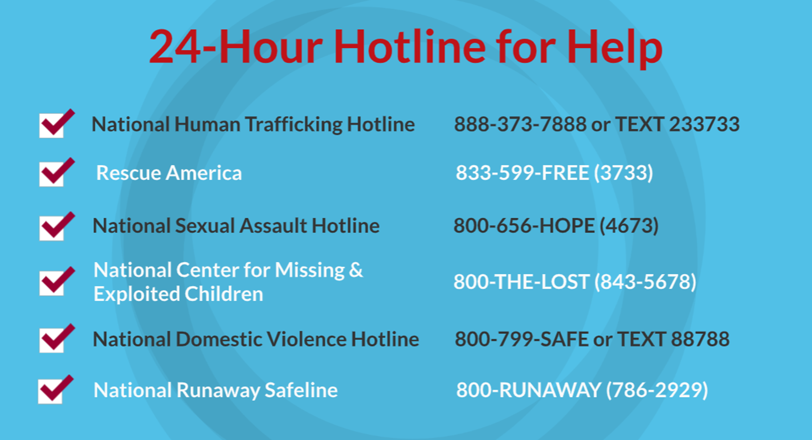
©2024-2026 Walking Wise
91
Notes:
NOTE TO PRESENTER
Presenters may ask their audience to consider adding a few "hotline for help" phone numbers to their cell phone contacts or take a photo of this slide.

Slide 92
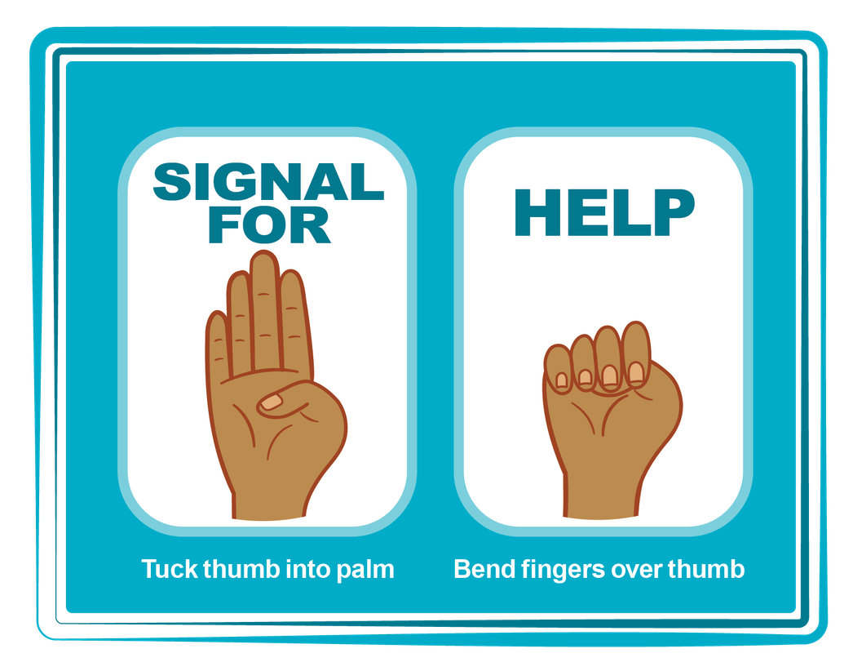
HAND SIGNAL FOR HELP
©2024-2026 Walking Wise
Source: Canadian Women’s Foundation, April 2020
92
Notes:
Although the hand signal for help has not yet achieved universal recognition, it may quietly get someone's attention in urgent situations.
SILENT
It can be used silently.
UNTRACKABLE
It leaves no digital footprint.
CONCEALED
It can be done secretly when a perpetrator is in the vicinity.
SIGNALS DISTRESS
A distressed facial expression can help others recognize that help is needed if the hand signal is not understood—but it is important not to alert the predator/trafficker, causing harm.
Source
Canadian Women's Foundation, April 2020

Slide 93


Thank you!
WalkingWise.com
Online Course for Adults Accredited by:
Postgraduate Institute for Medicine
Academy of Forensic Nursing
©2024-2026 Walking Wise
93
Notes:
NOTE TO PRESENTER
To access additional resources on rural risks, please refer to the last page of Lesson Plan #8 on the Walking Wise Learning Platform.
We welcome your feedback at support@WalkingWise.com.

