Slide 1


SEXUAL EXPLOITATION
EDUCATION
Trustworthy vs
Unsafe Adult
LESSON #2
Notes:
NOTE
Log in to WalkingWise.com and refer to the Implementation Toolkit for classroom teaching tips.
Most importantly:
DEFINE SCHOOL POLICY
Establish a sexual exploitation reporting protocol with a trauma-informed response. The Walking Wise Implementation Toolkit provides a sample protocol.
AGE & AUDIENCE
This presentation can be edited by following the procedures on page 3 to align with your school policies, specific age groups, and the involvement of at-risk audiences.
SUPPORT PROCEDURE
Provide your students with guidance on how to access immediate help or arrange a private meeting with a social worker, counselor, nurse, school resource officer, or another trustworthy staff member to report concerns about themselves or a peer.
SECOND SAFE ADULT
Ensure a second trustworthy adult, such as a teacher, is present in the learning setting to observe student reactions and identify those who may benefit from a follow-up meeting. This person should remain focused and free from other duties during the presentation.

Slide 2

NOTE TO PRESENTER
This PDF contains the same content as the PowerPoint presentation but has been condensed into fewer pages for easier reference. For live presentations, please use the PowerPoint version. It reveals bullet points one at a time.
Meaningful learning takes time. By introducing topics gradually over several years, educators can create steady growth in awareness and understanding.
Our recommended teaching plan offers a long-term path for middle and high school students to build knowledge and confidence.
5-Year Track
PARENTS & STAFF
#1 Myths & Reality
6th GRADE
#2 Trustworthy vs. Unsafe Adult
#3 Grooming Process
7th GRADE
#4 Pornography Link
#5 Sextortion Scheme
8th GRADE
#6 Male Victims
#7 Runaways as Targets
#8 Rural Risks
9th GRADE
#9 Human Traffickers
#10 Female & Peer Recruiters
10th GRADE
#11 Family Secret
#12 Hidden Buyers
©2024-2026 Walking Wise
2

Slide 3

NOTE TO PRESENTER
This presentation is exclusively for Walking Wise® subscribers and not for redistribution.
Walking Wise encourages the use of Slido.com, an interactive digital tool, to enhance audience engagement. For more information, contact us at support@WalkingWise.com. Once configured, integrate Slido polling and add a post-evaluation to the PowerPoint presentation.
Presenters are encouraged to edit speaker notes to match their speaking style (viewable in presentation mode). You can also delete slides and content from this Walking Wise presentation to ensure the information aligns with your school policies, is age-appropriate, and fits within available class time. However, the slides are copyright-protected and may not be reworded without prior written permission from Walking Wise.
We encourage you to add your own content by following these instructions:
Insert new PowerPoint slides.
Remove the Walking Wise logo and copyright "©2026 Walking Wise" from the new slides.
Always add your organization's name or logo to each new slide.
Please delete this instruction page before presenting to audiences.
©2024-2026 Walking Wise
3
Notes:
NOTE TO PRESENTER
The presenter is welcome to customize this Walking Wise presentation according to the instructions provided on this page.
For revision requests, please email us at: support@WalkingWise.com.

Slide 4
STATISTICS
Why Study Results Can Vary
Some crimes are never reported, making it hard to reveal the entire issue.
Studies collect information in different ways, leading to different results.
Small studies may not represent everyone.
©2024-2026 Walking Wise
4
Notes:
In this presentation, we'll discuss statistics, but it's important to note that while statistics provide valuable insights into an issue, they cannot be relied upon entirely.
Here are a few reasons:
UNREPORTED
Victims often do not report the crimes committed against them due to fear, shame, or manipulation.
INCONSISTENT COLLECTION
Geographical areas have different legal definitions for sexual crimes, which may make data hard to compare.
FOCUS GROUPS
Small or specific focus groups participating in a study or survey may not accurately reflect the diversity or experiences of the broader population.

Slide 5
SENSITIVE TOPICS WILL BE DISCUSSED
CONTENT NOTICE
We’ll be discussing serious safety issues today.
Some topics may be difficult to hear.
If you ever feel uncomfortable, you can step out and speak with a trustworthy adult for support.
You’re not alone—help is available.
©2024-2026 Walking Wise
5
Notes:
NOTE TO PRESENTER
Presenter Guidelines for Delivery
Present the information in a calm, matter-of-fact way and avoid sensational language.
Avoid graphic details. Focus on understanding behaviors and staying safe.
Never blame victims. Responsibility always belongs to the person who caused harm.
Maintain a steady tone. Students often mirror the presenter’s emotional cues.
Do not ask students to share personal experiences.
If students laugh or react awkwardly, stay calm and continue teaching.
Always pair risk information with solutions and support.
Remind students they are not alone and help is available.

Slide 6

CONFRONTING SEXUAL EXPLOITATION
WALKING WISE
KNOWLEDGE serves as a
powerful defense against
an unsafe adult.
©2024-2026 Walking Wise
6
Notes:
Education is one of the strongest tools for preventing exploitation.
When young people understand how predators operate, they are better able to recognize manipulation and avoid dangerous situations.
Reinforce that awareness increases safety.

Slide 7




EDUCATON GUIDE
VOCABULARY
VOCABULARY
Honorable
Obligated
Favoritism
Disguise
Authentic
Trustworthy
Unsafe Adult
Consent
©2024-2026 Walking Wise
7
3
Notes:
Understanding vocabulary terms related to the behaviors of sexual predators can empower young people to recognize warning signs of harmful situations.
Knowing terminology helps them identify manipulative tactics predators use to build trust and exploit vulnerabilities.
With this knowledge, young people are better equipped to spot red flags, understand that these behaviors are abusive, and feel more confident reporting predators to trusted adults or authorities, potentially preventing further harm.

Slide 8
EDUCATON GUIDE
VOCABULARY
TRUSTWORTHY
Deserving of being relied on as honest, loyal, responsible, dependable, and safe.
©2024-2026 Walking Wise
8
3
Notes:
Assisting Source
OpenAI. (2024). ChatGPT [Large language model]. https://chatgpt.com

Slide 9
EDUCATON GUIDE
VOCABULARY
AUTHENTIC
Someone or something that is true to its nature or beliefs and displays qualities that are trustworthy, genuine, and real.
©2024-2026 Walking Wise
9
3
Notes:
Assisting Source
OpenAI. (2024). ChatGPT [Large language model]. https://chatgpt.com

Slide 10
EDUCATON GUIDE
VOCABULARY
HONORABLE
A person who deserves respect because they are honest, fair, and try to do the right thing.
©2024-2026 Walking Wise
10
3
Notes:
Assisting Source
OpenAI. (2024). ChatGPT [Large language model]. https://chatgpt.com

Slide 11
EDUCATON GUIDE
VOCABULARY
UNSAFE ADULT
Someone who puts others at risk by being unkind, harmful, manipulative, or does not provide protection.
©2024-2026 Walking Wise
11
3
Notes:
Assisting Source
OpenAI. (2024). ChatGPT [Large language model]. https://chatgpt.com

Slide 12
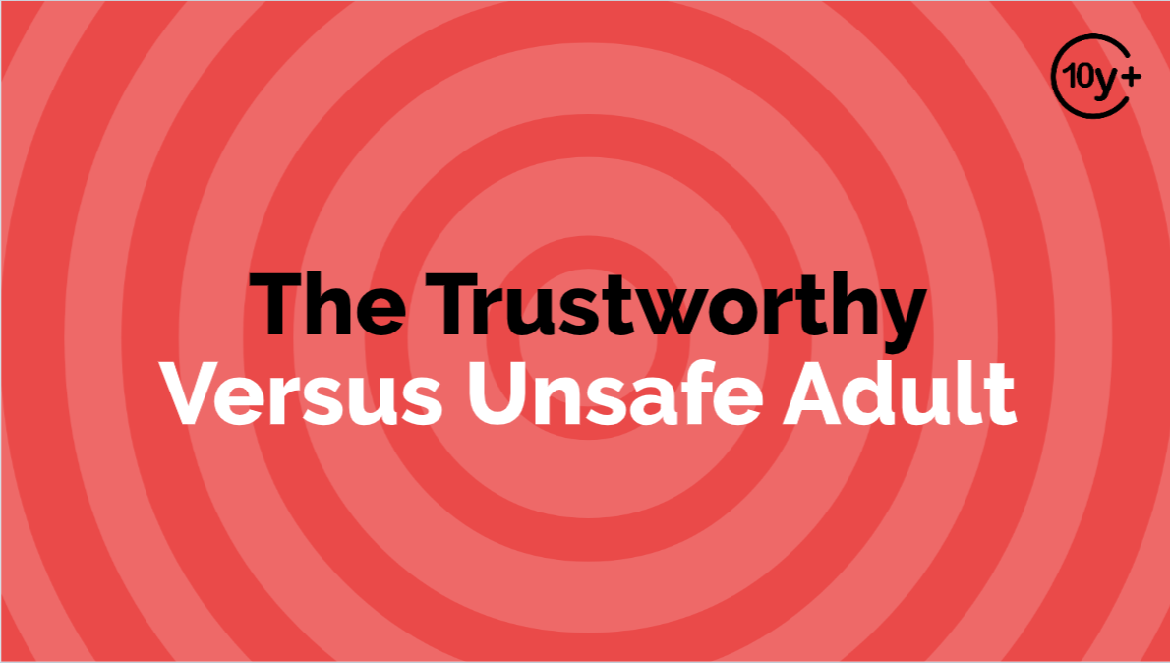
Log in to WalkingWise.com to access this animated video.
©2024-2026 Walking Wise
12
Notes:
Message Especially for Teens:
Businesses worldwide use explainer-style animation as a training tool for their employees.
So, this 3-minute Walking Wise animated video is appropriate for young people (ages 10+) and adults to learn how sexual predators use manipulation, intimidation, and coercion to exploit young people.
NOTE
Log in to Walking Wise.com to watch the three-minute animated video with audiences.

Slide 13
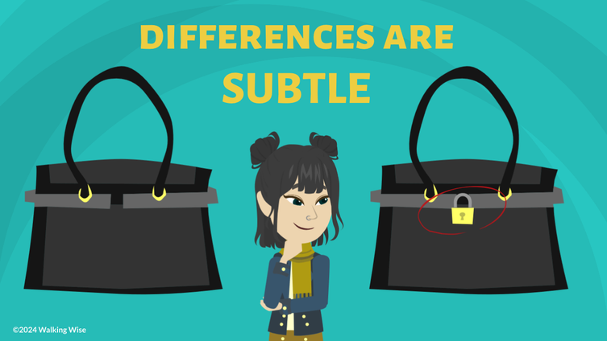
LESSON PLANS
NOTICE BEHAVIOR
When should we pay close attention to someone’s behavior?
©2024-2026 Walking Wise
13
3
Notes:
NOTE TO PRESENTER
Explaining that sexual abuse affects many young people can help students understand they are not alone. When discussed carefully and respectfully, this information can reduce shame and encourage students to seek help if they or someone they know is being harmed.
Education can help:
- Reduce stigma around talking about abuse
- Encourage open conversations with trusted adults
- Support students in asking for help
- Reduce self-blame among victims
- Build resilience and confidence
- Reduce victim blaming
- Encourage students to speak up when someone needs help

Slide 14
NOTICE BEHAVIOR
When to Notice Behavior
Choosing friends
©2024-2026 Walking Wise
14
Notes:
Explain that students evaluate behavior every day, often without realizing it.
The question to ask yourself is, "Does this person's actions match what they say?"

Slide 15
NOTICE BEHAVIOR
When to Notice Behavior
Choosing friends
Meeting new peers
©2024-2026 Walking Wise
15
Notes:
Explain that students evaluate behavior every day, often without realizing it.
The question to ask yourself is, "Does this person's actions match what they say?"

Slide 16
NOTICE BEHAVIOR
When to Notice Behavior
Choosing friends
Meeting new peers
Deciding whom to trust
©2024-2026 Walking Wise
16
Notes:
Explain that students evaluate behavior every day, often without realizing it.
The question to ask yourself is, "Does this person's actions match what they say?"

Slide 17
NOTICE BEHAVIOR
When to Notice Behavior
Choosing friends
Meeting new peers
Deciding whom to trust
Selecting role models
©2024-2026 Walking Wise
17
Notes:
Explain that students evaluate behavior every day, often without realizing it.
The question to ask yourself is, "Does this person's actions match what they say?"

Slide 18
NOTICE BEHAVIOR
When to Notice Behavior
Choosing friends
Meeting new peers
Deciding whom to confide in
Selecting role models
Asking someone for help
©2024-2026 Walking Wise
18
Notes:
Explain that students evaluate behavior every day, often without realizing it.
The question to ask yourself is, "Does this person's actions match what they say?"

Slide 19
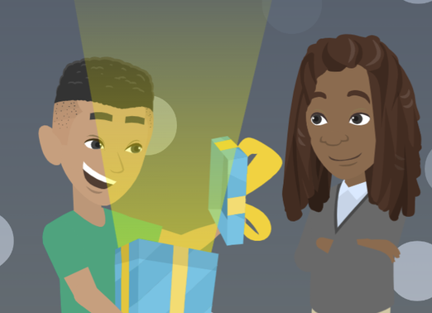
LESSON PLANS
EVALUATE BEHAVIOR
How to decide if someone is ‘real’ or authentic.
©2024-2026 Walking Wise
19
3
Notes:
NOTE TO PRESENTER
Teaching children as young as 10 years old that many girls and boys experience sexual abuse may help victims realize they are not alone and could potentially lead to asking for help.
Education will help:
1) Reduce stigma
2) Encourage openness
3) Empower reporting
4) Reduce self-blame
5) Build Resilience
6) Reduce victim blaming
7) Encourage advocacy

Slide 20
EVALUATE BEHAVIOR
Observe People We Know
Watch Actions: How do they behave in public, compared to when in private?
©2024-2026 Walking Wise
20
Notes:
ACTIONS
Watch how people act over time, both in public and private. Trustworthy people behave consistently. Someone who behaves very differently depending on who is watching may not be trustworthy.

Slide 21
EVALUATE BEHAVIOR
Observe People We Know
Evaluate Choices: Do they make good decisions?
©2024-2026 Walking Wise
21
Notes:
CHOICES
Notice whether someone makes good decisions — even when no one is watching. Trustworthy people are good role models because they follow rules, treat people fairly, and take responsibility for their mistakes.

Slide 22
EVALUATE BEHAVIOR
Observe People We Know
Ask Questions: Do their answers stay consistent?
©2024-2026 Walking Wise
22
Notes:
QUESTIONS
Ask questions and see if their answers stay consistent. Dishonest people often change their stories. Trustworthy people usually provide clear and consistent answers.

Slide 23
EVALUATE BEHAVIOR
Observe People We Know
Notice Reactions: Do they respect boundaries, or create pressure to get their way?
©2024-2026 Walking Wise
23
Notes:
REACTIONS
Notice how someone reacts when you set boundaries. A trustworthy adult will respect boundaries.
Unsafe adults may become angry, pressure the young person, or try to make them feel guilty.

Slide 24
EVALUATE BEHAVIOR
Trustworthy Behavior
Honest
Fair
Respectful
Dependable
Kind
Consistent
©2024-2026 Walking Wise
24
Notes:
TRUSTWORTHY BEHAVIOR
Safe adults are caring, thoughtful, loving, and gentle.
They behave in ways that demonstrate they are dependable, respectful, and honest.
Safe adults look for ways to be helpful and kind, and they treat young people fairly.
They do not pressure children to keep secrets and encourage them to talk with other safe adults.

Slide 25
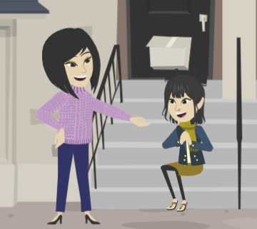
LESSON PLANS
SAFE VS. UNSAFE
How can you tell if someone is trustworthy?
©2024-2026 Walking Wise
25
3

Slide 26
SAFE VS. UNSAFE
Trust Takes Time
Reliable: Can people depend on them to do what they say?
©2024-2026 Walking Wise
26
Notes:
RELIABLE
Trustworthy people keep their promises whenever possible. They are people you can count on to do what they say they will. Unsafe adults may often break promises or fail to follow through.

Slide 27
SAFE VS. UNSAFE
Trust Takes Time
Fair: Do they have fair rules, and is everyone treated the same?
©2024-2026 Walking Wise
27
Notes:
FAIR
Fair people treat others equally and follow the same rules they expect others to follow.
Favortism happens when someone gives special treatment to one person while ignoring others.
Sometimes, favoritism is used to manipulate or control young people.

Slide 28
SAFE VS. UNSAFE
Trust Takes Time
Good Choices: Do they make responsible decisions, or do their choices harm others?
©2024-2026 Walking Wise
28
Notes:
CHOICES
Trustworthy people usually make responsible choices that help the people around them.
Responsible decisions often lead to positive and healthy outcomes.
Unsafe adults sometimes make decisions that benefit themselves but harm others.

Slide 29
SAFE VS. UNSAFE
Trust Takes Time
Honest: Do their stories stay the same, or do they change over time?
©2024-2026 Walking Wise
29
Notes:
HONESTY
Honest people usually give answers or tell stories that stay consistent over time.
Dishonest people may change their stories or give different answers.
Inconsistent stories can be a warning sign.

Slide 30
SAFE VS. UNSAFE
Trust Takes Time
Safe: Are they protective, or do they encourage risky behavior?
©2024-2026 Walking Wise
30
Notes:
SAFE
Safe adults usually look out for others' well-being.
Unsafe adults may encourage risky or rule-breaking behavior.

Slide 31
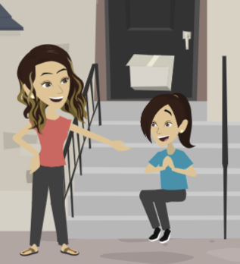
LESSON PLANS
SUPPORT SYSTEM
How can strong relationships with trustworthy adults improve a young person's life?
©2024-2026 Walking Wise
31
3

Slide 32
SUPPORT SYSTEM
Why Trustworthy Adults Matter
Provide emotional support
©2024-2026 Walking Wise
32
Notes:
PROTECTIVE FACTOR
Young people with supportive adults in their lives are more likely to ask questions, report concerns, and seek help.
Predators often avoid children and teens who have strong relationships with safe adults.

Slide 33
SUPPORT SYSTEM
Why Trustworthy Adults Matter
Provide emotional support
Offer guidance and advice
©2024-2026 Walking Wise
33
Notes:
PROTECTIVE FACTOR
Young people with supportive adults in their lives are more likely to ask questions, report concerns, and seek help.
Predators often avoid children and teens who have strong relationships with safe adults.

Slide 34
SUPPORT SYSTEM
Why Trustworthy Adults Matter
Provide emotional support
Offer guidance and advice
Help keep young people safe
©2024-2026 Walking Wise
34
Notes:
PROTECTIVE FACTOR
Young people with supportive adults in their lives are more likely to ask questions, report concerns, and seek help.
Predators often avoid children and teens who have strong relationships with safe adults.

Slide 35
SUPPORT SYSTEM
Why Trustworthy Adults Matter
Provide emotional support
Offer guidance and advice
Help keep young people safe
Build confidence
©2024-2026 Walking Wise
35
Notes:
PROTECTIVE FACTOR
Young people with supportive adults in their lives are more likely to ask questions, report concerns, and seek help.
Predators often avoid children and teens who have strong relationships with safe adults.

Slide 36
SUPPORT SYSTEM
Why Trustworthy Adults Matter
Provide emotional support
Offer guidance and advice
Help keep young people safe
Build confidence
Model healthy relationships
©2024-2026 Walking Wise
36
Notes:
PROTECTIVE FACTOR
Young people with supportive adults in their lives are more likely to ask questions, report concerns, and seek help.
Predators often avoid children and teens who have strong relationships with safe adults.

Slide 37
EDUCATON GUIDE
VOCABULARY
OBLIGATED
To be required or bound to do something.
©2024-2026 Walking Wise
37
3
Notes:
Assisting Source
OpenAI. (2024). ChatGPT [Large language model]. https://chatgpt.com

Slide 38
EDUCATON GUIDE
VOCABULARY
FAVORITISM
To unfairly give one person (or a group) better treatment than others.
©2024-2026 Walking Wise
38
3
Notes:
Assisting Source
OpenAI. (2024). ChatGPT [Large language model]. https://chatgpt.com

Slide 39
EDUCATON GUIDE
VOCABULARY
DISGUISE
To hide one’s appearance or true identity.
©2024-2026 Walking Wise
39
3
Notes:
Assisting Source
OpenAI. (2024). ChatGPT [Large language model]. https://chatgpt.com

Slide 40
VOCABULARY
BOUNDARIES
A personal limit that protects our body, feelings, and values.
It helps us decide what behavior is acceptable or unacceptable.
©2024-2026 Walking Wise
40
Notes:
Assisting Source
OpenAI. (2024). ChatGPT [Large language model]. https://chatgpt.com

Slide 41
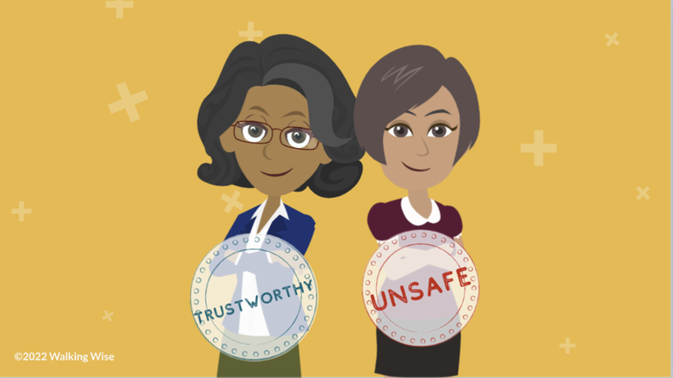
LESSON PLANS
UNSAFE BEHAVIOR
What behaviors might indicate that an adult, older teen, or peer is unsafe?
©2024-2026 Walking Wise
41
3
Notes:
Safety is about behavior.
Safety is not about how someone looks.
Safety is also not about whether the person is familiar or well-known.

Slide 42
UNSAFE BEHAVIOR
Inappropriate Behaviors
Dishonest
©2024-2026 Walking Wise
42
Notes:
UNSAFE BEHAVIOR
Children should focus on a person’s behavior, not their appearance, when deciding whether an adult, older teen, or even a peer is safe.
Unsafe people can be dishonest, uncaring, or irresponsible. They can also be a negative influence by breaking rules.
All of these behaviors can make a young person vulnerable or unprotected.

Slide 43
UNSAFE BEHAVIOR
Inappropriate Behaviors
Dishonest
Ignores Boundaries
©2024-2026 Walking Wise
43
Notes:
UNSAFE BEHAVIOR
Children should focus on a person’s behavior, not their appearance, when deciding whether an adult, older teen, or even a peer is safe.
Unsafe people can be dishonest, uncaring, or irresponsible. They can also be a negative influence by breaking rules.
All of these behaviors can make a young person vulnerable or unprotected.

Slide 44
UNSAFE BEHAVIOR
Inappropriate Behaviors
Dishonest
Ignores Boundaries
Break Rules
©2024-2026 Walking Wise
44
Notes:
UNSAFE BEHAVIOR
Children should focus on a person’s behavior, not their appearance, when deciding whether an adult, older teen, or even a peer is safe.
Unsafe people can be dishonest, uncaring, or irresponsible. They can also be a negative influence by breaking rules.
All of these behaviors can make a young person vulnerable or unprotected.

Slide 45
UNSAFE BEHAVIOR
Inappropriate Behaviors
Dishonest
Ignores Boundaries
Break Rules
Negative Influence
©2024-2026 Walking Wise
45
Notes:
UNSAFE BEHAVIOR
Children should focus on a person’s behavior, not their appearance, when deciding whether an adult, older teen, or even a peer is safe.
Unsafe people can be dishonest, uncaring, or irresponsible. They can also be a negative influence by breaking rules.
All of these behaviors can make a young person vulnerable or unprotected.

Slide 46
UNSAFE BEHAVIOR
Inappropriate Behaviors
Dishonest
Ignores Boundaries
Break Rules
Negative Influence
Unprotective
©2024-2026 Walking Wise
46
Notes:
UNSAFE BEHAVIOR
Children should focus on a person’s behavior, not their appearance, when deciding whether an adult, older teen, or even a peer is safe.
Unsafe people can be dishonest, uncaring, or irresponsible. They can also be a negative influence by breaking rules.
All of these behaviors can make a young person vulnerable or unprotected.

Slide 47
UNSAFE BEHAVIOR
Warning Signs
Ignore Boundaries
Ask Personal Questions
Cause Awkward Feelings
Give Too Many Gifts
©2024-2026 Walking Wise
47
Notes:
RED FLAG BEHAVIORS
Someone may seem friendly or appropriate at first, but over time, an unsafe person may show warning signs through their behavior.
Sometimes they change how they act depending on the vulnerabilities of the young person they are targeting.
They can use flattery or show favoritism to make a young person feel more important than others, often by granting special treatment not available to their peers.
They can cause a youth to feel confused, isolated, awkward, or embarrassed.
They may give expensive or frequent gifts to instill a young person’s sense of loyalty and obligation.
Unsafe adults can pressure youth to keep secrets and share private or personal information.
They can ask a young person to help them solve their problems.

Slide 48
UNSAFE BEHAVIOR
Warning Signs
Ignore Boundaries
Ask Personal Questions
Cause Awkward Feelings
Give Excessive Gifts
Create Obligation
Show Favortism
Encourage Secrets
Work to Isolate
©2024-2026 Walking Wise
48
Notes:
RED FLAG BEHAVIORS
Someone may seem friendly or appropriate at first, but over time, an unsafe person may show warning signs through their behavior.
Sometimes they change how they act depending on the vulnerabilities of the young person they are targeting.
They can use flattery or show favoritism to make a young person feel more important than others, often by granting special treatment not available to their peers.
They can cause a youth to feel confused, isolated, awkward, or embarrassed.
They may give expensive or frequent gifts to instill a young person’s sense of loyalty and obligation.
Unsafe adults can pressure youth to keep secrets and share private or personal information.
They can ask a young person to help them solve their problems.

Slide 49
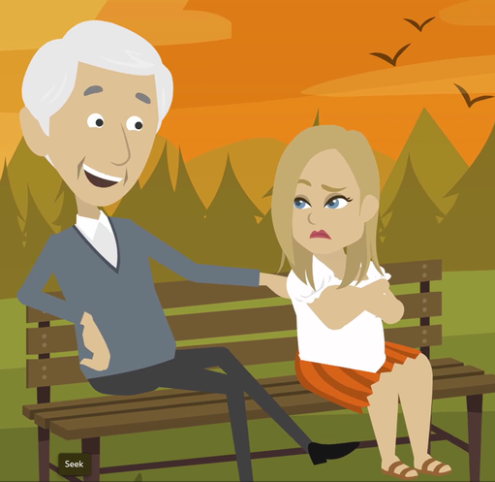
LESSON PLANS
TRICKY PEOPLE
Who can be an unsafe person?
©2024-2026 Walking Wise
49
3

Slide 50
TRICKY PEOPLE
Who Can Be Unsafe?
Someone the child or teen knows
50
Nurture Therapy (n.d.). Tricky People: A Better Way to Teach "Stranger Danger" to Kids. nurture-therapy.com.
©2024-2026 Walking Wise
Notes:
NOTE TO PRESENTER
SOMEONE KNOWN
The CDC reports that at least 90% of child sexual abuse is committed by someone the child and the child's family know and trust.[1]
Hence, understanding that strangers commit about 10% of child sexual abuse helps to put the concept of 'stranger danger' into perspective.
However, online or 'virtual' strangers have significantly increased the risk for young people using electronic devices.
Source
1. Centers for Disease Control and Prevention (2024, May). About Child Sexual Abuse. CDC.gov. Retrieved November 20, 2024, from https://www.cdc.gov/child-abuse-neglect/about/about-child-sexual-abuse.html?CDC_AAref_Val=https://www.cdc.gov/violenceprevention/childsexualabuse/fastfact.html
2. Katzenstein, J. (n.d.). Stranger Danger and Stranger Safety. HopkinsMedicine.org. Retrieved November 20, 2024, from https://www.hopkinsmedicine.org/health/wellness-and-prevention/stranger-danger-and-stranger-safety
3. Nurture Therapy (n.d.). Tricky People: A Better Way to Teach "Stranger Danger" to Kids. nurture-therapy.com. Retrieved November 20, 2024, from https://www.nurture-therapy.com/blog/tricky-people-a-better-way-to-teach-stranger-danger-to-kids

Slide 51
TRICKY PEOPLE
Who Can Be Unsafe?
Someone the child or teen knows
A peer or older teenager
51
Nurture Therapy (n.d.). Tricky People: A Better Way to Teach "Stranger Danger" to Kids. nurture-therapy.com.
©2024-2026 Walking Wise
Notes:
NOTE TO PRESENTER
SOMEONE KNOWN
The CDC reports that at least 90% of child sexual abuse is committed by someone the child and the child's family know and trust.[1]
Hence, understanding that strangers commit about 10% of child sexual abuse helps to put the concept of 'stranger danger' into perspective.
However, online or 'virtual' strangers have significantly increased the risk for young people using electronic devices.
Source
1. Centers for Disease Control and Prevention (2024, May). About Child Sexual Abuse. CDC.gov. Retrieved November 20, 2024, from https://www.cdc.gov/child-abuse-neglect/about/about-child-sexual-abuse.html?CDC_AAref_Val=https://www.cdc.gov/violenceprevention/childsexualabuse/fastfact.html
2. Katzenstein, J. (n.d.). Stranger Danger and Stranger Safety. HopkinsMedicine.org. Retrieved November 20, 2024, from https://www.hopkinsmedicine.org/health/wellness-and-prevention/stranger-danger-and-stranger-safety
3. Nurture Therapy (n.d.). Tricky People: A Better Way to Teach "Stranger Danger" to Kids. nurture-therapy.com. Retrieved November 20, 2024, from https://www.nurture-therapy.com/blog/tricky-people-a-better-way-to-teach-stranger-danger-to-kids

Slide 52
TRICKY PEOPLE
Who Can Be Unsafe?
Someone the child or teen knows
A peer or older teenager
A stranger
52
Nurture Therapy (n.d.). Tricky People: A Better Way to Teach "Stranger Danger" to Kids. nurture-therapy.com.
©2024-2026 Walking Wise
Notes:
NOTE TO PRESENTER
STRANGER DANGER
'Stranger Danger' is a concept that instructs children and young people to exercise caution and be aware when interacting with individuals they do not know personally. The concept emphasizes that strangers can pose a threat to their safety and well-being.
MISLEADING
The Stranger Danger concept implies that strangers pose the greatest threat to young people's security. Still, statistics show that incidents of abduction, sexual abuse, and human trafficking often involve individuals known to youth, like family members, neighbors, or family acquaintances.
DISTINCTION
Young people must know that not all strangers pose threats, and not all familiar people are safe.
Source
1. Centers for Disease Control and Prevention (2024, May). About Child Sexual Abuse. CDC.gov. Retrieved November 20, 2024, from https://www.cdc.gov/child-abuse-neglect/about/about-child-sexual-abuse.html?CDC_AAref_Val=https://www.cdc.gov/violenceprevention/childsexualabuse/fastfact.html
2. Katzenstein, J. (n.d.). Stranger Danger and Stranger Safety. HopkinsMedicine.org. Retrieved November 20, 2024, from https://www.hopkinsmedicine.org/health/wellness-and-prevention/stranger-danger-and-stranger-safety
3. Nurture Therapy (n.d.). Tricky People: A Better Way to Teach "Stranger Danger" to Kids. nurture-therapy.com. Retrieved November 20, 2024, from https://www.nurture-therapy.com/blog/tricky-people-a-better-way-to-teach-stranger-danger-to-kids

Slide 53
TRICKY PEOPLE
Who Can Be Unsafe?
Someone the child or teen knows
A peer or older teenager
A stranger
An online contact
53
Nurture Therapy (n.d.). Tricky People: A Better Way to Teach "Stranger Danger" to Kids. nurture-therapy.com.
©2024-2026 Walking Wise
Notes:
ONLINE
Online or 'Virtual' Danger is an ever-growing threat, making it imperative for young people to understand the unique risks associated with online interactions and to have the guidance they need to navigate potential dangers online.
Source
1. Centers for Disease Control and Prevention (2024, May). About Child Sexual Abuse. CDC.gov. Retrieved November 20, 2024, from https://www.cdc.gov/child-abuse-neglect/about/about-child-sexual-abuse.html?CDC_AAref_Val=https://www.cdc.gov/violenceprevention/childsexualabuse/fastfact.html
2. Katzenstein, J. (n.d.). Stranger Danger and Stranger Safety. HopkinsMedicine.org. Retrieved November 20, 2024, from https://www.hopkinsmedicine.org/health/wellness-and-prevention/stranger-danger-and-stranger-safety
3. Nurture Therapy (n.d.). Tricky People: A Better Way to Teach "Stranger Danger" to Kids. nurture-therapy.com. Retrieved November 20, 2024, from https://www.nurture-therapy.com/blog/tricky-people-a-better-way-to-teach-stranger-danger-to-kids

Slide 54
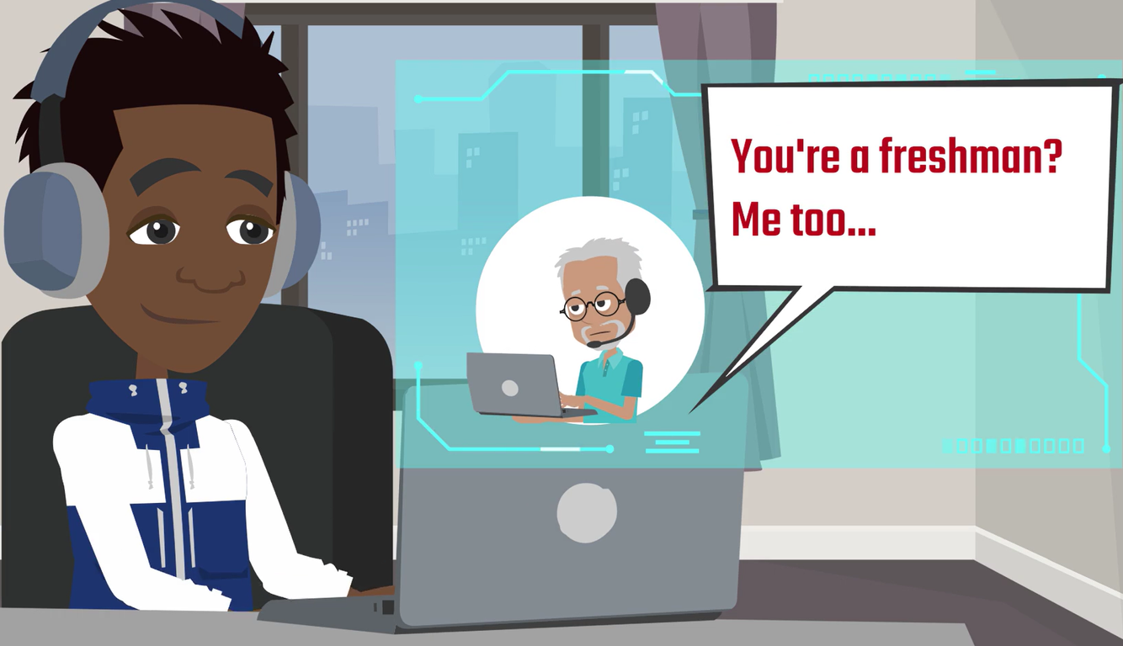
LESSON PLANS
ONLINE CONTACTS
Why can online-only friends be dangerous even if they seem safe?
©2024-2026 Walking Wise
54

Slide 55
ONLINE CONTACTS
Virtual Stranger
It’s usually impossible to know for certain who an ‘Online-Only Friend’ really is.
©2024-2026 Walking Wise
55
Notes:
Young people often do not view an online acquaintance as a mysterious stranger. Instead, they identify online connections as friends, just like in-person relationships. [1]
It is usually impossible to be sure that an 'online-only friend' is who they say they are. So, young people should not assume they are interacting with an honest, trustworthy, or safe acquaintance.
Online predators are often patient, investing considerable time in developing relationships during the grooming process before victimizing a young person.
Source
1. THORN (2022, April). Online Grooming: Examining risky encounters amid everyday digital socialization, p. 10. Benenson Strategy Group. Retrieved November 12, 2024 from https://info.thorn.org/hubfs/Research/2022_Online_Grooming_Report.pdf

Slide 56
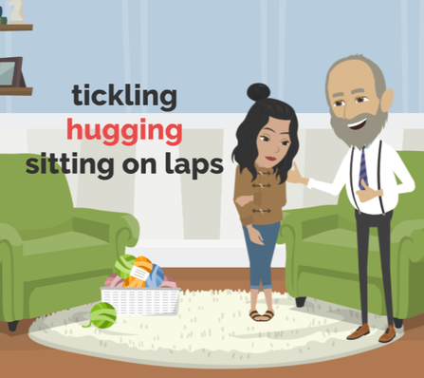
LESSON PLANS
BREAKING BOUNDARIES
What tricks might an unsafe person use to break a child’s physical boundaries?
©2024-2026 Walking Wise
56
3

Slide 57
BREAKING BOUNDARIES
Tricky Behavior
Try to spend time alone with a young person.
©2024-2026 Walking Wise
57
Notes:
TIME ALONE
Unsafe adults look for opportunities to spend time alone with a young person to gain trust.

Slide 58
BREAKING BOUNDARIES
Tricky Behavior
Give gifts and special attention.
©2024-2026 Walking Wise
58
Notes:
INDEBTED & OBLIGATION
Unsafe adults may claim the young person owes them for gifts, attention, favoritism, affection, etc., and eventually demand repayment.

Slide 59
BREAKING BOUNDARIES
Tricky Behavior
Share secrets, then require promises not to tell others.
©2024-2026 Walking Wise
59
Notes:
SECRETS
They often share personal secrets to make the young person feel like a special confidant.

Slide 60
BREAKING BOUNDARIES
Tricky Behavior
Invade personal space to break physical boundaries.
©2024-2026 Walking Wise
60
Notes:
BREAKING BOUNDARIES
Unsafe adults may attempt to normalize their inappropriate behavior by invading a victim's personal space, expressing romantic interest, violating physical boundaries, and finally involving the young person in sexual activity.

Slide 61
BREAKING BOUNDARIES
Tricky Behavior
Make sexual activity seem normal.
©2024-2026 Walking Wise
61
Notes:
BREAKING BOUNDARIES
Unsafe adults may attempt to normalize their inappropriate behavior by invading a victim's personal space, expressing romantic interest, violating physical boundaries, and finally involving the young person in sexual activity.

Slide 62
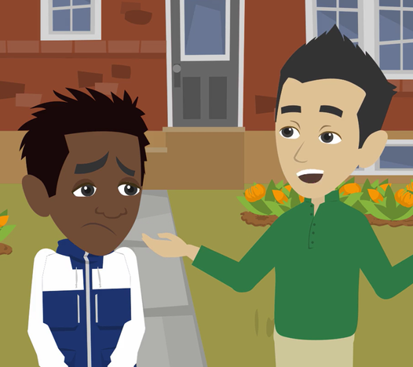
LESSON PLANS
UNSAFE SECRETS
How might an unsafe adult try to stop a young person from telling someone?
©2024-2026 Walking Wise
62
3

Slide 63
UNSAFE SECRETS
Using Fear to Keep Secrets
Blame: They usually blame the child, saying it is their fault.
©2024-2026 Walking Wise
63
Notes:
These tactics are used to control and scare victims into staying silent.
It is never the victim’s fault.
Unsafe adults are responsible for their actions.
BLAME & SHAME
They use blame and shame to manipulate the young person, making them feel responsible for the abusive actions.
ISOLATION
They gain control by distancing the young person from family and friends to limit outside influences.
THREATS
Unsafe adults may threaten to harm the young person or their loved ones, including family members or pets, to keep them from reporting the abuse.

Slide 64
UNSAFE SECRETS
Using Fear to Keep Secrets
Shame: They often make the child feel embarrassed or guilty.
©2024-2026 Walking Wise
64
Notes:
These tactics are used to control and scare victims into staying silent.
It is never the victim’s fault.
Unsafe adults are responsible for their actions.
BLAME & SHAME
They use blame and shame to manipulate the young person, making them feel responsible for the abusive actions.
ISOLATION
They gain control by distancing the young person from family and friends to limit outside influences.
THREATS
Unsafe adults may threaten to harm the young person or their loved ones, including family members or pets, to keep them from reporting the abuse.

Slide 65
UNSAFE SECRETS
Using Fear to Keep Secrets
Isolate: They may separate the child from trustworthy adults.
©2024-2026 Walking Wise
65
Notes:
These tactics are used to control and scare victims into staying silent.
It is never the victim’s fault.
Unsafe adults are responsible for their actions.
BLAME & SHAME
They use blame and shame to manipulate the young person, making them feel responsible for the abusive actions.
ISOLATION
They gain control by distancing the young person from family and friends to limit outside influences.
THREATS
Unsafe adults may threaten to harm the young person or their loved ones, including family members or pets, to keep them from reporting the abuse.

Slide 66
UNSAFE SECRETS
Using Fear to Keep Secrets
Threaten: They may threaten to harm their family or pets.
©2024-2026 Walking Wise
66
Notes:
These tactics are used to control and scare victims into staying silent.
It is never the victim’s fault.
Unsafe adults are responsible for their actions.
BLAME & SHAME
They use blame and shame to manipulate the young person, making them feel responsible for the abusive actions.
ISOLATION
They gain control by distancing the young person from family and friends to limit outside influences.
THREATS
Unsafe adults may threaten to harm the young person or their loved ones, including family members or pets, to keep them from reporting the abuse.

Slide 67
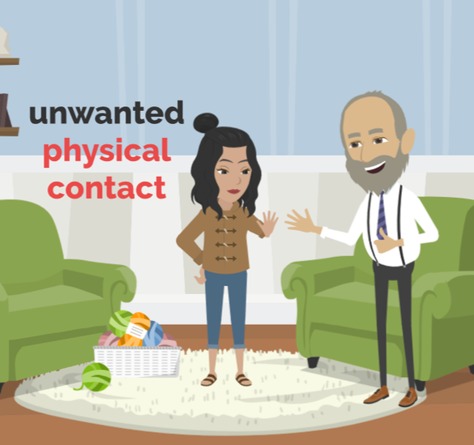
LESSON PLANS
SETTING BOUNDARIES
How can setting boundaries be empowering for young people?
©2024-2026 Walking Wise
67
3

Slide 68
SETTING BOUNDARIES
Youth Empowerment
Trust Your Instincts: Listen to your gut feelings and leave situations that seem wrong.
©2024-2026 Walking Wise
68

Slide 69
SETTING BOUNDARIES
Youth Empowerment
Say “NO”: Feel confident to say no if someone makes you feel uncomfortable, whether online or in person.
©2024-2026 Walking Wise
69

Slide 70
SETTING BOUNDARIES
Youth Empowerment
Stop the Pressure: Immediately end all conversations when feeling pressured or made to feel guilty.
©2024-2026 Walking Wise
70

Slide 71

ASK FOR HELP
©2024-2026 Walking Wise
71

Slide 72
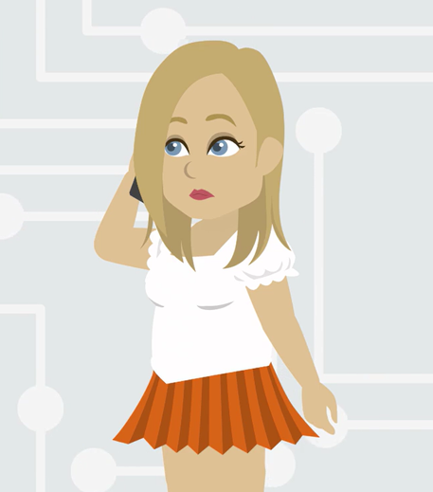
ASK FOR HELP
What are ways young people can ask for help?
©2024-2026 Walking Wise
72

Slide 73
ASK FOR HELP
How to Ask for Help
If you are in immediate danger, dial 911.
©2024-2026 Walking Wise
73

Slide 74
ASK FOR HELP
How to Ask for Help
If you are in immediate danger, dial 911.
If the sexual predator IS a family member, consider telling a trustworthy adult.
©2024-2026 Walking Wise
74

Slide 75
ASK FOR HELP
How to Ask for Help
If you are in immediate danger, dial 911.
If the sexual predator IS a family member, consider telling a trustworthy adult.
If the sexual predator is NOT family, consider telling a parent.
©2024-2026 Walking Wise
75

Slide 76
ASK FOR HELP
How to Ask for Help
If you are in immediate danger, dial 911.
If the sexual predator IS a family member, consider telling a trustworthy adult.
If the sexual predator is NOT family, consider telling a parent.
If you are a student in school, consider telling a trustworthy teacher, coach, school nurse, social worker, counselor, resource officer, or principal.
©2024-2026 Walking Wise
76

Slide 77
ASK FOR HELP
How to Ask for Help
If you are in immediate danger, dial 911.
If the sexual predator IS a family member, consider telling a trustworthy adult.
If the sexual predator is NOT family, consider telling a parent.
If you are a student in school, consider telling a trustworthy teacher, coach, school nurse, social worker, counselor, resource officer, or principal.
To gain internet access for help, consider using a computer at your school or a public library.
©2024-2026 Walking Wise
77

Slide 78
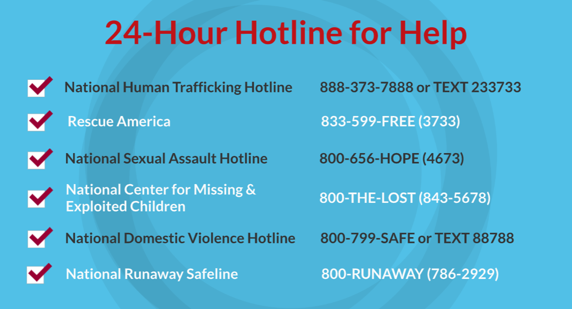
©2024-2026 Walking Wise
78
Notes:
NOTE
Presenters may ask their audience to consider adding a few "hotline for help" phone numbers in their cell phone contacts or take a photo of this slide.

Slide 79
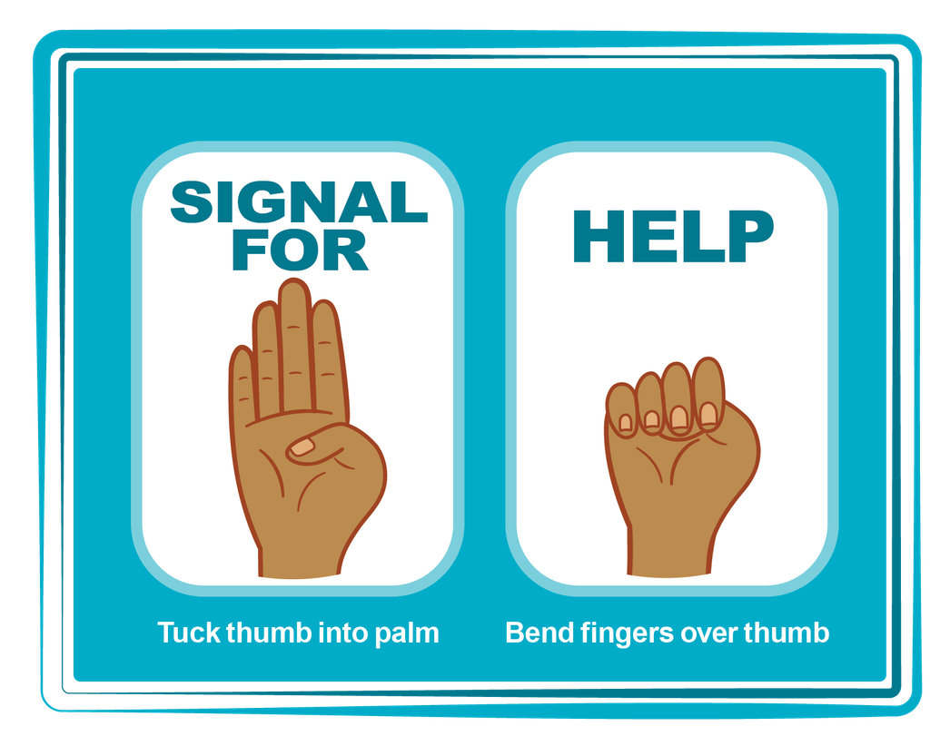
HAND SIGNAL FOR HELP
©2024-2026 Walking Wise
Source: Canadian Women’s Foundation, April 2020
79
Notes:
Although the hand signal for help has not yet achieved universal recognition, it may discreetly get someone's attention in urgent situations.
SILENT
It can be used silently.
UNTRACKABLE
It leaves no digital footprint.
CONCEALED
It can be done secretly when a perpetrator is in the vicinity.
SIGNALS DISTRESS
Combining the hand signal with a distressed facial expression might help attract the attention of an individual unfamiliar with the signal's meaning.
Source
Canadian Women's Foundation, April 2020

Slide 80



Thank you!
WalkingWise.com
Online Course for Adults Accredited by:
Postgraduate Institue for Medicine
Academy of Forensic Nursing
©2024-2026 Walking Wise
80
Notes:
NOTE TO PRESENTER
To access additional resources about Trustworthy vs. Unsafe Adult, please take a look at the last page of Lesson Plan #2 by logging in to the Walking Wise Learning Platform.
We welcome your feedback at support@WalkingWise.com.

