Slide 1


SEXUAL EXPLOITATION
EDUCATION
Trustworthy vs
Unsafe Adult
LESSON #2
Notes:
NOTE
Log in to WalkingWise.com and refer to the Walking Wise Education Guide to implement classroom teaching tips.
Most importantly:
• DEFINE SCHOOL POLICY
Establish a sexual exploitation reporting protocol with a trauma-informed response. The Walking Wise Implementation Guide provides a sample protocol.
• AGE & AUDIENCE
This presentation can be edited by following the procedures on page 3 to align with your school policies, specific age groups, and the involvement of at-risk audiences.
• SUPPORT PROCEDURE
Provide your audience with guidance on accessing immediate help or arranging a private meeting with a social worker, counselor, nurse, school resource officer, or another trustworthy staff member to report concerns for themselves or a peer.
• SECOND SAFE ADULT
Ensure a second trustworthy adult, such as a teacher, is present in the learning setting to observe audience reactions and identify those who may benefit from a follow-up meeting. This person should remain focused and free from other duties during the presentation.
• IMPLEMENT SLIDO.com
Please log in to WalkingWise.com for instructions on incorporating Slido into the PowerPoint presentation to engage your audience using digital polling.

Slide 2

NOTE TO PRESENTER
This presentation is exclusively for Walking Wise® subscribers and not for redistribution.
Walking Wise provides an interactive digital tool, Slido.com, to enhance audience engagement. To implement Slido for your organization, you can log in to WalkingWise.com for setup instructions. Once configured, integrate Slido polling and add a post-evaluation into the PowerPoint presentation.
Presenters are encouraged to edit speaker notes to match their speaking style (viewable in presentation mode). You can also delete slides from this Walking Wise presentation to make sure the content aligns with your school policies, is age-appropriate, and fits within available class time. However, the existing slides are copyright-protected and may not be modified without prior written permission from Walking Wise.
If you would like to add your own content, you may do so under the following conditions:
  Insert new PowerPoint slides.
  Remove the Walking Wise logo and copyright "©2025 Walking Wise" from the new slides.
  Always add your organization's name or logo to each new slide.
Please delete this instruction page before presenting to audiences.
©2025 Walking Wise
2
Notes:
NOTE
The presenter is welcome to customize this Walking Wise presentation according to the instructions provided on this page.
For revision requests, please send an email to support@WalkingWise.com.

Slide 3

CONFRONTING SEXUAL EXPLOITATION
WALKING WISE
KNOWLEDGE serves as a
powerful defense against
sexual predators.
©2025 Walking Wise
3

Slide 4
CONFRONTING SEXUAL EXPLOITATION
WALKING WISE
SEXUAL EXPLOITATION includes grooming, sextortion, pornography
& sex trafficking.
©2025 Walking Wise
4

Slide 5
SENSITIVE DISCUSSION AHEAD
CONTENT ALERT
We’ll be discussing serious issues about sexual exploitation.
Some parts may be difficult to hear.
If you ever feel uncomfortable, you can step out and speak with a trustworthy adult for support.
You’re not alone—we’re here to help you.
©2025 Walking Wise
5
Notes:
NOTE TO PRESENTER
Please tailor this message to align with your organization's policies and protocols.
Please provide a confidential avenue for students to report concerns and seek help for themselves or their peers if they suspect sexual abuse, grooming, sextortion, pornography-related exploitation, or human trafficking. This may include a designated address or text line.
Consider displaying posters in your school or facility that outline various ways students can access immediate support or request a private meeting with a school safety team member or another trusted adult.

Slide 6

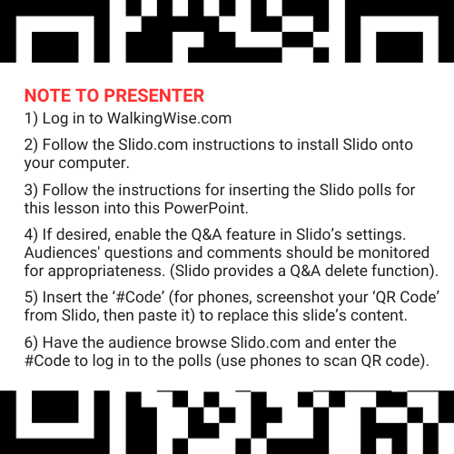
DIGITAL PARTICIPATION
©2025 Walking Wise
6
Notes:
NOTE
For digital interaction with audiences:
Log in to WalkingWise.com to follow instructions on setting up Slido questions/answers for this presentation. Then, replace the QR code and #code in this slide with your custom QR/#code.
Please verify whether the Q&A feature has been activated before presenting to audiences. An adult should monitor questions and comments to ensure appropriateness. Slido has a feature that allows you to delete unwanted questions and comments.

Slide 7


STATISTICS
Statistics are Only Estimates
  Study results may be unreliable because most sexual crimes go unreported.
©2025 Walking Wise
7
Notes:
In this presentation, we'll discuss statistics, but it's important to note that while statistics provide valuable insights into an issue, they cannot be entirely relied upon.
Here are a few reasons:
• UNREPORTED
Victims may stay silent due to fear, shame, or manipulation.
• INCONSISTENT COLLECTION
Geographical areas have different legal definitions for sexual crimes, making data hard to compare.
• FOCUS GROUPS
Small or specific focus groups participating in a study or survey may not accurately reflect the diversity or experiences of the broader population.

Slide 8
STATISTICS
Statistics are Only Estimates
  Study results may be unreliable because most sexual crimes go unreported.
  The methods used to collect information can vary widely between studies, leading to inconsistency.
©2025 Walking Wise
8
Notes:
In this presentation, we'll discuss statistics, but it's important to note that while statistics provide valuable insights into an issue, they cannot be entirely relied upon.
Here are a few reasons:
• UNREPORTED
Victims may stay silent due to fear, shame, or manipulation.
• INCONSISTENT COLLECTION
Geographical areas have different legal definitions for sexual crimes, making data hard to compare.
• FOCUS GROUPS
Small or specific focus groups participating in a study or survey may not accurately reflect the diversity or experiences of the broader population.

Slide 9
STATISTICS
Statistics are Only Estimates
  Study results may be unreliable because most sexual crimes go unreported.
  The methods used to collect information can vary widely between studies, leading to inconsistency.
  Focus groups in studies may not accurately represent the larger population.
©2025 Walking Wise
9
Notes:
In this presentation, we'll discuss statistics, but it's important to note that while statistics provide valuable insights into an issue, they cannot be entirely relied upon.
Here are a few reasons:
• UNREPORTED
Victims may stay silent due to fear, shame, or manipulation.
• INCONSISTENT COLLECTION
Geographical areas have different legal definitions for sexual crimes, making data hard to compare.
• FOCUS GROUPS
Small or specific focus groups participating in a study or survey may not accurately reflect the diversity or experiences of the broader population.

Slide 10


EDUCATON GUIDE
VOCABULARY
VOCABULARY
  Honorable
  Obligated
  Favoritism
  Disguise
  Authentic
  Trustworthy
  Unsafe Adult
  Consent
©2025 Walking Wise
10
3
Notes:
NOTE
Understanding vocabulary terms related to the behaviors of sexual predators can empower young people to recognize warning signs of harmful situations.
Knowing terminology helps them identify manipulative tactics predators use to build trust and exploit vulnerabilities.
With this knowledge, young people are better equipped to spot red flags, understand that these behaviors are abusive, and feel more confident reporting predators to trusted adults or authorities, potentially preventing further harm.

Slide 11
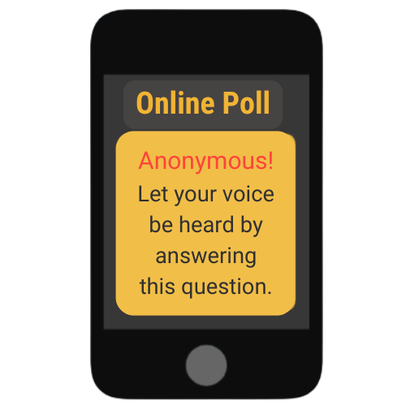
LESSON PLANS
SEXUAL ABUSE
Who are more likely to be victims of sexual abuse: Children or Adults?
Finkelhor, D., Shattuck, A. (2012, May). Characteristics of Crimes against Juveniles, Crimes Against Children Research Center, University of New Hampshire, p. 2.
11
©2024 Walking Wise
Notes:
SLIDO.com: Multiple Choice
Are children (under 18) or adults more likely to be victims of sexual abuse?
A) Children
B) Adults
ANSWER
A) Children (Under age 18)
For sex offenses, juveniles make up a majority of the victims, with 66% of youth under 18 reporting sexual crimes.
Source
Finkelhor, D., Shattuck, A. (2012, May). Characteristics of Crimes against Juveniles, Crimes Against Children Research Center, University of New Hampshire, p. 2. Retrieved November 13, 2024, from https://www.unh.edu/ccrc/sites/default/files/media/2022-03/characteristics-of-crimes-against-juveniles_0.pdf

Slide 12
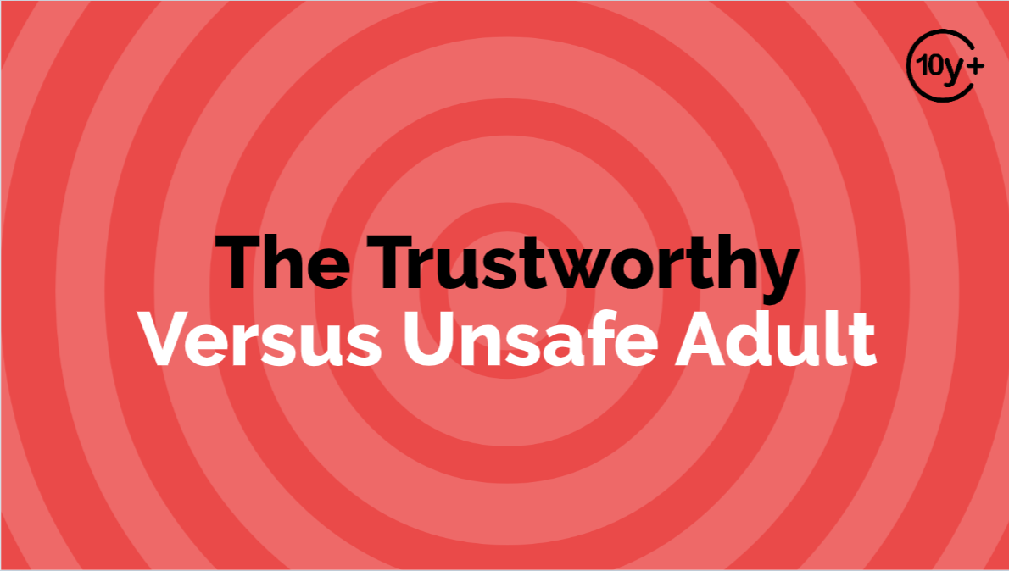
Log in to WalkingWise.com to access this animated video.
©2025 Walking Wise
12
Notes:
Message Especially for Teens:
Businesses worldwide use explainer-style animation as a training tool for their employees.
So, this 3-minute Walking Wise animated video is appropriate for young people (ages 10+) and adults to learn how sexual predators use manipulation, intimidation, and coercion to exploit young people.
NOTE
Log in to Walking Wise.com to watch the three-minute animated video with audiences.

Slide 13
SEXUAL ABUSE
How many girls & boys experience sexual abuse during their childhood?
Dube, S. R., Anda, R. F., Whitfield, C. L., Brown, D. W., Felitti, V. J., Dong, M., & Giles, W. H. (2005). Long-term consequences of childhood sexual abuse by gender of victim. American journal of preventive medicine, 28(5), 430–438.
13
©2025 Walking Wise
Notes:
SLIDO.com: Multiple Choice
How many girls and boys experience sexual abuse during their childhood?
A) 1 in 4 girls & 1 in 6 boys
B) 1 in 14 girls & 1 in 26 boys
C) 1 in 24 girls & 1 in 46 boys
ANSWER
A) 1 in 4 girls & 1 in 6 boys have experienced sexual abuse during their childhoods.
NOTE
Teaching children as young as 10 years old that many girls and boys experience sexual abuse will help victims realize they are not alone and could potentially break the cycle of silence.
Education will help:
1) Reduce stigma
2) Encourage openness
3) Empower reporting
4) Reduce self-blame
5) Build Resilience
6) Reduce victim blaming
7) Encourage advocacy
Source
Dube, S. R., Anda, R. F., Whitfield, C. L., Brown, D. W., Felitti, V. J., Dong, M., & Giles, W. H. (2005). Long-term consequences of childhood sexual abuse by gender of victim. American journal of preventive medicine, 28(5), 430–438. https://doi.org/10.1016/j.amepre.2005.01.015

Slide 14
EDUCATON GUIDE
VOCABULARY
AUTHENTIC
Someone or something that is true to its nature or beliefs and displays qualities that are trustworthy, genuine, and real.
©2025 Walking Wise
14
3
Notes:
Assisting Source
OpenAI. (2024). ChatGPT [Large language model]. https://chatgpt.com

Slide 15
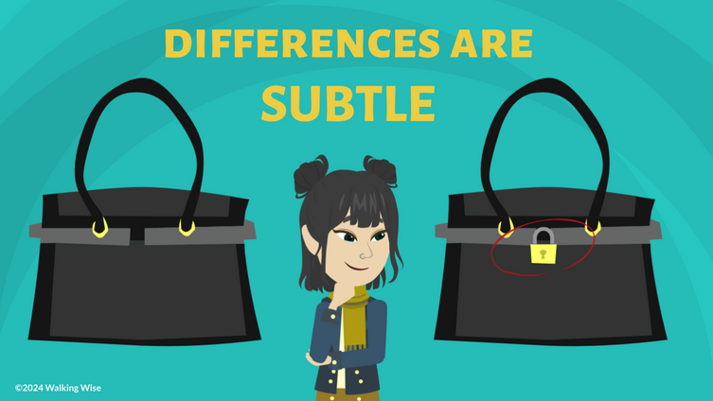
LESSON PLANS
AUTHENTIC PEOPLE
When should young people pay close attention to how someone acts or behaves?
©2025 Walking Wise
15
3
Notes:
NOTE
Teaching children as young as 10 years old that many girls and boys experience sexual abuse will help victims realize they are not alone and could potentially break the cycle of silence.
Education will help:
1) Reduce stigma
2) Encourage openness
3) Empower reporting
4) Reduce self-blame
5) Build Resilience
6) Reduce victim blaming
7) Encourage advocacy

Slide 16
AUTHENTIC PEOPLE
When to Notice Behavior
  Choosing friends
©2025 Walking Wise
16
Notes:
When is it necessary to assess the behavior of people around us?

Slide 17
AUTHENTIC PEOPLE
When to Notice Behavior
  Choosing friends
  Meeting new peers
©2025 Walking Wise
17
Notes:
When is it necessary to assess the behavior of people around us?

Slide 18
AUTHENTIC PEOPLE
When to Notice Behavior
  Choosing friends
  Meeting new peers
  Deciding who to confide in
©2025 Walking Wise
18
Notes:
When is it necessary to assess the behavior of people around us?

Slide 19
AUTHENTIC PEOPLE
When to Notice Behavior
  Choosing friends
  Meeting new peers
  Deciding who to confide in
  Selecting role models
©2025 Walking Wise
19
Notes:
When is it necessary to assess the behavior of people around us?

Slide 20
AUTHENTIC PEOPLE
When to Notice Behavior
  Choosing friends
  Meeting new peers
  Deciding who to confide in
  Selecting role models
  Choosing trustworthy adults
©2025 Walking Wise
20
Notes:
When is it necessary to assess the behavior of people around us?

Slide 21
AUTHENTIC PEOPLE
When to Notice Behavior
  Choosing friends
  Meeting new peers
  Deciding who to confide in
  Selecting role models
  Choosing trustworthy adults
  Asking for help
©2025 Walking Wise
21
Notes:
When is it necessary to assess the behavior of people around us?

Slide 22
AUTHENTIC PEOPLE
Determine Trustworthiness Over Time
  Observe ACTIONS...in public and private places.
©2025 Walking Wise
22
Notes:
• AUTHENTIC
Teaching authenticity through safe and unsafe adult behaviors nurtures critical thinking. It encourages young people to evaluate interactions with others, even those they already trust, and to reflect on the reasons behind that trust.
• TRUSTED
A "trusted adult," such as a teacher, caregiver, or family friend, is someone a young person trusts often by default due to the nature of the relationship.
• TRUSTWORTHY
Evaluating behavior over time will help to identify whether those who appear trustworthy are authentic or real, which is the process of “earning one’s trust.”
• BOUNDARIES
When setting boundaries, an unsafe adult can often be recognized by their negative reactions or resistance, such as gaslighting, to the limits that the potential victim has established.

Slide 23
AUTHENTIC PEOPLE
Determine Trustworthiness Over Time
  Observe ACTIONS...in public and private places.
  Evaluate CHOICES... for themselves and other people.
©2025 Walking Wise
23
Notes:
• AUTHENTIC
Teaching authenticity through safe and unsafe adult behaviors nurtures critical thinking. It encourages young people to evaluate interactions with others, even those they already trust, and to reflect on the reasons behind that trust.
• TRUSTED
A "trusted adult," such as a teacher, caregiver, or family friend, is someone a young person trusts often by default due to the nature of the relationship.
• TRUSTWORTHY
Evaluating behavior over time will help to identify whether those who appear trustworthy are authentic or real, which is the process of “earning one’s trust.”
• BOUNDARIES
When setting boundaries, an unsafe adult can often be recognized by their negative reactions or resistance, such as gaslighting, to the limits that the potential victim has established.

Slide 24
AUTHENTIC PEOPLE
Determine Trustworthiness Over Time
  Observe ACTIONS...in public and private places.
  Evaluate CHOICES... for themselves and other people.
  Ask QUESTIONS...to see if their responses are consistent.
©2025 Walking Wise
24
Notes:
• AUTHENTIC
Teaching authenticity through safe and unsafe adult behaviors nurtures critical thinking. It encourages young people to evaluate interactions with others, even those they already trust, and to reflect on the reasons behind that trust.
• TRUSTED
A "trusted adult," such as a teacher, caregiver, or family friend, is someone a young person trusts often by default due to the nature of the relationship.
• TRUSTWORTHY
Evaluating behavior over time will help to identify whether those who appear trustworthy are authentic or real, which is the process of “earning one’s trust.”
• BOUNDARIES
When setting boundaries, an unsafe adult can often be recognized by their negative reactions or resistance, such as gaslighting, to the limits that the potential victim has established.

Slide 25
AUTHENTIC PEOPLE
Determine Trustworthiness Over Time
  Observe ACTIONS...in public and private places.
  Evaluate CHOICES... for themselves and other people.
  Ask QUESTIONS...to see if their responses are consistent.
  Watch REACTIONS...when setting boundaries.
©2025 Walking Wise
25
Notes:
• AUTHENTIC
Teaching authenticity through safe and unsafe adult behaviors nurtures critical thinking. It encourages young people to evaluate interactions with others, even those they already trust, and to reflect on the reasons behind that trust.
• TRUSTED
A "trusted adult," such as a teacher, caregiver, or family friend, is someone a young person trusts often by default or automatically due to the nature of the relationship.
• TRUSTWORTHY
Evaluating behavior over time will help to identify whether those who appear trustworthy are authentic or real, which is the process of "earning one's trust."
• BOUNDARIES
When setting boundaries, an unsafe adult can often be recognized by their negative reactions or resistance, such as gaslighting, to the limits that the potential victim has established.

Slide 26
EDUCATON GUIDE
VOCABULARY
TRUSTWORTHY
Deserving of being relied on as honest, loyal, responsible, dependable, and safe.
©2025 Walking Wise
26
3
Notes:
Assisting Source
OpenAI. (2024). ChatGPT [Large language model]. https://chatgpt.com

Slide 27
EDUCATON GUIDE
VOCABULARY
HONORABLE
Someone who deserves respect because they are honest, have integrity, and strong moral values.
©2025 Walking Wise
27
3
Notes:
Assisting Source
OpenAI. (2024). ChatGPT [Large language model]. https://chatgpt.com

Slide 28
LESSON PLANS
AUTHENTIC PEOPLE
In one or two words, how would you determine if a ‘trusted person’ is real or authentic?
©2025 Walking Wise
28
3
Notes:
SLIDO.com: Word Cloud
The more frequently a word is used, the larger it appears in the cloud, making it easy to
see which words or ideas are most common among the audience.
POSSIBLE ANSWERS
Observe actions
Ask questions
Notice consistency
Evaluate respect
Seek honesty
Watch reactions

Slide 29
TRUSTWORTHY BEHAVIORS
Trustworthy Behavior
  Reliable
  Dependable
  Fair
  Safe
  Honest
  Respectful
©2025 Walking Wise
29
Notes:
• TRUSTWORTHY BEHAVIOR
Safe adults are caring, thoughtful, compassionate, loving, and gentle.
They behave in ways that demonstrate they are dependable, respectful, and honest.
Safe adults look for ways to be helpful and kind, and they treat young people fairly.

Slide 30
TRUSTWORTHY BEHAVIORS
Trustworthy Behavior
  Reliable
  Dependable
  Fair
  Safe
  Honest
  Respectful
  Forgiving
  Thoughtful
  Caring
  Kind
  Considerate
  Loving
©2025 Walking Wise
30
Notes:
• TRUSTWORTHY BEHAVIOR
Safe adults are caring, thoughtful, compassionate, loving, and gentle.
They behave in ways that demonstrate they are dependable, respectful, and honest.
Safe adults look for ways to be helpful and kind, and they treat young people fairly.

Slide 31
TRUSTWORTHY BEHAVIORS
Trustworthy Behavior
  Reliable
  Dependable
  Fair
  Safe
  Honest
  Respectful
  Forgiving
  Thoughtful
  Caring
  Kind
  Considerate
  Loving
  Loyal
  Gentle
  Accountable
  Empathetic
  Consistent
  Compassionate
©2025 Walking Wise
31
Notes:
• TRUSTWORTHY BEHAVIOR
Safe adults are caring, thoughtful, compassionate, loving, and gentle.
They behave in ways that demonstrate they are dependable, respectful, and honest.
Safe adults look for ways to be helpful and kind, and they treat young people fairly.

Slide 32
LESSON PLANS
TRUSTWORTHY BEHAVIORS
In one or two words, how would you describe the behavior of a trustworthy adult?
©2025 Walking Wise
32
Notes:
SLIDO.com: Word Cloud
The more frequently a word is used, the larger it appears in the cloud, making it easy to
see which words or ideas are most common among the audience.
POSSIBLE ANSWERS
Trustworthy Behavior:
o Reliable
o Dependable
o Fair
o Safe
o Honest
o Respectful
o Forgiving
o Thoughtful
o Caring
o Kind
o Considerate
o Loving
o Loyal
o Gentle
o Accountable
o Empathetic
o Consistent
o Compassionate

Slide 33
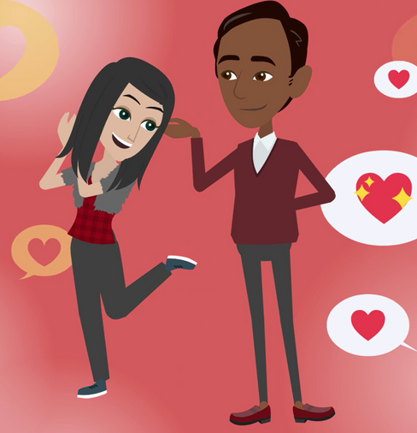
LESSON PLANS
EVALUATE BEHAVIOR
What questions can you ask yourself to decide if someone is trustworthy?
©2025 Walking Wise
33
3

Slide 34
EVALUATE BEHAVIOR
Trustworthy vs. Unsafe
  Are they RELIABLE...or is it difficult to depend on them?
©2025 Walking Wise
34

Slide 35
EVALUATE BEHAVIOR
Trustworthy vs. Unsafe
  Are they RELIABLE...or is it difficult to depend on them?
  Are they FAIR...or do they have favorites or unfair rules?
©2025 Walking Wise
35

Slide 36
EVALUATE BEHAVIOR
Trustworthy vs. Unsafe
  Are they RELIABLE...or is it difficult to depend on them?
  Are they FAIR...or do they have favorites or unfair rules?
  Do they make good CHOICES...even when no one is watching?
©2025 Walking Wise
36

Slide 37
EVALUATE BEHAVIOR
Trustworthy vs. Unsafe
  Are they RELIABLE...or is it difficult to depend on them?
  Are they FAIR...or do they have favorites or unfair rules?
  Do they make good CHOICES...even when no one is watching?
  Are they HONEST...or do their stories keep changing?
©2025 Walking Wise
37
Notes:
• HONESTY
Honest people’s responses or stories usually remain consistent over time, while dishonest individuals often struggle to keep their stories aligned, resulting in noticeable changes.

Slide 38
EVALUATE BEHAVIOR
Trustworthy vs. Unsafe
  Are they RELIABLE...or is it difficult to depend on them?
  Are they FAIR...or do they have favorites or unfair rules?
  Do they make good CHOICES...even when no one is watching?
  Are they HONEST...or do their stories keep changing?
  Are they SAFE...or do they encourage risky behavior?
©2025 Walking Wise
38

Slide 39
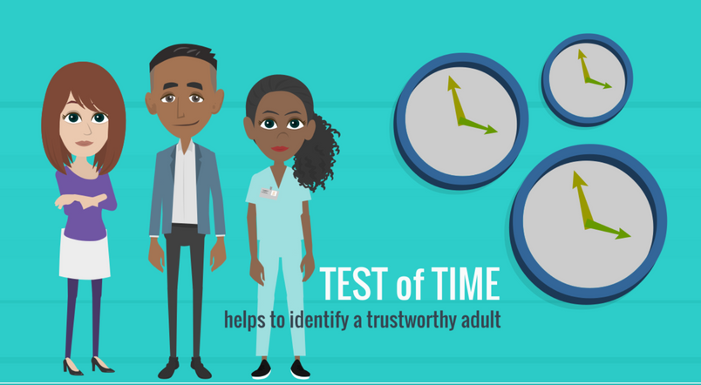
LESSON PLANS
PROTECTION
How can strong relationships with trustworthy adults improve a young person's life?
©2025 Walking Wise
39
3

Slide 40
PROTECTION
Benefits of Knowing a Trustworthy Adult
  Trustworthy adults provide emotional support.
©2025 Walking Wise
40
Notes:
• PROTECTIVE FACTORS
Young people who feel comfortable asking questions of their parent(s) or another trustworthy adult are more likely to report mistreatment by others.
Predators are also less likely to target teens or children who have a trustworthy adult involved in their lives.

Slide 41
PROTECTION
Benefits of Knowing a Trustworthy Adult
  Trustworthy adults provide emotional support.
  They serve as positive role models.
©2025 Walking Wise
41
Notes:
• PROTECTIVE FACTORS
Young people who feel comfortable asking questions of their parent(s) or another trustworthy adult are likelier to report mistreatment by others.
Predators are also less likely to target teens or children who have a trustworthy adult involved in their lives.

Slide 42
PROTECTION
Benefits of Knowing a Trustworthy Adult
  Trustworthy adults provide emotional support.
  They serve as positive role models.
  They increase a young person’s sense of security.
©2025 Walking Wise
42
Notes:
• PROTECTIVE FACTORS
Young people who feel comfortable asking questions of their parent(s) or another trustworthy adult are likelier to report mistreatment by others.
Predators are also less likely to target teens or children who have a trustworthy adult involved in their lives.

Slide 43
PROTECTION
Benefits of Knowing a Trustworthy Adult
  Trustworthy adults provide emotional support.
  They serve as positive role models.
  They increase a young person’s sense of security.
  They demonstrate healthy relationships.
©2025 Walking Wise
43
Notes:
• PROTECTIVE FACTORS
Young people who feel comfortable asking questions of their parent(s) or another trustworthy adult are likelier to report mistreatment by others.
Predators are also less likely to target teens or children who have a trustworthy adult involved in their lives.

Slide 44
PROTECTION
Benefits of Knowing a Trustworthy Adult
  Trustworthy adults provide emotional support.
  They serve as positive role models.
  They increase a young person’s sense of security.
  They demonstrate healthy relationships.
  They help build a young person’s self-esteem.
©2025 Walking Wise
44
Notes:
• PROTECTIVE FACTORS
Young people who feel comfortable asking questions of their parent(s) or another trustworthy adult are likelier to report mistreatment by others.
Predators are also less likely to target teens or children who have a trustworthy adult involved in their lives.

Slide 45
PROTECTION
Benefits of Knowing a Trustworthy Adult
  Trustworthy adults provide emotional support.
  They serve as positive role models.
  They increase a young person’s sense of security.
  They demonstrate healthy relationships.
  They help build a young person’s self-esteem.
  Reduce the risk of being targeted by predators.
©2025 Walking Wise
45
Notes:
• PROTECTIVE FACTORS
Young people who feel comfortable asking questions of their parent(s) or another trustworthy adult are likelier to report mistreatment by others.
Predators are also less likely to target teens or children who have a trustworthy adult involved in their lives.

Slide 46
EDUCATON GUIDE
VOCABULARY
UNSAFE ADULT
Someone who puts others at risk by being unkind, harmful, manipulative, or does not provide protection.
©2025 Walking Wise
46
3
Notes:
Assisting Source
OpenAI. (2024). ChatGPT [Large language model]. https://chatgpt.com

Slide 47
EDUCATON GUIDE
VOCABULARY
OBLIGATED
To be required or bound to do something.
©2025 Walking Wise
47
3
Notes:
Assisting Source
OpenAI. (2024). ChatGPT [Large language model]. https://chatgpt.com

Slide 48
EDUCATON GUIDE
VOCABULARY
FAVORITISM
To unfairly give one person (or a group) preferred or better treatment over others.
©2025 Walking Wise
48
3
Notes:
Assisting Source
OpenAI. (2024). ChatGPT [Large language model]. https://chatgpt.com

Slide 49
EDUCATON GUIDE
VOCABULARY
DISGUISE
To hide one’s appearance or true identity.
©2025 Walking Wise
49
3
Notes:
Assisting Source
OpenAI. (2024). ChatGPT [Large language model]. https://chatgpt.com

Slide 50
UNSAFE BEHAVIORS
Inappropriate Behaviors
  Dishonest
  Uncaring
  Irresponsible
  Reckless
  Unkind
  Unloving
©2025 Walking Wise
50
Notes:
• MANIPULATION
Unsafe adults often use inappropriate or manipulative behavior based on the vulnerabilities of the young person they are targeting.
Unsafe adults can be dishonest, uncaring, irresponsible, or reckless.
They can use flattery or show favoritism to make a young person feel more important than others, often by granting special treatment not made available to their peers.
They can cause a youth to feel a sense of confusion, isolation, awkwardness, or embarrassment.
They may give expensive or frequent gifts to instill a young person’s sense of loyalty and obligation.
Unsafe adults can pressure youth to keep secrets and share private or personal information with them.
They can ask a young person to help them solve their problems.

Slide 51
UNSAFE BEHAVIORS
Inappropriate Behaviors
  Dishonest
  Uncaring
  Irresponsible
  Reckless
  Unkind
  Unloving
  Create Confusion
  Cause Awkwardness
  Give Excessive Gifts
  Demand Loyalty
  Create Obligation
  Share Secrets
©2025 Walking Wise
51
Notes:
• MANIPULATION
Unsafe adults often use inappropriate or manipulative behavior based on the vulnerabilities of the young person they are targeting.
Unsafe adults can be dishonest, uncaring, irresponsible, or reckless.
They can use flattery or show favoritism to make a young person feel more important than others, often by granting special treatment not made available to their peers.
They can cause a youth to feel a sense of confusion, isolation, awkwardness, or embarrassment.
They may give expensive or frequent gifts to instill a young person’s sense of loyalty and obligation.
Unsafe adults can pressure youth to keep secrets and share private or personal information with them.
They can ask a young person to help them solve their problems.

Slide 52
UNSAFE BEHAVIORS
Inappropriate Behaviors
  Dishonest
  Uncaring
  Irresponsible
  Reckless
  Unkind
  Unloving
  Create Confusion
  Cause Awkwardness
  Give Excessive Gifts
  Demand Loyalty
  Create Obligation
  Share Secrets
  Show Favoritism
  Want Help
  Use Flattery
  Disloyal
  Aggressive
©2025 Walking Wise
52
Notes:
• MANIPULATION
Unsafe adults often use inappropriate or manipulative behavior based on the vulnerabilities of the young person they are targeting.
Unsafe adults can be dishonest, uncaring, irresponsible, or reckless.
They can use flattery or show favoritism to make a young person feel more important than others, often by granting special treatment not made available to their peers.
They can cause a youth to feel a sense of confusion, isolation, awkwardness, or embarrassment.
They may give expensive or frequent gifts to instill a young person’s sense of loyalty and obligation.
Unsafe adults can pressure youth to keep secrets and share private or personal information with them.
They can ask a young person to help them solve their problems.

Slide 53
LESSON PLANS
UNSAFE BEHAVIORS
In one or two words, describe an inappropriate behavior an unsafe adult might reveal.
©2025 Walking Wise
53
3
Notes:
SLIDO.com: Word Cloud
The more frequently a word is used, the larger it appears in the cloud, making it easy to
see which words or ideas are most common among the audience.
• MANIPULATION
Unsafe adults often use inappropriate or manipulative behavior based on the vulnerabilities of the young person they are targeting.

Slide 54
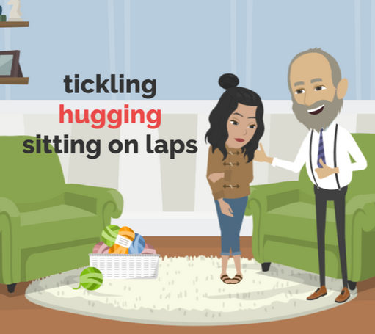
LESSON PLANS
BREAKING BOUNDARIES
How might an unsafe adult trick a young person into sexual activity?
©2025 Walking Wise
54
3

Slide 55
VOCABULARY
BOUNDARIES
A personal limit that defines your comfort levels with physical space, emotional connection, or personal values.
©2025 Walking Wise
55
Notes:
Assisting Source
OpenAI. (2024). ChatGPT [Large language model]. https://chatgpt.com

Slide 56
BREAKING BOUNDARIES
Tricky Behavior
  Try to spend time alone with a young person.
©2025 Walking Wise
56
Notes:
• TIME ALONE
Unsafe adults look for opportunities to spend time alone with a young person to gain trust.
• INDEBTED/OBLIGATION
Unsafe adults may claim the young person owes them for gifts, attention, favoritism, affection, etc., and eventually demand repayment.
• SECRETS
They often share personal secrets to make the young person feel like a special confidant.
• NORMALIZE INVADED BOUNDARIES
Unsafe adults may attempt to normalize their inappropriate behavior by invading a victim's personal space, expressing romantic interest, violating physical boundaries, and finally involving the young person in sexual activity.

Slide 57
BREAKING BOUNDARIES
Tricky Behavior
  Try to spend time alone with a young person.
  Give gifts and special attention.
©2025 Walking Wise
57
Notes:
• TIME ALONE
Unsafe adults look for opportunities to spend time alone with a young person to gain trust.
• INDEBTED/OBLIGATION
Unsafe adults may claim the young person owes them for gifts, attention, favoritism, affection, etc., and eventually demand repayment.
• SECRETS
They often share personal secrets to make the young person feel like a special confidant.
• NORMALIZE INVADED BOUNDARIES
Unsafe adults may attempt to normalize their inappropriate behavior by invading a victim's personal space, expressing romantic interest, violating physical boundaries, and finally involving the young person in sexual activity.

Slide 58
BREAKING BOUNDARIES
Tricky Behavior
  Try to spend time alone with a young person.
  Give gifts and special attention.
  Tell secrets to make the young person feel special.
©2025 Walking Wise
58
Notes:
• TIME ALONE
Unsafe adults look for opportunities to spend time alone with a young person to gain trust.
• INDEBTED/OBLIGATION
Unsafe adults may claim the young person owes them for gifts, attention, favoritism, affection, etc., and eventually demand repayment.
• SECRETS
They often share personal secrets to make the young person feel like a special confidant.
• NORMALIZE INVADED BOUNDARIES
Unsafe adults may attempt to normalize their inappropriate behavior by invading a victim's personal space, expressing romantic interest, violating physical boundaries, and finally involving the young person in sexual activity.

Slide 59
BREAKING BOUNDARIES
Tricky Behavior
  Try to spend time alone with a young person.
  Give gifts and special attention.
  Tell secrets to make the young person feel special.
  Invade personal space or disregard boundaries.
©2025 Walking Wise
59
Notes:
• TIME ALONE
Unsafe adults look for opportunities to spend time alone with a young person to gain trust.
• INDEBTED/OBLIGATION
Unsafe adults may claim the young person owes them for gifts, attention, favoritism, affection, etc., and eventually demand repayment.
• SECRETS
They often share personal secrets to make the young person feel like a special confidant.
• NORMALIZE INVADED BOUNDARIES
Unsafe adults may attempt to normalize their inappropriate behavior by invading a victim's personal space, expressing romantic interest, violating physical boundaries, and finally involving the young person in sexual activity.

Slide 60
BREAKING BOUNDARIES
Tricky Behavior
  Try to spend time alone with a young person.
  Give gifts and special attention.
  Tell secrets to make the young person feel special.
  Invade personal space or disregard boundaries.
  Make sexual activity seem normal.
©2025 Walking Wise
60
Notes:
• TIME ALONE
Unsafe adults look for opportunities to spend time alone with a young person to gain trust.
• INDEBTED/OBLIGATION
Unsafe adults may claim the young person owes them for gifts, attention, favoritism, affection, etc., and eventually demand repayment.
• SECRETS
They often share personal secrets to make the young person feel like a special confidant.
• NORMALIZE INVADED BOUNDARIES
Unsafe adults may attempt to normalize their inappropriate behavior by invading a victim's personal space, expressing romantic interest, violating physical boundaries, and finally involving the young person in sexual activity.

Slide 61
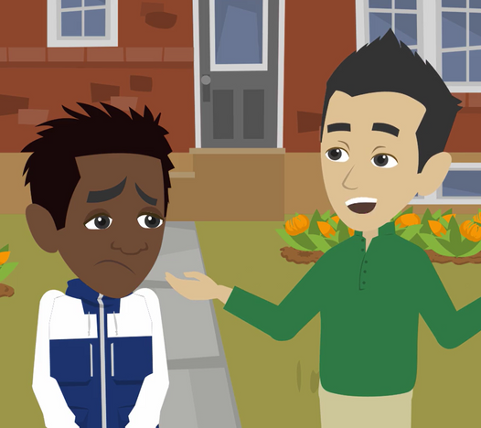
LESSON PLANS
SILENCING VICTIMS
How might an unsafe adult threaten a victim to keep sexual crimes a secret?
©2025 Walking Wise
61
3

Slide 62
SILENCING VICTIMS
Hiding Sexual Crimes
  BLAME victims for the crimes committed against them.
©2025 Walking Wise
62
Notes:
• BLAME & SHAME
They use blame and shame to manipulate the young person, making them feel responsible for the abusive actions.
• ISOLATION
They gain control by distancing the young person from family and friends to limit outside influences.
• THREATS
Unsafe adults may threaten to harm the young person or their loved ones, including family members or pets, to keep them from reporting the abuse.

Slide 63
SILENCING VICTIMS
Hiding Sexual Crimes
  BLAME victims for the crimes committed against them.
  SHAME victims to cause guilt or embarrassment.
©2025 Walking Wise
63
Notes:
• BLAME & SHAME
They use blame and shame to manipulate the young person, making them feel responsible for the abusive actions.
• ISOLATION
They gain control by distancing the young person from family and friends to limit outside influences.
• THREATS
Unsafe adults may threaten to harm the young person or their loved ones, including family members or pets, to keep them from reporting the abuse.

Slide 64
SILENCING VICTIMS
Hiding Sexual Crimes
  BLAME victims for the crimes committed against them.
  SHAME victims to cause guilt or embarrassment.
  ISOLATE victims from the support of family and friends.
©2025 Walking Wise
64
Notes:
• BLAME & SHAME
They use blame and shame to manipulate the young person, making them feel responsible for the abusive actions.
• ISOLATION
They gain control by distancing the young person from family and friends to limit outside influences.
• THREATS
Unsafe adults may threaten to harm the young person or their loved ones, including family members or pets, to keep them from reporting the abuse.

Slide 65
SILENCING VICTIMS
Hiding Sexual Crimes
  BLAME victims for the crimes committed against them.
  SHAME victims to cause guilt or embarrassment.
  ISOLATE victims from the support of family and friends.
  THREATEN to harm the victims or their parents, siblings, or pets.
©2025 Walking Wise
65
Notes:
• BLAME & SHAME
They use blame and shame to manipulate the young person, making them feel responsible for the abusive actions.
• ISOLATION
They gain control by distancing the young person from family and friends to limit outside influences.
• THREATS
Unsafe adults may threaten to harm the young person or their loved ones, including family members or pets, to keep them from reporting the abuse.

Slide 66
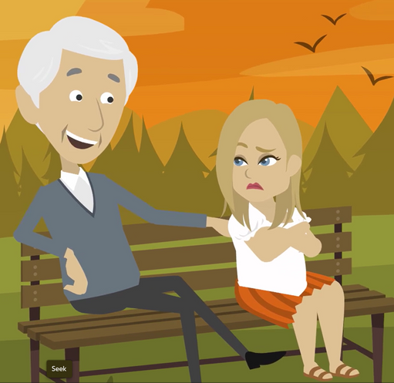
LESSON PLANS
TRICKY PEOPLE
Who can be an unsafe person?
©2025 Walking Wise
66
3

Slide 67
TRICKY PEOPLE
Tricky People
  Adults we KNOW who act inappropriately, such as ignoring boundaries, sharing secrets, or breaking rules.
67
Nurture Therapy (n.d.). Tricky People: A Better Way to Teach "Stranger Danger" to Kids. nurture-therapy.com.
©2025 Walking Wise
Notes:
NOTE
The CDC reports that at least 90% of child sexual abuse is committed by someone the child and the child's family know and trust.[1] Hence, understanding that strangers commit about 10% of child sexual abuse helps to put the concept of 'stranger danger' into perspective. However, online or 'virtual' strangers have significantly increased the jeopardy of young people using electronic devices.
'Stranger Danger' is a concept that instructs children and young people to be cautious and aware of interacting with individuals they do not know personally. The concept emphasizes that strangers can threaten their safety and well-being.
• MISLEADING
The Stranger Danger concept implies that strangers pose the greatest threat to young people's security. Still, statistics show that incidents of abduction, sexual abuse, and human trafficking often involve individuals known to youth, like family members, neighbors, or family acquaintances.
• DISTINCTION
Young people must know that not all strangers pose threats, and not all familiar people are safe.
• UNTRUSTING Overemphasizing the 'in-person' Stranger Danger concept might instill distrust, making it difficult for children to seek help, establish new relationships, or develop healthy social skills.
• ANXIETY
The constant fear of 'in-person' strangers can create unnecessary anxiety and stress in children, affecting their overall well-being.
• EMERGENCIES
Young people should know how to differentiate between safe helpers and potential threats to reduce confusion in emergencies.
• ONLINE
Online or 'Virtual' Danger is an ever-growing threat, making it imperative for young people to understand the unique risks associated with online interactions, where youth need guidance to navigate potential dangers online.
Source
1. Centers for Disease Control and Prevention (2024, May) About Child Sexual Abuse. CDC.gov. Retrieved November 20, 2024, from https://www.cdc.gov/child-abuse-neglect/about/about-child-sexual-abuse.html?CDC_AAref_Val=https://www.cdc.gov/violenceprevention/childsexualabuse/fastfact.html
2. Katzenstein, J. (n.d). Stranger Danger and Stranger Safety. HopkinsMedicine.org. Retrieved November 20, 2024, from https://www.hopkinsmedicine.org/health/wellness-and-prevention/stranger-danger-and-stranger-safety
3. Nurture Therapy (n.d.). Tricky People: A Better Way to Teach "Stranger Danger" to Kids. nurture-therapy.com. Retrieved November 20, 2024, from https://www.nurture-therapy.com/blog/tricky-people-a-better-way-to-teach-stranger-danger-to-kids

Slide 68
TRICKY PEOPLE
Tricky People
  Adults we KNOW who act inappropriately, such as ignoring boundaries, sharing secrets, or breaking rules.
  FRIENDS or PEERS who pressure youth into activities that feel wrong, like viewing pornography or engaging in sexual behaviors.
68
Nurture Therapy (n.d.). Tricky People: A Better Way to Teach "Stranger Danger" to Kids. nurture-therapy.com.
©2025 Walking Wise
Notes:
NOTE
The CDC reports that at least 90% of child sexual abuse is committed by someone the child and the child's family know and trust.[1] Hence, understanding that strangers commit about 10% of child sexual abuse helps to put the concept of 'stranger danger' into perspective. However, online or 'virtual' strangers have significantly increased the jeopardy of young people using electronic devices.
'Stranger Danger' is a concept that instructs children and young people to be cautious and aware of interacting with individuals they do not know personally. The concept emphasizes that strangers can threaten their safety and well-being.
• MISLEADING
The Stranger Danger concept implies that strangers pose the greatest threat to young people's security. Still, statistics show that incidents of abduction, sexual abuse, and human trafficking often involve individuals known to youth, like family members, neighbors, or family acquaintances.
• DISTINCTION
Young people must know that not all strangers pose threats, and not all familiar people are safe.
• UNTRUSTING Overemphasizing the 'in-person' Stranger Danger concept might instill distrust, making it difficult for children to seek help, establish new relationships, or develop healthy social skills.
• ANXIETY
The constant fear of 'in-person' strangers can create unnecessary anxiety and stress in children, affecting their overall well-being.
• EMERGENCIES
Young people should know how to differentiate between safe helpers and potential threats to reduce confusion in emergencies.
• ONLINE
Online or 'Virtual' Danger is an ever-growing threat, making it imperative for young people to understand the unique risks associated with online interactions, where youth need guidance to navigate potential dangers online.
Source
1. Centers for Disease Control and Prevention (2024, May) About Child Sexual Abuse. CDC.gov. Retrieved November 20, 2024, from https://www.cdc.gov/child-abuse-neglect/about/about-child-sexual-abuse.html?CDC_AAref_Val=https://www.cdc.gov/violenceprevention/childsexualabuse/fastfact.html
2. Katzenstein, J. (n.d). Stranger Danger and Stranger Safety. HopkinsMedicine.org. Retrieved November 20, 2024, from https://www.hopkinsmedicine.org/health/wellness-and-prevention/stranger-danger-and-stranger-safety
3. Nurture Therapy (n.d.). Tricky People: A Better Way to Teach "Stranger Danger" to Kids. nurture-therapy.com. Retrieved November 20, 2024, from https://www.nurture-therapy.com/blog/tricky-people-a-better-way-to-teach-stranger-danger-to-kids

Slide 69
TRICKY PEOPLE
Tricky People
  Unfamiliar people or STRANGERS with dangerous intentions, such as getting young people alone.
69
Nurture Therapy (n.d.). Tricky People: A Better Way to Teach "Stranger Danger" to Kids. nurture-therapy.com.
©2025 Walking Wise
Notes:
NOTE
The CDC reports that at least 90% of child sexual abuse is committed by someone the child and the child's family know and trust.[1] Hence, understanding that strangers commit about 10% of child sexual abuse helps to put the concept of 'stranger danger' into perspective. However, online or 'virtual' strangers have significantly increased the jeopardy of young people using electronic devices.
'Stranger Danger' is a concept that instructs children and young people to be cautious and aware of interacting with individuals they do not know personally. The concept emphasizes that strangers can threaten their safety and well-being.
• MISLEADING
The Stranger Danger concept implies that strangers pose the greatest threat to young people's security. Still, statistics show that incidents of abduction, sexual abuse, and human trafficking often involve individuals known to youth, like family members, neighbors, or family acquaintances.
• DISTINCTION
Young people must know that not all strangers pose threats, and not all familiar people are safe.
• UNTRUSTING Overemphasizing the 'in-person' Stranger Danger concept might instill distrust, making it difficult for children to seek help, establish new relationships, or develop healthy social skills.
• ANXIETY
The constant fear of 'in-person' strangers can create unnecessary anxiety and stress in children, affecting their overall well-being.
• EMERGENCIES
Young people should know how to differentiate between safe helpers and potential threats to reduce confusion in emergencies.
• ONLINE
Online or 'Virtual' Danger is an ever-growing threat, making it imperative for young people to understand the unique risks associated with online interactions, where youth need guidance to navigate potential dangers online.
Source
1. Centers for Disease Control and Prevention (2024, May) About Child Sexual Abuse. CDC.gov. Retrieved November 20, 2024, from https://www.cdc.gov/child-abuse-neglect/about/about-child-sexual-abuse.html?CDC_AAref_Val=https://www.cdc.gov/violenceprevention/childsexualabuse/fastfact.html
2. Katzenstein, J. (n.d). Stranger Danger and Stranger Safety. HopkinsMedicine.org. Retrieved November 20, 2024, from https://www.hopkinsmedicine.org/health/wellness-and-prevention/stranger-danger-and-stranger-safety
3. Nurture Therapy (n.d.). Tricky People: A Better Way to Teach "Stranger Danger" to Kids. nurture-therapy.com. Retrieved November 20, 2024, from https://www.nurture-therapy.com/blog/tricky-people-a-better-way-to-teach-stranger-danger-to-kids

Slide 70
TRICKY PEOPLE
Tricky People
  Unfamiliar people or STRANGERS with dangerous intentions, such as getting young people alone.
  Unknown ONLINE CONTACTS who make inappropriate requests or demands, like asking for nude photos or sexual videos.
70
Nurture Therapy (n.d.). Tricky People: A Better Way to Teach "Stranger Danger" to Kids. nurture-therapy.com.
©2025 Walking Wise
Notes:
NOTE
The CDC reports that at least 90% of child sexual abuse is committed by someone the child and the child's family know and trust.[1] Hence, understanding that strangers commit about 10% of child sexual abuse helps to put the concept of 'stranger danger' into perspective. However, online or 'virtual' strangers have significantly increased the jeopardy of young people using electronic devices.
'Stranger Danger' is a concept that instructs children and young people to be cautious and aware of interacting with individuals they do not know personally. The concept emphasizes that strangers can threaten their safety and well-being.
• MISLEADING
The Stranger Danger concept implies that strangers pose the greatest threat to young people's security. Still, statistics show that incidents of abduction, sexual abuse, and human trafficking often involve individuals known to youth, like family members, neighbors, or family acquaintances.
• DISTINCTION
Young people must know that not all strangers pose threats, and not all familiar people are safe.
• UNTRUSTING Overemphasizing the 'in-person' Stranger Danger concept might instill distrust, making it difficult for children to seek help, establish new relationships, or develop healthy social skills.
• ANXIETY
The constant fear of 'in-person' strangers can create unnecessary anxiety and stress in children, affecting their overall well-being.
• EMERGENCIES
Young people should know how to differentiate between safe helpers and potential threats to reduce confusion in emergencies.
• ONLINE
Online or 'Virtual' Danger is an ever-growing threat, making it imperative for young people to understand the unique risks associated with online interactions, where youth need guidance to navigate potential dangers online.
Source
1. Centers for Disease Control and Prevention (2024, May) About Child Sexual Abuse. CDC.gov. Retrieved November 20, 2024, from https://www.cdc.gov/child-abuse-neglect/about/about-child-sexual-abuse.html?CDC_AAref_Val=https://www.cdc.gov/violenceprevention/childsexualabuse/fastfact.html
2. Katzenstein, J. (n.d). Stranger Danger and Stranger Safety. HopkinsMedicine.org. Retrieved November 20, 2024, from https://www.hopkinsmedicine.org/health/wellness-and-prevention/stranger-danger-and-stranger-safety
3. Nurture Therapy (n.d.). Tricky People: A Better Way to Teach "Stranger Danger" to Kids. nurture-therapy.com. Retrieved November 20, 2024, from https://www.nurture-therapy.com/blog/tricky-people-a-better-way-to-teach-stranger-danger-to-kids

Slide 71
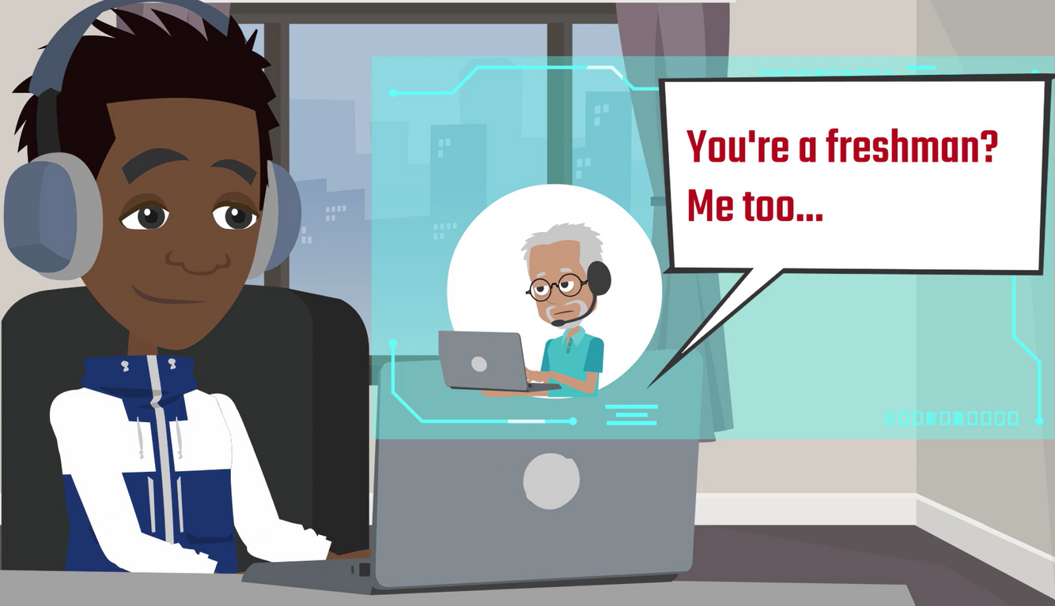
LESSON PLANS
ONLINE CONTACTS
Why can online-only friends be dangerous even if they seem kind?
©2025 Walking Wise
71

Slide 72
ONLINE CONTACTS
Virtual Stranger
It’s usually impossible to be sure that an ‘Online-Only Friend’ is who they say they are.
©2025 Walking Wise
72
Notes:
Young people often do not view an online acquaintance as a mysterious stranger. Instead, they identify online connections as friends, just like in-person relationships. [1]
It is usually impossible to be sure that an 'online-only friend' is who they say they are. So, young people should not assume they are interacting with an honest, trustworthy, or safe acquaintance.
Online predators are often patient, investing considerable time in developing relationships during the grooming process before victimizing a young person.
Source
1. THORN (2022, April). Online Grooming: Examining risky encounters amid everyday digital socialization, p. 10. Benenson Strategy Group. Retrieved November 12, 2024 from https://info.thorn.org/hubfs/Research/2022_Online_Grooming_Report.pdf

Slide 73
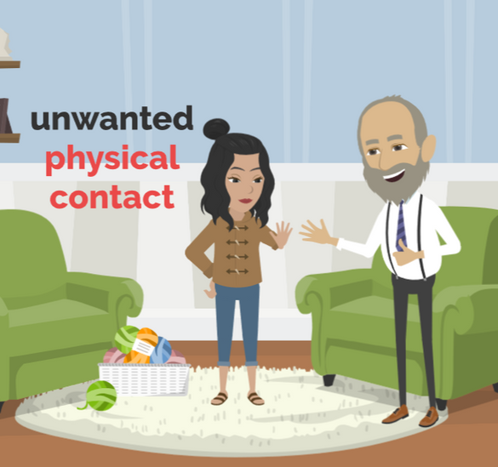
LESSON PLANS
SETTING BOUNDARIES
How can setting boundaries be empowering for young people?
©2025 Walking Wise
73
3

Slide 74
SETTING BOUNDARIES
Firm Mindset
  TRUST YOUR INSTINCTS: Listen to your gut feelings and leave situations that seem wrong.
©2025 Walking Wise
74

Slide 75
SETTING BOUNDARIES
Firm Mindset
  TRUST YOUR INSTINCTS: Listen to your gut feelings and leave situations that seem wrong.
  SAY “NO”: Feel empowered to say no if someone makes you feel uncomfortable, whether online or offline.
©2025 Walking Wise
75

Slide 76
SETTING BOUNDARIES
Firm Mindset
  TRUST YOUR INSTINCTS: Listen to your gut feelings and leave situations that seem wrong.
  SAY “NO”: Feel empowered to say no if someone makes you feel uncomfortable, whether online or offline.
  STOP THE PRESSURE: Immediately end all conversations when feeling pressured or made to feel guilty.
©2025 Walking Wise
76

Slide 77
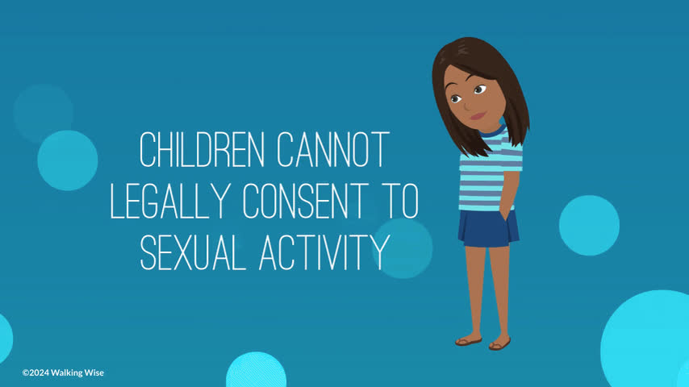
LESSON PLANS
AGE OF CONSENT
What does “age of consent” mean?
©2025 Walking Wise
77
3

Slide 78
EDUCATON GUIDE
VOCABULARY
AGE OF CONSENT
The minimum age at which a young person is legally able to agree to have sexual activity with an adult.
©2025 Walking Wise
78
3
Notes:
Age of consent is the age at which an individual can legally agree to participate in sexual activity. Depending on state laws, that age can range from 16 to 18. [1]
The age of consent also considers whether the individual has a developmental disability or illness or is under duress.
Source
1. World Population Review (2024). Age of Consent. worldpopulationreview.com. Retrieved December 1, 2024, from https://worldpopulationreview.com/state-rankings/age-of-consent-by-state
Cornell Law School (n.d.). Age of consent. Law.Cornell.edu. Retrieved February 27, 2024, from https://www.law.cornell.edu/wex/age_of_consent
Vocabulary Source
OpenAI. (2024). ChatGPT [Large language model]. https://chatgpt.com

Slide 79
AGE OF CONSENT
State Laws Protect Minors (youth)
  Adults involved in sexual activity with minors below the ‘age of consent’ face severe criminal penalties.
RAINN (n.d.), What Consent Looks Like. rainn.org
Cornell Law School (2022, February). Age of consent. Law.Cornell.edu.
79
©2025 Walking Wise
Notes:
NOTE
When adults age 18 or older grant consent, they can only give permission according to the conditions listed below.
• WILLING ADULT
Consent is valid only when freely given without pressure, threats, or submission to an authority figure – such as a family member, spiritual leader, educator, counselor, doctor, or police officer.
• COHERENT ADULT
An individual must be capable of speaking clearly and logically. They are considered incoherent and unable to give consent if they are asleep, intoxicated, ill, injured, or lack mental capacity.
• VERBAL ADULT
Consent must be clearly expressed with the word “yes“ by their own choice and not under duress. Mumbling or vague responses do not constitute consent.
• ONGOING
An adult can withdraw or stop their consent at any time and during various stages of sexual activity.
Source
RAINN (n.d.), What Consent Looks Like. rainn.org. Retrieved November 19, 2024, from https://www.rainn.org/articles/what-is-consent
Cornell Law School (2022, February). Age of consent. Law.Cornell.edu. Retrieved February 27, 2024, from https://www.law.cornell.edu/wex/age_of_consent
Cornell Law School (2022, August). Consent. Law.Cornell.edu. Retrieved November 19, 2024, from https://www.law.cornell.edu/wex/consent

Slide 80
AGE OF CONSENT
State Laws Protect Minors (youth)
  Adults involved in sexual activity with minors below the ‘age of consent’ face severe criminal penalties.
  Minors lack the mental and emotional maturity to understand all the risks and consequences of sexual activity.
RAINN (n.d.), What Consent Looks Like. rainn.org
Cornell Law School (2022, February). Age of consent. Law.Cornell.edu.
80
©2025 Walking Wise
Notes:
NOTE
When adults age 18 or older grant consent, they can only give permission according to the conditions listed below.
• WILLING ADULT
Consent is valid only when freely given without pressure, threats, or submission to an authority figure – such as a family member, spiritual leader, educator, counselor, doctor, or police officer.
• COHERENT ADULT
An individual must be capable of speaking clearly and logically. They are considered incoherent and unable to give consent if they are asleep, intoxicated, ill, injured, or lack mental capacity.
• VERBAL ADULT
Consent must be clearly expressed with the word “yes“ by their own choice and not under duress. Mumbling or vague responses do not constitute consent.
• ONGOING
An adult can withdraw or stop their consent at any time and during various stages of sexual activity.
Source
RAINN (n.d.), What Consent Looks Like. rainn.org. Retrieved November 19, 2024, from https://www.rainn.org/articles/what-is-consent
Cornell Law School (2022, February). Age of consent. Law.Cornell.edu. Retrieved February 27, 2024, from https://www.law.cornell.edu/wex/age_of_consent
Cornell Law School (2022, August). Consent. Law.Cornell.edu. Retrieved November 19, 2024, from https://www.law.cornell.edu/wex/consent

Slide 81
AGE OF CONSENT
State Laws Protect Minors (youth)
  Adults involved in sexual activity with minors below the age of consent face severe criminal penalties.
  Minors lack the mental and emotional maturity to understand all the risks and consequences of sexual activity.
  There is unequal power between minors, adults, and, in some cases, peers.
RAINN (n.d.), What Consent Looks Like. rainn.org
Cornell Law School (2022, February). Age of consent. Law.Cornell.edu.
81
©2025 Walking Wise
Notes:
NOTE
When adults age 18 or older grant consent, they can only give permission according to the conditions listed below.
• WILLING ADULT
Consent is valid only when freely given without pressure, threats, or submission to an authority figure – such as a family member, spiritual leader, educator, counselor, doctor, or police officer.
• COHERENT ADULT
An individual must be capable of speaking clearly and logically. They are considered incoherent and unable to give consent if they are asleep, intoxicated, ill, injured, or lack mental capacity.
• VERBAL ADULT
Consent must be clearly expressed with the word “yes“ by their own choice and not under duress. Mumbling or vague responses do not constitute consent.
• ONGOING
An adult can withdraw or stop their consent at any time and during various stages of sexual activity.
Source
RAINN (n.d.), What Consent Looks Like. rainn.org. Retrieved November 19, 2024, from https://www.rainn.org/articles/what-is-consent
Cornell Law School (2022, February). Age of consent. Law.Cornell.edu. Retrieved February 27, 2024, from https://www.law.cornell.edu/wex/age_of_consent
Cornell Law School (2022, August). Consent. Law.Cornell.edu. Retrieved November 19, 2024, from https://www.law.cornell.edu/wex/consent

Slide 82

ASK FOR HELP
©2025 Walking Wise
82

Slide 83
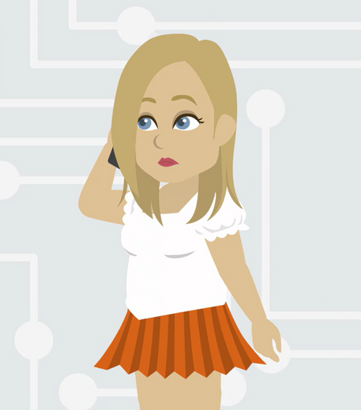
ASK FOR HELP
What are ways young people can ask for help?
©2025 Walking Wise
83

Slide 84
ASK FOR HELP
How to Ask for Help
  If you are in immediate danger, dial 911.
©2025 Walking Wise
84

Slide 85
ASK FOR HELP
How to Ask for Help
  If you are in immediate danger, dial 911.
  If the sexual predator IS a family member, consider telling a trustworthy adult.
©2025 Walking Wise
85

Slide 86
ASK FOR HELP
How to Ask for Help
  If you are in immediate danger, dial 911.
  If the sexual predator IS a family member, consider telling a trustworthy adult.
  If the sexual predator is NOT family, consider telling a parent.
©2025 Walking Wise
86

Slide 87
ASK FOR HELP
How to Ask for Help
  If you are in immediate danger, dial 911.
  If the sexual predator IS a family member, consider telling a trustworthy adult.
  If the sexual predator is NOT family, consider telling a parent.
  If you are a student in school, consider telling a trustworthy teacher, coach, school nurse, social worker, counselor, resource officer, or principal.
©2025 Walking Wise
87

Slide 88
ASK FOR HELP
How to Ask for Help
  If you are in immediate danger, dial 911.
  If the sexual predator IS a family member, consider telling a trustworthy adult.
  If the sexual predator is NOT family, consider telling a parent.
  If you are a student in school, consider telling a trustworthy teacher, coach, school nurse, social worker, counselor, resource officer, or principal.
  To gain internet access for help, consider using a computer at your school or a public library.
©2025 Walking Wise
88

Slide 89
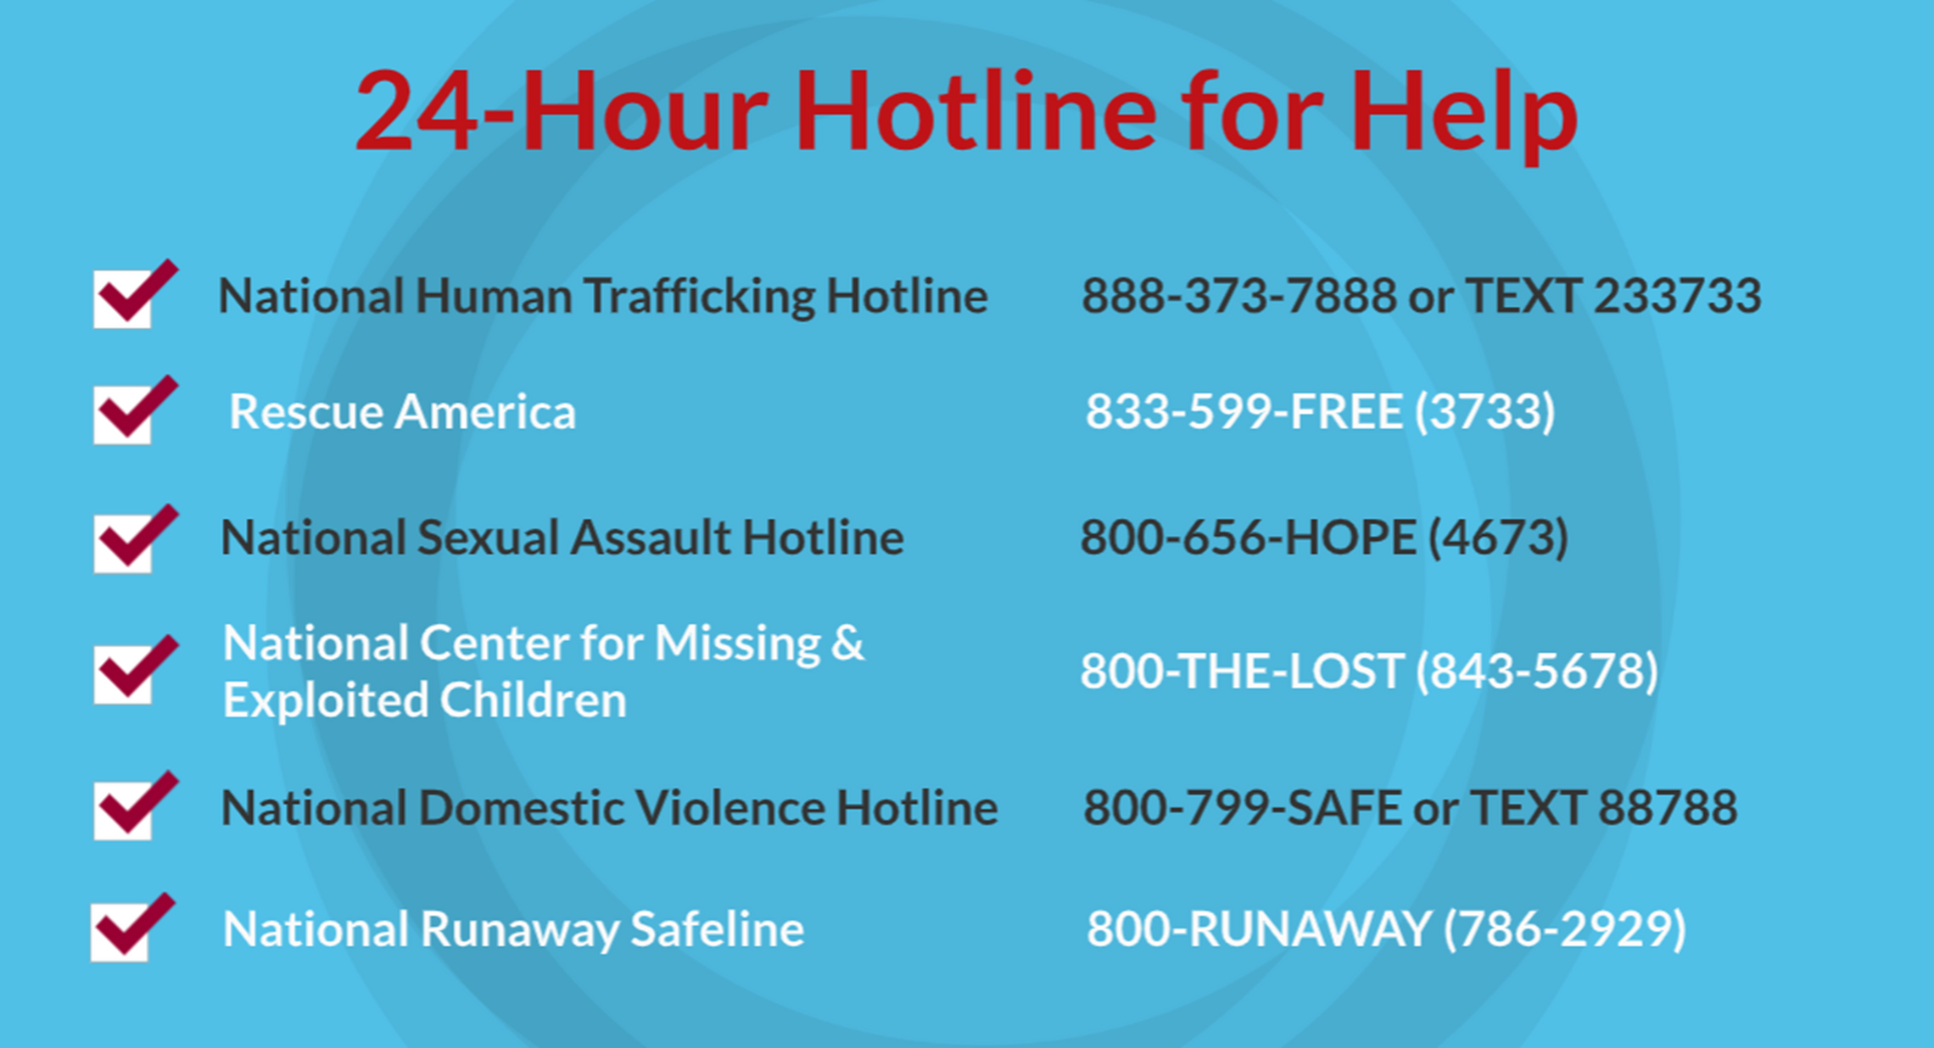
©2025 Walking Wise
89
Notes:
NOTE
Presenters may ask their audience to consider adding a few "hotline for help" phone numbers in their cell phone contacts or take a photo of this slide.

Slide 90
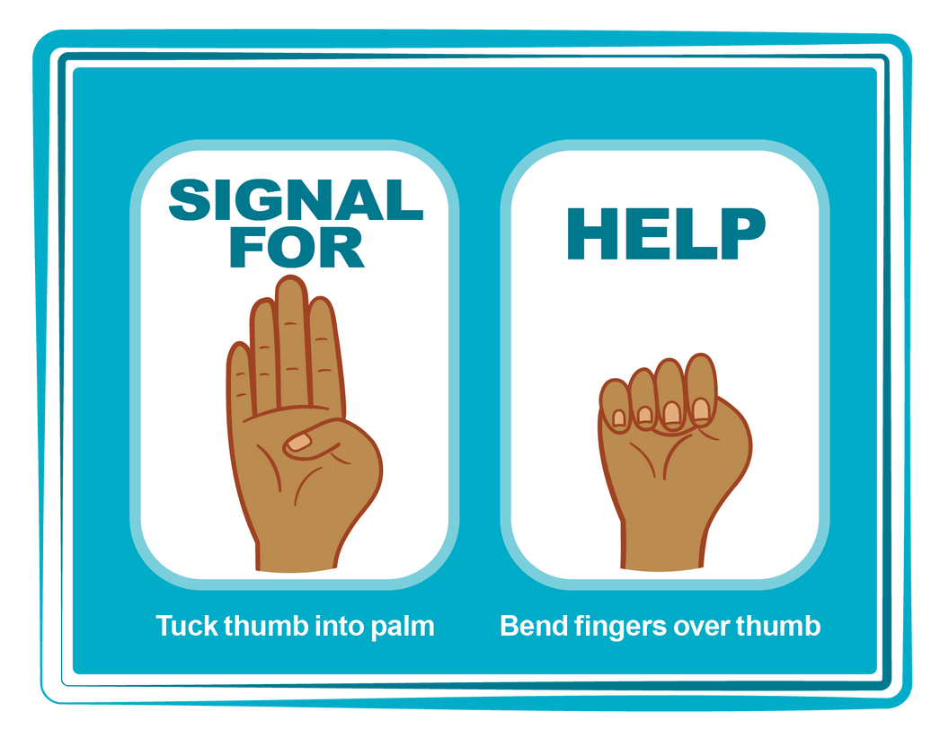
HAND SIGNAL FOR HELP
©2025 Walking Wise
Source: Canadian Women’s Foundation, April 2020
90
Notes:
Although the hand signal for help has not yet achieved universal recognition, it may discreetly get someone's attention in urgent situations.
• SILENT
It can be used silently.
• UNTRACKABLE
It leaves no digital footprint.
• CONCEALED
It can be done secretly when a perpetrator is in the vicinity.
• SIGNALS DISTRESS
Combining the hand signal with distressed facial expressions might help attract the attention of an individual who is unfamiliar with the signal's meaning.
Source
Canadian Women's Foundation, April 2020

Slide 91
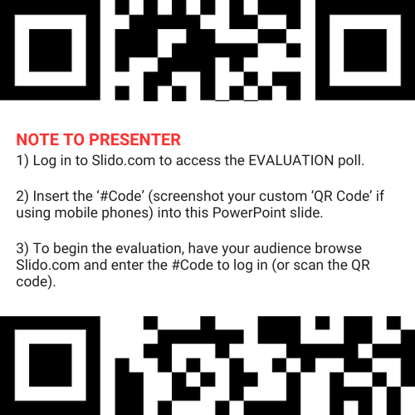
EVALUATION
©2025 Walking Wise
91
Notes:
SLIDO.com: 3-Question Survey
NOTE
Update this slide with your school/organization's custom QR code and #code.
Please encourage participants to scan your organization's custom QR code to share what they enjoyed and what could be improved about the lesson.
Please send any feedback you want to share to Walking Wise at support@WalkingWise.com.

Slide 92
SHARE YOUR THOUGHTS
1. How would you rate this lesson?
2. What was the one thing you liked?
3. What one thing should we improve?
Presenter: Replace “#XXXX” with your organization’s custom Slido code.
©2025 Walking Wise
92
Notes:
SLIDO.com: 3-Question Survey
NOTE
Follow the instructions provided on WalkingWise.com to access your school or organization's custom Slido QR code and #code, which will enable the audience to complete the 3-question evaluation.
Please encourage your audience to scan your organization's custom QR code to share what they enjoyed and what could be improved about the lesson.
Please send any feedback you want to share to Walking Wise at support@WalkingWise.com.

Slide 93



Thank you!
WalkingWise.com
Online Course for Adults Accredited by:
Postgraduate Institue for Medicine
Academy of Forensic Nursing
©2025 Walking Wise
93
Notes:
NOTE
To access additional resources about trustworthy vs. unsafe adults, please refer to the last page of Lesson Plan #2 in the Walking Wise Education Guide.
We welcome your feedback at support@WalkingWise.com.
Thank you!
Karla Highman
Founder, WalkingWise.com

